Slide 1
AntRCC-N: Contributions from
(a) AARI NADC
(b) ArcRCC North Eurasian node
Vasily Smolyanitsky
Arctic and Antarctic Research Institute (AARI)
Panel on Polar and High Mountains Observations, Research and Services
Antarctica Advisory Group
Norwegian Meteorological Institute, 12 March 2024, Oslo, Norway

Slide 2
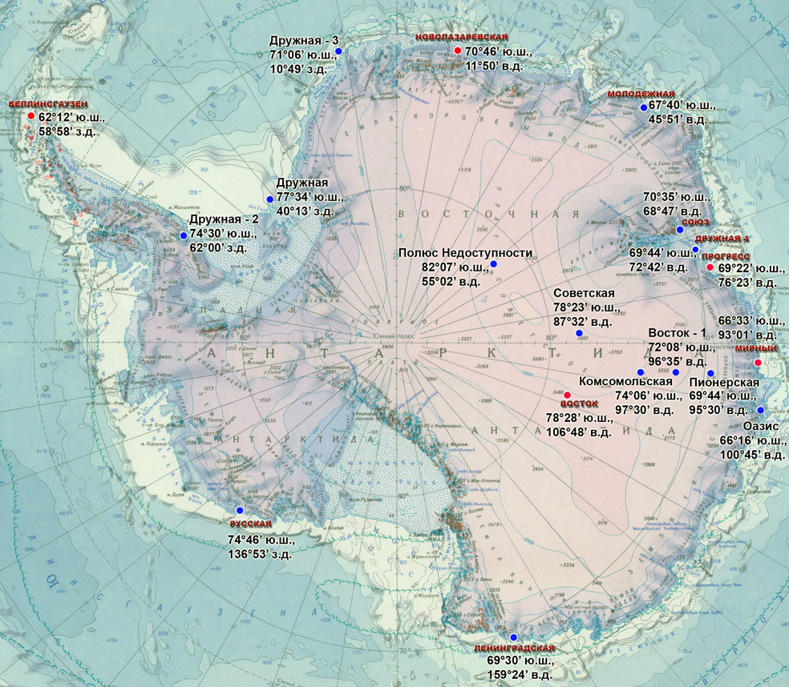
General information
AARI of Roshydromet is involved in the Antarctic activities since the start of the 1st Complex Soviet Antarctic Expedition in 1955 with further annual SAE and RAE wintering and seasonal expeditions to Antarctic with the current 69th RAE started in October 2023
The first coastal Mirny station was established in February 1956, with inland stations Vostok-1, Komsomolskaya and Vostok founded in 1957. In a total land-based observational network included more than 30 stations and field bases (http://old.aari.ru/aariaq/data/catalogue.html) with current 5 permanent stations and additional seasonal and/or MAWS stations operated by RAE (https://raexp.ru/).
Marine meteorological and oceanographic observations including in-situ sea ice measurements are routinely provided at the coastal stations and by the RAE vessels “Akademik Fedorov” and “Akademik Treoshnikov”
Sea-ice analysis included regional ice air reconnaissance during the CAE and SAE till the end of 1960s and circumpolar satellite-based ice charting from 1971 to present
Numerical modelling of the Southern Ocean is mostly done on regional scale and is aimed on investigation of special oceanographic features
Current databases proposed for AntRCC-N include:
Antarctic monthly meteorology as a part of NADC for 1956-present (http://old.aari.ru/aariaq/data/catalogue.html),
historical 10-days circumpolar Antarctic ice charting as a part of the former WMO GDSIDB project for 1971-1991 (http://wdc.aari.ru/datasets/d0001/south/)
Weekly 7-days circumpolar Antarctic ice charting as a part of AARI-NIC-NIS collaborative project (http://ice.aari.aq)
AARI WDC ice extent analysis (http://wdc.aari.ru/datasets/ssmi/data/south/extent/)
ArcRCC-N Antarctic seasonal monitoring (http://wdc.aari.ru/prcc/reanalysis/)
Notes:
Далее будет представлена информация по специализации институтов и образцы информационной продукции.

Slide 3
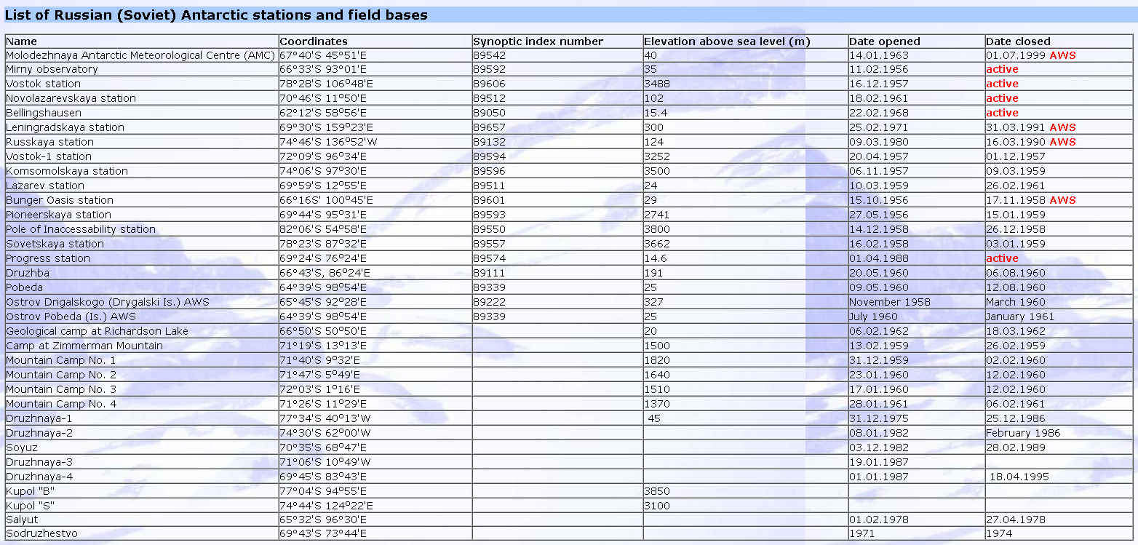
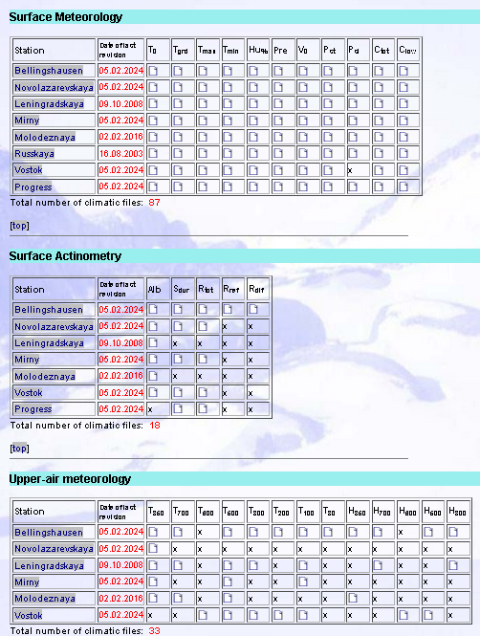
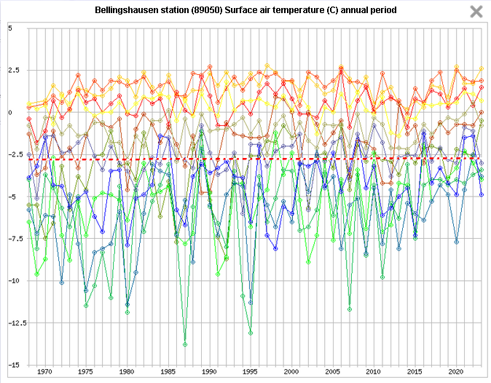
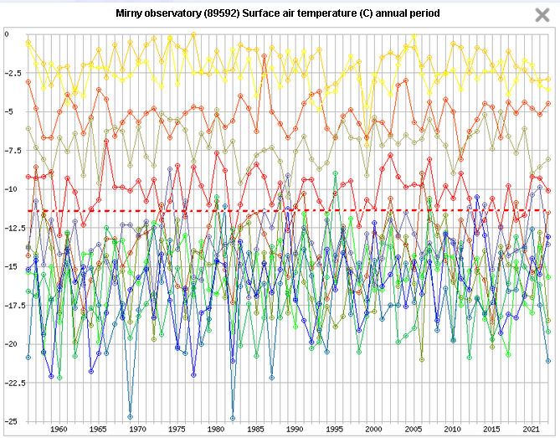
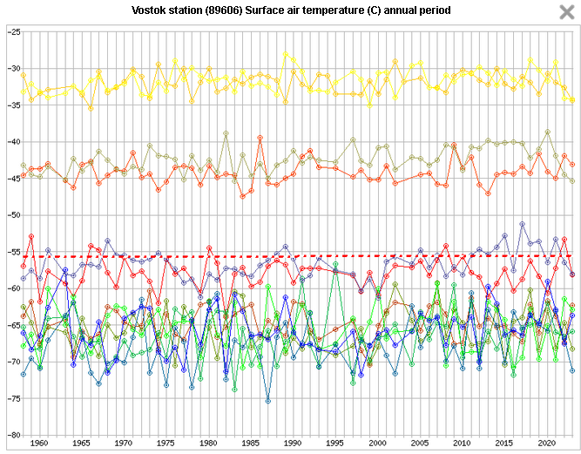
Meteorology (29 vars in .txt, .gif as obs and stats)
http://old.aari.ru/aariaq/data/catalogue.html
http://old.aari.ru/aariaq/data/pick.php?lang=0
Notes:
Далее будет представлена информация по специализации институтов и образцы информационной продукции.

Slide 4
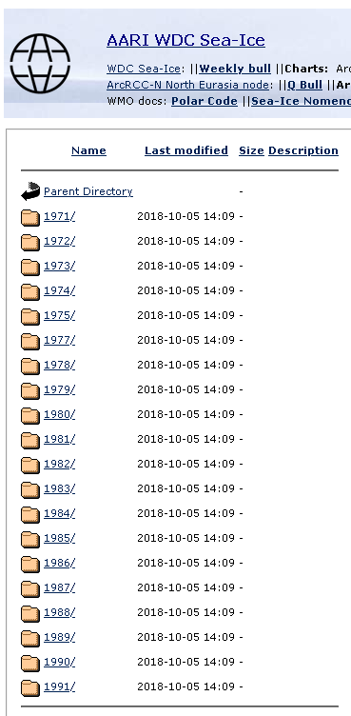
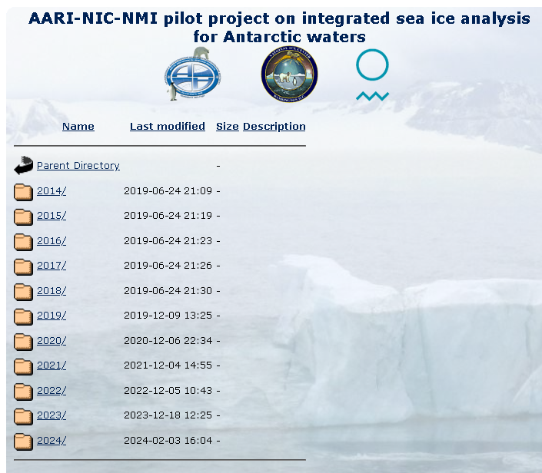
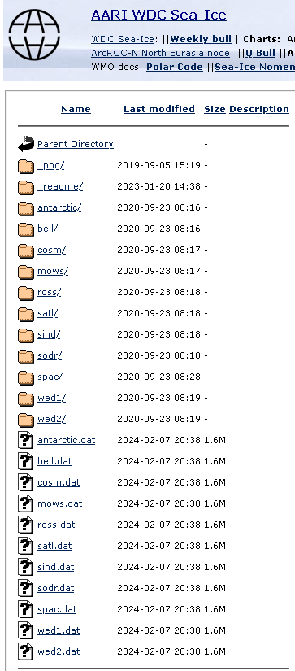
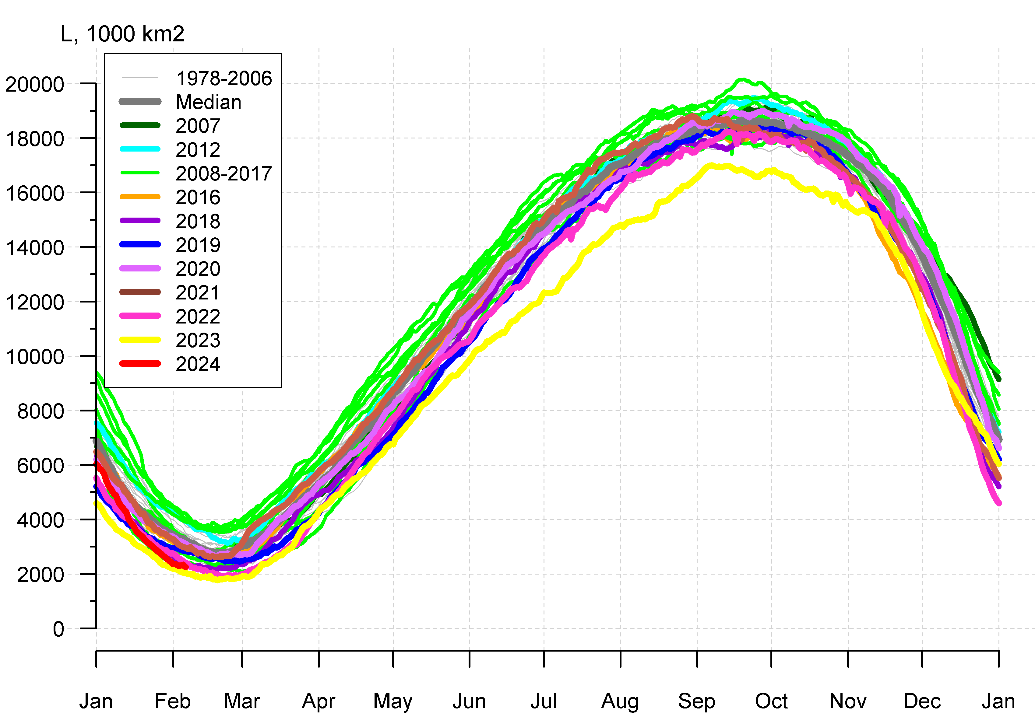
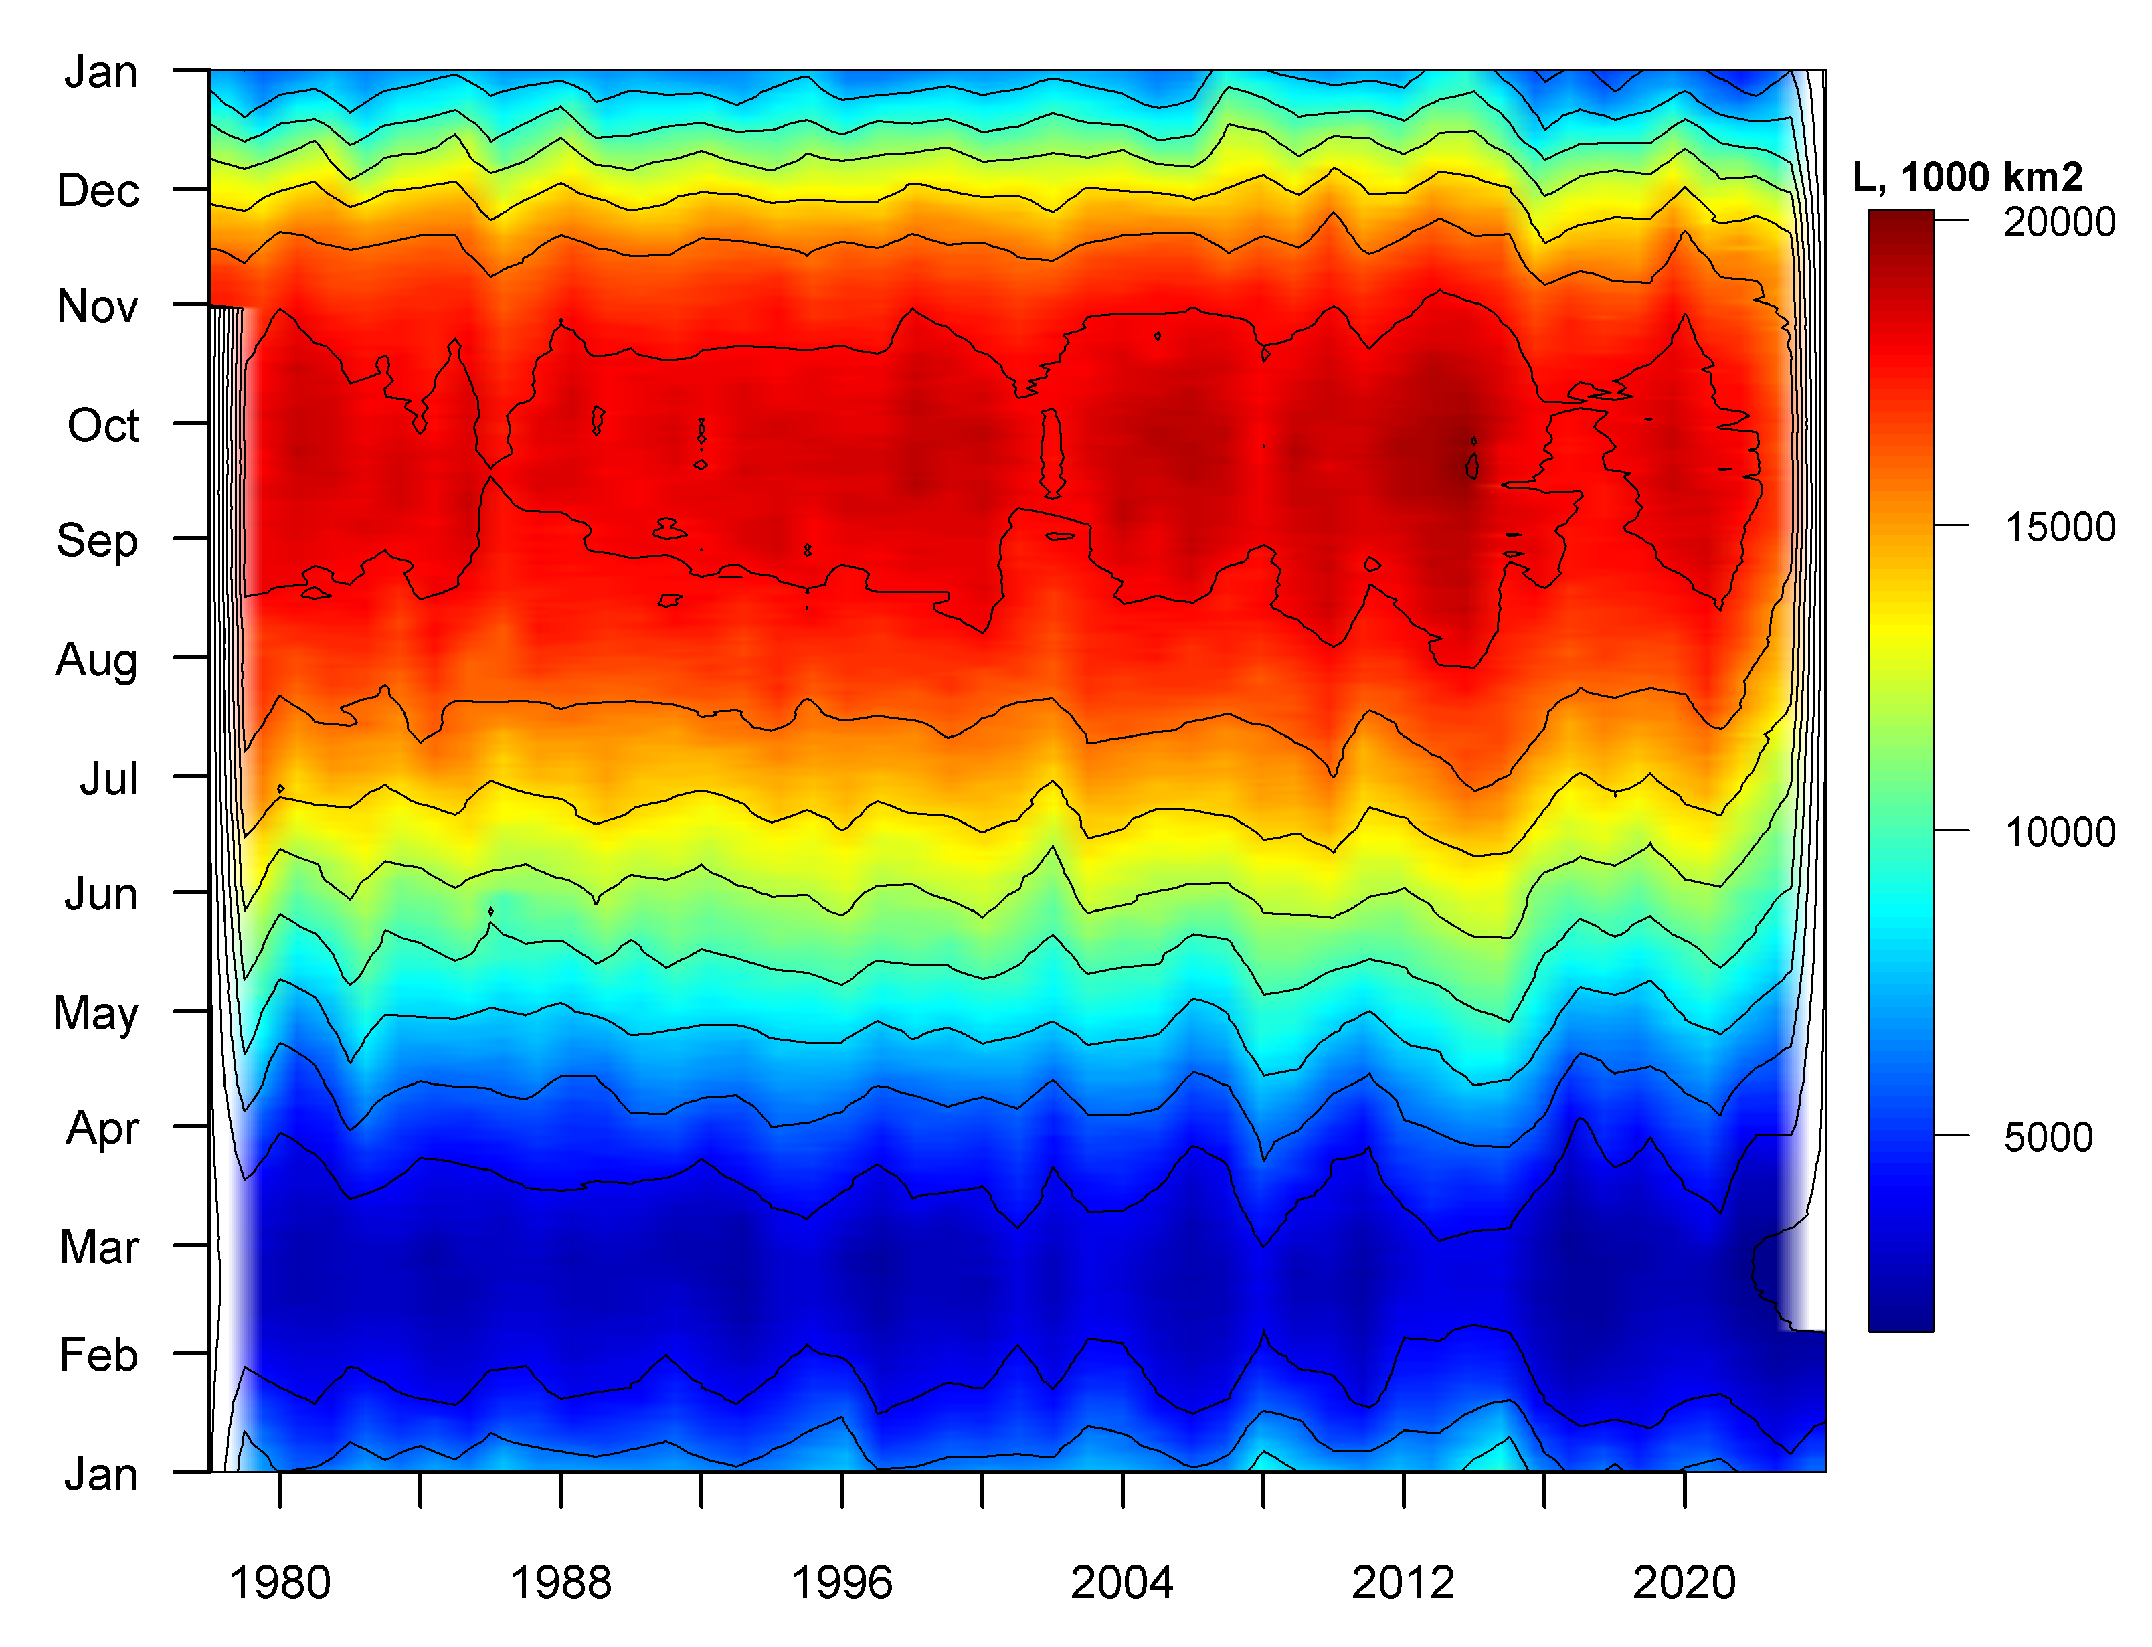
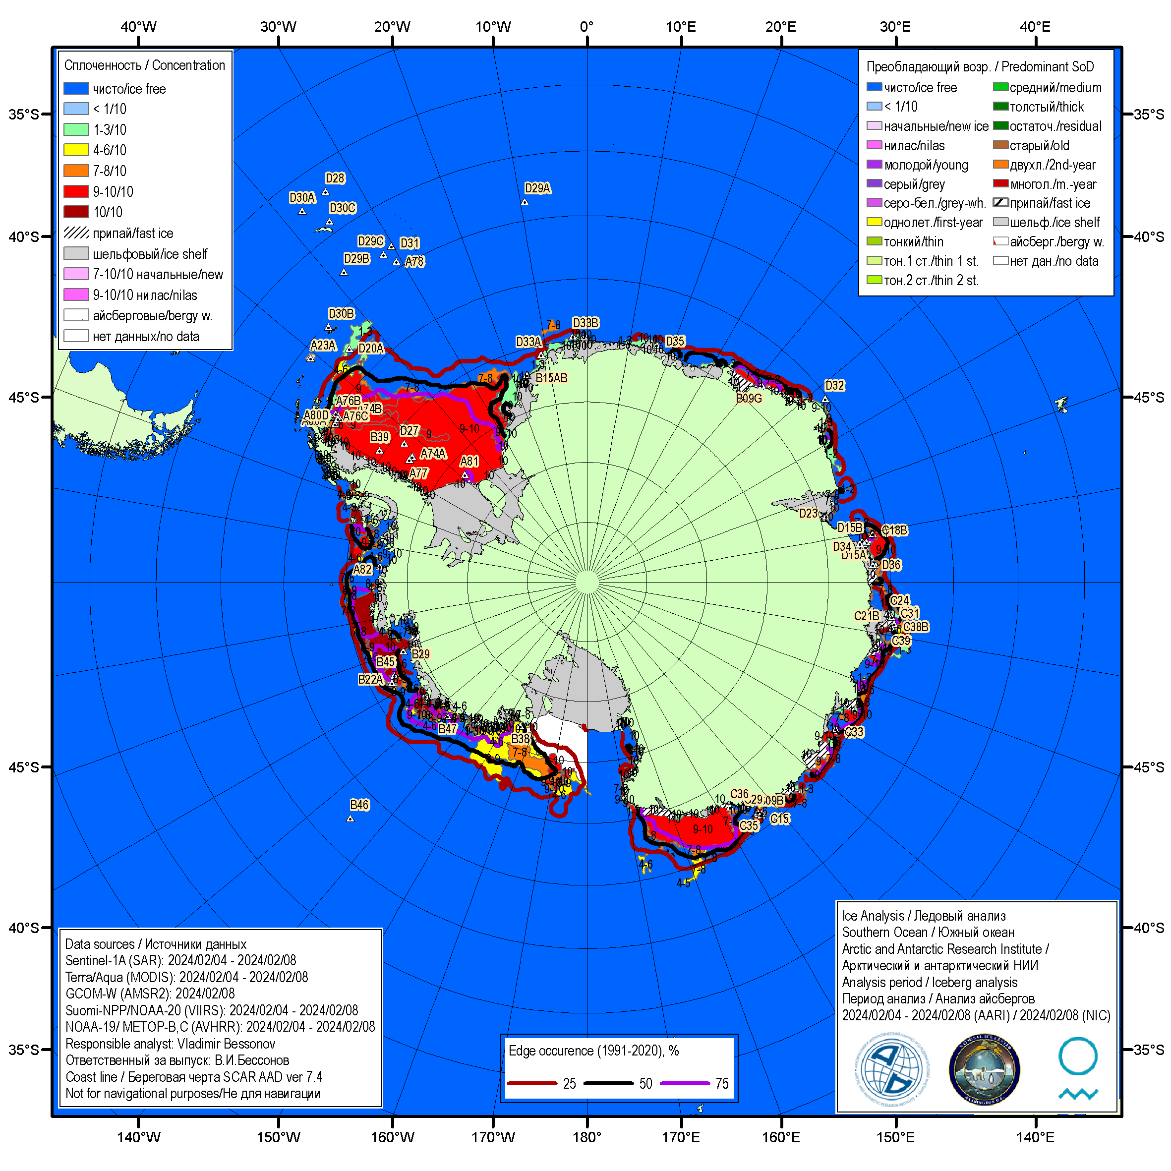
Sea ice (SIC, SoD, SIE, SIA, edge in .csv, .png, .shp, SIGRID-1,3 as obs and stats)
Notes:
Далее будет представлена информация по специализации институтов и образцы информационной продукции.

Slide 5
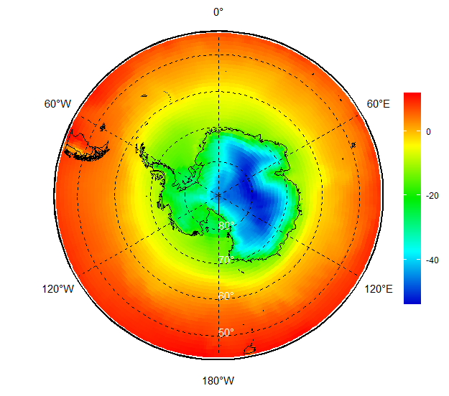
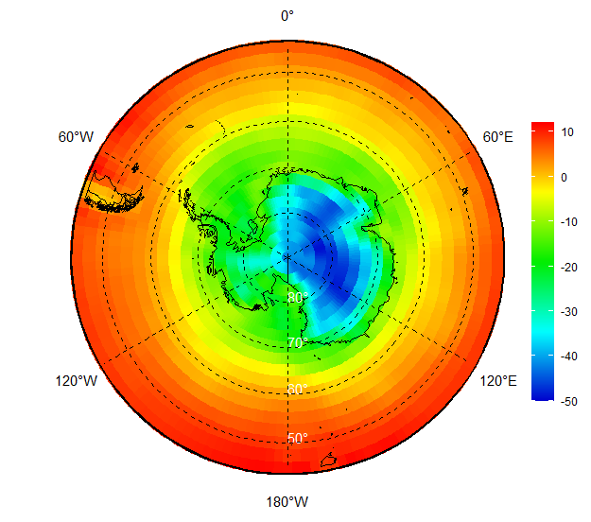
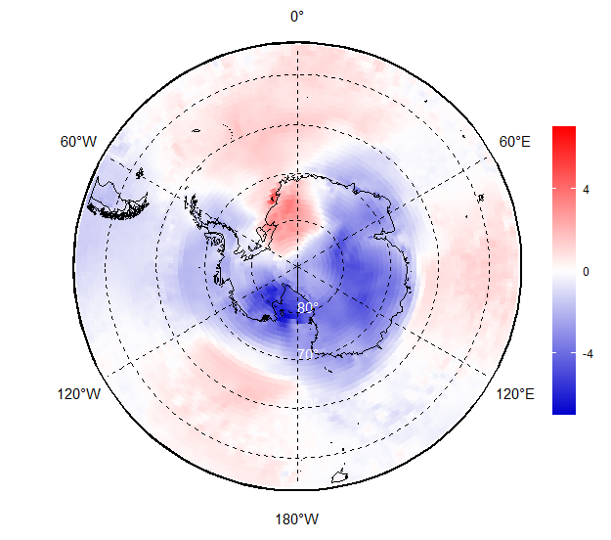
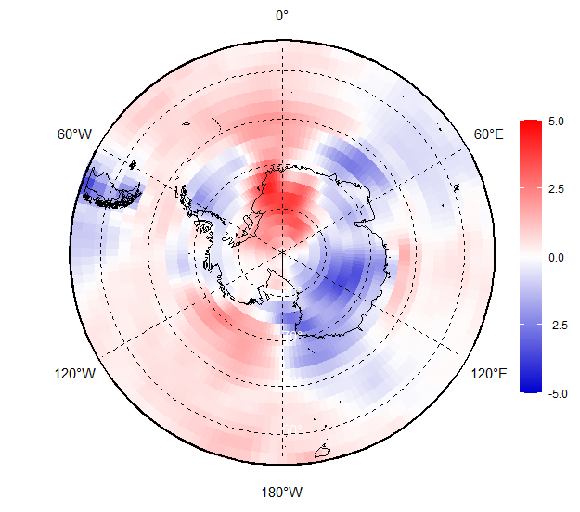
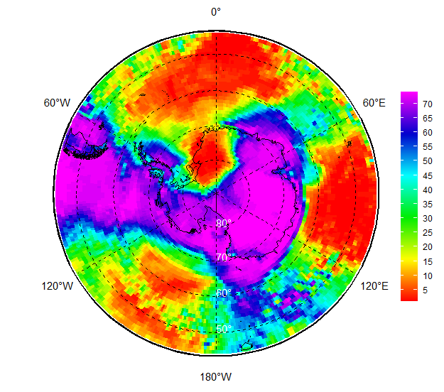
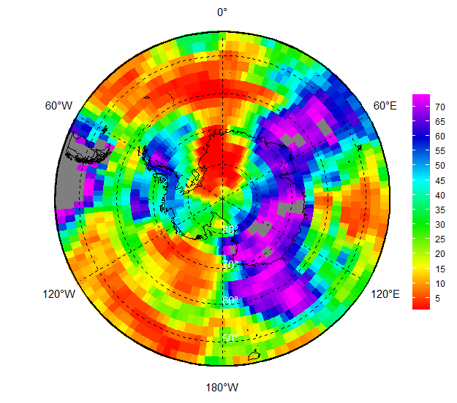
ECVs Reanalysis
OND 2023 SAT, anomaly 1991-2020 and rank 1950-2023
Implemented to support ArcRCC-N mandatory function of seasonal monitoring
Assessment of ECVs for Antarctic southward of 50S is done simultaneously with the ECVs for the ArcRCC-N domain northward of 45N
Based on modern reanalysis as ERA5, NCEP
Provided as monthly patterns, averaged seasonal patterns with the WMO LRF rolling season for the most important ECVs like SAT, SLP, SST etc and derived weather severity indexes
Assessed statistics include: anomalies 1950-present, 1961-1990, 1981-2010, 1991-2020 and ranks 1950-present and 1979-present
Data is provided in .CSV, .GeoTIFF and .PNG
CCCS ERA5
NCEP
Notes:
Далее будет представлена информация по специализации институтов и образцы информационной продукции.

Slide 6
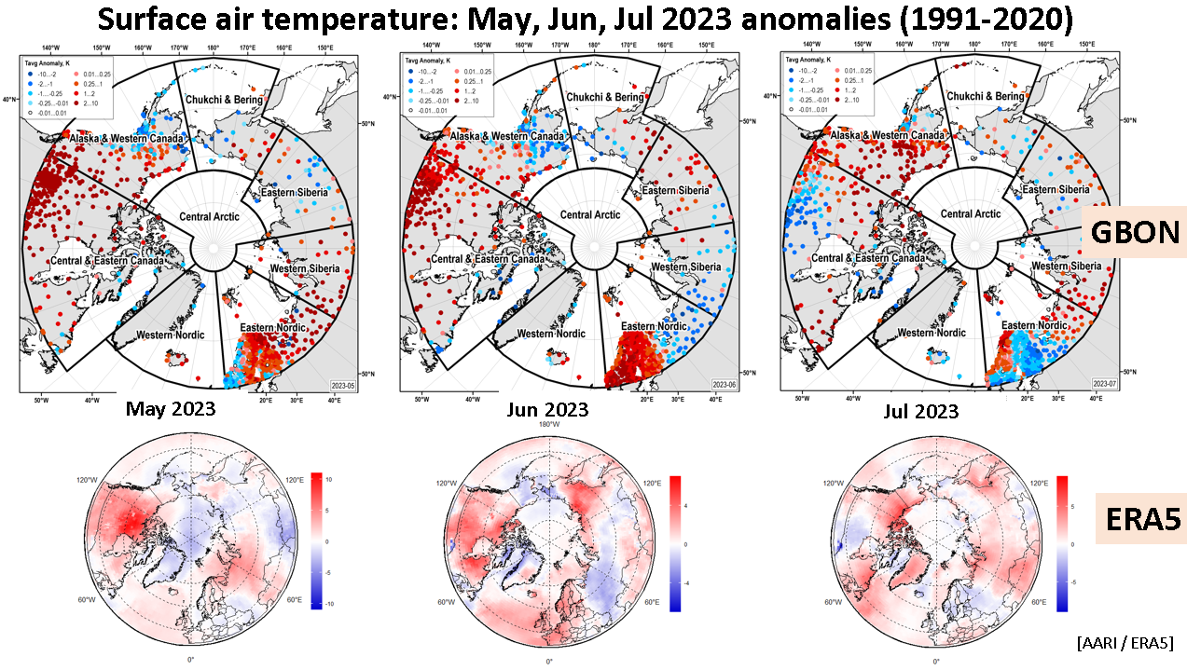
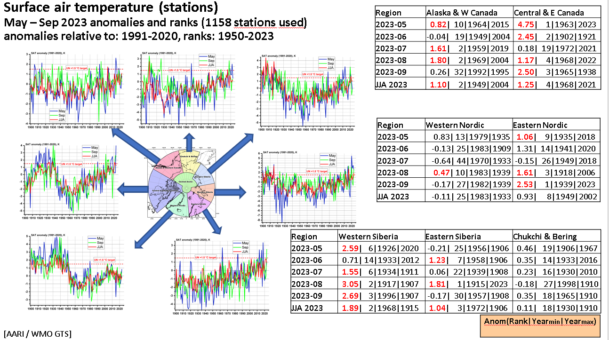
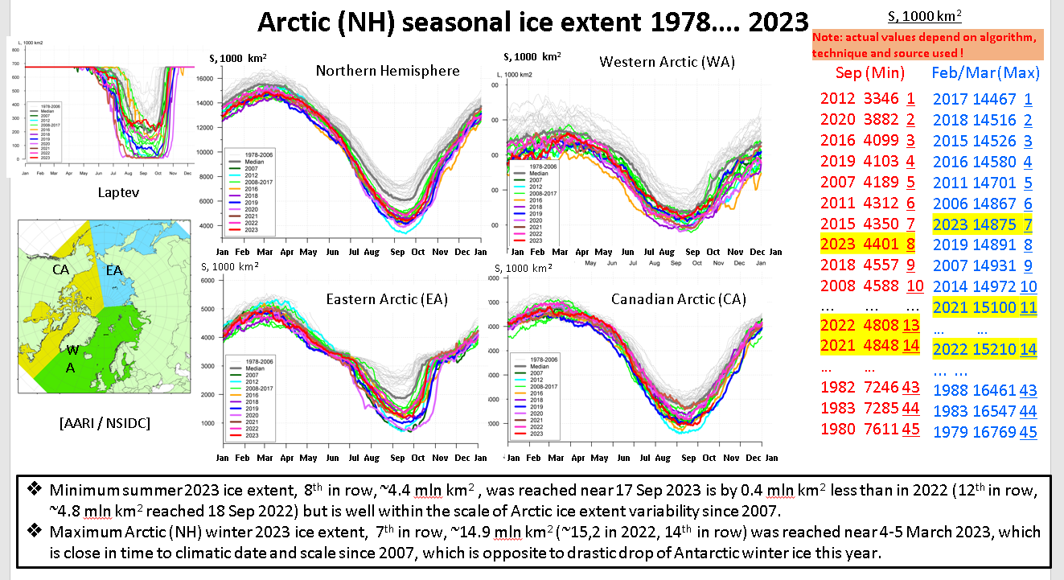
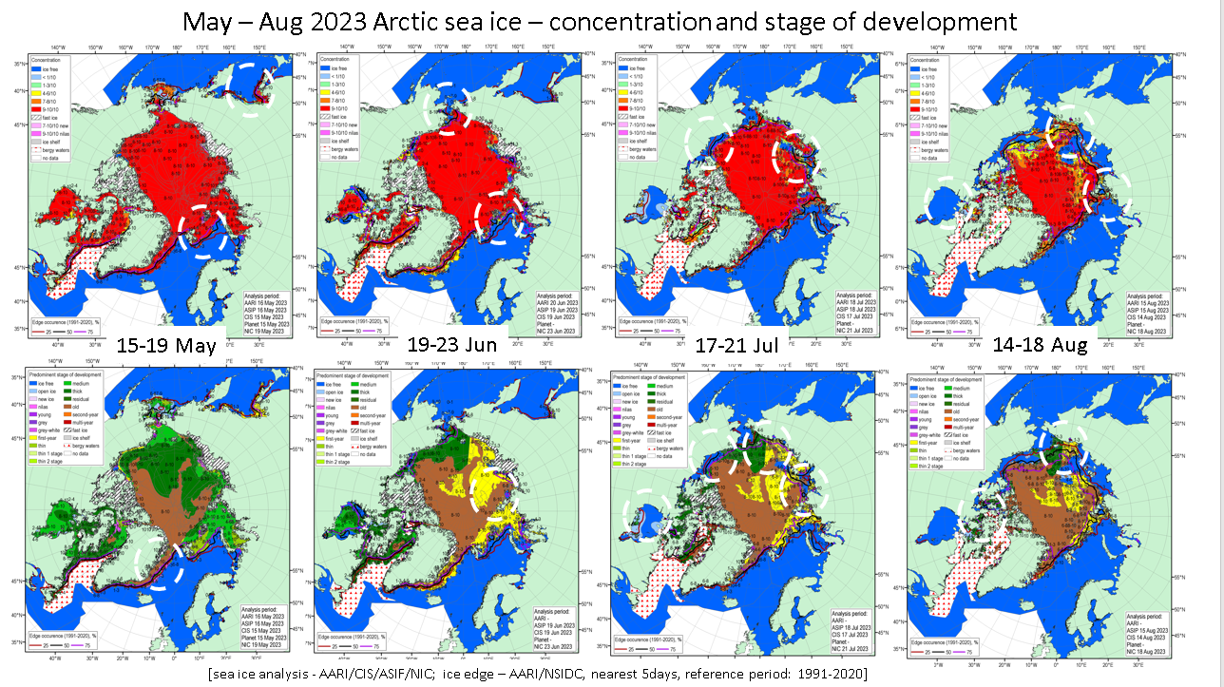
AARI and NE ArcRCC-N proposed input
Existing databases as reference material
Support in relevant parts for seasonal monitoring in WMO GTS, sea ice and reanalysis
Support for CS
Exchange of knowledge with ArcRCC-N and TPRCC
Notes:
Далее будет представлена информация по специализации институтов и образцы информационной продукции.

