Slide 1


AntCF-2: Climate Monitoring
(November 2025 – April 2026)
Vasily Smolyanitsky ¹
¹Arctic and Antarctic Research Institute (AARI)

Slide 2
Content of the Antarctic seasonal review for Nov 2025 – Apr 2026
Atmosphere
  Atmospheric circulation (ERA5 reanalysis)
  Surface air temperature (ERA5 reanalysis and Observations at stations)
  Precipitation (ERA5 reanalysis)
Sea ice
  Sea ice conditions: SIC, SoD, ice edge, ice age (ice charting and JAXA AMSR2)
  Sea Ice extent, including Feb 2026 austral summer minimum (NSIDC SIC passive microwave)
Polar Ocean and land ice surface heat content (ERA5 reanalysis)
  SST + STL3 (surface 28-100 cm layer temperature)
Information
  based on polar stations (WMO GTS), ERA5 reanalysis, AARI/US NIC sea ice analysis and NSIDC SIC and JAXA AMSR2 passive microwave patterns
  anomalies – relative to the latest 3rd WMO period 1991-2020,
  ranks – relative to period of reanalysis (1950-2025/2026) or sea ice analysis (1979…2026)
  graphics produced by AARI

Slide 3
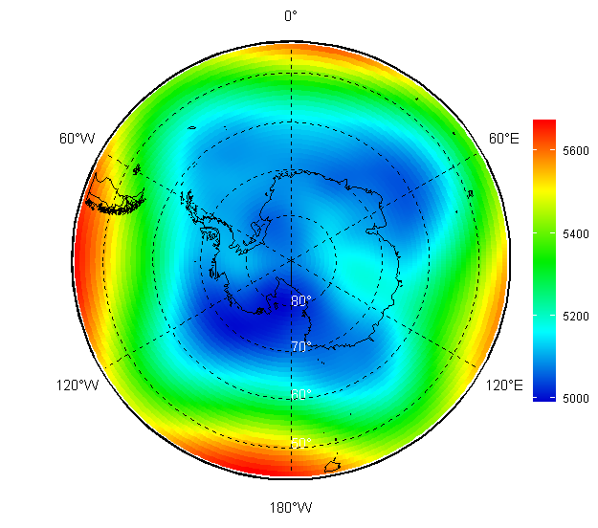
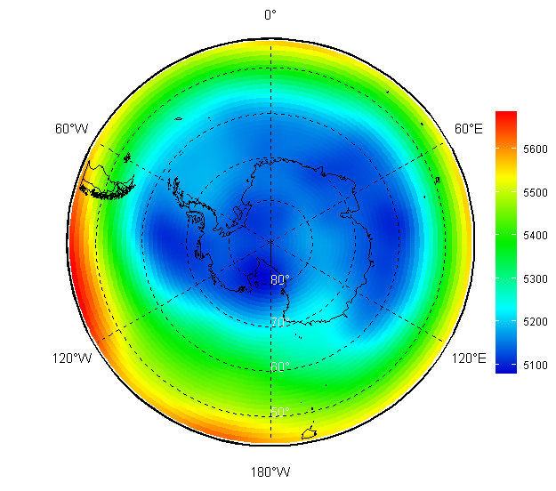
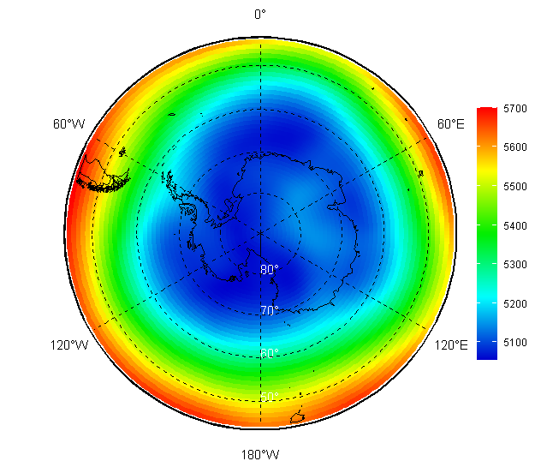
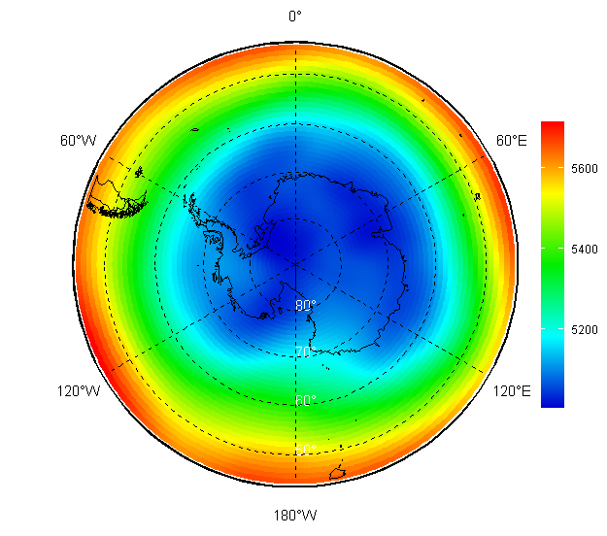
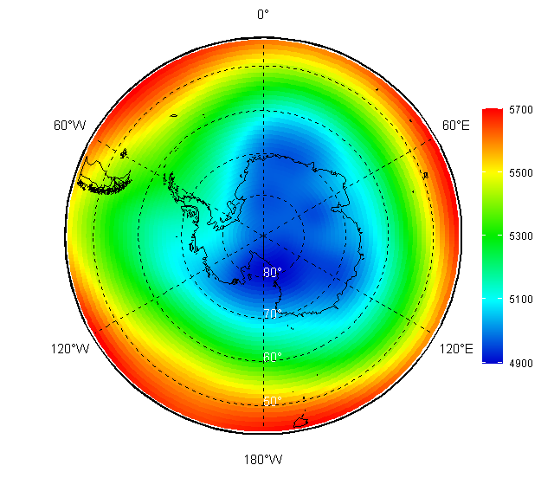
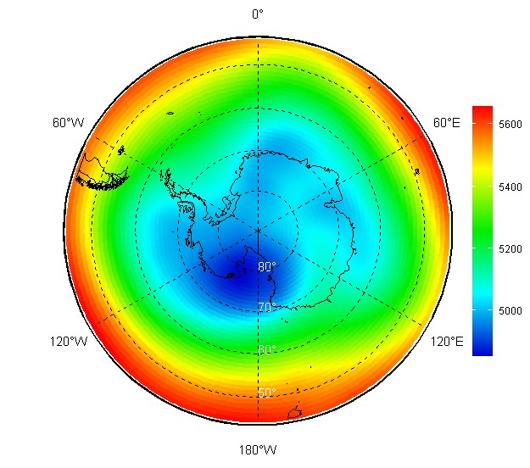
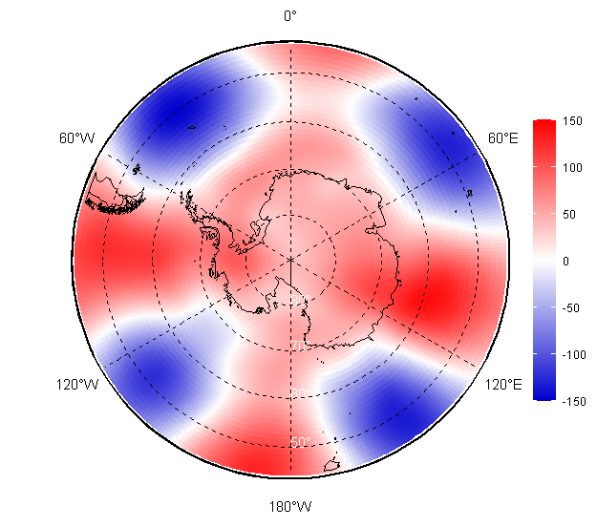
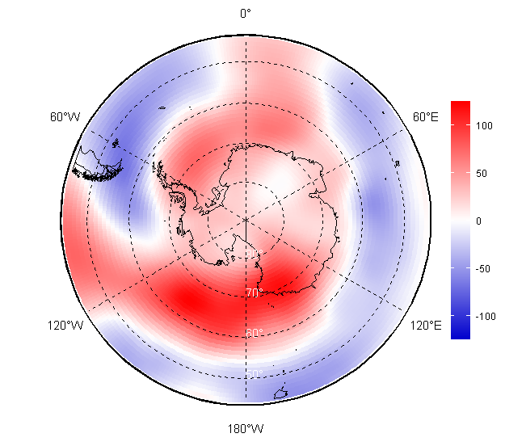
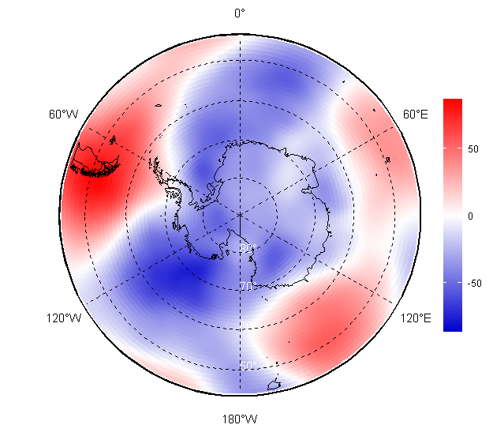
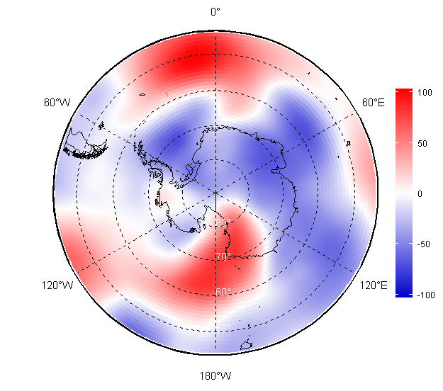
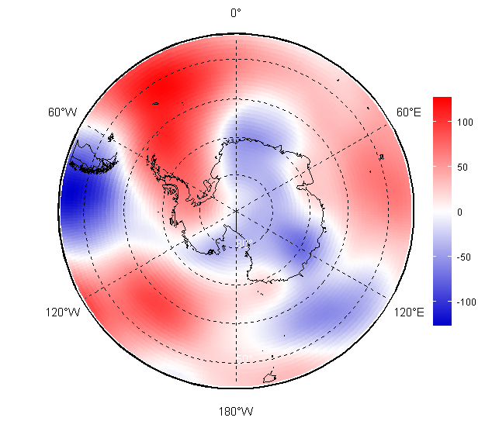
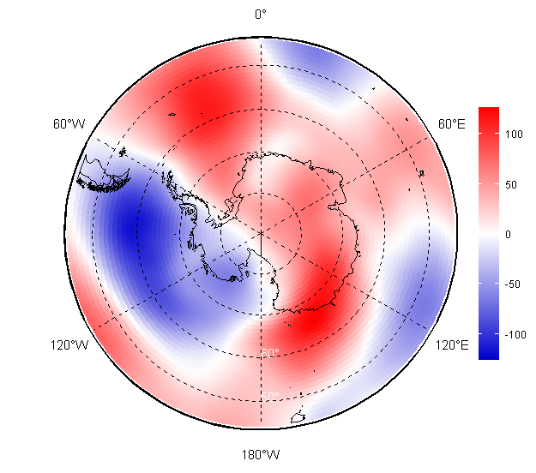
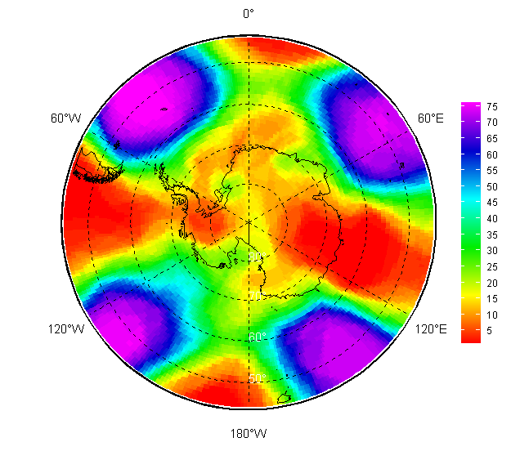
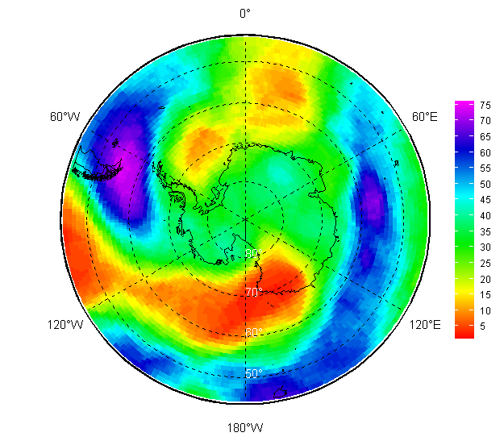
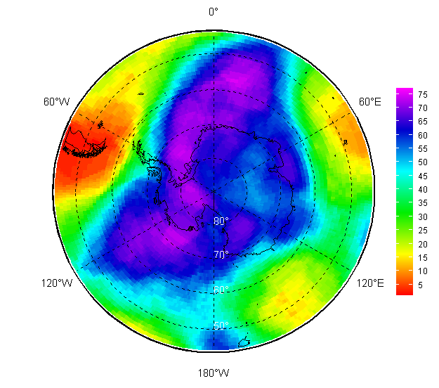
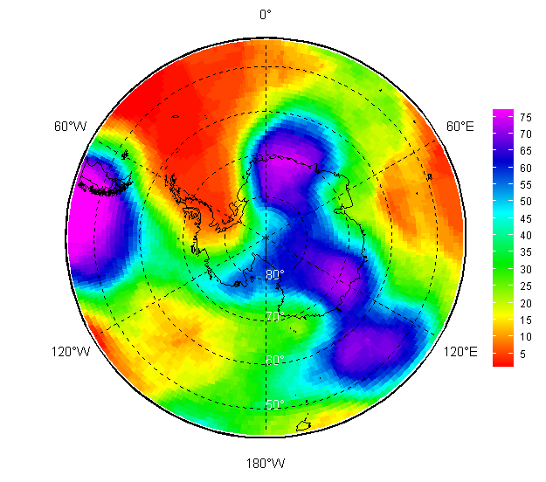
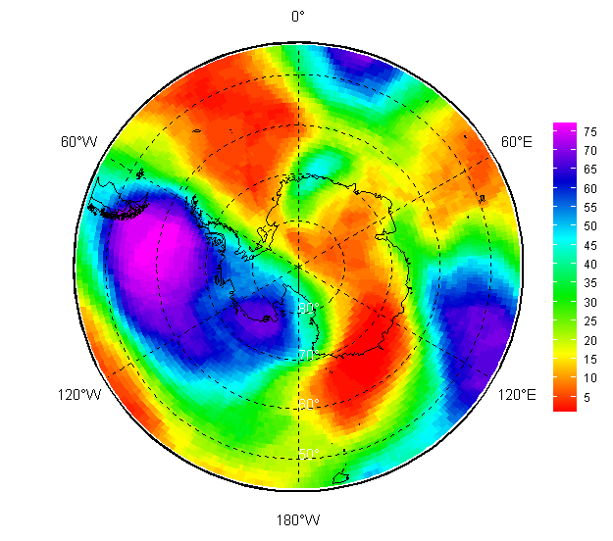
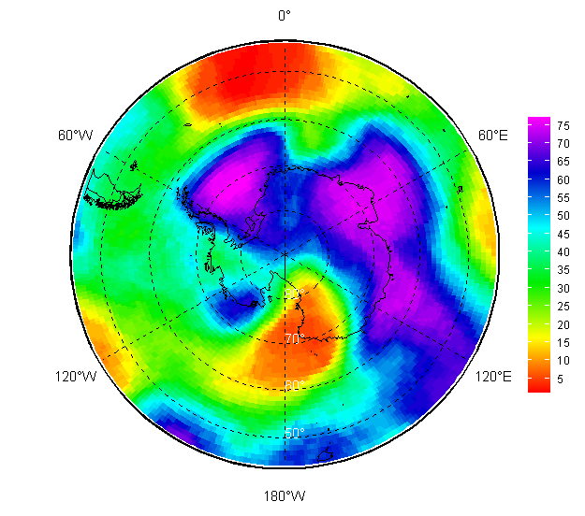
Atmosphere 2025/2026: monthly upper circulation (H500 HPa height) val/anom/rank
November | December | January | February | March | April

Slide 4
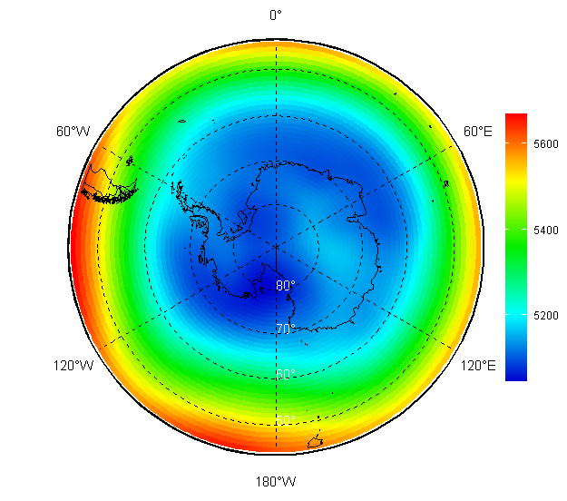
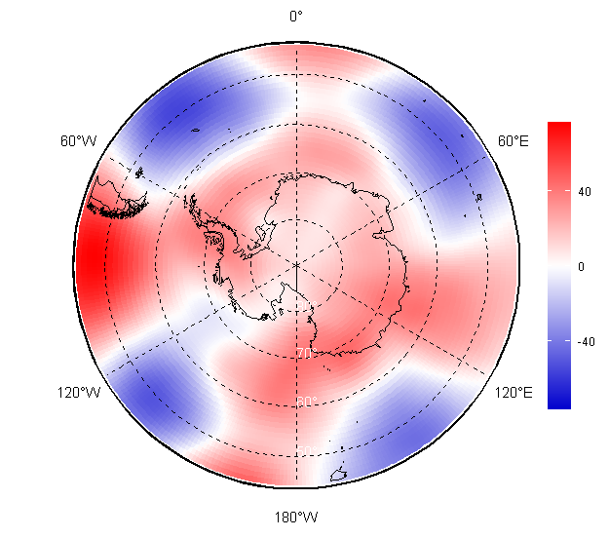
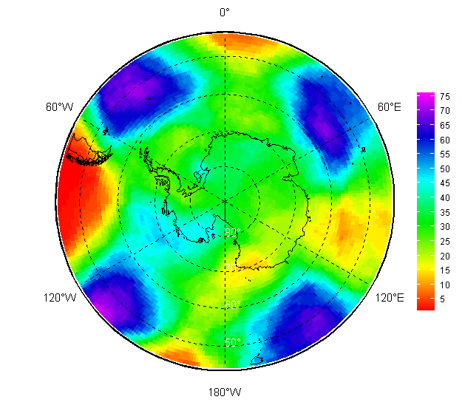
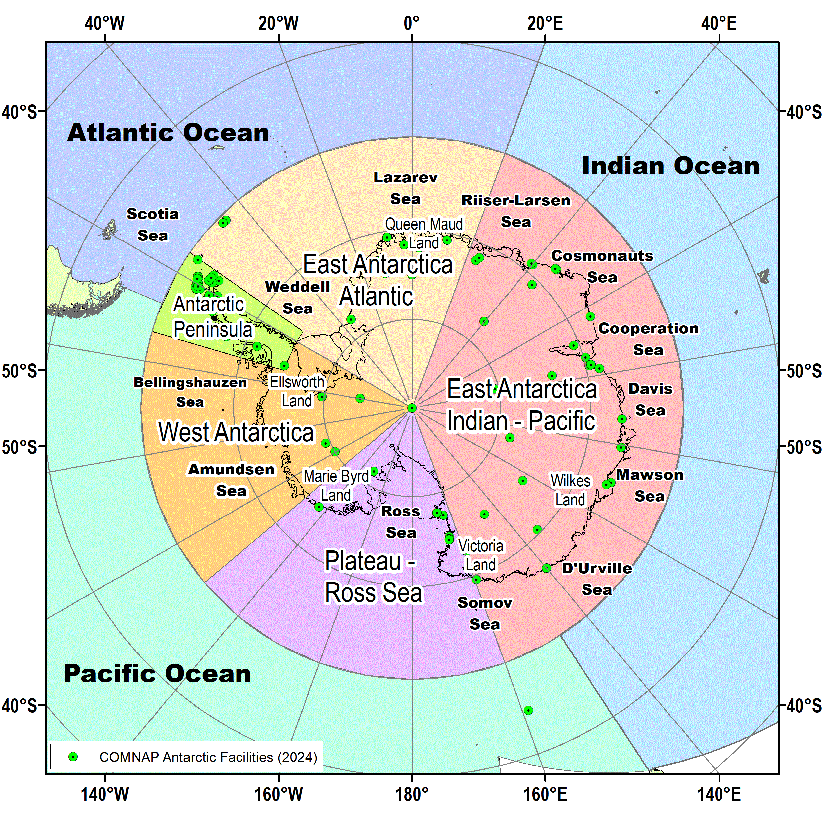
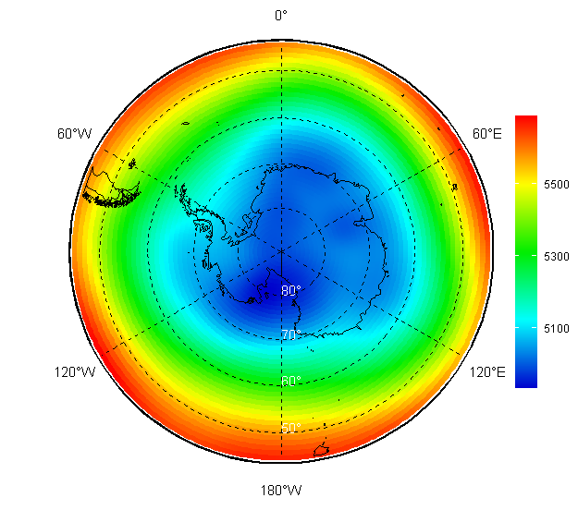
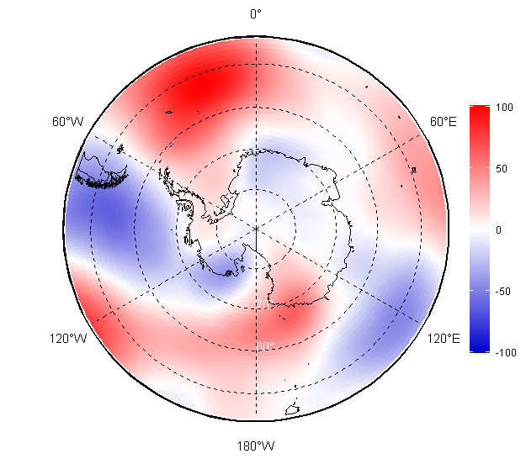
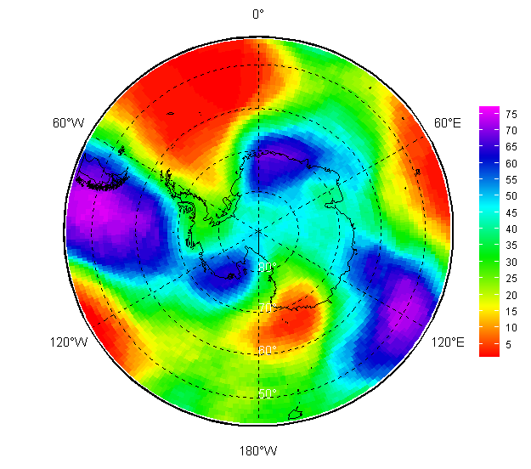
Atmosphere 2025/2026: seasonal upper circulation (H500 HPa height) val/anom/rank
Value Anom (1991-2020) Rank
NDJ 2025/2026
FMA 2026

Slide 5
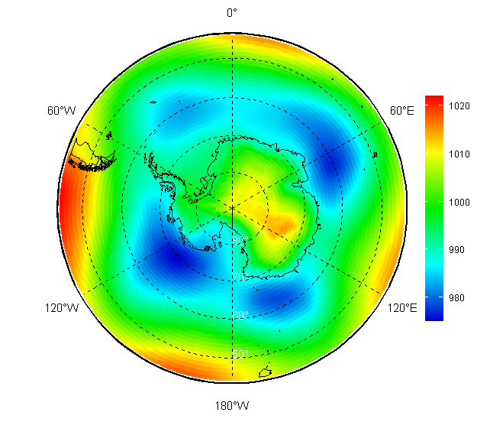
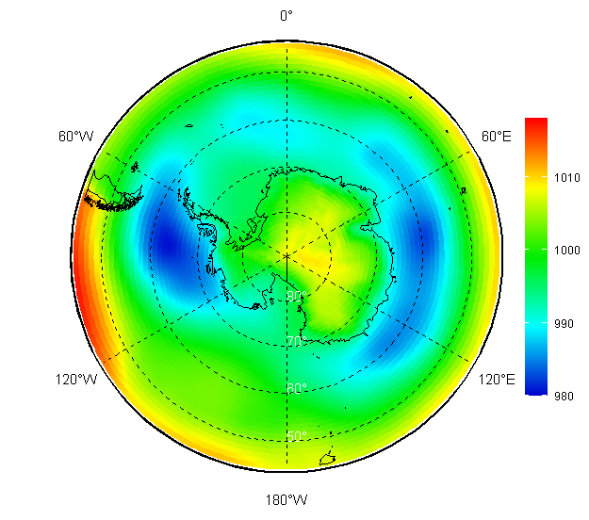
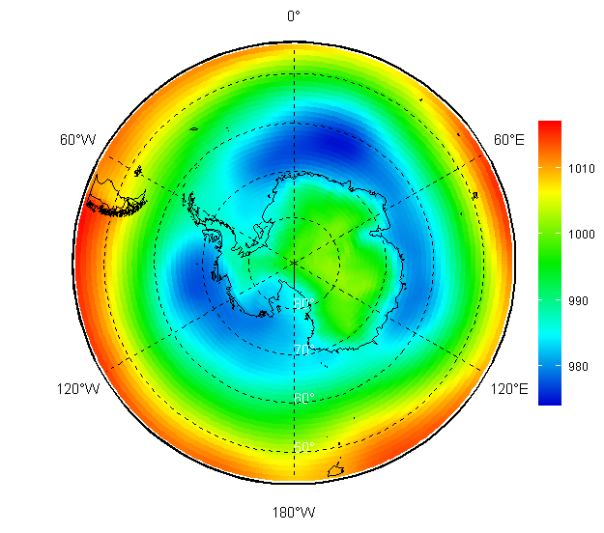
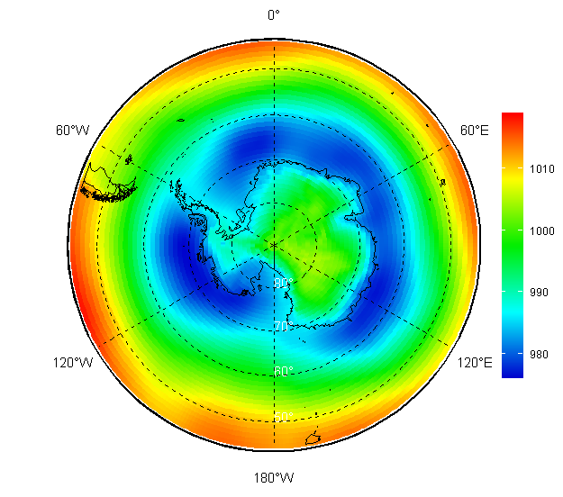
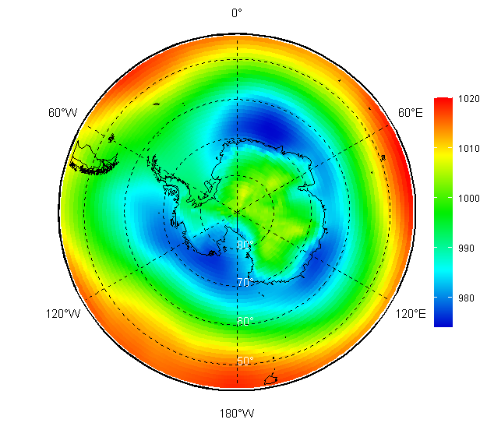
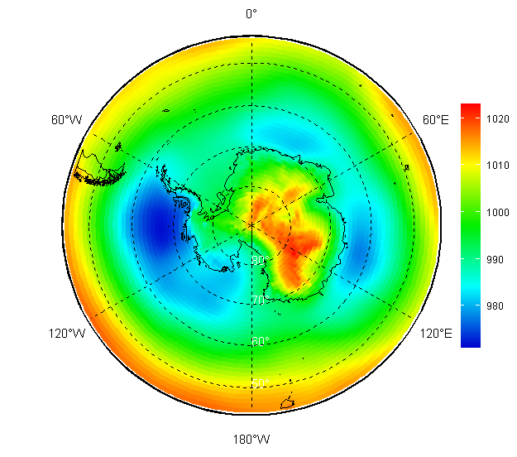
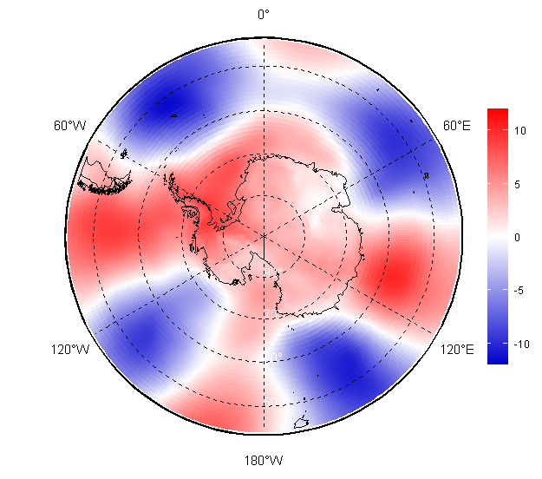
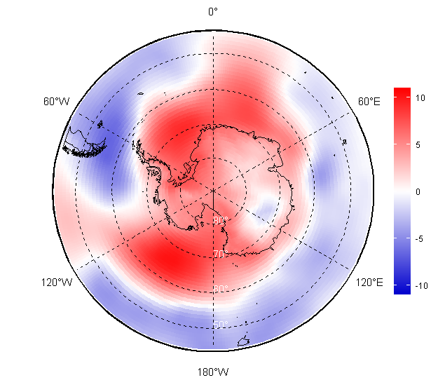
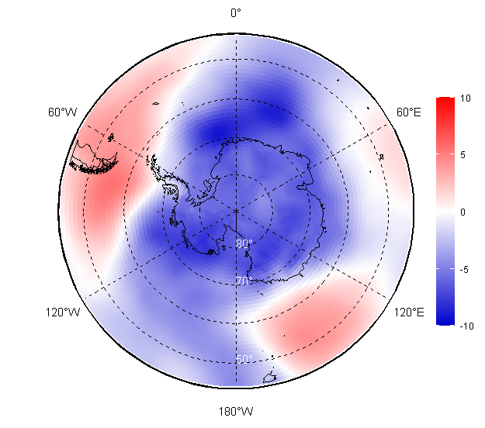
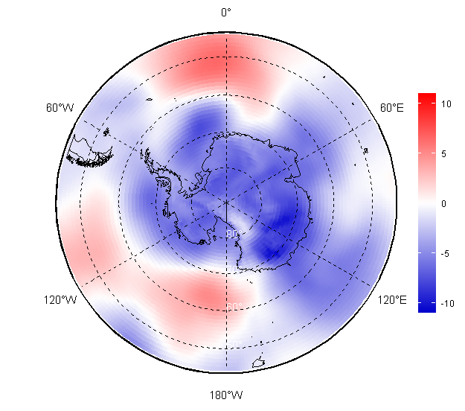
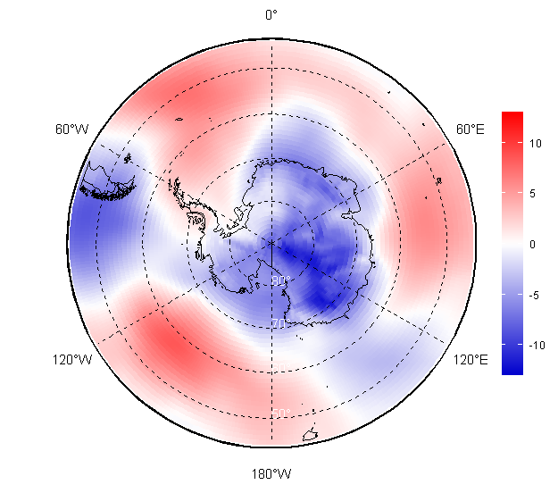
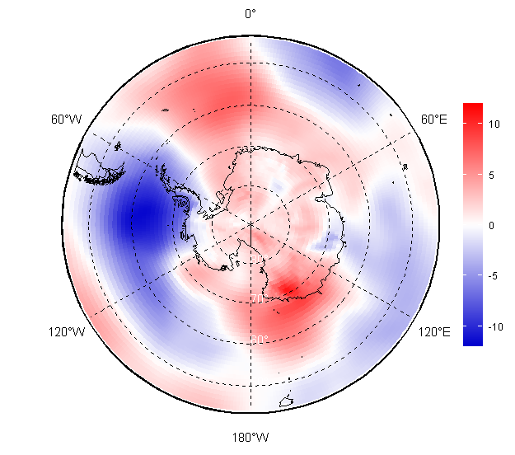
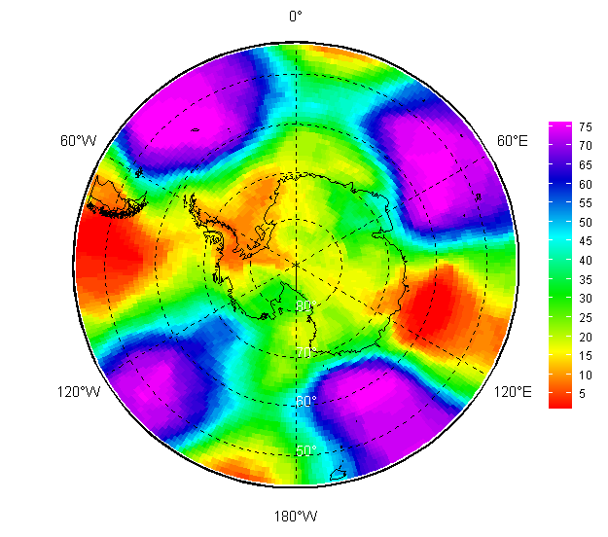
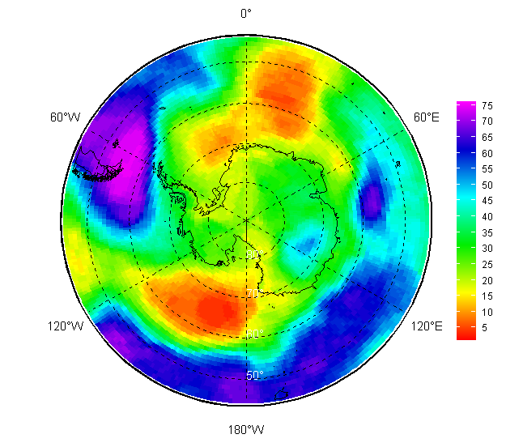
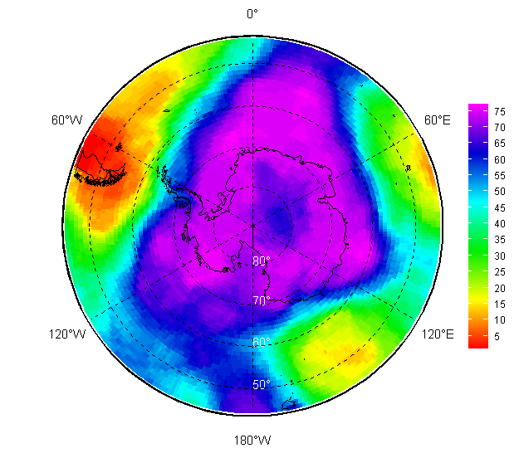
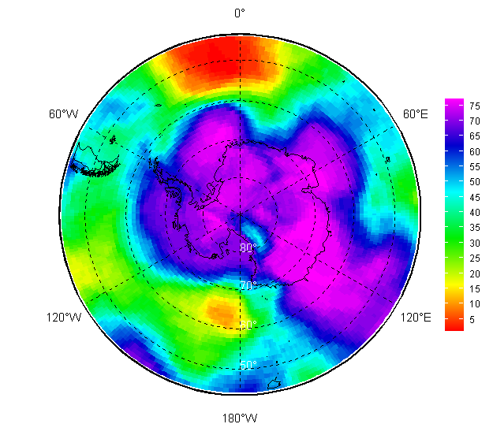
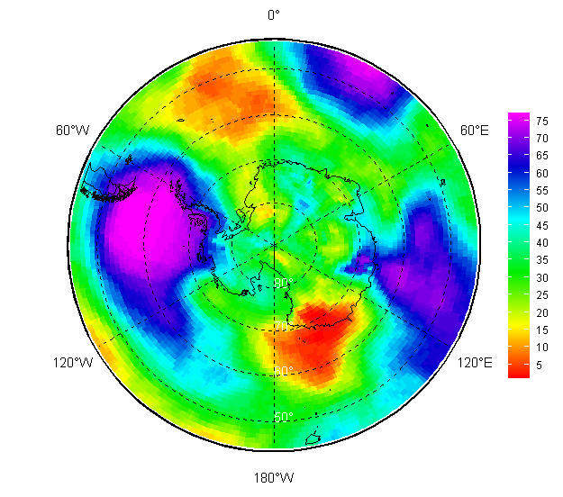
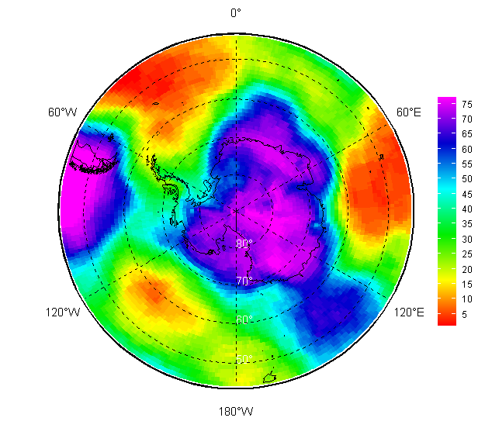
Atmosphere 2025/2026: monthly surface circulation (MSLP HPa) val/anom/rank
November | December | January | February | March | April

Slide 6
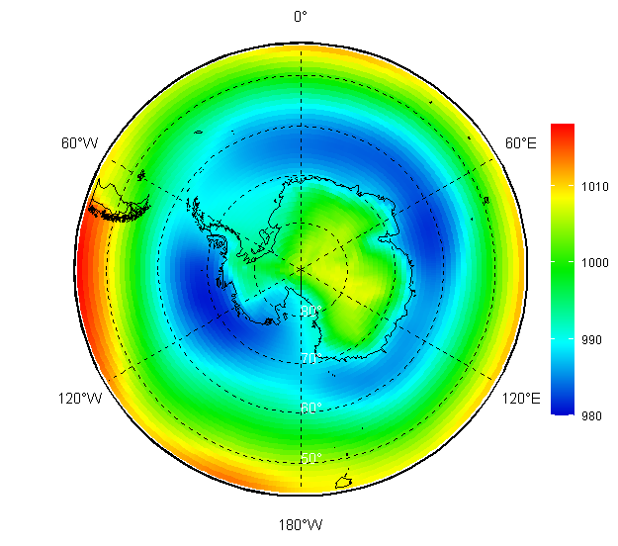
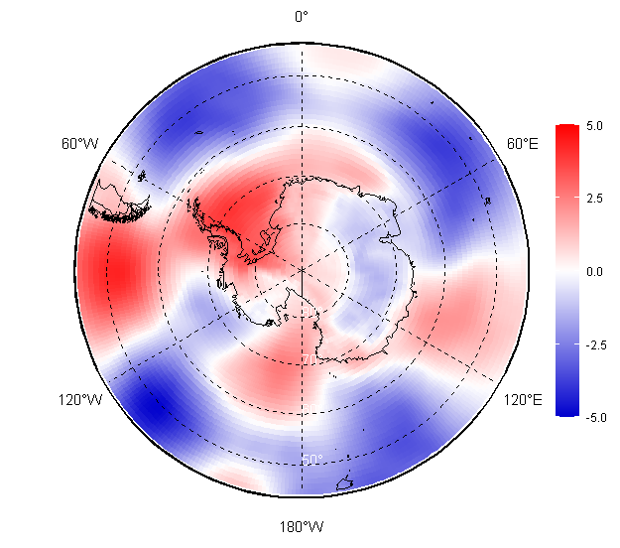
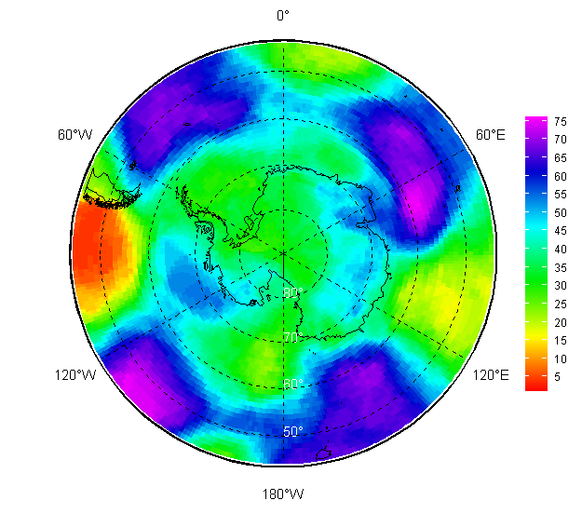
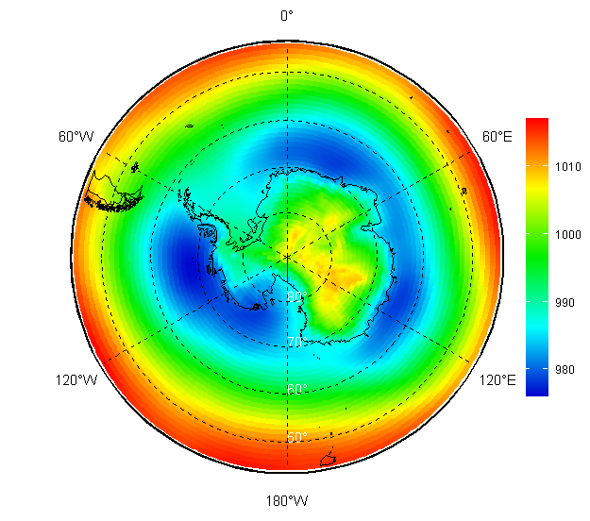
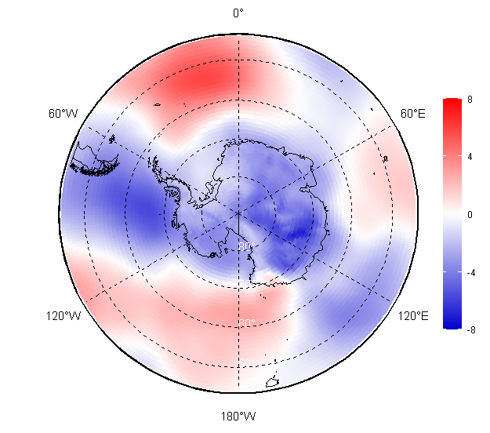
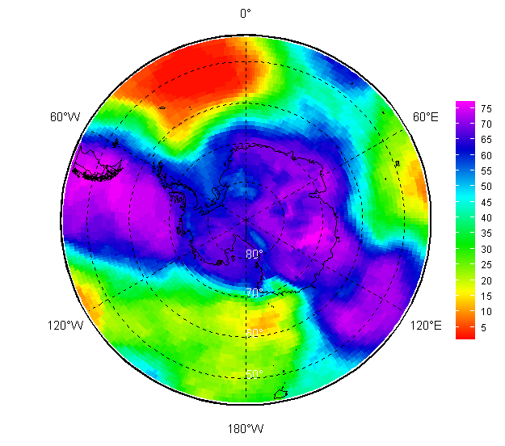
Atmosphere 2025/2026: seasonal surface circulation (MSLP HPa) val/anom/rank
Value Anom (1991-2020) Rank
NDJ 2025/2026
FMA 2026

Slide 7
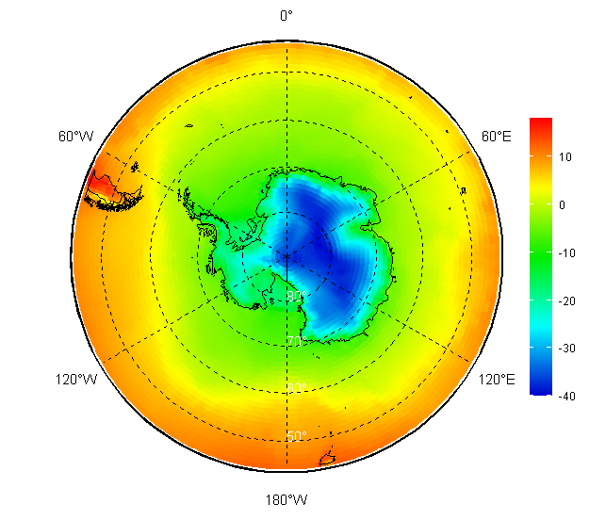

















Atmosphere 2025/2026: monthly surface air temperature (SAT 2m), degrees, val/anom/rank
November | December | January | February | March | April

Slide 8






Atmosphere 2025/2026: monthly surface air temperature (SAT 2m) – reanalysis verification (anom)
November | December | January | February | March | April
SAT 2m anomaly (to reference period 1991-2020) at the stations is based on monthly averaged mean daily data. Quality flags and gaps within reference period are not taken into account.

Slide 9








Atmosphere 2025/2026: seasonal surface air temperature (SAT 2m), degrees
Value Anom (1991-2020) Anom_{obs} (1991-2020) Rank
NDJ 2025/2026
FMA 2026

Slide 10





Atmosphere (climate): surface air temperature (SAT 2m), linear trend 1996-2025, deg/year
DJF
MAM
Year
JJA
SON

Slide 11


















Atmosphere 2025/2026: monthly surface precipitation, mm/mon, val/anom/rank
November | December | January | February | March | April

Slide 12






Atmosphere 2025/2026: seasonal surface precipitation, mm/month
Value Anom (1991-2020) Rank
NDJ 2025/2026
FMA 2026

Slide 13


















Polar Ocean and glaciers 2025/2026: monthly SST+STL3(28-100 cm) val/anom/rank
November | December | January | February | March | April

Slide 14






Polar Ocean and glaciers 2025/2026: seasonal SST+STL3(28-100 cm)
Value Anom (1991-2020) Rank
NDJ 2025/2026
FMA 2026

Slide 15


















Sea ice 2025: monthly ice conditions (CT, SoD, ice edge, ice age)
13 November | 18 December | 16 January | 27 February | 19 March | 16 April

Slide 16










Sea ice 2025/2026: daily sea ice extent
Minimum: 22-26/02/ 2026 - 2.6-2.8 million square km
Rank | Year | SIE
1 | 2023 | 1777
2 | 2022 | 1919
3 | 2024 | 1981
4 | 2025 | 2018
5 | 2017 | 2081
6 | 2018 | 2157
… | … | …
16 | 2026 | 2577
… | … | …
23 | 2020 | 2670
… | … | …
46 | 2003 | 3633
47 | 2013 | 3664
48 | 2008 | 3707
17/02/2023
18/02/2008
Rank | Year | SIE
1 | 2023 | 16999
2 | 2024 | 17242
3 | 2025 | 17891
4 | 1986 | 18043
5 | 2017 | 18080
6 | 2002 | 18137
7 | 2022 | 18240
8 | 2018 | 18241
22 | 2021 | 18726
45 | 2012 | 19471
46 | 2013 | 19586
47 | 2014 | 20163
07/09/2023
20/09/2014

