Slide 1




AntCF-2: Climate Monitoring
(November 2025 – April 2026)
Vasily Smolyanitsky ¹, Vito Vitale ²
¹Arctic and Antarctic Research Institute (AARI)
² Institute of Polar Sciences (CNR-ISP)

Slide 2
Content of the Antarctic seasonal review for Nov 2025 – Apr 2026
Atmosphere
  Atmospheric circulation (ERA5 reanalysis)
  Surface air temperature (ERA5 reanalysis and Observations at stations)
  Precipitation (ERA5 reanalysis and Observations at the stations)
Sea ice
  Sea ice conditions: SIC, SoD, ice edge, ice age (ice charting and JAXA AMSR2)
  Sea Ice extent, including Feb 2026 austral summer minimum (NSIDC SIC passive microwave)
Polar Ocean and land ice surface heat content (ERA5 reanalysis)
  SST + STL3 (surface 28-100 cm layer temperature)
Information
  based on polar stations and data repositories (READER, NOAA, WMO GTS, National), ERA5 reanalysis, AARI/US NIC sea ice analysis and NSIDC SIC and JAXA AMSR2 passive microwave patterns, and more
  anomalies – relative to the latest 3rd WMO period 1991-2020,
  ranks – relative to period of reanalysis (1950-2025/2026) or sea ice analysis (1979…2026)
  Information on extremes will be added
  graphics produced by AARI and others

Slide 3
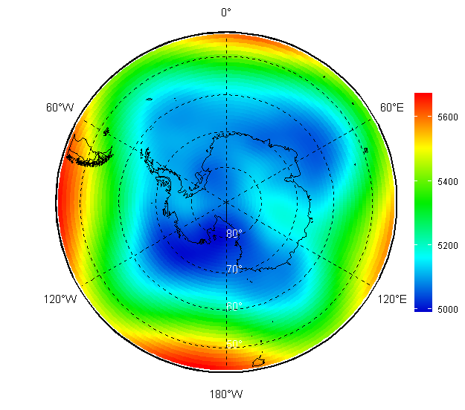
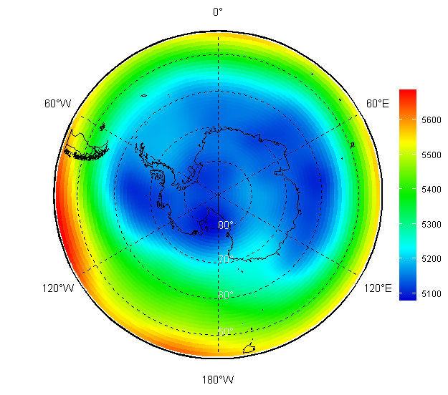
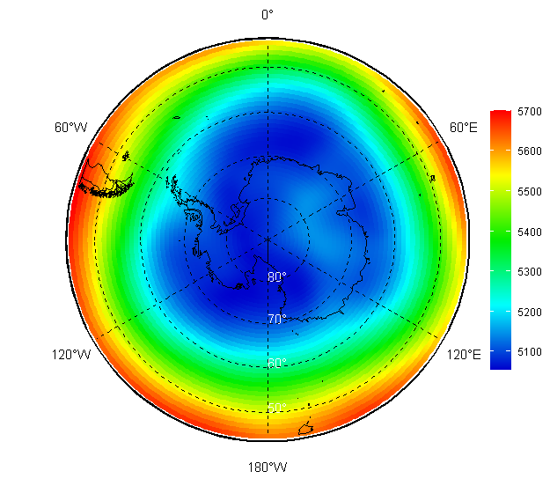
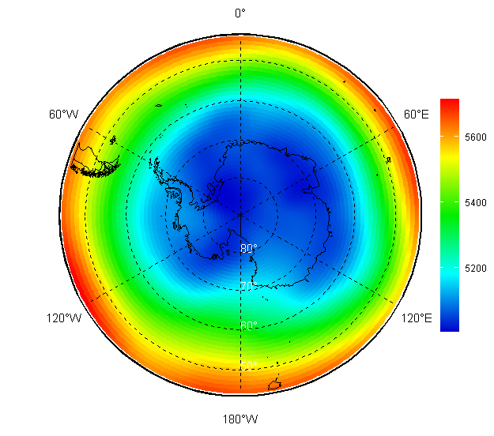
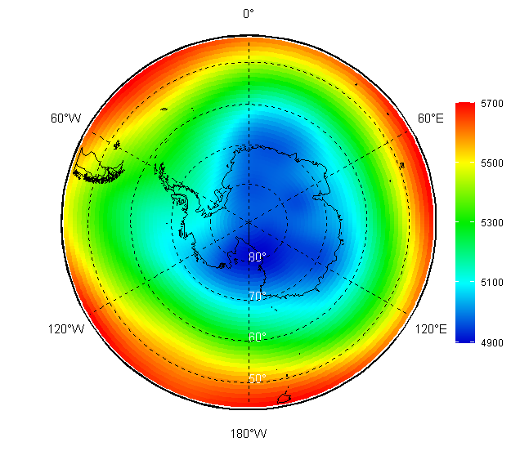
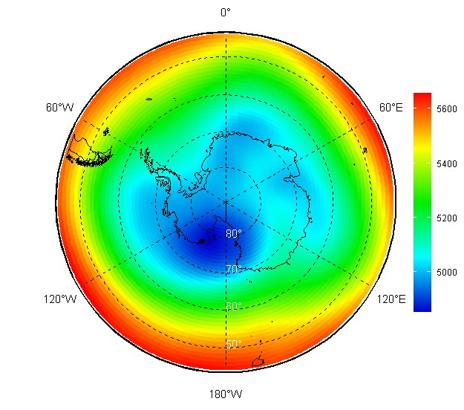
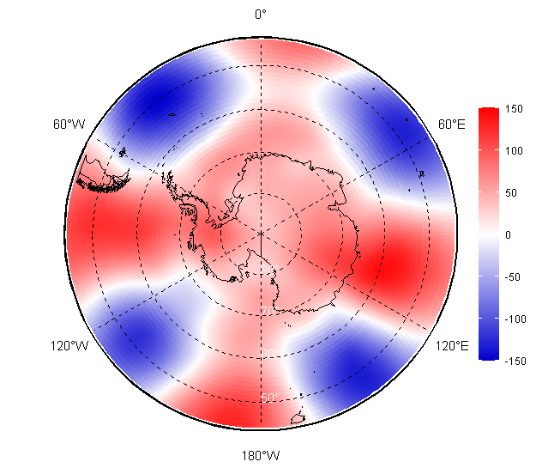
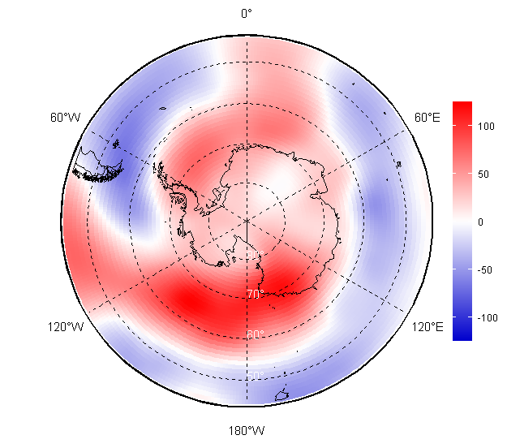
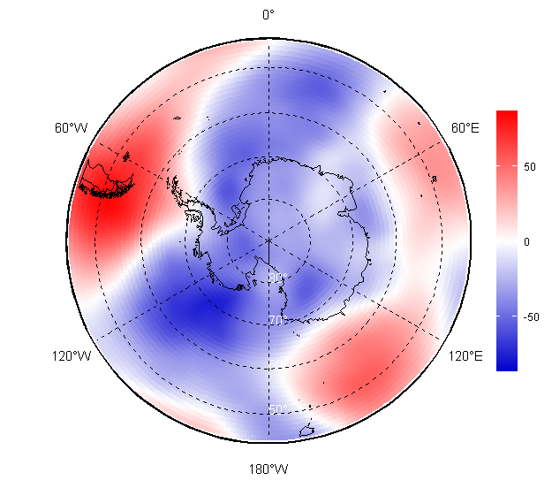
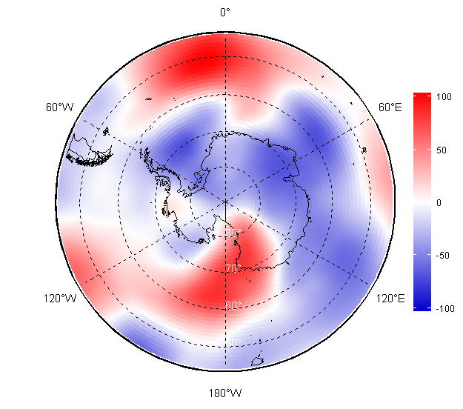
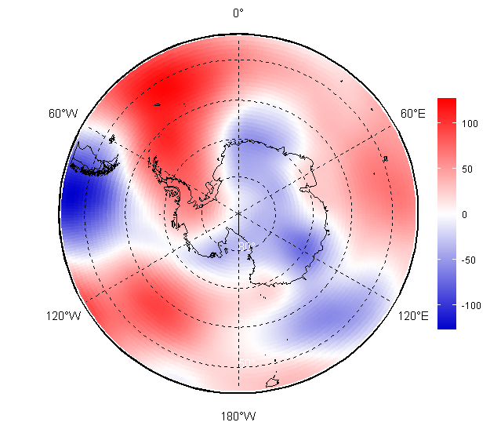
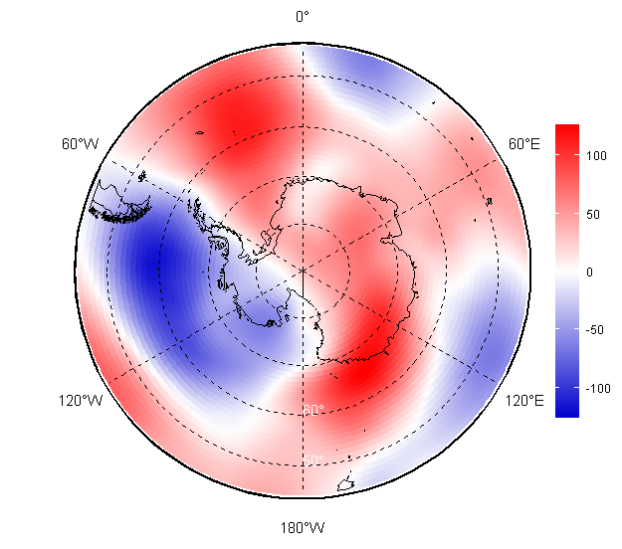
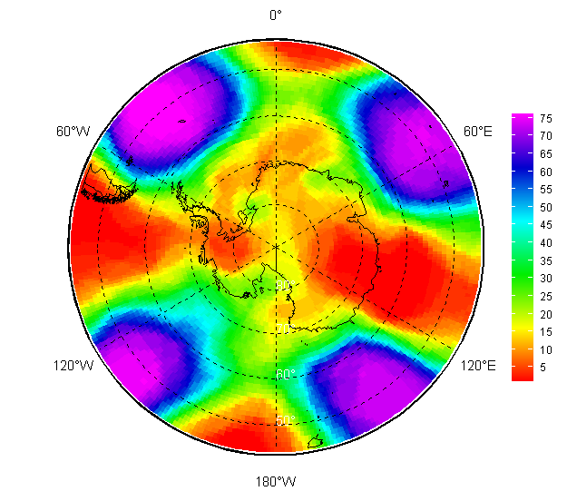
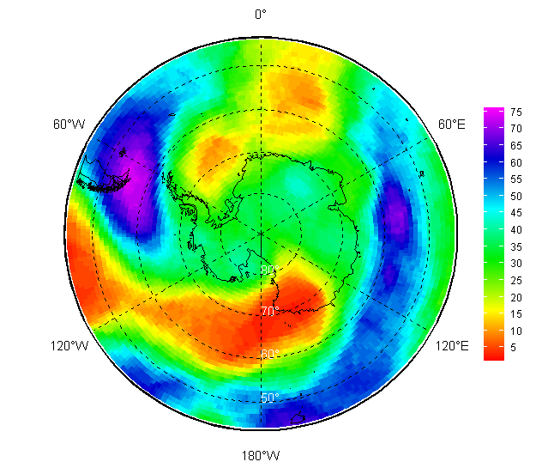
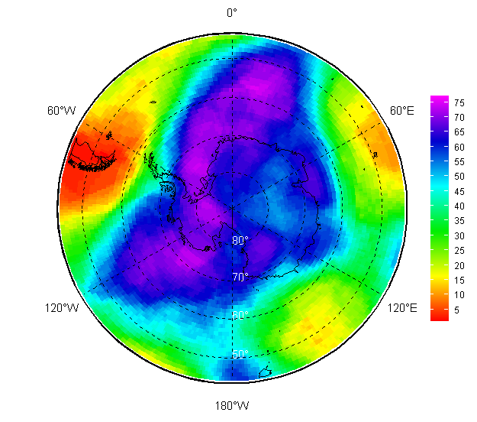
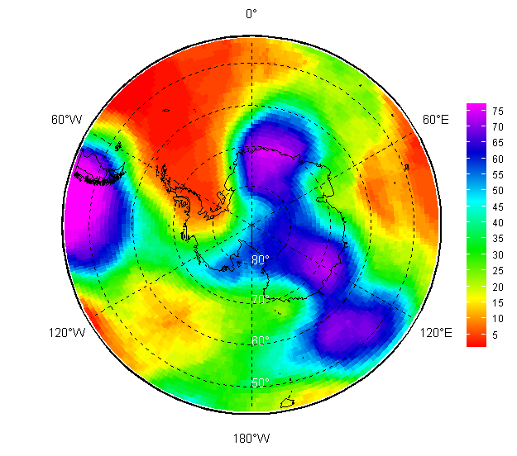
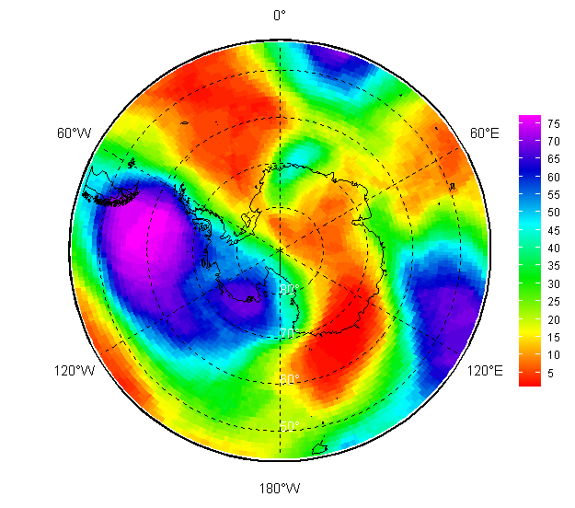
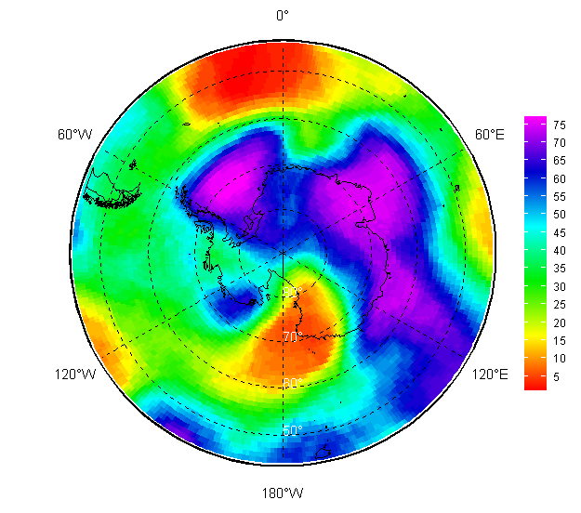
Atmosphere 2025/2026: monthly upper circulation (H500 HPa height) val/anom/rank
November | December | January | February | March | April

Slide 4
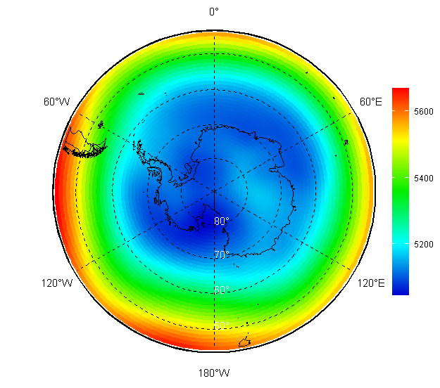
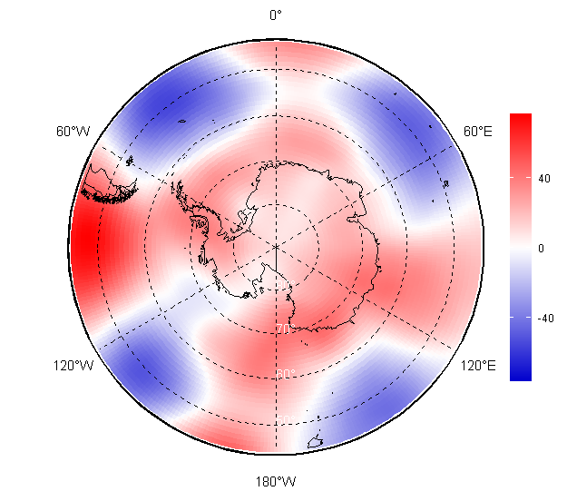
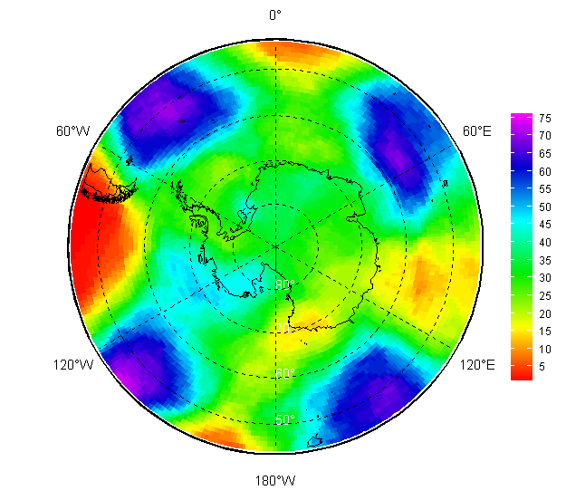
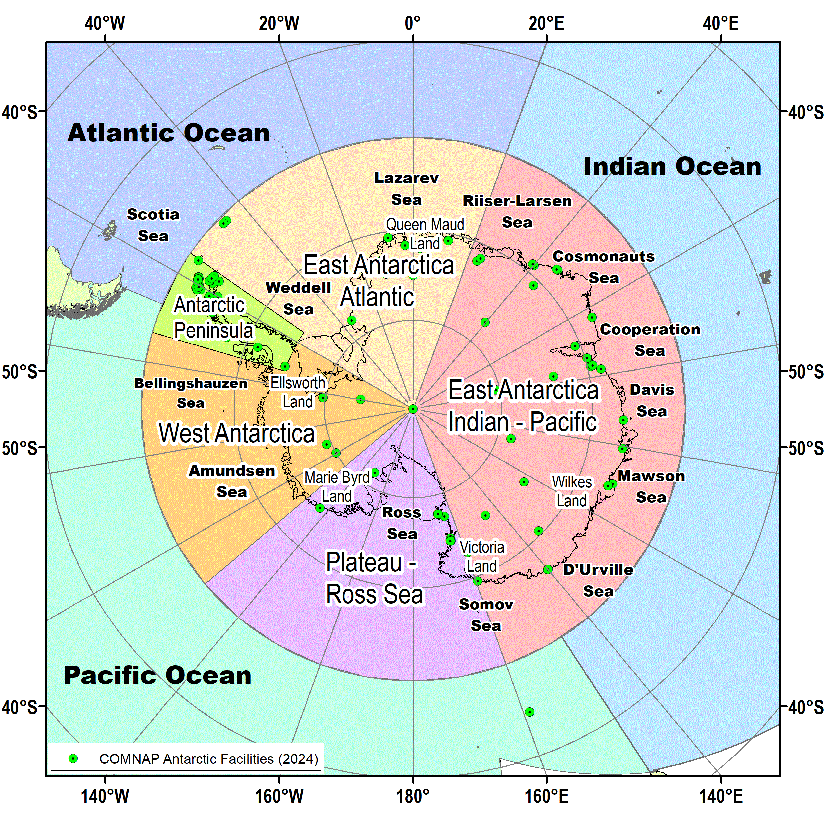
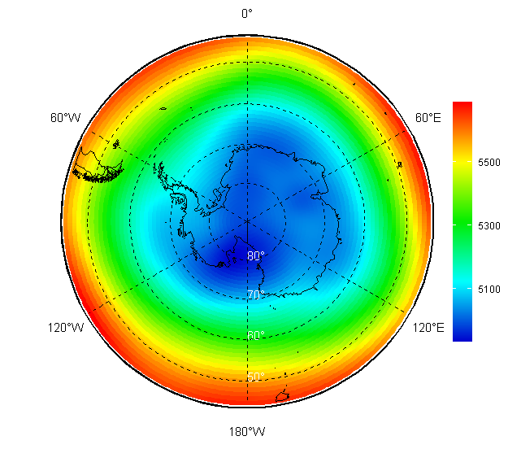
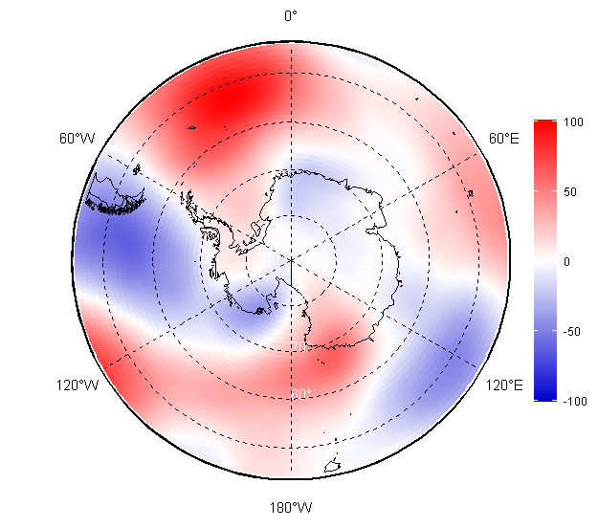
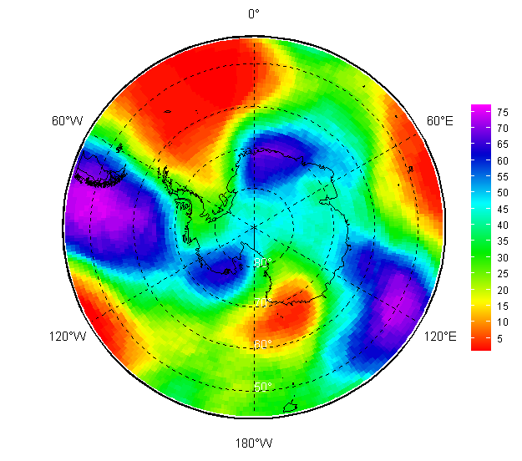
Atmosphere 2025/2026: seasonal upper circulation (H500 HPa height) val/anom/rank
Value Anom (1991-2020) Rank
NDJ 2025/2026
FMA 2026

Slide 5
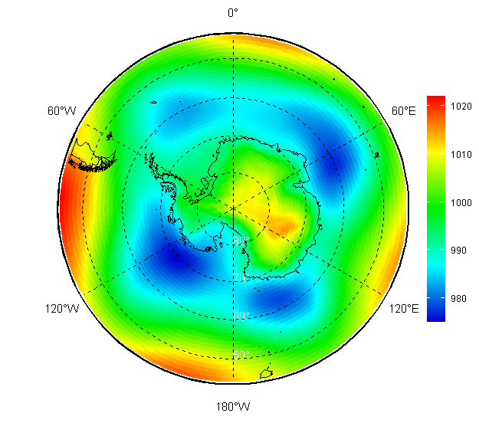
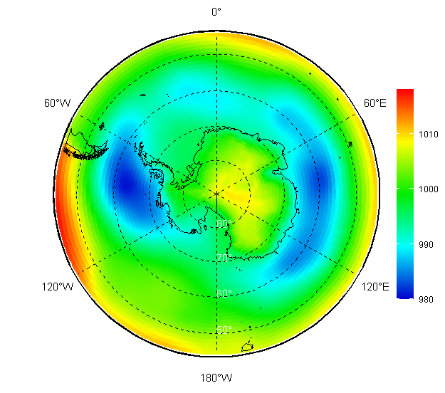
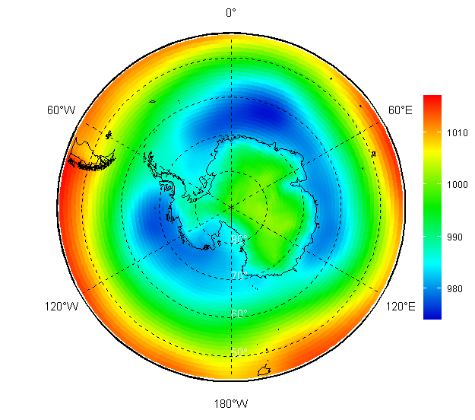
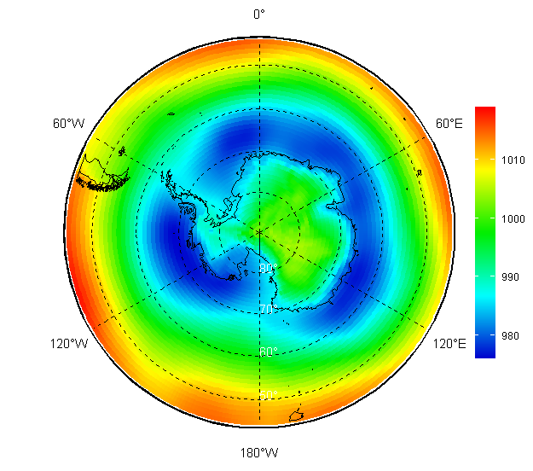
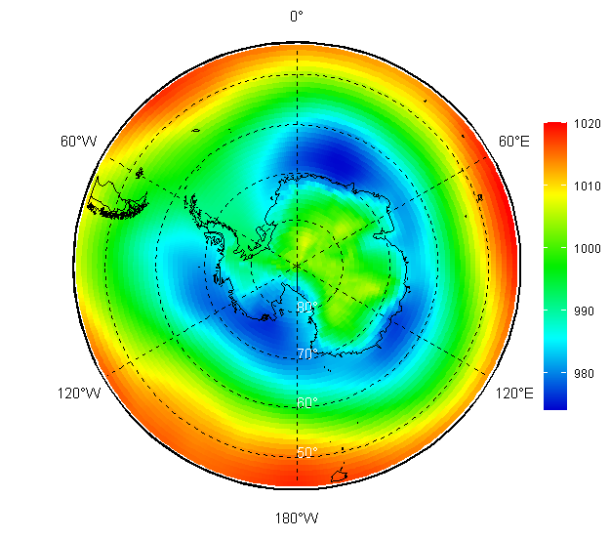
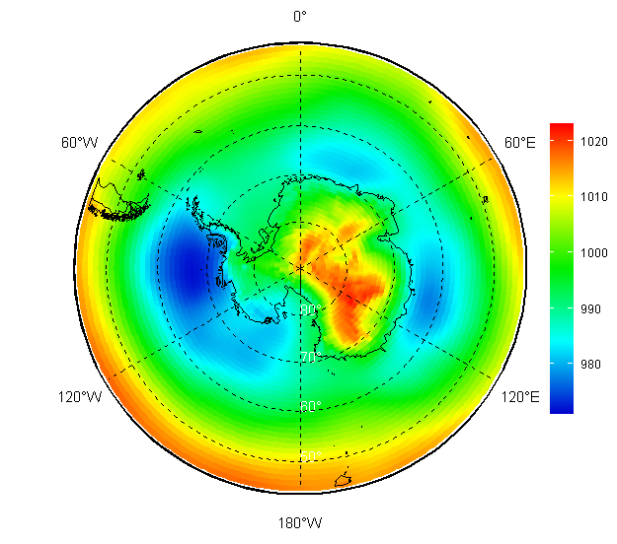
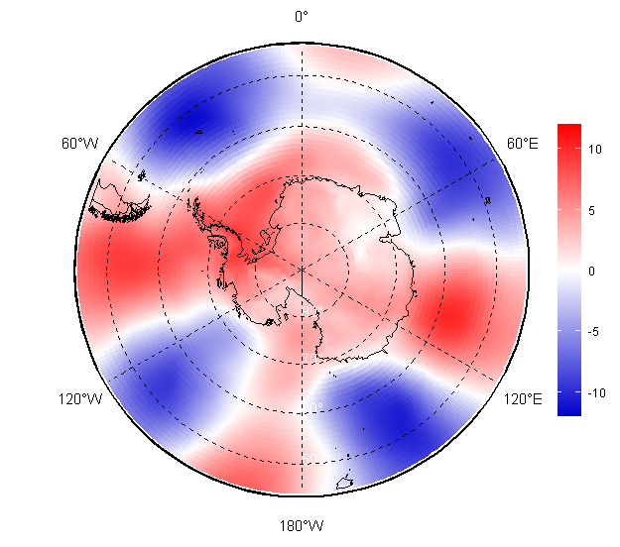
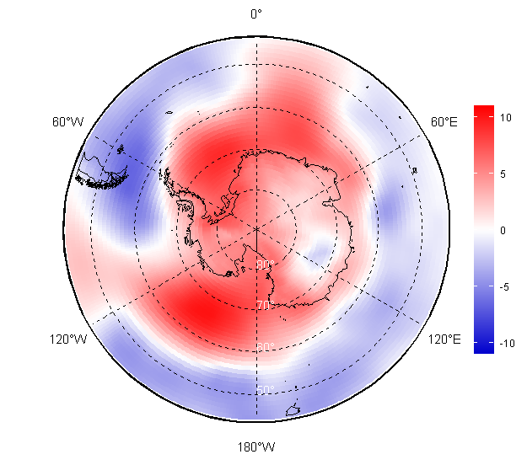
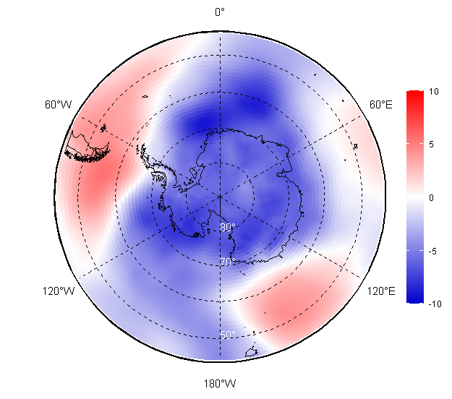
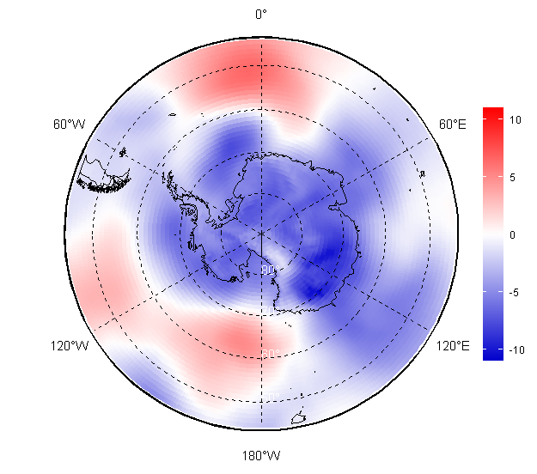
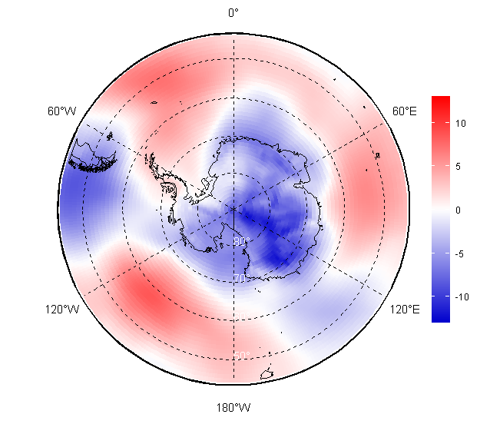
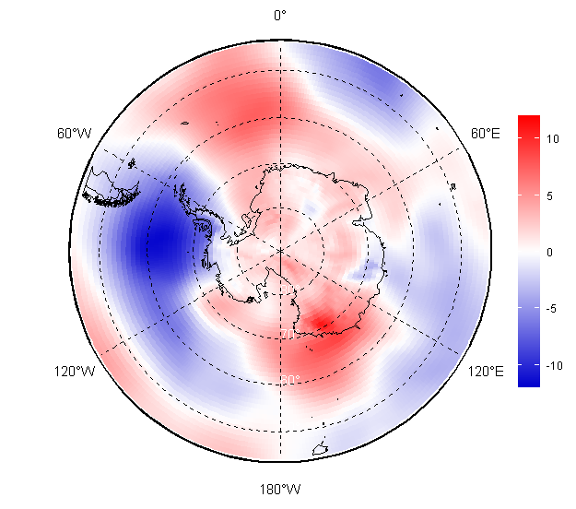
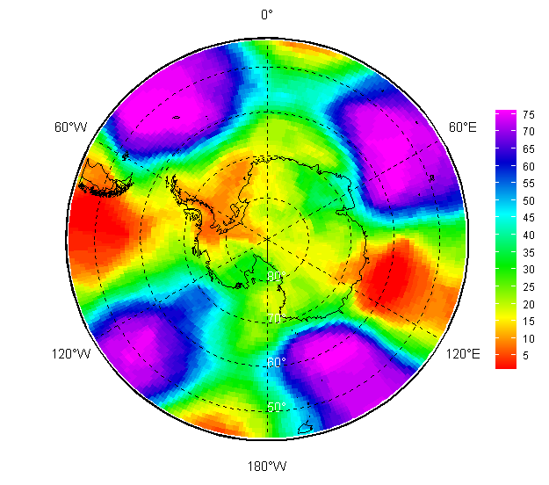
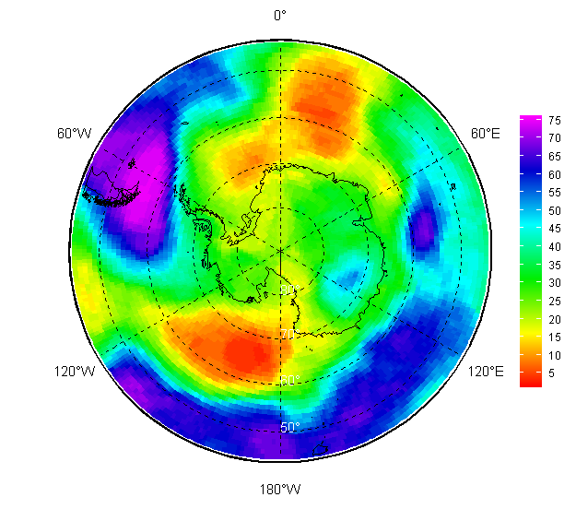
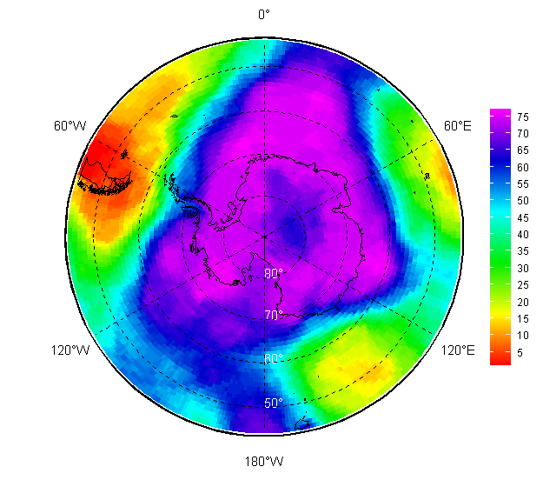
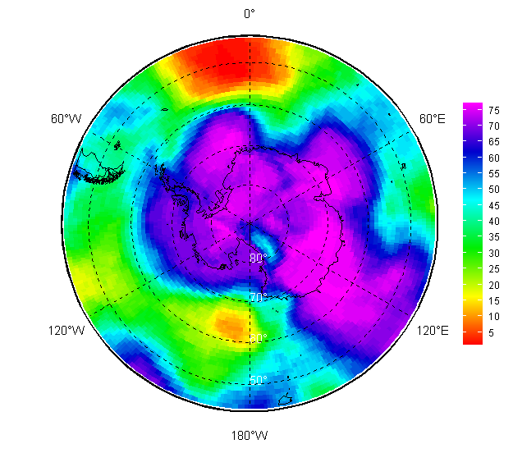
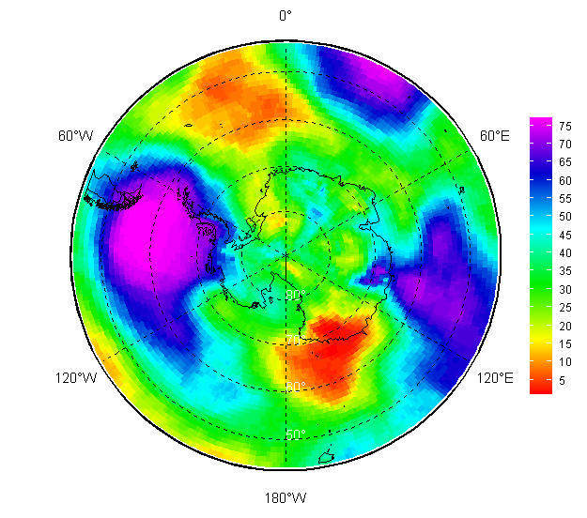
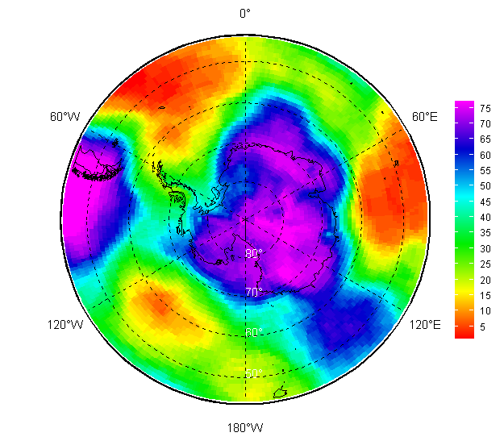
Atmosphere 2025/2026: monthly surface circulation (MSLP HPa) val/anom/rank
November | December | January | February | March | April

Slide 6
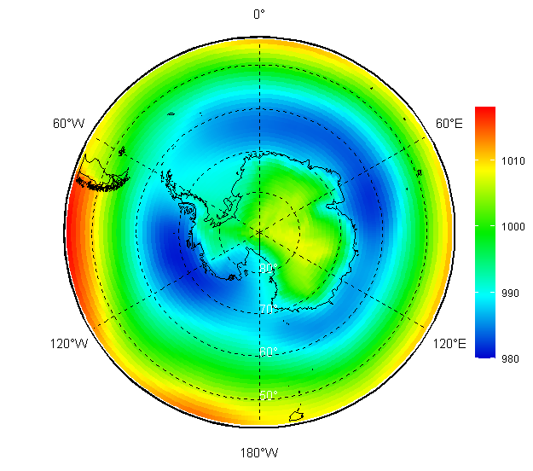
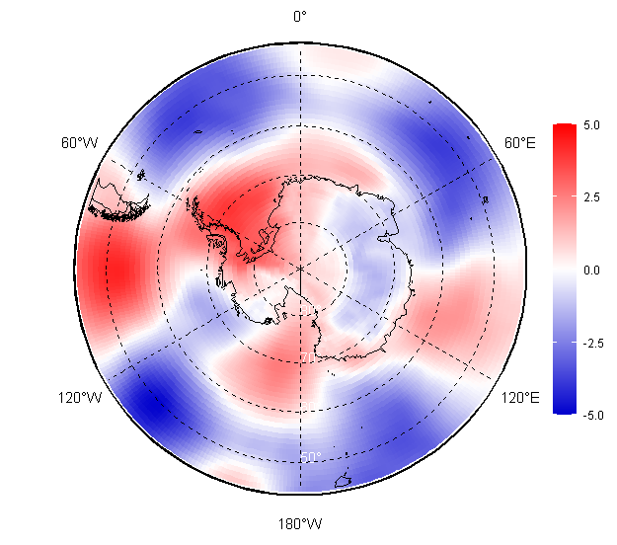
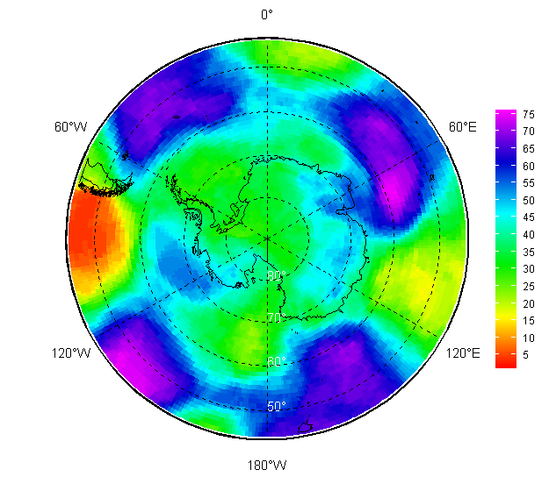
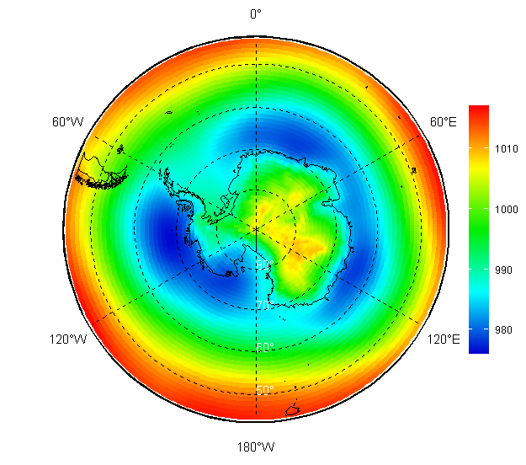
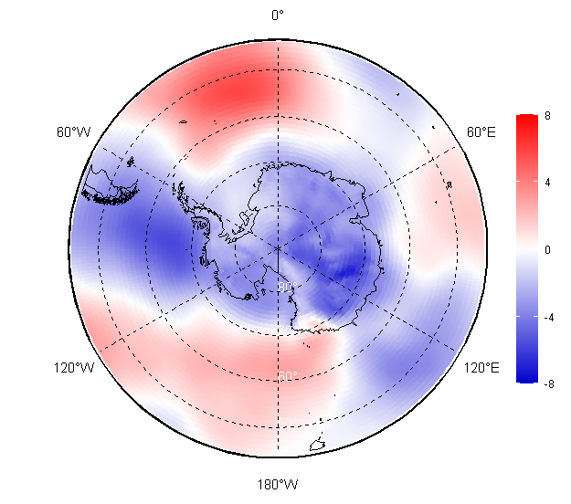
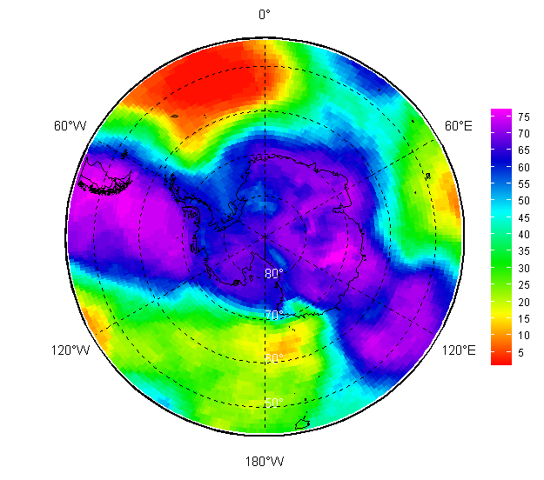
Atmosphere 2025/2026: seasonal surface circulation (MSLP HPa) val/anom/rank
Value Anom (1991-2020) Rank
NDJ 2025/2026
FMA 2026

Slide 7
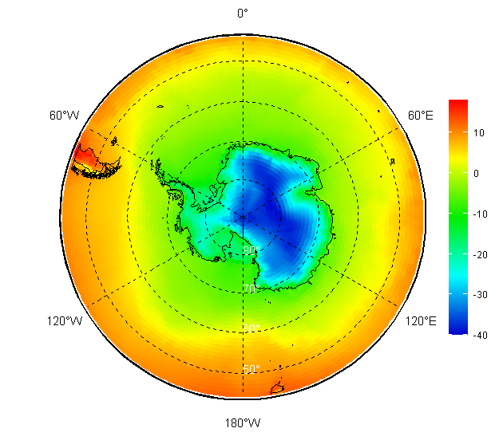

















Atmosphere 2025/2026: monthly surface air temperature (SAT 2m), degrees, val/anom/rank
November | December | January | February | March | April

Slide 8






Atmosphere 2025/2026: monthly surface air temperature (SAT 2m) – reanalysis verification (anom)
November | December | January | February | March | April
OBSERVATIONS: SAT 2m anomaly evaluated at about 30 stations selected on the basis of relevance, data completeness and QC

Slide 9








Atmosphere 2025/2026: seasonal surface air temperature (SAT 2m)
Value Anom (1991-2020) Anom_{obs} (1991-2020) Rank
NDJ 2025/2026
FMA 2026

Slide 10




Atmosphere 2025/2026: surface air temperature (SAT 2m) – a deep look to observations (anom)
Mc MURDO
VOSTOK
BYRD
ESPERANZA

Slide 11




Atmosphere 2025/2026: surface air temperature (SAT 2m) – a deep look to observations (anom)
DAVIS
NEUMAYER
BELGRANO
DDU

Slide 12



Atmosphere 2025/2026: surface air temperature (SAT 2m) – a deep look to observations (anom)
CONCORDIA
AMUNDSEN-SCOTT
MARIO ZUCCHELLI

Slide 13






Atmosphere 2025/2026: surface air temperature (SAT 2m) – a deep look to observations (statistics)
ESPERANZA
AMUNDSEN
DAVIS
SON
SON
SON
DJF
DJF
DJF

Slide 14





Atmosphere (climate): surface air temperature (SAT 2m), linear trend 1996-2025, deg/year
DJF
MAM
Year
JJA
SON

Slide 15


Atmosphere 2025/2026: surface air temperature (SAT 2m) – observed trends at stations
AMUNDSEN-SCOTT
+ 0.11 °C/dec
MARAMBIO
+ 0.42 °C/dec

Slide 16


Atmosphere 2025/2026: surface air temperature (SAT 2m) – observed trends at stations
DAVIS
+ 0.06 °C/dec
CASEY
- 0.12 °C/dec

Slide 17


















Atmosphere 2025/2026: monthly surface precipitation, mm/mon, val/anom/rank
November | December | January | February | March | April

Slide 18






Atmosphere 2025/2026: seasonal surface precipitation, mm/month
Value Anom (1991-2020) Rank
NDJ 2025/2026
FMA 2026

Slide 19


Atmosphere 2025/2026: surface precipitation – precipitation days anomaly in the Peninsula
GREAT WALL
OBSERVATIONS: Total and snow precipitation days anomaly at Argentinian station (human observations and rain gauge measurements

Slide 20

Atmosphere 2025/2026: surface precipitation – SWE from Micro Rain Radar (MRR) measures
GREAT WALL
OBSERVATIONS: Evaluation of cumulated Snow water equivalent (SWE) precipitation amount at Mario Zucchelli as determined from MRR measurements using the methodology proposed by Bracci et al, 2022.

Slide 21


















Polar Ocean and glaciers 2025/2026: monthly SST+STL3(28-100 cm) val/anom/rank
November | December | January | February | March | April

Slide 22






Polar Ocean and glaciers 2025/2026: seasonal SST+STL3(28-100 cm)
Value Anom (1991-2020) Rank
NDJ 2025/2026
FMA 2026

Slide 23


















Sea ice 2025: monthly ice conditions (CT, SoD, ice edge, ice age)
13 November | 18 December | 16 January | 27 February | 19 March | 16 April

Slide 24










Sea ice 2025/2026: daily sea ice extent
Minimum: 22-26/02/ 2026 - 2.6-2.8 million square km
Rank | Year | SIE
1 | 2023 | 1777
2 | 2022 | 1919
3 | 2024 | 1981
4 | 2025 | 2018
5 | 2017 | 2081
6 | 2018 | 2157
… | … | …
16 | 2026 | 2577
… | … | …
23 | 2020 | 2670
… | … | …
46 | 2003 | 3633
47 | 2013 | 3664
48 | 2008 | 3707
17/02/2023
18/02/2008
Rank | Year | SIE
1 | 2023 | 16999
2 | 2024 | 17242
3 | 2025 | 17891
4 | 1986 | 18043
5 | 2017 | 18080
6 | 2002 | 18137
7 | 2022 | 18240
8 | 2018 | 18241
22 | 2021 | 18726
45 | 2012 | 19471
46 | 2013 | 19586
47 | 2014 | 20163
07/09/2023
20/09/2014

