Slide 1

October 2017- March 2018
Arctic Winter
Seasonal Review
Rick Thoman
National Weather Service – Alaska Region
Vasily Smolianitsky
Arctic and Antarctic Research Institute- Russia
Gabrielle Gascon
Meteorological Service of Canada

Slide 2
Arctic Winter Highlights
  Temperature & Precipitation
Average surface temperature: third highest since 1949
Precipitation: slightly above 1950-2010 average
                Source: NCEP/NCAR R1 Reanalysis
  Arctic (NH) Sea Ice
Maximum Ice Extent (how much of the Arctic is covered in sea-ice) is recorded every March using satellites and compared to all previous years since 1979: March 2017 ice extent was 14.48 million km², second lowest on record.
Mean Extent
  Oct-Apr: Second lowest on record
  Jan-Apr: Lowest on record
                Source: NSIDC

Slide 3
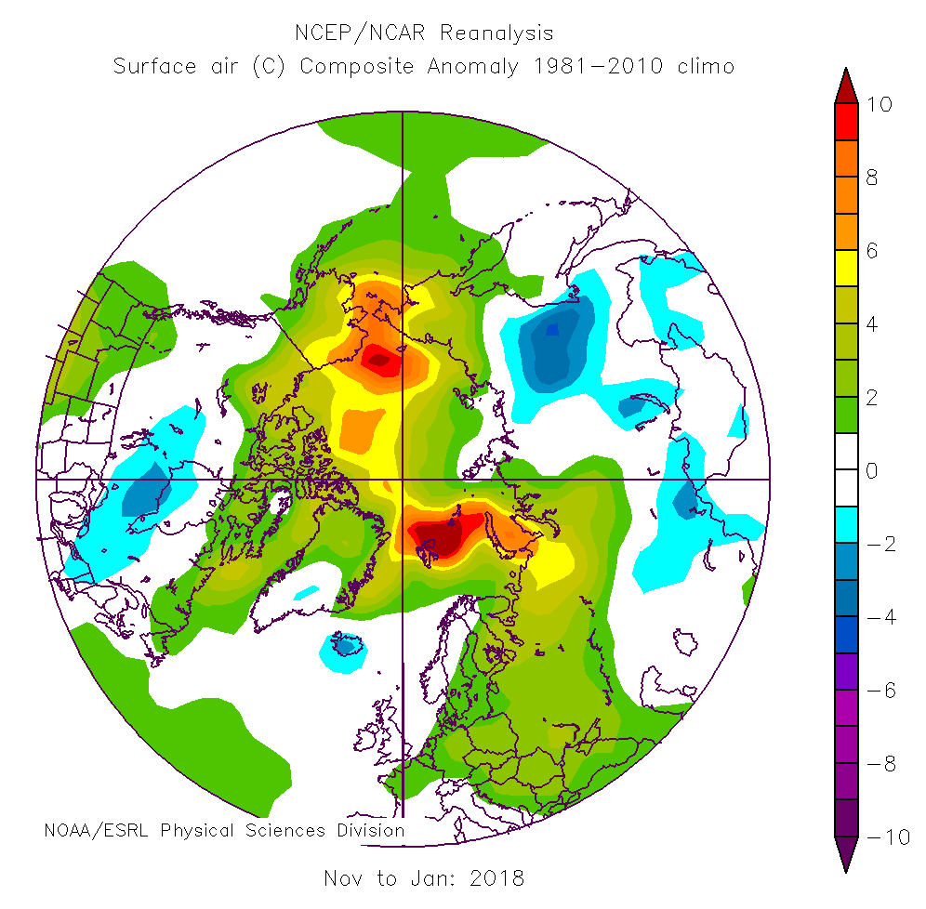
Nov 2017 to Jan 2018 Seasonal Temperature Departures

Slide 4
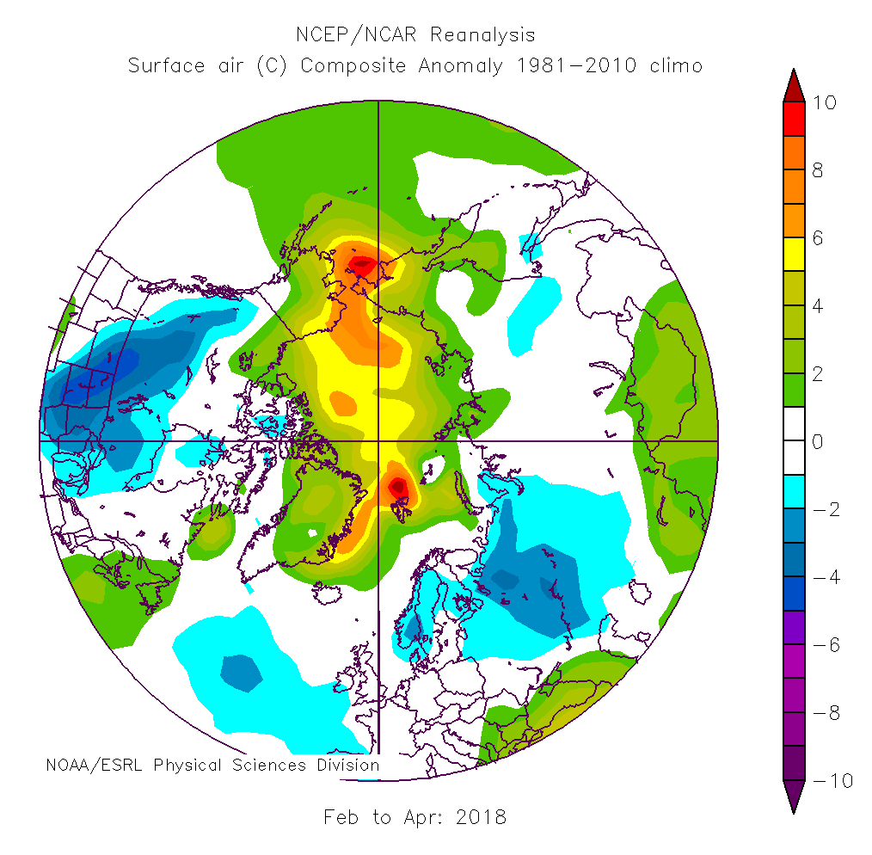
Feb to April 2018 Seasonal Temperature
Departures

Slide 5
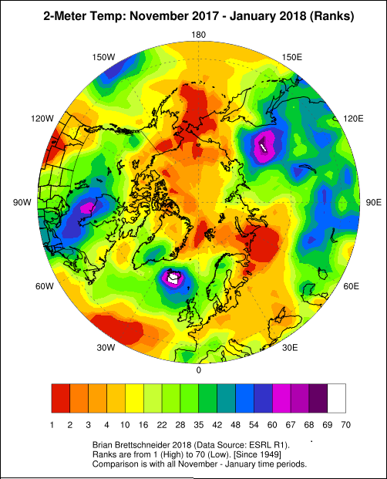
Nov 2017- Jan 18 Seasonal Temperature Ranks
(since 1949)

Slide 6
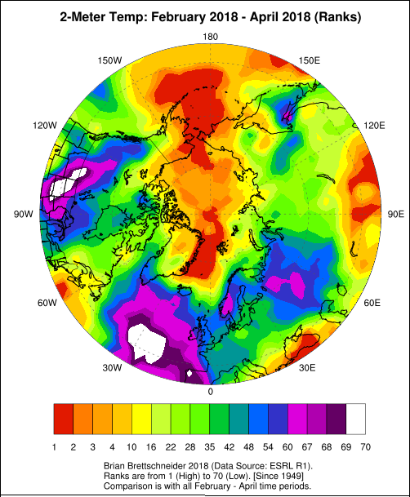
Feb – April 2018 Seasonal Temperature Ranks
(since 1949)

Slide 7
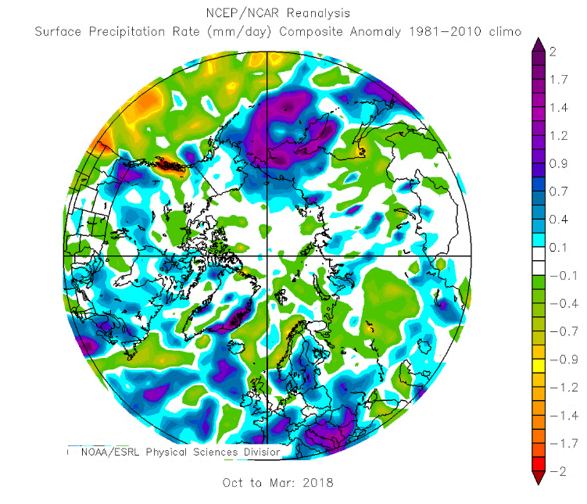
Oct 2017- Mar 2018 Seasonal Precipitation

Slide 8
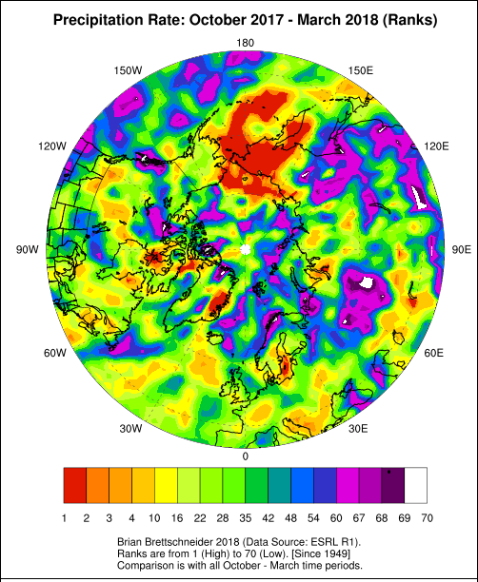
Precipitation Ranks
(since 1949)
Oct 2017 to
March 2018

Slide 9
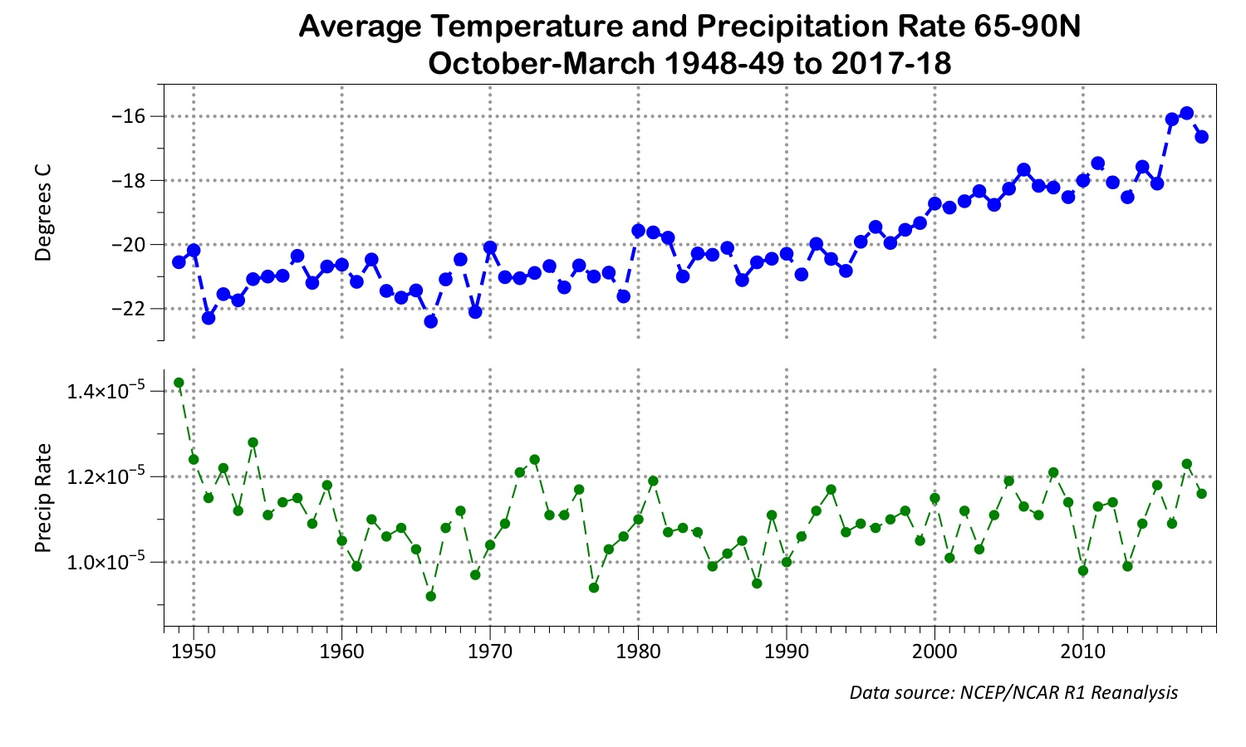
Average Arctic Temperature and Precipitation

Slide 10
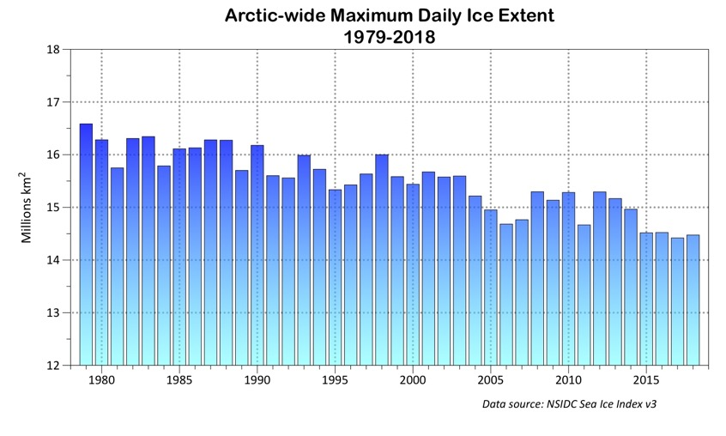
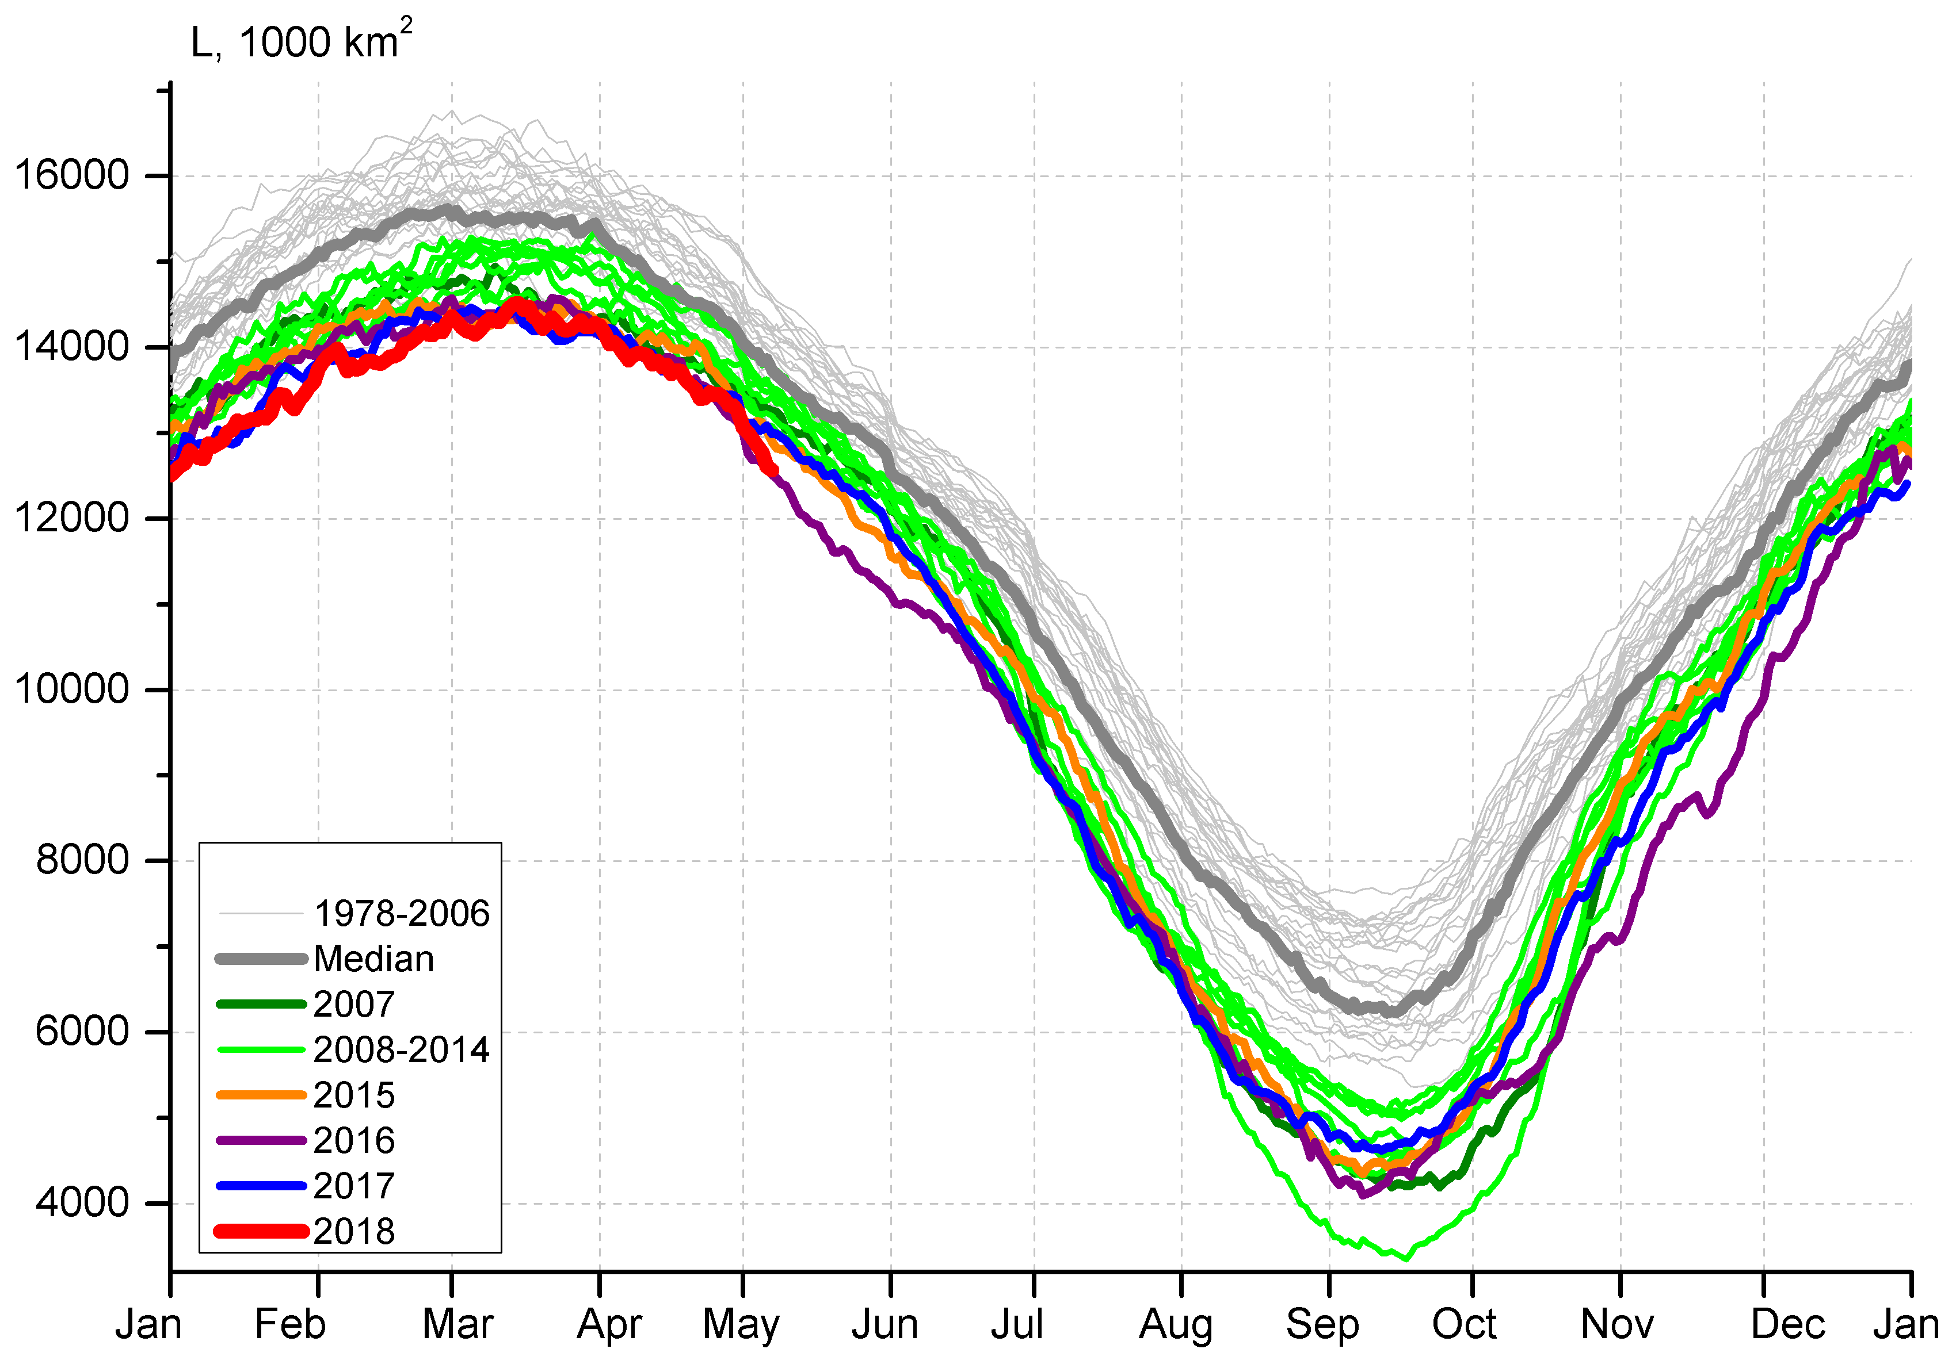
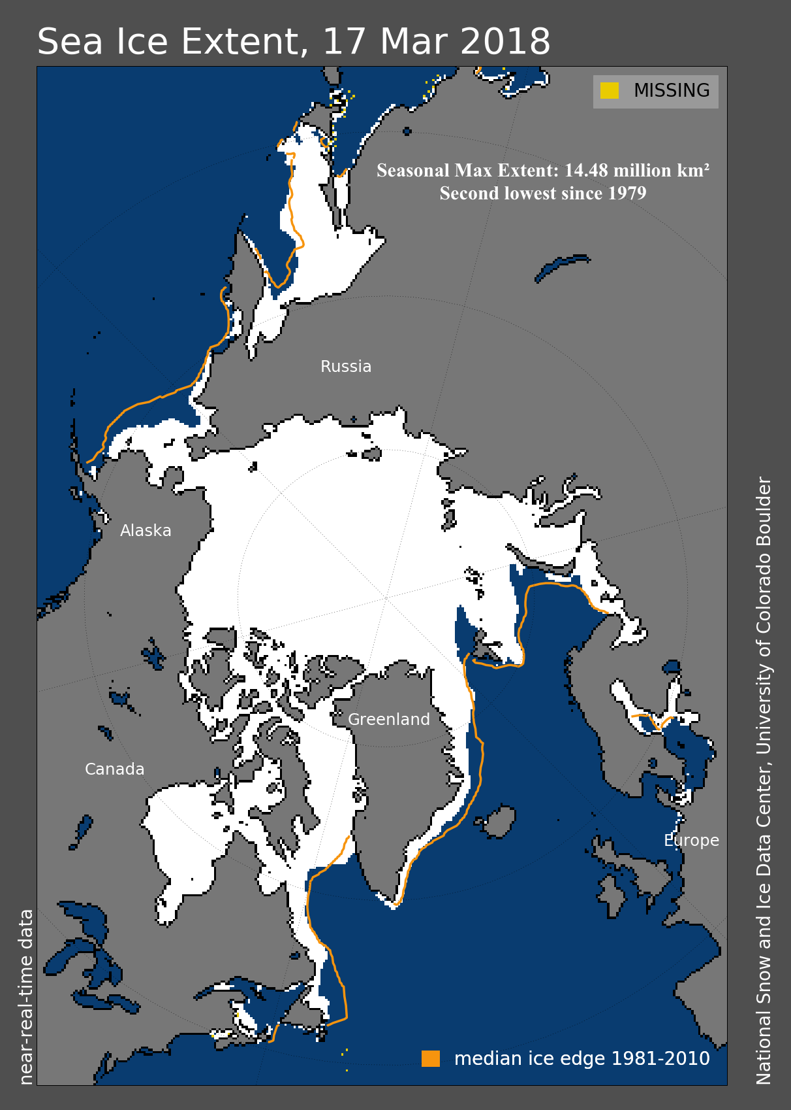
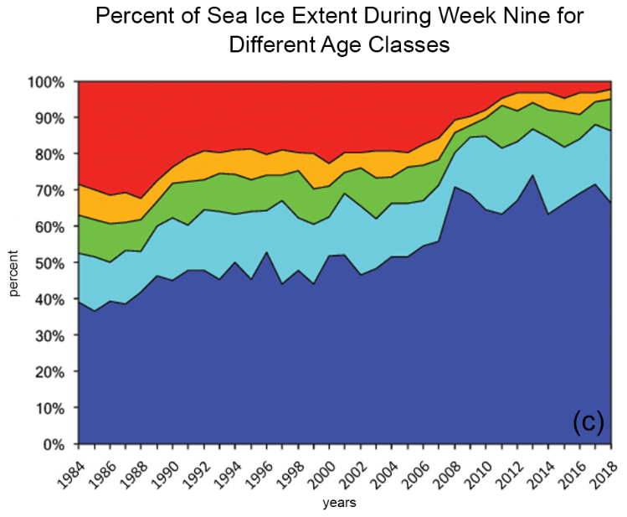
2018 Arctic (NH) Max Ice extent and ice age
Arctic ice extent Max 1979-2018
Seasonal ice extent
1979-2018
Ice extent 17 March 2018
Age of Sea Ice (Years) 1984-2018

Slide 11
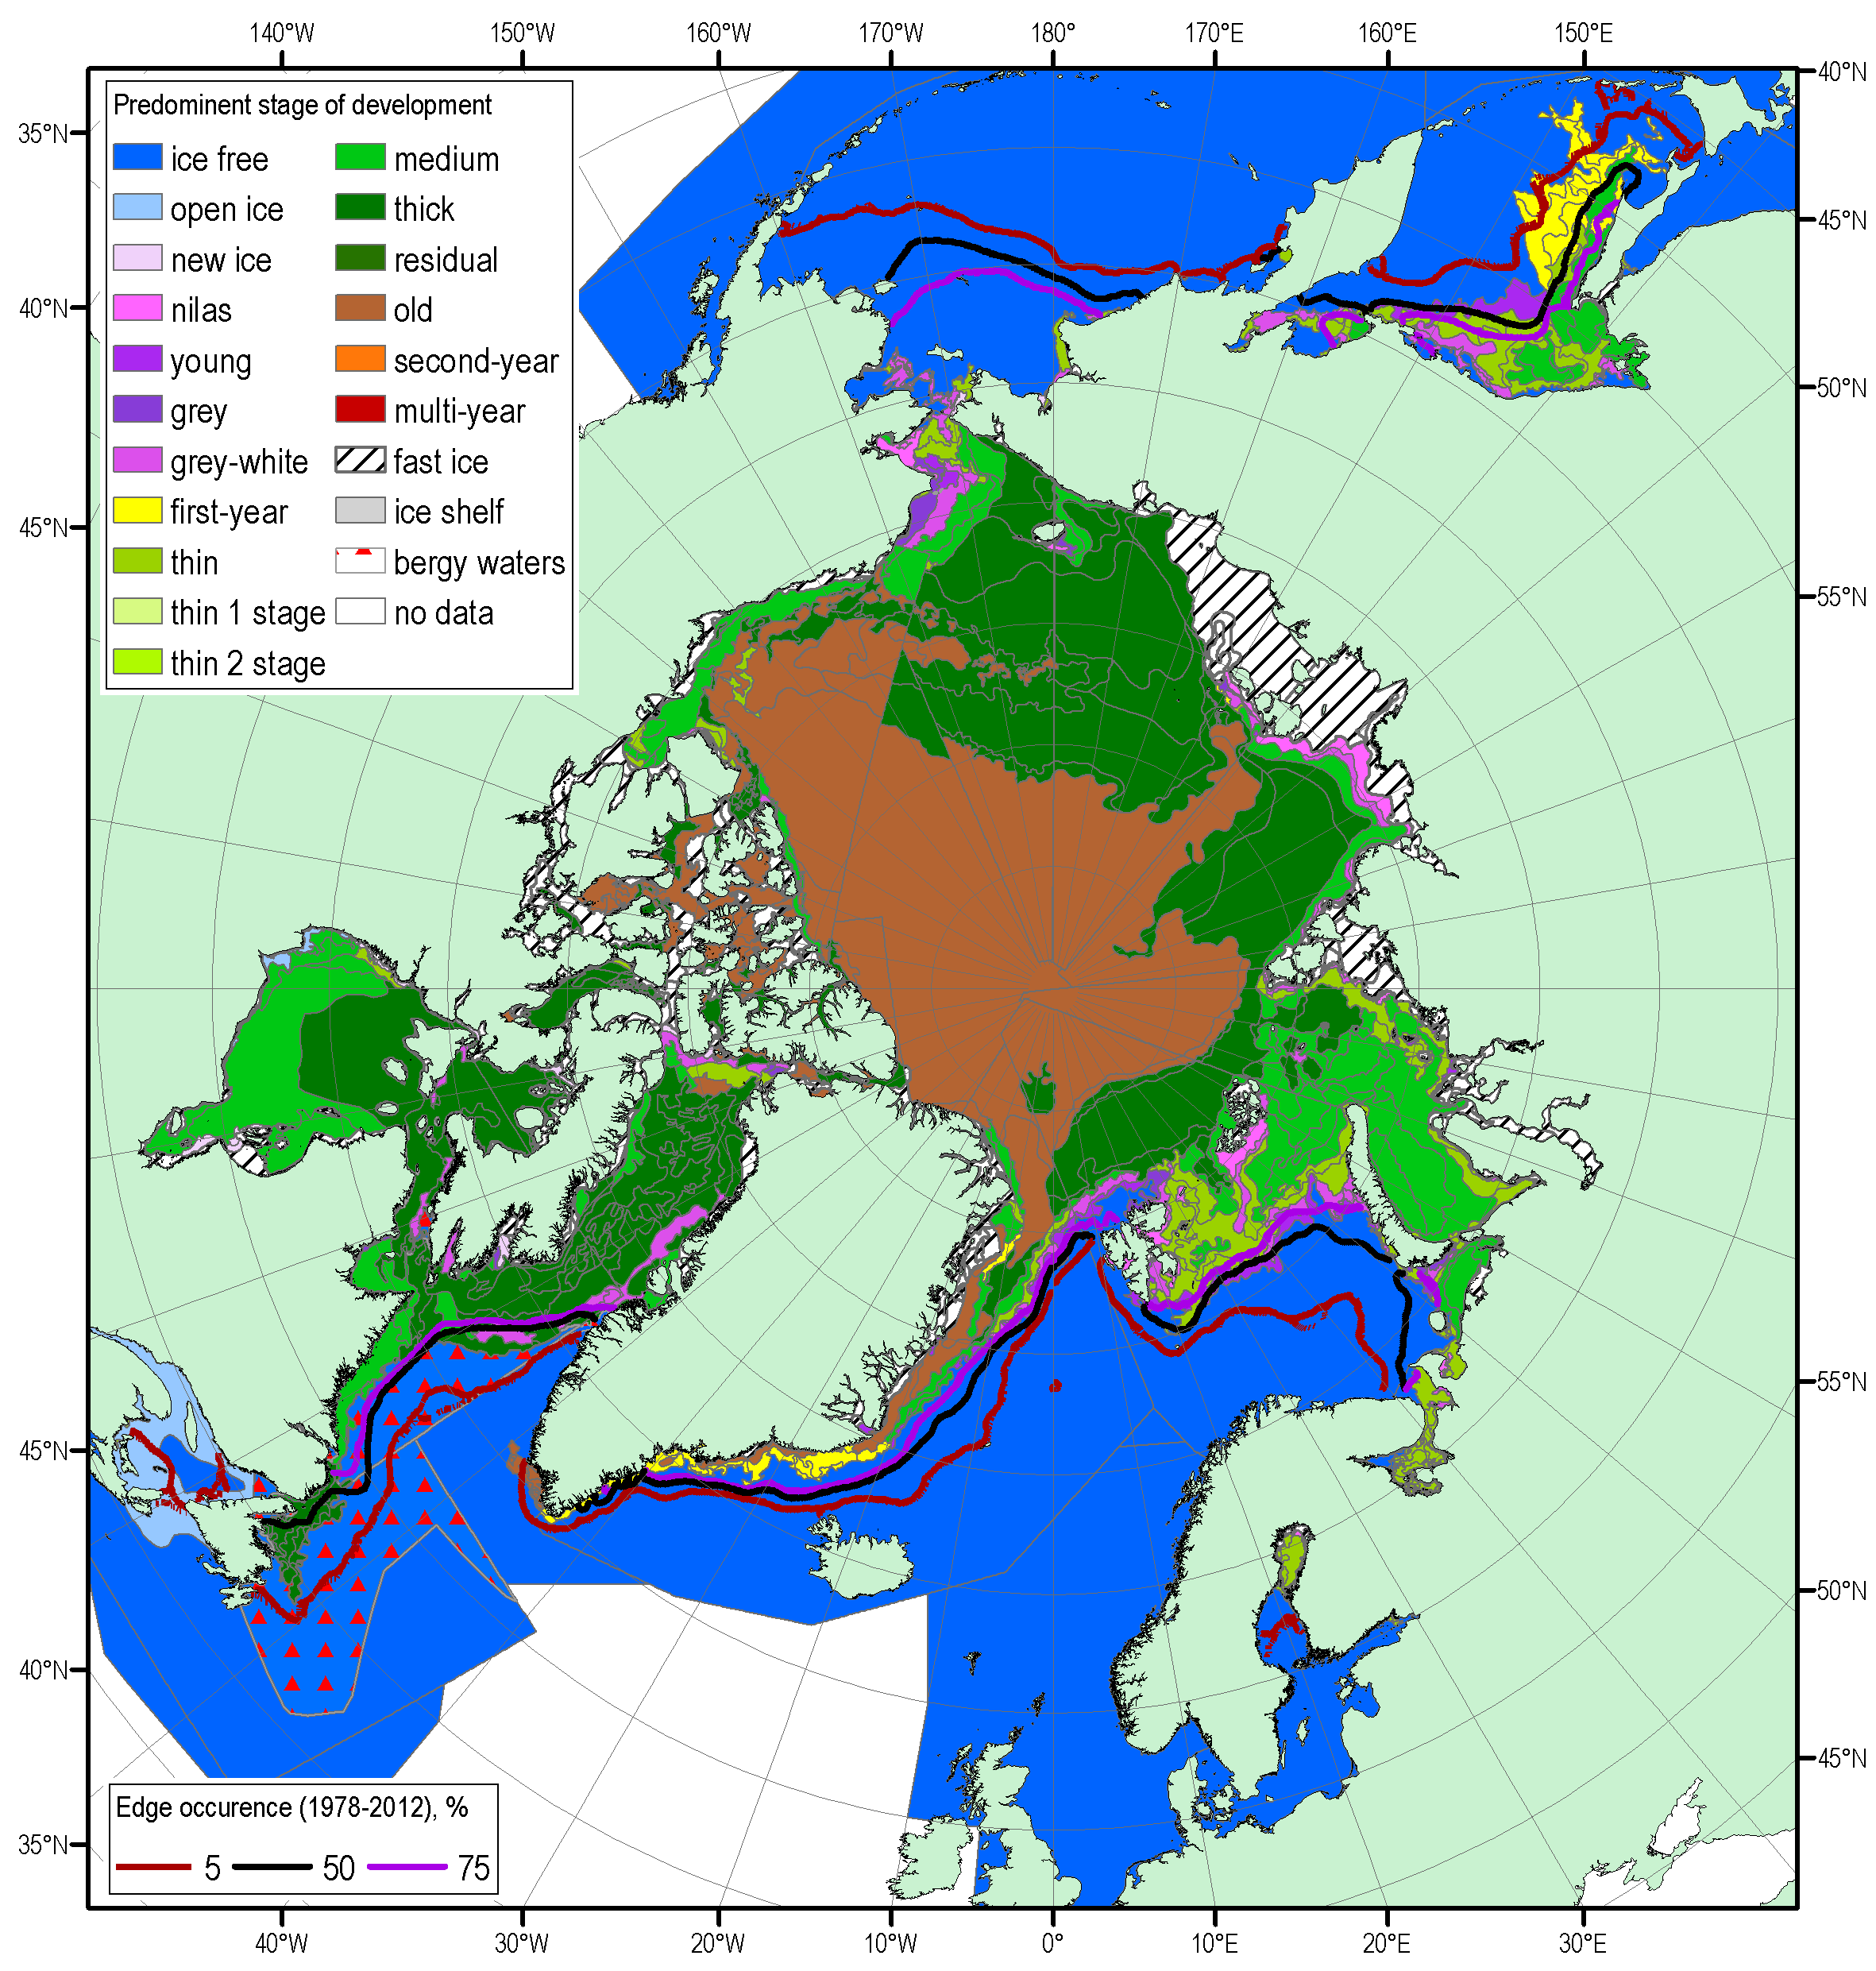
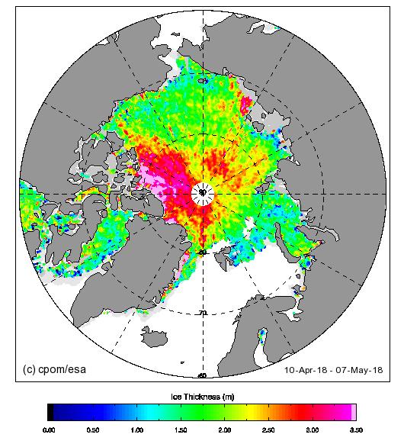
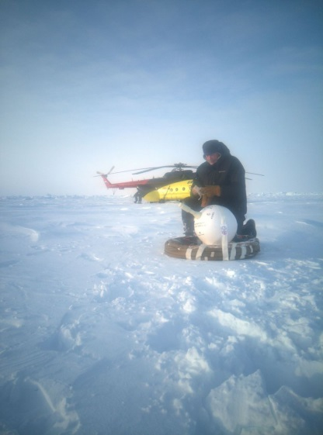
Current Ice Conditions (April-May 2018)
CryoSat Sea Ice Thickness
Fast ice thickness in general 20-50 cm lower than normal though ice thickness at North Pole was close to potential 180-190 cm
Blended Arctic ice chart (AARI, CIS, NIC) for 23-26 April 2018 and ice edge occurrence for 21-25 April for 1979-2012

Slide 12
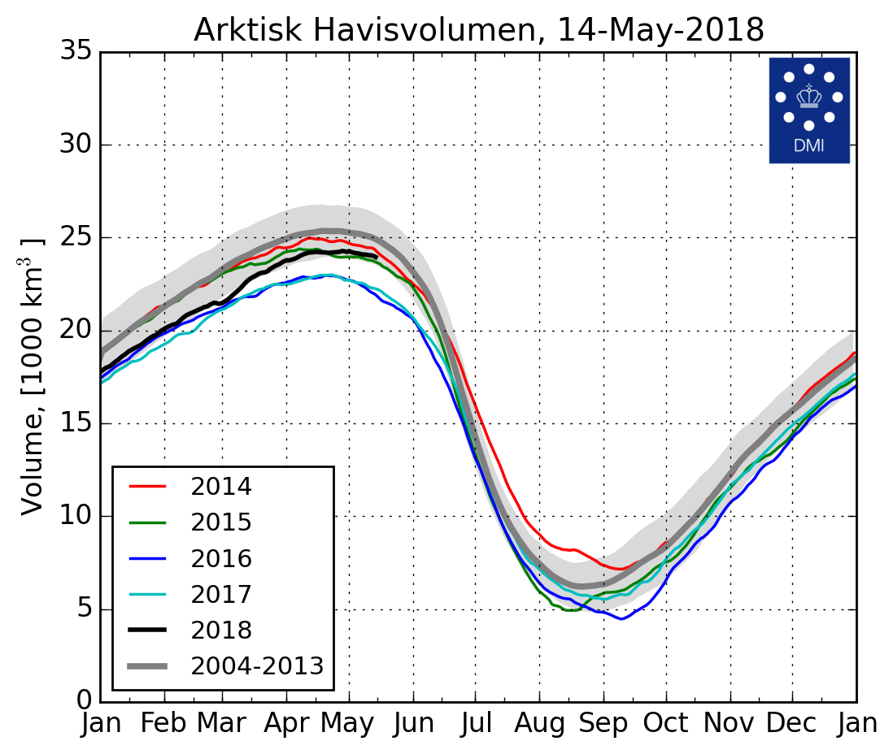
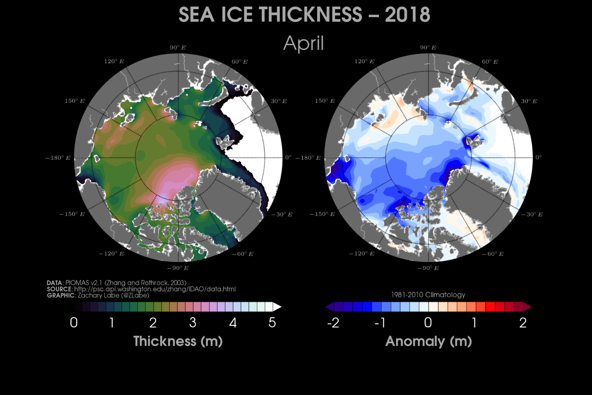
Pan-Arctic Ice Ocean Reanalysis, Modeling and Assimilation System
2018
Model shows Arctic ice volume greater than in 2016, 2017
(Zhang and Rothrock, 2003) run out of the Polar Science Center at the University of Washington. Sea Ice Thickness
Danish Meteorological Institute North Atlantic - Arctic Ocean model HYCOM-CICE - http://ocean.dmi.dk/models/hycom.uk.php

Slide 13
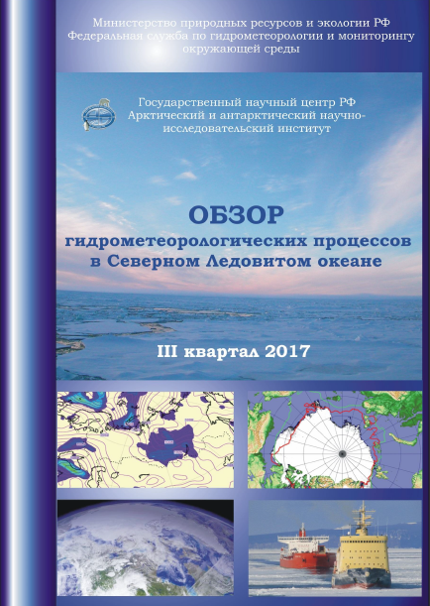
Planned content of summaries / Pan-Arctic bulletin
Based on Arctic and Antarctic Research Institute (AARI) of Roshydromet experience from 1920s & scientific background
Monitoring and content of the bulletin will be grouped by 5 spheres and sections:
Atmosphere
Sea Ice
Oceanography
Land hydrology & snow
Permafrost
Each section will contain variables described with varying periodicity – from 1M to 1Y
To follow the end-users needs, proposed list of variables should extend the WMO-No.485
To begin with, bulletin will include atmosphere and sea-ice with full content by end of demo-phase
Content will be generated by Eurasian node based on harmonized sustained input from 3 nodes and WMO programs (e.g. GCW, JCOMM)
Summary
of environmental conditions in the Arctic
October – December 2018

Slide 14
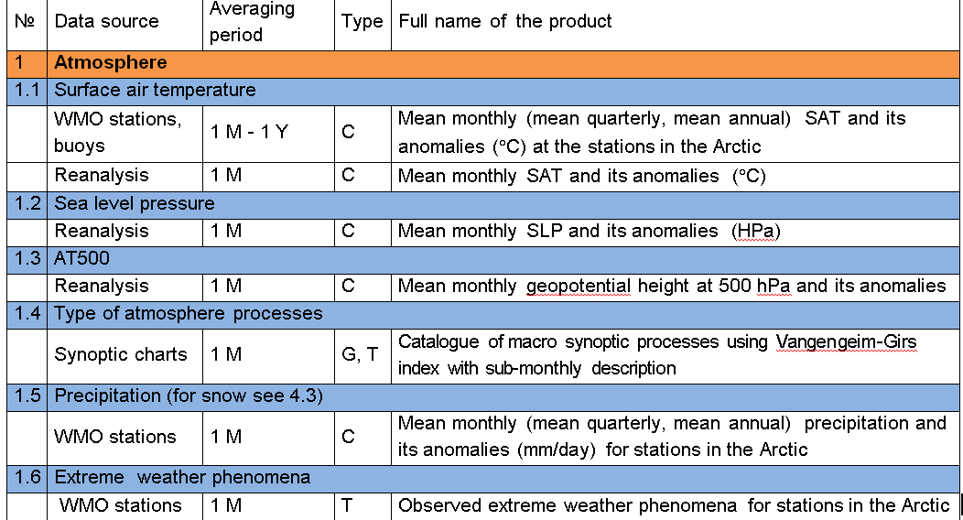
i) Atmosphere
Type: C – chart, G – graph, T - table

Slide 15
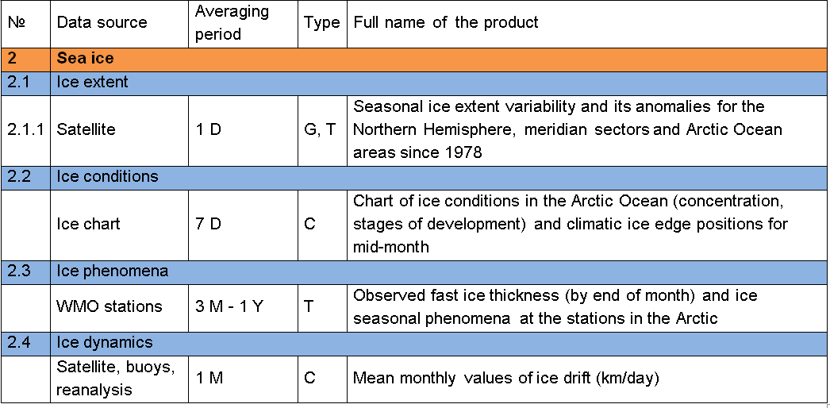
ii) Sea ice
Type: C – chart, G – graph, T - table

Slide 16
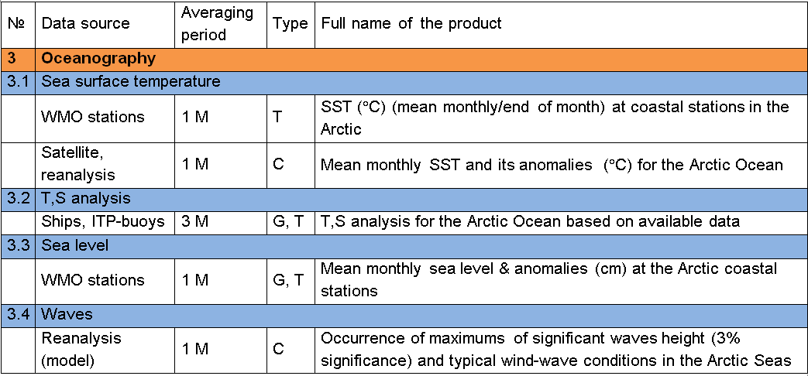
iii) Oceanography
Type: C – chart, G – graph, T - table

Slide 17
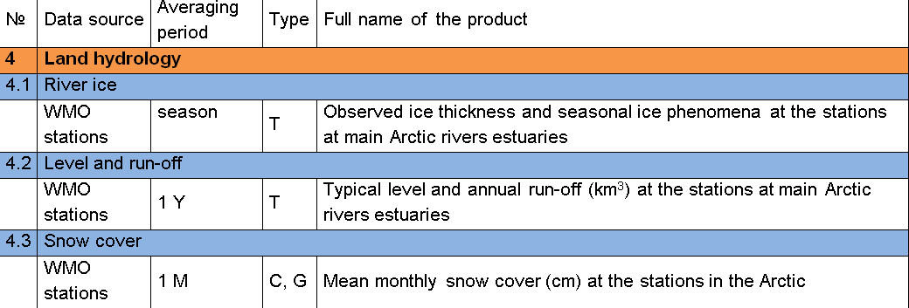
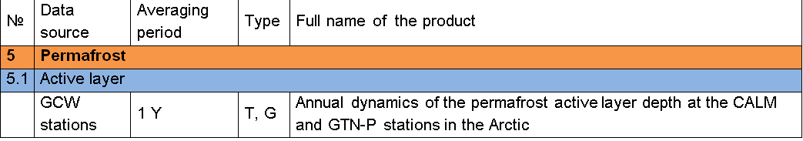
iv) Land hydrology & snow
v) Permafrost
Type: C – chart, G – graph, T - table

Slide 18
Seasonal Summary Break-Out Groups: Questions for Discussion
Do you have any questions on climate monitoring information and summaries?
Where do you currently obtain your information? What climate monitoring database information would be most useful for you?
How do you currently use seasonal summaries information? Are there critical gaps?
What time period(s) are useful to you (7/10-day, monthly, seasonally, annual)? In what way?
How useful are seasonal summaries for decision making?
How do you prefer information to be presented (graphs, tables, charts, text summary, etc.)? How much detail do you require?
What do you need but don't have access to?

Slide 19
Thank you!

