Slide 1



ARCTIC REGIONAL CLIMATE CENTRE (ArcRCC) Network
16th Arctic Climate Forum (ACF-16)
November 5 and 6, 2025, 15:00 to 18:00 UTC

Slide 2
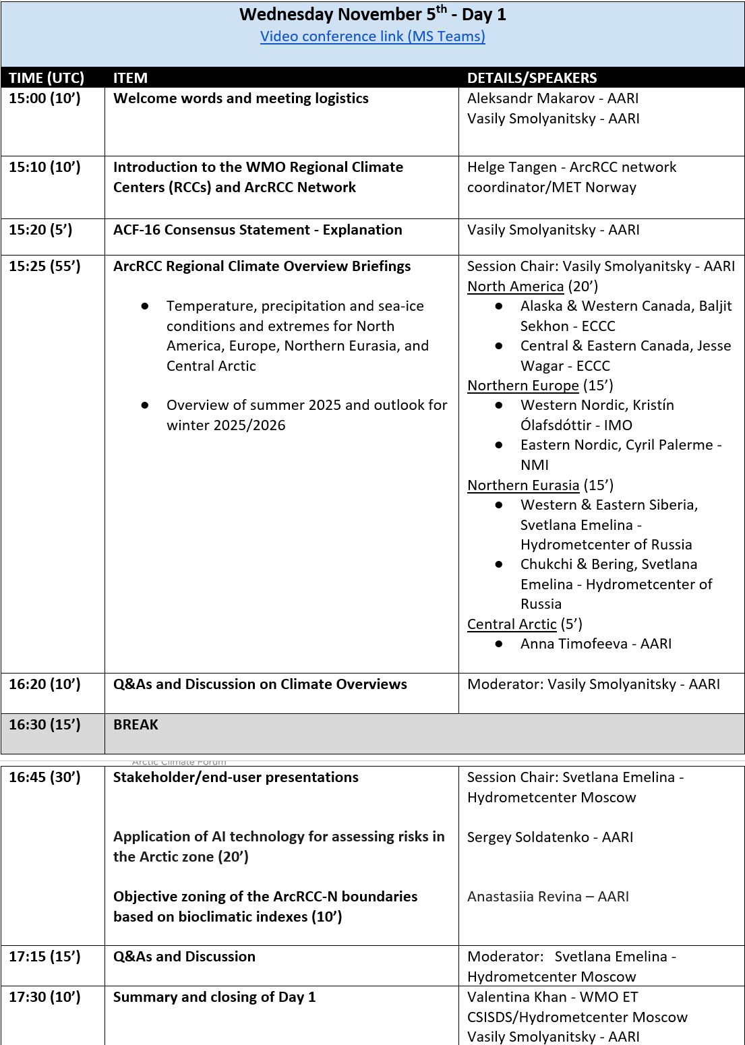
Meeting Logistics
Please register with name, surname and affiliation
Please keep your mic and camera muted
Use the “raise hand” feature to ask questions
Chat be used for relevant questions or comments
This forum will be recorded
All slides are operated centrally

Slide 3
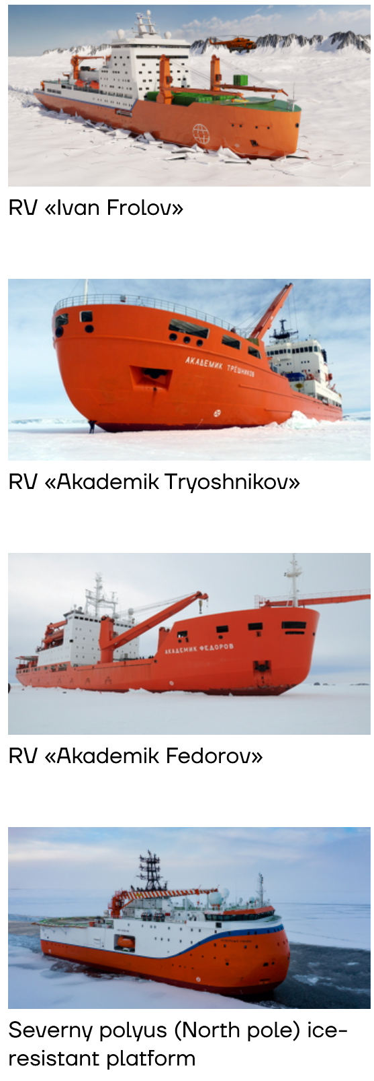

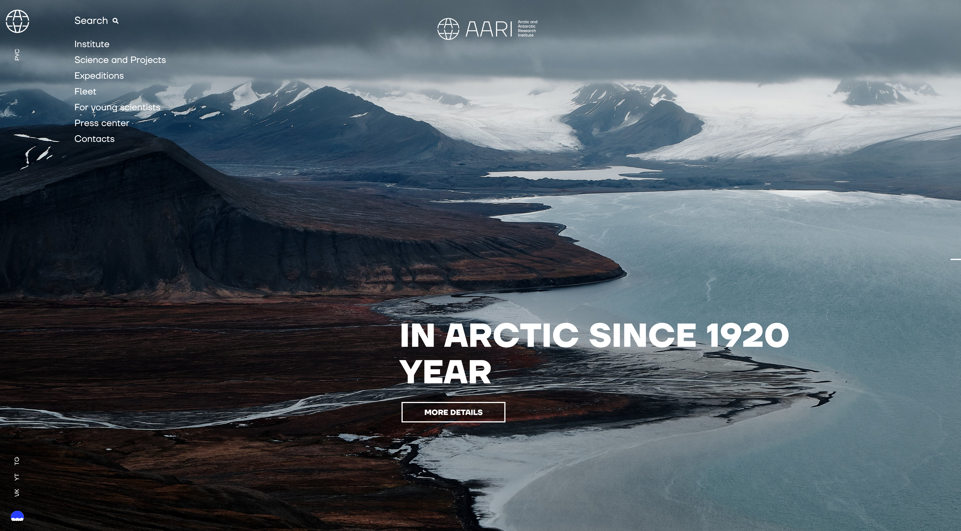
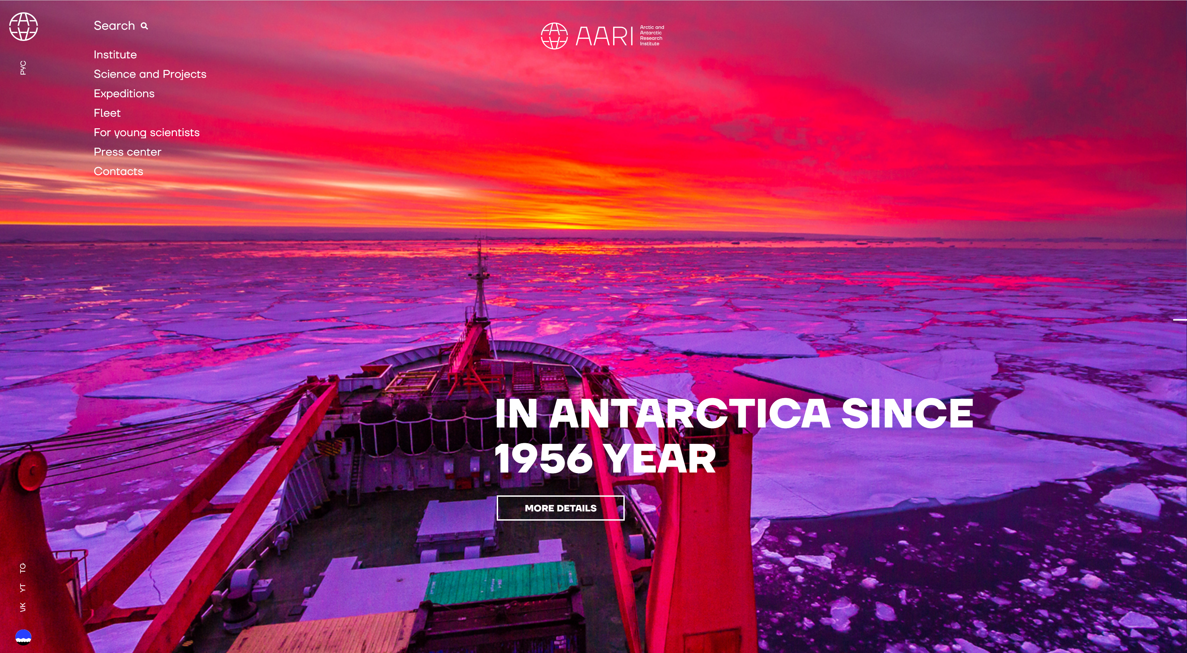
Welcome Address
Prof Aleksandr Makarov
Director, Arctic and Antarctic Research Institute (AARI)
Federal Service for Hydrometeorology and Environmental Monitoring (Roshydromet)

Slide 4




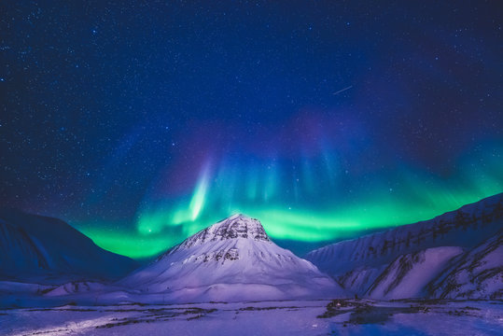







Introducing the
Arctic Regional Climate Centre Network
(ArcRCC-N)
https://www.arctic-rcc.org
Arctic Climate Forum-7, May 26-28, 2021
Helge Tangen
Norwegian Meteorological Institute
ArcRCC Network Coordinator
Photo: Adobe Stock

Slide 5
WMO Regional Climate Centres
The World Meteorological Organization (WMO) Regional Climate Centres (RCCs) are centres of excellence dedicated to providing regional climate products and services. Their mission is to enhance the capacity of WMO Members in each region, enabling them to deliver high quality climate services to national users.
RCCs produce mandatory regional products, including climate data sets, climate monitoring tools and long-range forecasts, which serve as critical regional inputs for National Meteorological and Hydrological Services (NMHS) climate operations. Additionally, RCCs undertake various highly recommended functions to address the needs of their respective regional domains.

Slide 6
Welcome to Arctic Climate Forum #16 – ACF-16
A forum for Arctic Regional Climate Centre Network to meet stakeholders and users
Every spring (last part of May) and every fall (last part of October or early November)

Slide 7
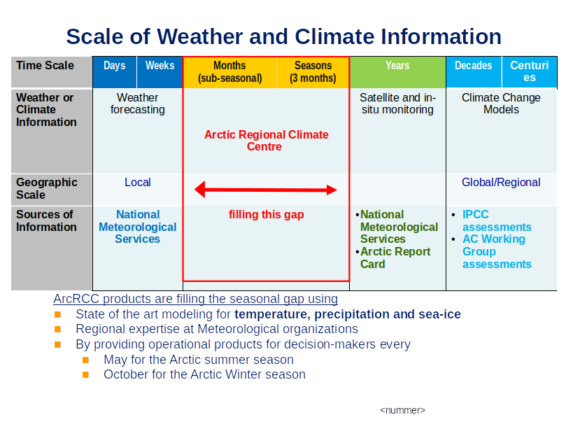

Slide 8
The Arctic Regional Climate Centre
NATIONAL |  | REGIONAL |  | CIRCUMPOLAR
Countries | Meteorological Organizations | Regional Climate Centres (RCCs) |  | Arctic Regional Climate Centre
United States | NOAA | North American Node | Forecasting
Canada | ECCC
Denmark | DMI | Nordic Node | Data Services
Iceland | IMO
Norway | NMI
Sweden | SMHI
Finland | FMI
Russia | AARI | Northern Eurasia Node | Monitoring
Collaboration/Networking across Arctic regional nodes and Meteorological Organizations
Notes:
The Arctic PRCC-Network falls across three of the WMO Regional Associations, Asia, Europe and North America.
The participating nations are the 8 Arctic Council states
The structure for the Arctic PRCC-Network will be on two levels.
Each Regional Association (node) will perform all mandatory functions for the countries in its domain:
Canada will lead the North American Node (Canada and USA);
Norway will lead the Northern Europe and Greenland Node (Denmark, Finland, Iceland, Norway, and Sweden); and
the Russian Federation will lead the Eurasian Node, see Figure 1.
4th mandatory function is training that is shared across the Nodes

Slide 9
ArcRCC Products -
produced each May and October/November
1. Arctic Consensus Statement:
Text and graphics that summarize the temperature, precipitation and sea-ice climate trends for the past season and forecasts for the upcoming season. A collaborative effort by the network in reviewing:
Trends in the historical monitoring data
Forecasts from the models
Using Met/Ice climate expertise, fill gaps in the data
https://arctic-rcc.org/consensus-statements
2. Regional Summaries
The same information that is in the consensus statement but organized by Arctic region and added information about potential impacts to regional users.

Slide 10
Way forward
After obtaining designation from WMO in 2024, we are now recognized as a fully operational Regional Climate Centre Network after a successful demonstration phase
Continue with 2 Arctic Climate Forums per year - to ensure user contact
Open for developing new products, built on user needs

Slide 11
Thank you!

Slide 12
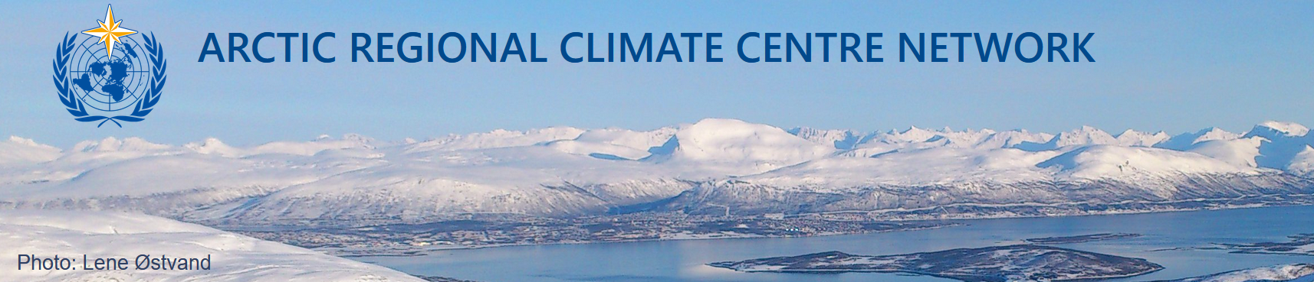
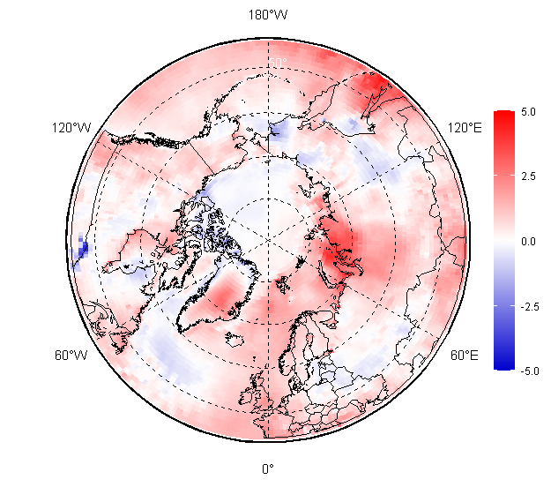
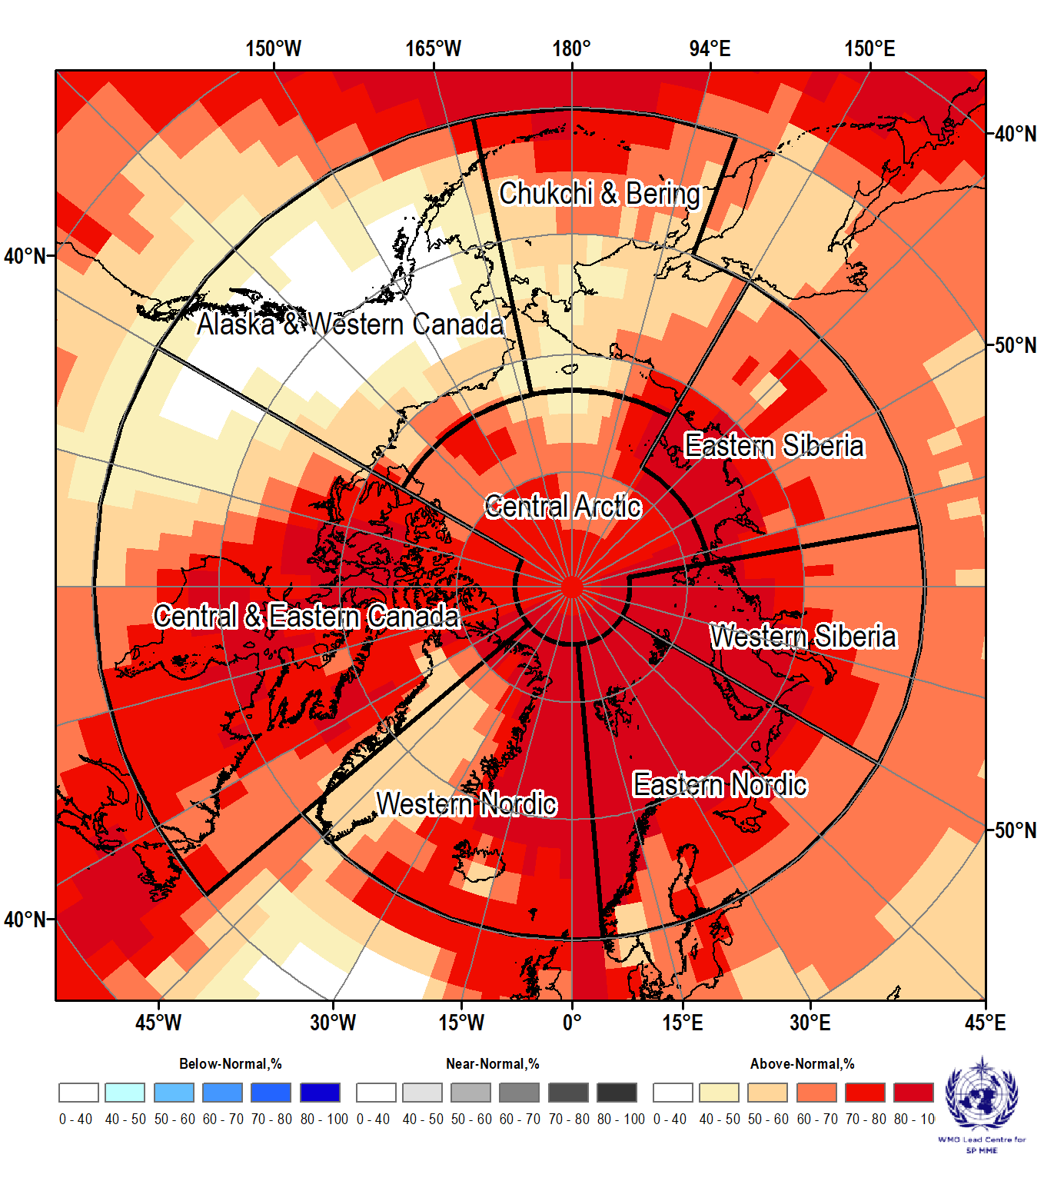

Arctic Consensus Statement - what is inside and how it is generated
Vasily Smolyanitsky (Arctic and Antarctic Research Institute)
ACF-16, 5 – 6 November 2025

Slide 13
What is the ArcRCC-N Consensus Statement?
It is a document containing:
summary of the variability for the past season of the WMO Essential Climate Variables (or ECVs) and derived indexes, valid for the Arctic, including air temperature, precipitation, sea-ice;
verification of the seasonal outlooks (forecasts) for the past season of the above ECVs and their outlooks for the upcoming season
summary of the extremes events that happened during the previous season and their possible socio-economic impacts

Slide 14
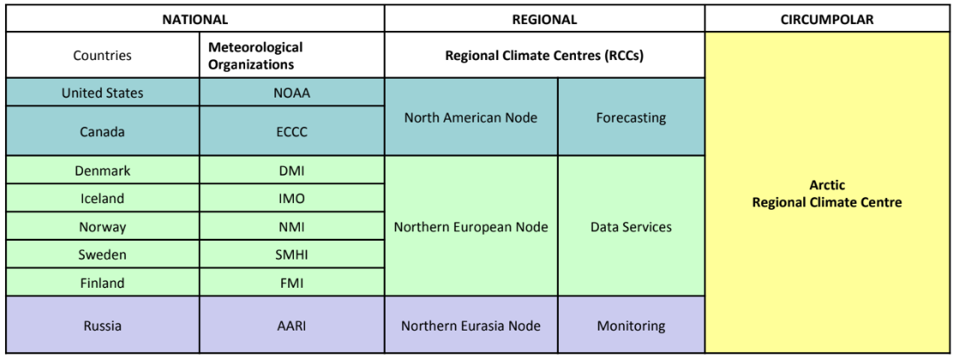
How is it produced?
It is a joint effort by 3 nodes and meteorological services supporting the Arctic RCC
Circumpolar climate monitoring and forecast information is provided by the responsible nodes with input from the WMO Information Systems (WIS) centers
Regional information on climate statistics, extremes and derived impacts and risks is provided by the 8 national meteorological services within the region with desirable input from participants of the ACF
CS draft is circulated among the team prior and during the forum
Final version published shortly after the Arctic Climate Forum

Slide 15
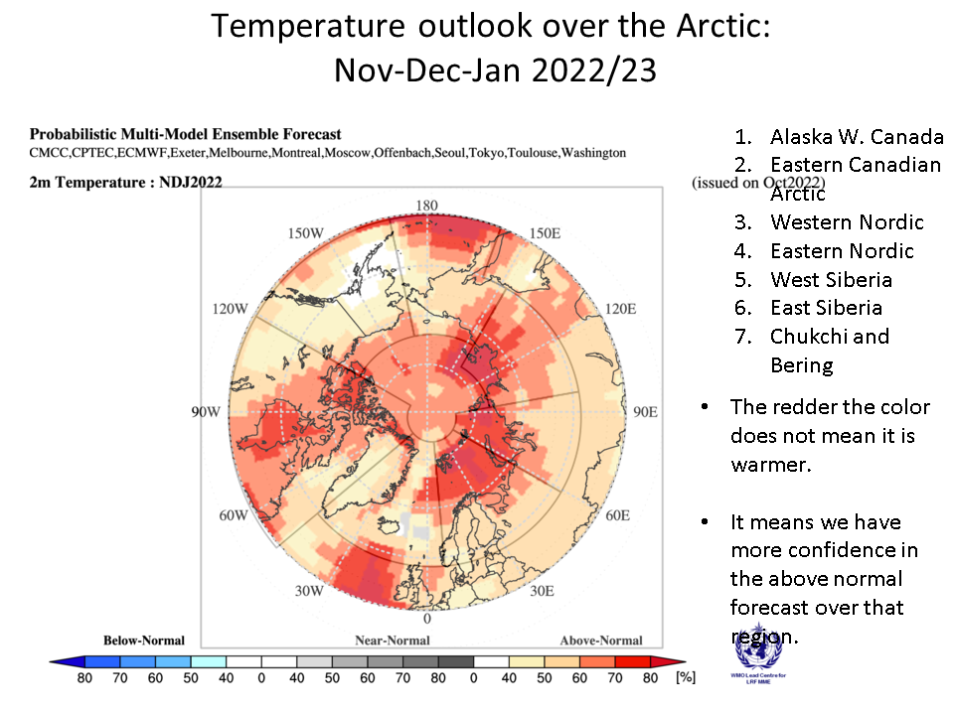
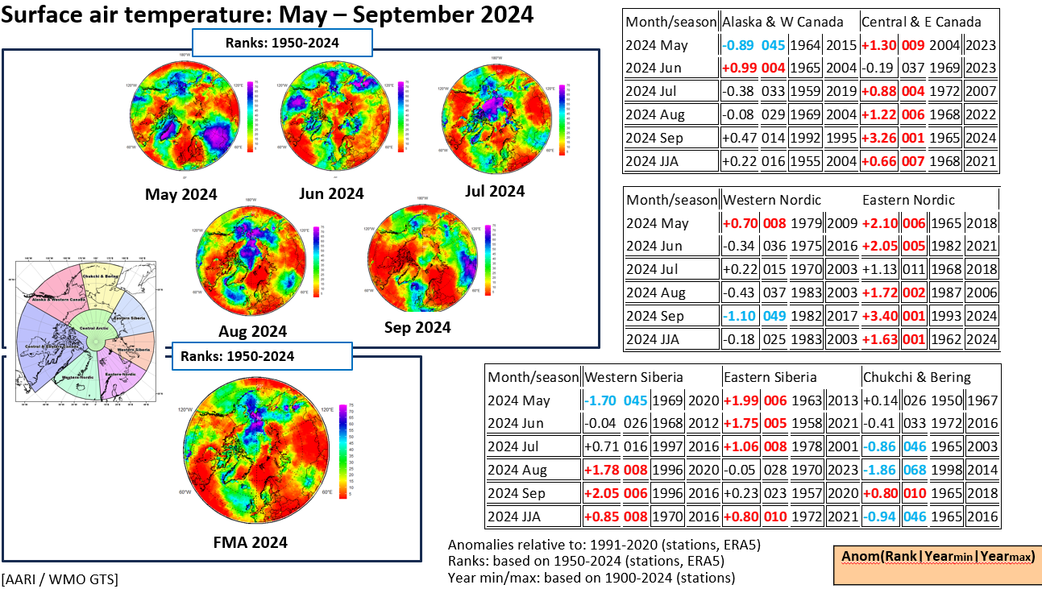
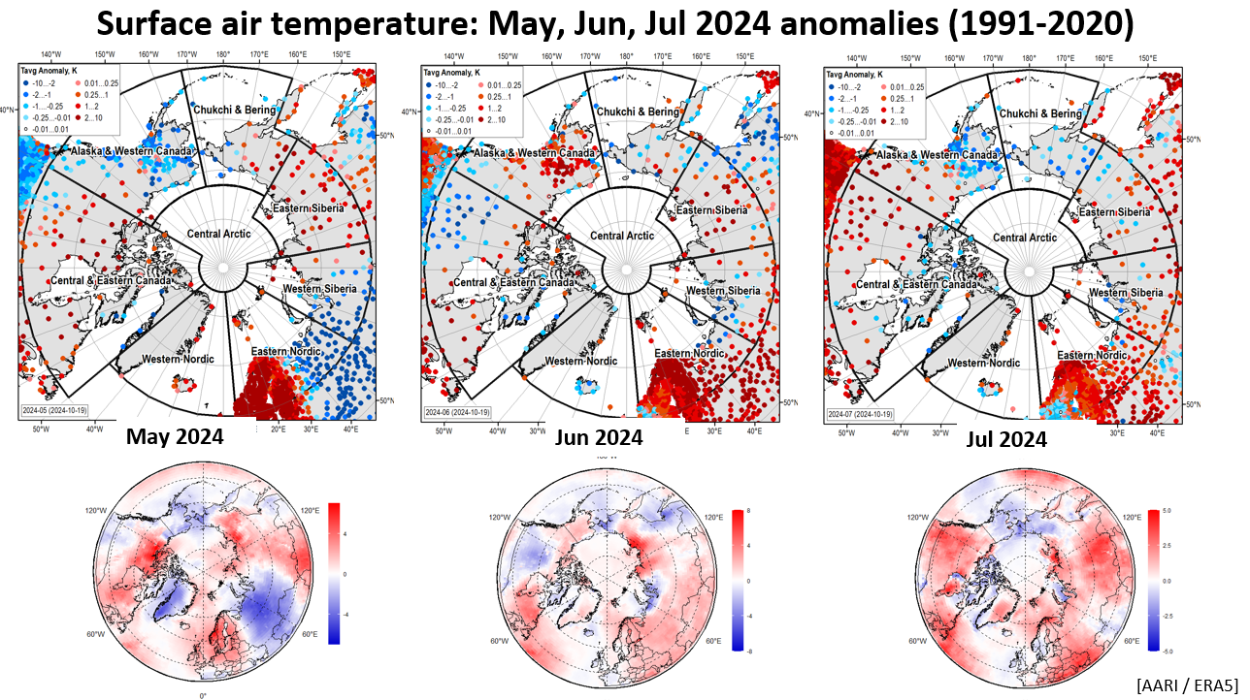
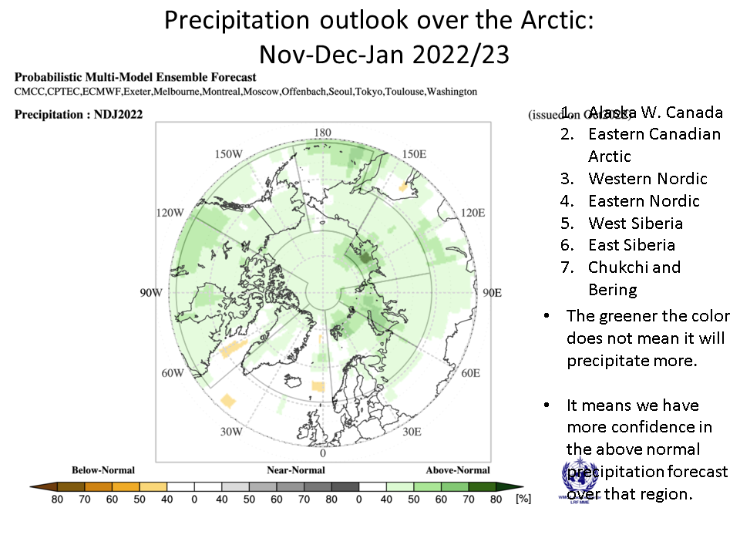
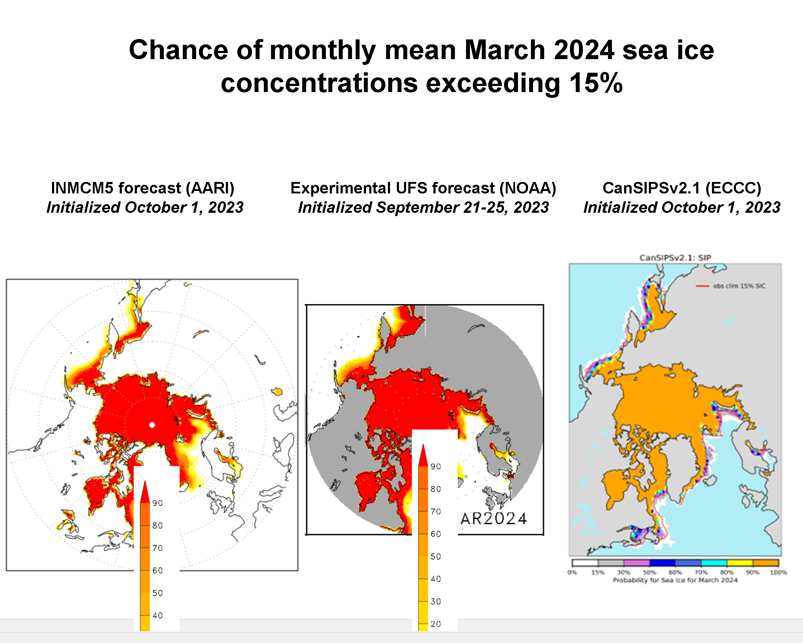
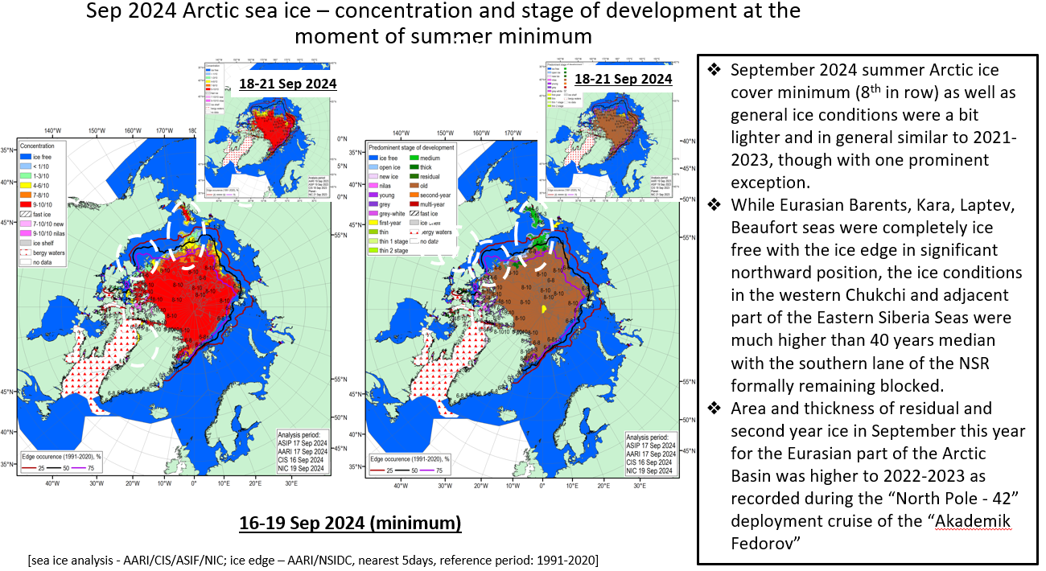
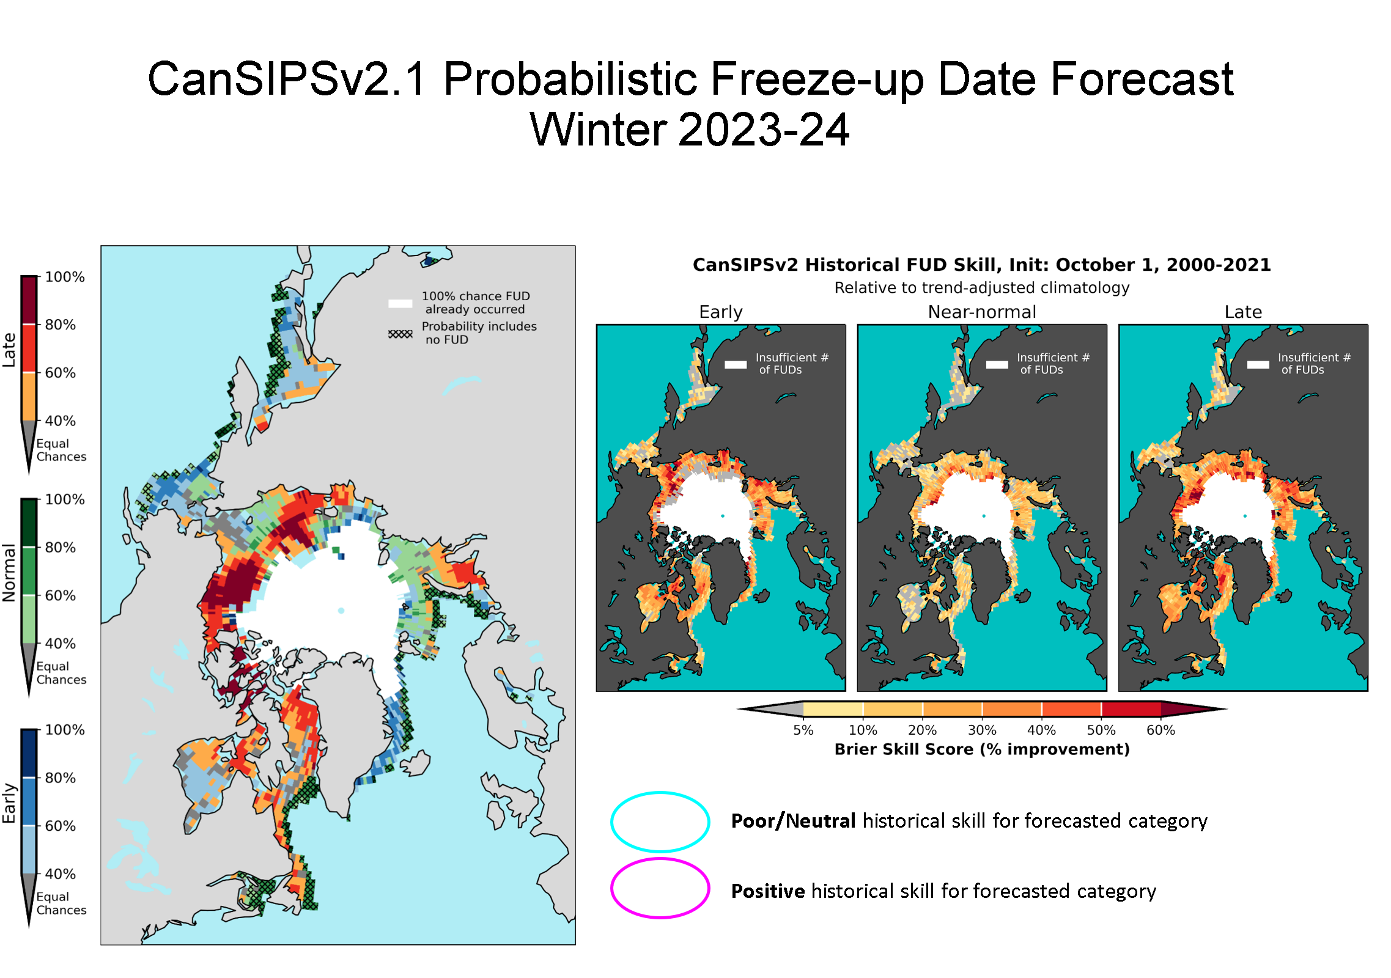
What does it contain?
The statement includes:
Introduction the role of the Arctic RCC in the WMO Climate Information System
Highlights for decision making
Hints for understanding the statement
Summaries and outlooks for ECVs and bioclimatic indexes
Observed extremes and impacts
Data sources and useful links
Information is presented as graphics, text and tables

Slide 16
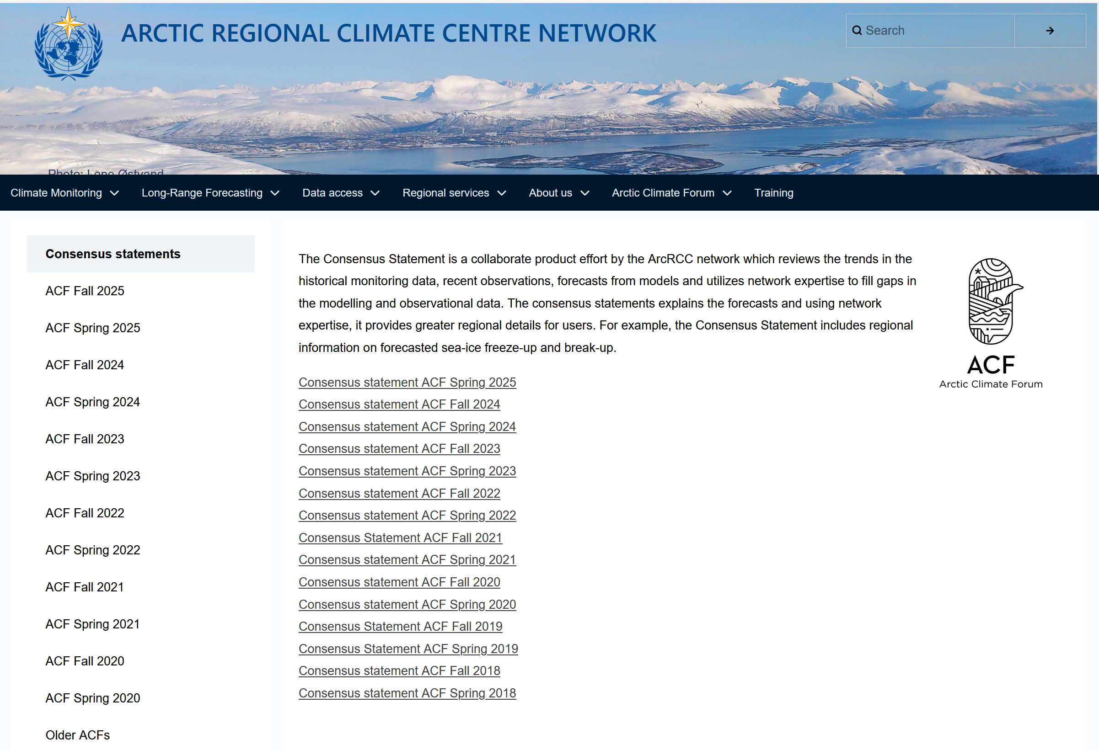
Where is it published?
Website: https://www.arctic-rcc.org/consensus-statements

Slide 17
Thank you!
vms@aari.aq

Slide 18
16th Arctic Climate Forum
November 2025
Regional Overview - Summary of Summer 2025 and Outlook for Winter 2025/2026
Chair: Vasily Smolyanitsky
Arctic Regional Climate Centre Network
World Meteorological Organization

Slide 19
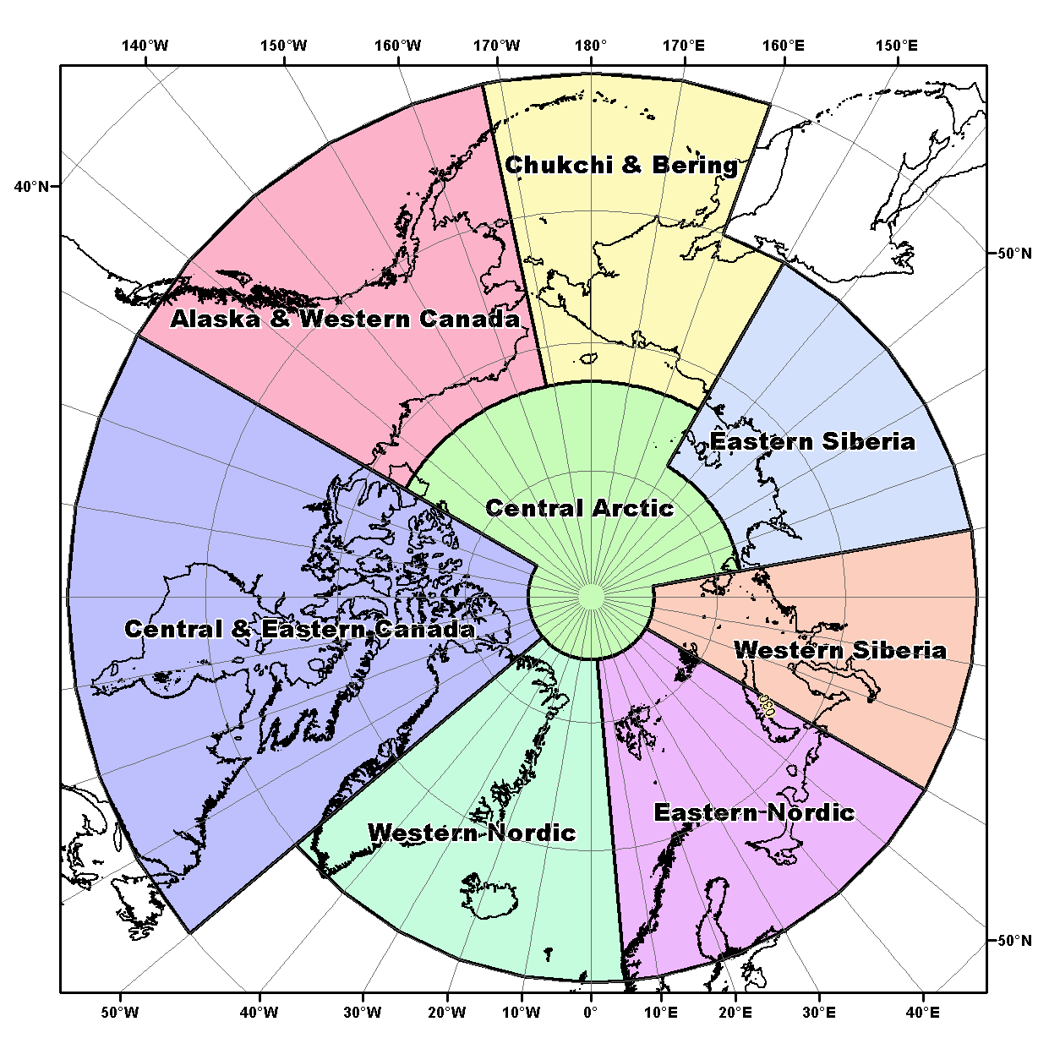
Terrestrial Regions covered
North American Node
Alaska & Western Canada: Includes Alaska, and the Yukon and the Northwest Territories in Canada
Central & Eastern Canada: Central and Eastern Canada and Western Greenland
Northern European Node
Western Nordic: Eastern Greenland, Iceland
Eastern Nordic: Svalbard and Scandinavia
Eurasian Node
Western Siberia
Eastern Siberia
Chukchi & Bering
Central Arctic

Slide 20
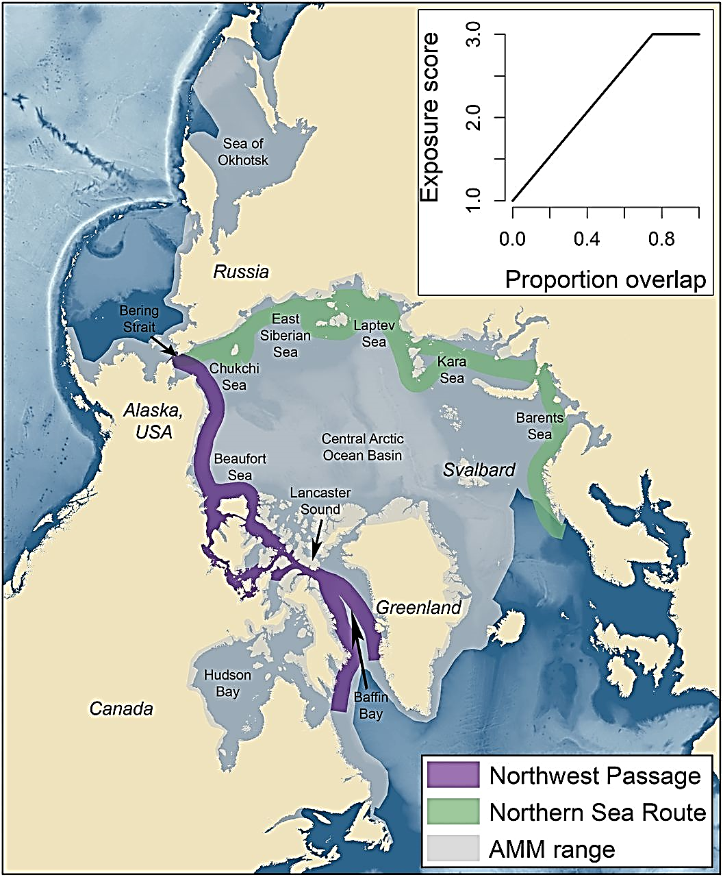

Sea-Ice Navigational Regions
Greenland Sea
Sea-Ice Regions. Map Source: Courtesy of the U.S. National Academy of Sciences.

Slide 21
How this summary was developed
Available observations
+
State of the art modeling for temperature, precipitation and sea-ice
+
Arctic regional climate expertise from
National meteorological organizations*
+
Information about potential impacts for regional users
*As a result, the regional outlooks may not always match the model output

Slide 22
North American node
Alaska & Western Canada – Baljit Sekhon, ECCC
Central & Eastern Canada – Jesse Vagar, ECCC
Arctic Regional Climate Centre Network
Arctic Climate Forum #16 5-6 November 2025

Slide 23
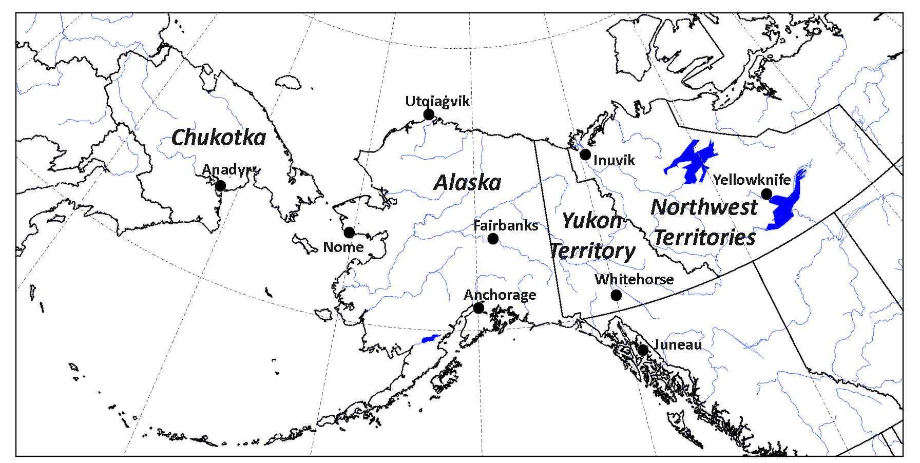
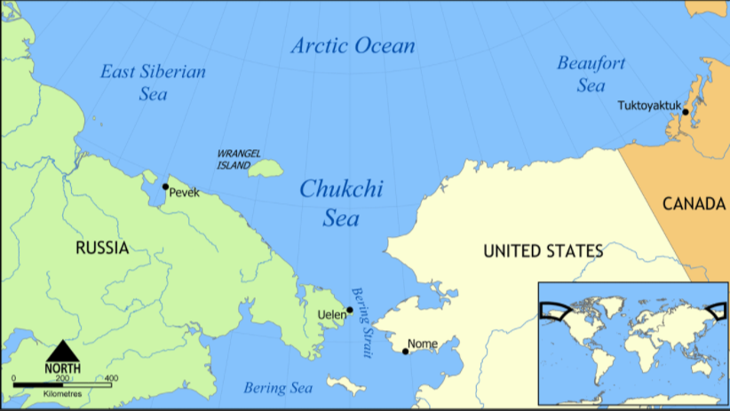
Alaska and Western Canada
Arctic Climate Forum #16 5-6 November 2025

Slide 24
Alaska and Western Canada
Seasonal Summary: Summer 2025
Observations above (+) and below (-) climatological normal
Temperature Normal 1991-2020 | 2025 value is 10.63°C Normal is 10.14°C Departure was +0.49°C | Record warmest was 11.50°C in 2004. This was 1.36 above the 1991-2020 normal. | Record coolest was 8.38°C in 1949. This was 1.76 below the 1991-2020 normal.
Precipitation Normal 1991-2020 | 2025 value 231 mm – which is 102% of normal. Normal is 230 mm Departure was +1 mm | Record wettest was 265 mm in 2020 | Record driest was 192 mm in 2004
Sea-Ice Normal 1991-2020 Ice extent rank since 1979 | 2025 ice extent: Chukchi Sea near normal, Beaufort Sea below normal | Beaufort: 7th lowest since 1979; below normal* Chukchi: 15th lowest since 1979; near normal*
*reference: Sea Ice Index, Version 3 | National Snow and Ice Data Center
Arctic Climate Forum #16 5-6 November 2025
Notes:
Slide updated Oct 28, 2025. Reporting on Alaska and Western Canada domain
TEMPERATURE
-Map for ACF region has +0.5C, we calculate +0.49
-Record warmest and coldest remain the same – these are just stats from the timeseries data
PRECIPITATION
-Used 1991-2020 normal value (230mm when rounded)
-Record wettest and Record driest remains the same, unchanged
“In the table you could put a * beside the stats with the reference on the bottom of the slide. These are the regional extent values I had been using to verify the forecasts so there's consistency there. In the dry run tomorrow (whoever presents) could ask US colleagues (if they're there) or the group in general if this is an ok approach.”
Western Arctic: Around 1-2 weeks later than normal
Western Arctic (ISR):
Unusual presence of old ice in southern and eastern Beaufort sea all season and observation of icebergs/ice islands in the Beaufort Sea, Amundsen Gulf (including Dolphin and Union Strait) & Victoria Strait
Generally, more difficult navigation in western Arctic all season
Multiple iceberg/ice island observations lead to expansion of iceberg limit in the western Arctic.

Slide 25
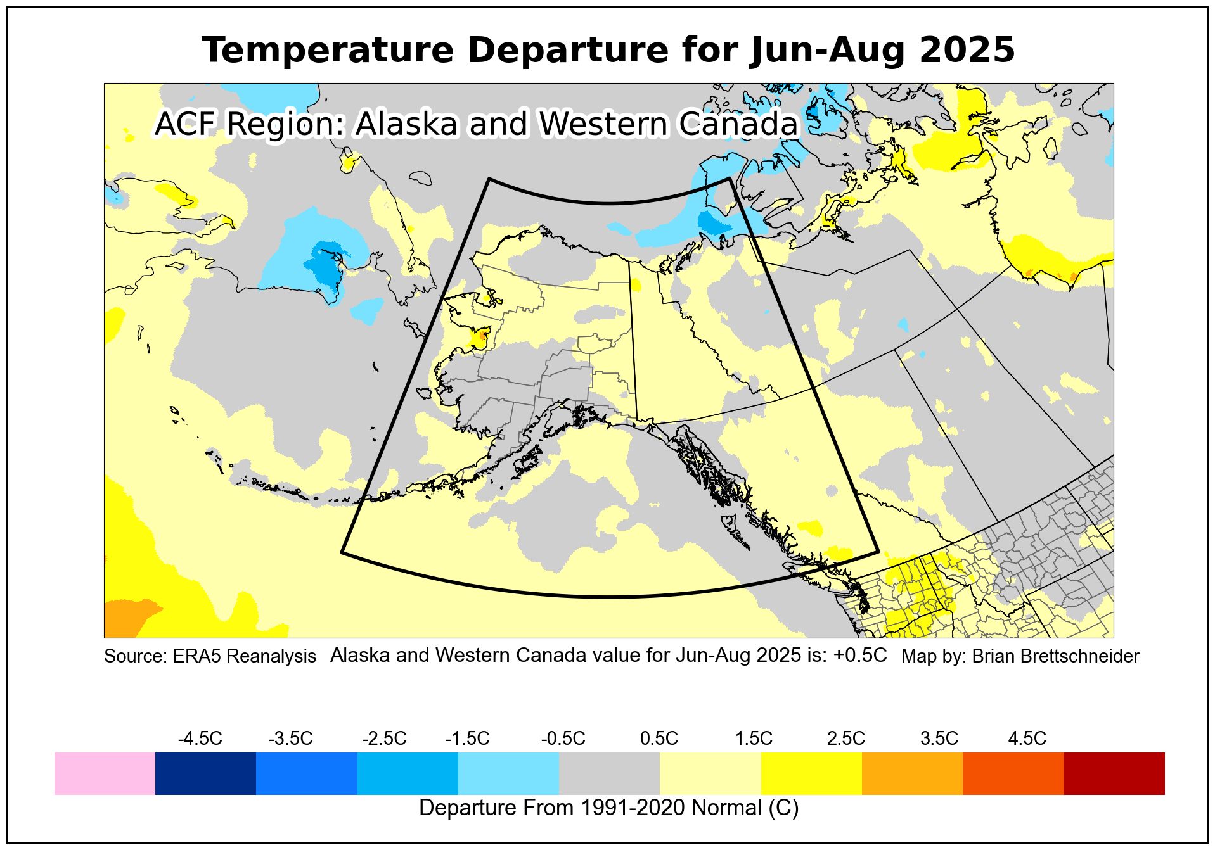
Alaska and Western Canada
Tool developed by Brian Brettschneider
Arctic Climate Forum #16 5-6 November 2025
Notes:
Slide updated on Oct 28, 2025 (E.Tetlock)
Attribution added Oct 29, 2025 (E.Tetlock)

Slide 26
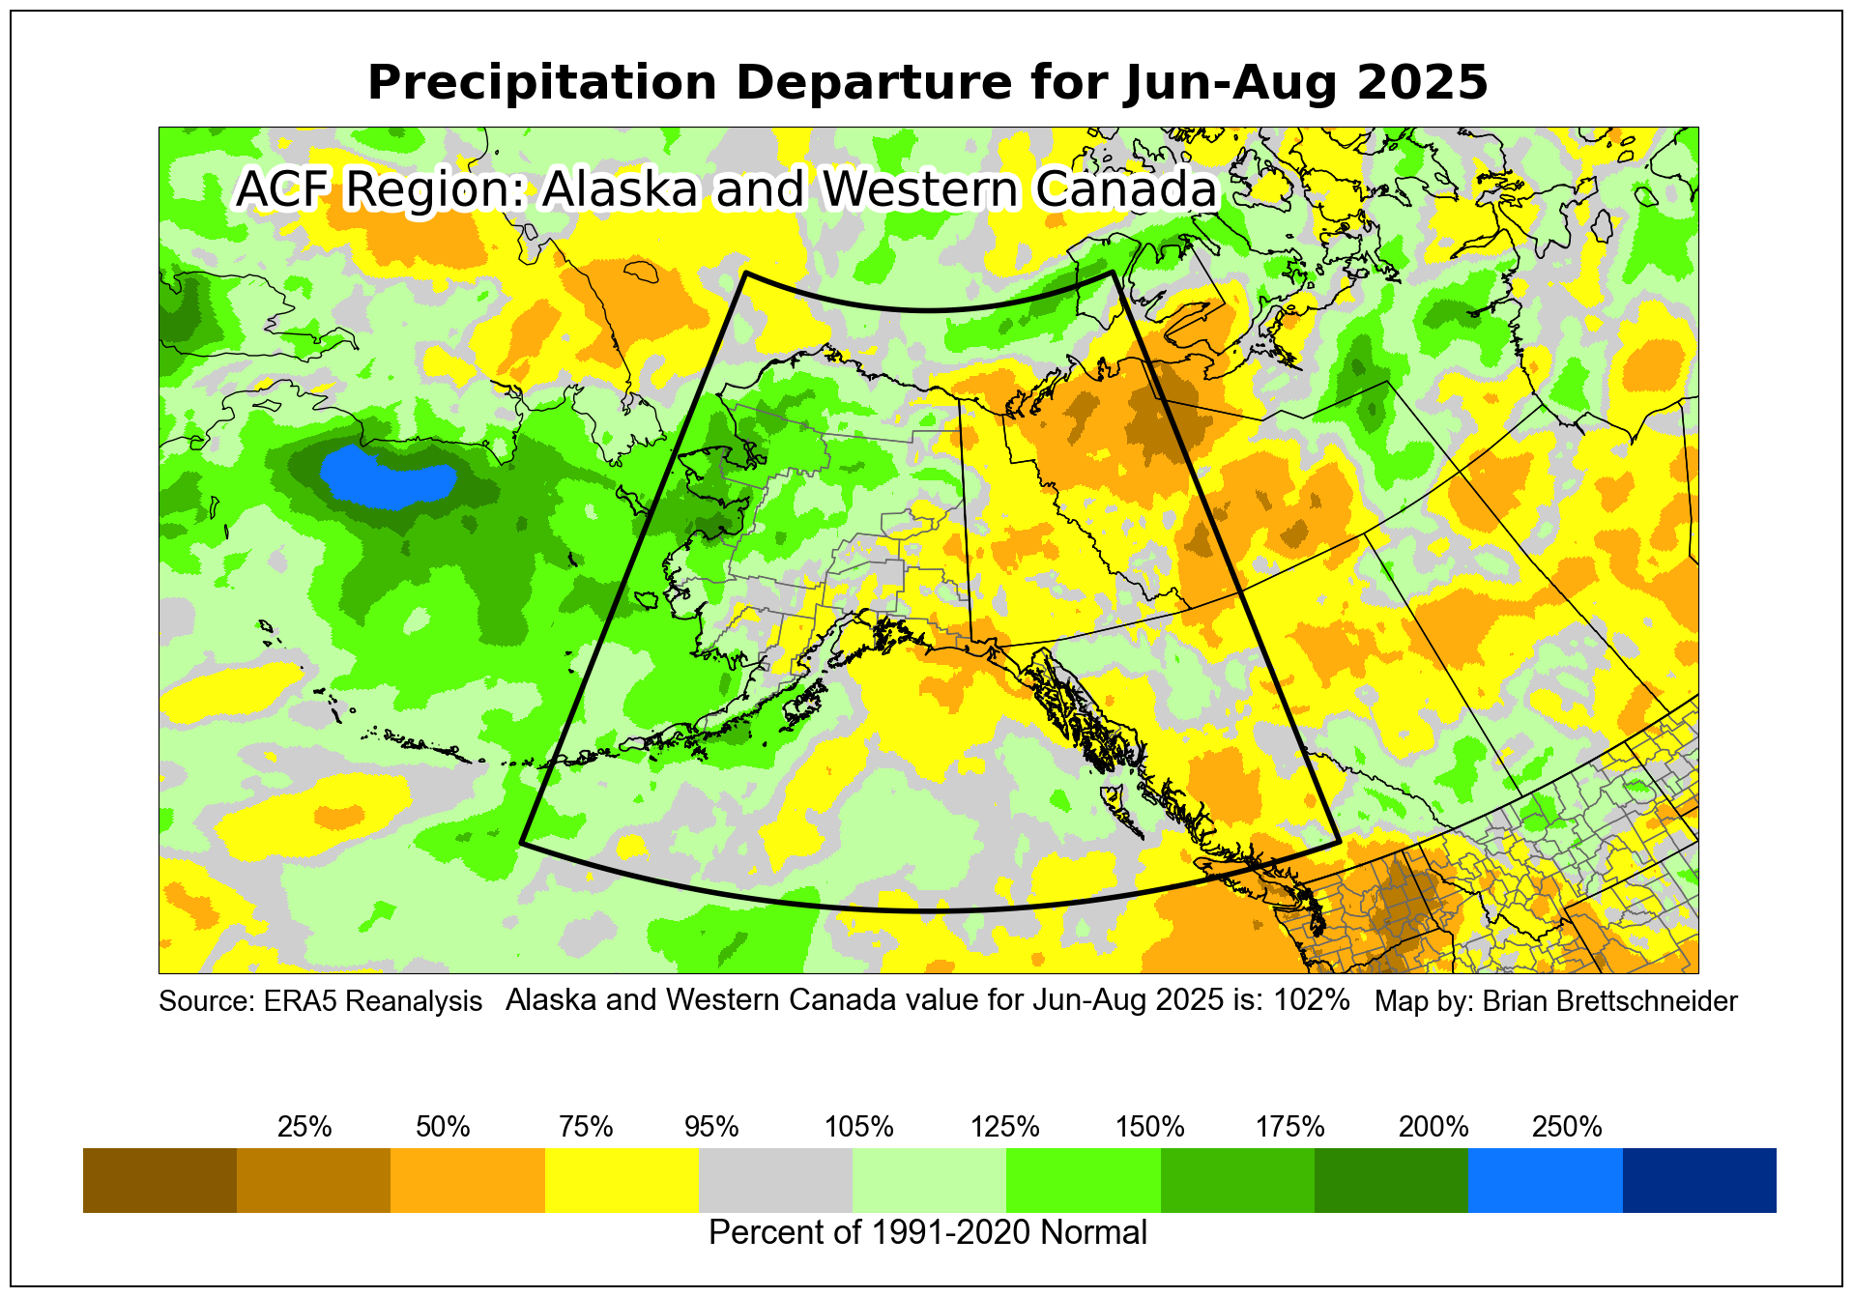
Alaska and Western Canada
Tool developed by Brian Brettschneider
Arctic Climate Forum #16 5-6 November 2025
Notes:
Slide updated on Oct 28, 2025 (E.Tetlock)
Attribution added Oct 29, 2025 (E.Tetlock)

Slide 27
Alaska and Western Canada
Observed extreme climate events Summer 2025
Category | Location | Rarity | Impacts associated with event
Warm temperatures | Nome, Alaska Bettles, Alaska | Warmest summer in Nome since 2020, and warmest since 2019 Abnormally warm temperatures in early July, reaching 90°F | Intense wildfire season in Alaska, over one million acres burned, nearly all between mid-June and mid-July. High impact fires include the Bear Creek fire in Denali Borough that burned residences and forced long delays on Park highway. Around Fairbanks, the Aggie Creek and Himalaya Road fires prompted evacuation notices for subdivisions in late June, and the Nenana Ridge Complex threatened homes and businesses and created long traffic delays in and out of Fairbanks over July 4th weekend. Smoky summer in Fairbanks, fourth consecutive year with >100 hours of visibility restricting smoke at the airport
Dryness | Parts of Western Canada | Fort Simpson, driest summer on record at 26% of normal precipitation Whitehorse, Fort Nelson and Fort Liard recorded their driest June on record | Yukon saw abnormally warm temperatures and dry conditions in mid-late June; it also had high volume of lightning strikes. Conditions contributed to active wildfires in Dawson area in June. Impacts include evacuation alerts issued to nearly 200 properties, and heavy smoke cancelling flights at the airport. The Yukon River Quest (paddle race) was cut short for second year in a row, changing route to end in Carmacks instead of Dawson.
Arctic Climate Forum #16 5-6 November 2025
Notes:
Slide updated on Oct 22, 2025 by J.Kwan
-based on content from Alaska/Northwest Canada binational seasonal bulletin

Slide 28
Alaska and Western Canada
✔
Seasonal Outlook: Winter 2025-2026 |  | Multi Model Agreement
Climatological variables | Forecast relative to climatological normal | High | Moderate | Low | No
Temperature | Western Canada: Equal Chance | Above (Warmer)/ Below (Colder) |  |  | ✔
 | Northern Alaska: Above Normal |  |  | ✔
 | Southern Alaska: Below Normal |  |  |  | ✔
Precipitation | Western Canada: Above Normal | Above (Wetter)/ Below (Drier) |  | ✔
 | Northern Alaska: Above Normal |  |  | ✔
 | Southern Alaska: Below Normal |  |  |  | ✔
Sea-Ice | Break-up/Freeze-up | Bering Sea: Early | Early/Late |  |  | ✔
 |  | Chukchi Sea: Early | Early/Late |  | ✔
 |  | Beaufort Sea: Early | Early/Late | ✔
 | Maximum/minimum Ice Extent [2025] | Chukchi & Beaufort Seas: Near Normal | Above/Below | ✔
 |  | Bering Sea: Below Normal | Above/Below |  |  | ✔
Snow Water Equivalent | Mainland Alaska and Western Canada: Above Normal |  | Above/Below |  |  | ✔
 | Southern Alaska: Above Normal |  | Above/Below |  |  | ✔
Arctic Climate Forum #16 5-6 November 2025
Notes:
Freeze-up
Bering Sea – early – low confidence
Chukchi Sea - early – moderate to high confidence
Beaufort Sea – early – high confidence
Maximum sea ice extent – not sure why we choose these regions – the first two should be nearly fully ice covered every winter
Chukchi and Beaufort – near normal – high confidence
Bering – below normal – low to moderate confidence

Slide 29
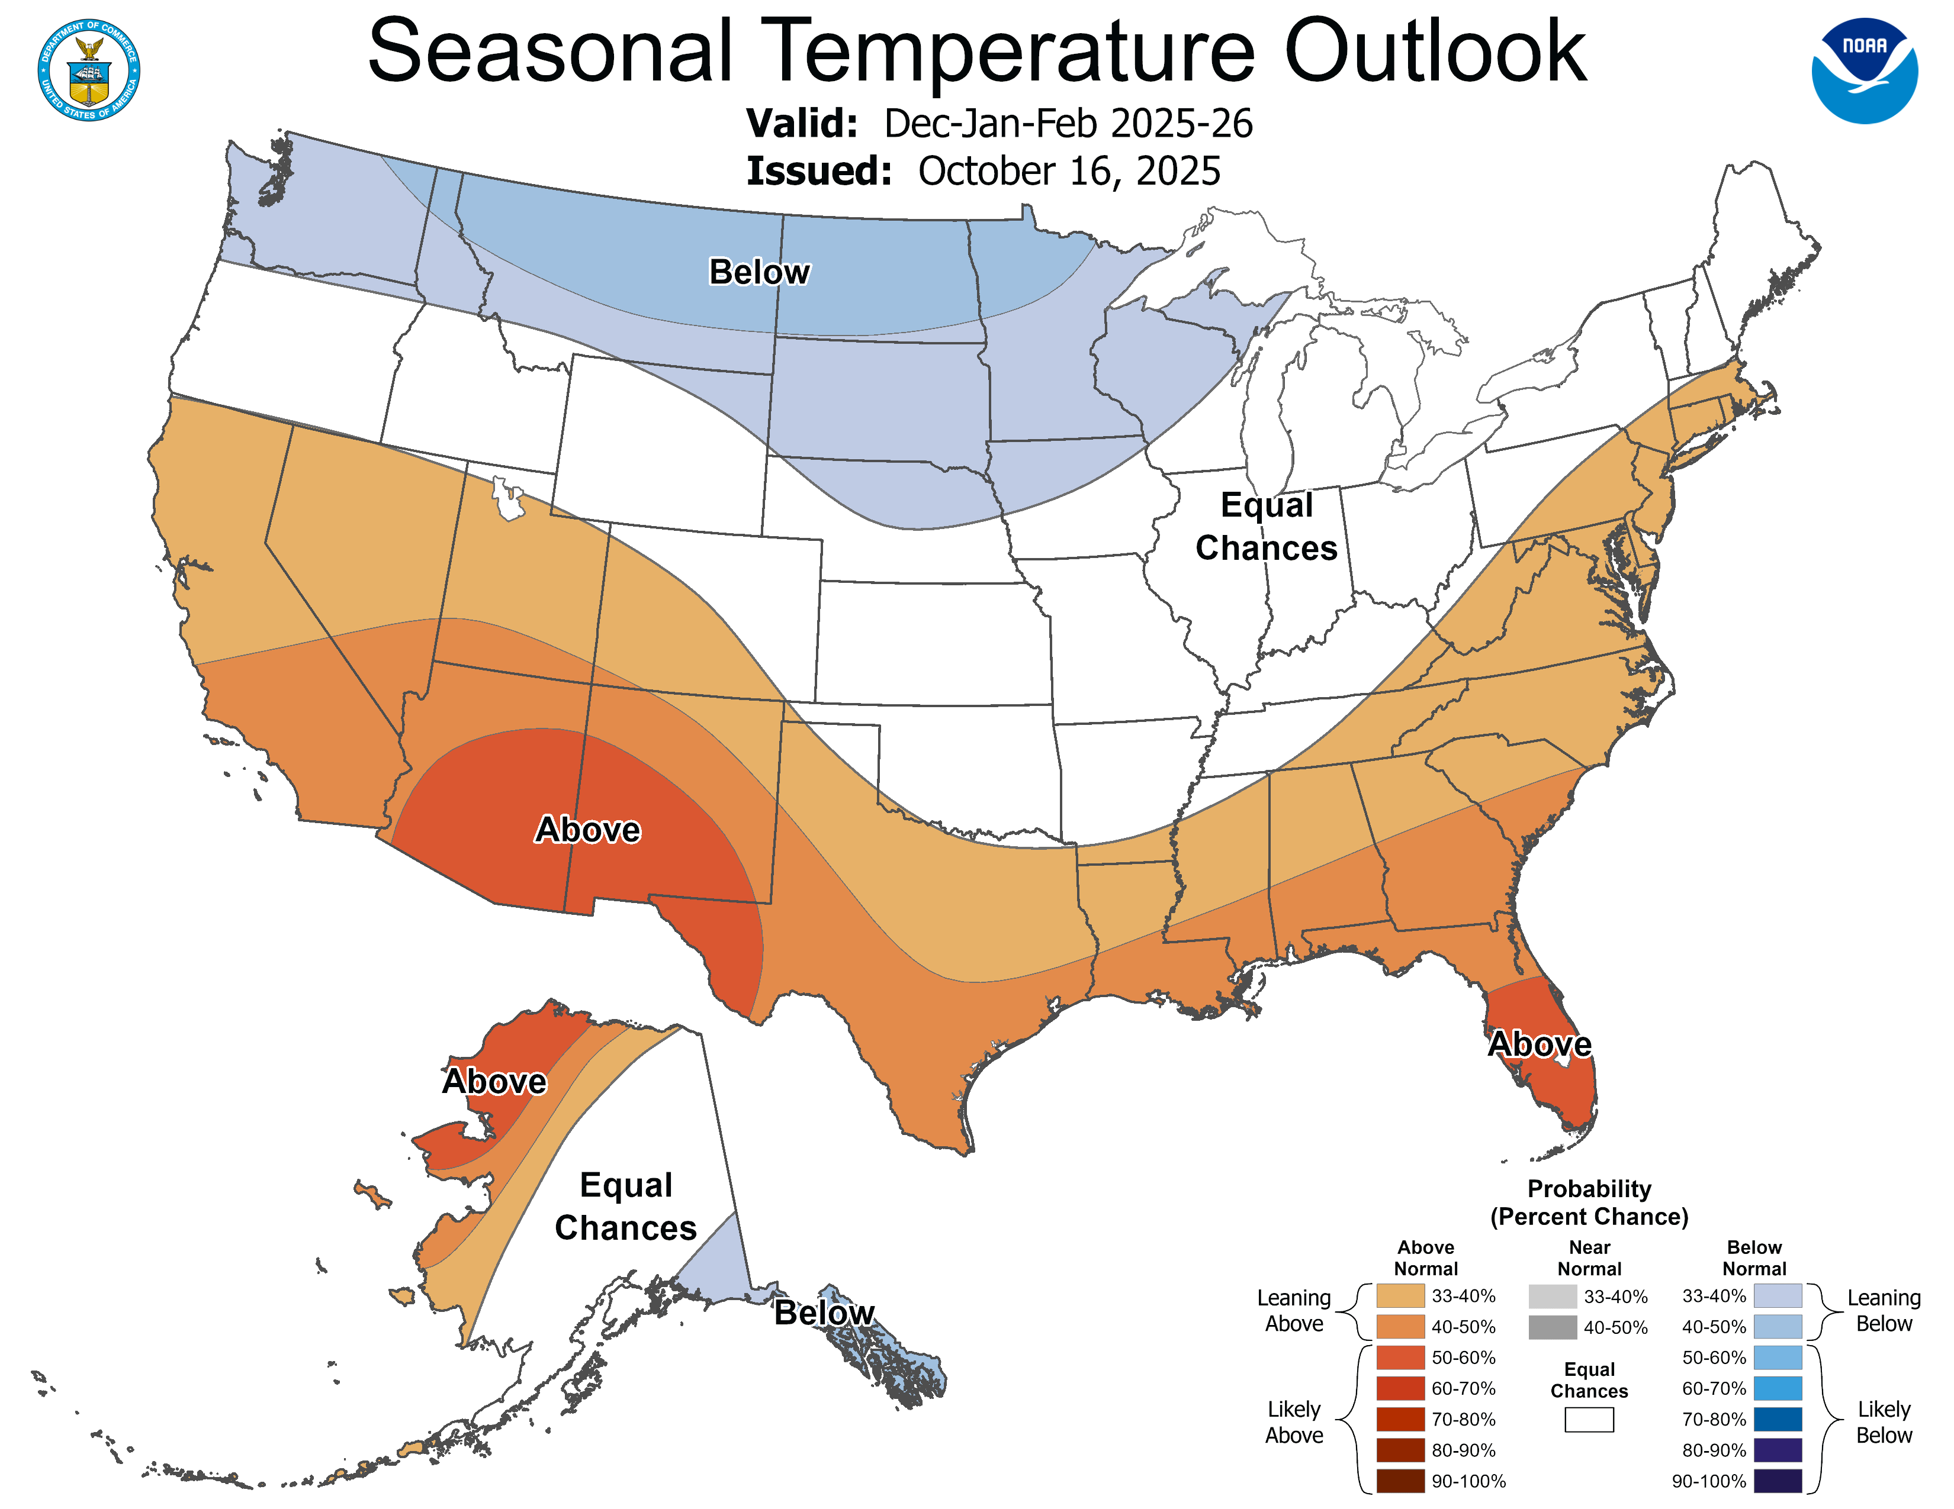
Alaska and Western Canada
Arctic Climate Forum #16 5-6 November 2025

Slide 30
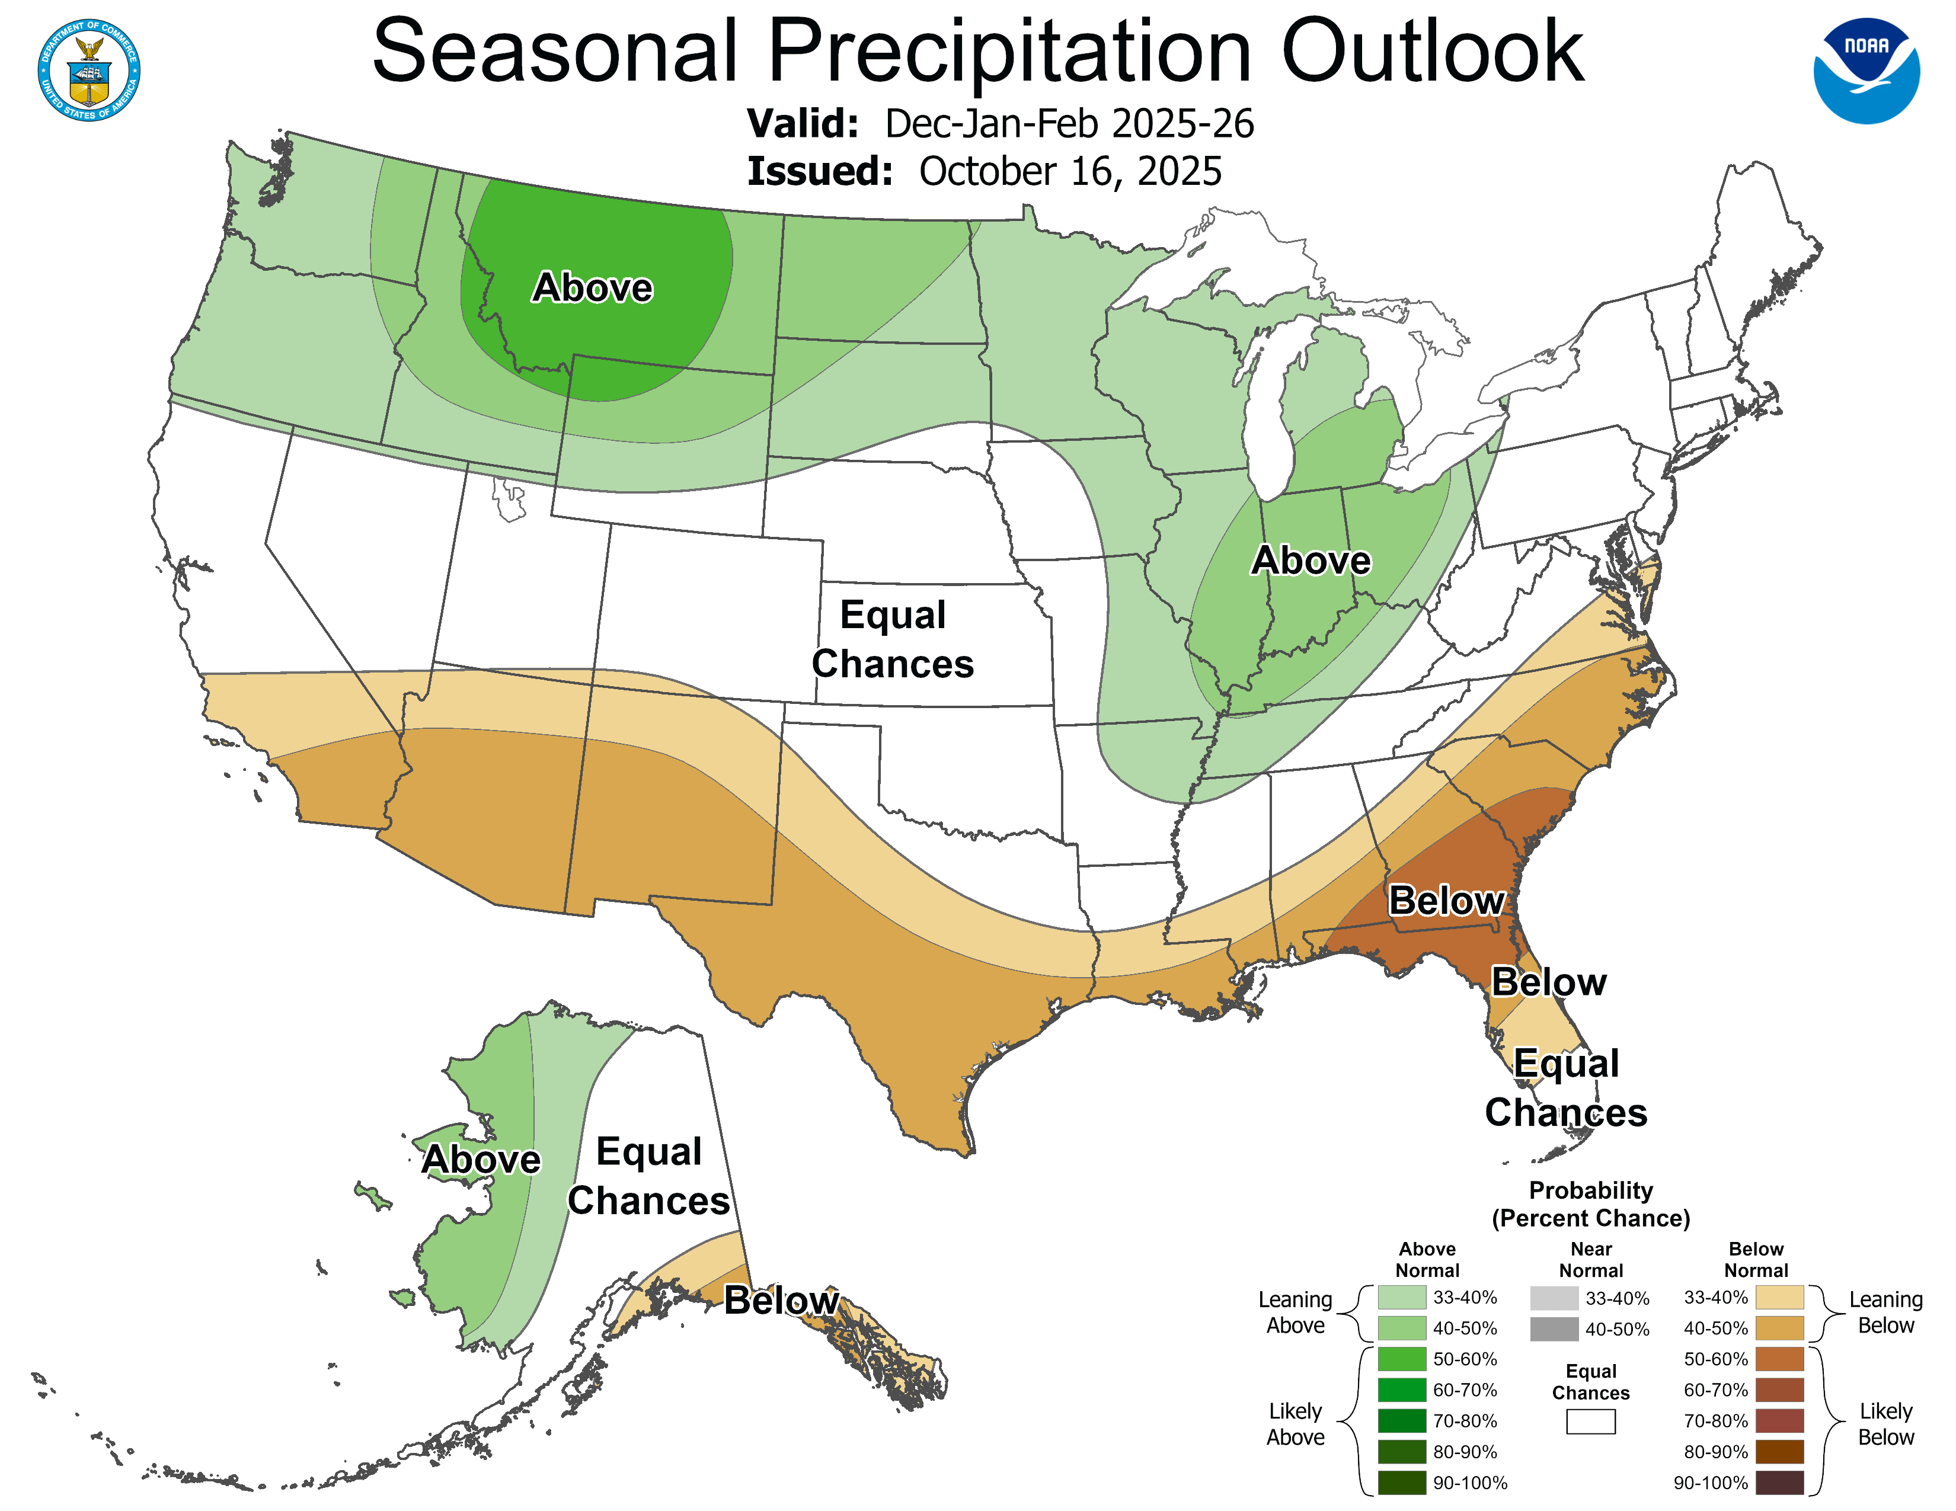
Alaska and Western Canada
Arctic Climate Forum #16 5-6 November 2025

Slide 31
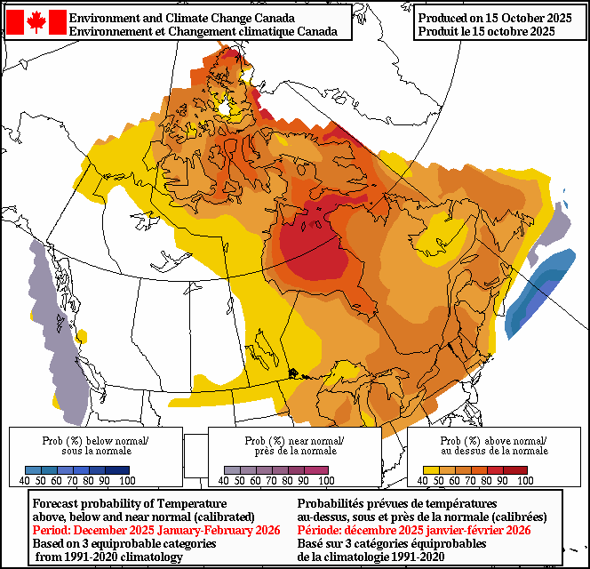
Alaska and Western Canada
Arctic Climate Forum #16 5-6 November 2025

Slide 32
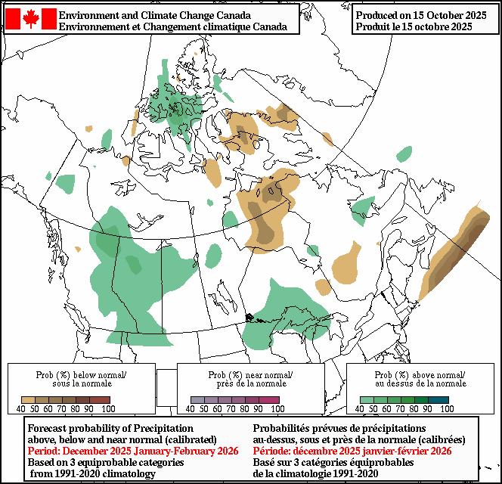
Alaska and Western Canada
Arctic Climate Forum #16 5-6 November 2025

Slide 33
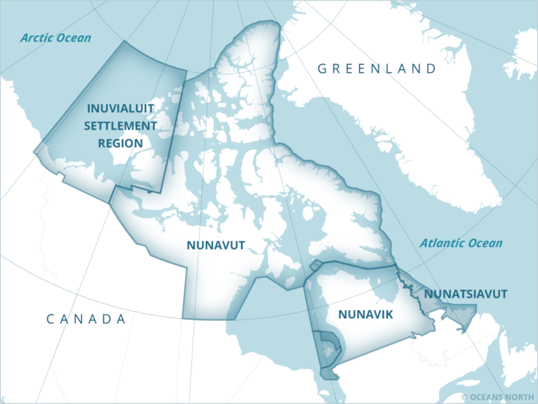
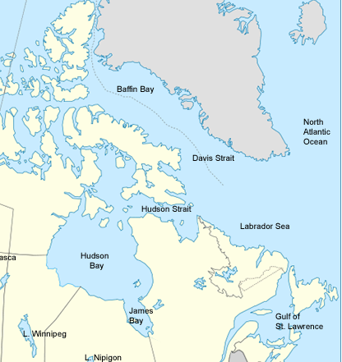
Central & Eastern Canadian Arctic
Arctic Climate Forum #16 5-6 November 2025

Slide 34
Central & Eastern Canadian Arctic
Seasonal Summary: SUMMER 2025
Observations above (+) and below (-) climatological normal
Temperature Normal 1991-2020 | +0.04°C Normal | Record warmest Arviat: 10.3°C (2nd warmest) Hopedale: 11.4°C (5th warmest) | Record coldest – none
Precipitation Normal 1991-2020 | Variable mix of wet and dry conditions Drier than normal in ISR-Arctic coast | Record wettest - none | 1st Record Driest Kinngait (40.6%)*
Sea-Ice Below normal 1991-2020 | Freeze-up: Eastern Arctic: 4-5 weeks later than normal. Western Arctic: 1-2 weeks later than normal | Hudson Bay: 9th lowest since 1979; below normal Baffin Bay: 21st lowest since 1979; above normal CAA: 9th lowest since 1979; below normal
Arctic Climate Forum #16 5-6 November 2025
Notes:
Temperature and Precipitation rows updated Oct 17, 2025
-column 2 is from ERA5 reanalysis, compared to ERA5 climatology (1991-2020)
-Temperature records (context for Jesse): Gjoa Haven 2nd warmest June on record
-column 3 is from observations, compared to MSC Normals (1991-2020)
-*Precipitation: Kinngait (40.6%) has 6 days of missing data. Estimate 1.6 mm for the 6 missing days based on hourly data on CDO. Total precip 52.6 + 1.6 = 54.2 mm, 41.9%, still ranked #1 driest out of 24 years of full seasonal precipitation data.
Sea Ice – Old, Jesse needs to re-confirm this info for JJA 2025
Later than normal freeze-up throughout the region
Below normal March ice extent; 15th lowest since 1979
Late start to the winter but some recovery in March

Slide 35
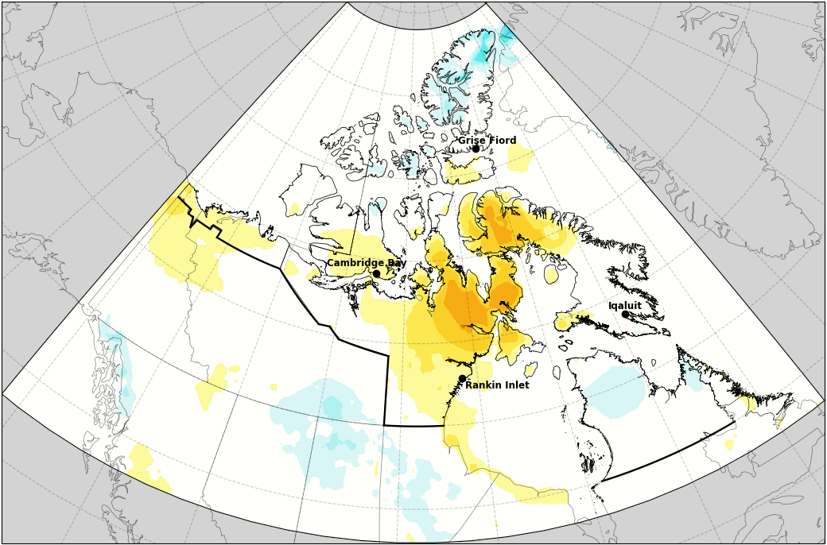
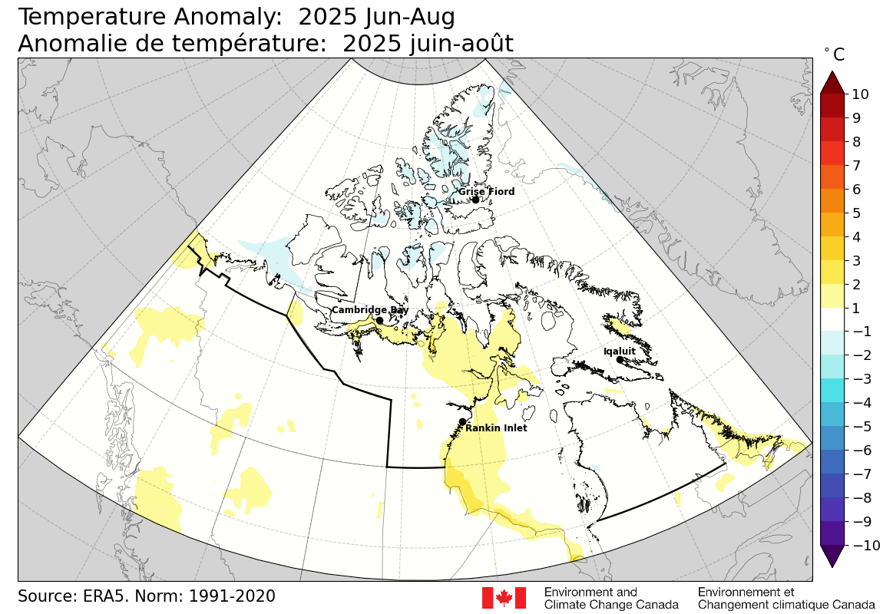
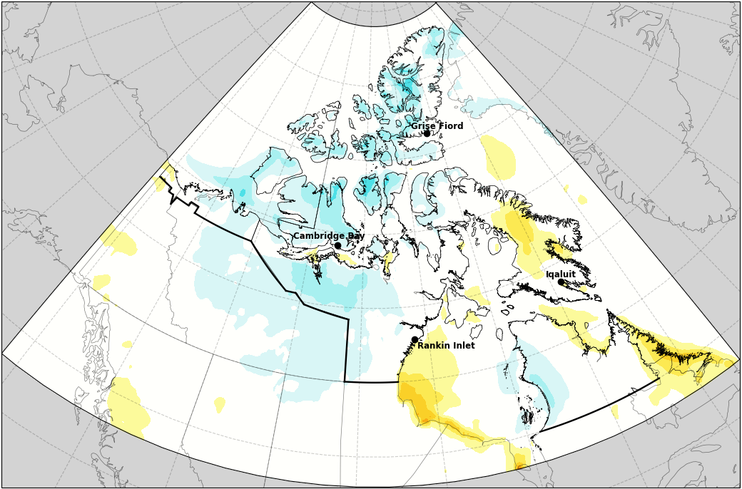
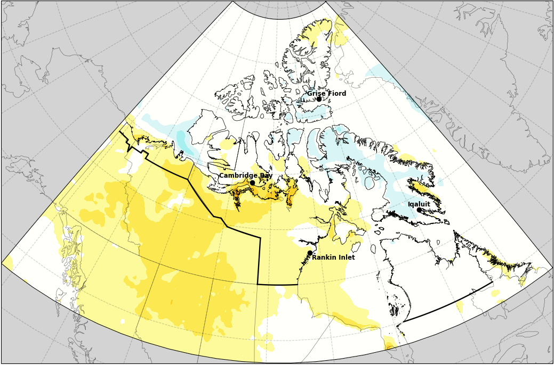
Central & Eastern Canadian Arctic
Summer 2025 Mean Temperature Anomalies​
Jun
Jul
Aug
Source: ERA5 Reanalysis, Normals: 1991 - 2020
Arctic Climate Forum #16 5-6 November 2025
Notes:
Slide updated on Oct 14, 2025
Using ERA5 Reanalysis for temperature maps

Slide 36
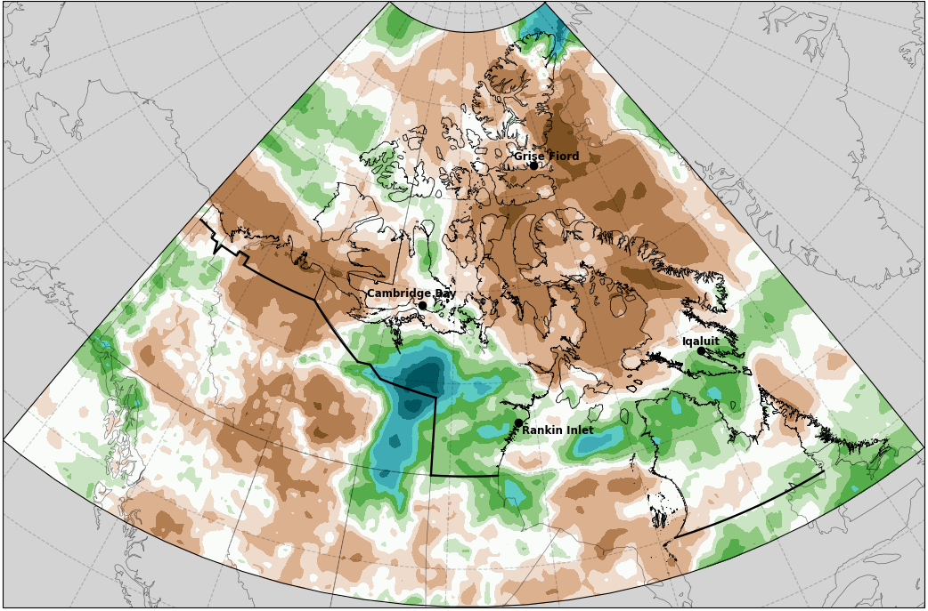
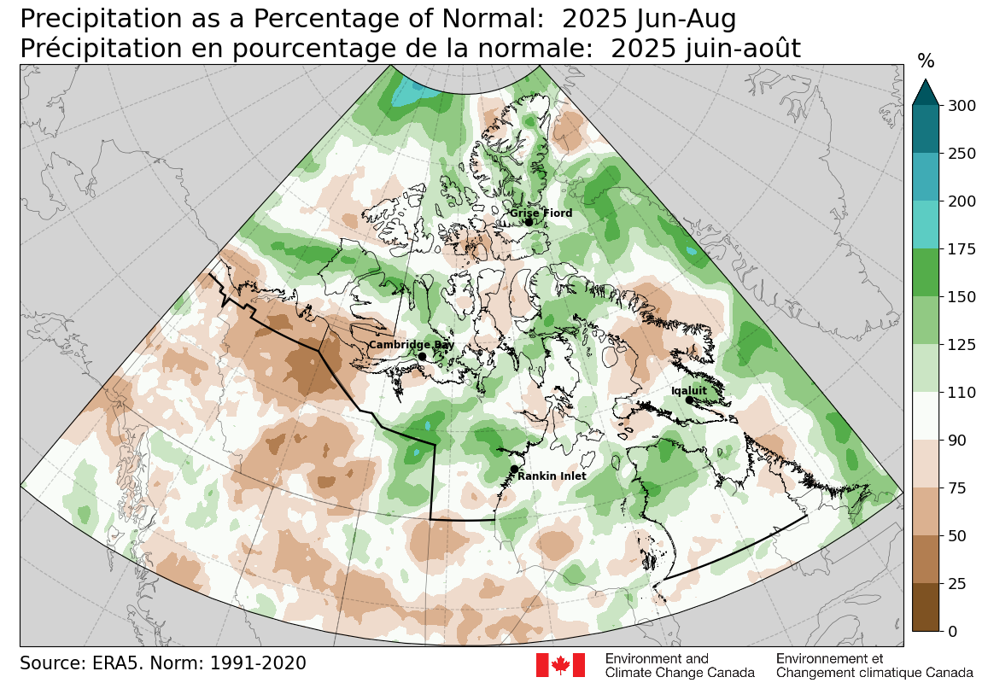
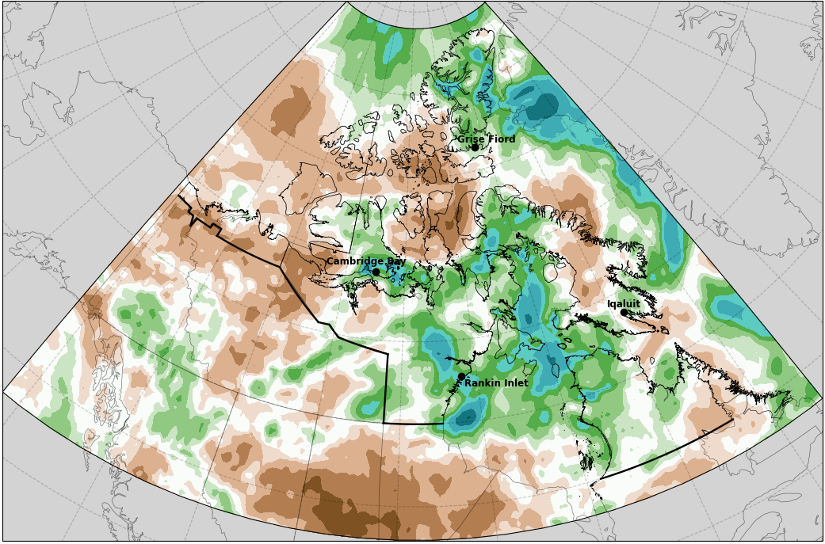
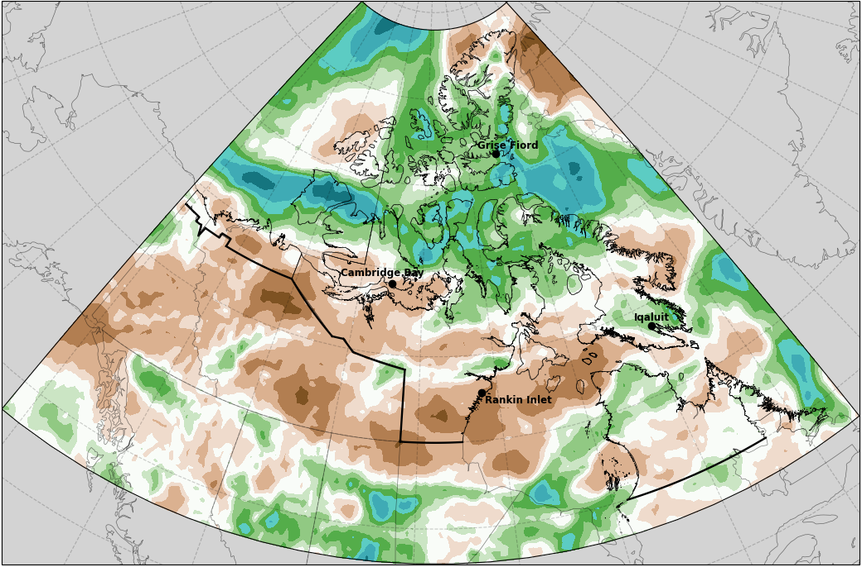
Central & Eastern Canadian Arctic
Summer 2025 Precipitation Anomalies​
Jun
Jul
Aug
Source: ERA5 Reanalysis, Normals: 1991 - 2020
Arctic Climate Forum #16 5-6 November 2025
Notes:
Slide updated on Oct 14, 2025
Using ERA5 Reanalysis for precipitation maps
This season, CaPA maps are too dry, when compared to station data and ERA5

Slide 37
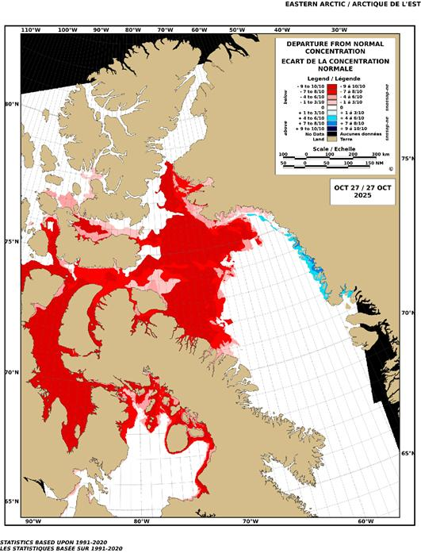
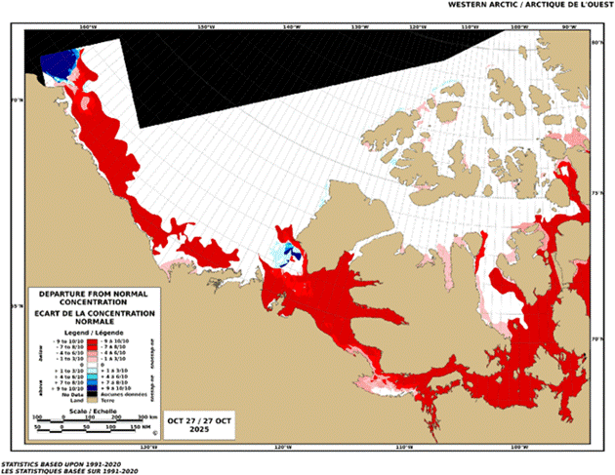
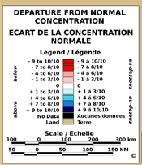
Central & Eastern Canadian Arctic
Sea Ice Concentration Anomaly During Freeze-up
Ice Concentration Anomaly Oct 27, 2025
Arctic Climate Forum #16 5-6 November 2025
Notes:
Significant delays in freeze-up throughout the Arctic
A snapshot of ice concentration anomaly maps during freeze-up
> Nov 4 for WA/EA (regions with no anomalies already ice covered)
Jan 6 for HB (regions with no anomalies already ice covered)
Below normal ice cover throughout the freeze-up period

Slide 38
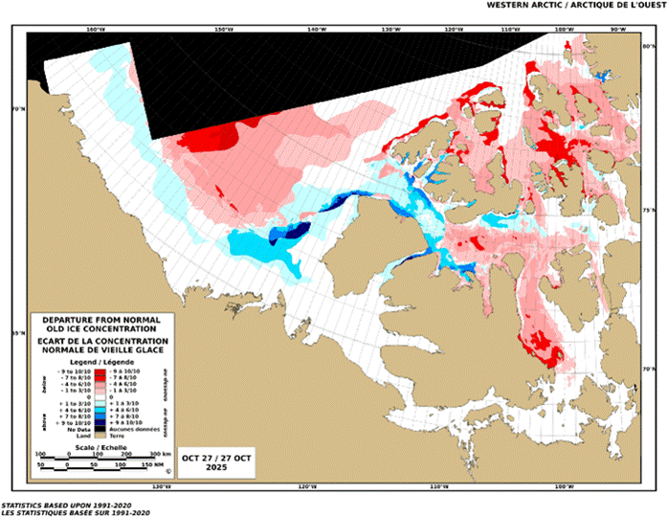
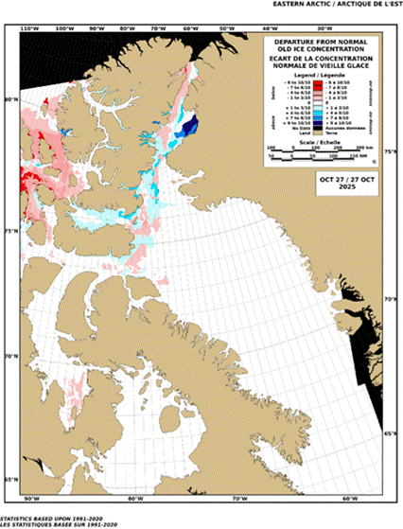
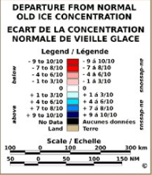
Central & Eastern Canadian Arctic
Old Ice Concentration Anomaly as of Oct 27, 2025
Arctic Climate Forum #16 5-6 November 2025
Notes:
Notable anomalies in MYI this winter that will impact break-up and summer ice conditions
Snapshot March 3rd, similar anomaly pattern throughout the winter
High arctic islands
Significantly less MYI in the high arctic islands, some waterways void of MYI for the first time in our records dating back to the 60s
Beaufort Sea
Tongue of MYI extending across the southern Beaufort Sea but less MYI than normal in the polar pack
NWP
More MYI than normal in M'Clure Strait
Less MYI than normal in Parry Chennel and south through M'Clintock Channel

Slide 39
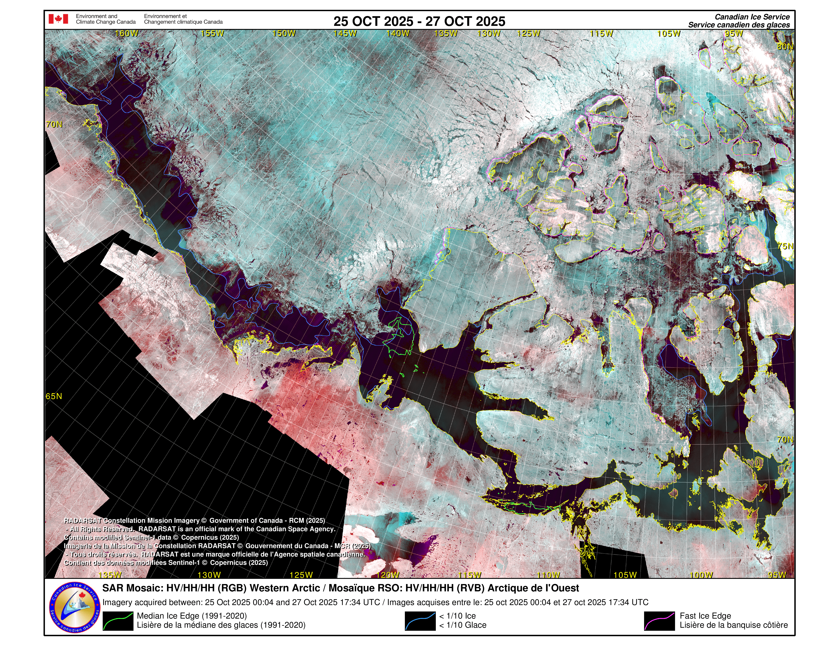
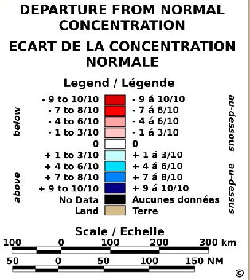
Central & Eastern Canadian Arctic
Sea Ice
Arctic Climate Forum #16 5-6 November 2025

Slide 40
Central & Eastern Canadian Arctic
Observed extreme climate events SUMMER 2025
Category | Location | Rarity | Impacts associated with event
High Temperature | Nunatsiavut Nunavik Nunavut | Happy Valley-Goose Bay broke the record for maximum temperature in August in all of Labrador with 36.5°C. It also saw Cartwright tie the provincial humidex record. Eastern Nunavik experienced a heatwave with well above normal temperatures in early-mid July. On July 11, Kuujjuaq observed 31.7°C setting a new daily temperature record. Kugaaruk reached 19.6°C on Aug 23 and Igloolik reached 18.7°C on Aug 24, very high temperatures for so late in the season. | Mid-August saw a prolonged hot and dry spell which shattered temperature records and fueled many new and fast-growing wildfires in Labrador. Accelerated snow melt and heavy rain led to flooding near Deception Bay, Nunavik in June. 40 cabins flooded.
Low Precipitation | ISR | Inuvik received 52% of normal seasonal precipitation. In July, Old Crow only received 12.5 mm (29.5% of normal) despite July typically being its second wettest month. | Low precipitation in much of the ISR and northern Yukon. The Yukon extended its wildfire season due to dry conditions in August
Storm Surge | ISR | Tuktoyaktuk set a new record for highest water level on August 30 when a storm surge reached 2.62 m above chart datum, nearly 0.42 m higher than the literature reported 2.2 m. | Homes flooded, roads washed away, power outages, and extensive inland flooding. Just completed $54M shoreline protection program the month before. At Herschel Island, high water levels prevented planes from using the airstrip.
Poor Air Quality | Nunavut Nunatsiavut | Thick smoke from wildfires nearby being transported throughout Nunavut is becoming more common In early June, wildfire smoke from the Prairies caused poor air quality in much of Labrador. | Increasing number of days with Air Quality Advisories, people remaining indoors
Sea Ice | ISR | Abnormal old ice | Impacted resupply schedules and shipping routes
Arctic Climate Forum #16 5-6 November 2025
Notes:
Slide update on Oct 20, 2025
-High Temp, Precipitation, Storm Surge, Poor Air Quality content confirmed on Oct 20
-re-confirm w Jesse on Sea Ice content? Has this been updated??
Extra Content dropped from this slide:
*Heavy rain event on June 20-21 over central and southeastern Labrador recorded 78 mm at Happy Valley-Goose Bay and 60.5 mm at Cartwright.
*[Not in the ISR but interesting] Northern Yukon saw temperature above normal this summer, with Old Crow recording the highest maximum temperature of 29°C between June 19 – 20. (Notes from Erica: felt this should be removed, as after validation it only was in the 90th percentile, and after reviewing daily and seasonal temp anoms, Yukon was not that much above normal this summer, except for the last days of August. It also got hotter at this station in July, 29.3 on July 6).

Slide 41
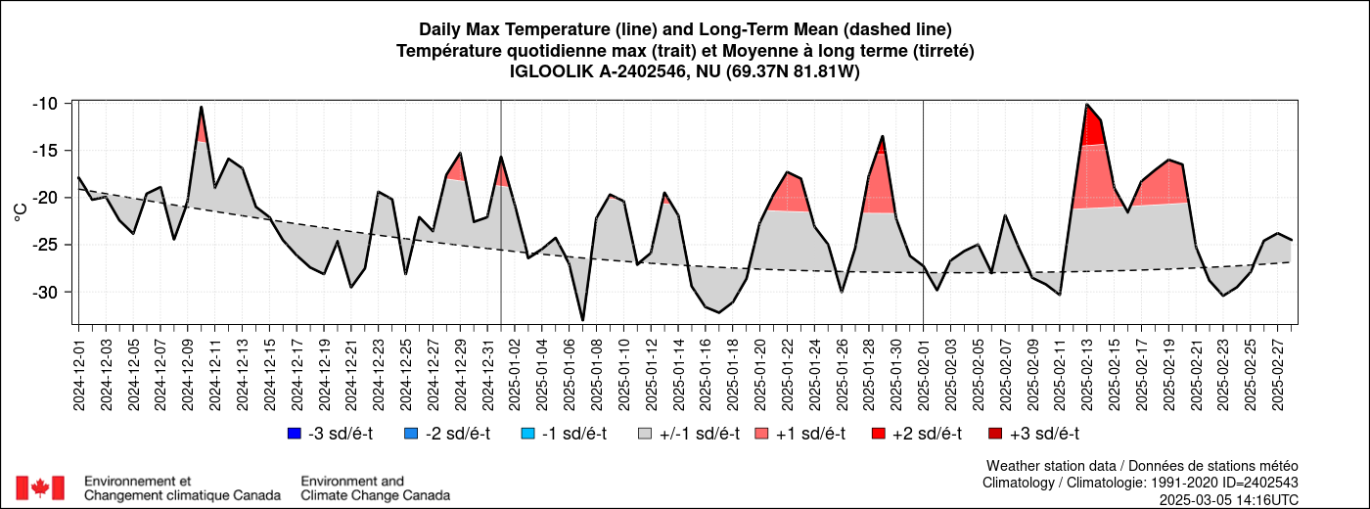
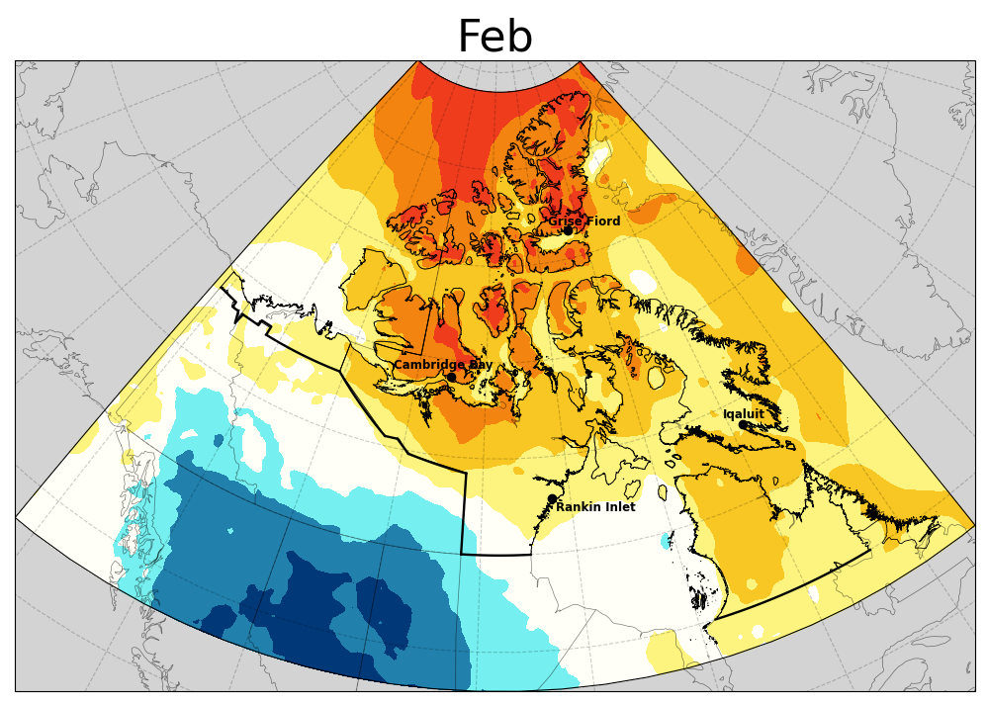
Central & Eastern Canadian Arctic
Extreme Winter Warming Days
Harmful Impacts on Arctic Wildlife
Igloolik, NU
Lemaire et. al. (2025), Increases in Arctic Extreme Climatic Events Are Linked to Negative Fitness Effects on the Local Biota. Glob Change Biol, 31: e70157. https://doi.org/10.1111/gcb.70157
Arctic Climate Forum #16 5-6 November 2025
Notes:
Lemaire, M., Bokhorst, S., Witheford, A., Macias-Fauria, M. and Salguero-Gomez, R. (2025), Increases in Arctic Extreme Climatic Events Are Linked to Negative Fitness Effects on the Local Biota. Glob Change Biol, 31: e70157. https://doi.org/10.1111/gcb.70157
To identify extreme winter warming days, we calculated the 99th percentile for the maximum daily winter temperature for each grid cell in the Arctic based on the climatological period 1950–1980.
above 98th percentile

Slide 42
Central & Eastern Canadian Arctic
Seasonal Outlook: Winter 2025-26 |  | Multi Model Agreement
Climatological variables | Forecast relative to climatological normal | High | Moderate | Low | No
Temperature | Nunavut: Hudson Bay, Foxe Basin, Hudson Strait | Above Normal
 | Nunavut: central regions, Arctic Archipelago
 | Nunavut: eastern Baffin Island, eastern Ellesmere Island;
 | Inuvialuit Settlement Region; western Nunavut (western Kitikmeot), southern Kivalliq
 | Northern Inuvialuit Settlement Region; Northern Nunatsiavut
 | Western Greenland, Baffin Bay
Precipitation | Nunavut – Hudson Bay | Above Normal
 | Nunavut – northern regions, Ellesmere Island, Northern Baffin Island, Baffin Bay; western and Greenland, | Above Normal
 | Inuvialuit Settlement Region, Arctic Archipelago, southeastern Baffin Island | Equal Chance
 | Nunavik
Sea-Ice | Freeze-up |  | Baffin Bay | Earlier than Normal
 |  |  | Hudson Bay / Labrador Sea | Earlier than Normal
 |  |  | Beaufort Sea | Earlier than Normal Later than normal (coast)
 |  |  | Canadian Arctic Archipelago | Late in most regions
 | Maximum Ice Extent [March, 2026] |  | Canadian Arctic Archipelago | Below Normal
Snow Water Equivalent | Nunavut: Eastern Baffin Island, northern Ellesmere Island |  |  | Above Normal
 | Nunavut: eastern and southeastern, Nunavik, Nunatsiavut |  |  | Below Normal
Arctic Climate Forum #16 5-6 November 2025

Slide 43
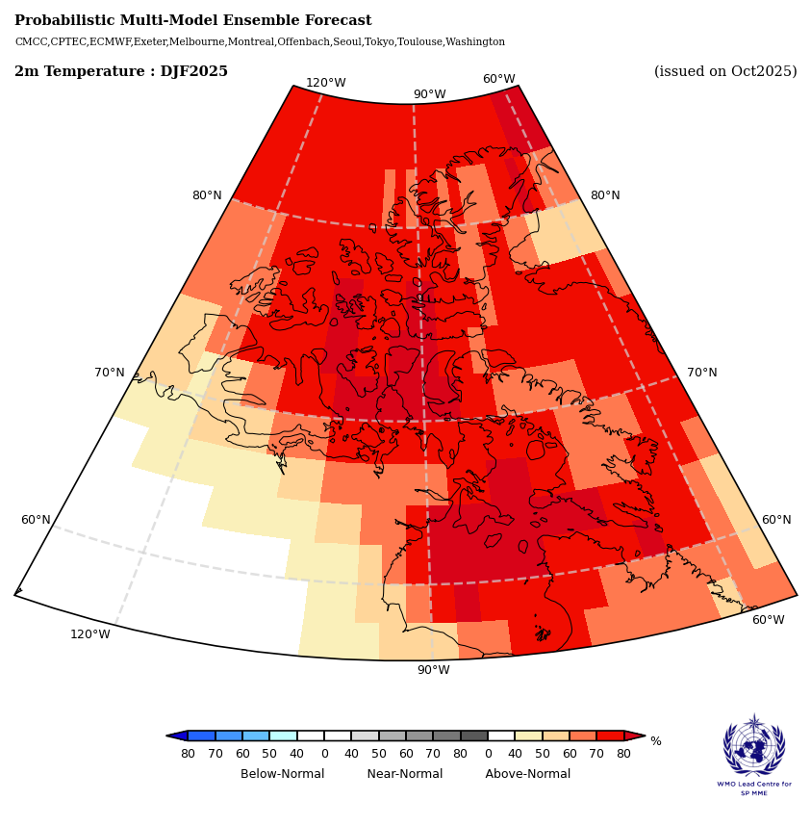
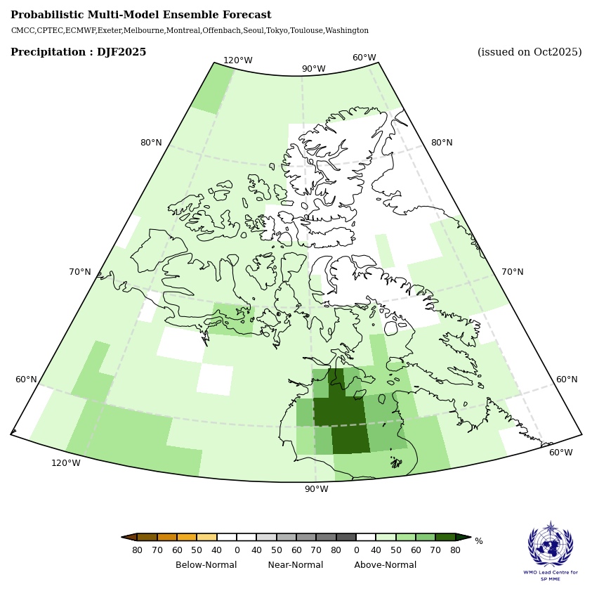
Central & Eastern Canadian Arctic
DJF Multi-Model Temperature Outlook
DJF Multi-Model Precipitation Outlook
Arctic Climate Forum #16 5-6 November 2025
Notes:
-140, -32.5; 50, 85

Slide 44
Central & Eastern Canadian Arctic
Potential societal and environmental impacts
Economy sector/ Livelihood conditions | Relevant variables from the Seasonal Outlook | Impacts associated
Subsistence fishing and hunting | Higher than normal temperatures, delayed freeze up | Delayed sea ice formation Delayed subsistence fishing/hunting Unpredictable shift in fresh water availability On water activities stretching into October – higher risk (storm season)
Marine Traffic Sea Lift, Resupply Marine Domain Awareness
Search and Rescue (SAR) cases are increasing year over year Weather is one of the top 5 causes for SAR activations in the Canadian Arctic
Arctic Climate Forum #16 5-6 November 2025
Notes:
the old ice in Beaufort/M'Clure could hold things up, the lack of MYI in the islands could favour an early clearing BUT of that happens, there could be more import of MYI from the Beaufort than normal – it all depends on the winds

Slide 45
North European Node
Western Nordic - Kristín Ólafsdóttir - IMO
Eastern Nordic - Cyril Palerme - NMI
Arctic Regional Climate Centre Network
Arctic Climate Forum #16 5-6 November 2025

Slide 46

Western Nordic
Arctic Climate Forum #16 5-6 November 2025
Notes:
Note to regional presenter: please replace with high resolution image

Slide 47
Western Nordic
Seasonal Summary: Summer 2025 (JJA)
Observations above (+) and below (-) climatological normal
Temperature Normal 1991-2020 | The average temperature for the whole region was 0.3 °C above normal 12th warmest on record (based on 1950-2025) May and July unusually warm (2nd warmest on record) | Warmest year (since 1900) was 1933 | Coldest year (since 1900) was 1933
Precipitation Normal 1991-2020 | Above normals for the summer but not in each month | Close to normal in Reykjavik, 29% above in Akureyri | Tassilaq 1.7 mm precip in June, normal is 35 mm
Sea-Ice Normal 1991-2020 Ice extent rank since 1979 | Sea ice extent east of Greenland (at the minimum in September) was well below the 1991-2020 average, the extent was 4.6 million sq km2 which is 10th lowest in the record
Arctic Climate Forum #16 5-6 November 2025

Slide 48




Western Nordic
Summer (JJA)
The average temperature for the whole region was above the 1991 to 2020 normal
July was especially warm (2nd warmest on record)
June was colder than normal in Iceland and large part of Greenland
Reference period: 1991-2020
Data: ERA5
June
July
August
Reference period: 1991-2020
Data: ERA5
Reference period: 1991-2020
Data: ERA5
Reference period: 1991-2020
Data: ERA5
Arctic Climate Forum #16 5-6 November 2025

Slide 49




Western Nordic
Summer (JJA)
JJA precipitation was above 1991 - 2020 normal for the whole region
However, during each month the signal was regionally heterogeneous with both dry and wet subregions
June
July
August
Arctic Climate Forum #16 5-6 November 2025

Slide 50
Western Nordic
Observed extreme climate events Summer 2025 (MJJAS)
Category | Location | Rarity | Impacts associated with event
Temperature | Iceland and Greenland May, Spring | Warmest May on record Warmest spring (April and May) on record Heat wave (13– 21 May) | The World Weather Attribution program did examine the event and concluded that “climate change made the extreme heat about 3°C hotter and about 40 times more likely”
Temperature | Iceland Greenland Heatwave | New maximum temperature record set for May at ~95% of all weather stations in Iceland Heat wave (13– 21 May) | Few impacts have been reported, but cold adapted ecosystems are known to be sensitive to temperature shifts
Temperature | Iceland July | Warmest July on record (along with July 1933) | None
Arctic Climate Forum #16 5-6 November 2025

Slide 51



Western Nordic
https://en.vedur.is/about-imo/news/analysis-climate-change-made-the-may-heatwave-more-likely-and-more-intense
https://www.dmi.dk/nyheder/2025/rekordvarm-maj-og-foraar-i-nogle-af-groenlands-koldeste-egn
https://www.worldweatherattribution.org/climate-change-drives-record-breaking-heat-in-iceland-and-greenland-challenging-cold-adapted-ecosystems-and-societies/
Arctic Climate Forum #16 5-6 November 2025

Slide 52
Western Nordic
Seasonal Outlook: Winter 2025/2026 |  | Multi Model Agreement
Climatological variables | Forecast relative to climatological normal | High | Moderate | Low | No
Temperature | Northern, southern and continental Greenland | Warmer |  | ✓ |  | ✓
 | Iceland | Warmer | ✓ | ✓
 | Northern North Atlantic | Inconclusive |  |  |  | ✓
 | Greenland seas | Warmer | ✓
Precipitation | Continental and west Greenland | Inconclusve |  |  |  | ✓
 | East Greenland | Wetter |  | ✓
 | Iceland | Inconclusive |  |  |  | ✓
SST& Sea Ice | SST: Northern North Atlantic | Colder (Blue Blob) |  | ✓ | ✓
 | SST: Iceland and Greenland seas | Warm | ✓ | ✓ |  | ✓
 | Sea ice |  |  | ✓ | ✓ | ✓
Arctic Climate Forum #16 5-6 November 2025

Slide 53
Western Nordic
Potential societal and environmental impacts
Economy sector/ Livelihood conditions | Relevant variables from the Seasonal Outlook | Impacts associated
Arctic Climate Forum #16 5-6 November 2025

Slide 54

Eastern Nordic
Arctic Climate Forum #16 5-6 November 2025
Notes:
Note to regional presenter: please replace with high resolution image

Slide 55
Eastern Nordic
Seasonal Summary: Summer 2025
Observations above (+) and below (-) climatological normal
Temperature Normal 1991-2020 | +0.52 ℃ in June - July - August 2025 +2.27 ℃ in September 2025 (3rd warmest September ever) | Warmest year: 2024 (June - July - August) | Coldest year: 1949 (June - July - August)
Precipitation Normal 1991-2020 | Anomalies for MJJAS 2025: wetter in west, drier in east
Sea-Ice Normal 1991-2020 Ice extent rank since 1979 | Sea ice extent much lower than normal
Arctic Climate Forum #16 5-6 November 2025

Slide 56
Eastern Nordic
Observed extreme climate events Summer 2025
Category | Location | Rarity | Impacts associated with event
Temperature | Nordic countries (Norway, Sweden, Finland) | New record | Heat wave that lasted about 2 weeks from mid-July: - 22 consecutive days with temperatures > 30°C in Finland. - Many hospital admissions and difficulties for cooling hospital buildings - Numerous wildfires
Wind | Finland | New record | Storm “Ulla”: - New wind speed record for July in Finland, with a 10-minute average wind speed of 25.6 m/s. - High storm surges with +100 cm in Hamina and +67 cm in Helsinki (relative to the theoretical mean sea level)
Arctic Climate Forum #16 5-6 November 2025

Slide 57


Eastern Nordic
Arctic Climate Forum #16 5-6 November 2025

Slide 58
Eastern Nordic
Seasonal Outlook: Winter 2025/26 (November - January) |  | Multi Model Agreement
Climatological variables | Forecast relative to climatological normal | High | Moderate | Low | No
Temperature | Svalbard, Barents sea | Warmer | ✓
 | Murmansk, White Sea, Continent |  | ✓
 | Scandinavia, Norwegian Sea |  | ✓
Precipitation | Svalbard, northern Barents sea | Wetter | ✓
 | Southern Barents Sea, Murmansk, White Sea, Continent | Wetter |  | ✓
 | Scandinavia, Norwegian Sea | No multi-model agreement |  |  |  | ✓
Sea-Ice | Freeze-up | Barents Sea | Late |  | ✓
 | Maximum Ice Extent | Barents Sea | Below than normal |  | ✓
Snow Water Equivalent | Svalbard |  | Above than normal |  | ✓
 | Scandinavia |  | Below than normal | ✓
Arctic Climate Forum #16 5-6 November 2025

Slide 59


Eastern Nordic
Arctic Climate Forum #16 5-6 November 2025

Slide 60
Eurasian Node
Western Siberian
Eastern Siberian Svetlana Emelina
Chukchi & Bering
Arctic Regional Climate Centre Network
Arctic Climate Forum #16 5-6 November 2025

Slide 61

Western Siberia
Arctic Climate Forum #16 5-6 November 2025

Slide 62
Western Siberia
Seasonal Summary: SUMMER 2025
Observations above (+) and below (-) climatological normal
Temperature Normal 1991-2020 | +1.98℃ warmer than normal in JJA 2th warmest year on record JUN +2,08 (5th), AUG +3,85 (1th) | Warmest year was 1915 | Coldest year was 1968
Precipitation Normal 1991-2020 | Drier | Wettest year was 2002 | Driest year was 1946
Sea-Ice Normal 1991-2020 Ice extent rank since 1979 | Kara Sea: Late break-up in the west; Early break-up in the east | Kara Sea: Above normal sea-ice extent
Arctic Climate Forum #16 5-6 November 2025

Slide 63






Western Siberia
ERA5
Temperature
JUNE JULY AUGUST
Precipitation
Arctic Climate Forum #16 5-6 November 2025

Slide 64
Western Siberia
Observed extreme climate events SUMMER 2025
Category | Location | Impacts associated with event
Above normal temperature JUN +2,08 (5th), AUG +3,85 (1th) | Yamal peninsula | At all stations in the Yamalo-Nenets Okrug precipitation was above-normal in July. August was very warm, with anomalies at stations ranging from +3.3 to +5.1 °C, and maximum temperatures exceeding +26°C. Reports from agrometeorological stations indicated that reindeer grazing was difficult due to the abundance of midges (due to the warm weather), and in some areas of the district there were heavy rains, contributing to the flooding of pastures.
Above normal precipitation on July
Arctic Climate Forum #16 5-6 November 2025

Slide 65
Western Siberia
Seasonal Outlook: Winter 2025/2026 |  | Multi Model Agreement
Climatological variables | Forecast relative to climatological normal | High | Moderate | Low | No
Temperature | Over the Kara Sea and in the north of the Yamal Peninsula | Above normal (warmer) | ✓
 | Center and south of Yamal Peninsula |  |  | ✓
Precipitation | Over the Kara Sea and in the north of the Yamal Peninsula | Above normal (wetter) |  | ✓
 | Center and south of Yamal Peninsula |  |  |  | ✓
 |  |  | ✓
 | north of the Novaya Zemlya archipelago
Sea-Ice | Freeze-up | Kara sea (south) | Late |  | ✓
 |  | Kara sea (north) | Near normal |  | ✓
 | Maximum Ice Extent March 2026 | Kara sea | Near normal |  | ✓
Arctic Climate Forum #16 5-6 November 2025

Slide 66




Western Siberia
Arctic Climate Forum #16 5-6 November 2025

Slide 67

Eastern Siberia
Arctic Climate Forum #16 5-6 November 2025

Slide 68
Eastern Siberia
Seasonal Summary: SUMMER 2025
Observations above (+) and below (-) climatological normal
Temperature Normal 1991-2020 | +0.26℃ warmer than normal in JJA 17th warmest year on record (JUN -0,96, SEP -1,28) | Warmest year was 1906 | Coldest year was 1972
Precipitation Normal 1991-2020 | Drier | Wettest year was 1988 | Driest year as 1967
Sea-Ice Normal 1991-2020 Ice extent rank since 1979 | Laptev sea: early break-up Eastern Siberian sea: late (west), early (east) break-up | Laptev sea: near normal sea-ice extent Eastern Siberian sea: near normal sea-ice extent
Arctic Climate Forum #16 5-6 November 2025

Slide 69
Eastern Siberia
Observed extreme climate events SUMMER 2025
Category | Location | Impacts associated with event
Strong wind | north of the Krasnoyarsk region | • On the night of June 18, near Norilsk, strong southeasterly winds with gusts of 22-24 m/s were observed. • On June 21-22, thunderstorms were reported in some areas, with squall winds increasing to 22-24 m/s. Damage: in the Evenki and Turukhansk districts, power outages were reported in 18 municipalities (105 settlements, 13,336 residential buildings, 170 socially significant facilities), 17 trees were downed, and one vehicle was damaged.
Very high temperatures |  | 11.07 A short episode of hot weather. In the Evenki municipal district, at the Poligus weather station, there was intense heat with a maximum air temperature of +35.4°C. From 11-12.07 in the north of Krasnoyarsk Krai, maximum air temperatures were +30.0…+34.4°C.
Hail |  | July 17, in the village of Tommot, large hailstones with a diameter of 28 mm were recorded. Damage: a thermometer was broken at the weather station.
Heavy rain |  | August 10 - on the night of August 11, there was prolonged heavy rain, with 100 mm in 36 hours recorded at the Uyar weather station.
early break-up Laptev and East Siberian Seas | Coastal areas | In recent years, ice-free areas in the East Siberian and Laptev Seas have become commonplace. This also facilitated the early start of seasonal shipping along the Northern Sea Route in 2025, albeit under icebreaker escort.
Arctic Climate Forum #16 5-6 November 2025

Slide 70
Eastern Siberia
Seasonal Outlook: Winter 2025/2026 |  | Multi Model Agreement
Climatological variables | Forecast relative to climatological normal | High | Moderate | Low | No
Temperature | Over the Sea areas and in the north of the Krasnoyarsk region, north-west of Yakutia | Above normal (warmer) | ✓
 | Northwest of Krasnoyarsk Territory (land) |  |  | ✓
Precipitation | Mainly all region | Above normal (wetter) |  | ✓
Sea-Ice | Freeze-up | Laptev sea (South) | Late | ✓
 |  | Laptev sea (North), East Siberian (West) | Near normal | ✓
 |  | East Siberian sea (East) | Early | ✓
 | Maximum Ice Extent March 2026 | Laptev sea, East Siberian Sea | Near normal |  | ✓
Arctic Climate Forum #16 5-6 November 2025

Slide 71
Eastern Siberia
Arctic Climate Forum #16 5-6 November 2025

Slide 72

Chukchi and Bering
Arctic Climate Forum #16 5-6 November 2025

Slide 73
Chukchi and Bering
Seasonal Summary: SUMMER 2025
Observations above (+) and below (-) climatological normal
Temperature Normal 1991-2020 | -0.30 ℃ colder than normal in JJA 14th warmest year on record (SEP +1,31 (4th) | Warmest year was 1910 | Coldest year was 1930
Precipitation Normal 1991-2020 | Mostly wetter, normal to drier in the west | Wettest year was 1954 | Driest year was 1982
Sea-Ice Normal 1991-2020 Ice extent rank since 1979 | Chukchi Sea, Bering Sea: late break-up | Chukchi Sea: above normal sea-ice extent
Arctic Climate Forum #16 5-6 November 2025

Slide 74
Chukchi and Bering
Observed extreme climate events SUMMER 2025
Category | Location | Impacts associated with event
Heavy rain | Magadan region | From August 13 to August 15, Magadan experienced persistent rain, with precipitation totaling 97 mm. From August 17 to August 19, in the eastern Olsky Municipal District of the Magadan Region, at the Shelikhova Meteorological Station, there was persistent heavy rain, with precipitation totaling 120 mm.
Strong wind Hurricane-force winds | Pevek (Chukchi peninsula) | June 16-17, in the Chukotka Autonomous Okrug, in the city of Pevek, a hurricane-force southeasterly wind with gusts of 43 m/s occurred.
Arctic Climate Forum #16 5-6 November 2025

Slide 75
Problems of the Western, Eastern Siberia & Chikchi -Bering
Declining reindeer populations
Causes:
• Global climate change: increased frequency of fires, floods, degradation of pastures with declining forage resources, and the spread of disease.
• Anthropogenic: the number of predators is growing due to stricter federal hunting regulations and the increased cost of culling. In 2024, reindeer farms lost 10,000 heads due to wolves, with damages reaching 140 billion rubles (~1,8.bill.$)
The situation with wild reindeer is also alarming. In some areas of their former habitat, they have completely disappeared, and vast territories are now largely occupied by domesticated reindeer. In the mid-1990s, the wild reindeer population was estimated at over 130,000 heads.
Currently, it is 1.5-2 thousand, and in recent years there have been no signs of growth, despite the current hunting ban.
https://www.eastrussia.ru/material/arkan-dlya-olenevoda/
Arctic Climate Forum #16 5-6 November 2025

Slide 76
Chukchi and Bering
Seasonal Outlook: Winter 2025/2026 |  | Multi Model Agreement
Climatological variables | Forecast relative to climatological normal | High | Moderate | Low | No
Temperature | Over East Siberian Sea | Above normal (warmer) | ✓
 | Northwest coast |  |  | ✓
 | Chukchi Peninsula |  |  |  | ✓
Precipitation | Mainly all region | Above Normal (wetter) |  |  | ✓
 | the east of the Chukchi Peninsula near the Bering Strait |  |  |  |  | ✓
Sea-Ice | Freeze-up | Chukchi sea (east) | Early | ✓
 |  | Bering Sea | Early |  |  | ✓
 |  | Sea of Okhotsk | Late to near normal |  |  | ✓
 | Maximum Ice Extent March 2024 | Bering Sea, Sea of Okhotsk | Below normal |  | ✓
Arctic Climate Forum #16 5-6 November 2025

Slide 77
Chukchi and Bering
Arctic Climate Forum #16 5-6 November 2025

Slide 78
Western & Eastern Siberia,
Chukchi and Bering
Potential societal and environmental impacts
Economy sector/ Livelihood conditions | Relevant variables from the Seasonal Outlook | Impacts associated
Local life, transport, public utilities | Temperature & precipitation above normal | Due to prolonged positive temperature anomalies, the time for using winter roads (along rivers or swamps) may be reduced. This will lead to financial costs for helicopter and aircraft transport to provide services to remote areas.
Local life, nature | Temperature above normal | Warm winters disrupt the lives of Arctic animals such as walruses, seals and reindeer, which depend on the ice for hunting and breeding.
Local life, mining industry, livestock and reindeer herding | Precipitation above normal | Deep snow prevents reindeer and other animals from reaching vegetation. Reindeer herders may face difficulties moving their herds due to deep snow. Heavy snowfalls in winter can lead to severe melting and flooding in summer.
Arctic Climate Forum #16 5-6 November 2025

Slide 79
Central Arctic
Anna Timofeeva
Arctic Regional Climate Centre Network

Slide 80
Thank you for your attention!
Arctic Climate Forum #16 5-6 November 2025

Slide 81
Questions for the presenters?
Moderator: Vasily Smolyanitsky

Slide 82
Break for 15 min
Presentations resume at 16:45 UTC

Slide 83
Stakeholder presentations
Application of AI technology for assessing risks in the Arctic zone – Dr Sergey Soldatenko, AARI (20’)
Objective zoning of the ArcRCC-N boundaries based on bioclimatic indexes – Anastasiya Revina, AARI (10’)
Chair: Svetlana Emelina

Slide 84

Sergey Soldatenko
Arctic and Antarctic Research Institute (AARI)

Slide 85
Thank you for your attention! soldatenko@aari.ru
Arctic Climate Forum #16 5-6 November 2025

Slide 86


Objective zoning of the ArcRCC-N boundaries based on bioclimatic indexes
Anastasiia Revina, Vasily Smolyanitsky
Arctic and Antarctic Research Institute (AARI)
16th Arctic Climate Forum, 5 – 6th November 2025

Slide 87

Proposed new Arctic zoning based on bioclimatic indexes
Based on an analysis of the Bodman index and ET a new zoning of the Arctic zone is proposed.
The aim is an objective zoning of the ArcRCC-N boundaries based on bioclimatic indexes' seasonal variability using averaged seasonal values ​​of the Bodman and ET indices for the period 1991–2020.
The final boundary of the Arctic zone is shown in red.
Figure 1 - Arctic map with regions. 1 - Western Nordic, 2 – Eastern Nordic, 3 – Western Siberia, 4 – Eastern Siberia, 5 – Chukchi and Bering, 6 – Alaska and Western Canada, 7 – Central and Eastern Canada, 8 – Central Arctic.
Green line - Arctic Monitoring and Assessment Program (AMAP) Arctic boundary, red line - Arctic boundary proposed here, beige line – ArcRCC-N existing boundaries. Background image - Blue Marble Earth image for April 2004.

Slide 88
How to evaluate weather comfort on seasonal timescales?
Complex indicator that takes into account several weather factors
Bodman’s weather severity index (S)
[Rusanov, 1981, Isaev, 2003]
Effective temperature index
All year
This index was developed specifically for the Arctic region, for initially difficult climatic conditions. It is widely used in biometeorological practice to assess the possibility of working outdoors.
ET = T – 0,4(T – 10)(1 – f / 100)
T - air temperature (in °C), f – relative humidity
S = (1 – 0.04 T) (1 + 0.272 V)
V - wind speed (in m/ s) at 10 m above ground level, T - air temperature (in °C)
 | Thermal sensation | Physiological effect | Comfort sensation
≥+30 | Very hot | Incomprensible heat | Discomfort
+24..+30 | Hot | Slightly uncomfortable | Partial discomfort
+18..+24 | Warm | Comfortable | Comfort
+12..+18 | Slightly warm | Neutral | Partial comfort
+6..+12 | Slightly cool | Slightly uncomfortable | Slightly uncomfortable
0..+6 | Cool | Slightly uncomfortable | Slightly uncomfortable
-12..0 | Cold | Uncomfortable | Partial discomfort
-24..-12 | Very cold | Uncomfortable | Discomfort
-30..-24 | Extremely cold | Incomprensible cold | Extremely discomfort
≥-30 | Extremely cold | Incomprensible cold | Extremely discomfort
Bodman index | Conditions
Less than 1 | Mild
1 - 2 | Less severe
2 – 3 | Slightly severe
3 – 4 | Severe
4 – 5 | Very severe
5 - 6 | Extremely severe
More than 6 | Extraordinary severe

Slide 89



Definition of method (1), based on Effective Temperature (ET)
a
The Arctic zone is defined as the area where:
ET index values ​​lie in the area of slightly discomfort and more severe in summer.
An area with extreme discomfort according to the ET index in winter also included.
$$Arctic Zone=$$
$$\left({{ET}_{summer}}_{sl. uncomf}∪{{ET}_{summer}}_{rel.disc.}∪{{ET}_{summer}}_{disc.}∪{{ET}_{winter}}_{extr.disc.}\right),$$
where $∪$ is ”union”
b
Figure 2 – Effective temperature (ET): mean in comfort gradation in summer (а) and winter (b) period for 1991-2020
a) 1 — relative comfort, 2 — slightly uncomfortable, 3 — partial discomfort, 4 — discomfort.
b) 1 — slightly uncomfortable, 2 — partial discomfort, 3 — discomfort, 4 — extremely discomfort.

Slide 90



Definition of method (2), based on Bodman index
3. The zone with severe winter values ​​according to the Bodman index is excluded.
$$Arctic Zone=$$
$$\left({{ET}_{summer}}_{sl. uncomf}∪{{ET}_{summer}}_{rel.disc.}∪{{ET}_{summer}}_{disc.}∪{{ET}_{winter}}_{extr.disc.}\right)$$
$\backslash {(Bodman_{winter}}_{severe}$)
where $∪$ is ”union”, \ is ”set difference”
Figure 3 – Bodman index: mean in comfort gradation in winter for 1991-2020
1 — slightly severe, 2 — severe, 3 — very severe,
4 — extremely severe, 5 — extraordinary severe.

Slide 91

Results and proposals
The Arctic zone boundary objectively identified in this study (red line) coincides in some areas with the Arctic Monitoring and Assessment Program (AMAP) boundary (green line).
However, in other areas, primarily over the Atlantic and Pacific Oceans and the Sea of ​​Okhotsk, the objective boundary lies significantly further south, likely due to the role of humidity in the ET index over the water surface.
For other areas border lies a bit to north than AMAP, which could be explained by changing conditions (as AMAP borders where described based on earlier climatic data).
Proposal:
Extend ArcRCC-N domain by adding area of the Sea of Okhotsk (along latitude 50N to longitude 135E) to Chukchi-Bering region (possible new name Okhotsk-Chukchi-Bering)
Adjust definition of the ArcRCC-N boundary by adding that it is based on the union of the AMAP Arctic zone boundary and objective zoning of the Arctic using bioclimatic indexes of weather severity.
Figure 4 – Boundaries of the ArcRCC-N regions. 1 - Western Nordic, 2 – Eastern Nordic, 3 – Western Siberia, 4 – Eastern Siberia, 5 – Chukchi – Bering - Okhotsk, 6 – Alaska and Western Canada, 7 – Central and Eastern Canada, 8 – Central Arctic. Green line - Arctic Monitoring and Assessment Program (AMAP) Arctic boundary, red line - Arctic boundary proposed here, beige line – ArcRCC-N existing boundaries, violet line – new boundary of the Chukchi- Bering – Okhotsk region
Background image - Blue Marble Earth image for April 2004.

Slide 92
Thank you for your attention! adrevina@aari.ru
Arctic Climate Forum #16 5-6 November 2025

Slide 93
Questions for the presenters?
Moderator: Svetlana Emelina

Slide 94
Summary and closing of Day 1
Valentina Khan – WMO ET CSISDS/Hydrometcenter Moscow
Vasily Smolyanitsky, AARI

Slide 95

Thank you!
See you tomorrow at 15:00 UTC.

