Slide 1



ARCTIC REGIONAL CLIMATE CENTRE (ArcRCC) Network
16th Arctic Climate Forum (ACF-16)
November 5 and 6, 2025, 15:00 to 18:00 UTC

Slide 2
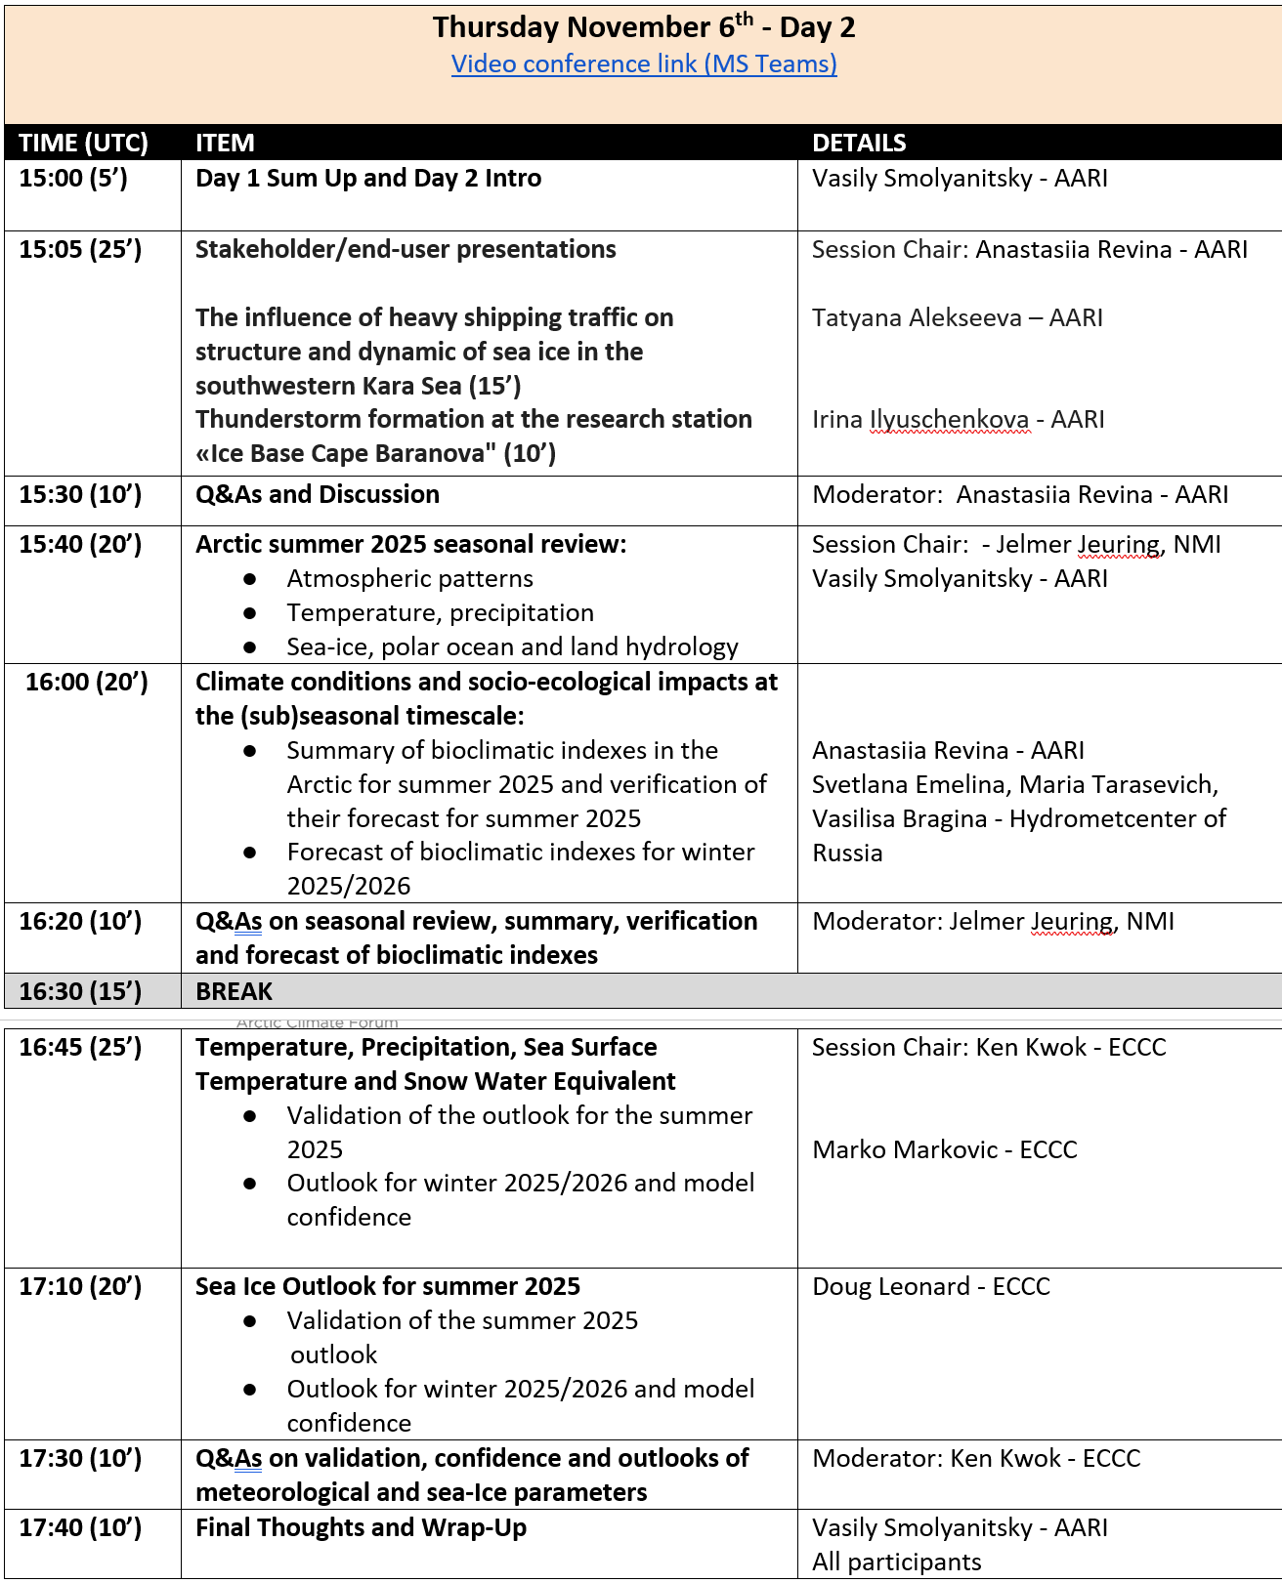
Meeting Logistics
Please register with name, surname and affiliation
Please keep your mic and camera muted
Use the “raise hand” feature to ask questions
Chat be used for relevant questions or comments
This forum will be recorded
All slides are operated centrally

Slide 3
Stakeholder presentations
Influence of heavy shipping traffic on structure and dynamic of sea ice in the southwestern Kara Sea (15’) – Tatyana Alekseeva, AARI (15’)
Thunderstorm formation at the research station “Ice Base Cape Baranova”, Severnaya Zemlya Archipelago (10’) – Irina Ilyuschenkova, AARI (10’)
Chair: Anastasiia Revina

Slide 4


Formation of thunderstorms at the Ice Base Cape Baranova research station
Leonid Startsev¹, Irina Ilyushchenkova¹, Marina Yezhikova²
1- Arctic and Antarctic Research Institute (AARI)
2 - Russian State Hydrometeorological University, St. Petersburg
16th Arctic Climate Forum, 5 – 6th November 2025

Slide 5
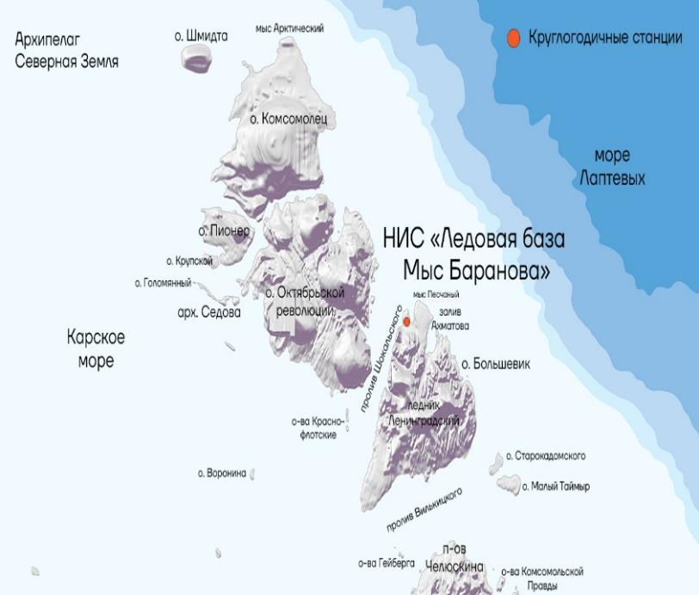
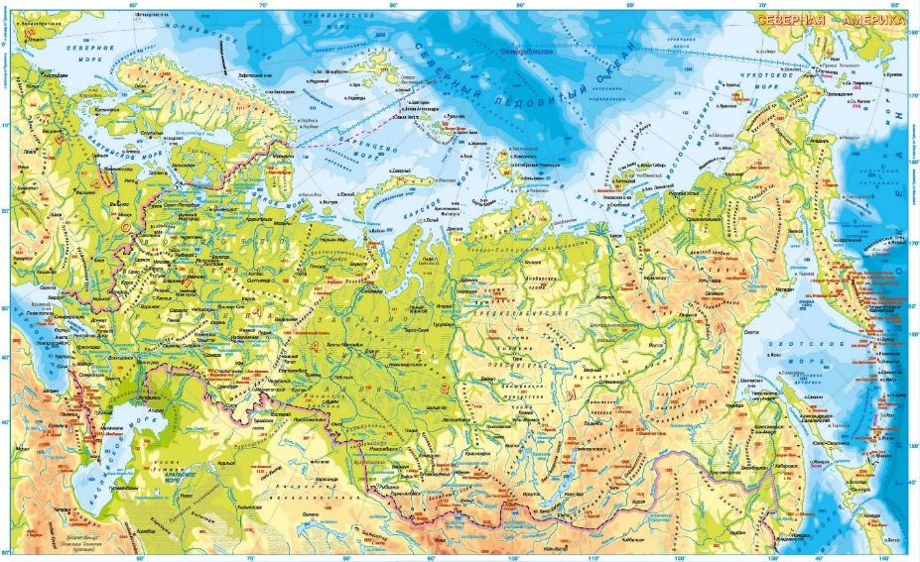

Ice Base Cape Baranova, 79°16´ N, 101°45 ´ E
June 20, 2019 scientists from the Arctic and Antarctic Research Institute recorded the first thunderstorm at the Ice Base Cape Baranova research station.
July 27, 2022 scientists from the Arctic and Antarctic Research Institute recorded the longest thunderstorm ever observed in the high-latitude Arctic. The natural phenomenon lasted for 55 minutes.
Scan for quick access:

Slide 6
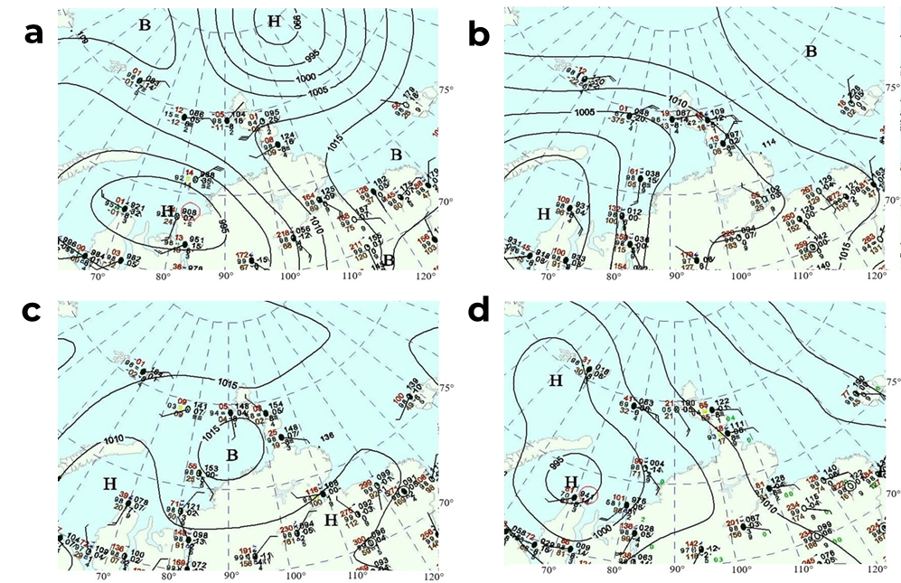
Surface weather map, sea level pressure
а – June 20, 2019, 00 UTC
b – June 24, 2020, 00 UTC
c – June 30, 2020, 00 UTC
d – July 27, 2022, 00 UTC

Slide 7
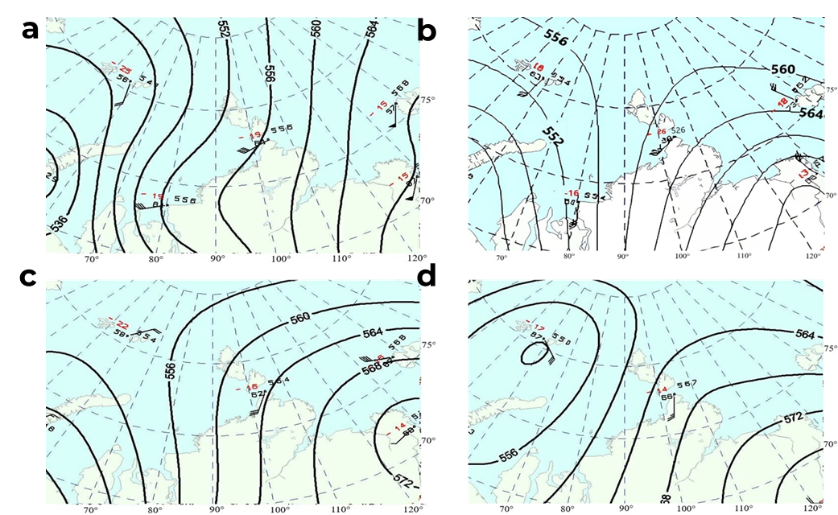
Geopotential surface height map 500 hPa, gpdam
а – June 20, 2019, 00 UTC
b – June 24, 2020, 00 UTC
c – June 30, 2020, 00 UTC
d – July 27, 2022, 00 UTC

Slide 8
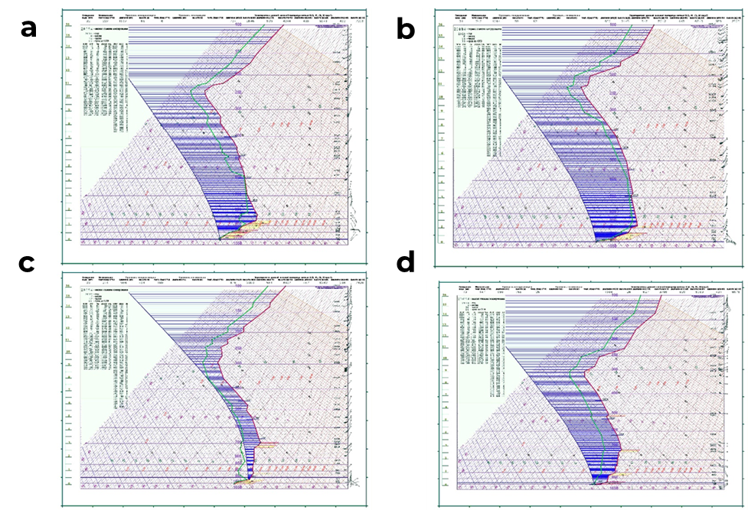
Aerological diagrams, based on morning radiosonde data at 00:00 UTC
а – June 20, 2019, 00 UTC
b – June 24, 2020, 00 UTC
c – June 30, 2020, 00 UTC
d – July 27, 2022, 00 UTC

Slide 9
Meteorological conditions
Surface temperatures,
maximum temperature of the inversion layer,
thickness of the inversion layer
Date | Surface temperature, °C | Maximum temperature of the inversion layer, °C | Thickness of the inversion layer, m
20.06.2019 | 0,1 | 3,9 | 240
24.06.2020 | 1,1 | 9,0 | 1305
30.06.2020 | 1,5 | 12,6 | 1116
27.07.2022 | 6,5 | 11,0 | 342

Slide 10
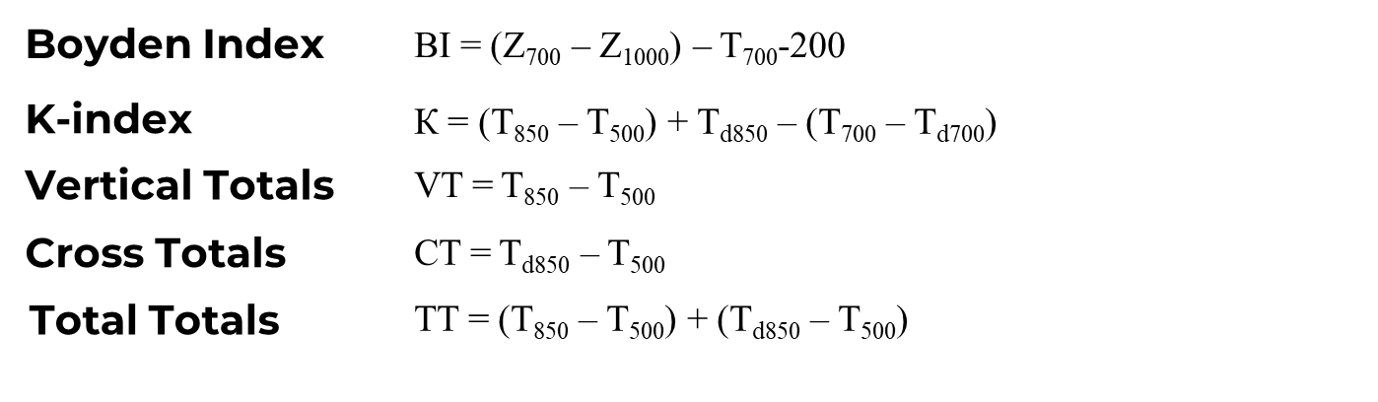
Instability indices
Date | BI>94 | K>20 | VT>28 | CT>18 | TT>44
20.06.2019 | 90,7 | –3,1 | 23,2 | 12,2 | 35,4
24.06.2020 | 92,3 | 14,2 | 27,5 | 14,2 | 33,9
30.06.2020 | 93,6 | 32,5 | 24,5 | 22,8 | 47,3
27.07.2022 | 90,6 | –1,3 | 22,8 | 18,4 | 41,2

Slide 11
Results and proposals
Thunderstorms can develop even in the presence of a strong inversion
The classic instability indices require significant adjustment for a specific geographical region
The orographic factor plays an important role in the development of convection
There is a mechanism of interaction between warm continental air masses and cold Arctic air.

Slide 12
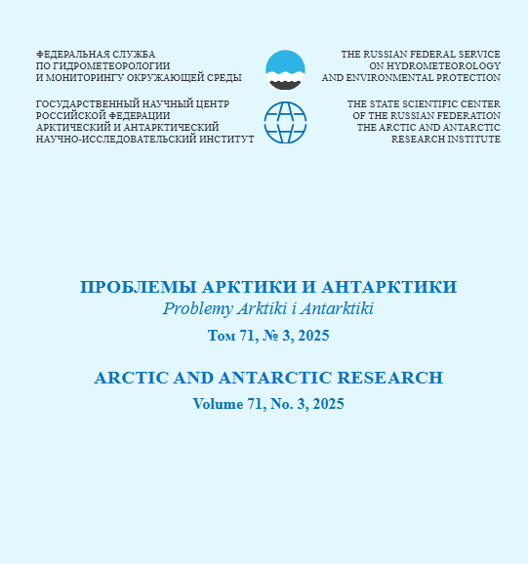

More information
Startsev L.A., Ilyushchenkova I.A., Yezhikova M.A. Study of thunderstorm formation conditions at the research station “Ice Base Cape Baranova”. Arctic and Antarctic Research. 2025;71(3):277-290. (In Russ.) https://doi.org/10.30758/0555-2648-2025-71-3-277-290
Scan for quick access:

Slide 13
Questions for the presenters?
Moderator: Anastasiia Revina

Slide 14
May - September 2025 Arctic Seasonal Review
Vasily Smolyanitsky - AARI
Bioclimatic indexes in the Arctic:
summary for May – September 2025
and weather Comfort Outlook for winter 2025/2026
Anastasiia Revina - AARI
Svetlana Emelina, Maria Tarasevich, Vasilisa Bragina - Hydrometcenter of Russia
Chair: Jelmer Jeuring

Slide 15


May – September 2025
Arctic Seasonal Review
Vasily Smolyanitsky (analysis, sea-ice)
vms@aari.aq/vsmolyanitsky@gmail.com
Anastasia Revina (surface reanalysis)
Anna Danshina (marine reanalysis)
Arctic and Antarctic Research Institute (AARI)

Slide 16
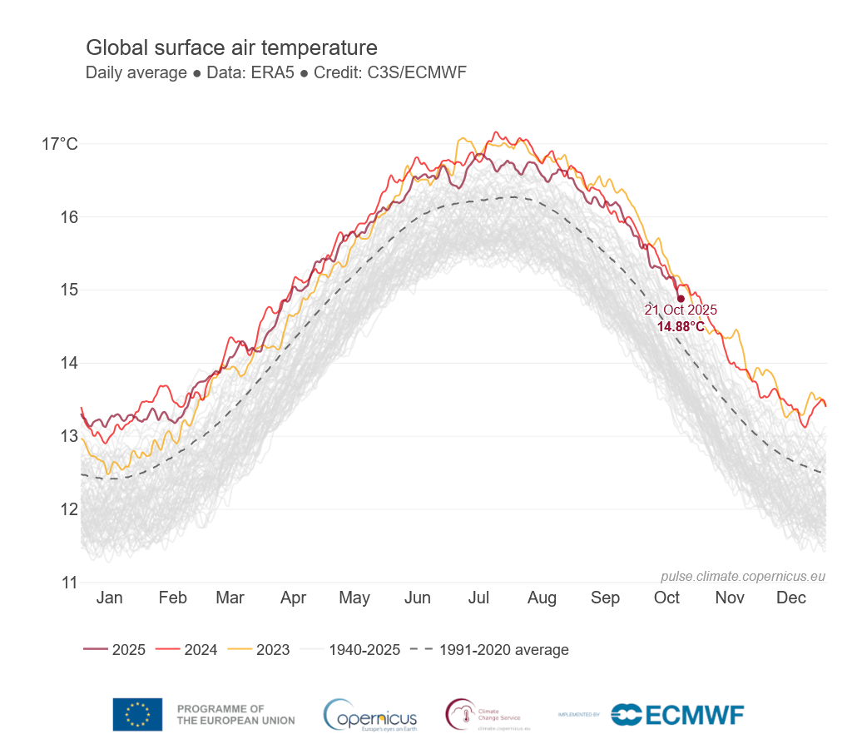
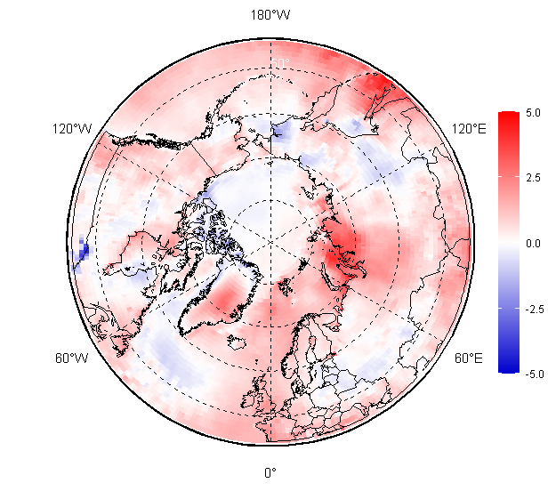
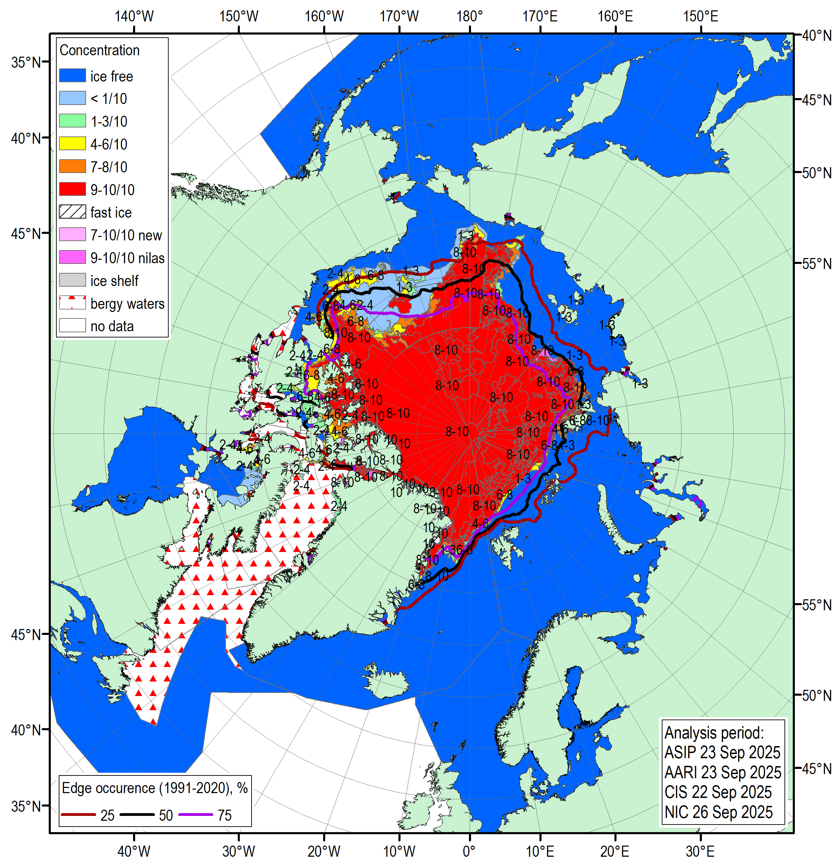
Content of seasonal review for May – September (MJJAS) 2025
Atmosphere
  Atmospheric circulation
  Surface air temperature
  Precipitation
Sea ice
  Precursors in atmosphere and polar ocean
  Sea Ice extent, conditions, including Sep 2025 minimum
  Sea ice thickness, volume
Polar Ocean
  Heat content
  Waves and swell height (storminess)
  pH (acidification/alkalization estimates)
Land hydrology
  river discharge
  snow extent
Majority of the described parameters are the WMO Essential Climate Variables (ECV). Information is based on reanalysis, sea ice analysis and surface observations and is provided:
  for anomalies – relative to the latest 3rd WMO period 1991-2020, for ranks – to period of observation/reanalysis 1950-2025 or 1979…2025

Slide 17
Atmosphere
Atmospheric circulation
Surface air temperature
Precipitation

Slide 18
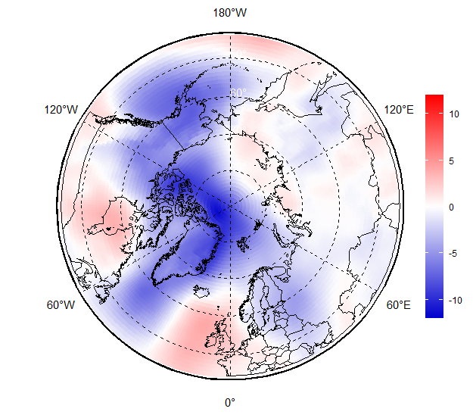

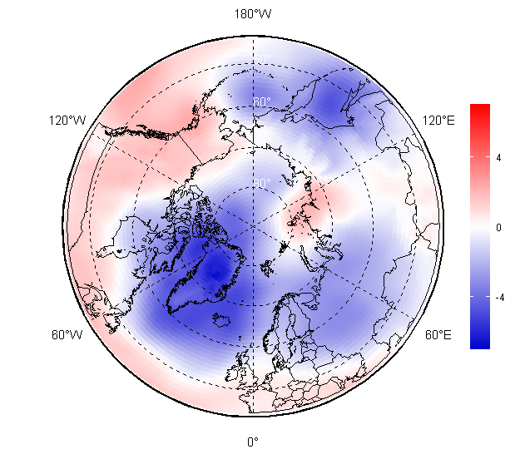
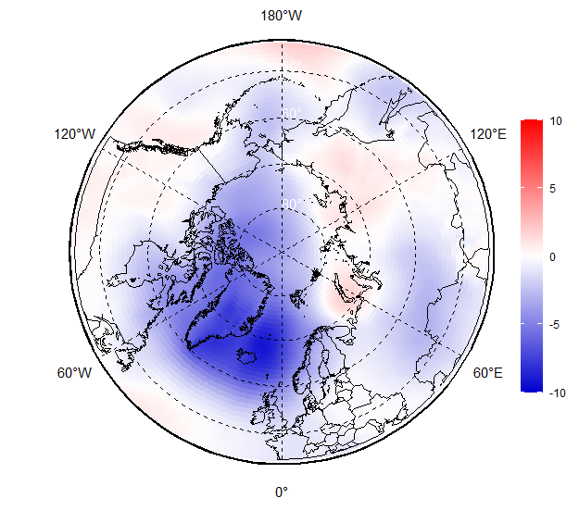
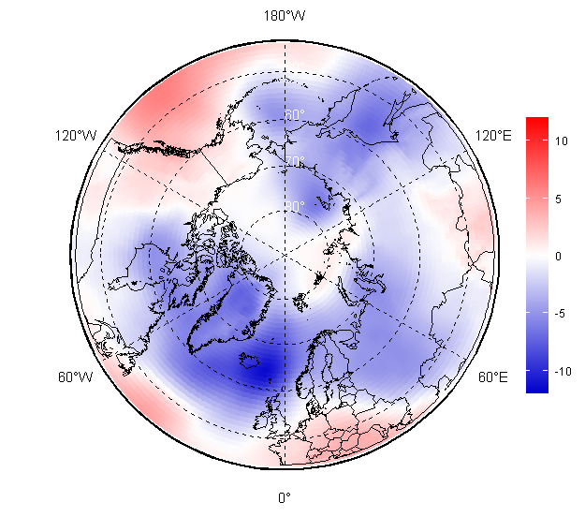
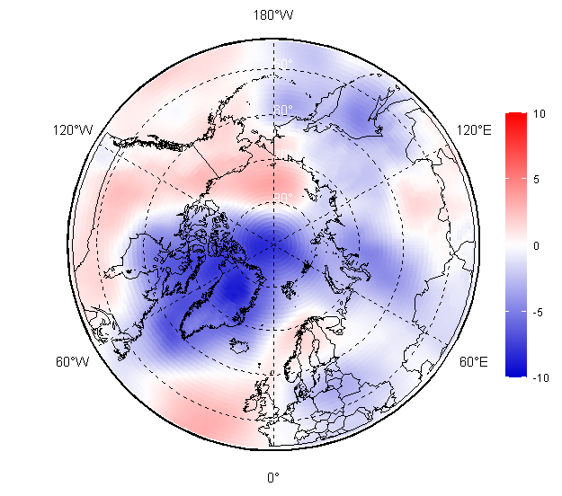
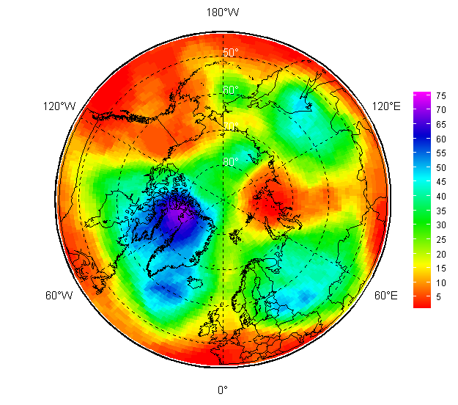
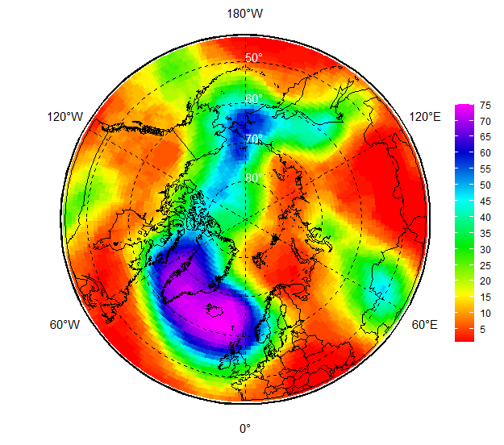
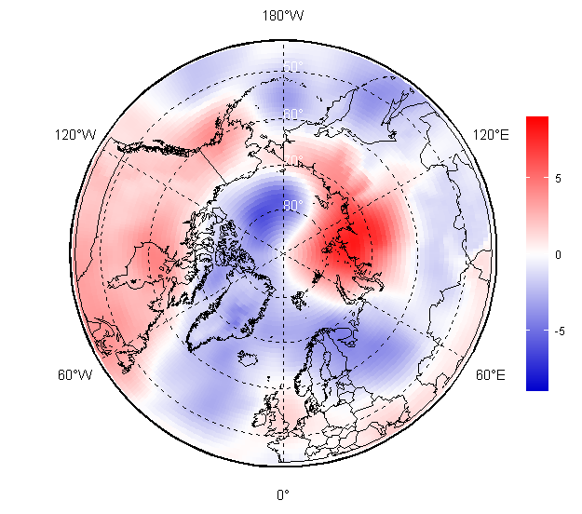
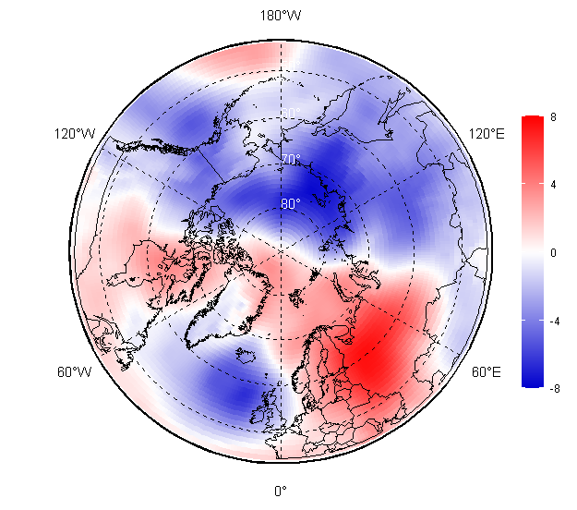
Atmospheric circulation: May – September 2025
May
During summer 2025 (JJA) an intense single-center polar vortex (dark violet, 500hPa geopotential height patterns) was observed over the Baffin Sea which is somewhat different to summer 2024 with a bi-polar vortex located over Greenland Sea and Bering Sea.
Consequently, predominance of negative mean sea level atmospheric pressure (MSLP) anomalies (lower pressure, marked in blue) and cyclonic activity was observed over the Nordic (May, Jun, Aug), Siberia (May, Jun), Canadian and Alaska (May, Sep) regions.
Predominance of positive MSLP anomalies (higher pressure, marked in red) and anticyclonic activity was observed over the Nordic (Sep), Siberia (Aug), Canadian and Alaska (Jul, Aug) regions.
In the polar region in May - Jul trajectories of the North Atlantic cyclones were shifted northward with opposite situation in September.
Jun
JJA 2024
Jul
JJA 2025 MSLP anomaly (1991-2020)
Aug
JJA 2024
Sep
MJJAS 2025 MSLP anomaly (1991-2020)
[AARI / ERA5 analysis and reanalysis]
JJA 2025 H500 rank (1950-2024)

Slide 19
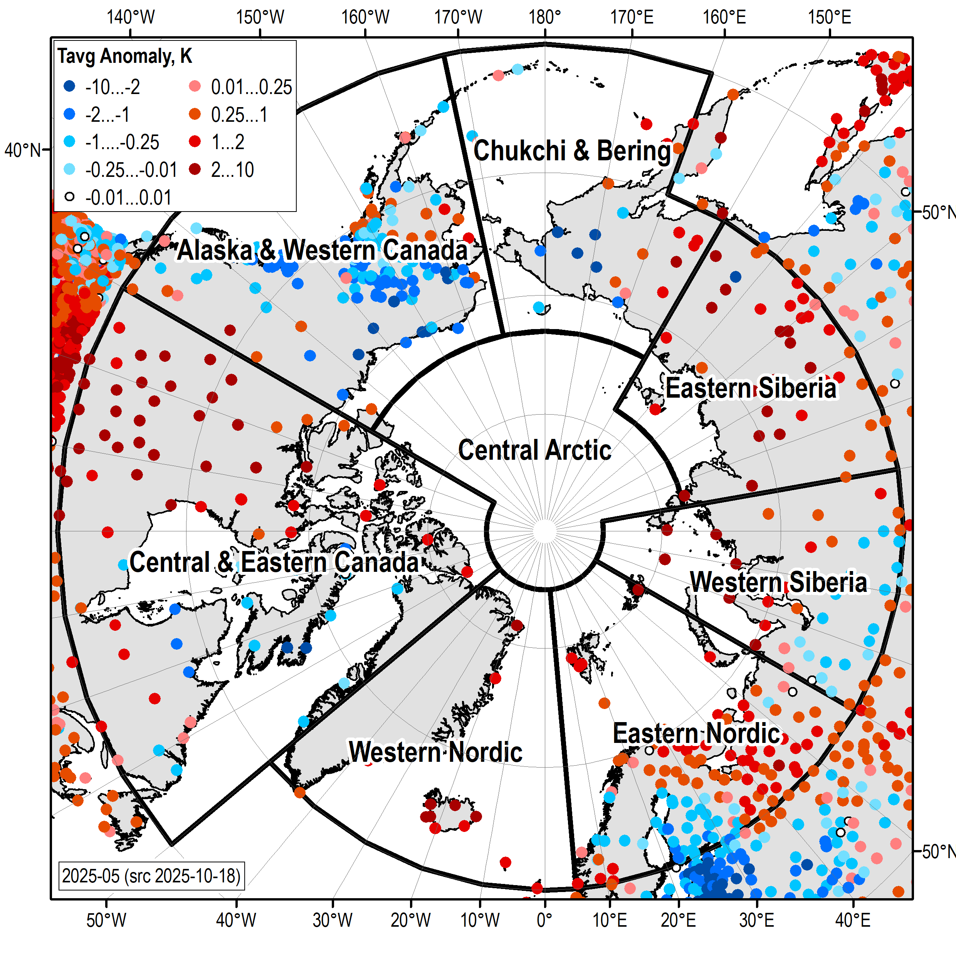
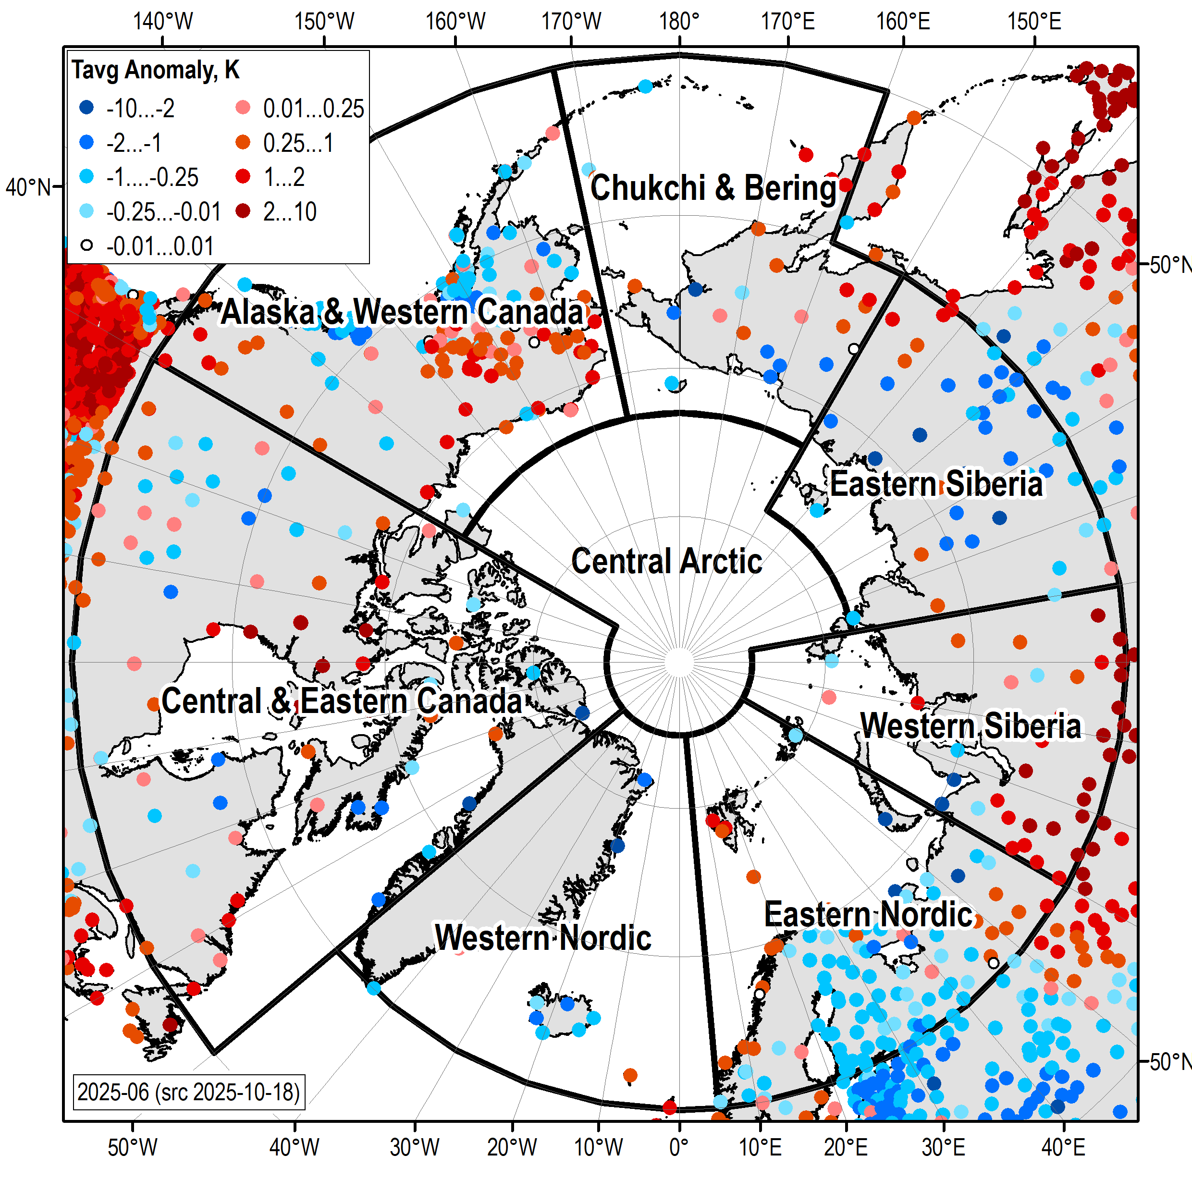
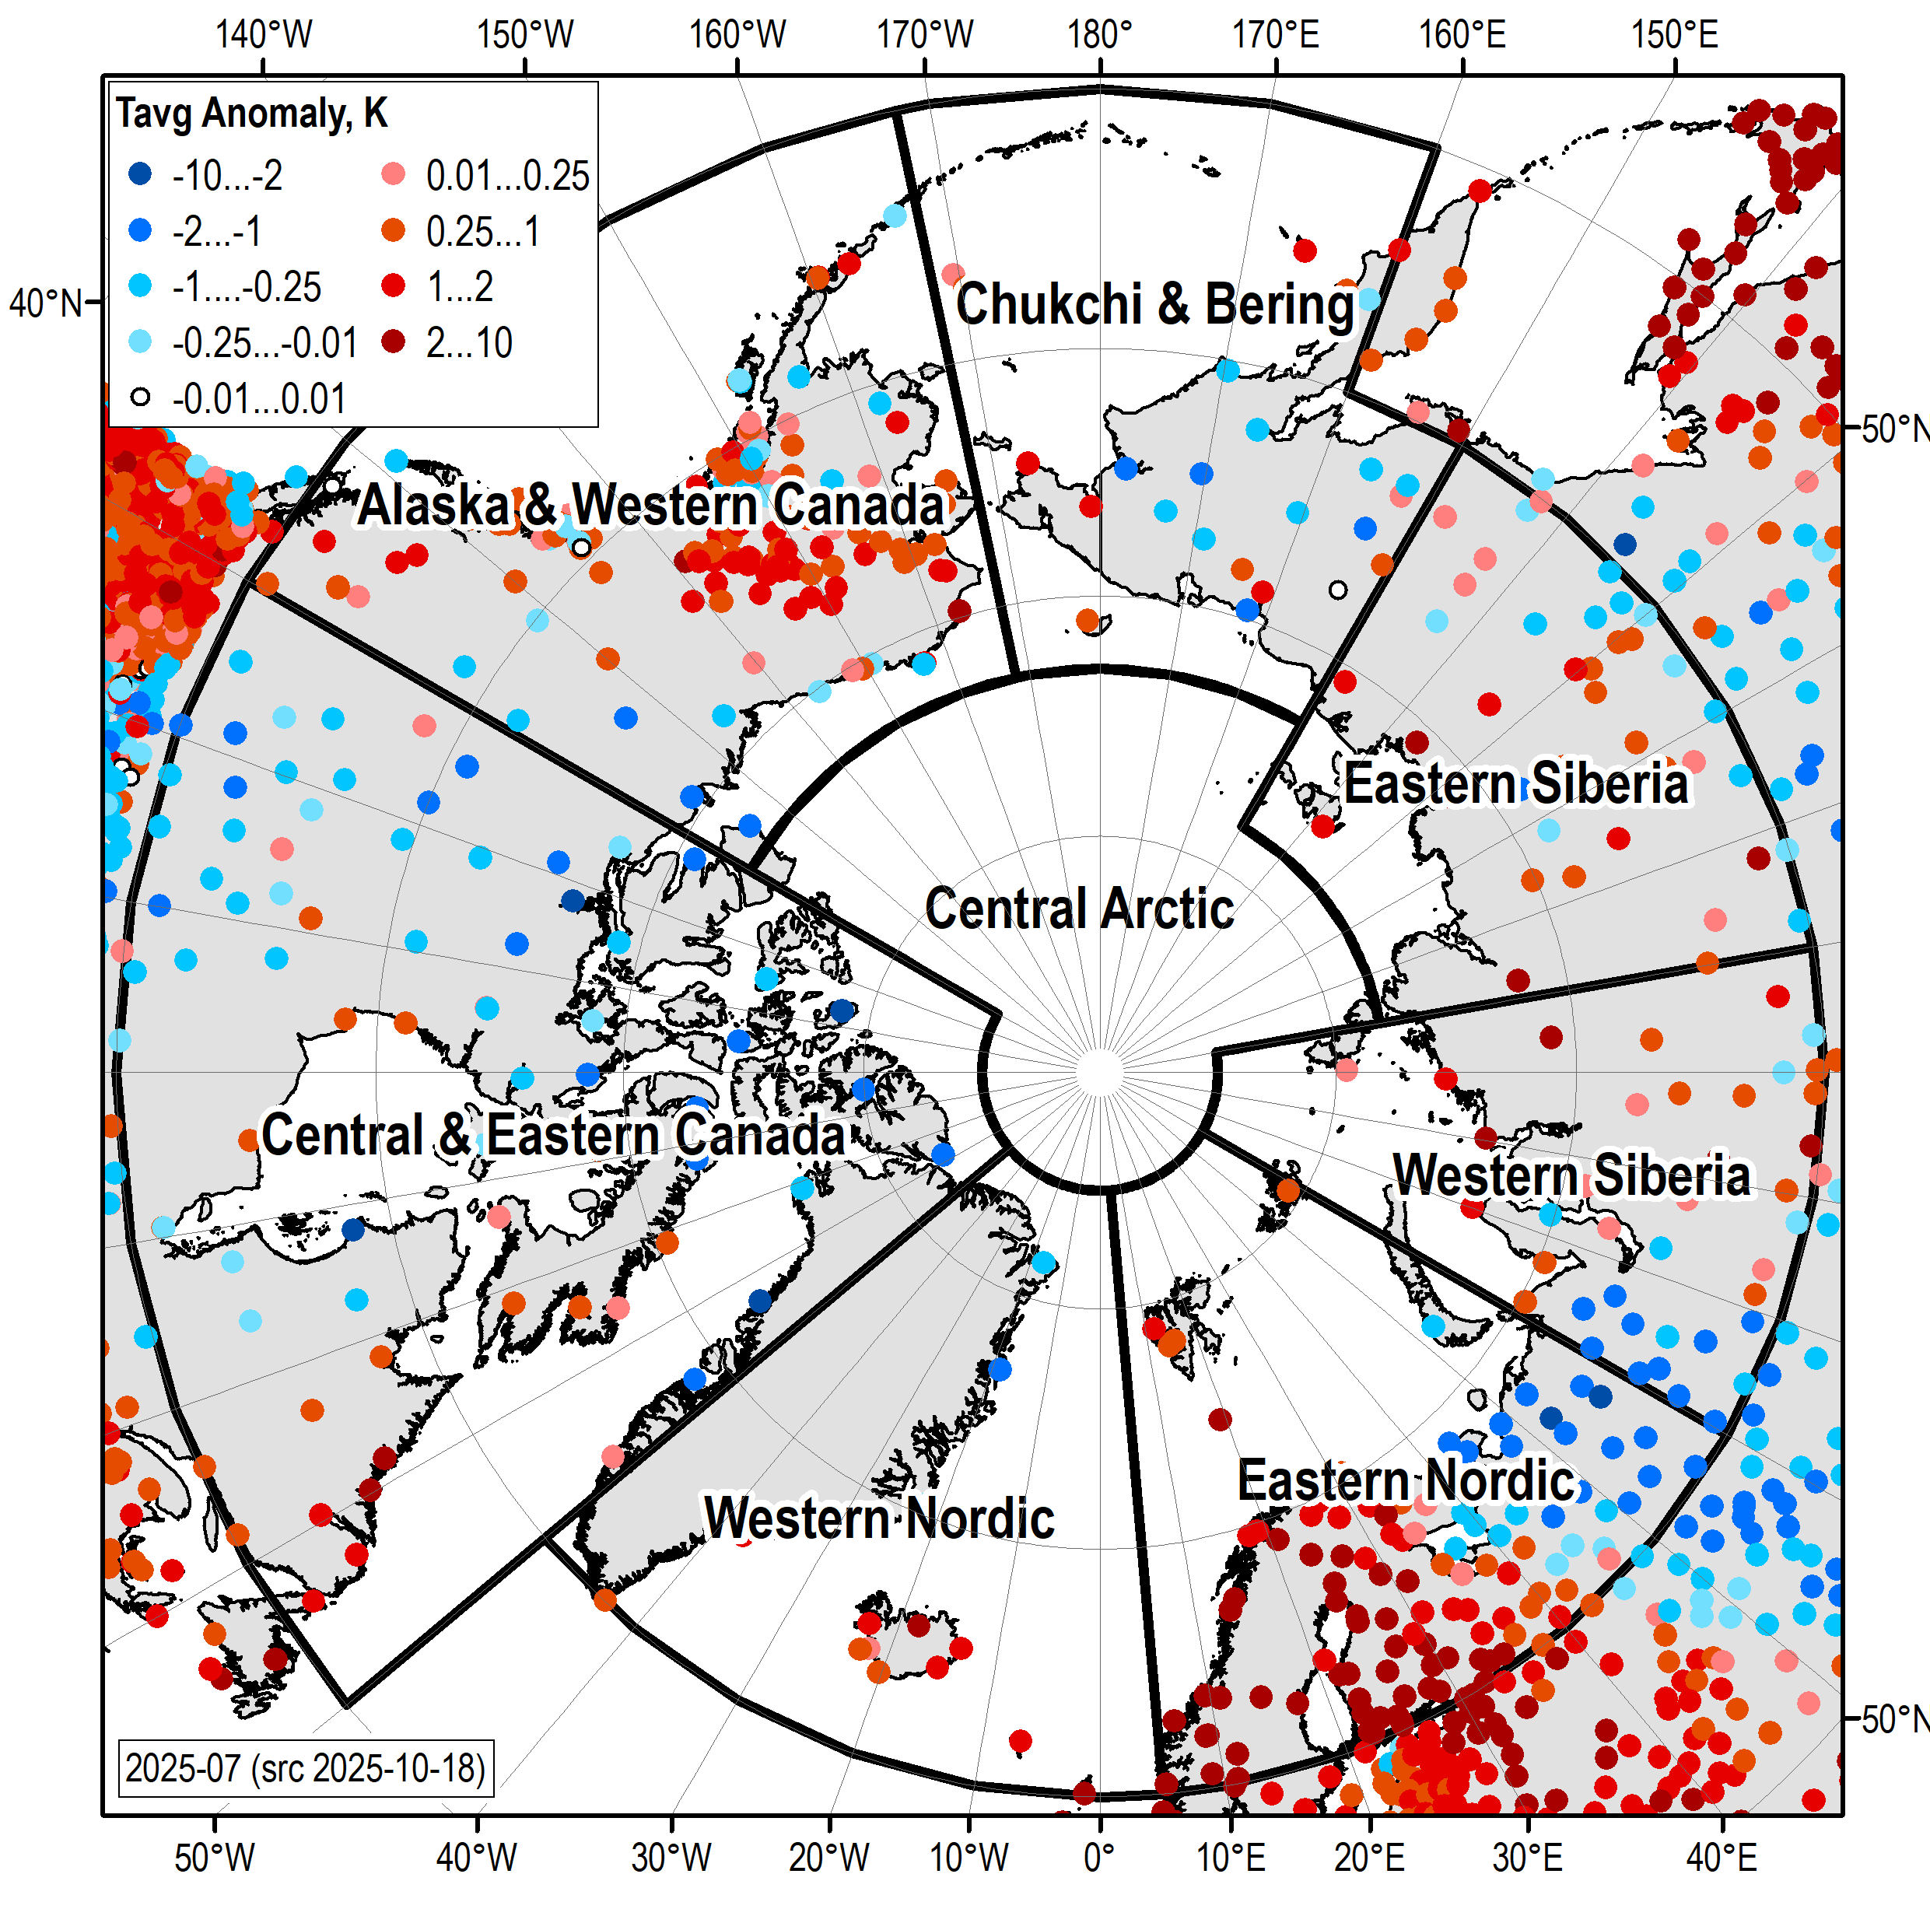
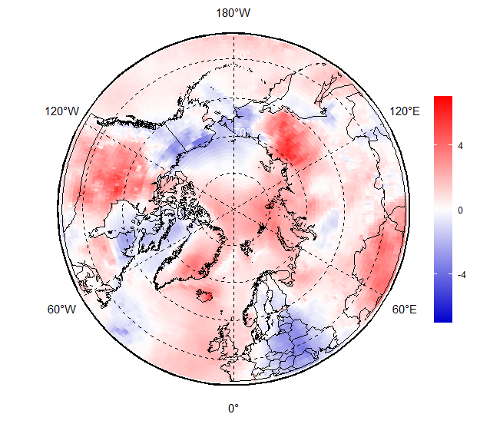
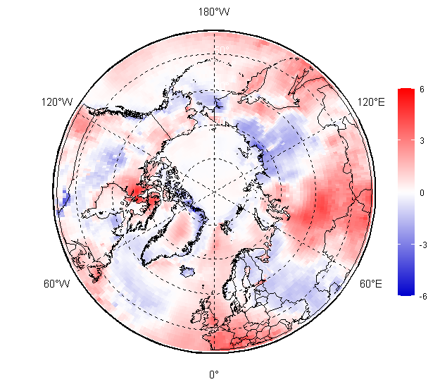
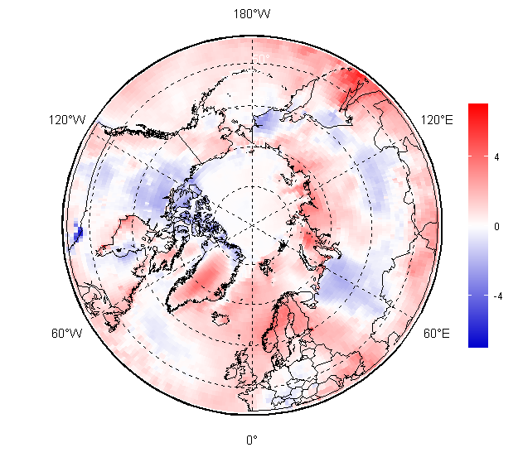
Surface air temperature: May, Jun, Jul 2025 anomalies (1991-2020)
May 2025
Jun 2025
Jul 2025
[AARI / ERA5]

Slide 20
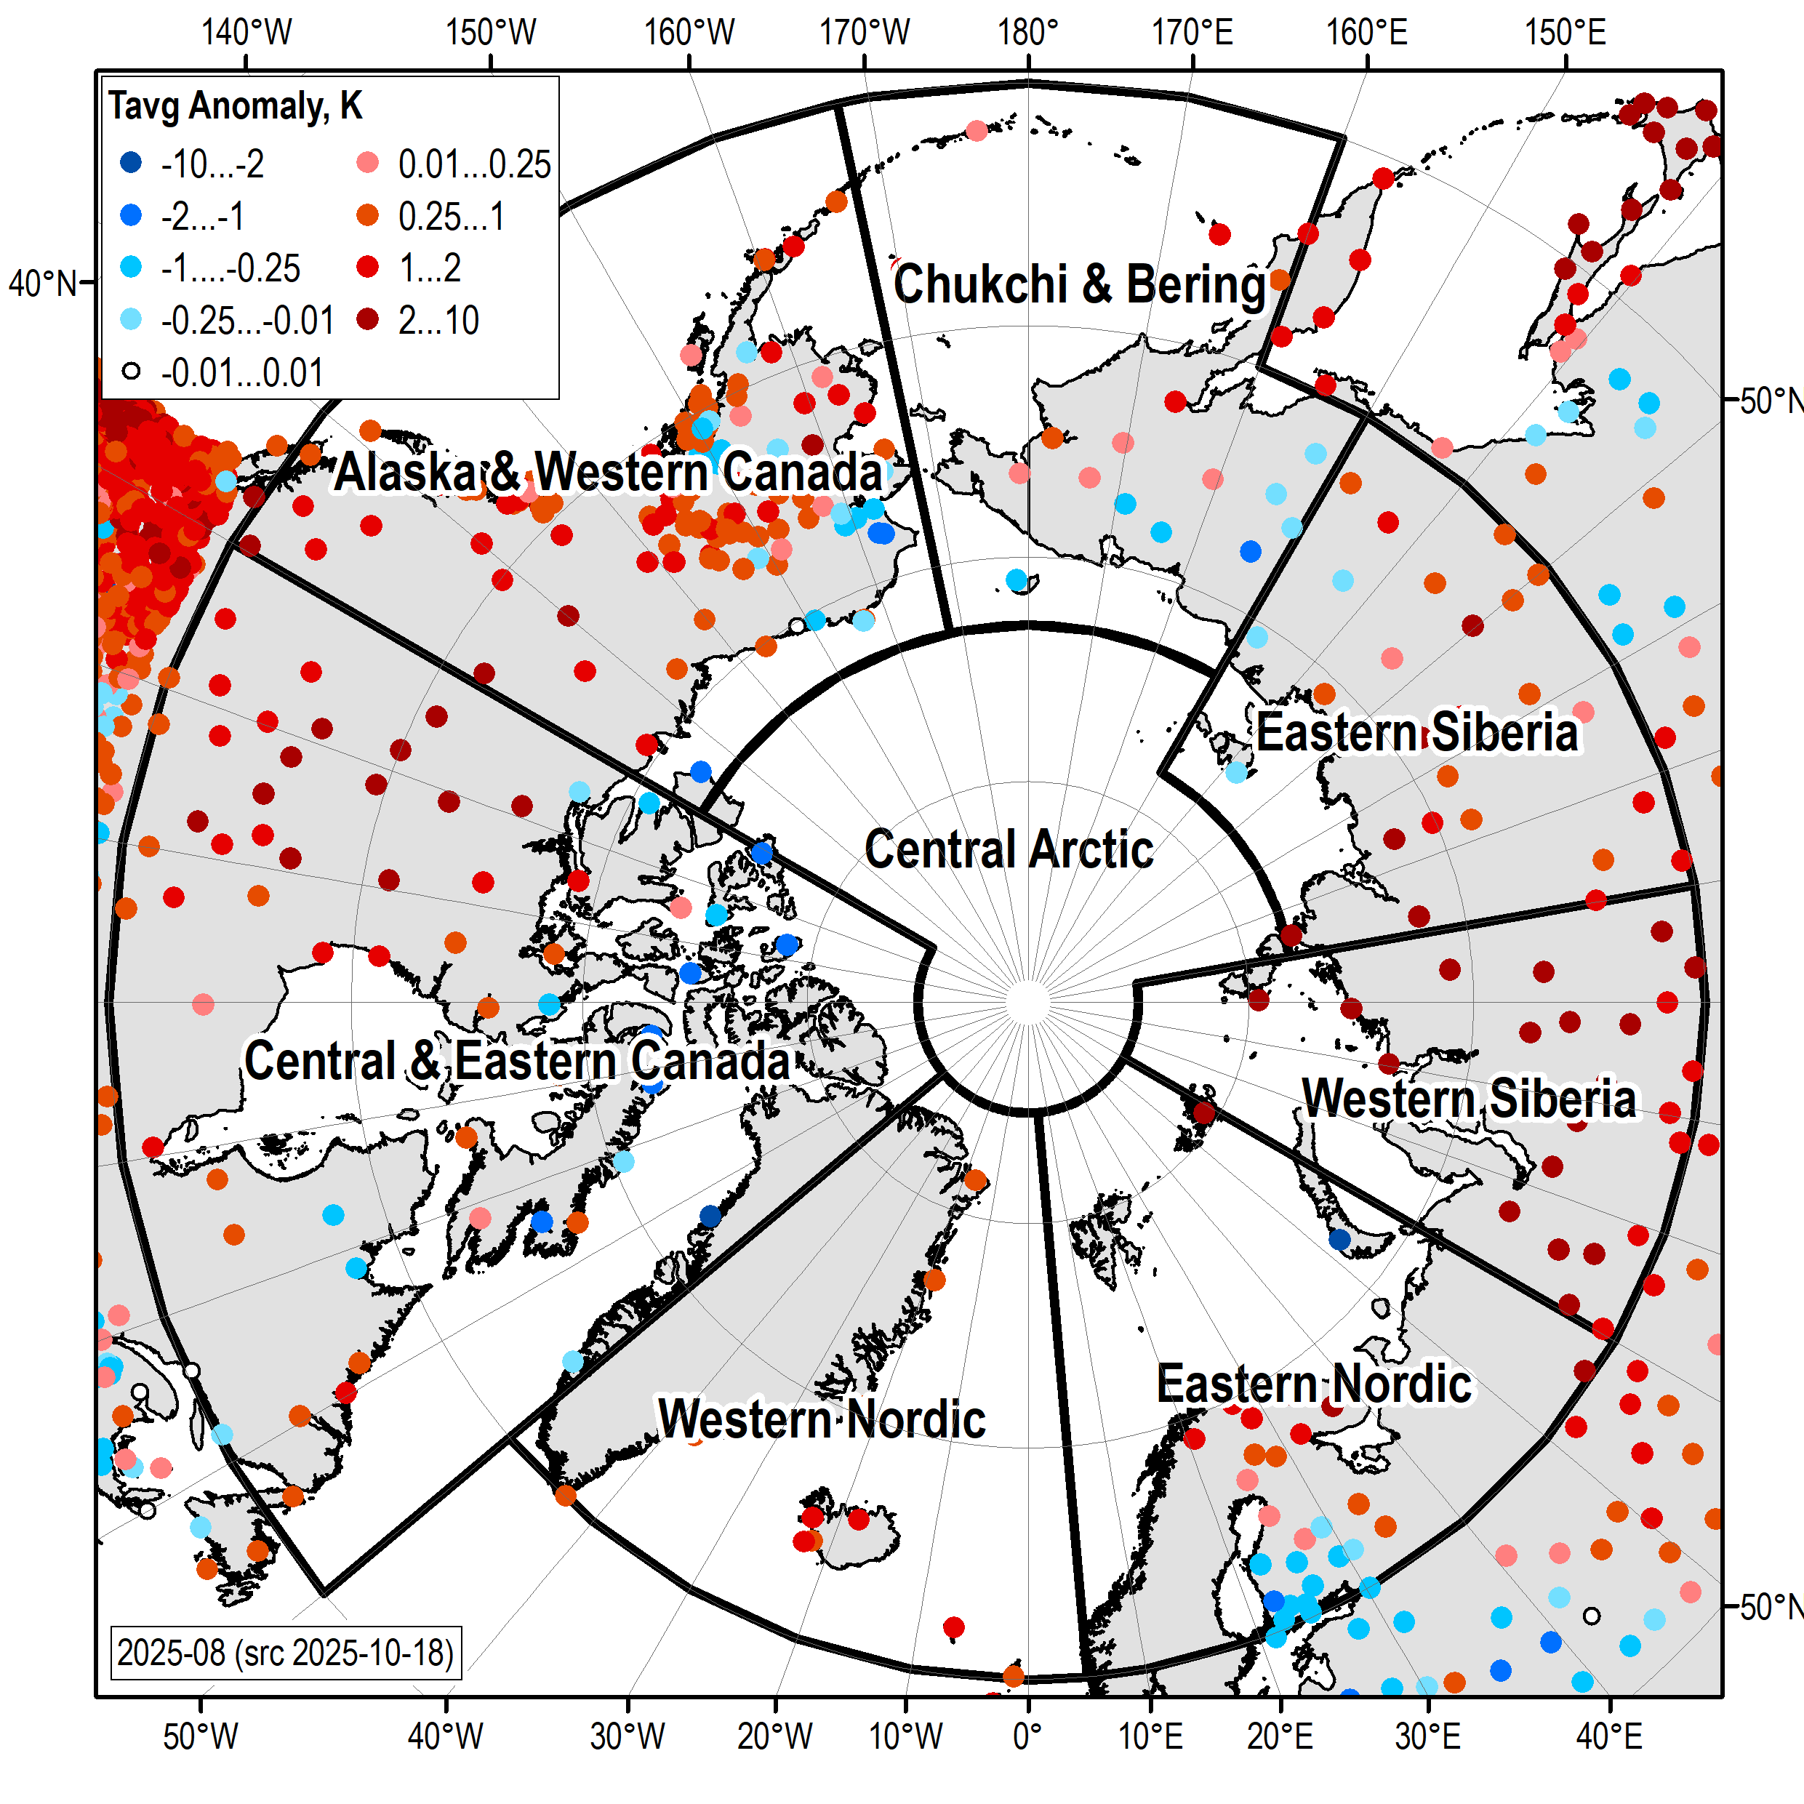
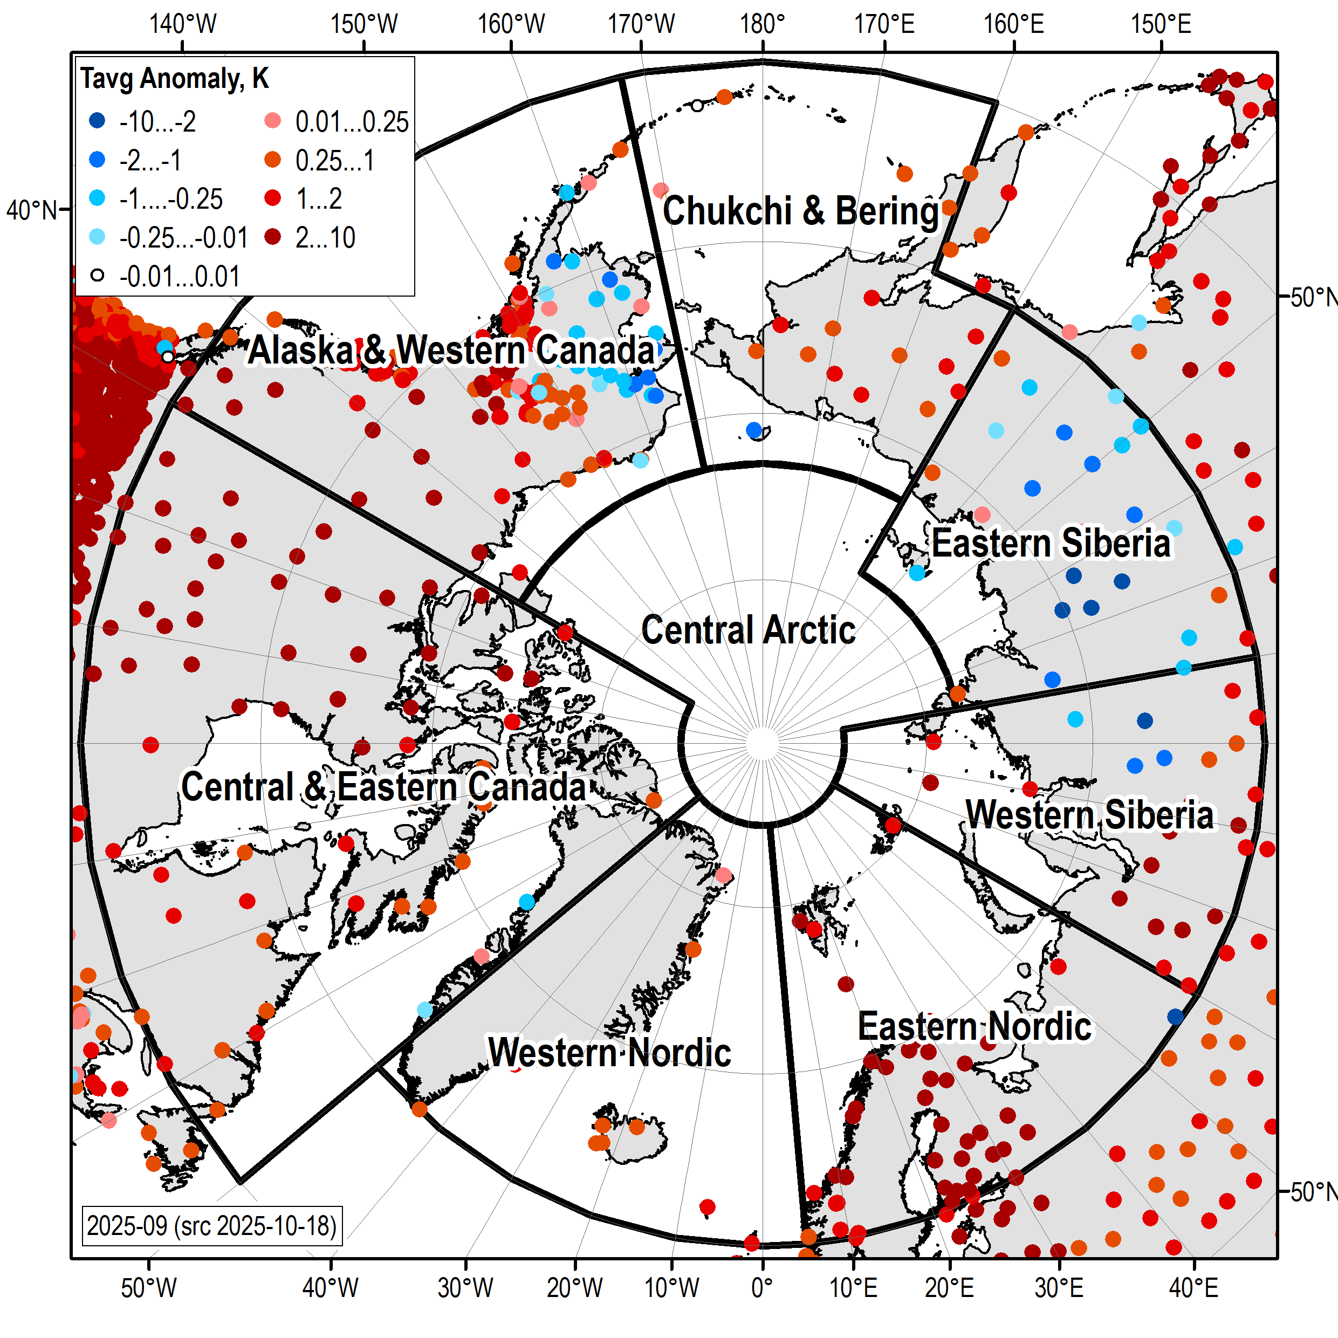
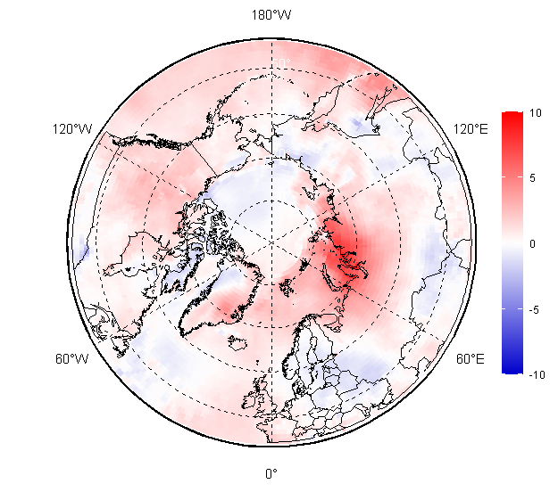
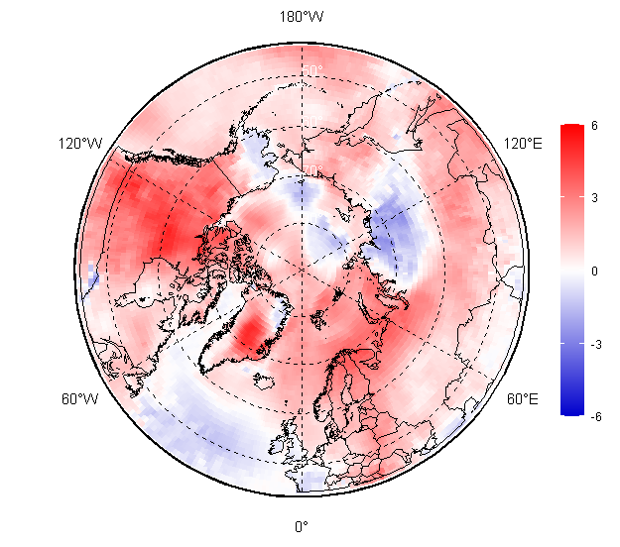
Surface air temperature: Aug, Sep and JJA 2025 anomalies (1991-2020)
Aug 2025
Sep 2025
JJA (summer) 2025
[AARI / ERA5]

Slide 21
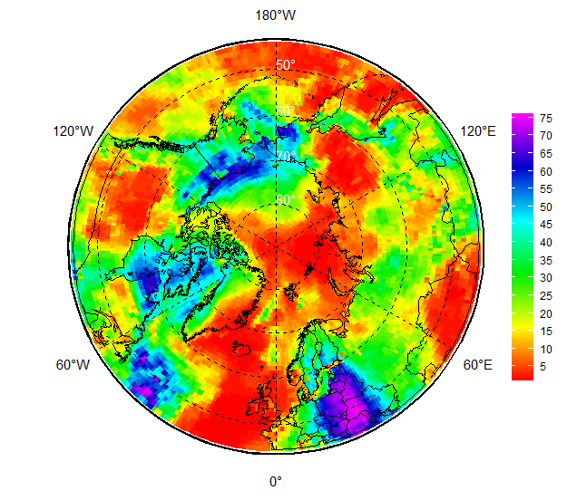
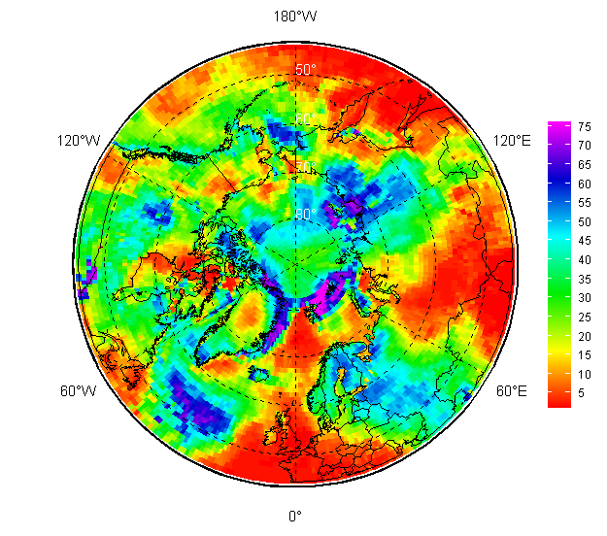
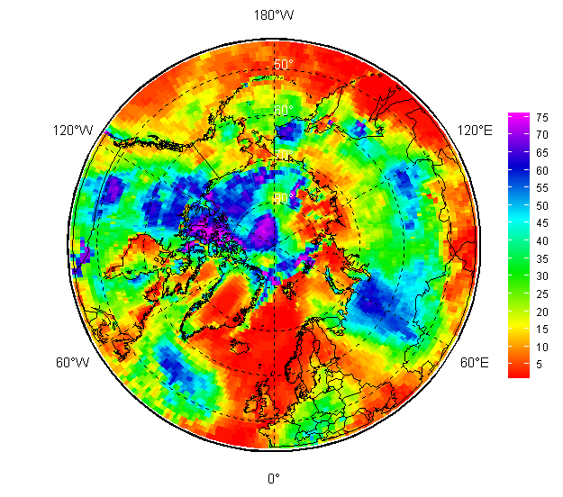
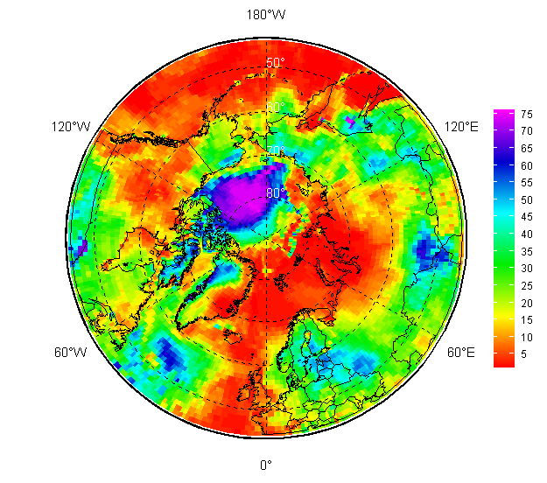
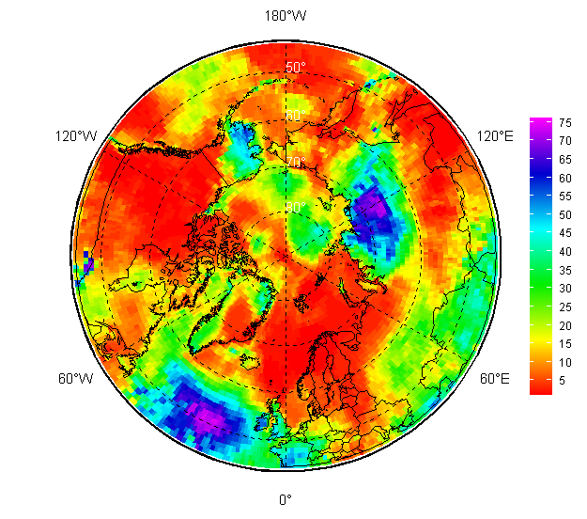
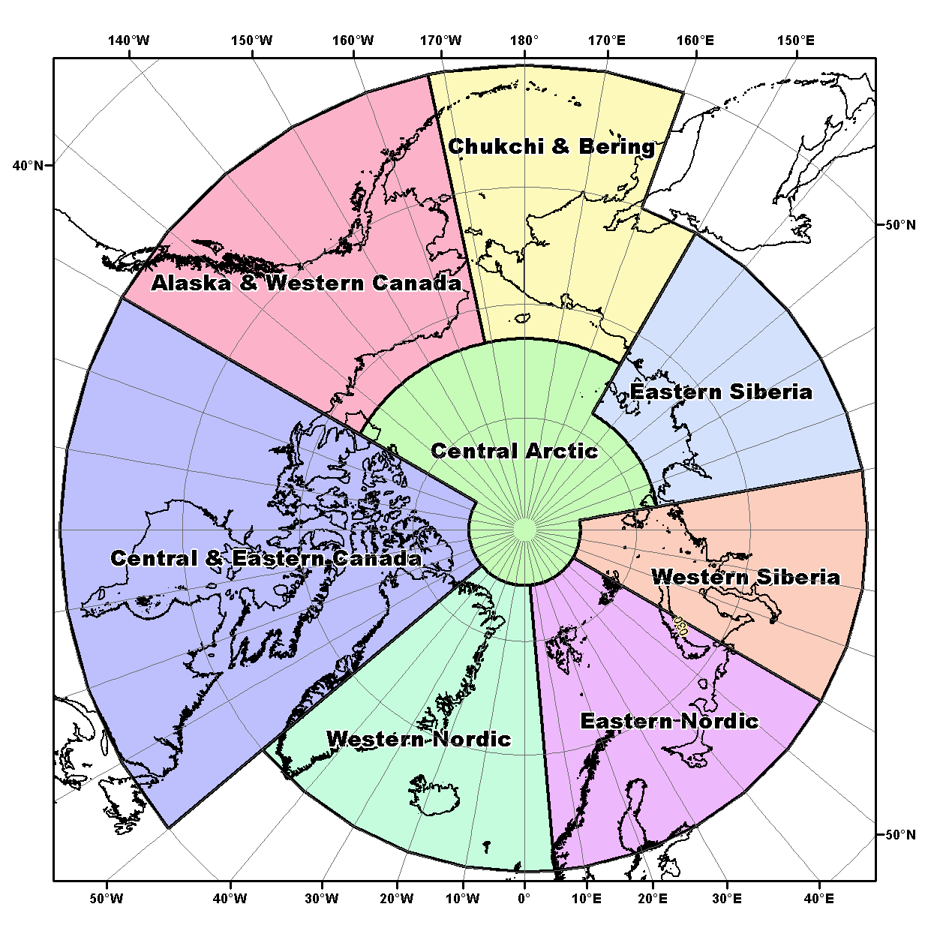
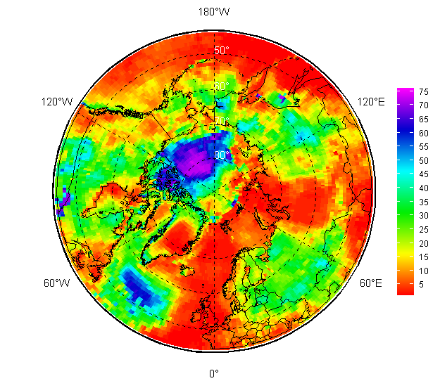
Surface air temperature: May – September 2025 (ranks)
Ranks: 1950-2025
May 2025
Jun 2025
Jul 2025
Aug 2025
Sep 2025
Ranks: 1950-2025
JJA 2025
Anomalies relative to: 1991-2020 (stations, ERA5)
Ranks: based on 1950-2025 (stations, ERA5)
Year min/max: based on 1900-2025 (stations)
Anom(Rank|Yearmin|Yearmax)
[AARI / WMO GTS]

Slide 22
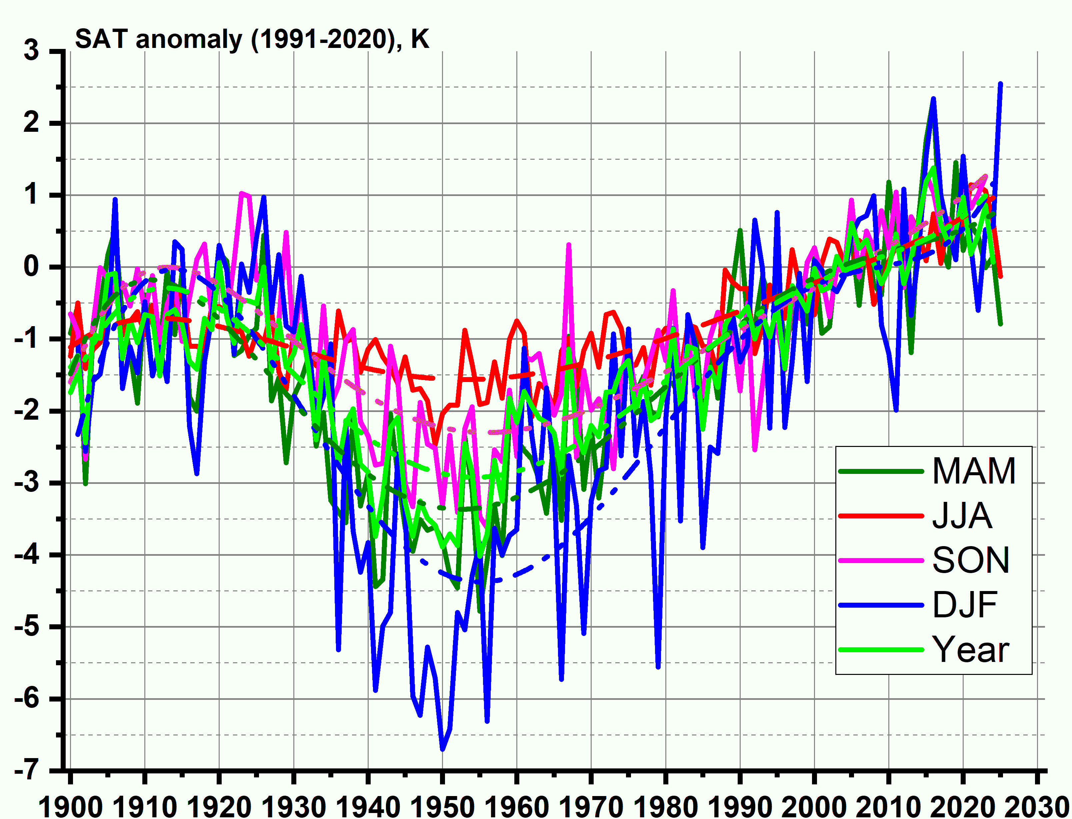
Surface air temperature (based on stations data)
During start of summer 2025 (May-Jun) extremely positive anomalies of the surface air temperature were observed for Western Nordic (2nd row in May – here and further from 1950) and Western Siberia (5th in row in Jun) with negative anomalies also in Western Nordic (46th in row in Jun), Eastern Siberia (42nd in row in Jun) and Alaska and Western Canada (41st – 23rd).
During mid-summer (Jul-Aug) similar extremely or record positive anomalies were observed over the Western Nordic (2nd in row in Jul), Western Siberia (1st in row in August) with no negative anomalies.
By the end of summer in September 2025 extremely positive anomalies were observed over Eastern Nordic (3rd in row), Chukchi and Bering (4th in row), Central and Eastern Canada (2nd in row) with negative anomalies over Eastern Siberia (59th in row).
Conclusions for the Central Arctic (due to lack of in-situ observations) are done on reanalysis, and include mostly close to normal in Jun – Aug, predominance of warmer in May 2025 and both warmer and colder areas in Sep 2025.
For the whole land Arctic during May - Jun negative or slightly negative anomalies were observed with ranks varying from the 23rd in row (May) to 26th (Jun) with positive anomalies in Jul – Sep with ranks varying 14th – 20th in row. Preliminary resulting rank for JJA 2025 for the land Arctic is the 20th in row (from 1950), though large regional and inner season variations and changes in anomaly sign continue to occur. In general, much lesser positive anomalies are normally observed for the Artic regions with a greater share of the sea area – the Western Nordic and Chukchi-Bering, though that was not the case in 2025 for the Western Nordic with observed positive extremes.
Anom | Rank|Yearmin|Yearmax

Slide 23
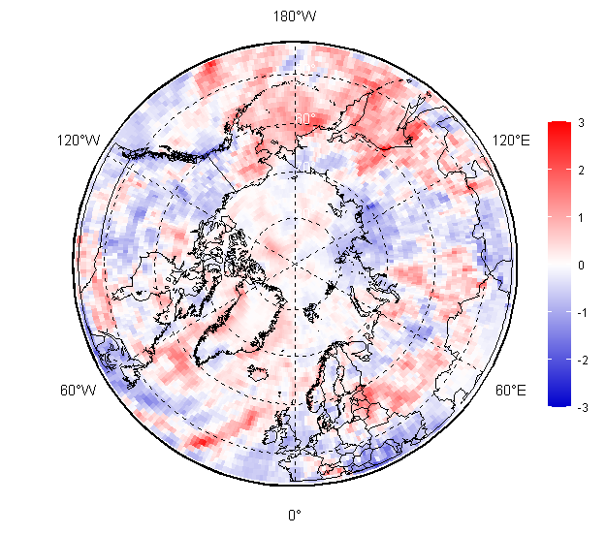
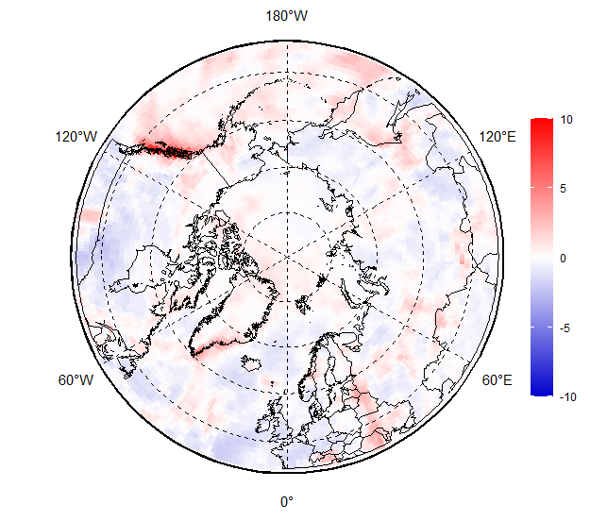
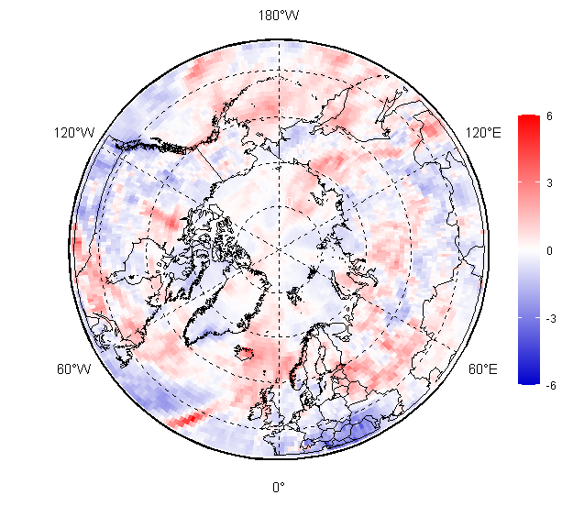
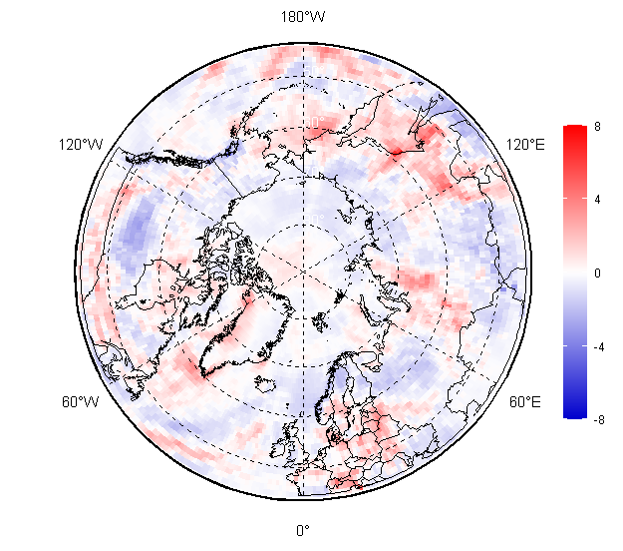
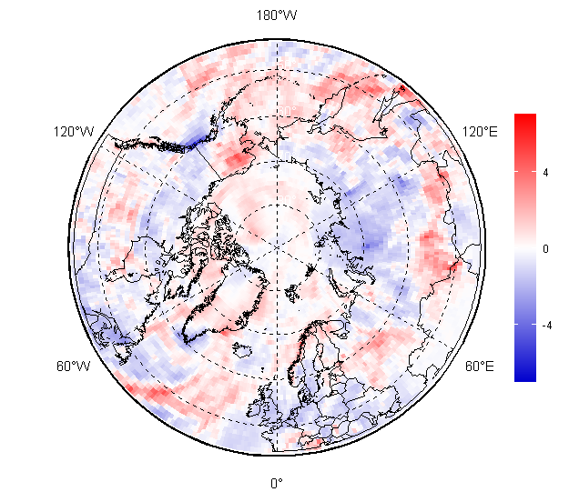
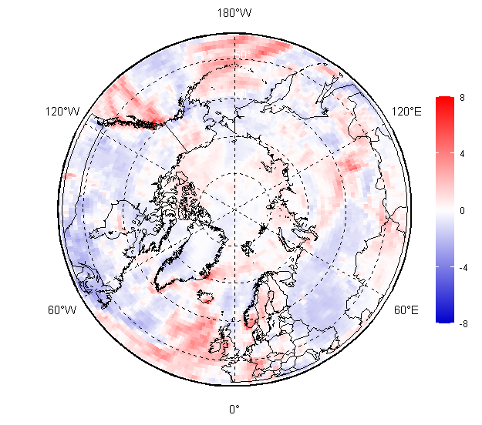
Surface precipitation:
JJA 2025 anomalies (1991-2020)
[AARI / CCCS ERA5]
In general, during the summer season drier conditions dominated over Siberia, and Canada regions
Wetter conditions dominated over Western Nordic, Bering and Chukchi, Okhotsk Sea and Alaska regions
JJA 2025
May 2025
Jun 2025
Jul 2025
Aug 2025
Sep 2025

Slide 24
Surface precipitation: seasonal MJJAS 2025 anomalies (reanalysis)
Region | JJA 2025
Western Nordic | wetter
Eastern Nordic | wetter in west, drier in east
Western Siberia | drier
Eastern Siberia | drier
Bering & Chukchi | mostly wetter, normal to drier in west
W Canada & Alaska | mostly wetter in west, drier in east
Central & E Canada | Intermittent pattern including wetter, normal and drier
Central Arctic | slightly wetter
Reference period: 1991-2020
Lesser precipitation occurred in parts Eastern Nordic, most of Western and Eastern Siberia, Western Canada regions
Greater precipitation was observed in the Western Nordic and Chukchi & Bering regions.
Somewhat wetter to normal conditions are estimated for the Central Arctic
[AARI / CCCS ERA5]

Slide 25
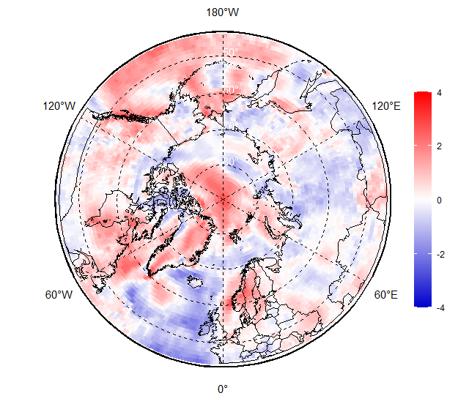
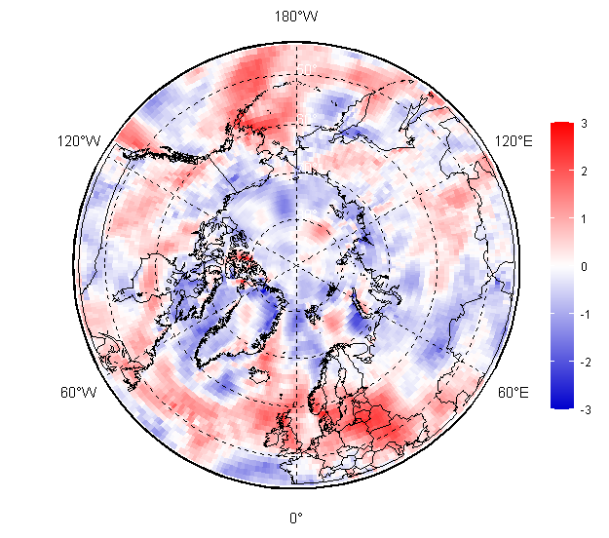
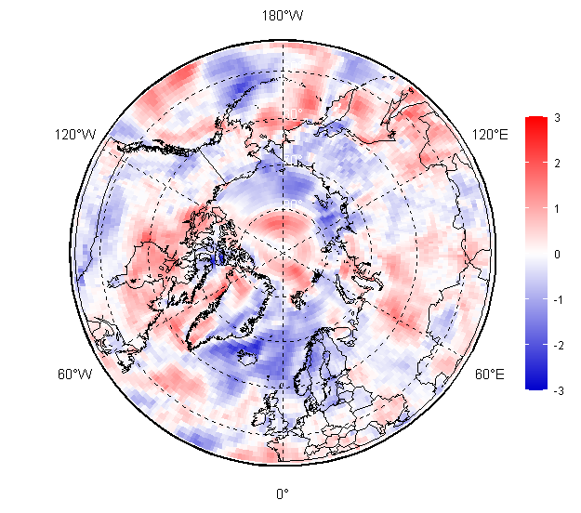
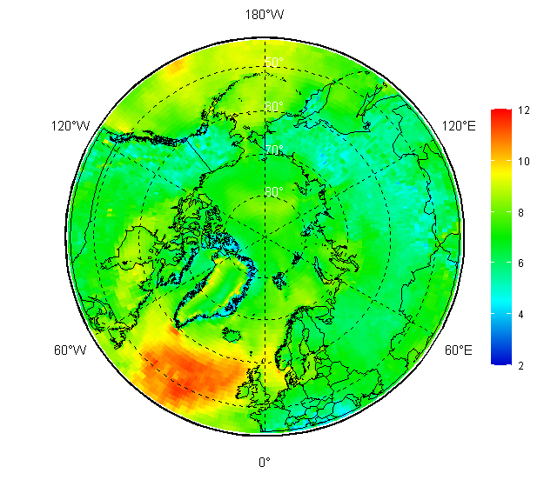
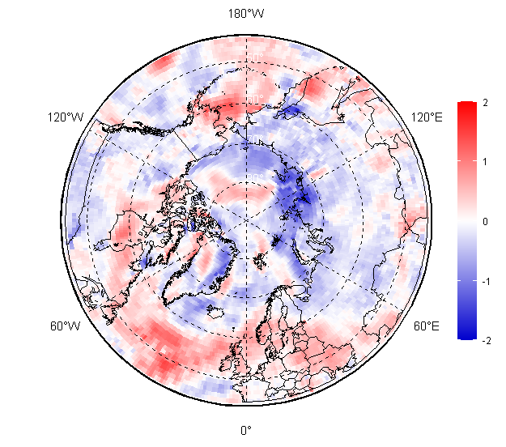
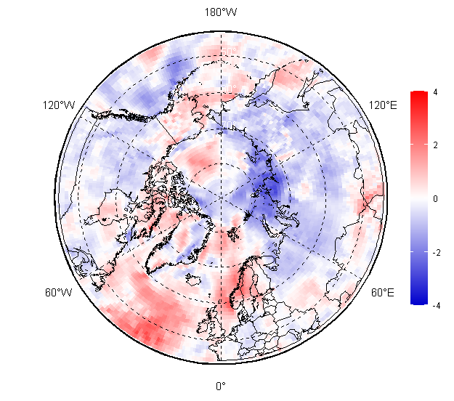


Surface wind (wind speed in gusts, 2 m) anomales
[AARI / CCCS ERA5]
JJA 2025
Reference period: 1991-2020
May
Jun
Jul
Jul
V m/s
anomaly
Aug
Sep
Trend 1m/s/10y
Calmer (less windy) conditions (relative to the WMO period 1991-2020) were observed in most of the Eurasian Arctic and parts of the Arctic Ocean.
More windy conditions were observed in the Bering Sea, eastern Canada and southern parts of Nordic regions
Wind speed along with surface temperature and humidity have direct impact on bioclimatic conditions which is described in a separate presentation

Slide 26
Sea ice
  Precursors in atmosphere and polar ocean
  Ice extent and ice conditions based on ice charting
  Sea ice thickness and volume based on reanalysis

Slide 27



Precursors in atmosphere and polar ocean for JJAS 2025 ice conditions
In addition to positive ice thickness anomaly negative and close to normal ocean heat capacity (HC) anomaly (to 1993-2020) in upper 15m during May-June 2025 for Beaufort, Chukchi, Bering Seas slowed ice melt in these regions
Further in season, dominance of positive surface air temperature anomalies over most of Eurasian Arctic, parts of Hudson Bay stimulated ice melt in these regions.
Opposite negative or zero anomalies preserved ice cover in parts of Chukchi, Eastern Siberia, Beaufort Seas slowed ice reduction in the area towards end of summer 2025.
May 2025 Heat Capacity 15m
anomaly, 1993-2020
Jun 2025 Heat Capacity 15m
anomaly, 1993-2020
Apr 2025 SIT anomaly,
2011-2025 (CryoSAT2-SMOS)
JJA 2025 SAT anomaly, 1991-2020
[AARI / CCCS MEMS & ERA5]

Slide 28







Arctic (NH) seasonal ice extent 1978…. 2025
S, 1000 km²
Note: actual values depend on algorithm, technique, period and source used
S, 1000 km²
Northern Hemisphere
S, 1000 km²
Western Arctic (WA)
Sep (Min) Feb/Mar (Max)
2012 3346 1
2020 3882 2
2016 4099 3
2019 4103 4
2007 4189 5
2011 4312 6
2015 4350 7
2023 4401 8
2024 4419 9
2018 4557 10
… … …
2022 4808 14
2025 4818 15
2021 4848 16
… …
1983 7285 46
1980 7611 47
2017 14467 1
2018 14516 2
2015 14526 3
2016 14580 4
2025 14626 5
2011 14701 6
2006 14867 7
2023 14875 8
2019 14891 9
2007 14931 10
2014 14972 11
2021 15100 12
… …
2022 15210 15
2024 15317 16
... ...
1979 16769 47
Beaufort
Jan Feb Mar Apr May Jun Jul Aug Sep Oct Nov Dec Jan
Jan Feb Mar Apr May Jun Jul Aug Sep Oct Nov Dec Jan
NSR seas
S, 1000 km²
S, 1000 km²
Eastern Arctic (EA)
Canadian Arctic (CA)
CA
EA
WA
[AARI / NSIDC]
Jan Feb Mar Apr May Jun Jul Aug Sep Oct Nov Dec Jan
Jan Feb Mar Apr May Jun Jul Aug Sep Oct Nov Dec Jan
[AARI / NSIDC]
Minimum daily 2025 ice extent, 14-16th in row or 4.81 mln km² (14th in row or 4.99 mln km² for mean monthly values) was reached during 8-9 Sep 2024, was earlier and greater by 0.4 mln km² to 2024, very close by minimum value to 2021 and 2022 and well within the scale of Arctic ice extent variability since 2007. Uncommon for last decade, prominent areas of thick FYI dominated till September in the eastern part of the Eastern Siberian Sea with summer sea ice extent in the NSR seas close to 1978-2025 median.

Slide 29
















May – Aug 2025 Arctic sea ice – concentration and stage of development
19-23 May
16-20 Jun
15-18 Jul
11-15 Aug
[sea ice analysis - AARI/CIS/ASIF/NIC; ice edge – AARI/NSIDC, nearest 5days, reference period: 1991-2020]

Slide 30



Sep 2025 Arctic sea ice – concentration and stage of development at the moment of summer minimum
16-19 Sep 2024
16-19 Sep 2024
September 2025 summer Arctic ice cover minimum (15th in row) as well as general ice conditions were somewhat harder than in 2024 but in general similar to 2021-2024 with following exceptions.
While Eurasian Barents, Kara, western part of ESS seas were completely ice free with the ice edge in significant northward position, the ice conditions in the Laptev Sea were close to median, while eastern ESS, Chukchi, eastern Beaufort Sea had much higher than 40 years median ice extent.
The southern part of the NSR as well as the eastern part of the NWP experienced minimum ice extent 22-26 Sep.
22-26 Sep 2025 (minimum for NSR and NWP)
[sea ice analysis - AARI/CIS/ASIF/NIC; ice edge – AARI/NSIDC, nearest 5days, reference period: 1991-2020]

Slide 31




Seasonal NH ice extent variability: 1978 -2025
Beaufort
NSR seas
Seasonal patterns and smoothed annual patters of daily ice extent/area allow to retrieve additional information on interseasonal, interannual and decadal variability of the Arctic sea ice. Though both winter maximums and summer minimums are generally diminishing with global SIC going down, quasi-cyclicity of 2-6 years continue to occur pointing to possibility of extreme sea ice events within the commonly used shipping lanes in the next decades
[AARI / NSIDC]

Slide 32






















Sea ice thickness for 18 Sep 2004…2025 and ice volume
2025
2024
2023
2022
2021
2020
2018
2017
2016
2015
2014
2013
2012
2011
2010
2009
2025
Based on modelling, rank of the total Arctic ice volume for summer 2025 is close to the lowest for 2004-2025 though same as in 2024, mostly due to loss of SIT in Canadian Arctic
2008
2007
2006
2005
2004
[DMI North Atlantic - Arctic Ocean model HYCOM-CICE - http://ocean.dmi.dk/models/hycom.uk.php]

Slide 33
Polar Ocean
  Storms - Wave and swell height
  Upper ocean heat content
  pH and acidification of the Arctic

Slide 34







Wind waves and swell heights: MJJAS 2025 ranks (reanalysis)
May
Jun
Both due to the level of cyclonic activity, partly lesser ice extent the northern Barents, Kara, Laptev, Bering, Canadian Arctic northern Beaufort were exposed to higher than in past stormy conditions with calmer conditions occurring in southern Barents as well as partly in the NSR during some summer months.
Jul
JJA 2025 WWSH
rank (1950-2024)
Aug
Sep
[AARI / CCCS ERA5]
JJA 2024 WWSH rank (1950-2024)

Slide 35






Upper ocean layer heat content: MJJAS 2025 anomalies (reanalysis)
May
During summer 2025 higher (to 1993-2020) 15 m upper ocean layer Heat Content (HC) was noticed for Greenland (Jul-Sep), Barents, Kara, Laptev, most of Hudson Bay and Canadian Archipelago. Lower or zero anomaly of HC was noticed for Greenland (May-Jun), Beaufort, Bering, Chukchi, parts of East Siberia Seas with somewhat neutral or higher anomaly over the Arctic Basin.
Major differences between 2025 and 2024 include lower HC or colder Beaufort Sea and higher HC for Kara and Greenland Seas.
Jun
Jul
JJA 2025 HC 15m anomaly (1993-2020)
Aug
Sep
JJA 2024
HC 15m anomaly
JJA 2023
HC 15m anomaly
[AARI / CCCS MEMS & ERA5]

Slide 36








pH 2 meter layer: MJJAS 2025 anomalies (reanalysis)
May
Numerical models show for the current summer season both positive pH 2m anomalies for the Arctic Basin, Laptev, Chukchi, Bering Seas, Hudson Bay and negative pH anomalies (acidification) for the Barents, parts of the Kara, East Siberian, Greenland Seas to the 1993-2020 period
That is in general similar to 2022-2024, pointing to both acidification processes in the Barents, Kara, Bering Seas and large interannual variability for most parts of the Arctic Ocean – the area, where following the UN World Ocean Assessment (WOAIII) interdecadal pH trends signal/noise ratio remain <1.
Jun
Jul
JJA 2025 pH 2m anomaly (1993-2020)
Aug
Sep
JJA 2024 pH 2m anomaly
(1993-2020)
JJA 2023 pH 2m anomaly
(1993-2020)
[AARI / CCCS MEMS & ERA5]

Slide 37
Hydrology and land Snow
  River discharge
  Snow height and extent

Slide 38









Impacts of summer 2024 precipitation and evaporation on river discharge (reanalysis)
Impacts of wetter/drier conditions and evaporation were reflected in the MJJAS 2025 Arctic rivers discharge:
Lesser drainage than normal was seen for Mackenzie, partly Kolyma (Jun), Yenisei (Aug, Sep), Lena (Sep) rivers
Greater drainage was seen for Ob’, Yenisei (Jun, Jul), Lena (Jul) and Yukon (Jun, Sep)
Such greater drainage situation this summer is somewhat similar to 2023-2024 both for Eurasian Arctic and American sector
2022
2023
JJA 2025 precipitation
anomaly, 1991-2020
JJA 2025 river discharge anomaly, 1991-2020
AARI / ERA5 reanalysis
May
Jun
2024
Aug
Jul
Sep
May – September 2024 river discharge anomaly (1991-2020)

Slide 39





MJJAS 2025 land snow
S, 1000 km²
In May 2025 lesser snow height as well as snow extent dominated over parts of Central and Eastern Canada, parts of Central Siberia and Chukchi with positive anomalies in coastal Alaska, parts of western Siberia
In September 2025 negative anomalies of snow extent were observed in Canadian and Alaska regions with significant positive snow extent over Eurasia
May 2025
snow height anomaly (1991-2020)
[AARI / CCCS ERA5 / WMO GCW SnowWatch]
[GCW / Rutgers Global SnowLab]

Slide 40
Major data sources and useful links:
WMO Global Cryosphere Watch - https://globalcryospherewatch.org
AARI Review of Hydrometeorological Processes in the Northern Polar Region (http://old.aari.ru/misc/publicat/gmo.php)
Copernicus Climate Change Service (https://cds.climate.copernicus.eu)
  ERA5 monthly averaged data on pressure and single levels (ERA5)
  Marine environment monitoring service (CMEMS)
  GloFAS operational global river discharge reanalysis (ERA5-GloFAS)
Blended ice charts from AARI, CIS, NIC, ASIP, Planet (http://wdc.aari.ru/prcc/datasets/icecharts/gallery.html, http://wdc.aari.ru)
NSIDC Near-Real-Time DMSP SSMIS Daily Polar Gridded Sea Ice Concentrations
ESA CryoSAT-2 data (AWI, https://data.seaiceportal.de/data/cryosat2/)
DMI PolarPortal (http://polarportal.dk)
WMO GCW SnowWatch (FMI, ECCC, Rutgers Glob Snow Lab, http://climate.rutgers.edu/snowcover)

Slide 41

Thank you! Merci! Takk! Спасибо! Tak! Tack! Kiitos! þakka þér fyrir!
Naqurmiik ! Qaĝaasakuq ! Giitu!
Questions: vms@aari.aq/vsmolyanitsky@gmail.com
Monthly and seasonal graphs at full resolution and for all ECVs are available at:
http://wdc.aari.ru/prcc/reanalysis/era5/png/monthly/arctic/0/
http://wdc.aari.ru/prcc/reanalysis/era5/png/season/arctic/0/
http://wdc.aari.ru/prcc/datasets/icecharts/gallery.html

Slide 42

Bioclimatic indexes in the Arctic:
summary for May 2025– September 2025
and weather Comfort Outlook for winter 2025/2026
Anastasiia Revina
Arctic and Antarctic Research Institute (AARI)
Svetlana Emelina, Maria Tarasevich, Vasilisa Bragina
Hydrometeocentre of Russia

Slide 43
Summary for May 2025– September 2025
Anastasiia Revina (AARI)
nfennni@gmail.com
Svetlana Emelina (Hydrometcenter Russia)

Slide 44
How to evaluate weather comfort on seasonal timescales?
Complex indicator that takes into account several weather factors
Effective temperature index
All year
Bodman’s weather severity index (S)
[Rusanov, 1981, Isaev, 2003]
ET = T – 0,4(T – 10)(1 – f / 100)
T - air temperature (in °C), f – relative humidity
This index was developed specifically for the Arctic region, for initially difficult climatic conditions. It is widely used in biometeorological practice to assess the possibility of working outdoors.
S = (1 – 0.04 T) (1 + 0.272 V)
V - wind speed (in m/ s) at 10 m above ground level, T - air temperature (in °C)
 | Thermal sensation | Physiological effect | Comfort sensation
≥+30 | Very hot | Incomprensible heat | Discomfort
+24..+30 | Hot | Slightly uncomfortable | Partial discomfort
+18..+24 | Warm | Comfortable | Comfort
+12..+18 | Slightly warm | Neutral | Partial comfort
+6..+12 | Slightly cool | Slightly uncomfortable | Partial discomfort
0..+6 | Cool | Slightly uncomfortable | Partial discomfort
-12..0 | Cold | Uncomfortable | Partial discomfort
-24..-12 | Very cold | Uncomfortable | Discomfort
-30..-24 | Extremely cold | Incomprensible cold | Extremely discomfort
≥-30 | Extremely cold | Incomprensible cold | Extremely discomfort
S | Severity of the weather | Working conditions
S<2 | Slightly&less severe | Slightly uncomfortable
2 ≤ S <5 | Severe & very severe | Uncomfortable
5≤ S | Extremely severe | Extremely discomfort

Slide 45






Bodman’s index (S) of weather severity
MAM (Mar, Apr, May) 2025
2024
Alaska and Canada
Nordic
Eurasia
In spring 2025 extremely severe conditions were almost not observed over Eurasia land terretories (it could be also seen on the anomalies map with warmer anomalies in this zone), which differs from several previous years.
In the North Pole zone extremely severe conditions were similar to the last year, again with only severe conditions over Eurasian Seas.
Mostly there were milder conditions (blue color) over all Arctic except of Beaufort Sea, north of Canadian Arctic Archipelago, North Pole area and south of Greenland, where there were slightly more severe conditions.
In Eastern Canada and Nordic areas conditions were close to normal for 1991-2020 period.
anomalies from (1991– 2020)
2024
2025

Slide 46






Effective temperature ET
JJA (Jun, Jul, Aug) 2025
2024
Alaska and Canada
Nordic
Eurasia
In summer 2025 cold discomfort zone spreads in Arctic over sea areas, Greenland, Canadian Arctic Archipelago, Hudson Bay and land area around and over northern shores of Eurasia from Scandinavian to Chukchi Peninsula. Comfort zone dominates in the land area and borders with ”hot” discomfort zone, that locates in the middle latitudes.
North of Nordic countries was in cold discomfort zone, which differs from summer 2024, when it was in comfort zone
On the anomalies map there were milder conditions over Eurasia except from Nordic countries, European part of Russia, Taymyr and Kamchatka peninsulas. There were mostly milder conditions over North America, but more severe conditions over part of Eastern Canada and Alaska, Canadian Arctic Archipelago, Greenland and Iceland.
Over seas conditions changed from more severe in Atlantic zone, to milder in Greenland Sea, Barens and Kara Sea area, close to norm in Eastern Siberian and milder again over Chukchi Sea and Bering Strait.
anomalies from (1991– 2020)
2024
2025

Slide 47


September 2025
Bodman index (anomalies 1991-2020)
Effective temperature ET
In September 2025 there were mostly milder (blue color) conditions in the Arctic based on Bodman index anomalies from 1991-2020.
There were slightly more severe conditions (red color) in the Eastern Siberia, ober Eastern Siberian and Laptev Seas, some areas around the North Pole, in Denmark Strait and part of Labrador Sea.
ET shows us the most discomfort conditions also in Greenland, while the majority of the area is in relative comfort conditions except from Central Arctic and part of Canadian Arctic Archipelago.

Slide 48

Summer (JJA) 2025 effective temperature ET: Comparison with forecast for Alaska and Canada region
Forecast
ERA5 data
The forecast was quite accurate for this region.
It has shown more severe conditions for Gulf of Alaska, while according to ERA5 reanalysis there was mostly a “comfort” zone.

Slide 49

Summer (JJA) 2025 effective temperature ET: Comparison with forecast for Eurasia region
Forecast
ERA5 data
The forecast was quite accurate for the whole region. Small differences between forecast and ERA5 data were over shores of Earasian seas, where the forecast showed cold discomfort area narrower, than ERA5.
Also it was hard for forecast to reproduce spotted pattern between cold discomfort and comfort zone over eastern part of Eastern Siberia to the north from Okhotsk Sea.

Slide 50
Weather Comfort Outlook for
Winter 2025/2026
Svetlana Emelina (Hydrometcenter Russia)
tkachukzn@gmail.com

Slide 51
Degree of discomfort in weather conditions during cold season
Unfavorable weather and natural factors in the Arctic:
low temperatures
high wind speed (=cooling)
high humidity
lack of sun
geomagnetic phenomena
S | Severity of the weather | Working conditions
S<2 | Slightly&less severe | Slightly uncomfortable
2 ≤ S <5 | Severe & very severe | Uncomfortable
5 ≤ S | Extremely severe | Extremely discomfort
Bodman’s weather
severity index (S)
[Rusanov, 1981, Isaev, 2003]
TEMPERATURE + WIND
Forecast: INM-CM* model since summer-2025 NEW version 6 is used to forecast the severity of weather conditions
resolution 1.25°×1.25° (version 5 2.5°x2.5°)
30 ensemble members (version 6 20 members)
Estimates of the S forecast calculated
on historical INM-CM forecasts for 1991–2019 DJF (compared to ERA5)
Arctic regions | OLD |  | NEW
 | RMSE |  | ACC
Alaska and Western Canada | 0,15 | 0,13 | 0,61 | 0,64
Central and Eastern Canada | 0,36 | 0,26 | 0,33 | 0,41
Western Nordic | 0,11 | 0,09 | 0,37 | 0,39
Eastern Nordic | 0,34 | 0,22 | 0,66 | 0,82
Western Siberia | 0,16 | 0,08 | 0,26 | 0,34
Eastern Siberia | 0,23 | 0,21 | 0,60 | 0,51
Chukchi and Bering | 0,32 | 0,40 | 0,35 | 0,46
Evaluation of the old and new versions of INM-CM
hindcasts for air temperature for NDJ
 | GLOBE
 | OLD | NEW
RMSE (Root mean square error) | 0.69 | 0.68
ACC (anomaly correlation coefficient) | 0.51 | 0.54
 | North extratropical zone
RMSE | 1.18 | 1.17
ACC | 0.4 | 0.42
*Vorobyeva, V., Volodin, E.: Evaluation of the INM RAS climate model skill in climate indices and stratospheric anomalies on seasonal timescale. Tellus A: Dynamic Meteorology and Oceanography 73(1), 1–12(2021).https://doi.org/10.1080/16000870.2021.189243535.

Slide 52


Severity of the weather DJF 2025/2026
Moderate discomfort is forecast for most of Alaska, Canada's northwest territories, Yukon and southwest Nunavut. Extreme weather conditions are expected along the coast of Alaska, Nunavut and northern Quebec.
In the eastern hemisphere, extreme discomfort is predicted in Western Siberia and Eastern Siberia and northern Chukotka with some minor areas of more comfortable conditions. In Iceland, Norway, Sweden, Finland weather conditions are expected to be moderately uncomfortable.
Issued 28 October 2025

Slide 53


Winter 2025/2026: Regional Comparison of Forecasted Degree of Comfort
Bodman Index anomalies in the Arctic winter of 2025–2026
in the Western and Eastern Hemispheres
less comfortable more comfortable
Regions | Winter 2025-2026
Alaska and Western Canada | less severe
Central and Eastern Canada | less severe
Western Nordic | less severe
Eastern Nordic | less severe
Western Siberia | less severe
Eastern Siberia | less severe
Chukchi and Bering | less severe
Central Arctic | less severe
Based on Bodman Index anomaly values, the 2025-2026 winter season will be close to the 1991-2019 norm, but slightly more comfortable conditions are expected in all Arctic regions. but the transition to another gradation of thermal sensation (more comfortable) will not occur.
In the Western Nordic and Eastern Nordic nodes conditions will be characterized as severe and very severe. Alaska and Western Canada, Central and Eastern Canada Western Siberia, Eastern Siberia, Chukchi and Bering, Central Arctic – the winter is predicted to be extremely severe.
*less severe - relative to average climatic values ​​of B-index (to 1991-2020)

Slide 54


Thank you for your attention! adrevina@aari.ru tkachukzn@gmail.com

Slide 55
Questions for the presenters?
Moderator: Jelmer Jeuring

Slide 56
Break for 15 min
Presentations resume at 16:45 UTC

Slide 57
Verification of the JJA 2025 season and Seasonal forecast for the NDJ 2025/2026 season
Marko Markovic - ECCC
Summer 2025 Sea Ice Outlook Verification and Outlook for Winter 2025/2026
Douglas Leonard - ECCC
Chair: Ken Kwok

Slide 58




ACF - 16: Verification of the JJA 2025 season
ACF - 16: Seasonal forecast for the NDJ 2025/26 season
Marko Markovic
Meteorological Service of Canada
Environment and Climate Change Canada

Slide 59

Seasonal forecast over the Arctic, JJA 2025
reminder
Considering multi-model ensemble forecast and a limited model skill over the Arctic:
Temperature: For June July August 2025 (JJA25), there was a probability of 40% or more that temperatures will be above normal in all Arctic regions. The highest probabilities of 70% or more was expected in southern parts of the eastern Nordic region and in southeastern Siberian region.

Slide 60

Seasonal forecast over the Arctic, JJA 2025
reminder
Considering multi-model ensemble forecast and a limited model skill over the Arctic:
Precipitation: Over most of the Arctic, the MME was not decisive (white color on the map). Above normal probabilities of 40% or higher were expected in the western Alaska and western Canada and Chukchi Bering regions. More, over northern eastern Siberia and over western Nordic region, above normal precip were also expected. Below normal precip of 40 or more were forecast for southern parts of the eastern Nordic region.

Slide 61




How do we verify seasonal forecasts?
- We need observations!
Unfortunately we can not measure temperature or precipitation on every single point over the globe.
This is why we use statistical techniques to interpolate measured variables over the regions where we can measure. The results is called the re-analysis.
Precipitation
Precipitation Re-Analysis
Data
Assimilation
+ numerical modeling
https://djlorenz.github.io/downscaling2/ProbApp/interp.html

Slide 62

How do we verify seasonal forecasts?
We need some metric, some number to quantify the verification result
We call this metric a score
For the verification over the Arctic, we will use a subjective score: a percentage of the correct forecast over a selected region in the Arctic.
Forecast
Observations
a 50% correct forecast
http://www.supercoloring.com/silhouettes/alaska-map

Slide 63

Forecast, temp JJA 2025
Verification
Temperature
Verif: | Forecast | ERA5 Reanalysis | Subj. Result
Alaska, W. Can | Mostly above normal | Above normal in center and south near normal over the western and northern parts. | 50% where forecast
C. - E. Canada
W. Nordic
E. Nordic
W. Siberia
E. Siberia
Chukchi-Bering

Slide 64
Forecast, temp JJA 2025
Verification
Temperature
Verif: | Forecast | ERA5 Reanalysis | Subj. Result
Alaska, W. Can | Mostly above normal | Above normal in center and south near normal over the western and northern parts. | 50% where forecast
C. - E. Canada | Mostly above normal | Mostly near normal except over western Hudson Bay region and in the southwest | 20%
W. Nordic
E. Nordic
W. Siberia
E. Siberia
Chukchi-Bering

Slide 65
Forecast, temp JJA 2025
Verification
Temperature
Verif: | Forecast | ERA5 Reanalysis | Subj. Result
Alaska, W. Can | Mostly above normal | Above normal in center and south near normal over the western and northern parts. | 50% where forecast
C. - E. Canada | Mostly above normal | Mostly near normal except over western Hudson Bay region and in the southwest | 20%
W. Nordic | Mostly above normal | Mostly above normal except in the north | 80%
E. Nordic
W. Siberia
E. Siberia
Chukchi-Bering

Slide 66
Forecast, temp JJA 2025
Verification
Temperature
Verif: | Forecast | ERA5 Reanalysis | Subj. Result
Alaska, W. Can | Mostly above normal | Above normal in center and south near normal over the western and northern parts. | 50% where forecast
C. - E. Canada | Mostly above normal | Mostly near normal except over western Hudson Bay region and in the southwest | 20%
W. Nordic | Mostly above normal | Mostly above normal except in the north | 80%
E. Nordic | Above normal | Mostly above normal except n the southeast | 80%
W. Siberia
E. Siberia
Chukchi-Bering

Slide 67
Forecast, temp JJA 2025
Verification
Temperature
Verif: | Forecast | ERA5 Reanalysis | Subj. Result
Alaska, W. Can | Mostly above normal | Above normal in center and south near normal over the western and northern parts. | 50% where forecast
C. - E. Canada | Mostly above normal | Mostly near normal except over western Hudson Bay region and in the southwest | 20%
W. Nordic | Mostly above normal | Mostly above normal except in the north | 80%
E. Nordic | Above normal | Mostly above normal except n the southeast | 80%
W. Siberia | Above normal | Above normal | >90%
E. Siberia
Chukchi-Bering

Slide 68
Forecast, temp JJA 2025
Verification
Temperature
Verif: | Forecast | ERA5 Reanalysis | Subj. Result
Alaska, W. Can | Mostly above normal | Above normal in center and south near normal over the western and northern parts. | 50% where forecast
C. - E. Canada | Mostly above normal | Mostly near normal except over western Hudson Bay region and in the southwest | 20%
W. Nordic | Mostly above normal | Mostly above normal except in the north | 80%
E. Nordic | Above normal | Mostly above normal except n the southeast | 80%
W. Siberia | Above normal | Above normal | >90%
E. Siberia | Above normal | Mostly near normal except over the north and southeast | 20%
Chukchi-Bering

Slide 69
Forecast, temp JJA 2025
Verification
Temperature
Verif: | Forecast | ERA5 Reanalysis | Subj. Result
Alaska, W. Can | Mostly above normal | Above normal in center and south near normal over the western and northern parts. | 50% where forecast
C. - E. Canada | Mostly above normal | Mostly near normal except over western Hudson Bay region and in the southwest | 20%
W. Nordic | Mostly above normal | Mostly above normal except in the north | 80%
E. Nordic | Above normal | Mostly above normal except n the southeast | 80%
W. Siberia | Above normal | Above normal | >90%
E. Siberia | Above normal | Mostlhy near normal except over the north and southeast | 20%
Chukchi-Bering | Above normal | Mostly below and near normal, above in the south | 20%

Slide 70

Differences between CFSR and ERA5 reanalysis
tercile categories

Slide 71

Forecast, prec JJA 2025
Verification:
Precipitation
Verif: | Forecast FMA | ERA5 Reanalysis | Subj. Result
Alaska, W. Can | Above normal in the west | Above normal in the west, below normal in the E and S | 40% where forecast
C. - E. Canada | Equal chances, above in the north | Below normal in the west, near normal in the east | ~
W. Nordic | Above normal in the region center, mostly equal chances | Mostly above normal | ~
E. Nordic | Below normal in the south, equal chances | Mostly near normal | ~
W. Siberia | Equal chances | Below normal in the east, above in the south | ~
E. Siberia | Mostly equal chances | Mostly below normal, equal chances in the southeast | ~
Chukchi Bering | Mostly equal chances | Above normal in the south and center, below in the north | ~

Slide 72

Differences between CFSR and ERA5 reanalysis
tercile categories

Slide 73
Overall result, subjective verification
Temperature: Considering all Arctic regions the subjective score is around 50%.
Precipitation: The forecast was mostly non decisive for JJA2025

Slide 74
Actual (real time) seasonal forecasts over the Arctic NDJ 2025/6
      Temperature
      Precipitation
      Snow Water Equivalent

Slide 75

Temperature outlook over the Arctic: NDJ 2025/6
Alaska W. Canada
Eastern Canadian Arctic
Western Nordic
Eastern Nordic
West Siberia
East Siberia
Chukchi and Bering
The redder the color does not mean it is warmer.
It means we have more confidence in the above normal forecast over that region.

Slide 76

Precipitation outlook over the Arctic: NDJ 2025/6
Alaska W. Canada
Eastern Canadian Arctic
Western Nordic
Eastern Nordic
West Siberia
East Siberia
Chukchi and Bering
The greener the color does not mean it will precipitate more.
It means we have more confidence in the above normal precipitation forecast over that region.

Slide 77


Snow Water Equivalent outlook over the Arctic: NDJ 2025/26
Experimental product
Alaska W. Canada
Eastern Canadian Arctic
Western Nordic
Eastern Nordic
West Siberia
East Siberia
Chukchi and Bering

Slide 78
Global Seasonal Climate Update by WMO
Global information on state of climate (monitoring and prediction)
The plots get updated once a month and are available from
https://public.wmo.int/en/our-mandate/climate/global-seasonal-climate-update
https://wmolc.org/gscuBoard/list
Climate report is available for download

Slide 79




Discussing historical skill over the Arctic, Temperature
(confidence with respect to the historical (1993-2009) skill)
NDJ 2025/26
If a historical skill was good over a certain region (e.g. colored region on the upper figure) we are more confident about the forecast results over the same region
Overall confidence is moderate in JJA over the Arctic.

Slide 80



Discussing historical skill over the Arctic, Precipitation
(confidence with respect to the historical (1993-2009) skill)
NDJ 2025/26
We don’t have a very high confidence in precipitation skill over the Arctic in NDJ 2025/6

Slide 81


Discussing historical skill over the Arctic, SWE
(confidence with respect to the historical skill)
If a historical skill was good over a certain region (e.g. colored region on the upper figure) we are more confident about the forecast results over the same region

Slide 82
Conclusions
We use Multi Model Ensemble (MME) approach to calculate seasonal forecast.
We use probabilistic approach to communicate seasonal forecast results.
For evaluation over the Arctic, we use a combination of observations and model results called re-analysis.
Accuracy of the JJA2025 MME temperature forecast over the Arctic was around 50%. Precipitation forecast was mostly non decisive.
We expect above normal temperatures over all Arctic regions winter 2025/6 with highest probabilities northern parts of Siberian, Nordic, Chukchi-Bering regions and eastern Canada.
Over the Arctic for NDJ2025/26, above normal precipitation chances are mostly forecast.
Below normal snow water equivalent (SWE) is expected over most of the eastern Canada, both Nordic regions and western parts of western Siberia. Above normal SWE is expected over eastern Siberia, eastern part of western Siberia and in coastal regions of Alaska western Canada.

Slide 83
Thank you!

Slide 84
16th Arctic Climate Forum
November 2025
Summer 2025 Sea Ice Outlook Verification and
Outlook for Winter 2025/26
D. Leonard*, Bill Merryfield¹, Arlan Dirkson¹, Gulilat Diro¹, Cathy Reader¹, Michael Sigmond¹, V. V.Bragina^{2,3}, M. A. Tarasevich^{2,3,4}, E. M. Volodin², A. S. Gritsun²
1- Environment and Climate Change Canada; 2- Marchuk Institute of Numerical Mathematics, Russian Academy of Sciences; 3-Hydrometeorological Research Center of Russian Federation; 4-Moscow Institute of Physics and Technology

Slide 85
ArcRCC Sea-Ice Outlooks: Content and Methods
Winter Sea Ice Outlook
Freeze-up Forecast
March (maximum) Sea Ice Extent Forecast
Summer Sea Ice Outlook
Break-up Forecast
September (minimum) Sea Ice Extent Forecast
Outlook for sea ice conditions in key shipping regions
Outlook Production
Sea Ice Outlooks are based primarily on the Canadian Seasonal to Inter-annual Prediction System (CanSIPSv3, 40 ensemble members, 20 each from GEM5.2-NEMO and CanESM5)
Additional use of sea ice forecasts:
* Coupled Unified Forecast System (NOAA UFS; 5 ensemble members)
* INM-CM5 climate model (INM RAS/Hydrometcenter of Russia, 10 ensemble members)
MME for sea ice is not yet available; outlook is a subjective ‘ensemble’ of probabilistic/deterministic model forecasts; forecast confidence is a subjective assessment of hindcast model skill, ensemble spread and forecast agreement between models

Slide 86
Comparison:
Actual Summer 2025 Conditions
with
Summer 2025 Sea Ice Outlook

Slide 87


September 2025 Minimum Sea Ice Extent (Actual)
Summer sea ice reached the minimum ice extent in mid-September: 10th lowest / NSIDC
September average ice extent 11th lowest/ NSIDC
Above normal conditions in the Chukchi Sea
2nd lowest extent in the Beaufort Sea and CAA
September 2025 Ice Concentration from Ice Charts (Sep 9-11)
September Northern Hemisphere Sea Ice Extent 1979-2025
Source: Arctic and Antarctic Research Institute
Source: National Snow and Ice Data Center

Slide 88
September 2025 Minimum Sea Ice Extent (Actual)
September 2025 Ice Concentration from Ice Charts (Sep 9-11)
Because the Arctic sea ice is changing so rapidly, forecasts show predicted conditions compared to the most recent 9 years
September Northern Hemisphere Sea Ice Extent 1979-2025
Source: Arctic and Antarctic Research Institute
Source: National Snow and Ice Data Center

Slide 89


ArcRCC Summer 2025 Outlook
September Sea Ice Extent
Actual vs Outlook
Verification against observed regional ice extent provided by NOAA calculated from version 4 NOAA/NSIDC Climate Data Record of Passive Microwave Sea Ice
Regions | CanSIPSv2.1 Extent Forecast Confidence | CanSIPSv2.1 Extent Forecast (2016-2024 average) | Observed Ice Extent NOAA/NSIDC CDR1* (2016-2024 average) | Sea-Ice Forecast Accuracy
Beaufort Sea |  |  | Below normal
Chukchi Sea |  |  | Above normal
East Siberian Sea |  |  | Near normal
Laptev Sea |  |  | Near Normal
Kara Sea |  |  | Below normal
Barents Sea |  |  | Normal (no ice)
Greenland Sea |  |  | Below normal
Canadian Arctic Archipelago |  |  | Below normal
* Regional Sea Ice | National Centers for Environmental Information (NCEI) (noaa.gov)
Notes:
2016-2025 median - 0.402

Slide 90





Experimental Deterministic Forecasts of September 2025 Sea Ice Concentration
Forecasts from April/May 2025
Experimental INMCM5 Forecast
September 2025 Ice Concentration Anomaly
2016-2024 reference period
Forecast from May 1st , 2025
Experimental UFS forecast (NOAA)
Ice Concentration (%)
Forecast from April 21-25, 2025
Observed Ice Concentration
Sep 2025
NOAA/NSIDC CDR
Red contour is the 1991-2020 mean ice edge
update
SEP 2025
15 30 45 60 75 90
Source: National Snow and Ice Data Center
Source: Arctic and Antarctic Research Institute
Source: U.S. NOAA

Slide 91

CanSIPS v2.1: Probability of September 2025 sea ice concentration exceeding 15% Forecast from May 1, 2025
CanSIPS v3.0 Forecast
Probability of ice concentration > 15%
Red: observed Sep2025 extent
Observed Ice Concentration
NOAA/NSIDC CDR
Forecast Error
Spatial Probability Score
Red: observed Sep2025 extent
*SPS = Spatial Probability Score (lower is better)
Source: Environment and Climate Change Canada

Slide 92
ArcRCC Summer 2025 Outlook
September Sea Ice Extent
Actual vs Outlook
Forecast Categories (2015-2023 normal) :
Above normal ice extent
Near normal ice extent
Below normal ice extent
Outlook Confidence Categories:
low
moderate
high
Regions | CanSIPSv2.1 Extent Forecast Confidence | CanSIPSv2.1 Extent Forecast (2015-2023 average) | Observed Ice Extent NOAA/NSIDC CDR1* (2016-2024 average) | Sea-Ice Forecast Accuracy
Beaufort Sea | moderate | Below normal | Below normal | Hit (W)
Chukchi Sea | Moderate | Below normal | Above normal | Miss
East Siberian Sea | Moderate | Below normal | Near normal | Miss
Laptev Sea | Moderate | Below normal | Near Normal | Miss
Kara Sea | Moderate | Below normal | Below normal | Hit
Barents Sea | Moderate | Below normal | Normal (no ice) | ~Hit
Greenland Sea | moderate | Below normal (W), Near normal (E) | Below normal | Hit
Canadian Arctic Archipelago | low | Below normal | Below normal | Hit
* Regional Sea Ice | National Centers for Environmental Information (NCEI) (noaa.gov)

Slide 93

ArcRCC Summer 2025 Outlook
Sea Ice Break-up verification
Deterministic break-up forecast from CanSIPSv3: break-up date anomaly from 2016-2024 average.
What is Normal break-up?
The average date when the ice concentration drops below 50%
Based on 2016-2024 reference period
Break-up Categories:
Red-Orange: Early break-up
Yellow-Light Blue: Near normal break-up
Blue: Late break-up
The break-up outlook has three confidence categories: low, moderate and high. The confidence categories are based on the skill of past forecasts.
Source: Environment and Climate Change Canada

Slide 94

Verification of CanSIPSv2.1 deterministic forecast for Summer 2025 Break-up
Forecast
Freeze-up date anomaly
Observed
Freeze-up date anomaly
Incorrect
Category
CanSIPS v3 Break-up Date Anomaly
2016-2024 reference period
forecast from May 1, 2025
Notes:
* Verification of the deterministic forecst

Slide 95

ArcRCC Sea-Ice Break-up Outlook 2025
Actual vs. Outlook
Regions | CanSIPSv3 Forecast Confidence | CanSIPSv3 Break-Up Forecast | Observed Break-up | CanSIPSv3 Forecast Accuracy
Baffin Bay /Lab Sea | Moderate | Early | Early | HIT
Hudson Bay | High | Early (NW); Near-Normal | Early (west); near-normal | HIT
CAA | Low | Early in most waterways | Early in many waterways. | HIT
Beaufort Sea | Moderate | Early: Late (coast) | Near Normal; Late (coast) | Miss; HIT
Bering Sea | Already occurred | Already occurred | - | -
Chukchi Sea | Moderate | Early; late (coast) | Early; Late (coast) | HIT
East Siberian Sea | Low | Early | LATE | MISS
Laptev Sea | Low | Early | Late (coast); Early (east); normal (west) | ~HIT
Kara Sea | High | Early | Early | HIT
Barents Sea | Moderate | Early; Late SE Svaldbard | Early; normal SE Svaldbard | HIT; MISS
Greenland Sea (N) | Low | Early; Late NE | Early; Late SE | HIT; HIT
Observed
Notes:
Verification table
Variable

Slide 96
ArcRCC Sea-Ice Outlook
Winter 2025-26

Slide 97
ArcRCC 2025-26 Winter Outlook
Sea Ice Freeze-up
What is Normal freeze-up?
the date when the ice concentration rises above 50%
based on past 9-year reference period (2016-2024)
Regions | CanSIPSv3.0 Sea- Ice Forecast Confidence | CanSIPSv3.0 Sea-Ice Freeze-up Forecast
Baffin Bay
Labrador Sea
Hudson Bay
CAA
Beaufort Sea
Bering Sea
Sea of Okhotsk
Chukchi Sea (E)
East Siberian Sea
Laptev Sea
Kara Sea
Barents Sea
Greenland Sea (S)
Ice Concentration Sep 23-26, 2025
Ice Charts
Source: Arctic and Antarctic Research Institute

Slide 98



Predicted freeze-up dates (for concentrations rising above 50%)
Deterministic forecast from October 1, 2025
2025 Freeze-Up Date (bias corrected)
2025 Freeze-Up Date Anomaly*
Historical Skill 1995-2024
(anomaly correlation detrended)
*compared to 2016-2024 average
Poor/Neutral historical skill for forecasted category

Slide 99



Chance of Early, near-normal or late freeze-up dates relative to 2016-2024
Probabilistic forecast from October 1, 2025
Probability for Early, Near-Normal, or Late FUD (cf. 2016-2024) CanSIPSv3 forecast from 1 October 2025
In historical skill maps, white areas represent locations that were too seldom ice free in 1995-2024 for skill to be calculated
Poor/Neutral historical skill for forecasted category
White area represents locations that were never ice-free or freeze-up has already occurred (concentration never <50%)
Hatching indicates where near-normal category is most likely, and includes the case that freeze-up does not occur (concentration never >50%)

Slide 100
ArcRCC 2025-26 Winter Outlook
Sea Ice Freeze-up
What is Normal freeze-up?
the date when the ice concentration rises above 50%
based on past 9-year reference period (2016-2024)
Freeze-up Categories:
Red = Late freeze-up
Yellow-light Blue = Near normal freeze-up
Blue = Early freeze-up
Regions | CanSIPSv3 Sea- Ice Forecast Confidence | CanSIPSv3 Sea-Ice Freeze-up Forecast
Baffin Bay | High | Late
Labrador Sea | Low | Normal
Hudson Bay | Moderate | Normal (E); Late (W)
CAA | High | Mainly Late
Beaufort Sea | High | Early
Bering Sea | Low | Early
Sea of Okhotsk | Low | Normal
Chukchi Sea (E) | Moderate to High | Early
East Siberian Sea | High | Early; Late (coast)
Laptev Sea | High | Normal
Kara Sea | High | Late
Barents Sea | Moderate | Late
Greenland Sea (S) | Moderate to High | Late (N); Early (S)
days
Source: Environment and Climate Change Canada
Deterministic freeze-up forecast from CanSIPSv3: freeze-up date anomaly from 2016-2024 average.

Slide 101




Probablity of monthly mean March 2026 sea ice concentrations exceeding 15%
Experimental INMCM5 forecast Initialized October 1, 2025
Experimental UFS forecast (NOAA)
Initialized September 21-25, 2025
CanSIPS (ECCC)
Initialized October 1, 2025
(mean ice edge 2017-2025)
Median predicted Mar 2026 ice edge is defined by the 50% contour
March 2025
March 2026
Source: Arctic and Antarctic Research Institute
Source: U.S. NOAA
Source: Environment and Climate Change Canada

Slide 102
ArcRCC March 2026 Sea Ice Extent Outlook
Median predicted Mar 2026 ice edge is defined by the 50% contour
Regions | Sea-Ice Forecast Confidence | Sea-Ice Forecast Extent
Bering Sea | Low to moderate | Below normal
Sea of Okhotsk | Moderate | Below normal
Barents Sea | Moderate | Below normal
Greenland Sea | Moderate | Near normal(S); Below(N)
Labrador Sea | Low to Moderate | Near normal(N);Below(S)
Northern Baltic Sea | Low | Below normal
March 2026
CanSIPS (ECCC)
Initialized October 1, 2025
Red: 2017-2025 mean ice extent
Source: Environment and Climate Change Canada

Slide 103
Models and methods
ECCC CanSIPSv2 seasonal forecasting system
Lin, H., W. J. Merryfield, R. Muncaster, G. C. Smith, M. Markovic, F. Dupont, F. Roy, J.-F. Lemieux, A. Dirkson, S. Kharin, W.-S. Lee, M. Charron, A. Erfani, 2020: The Canadian Seasonal to Interannual Prediction System Version 2 (CanSIPSv2). Weather and Forecasting, 35, 1317-1343, https://doi.org/10.1175/WAF-D-19-0259.1
ECCC CanSIPSv2.1 seasonal forecasting system
https://collaboration.cmc.ec.gc.ca/cmc/cmoi/product_guide/docs/tech_notes/technote_cansips-210_e.pdf
SIP forecasting method
Dirkson, A., W. J. Merryfield, A. H. Monahan, 2019: Calibrated Probabilistic Forecasts of Arctic Sea Ice Concentration. Journal of Climate, 32, 1251-1271, https://doi.org/10.1175/JCLI-D-18-0224.1
IFD/FUD deterministic forecasting method
Sigmond, M., M. C. Reader, G. M. Flato, W. J. Merryfield, A. Tivy, 2016: Skillful seasonal forecasts of Arctic sea ice retreat and advance dates in a dynamical forecasting system. Geophysical Research Letters, 43, 12,457-12,465, https://doi.org/10.1002/2016GL071396
IFD/FUD probabilistic forecasting method
Dirkson, A., B. Denis, M. Sigmond, W. J. Merryfield, 2021: Development and calibration of seasonal probabilistic forecasts of ice-free dates and freeze-up dates. Weather and Forecasting, 30, 301-324, https://doi.org/10.1175/WAF-D-20-0066.1
NOAA UFS forecasting system
Zhu, J., W. Wang, Y. Liu, A. Kumar, D. DeWitt, 2023: Advances in Seasonal Predictions of Arctic Sea Ice With NOAA UFS. Geophysical Research Letters, 50, e2022GL102392, https://doi.org/10.1029/2022GL102392
Spatial Probability Score
Goessling, H. F., T. Jung, 2018: A probabilistic verification score for contours: Methodology and application to Arctic ice-edge forecasts. Quarterly Journal of the Royal Meteorological Society, 144, 735-743, https://doi.org/10.1002/qj.3242
INM-CM5 Climate Model
Vorobyeva V. and Volodin E. 2021. Evaluation of the INM RAS Climate Model Skill in Climate Indices and Stratospheric Anomalies on Seasonal Timescale, Tellus A: Dynamic Meteorology and Oceanography, 73 (1), doi: 10.1080/16000870.2021.1892435
E. M. Volodin, E. V. Mortikov, S. V. Kostrykin, V. Y. Galin, V. N. Lykossov, A. Gritsun, N. Diansky, A. Gusev, and N. Iakovlev. 2017. Simulation of the Present Day Climate with the Climate Model INMCM5, Climate Dynamics, 49 (11-12), pp. 3715–3734, doi: 10.1007/s00382-017-3539-7

Slide 104
Thank you for your attention!
Arctic Regional Climate Center Network

Slide 105
Questions for the presenters?
Moderator: Ken Kwok

Slide 106
Final Thoughts
Vasily Smolyanitsky
Leading scientist, ArcRCC-N North Eurasia node coordinator
Arctic and Antarctic Research Institute

Slide 107
Thank you!
Visit us at www.arctic-rcc.org
Arctic Climate Forum Fall 2025 | Arctic Regional Climate Centre Network

