Slide 1

May 2018 – September 2018
Arctic Summer
Seasonal Review
Vasily Smolianitsky
Arctic and Antarctic Research Institute- Russia
Rick Thoman
National Weather Service – Alaska Region
Gabrielle Gascon
Meteorological Service of Canada

Slide 2
Arctic Summer Highlights
  Temperature & Precipitation (summer, JJA)
Air temperature anomalies for summer 2018 were above average (for the reference period 1961-1990), with the exception of the Canadian Arctic and stations along the coast of Greenland, where anomalies were negative. Summer 2018 was Siberia’s warmest summer since 1935
Precipitation between June and August 2018 was slightly below average over the Arctic region. Lower than average precipitation was observed for the whole Arctic region (94,0 %), with the lowest amount observed in the Eastern Siberian (85,0 %) and Chukchi region. Close to normal values, on the other hand, were observed in Atlantic and N European regions
Arctic (NH) Sea Ice (summer, JJAS)
The summer minimum sea ice extent (4.56 mln km²), reached on 16/09, was the 6th minimum in row since 1979 (2017 – 8th), with the maximum sea ice extent observed in 1980 (7.61 mln km²)
Estimates of the sea ice volume, based on numerical reanalysis (HYCOM-CICE, PIOMAS), show similar 6th minimum in row (5.09 thou km³) and higher ice thicknesses in comparison to 2017, with maximum volume observed in 1979 (16.91 thou km³). A precursor of higher sea ice thicknesses in the Central Arctic could be higher precipitation during pre-melt season (April).
High variability of ice conditions due to high mobility of sea ice was observed through the whole 2018 summer period. Sea ice extent for the Canadian Arctic was higher than the last decade median, with the North West Passage remaining blocked for ice free navigation. Simultaneously, parts of the Eurasian Arctic (SE Barents, Kara, Eastern Siberian Seas) showed close to 1998-2017 median ice coverage until the middle of July, with further extreme low sea ice extent in the most parts of this region until the end of September
Between late August and the end of October 2018, strong westerly winds (positive North Atlantic Oscillation index - NAO) continued to preserve positive temperature anomalies over the Eastern and Central Arctic, with the exception of the Canadian archipelago and the Hudson Bay regions, slowing the ice formation process
Terrestrial Arctic Snow (pre-summer, AMJ) (contribution of Snow Watch/GCW)
Snow accumulation during the 2017/18 winter was above average across both the North American and Eurasian Arctic, consistent with an early start to the snow season in the fall (therefore a longer accumulation period) and above-average winter snowfall.
Snow cover extent for Eurasia was above average during April, slightly above average for May, and below average by June (relative to the 1981-2010 average). This month-to-month change is consistent with unusually high early spring accumulation combined with rapid late spring snow loss.
Despite relatively high spring snow accumulation and snow cover extent over the Arctic during the previous two spring seasons, long-term trends remain negative.

Slide 3
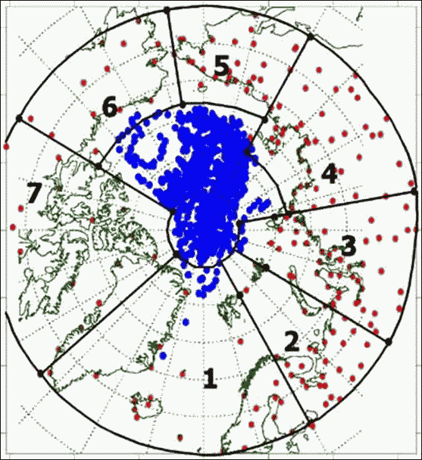
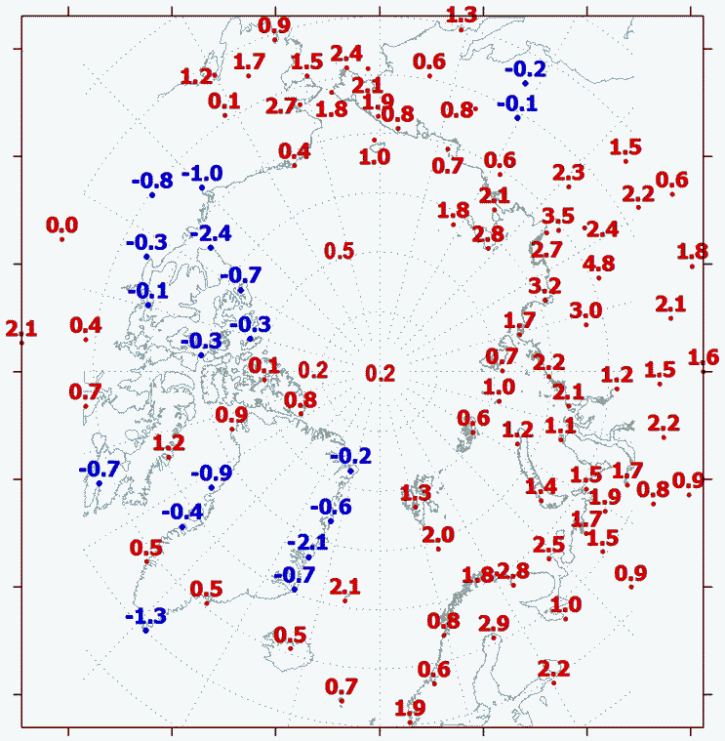
May 2018 to Sep 2018 Surface Air Temperature (SAT) anomalies
(observations)
5
6
4
7
3
2
1
Network of meteorological stations and boundary of the regions: 1 – Atlantic; 2 – N Europe; 3 – West Siberia; 4 – East Siberia; 5 –Chukchi; 6 – Alaska; 7 – Canada
SAT anomalies for summer (JJA) 2018
reference period: 1961-1990
[AARI]

Slide 4
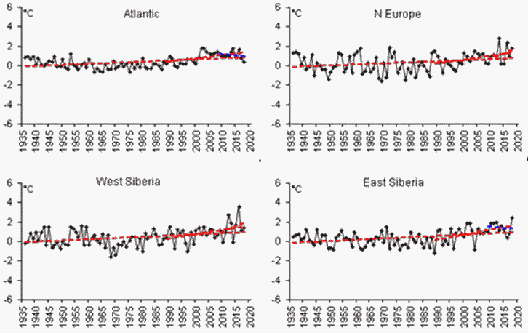
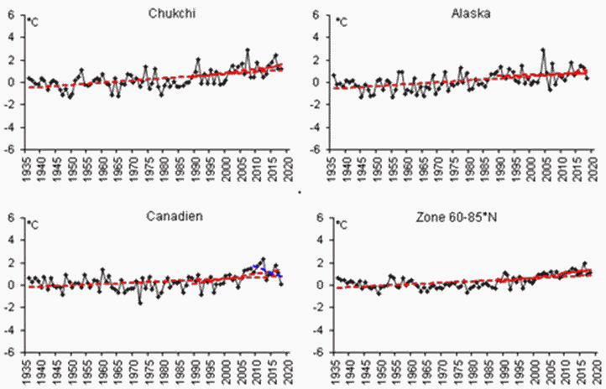
SAT anomalies by regions
(observations)
Region | Anomaly | Anomaly number in row | The warmest year (anomaly) | The coldest year (anomaly)
Atlantic | 0,4 | 13 | 2003 (1,9) | 1965 (-0,7)
N Europe | 1,8 | 4 | 2013 (2,8) | 1969 (-1,6)
West Siberia | 1,4 | 7 | 2016 (3,6) | 1968 (-1,6)
East Siberia | 2,4 | 1 | 2018 (2,4) | 1989 (-1,2)
Chukchi | 1,2 | 8 | 2007 (2,9) | 1949 (-1,3)
Alaska | 0,4 | 14 | 2004 (2,9) | 1945, 1955 (-1,3)
Canadian | 0,1 | 17 | 2012 (2,3) | 1972 (-1,6)
Reference period: 1961-1990
1- Atlantic
2 - N Europe
5 - Chukchi
6 - Alaska
3 - West Siberia
4 - East Siberia
7 - Canadian
Zone 60-85 °N
[AARI]

Slide 5
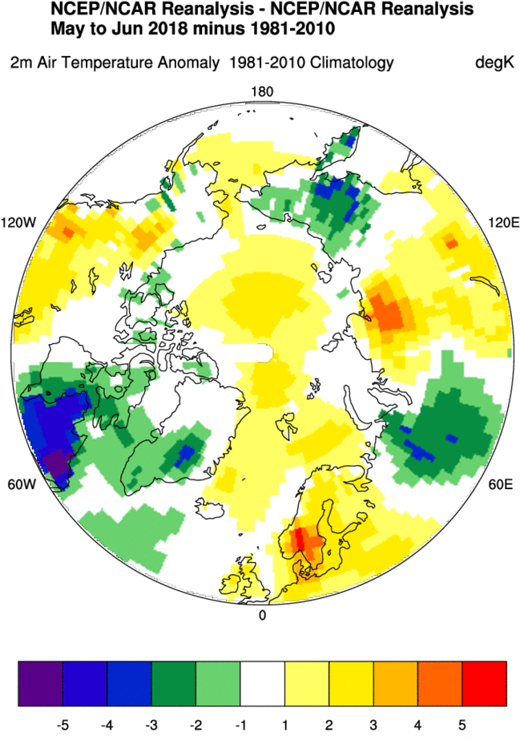
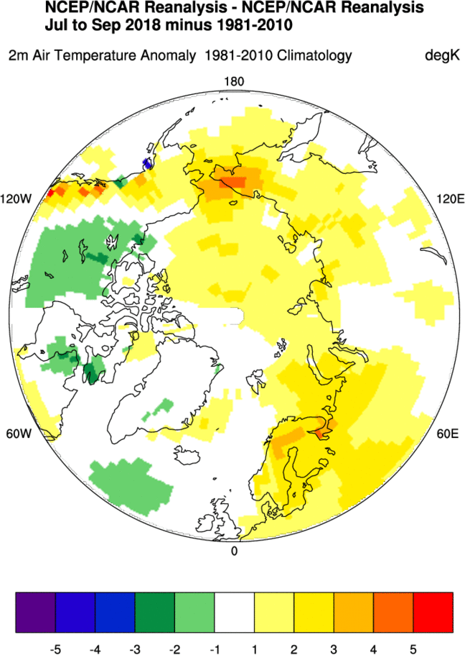
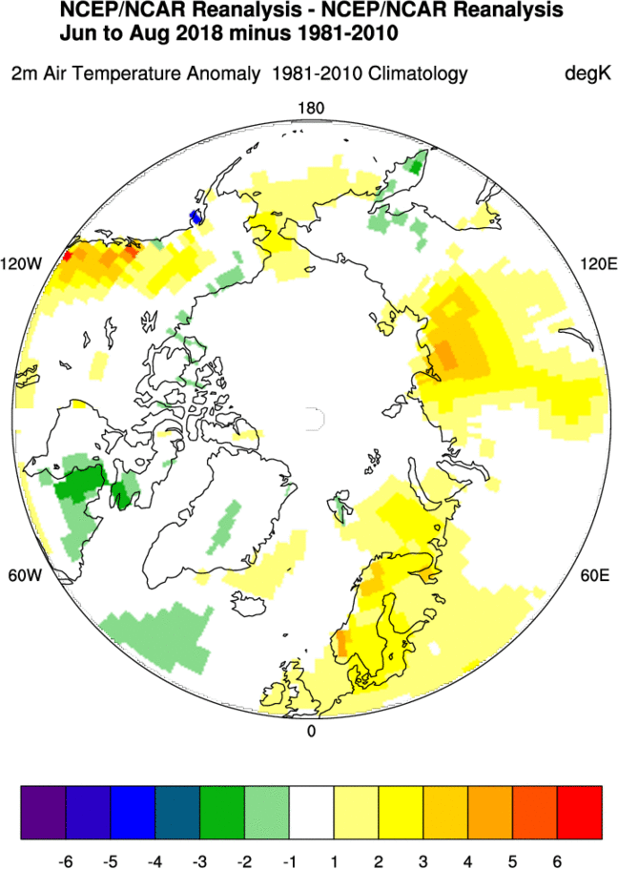
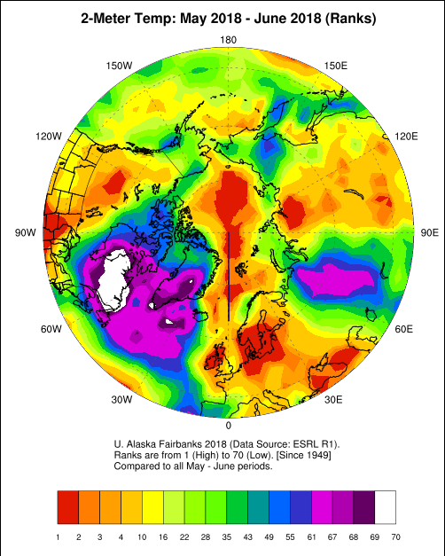
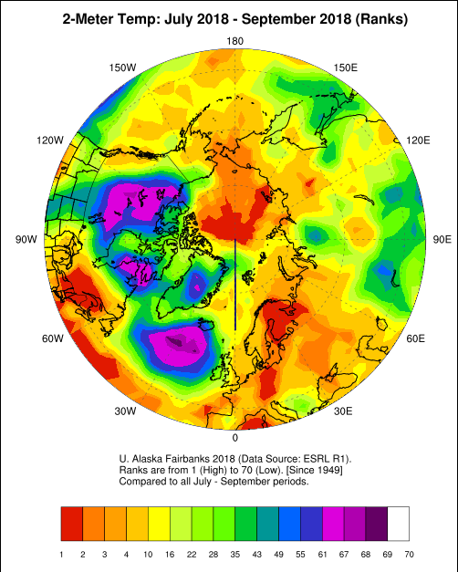
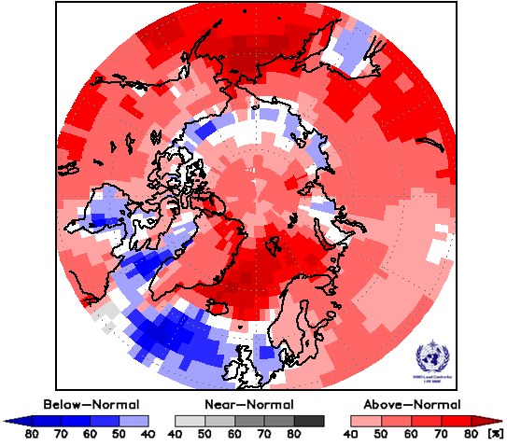
May – Sep 2018 SAT: anomalies and ranks (reanalysis)
May – Jun 2018
Jul – Sep 2018
Jun – Aug 2018
PARCOF-1 Summer Temp LRF

Slide 6
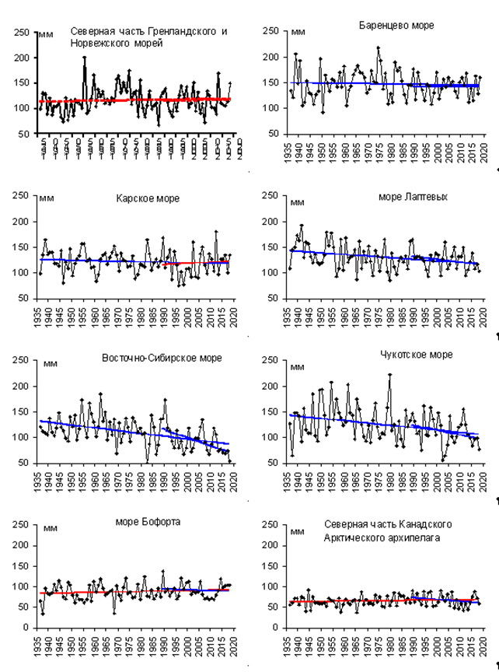
Precipitation anomalies by regions
N Greenland and Norwegian Seas
Barents Sea
Region | Relative anom, % | The greatest value | The lowest value
Atlantic | 101,4 | 1964 (120,5) | 1968 (75,2)
N Europe | 98,3 | 1981 (128,4) | 1980 (68,5)
West Siberia | 91,0 | 2002 (122,6) | 1946 (72,4)
East Siberia | 85,0 | 1988 (125,2) | 1967 (78,4)
Chukchi | 80,4 | 1954 (139,6) | 1982 (60,2)
Alaska | 90,1 | 1951 (164,4) | 1968 (54,1)
Canada | 91,8 | 2005 (123,5) | 1977 (75,0)
60-70°N | 93,3 | 1954 (115%) | 1968 (88%)
70-85°N | 97,7 | 1989 (127%) | 1998 (84%)
60-85°N | 94,0 | 1954 (117%) | 1980 (90%)
Kara Sea
Laptev Sea
Eastern Siberian Sea
Chukchi Sea
Beaufort Sea
N Canadian Archipelago
Reference period: 1961-1990
[AARI]

Slide 7
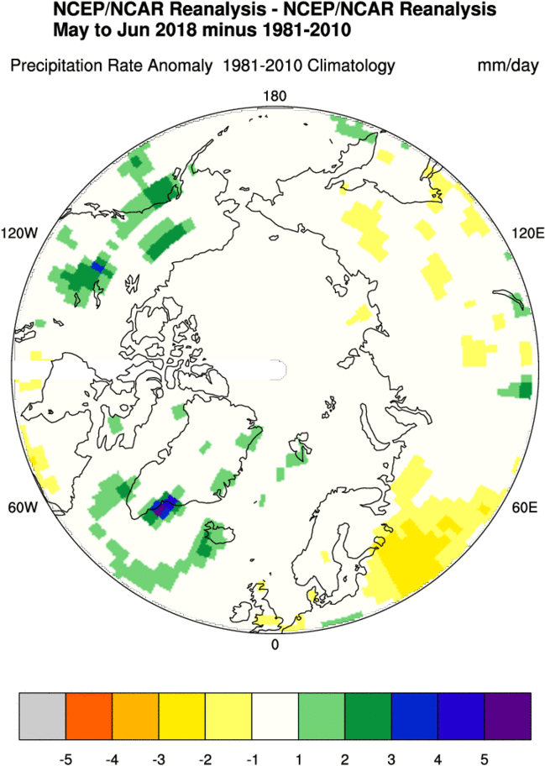
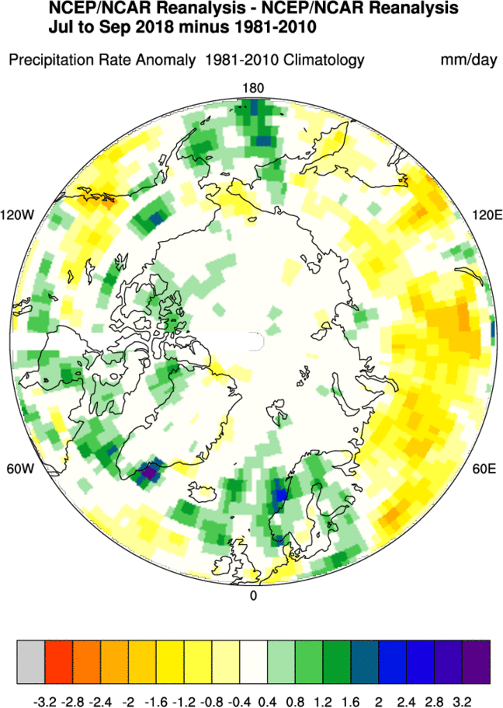
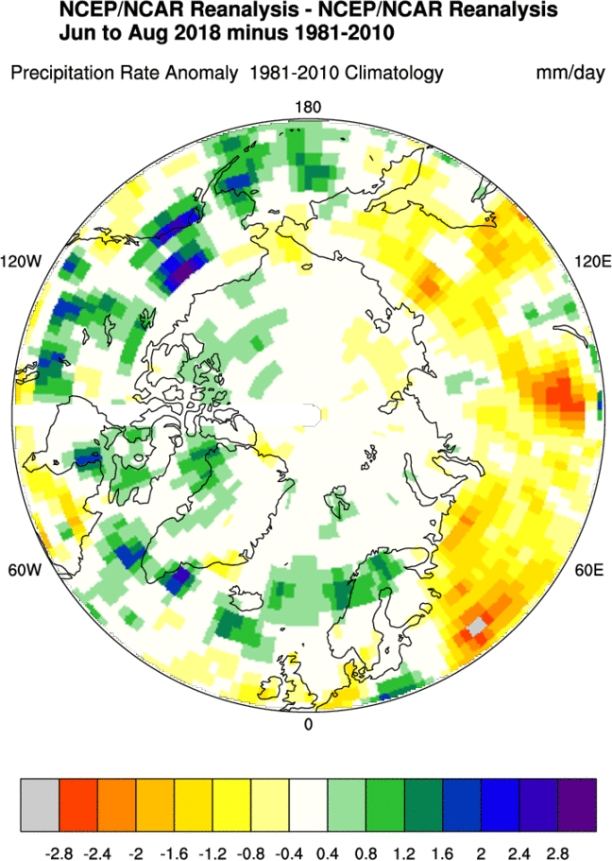
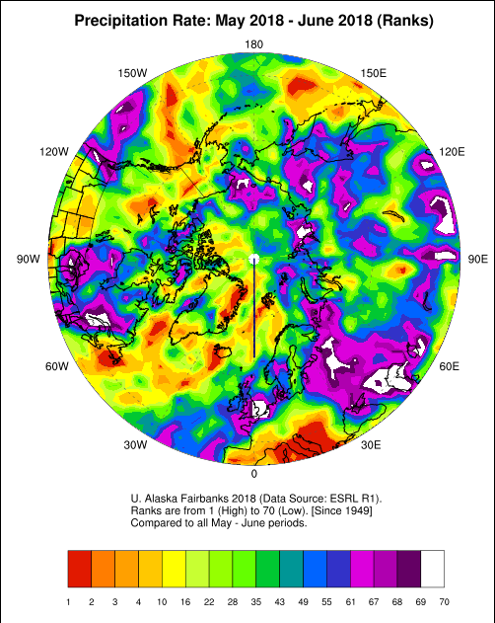
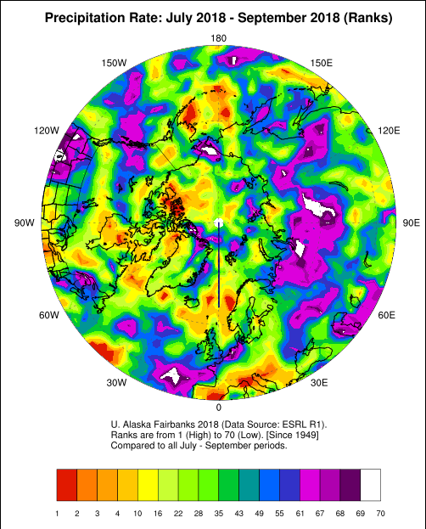
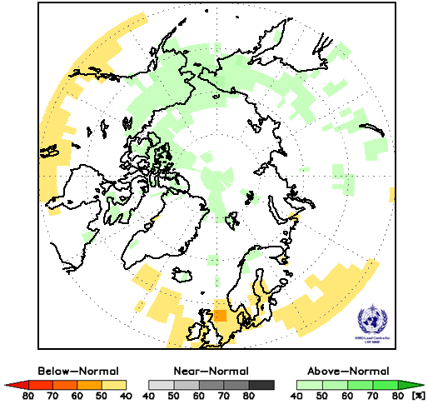
May – Sep 2018 Precipitation anomalies and ranks
May – Jun 2018
Jul – Sep 2018
Jun – Aug 2018
PARCOF-1 Summer prec LRF

Slide 8
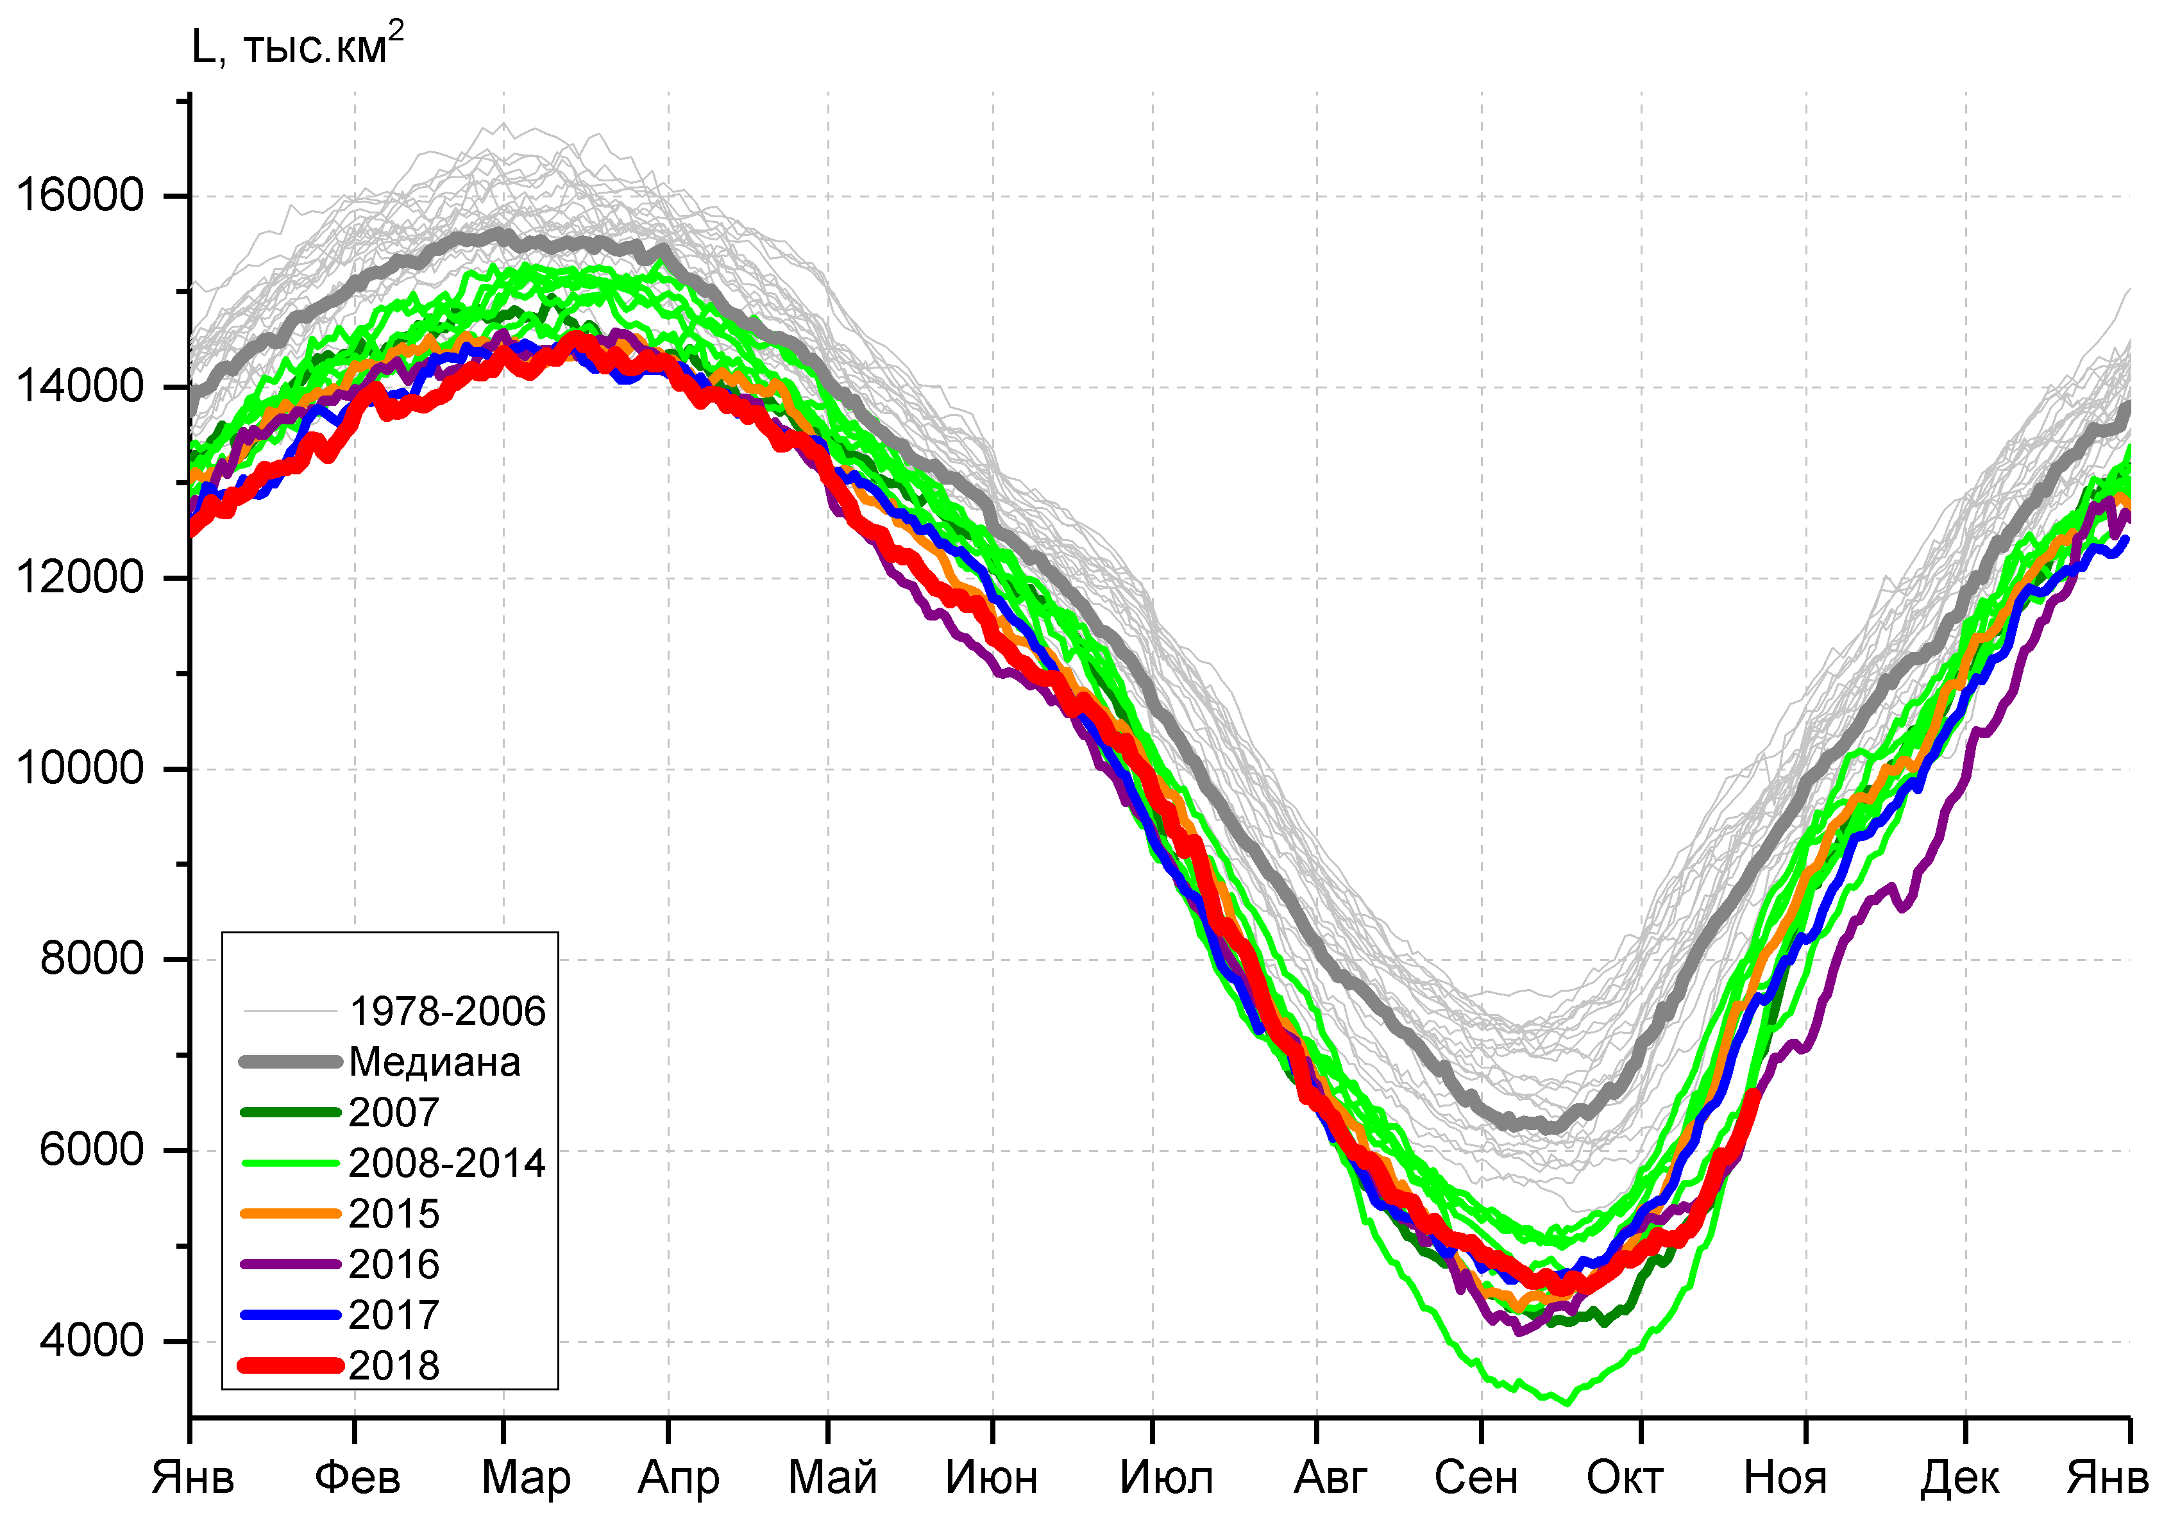
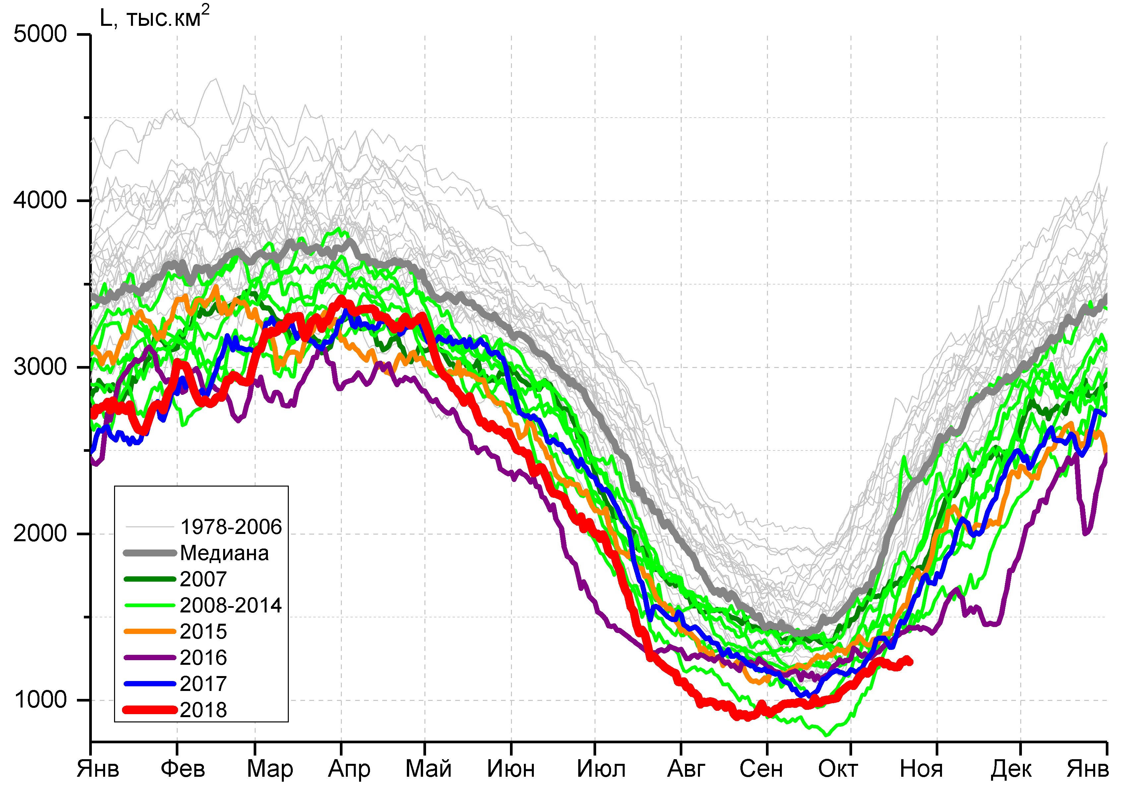
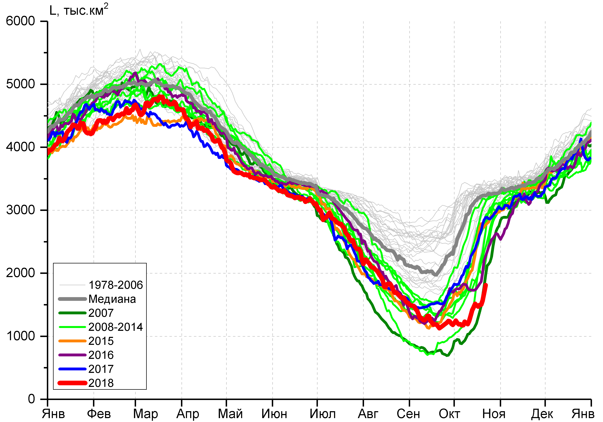
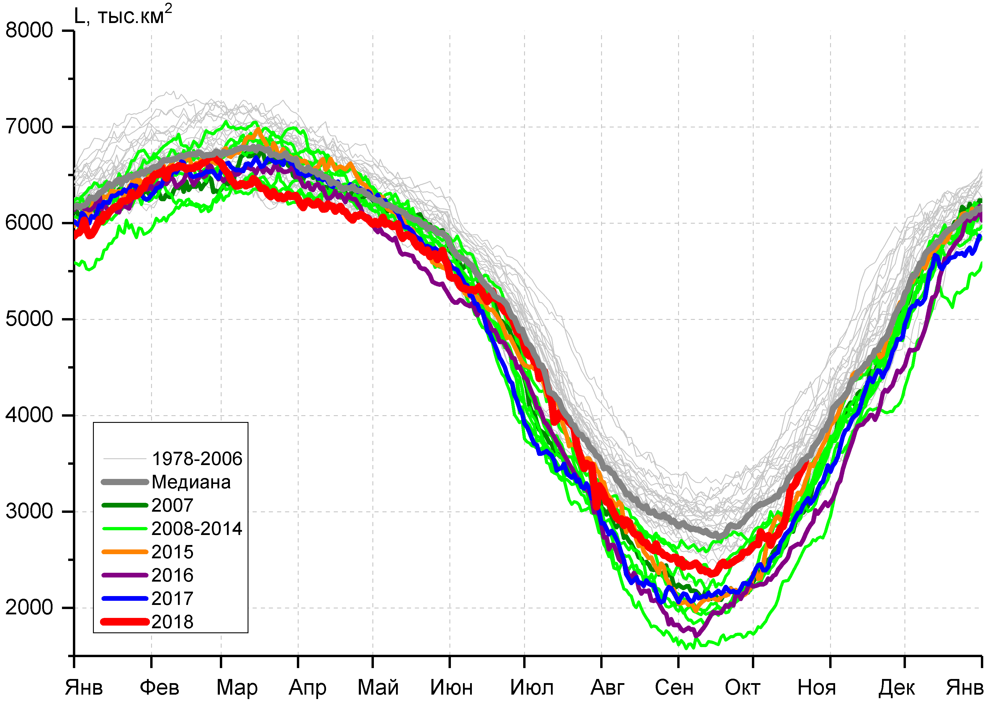

Arctic (NH) seasonal ice extent – 2018 …. 1979
S, 1000 km^{2*}
S, 1000 km²
S, 1000 km²
2012 | 3346.2
2016 | 4099.7
2007 | 4189.4
2011 | 4312.7
2015 | 4350.3
2018 | 4557.5
2008 | 4588.2
2017 | 4622
… | …
1982 | 7246.1
1983 | 7285.2
1980 | 7611.3
Northern Hemisphere
Western Arctic (WA)
Jan Feb Mar Apr May Jun Jul Aug Sep Oct Nov Dec Jan
Jan Feb Mar Apr May Jun Jul Aug Sep Oct Nov Dec Jan
S, 1000 km²
Eastern Arctic (EA)
S, 1000 km²
Canadian Arctic (CA)
* - minimum for Sep (AARI)
CA
EA
WA
Jan Feb Mar Apr May Jun Jul Aug Sep Oct Nov Dec Jan
Jan Feb Mar Apr May Jun Jul Aug Sep Oct Nov Dec Jan
Minimum ice extent 4,56 mln km² (4.62 in 2017) reached 17 September 2018
[AARI, NSIDC]

Slide 9
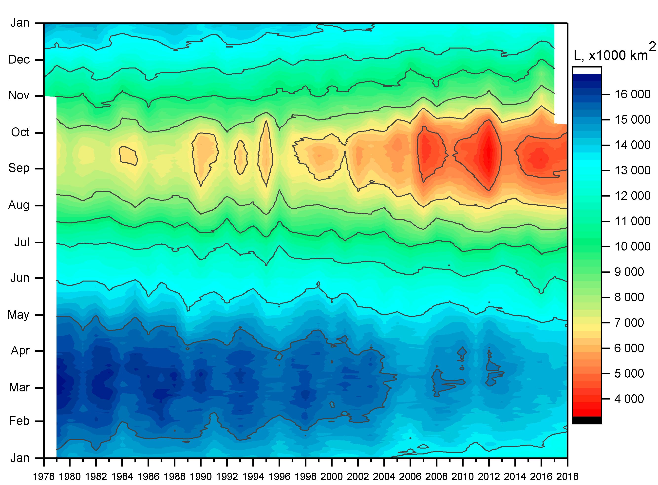
Seasonal NH (Arctic Ocean in summer) ice extent variability: 1978 - 2018
[AARI, NSIDC]

Slide 10
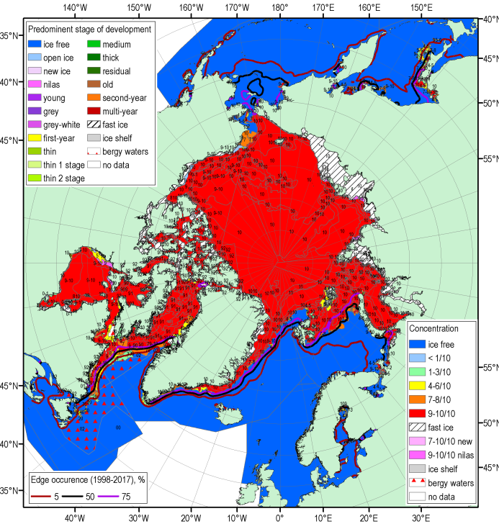
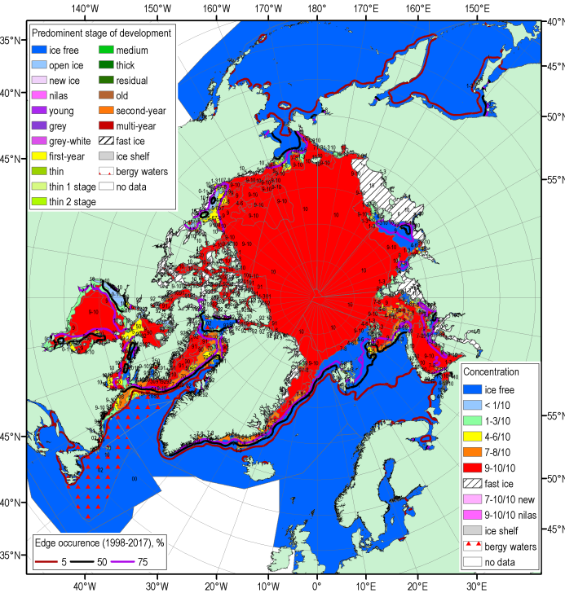
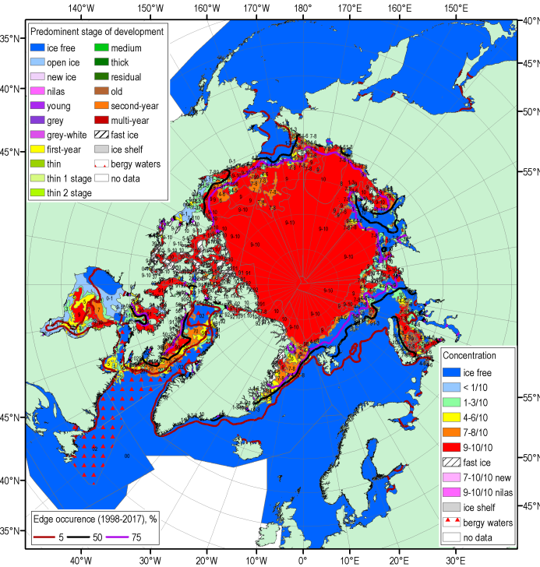
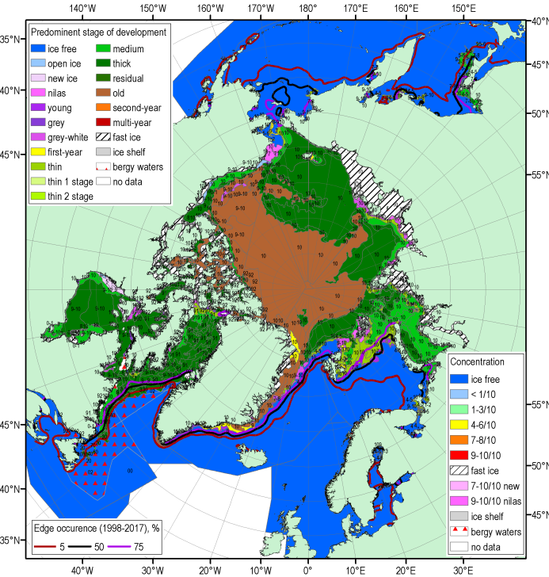
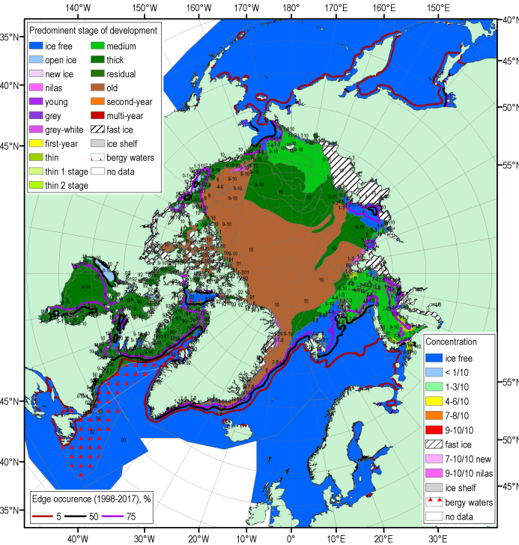
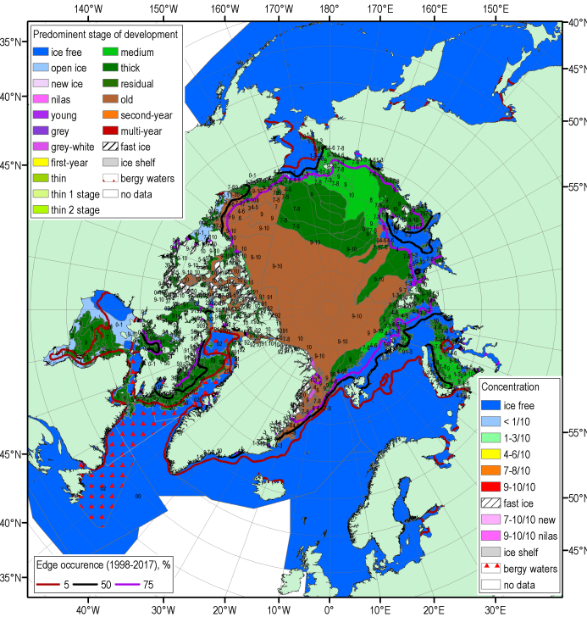
MJJ 2018 Arctic sea ice – conc. and stages of development
14-17 May
18-21 June
16-19 July
Blended AARI/CIS/NIC ice charts; ice edge – nearest pentade, reference period: 1998-2017

Slide 11
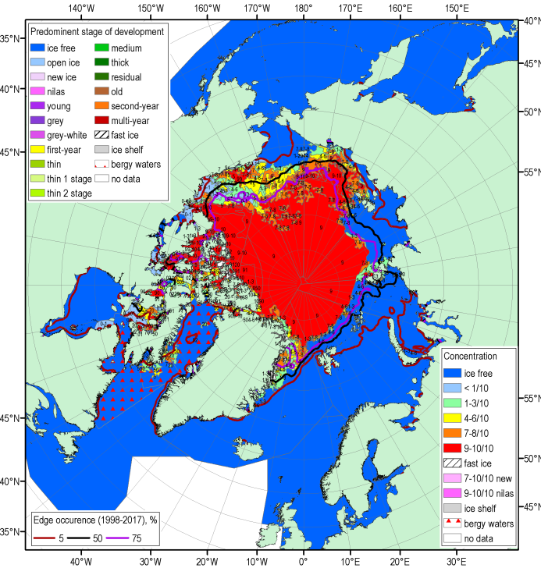
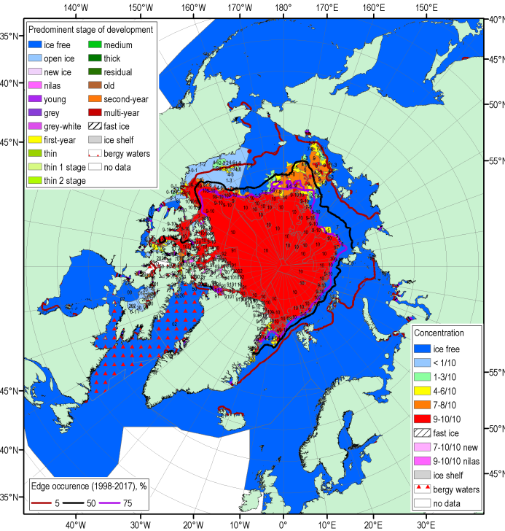
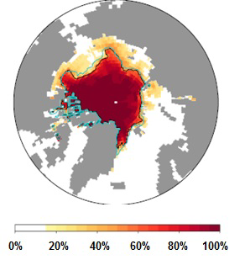
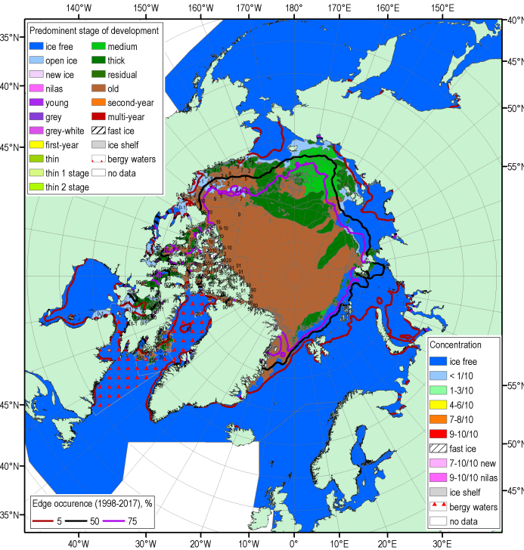
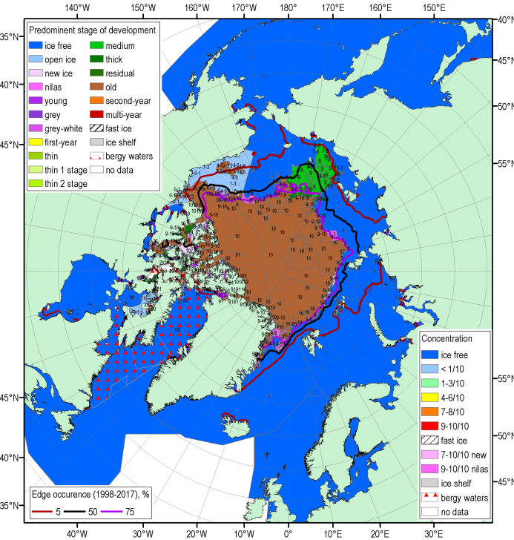
End of summer 2018 Arctic sea ice – conc. and stages of development
13-16 Aug
17-20 Sep
PARCOF-1 Sep’18
minimum LRF
Blended AARI/CIS/NIC ice charts; ice edge – nearest pentade, reference period: 1998-2017

Slide 12
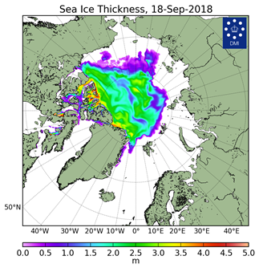
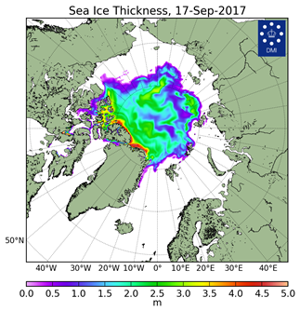
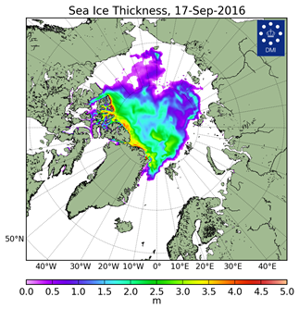
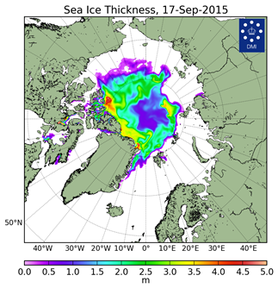
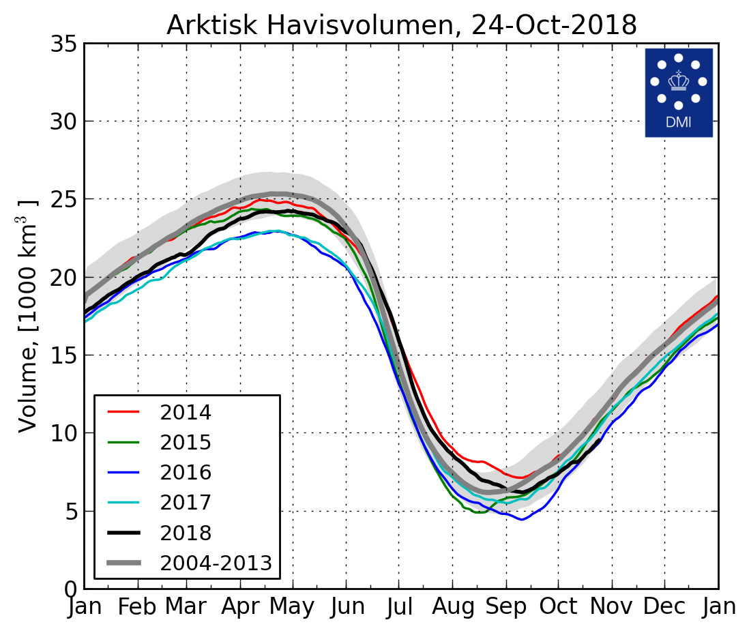
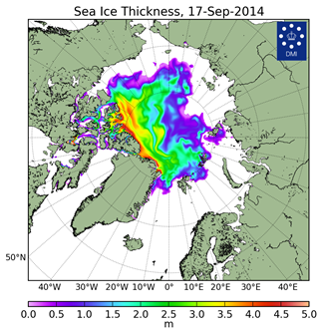
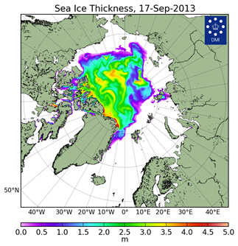
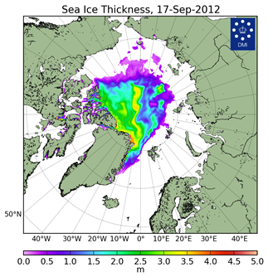
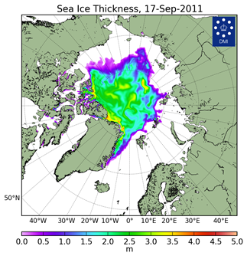
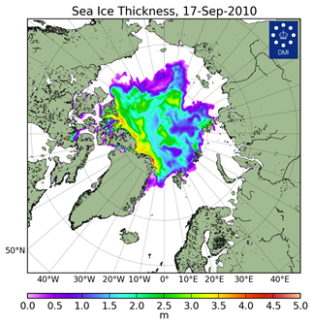
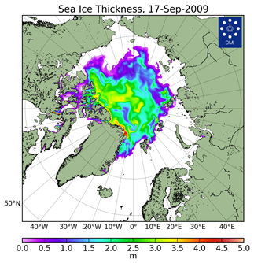
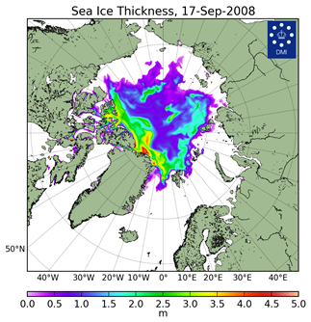
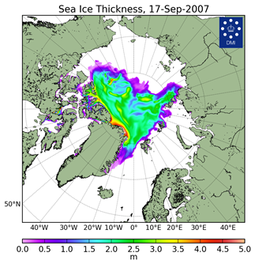
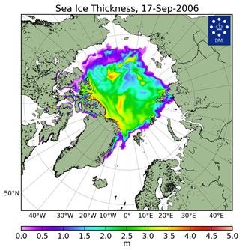
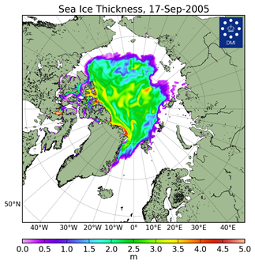
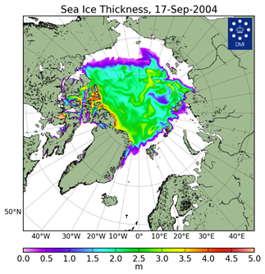
Arctic Sea Ice Reanalysis – HYCOM-CICE and PIOMAS
[Madsen et al, 2015]
2018
2017
2016
2015
2014
2013
2012
2011
2018
S,1000 km^{2*}
**V,1000 km^{3 **}(PIOMAS)
2012 | 3346.2
2016 | 4099.7
2007 | 4189.4
2011 | 4312.7
2015 | 4350.3
2018 | 4557.5
2008 | 4588.2
2017 | 4622
… | …
1982 | 7246.1
1983 | 7285.2
1980 | 7611.3
2012 | 3.787
2011 | 4.48
2016 | 4.53
2017 | 4.679
2010 | 4.742
2018 | 5.09
2013 | 5.479
2015 | 5.852
… | …
1986 | 16.076
1980 | 16.316
1979 | 16.911
2010
2009
2008
2007
Models show Arctic ice volume greater or same as in 2017 though ice extent is lower, i.e. overall ice thickness in 2018 is greater
2006
2005
2004
DMI North Atlantic - Arctic Ocean model HYCOM-CICE - http://ocean.dmi.dk/models/hycom.uk.php
** - minimum for Sep
** - monthly mean for Sep

Slide 13
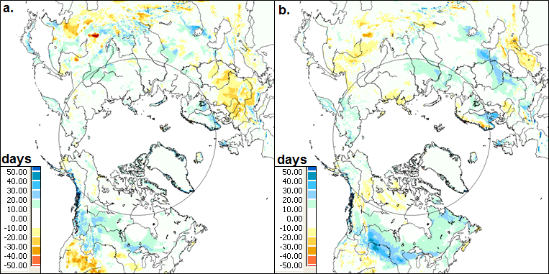
Terrestrial snow: snow cover duration
Snow cover duration (SCD in days) departures (difference from 1998-2010 mean) for the 2017-2018 snow year: (a) fall; and (b) spring. The grey circle marks the latitude 60° N. Source: NOAA IMS data record.
Snow accumulation during the 2017/18 winter was above average across both the North American and Eurasian Arctic, consistent with an early start to the snow season in the fall (therefore a longer accumulation period) and above-average winter snowfall.
Snow Watch/GCW: 2018 Arctic Report Card, L. Mudryk, R. Brown, C. Derksen, K. Luojus, and S. Helfrich.

Slide 14

Terrestrial snow: snow depth anomaly, MAMJ 2018
Snow cover extent for Eurasia was above average during April, slightly above average for May, and below average by June (relative to the 1981-2010 average).
This month-to-month change is consistent with unusually high early spring accumulation combined with rapid late spring snow loss.
Snow depth anomaly (% of the 1999-2017 average) in 2018 for (a) March, (b) April, (c) May, and (d) June. Source: CMC snow depth analysis.
Snow Watch/GCW: 2018 Arctic Report Card, L. Mudryk, R. Brown, C. Derksen, K. Luojus, and S. Helfrich.

Slide 15







Current Ice Conditions (22-23 October 2018)
Till the end of October 2018, with exception of Canadian archipelago and Hudson Bay, strong westerly winds (NAO>0) continued to preserve positive temperature anomalies over the Eastern and Central Arctic, slowing the ice formation process
Blended AARI/CIS ice charts for 22-23 October 2018
Surface air temperature anomalies (2m) relative to 2004-2013 and mean wind vectors (10 m) for 06.10-24.10.2018 (http://polarportal.dk)

Slide 16
Thank you! Merci! Takk! Спасибо!
Tak! Tack! Kiitos! þakka þér fyrir!

