Slide 1


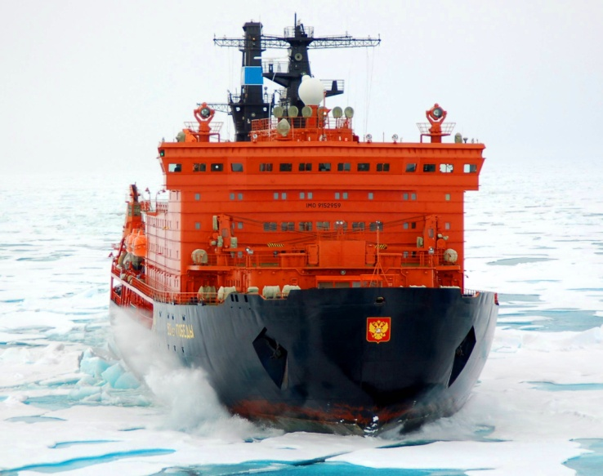
The Northern Sea Route Administration
The Main Results
Navigation in the Water Area
of the Northern Sea Route
of 2018

Slide 2


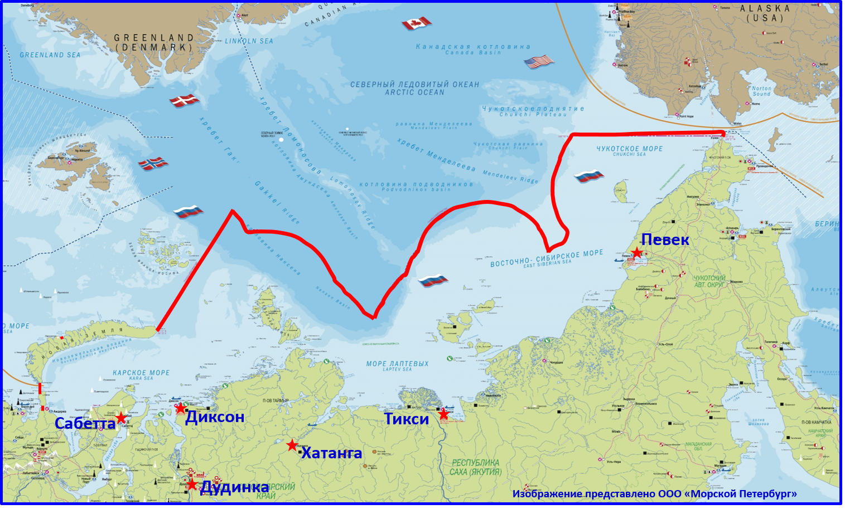
The Water Area
of the Northern Sea Route
2

Slide 3

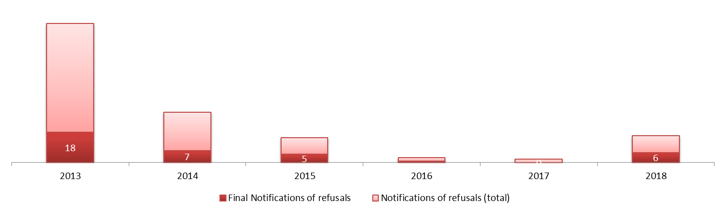
Statistical Data on the Permissions & Notifications of Refusals Issued by the NSRA
715
718
792
625
632
644
83
30
16
15
3
2
3

Slide 4
Statistical Data on the Permissions Issued by the NSRA
The quantity of shipping companies that submitted applications for passing of their vessels through the waters of NSR in 2018
foreign
shipping
companies
14%
47
domestic
shipping
companies
86%
119
Total: 166 companies in 2018
4

Slide 5
Statistical Data on the Permissions Issued by the NSRA
The quantity of applications submitted by foreign shipping companies for passing of their vessels through the waters of NSR
№ | Country | 2013 | 2014 | 2015 | 2016 | 2017 | 2018
1 | Australia | - | 1 | - | - | - | -
2 | Antigua and Barbuda | 4 | - | 5 | 9 | 12 | 3
3 | Bahamas | 2 | 4 | 15 | 3 | - | 8
4 | Belize | 1 | 1 | - | - | 1 | -
5 | Belgium | 2 | 9 | 9 | 1 | - | -
6 | Bermudas | 4 | 11 | - | - | - | -
7 | United Kingdom | 7 | 7 | 3 | 1 | 1 | -
8 | Germany | - | 2 | 1 | 3 | - | 1
9 | Gibraltar | - | 1 | - | 3 | 2 | 2
10 | Hong Kong | 5 | - | 1 | 4 | 5 | 4
11 | Greece | 1 |  | - | - | - | -
12 | Denmark | - | 3 | 3 | 1 | - | 1
13 | Jersey | - | - | 1 | - | - | -
14 | Ireland | - | - | - | 1 | - | -
15 | Iceland | - | 1 | - | 1 | - | -
16 | Italy | - | - | 1 | 1 | - | -
17 | Cayman islands | 4 | 2 | - | - | - | -
18 | Cambodia | - | 1 | - | - | - | -
19 | Canada | - | - | 1 | - | - | -
20 | Cyprus | 3 | 10 | 7 | 4 | 8 | 8
21 | China | 1 | - | 1 | 5 | 10 | 7
22 | Korea | - | - | 1 | - | - | -
№ | Country | 2013 | 2014 | 2015 | 2016 | 2017 | 2018
23 | Curacao | 1 | 2 | 1 | 9 | 4 | -
24 | Liberia | 11 | 2 | 13 | 13 | 6 | 16
25 | Luxembourg | 18 | - | 1 | 21 | 4 | -
26 | Mauritius | 1 | - | - | 1 | - | -
27 | Malta | 7 | 3 | 9 | 5 | 3 | 1
28 | Marshall Islands | 5 | 1 | 2 | 3 | 3 | 3
29 | Netherlands | 5 | 20 | 26 | 37 | 11 | 5
30 | Norway | 11 | 10 | 7 | 2 | 9 | 5
31 | Panama | 8 | 8 | 4 | 6 | 10 | 3
32 | Poland | 1 | - | - | - | - | 2
33 | Portugal | - | - | - | 3 | 10 | 11
34 | Saint Vincent and the Grenadines | 2 | 3 | 1 | 3 | 1 | -
35 | Federation of Saint Kitts and Nevis | - | - | 1 | 2 | 2 | 1
36 | Singapore | - | - | - | 1 | 1 | -
37 | Sierra Leone | - | - | - | 1 | 1 | 1
38 | Finland | 6 | 5 | 3 | - | - | 1
39 | France | 2 | 2 | 1 | - | - | 1
40 | Sweden | - | 3 | 1 | - | - | -
41 | Estonia | - | 1 | - | - | - | -
42 | Jamaica | 1 | - | - | - | - | -
43 | Isle of Man | - | - | - | - | 1 | -
 | Total | 113 | 113 | 119 | 144 | 105 | 84
5

Slide 6
Annual Cargo Volumes Transported in the NSR Water Aria
Cargo volumes in thousand tons
20180
10729
7479
5431
3914
3982
6

Slide 7
Actual and Historical Data of Cargo Volumes Transported Along the NSR
Data from 1933 to 2018 in thousand tons
10729
6578
7

Slide 8
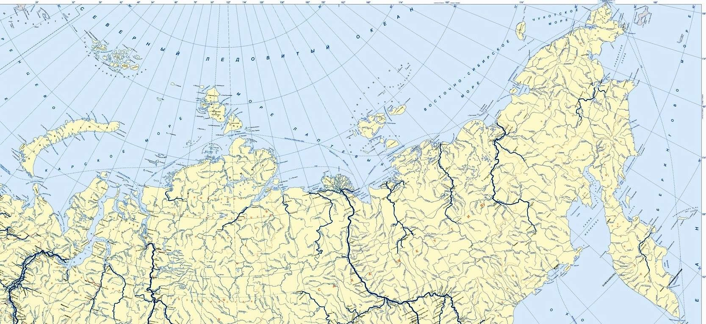

Ports and Cargo Volumes
General ports and points of the NSR where
cargo operations were carried out as on 01.11. 2018
Vrangelya Island
Uelen
Arctic Ocean
1,139
25,198
Shmidta cape
12,809
East Siberian Sea
Pevek
419,772
Bolshevik Island
6,569
Kotelnyy Island
Laptev Sea
4,973
Zeleniy Cape
Kara Sea
52,141
Indigirka mouth
Dikson
55,378
63,614
Tiksi
Nizhneyansk
Amderma
Sabetta
Yuryung-
Khaya
133,122
1,742
7378,022
Khatanga
29,375
76,296
63,062
Kamenniyy cape
Dudinka
5937,526
1105,832
total cargo volumes in thousand tons
8

Slide 9
Cargo Transit Along the NSR
Transit cargo volumes in thousand tons
37
Quantity of vessels’ voyages
29
23
18
18
Vessels in ballast
9

Slide 10
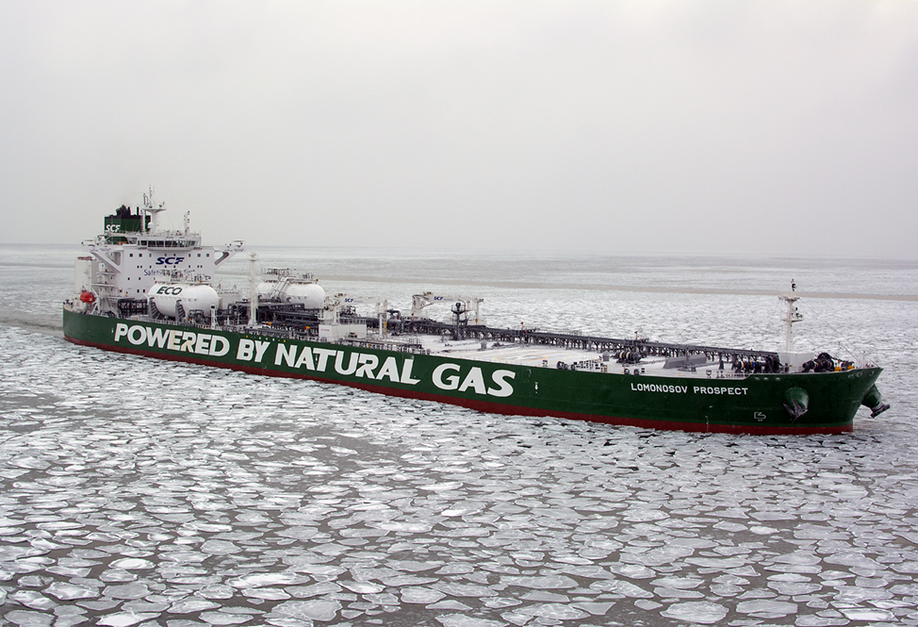
A new-generation LNG-fuelled Tanker «Lomonosov Prospect» successfully completed a voyage along Northern Sea Route on 30 October 2018
Length - 250 m.
Breadth - 44 m.
Deadweight - 114,000 t.
Ice class –Arc4.
Crew numbers - 22.
Tanker using LNG fuel as its primary fuel.
10

Slide 11
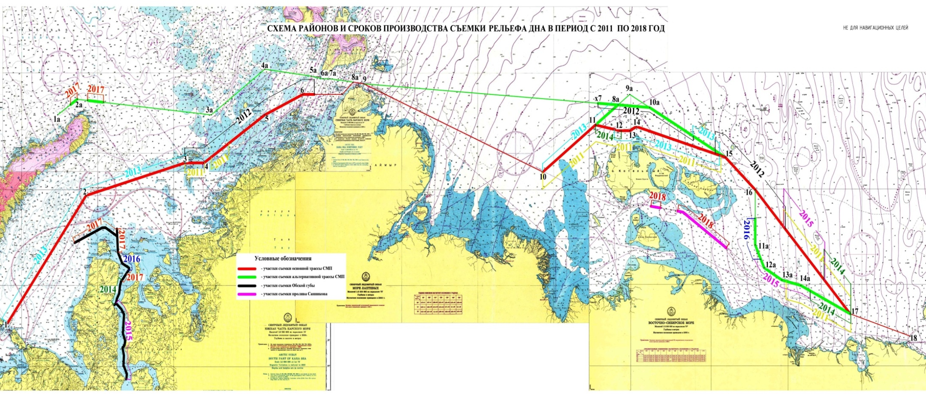
Swath Hydrographic Surveys on the Recommended Sea Routes in the NSR Water Area in 2011-2018
11

Slide 12
12

Slide 13
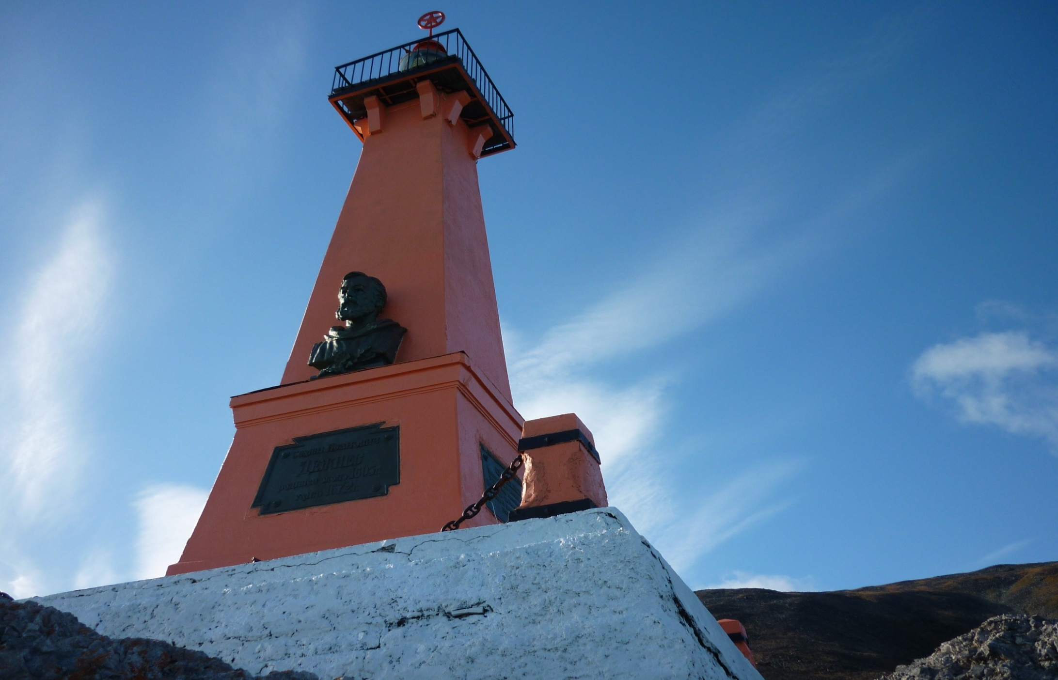
Lighthouse-monument to Dezhnev, Cape Dezhnev,
Bering Strait (reconstructed in 2018)
13

Slide 14
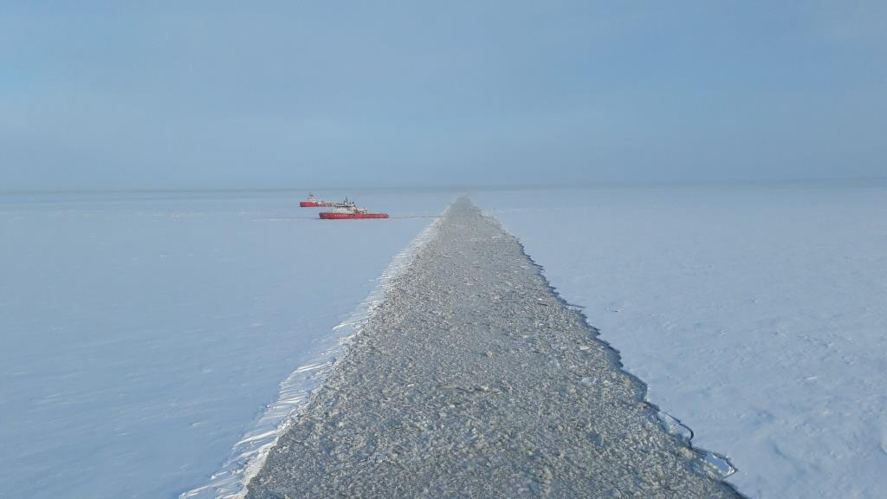
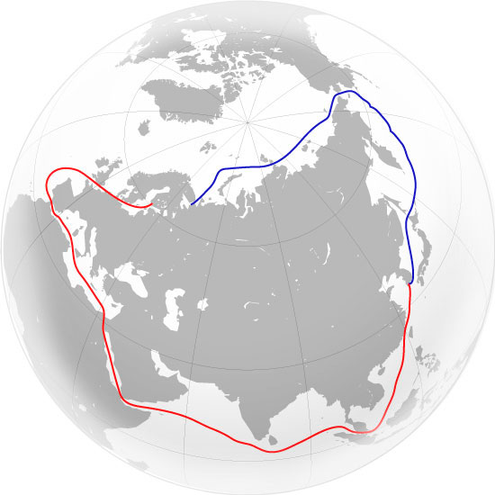
Thank you for your attention!
Welcome to the
Northern Sea Route!
Northern Sea Route Administration
www.nsra.ru
15

