Slide 1

November 2018 – April 2019
Arctic Seasonal Review
Vasily Smolyanitsky
Arctic and Antarctic Research Institute- Russia
Gabrielle Gascon
Prediction Service West, Meteorological Service of Canada
Adrienne Tivy
Canadian Ice Service

Slide 2
Content of review
Review for 2 periods: November, December, January 2018/2019 (NDJ) and February, March, April 2019 (FMA)
Atmosphere variables include:
  Atmospheric circulation (mean sea level pressure) and geopotencial height)
  Surface air temperature
  Precipitation
Sea ice variables include:
  Ice extent analysis
  Ice conditions analysis
  Ice thickness observations at coastal stations
  Sea ice thickness and volume reanalysis
Solid precipitation (snow)
Current status
Background slides: highlights and ranks

Slide 3
Atmosphere variables:
  Atmospheric circulation
  Surface air temperature
  Precipitation
  Source:
  [AARI, HMC Moscow, NOAA NCEP-NCAR, DMI]

Slide 4
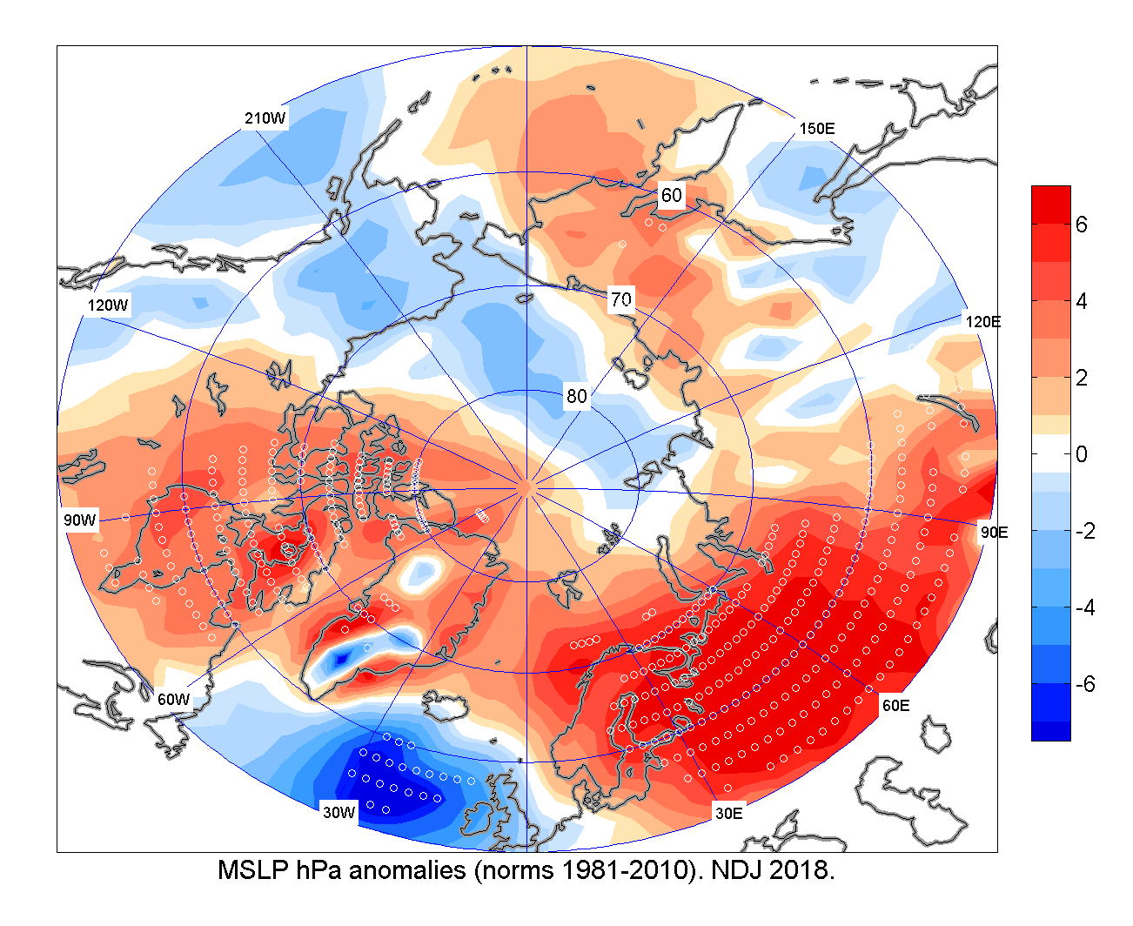
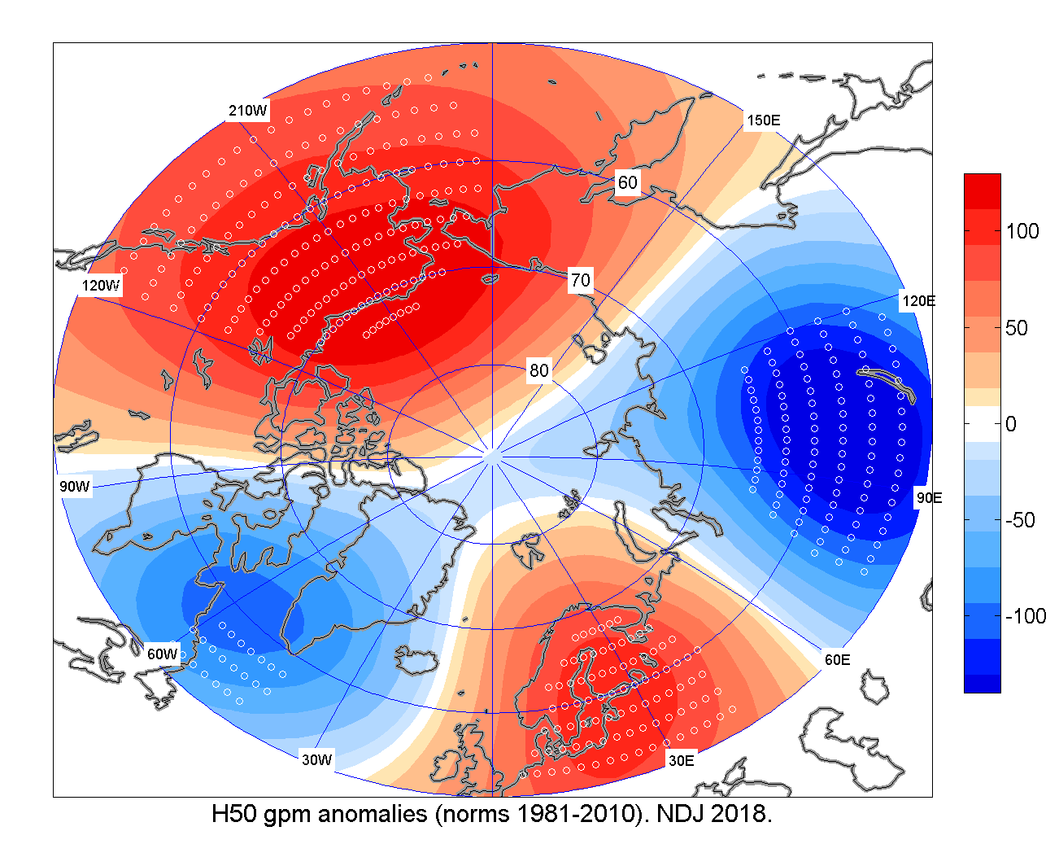
NDJ 2018/2019 atmospheric circulation
Based on atmosphere numerical model analysis)
Positive mean sea level atmospheric pressure (MSLP) anomalies (higher pressure, marked in red) dominated over European and west Siberian region
Opposite situation (lower pressure, marked in blue) observed for Atlantic and Alaska regions.
That led to prevalence of meridian form of circulation (transfer of heal/cold northward along meridian) in the troposphere and bi-central polar vortex, clearly seen on the 50 hPa geopotencial height (H50)
MSLP hPa anomalies (norms 1981-2010)
H50 anomalies (norms 1981-2010)
[HMC Moscow]

Slide 5
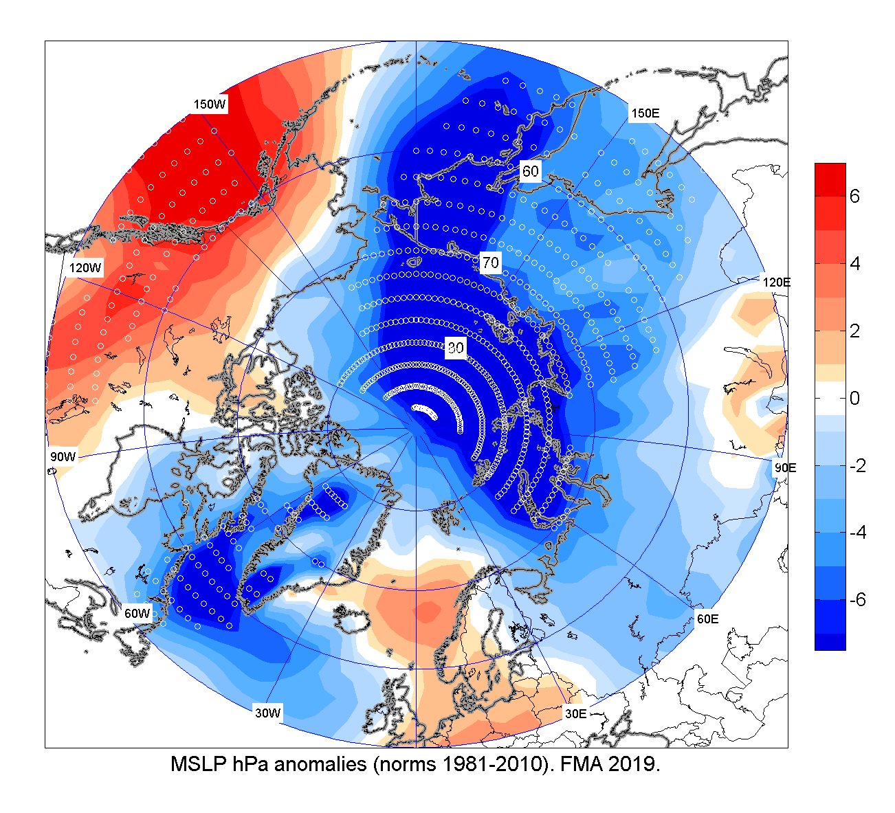
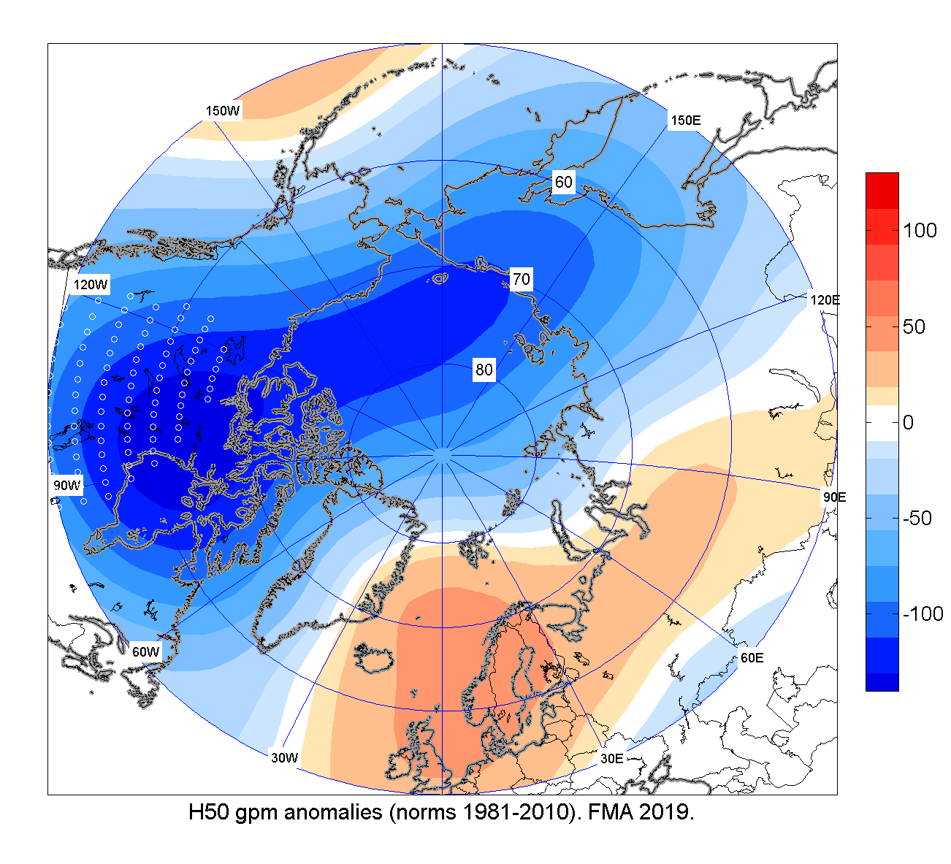
FMA 2019 atmospheric circulation
Very significant negative MSLP anomalies (lower pressure, marked in blue) observed in the northern Eurasia and Greenland
That led to increased cyclonic activity, more polar lows with further increased precipitation, but not in Barents and Alaska regions !
Single center polar vortex observed again as observed at H50 pattern
MSLP hPa anomalies (norms 1981-2010)
H50 anomalies (norms 1981-2010)
[source: HMC Moscow]

Slide 6
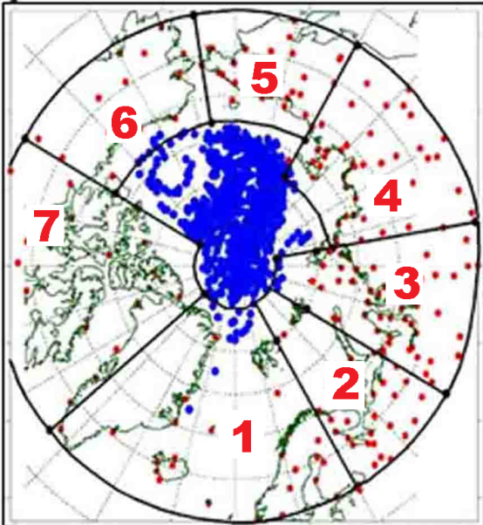
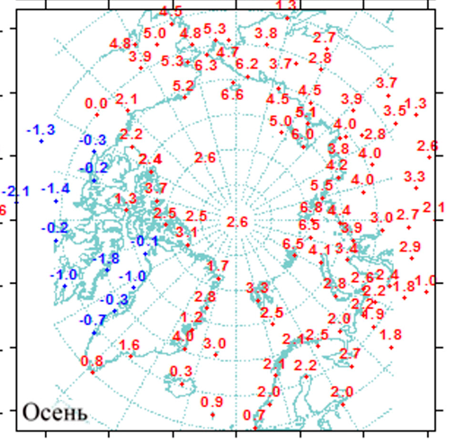
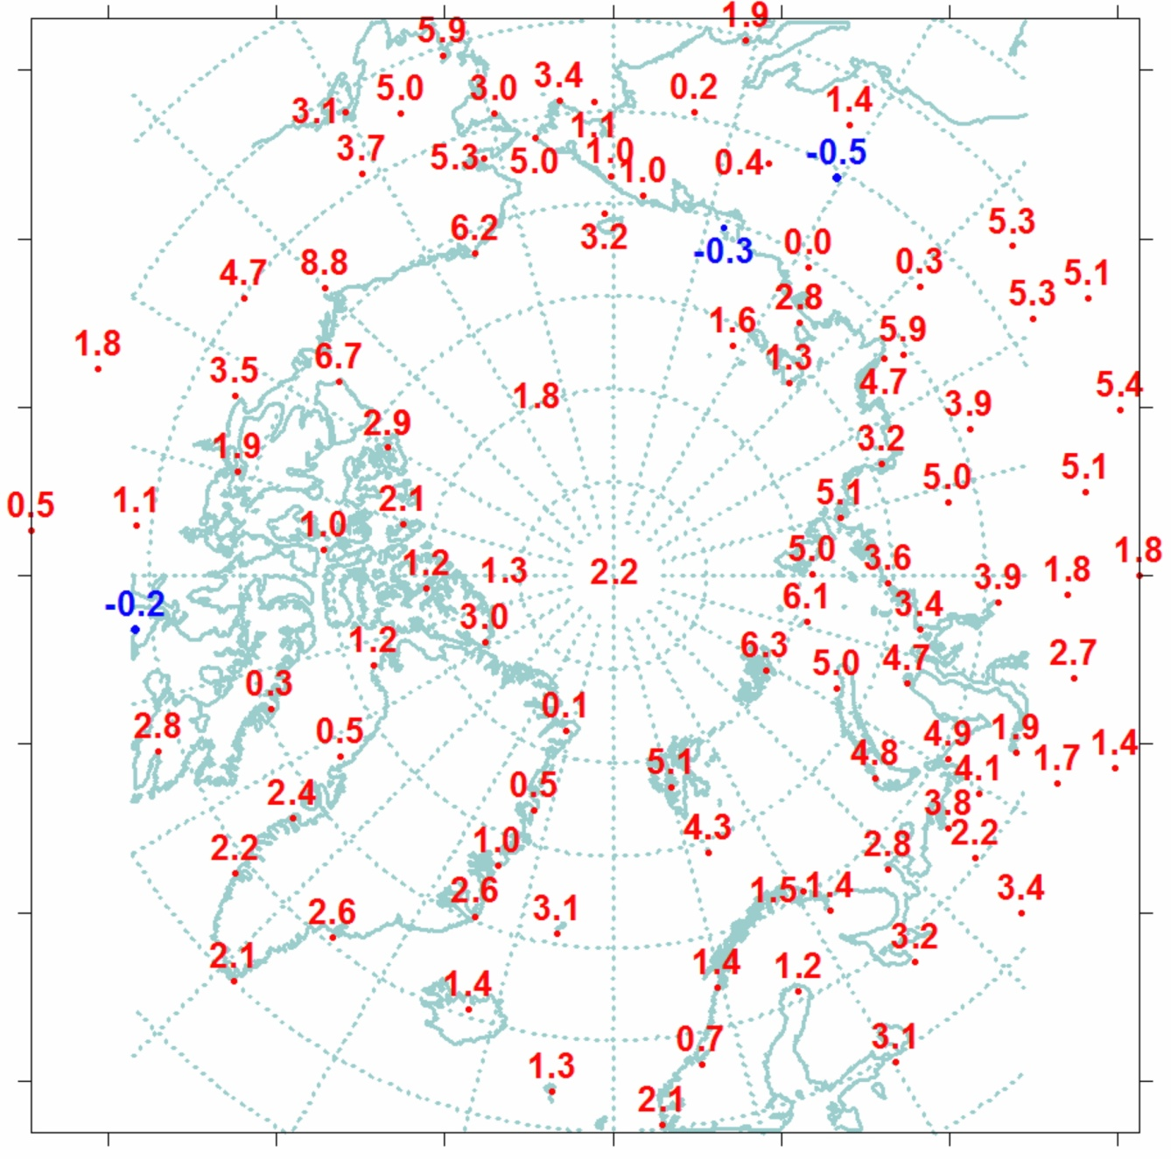
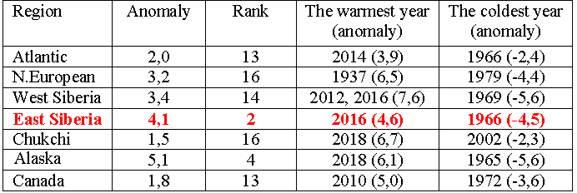
OND 2018 / JFM 2019 Surface Air
Temperature (SAT) anomalies (observations)
Warm !
Warm !
Cold !
Network of meteorological stations and boundary of the regions: 1 – Atlantic; 2 – N Europe; 3 – West Siberia; 4 – East Siberia; 5 –Chukchi; 6 – Alaska; 7 – Canada
OND 2018
JFM 2019
JFM 2019
Warmest !
[AARI]
reference period: 1961-1990

Slide 7
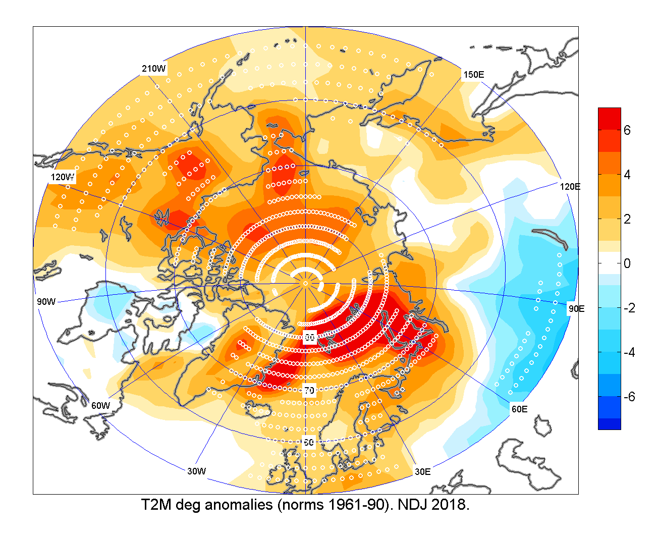
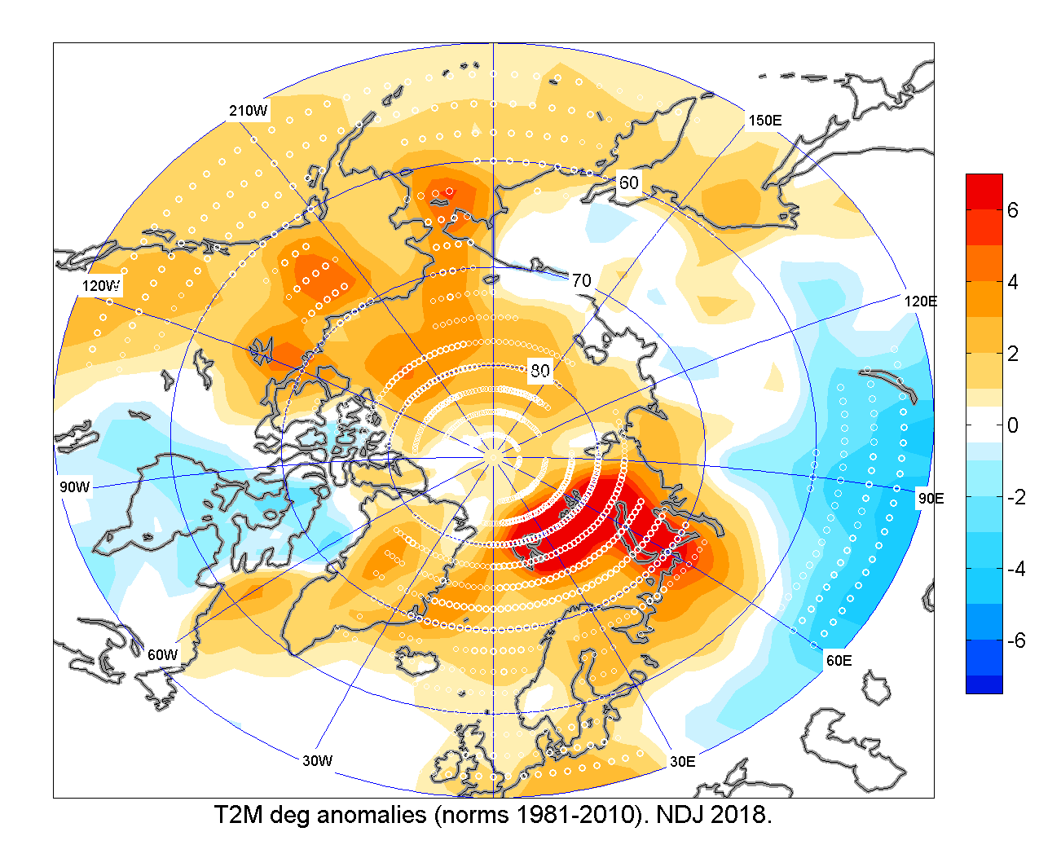
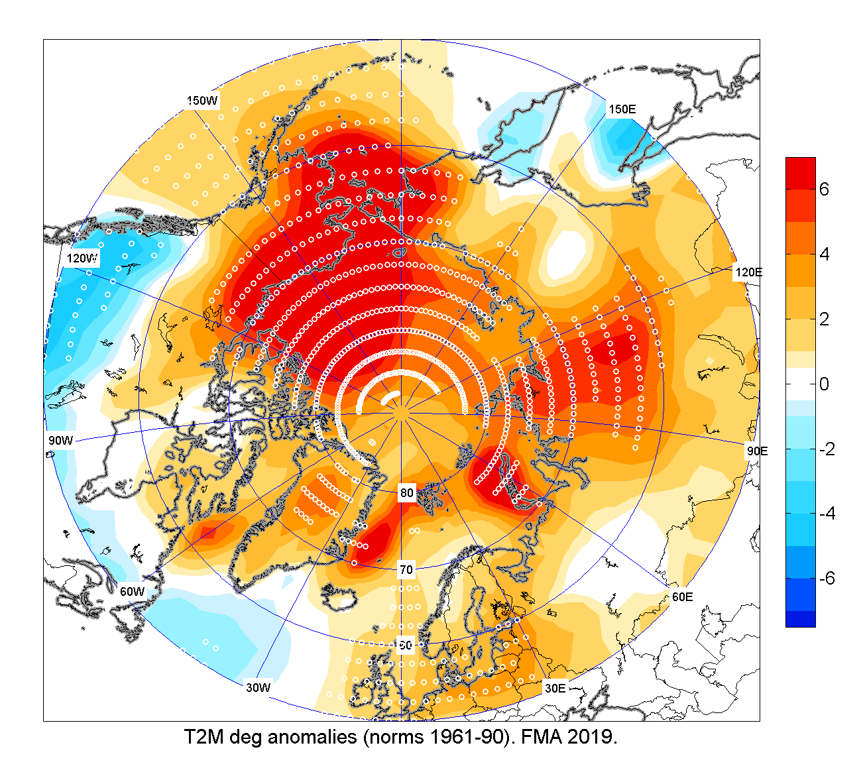
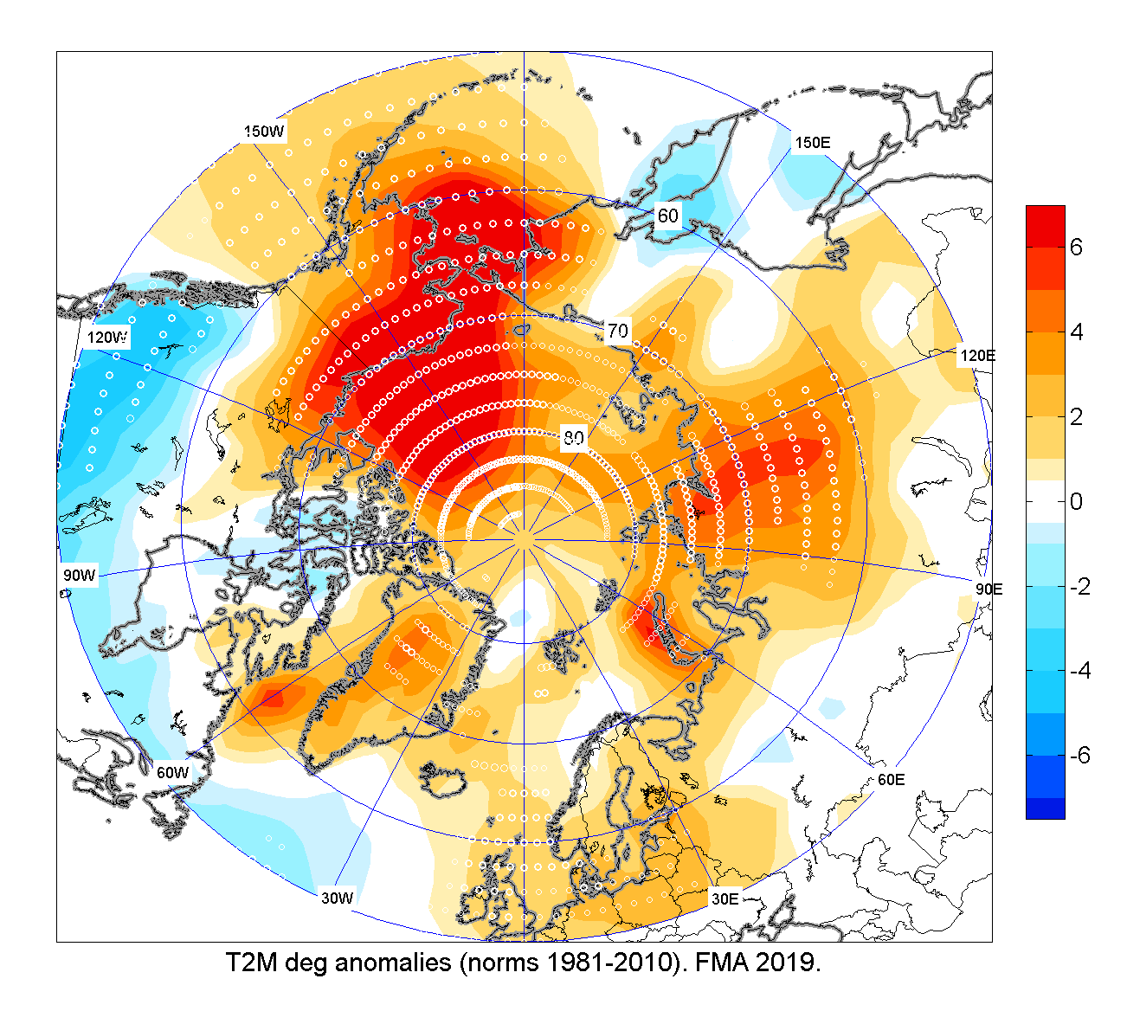
SAT NDJ and FMA 2018/2019: anomalies and ranks
NDJ 2018/2019
NDJ 2018/2019 temperature in the Arctic domain north of 65°N in majority above average.
10 warmest over parts of Alaska, Greenland, and the European Arctic
Contrary, 3rd coldest (a portion of the southern Canadian Arctic) in 70 years
FMA 2019 temperature in the majority, above average
Alaska, NW Canada, central Siberia, and the Beaufort, Chukchi and Bering Seas saw their warmest spring
Contrary, temperature over eastern Canadian Arctic close to normal
Ref [1961-1990]
Ref [1981-2010]
FMA 2018/2019
Ref [1961-1990]
Ref [1981-2010]
HMC Moscow

Slide 8
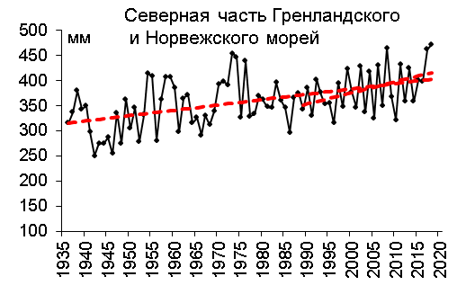
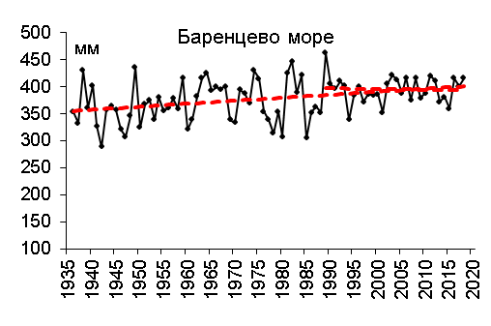
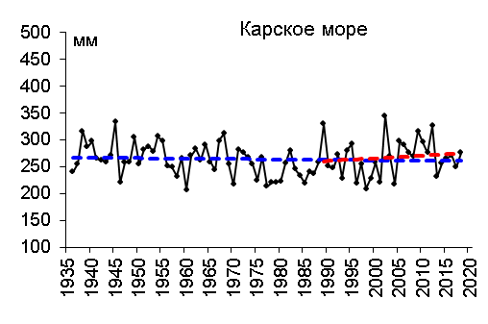
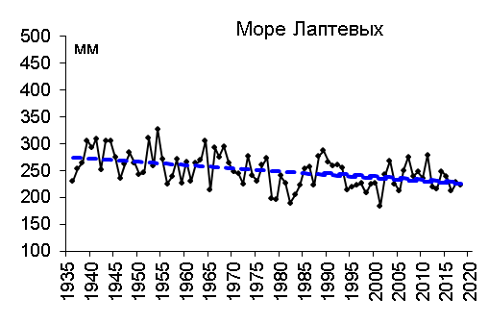
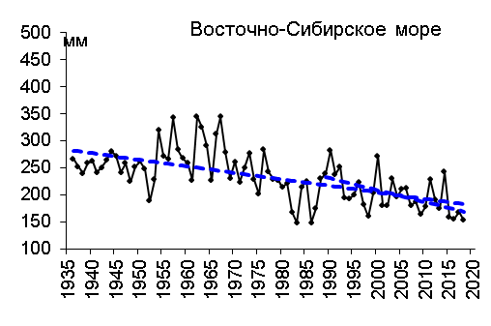
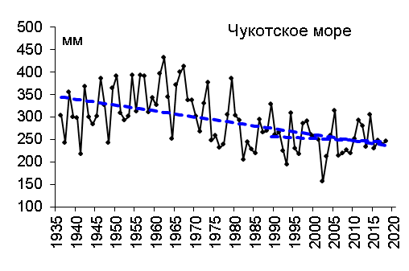
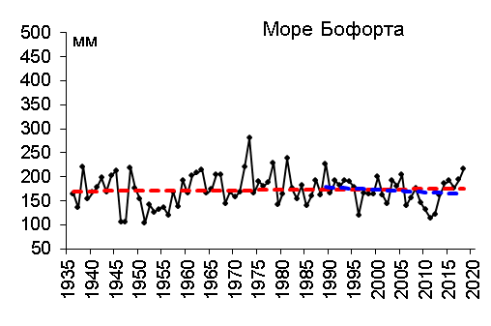
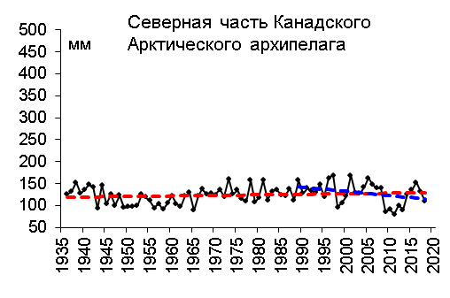
Precipitation trends for
ND 2018 - JFM 2019
N Greenland and Norwegian Seas
Barents Sea
Kara Sea
Laptev Sea
Analysis based on observations by the Arctic seas
Significant general positive trends – wetter conditions – for the Nordic seas
General negative trends – drier conditions - for Siberian shelf seas
No general significant trends for Alaska and Canadian Arctic regions
Eastern Siberian Sea
Chukchi Sea
Beaufort Sea
N Canadian Archipelago
Reference period: 1961-1990
[AARI]

Slide 9
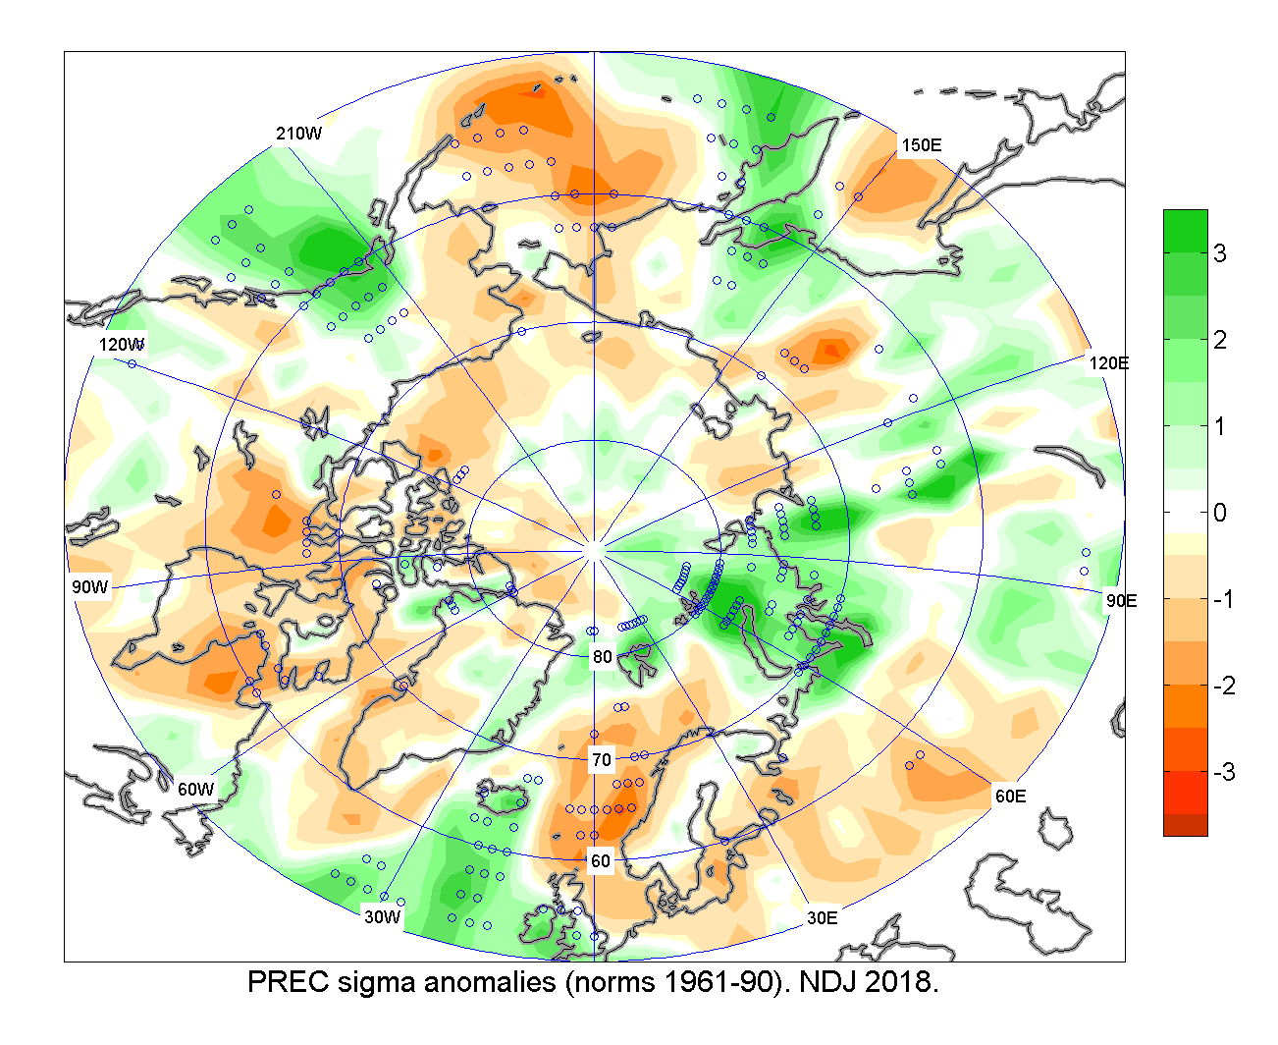
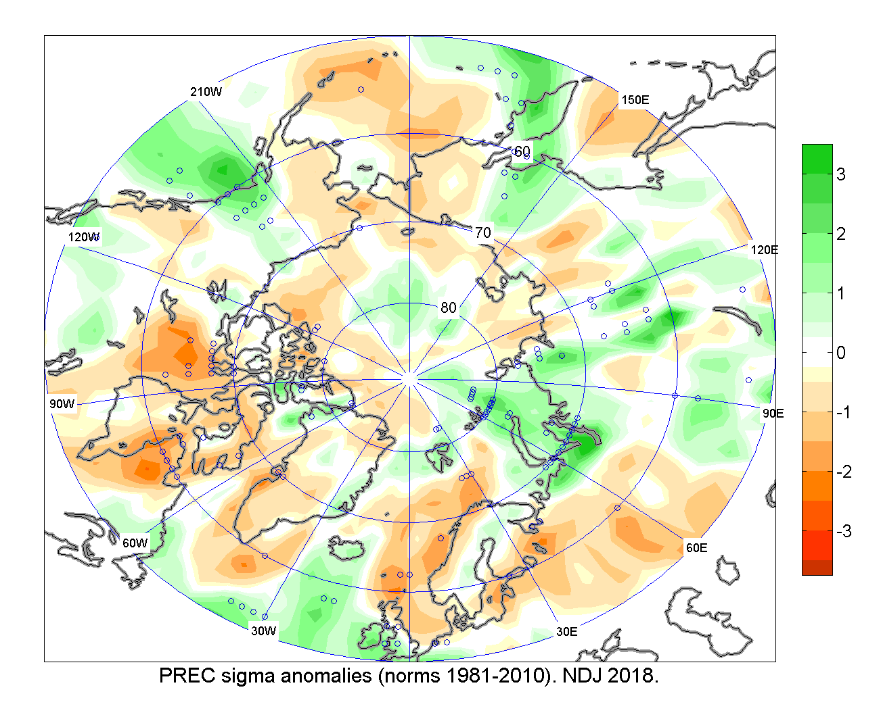
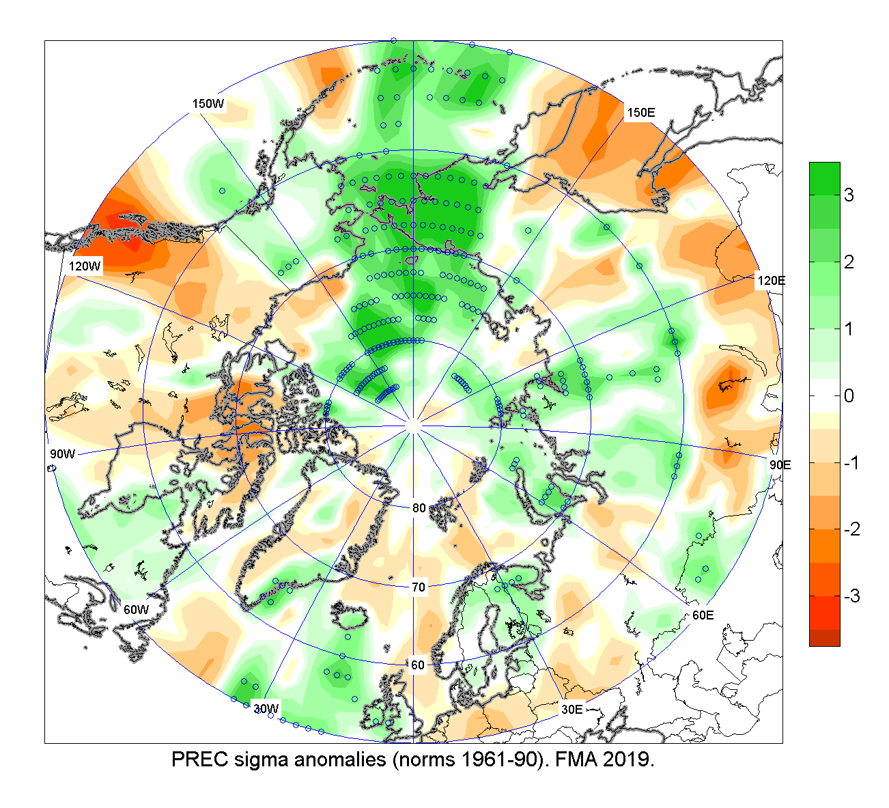
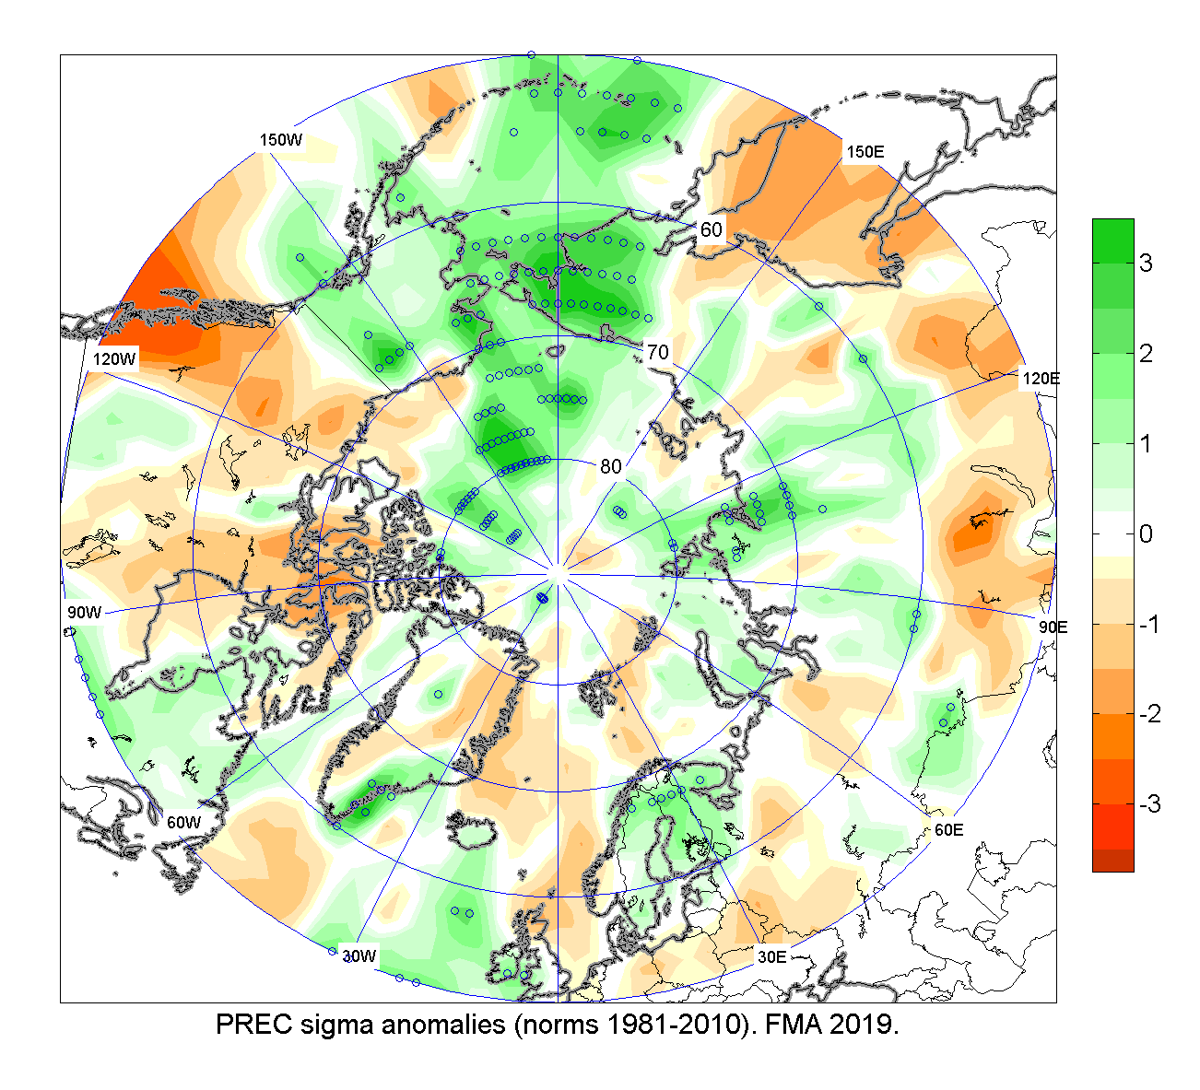
Precipitation NDJ and FMA 2018/2019: anomalies and ranks
NDJ 2018/2019
For NDJ 2018/2019 Siberia saw the driest winter (NDJ) in the 70-year record.
For FMA southern portion of the Canadian Arctic saw their driest spring in the 70-year record,
Contrary, NE Siberia and part of the Arctic Ocean saw their wettest spring on record.
Ref [1961-1990]
Ref [1981-2010]
FMA 2018/2019
Ref [1961-1990]
Ref [1981-2010]
HMC Moscow

Slide 10
Sea ice variables:
  Ice extent analysis
  Ice conditions analysis
  Ice thickness at coastal stations
  Sea ice thickness and volume for the Arctic Ocean
  Source:
  [AARI, NSIDC, CIS, US NIC, DMI] / JCOMM

Slide 11
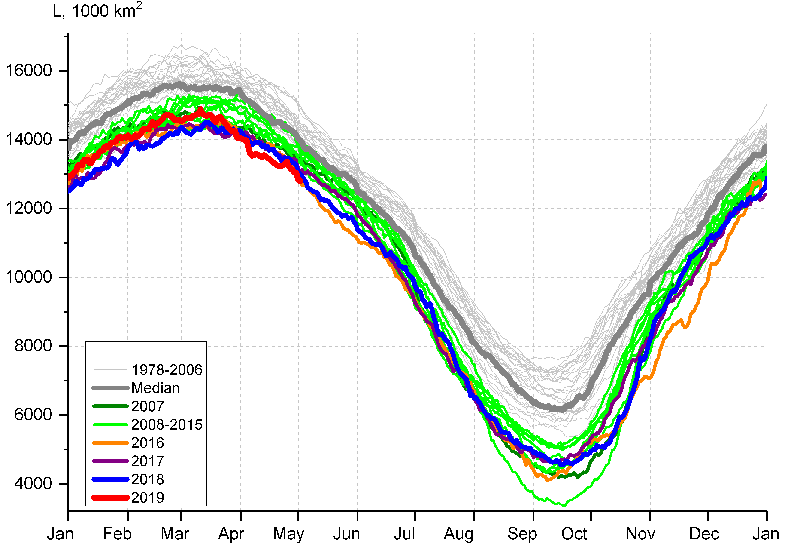
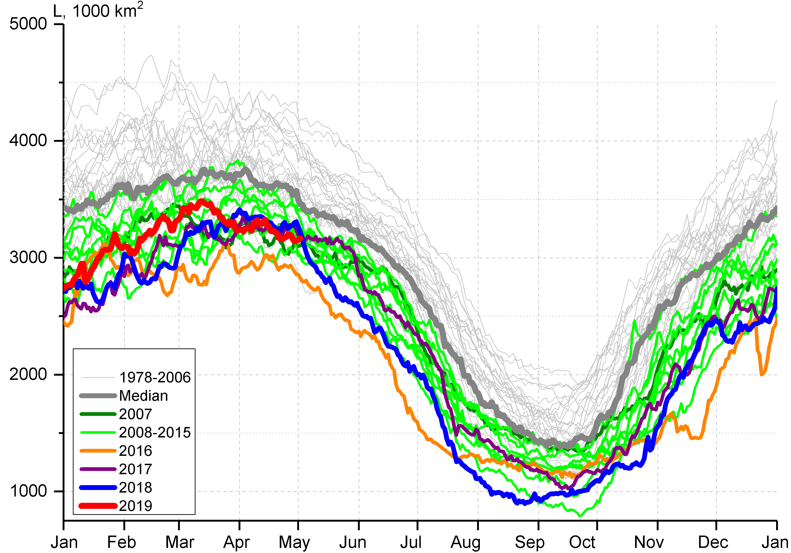
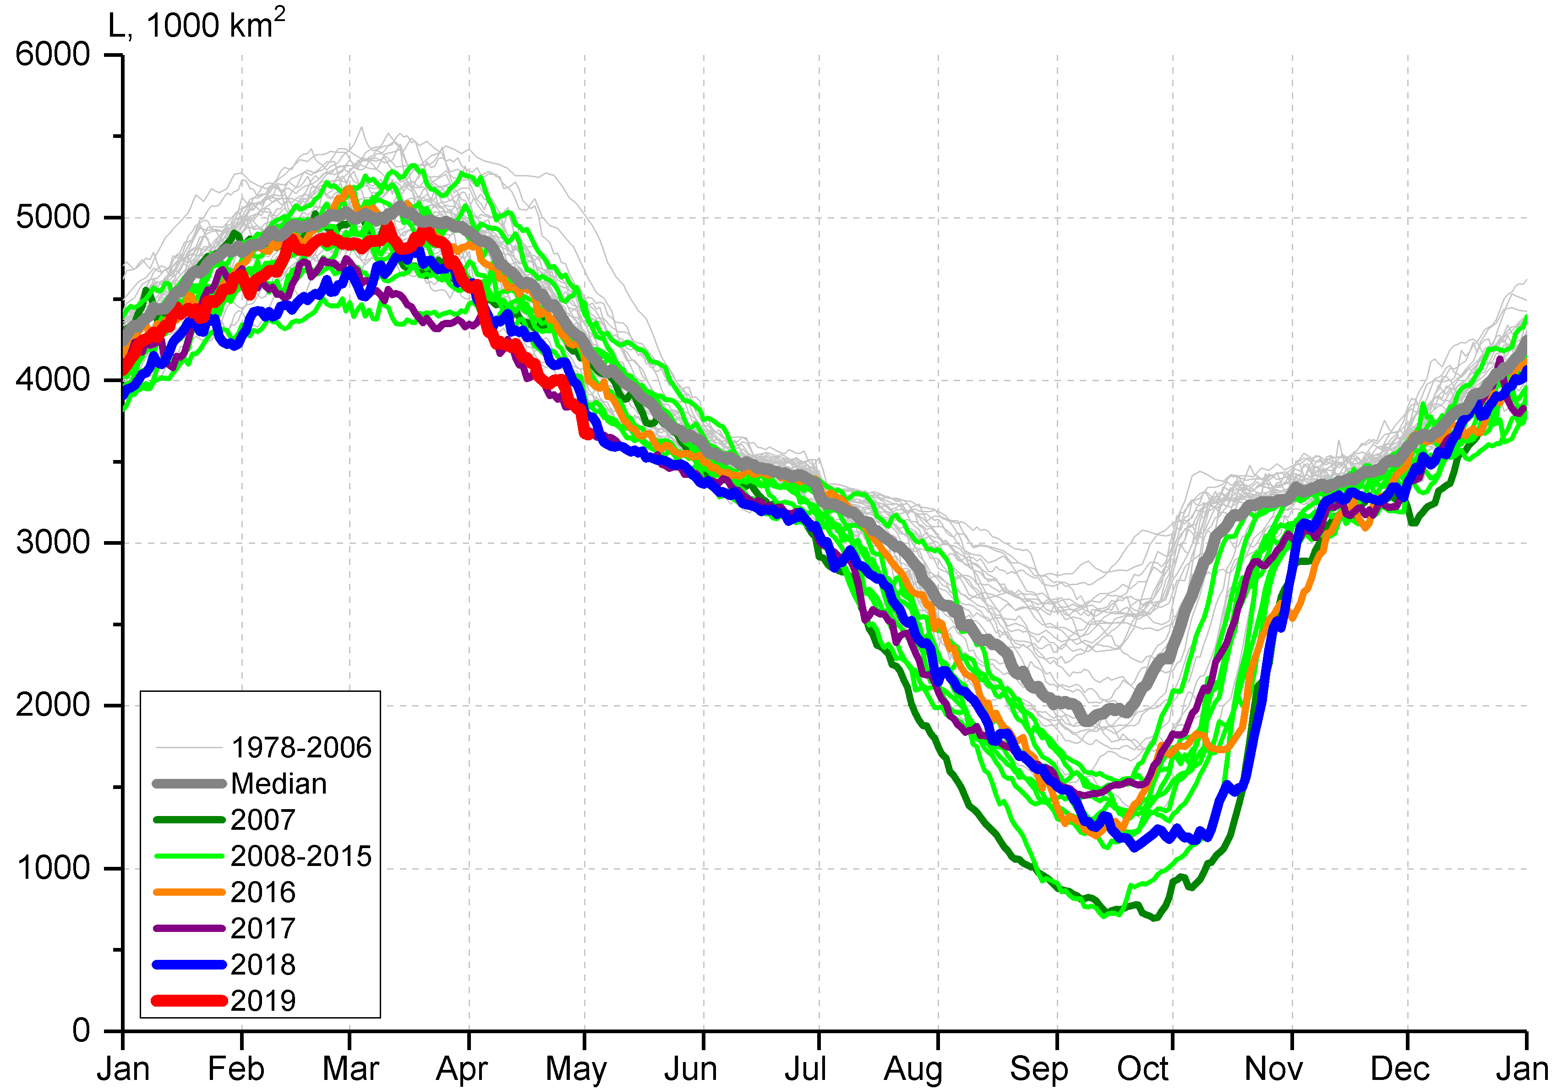
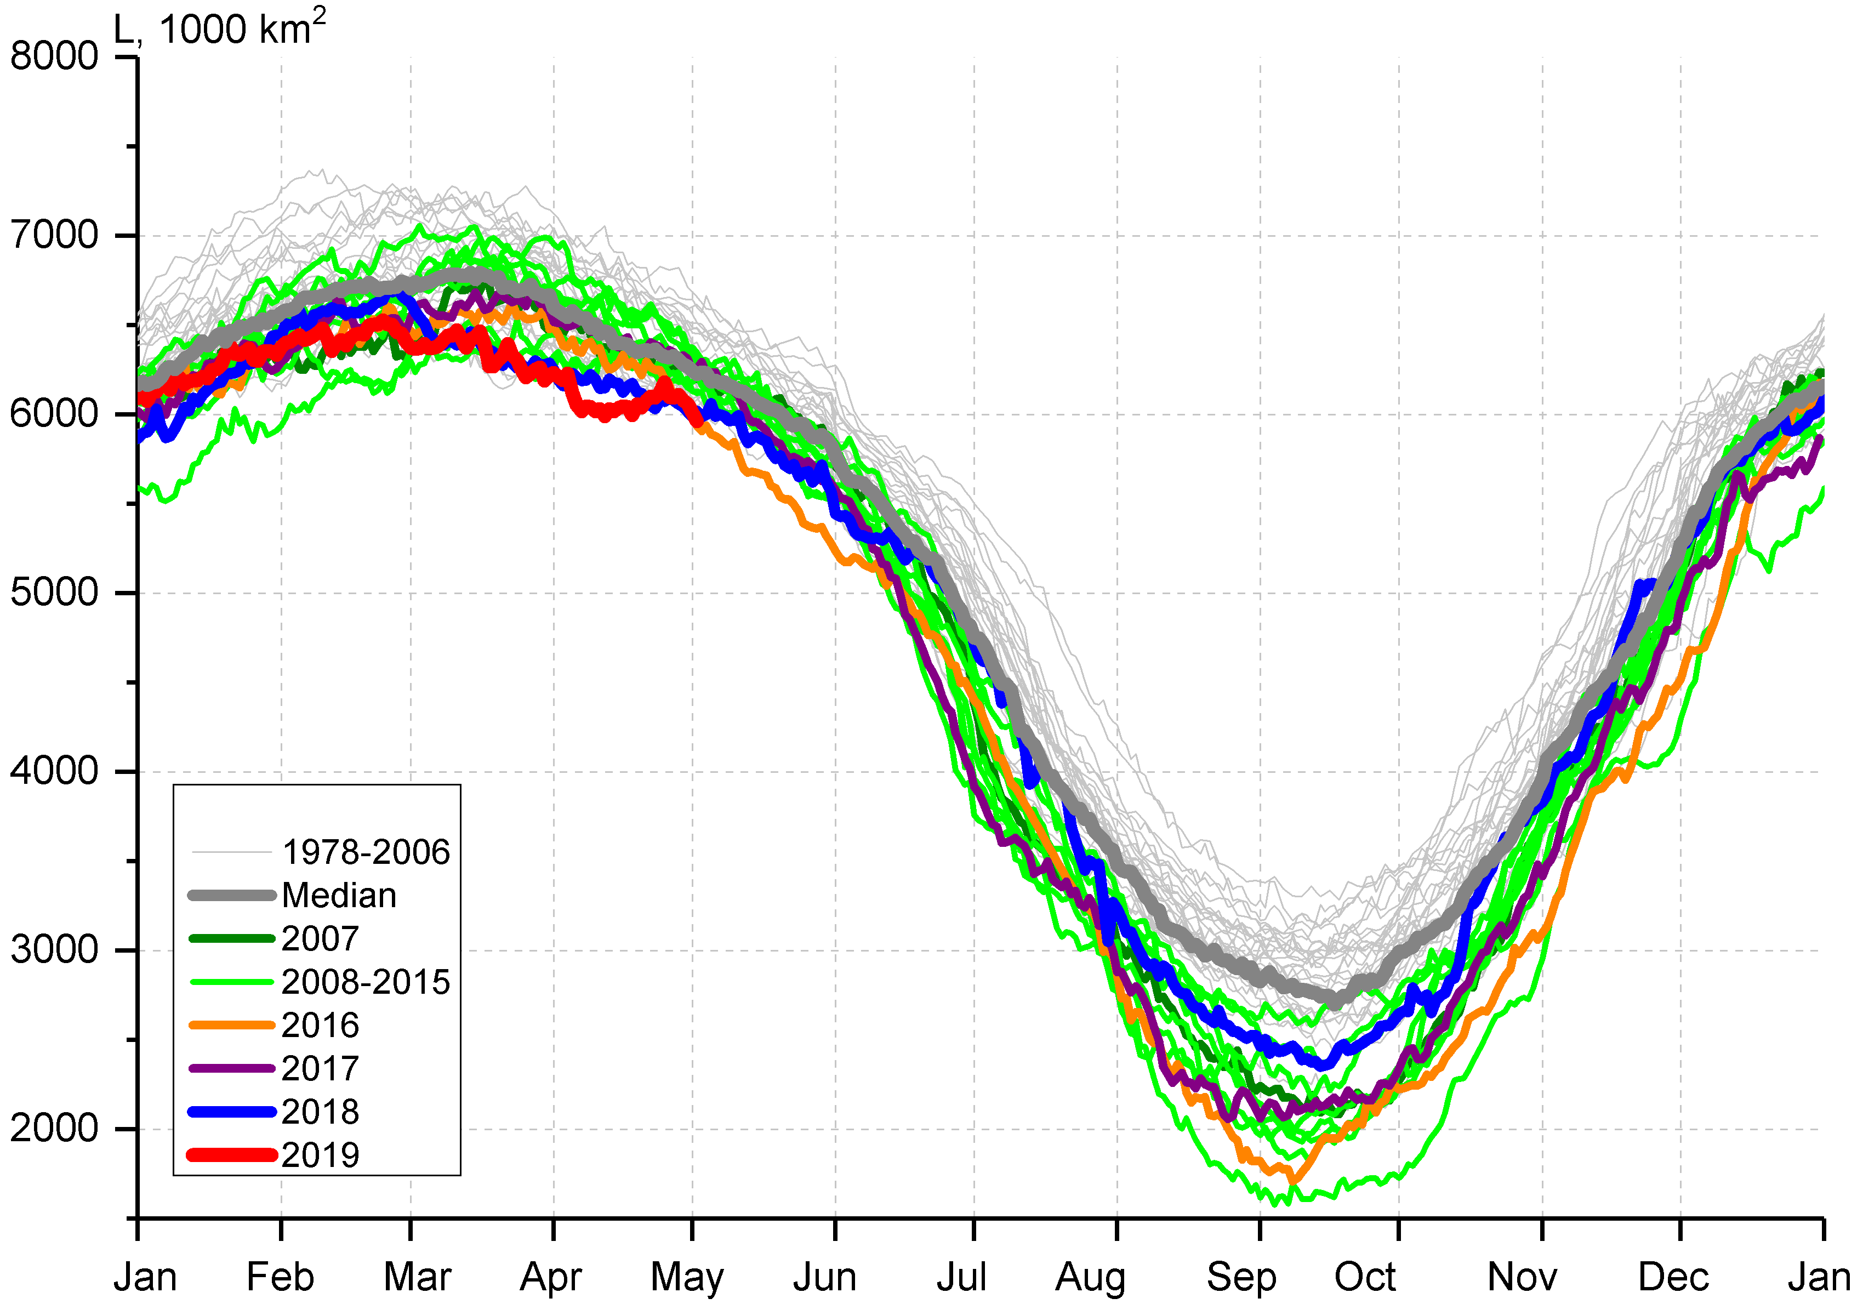

Arctic (NH) seasonal ice extent 1978…. 2019
S, 1000 km^{2*}
S, 1000 km²
S, 1000 km²
2017 | 14467
2018 | 14516
2015 | 14526
2016 | 14580
2011 | 14701
2006 | 14867
2019 | 14891
2007 | 14931
… | …
1988 | 16461
1983 | 16547
1979 | 16769
Northern Hemisphere
Western Arctic (WA)
Jan Feb Mar Apr May Jun Jul Aug Sep Oct Nov Dec Jan
Jan Feb Mar Apr May Jun Jul Aug Sep Oct Nov Dec Jan
S, 1000 km²
Eastern Arctic (EA)
S, 1000 km²
Canadian Arctic (CA)
* - minimum for Sep (AARI)
CA
EA
WA
Jan Feb Mar Apr May Jun Jul Aug Sep Oct Nov Dec Jan
Jan Feb Mar Apr May Jun Jul Aug Sep Oct Nov Dec Jan
Maximum winter ice extent, 7th in row, 14,89 mln km² (14,52 in 2018) reached 11 March 2019
Lowest on record in April due to Bering Sea
[AARI, NSIDC]

Slide 12
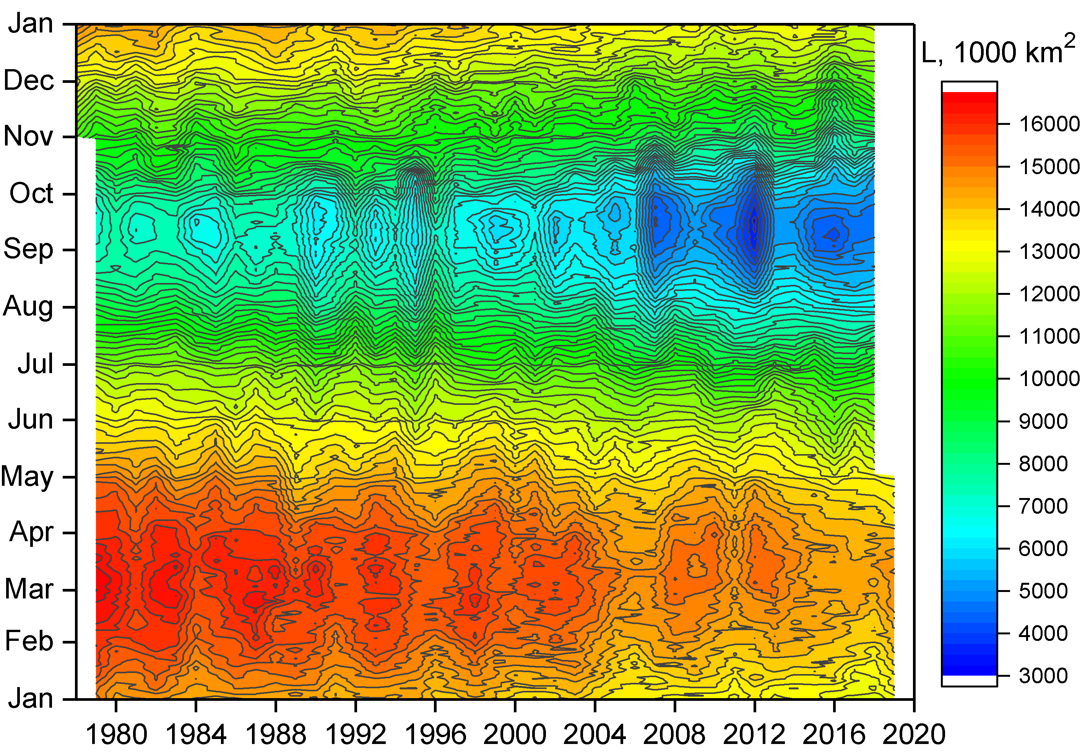
Seasonal NH ice extent variability: 1978 - 2019
Year-Seasonal diagram allows to analysis seasonal variability of ice extent
Both winter maximums and summer minimums continue to reduce….
Though… significant interannual variability of ice extent, ice conditions actually occurs
[AARI, NSIDC]

Slide 13
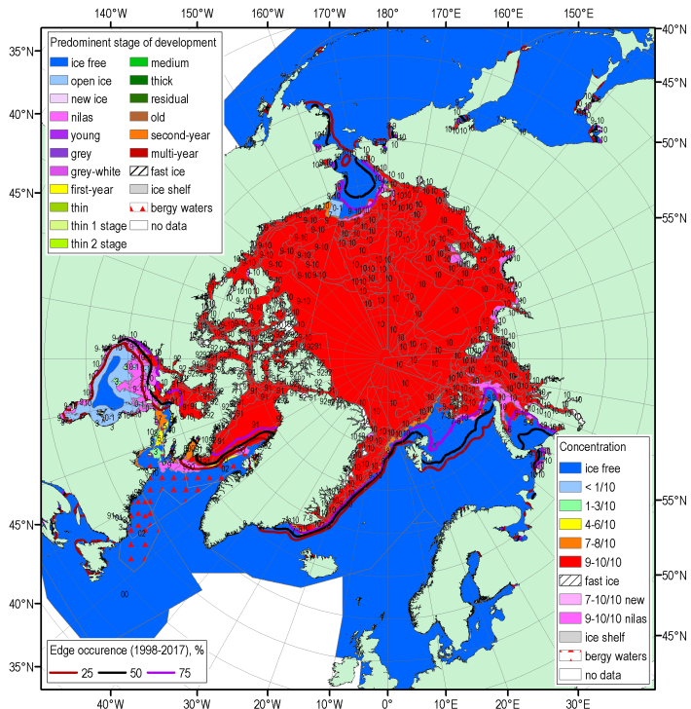
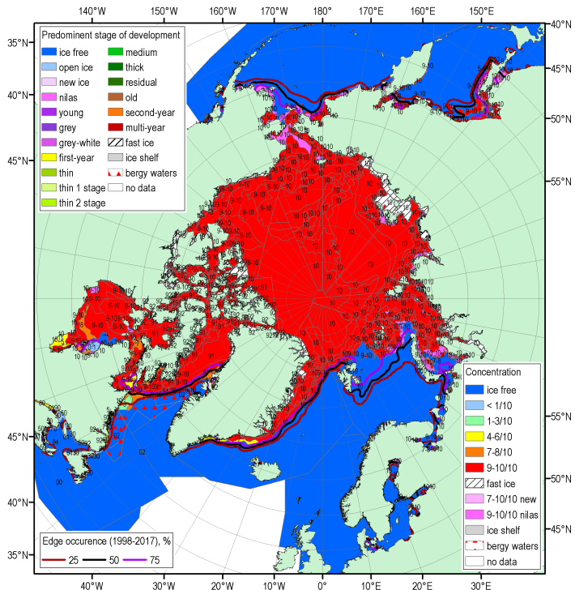
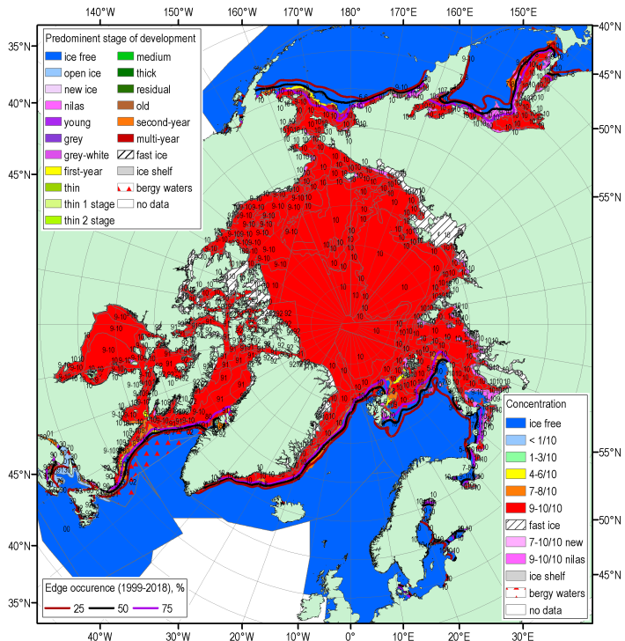
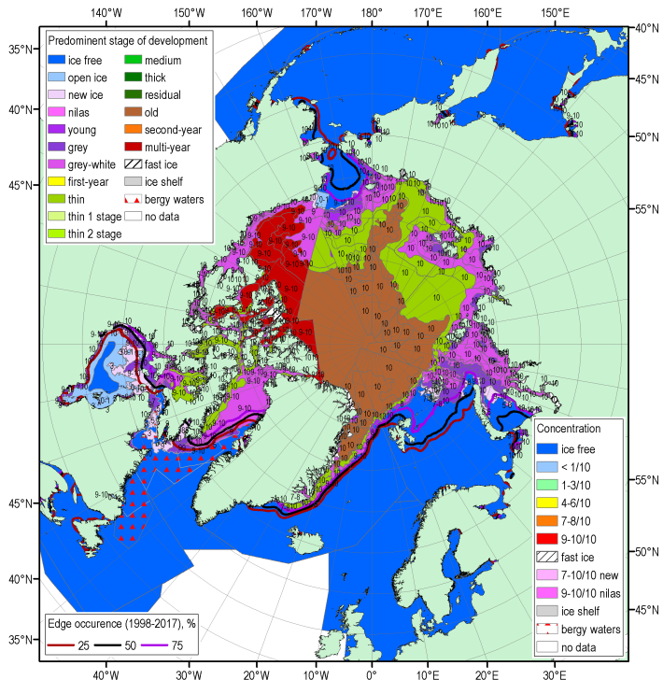
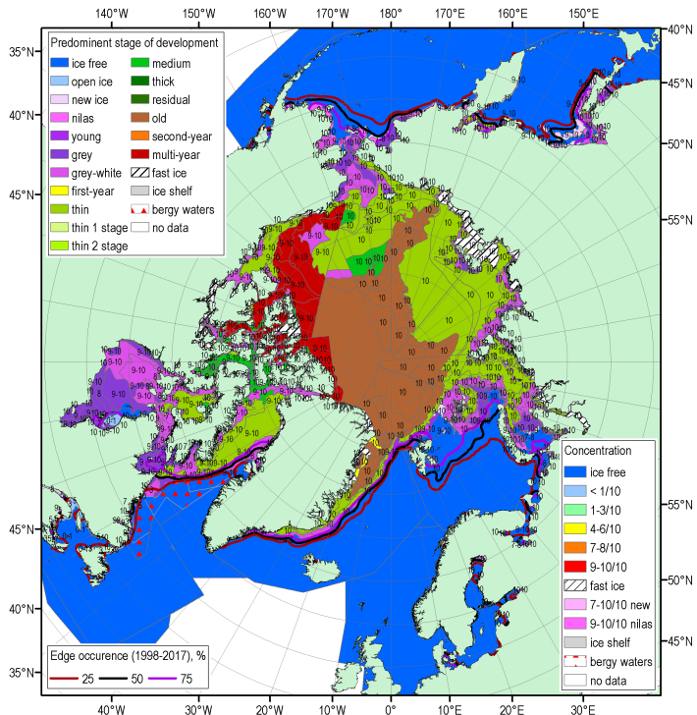
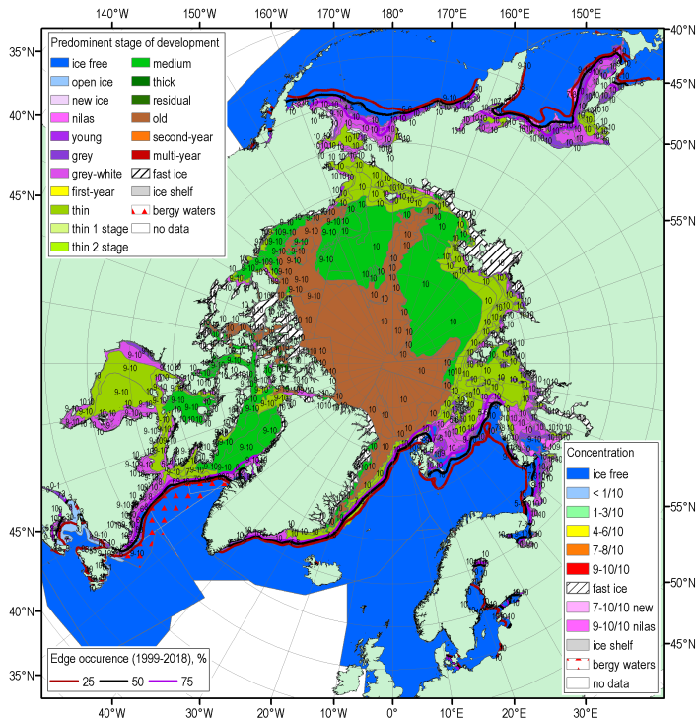
NDJ 2018/2019 Arctic sea ice – concentration and age (stage of development)
19-22 Nov
14-18 Jan
17-20 Dec
Blended AARI/CIS/NIC (JCOMM) ice charts; ice edge – nearest 5days, reference period: 1998-2017 (ND) and 1999-2018 (J)

Slide 14
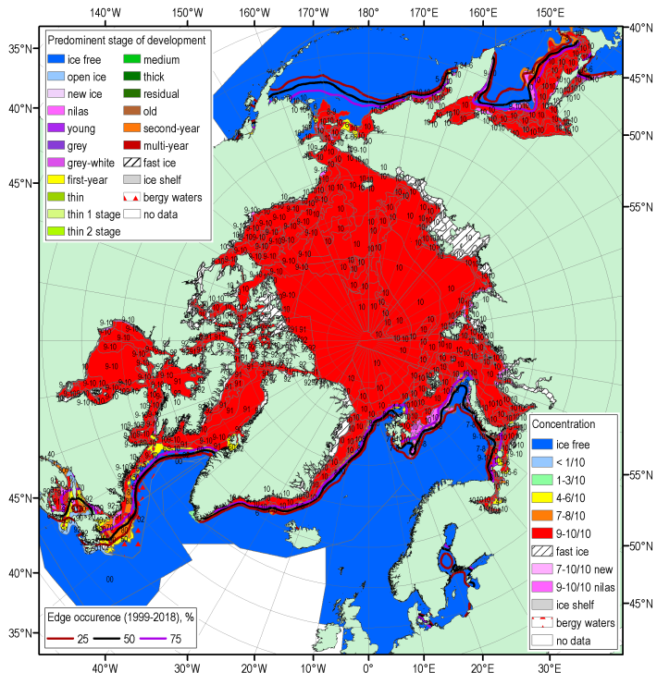
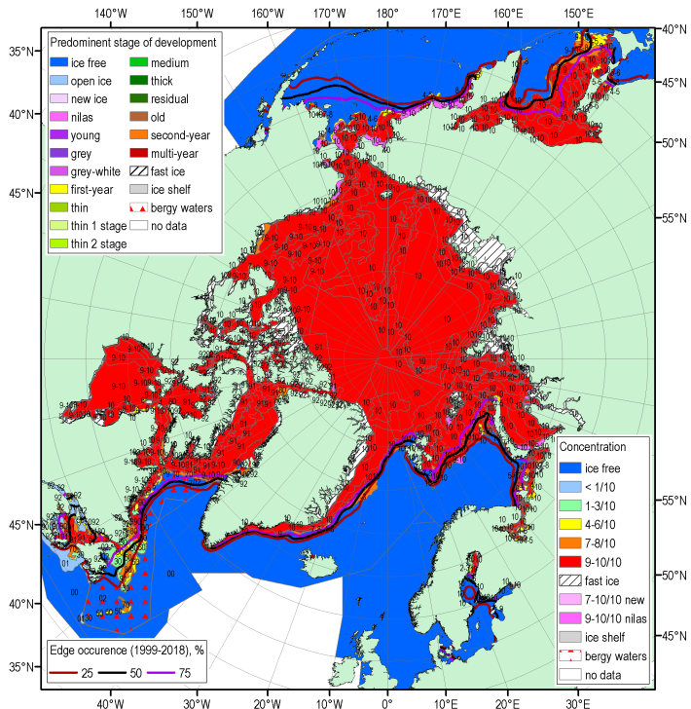
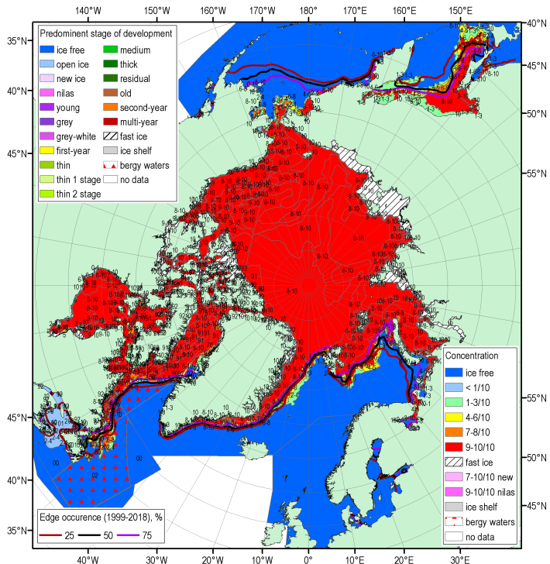
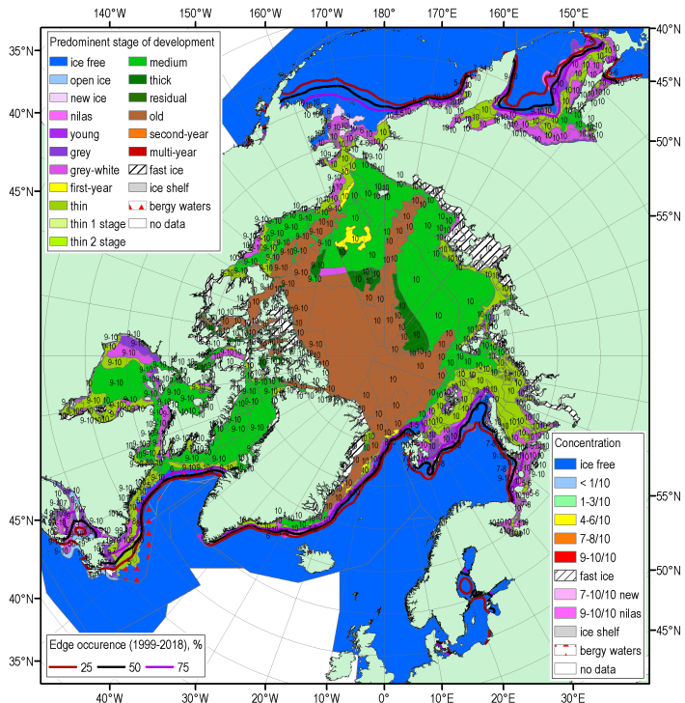
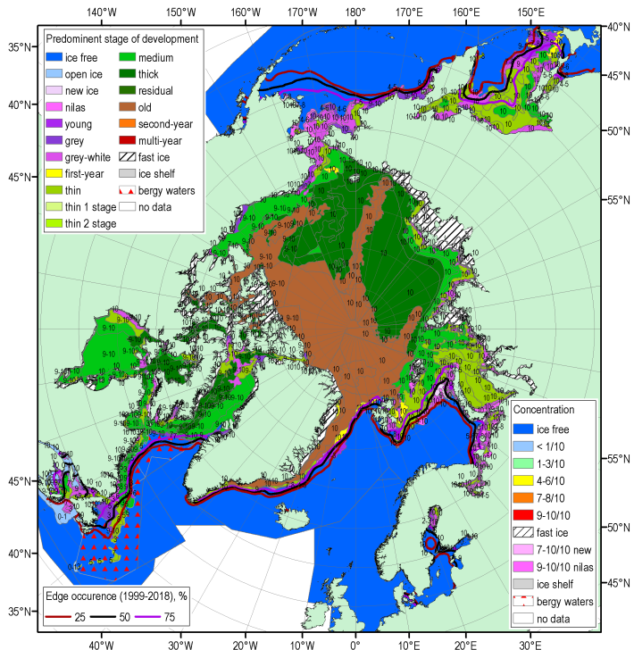
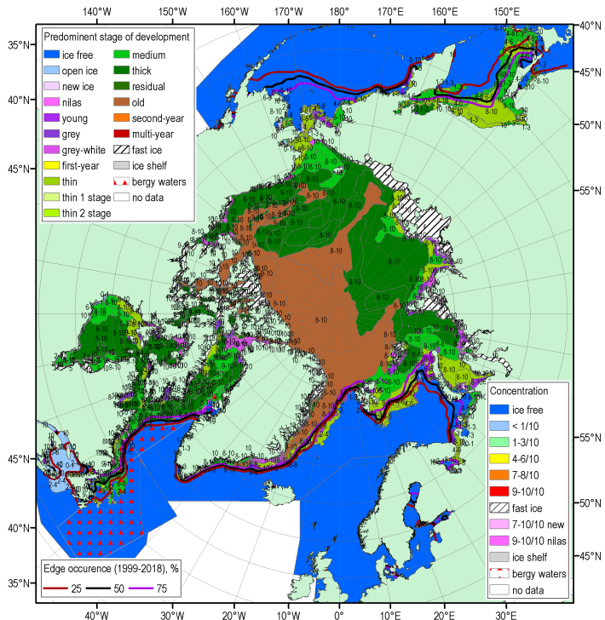
FMA 2019 Arctic sea ice – concentration and age (stage of development)
11-14 Feb
19-22 Mar
11-15 Apr
Blended AARI/CIS/NIC (JCOMM) ice charts; ice edge – nearest 5 days, reference period: 1999-2018

Slide 15
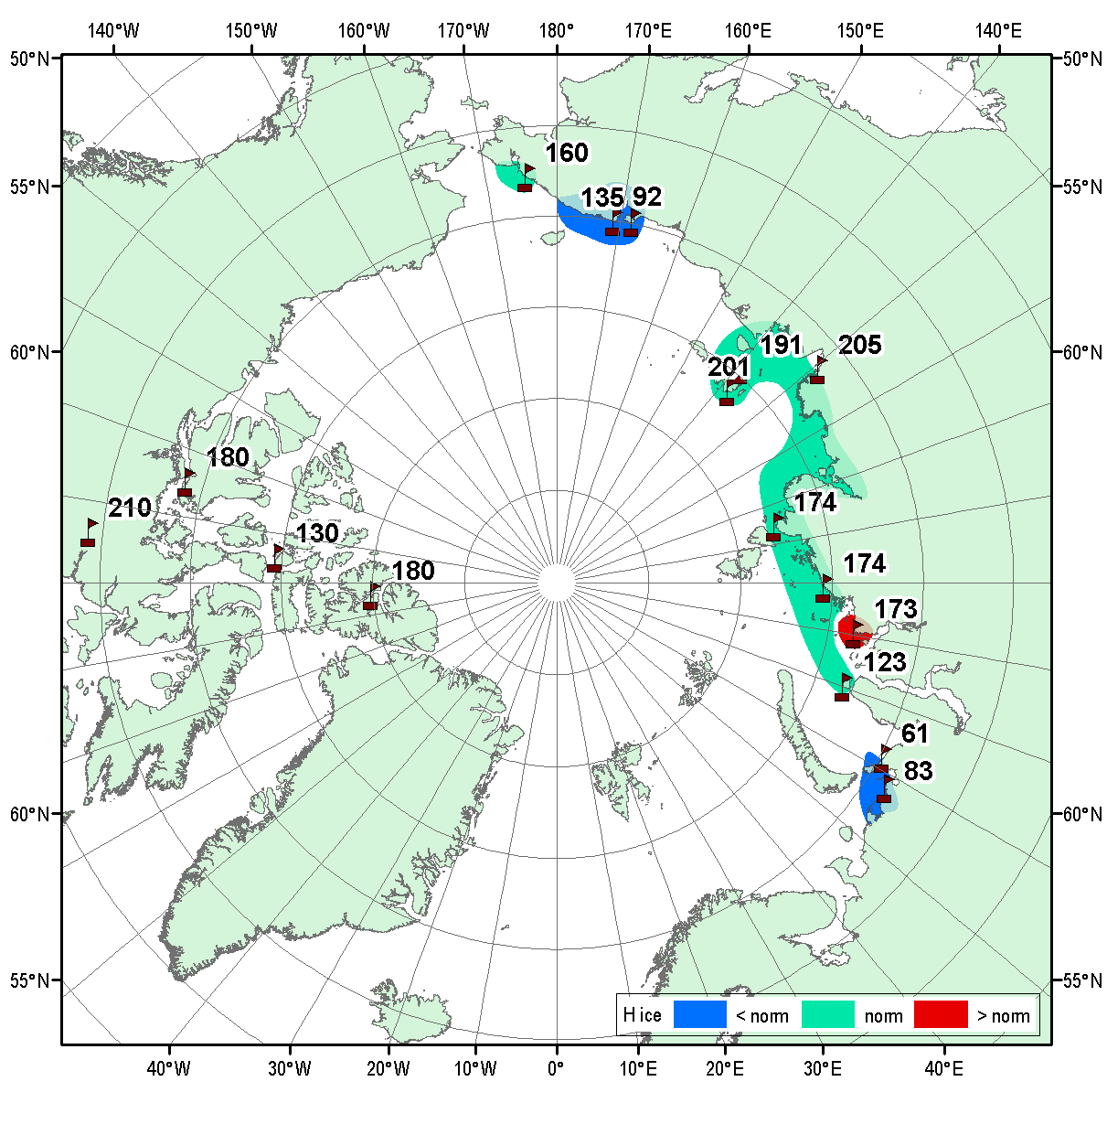
Sea ice fast ice maximum thickness values and anomalies by end of April/Mar 2019 (stations)
WMO stations used:
Russia: 12 (Varandey, Amderma, Belyi, Dikson, Sterlegova, Cheluskin, Tiksi, Kotelnyi, Sannikova, Ayon, Valkarkay, Vankarem)
Canada: 5 (Eureka, Baker Lake, Cambridge Bay, Resolute, Nain NL)
Observed maximum winter ice thicknesses slightly less than normal for most of the Arctic seas
Thicker ice observed in Kara sea
Significantly thinner observed in Chukchi Sea region.
Several stations - Baker Lake, Tiksi, Kotelny, North Pole, recorded values (201…215 cm) close to physical maximum for the first year ice.
Ref [1989-2019]
[AARI, CIS]

Slide 16
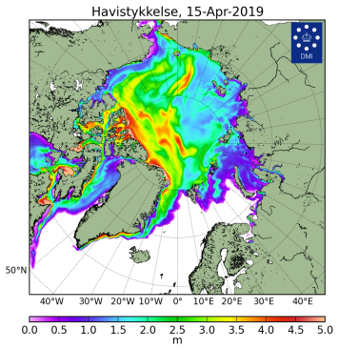
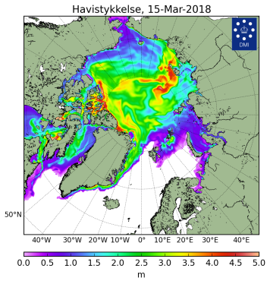
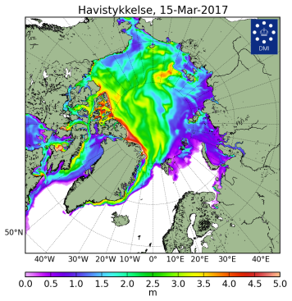
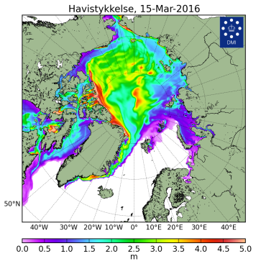
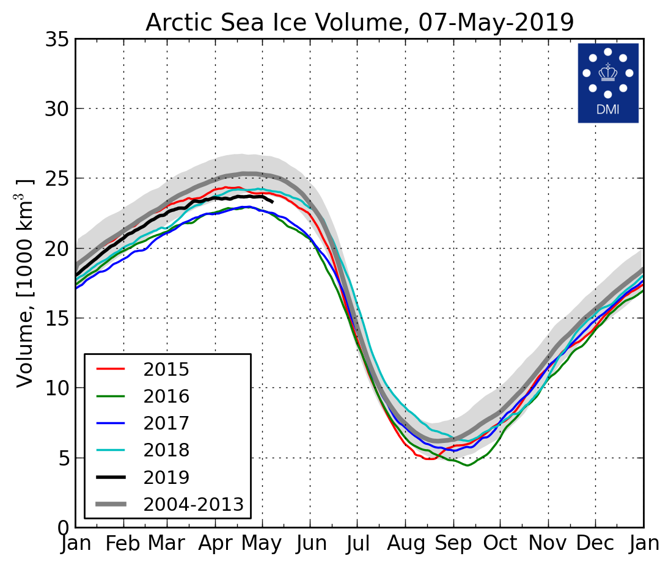
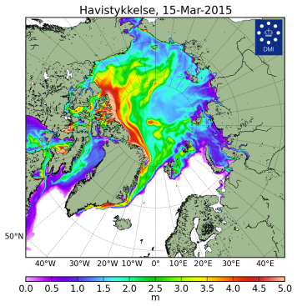
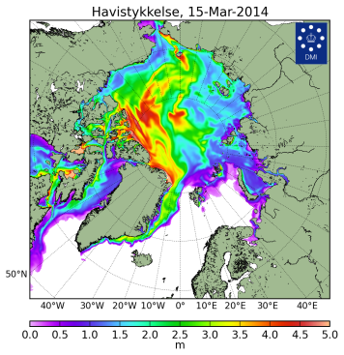
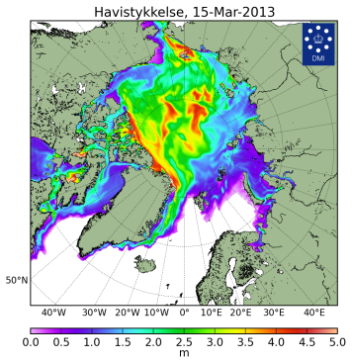









Sea ice thickness for 15 Mar 2004…2019 and ice volume
[Madsen et al, 2015]
2019
2018
2017
2016
2019
2015
2014
2013
2012
Models show Arctic ice volume greater or slightly less as in 2018 for JFMA 2019,
Similar ice extent means overall ice thicknesses in winter 2019 are comparable to winter 2018
2011
2010
2009
2008
2007
2006
2005
2004
DMI North Atlantic - Arctic Ocean model HYCOM-CICE - http://ocean.dmi.dk/models/hycom.uk.php

Slide 17
Solid precipitation (snow):
  Snow water equivalent (ocean, land)
  Snow area (land)
  Source:
  [FMI, ECCC] / GCW

Slide 18





Terrestrial and marine snow
Snow water equivalent (SWE) – marine + land
Snow volume on sea ice and land (snow water equivalent) was higher than on record for the past season
Higher than normal land snow area recorded for Canada and Alaska with lesser than normal for parts of the season for Eurasia region
Snow area – land
[FMI, ECCC / GCW)]

Slide 19




Current Ice Conditions (22-23 October 2018)
Current status (2 …. 7 May 2019)
High variability of ice conditions remains typical feature for the regional seas.
Till the beginning of May 2019 week westerly and strong northern winds (NAO<0) in the Barents and partly in the Kara Seas regions continue to preserve negative temperature anomalies
N Barents Sea preserves a prominent sea ice extent close to normal which will slow melting process
Contrary Bering and adjacent Chukchi Seas have very mild ice conditions, consequently higher waves
AARI/NIC ice chart for 2-7 May 2019
Surface air temperature (2m), precipitation anomalies
and mean wind vectors (10 m) for 3-7.05.2019 (http://polarportal.dk)

Slide 20
Thank you! Merci! Takk! Спасибо!
Tak! Tack! Kiitos! þakka þér fyrir!
Giitu !

Slide 21
Background slides

Slide 22
Arctic Seasonal Highlights
  Temperature & Precipitation (NDJ 2018/2019 and FMA 2019)
Atmospheric circulation: For NDJ positive MSLP anomalies dominated over European and west Siberian region with opposite situation in the Atlantic and Alaska regions. That led to prevalence of meridian form of circulation in the troposphere and bi-central polar vortex. For FMA very significant negative anomalies observed in the northern Eurasia and Greenland led to increased cyclonic activity with further increased precipitation.
Surface air temperature: The November 2018, December 2018, and January 2019 (NDJ, winter) average surface air temperature in the Arctic domain north of 65°N was, in the majority, above average. Using data from NCEP/NCAR reanalysis to rank the average surface air temperature, the NDJ period ranged from the top 10 warmest over parts of Alaska, Greenland, and the European Arctic, to the 3rd coldest (a portion of the southern Canadian Arctic) winter in 70 years, since the start of the record in 1949. Over the February, March, and April (FMA, spring) 2019 period, average surface air temperature in the Arctic domain north of 65°N was, in the majority, above average. Particularly, Alaska, northwestern Canada, central Siberia, and the Beaufort, Chukchi and Bering Seas saw their warmest spring (FMA) since the start of the record in 1949. On the other hand, average surface air temperature over eastern Canadian Arctic for that same time period was only the 30th-45th warmest, that is near the median for the same period.
Precipitation: Siberia saw their driest winter (NDJ) in the 70-year record. The southern portion of the Canadian Arctic saw their driest spring (FMA) in the 70-year record, while northeastern Siberia and a portion of the Arctic Ocean saw their wettest spring on record.
Arctic (NH) Sea Ice (NDJ 2018/2019 and FMA 2019)
Sea ice: The winter maximum sea ice extent (14.89 mln km²), reached on 11/03, was the 7th minimum in row since 1979 (2018 – 2nd), with the maximum winter sea ice extent observed in 1979 (16.77 mln km²). Estimates of the sea ice volume, based on numerical reanalysis (HYCOM-CICE, PIOMAS), show slightly higher or similar to 2018 values and significantly higher than in 2016-2017. Observed at coastal stations maximum winter ice thicknesses was slightly less than normal for most of the Arctic seas with some positive anomalies observed in Kara sea and significant negative anomalies in Chukchi Sea region. At several stations Baker Lake, Tiksi, Kotelny, North Pole) recorded vales (201…215 cm) were close to physical maximum for the first year ice.
High variability of ice conditions was recorded during the observed period for some of the regional seas. The thermal and wind patterns during winter 2018-2019 led to extreme low ice extent in Bering Sea with close to normal ice extent in the adjacent Sea of Okhotsk. Predominance of northerly winds in the Barents Sea region since Jan 2019 led to close to normal ice extent in the northern part of this area which is opposite both to autumn 2018 as well as last decade situation.

Slide 23












NDJ 2018/2019 atmospheric circulation (reanalysis)
November
MSLP
H500
H200
December
H50
[HMC Moscow, DMI]
January
reference period: 2004-2013

Slide 24












FMA 2019 atmospheric circulation (reanalysis)
February
MSLP
H500
H200
March
H50
[HMC Moscow, DMI]
April
reference period: 2004-2013

Slide 25


SAT NDJ and FMA 2018/2019: anomalies and ranks (reanalysis)
NDJ 2018/2019
Ref [1961-1990]
Ref [1981-2010]
FMA 2018/2019
Ref [1961-1990]
Ref [1981-2010]
[HMC Moscow, NOAAI]

Slide 26


Precipitation NDJ and FMA 2018/2019: anomalies and ranks (reanalysis)
NDJ 2018/2019
Ref [1961-1990]
Ref [1981-2010]
FMA 2018/2019
Ref [1961-1990]
Ref [1981-2010]

Slide 27




Terrestrial and marine snow
Snow water equivalent (SWE)
The snow water equivalent product (SWE) is based on the combination of satellite-based microwave radiometer and ground-based weather station data
The areal snow extent product is based on satellite-based optical data. It includes daily, weekly and monthly snow extent products excluding glaciers, Greenland, Antarctica and snow on ice (lakes/seas/oceans).
Snow area

