Slide 1

June 2019 – August 2019
Arctic Summer
Seasonal Review
Hydrometcenter of Russia
Arctic and Antarctic Research Institute

Slide 2
Content of JJA 2019 review
Atmospheric circulation conditions (mean sea level pressure and geopotential height)
State of surface climate (air temperature and precipitation)
Sea ice characteristic analysis
Ice extent
Ice conditions
Ice thickness and volume
Solid precipitation (snow)
Summer highlights

Slide 3
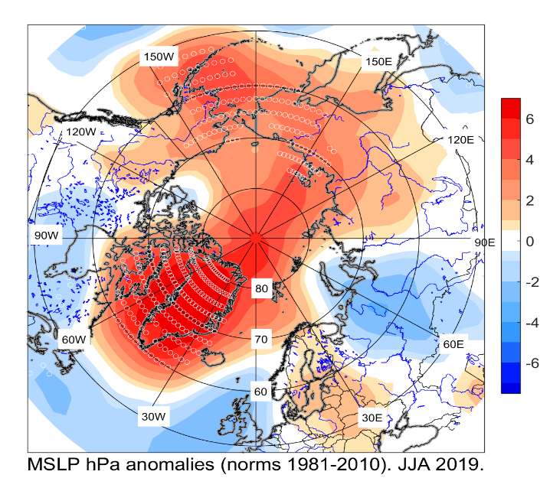
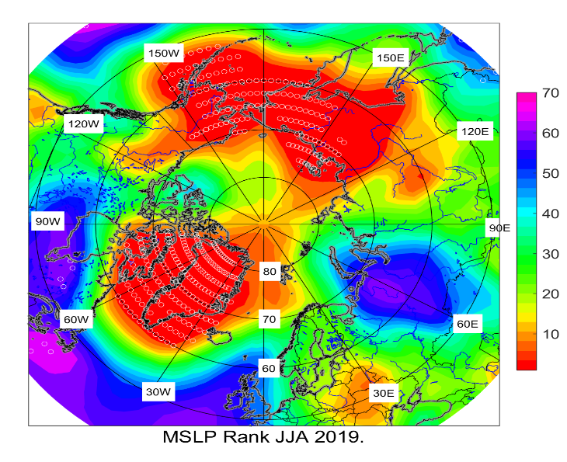
JJA 2019 atmospheric circulation
Low troposphere
Intensification of polar and subpolar anticyclones led to large positive anomalies in pressure fields.
Record high pressure was observed in parts of Greenland, Alaska and Siberia.
Atlantic cyclones moved along Arctic sea coast and frequently were blocked in North of European Territory of Russia where low pressure system had been persisted with notable negative anomalies.
HMC, Moscow/ NCEP/NCAR reanalysis

Slide 4
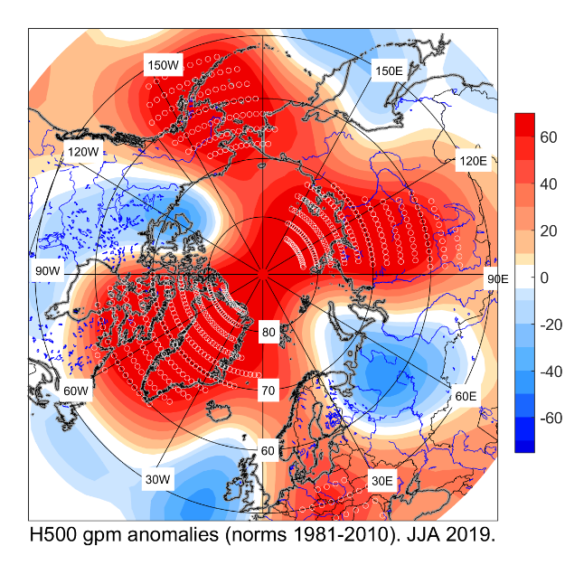
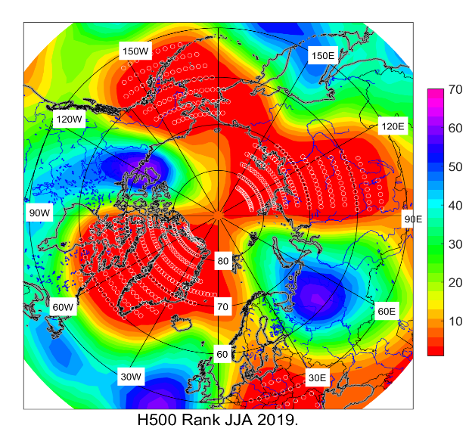
JJA 2019 atmospheric circulation
Middle troposphere
High pressure system was intensified over Greenland, central Arctic, North Siberia, and North of Pacific ocean by tropospheric Atlantic, Pacific and West Siberia ridges.
The dominance of meridional form of circulation in the middle troposphere has been observed.
Polar vortex was weak and separated into two low-pressure zones (north of Canada, north of Siberia).
HMC, Moscow/ NCEP/NCAR reanalysis

Slide 5
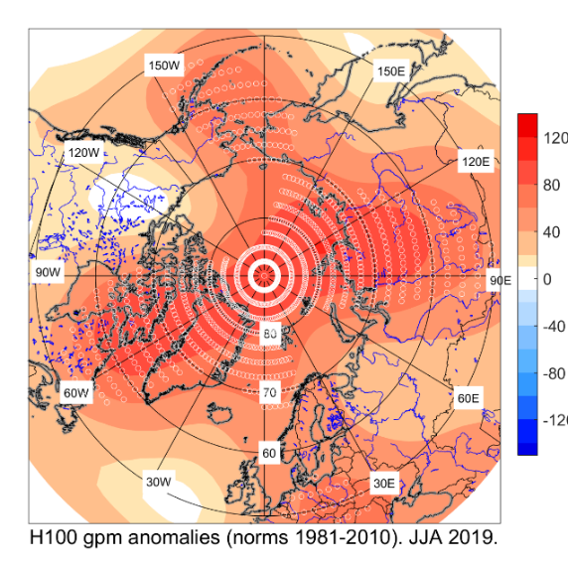
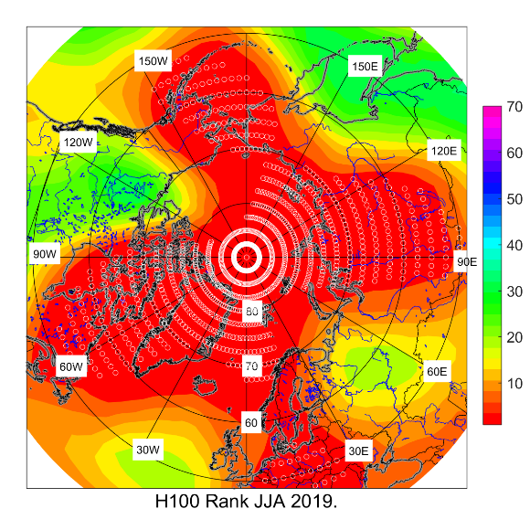
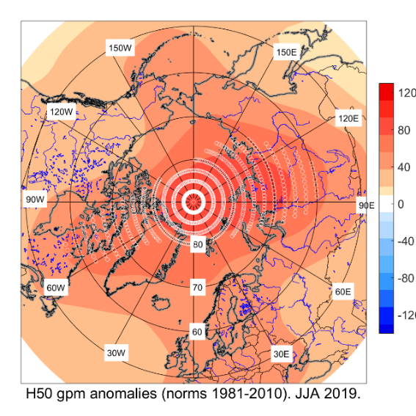
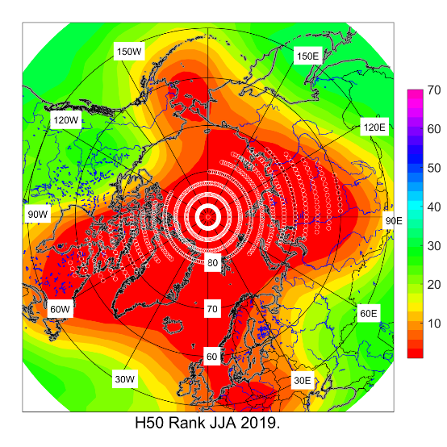
JJA 2019 atmospheric circulation
Upper troposphere and
low stratosphere
Location of center of stratospheric anticyclone was close to normal.
Near record positive geopotential anomalies were observed in the upper troposphere and low stratosphere.
HMC, Moscow/ NCEP/NCAR reanalysis

Slide 6
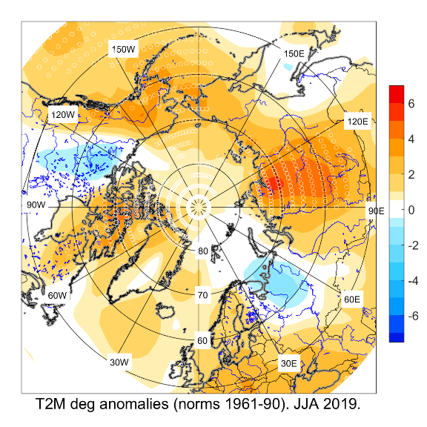
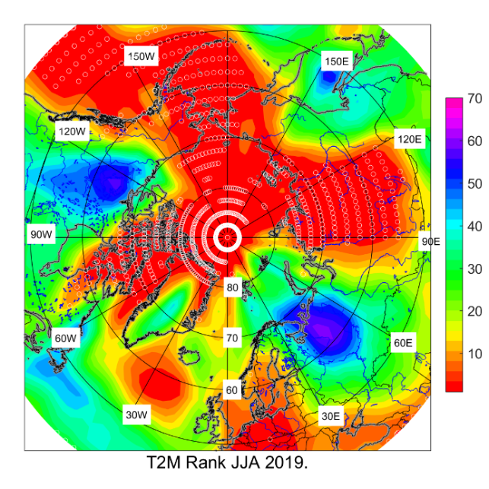
June – August 2019 T2m: anomalies and ranks (reanalysis)
Jun – Aug 2018
The summer air temperature across Arctic was above normal except northern part of Canada and north-west of Russia.
The most notable positive anomalies were present across of Alaska and surrounding sea, Canadian Archipelago, North of Siberia.
The record temperatures were observed in East Siberia.
HMC, Moscow/ AARI/
NCEP/NCAR reanalysis

Slide 7
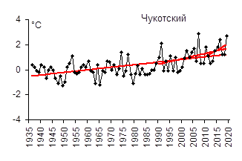
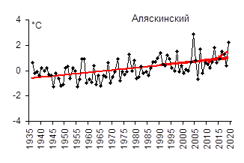

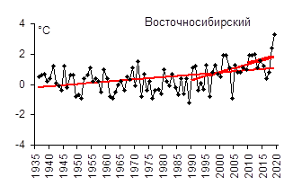
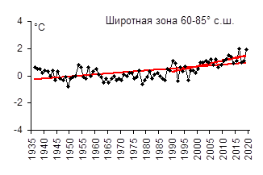
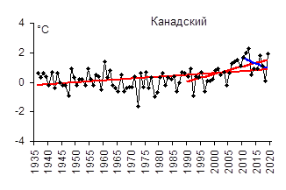
SAT anomalies by regions in 2019
(observations)
Region | Anomaly | Anomaly number in row | The warmest year (anomaly) | The coldest year (anomaly)
Atlantic | 1,5 | 3 | 2003 (1,9) | 1965 (-0,7)
N Europe | 0,0 | 20 | 2013 (2,8) | 1969 (-1,6)
West Siberia | 1,7 | 4 | 2016 (3,6) | 1968 (-1,6)
East Siberia | 2,9 | 1 | 2019 (2,9) | 1989 (-1,2)
Chukchi | 2,7 | 2 | 2007 (2,9) | 1949 (-1,3)
Alaska | 1,9 | 2 | 2004 (2,9) | 1945, 1955 (-1,3)
Canadian | 1,7 | 5 | 2012 (2,3) | 1972 (-1,6)
Reference period: 1961-1990
1- Atlantic
2 - N Europe
5 - Chukchi
6 - Alaska
3 - West Siberia
4 - East Siberia
7 - Canadian
Zone 60-85 °N
[AARI]

Slide 8
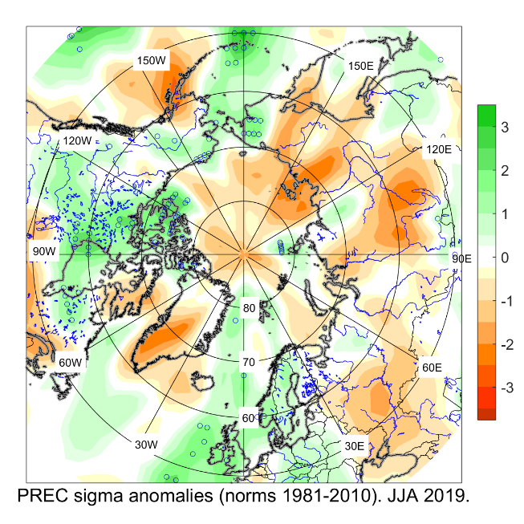
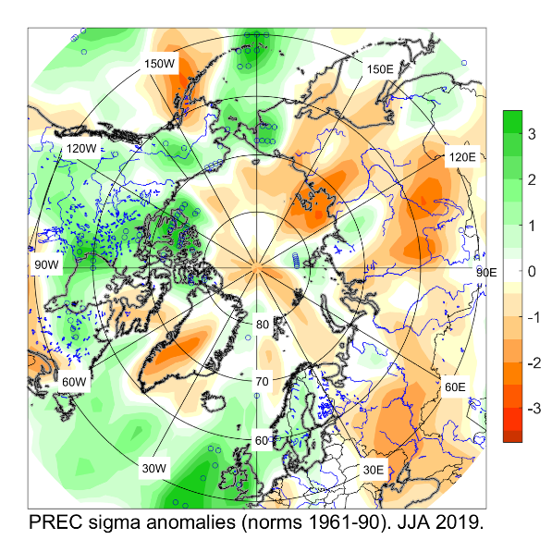
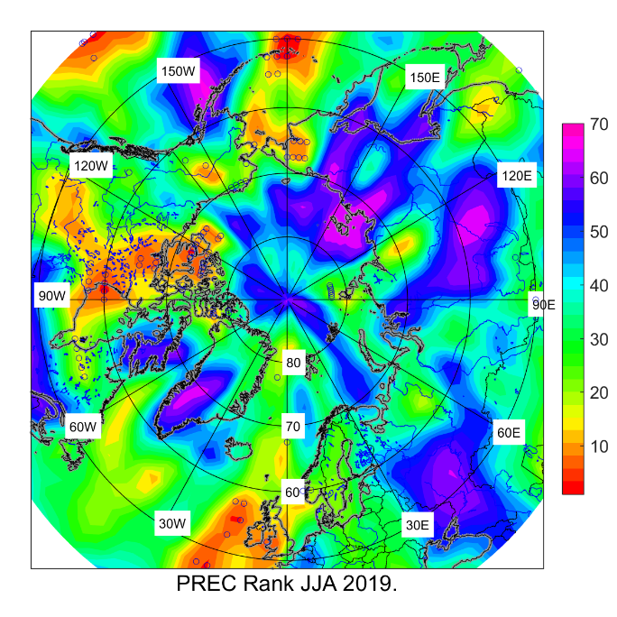
May – Sep 2019 Precipitation anomalies and ranks
Jun – Aug 2019
Drier than average conditions were observed across much of North Eurasia except North Europe and East of Chukotka.
The summer precipitation for the central Arctic and Greenland was bellow average.
Above normal precipitation were present across much of Canada (near record), North of Atlantic, Okhotsk sea.
HMC, Moscow/
NCEP/NCAR reanalysis

Slide 9
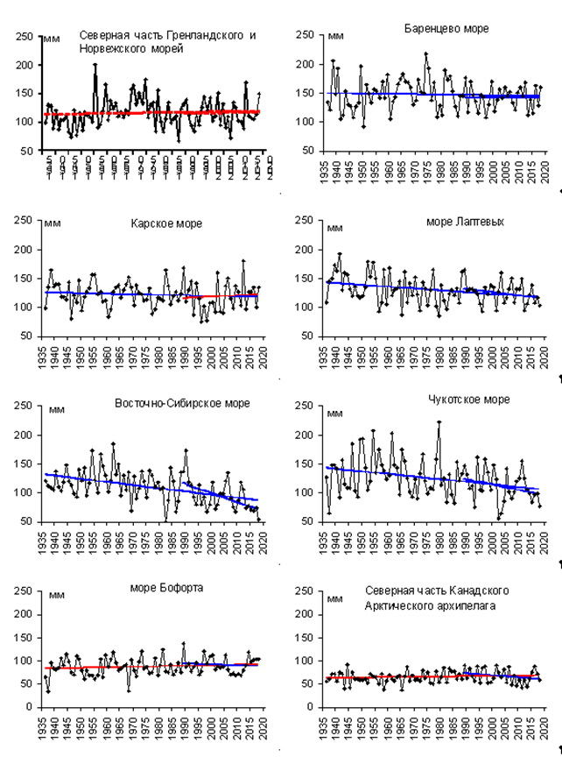
Precipitation anomalies by regions in 2019
N Greenland and Norwegian Seas
Barents Sea
Region | Relative anom, % | The greatest value | The lowest value
Atlantic | 98,0 | 1964 (120,5) | 1968 (75,2)
N Europe | 104,5 | 1981 (128,4) | 1980 (68,5)
West Siberia | 112,3 | 2002 (122,6) | 1946 (72,4)
East Siberia | 81,7 | 1988 (125,2) | 1967 (78,4)
Chukchi | 81,1 | 1954 (139,6) | 1982 (60,2)
Alaska | 113,1 | 1951 (164,4) | 1968 (54,1)
Canada | 111,6 | 2005 (123,5) | 1977 (75,0)
60-70°N | 102,6 | 1954 (115%) | 1968 (88%)
70-85°N | 103,2 | 1989 (127%) | 1998 (84%)
60-85°N | 100,6 | 1954 (117%) | 1980 (90%)
Kara Sea
Laptev Sea
Eastern Siberian Sea
Chukchi Sea
Beaufort Sea
N Canadian Archipelago
Reference period: 1961-1990
[AARI]

Slide 10
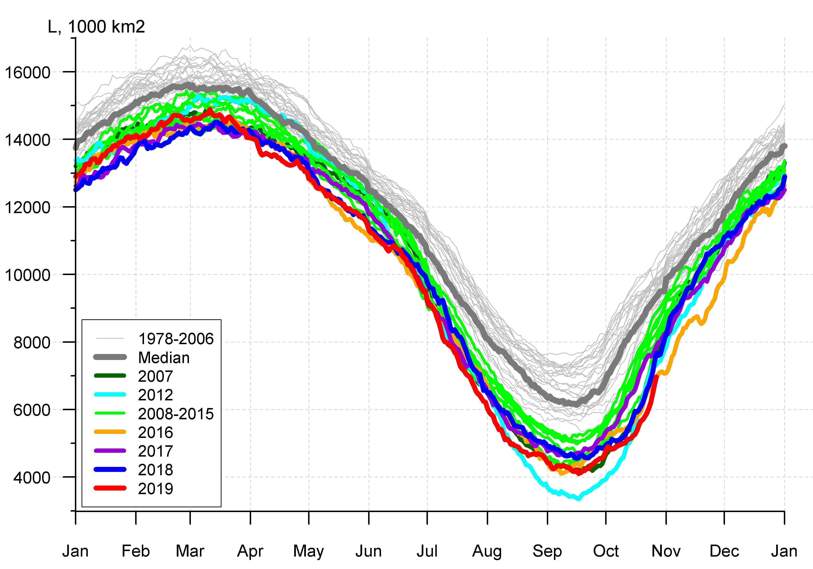
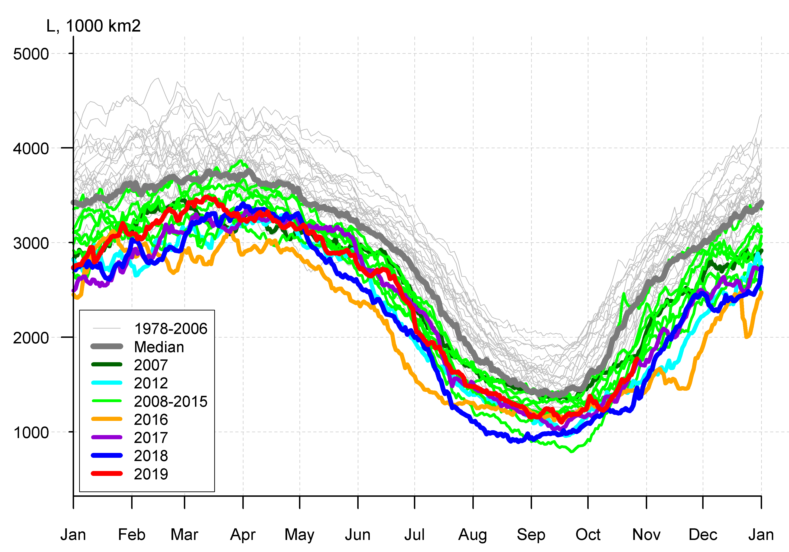
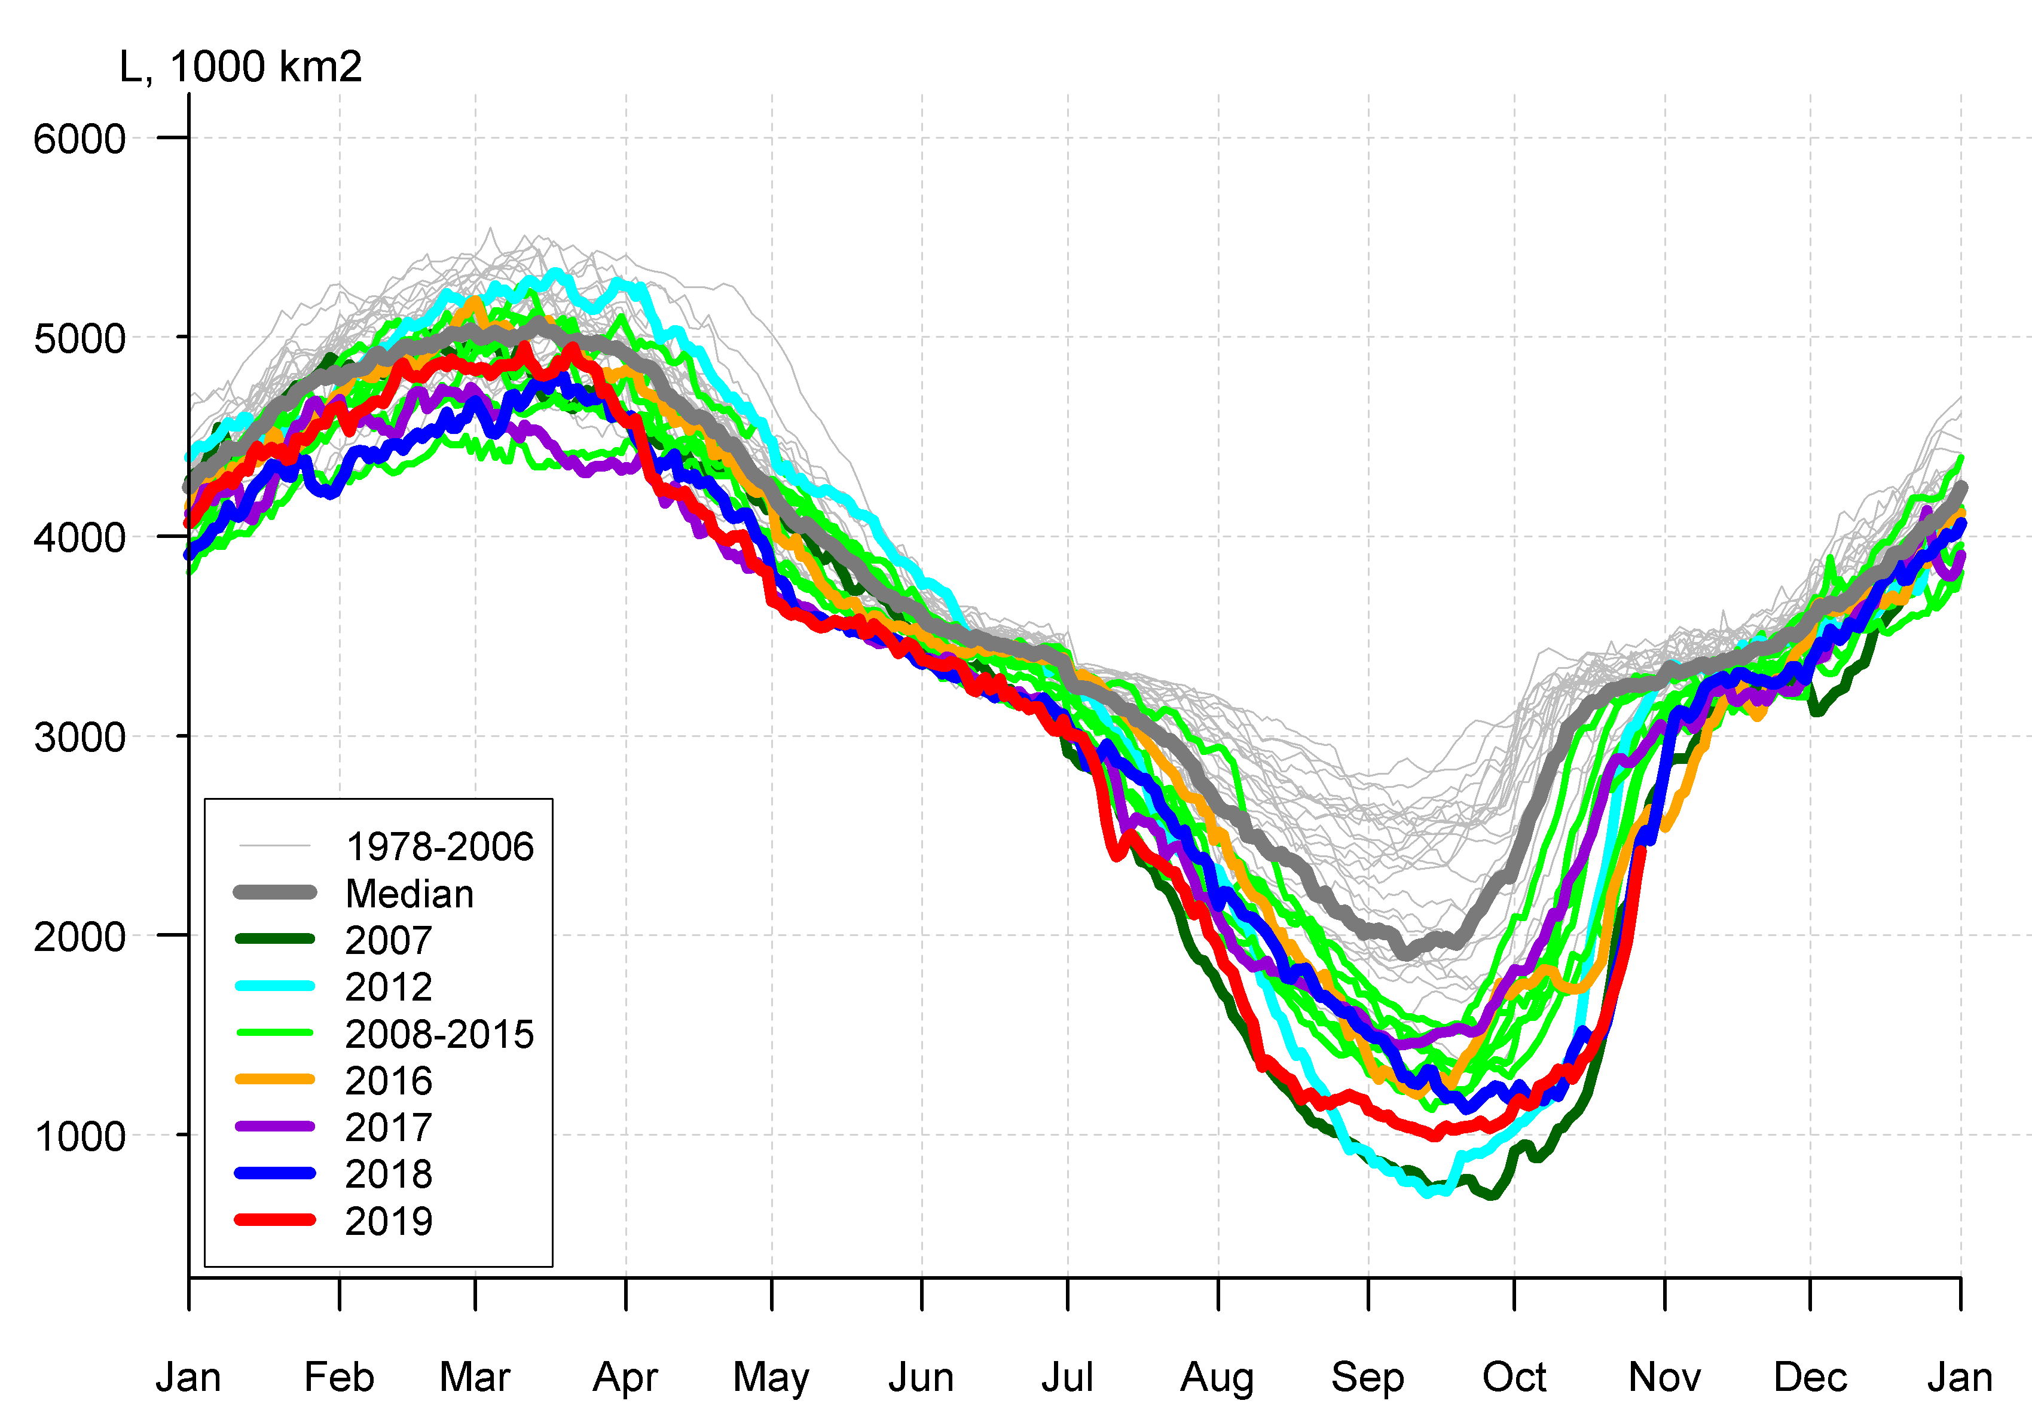
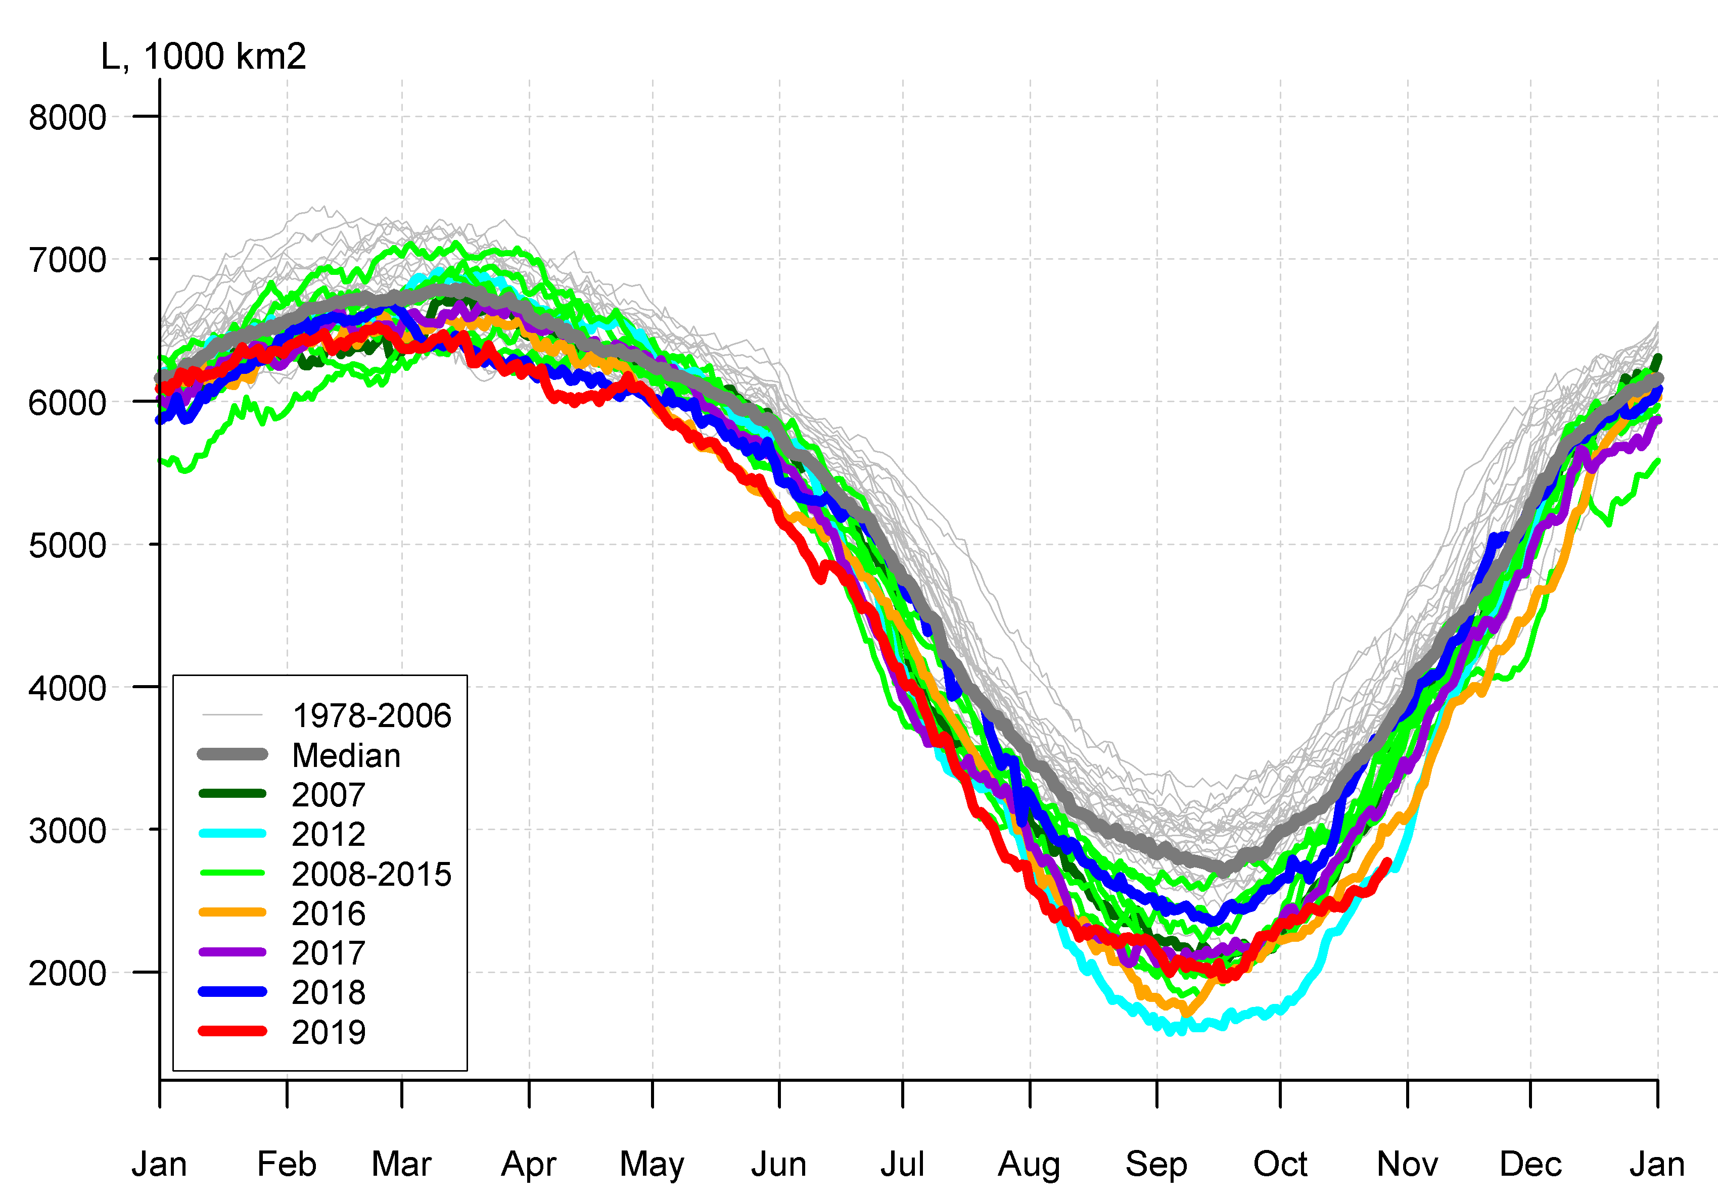

Arctic (NH) seasonal ice extent – 2019 …. 1979
S, 1000 km^{2*}
S, 1000 km²
Northern Hemisphere
S, 1000 km²
Western Arctic (WA)
2012 | 3346.2
2016 | 4099.7
2019 | 4103.4
2007 | 4189.4
2011 | 4312.7
2015 | 4350.3
2018 | 4557.5
… | …
1986 | 7230.6
1982 | 7246.1
1983 | 7285.2
1980 | 7611.3
Jan Feb Mar Apr May Jun Jul Aug Sep Oc Nov Dec Jan
Jan Feb Mar Apr May Jun Jul Aug Sep Oct Nov Dec Jan
S, 1000 km²
Eastern Arctic (EA)
S, 1000 km²
Canadian Arctic (CA)
* - minimum for Sep (AARI)
CA
EA
WA
Jan Feb Mar Apr May Jun Jul Aug Sep Oct Nov Dec Jan
Jan Feb Mar Apr May Jun Jul Aug Sep Oct Nov Dec Jan
Minimum ice extent 4,103 mln km² (4.56 in 2018) 3rd/2nd from 1979 reached 17/09/2019
[AARI, NSIDC]

Slide 11
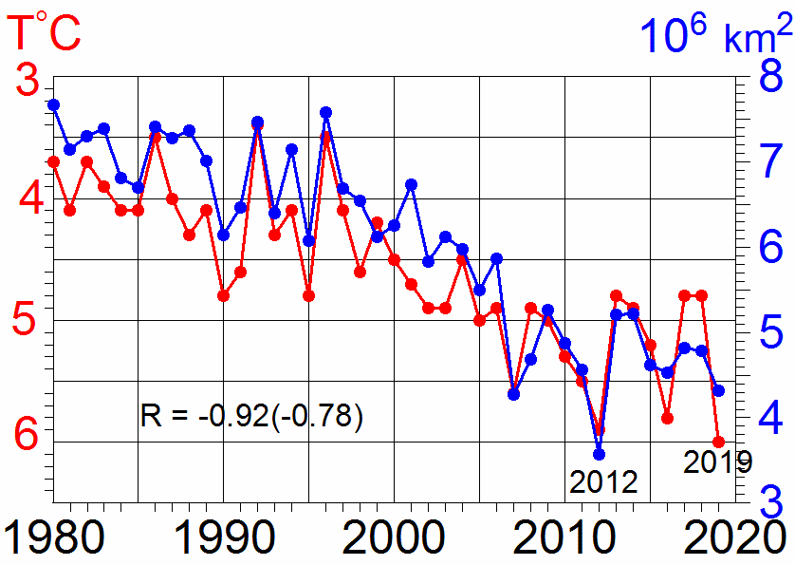
Summer SAT and September SIE in the marine Arctic
᷉᷉ ice edge
41 stations •

Slide 12
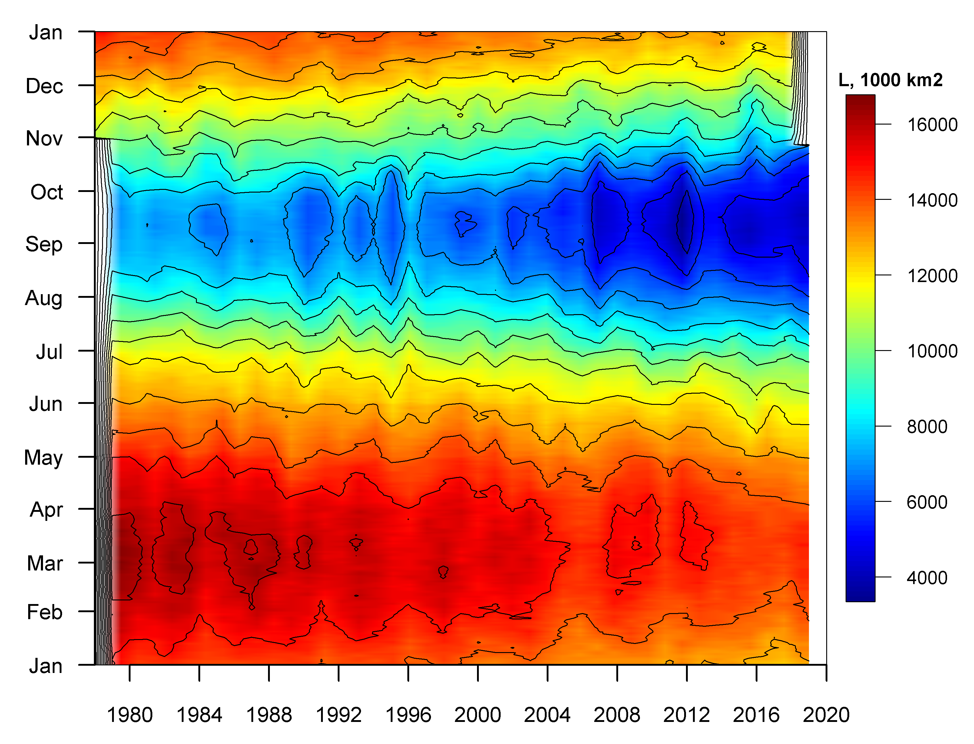
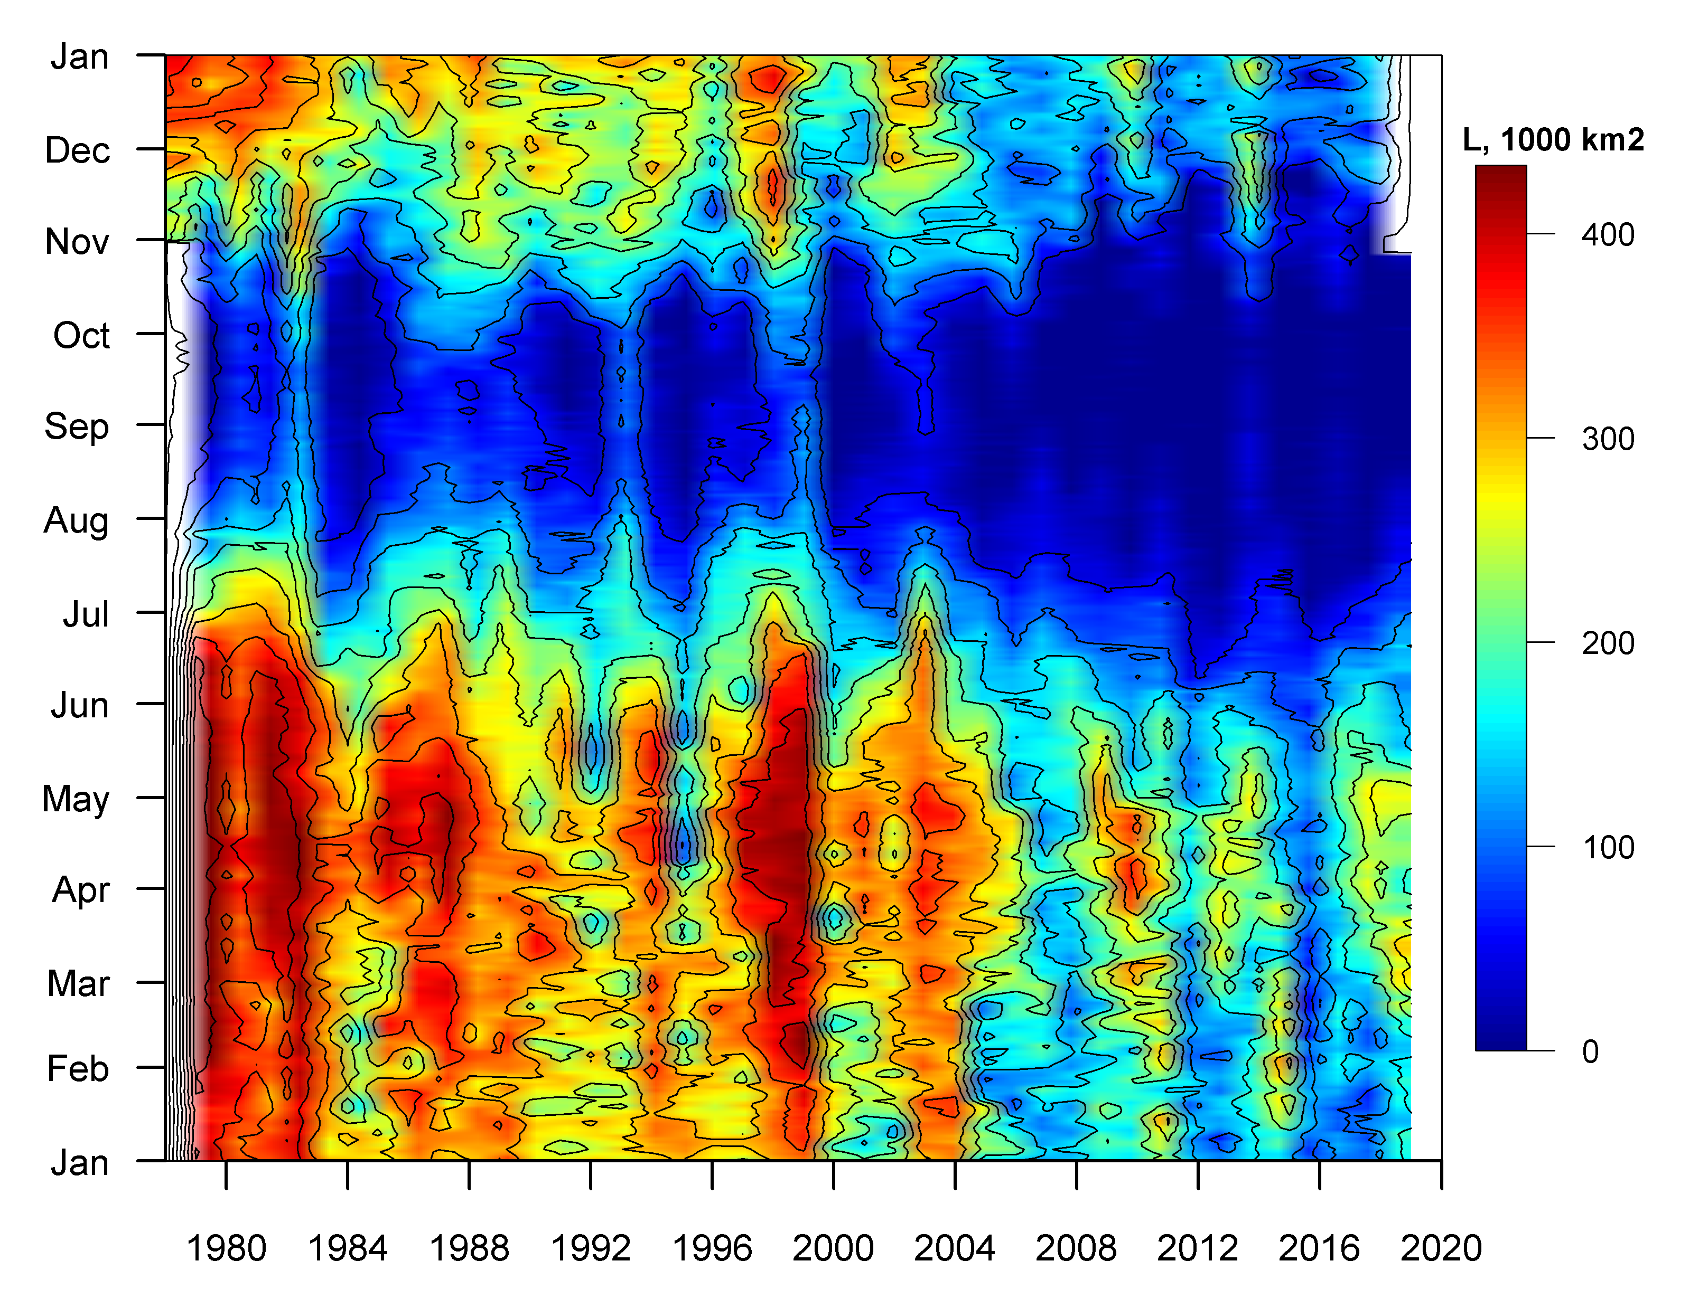
Seasonal NH (Arctic Ocean in summer) and regional (NE Barents) ice extent variability: 1978 - 2019
Northern Hemisphere
NE Barents Sea
[AARI, NSIDC]

Slide 13
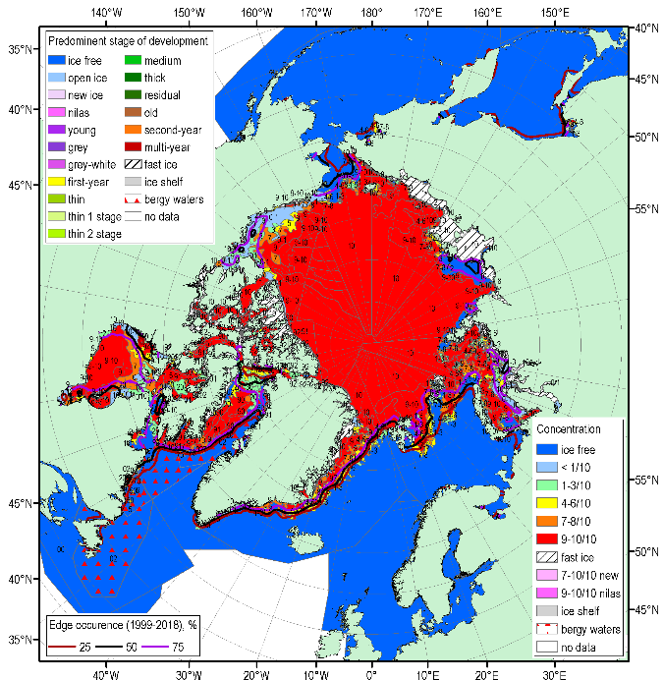
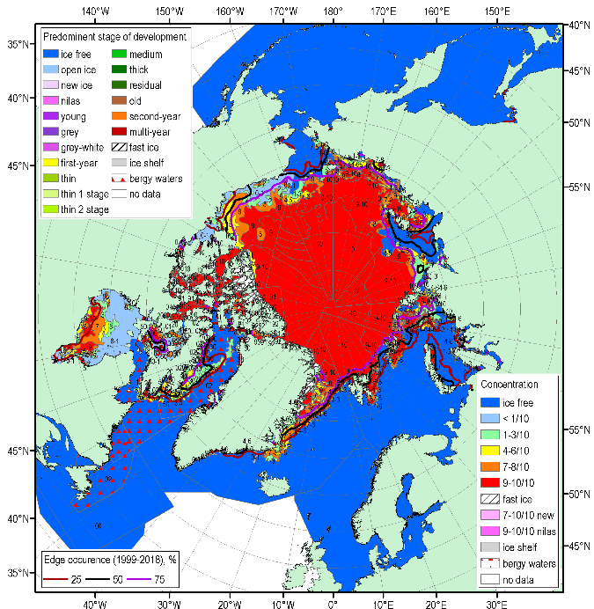
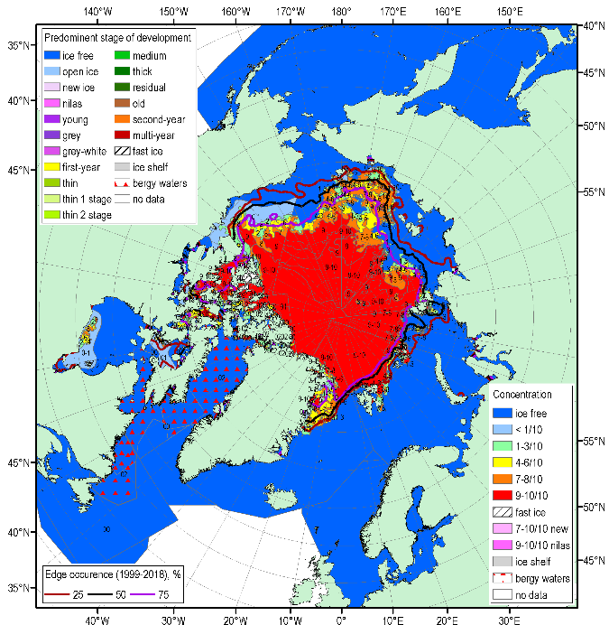
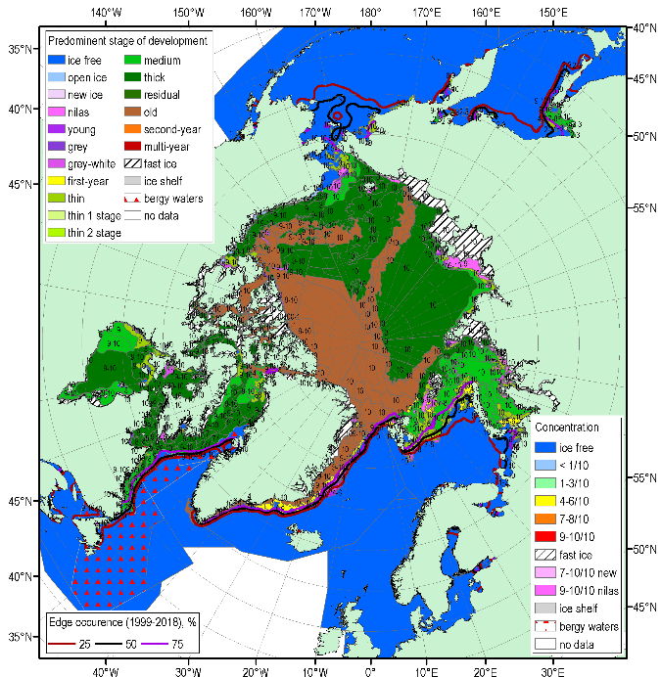
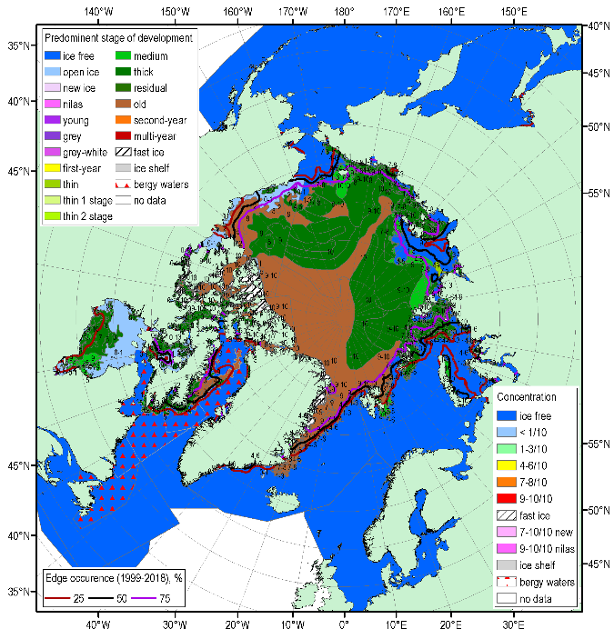
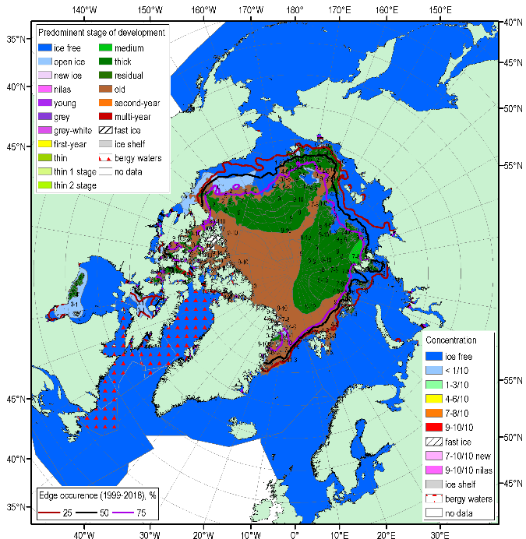
JJA 2019 Arctic sea ice – conc. and stages of development
17-20 June
15-18 July
12-15 August
Blended AARI/CIS/NIC ice charts; ice edge – nearest pentade, reference period: 1998-2018

Slide 14
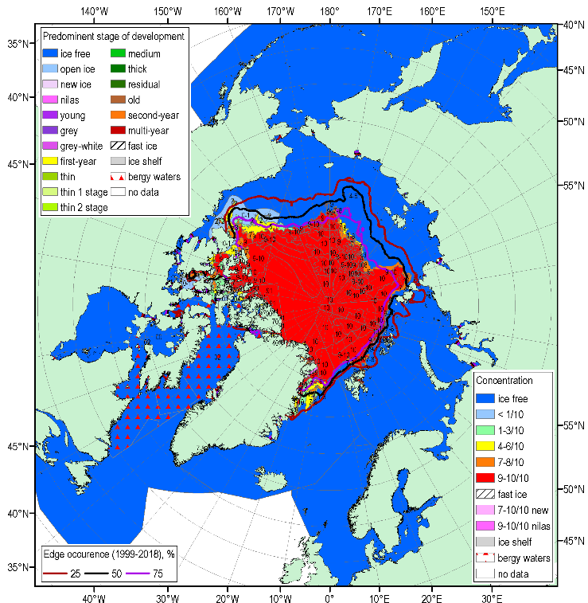
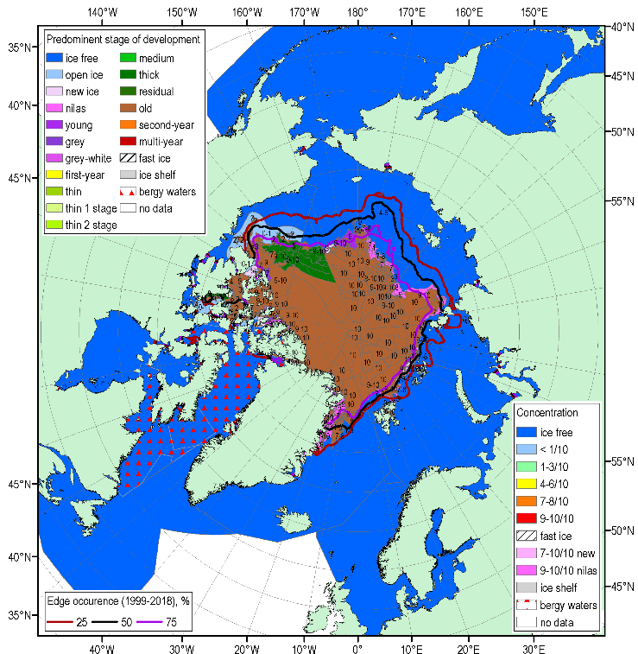
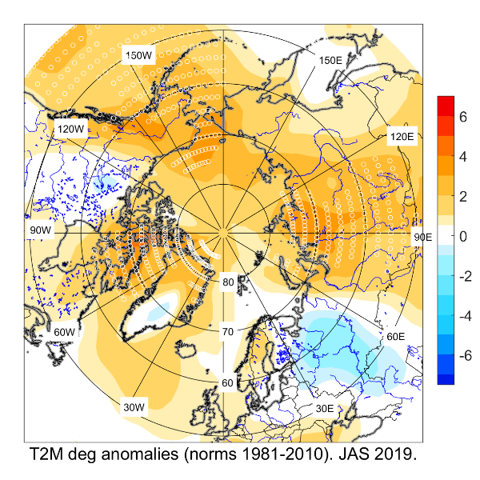
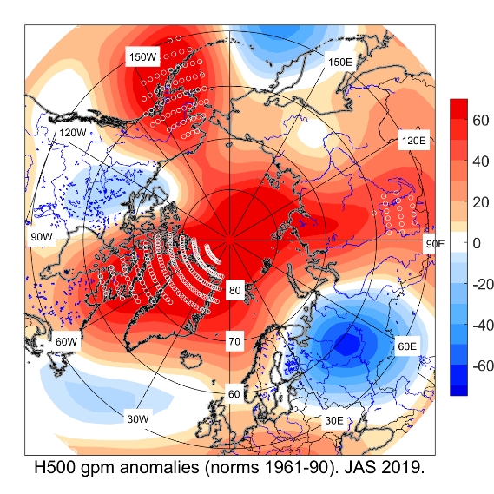
September 2019 minimum (3 October-8 October 2019)
Arctic Oscillation was negative during JJA and turned to positive phase in September.
Dominance of ridging/positive
Geopotential height anomalies with above normal temperatures resulted in extreme bellow normal sea ice extent in summer 2019 throughout majority of the Arctic Ocean areas, though not all

Slide 15
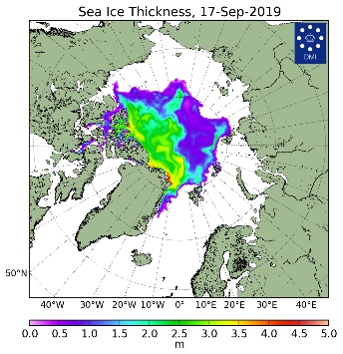
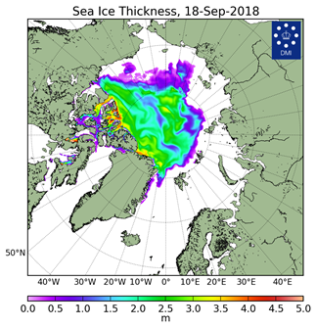
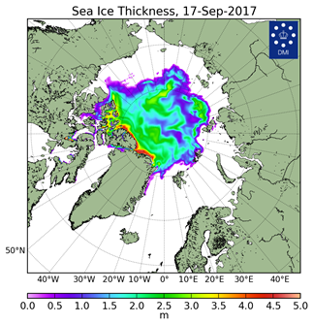
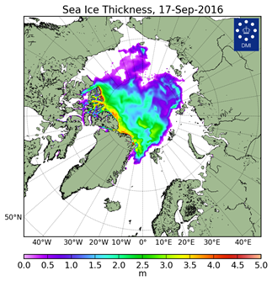
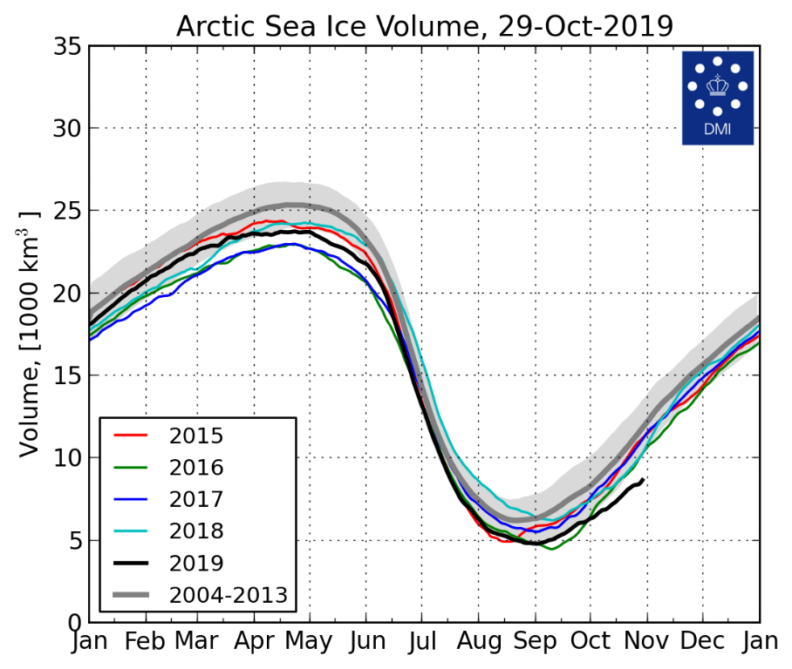
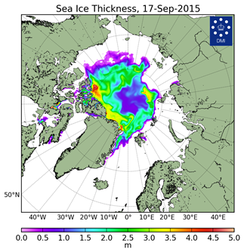
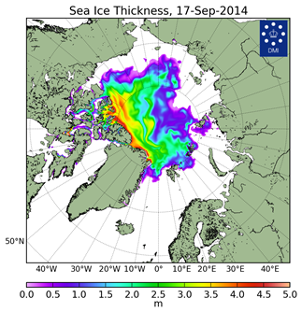
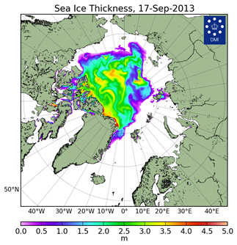
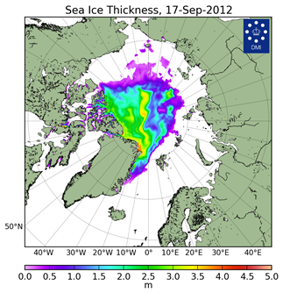
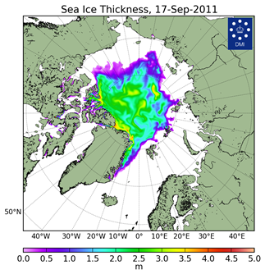
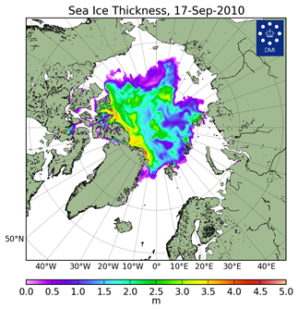
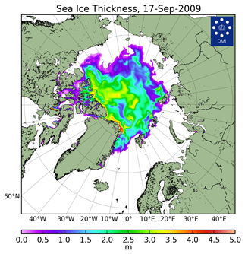
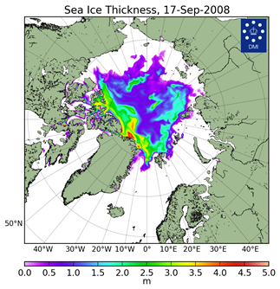
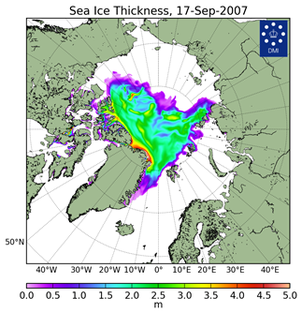


Arctic Sea Ice Reanalysis – HYCOM-CICE and PIOMAS
[Madsen et al, 2015]
2019
2018
2017
2016
2015
2014
2013
2012
2019
2012 | 3.787
2019 | 4,06
2011 | 4,48
2016 | 4,53
2017 | 4.679
2010 | 4.742
2018 | 5,09
2013 | 5.479
2015 | 5.852
… | …
1986 | 16.076
1980 | 16.316
1979 | 16.911
**V,1000 km^{3 **}(PIOMAS)
2011
2010
2009
2008
Models show Arctic ice volume 2nd minimum at summer minimum or similar to 2016 though ice extent was greater, i.e. overall ice thickness in 2019 is lesser
2007
2006
2005
DMI North Atlantic - Arctic Ocean model HYCOM-CICE - http://ocean.dmi.dk/models/hycom.uk.php
** - monthly mean for Sep

Slide 16


Terrestrial snow: spring 2019 snow cover
NH land area (excluding Greenland) spring (April, May, June) snow cover extent variability over 1972-2019. Source: NOAA-CDR snow product at Rutgers University
Difference in January-June snow cover duration (days) between 2019 and the 1998-2017 average for the CMC operational snow depth analysis (left) and the NOAA IMS24 daily snow cover analysis (right).
NH spring (April, May, June 2019) snow cover extent has decreased significantly (0.05 level of significance) over the period 1972-2019 at a rate of 0.865 million km² per decade. The 2019 June SCE value of 3.63 million km2 was 1.48 standard deviations below the 1981-2010 reference period average.
2019 Snow Assessment, Global Cryosphere Watch, WMO https://globalcryospherewatch.org/assessments/snow/

Slide 17




Terrestrial snow: snow depth anomaly, MAMJ 2019
Snow cover extent for most parts of N. Eurasia was normal to bellow average during MAMJ. Slightly above average for April in south Siberia. (relative to the 1981-2010).
For Canada it was slightly bellow normal in April, May, June except eastern region.
Snow depth anomaly (% of the 1981-2010 average) in 2019 for (a) March, (b) April, (c) May, and (d) June. Source: RUTGERS GLOBAL SNOW LAB

Slide 18
Arctic Summer Highlights
  Atmospheric circulation (summer, JJA)
High pressure system was intensified over Greenland, central Arctic, Siberia, and North of Pacific ocean with influence of tropospheric Atlantic, Pacific and West Siberia ridges. Record high pressure was observed in Greenland, Alaska and Siberia regions. The dominance of meridional form of circulation in the middle troposphere was noted. Polar vortex was weak and separated into two low-pressure zones (north of Canada, north of Siberia). Location of center of stratospheric anticyclone was close to normal. Near record positive geopotential anomalies were observed in the upper troposphere and low stratosphere.
  Temperature & Precipitation (summer, JJA)
Air temperature across Arctic was above normal except northern part of Canada and north-west of Russia. The most notable positive anomalies were present across of Alaska, Canadian Archipelago, North of Siberia. The record positive anomalies (2.9C) were in East Siberia. Drier than average conditions were observed across much of North Eurasia except North Europe and East of Chukotka. Above normal precipitation were present across much of Canada and Atlantic.

Slide 19
Arctic Summer Highlights
Arctic (NH) Sea Ice (summer, JJAS)
Minimum ice extent 4,1 mln km² (4.56 in 2018) reached 17 September 2019 and was 3rd/2nd in row (close to 2016) moving 2007 to 4th row. With some regional exceptions like N Barents, Greenland Seas ice edge was in northward positions. Estimated ice volume could be 2nd or 3rd in row which tells the ice thickness was much less in 2019 in comparison to 2018 and 2017 years.
Terrestrial Arctic Snow (pre-summer, MAMJ)
Snow cover extent for most of N.Eurasia was normal to bellow average during MAMJ2019 For Canada it was slightly bellow normal in April, May, June except eastern parts. NH spring snow cover extent has tendency to decrease during the period 1972-2019. The 2019 June SCE was 1.48 standard deviations below the 1981-2010 reference period average.

Slide 20
Thank you! Merci! Takk! Спасибо!
Tak! Tack! Kiitos! þakka þér fyrir!

