Slide 1











Introducing the
Arctic Regional Climate Centre Network
(ArcRCC-N)
https://www.arctic-rcc.org/
Helge Tangen
Norwegian Meteorological Institute
ArcRCC Network Coordinator
Arctic Climate Forum-5, May 27-28, 2020

Slide 2
Welcome to Arctic Climate Forum number 5 ACF-5
A forum for Arctic Regional Climate Centre Network to meet stakeholders and users
Usually: Every spring a face-to-face meeting, this spring converted to online meeting
Every fall a virtual meeting - like this one

Slide 3



What’s the difference?
Weather
Conditions of the atmosphere over a short period of time
Reported in terms of hours and days for a city, town, region
It answers these questions
What is the temperature right now?
Will I need a coat this afternoon?
Will it snow this weekend?
Climate
Average weather of a place over period of many years
Tells us what’s normal for an area.
It answers these questions
What is an average winter like in Ottawa?
Was 2015 the warmest summer on record?
Will Tromsø have above normal temperatures this summer?
Climate is what you expect, weather is what you get
(sources: NOAA, NSIDC and WMO and websites)

Slide 4
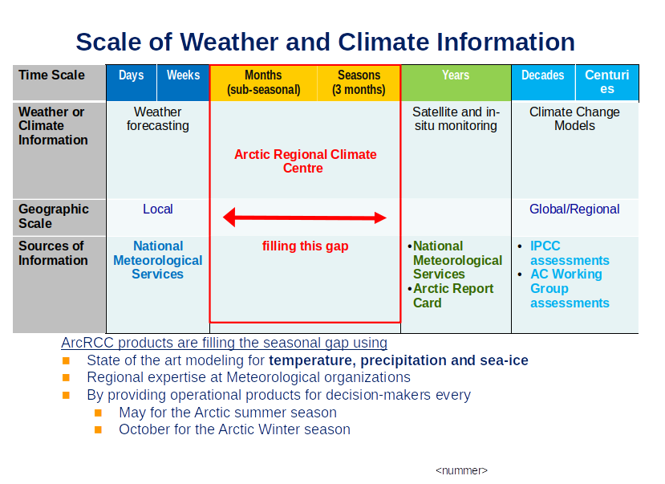

Slide 5
The Arctic Regional Climate Centre
NATIONAL |  | REGIONAL |  | CIRCUMPOLAR
Countries | Meteorological Organizations | Regional Climate Centres (RCCs) |  | Arctic Regional Climate Centre
United States | NOAA | North American Node | Forecasting
Canada | ECCC
Denmark | DMI | Northern European / Greenland Node | Data Services
Iceland | IMO
Norway | NMI
Sweden | SMHI
Finland | FMI
Russia | AARI | Northern Eurasia Node | Monitoring
Collaboration/Networking across Arctic regional nodes and Meteorological Organizations
Notes:
The Arctic PRCC-Network falls across three of the WMO Regional Associations, Asia, Europe and North America.
The participating nations are the 8 Arctic Council states
The structure for the Arctic PRCC-Network will be on two levels.
Each Regional Association (node) will perform all mandatory functions for the countries in its domain:
Canada will lead the North American Node (Canada and USA);
Norway will lead the Northern Europe and Greenland Node (Denmark, Finland, Iceland, Norway, and Sweden); and
the Russian Federation will lead the Eurasian Node, see Figure 1.
4th mandatory function is training that is shared across the Nodes

Slide 6
ArcRCC Products
produced each May and October
Arctic Consensus Statement:
Text and graphics that summarize the temperature, precipitation and sea-ice climate trends for the past season and forecasts for the upcoming season. A collaborate effort by the network in reviewing:
Trends in the historical monitoring data
Forecasts from the models
Using Met/Ice climate expertise, fill gaps in the data
https://arctic-rcc.org/consensus-statements
Regional Summaries
The same information that is in the consensus statement but organized by Arctic region and added information about potential impacts to regional users.

Slide 7
How is this information different than?
The Arctic Council’s Arctic Monitoring and Assessment Programme (AMAP)
i.e. the Snow Water Ice and Permafrost Assessment (SWIPA) report discusses trends and future predictions, updated once every 5-6 years
National Snow and Ice Data Centre –Arctic Report Card
Annual Summary of the Arctic climate over the past year
ArcRCC products are ongoing operational Arctic climate summary and forecast products that are updated every Winter and Summer
Notes:
Hand off to John to explain the PARCOF

Slide 8
Thank you!

