Slide 1


Arctic Climate Forum
May 2020
Non-Technical Review:
Summary of Winter 2020 and
Outlook for Summer 2020
Arctic Regional Climate Center

Slide 2
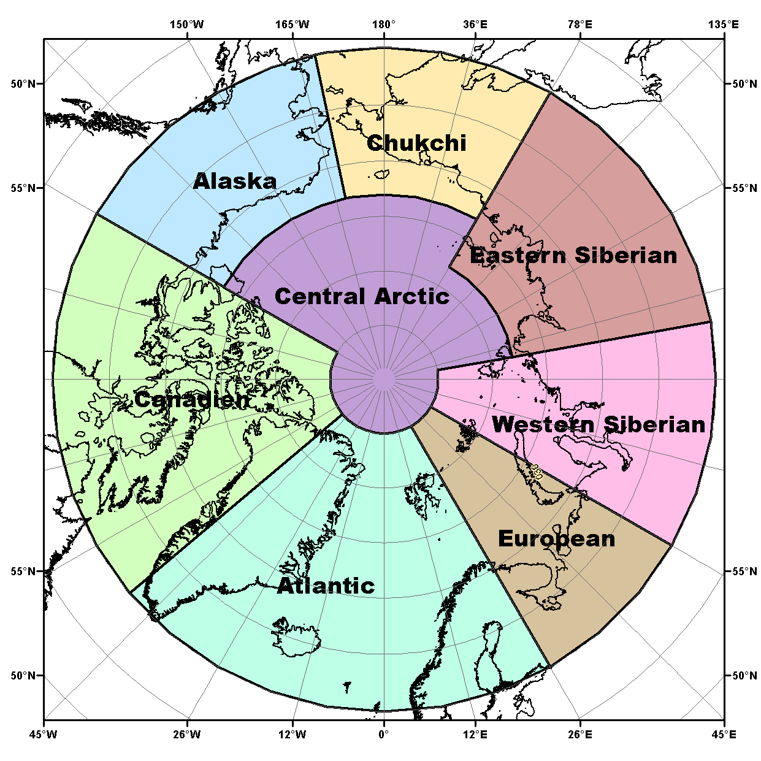
Temperature and Precipitation
Terrestrial Regions
North America Node
Alaska: Includes the Yukon and the Northwest Territories
Canadian: Central and Eastern Canada and Western Greenland
European Node
Atlantic: Western Greenland, Iceland, Svalbard and Scandinavia
European
Eurasian Node
Western Siberian
Eastern Siberian
Chukchi
Central Arctic

Slide 3
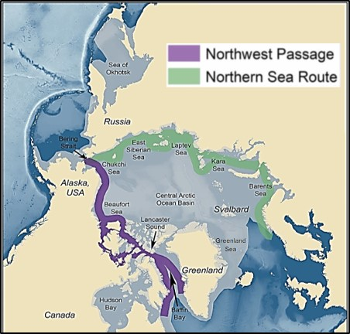
Sea-Ice Navigational Regions
Sea-Ice Regions. Map Source: Courtesy of the U.S. National Academy of Sciences.

Slide 4
How this summary was developed
Available observations +
State of the art modeling for temperature, precipitation and sea-ice +
Adjustments based on regional expertise at Arctic meteorological organizations =
Information about potential impacts for regional users.
*As a result, the regional outlooks may not always match the model output

Slide 5
North American Node

Slide 6
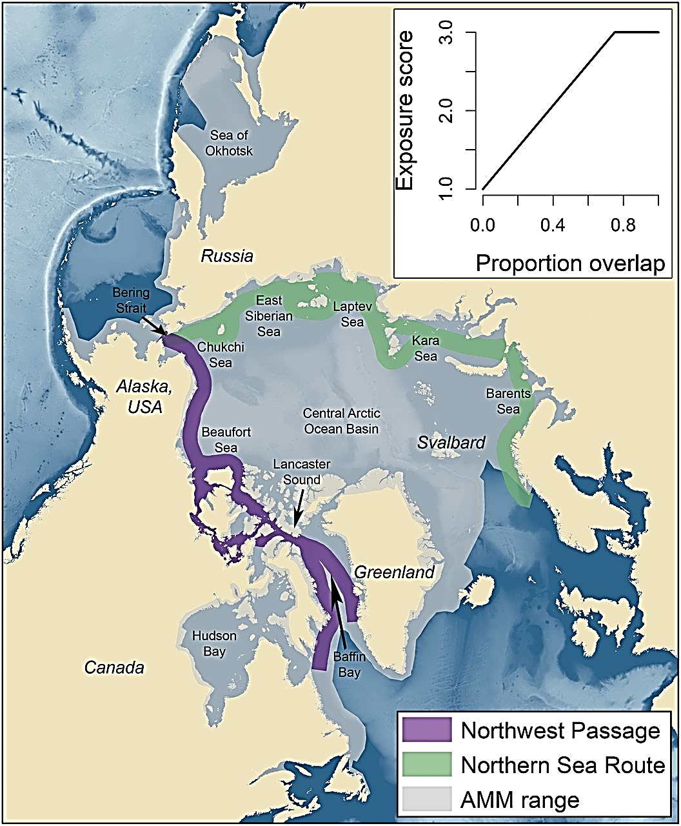

Alaska
Includes the Yukon and the Northwest Territories
Seasonal Summary: Winter 2019 & Spring 2020
Observations above (+) and below (-) normal
Temperature Normal 1961-1990 | Near normal in Alaska, Yukon and the NWT | Warmest year was 2004 (+2.9˚C) | Coldest years were 1945 & 1955 (-1.3˚C)
Precipitation Normal 1961-1990 | Wetter in Alaska, Yukon and the NWT | Wettest year was 1951 (+65 %) | Driest year was 1968 (-46 %)
Sea-Ice Since 1979 | March maximum sea-ice extent: Normal for the Bering sea Chukchi and Beaufort seas were ice covered
Outlook: June, July August (JJA) 2020 |  |  |  | Multi Model Agreement
Forecast |  |  |  | High | Moderate | Low
Temp * | Bering Sea, Northern Alaska |  | Warmer | ✓
 | Western, coastal and continental Alaska, Yukon, Northwest Territories |  |  |  | ✓
 | Beaufort Sea |  | No forecast | No agreement
Precip * | Chukchi and Beaufort seas |  | No forecast | No agreement
 | Northern Northwest Territories |  | Drier |  |  | ✓
 | Bering sea |  | Wetter |  |  | ✓
 | Yukon, Alaska
Sea-Ice | Break-up | Chukchi Sea | Earlier | ✓
 |  | Western Beaufort Sea |  | ✓
 |  | Bering Sea |  |  | ✓
 | Min. Ice Extent Sept 2020 | Chukchi Sea | Below normal | ✓
 |  | Beaufort Sea
 |  |  |  |  | ✓
Greenland Sea

Slide 7
Alaska & Western Canada
Risks and Impacts
Wildfires: Above normal temperatures may increase the threat of larger than typical wildfires.
River Flooding: Above normal precipitation may increase the threat of river flooding in Alaska and the Yukon.
Coastal Erosion and Flooding: Below normal sea ice extent in the Chukchi Sea may result in longer open water fetch and will greatly enhance erosion and the increase the risk of coastal flooding from late summer storms on unprotected west facing coasts of Alaska.
Wildlife: Warmer summer temperatures increases the chances of negative impacts on fish, especially salmon that can not tolerate warm water once they enter fresh water rivers.
Hunting: Early sea ice loss may result in an a shorter seasons for sea ice-based subsistence hunting activities.
Shipping:
  Early observations are already showing minimal sea-ice in the Bering Sea earlier than normal shipping activities are expected.
  Early sea-ice break-up in the Beaufort Sea region may result in areas of old ice becoming become mobile earlier in the season increasing shipping hazards.

Slide 8
Canada
Includes central and eastern Canada and Western Greenland
Seasonal Summary: Winter 2019 & Spring 2020
Observations above (+) and below (-) normal
Temperature Normal 1961-1990 | Near to below normal | Warmest year was 2012 (+2.3˚C) | Coldest year was 1972(-1.6˚C)
Precipitation Normal 1961-1990 | Near normal in Nunavut’s Qikiqtaaluk region Drier in Nunavut’s Kitikmeot and Kivalliq regions, Nunavik and Nunatsiavut | Wettest year was 2005 (+23.5 %) | Driest year was 1977 (-25 %)
Sea-Ice Since 1979 | March maximum sea-ice extent: Below to near normal in the Gulf of St. Lawrence and Labrador sea. All other areas ice covered
Outlook: June, July August (JJA) 2020 |  |  |  | Multi Model Agreement
Forecast |  |  |  | High | Moderate | Low
Temp | Western Greenland |  | Warmer | ✓
 | Nunatsiavut, Nunavik, Nunavut |  |  |  | ✓
 | Baffin Bay, Davis Strait, Hudson Strait, Labrador Sea
 |  |  |  |  | ✓
 | Western Hudson Bay, Eastern Hudson Bay |  | Colder to Normal |  | ✓
Precip | Nunavut Qikiqtaaluk region, northern Hudson Bay, Foxe Basin, Western Greenland |  | Wetter |  |  | ✓
 | Northeast Nunavik and Nunatsiavut (Torngat Mountains region), Labrador |  | Drier |  |  | ✓
 | Nunavut Kitikmeot and Kivalliq regions, Baffin Bay, southern Hudson Bay, Labrador Sea |  | No Forecast | No Agreement
Sea-Ice | Break-up | Baffin Bay, Davis Strait, Labrador Sea | Earlier | ✓
 |  | Western Hudson Bay | Near normal |  | ✓
 |  | Eastern Hudson Bay | Later |  | ✓
 | Min Ice Extent Sept 2020 | Canadian Arctic Archipelago | Below normal |  | ✓
Greenland Sea

Slide 9
Central and Eastern Canada, Western Greenland
Risks and Impacts
Wildfires: Above-normal temperatures and drier than normal conditions forecasted for Labrador may lead to an increased threat of wildfires
River flooding:
  Wetter conditions forecasted may increase the threat of river flooding in Nunavut’s Qikiqtaaluk region.
  Below-normal snowfall throughout the winter and spring should reduce the risk of flooding this year in Labrador.
Wildlife: Wetter conditions forecasted may lead to increased freezing rain in the early summer affecting wildlife foraging in Nunavut’s Qikiqtaaluk region.
Hunting: Early sea-ice loss may result in a shorter season for sea ice-based subsistence hunting activities.

Slide 10
Shipping
  Northwest Passage: light ice conditions may be experienced in the southern route of the Northwest Passage in August and in the northern route by early September. However, light ice conditions may allow old ice from the Canadian Arctic Archipelago to become mobile earlier in the season increasing navigation risks.
  Hudson Bay:
    Faster than normal sea ice break-up is currently underway in Hudson Strait with significant areas of open water expanding in the northern portion of the strait.
    Near normal break-up is expected for western Hudson Bay.
    Later than normal break-up is expected for eastern Hudson Bay. Thicker ice coverage along with colder temperatures forecasted could lead to a more challenging navigation season in the eastern half of Hudson Bay.
  Baffin Bay: light ice conditions may be experienced in Baffin Bay and no specific hazards are anticipated. The presence of an ice bridge in Nares Strait well into the spring normally cuts off the inflow of old ice from the Arctic Ocean into northern Baffin Bay, limiting the import of old ice into the region.
  Labrador Coast: ice coverage along the Labrador coast has been normal throughout the winter and spring showing near normal ice extent but lower concentrations. Break-up in Lake Melville is expected to be normal.

Slide 11
Nordic Node

Slide 12
Atlantic
Seasonal Summary: Winter 2019 & Spring 2020
Observations above (+) and below (-) normal
Temperature Normal 1961-1990 | Warmer in Scandinavia All other regions normal | Warmest year was 2003 (+1.9˚C) | Coldest year was 1965 (-0.7˚C)
Precipitation Normal 1961-1990 | Wetter in Iceland and Norway Drier eastern Greenland and Svalbard All other regions normal | Wettest year was 1964 (+20.5%) | Driest year was 1968 (-24.9%)
Sea-Ice Since 1979 | March maximum sea-ice extent: Greenland sea Below to near normal
Outlook: June, July August (JJA) 2020 |  |  |  | Multi Model Agreement
Forecast |  |  |  | High | Moderate | Low
Temp | Southern Greenland |  | Warmer | ✓
 | Svalbard, northern and continental Greenland and Baltic sea |  |  |  | ✓
 |  |  |  |  |  | ✓
 | Iceland, Scandinavia
 | North Atlantic |  | Colder | ✓
 | Greenland and Norwegian seas |  | No Forecast | No Agreement
Precip | North Atlantic, North sea and southern Baltic sea |  | Drier |  |  | ✓
 | Norwegian and southern Baltic seas, continental Greenland, Iceland, and Scandinavia |  | No Forecast | No Agreement
Sea-Ice | Break-up | Greenland Sea | Later |  | ✓
 | Min Ice Extent Sept 2020 |  | Above Normal | ✓
Greenland Sea

Slide 13
Atlantic
Risks and Impacts
Wildfires:
  Warmer temperatures and drier than normal conditions forecasted for Scandinavia indicates a potential for Wildfires, although the forecast agreement is low.
  Trends in land cover in Iceland resulting from long term warming are increasing the risk of wildfires associated with droughts, with one large event so far this spring.
Flooding:
  Late warming and large amounts of snow accumulation indicates a high risk of floods for inland Norway.
  A combination of above normal snow accumulation and a late melt season in the highlands of northern Iceland may result in a greater risk for flooding in the coming weeks.
Permafrost: The continued trend of warmer temperatures in Svalbard leads to the thawing of the permafrost, resulting in a greater risk of landslides which may impact stability of some structures. In general this risk is also increasing in Iceland and Scandinavia due to recent warming trends

Slide 14
Atlantic
RiskS and Impacts Continued…
Wildlife / Hunting: Prolonged thick snow cover in Northern Scandinavia / Lapland may impact Reindeer not reaching the lichen that is under the snow cover.
Shipping:
  Svalbard: Warmer conditions and generally near normal sea-ice around the Svalbard region may indicate normal shipping activities in this region.
  Iceland: Sea-ice concentrations are unusually low in the Denmark Strait even though the marginal ice zone (MIZ) extent is near normal. The extent of the MIZ extent may pose a risk to shipping.

Slide 15
European
Seasonal Summary: Winter 2019 & Spring 2020
Observations above (+) and below (-) normal
Temperature Normal 1961-1990 | Warmer for the entire region | Warmest year was 2013 (+2.8˚C) | Coldest year was 1969 (-1.6˚C)
Precipitation Normal 1961-1990 | Wetter for the entire region | Wettest year was 1981 (+28 %) | Driest year was 1980 (-32 %)
Sea-Ice Since 1979 | March maximum sea-ice extent: Barents sea below normal
Outlook: June, July August (JJA) 2020 |  |  |  | Multi Model Agreement
Forecast |  |  |  | High | Moderate | Low
Temp | Southern Barents Sea |  | Warmer | ✓
 | Murmansk/White Sea/Continent |  |  |  |  | ✓
 | Northern Barents Sea |  | No forecast | No agreement
Precip | Entire Region |  | No forecast | No agreement
Sea-Ice | Break-up | Northern Barents sea | Later | ✓
 | Min Ice Extent Sept 2020 |  | Above Normal |  |  | ✓
Greenland Sea

Slide 16
Eurasian Node

Slide 17
Western Siberia
Seasonal Summary: Winter 2019 & Spring 2020
Observations above (+) and below (-) normal
Temperature Normal 1961-1990 | Warmer for the entire region | Warmest year was 2016 (+3.6˚C) | Coldest year was 1968 (-1.6˚C)
Precipitation Normal 1961-1990 | Wetter for the entire region | Wettest year was 2002 (+ 22.6 %) | Driest year was 1946 (- 27.6 %)
Sea-Ice Since 1979 | March maximum sea-ice extent: Kara Sea, ice covered
Outlook: June, July August (JJA) 2020 |  |  |  | Multi Model Agreement
Forecast |  |  |  | High | Moderate | Low
Temp | Western Kara Sea |  | Warmer | ✓
 | Continent |  |  |  | ✓
 | Eastern Kara Sea |  |  |  |  | ✓
Precip | Continent |  | Wetter |  |  | ✓
 | Barents sea, Murmansk coast |  | No forecast | No agreement
Sea-Ice | Break-up | Kara Sea West | Early | ✓
 |  | Kara Sea East | Near normal |  | ✓
 | Min Ice Extent Sept 2020 | Kara Sea | Below Normal | ✓
Greenland Sea

Slide 18
Western Siberia
Risks and Impacts
Wildfires: A risk of forest fires is possible in the State reserve "Verkhne-Tazovsky” region at the beginning of the summer due to above normal temperatures and below normal precipitation forecasted in the north of West Siberia.
Flooding: The threat of river flooding in Ob’ and Yenisei is uncertain.
Coastal Erosion: Forecasted high temperatures may lead to continued permafrost degradation and coastal erosion.
Wildlife/Hunting: The reduction in the sea-ice extent and permafrost degradation in tundra may create difficulties for “keystone” species, e.g. polar bears, caribou, whales etc.
Shipping: Shipping in the Northwest Passage from west to east is expected to start earlier than normal with safe and easy ice conditions for independent navigation of large-capacity tankers, gas carriers and bulk vessels. However, above normal temperatures may increase the number of icebergs due to glacier calving in the Islands Novaya Zemlya and Severnaya Zemlya, creating navigation hazards.

Slide 19
Eastern Siberia
Seasonal Summary: Winter 2019 & Spring 2020
Observations above (+) and below (-) normal
Temperature Normal 1961-1990 | Warmer for the entire region | Warmest year was 2019 (+2.9˚C) | Coldest year was 1989 (-1.2˚C)
Precipitation Normal 1961-1990 | Wetter for the entire region | Wettest year was 1988 (+25.2%) | Driest year as 1967 (-21.6%)
Sea-Ice Since 1979 | March maximum sea-ice extent: Laptev sea, ice covered
Outlook: June, July August (JJA) 2020 |  |  |  | Multi Model Agreement
Forecast |  |  |  | High | Moderate | Low
Temp | Laptev sea and continental regions |  | Warmer |  | ✓
Precip | Laptev Sea and Continent |  | Wetter |  |  | ✓
Sea-Ice | Break-up | Laptev Sea | Early |  |  | ✓
 | Min Ice Extent Sept 2020 |  | Below Normal | ✓
Greenland Sea

Slide 20
Eastern Siberia
Risks and Impacts
Wildfires: A risk of forest fires is possible for the northwest of Yakutiya region at the beginning of the summer due above normal temperatures and below normal precipitation forecasted.
Flooding: The threat of flooding of main Arctic rivers (Lena, Yana, Indigirka, Kolyma) is uncertain.
Coastal Erosion: Forecasted high temperatures may lead to continued permafrost degradation and coastal erosion.
Wildlife/Hunting: The reduction in the sea-ice extent and permafrost degradation in tundra may create difficulties for “keystone” species, e.g. polar bears, caribou, whales etc.
Shipping: Shipping across the Northern Sea Route is expected to be start earlier than normal with safe and easy ice conditions for the independent navigation of large-capacity tankers, gas carriers and bulk vessels. The navigation season on estuaries of main Arctic rivers (Lena, Yana, Indigirka, Kolyma) for cargo delivery by vessels type “river-sea” will start earlier.

Slide 21
Chukchi
Seasonal Summary: Winter 2019 & Spring 2020
Observations above (+) and below (-) normal
Temperature Normal 1961-1990 | Warmer to near normal | Warmest year was 2007 (+2.9˚C) | Coldest year was 1949 (-1.3˚C)
Precipitation Normal 1961-1990 | normal | Wettest year was 1954 (+39.6 %) | Driest year was 1982 (-39.8%)
Sea-Ice Since 1979 | March maximum sea-ice extent: Sea of Okhotsk – Below to near normal Chukchi sea, ice covered
Outlook: June, July August (JJA) 2020 |  |  |  | Multi Model Agreement
Forecast |  |  |  | High | Moderate | Low
Temp | Bering sea |  | Warmer | ✓
 | Eastern and Southern continental regions |  |  |  | ✓
 | Eastern Siberian Sea, Chukchi sea, Northern continental regions |  |  |  |  | ✓
Precip | Bering Sea and continental regions |  | Wetter |  |  | ✓
 | Eastern Siberian Sea, Chukchi sea |  | No forecast | No agreement
Sea-Ice | Break-up | Chukchi Sea | Early | ✓
 |  | East Siberian |  |  |  | ✓
 | Min Ice Extent Sept 2020 | Chukchi Sea | Below Normal | ✓
 |  | East Siberian |  |  | ✓
Greenland Sea

Slide 22
Chukchi
Risks and Impacts
Wildfires: Due to above normal precipitation forecasted wildfires are not expected
Flooding: Above normal precipitation may increase the threat of river flooding in Indigirka and the Kolyma.
Coastal Erosion: A possible increase of storm activity may negatively impact coastal erosion. Forecasted high temperatures may lead to continued permafrost degradation and coastal erosion.
Wildlife: Possible increase of storm activity at the end of summer may impact migratory birds and fish passages.
Hunting: Possible increase of storm activity may negatively impact hunting and fishing.
Shipping: Shipping across the Northern Sea Route is expected to be start earlier than normal with safe and easy ice conditions for the independent navigation of large-capacity tankers, gas carriers and bulk vessels. Cargo navigation for all vessel classes to the Chukchi sea from the Pacific Ocean will start earlier.

Slide 23
Central Arctic
Seasonal Summary: Winter 2019 & Spring 2020
Observations above (+) and below (-) normal
Temperature Normal 1961-1990 | Warmer | Warmest year was 2012 (+2.0˚C) | Coldest year was 1963 (-0.7˚C)
Precipitation Normal 1961-1990 | n/a | Wettest year was 1989 (+27%) | Driest year was 1998 (-16%)
Sea-Ice Since 1979 | March maximum sea-ice extent: Region is covered in sea-ice
Outlook: June, July August (JJA) 2020 |  |  |  | Multi Model Agreement
Forecast |  |  |  | High | Moderate | Low
Temp | Near the Alaskan, Chukchi, Eastern and Western Siberian regions |  | Warmer |  | ✓
 | North pole, European and Atlantic regions |  |  |  |  | ✓
Precip | All regions |  | No forecast | No agreement
Sea-Ice | Break-up | No Forecast
Greenland Sea

Slide 24
Discussion on regional impacts
Arctic Regional Climate Center

