Slide 1


Arctic Climate Forum
May 2020
Arctic Consensus Statement:
Summary of Winter 2020 and
Outlook for Summer 2020
Arctic Regional Climate Center

Slide 2
What is ArcRCC Consensus Statement?
A collaborative product developed amongst Arctic meteorological and ice services to synthesize observations, historical trends, forecast models and fill gaps with regional expertise.
The consensus statement provides:
a review of the major Arctic climate trends of the previous season,
verification of the previous seasons outlooks and
outlooks for the upcoming season for temperature, precipitation and sea-ice.

Slide 3
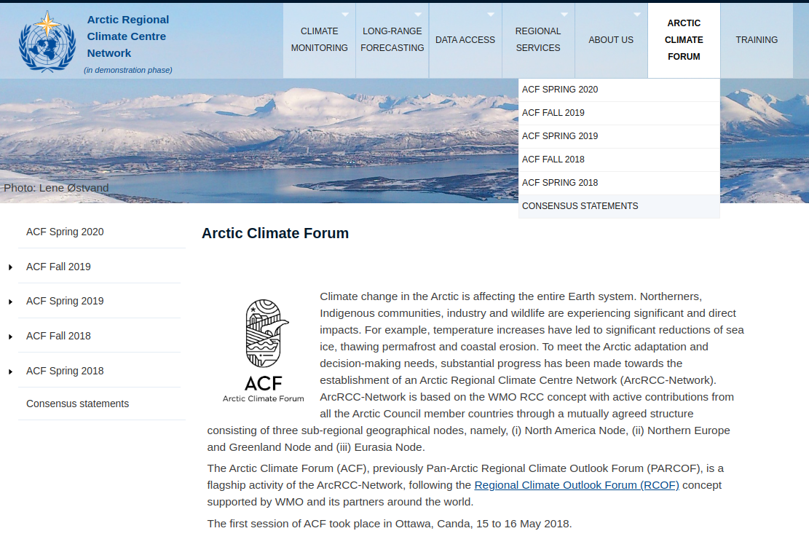
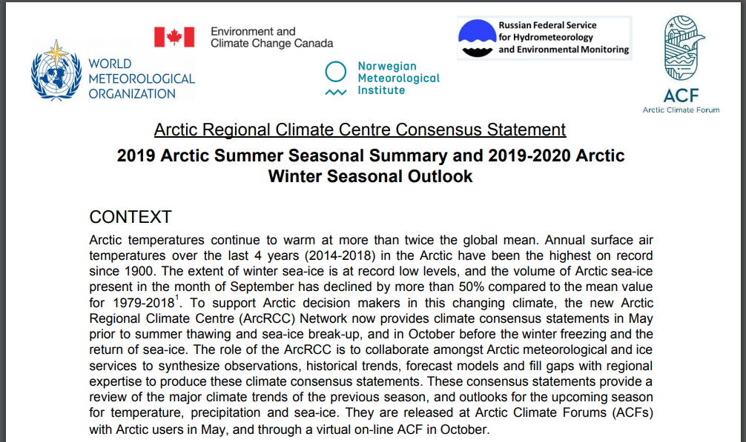
Will be published on https://arctic-rcc.org/acf

Slide 4
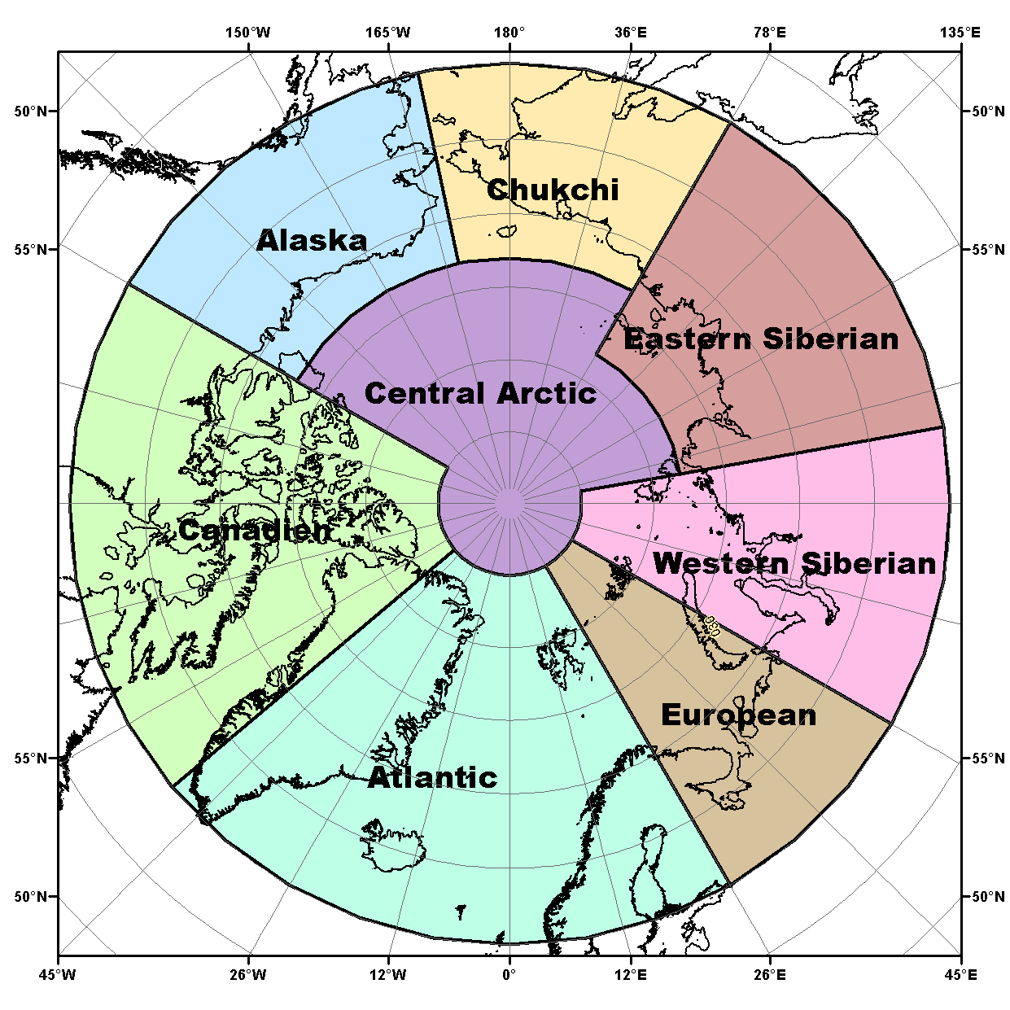
Circumpolar Arctic Perspective
Temperature & Precipitation
Outlooks are based on eight WMO Long-Range Forecasts models.
All the model forecasts are compared and areas where all eight models
  agree = high forecast confidence
  disagree = low forecast confidence
Called a multi-model ensemble (MME) approach
A methodology reputed as providing the most reliable objective forecasts.

Slide 5
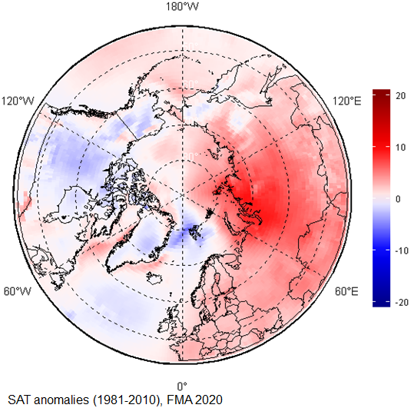
TEMPERATURE: Observations from Winter 2020
Higher than normal in the eastern hemisphere
Lower than normal in the western hemisphere
Scandinavia and the majority of the Eastern and Western Scandinavia regions experienced warmer than normal conditions (red areas)
Parts of Eastern and Western Siberia saw their fifth warmest FMA since the start of the record in 1949.
Canada, Alaska, Greenland, and the North Atlantic Ocean experienced near normal (white areas) or slightly below normal (light blue) conditions.
February, March, and April (FMA) 2020 surface air temperature anomaly based on the 1981-2010 reference period. Red indicates warner than normal temperature, and blue indicates cooler than normal temperatures. Map produced by the Hydrometcenter of Russia https://meteoinfo.ru/ Data source: ERA-5.

Slide 6
TEMPERATURE: Winter 2020
How did the forecasts perform ?
Regions | MME Temperature Forecast Agreement | MME Temperature Forecast | Observations NCAR CFSR Reanalysis | MME Temperature Forecast Accuracy
Alaska | Low | Above normal | Near normal | Low
Chukchi | High | Above normal | Above to near normal | Moderate
Eastern Siberia | High | Above normal | Above normal | High
Western Siberia | High | Above normal | Above normal | High
European | Moderate | Above normal | Above normal | High
Atlantic | Moderate | Mostly near normal | Above normal (Scandinavia only) | Moderate
Canada | Low | Above normal | Near to below normal | Low
Central Arctic | High | Above normal | Above normal | High
Notes:
The Winter 2020 temperature forecast was verified by comparing the forecast with meteorological observations and reanalysis technics to fill gaps in observations.
The observed near-normal temperatures over Alaska and the majority of Canada were not accurately forecast
Above-normal surface air temperatures over the European, Eastern Siberia, Western Siberia, and Central Arctic regions were accurately forecast for the JFMA 2020 season.
Over the Atlantic region, the forecast accuracies were variable but near-normal
Temperatures over Iceland and parts of Greenland were accurately forecast.
The observed below-normal temperatures over the Norwegian Sea and parts of Greenland were not accurately forecast.
As a general conclusion, the multi-model ensemble forecast was accurate for approximately 50-60% of the Arctic territory.

Slide 7
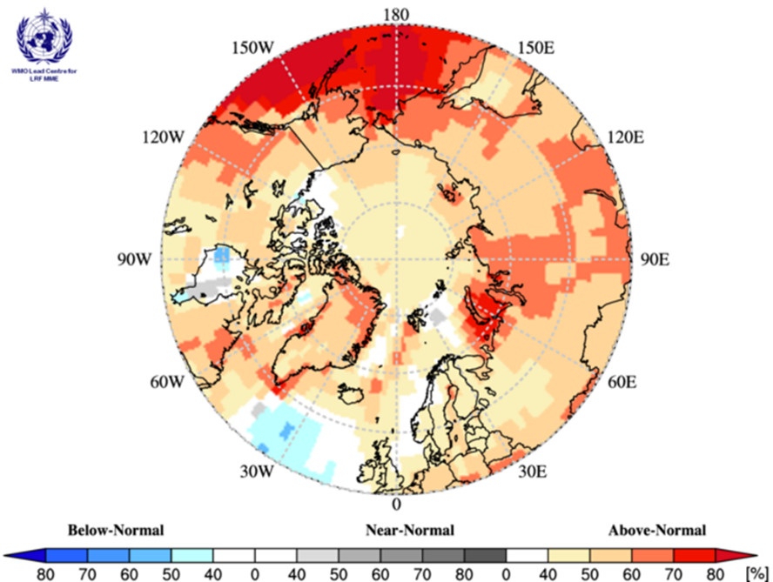
TEMPERATURE: Outlook Summer 2020
Multi model ensemble probability forecast for surface temperature for June, July, and August 2020. Three categories: below normal (blue), near normal (grey), above normal (red) and no agreement amongst the models (white). Source: www.wmolc.org.
Notes:
Surface air temperatures during summer 2020 (June, July, and August 2020) are forecast to be above normal across the majority of the Arctic regions (orange and red areas in Figure).
The confidence of the forecast is low to moderate over the majority of the continental Arctic (land areas) (yellow and orange areas in Figure), while
Forecast confidences are high for the maritime parts of the Atlantic region, the Bering Sea, and a portion of the Barents and Kara Seas (dark red areas).
The multi-model ensemble did not agree over a few maritime areas across the Arctic (white areas).
Refer back to the non-technical presentation gave you more regional details using local expertise

Slide 8
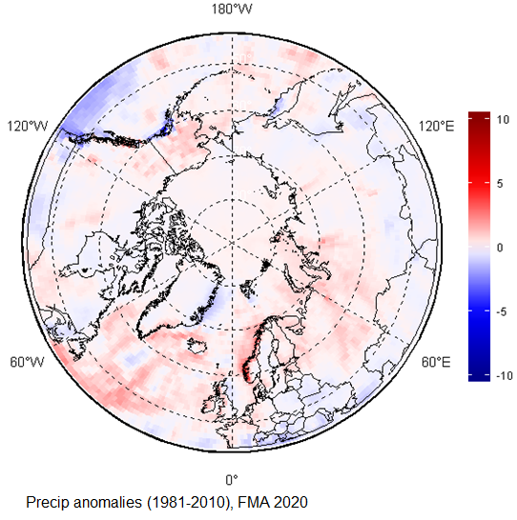
PRECIPITATION: Observations from Winter 2020
Wetter than average conditions were observed across a majority of Arctic region (red areas).
Only a few isolated areas, including the northeastern coast of Greenland, northern Canada, and a small swath over southern Alaska, experienced drier than average conditions (blue areas)
February, March, and April (FMA) 2020 precipitation based on the 1981-2010 reference period. Red indicates wetter than normal conditions, and blue indicates drier than normal conditions. Map produced by the Hydrometcenter of Russia https://meteoinfo.ru/ Data source: ERA-5.

Slide 9
PRECIPITATION: Winter 2020
How did the forecasts perform ?
Regions | MME Precipitation Forecast Agreement | MME Precipitation Forecast | Observations NCAR CFSR Reanalysis | MME Precipitation Forecast Accuracy
Alaska | Moderate | Above normal | Above normal | High
Chukchi | Moderate | Above normal | Near normal | Low
Eastern Siberia | Moderate | Above normal | Above normal | High
Western Siberia | Moderate | Above normal | Above normal | High
European | Moderate | Above normal | Above normal | High
Atlantic | Moderate | Above normal (continental regions only) | Above normal (continental regions only) | High
Canada | No agreement | No forecast | Near normal in the south and west, below in the center | N/A
Central Arctic | No agreement | No forecast | N/A | N/A
Notes:
The Winter 2020 precipitation forecast was verified by comparing the forecast with meteorological observations and reanalysis technics to fill gaps in observations.
Above-normal precipitation over the majority of the Arctic were accurately forecast for the Winter 2020 season.
The only exception was in the Chukchi area, where observed near-normal precipitation were inaccurately forecast.
There was no agreement amongst the models over the Eastern Canada and Central Arctic region (predominance of white areas over those regions).
As a general conclusion, the multi-model ensemble forecast was accurate for approximately 70% of the Arctic territory.

Slide 10
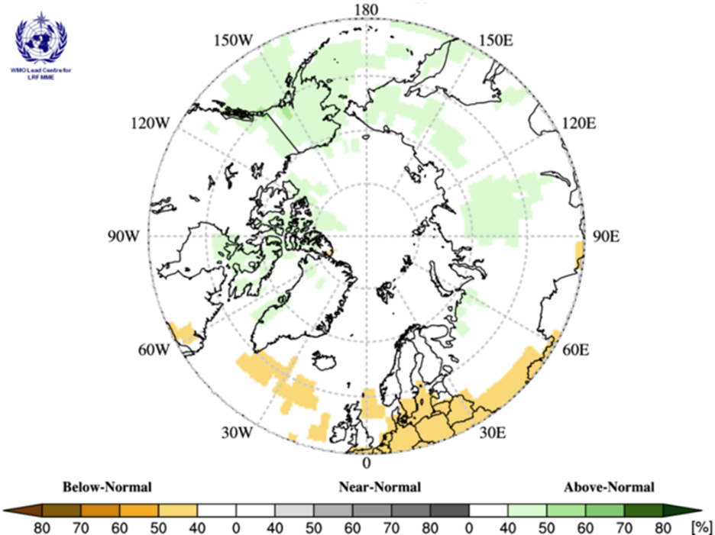
PRECIPITATION: Outlook Summer 2020
Multi model ensemble probability forecast for precipitation for JJA 2020. Green indicates wetter conditions, orange drier conditions and white, no agreement amongst the models. Source: www.wmolc.org.
Notes:
Precipitation during summer 2020 (June, July, and August) is forecast to be
above normal over Alaska, and portions and the Chukchi, Eastern Siberia, and northern Canadian region; the confidence of the forecast is low (light green areas).
below normal for a portion of Northern Atlantic; the confidence of the forecast is low (light orange areas).
The multi-model ensemble did not agree over the remainder of the Arctic region (white areas).

Slide 11
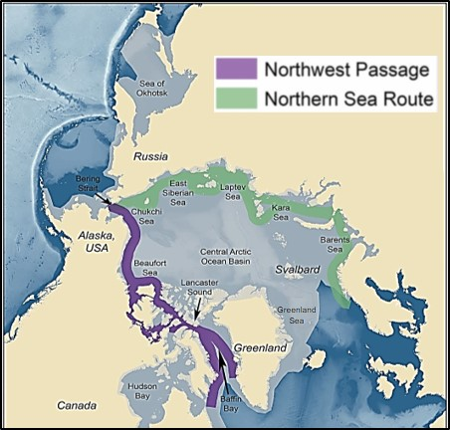
Sea-Ice: From a Circumpolar Perspective
Maximum sea-ice extent, volume and thickness is normally reached each year in the Arctic during the month of March.
The forecast for March 2020 sea ice extent was based on output from CanSIPSv2, an MME of two climate models

Slide 12
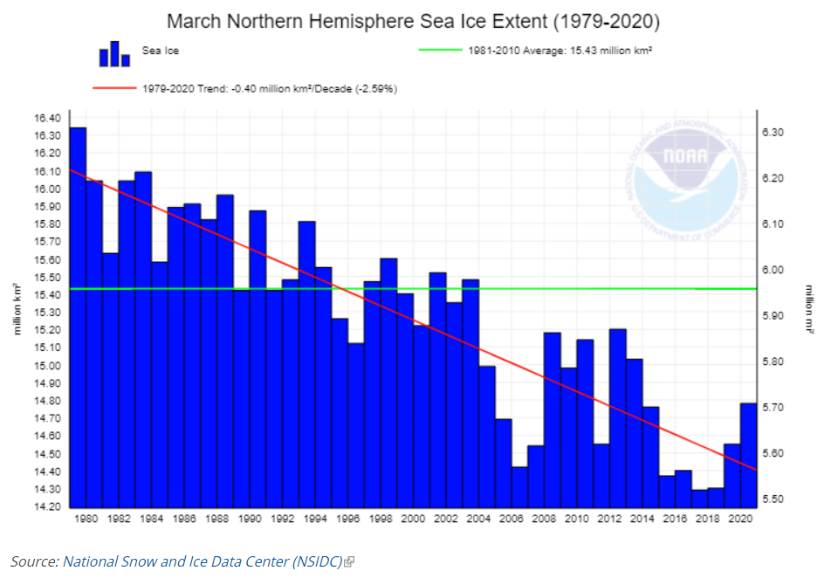
SEA-ICE Extent: Observations from Winter 2020
Notes:
2020 Sea ice extents were not at a minimum over the 40 year record, 2020 rebounded slightly but trends are still declining

Slide 13
SEA-ICE: Winter 2020
How did the forecasts perform ?
Regions | CanSIPS Sea-Ice Forecast Confidence | CanSIPS Sea-Ice Forecast | Observed Ice Extent | CanSIPS Sea-Ice Forecast Accuracy
Bering Sea | Low | Below normal | Normal | Low
Sea of Okhotsk | Low | Below to near normal | Below to near normal | High
Barents Sea | Low | Near normal | Below normal | Low
Greenland Sea | High | Near normal | Below to near normal | Moderate
Gulf of St. Lawrence | Low | Below normal | Below to near normal | High
Labrador Sea | Moderate | Below normal | Below to near normal | Moderate
Notes:
Normal ice extent in the Bering Sea, below normal was forecasted = low forecast accuracy
Below to near normal ice extent for the Sea of Okhotsk, high forecast accuracy. Normal surface pressure and air temperature patterns in the Bering and Sea of Okhotsk regions led to near normal ice coverages.
Below normal ice extent in the Barents (low accuracy) and moderate accuracy for the Barents Sea. Pronounced warm air temperature and low surface level pressure anomalies over these areas in winter 2019/20 restricted sea ice development, and ice expansion was slowed by the lack of deep, sustained cold and the presence of regular destructive wind events.
Moderate accuracy for the Labrador Sea. Above normal air temperatures in Davis Strait and over the northern Labrador Coast suppressed ice growth during the past winter, leading to significantly lower ice export from these regions southward along the Labrador Coast and into the northwestern section of the Gulf of St. Lawrence.
High Accuracy for the Gulf of St. Lawrence. Near normal temperatures and a lack of sea ice from northern regions led to a lower than normal ice extent for the Gulf.

Slide 14
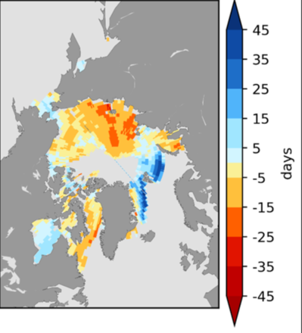
SEA-ICE: Break-up Outlook 2020
What is Normal break-up?
The first day in a 10 day period when the ice concentration goes below 50%
based on climatological period (2009-2017)
Break-Up Categories:
Late break-up
Near normal break-up
Early break-up
Regions | CanSIPS Sea-Ice Forecast Confidence | CanSIPS Sea-Ice Break-up Forecast
Baffin Bay | High | Early
Barents Sea | High | Late in northern section
Beaufort Sea | High | Early
Bering Sea* | Moderate | Near normal to late
Chukchi Sea | High | Early
East Siberian | Low | Early southern section, near normal northern section
Greenland Sea | High | Late
Hudson Bay | Moderate | Late eastern half, near normal western half
Kara Sea | Moderate | Early in the west, near normal in the east
Labrador Sea | High | Early
Laptev Sea | Low | Early
Forecast for the 2020 spring/summer break-up expressed as an anomaly (difference from normal) Source: CanSIPS (ECCC)
Notes:
These regions break-up details were covered in the non-technical regional presentation, but the consensus statement explains and shows you the model output for the entire circumpolar Canadian Arctic
“The Bering Sea ice break-up on the slide is already out of date: daily Bering Sea ice extent has been below 1981-2010 average since early March and is currently at about 75% of the 30-year median for this date. By the time of ACF-5, there is likely to be only limited ice remaining in the Bering Sea by late May

Slide 15
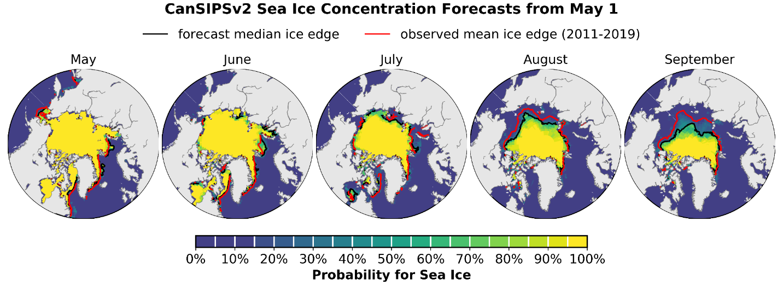



Minimum SEA-ICE Extent: Outlook September 2020
Regions | CanSIPS Sea-Ice Forecast Confidence | CanSIPS Sea-Ice Forecast
Barents Sea | Low | Above normal (northern section)
Beaufort Sea | Moderate | Below normal
Canadian Arctic Archipelago | Moderate | Below normal
Chukchi Sea | High | Below normal
Eastern Siberian Sea | Moderate | Below normal
Greenland Sea | High | Above normal
Kara Sea | High | Below normal
Laptev Sea | High | Below normal
September 2020 probability of sea ice at concentrations greater than 15% from CanSIPSv2 (ECCC). Forecast median ice extent from CanSIPSv2 (black) and observed mean ice edge 2011-2019 (red).
Notes:
Again, the sea-ice extent details were covered in the non-technical regional presentation, but the consensus statement explains and shows you the model output for the entire circumpolar Canadian Arctic

Slide 16
Questions & Wrap Up
Arctic Regional Climate Center

