Slide 1
Using INTAROS project results for North Eurasia node: Access to seasonal summary data
5th Arctic Climate Forum (ACF-5)
Arctic Regional Climate Center – network (ArcRCC-N)
May 27-28, 2020
Evgenii Viazilov, RIHMI-WDC

Slide 2
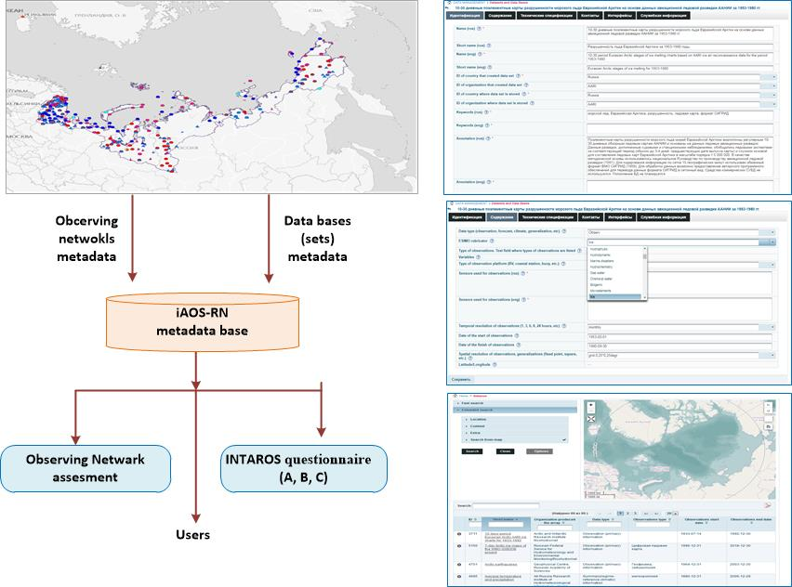
Assessment of Russian observing systems and databases
http://portal.intaros.meteo.ru/portal/intaros/meta
Russian systems of account of observation networks and metadata (http://asunp.meteo.ru

Slide 3
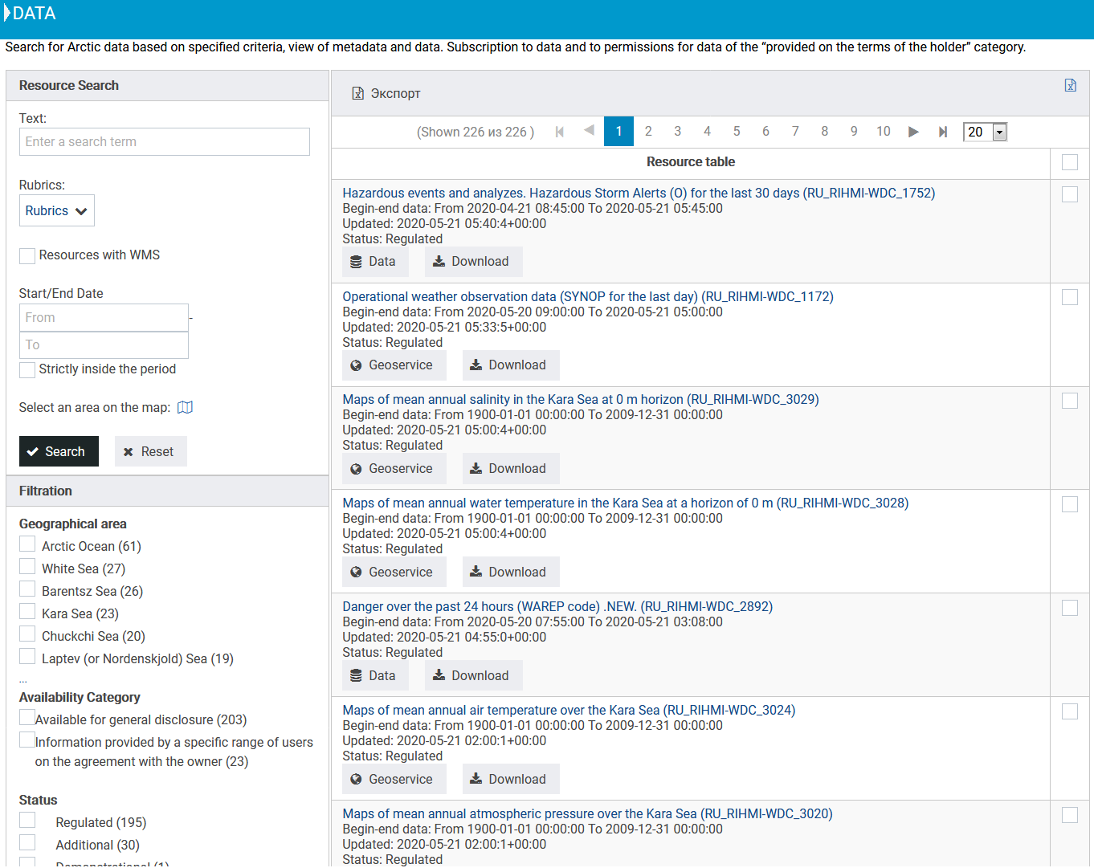
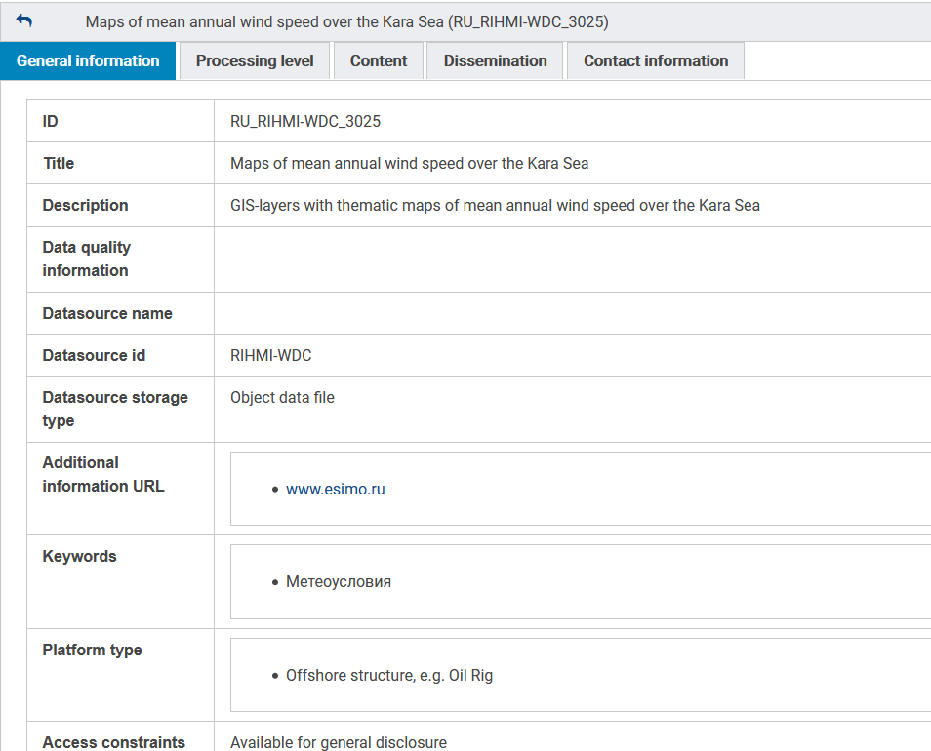
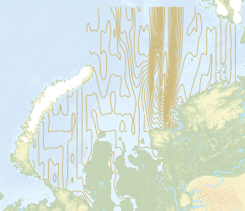
Integration of multidisciplinary, distributed and heterogeneous databases within iAOS-Russian Node
http://portal.intaros.meteo.ru/portal/intaros/data
Short information:
Total -226 information resources
RIHMI-WDC – 165
AARI – 59
Nansen Centre -2
Rubric
Meteo - 112
Data for river - 63
Hydrochemistry - 24
Ice - 24
Function:
integration data
metadata access
search information resources
data access
data exchange
data delivery to ftp or e-mail
visualization data (map, graphic, table)
Metadata
Data
Link for “Data Access” is on ArcRCC site https://arctic-rcc.org

Slide 4
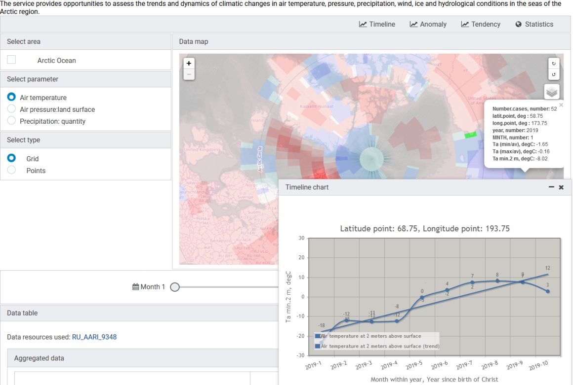
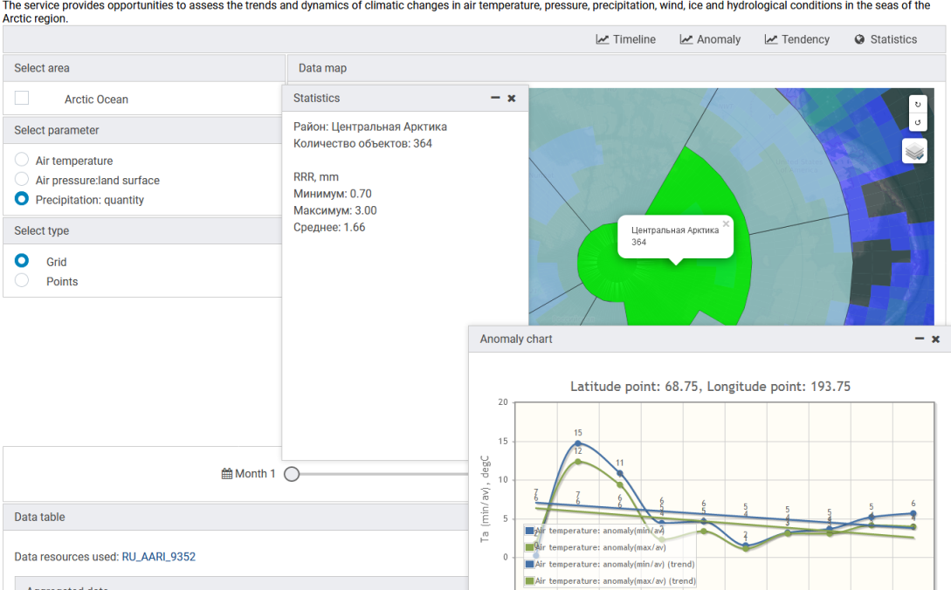
iAOS applications for information support of marine activities in the Arctic
http://portal.intaros.meteo.ru/portal/intaros/services/climate_monitoring
Applied tasks:
- Disasters and support decision
- Assessment of climate
- Monitoring of climate
- Support of Long-Range forecasts
- Hydrometeorological support of transport operations
Functions:
- Configuring information resources, portlets, tools, geo-area, parameters for applied tasks
- Calculation of anomalies, trends, rank, extrema, statistical characteristics by macro-regions
- Data visualization (map, graph, table)
- Preparation of materials for the report

Slide 5
THANK YOU FOR YOUR ATTENTION !
INTegrated ARctic Observing System (INTAROS)
EC HORIZON 2020-BG-09-2016
Agreement between Ministry of Education and Science of Russia and RIHMI-WDC № RFMEFI61618X0103
The participants of project:
- All-Russian Research Institute of Hydrometeorological Information - World Data Center (RIHMI-WDC)
- Arctic and Antarctic Institute (AARI)
- Nansen International Environmental Remote Sensing Center (NIERSC)

