Slide 1



ACF - 5: Verification of the FMA2020 season
ACF - 5: Seasonal forecast for the JJA2020 season
Marko Markovic
Meteorological Service of Canada

Slide 2
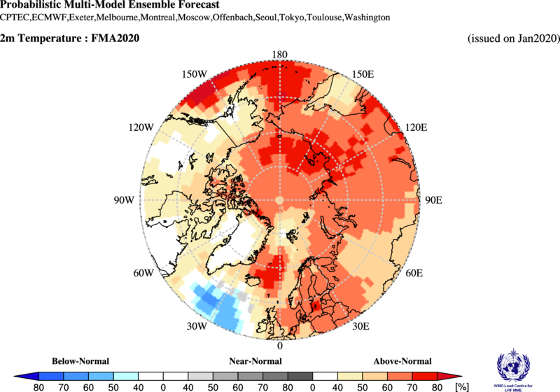
Seasonal forecast over the Arctic, Feb-March-April 2020
A reminder
Considering multi-model ensemble forecast and a limited model skill over the Arctic:
Temperature: there is probability of 40% or more that temperatures will be above normal over the Alaska and W. Canada and over most of the continental Canadian Arctic. Same above normal probabilities, but with higher confidence, was forecasted for European, Atlantic, W and E Siberian and Chukchi regions.

Slide 3
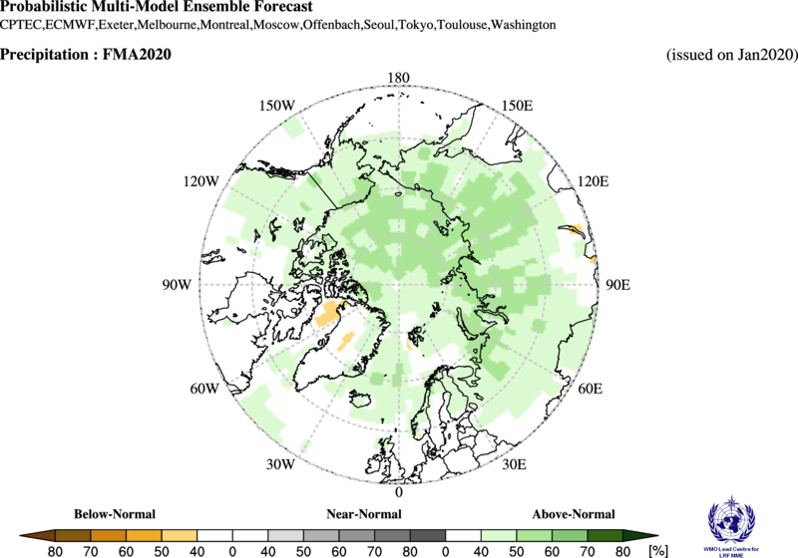
Seasonal forecast over the Arctic, Feb-March-April 2020
A reminder
Considering multi-model ensemble forecast and a limited model skill over the Arctic:
Precipitation: Mostly equal chances were expected over eastern Canada and and some parts of Atlantic region (mostly Greenland). Over other Arctic regions, above normal precipitation probabilities were expected with ~40% chance.

Slide 4
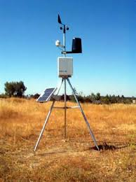
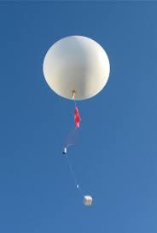

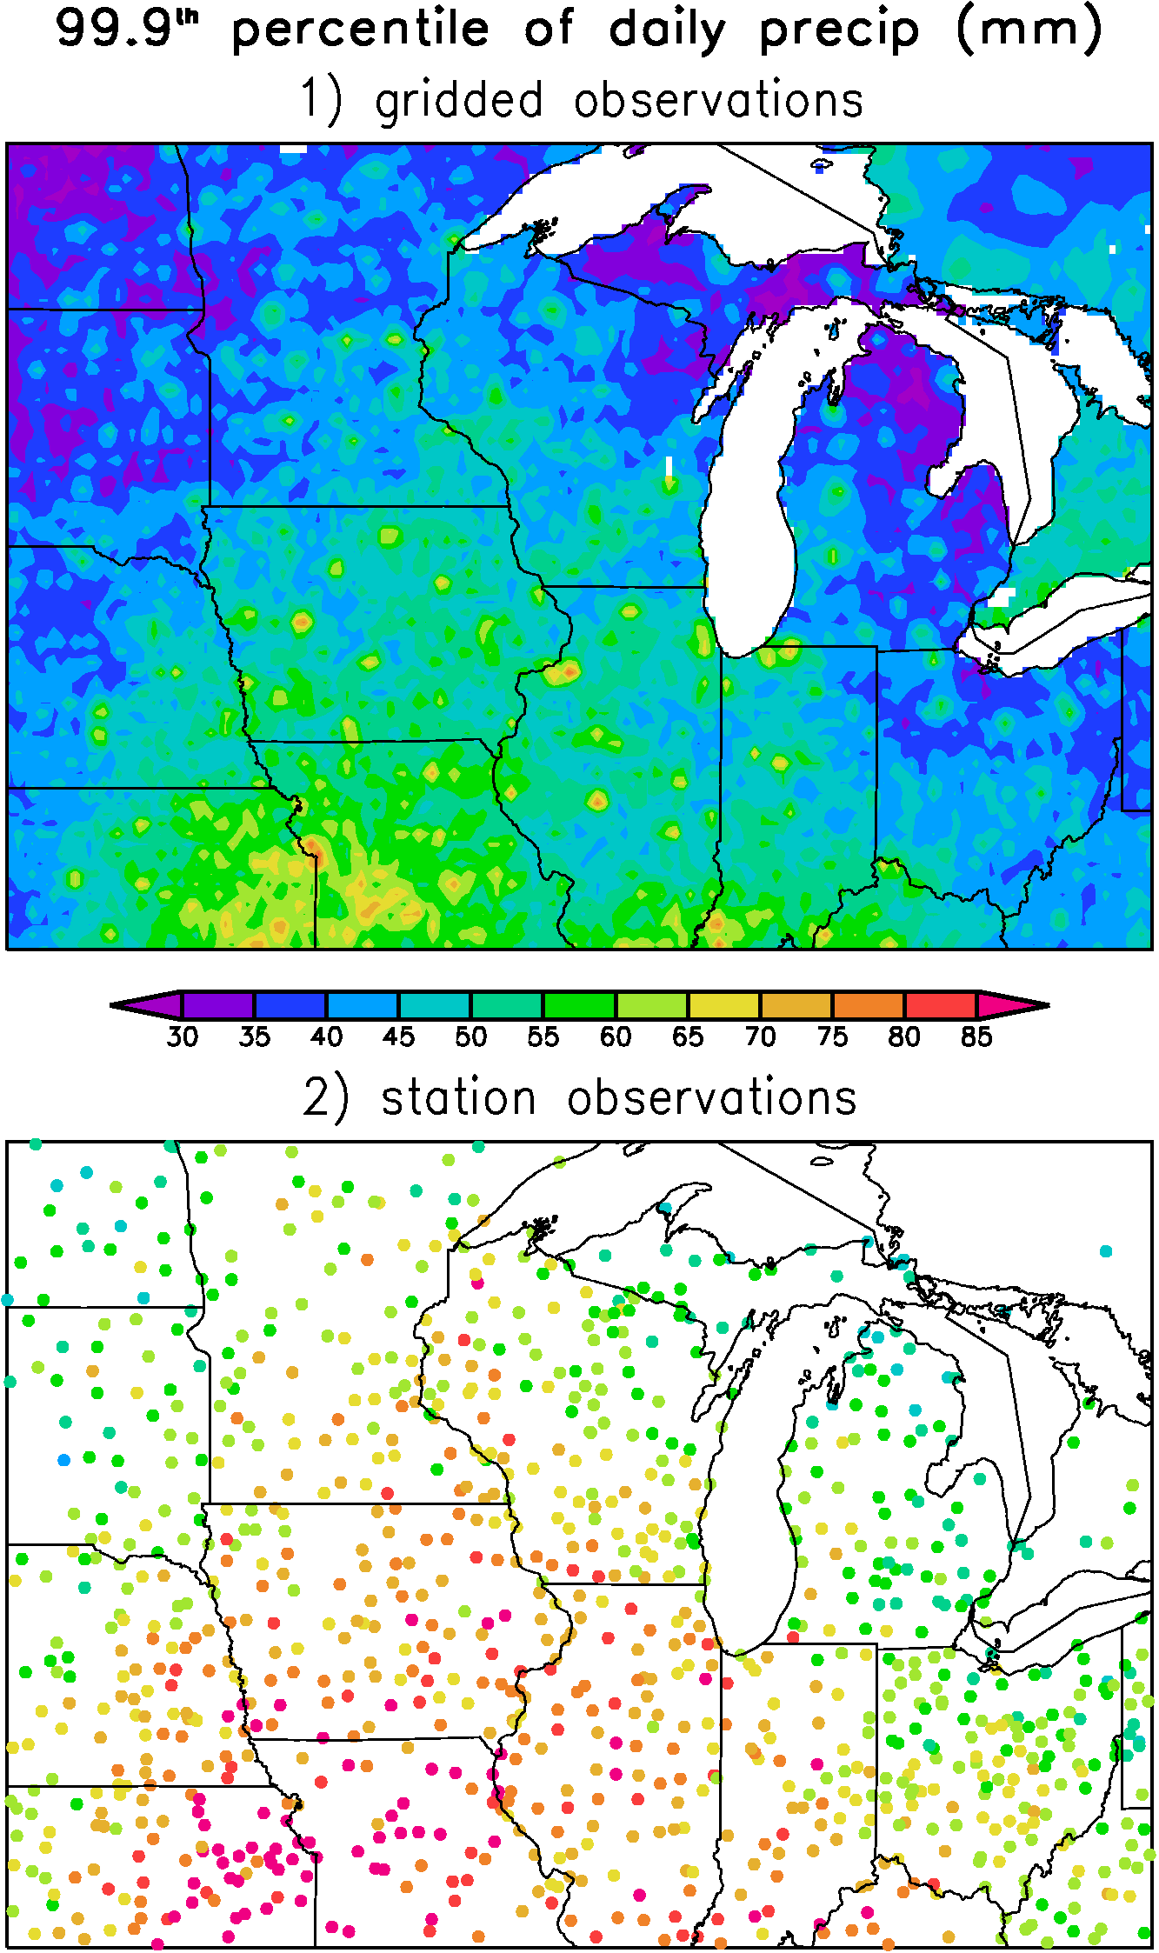
How do we verify seasonal forecasts?
- We need observations!
Unfortunately we can not measure temperature or precipitation on every single point over the globe.
This is why we use statistical techniques to interpolate measured variables over the regions where we can measure. The results is called the re-analysis.
Precipitation
Precipitation Re-Analysis
Data
Assimilation
+ numerical modeling
https://djlorenz.github.io/downscaling2/ProbApp/interp.html

Slide 5
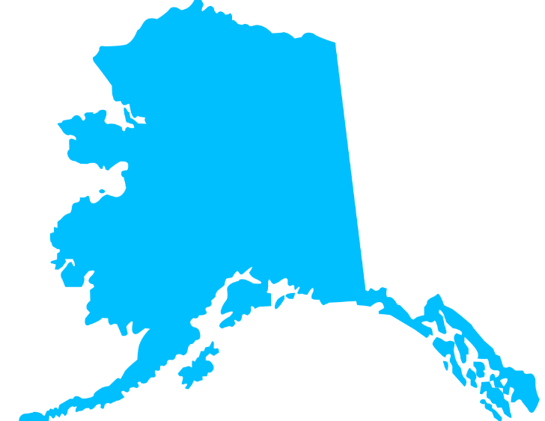
How do we verify seasonal forecasts?
We need some metric, some number to quantify the verification result
We call this metric a score
For the verification over the Arctic we will use a subjective score: a percentage of the correct forecast over a selected region in the Arctic.
Forecast
Observations
a 50% correct forecast
http://www.supercoloring.com/silhouettes/alaska-map

Slide 6
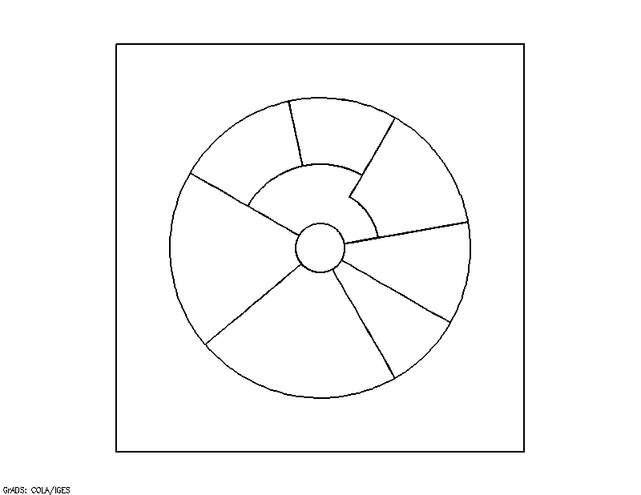
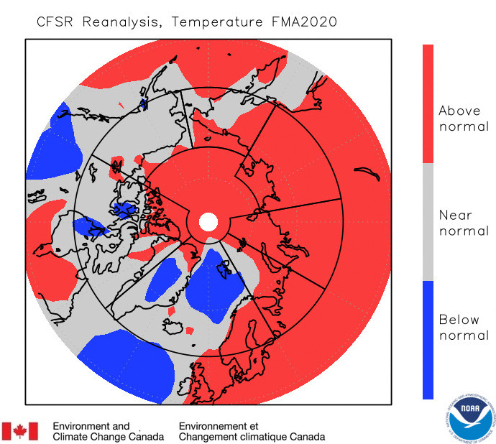
Forecast, temp FMA 2020
Verification
Temperature
Verif: | Forecast | CFS Reanalysis | Subj. Result
Alaska, W. Can | Above normal | Near normal | miss
E. Canada
N. Atlantic
European
W. Siberia
E. Siberia
Chukchi

Slide 7
Forecast, temp FMA 2020
Verification
Temperature
Verif: | Forecast | CFS Reanalysis | Subj. Result
Alaska, W. Can | Above normal | Near normal | miss
E. Canada | Mostly above normal | Mostly near normal | miss
N. Atlantic
European
W. Siberia
E. Siberia
Chukchi

Slide 8
Forecast, temp FMA 2020
Verification
Temperature
Verif: | Forecast | CFS Reanalysis | Subj. Result
Alaska, W. Can | Above normal | Near normal | miss
E. Canada | Mostly above normal | Mostly near normal | miss
N. Atlantic | Equal chance over east, above normal over Scand. and Island | Above over Scandinavia, near norm over Island | 30% hit, 70miss
European
W. Siberia
E. Siberia
Chukchi

Slide 9
Forecast, temp FMA 2020
Verification
Temperature
Verif: | Forecast | CFS Reanalysis | Subj. Result
Alaska, W. Can | Above normal | Near normal | miss
E. Canada | Mostly above normal | Mostly near normal | miss
N. Atlantic | Equal chance over east, above normal over Scand. and Island | Above over Scandinavia, near norm over Island | 30% hit, 70miss
European | Above normal | Above normal | hit
W. Siberia
E. Siberia
Chukchi

Slide 10
Forecast, temp FMA 2020
Verification
Temperature
Verif: | Forecast | CFS Reanalysis | Subj. Result
Alaska, W. Can | Above normal | Near normal | miss
E. Canada | Mostly above normal | Mostly near normal | miss
N. Atlantic | Equal chance over east, above normal over Scand. and Island | Above over Scandinavia, near norm over Island | 30% hit, 70miss
European | Above normal | Above normal | hit
W. Siberia | Above normal | Above normal | hit
E. Siberia
Chukchi

Slide 11
Forecast, temp FMA 2020
Verification
Temperature
Verif: | Forecast | CFS Reanalysis | Subj. Result
Alaska, W. Can | Above normal | Near normal | miss
E. Canada | Mostly above normal | Mostly near normal | miss
N. Atlantic | Equal chance over east, above normal over Scand. and Island | Above over Scandinavia, near norm over Island | 30% hit, 70miss
European | Above normal | Above normal | hit
W. Siberia | Above normal | Above normal | hit
E. Siberia | Above normal | Above normal | hit
Chukchi

Slide 12
Forecast, temp FMA 2020
Verification
Temperature
Verif: | Forecast | CFS Reanalysis | Subj. Result
Alaska, W. Can | Above normal | Near normal | miss
E. Canada | Mostly above normal | Mostly near normal | miss
N. Atlantic | Equal chance over east, above normal over Scand. and Island | Above over Scandinavia, near norm over Island | 30% hit, 70miss
European | Above normal | Above normal | hit
W. Siberia | Above normal | Above normal | hit
E. Siberia | Above normal | Above normal | hit
Chukchi | Above normal | Above normal, near normal | 50% hit/miss

Slide 13
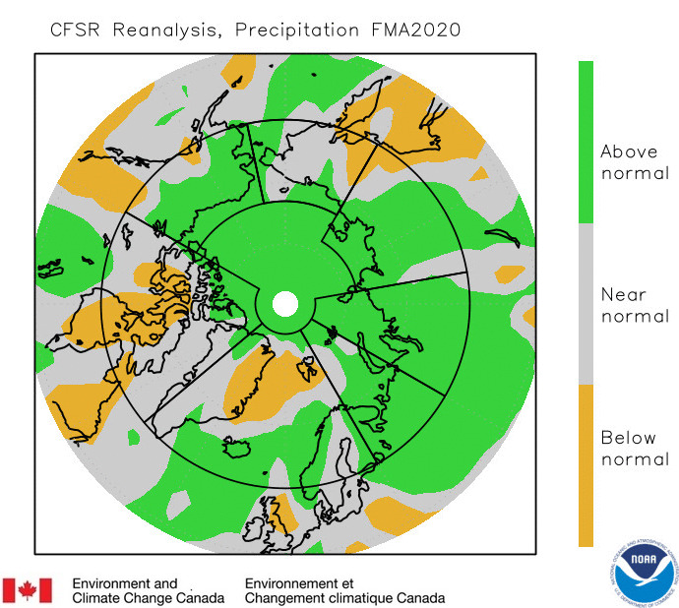
Forecast, prec FMA 2020
Verification
Precipitation
Verif: | Forecast FMA | CFS Reanalysis | Subj. Result
Alaska, W. Can | Mostly above | Mostly above | 80% hit
E. Canada | Mostly Indecisive | Near normal in the south and west, below in the center | %
N. Atlantic | Indecisive, above normal | Above over Island and W and E Scandinavia. | mostly hit where decisive
European | Above | Above | hit
W. Siberia | Above | Above | hit
E. Siberia | Above | Above | hit
Chukchi | Above | Mostly near normal | Mostly miss

Slide 14
Overall result, subjective verification
Temperature: In the regions where forecast was decisive the subjective score was 50-60%. This is a good score considering that everything below or equal 33% is considered worse than a pure chance.
Precipitation: In the regions where forecast was decisive, the subjective score is ~70%. Very good precipitation forecast for FMA2020!!!
Precipitation forecasts are usually not this skilful over the Arctic, the chance was on our side this time!!

Slide 15
Actual (real time )seasonal forecasts over the Arctic JJA-2020
      temperature
      precipitation

Slide 16
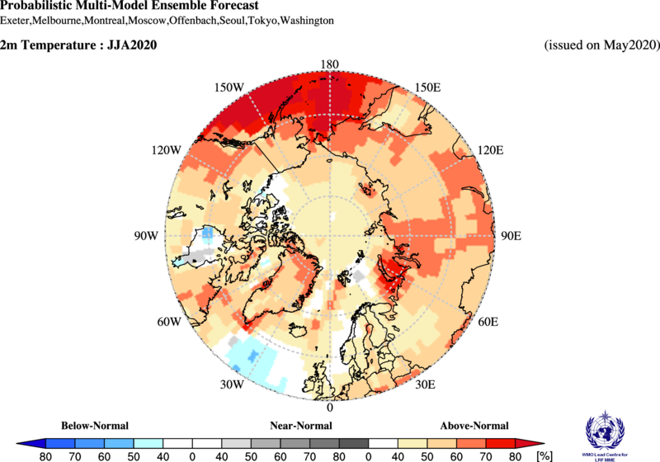
Temperature outlook over the Arctic:
Jun-July-August 2020
Alaska W. Canada
Eastern Canadian Arctic
N. Atlantic region
European region
West Siberia
East Siberia
Chukchi
The redder the color does not mean it is warmer.
It means we have more confidence in the above normal forecast over that region.

Slide 17
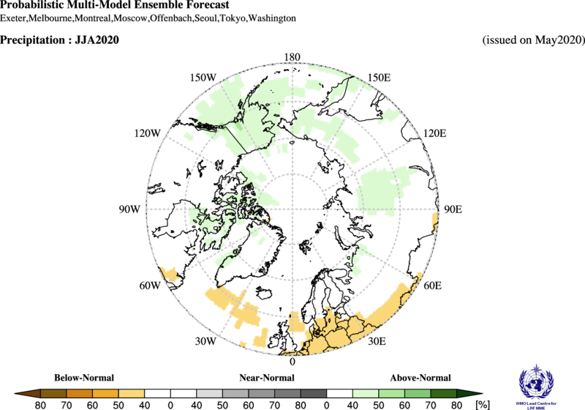
Precipitation outlook over the Arctic:
Jun-July-August 2020
Alaska W. Canada
Eastern Canadian Arctic
N. Atlantic region
European region
West Siberia
East Siberia
Chukchi
The greener the color does not mean it will precipitate more.
It means we have more confidence in the above normal precipitation forecast over that region.

Slide 18
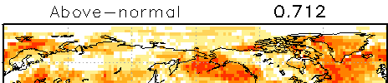
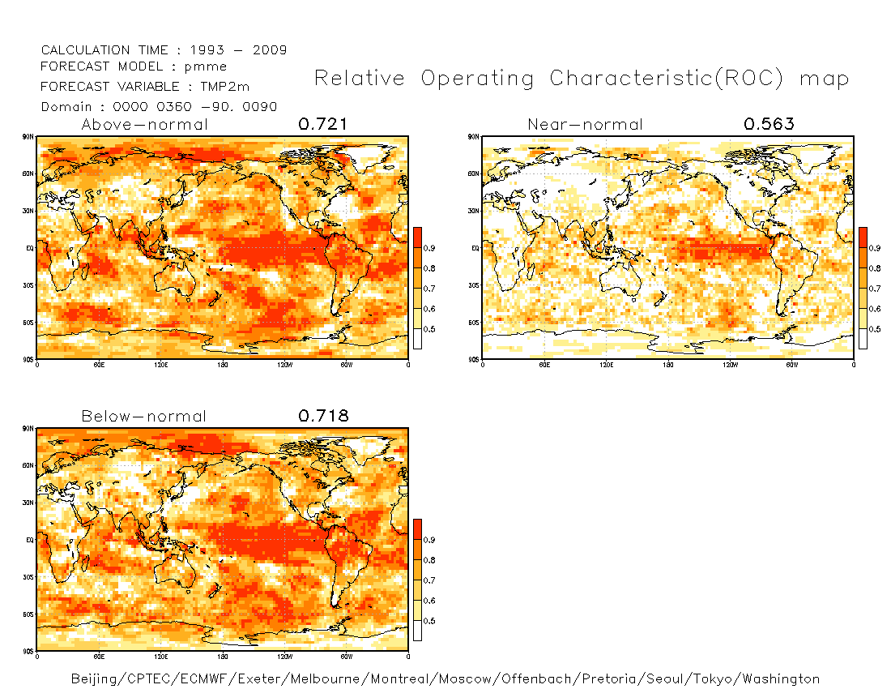
Discussing historical skill over the Arctic, Temperature
(confidence with respect to the historical skill)
If a historical skill was good over a certain region (e.g. colored region on the upper figure) we are more confident about the forecast results over the same region
Overall confidence is weak in JJA over the Arctic with the exception of the European (Scandinavia), East Siberian region and south Alaska.

Slide 19
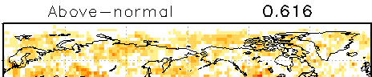
Discussing historical skill over the Arctic, Precipitation
(confidence with respect to the historical skill)
We don’t have a very high confidence in precipitation skill over the Arctic in JJA.

Slide 20
Conclusions
We use Multi Model Ensemble (MME) approach to calculate seasonal forecast.
We use probabilistic approach to communicate seasonal forecast results.
For evaluation over the Arctic we use a combination of observations and model results called re-analysis.
FMA2020 MME temperature forecast over the Arctic region was 50-60% correct, which is generally good result and much higher than a pure chance (i.e. 33%).
We expect above normal temperatures over all Arctic regions in JJA2020.
We expect above normal precipitation over the Alaskan Arctic, Chukchi, East Siberian and west Siberian region. Other Arctic regions mostly have equal chances for precipitation except Canadian Archipelago where we expect above normal precipitation in JJA20. Historically, we do not have a high confidence in precipitation forecast over the Arctic in JJA.

Slide 21
Thank you!

