Slide 1

Arctic Regional Climate Centre
Review of 2019/20 Winter Sea-Ice Outlook
Present the 2020 Summer Sea-Ice Outlook
Scott Weese and Katherine Wilson
Canadian Ice Service

Slide 2
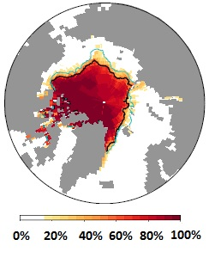
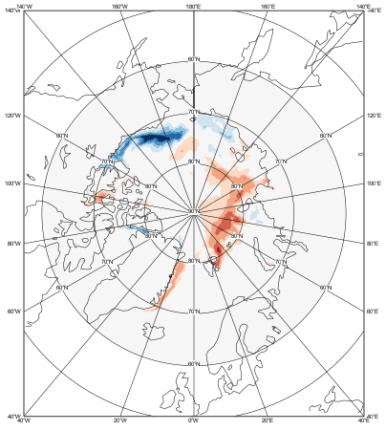
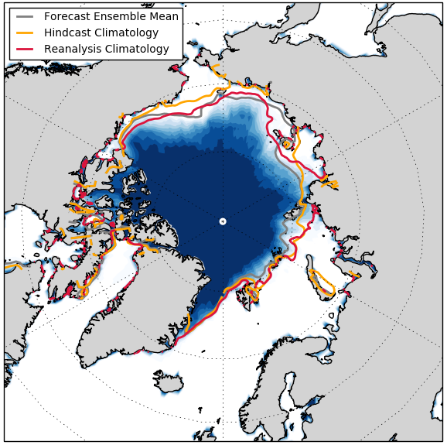
Models used for the ArcRCC Sea-Ice Outlooks
Based on 4 experimental forecasts from 4 WMO Global Producing Centers Output: France - ECMWF, United States- NOAA/CPC, Canada - ECCC/CCCMA and the UKMetOffice, 3 shown below)
Experts at the ArcRCC compare these models, so you don’t have to, and develop products for users.
Probability of Sea Ice > 15%
September 2018
ECCC (CanCM3+CanCM4)
Sea Ice Concentration Anomaly
September 2019
ECMWF (SEAS5)
Probability of Sea Ice > 15%
September 2019
UK Met Office (GloSea5)

Slide 3
Review of 2019/20 Winter
Arctic sea-ice conditions

Slide 4
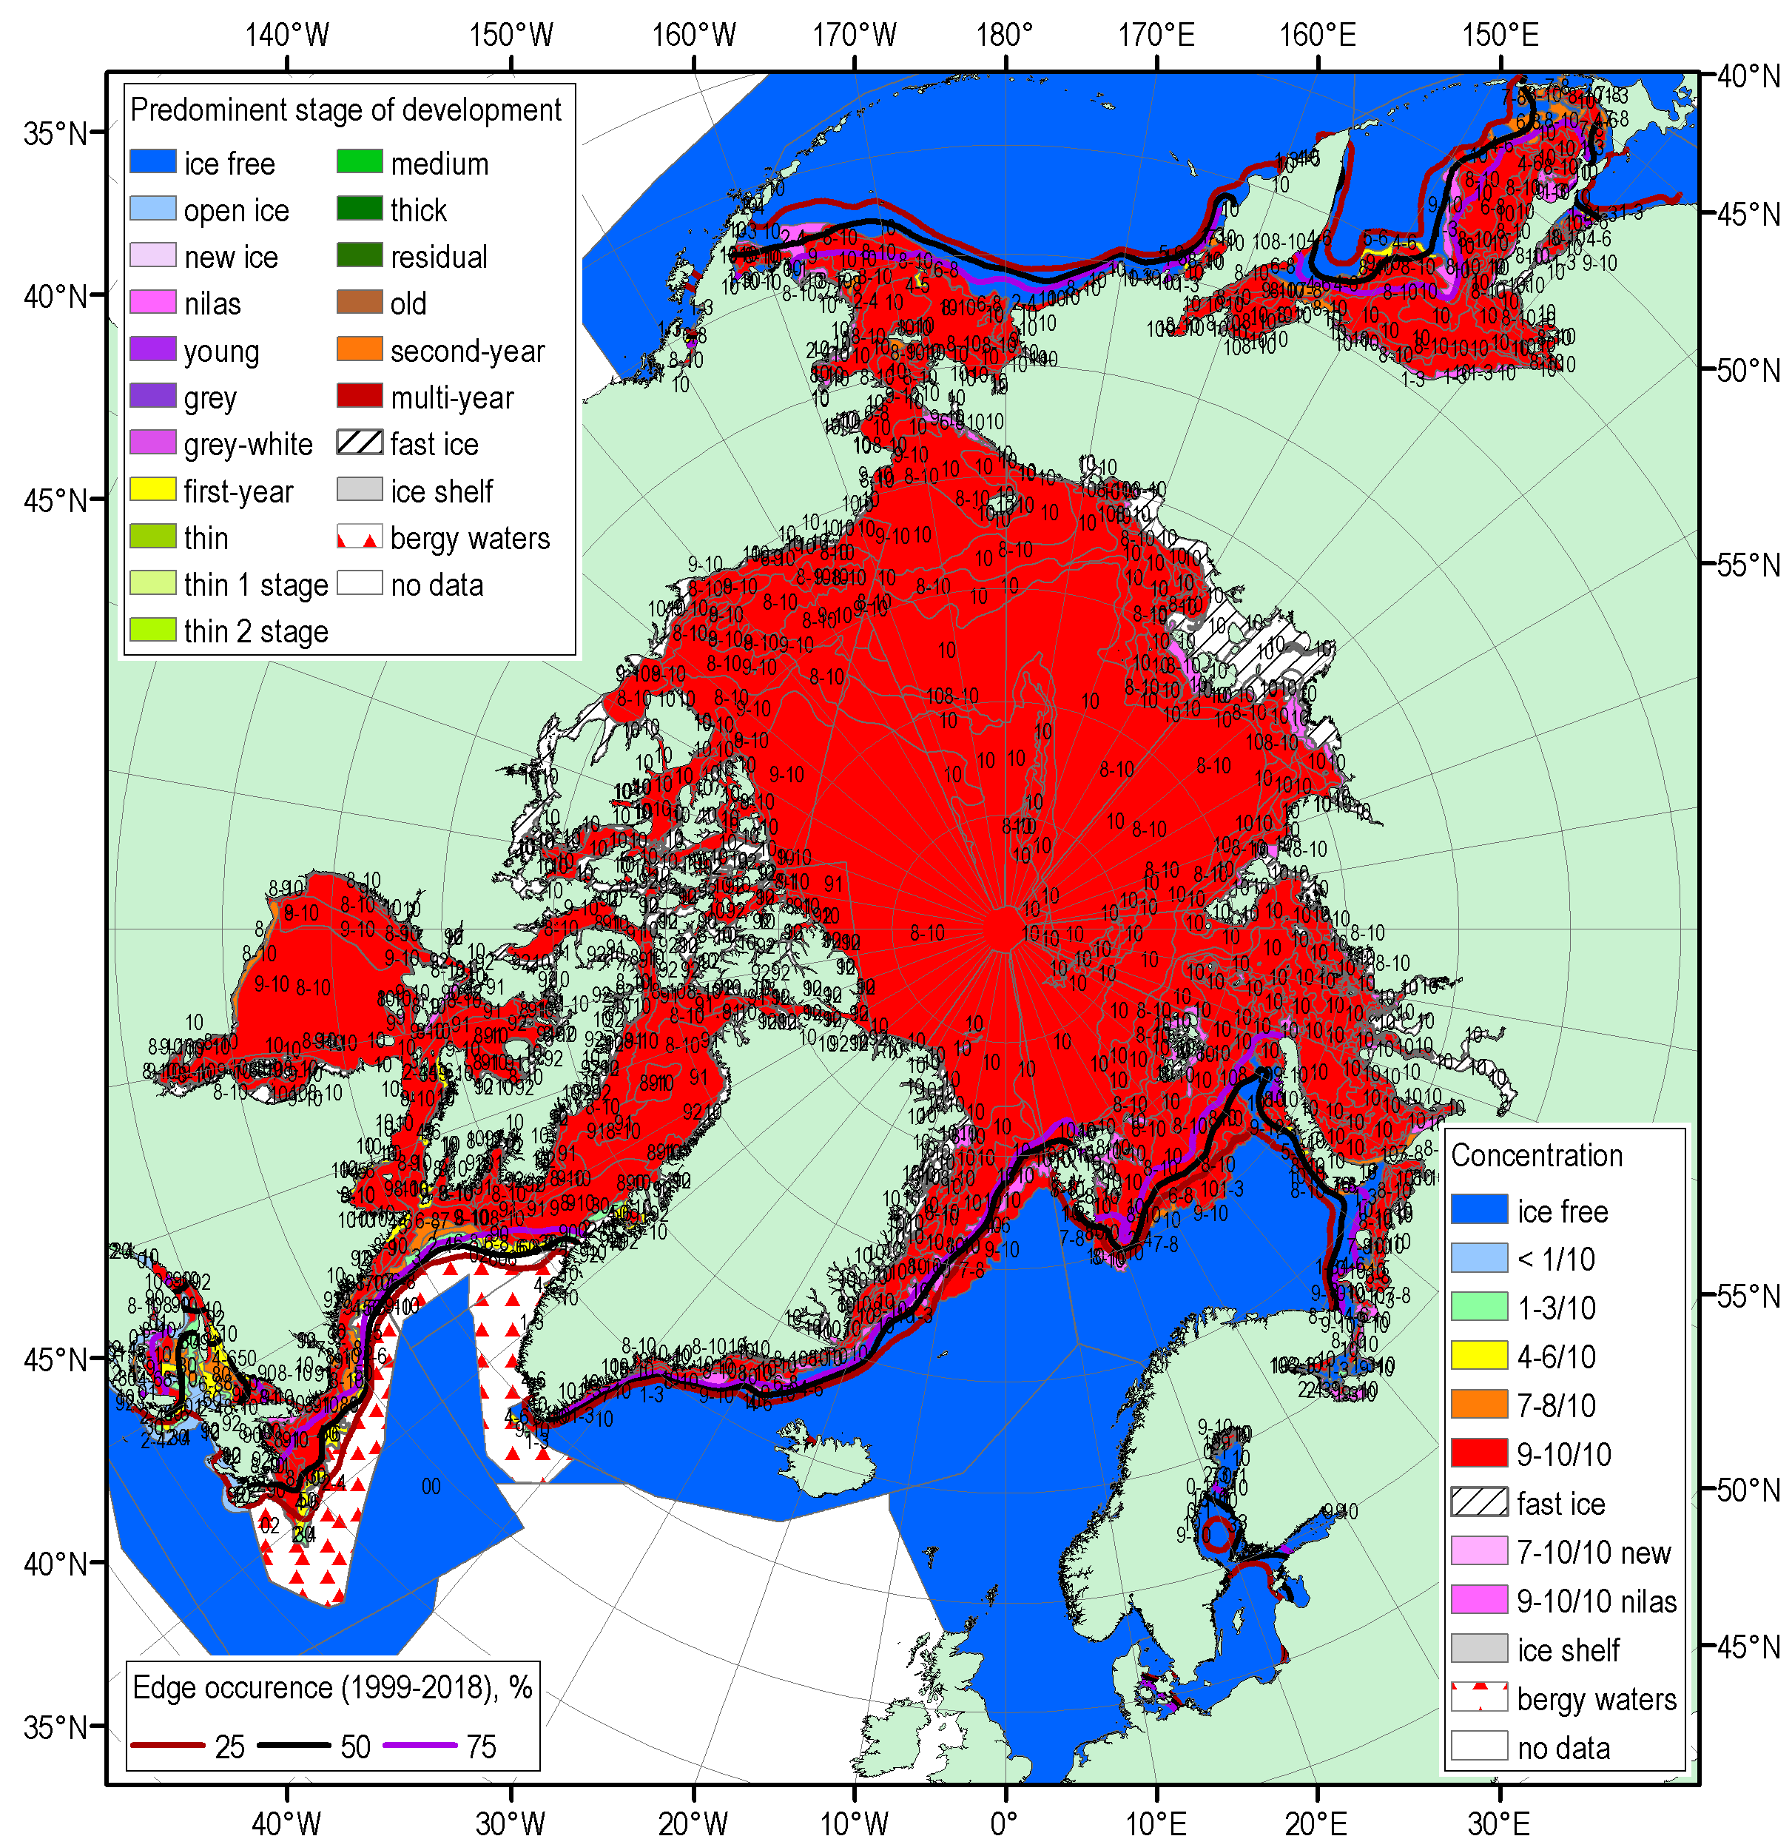
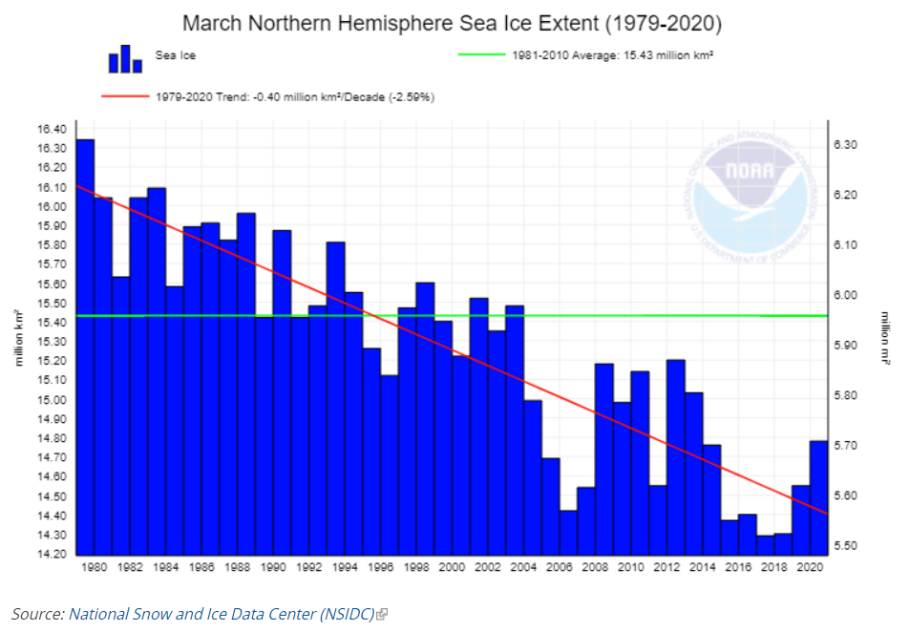
Actual March 2020 Maximum
Sea-Ice Extent
Left: Blended weekly ice charts for mid-March 2020
Below: March Northern Hemisphere sea ice extent
Source: National Snow and Ice Data Center
Source: Arctic and Antarctic Research Institute

Slide 5
Comparison: Actual Winter 2019/20 Conditions with
ArcRCC Sea-Ice Winter 2019/20 Outlook

Slide 6
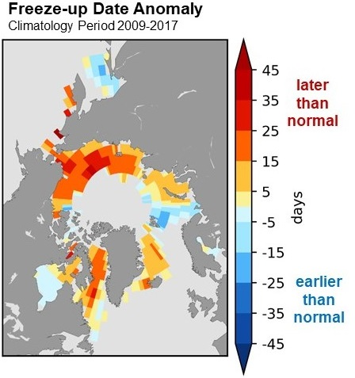
A. ArcRCC Sea-Ice Freeze-up Outlook
2019 Categories
What is Normal freeze-up?
The average date when the ice concentration rises above 50%
based on climatological period (2009-2017)
Freeze-Up Categories:
Late freeze-up
Near normal freeze-up
Early freeze-up
Only regions where the model has historical skill are included in the outlook The freeze-up outlook has three confidence categories; low, moderate and high
Source: Canadian Seasonal to Inter-Annual Prediction System (CanSIPS, courtesy ECCC)

Slide 7
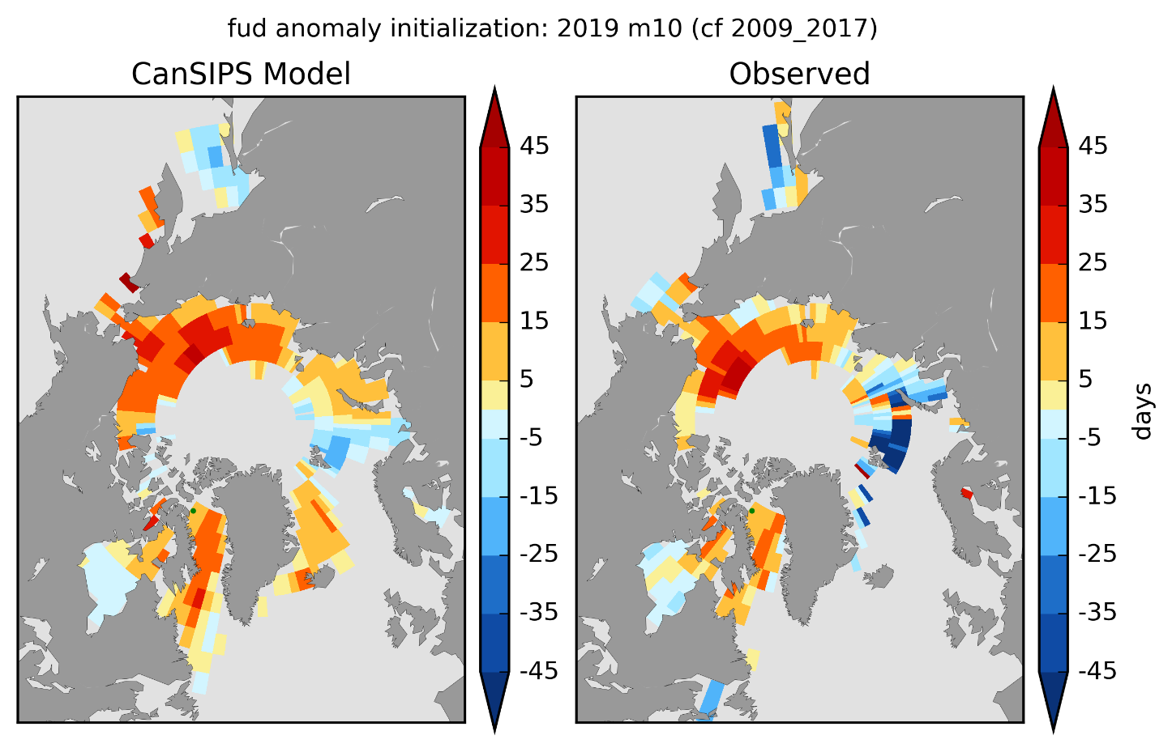
A. ArcRCC Sea-Ice Freeze-up Outlook
2019/20
Actual vs. Outlook
Regions | CanSIPS Sea-Ice Forecast Confidence | CanSIPS Sea-Ice Forecast | Observed Freeze-up | CanSIPS Sea-Ice Forecast Accuracy
Hudson Bay | moderate to high | near normal | late freeze-up | low
Baffin Bay/Labrador Sea | moderate to high | late freeze-up | late freeze-up | high
Greenland Sea | moderate | late freeze-up | near normal to early freeze-up | low
Barents Sea | moderate | early freeze-up | early freeze-up | high
East Siberian/Laptev Seas | moderate to high | late freeze-up | late freeze-up | high
Kara Sea | moderate | late freeze-up | near normal freeze-up | moderate
Chukchi Sea | high | late freeze-up | late freeze-up | high
Beaufort Sea | high | late freeze-up | late freeze-up | high
Sea of Okhotsk | low | late freeze-up | late freeze-up | high
Bering Sea | low | late freeze-up | late freeze-up | high
Notes:
Bering started slowly then accelerated in early 2020
Chukchi was very late, not record though

Slide 8
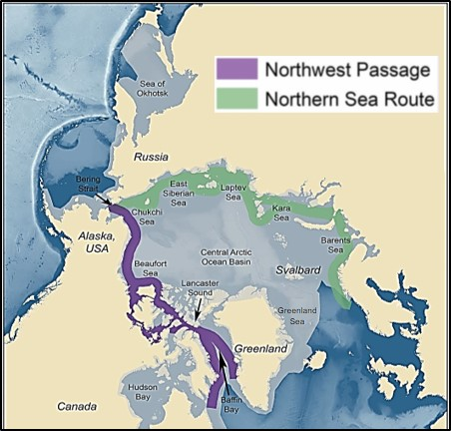
B. ArcRCC Sea-Ice Extent Outlook Winter 2020
Actual vs. Outlook
Maximum = March (Winter)
Forecast Categories:
Above normal ice extent
Near normal ice extent
Below normal ice extent
Outlook Confidence Categories
low agreement between the models
moderate agreement between models
high agreement between models
Regions | CanSIPS Sea-Ice Forecast Confidence | CanSIPS Sea-Ice Forecast (2009-2017 climate normal) | Observed Ice Extent (2009-2017 climate normal) | CanSIPS Sea-Ice Forecast Accuracy
Bering Strait | low | below normal | normal | low
Sea of Okhotsk | low | below to near normal | below to near normal | high
Barents Sea | low | near normal | below normal | low
Greenland Sea | high | near normal | below to near normal | moderate
Gulf of St. Lawrence | low | below normal | below to near normal | high
Labrador Sea | moderate | below normal | below to near normal | moderate

Slide 9
ArcRCC Sea-Ice Outlook
Summer 2020

Slide 10
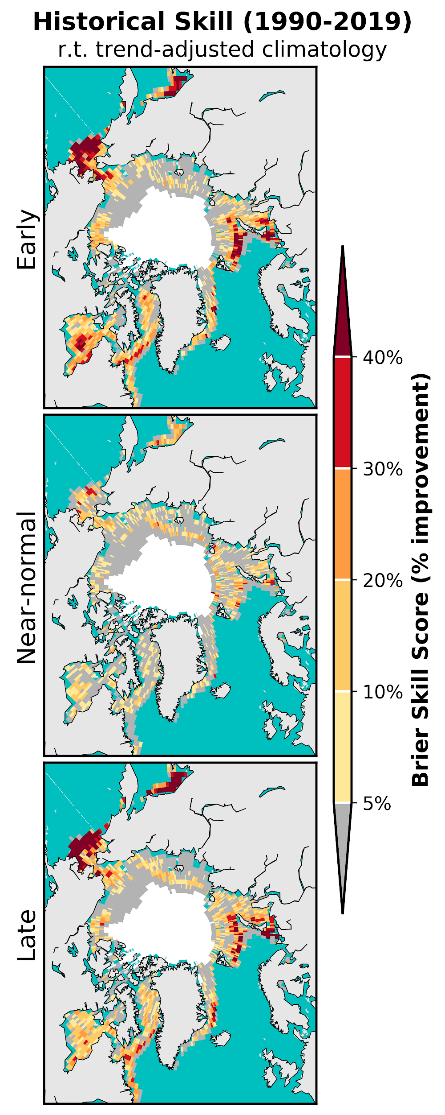
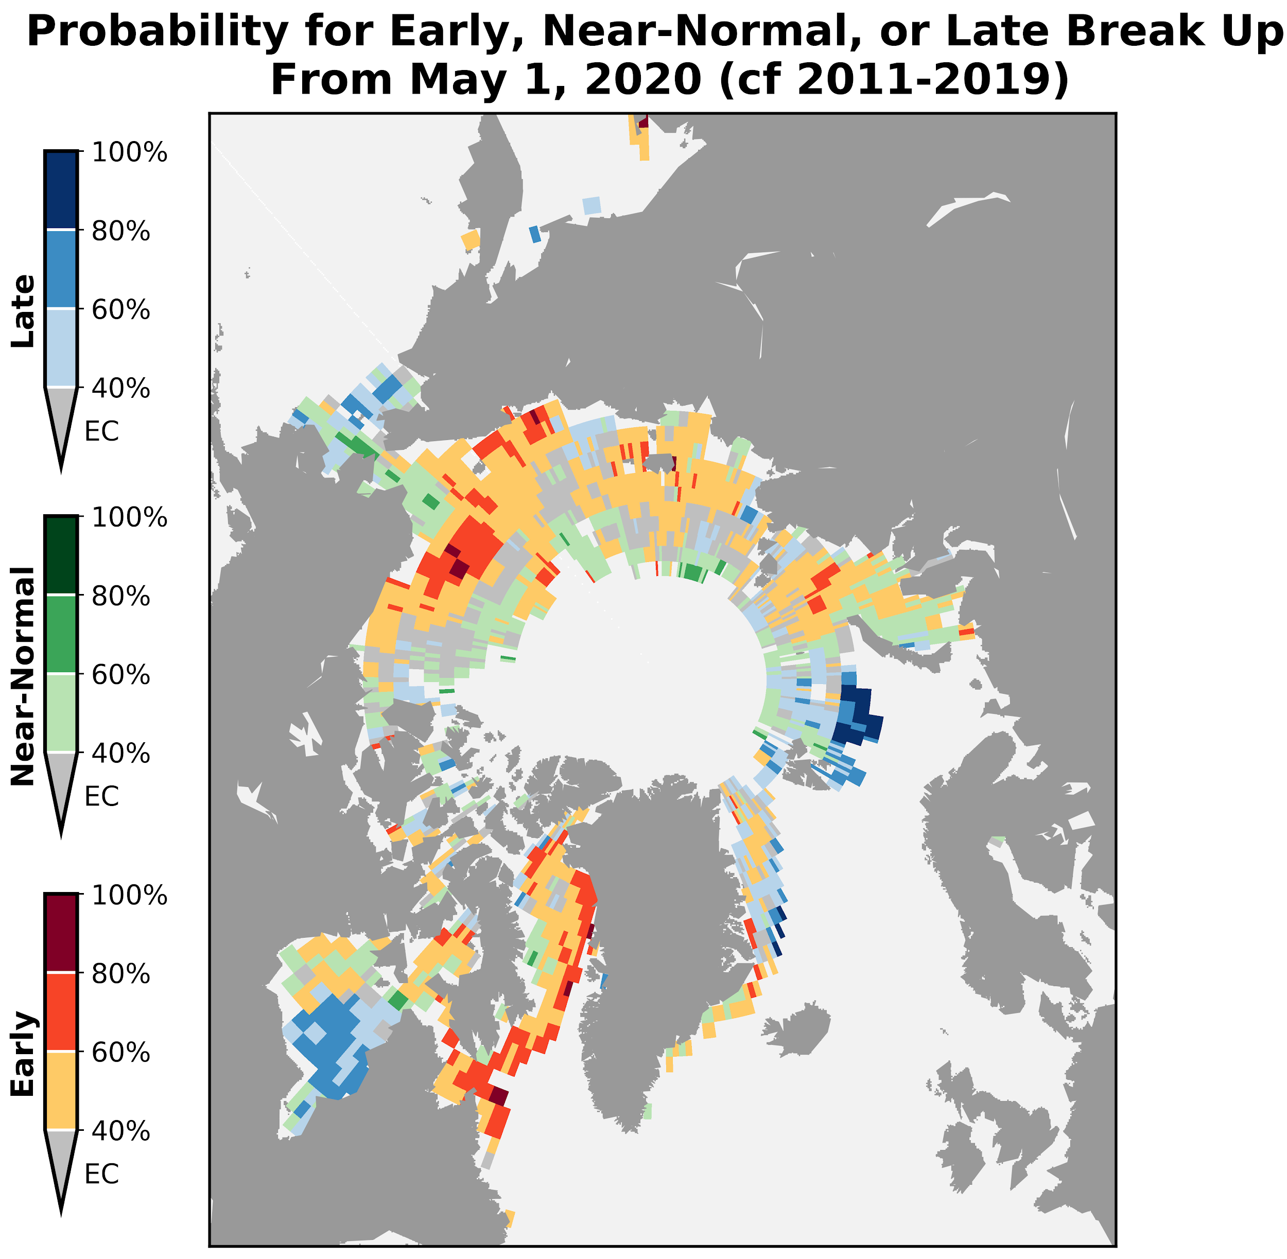
C. ECCC Ice-Free Date Probability Forecast Summer 2020 (Experimental)
Lower trust
Higher trust

Slide 11
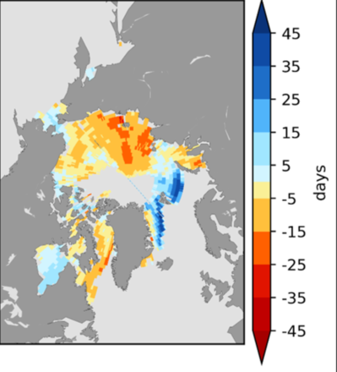
C. ArcRCC Sea-Ice Break-up Outlook 2020
What is Normal break-up?
The date when the ice concentration goes above 50%
based on climatological period (2009-2017)
Break-Up Categories:
Late break-up
Near normal break-up
Early break-up
Regions | CanSIPS Sea-Ice Forecast Confidence | CanSIPS Sea-Ice Break-up Forecast
Baffin Bay | High | Early
Barents Sea | High | Late in northern section
Beaufort Sea | High | Early
Bering Sea* | Moderate | Near normal to late
Chukchi Sea | High | Early
East Siberian | Low | Early southern section, near normal northern section
Greenland Sea | High | Late
Hudson Bay | Moderate | Late eastern half, near normal western half
Kara Sea | Moderate | Early in the west, near normal in the east
Labrador Sea | High | Early
Laptev Sea | Low | Early
Forecast for the 2020 spring/summer break-up expressed as an anomaly (difference from normal) where break-up is defined as the first day in a 10-day interval where ice concentration falls below 50%.
Source: CanSIPS (ECCC)
Notes:
“The Bering Sea ice break-up on the slide is already out of date: daily Bering Sea ice extent has been below 1981-2010 average since early March and is currently at about 75% of the 30-year median for this date. By the time of ACF-5, there is likely to be only limited ice remaining in the Bering Sea by late May

Slide 12
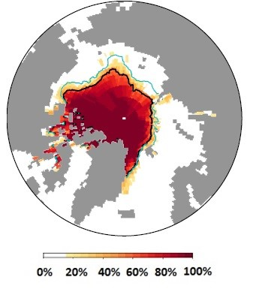
D. ArcRCC Sea-Ice Extent Outlook
Summer 2020
Minimum = September
What is Normal ?
Average ice extent based on conditions from 2009-2017.
Forecast Categories:
Above normal ice extent
Near normal ice extent
Below normal ice extent
Outlook Confidence
low agreement between the models
moderate agreement between models
high agreement between models
Source: CanSIPS (ECCC)

Slide 13
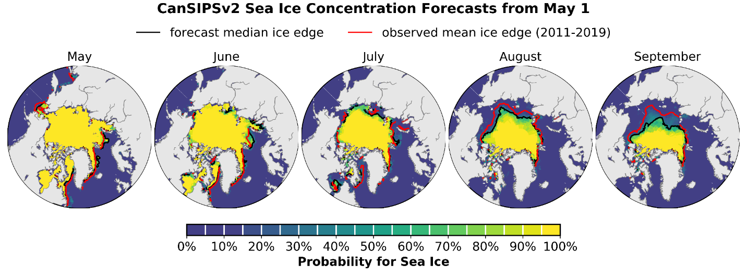



D. ArcRCC Sea-Ice Extent Outlook Summer 2020
Minimum = September
September 2020 sea ice probability of ice concentration > 15%
Regions | CanSIPS Sea-Ice Forecast Confidence | CanSIPS Sea-Ice Forecast
Barents Sea | Low | Above normal (northern section)
Beaufort Sea | Moderate | Below normal
Canadian Arctic Archipelago | Moderate | Below normal
Chukchi Sea | High | Below normal
Eastern Siberian Sea | Moderate | Below normal
Greenland Sea | High | Above normal
Kara Sea | High | Below normal
Laptev Sea | High | Below normal
September 2020 probability of sea ice at concentrations greater than 15% from CanSIPSv2 (ECCC). Forecast median ice extent from CanSIPSv2 (black) and observed mean ice edge 2011-2019 (red).
Notes:
Barents Shipping: Light ice conditions are expected for the whole of the northern sea route. Summer minimum sea ice extent is forecast somewhat above normal, but with low forecast confidence. We expect near normal impacts in terms of sea ice cover around Svalbard for the 2020 summer indicating normal shipping activities.
Greenland: Sea ice concentration is unusually low in the Danmark Strait even though the marginal ice zone (MIZ) extend is near normal.
The extent of this low concentration ice may pose a risk to shipping.

Slide 14
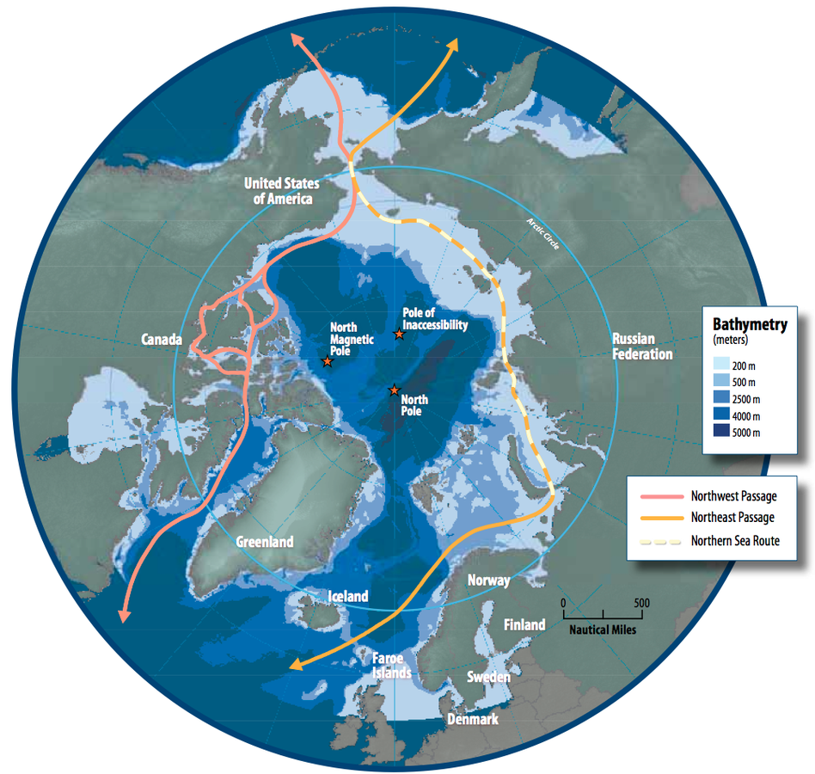
E. 2020 Summer Ice Conditions in Key Shipping Areas
Produced by the National Ice Services (forecaster experience and statistical methods)
Bering Sea
Bering Sea ice extent has been below 1981-2010 average since early March and is currently at about 75% of the 30-year median for this date.
There will be limited ice remaining in the Bering Sea by the end of May 2020
Figure from Arctic Council - Arctic marine shipping assessment

Slide 15
Coastal Beaufort Sea
Break-up of sea ice is expected to be earlier than normal throughout the Northwest Passage this summer, and areas of consolidated ice will become mobile earlier in the season than normal.
Anomalous concentrations of old ice are a potential hazard for the northern route and the western portion of the passage, as higher than normal amounts of old sea ice are present in these areas.
Figure from Arctic Council - Arctic marine shipping assessment

Slide 16
Northwest Passage
Break-up of sea ice is expected to be earlier than normal throughout the Northwest Passage this summer, and areas of consolidated ice will become mobile earlier in the season than normal.
Ice conditions will be light in the southern route of the Northwest Passage in August with lessening ice conditions following in northern route by early September.
Enhanced mobility of sea ice in the Canadian Arctic Archipelago could maintain elevated old ice concentrations in the aforementioned sectors throughout the summer 2020 period.
Figure from Arctic Council - Arctic marine shipping assessment

Slide 17
Baffin Bay
Early than normal sea ice break-up is forecasted for Baffin Bay this summer, due to current lower than normal ice extents in the region and predicted warmer than normal temperatures in the area of interest.
Old ice concentrations in the bay are in line with climatological normals and no specific hazards are anticipated. The presence of an ice bridge in Nares Strait well into this spring has cut off the inflow of old ice from the Arctic Ocean into northern Baffin Bay, thereby maintaining a limited influx of old ice into the region.
Figure from Arctic Council - Arctic marine shipping assessment

Slide 18
Svalbard
Summer minimum sea ice extent is forecast somewhat above normal, but with low forecast confidence. Expecting near normal impacts from sea ice cover around Svalbard for the 2020 summer indicating normal shipping activities.
Figure from Arctic Council - Arctic marine shipping assessment
Figure from Arctic Council - Arctic marine shipping assessment

Slide 19
Northern Sea Route
Ice conditions are not expected to be problematic for the whole of the NSR during the spring and summer seasons in 2020.
Currently observed below normal ice conditions, and projected above normal air temperatures and earlier than normal sea ice deterioration form the basis for this assessment.
Light ice conditions will prevail throughout the sector and areas of landfast ice will break-up earlier than normal. Significant incursions of old ice are not expected along the route this summer season.
Figure from Arctic Council - Arctic marine shipping assessment

Slide 20
Hudson Bay and Hudson Strait
Faster than normal sea ice break-up is underway in Hudson Strait with areas of open water expanding in the northern portion of the strait this spring
Near normal break-up forecasted for the western portion of Hudson Bay and later than normal in the eastern section.
Ice thicknesses throughout Hudson Bay are thicker this spring than spring 2019, as predominantly thick first-year ice covers the western and central portions of the bay while in 2019 medium first-year ice comprised a significant fraction of the ice cover
Thicker ice coverage along with forecasted colder than normal surface air temperatures over Hudson Bay could lead to a more challenging navigation season, particularly in the eastern half of Hudson Bay
Figure from Arctic Council - Arctic marine shipping assessment

Slide 21
Questions?

