Slide 1


5th Arctic Climate Forum (ACF-5)
Arctic Regional Climate Center – network (ArcRCC-N)
27-28 May, 2020
Videoconferences
Summary version May 28th
Helge Tangen, ArcRCC-N coordinator,
Norwegian Meteorological Institute
Vasily Smolyanitsky, ArcRCC – N Northern Eurasia node coordinator (host)
Arctic and Antarctic Research Institute (AARI)

Slide 2


Slide 3
5th Arctic Climate Forum (ACF-5) videoconference - format
Schedule:
  May 27th 2020, Wednesday, Day 1, 1600-1740 UTC, non-technical session, will present: key climate information from Winter/Spring 2019/20 and the Arctic Summer 2020 outlook for 8 regions in the Arctic (see ACF-5 draft as explanation); and the Consensus Statement (see ACF-5 draft as explanation) which provides an overall summary for the circumpolar Arctic;
  May 28th 2020, Thursday, Day 2, 1600-1810 UTC, technical session, will provide greater detail on the Winter/Spring 2019/20 observations, and the modelled and consensus aspects of the temperature, precipitation and sea-ice information used to develop the ArcRCC products.
  Following each session, the organizing committee will distribute summaries of key points
Recording – sessions will be recorded and available later at https://arctic-rcc.org/acf-spring-2020
Connection and session rules (same for 2 days):
  16:00 UTC: https://bluejeans.com/431362831/9648?src=calendarLink
  for stable and better performance, you are very kindly asked to turn off your video and mute microphone for most of the time of the sessions, unless you intend to speak – during the sessions only moderators will be unmuted by default
  During the sessions use the BlueJeans “CHAT function” to ask the questions, pass comments to moderator, everyone or particular person or rise your hand for a question during the time for discussion - all notes will be properly considered by the moderator(s) and answered during discussions
Access to ArcRCC products and session ppts
  All ArcRCC information (including the ACFs) is available at https://arctic-rcc.org/
  Fast access to ACF-5 information (ppts, pdf, docs) is organized at http://wdc.aari.ru/acf5/
Group Photo ? – at the end of sessions you’ll be asked to switch on your cameras and the Secretariat will try to make a screenshot

Slide 4


Brief review of May 27th Non-Technical Regional Briefing session
81 participants at most, slightly varying during the session between 65….73
2 non-technical presentations
  Review on past season climate (winter-spring 2019/2020) by 8 regions – SAT, Prec, sea-ice
    Briefs on the forecasted SAT, Prec, sea-ice for the coming summer 2020 for the same 8 regions
    Risks and impacts including wildfires, river flooding, erosion, wildlife, hunting and shipping – actually for ACFs for the first time with such details
  Presentation of the ACF-5 Consensus statement
    Content, technique of creation the statement
3 on-line discussions , 4 pages doc
  Questions touched – additional observations at end-user side
  Normal s– what and where
  Etc
General reflection – professional, useful information and presentations
Arctic Regional Climate Center

Slide 5
ACF-5 Technical Regional Briefing Agenda Thursday May 28, 2020, 16:00 – 18:10 UTC To determine your local time go to: https://www.timeanddate.com/worldclock/timezone/utc Intended Audience: Users interested in specifics of the climate observations and models
TIME | ITEM | DETAILS
16:00 (10’) | Welcome Introduce the Arctic Climate Virtual Forum Brief review of yesterday’s agenda (doc) Format, how to ask questions and make comments Where to find the ArcRCС products and presentations | Vasily Smolianitsky, AARI
16:10 (20’) | Arctic winter 19/20 and spring 2020 Seasonal Summary: Temperature, precipitation, sea-ice , ocean, land hydrology Review of observational and reanalysis data (ppt, pdf) | Vasily Smolyanitsky, AARI Gabrielle Gascon, ECCC
16:30 (5’) | Using INTAROS project results for ArcRCC Northern Eurasia node: Access to seasonal summary data (ppt, pdf) | Evgeny Vyazilov, RIHMI-WDC, Obninsk
16:35 (15’) | On-line discussion (with end-users) on seasonal summary | Shanna Combley (moderator) U.S. National Weather Service (NWS)
16:50 (20’) | Temperature and Precipitation (ppt, pdf) Introducing the multi-ensemble method Validation of the outlook for winter 19/20 and spring 2020 Review of model confidence for summer 2020 outlook | Marko Markovic, ECCC
17:10 (15’) | On-line discussion (with end-users) on temperature and precipitation outlook | Valentina Khan (moderator), HMC Moscow
17:25 (20’) | Sea-Ice Outlook for Summer 2020 (ppt, pdf) Introducing the models Validation of outlook for winter 19/20 and spring 2020 Review of model confidence for summer 2020 outlook | Scott Weese, ECCC
17:45 (15’) | On-line discussion (with end-users) on sea ice outlook | Vasily Smolyanitsky (moderator), AARI Scott Weese (moderator) ECCC
18:00 (5’) | Final thoughts & Wrap-up | Vasily Smolianitsky, AARI Helge Tangen, ArcRCC Network coordinator Anahit Hovsepyan, WMO
18:10 | End of ACF-5

Slide 6
November 2019 – April 2020
Arctic Seasonal Review
Vasily Smolyanitsky
Arctic and Antarctic Research Institute
Arctic Regional Climate Center

Slide 7
Content of review
Review for 2 periods: NDJ 2019/2020 and FMA 2020
Atmosphere variables include:
  Atmospheric circulation (MSL) and geopotential height (gp50, gp500)
  Surface air temperature
  Precipitation
Sea ice variables include:
  atmosphere and polar ocean precursors
  Ice extent and ice conditions analysis
  Sea ice thickness and volume reanalysis
Polar Ocean
  SST, waves and swell height (storminess)
  pH (acidification/alkalization estimates)
Solid precipitation (land snow)
Briefs on current status (SAT, winds, Prec, sea ice, snow)

Slide 8
Atmosphere:
  Precursors - atmospheric circulation patterns
  Surface air temperature
  Precipitation

Slide 9
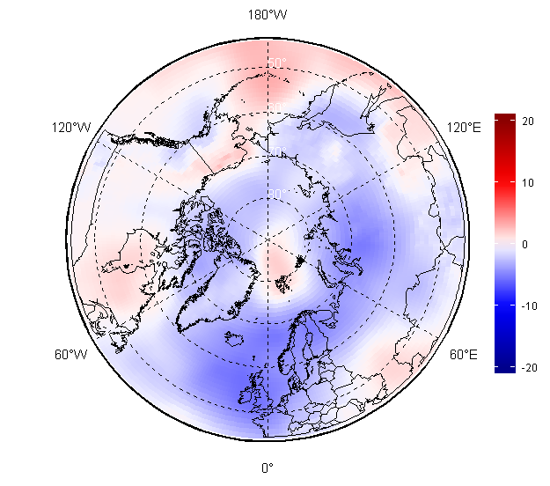
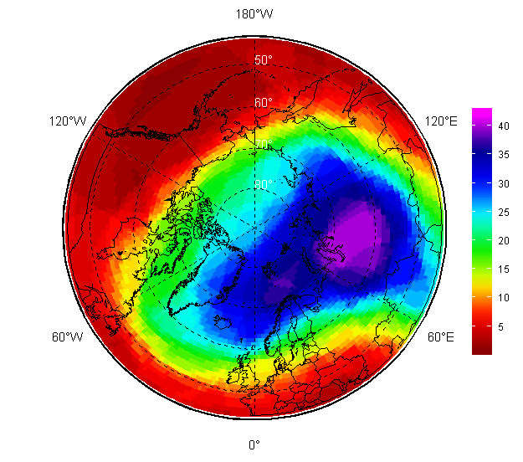
NDJ 2019/2020 atmospheric circulation
Based on atmosphere numerical model (reanalysis)
Negative mean sea level atmospheric pressure (MSLP) anomalies (lower pressure, marked in blue) dominated through the European, Siberian and Canadian archipelago regions
Opposite situation (higher pressure, marked in red) was observed over Svalbard, Canadian and Alaska regions, Bering Sea
That led to prevalence of zonal form of circulation (transfer of heal/cold west/east) in the troposphere with the center of polar vortex over western Siberia as seen on the 50 hPa geopotential height (H50)
MSLP hPa anomalies (norms 1981-2010)
AARI / ERA5 reanalysis
H50 ranks (1979-2020)

Slide 10
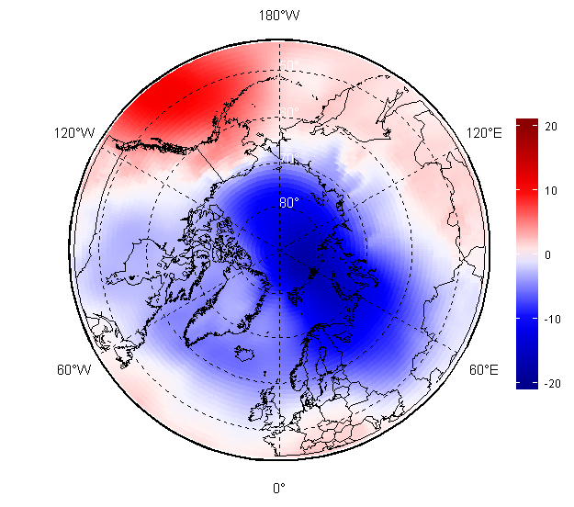
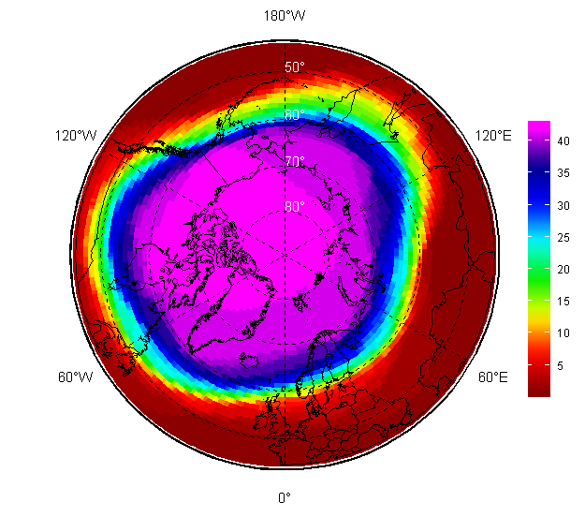
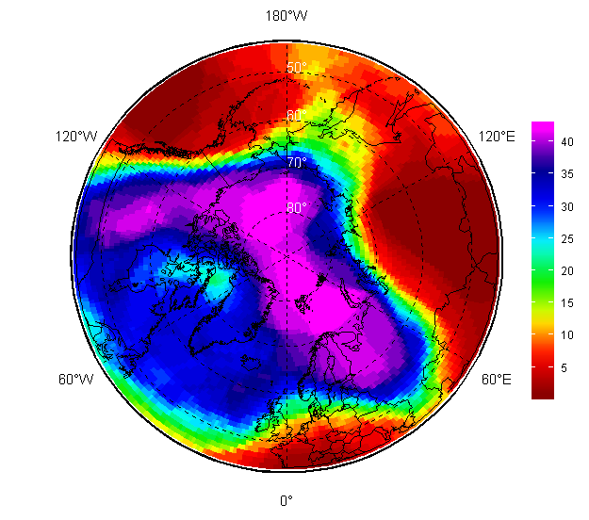
FMA 2020 atmospheric circulation
Much stronger negative MSLP anomalies (lower pressure, marked in blue) were observed during FMA 2020 in the European region, Western Siberia, Arctic Ocean but not in Alaska and Bering Sea
That again led to increased cyclonic activity, more polar lows with further increased precipitation
Polar vortex was very intense as observed at H50 pattern and caused meridian type of circulation with several ‘heat waves’ in Western and Eastern Siberia
MSLP hPa anomalies (norms 1981-2010)
H50 (left) and H500 ranks (1979-2020)
[AARI / ERA5 reanalysis]

Slide 11
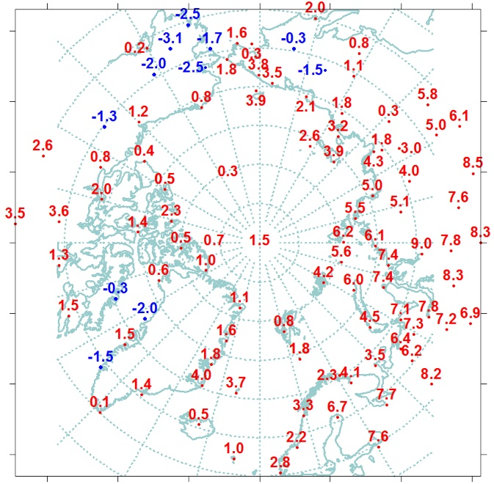
December 2019 – February 2020 SAT (T2m): anomalies and ranks (observation)
The winter air temperature across Arctic was above normal except Alaska, Greenland, Svalbard, some parts of Canadian archipelago and Chukchi region.
The most notable positive anomalies were present across of Western and Eastern Siberia Alaska and some parts of N Atlantic
Very close to record high temperatures were observed in Eastern Siberia.
Cold !
Warm !
Cold !
[AARI]

Slide 12

SAT anomalies by regions during winter 2019/20 (DJF)
(observations)
Region | Anomaly | Rank | The warmest year (anomaly) | The coldest year (anomaly)
North Atlantic | 1,9 | 14 | 2014 (3,9) | 1966 (-2,4)
Barents | 5,4 | 3 | 1937 (6,5) | 1979 (-4,4)
Western Siberia | 7,2 | 3 | 2012, 2016 (7,6) | 1969 (-5,6)
Eastern Siberia | 4,6 | 2 | 2016 (4,6) | 1966 (-4,5)
Chukchi | 1,8 | 13 | 2018 (6,7) | 2002 (-2,3)
Western Canada | -0,9 | 42 | 2018 (6,1) | 1965 (-5,6)
Eastern Canada | 1,2 | 18 | 2010 (5,0) | 1972 (-3,6)
Reference period: 1961-1990
1- N Atlantic
2 - N Europe
6 – W Canada
5 - Chukchi
3 - Western Siberia
4 - East Siberia
7 – E Canada
Zone 60-85 °N
[AARI]

Slide 13
SAT anomalies by Arctic seas during winter 2019/20 (DJF)
(observations)
Sea | Anomaly | Rank | The warmest year (anomaly) | The coldest year (anomaly)
Northern part of Greenland and Norwegian Seas | 2,1 | 19 | 2014 (6,1) | 1966 (-2,7)
Barents Sea | 3,3 | 20 | 1937 (7,6) | 1979 (-3,4)
Kara Sea | 6,5 | 8 | 1945 (9,8) | 1979 (-5,9)
Laptev Sea | 4,4 | 3 | 2012 (4,6) | 1979 (-4,4)
Eastern Siberian Sea | 2,9 | 7 | 2018 (6,5) | 1966 (-3,3)
Chukchi Sea | 1,6 | 19 | 2018 (8,8) | 1939 (-3,4)
Beaufort Sea | 0,7 | 29 | 2018 (6,3) | 1966 (-3,1)
N part of Canadian arhipelago | 1,0 | 18 | 2010 (5,0) | 1949 (-3,6)
Reference period: 1961-1990
N Greenland and Norwegian
Barents
Kara
Laptev
E Siberian
Chukchi
Beaufort
N Canadian archipelago
[AARI]

Slide 14
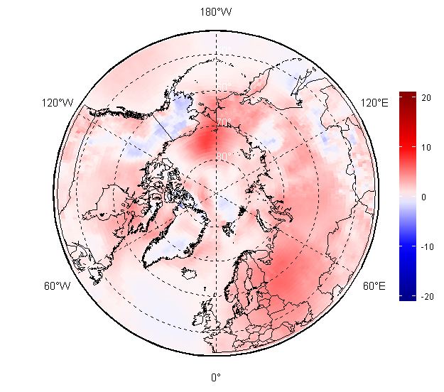
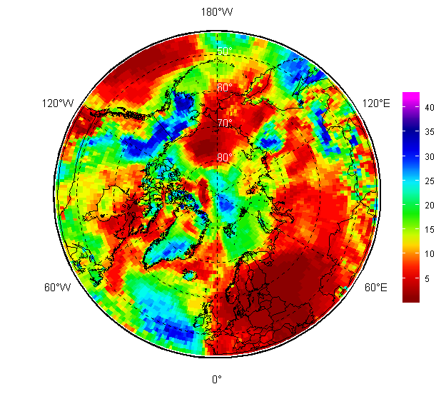
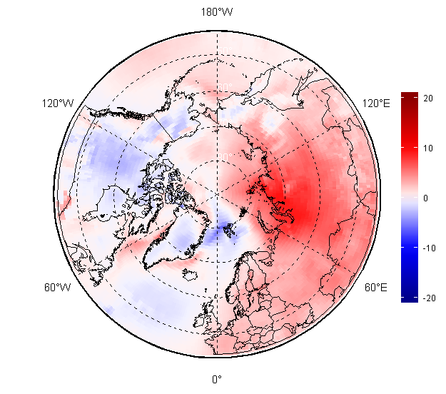
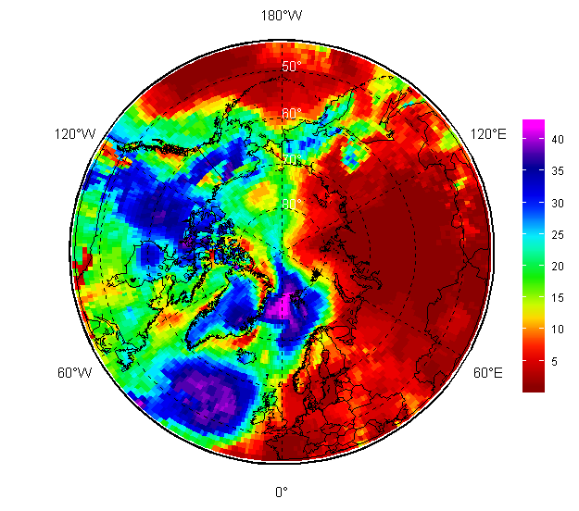
NDJ 2019-2020, FMA 2020 – SAT (T2m): anomalies and ranks
NDJ 2019/2020
For the whole season from November 2019 – April 2010 positive close to maximum air temperature anomalies prevailed over Western and Eastern Siberia, with negative anomalies prevailing in marine Barents, Alaska and parts of Western Canada
Atlantic and partly Chukchi areas experienced switch from positive to negative anomalies during NDJ - FMA
SAT anomaly, 1981-2010
SAT rank, 1979-2020
FMA 2020
AARI / ERA5 reanalysis
SAT anomaly, 1981-2010
Rank, 1979-2020

Slide 15
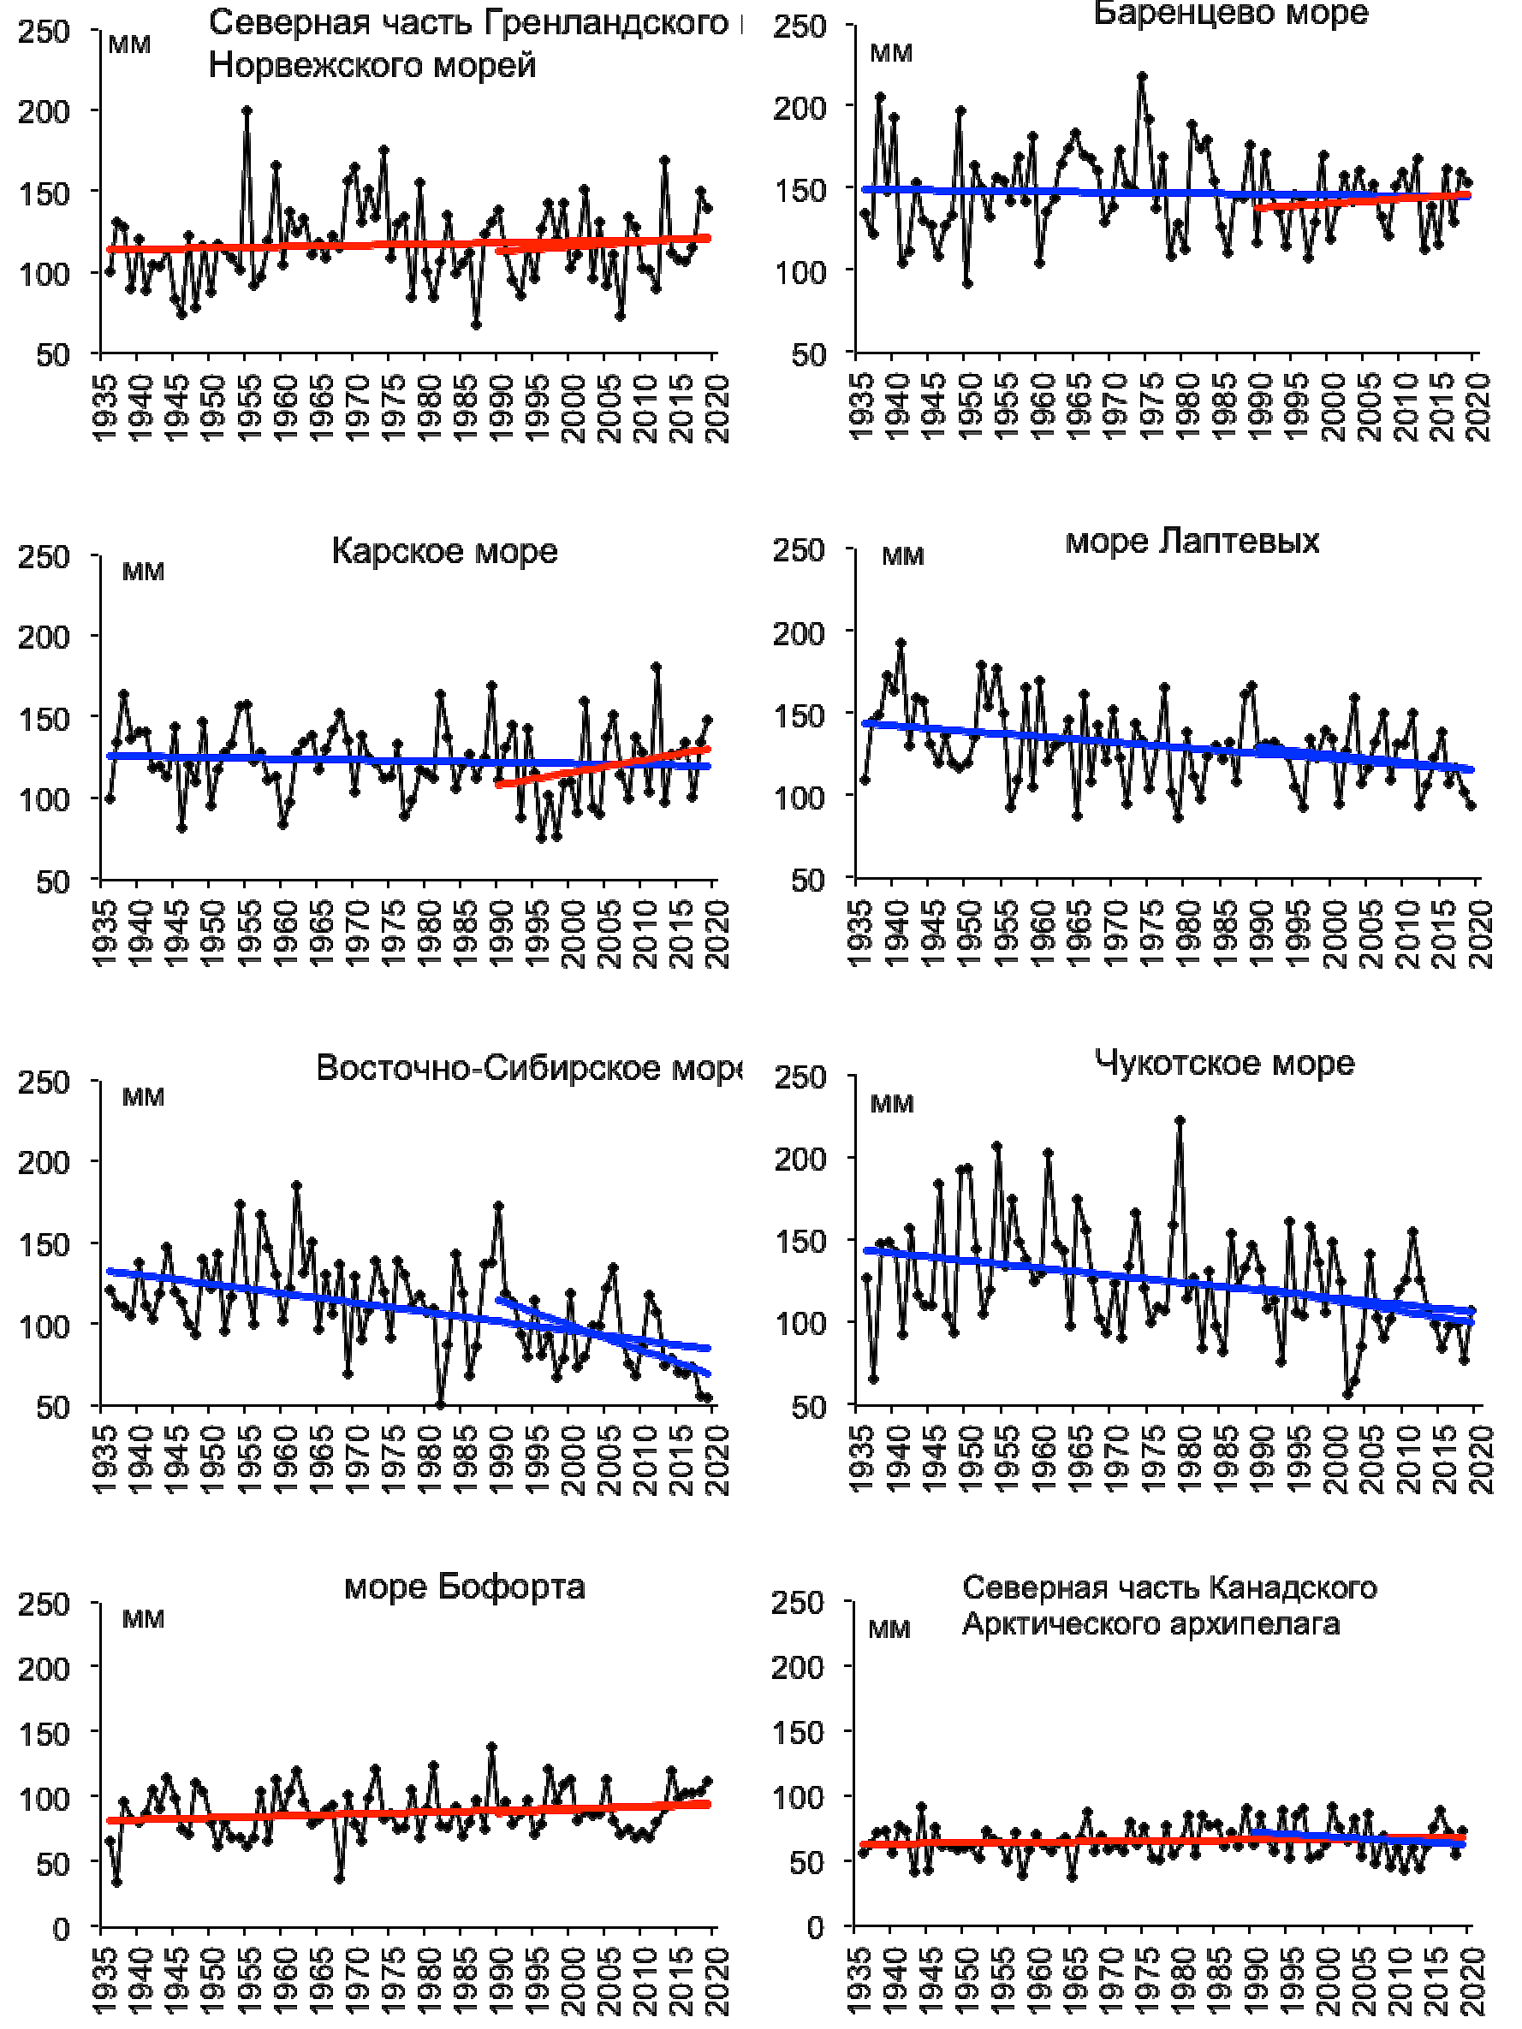
Precipitation trends for
ND 2019 - J 2020
N Greenland and Norwegian Seas
Barents Sea
Kara Sea
Laptev Sea
Analysis based on observations by the Arctic seas
General positive trends – wetter conditions – for the Nordic seas, Beaufort Sea
General negative trends – drier conditions - for Siberian shelf seas
No general significant trends for Canadian Arctic regions
Eastern Siberian Sea
Chukchi Sea
Beaufort Sea
N Canadian Archipelago
Reference period: 1961-1990
[AARI]

Slide 16
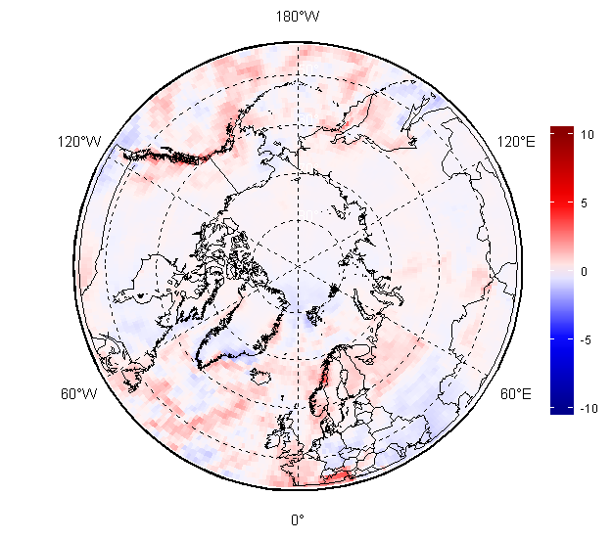
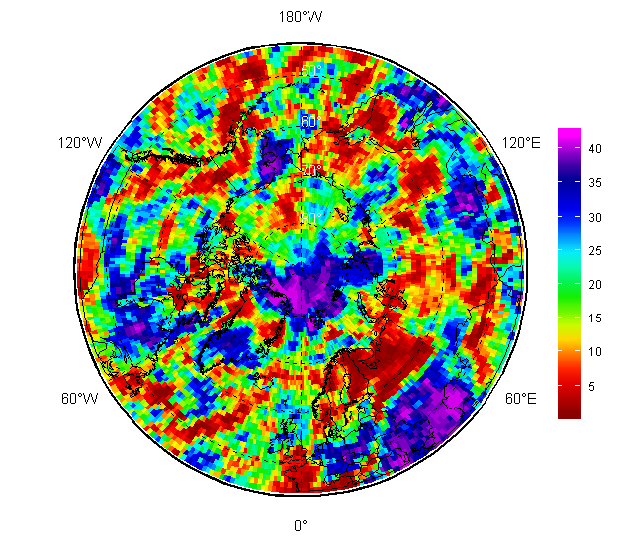
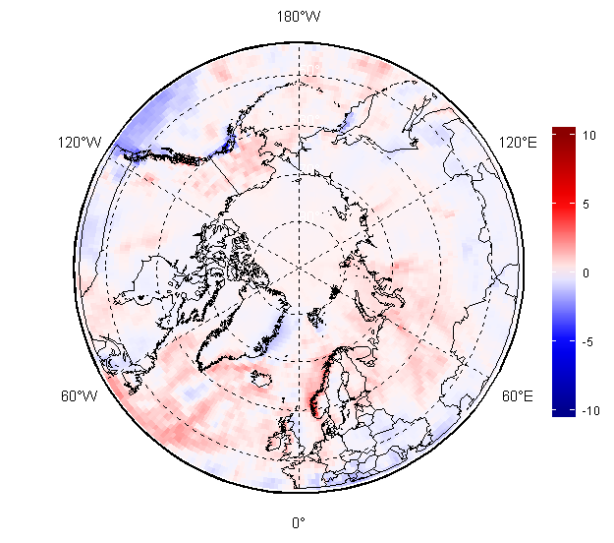
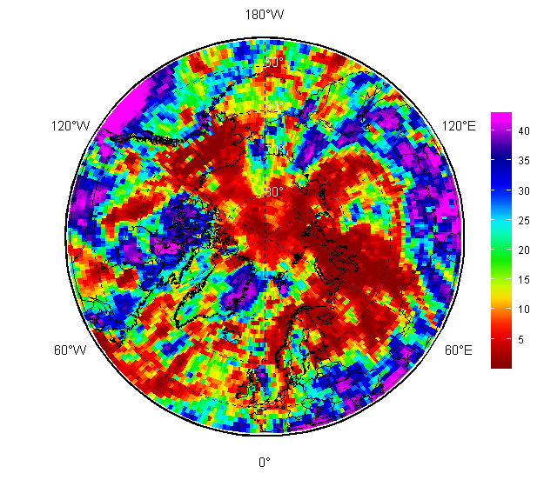
Precipitation (Prec) NDJ and FMA 2019/2020: anomalies and ranks
NDJ 2019/2020
For NDJ 2019/2020 and FMA 2020 Barents and Western Siberia regions saw very wet seasons
Same wetter conditions observed for Alaska during FMA 2020
Drier conditions were observed over Svalbard, parts of Greenland, Sea of Okhotsk
Prec Anomaly, 1981-2010
Prec Rank, 1979-2020
FMA 2020
[AARI / ERA5 reanalysis]
Prec Anomaly, 1981-2010
Prec Rank, 1979-2020

Slide 17
Sea ice:
  Precursors in atmosphere and polar ocean
  Ice extent and ice conditions analysis
  Sea ice thickness and volume based on coastal stations and reanalysis

Slide 18
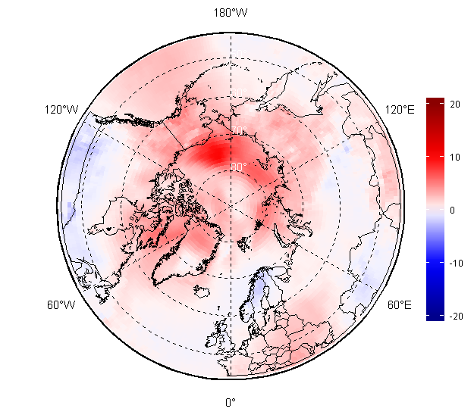
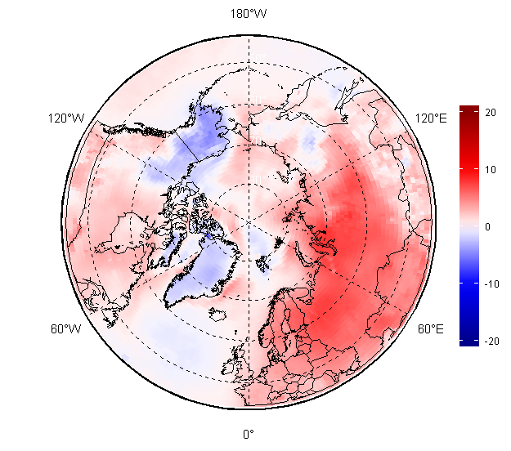
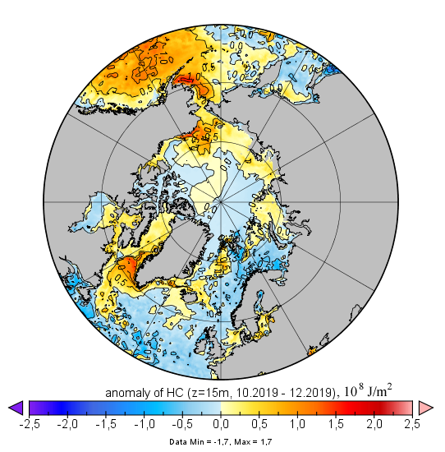
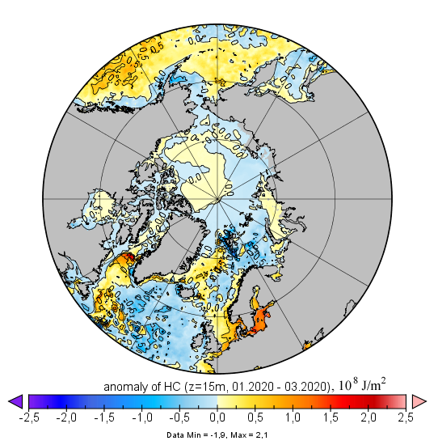
Atmosphere – polar ocean precursors for winter – spring 2019 – 2020 sea ice conditions
High positive anomalies in surface air temperature (SAT) as well as prevailing positive polar ocean heat capacity (HC) in upper 15m during OND 2019 slowed in general freeze-up and sea ice growth in the Arctic
Further in time lesser positive SAT anomalies as well as in general neutral HC anomalies during JFM stimulated ice extent growth
Prominent negative HC anomalies lead to close to normal ice growth in the N Barents Sea and Sea of Okhotsk
SAT SON anomaly,
1981-2010
SAT DJF anomaly,
1981-2010
Heat Capacity anomaly OND,
2000-2019
Heat Capacity anomaly JFM,
2000-2019
[AARI / Copernicus Climate Change Service
(ERA5 & MERCATOR reanalysis)]

Slide 19
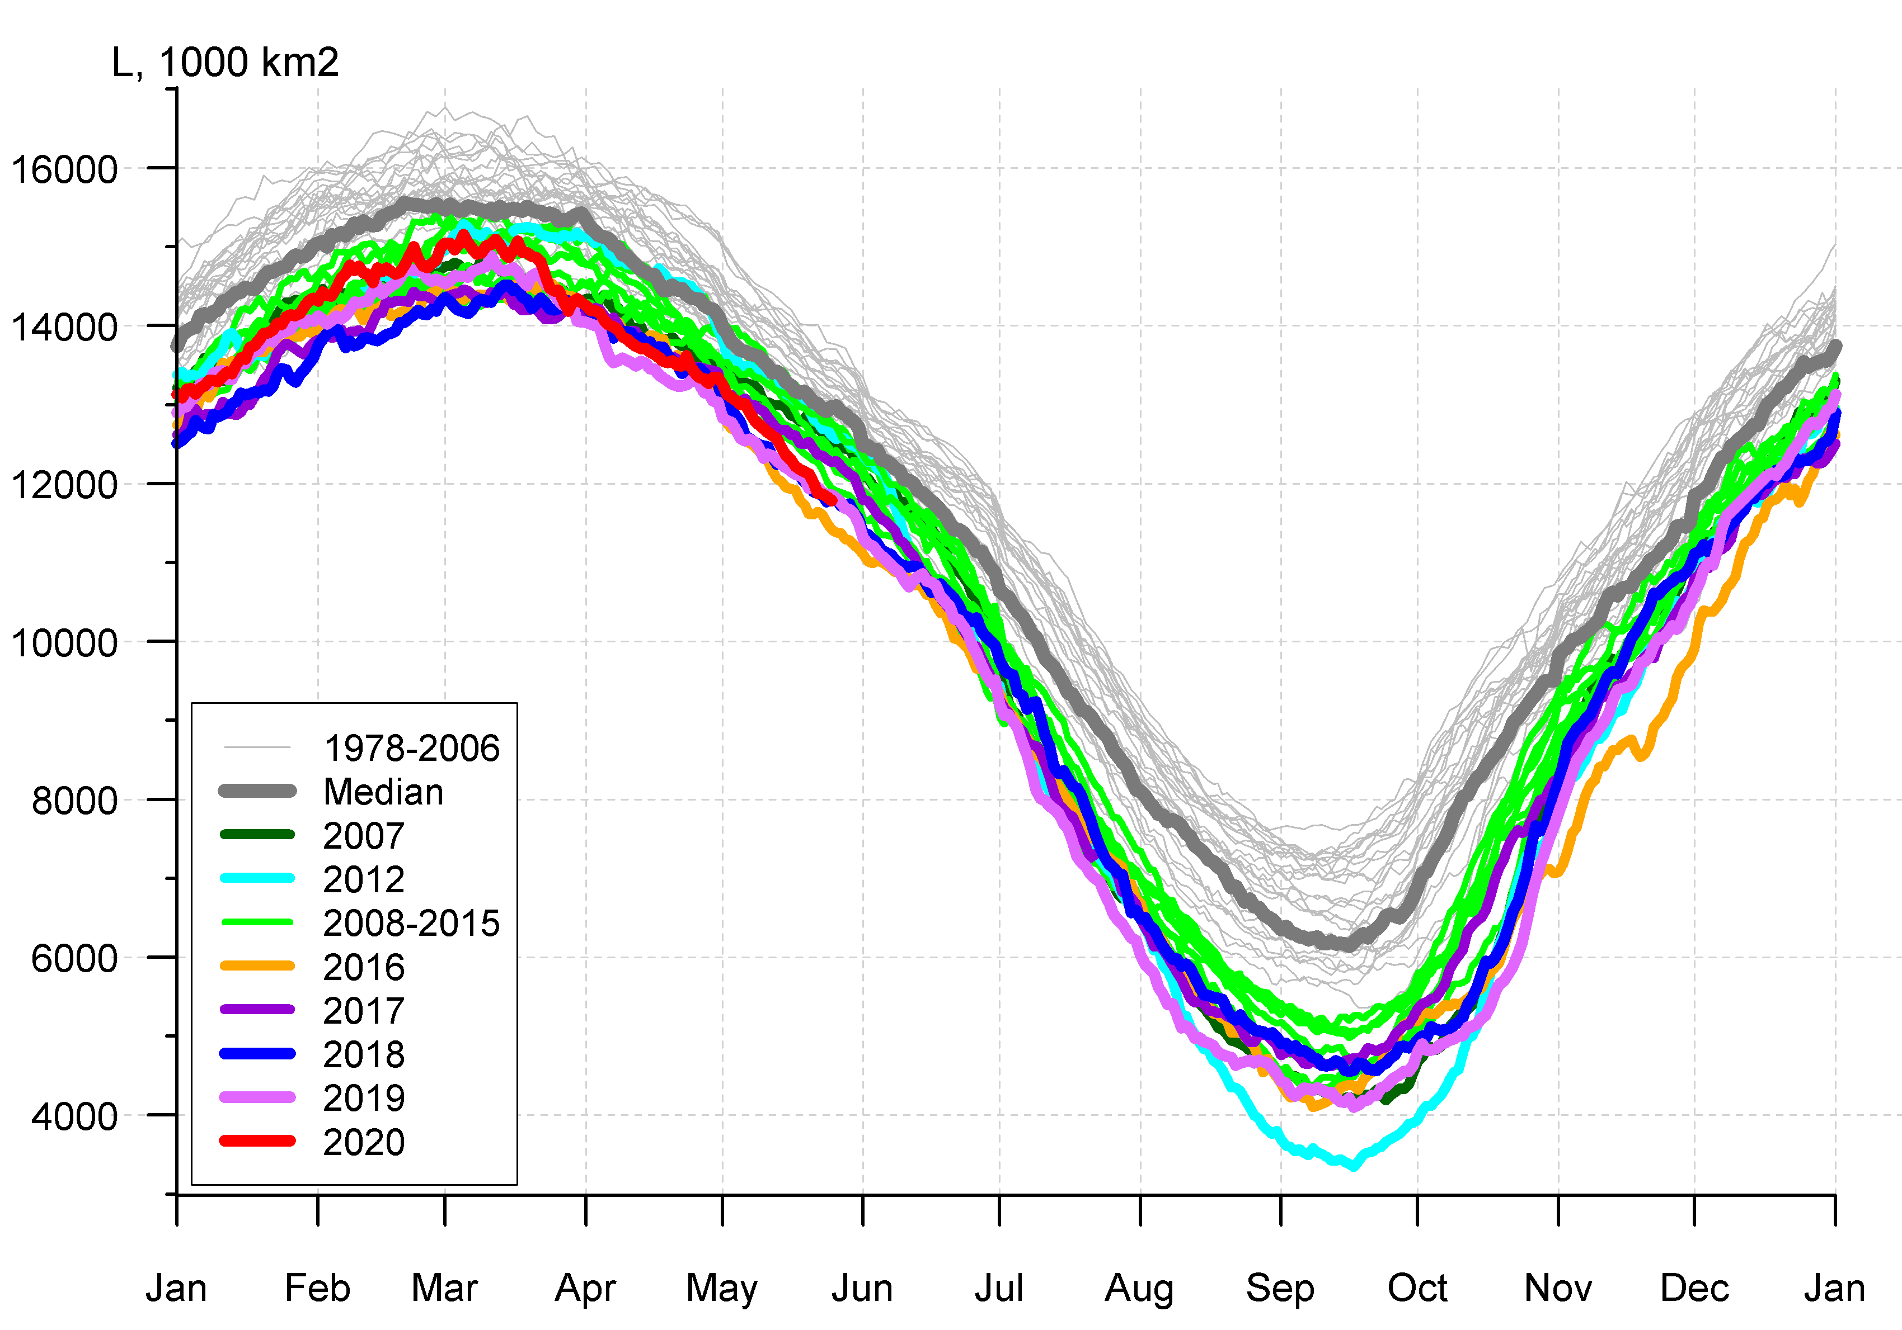
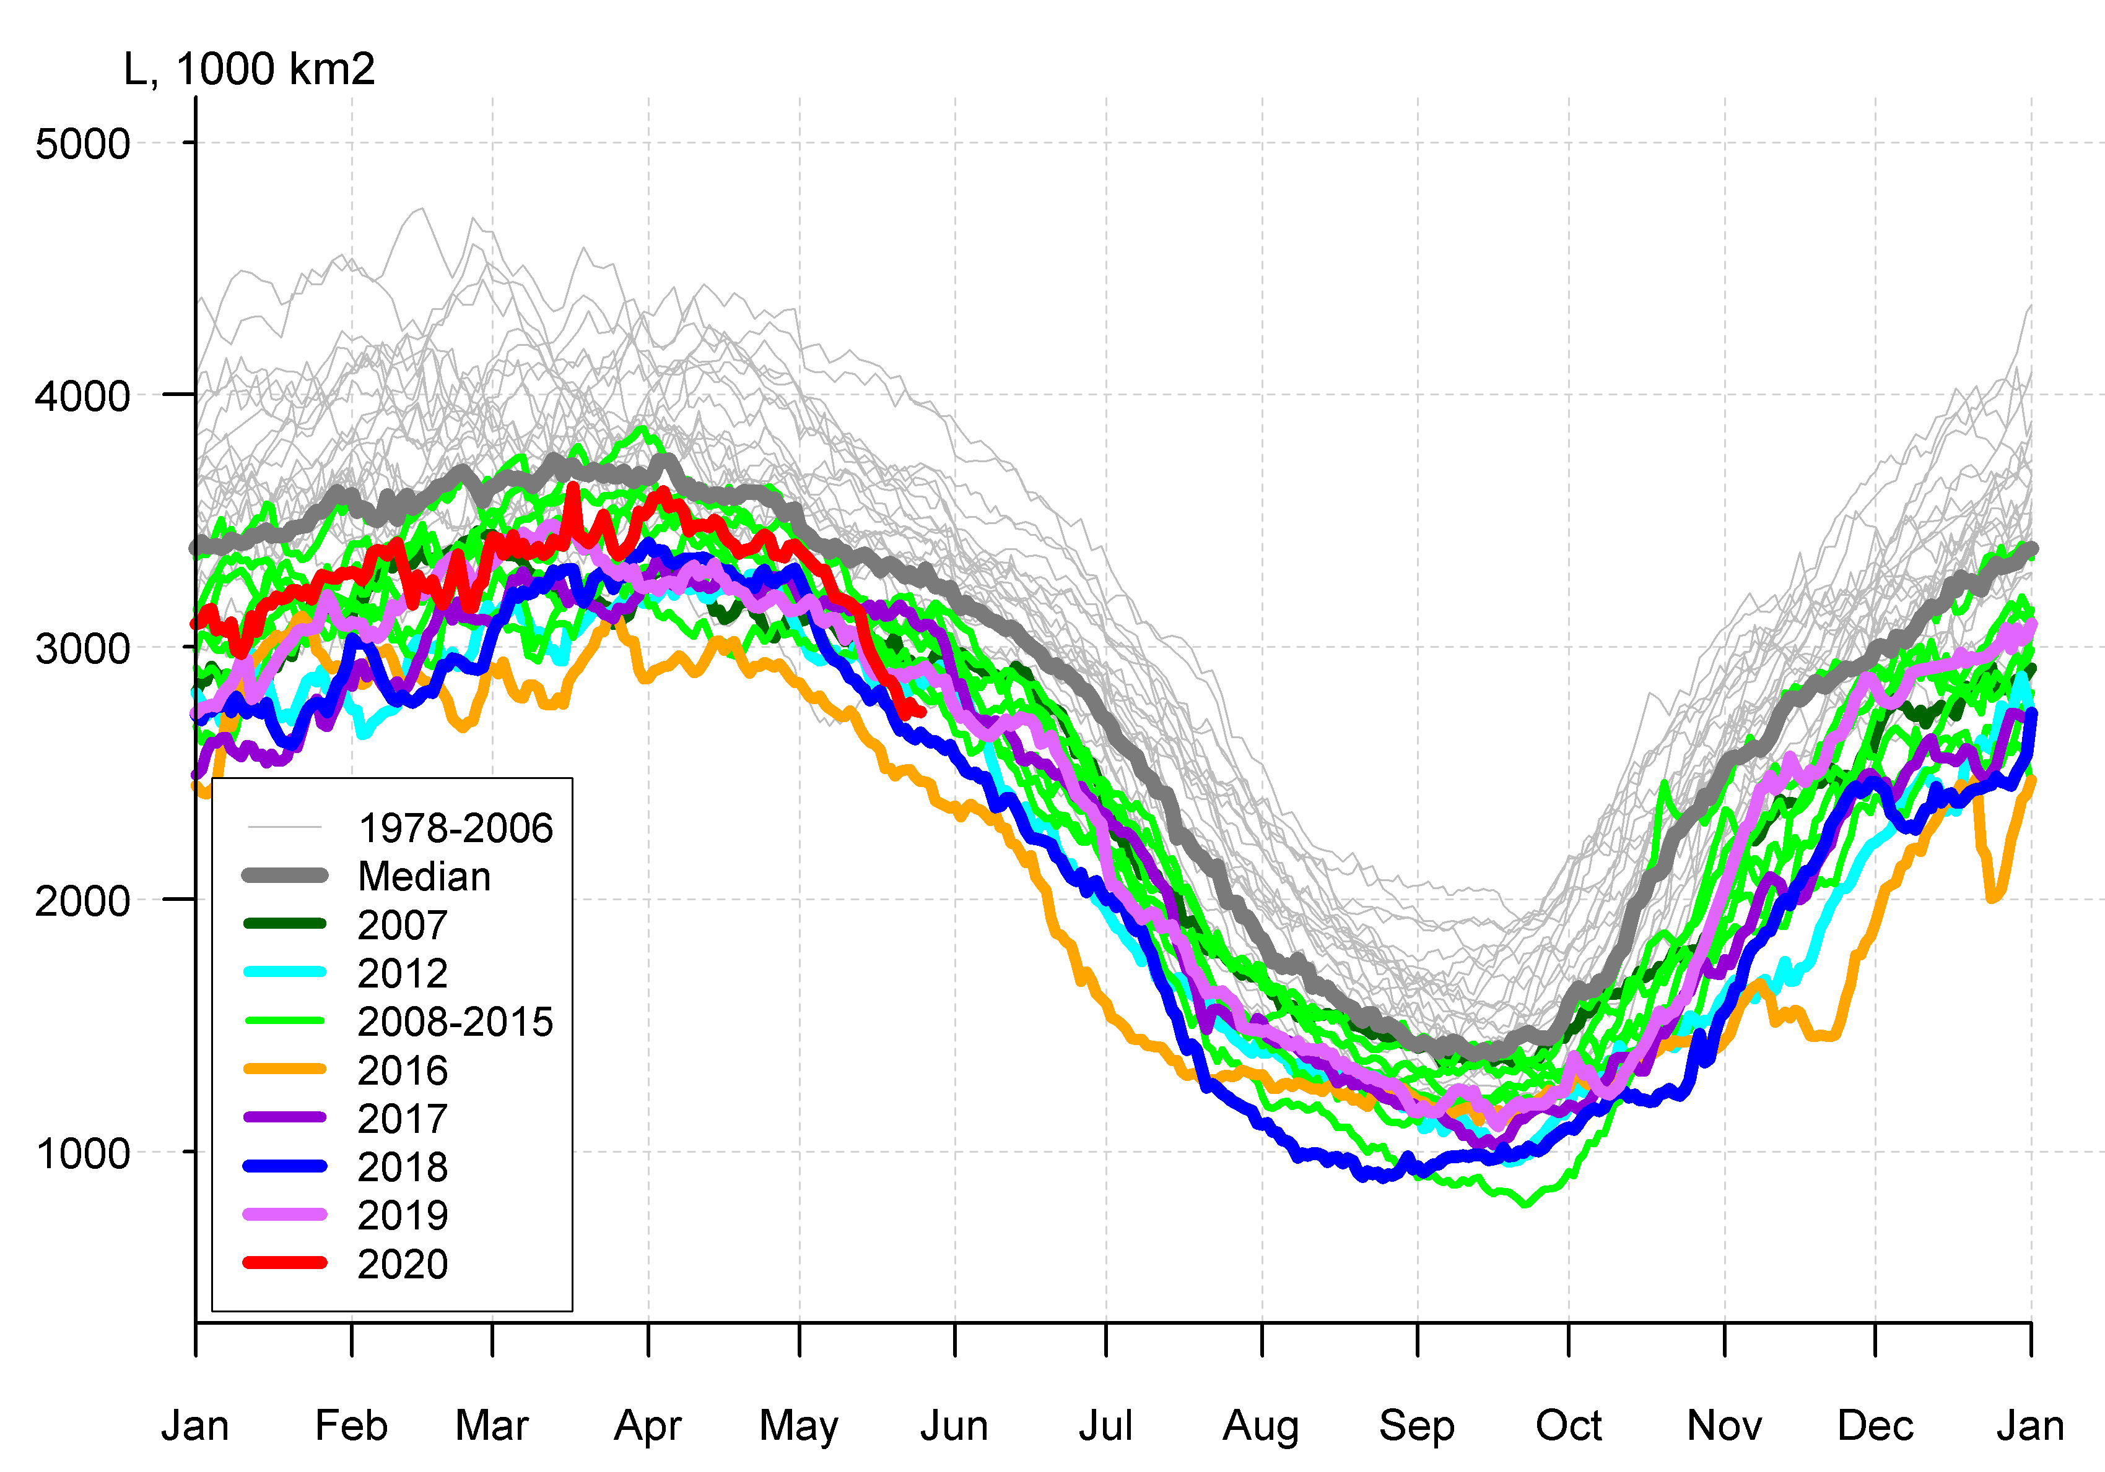
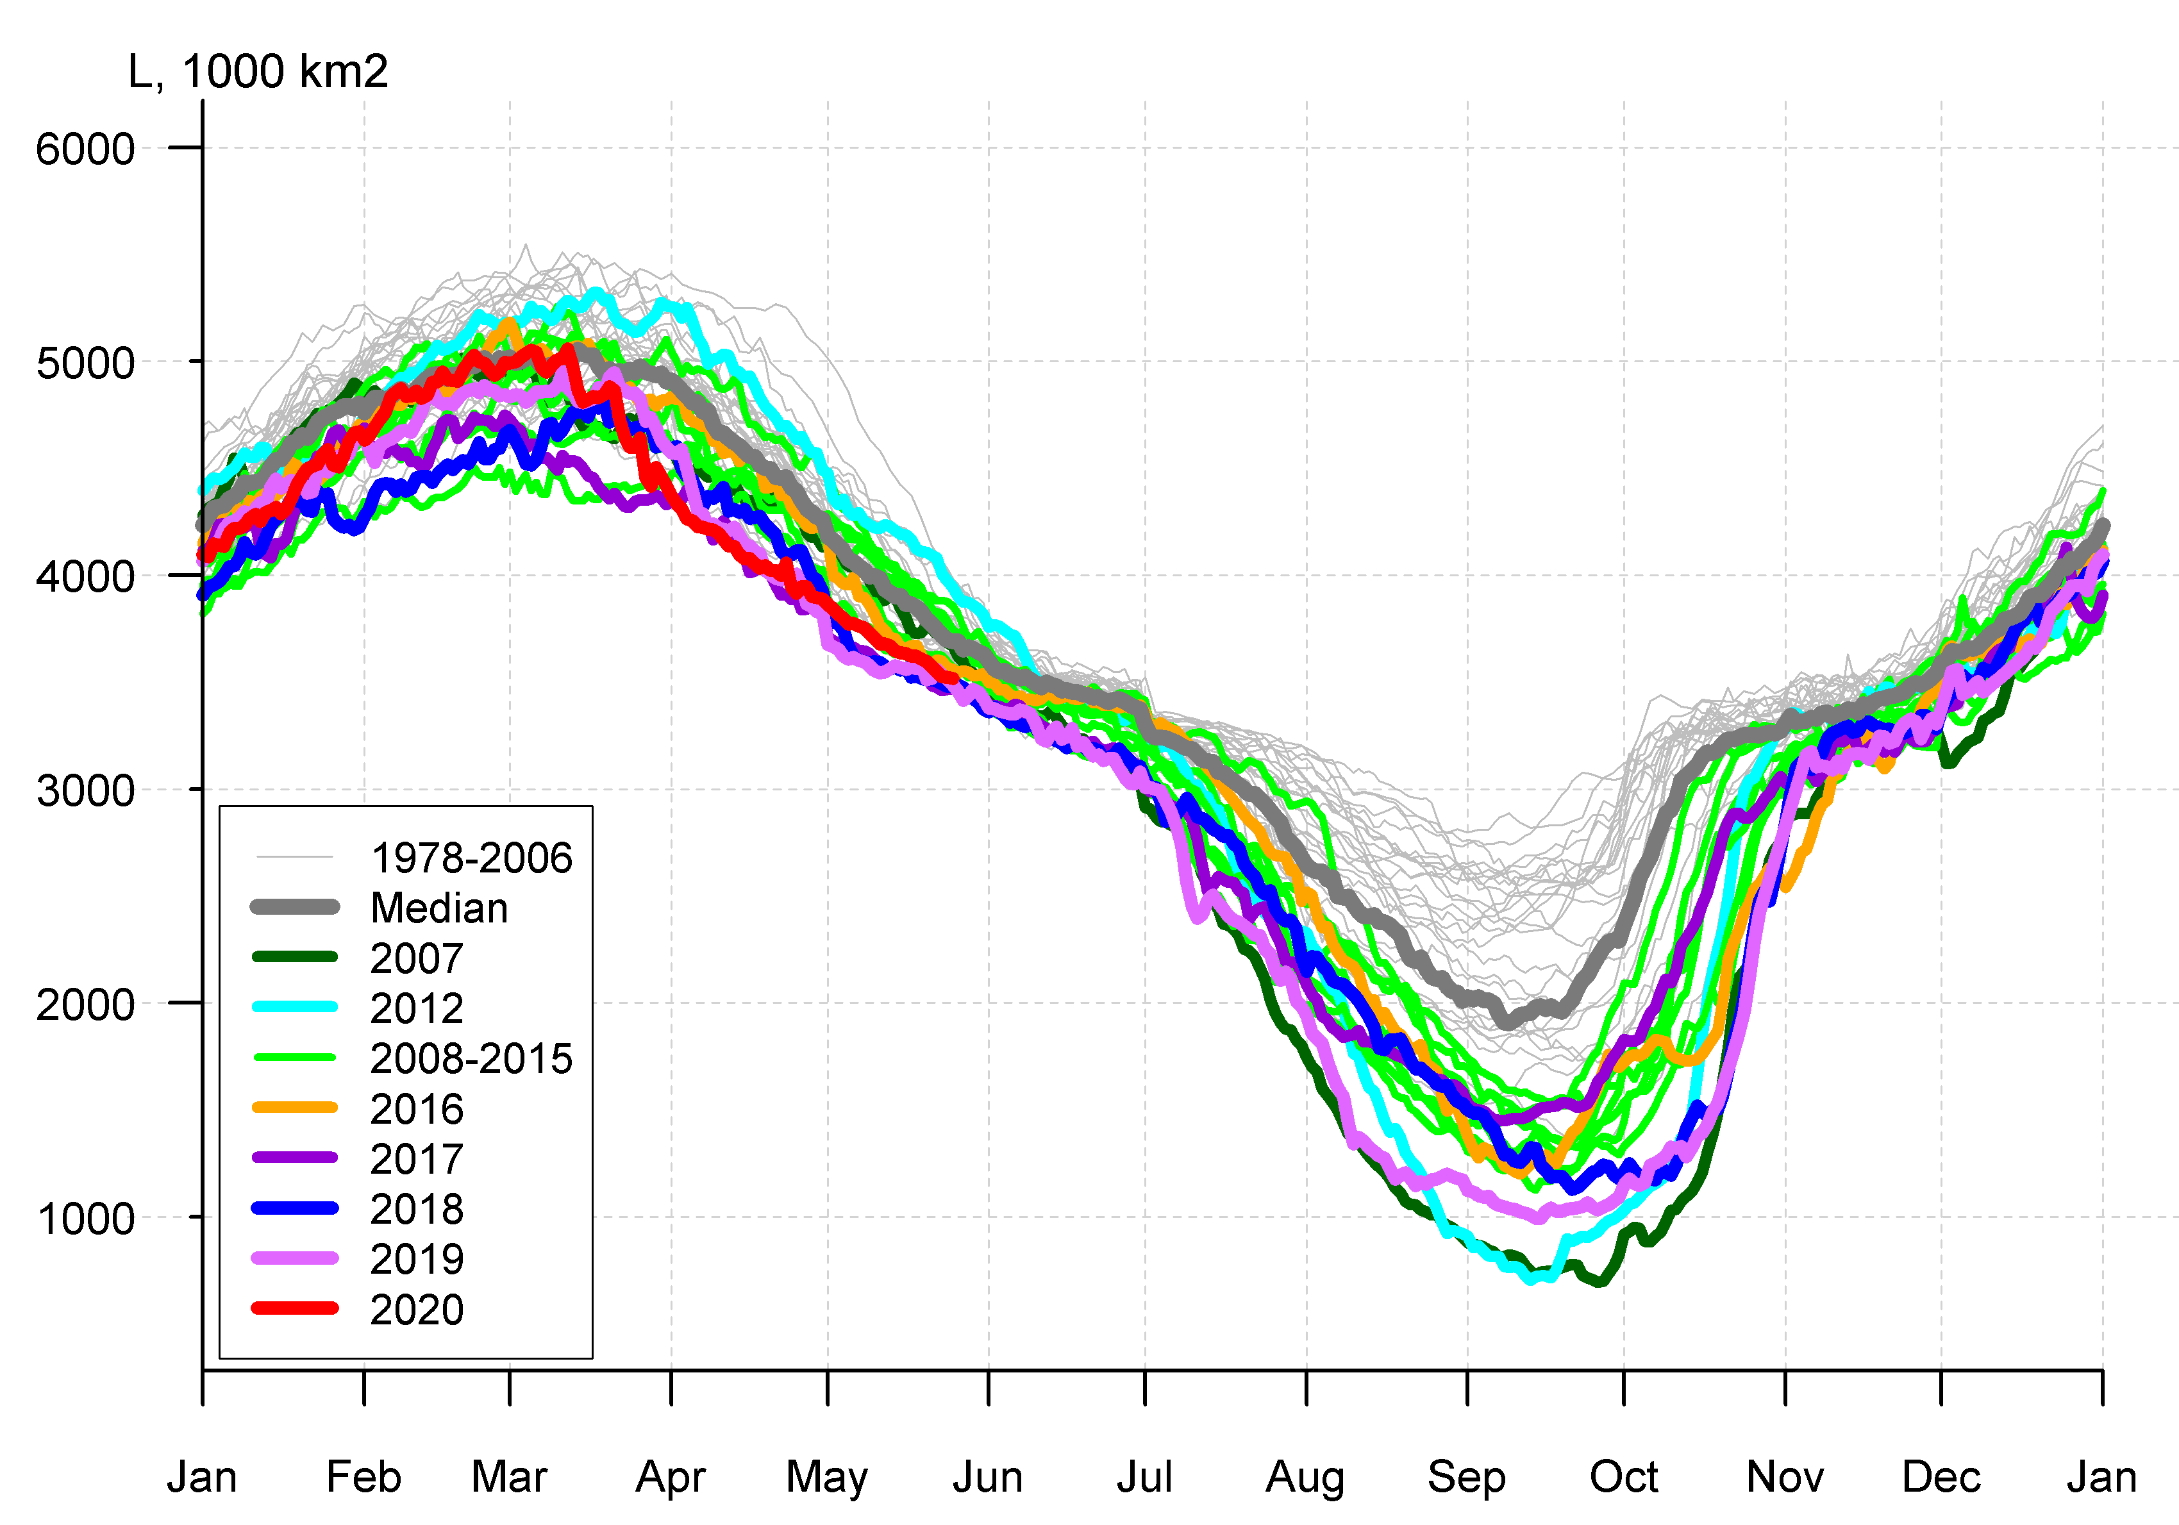
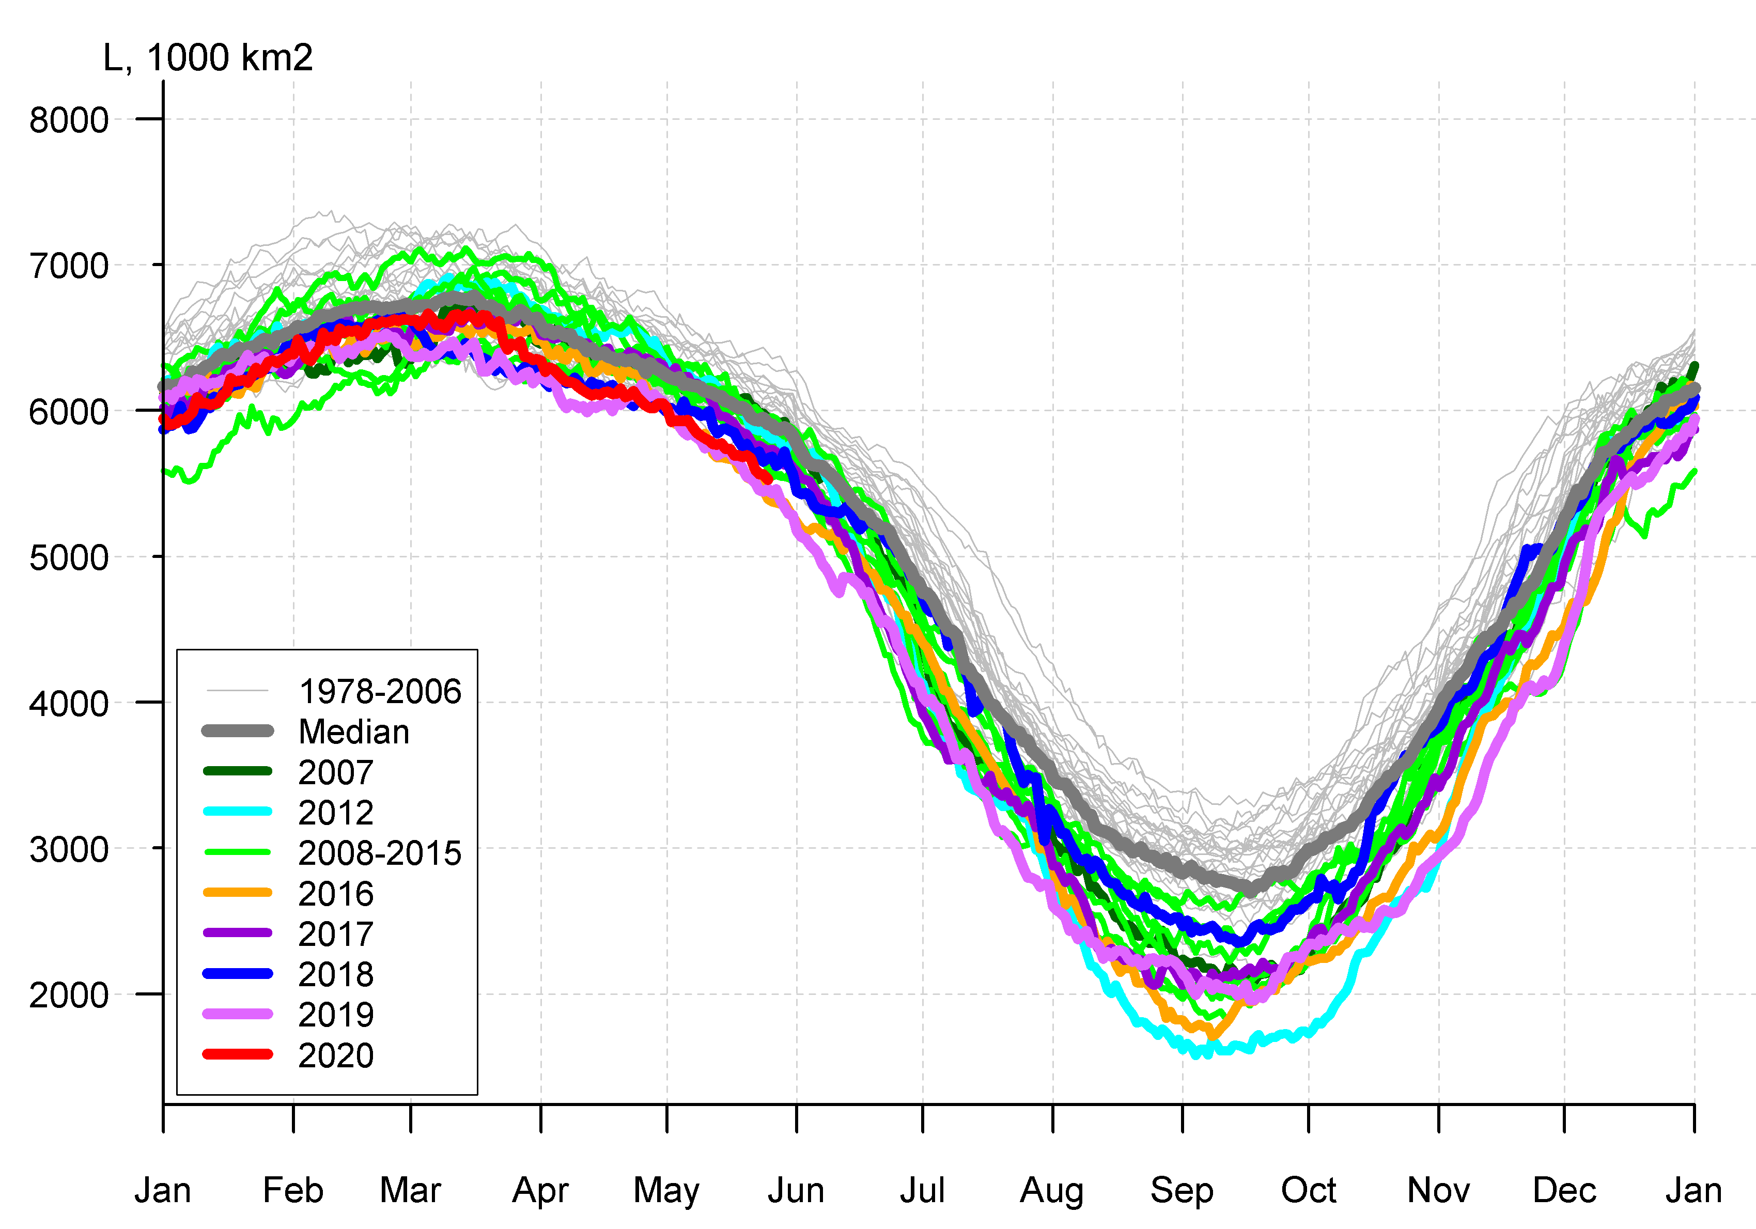

Arctic (NH) seasonal ice extent 1978…. 2020
S, 1000 km^{2*}
S, 1000 km²
2017 14467
2018 14516
2015 14526
2016 14580
2011 14701
2006 14867
2019 14891
2007 14931
2014 14972
2005 15101
2020 15159
... ...
1988 16461
1983 16547
1979 16769
S, 1000 km²
Northern Hemisphere
Western Arctic (WA)
Jan Feb Mar Apr May Jun Jul Aug Sep Oct Nov Dec Jan
Jan Feb Mar Apr May Jun Jul Aug Sep Oct Nov Dec Jan
S, 1000 km²
Eastern Arctic (EA)
S, 1000 km²
Canadian Arctic (CA)
* - maximum for Mar (AARI)
CA
EA
WA
Jan Feb Mar Apr May Jun Jul Aug Sep Oct Nov Dec Jan
Jan Feb Mar Apr May Jun Jul Aug Sep Oct Nov Dec Jan
Maximum winter ice extent, 11th in row, 15,16 mln km² (14,89 in 2019) reached 4 March 2020 (11 March in 2019)
During freezing period (ND 2019) lowest on record was observed due to extreme minimums in Bering, Chukchi Seas
[AARI, NSIDC]

Slide 20
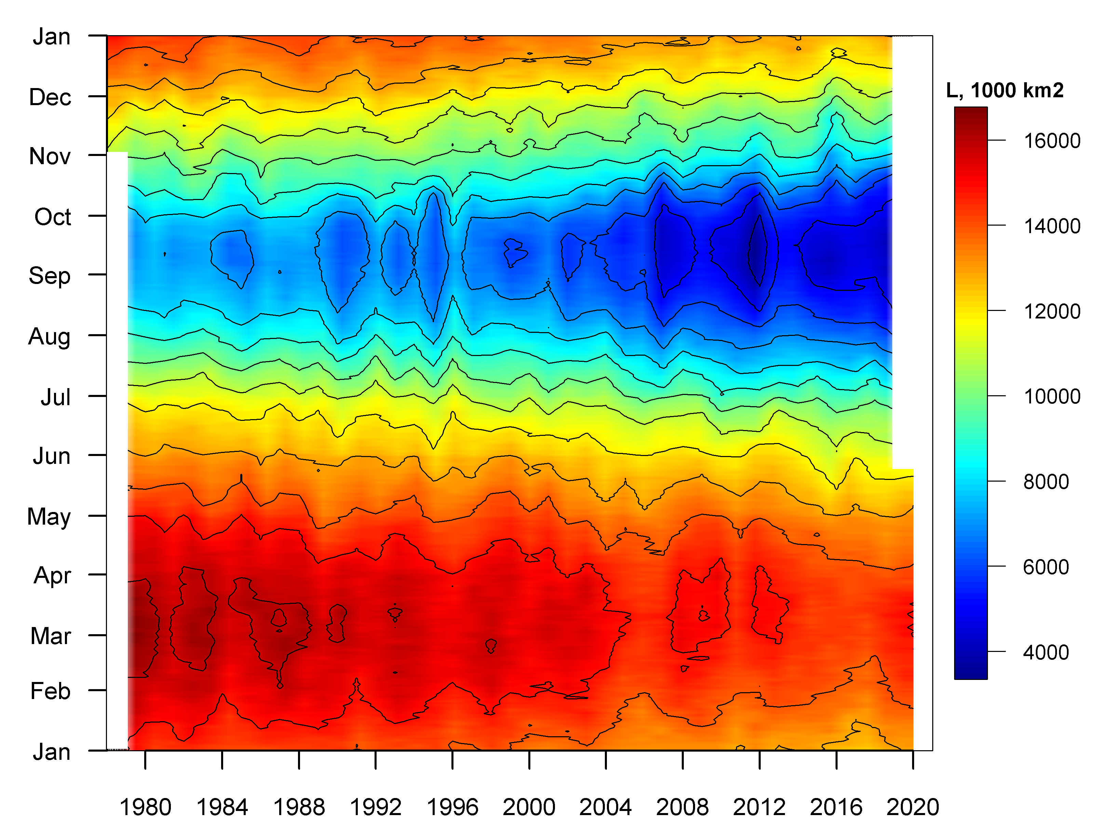
Seasonal NH ice extent variability: 1978 - 2020
Seasonal patterns of daily ice extent allows to analysis seasonal variability of ice extent
Both winter maximums and summer minimums continue to diminish
Though, significant interannual variability of ice extent occurs
[AARI, NSIDC]

Slide 21
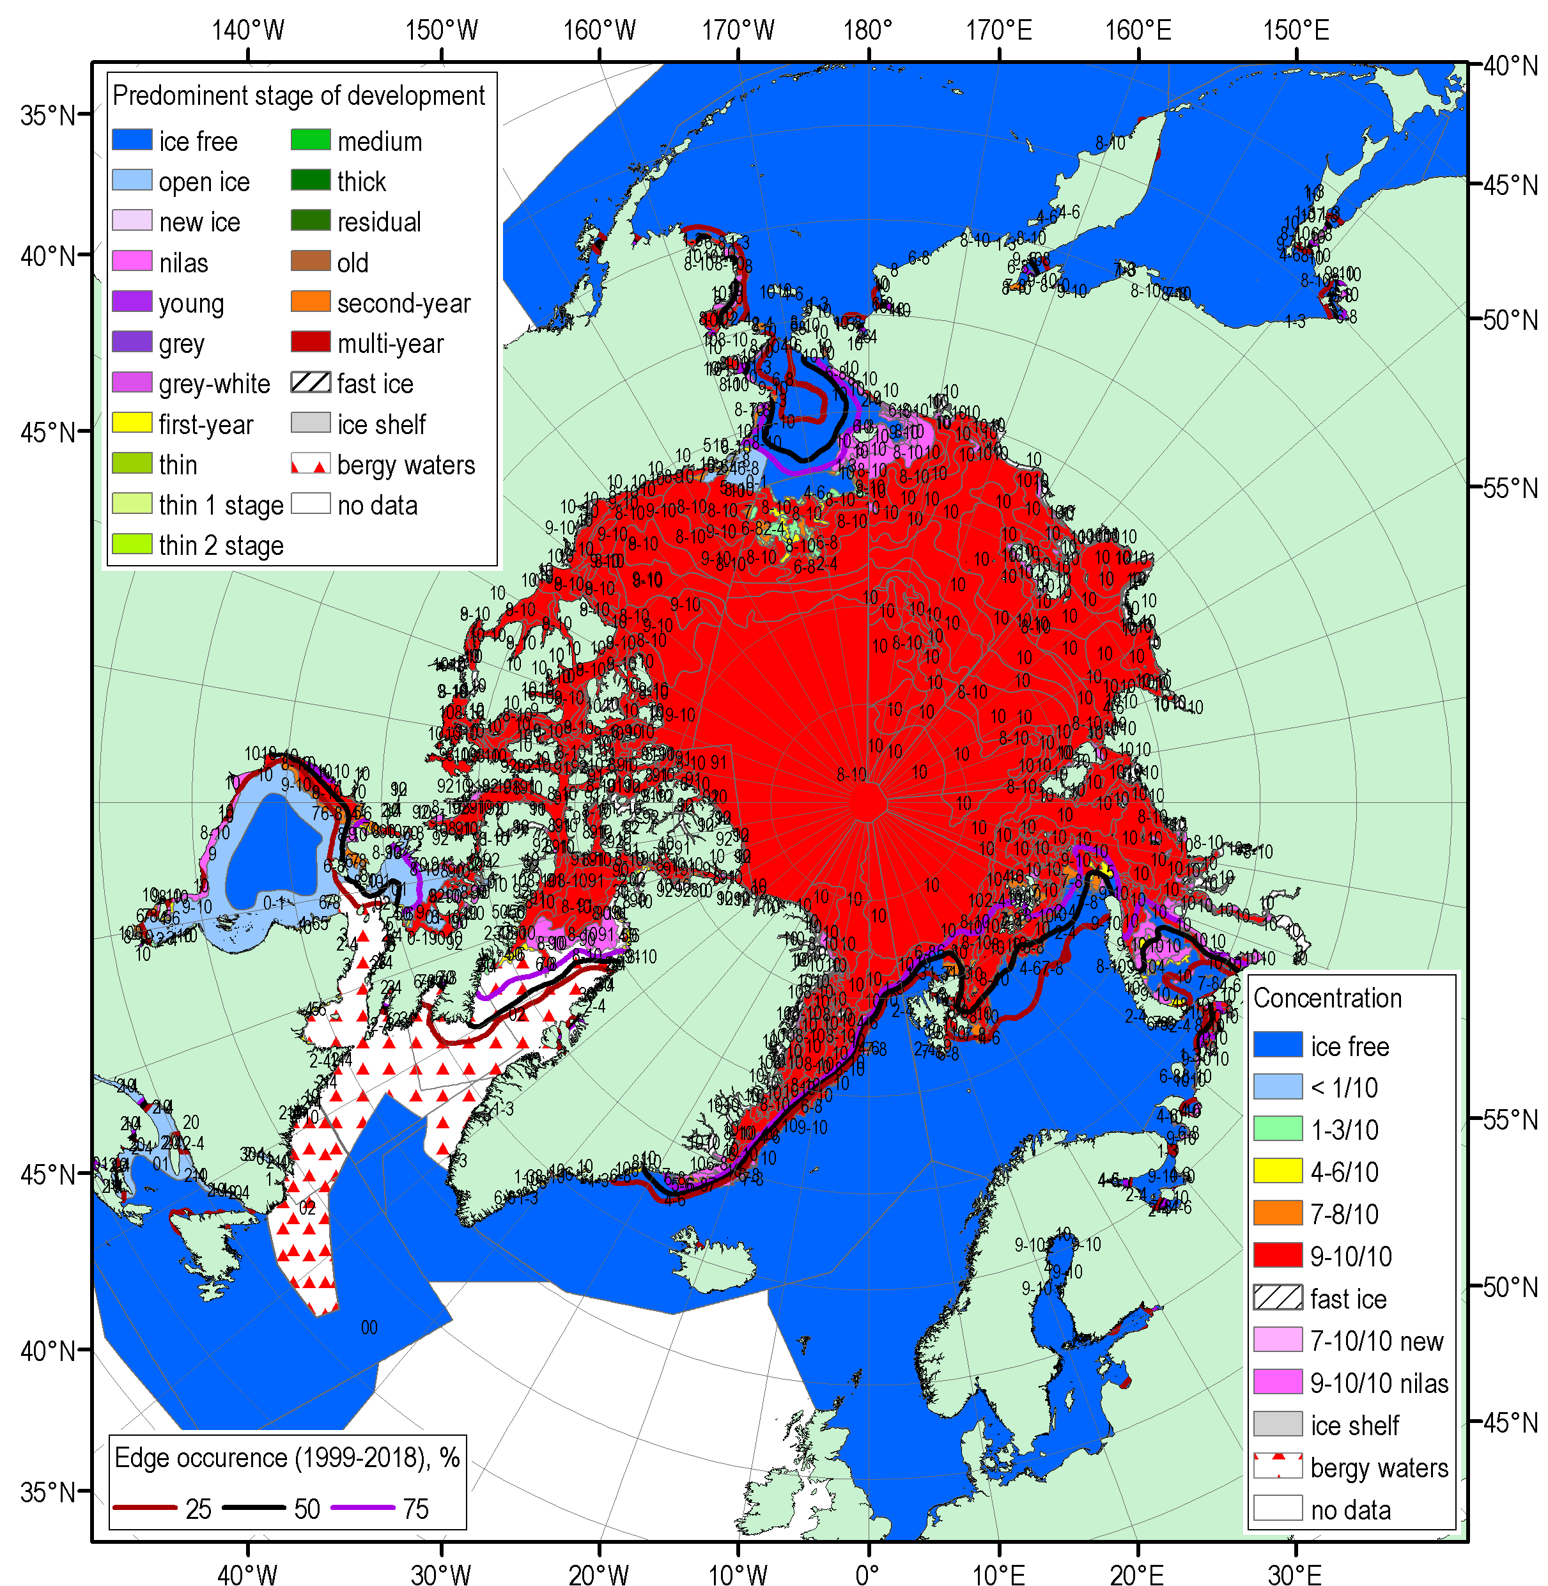
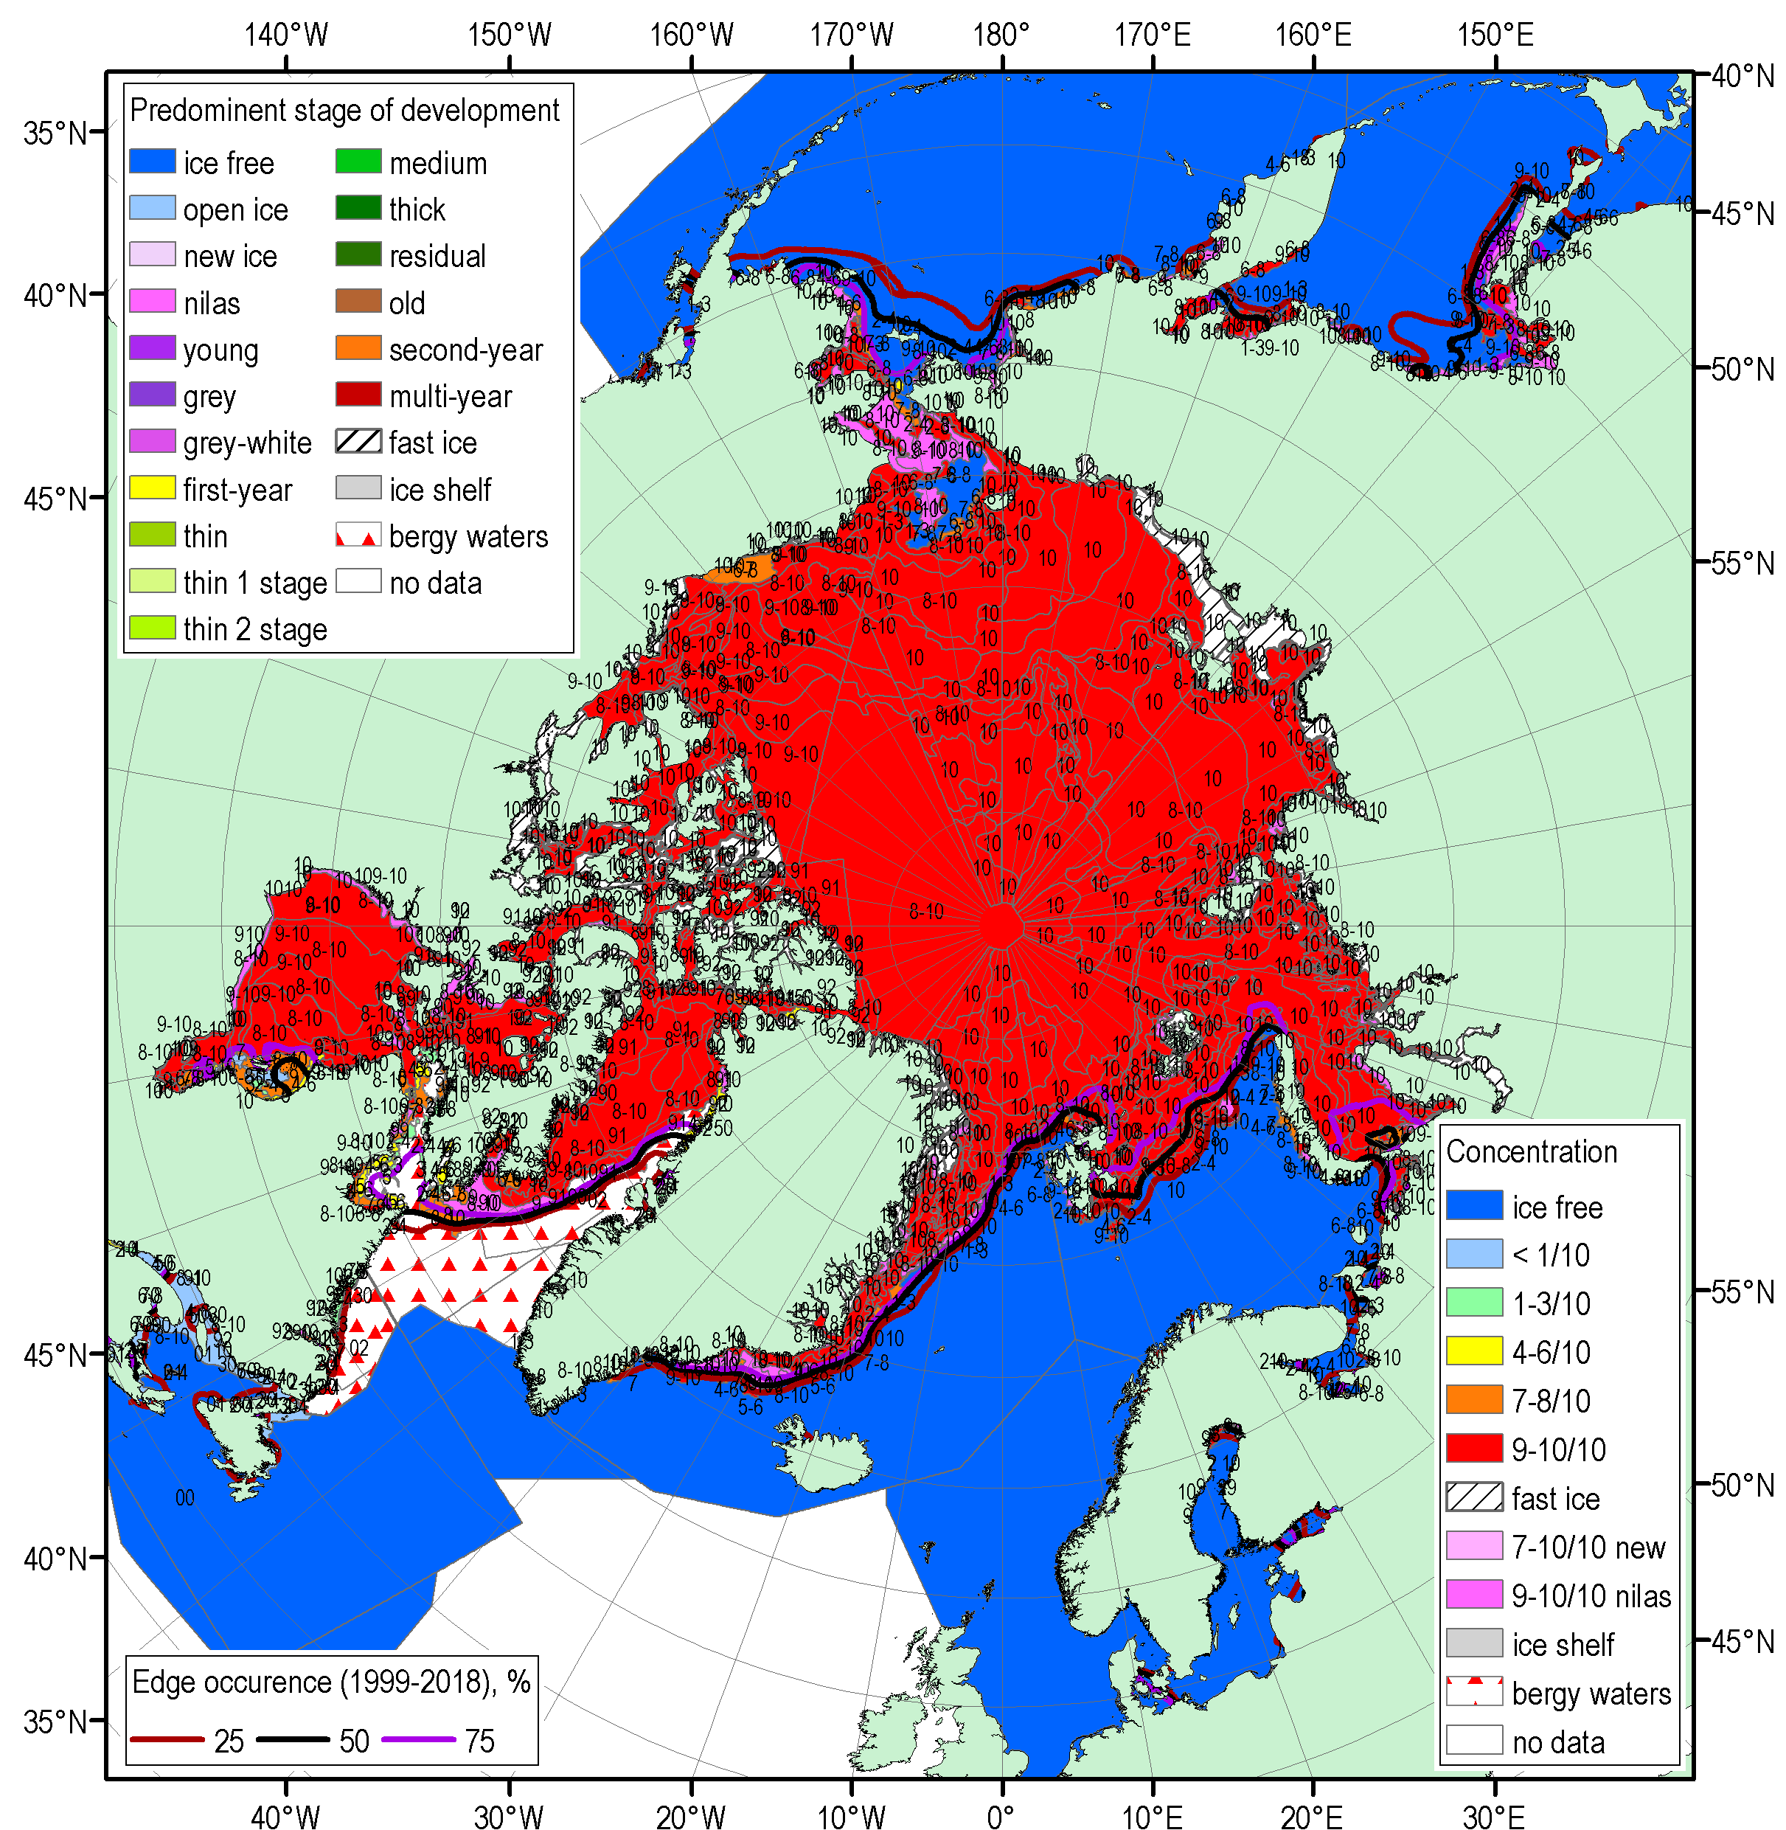
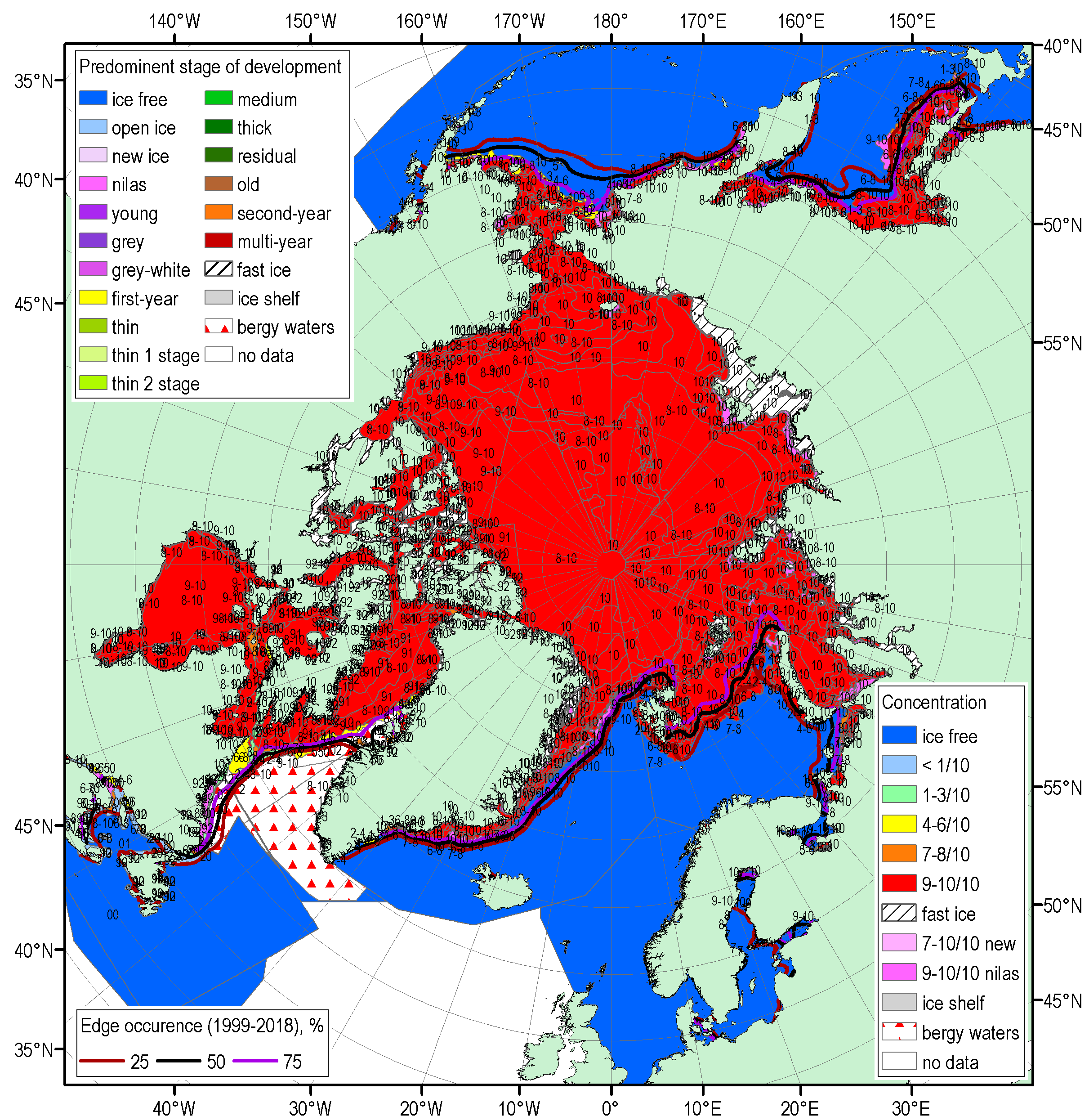
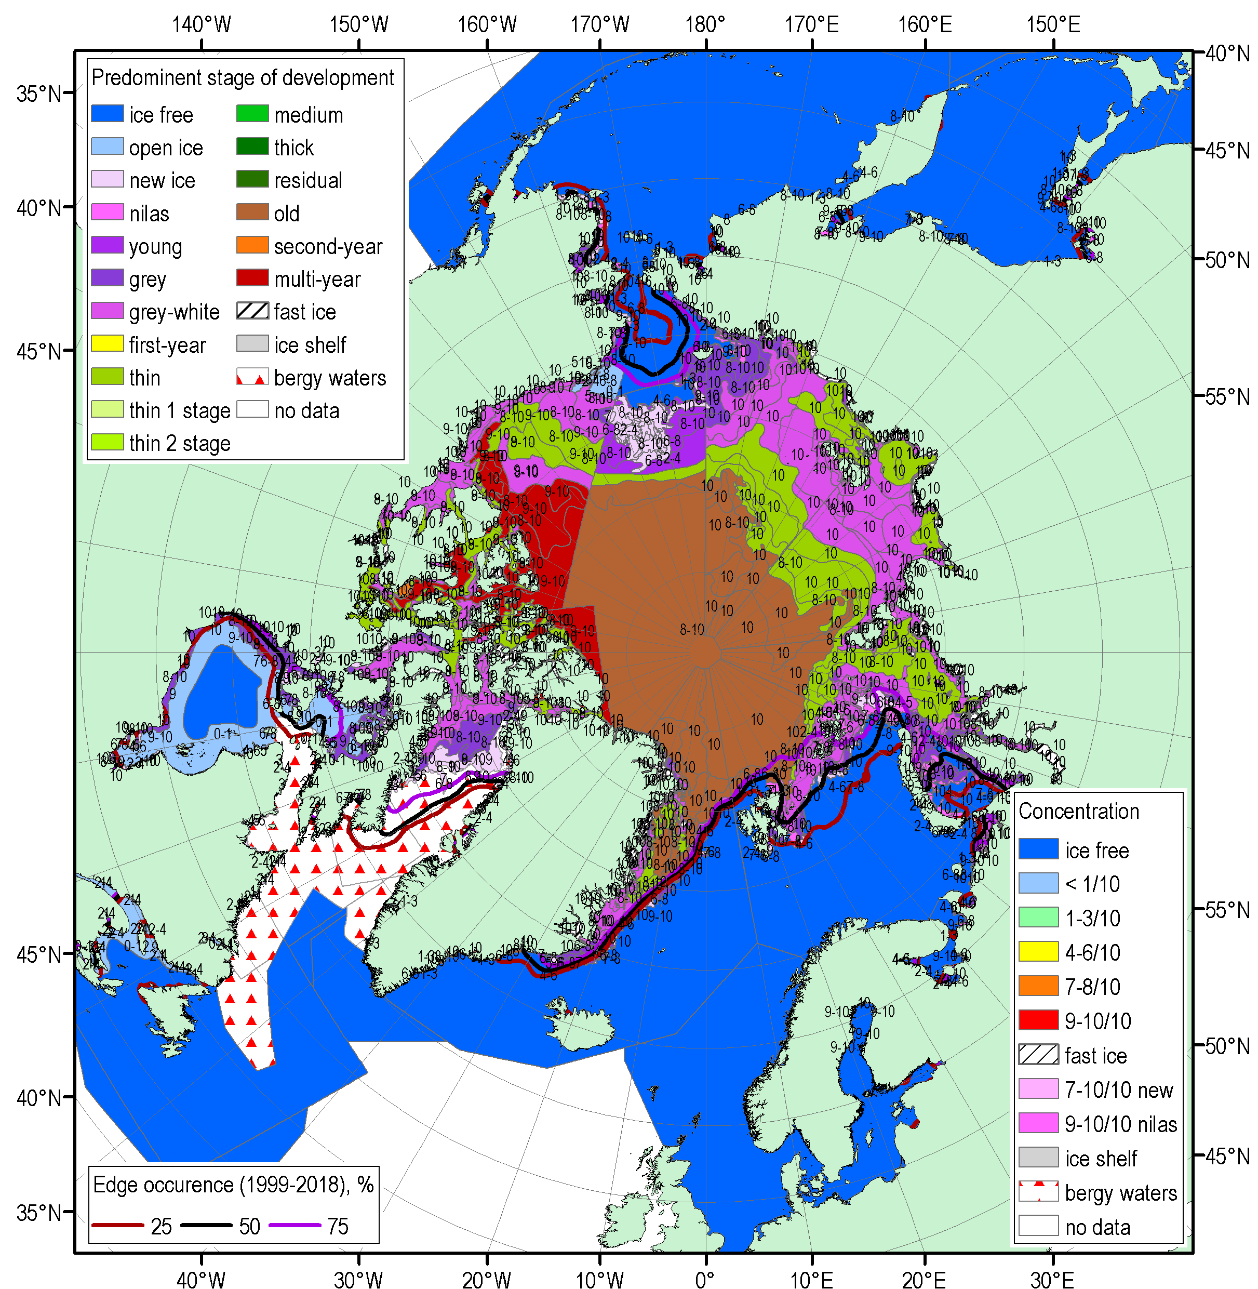
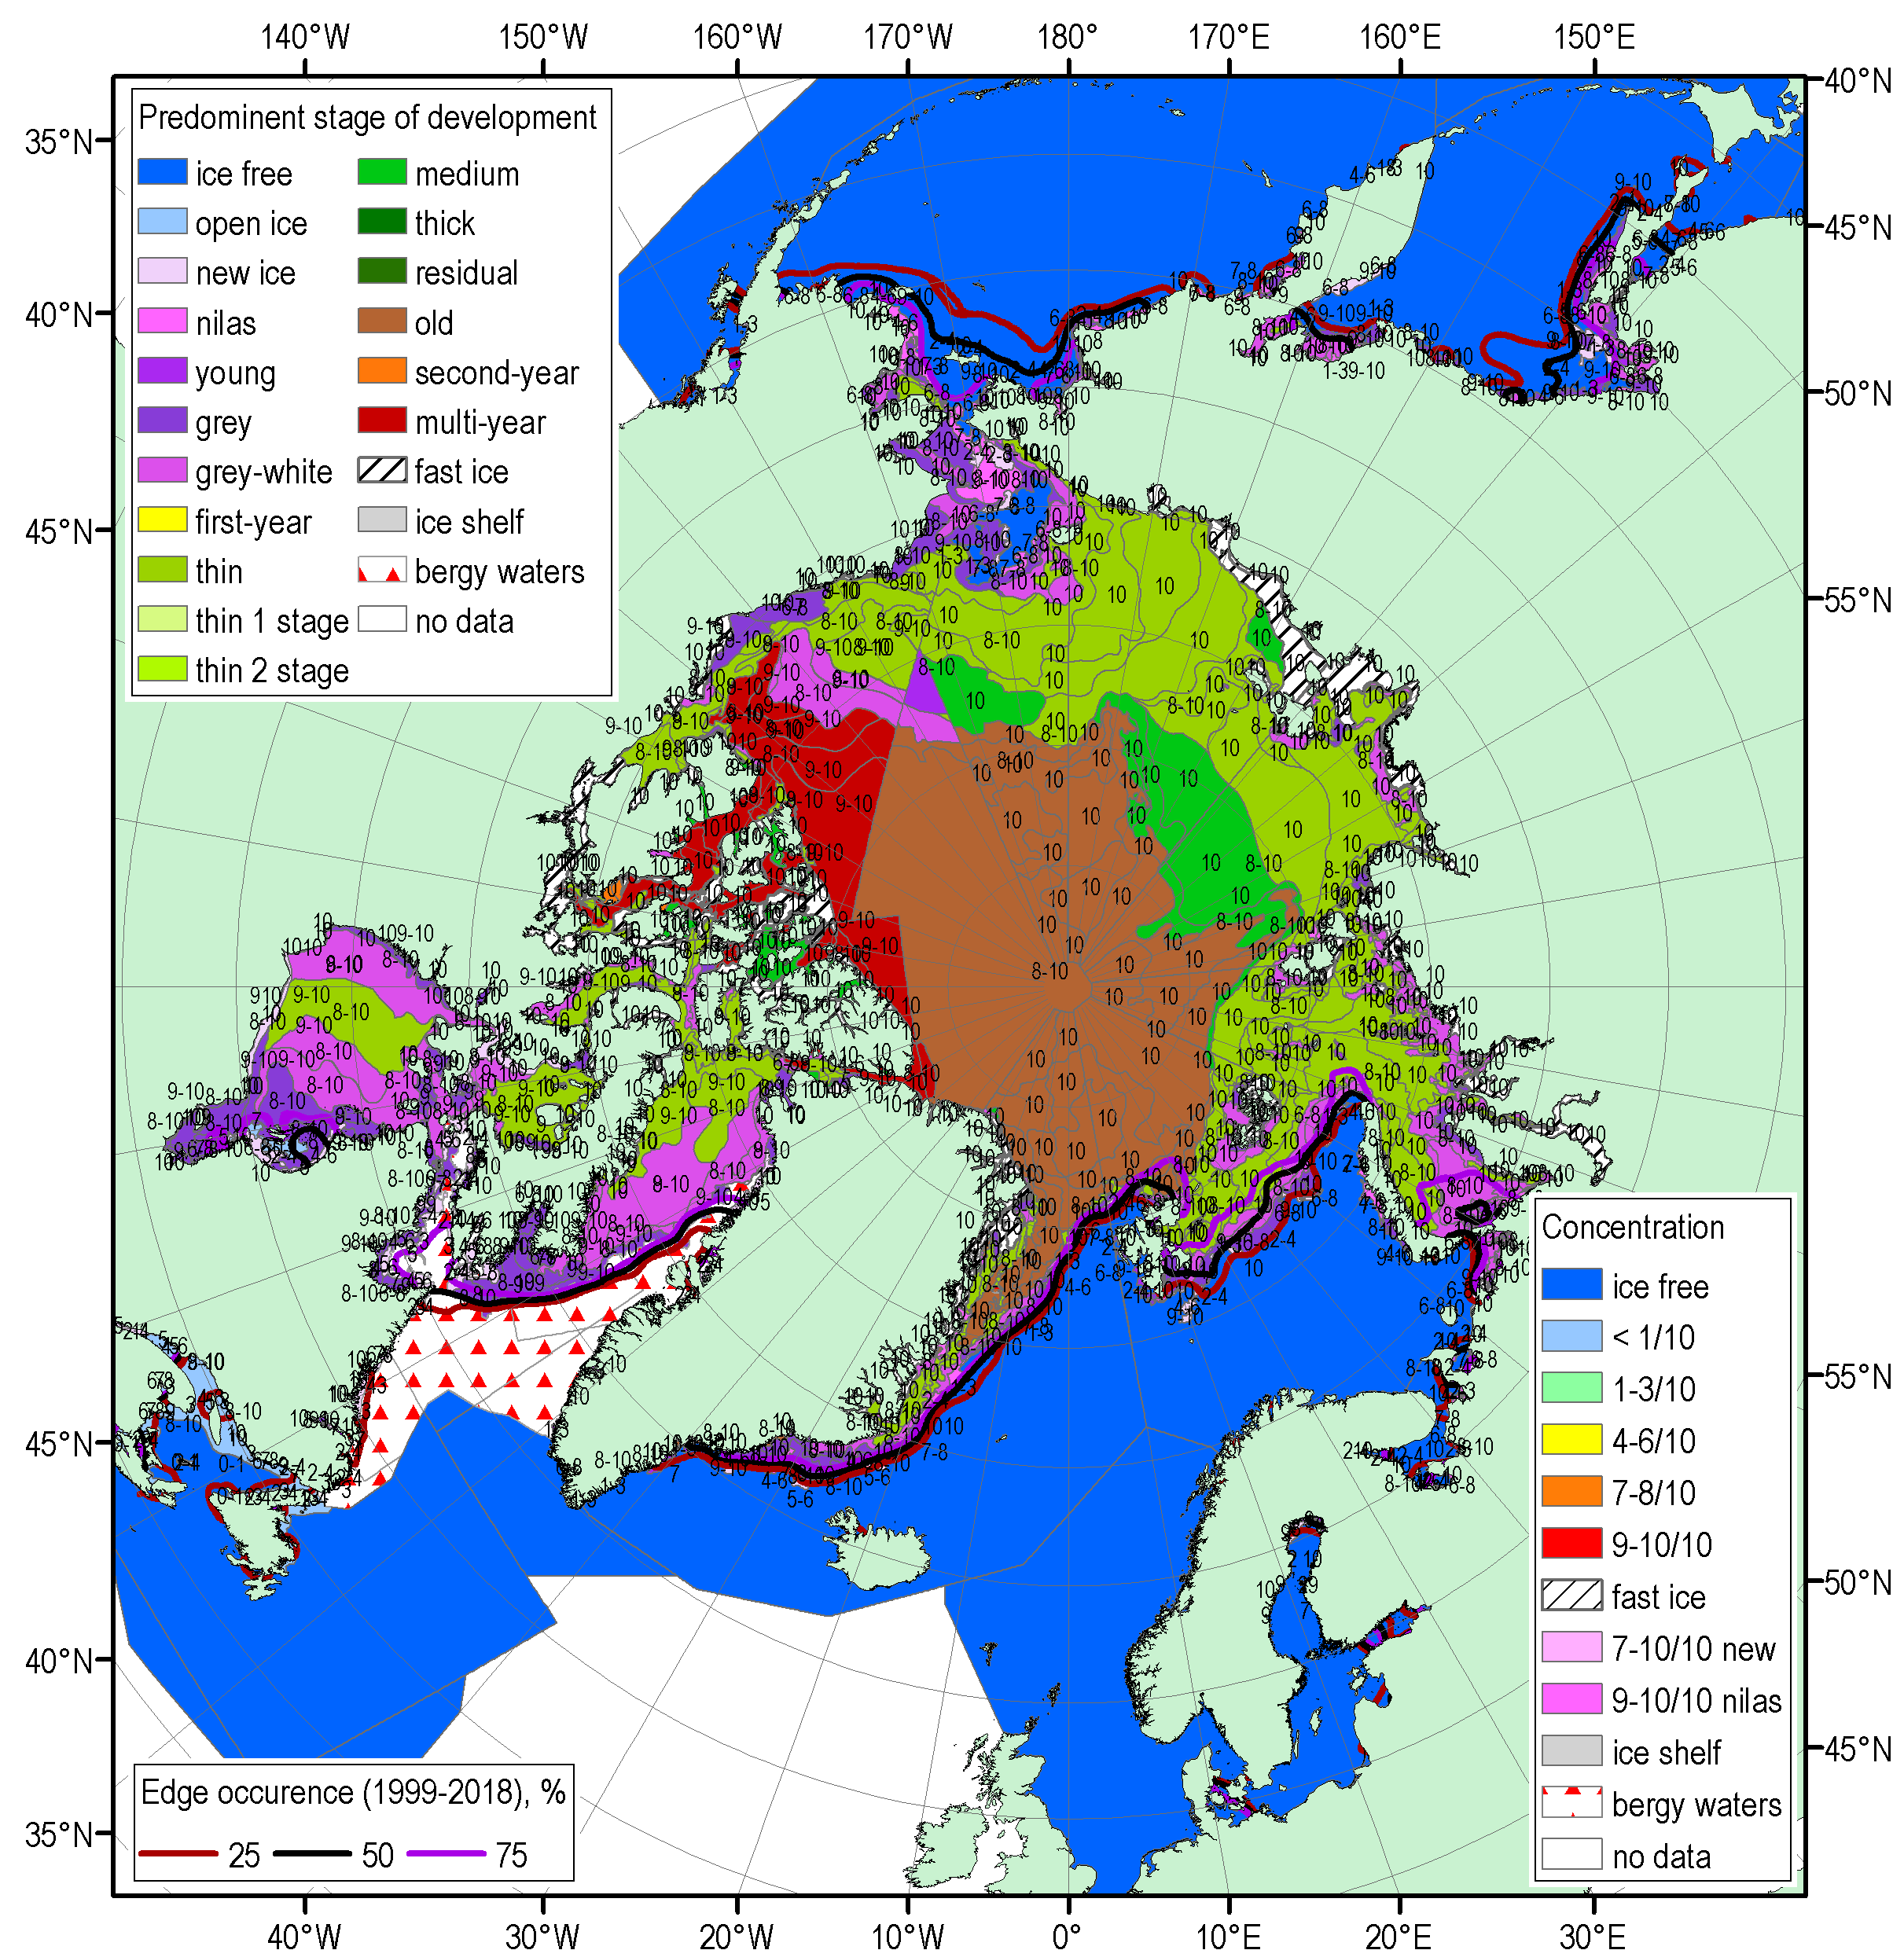
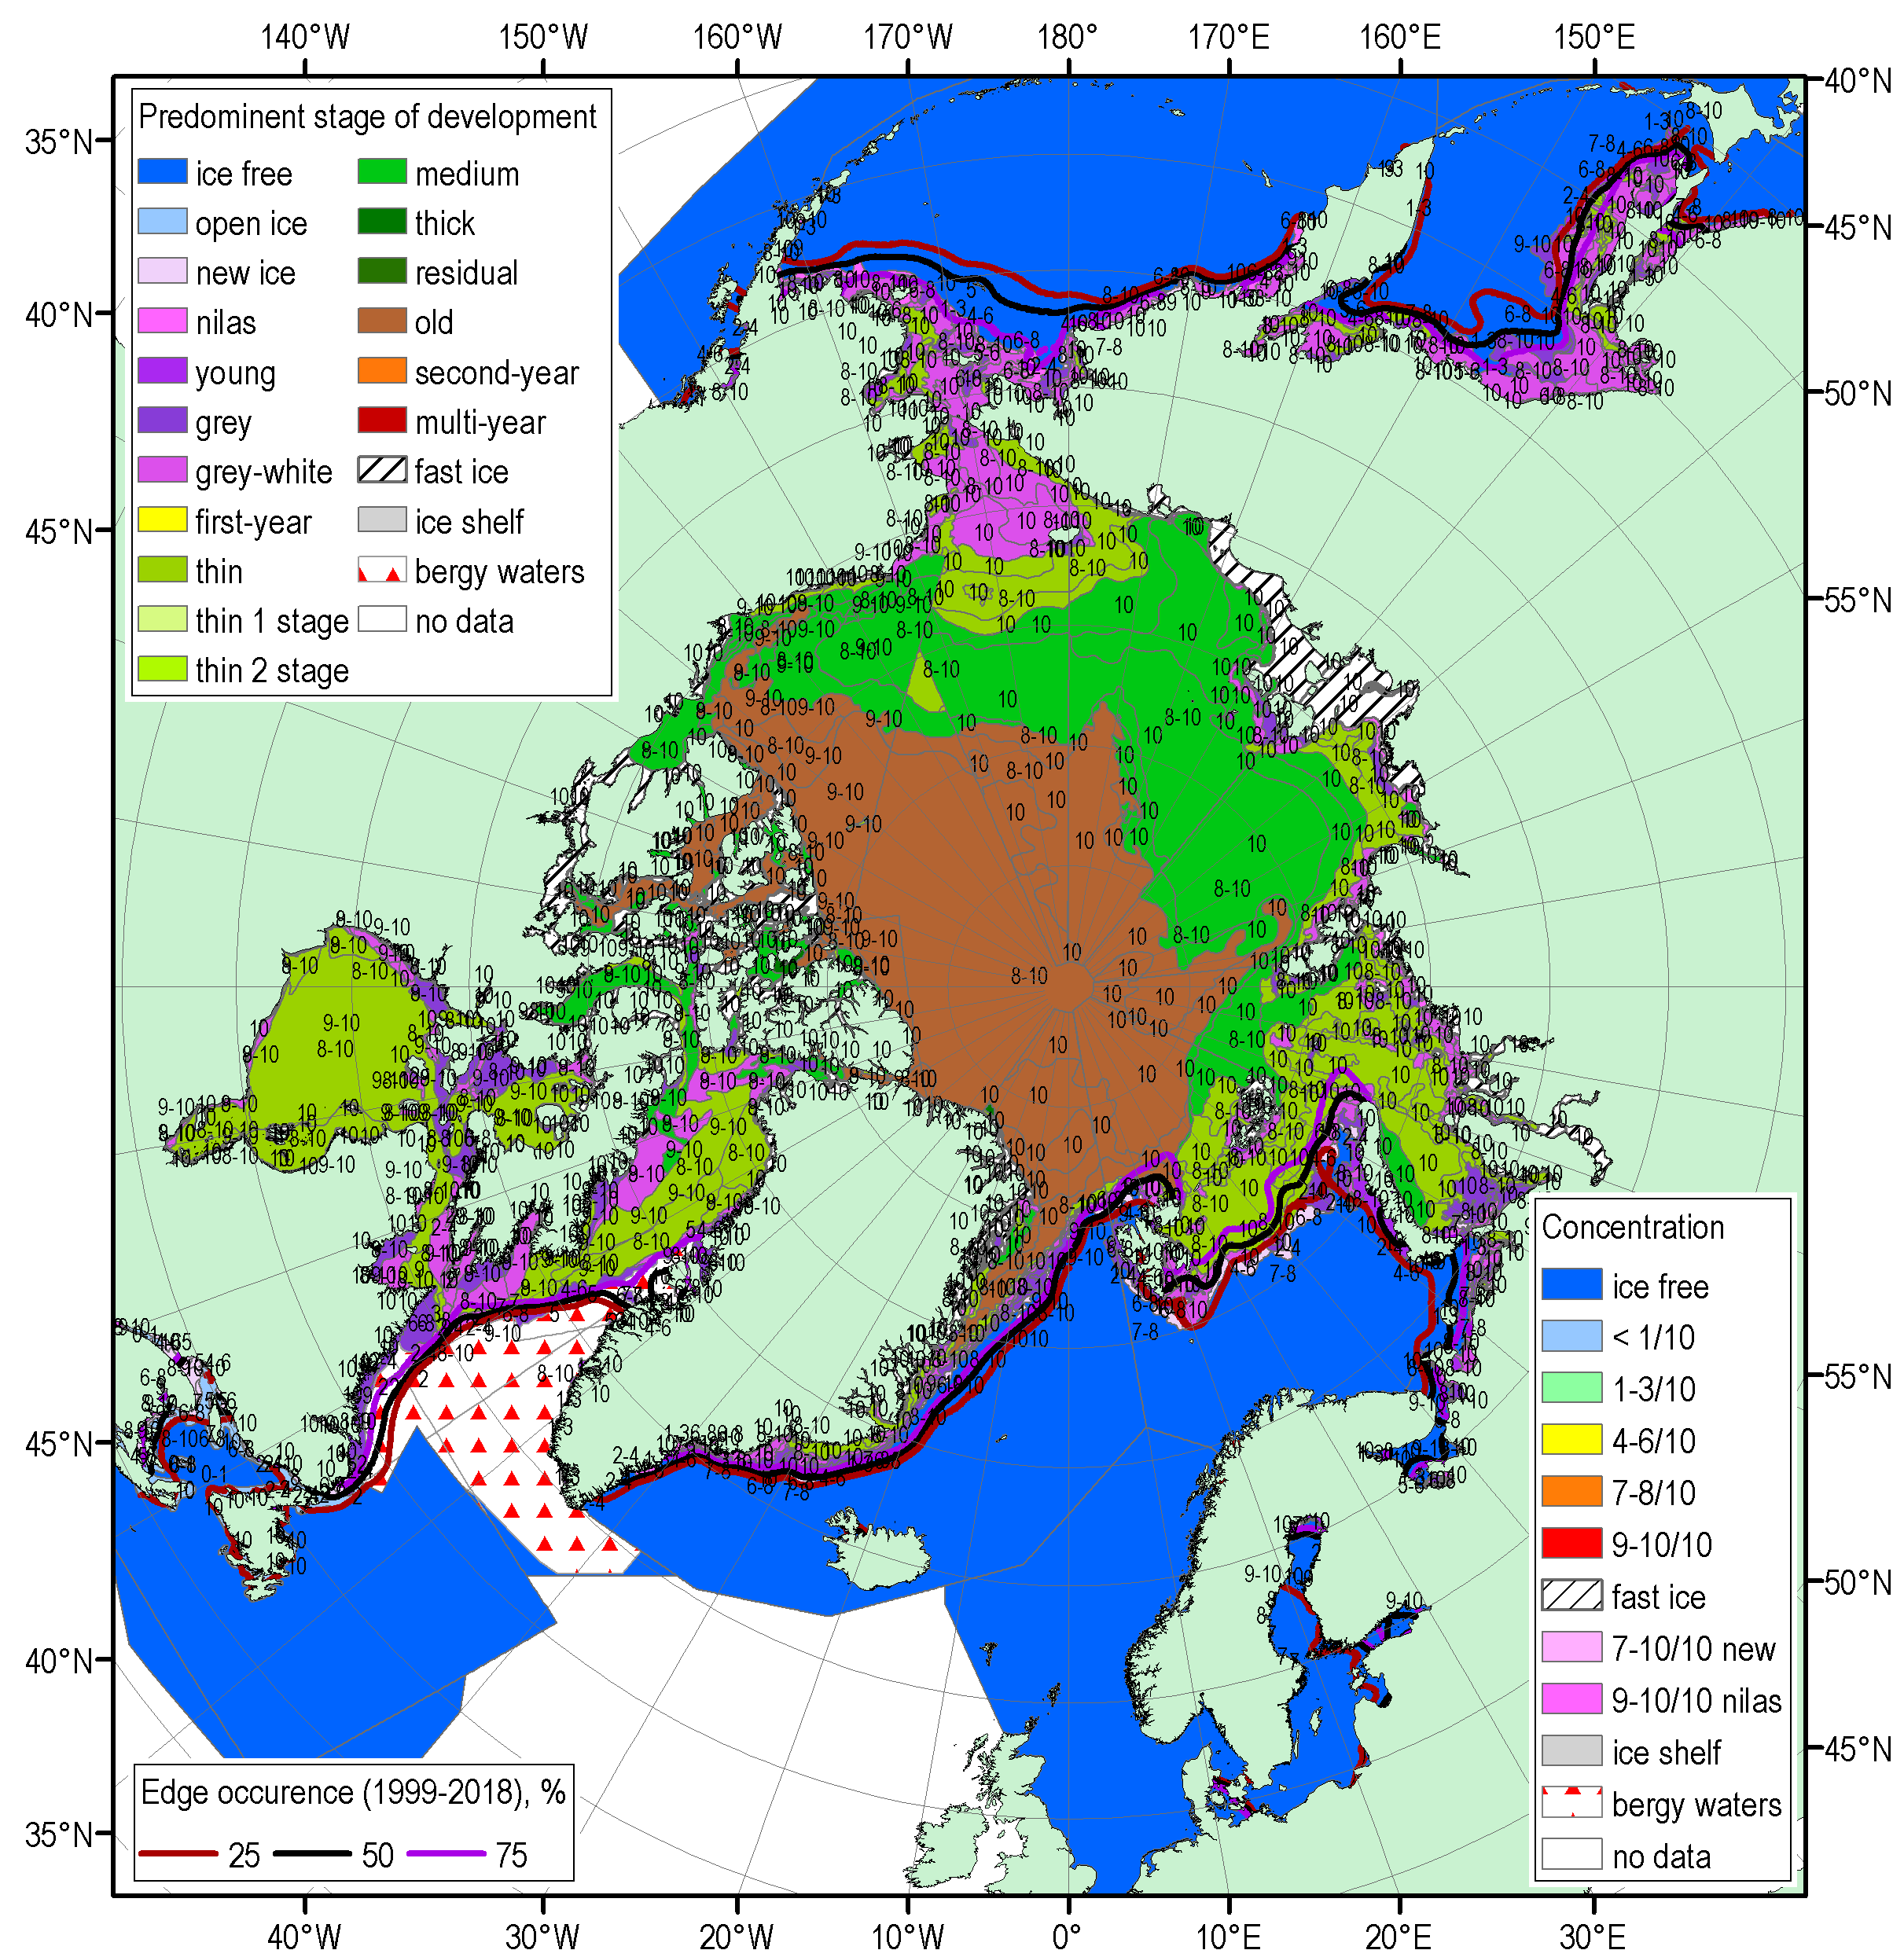
NDJ 2019/2020 Arctic sea ice – concentration and stage of development
18-21 Nov
16-19 Dec
13-16 Jan
Blended AARI/CIS/NIC (JCOMM) ice charts; ice edge – nearest 5days, reference period: 1999-2018

Slide 22
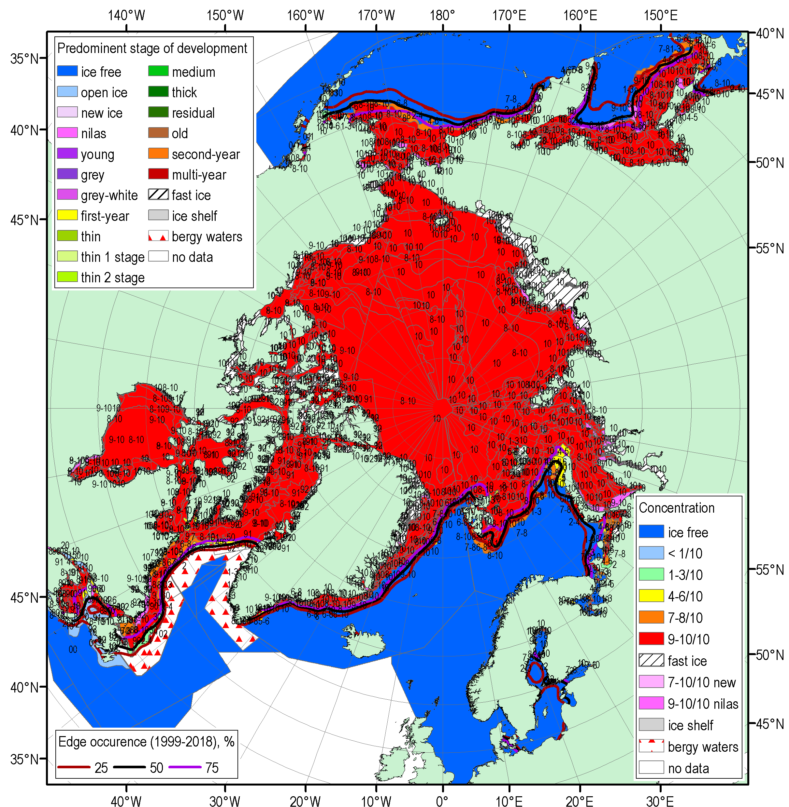

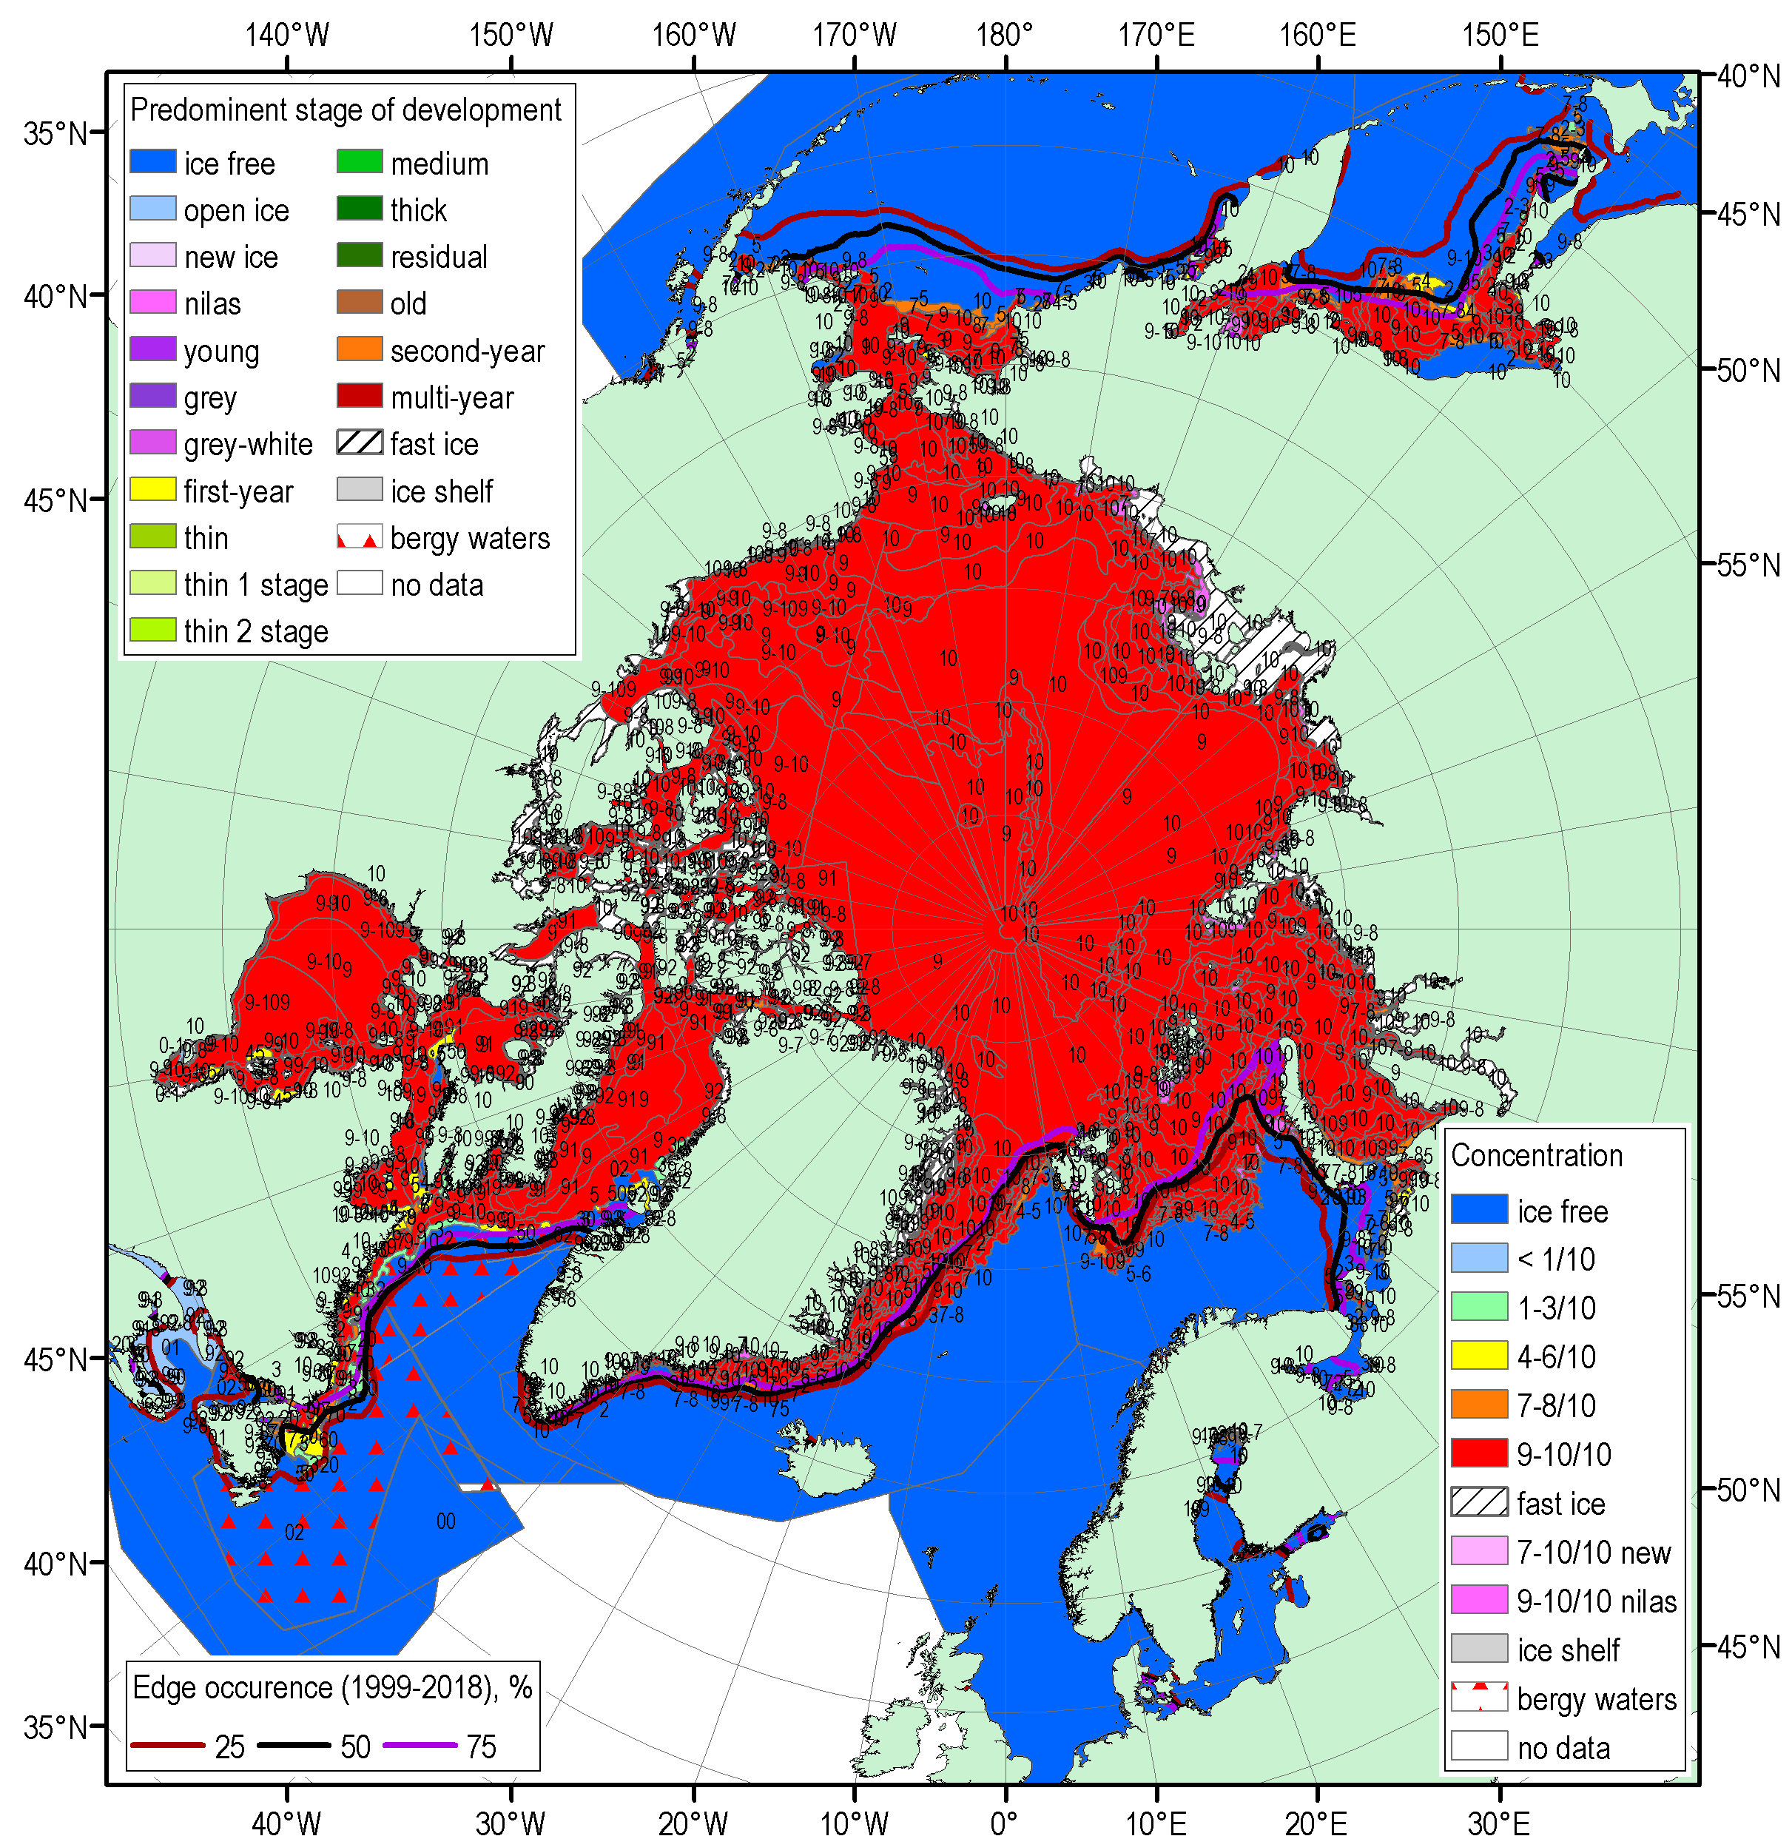
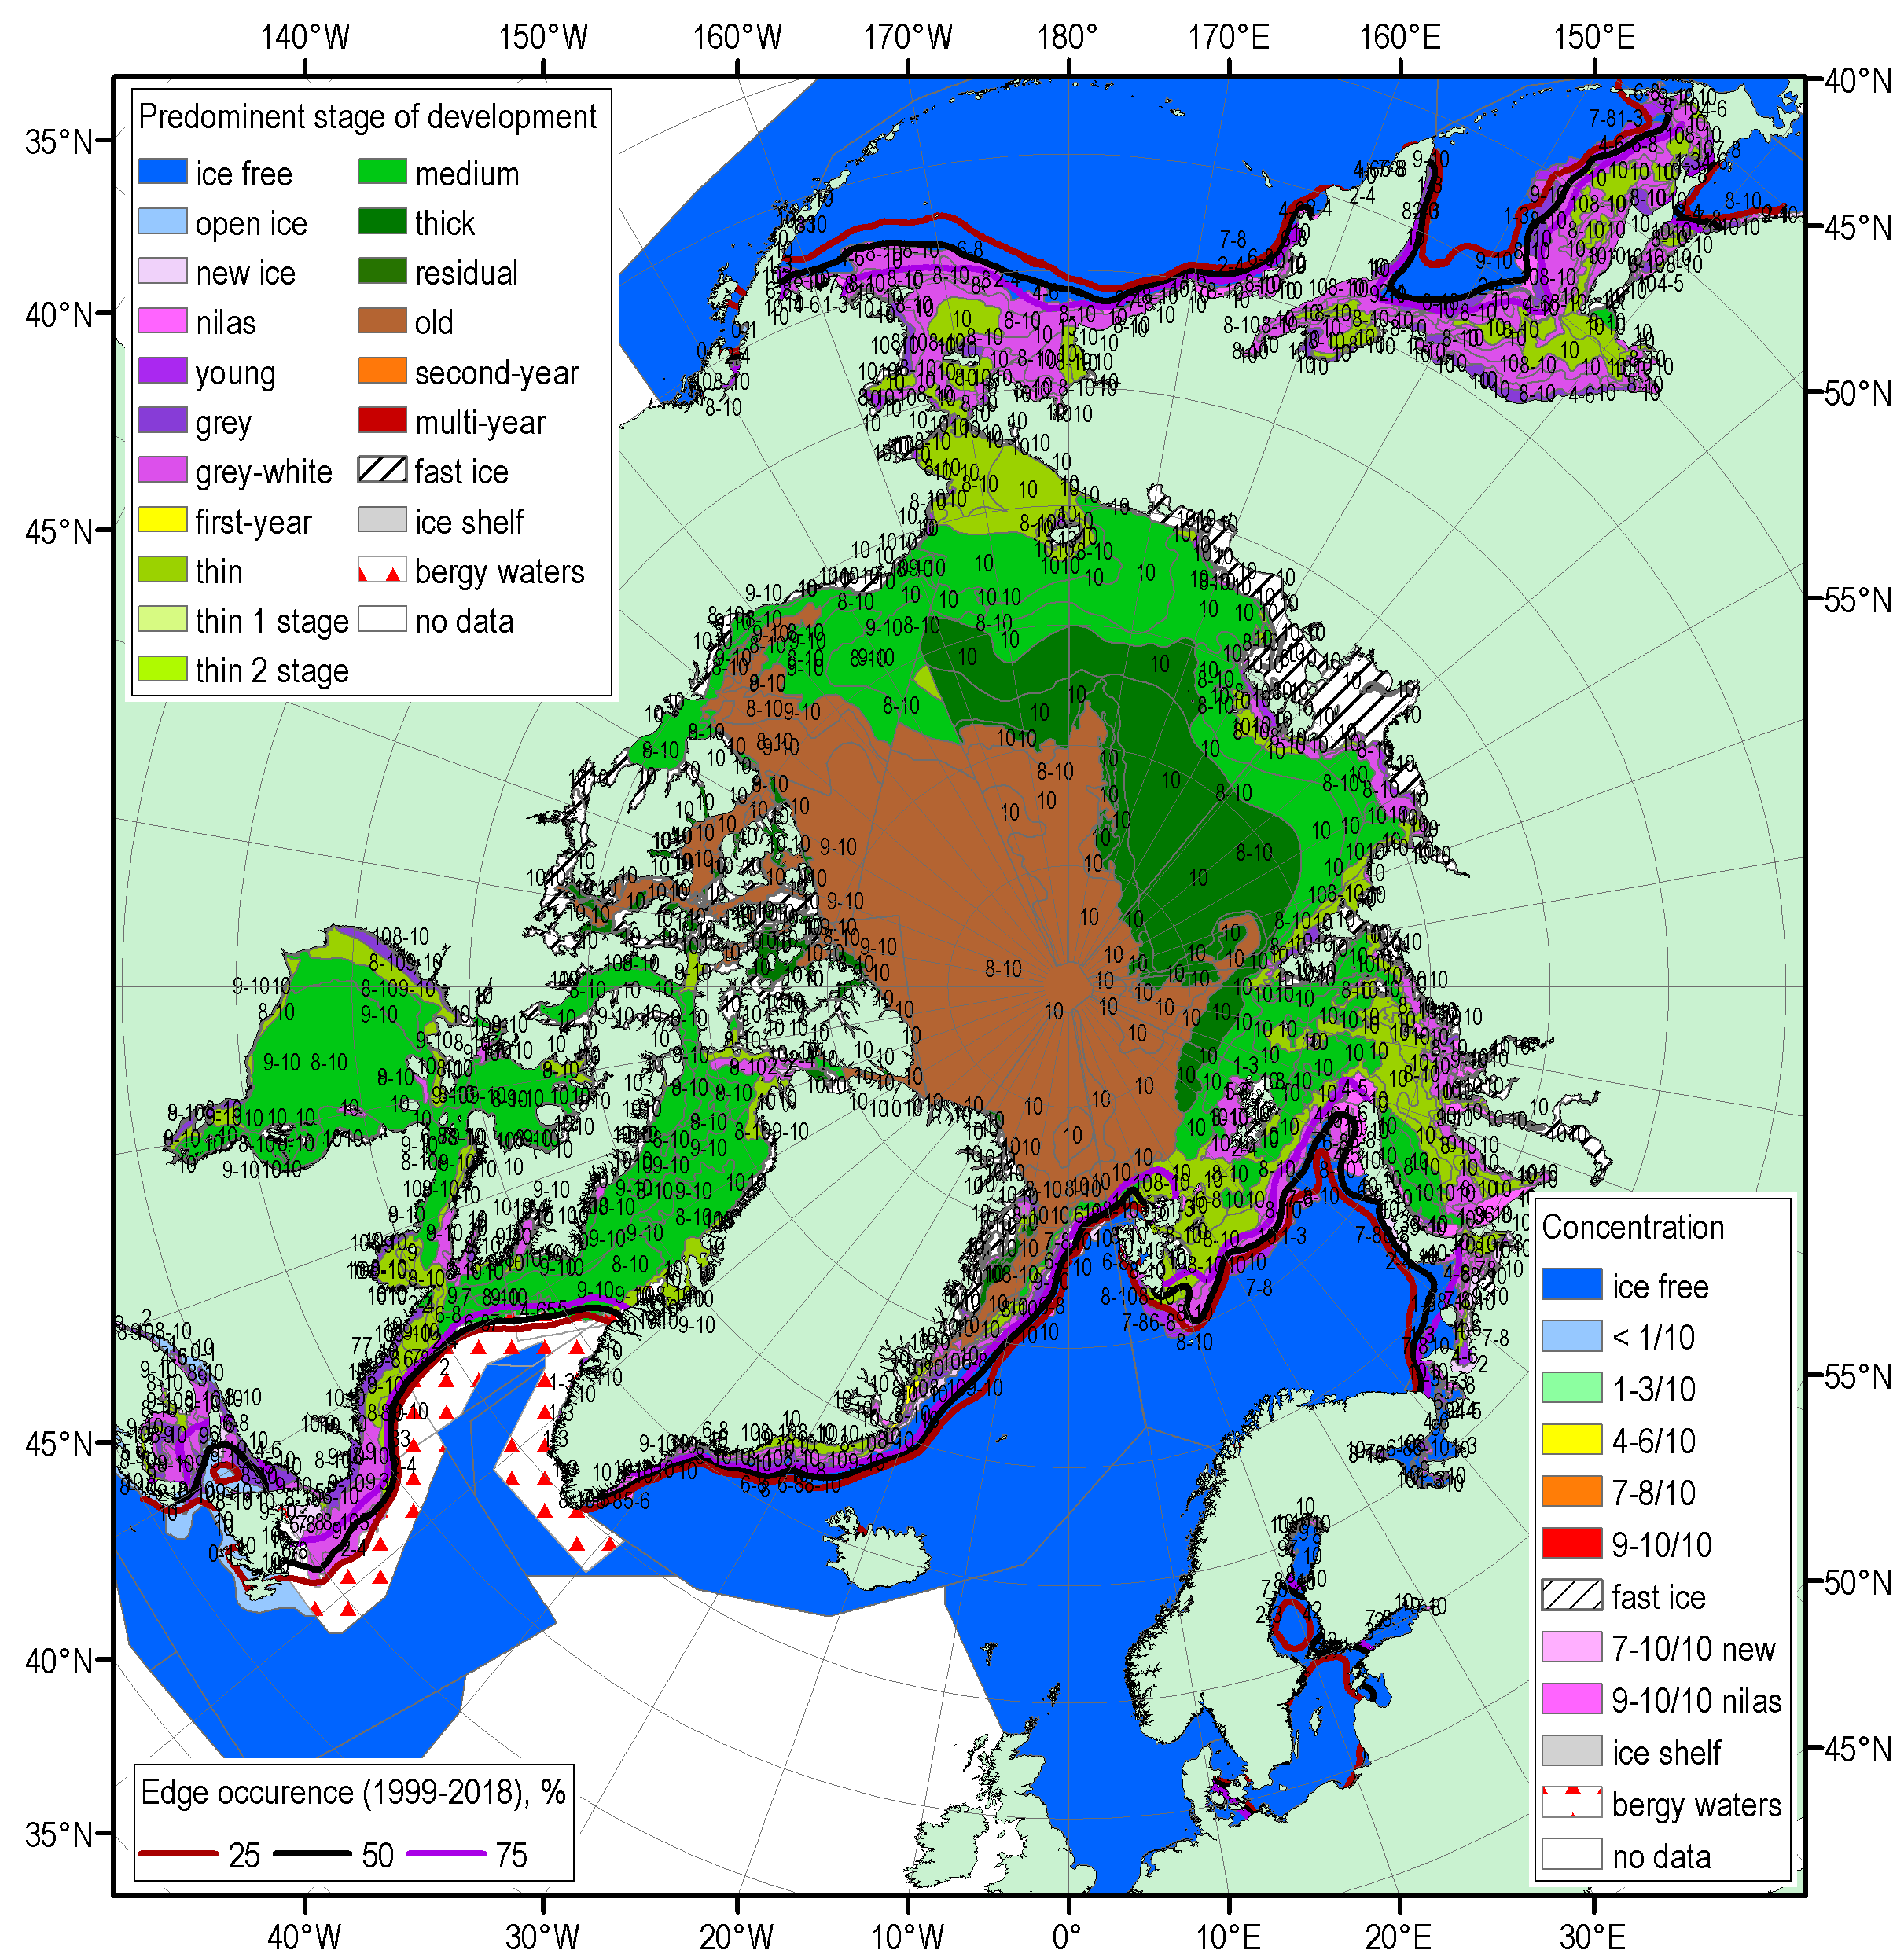
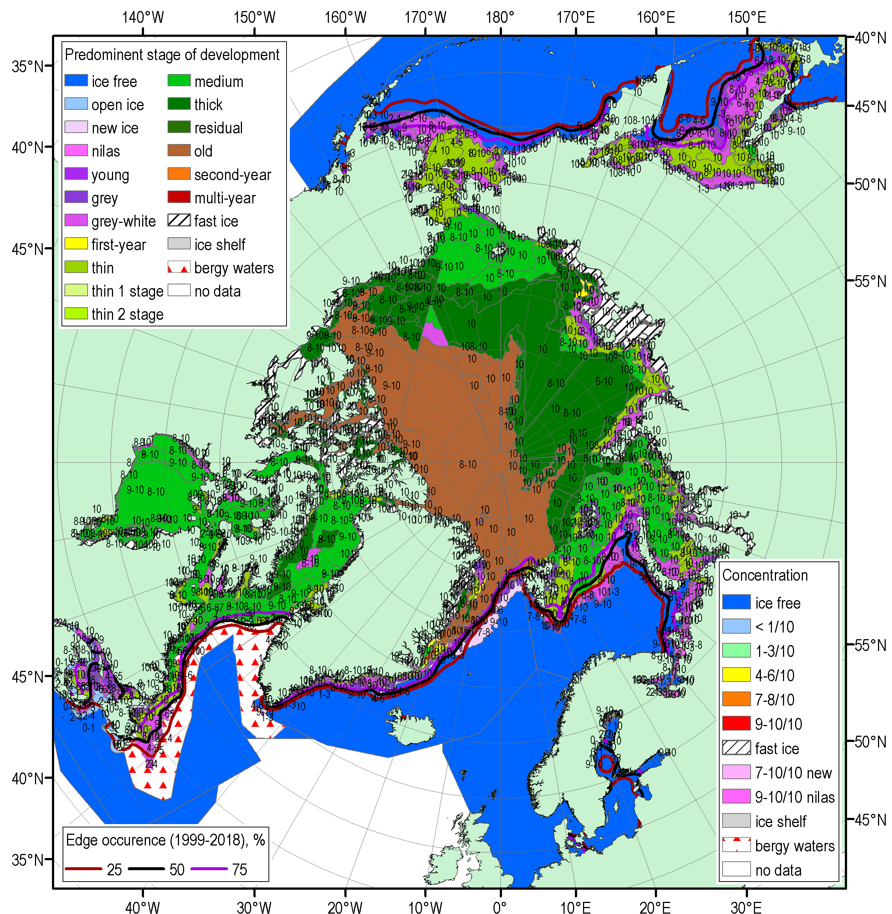
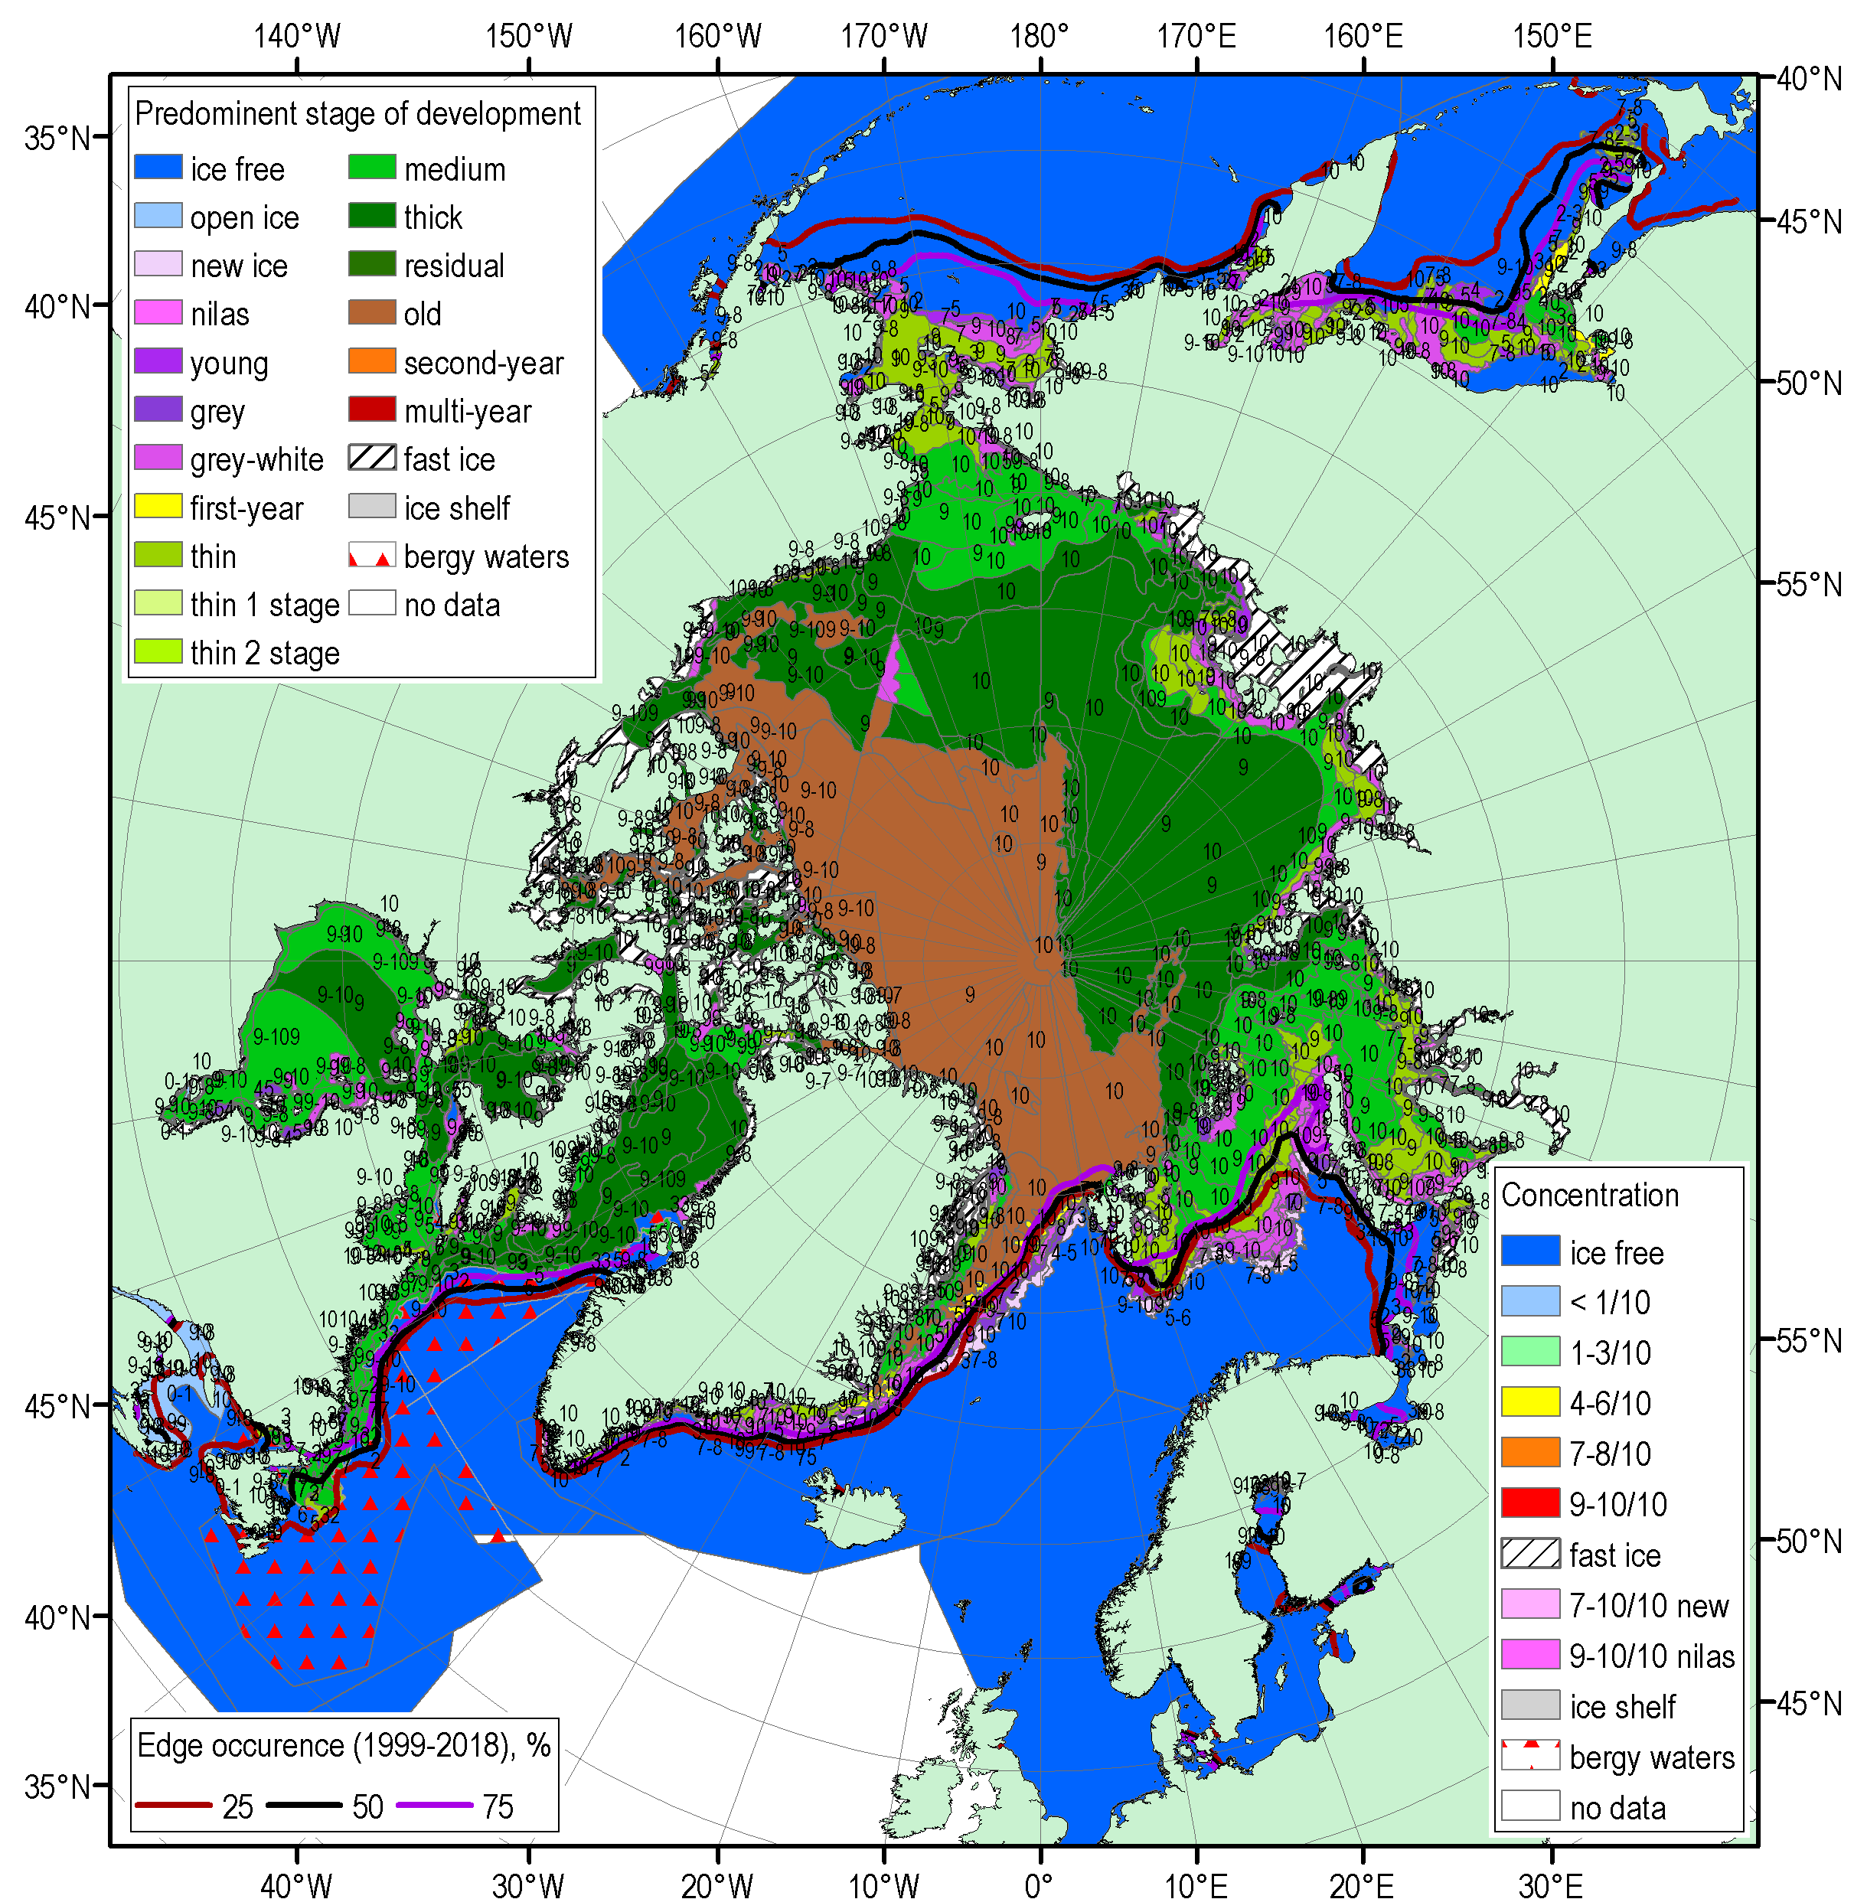
FMA 2020 Arctic sea ice – concentration and stage of development
17-21 Feb
16-19 Mar
13-17 Apr
Blended AARI/CIS/NIC (JCOMM) ice charts; ice edge – nearest 5 days, reference period: 1999-2018

Slide 23
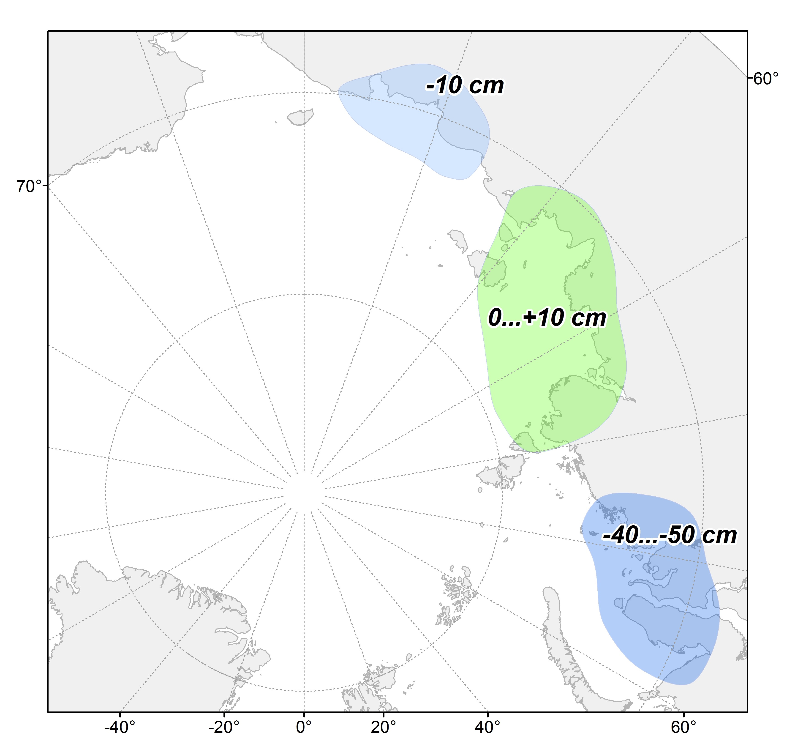
Sea ice fast ice maximum thickness values and anomalies by end of April/Mar 2019 (stations)
WMO stations used:
Russia: 12 (Varandey, Amderma, Belyi, Dikson, Sterlegova, Cheluskin, Tiksi, Kotelnyi, Sannikova, Ayon, Valkarkay)
Observed maximum winter ice thicknesses significantly less than normal (for the last 30 years) for Kara Sea (up to -50 cm, which is opposite to 2019) and slightly less than normal for Eastern Siberian Sea
Slightly thicker ice observed in Laptev Sea
Ref [1989-2019]
[AARI]

Slide 24
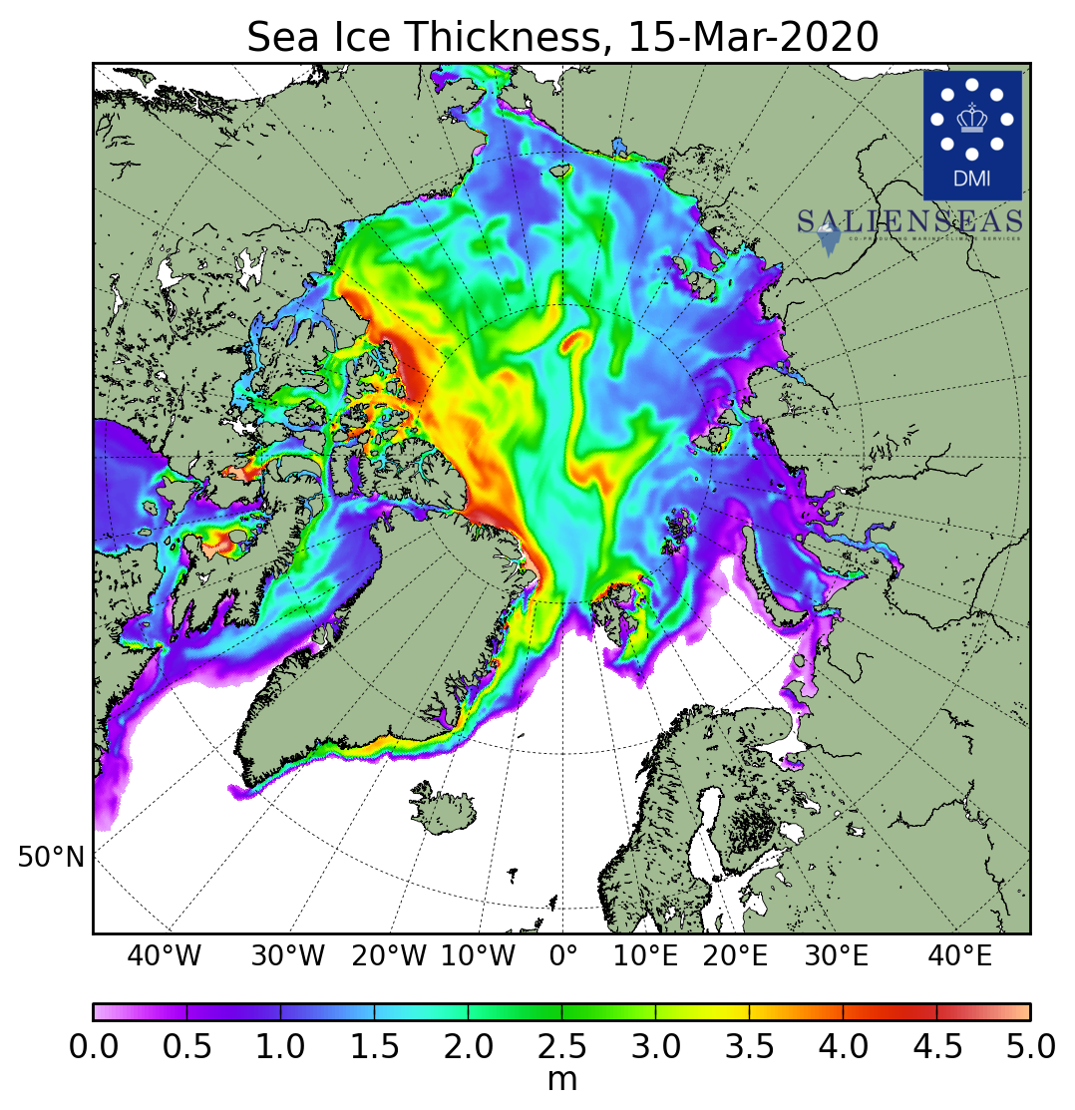
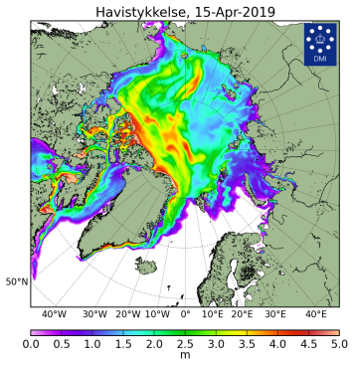
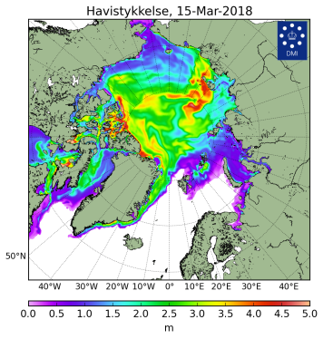
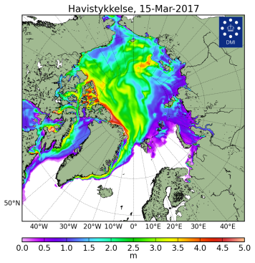
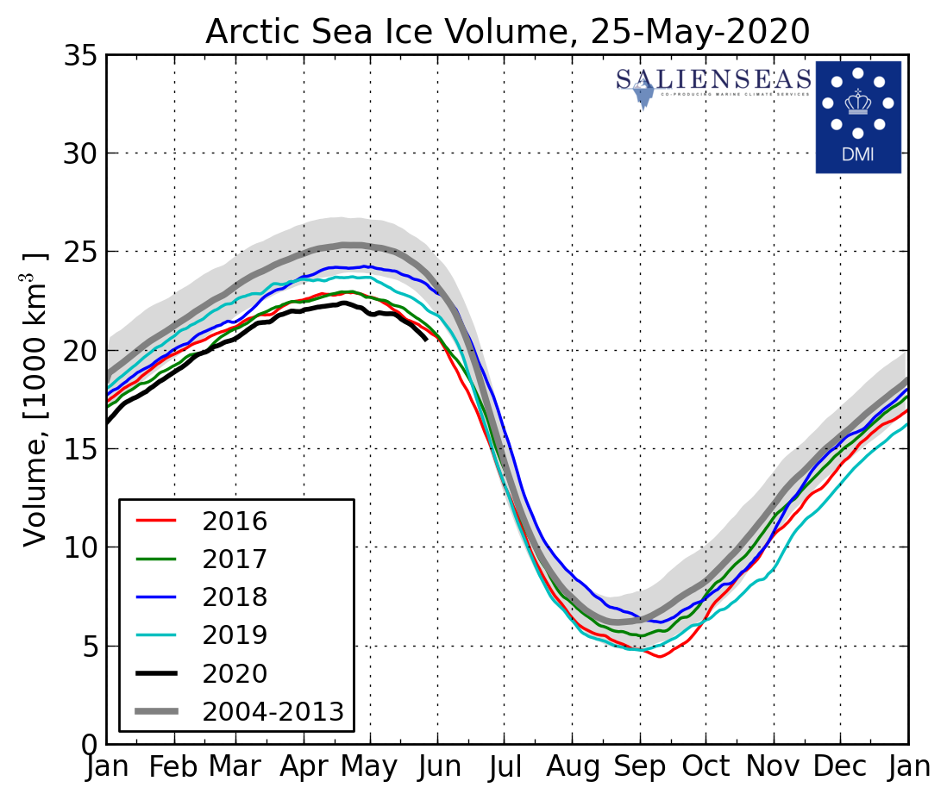
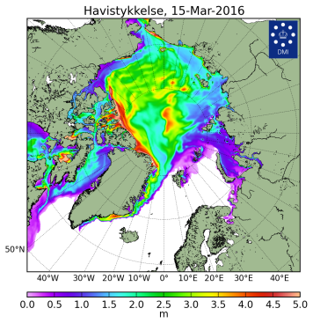
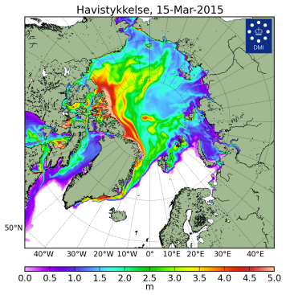
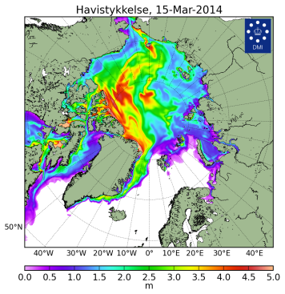
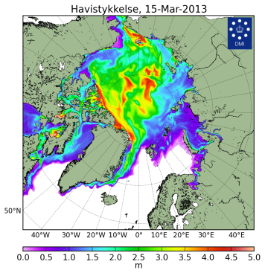
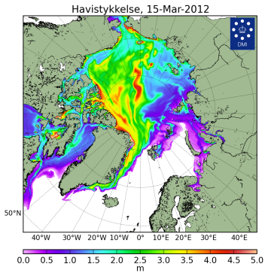
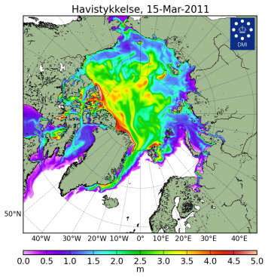
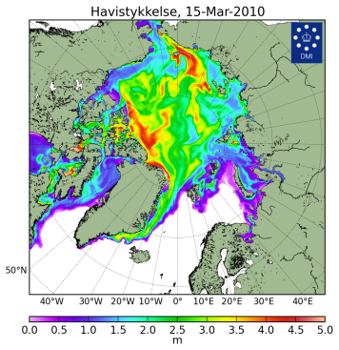

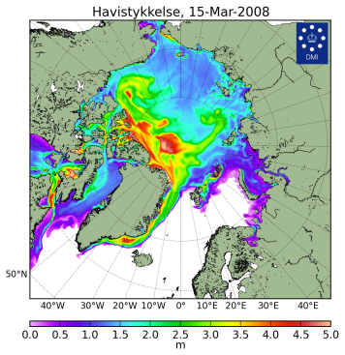
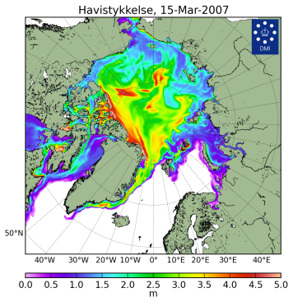


Sea ice thickness for 15 Mar 2004…2020 and ice volume
[Madsen et al, 2015]
2020
2019
2018
2017
2020
2016
2015
2014
2013
Models show Arctic ice volume in 2020 the lowest from Oct 2019 for 2004-2020 with 2nd in row in 2016
The present ice extent slightly higher then in 2016 means sea ice thicknesses in winter / spring 2019/2020 are in general lower then in 2019
2012
2011
2010
2009
2008
2007
2006
2004
DMI North Atlantic - Arctic Ocean model HYCOM-CICE - http://ocean.dmi.dk/models/hycom.uk.php
[DMI]

Slide 25
Polar Ocean:
  Sea surface temperature
  pH and acidification or alkalization of the Arctic ?
  Storms - Wave and swell height

Slide 26






Waves and ph in the Arctic Ocean - NDJ 2019-2020, FMA 2020
Boundary seas of the Arctic Ocean were in general warmer and stormy during winter-spring 2019-2020 with exceptions Svalbard and N Greenland (colder, calmer), Sea of Okhotsk (colder)
Numerical models show both positive (Arctic Basin, Chukchi Sea) and negative pH (Barents, Kara Sea, Canadian Arctic) anomalies to the last 20 years, that allows occurrence of both alkalization and acidification processes in the Arctic (no effect to wildlife?
SST NDJ anomaly, 1981-2010
SST FMA anomaly, 1981-2010
WW&S height NDJ rank, 1979-2020
WW&S height FMA rank, 1979-2020
AARI / Copernicus Climate Change Service
(ERA5 & MERCATOR reanalysis)
pH anomaly 2m SON 2000-2019
pH anomaly 2m DJF 2000-2019

Slide 27
Land Snow:
  Snow water equivalent
  Snow extent

Slide 28









Land snow (satellite, obs)
Snow extent in winter-spring 2019/2020 was less than normal with prominent negative anomalies (no snow) in most of European sector
Positive anomalies (more snow) were observed in Scandinavia, southern Canada
Greater Snow Water Equivalent in 2019/2020 means higher snow height observed
Nov
Dec
Jan
Jan
Mar
Apr
Ref [1981-2010]
[FMI, ECCC, Rutgers Glob Snow Lab / GCW)]

Slide 29




Current Conditions (21-26 May 2020)
Till now week westerly, moderate northern winds in European sector and strong southern winds over Siberia (NAO~0) led to lower SAT in European sector, prominent higher SAT over Siberia and the Arctic Ocean (‘heat waves’)
Northern Scandinavia, Arctic coasts, Chukchi peninsula are still under snow
NE part of Barents Sea, Kara, W Laptev Seas, Chukchi Sea are under intense ice melt which is extreme
However general pattern of TransArctic drift keeps ice conditions in Greenland Sea and Svalbard waters near normal
SAT, precipitation, mean wind vectors, NAO for 23-27.05.2020 (http://polarportal.dk)
AARI/NIC ice chart for 21-26 May 2020
Snow extent for 27 May 2020,
Rutgers Global snow lab

Slide 30
Using INTAROS project results for North Eurasia node: Access to seasonal summary data
Evgenii Viazilov
All-Russian Research Institute of Hydrometeorological Information - World Data Center (RIHMI-WDC)
Arctic Regional Climate Center

Slide 31

Assessment of Russian observing systems and databases
http://portal.intaros.meteo.ru/portal/intaros/meta
Russian systems of account of observation networks and metadata (http://asunp.meteo.ru

Slide 32



Integration of multidisciplinary, distributed and heterogeneous databases within iAOS-Russian Node
http://portal.intaros.meteo.ru/portal/intaros/data
Short information:
Total - 226 information resources
RIHMI-WDC - 165
AARI - 59
Nansen Centre -2
Rubric
Meteo - 112
Data for river - 63
Hydrochemistry - 24
Ice - 24
Function:
integration data
metadata access
search information resources
data access
data exchange
data delivery to ftp or e-mail
visualization data (map, graphic, table)
Metadata
Data
Link for “Data Access” is on ArcRCC site https://arctic-rcc.org

Slide 33


iAOS applications for information support of marine activities in the Arctic
http://portal.intaros.meteo.ru/portal/intaros/services/climate_monitoring
Applied tasks:
Disasters and support decision
Assessment of climate
Monitoring of climate
Support of Long-Range forecasts
Hydrometeorological support of transport operations
Functions:
Configuring information resources, portlets, tools, geo-area, parameters for applied tasks
Calculation of anomalies, trends, rank, extrema, statistical characteristics by macro-regions
Data visualization (map, graph, table)
Preparation of materials for the report

Slide 34
Thank you for your attention !
INTegrated ARctic Observing System (INTAROS)
EC HORIZON 2020-BG-09-2016
Agreement between Ministry of Education and Science of Russia and RIHMI-WDC № RFMEFI61618X0103
Participants of project:
All-Russian Research Institute of Hydrometeorological Information - World Data Center (RIHMI-WDC)
Arctic and Antarctic Institute (AARI)
Nansen International Environmental Remote Sensing Center (NIERSC)

Slide 35
On-line discussion with end-users on seasonal summary
Shanna Combley
Possible themes - points for discussion (using CHAT function raise your hand or ask a question):
Is the content of the summary appropriate (details, variable) ?
What parameters are missing ?
What regions are missing ?
Any other ?

Slide 36



ACF - 5: Verification of the FMA2020 season
ACF - 5: Seasonal forecast for the JJA2020 season
Marko Markovic
Meteorological Service of Canada

Slide 37

Seasonal forecast over the Arctic, Feb-March-April 2020
A reminder
Considering multi-model ensemble forecast and a limited model skill over the Arctic:
Temperature: there is probability of 40% or more that temperatures will be above normal over the Alaska and W. Canada and over most of the continental Canadian Arctic. Same above normal probabilities, but with higher confidence, was forecasted for European, Atlantic, W and E Siberian and Chukchi regions.

Slide 38

Seasonal forecast over the Arctic, Feb-March-April 2020
A reminder
Considering multi-model ensemble forecast and a limited model skill over the Arctic:
Precipitation: Mostly equal chances were expected over eastern Canada and and some parts of Atlantic region (mostly Greenland). Over other Arctic regions, above normal precipitation probabilities were expected with ~40% chance.

Slide 39




How do we verify seasonal forecasts?
- We need observations!
Unfortunately we can not measure temperature or precipitation on every single point over the globe.
This is why we use statistical techniques to interpolate measured variables over the regions where we can measure. The results is called the re-analysis.
Precipitation
Precipitation Re-Analysis
Data
Assimilation
+ numerical modeling
https://djlorenz.github.io/downscaling2/ProbApp/interp.html

Slide 40

How do we verify seasonal forecasts?
We need some metric, some number to quantify the verification result
We call this metric a score
For the verification over the Arctic we will use a subjective score: a percentage of the correct forecast over a selected region in the Arctic.
Forecast
Observations
a 50% correct forecast
http://www.supercoloring.com/silhouettes/alaska-map

Slide 41


Forecast, temp FMA 2020
Verification
Temperature
Verif: | Forecast | CFS Reanalysis | Subj. Result
Alaska, W. Can | Above normal | Near normal | miss
E. Canada
N. Atlantic
European
W. Siberia
E. Siberia
Chukchi

Slide 42
Forecast, temp FMA 2020
Verification
Temperature
Verif: | Forecast | CFS Reanalysis | Subj. Result
Alaska, W. Can | Above normal | Near normal | miss
E. Canada | Mostly above normal | Mostly near normal | miss
N. Atlantic
European
W. Siberia
E. Siberia
Chukchi

Slide 43
Forecast, temp FMA 2020
Verification
Temperature
Verif: | Forecast | CFS Reanalysis | Subj. Result
Alaska, W. Can | Above normal | Near normal | miss
E. Canada | Mostly above normal | Mostly near normal | miss
N. Atlantic | Equal chance over east, above normal over Scand. and Island | Above over Scandinavia, near norm over Island | 30% hit, 70miss
European
W. Siberia
E. Siberia
Chukchi

Slide 44
Forecast, temp FMA 2020
Verification
Temperature
Verif: | Forecast | CFS Reanalysis | Subj. Result
Alaska, W. Can | Above normal | Near normal | miss
E. Canada | Mostly above normal | Mostly near normal | miss
N. Atlantic | Equal chance over east, above normal over Scand. and Island | Above over Scandinavia, near norm over Island | 30% hit, 70miss
European | Above normal | Above normal | hit
W. Siberia
E. Siberia
Chukchi

Slide 45
Forecast, temp FMA 2020
Verification
Temperature
Verif: | Forecast | CFS Reanalysis | Subj. Result
Alaska, W. Can | Above normal | Near normal | miss
E. Canada | Mostly above normal | Mostly near normal | miss
N. Atlantic | Equal chance over east, above normal over Scand. and Island | Above over Scandinavia, near norm over Island | 30% hit, 70miss
European | Above normal | Above normal | hit
W. Siberia | Above normal | Above normal | hit
E. Siberia
Chukchi

Slide 46
Forecast, temp FMA 2020
Verification
Temperature
Verif: | Forecast | CFS Reanalysis | Subj. Result
Alaska, W. Can | Above normal | Near normal | miss
E. Canada | Mostly above normal | Mostly near normal | miss
N. Atlantic | Equal chance over east, above normal over Scand. and Island | Above over Scandinavia, near norm over Island | 30% hit, 70miss
European | Above normal | Above normal | hit
W. Siberia | Above normal | Above normal | hit
E. Siberia | Above normal | Above normal | hit
Chukchi

Slide 47
Forecast, temp FMA 2020
Verification
Temperature
Verif: | Forecast | CFS Reanalysis | Subj. Result
Alaska, W. Can | Above normal | Near normal | miss
E. Canada | Mostly above normal | Mostly near normal | miss
N. Atlantic | Equal chance over east, above normal over Scand. and Island | Above over Scandinavia, near norm over Island | 30% hit, 70miss
European | Above normal | Above normal | hit
W. Siberia | Above normal | Above normal | hit
E. Siberia | Above normal | Above normal | hit
Chukchi | Above normal | Above normal, near normal | 50% hit/miss

Slide 48

Forecast, prec FMA 2020
Verification
Precipitation
Verif: | Forecast FMA | CFS Reanalysis | Subj. Result
Alaska, W. Can | Mostly above | Mostly above | 80% hit
E. Canada | Mostly Indecisive | Near normal in the south and west, below in the center | %
N. Atlantic | Indecisive, above normal | Above over Island and W and E Scandinavia. | mostly hit where decisive
European | Above | Above | hit
W. Siberia | Above | Above | hit
E. Siberia | Above | Above | hit
Chukchi | Above | Mostly near normal | Mostly miss

Slide 49
Overall result, subjective verification
Temperature: In the regions where forecast was decisive the subjective score was 50-60%. This is a good score considering that everything below or equal 33% is considered worse than a pure chance.
Precipitation: In the regions where forecast was decisive, the subjective score is ~70%. Very good precipitation forecast for FMA2020!!!
Precipitation forecasts are usually not this skilful over the Arctic, the chance was on our side this time!!

Slide 50
Actual (real time )seasonal forecasts over the Arctic JJA-2020
      temperature
      precipitation

Slide 51

Temperature outlook over the Arctic:
Jun-July-August 2020
Alaska W. Canada
Eastern Canadian Arctic
N. Atlantic region
European region
West Siberia
East Siberia
Chukchi
The redder the color does not mean it is warmer.
It means we have more confidence in the above normal forecast over that region.

Slide 52

Precipitation outlook over the Arctic:
Jun-July-August 2020
Alaska W. Canada
Eastern Canadian Arctic
N. Atlantic region
European region
West Siberia
East Siberia
Chukchi
The greener the color does not mean it will precipitate more.
It means we have more confidence in the above normal precipitation forecast over that region.

Slide 53


Discussing historical skill over the Arctic, Temperature
(confidence with respect to the historical skill)
If a historical skill was good over a certain region (e.g. colored region on the upper figure) we are more confident about the forecast results over the same region
Overall confidence is weak in JJA over the Arctic with the exception of the European (Scandinavia), East Siberian region and south Alaska.

Slide 54

Discussing historical skill over the Arctic, Precipitation
(confidence with respect to the historical skill)
We don’t have a very high confidence in precipitation skill over the Arctic in JJA.

Slide 55
Conclusions
We use Multi Model Ensemble (MME) approach to calculate seasonal forecast.
We use probabilistic approach to communicate seasonal forecast results.
For evaluation over the Arctic we use a combination of observations and model results called re-analysis.
FMA2020 MME temperature forecast over the Arctic region was 50-60% correct, which is generally good result and much higher than a pure chance (i.e. 33%).
We expect above normal temperatures over all Arctic regions in JJA2020.
We expect above normal precipitation over the Alaskan Arctic, Chukchi, East Siberian and west Siberian region. Other Arctic regions mostly have equal chances for precipitation except Canadian Archipelago where we expect above normal precipitation in JJA20. Historically, we do not have a high confidence in precipitation forecast over the Arctic in JJA.

Slide 56
Thank you!

Slide 57
On-line discussion with end-users on seasonal SAT and Prec outlook
Valentina Khan
1. Until now, consensus statement provides outlook for the upcoming season for precipitation, surface air temperature and sea-ice break-up and minimum Ice extent in September.
Additional parameters in the outlook can be included to meet the user
needs.
Beyond precipitation, surface air temperature and sea-ice characteristics, which meteorological parameters are of primary interest?
(Zonal and meridional components of the wind, snow cover depth, snow water equivalent, mean sea level pressure, others?)
2. Climate extremes such as cold waves, long-lasting excessive precipitation, etc. may negatively impact on everyday life and economy/
What kind of extreme climate events cause major risk and hazards in your activity sector?

Slide 58
Review of 2019/20 Winter Sea-Ice Outlook
Present the 2020 Summer Sea-Ice Outlook
Scott Weese and Katherine Wilson
Canadian Ice Service

Slide 59



Models used for the ArcRCC Sea-Ice Outlooks
Based on 4 experimental forecasts from 4 WMO Global Producing Centers Output: France - ECMWF, United States- NOAA/CPC, Canada - ECCC/CCCMA and the UKMetOffice, 3 shown below)
Experts at the ArcRCC compare these models, so you don’t have to, and develop products for users.
Probability of Sea Ice > 15%
September 2018
ECCC (CanCM3+CanCM4)
Sea Ice Concentration Anomaly
September 2019
ECMWF (SEAS5)
Probability of Sea Ice > 15%
September 2019
UK Met Office (GloSea5)

Slide 60
Review of 2019/20 Winter
Arctic sea-ice conditions

Slide 61

Actual March 2020 Maximum
Sea-Ice Extent
Left: Blended weekly ice charts for mid-March 2020
Below: March Northern Hemisphere sea ice extent
Source: National Snow and Ice Data Center
Source: Arctic and Antarctic Research Institute

Slide 62
Comparison: Actual Winter 2019/20 Conditions with
ArcRCC Sea-Ice Winter 2019/20 Outlook

Slide 63

A. ArcRCC Sea-Ice Freeze-up Outlook
2019 Categories
What is Normal freeze-up?
The average date when the ice concentration rises above 50%
based on climatological period (2009-2017)
Freeze-Up Categories:
Late freeze-up
Near normal freeze-up
Early freeze-up
Only regions where the model has historical skill are included in the outlook The freeze-up outlook has three confidence categories; low, moderate and high
Source: Canadian Seasonal to Inter-Annual Prediction System (CanSIPS, courtesy ECCC)

Slide 64

A. ArcRCC Sea-Ice Freeze-up Outlook
2019/20
Actual vs. Outlook
Regions | CanSIPS Sea-Ice Forecast Confidence | CanSIPS Sea-Ice Forecast | Observed Freeze-up | CanSIPS Sea-Ice Forecast Accuracy
Hudson Bay | moderate to high | near normal | late freeze-up | low
Baffin Bay/Labrador Sea | moderate to high | late freeze-up | late freeze-up | high
Greenland Sea | moderate | late freeze-up | near normal to early freeze-up | low
Barents Sea | moderate | early freeze-up | early freeze-up | high
East Siberian/Laptev Seas | moderate to high | late freeze-up | late freeze-up | high
Kara Sea | moderate | late freeze-up | near normal freeze-up | moderate
Chukchi Sea | high | late freeze-up | late freeze-up | high
Beaufort Sea | high | late freeze-up | late freeze-up | high
Sea of Okhotsk | low | late freeze-up | late freeze-up | high
Bering Sea | low | late freeze-up | late freeze-up | high
Notes:
Bering started slowly then accelerated in early 2020
Chukchi was very late, not record though

Slide 65

B. ArcRCC Sea-Ice Extent Outlook Winter 2020
Actual vs. Outlook
Maximum = March (Winter)
Forecast Categories:
Above normal ice extent
Near normal ice extent
Below normal ice extent
Outlook Confidence Categories
low agreement between the models
moderate agreement between models
high agreement between models
Regions | CanSIPS Sea-Ice Forecast Confidence | CanSIPS Sea-Ice Forecast (2009-2017 climate normal) | Observed Ice Extent (2009-2017 climate normal) | CanSIPS Sea-Ice Forecast Accuracy
Bering Strait | low | below normal | normal | low
Sea of Okhotsk | low | below to near normal | below to near normal | high
Barents Sea | low | near normal | below normal | low
Greenland Sea | high | near normal | below to near normal | moderate
Gulf of St. Lawrence | low | below normal | below to near normal | high
Labrador Sea | moderate | below normal | below to near normal | moderate

Slide 66
ArcRCC Sea-Ice Outlook
Summer 2020

Slide 67


C. ECCC Ice-Free Date Probability Forecast Summer 2020 (Experimental)
Lower trust
Higher trust

Slide 68

C. ArcRCC Sea-Ice Break-up Outlook 2020
What is Normal break-up?
The date when the ice concentration goes above 50%
based on climatological period (2009-2017)
Break-Up Categories:
Late break-up
Near normal break-up
Early break-up
Regions | CanSIPS Sea-Ice Forecast Confidence | CanSIPS Sea-Ice Break-up Forecast
Baffin Bay | High | Early
Barents Sea | High | Late in northern section
Beaufort Sea | High | Early
Bering Sea* | Moderate | Near normal to late
Chukchi Sea | High | Early
East Siberian | Low | Early southern section, near normal northern section
Greenland Sea | High | Late
Hudson Bay | Moderate | Late eastern half, near normal western half
Kara Sea | Moderate | Early in the west, near normal in the east
Labrador Sea | High | Early
Laptev Sea | Low | Early
Forecast for the 2020 spring/summer break-up expressed as an anomaly (difference from normal) where break-up is defined as the first day in a 10-day interval where ice concentration falls below 50%.
Source: CanSIPS (ECCC)
Notes:
“The Bering Sea ice break-up on the slide is already out of date: daily Bering Sea ice extent has been below 1981-2010 average since early March and is currently at about 75% of the 30-year median for this date. By the time of ACF-5, there is likely to be only limited ice remaining in the Bering Sea by late May

Slide 69

D. ArcRCC Sea-Ice Extent Outlook
Summer 2020
Minimum = September
What is Normal ?
Average ice extent based on conditions from 2009-2017.
Forecast Categories:
Above normal ice extent
Near normal ice extent
Below normal ice extent
Outlook Confidence
low agreement between the models
moderate agreement between models
high agreement between models
Source: CanSIPS (ECCC)

Slide 70




D. ArcRCC Sea-Ice Extent Outlook Summer 2020
Minimum = September
September 2020 sea ice probability of ice concentration > 15%
Regions | CanSIPS Sea-Ice Forecast Confidence | CanSIPS Sea-Ice Forecast
Barents Sea | Low | Above normal (northern section)
Beaufort Sea | Moderate | Below normal
Canadian Arctic Archipelago | Moderate | Below normal
Chukchi Sea | High | Below normal
Eastern Siberian Sea | Moderate | Below normal
Greenland Sea | High | Above normal
Kara Sea | High | Below normal
Laptev Sea | High | Below normal
September 2020 probability of sea ice at concentrations greater than 15% from CanSIPSv2 (ECCC). Forecast median ice extent from CanSIPSv2 (black) and observed mean ice edge 2011-2019 (red).
Notes:
Barents Shipping: Light ice conditions are expected for the whole of the northern sea route. Summer minimum sea ice extent is forecast somewhat above normal, but with low forecast confidence. We expect near normal impacts in terms of sea ice cover around Svalbard for the 2020 summer indicating normal shipping activities.
Greenland: Sea ice concentration is unusually low in the Danmark Strait even though the marginal ice zone (MIZ) extend is near normal.
The extent of this low concentration ice may pose a risk to shipping.

Slide 71

E. 2020 Summer Ice Conditions in Key Shipping Areas
Produced by the National Ice Services (forecaster experience and statistical methods)
Bering Sea
Bering Sea ice extent has been below 1981-2010 average since early March and is currently at about 75% of the 30-year median for this date.
There will be limited ice remaining in the Bering Sea by the end of May 2020
Figure from Arctic Council - Arctic marine shipping assessment

Slide 72
Coastal Beaufort Sea
Break-up of sea ice is expected to be earlier than normal throughout the Northwest Passage this summer, and areas of consolidated ice will become mobile earlier in the season than normal.
Anomalous concentrations of old ice are a potential hazard for the northern route and the western portion of the passage, as higher than normal amounts of old sea ice are present in these areas.
Figure from Arctic Council - Arctic marine shipping assessment

Slide 73
Northwest Passage
Break-up of sea ice is expected to be earlier than normal throughout the Northwest Passage this summer, and areas of consolidated ice will become mobile earlier in the season than normal.
Ice conditions will be light in the southern route of the Northwest Passage in August with lessening ice conditions following in northern route by early September.
Enhanced mobility of sea ice in the Canadian Arctic Archipelago could maintain elevated old ice concentrations in the aforementioned sectors throughout the summer 2020 period.
Figure from Arctic Council - Arctic marine shipping assessment

Slide 74
Baffin Bay
Early than normal sea ice break-up is forecasted for Baffin Bay this summer, due to current lower than normal ice extents in the region and predicted warmer than normal temperatures in the area of interest.
Old ice concentrations in the bay are in line with climatological normals and no specific hazards are anticipated. The presence of an ice bridge in Nares Strait well into this spring has cut off the inflow of old ice from the Arctic Ocean into northern Baffin Bay, thereby maintaining a limited influx of old ice into the region.
Figure from Arctic Council - Arctic marine shipping assessment

Slide 75
Svalbard
Summer minimum sea ice extent is forecast somewhat above normal, but with low forecast confidence. Expecting near normal impacts from sea ice cover around Svalbard for the 2020 summer indicating normal shipping activities.
Figure from Arctic Council - Arctic marine shipping assessment
Figure from Arctic Council - Arctic marine shipping assessment

Slide 76
Northern Sea Route
Ice conditions are not expected to be problematic for the whole of the NSR during the spring and summer seasons in 2020.
Currently observed below normal ice conditions, and projected above normal air temperatures and earlier than normal sea ice deterioration form the basis for this assessment.
Light ice conditions will prevail throughout the sector and areas of landfast ice will break-up earlier than normal. Significant incursions of old ice are not expected along the route this summer season.
Figure from Arctic Council - Arctic marine shipping assessment

Slide 77
Hudson Bay and Hudson Strait
Faster than normal sea ice break-up is underway in Hudson Strait with areas of open water expanding in the northern portion of the strait this spring
Near normal break-up forecasted for the western portion of Hudson Bay and later than normal in the eastern section.
Ice thicknesses throughout Hudson Bay are thicker this spring than spring 2019, as predominantly thick first-year ice covers the western and central portions of the bay while in 2019 medium first-year ice comprised a significant fraction of the ice cover
Thicker ice coverage along with forecasted colder than normal surface air temperatures over Hudson Bay could lead to a more challenging navigation season, particularly in the eastern half of Hudson Bay
Figure from Arctic Council - Arctic marine shipping assessment

Slide 78
On-line discussion with end-users on sea-ice outlook
Scott Wiese, Canadian Ice Service / ECCC
Vasily Smolianitsky, AARI
Possible themes - points for discussion (using CHAT function raise your hand or ask a question):
Is the content of the outlook appropriate (A, B, C, D, E) ?
Whether C & D should include more sea ice parameters
Did the section E have enough details ?
Any other ?

Slide 79
Final thoughts and & Wrap Up
Reflections on the forum from all
Vasily Smolianitsky, AARI
Helge Tangen, ArcRCC Network coordinator
Anahit Hovsepyan, WMO
Arctic Regional Climate Center

Slide 80

Thank you! Merci! Takk! Спасибо!
Tak! Tack! Kiitos! þakka þér fyrir!
Naqurmiik ! Qaĝaasakuq !
Grazie! Giitu! Vielen Dank!
Dhanyavaad !

