Slide 1


Arctic summer (May - Oct) 2020
seasonal Review
Vasily Smolyanitsky
Arctic and Antarctic Research Institute (AARI)
Rick Thoman
International Arctic Research Center (IARC), Alaska
Gabrielle Gascon
Environment and Climate Change Canada (ECCC)
Anna Danshina, Anastassiya Revina
Arctic and Antarctic Research Institute (AARI)

Slide 2
Content of review
Review for 2 periods: NDJ 2019/2020 and FMA 2020
Atmosphere variables include:
  Atmospheric circulation (MSL) and geopotential height (gp50, gp500)
  Surface air temperature
  Precipitation
Sea ice variables include:
  atmosphere and polar ocean precursors
  Ice extent and ice conditions analysis
  Sea ice thickness and volume reanalysis
Polar Ocean
  SST, waves and swell height (storminess)
  pH (acidification/alkalization estimates)
Solid precipitation (land snow)
Briefs on current status (SAT, winds, Prec, sea ice, snow)

Slide 3
Atmosphere:
  Precursors - atmospheric circulation patterns
  Surface air temperature
  Precipitation

Slide 4
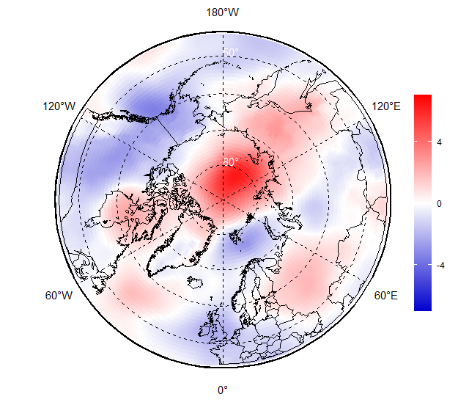
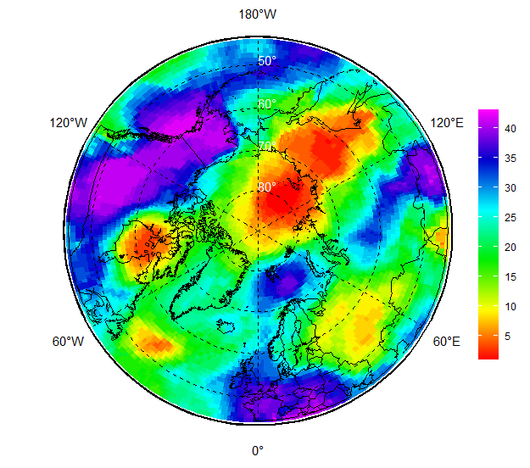
JJA 2020 atmospheric circulation
Based on atmosphere numerical model (reanalysis)
Negative mean sea level atmospheric pressure (MSLP) anomalies (lower pressure, marked in blue) dominated through the European, Siberian and Canadian archipelago regions
Opposite situation (higher pressure, marked in red) was observed over Svalbard, Canadian and Alaska regions, Bering Sea
That led to prevalence of zonal form of circulation (transfer of heal/cold west/east) in the troposphere with the center of polar vortex over western Siberia as seen on the 50 hPa geopotential height (H50)
MSLP hPa anomalies (norms 1981-2010)
AARI / ERA5 reanalysis
MSLP ranks (1979-2020)

Slide 5
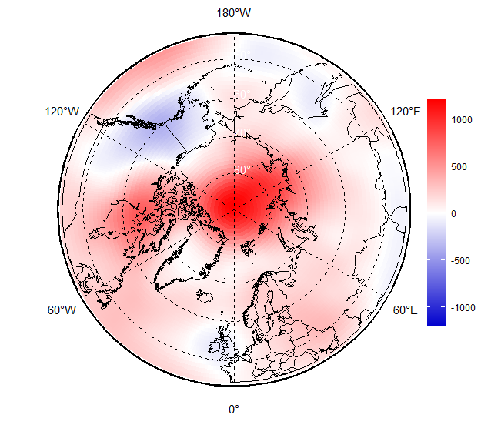
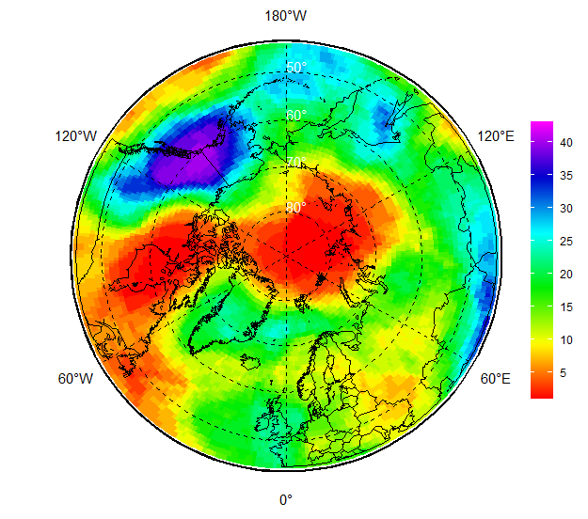
JJA 2020 upper atmosphere (H500 )
Based on atmosphere numerical model (reanalysis)
Negative mean sea level atmospheric pressure (MSLP) anomalies (lower pressure, marked in blue) dominated through the European, Siberian and Canadian archipelago regions
Opposite situation (higher pressure, marked in red) was observed over Svalbard, Canadian and Alaska regions, Bering Sea
That led to prevalence of zonal form of circulation (transfer of heal/cold west/east) in the troposphere with the center of polar vortex over western Siberia as seen on the 50 hPa geopotential height (H50)
H500 anomalies (norms 1981-2010)
AARI / ERA5 reanalysis
H500 ranks (1979-2020)

Slide 6
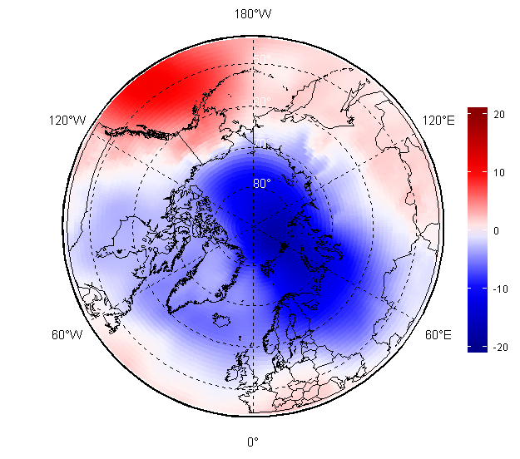
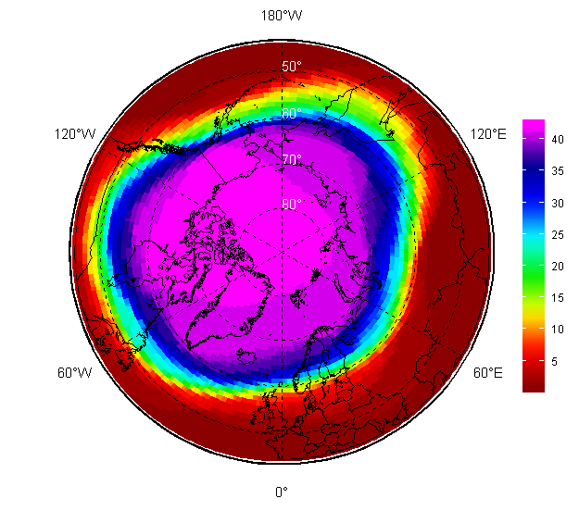
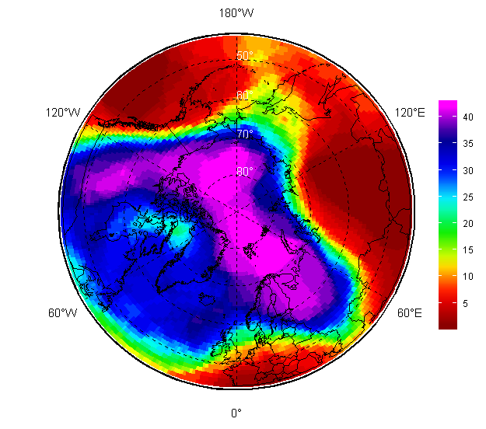
FMA 2020 atmospheric circulation
Much stronger negative MSLP anomalies (lower pressure, marked in blue) were observed during FMA 2020 in the European region, Western Siberia, Arctic Ocean but not in Alaska and Bering Sea
That again led to increased cyclonic activity, more polar lows with further increased precipitation
Polar vortex was very intense as observed at H50 pattern and caused meridian type of circulation with several ‘heat waves’ in Western and Eastern Siberia
MSLP hPa anomalies (norms 1981-2010)
H50 (left) and H500 ranks (1979-2020)
[AARI / ERA5 reanalysis]

Slide 7
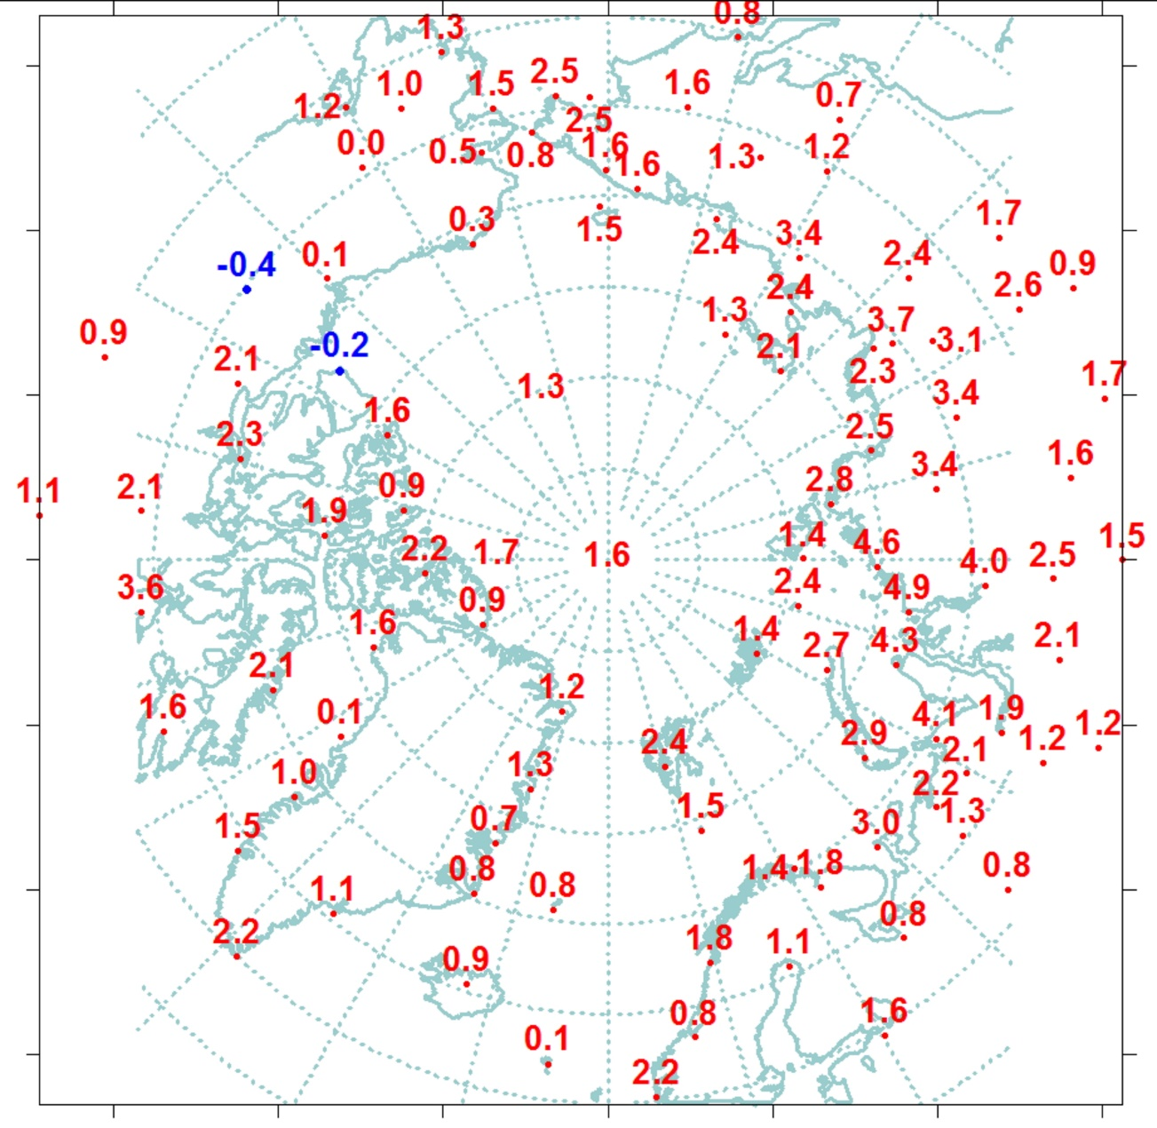
June – August 2020 SAT (T2m): anomalies and ranks (observation)
The summer air temperature across Arctic was above normal except small part of Alaska a& Western Canada region
The most notable positive anomalies were present across of Western and Eastern Siberia
Record high temperatures were observed in Eastern Siberia in June near Verkhoyansk
Cold !
Warm !
Zone, latitudes, °N. | Anomaly | Rank | The warmest year (anomaly) | The coldest year (anomaly)
70-85 | 1,8 | 3 | 2012 (2,0) | 1963 (-0,7)
60-70 | 1,7 | 3 | 2016 (2,0) | 1949 (-0,8)
60-85 | 1,7 | 2 | 2016 (2,0) | 1949 (-0,8)
[AARI]

Slide 8

SAT anomalies by regions during summer 2020 (JJA)
(observations)
Region | Anomaly | Rank | The warmest year (anomaly) | The coldest year (anomaly)
North Atlantic | 1,3 | 5 | 2003 (1,9) | 1965 (-0,7)
Barents | 1,7 | 5 | 2013 (2,8) | 1969 (-1,6)
Western Siberia | 2,8 | 2 | 2016 (3,6) | 1968 (-1,6)
Eastern Siberia | 2,4 | 2 | 2019 (2,9) | 1989 (-1,2)
Chukchi | 1,7 | 6 | 2007 (2,9) | 1949 (-1,3)
Western Canada and Alaska | 0,7 | 12 | 2004 (2,9) | 1945,1955(-1,3)
Eastern Canada | 1,5 | 6 | 2012 (2,3) | 1972 (-1,6)
Reference period: 1961-1990
1- N Atlantic
2 - N Europe
5 - Chukchi
6 – W Canada & Alaska
3 - Western Siberia
4 - East Siberia
7 – E Canada
Zone 60-85 °N
[AARI]

Slide 9
SAT anomalies by Arctic seas during summer 2020 (JJA) - observations
Sea | Anomaly | Rank | The warmest year (anomaly) | The coldest year (anomaly)
Northern part of Greenland and Norwegian Seas | 1,2 | 10 | 2016 (2,4) | 1965 (-0,7)
Barents Sea | 2,0 | 3 | 2013 (2,8) | 1949 (-1,2)
Kara Sea | 3,5 | 1 | 2020 (3,5) | 1968 (-1,2)
Laptev Sea | 2,4 | 3 | 2019 (3,2) | 1962 (-1,5)
Eastern Siberian Sea | 2,1 | 3 | 2007 (3,7) | 1949 (-1,6)
Chukchi Sea | 1,3 | 9 | 2007 (3,9) | 1965 (-1,6)
Beaufort Sea | 0,5 | 14 | 2012 (2,5) | 1947 (-1,5)
N part of Canadian arhipelago | 1,4 | 8 | 2011, 2012 (2,7) | 1972 (-1,6)
Reference period: 1961-1990
N Greenland and Norwegian
Barents
Kara
Laptev
E Siberian
Chukchi
Beaufort
N Canadian archipelago
[AARI]

Slide 10
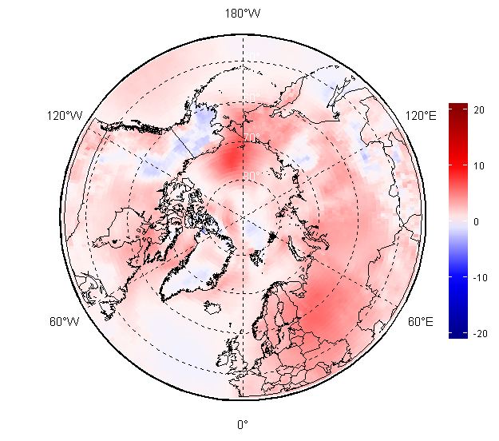
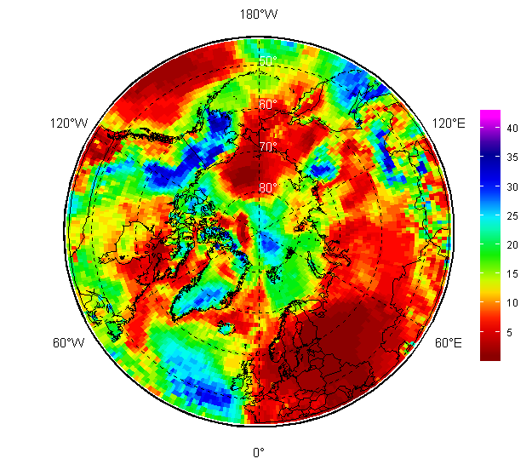
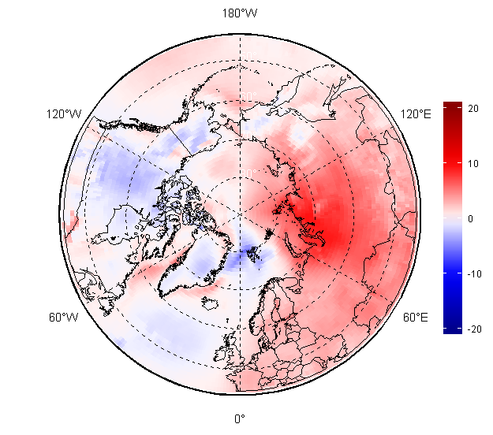
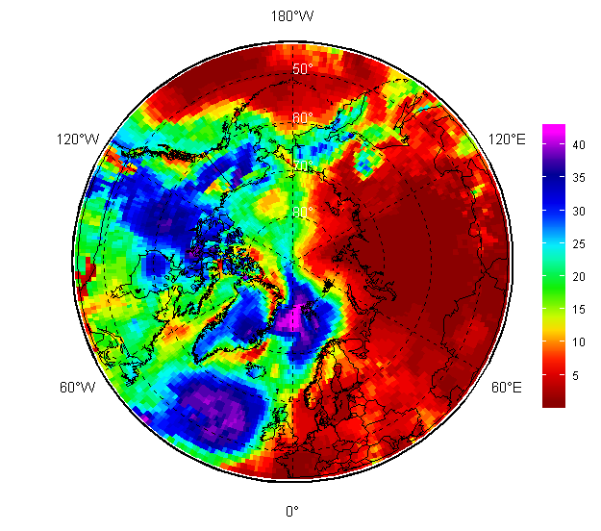
NDJ 2019-2020, FMA 2020 – SAT (T2m): anomalies and ranks
NDJ 2019/2020
For the whole season from November 2019 – April 2010 positive close to maximum air temperature anomalies prevailed over Western and Eastern Siberia, with negative anomalies prevailing in marine Barents, Alaska and parts of Western Canada
Atlantic and partly Chukchi areas experienced switch from positive to negative anomalies during NDJ - FMA
SAT anomaly, 1981-2010
SAT rank, 1979-2020
FMA 2020
AARI / ERA5 reanalysis
SAT anomaly, 1981-2010
Rank, 1979-2020

Slide 11
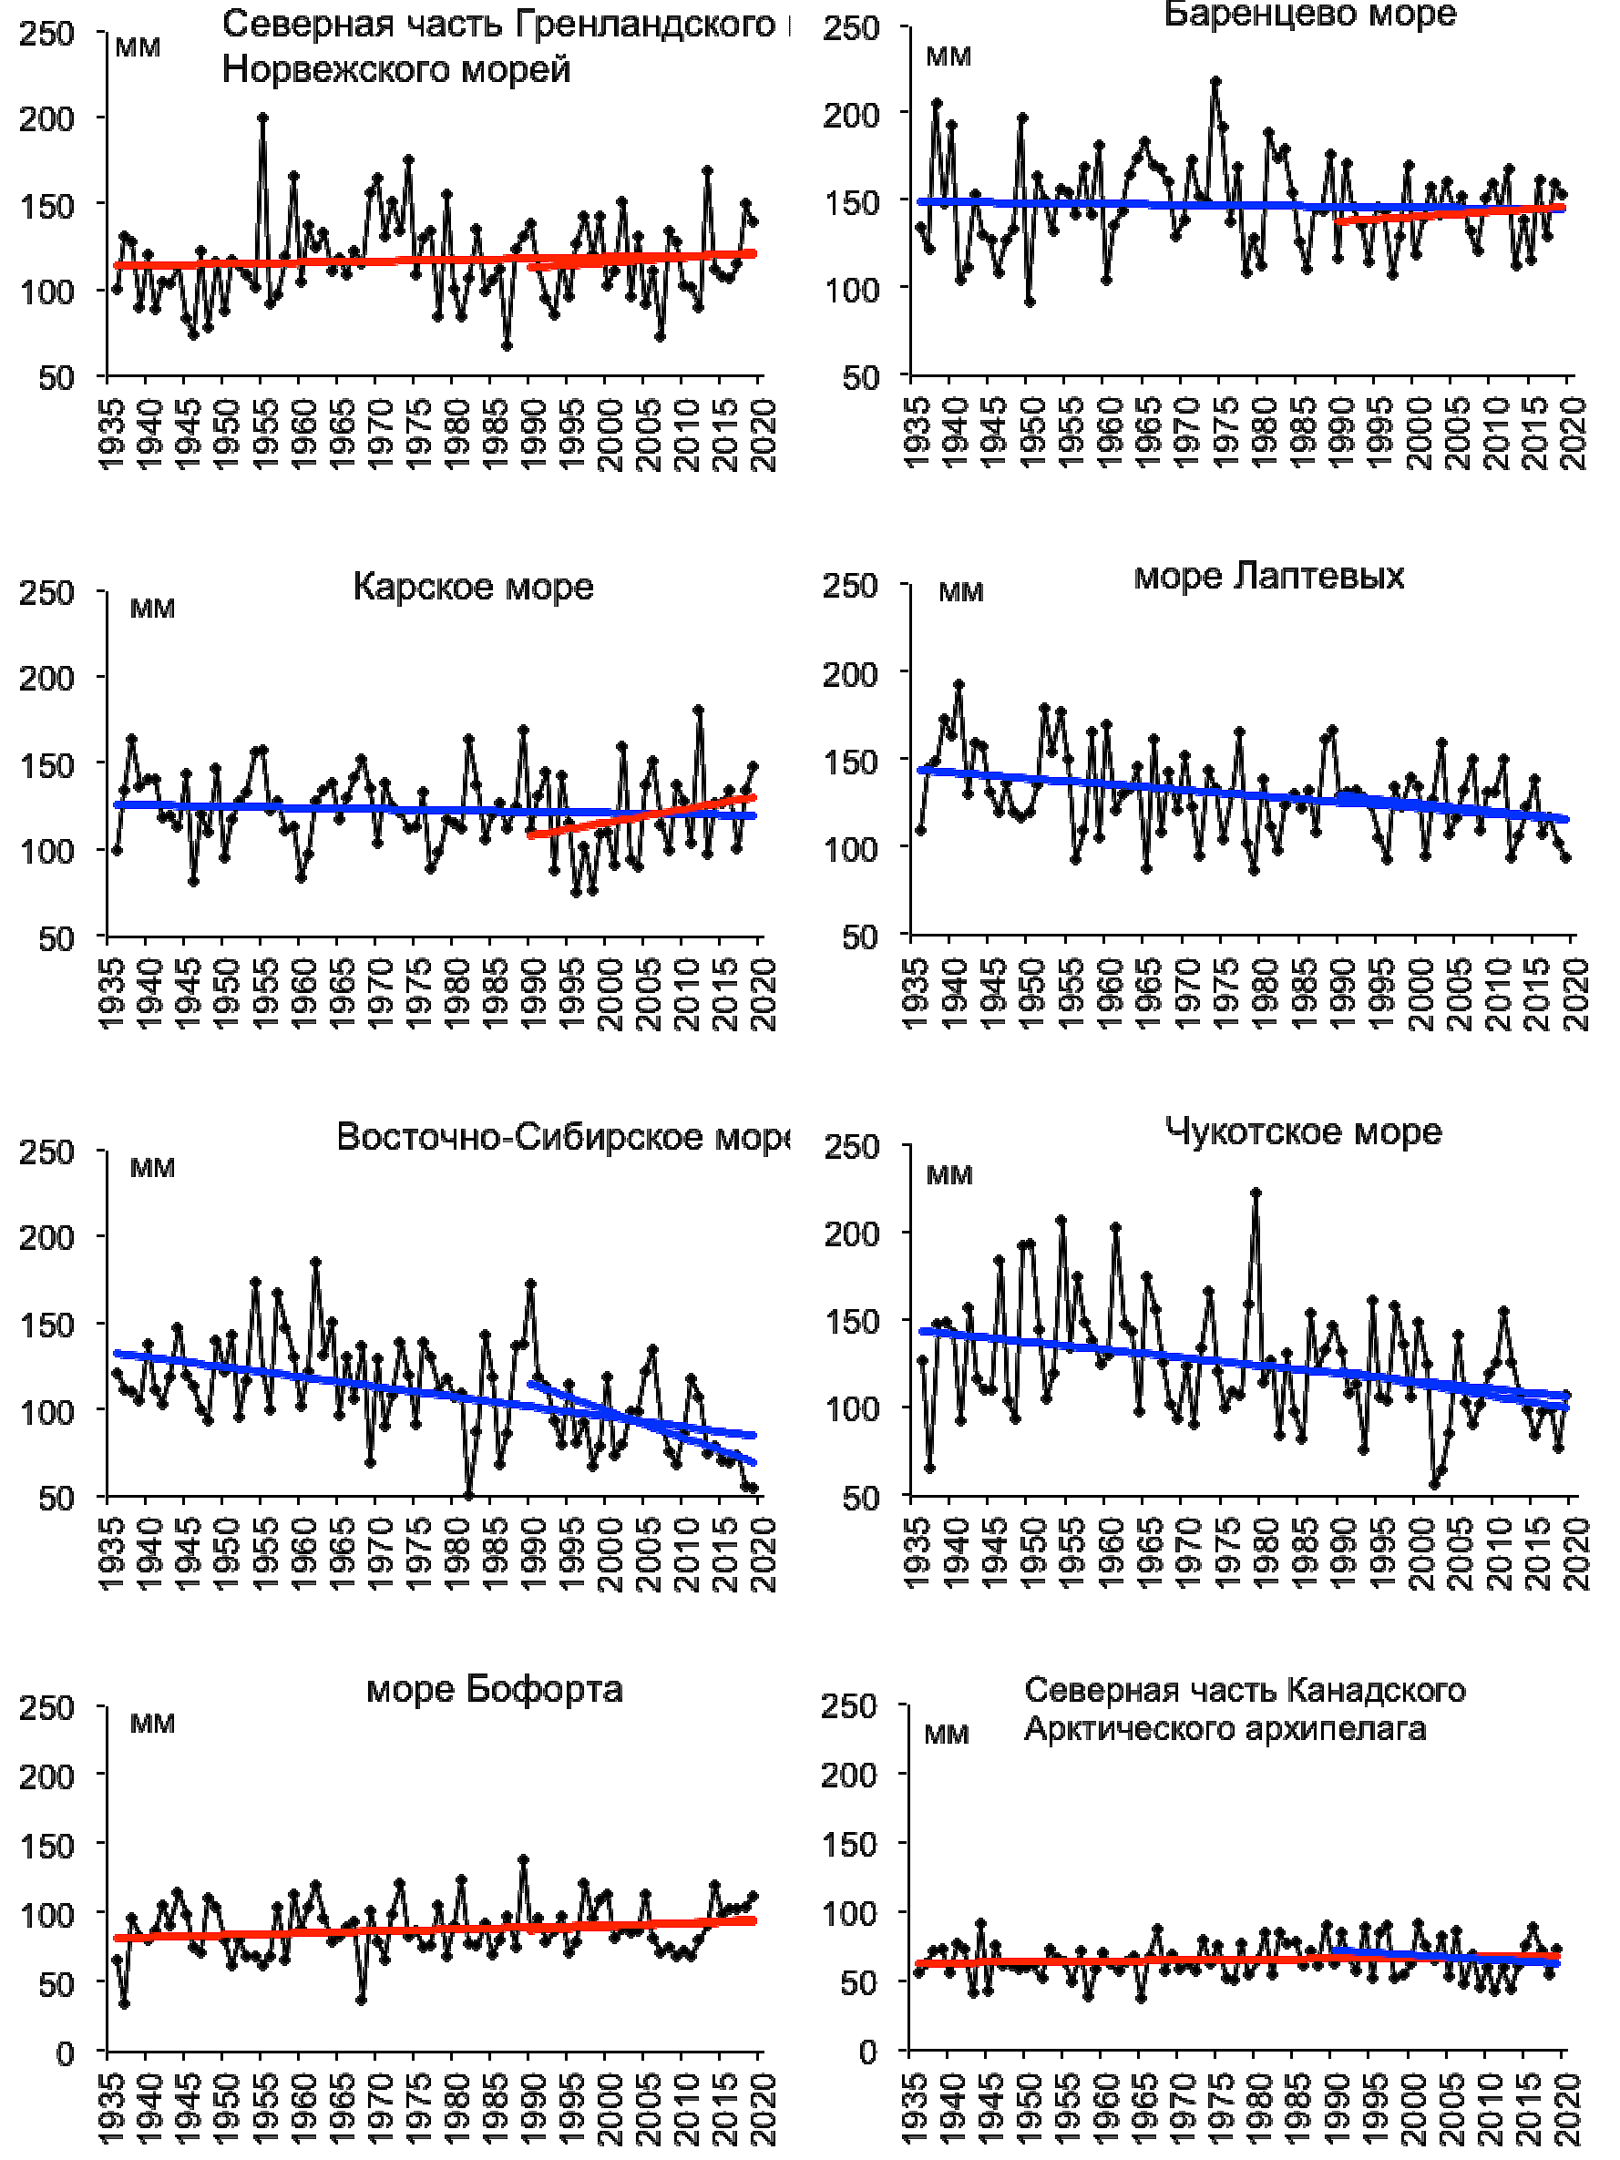
Precipitation trends for
ND 2019 - J 2020
N Greenland and Norwegian Seas
Barents Sea
Kara Sea
Laptev Sea
Analysis based on observations by the Arctic seas
General positive trends – wetter conditions – for the Nordic seas, Beaufort Sea
General negative trends – drier conditions - for Siberian shelf seas
No general significant trends for Canadian Arctic regions
Eastern Siberian Sea
Chukchi Sea
Beaufort Sea
N Canadian Archipelago
Reference period: 1961-1990
[AARI]

Slide 12
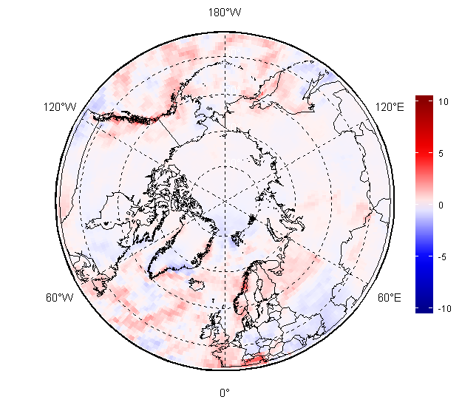
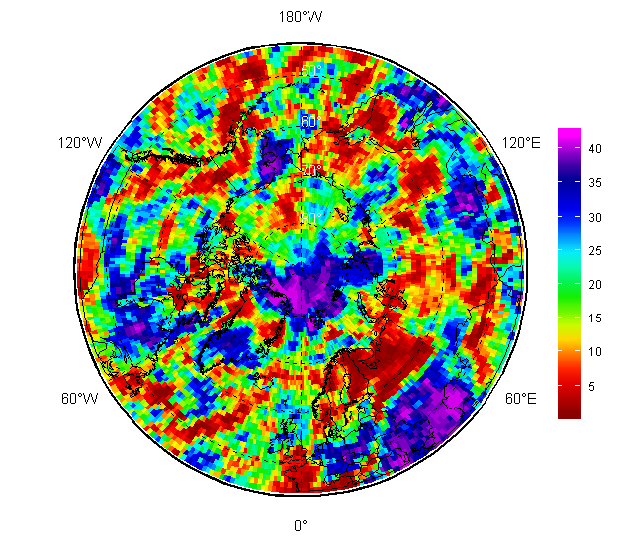
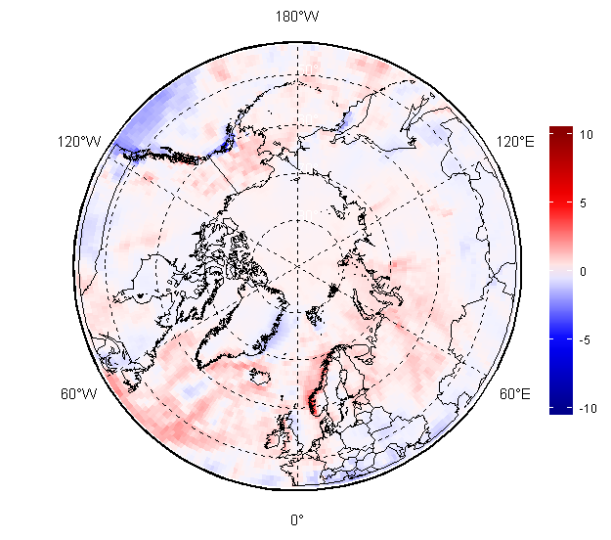
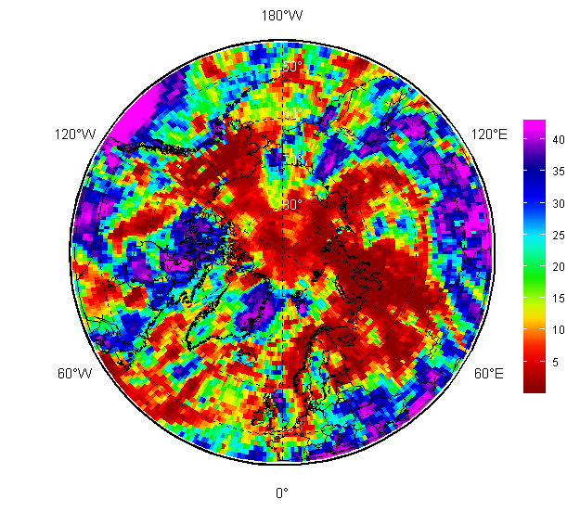
Precipitation (Prec) NDJ and FMA 2019/2020: anomalies and ranks
NDJ 2019/2020
For NDJ 2019/2020 and FMA 2020 Barents and Western Siberia regions saw very wet seasons
Same wetter conditions observed for Alaska during FMA 2020
Drier conditions were observed over Svalbard, parts of Greenland, Sea of Okhotsk
Prec Anomaly, 1981-2010
Prec Rank, 1979-2020
FMA 2020
[AARI / ERA5 reanalysis]
Prec Anomaly, 1981-2010
Prec Rank, 1979-2020

Slide 13
Sea ice variables:
  Precursors in atmosphere and polar ocean
  Ice extent and ice conditions analysis
  Sea ice thickness and volume based on coastal stations and reanalysis

Slide 14
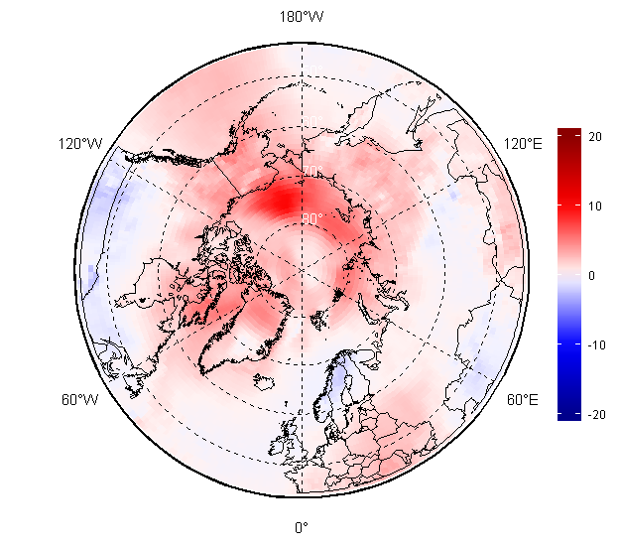
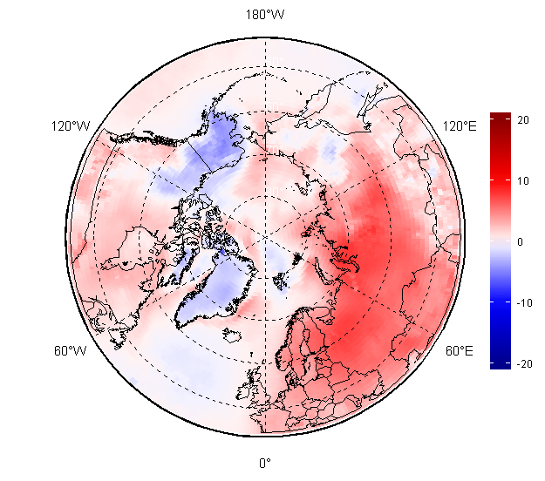
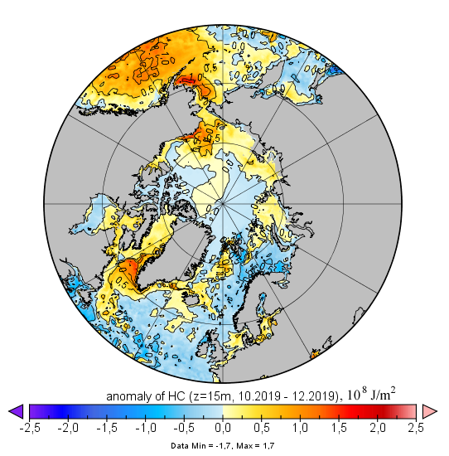
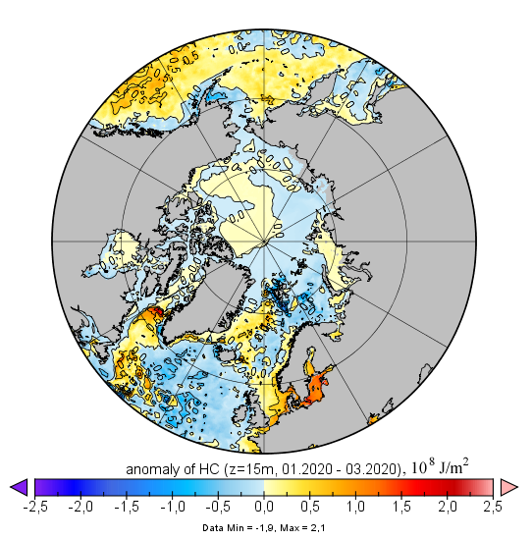
Atmosphere – polar ocean precursors for winter – spring 2019 – 2020 sea ice conditions
High positive anomalies in surface air temperature (SAT) as well as prevailing positive polar ocean heat capacity (HC) in upper 15m during OND 2019 slowed in general freeze-up and sea ice growth in the Arctic
Further in time lesser positive SAT anomalies as well as in general neutral HC anomalies during JFM stimulated ice extent growth
Prominent negative HC anomalies lead to close to normal ice growth in the N Barents Sea and Sea of Okhotsk
SAT SON anomaly,
1981-2010
SAT DJF anomaly,
1981-2010
Heat Capacity anomaly OND,
2000-2019
Heat Capacity anomaly JFM,
2000-2019
[AARI / Copernicus Climate Change Service
(ERA5 & MERCATOR reanalysis)]

Slide 15
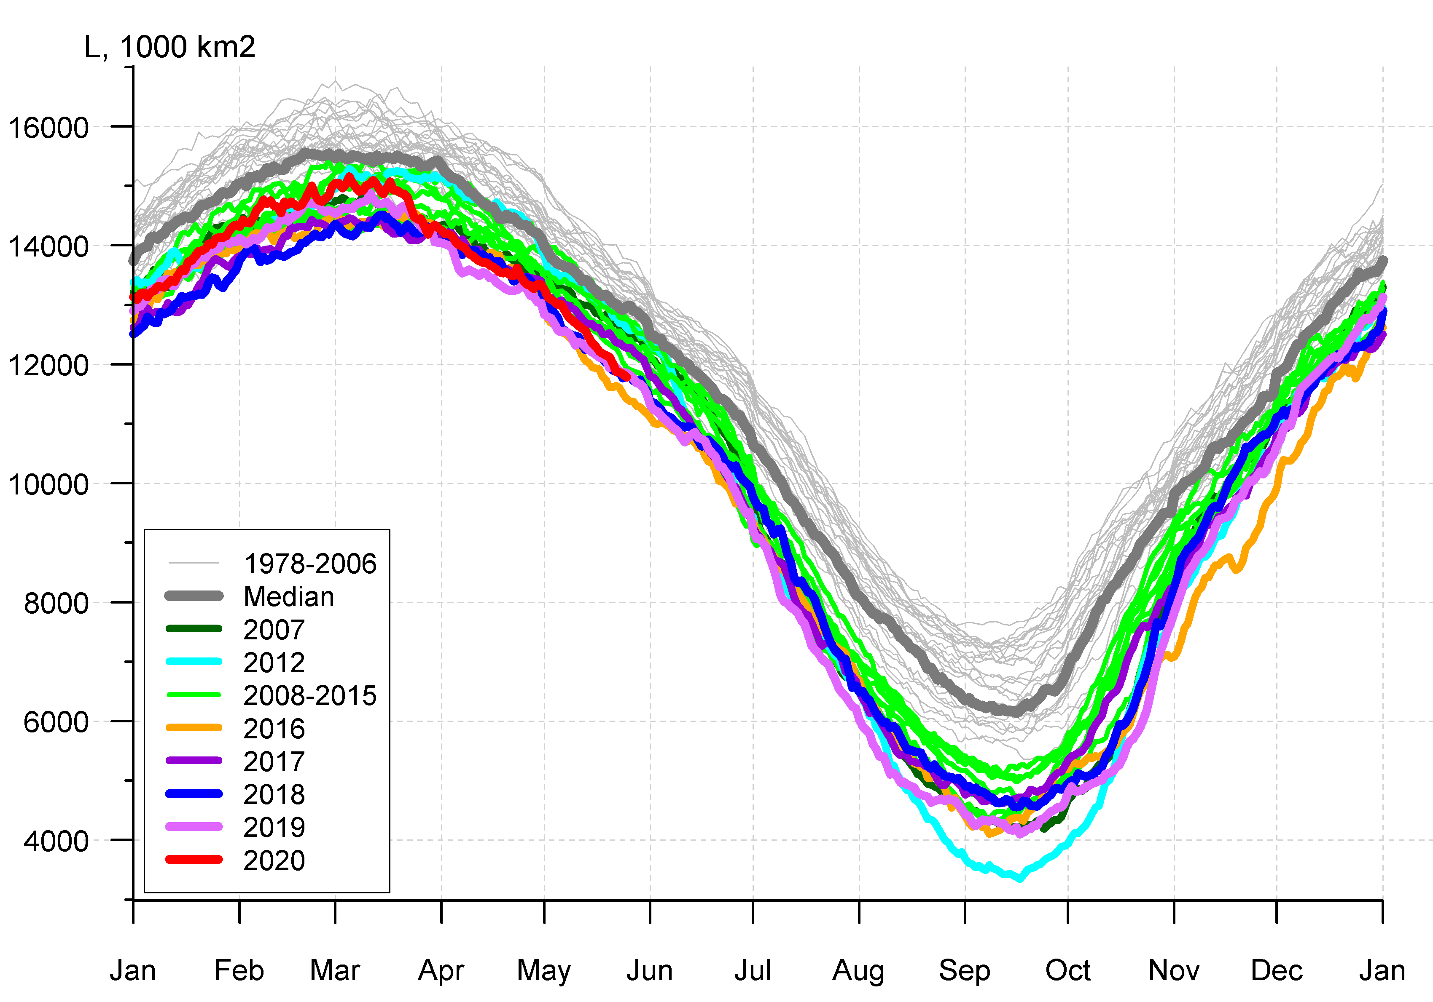
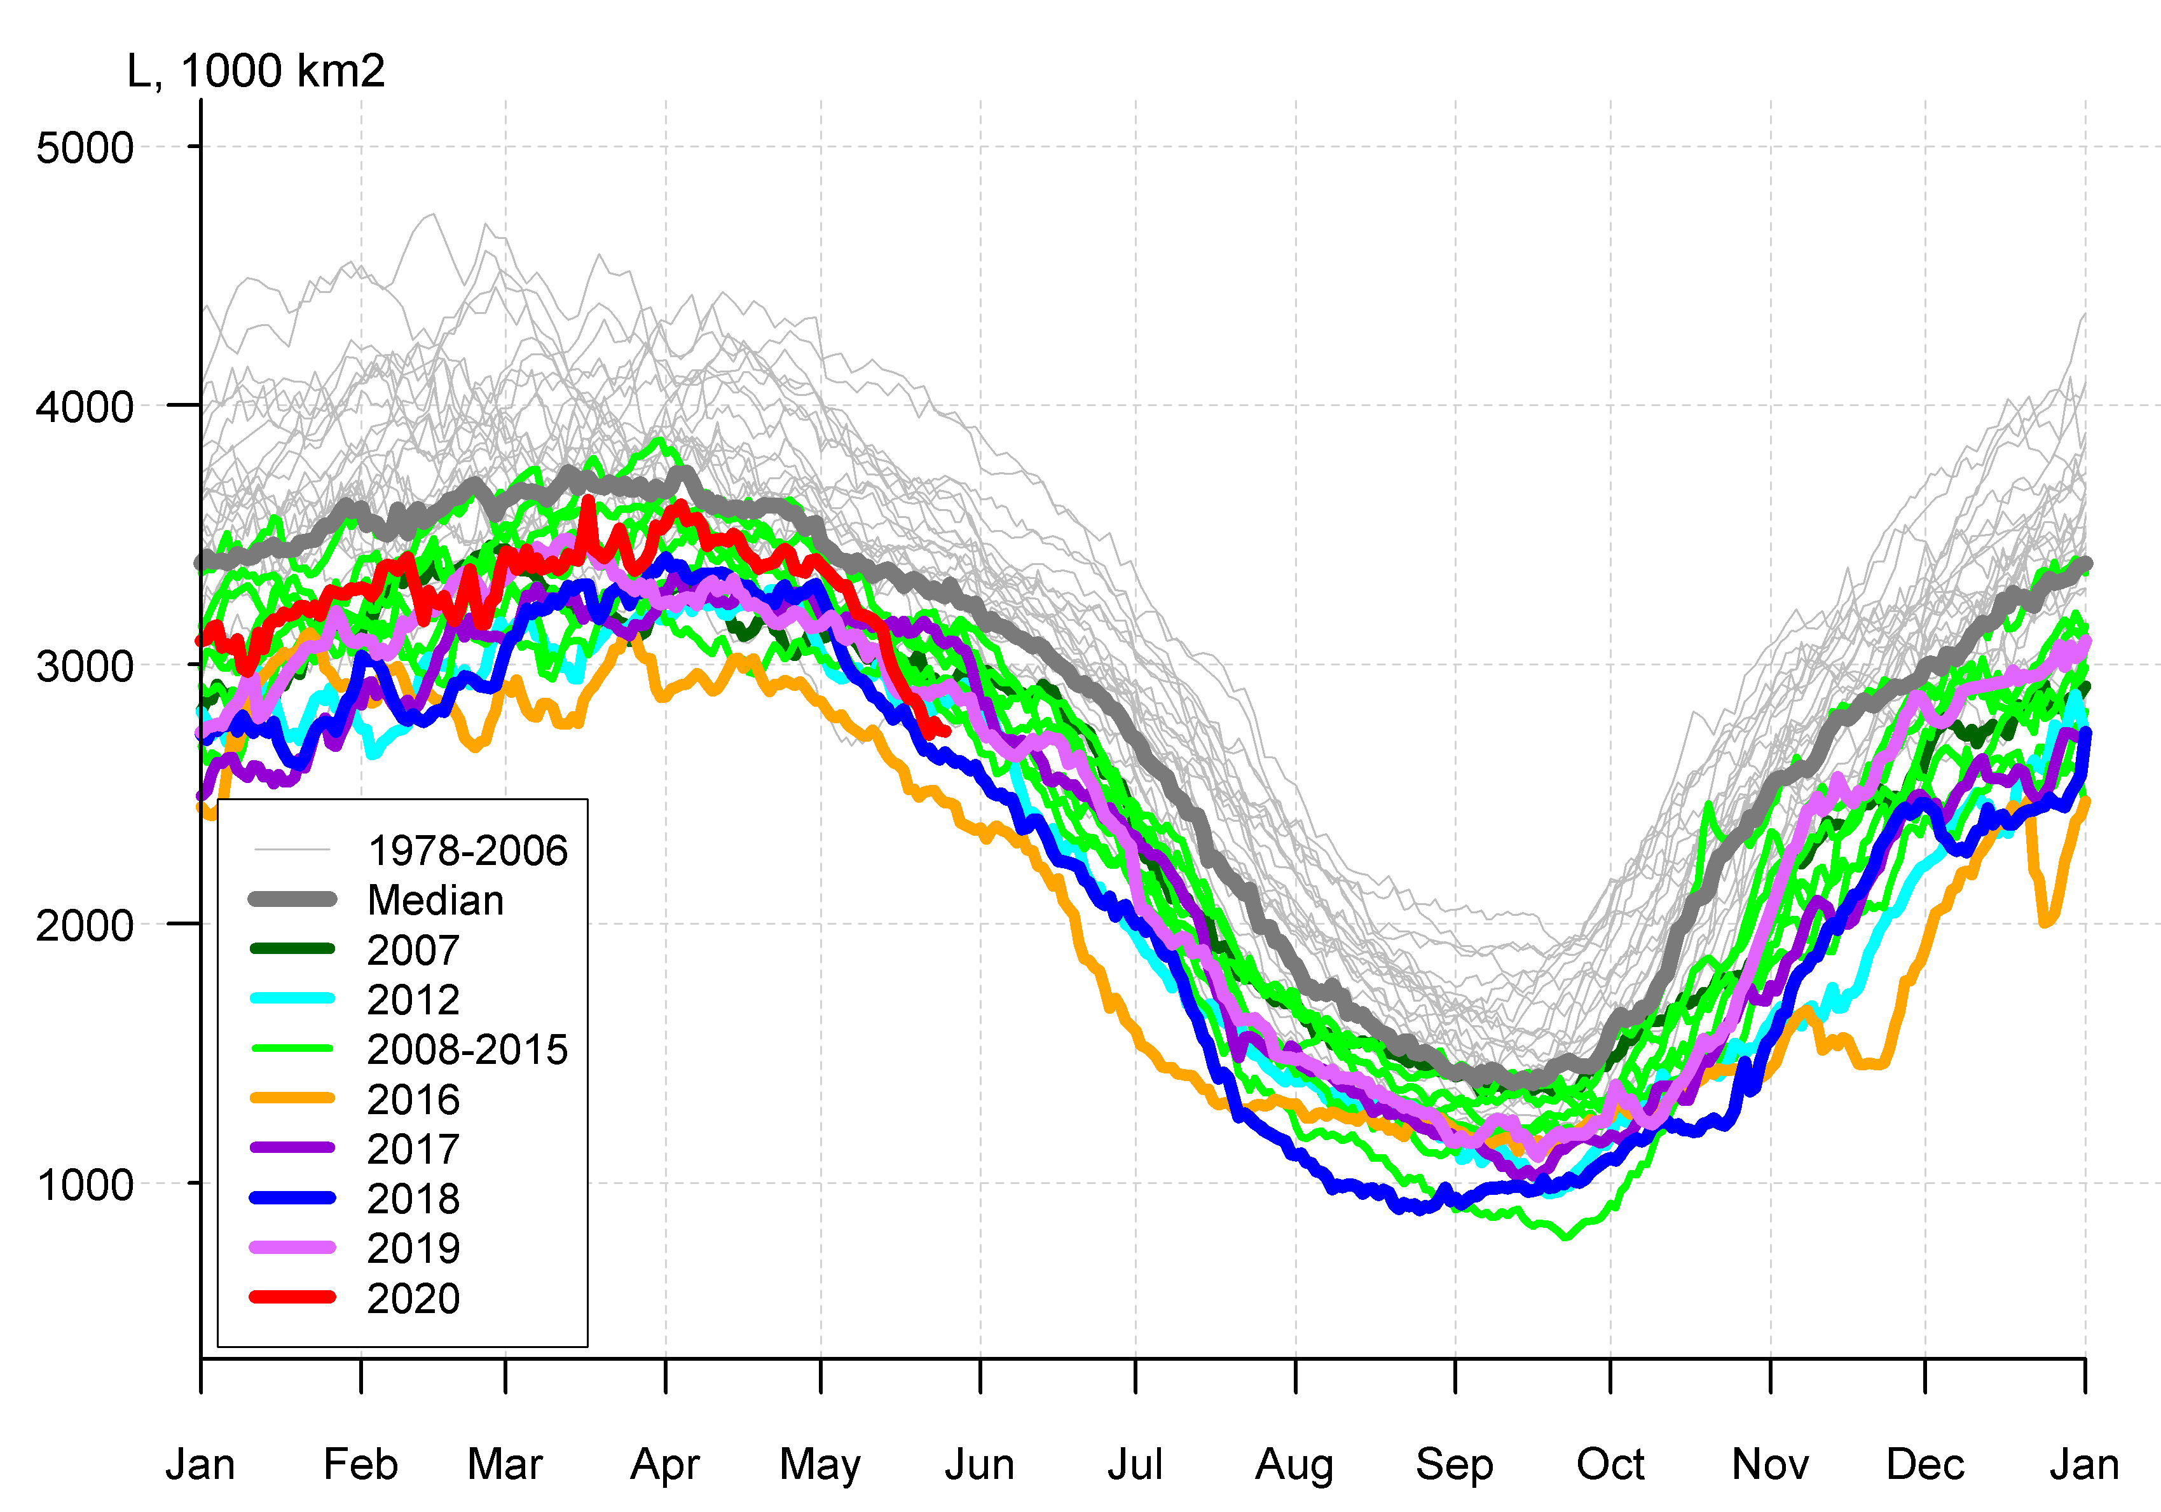
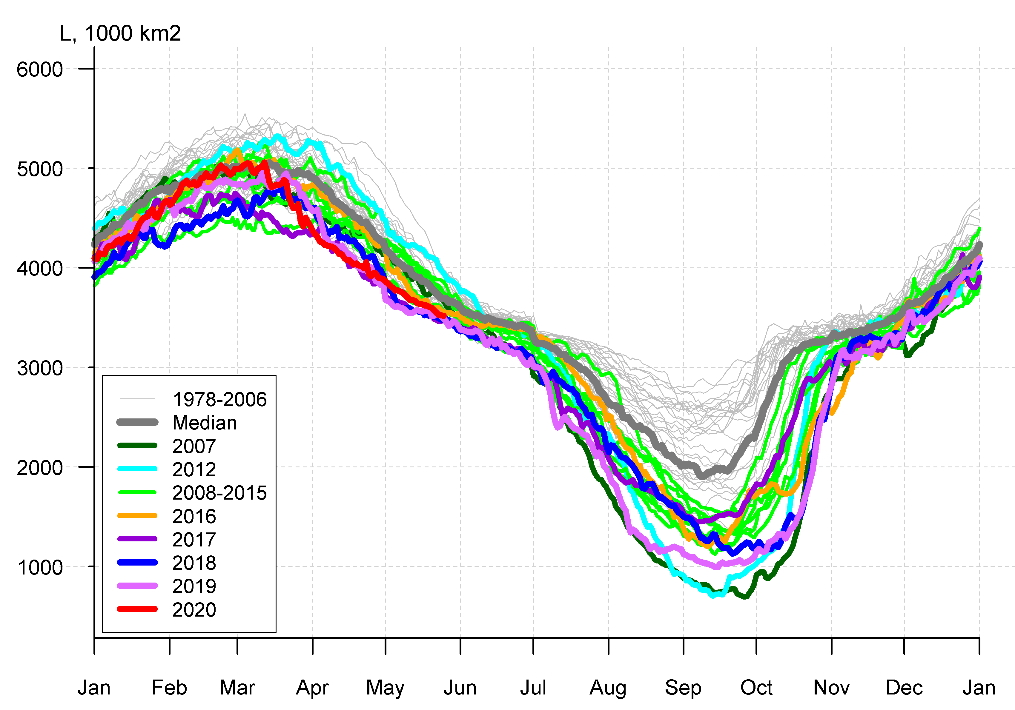
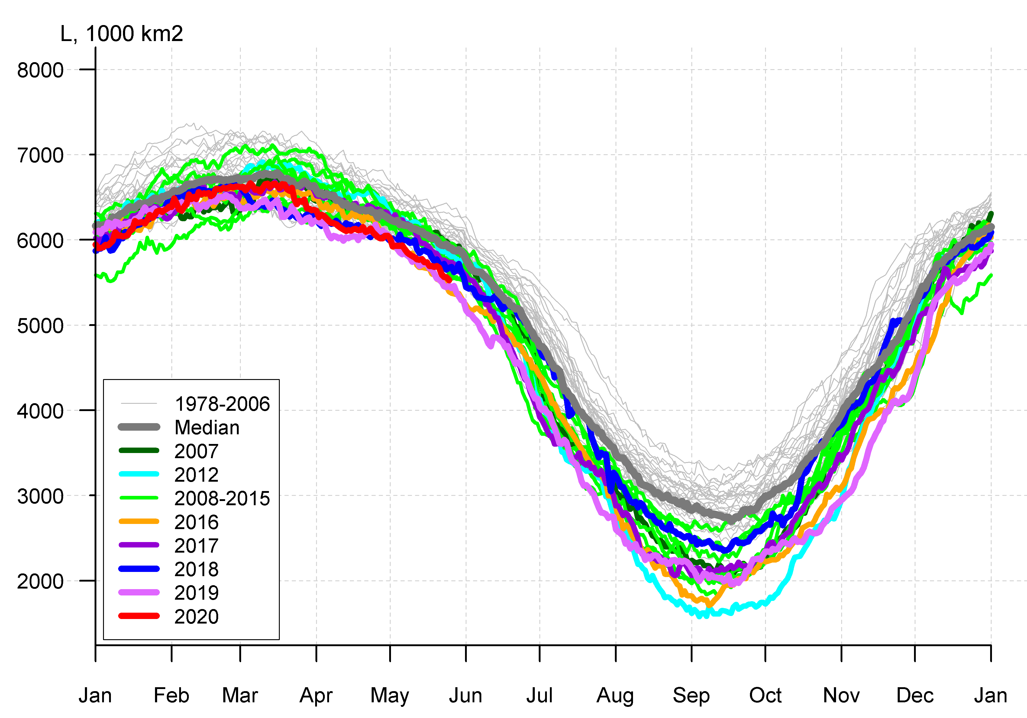

Arctic (NH) seasonal ice extent 1978…. 2020
S, 1000 km^{2*}
S, 1000 km²
2017 14467
2018 14516
2015 14526
2016 14580
2011 14701
2006 14867
2019 14891
2007 14931
2014 14972
2005 15101
2020 15159
... ...
1988 16461
1983 16547
1979 16769
S, 1000 km²
Northern Hemisphere
Western Arctic (WA)
Jan Feb Mar Apr May Jun Jul Aug Sep Oct Nov Dec Jan
Jan Feb Mar Apr May Jun Jul Aug Sep Oct Nov Dec Jan
S, 1000 km²
Eastern Arctic (EA)
S, 1000 km²
Canadian Arctic (CA)
* - maximum for Mar (AARI)
CA
EA
WA
Jan Feb Mar Apr May Jun Jul Aug Sep Oct Nov Dec Jan
Jan Feb Mar Apr May Jun Jul Aug Sep Oct Nov Dec Jan
Maximum winter ice extent, 11th in row, 15,16 mln km² (14,89 in 2019) reached 4 March 2020 (11 March in 2019)
During freezing period (ND 2019) lowest on record was observed due to extreme minimums in Bering, Chukchi Seas
[AARI, NSIDC]

Slide 16
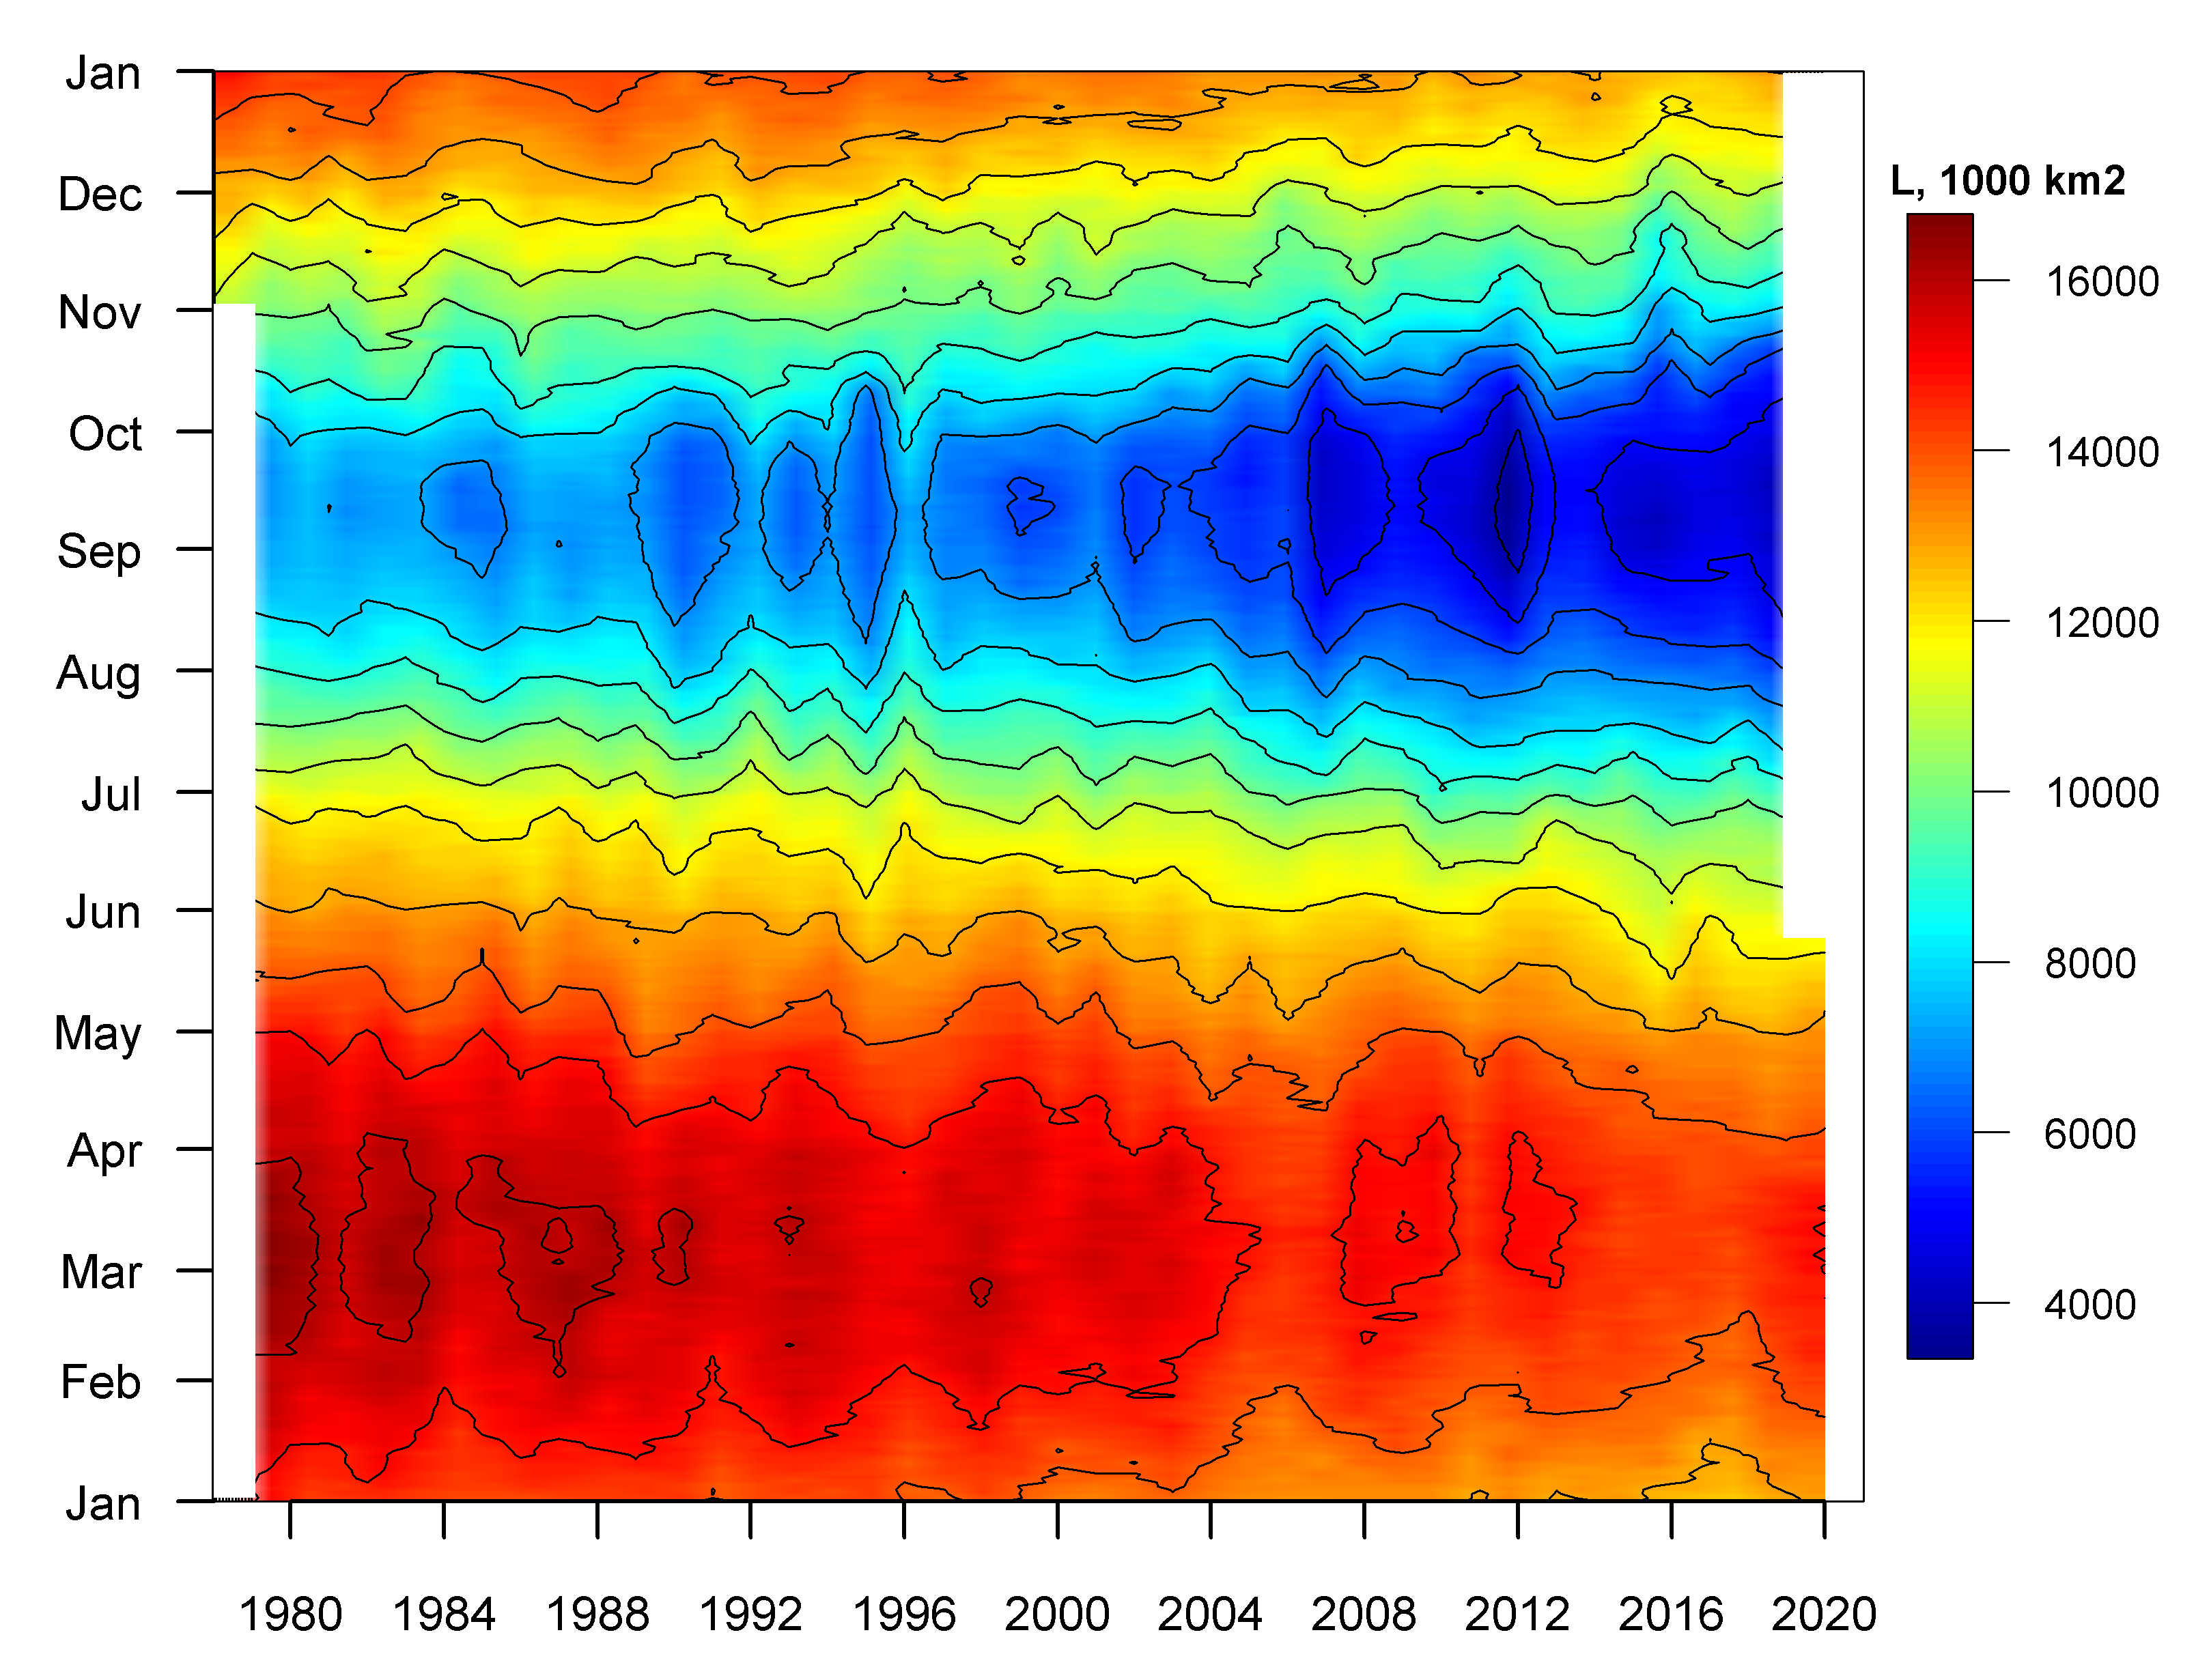
Seasonal NH ice extent variability: 1978 - 2020
Seasonal patterns of daily ice extent allows to analysis seasonal variability of ice extent
Both winter maximums and summer minimums continue to diminish
Though, significant interannual variability of ice extent occurs
[AARI, NSIDC]

Slide 17
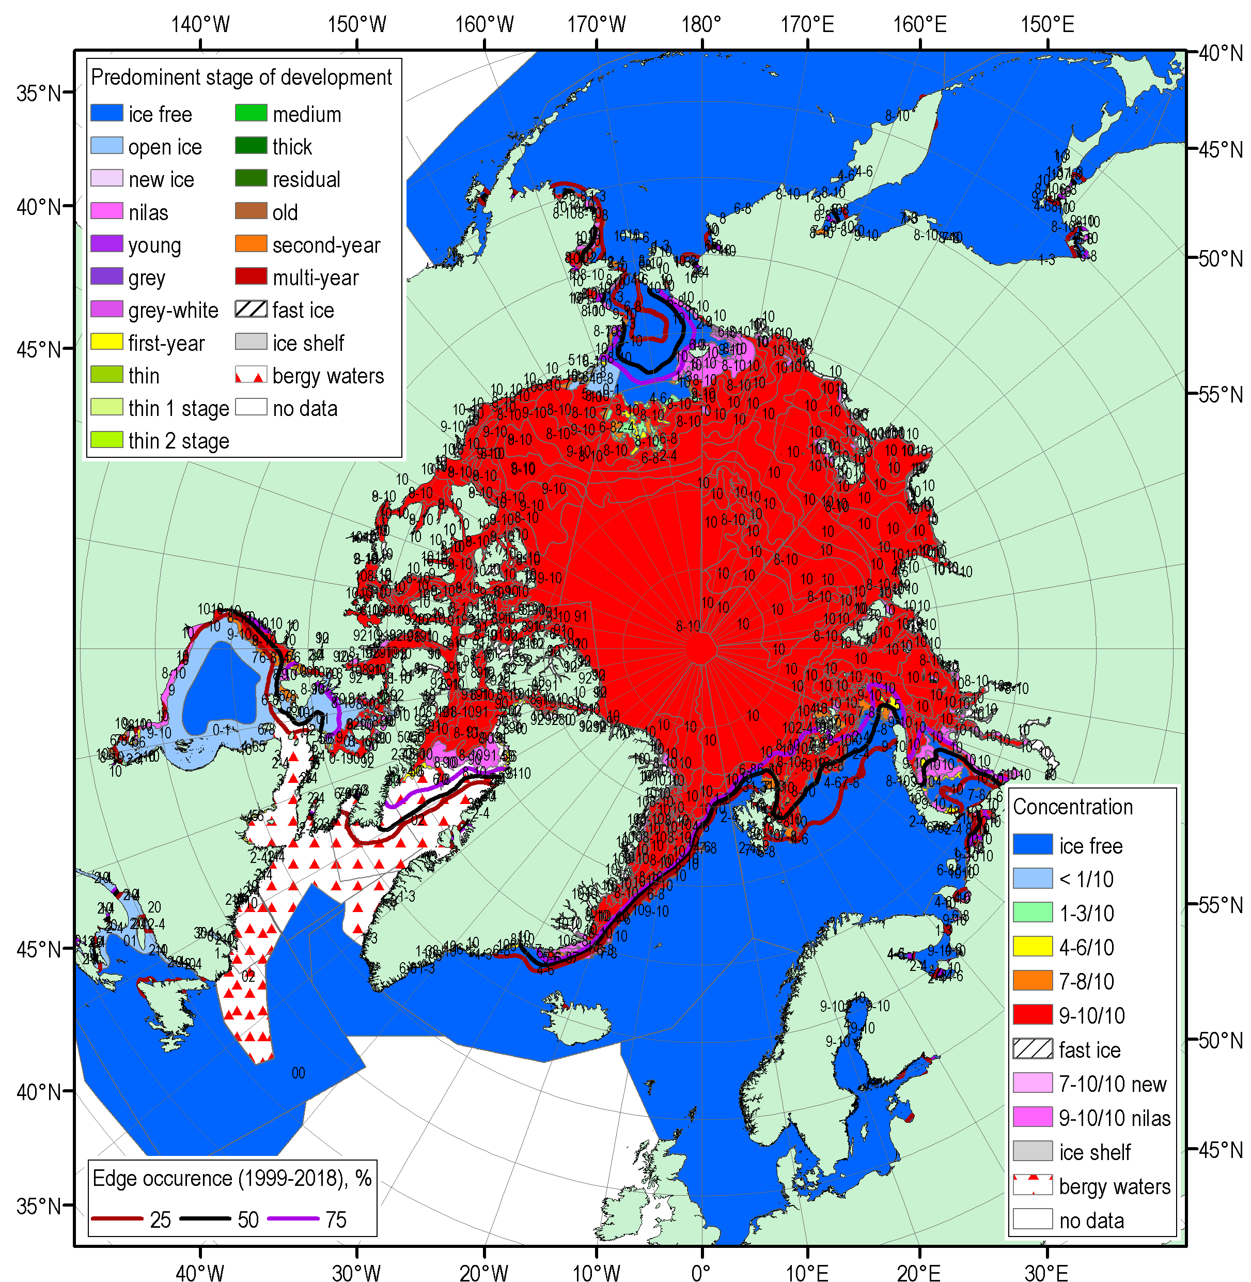
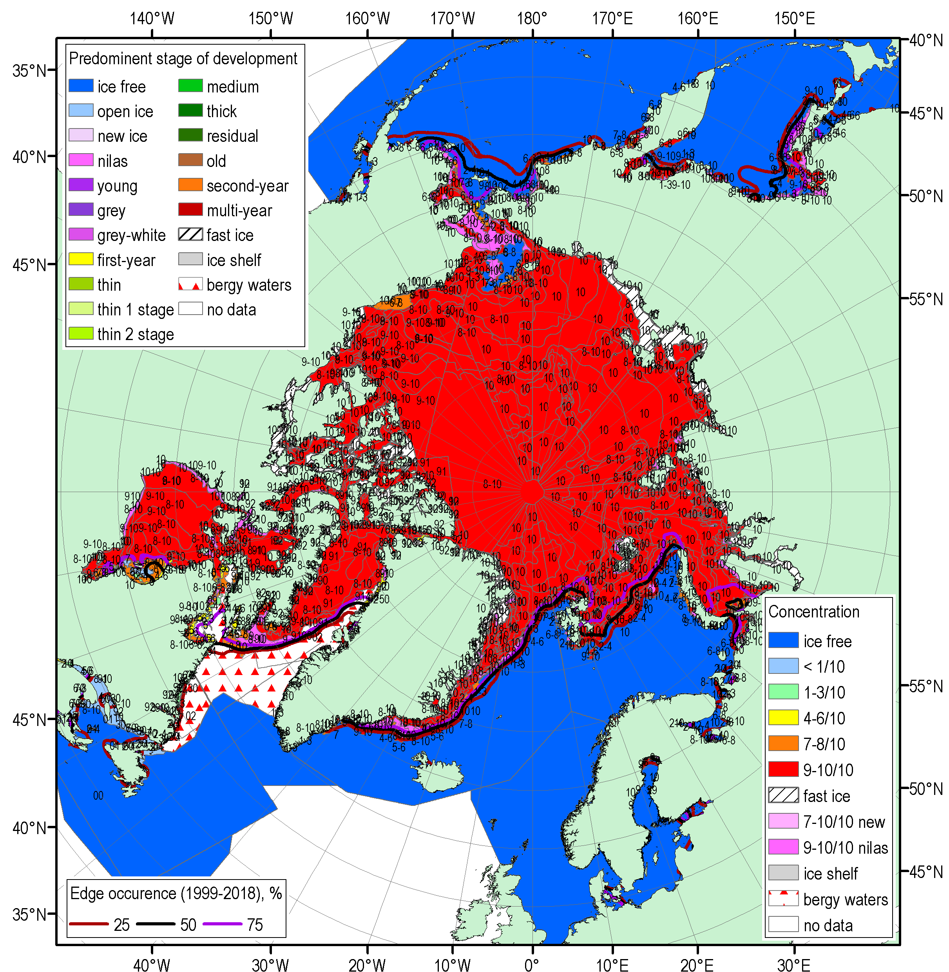
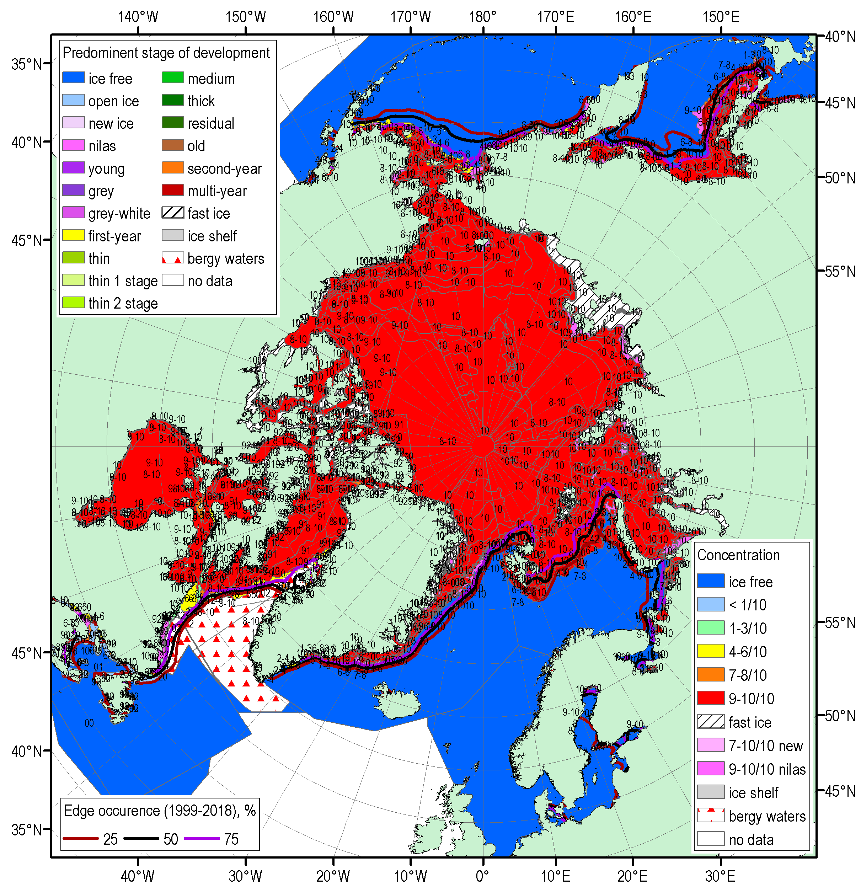
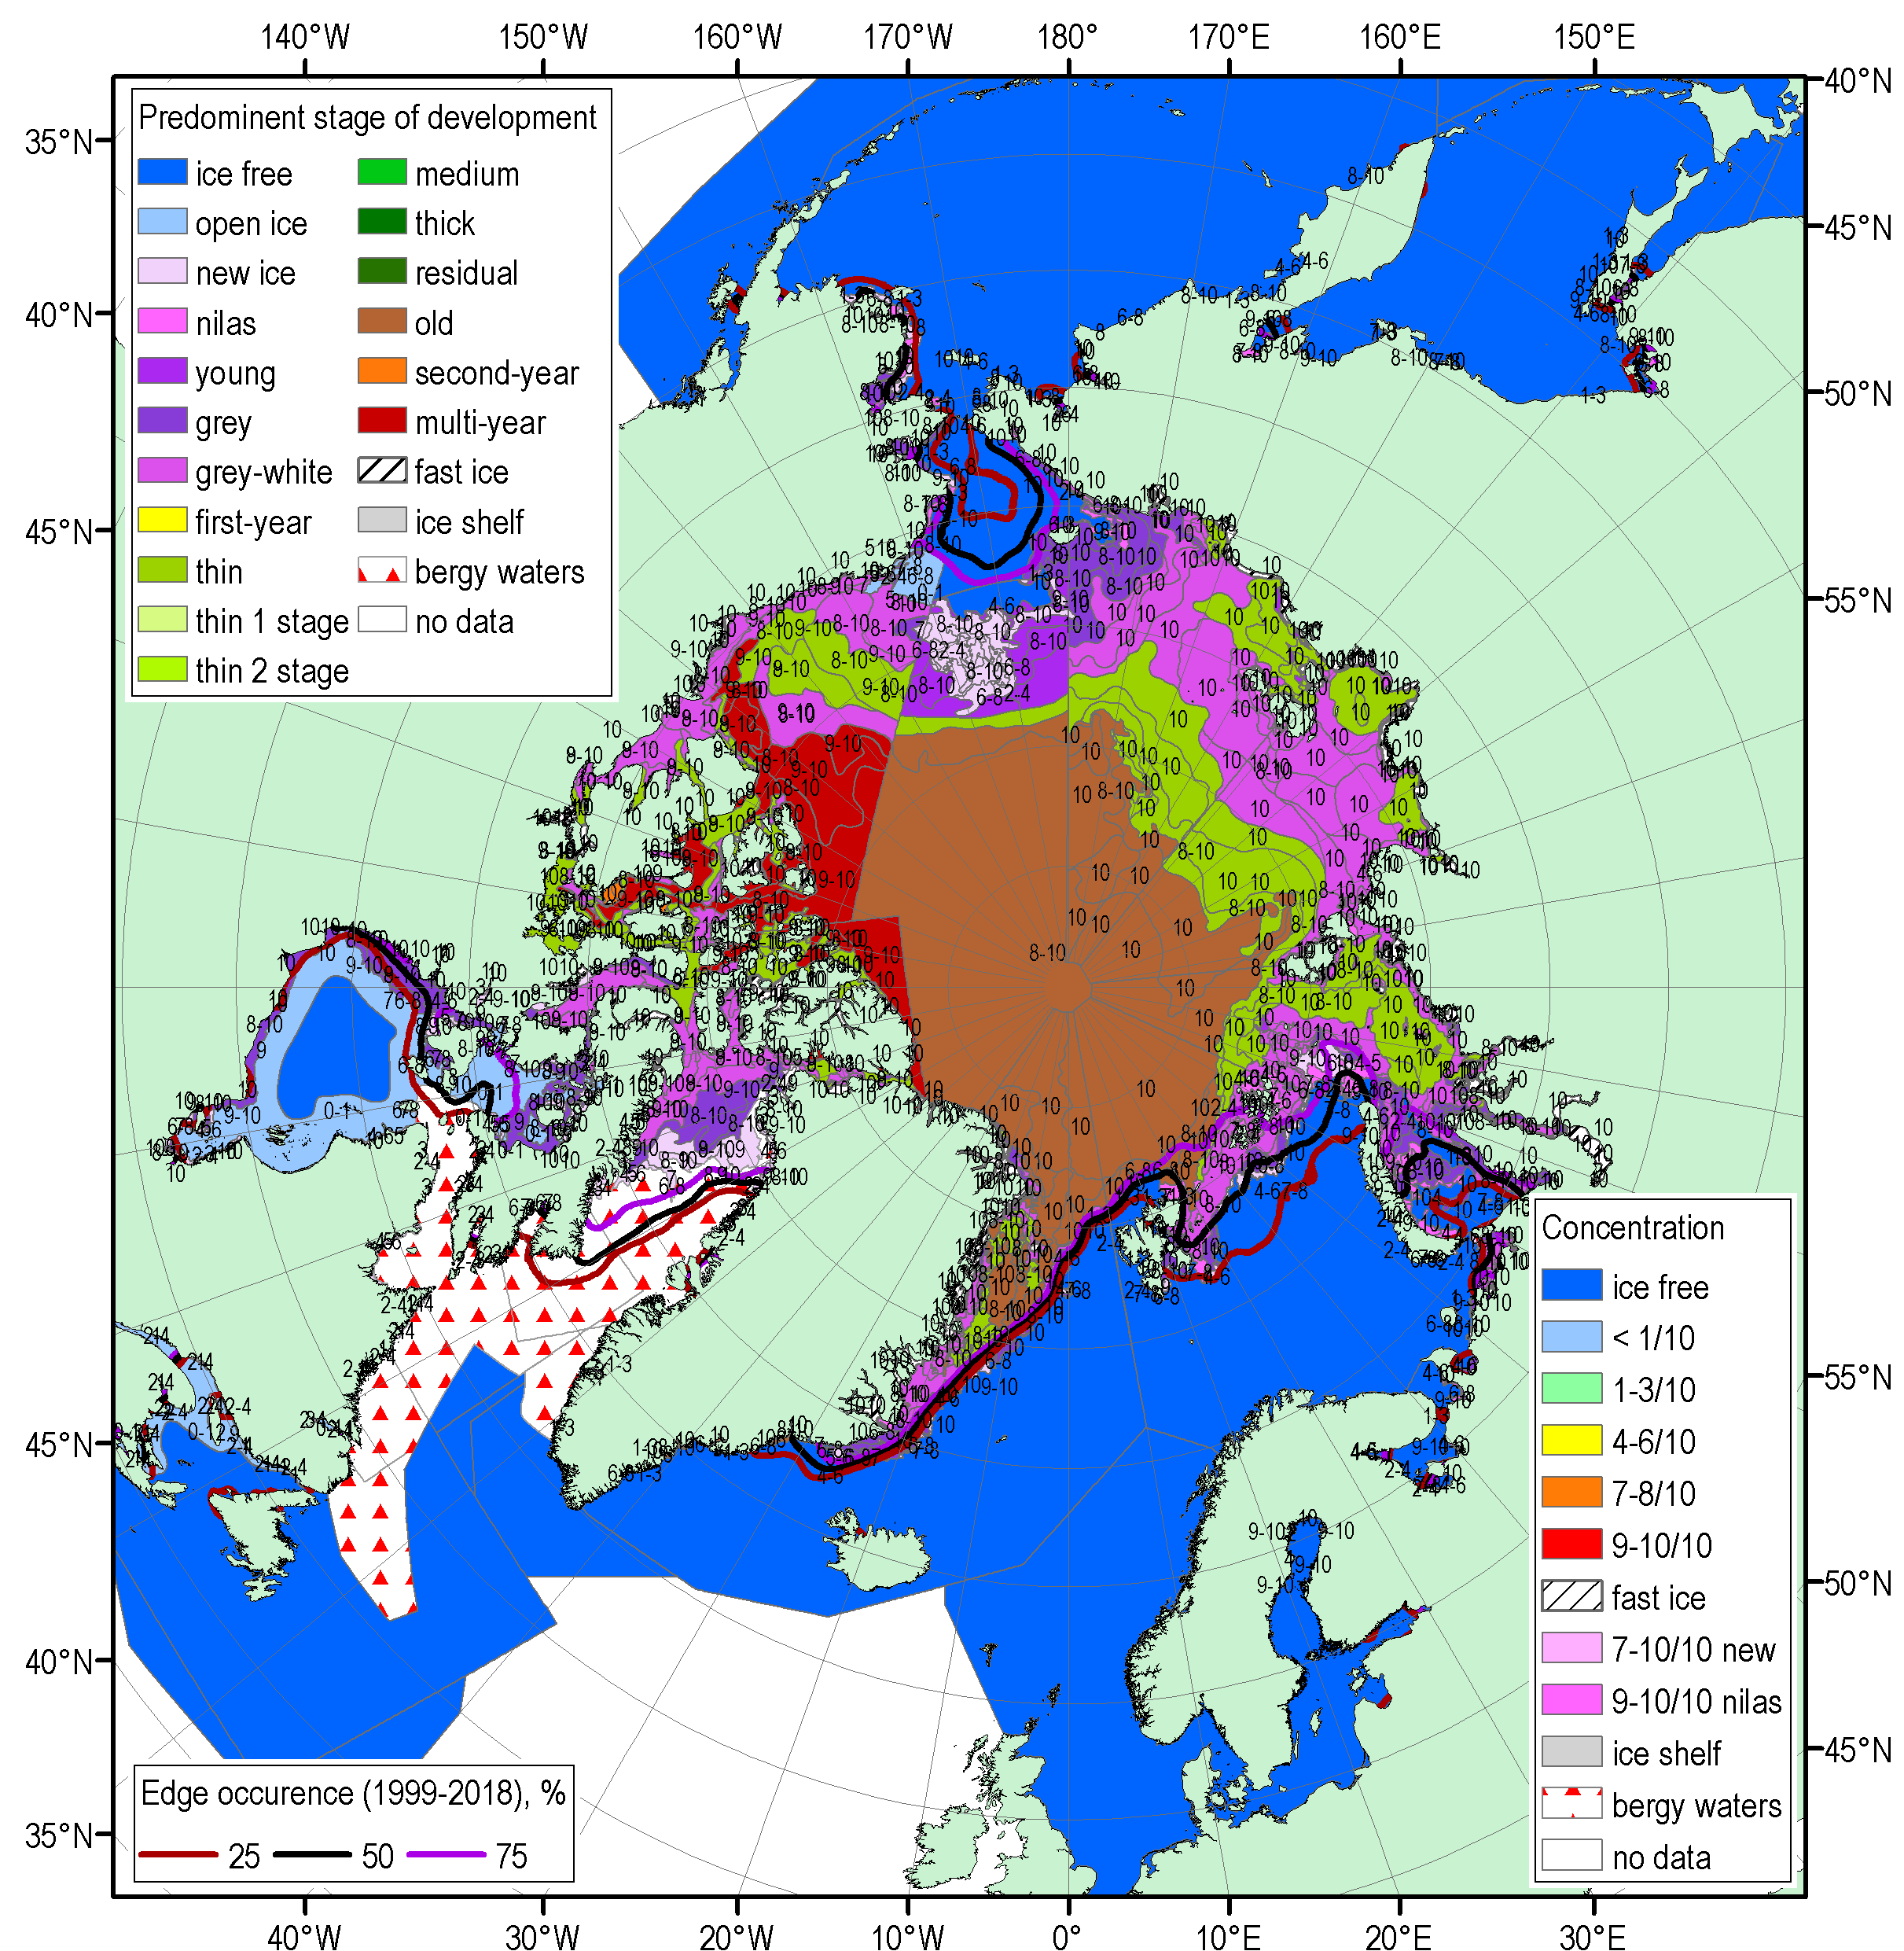
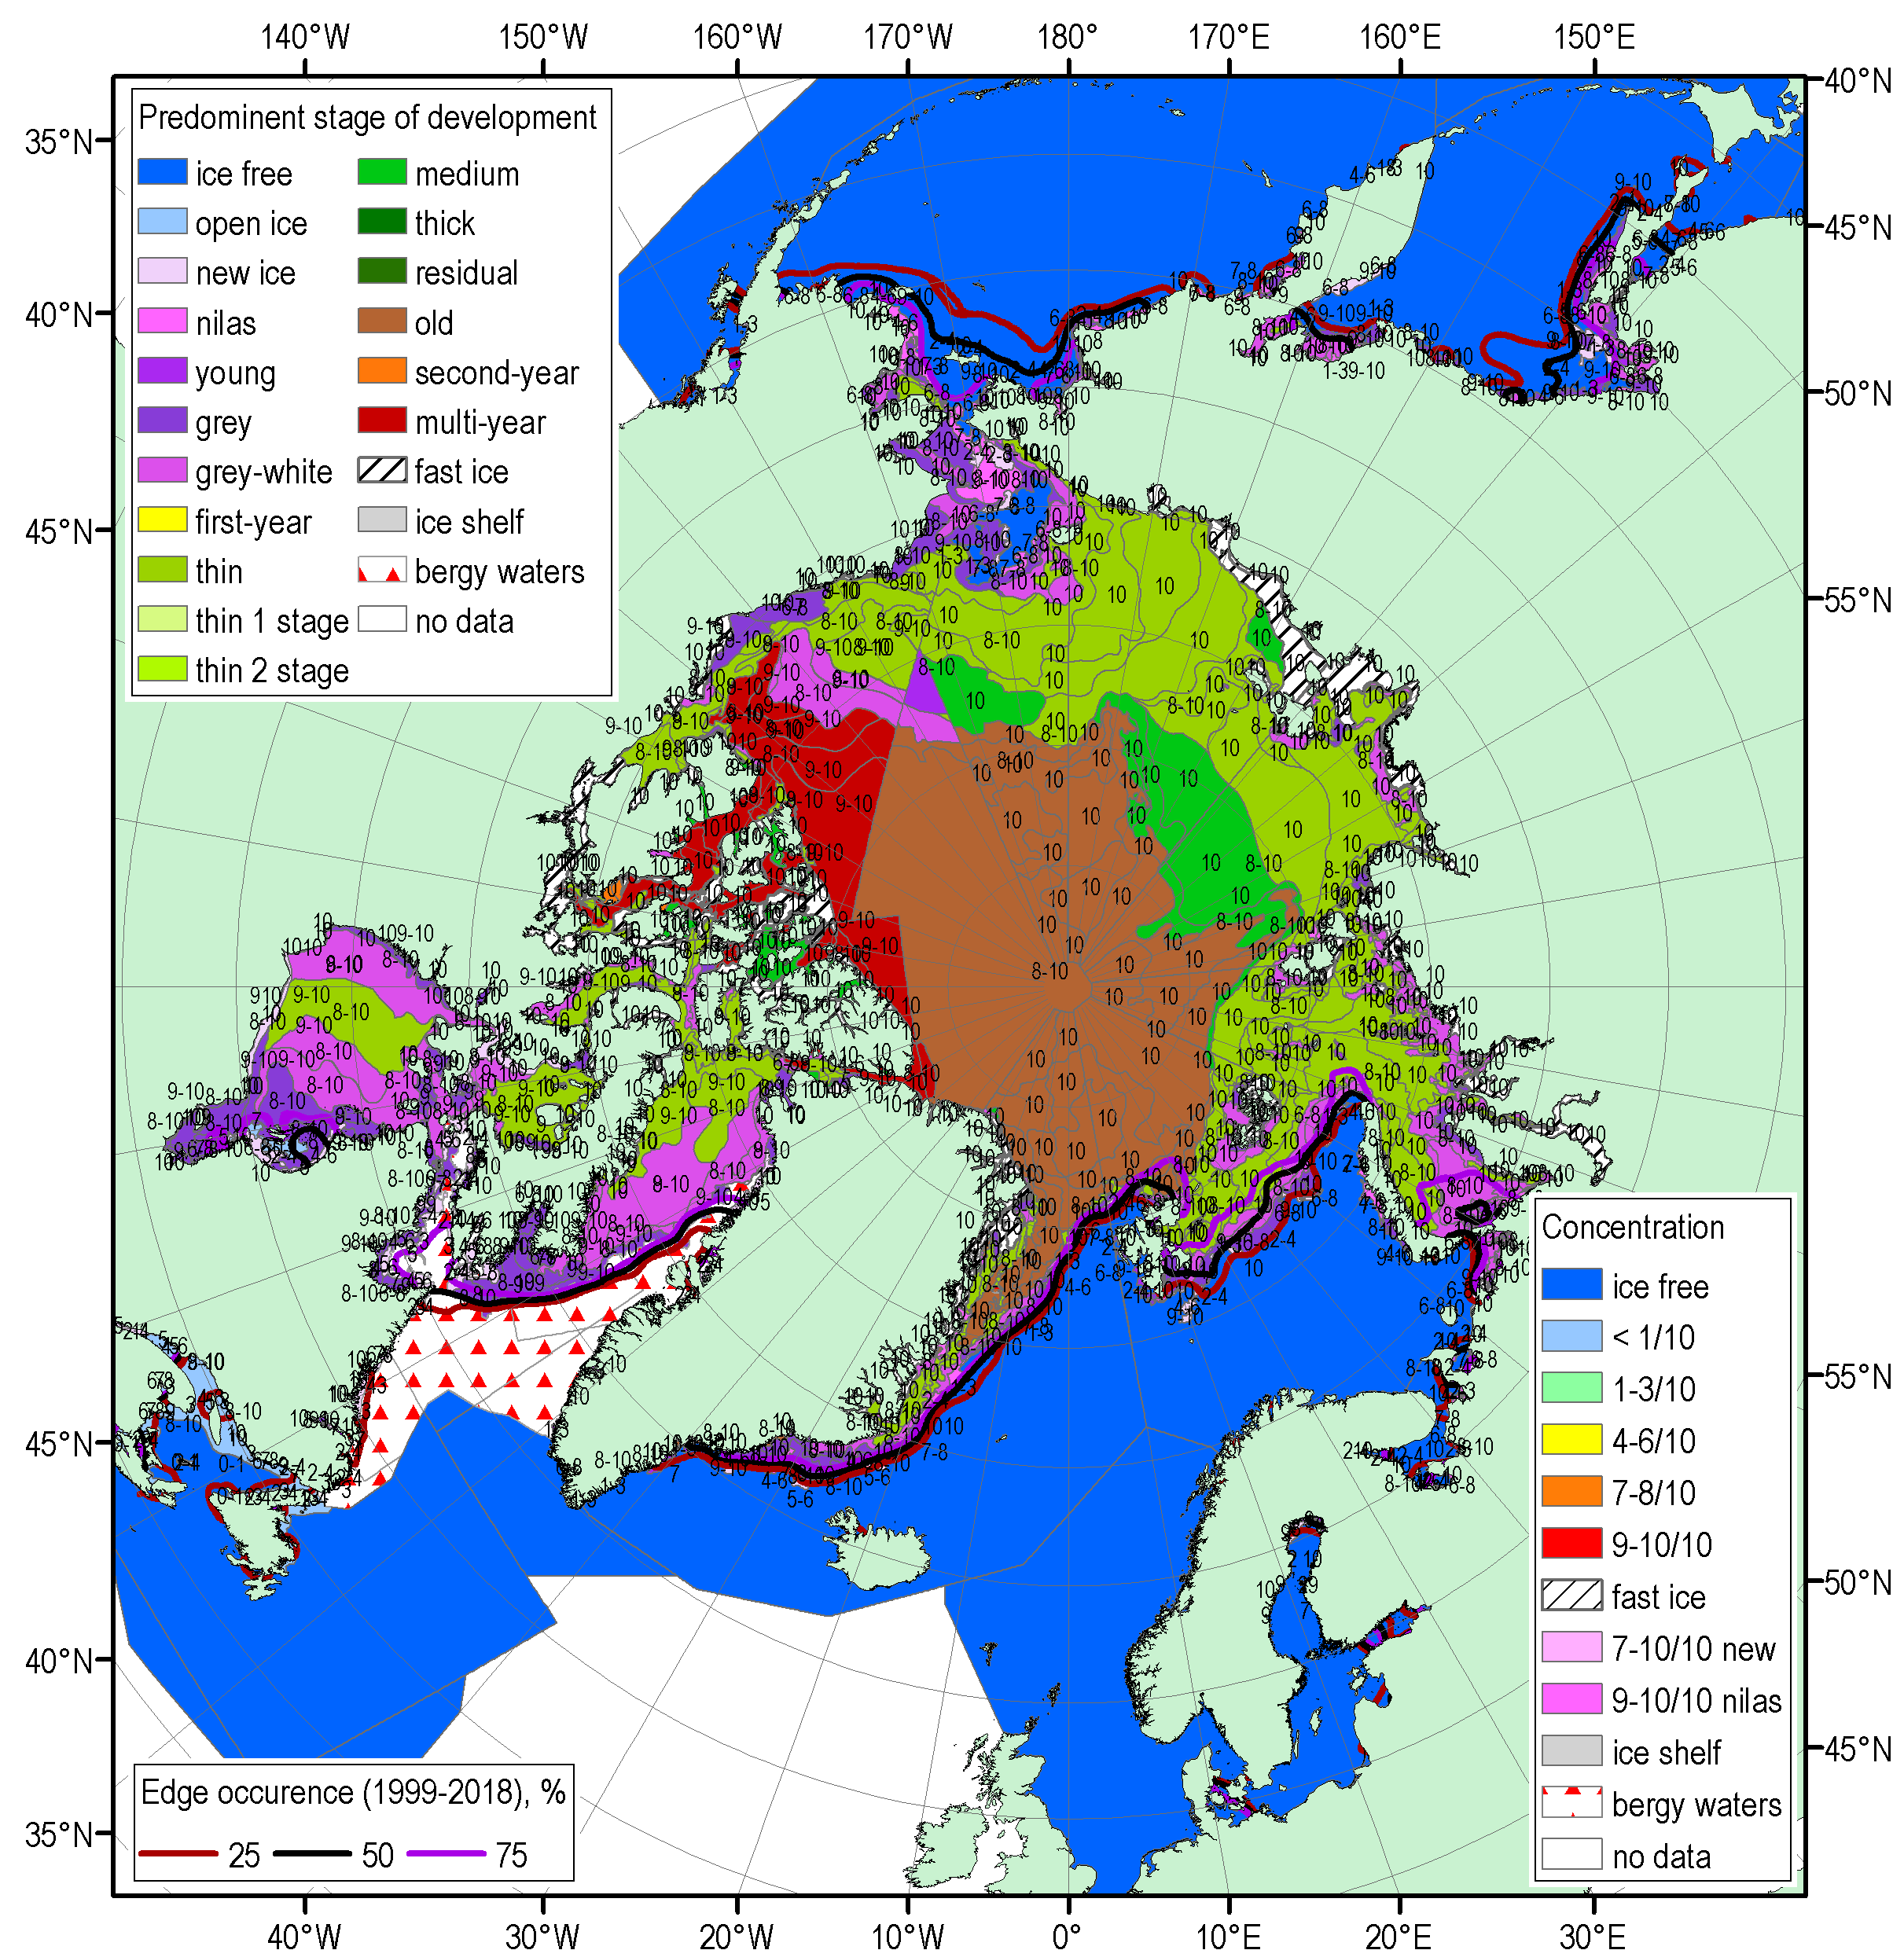
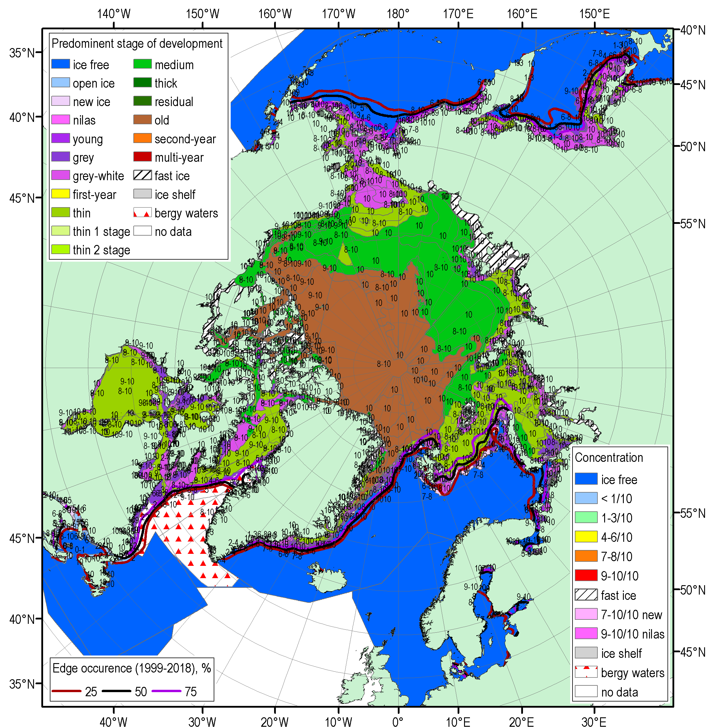
NDJ 2019/2020 Arctic sea ice – concentration and stage of development
18-21 Nov
16-19 Dec
13-16 Jan
Blended AARI/CIS/NIC (JCOMM) ice charts; ice edge – nearest 5days, reference period: 1999-2018

Slide 18
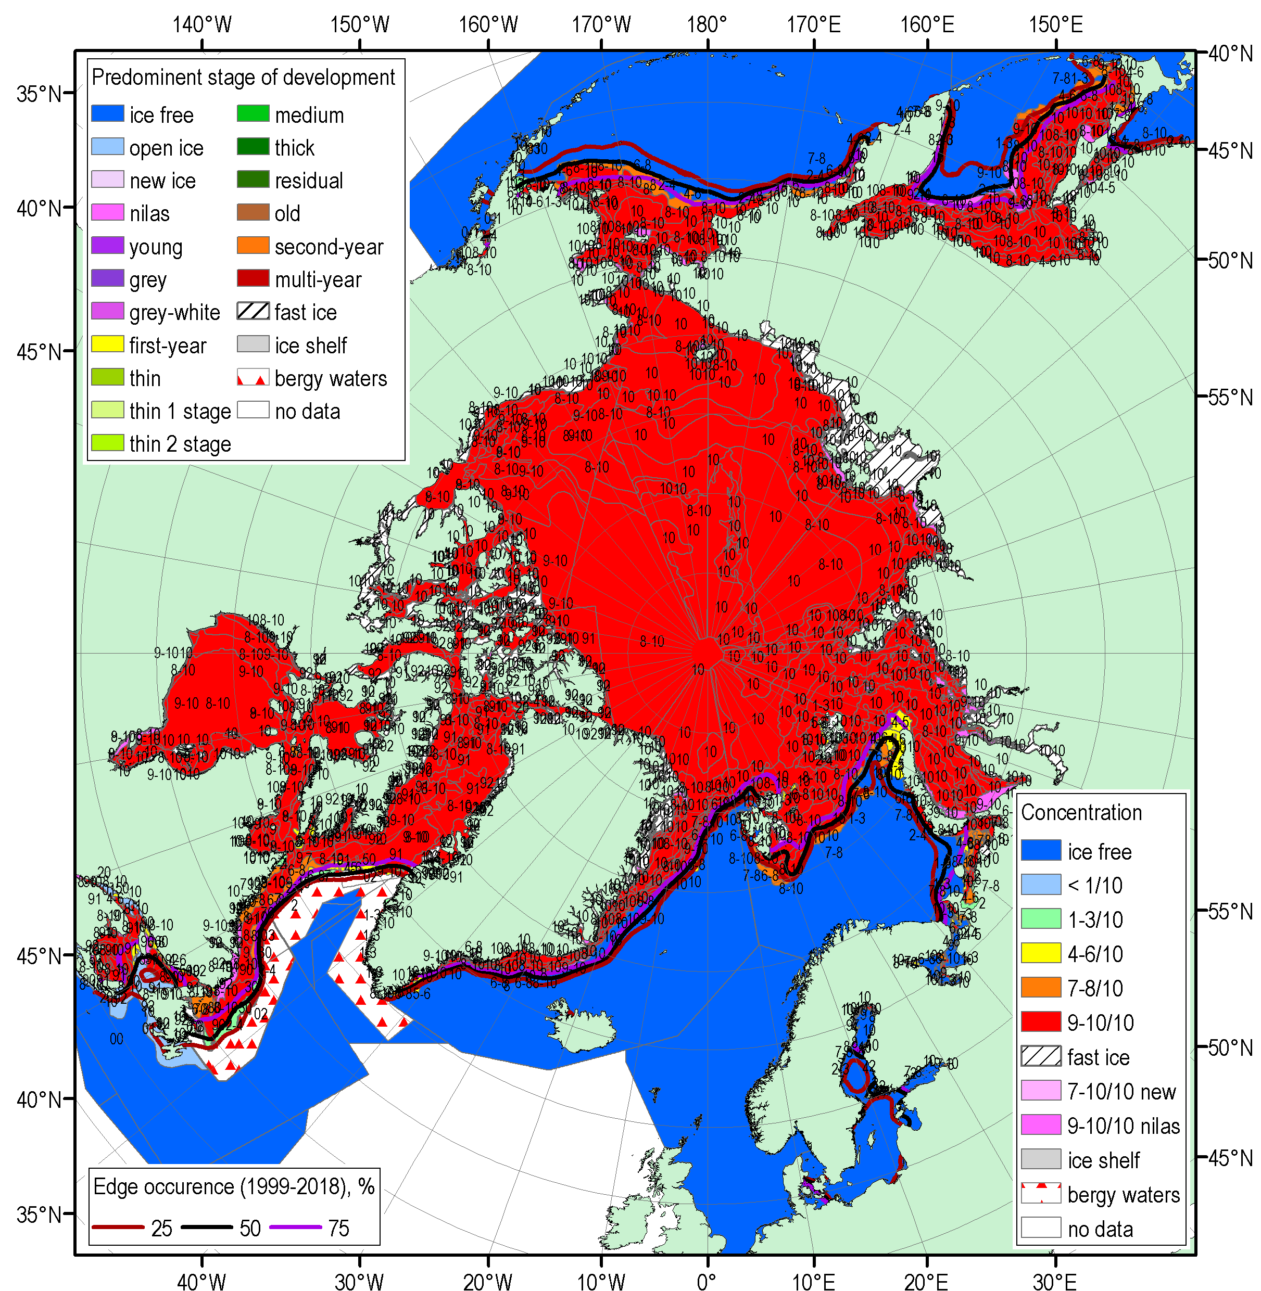

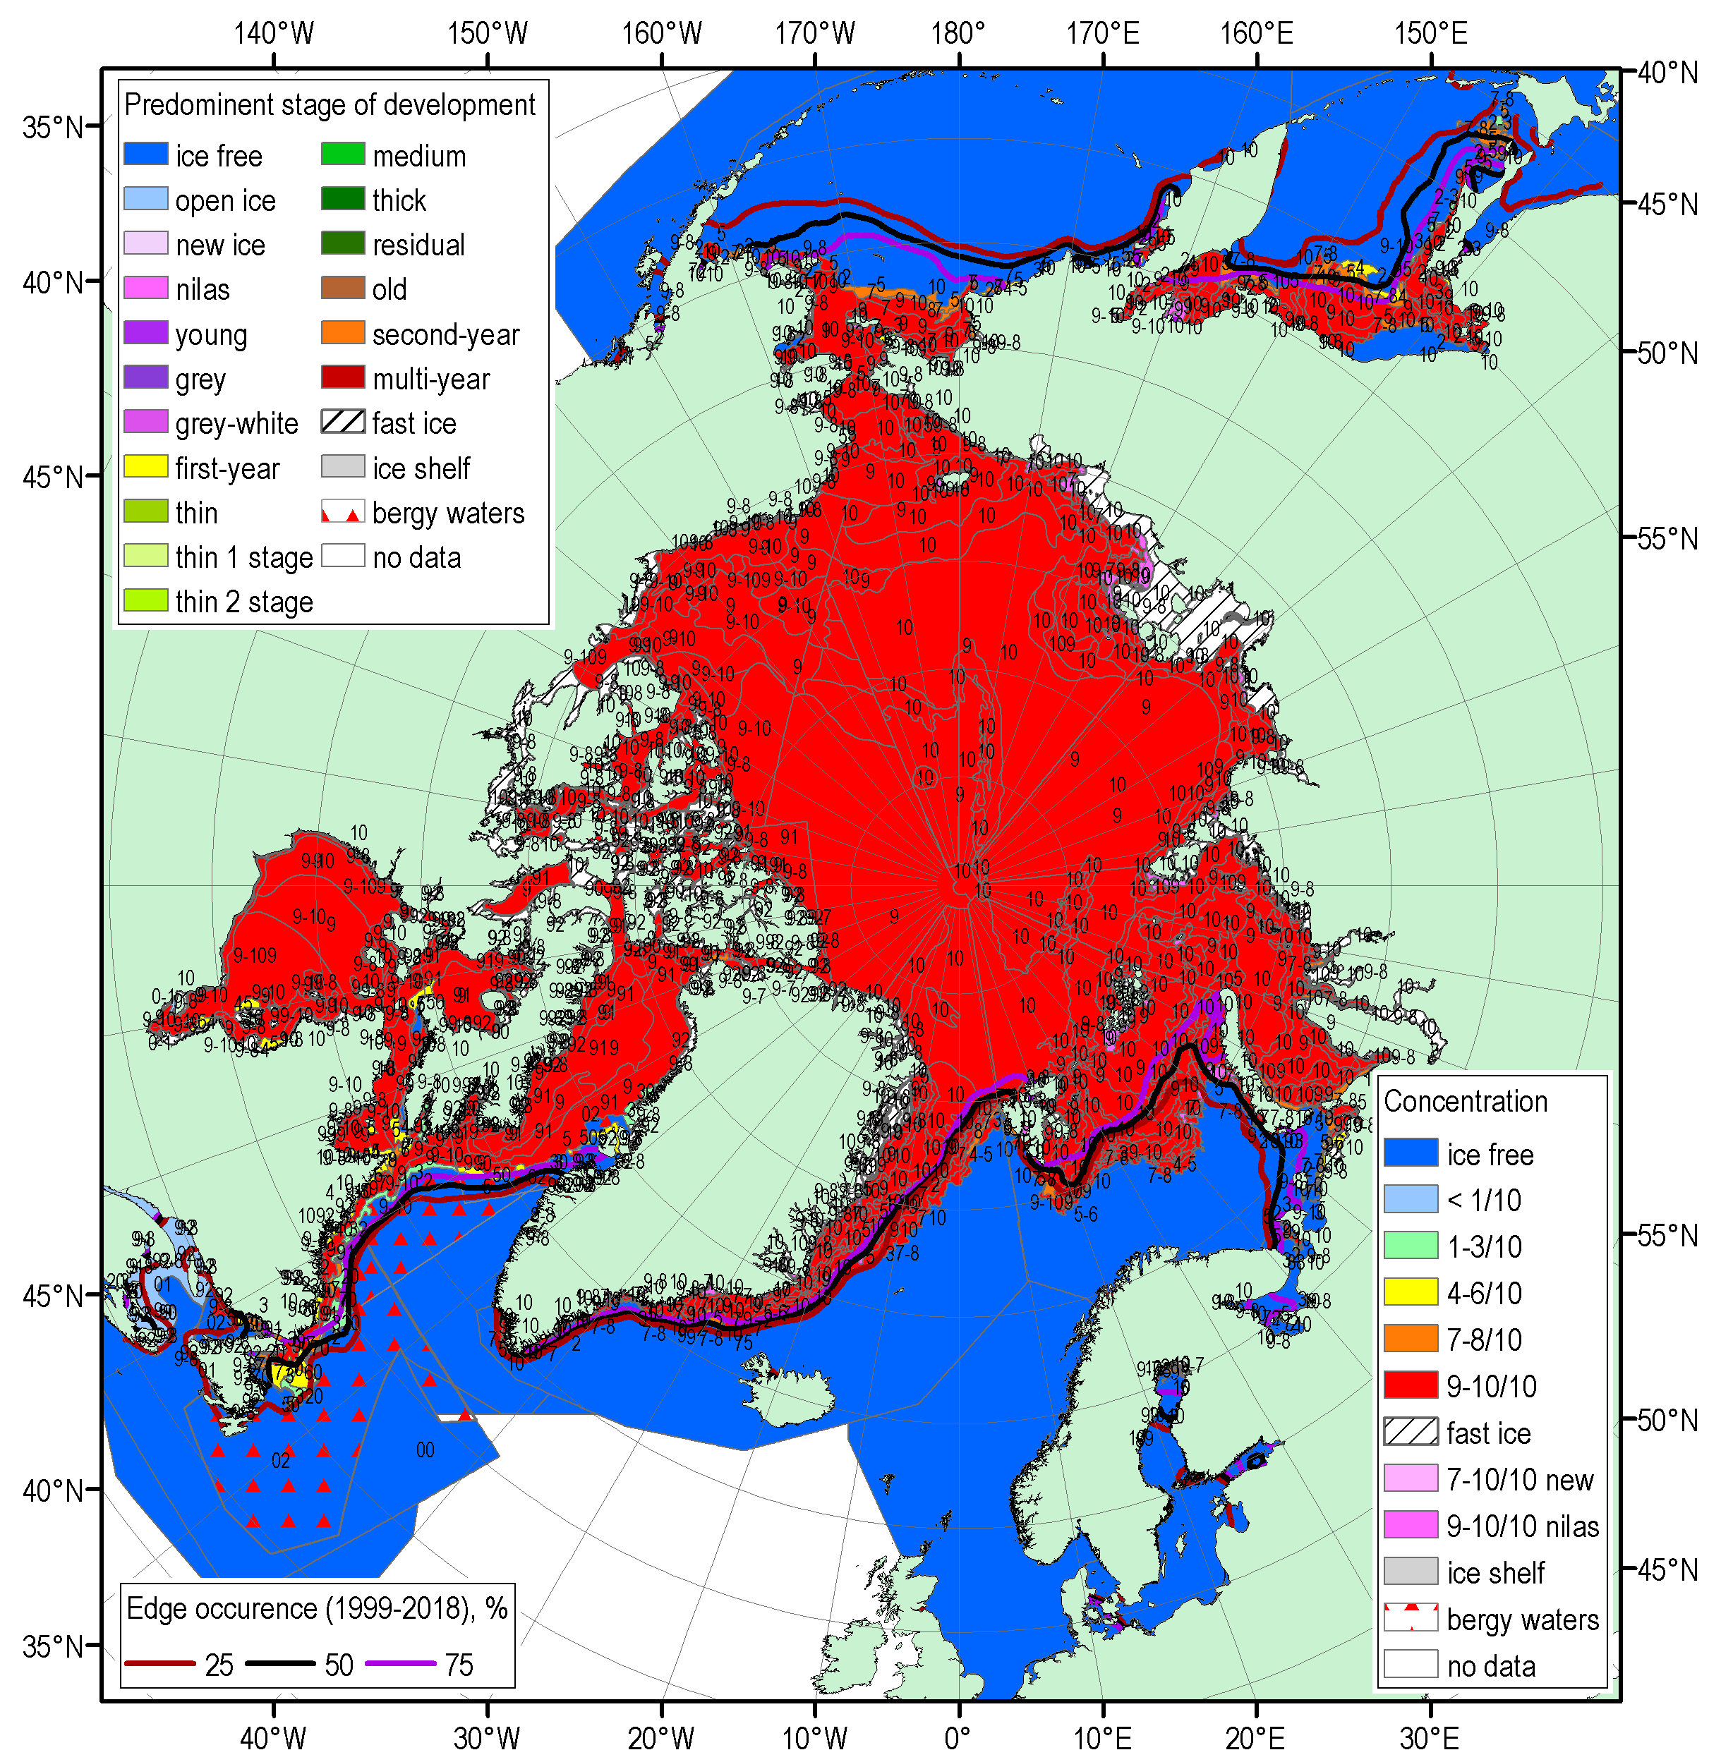
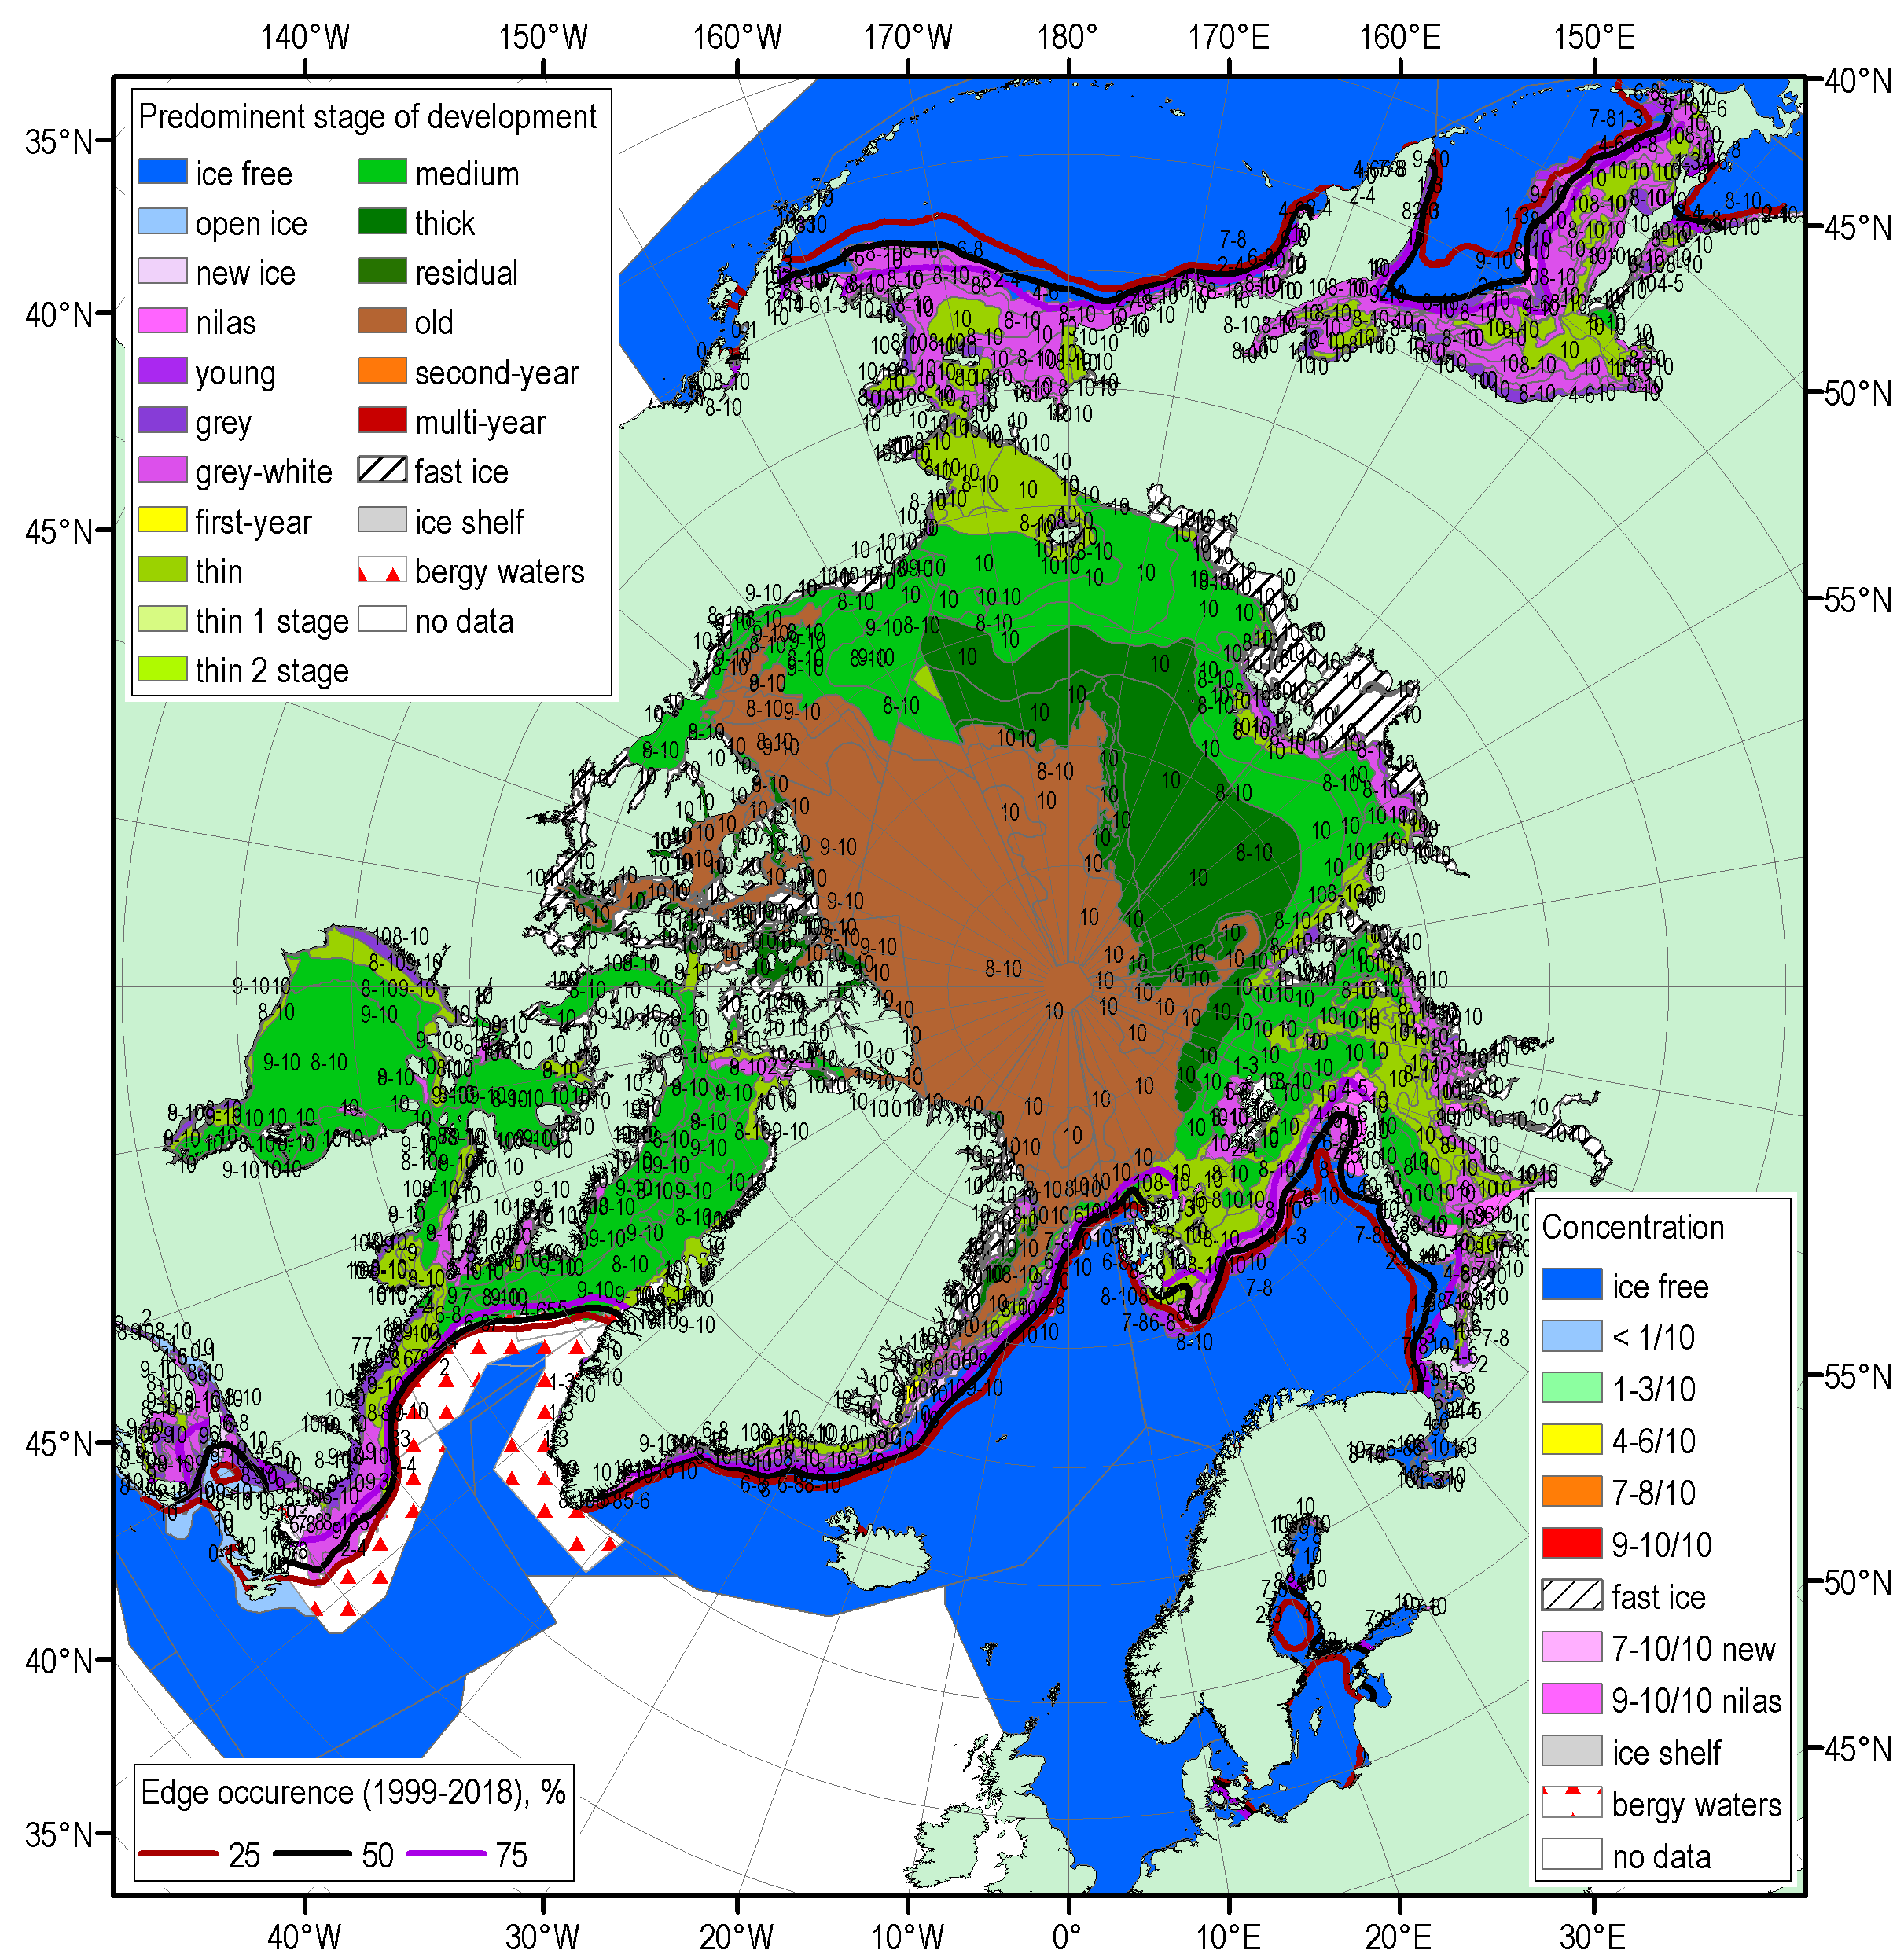
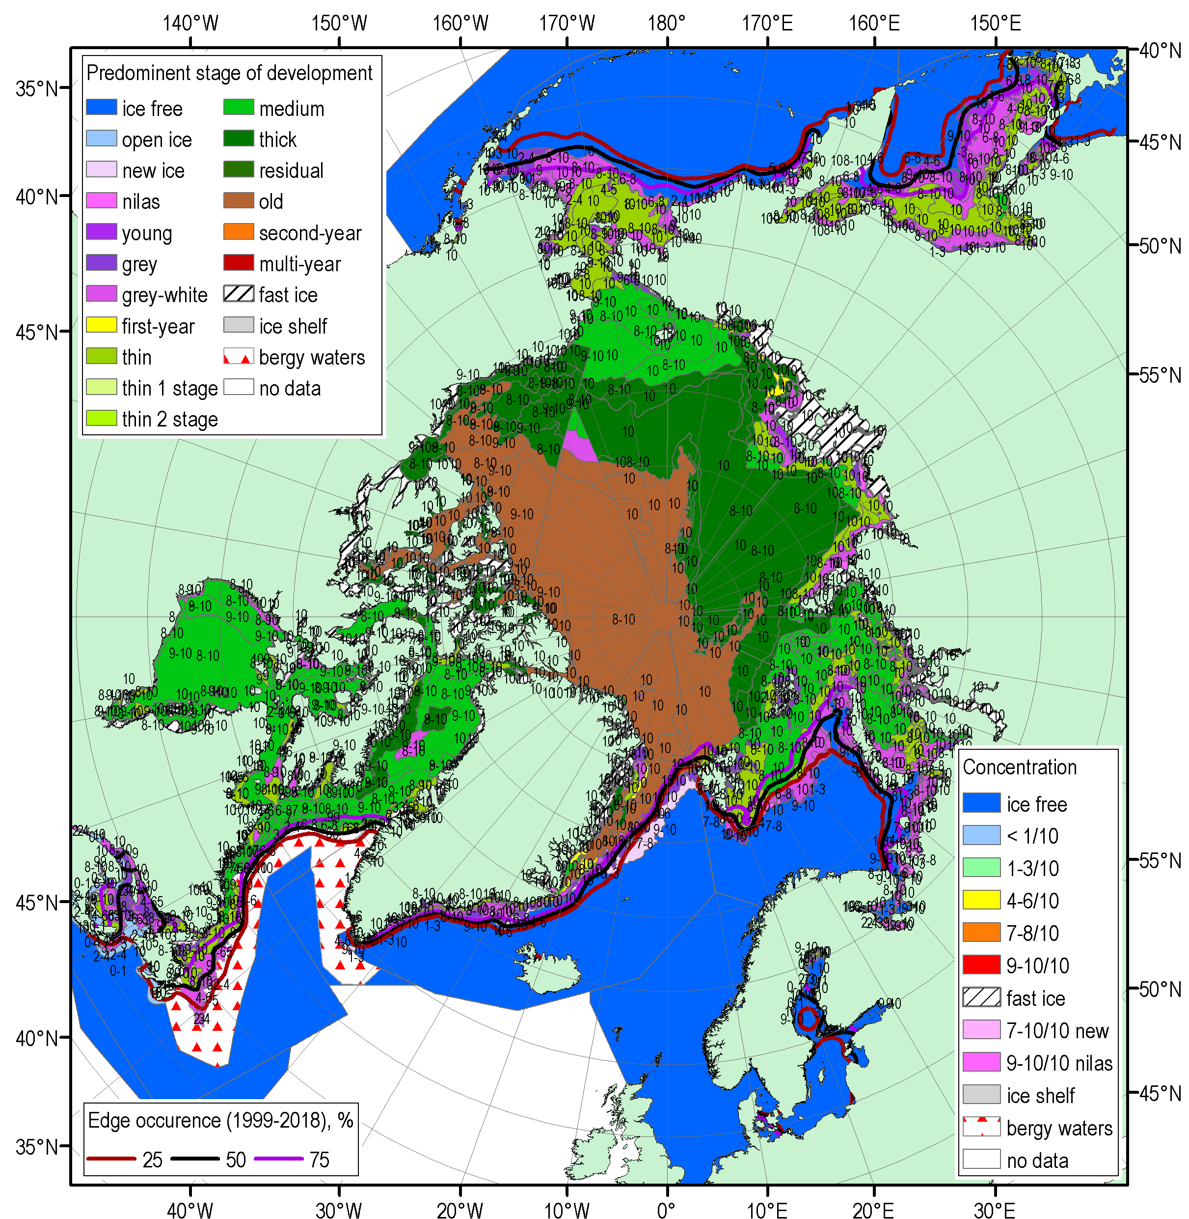
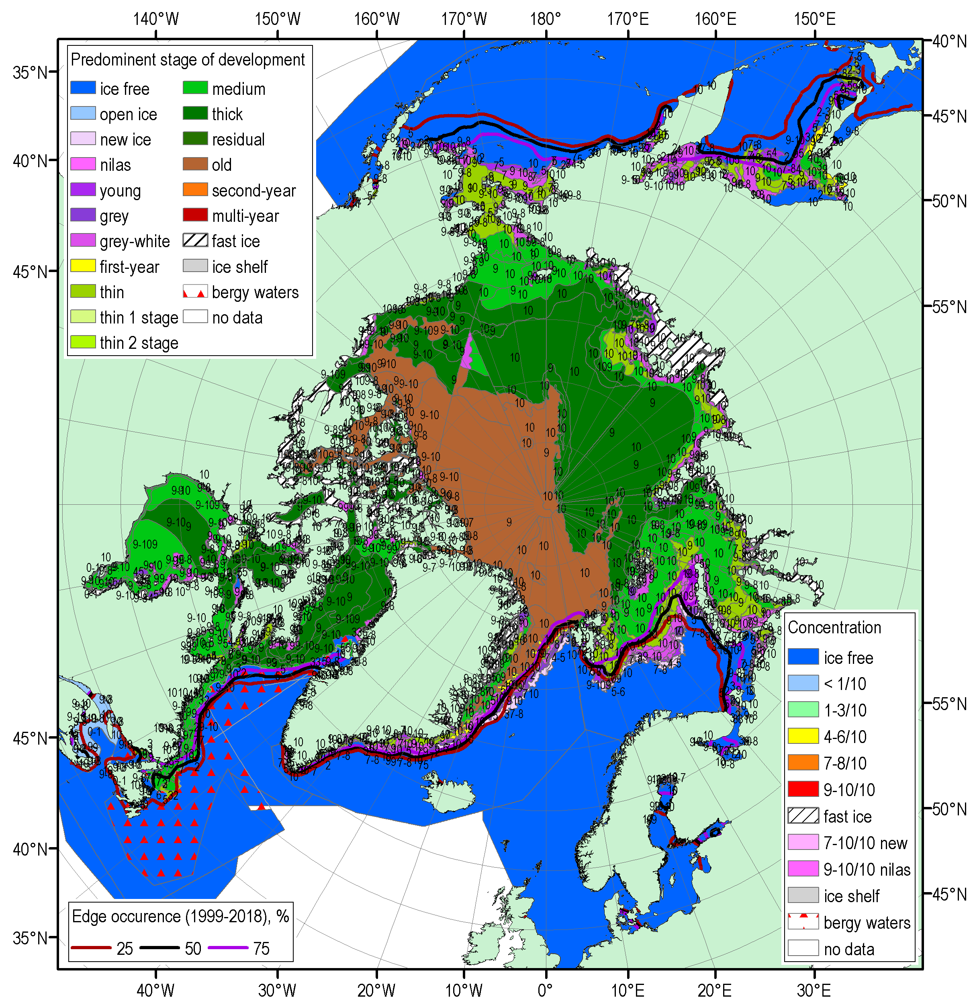
FMA 2020 Arctic sea ice – concentration and stage of development
17-21 Feb
16-19 Mar
13-17 Apr
Blended AARI/CIS/NIC (JCOMM) ice charts; ice edge – nearest 5 days, reference period: 1999-2018

Slide 19
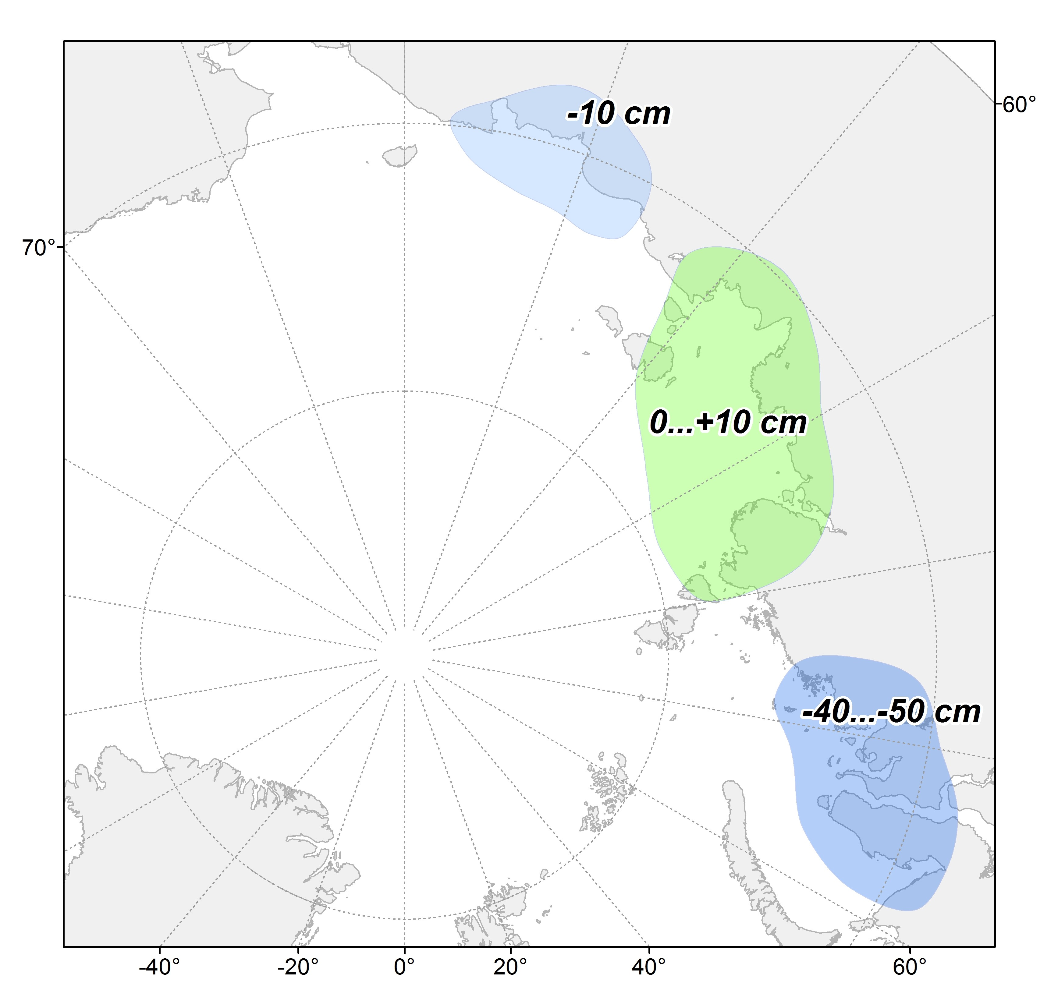
Sea ice fast ice maximum thickness values and anomalies by end of April/Mar 2020 (stations)
WMO stations used:
Russia: 12 (Varandey, Amderma, Belyi, Dikson, Sterlegova, Cheluskin, Tiksi, Kotelnyi, Sannikova, Ayon, Valkarkay)
Observed maximum winter ice thicknesses significantly less than normal (for the last 30 years) for Kara Sea (up to -50 cm, which is opposite to 2019) and slightly less than normal for Eastern Siberian Sea
Slightly thicker ice observed in Laptev Sea
Ref [1991-2020]
[AARI]

Slide 20
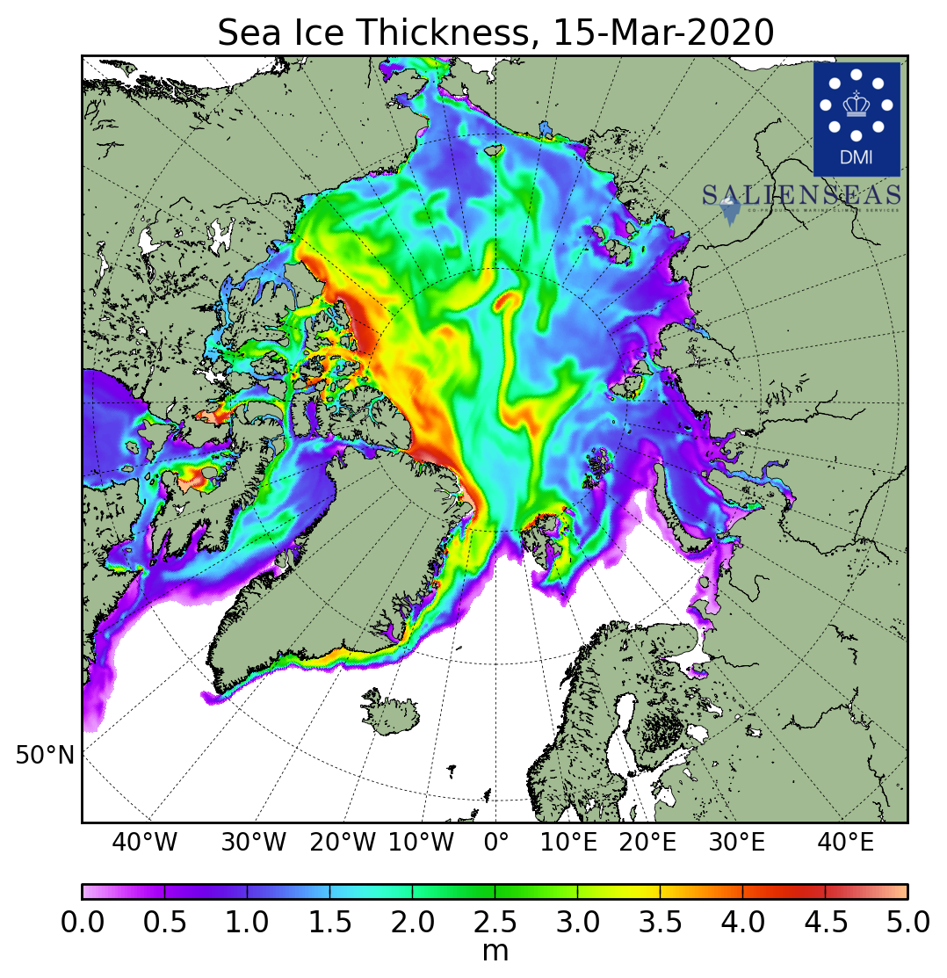
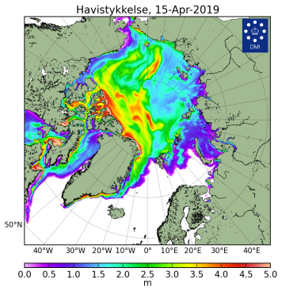
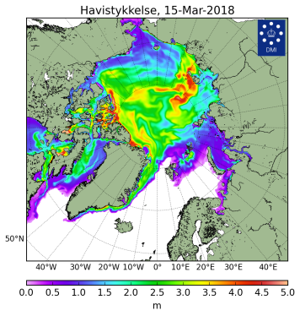
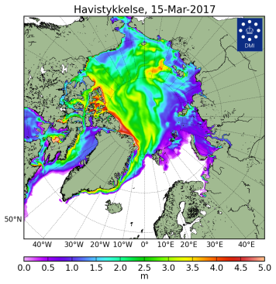
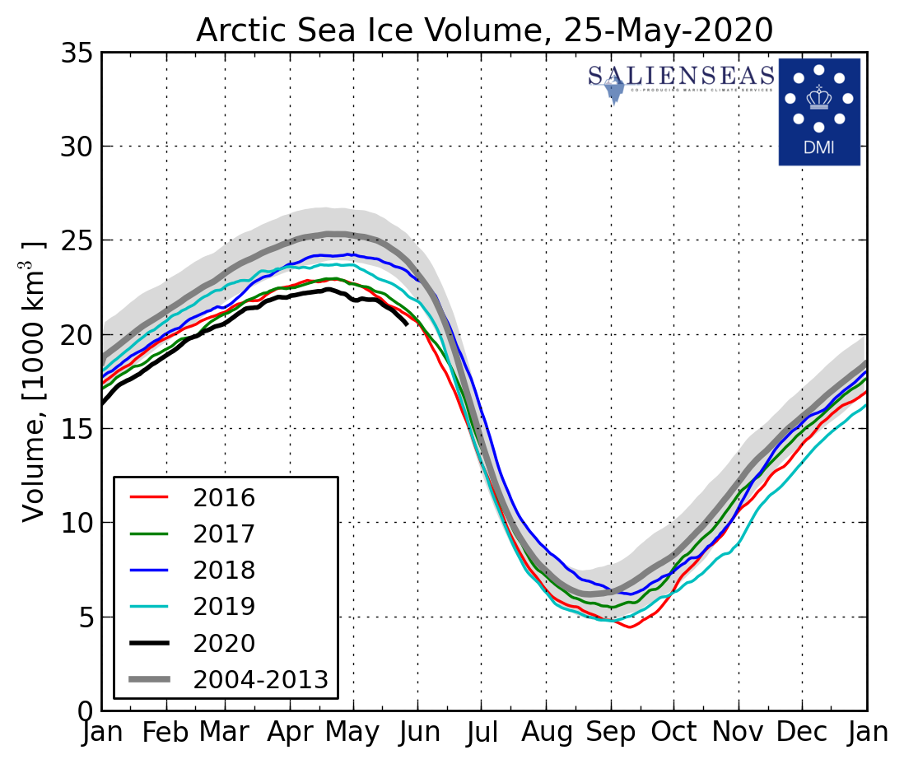
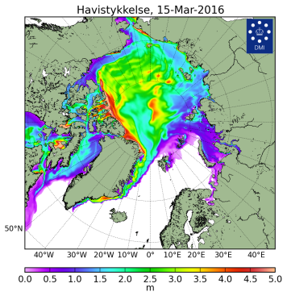
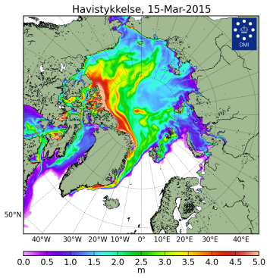
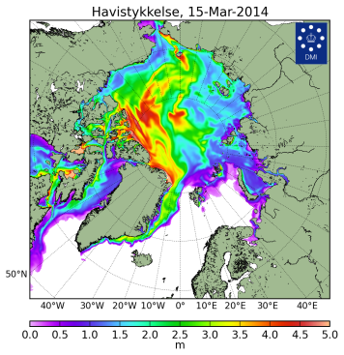
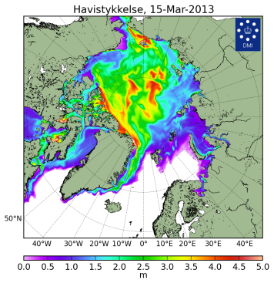
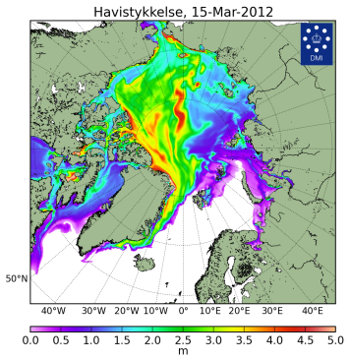
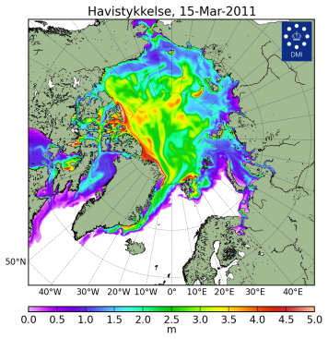
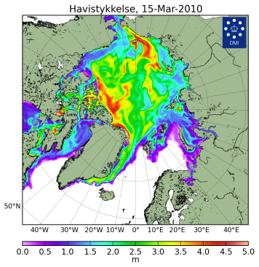





Sea ice thickness for 15 Mar 2004…2020 and ice volume
[Madsen et al, 2015]
2020
2019
2018
2017
2020
2016
2015
2014
2013
Models show Arctic ice volume in 2020 the lowest from Oct 2019 for 2004-2020 with 2nd in row in 2016
The present ice extent slightly higher then in 2016 means sea ice thicknesses in winter / spring 2019/2020 are in general lower then in 2019
2012
2011
2010
2009
2008
2007
2006
2004
DMI North Atlantic - Arctic Ocean model HYCOM-CICE - http://ocean.dmi.dk/models/hycom.uk.php
[DMI]

Slide 21
Polar Ocean:
  Sea surface temperature
  pH and acidification or alkalization of the Arctic ?
  Storms - Wave and swell height

Slide 22






Waves and ph in the Arctic Ocean - NDJ 2019-2020, FMA 2020
Boundary seas of the Arctic Ocean were in general warmer and stormy during winter-spring 2019-2020 with exceptions Svalbard and N Greenland (colder, calmer), Sea of Okhotsk (colder)
Numerical models show both positive (Arctic Basin, Chukchi Sea) and negative pH (Barents, Kara Sea, Canadian Arctic) anomalies to the last 20 years, that allows occurrence of both alkalization and acidification processes in the Arctic (no effect to wildlife?
SST NDJ anomaly, 1981-2010
SST FMA anomaly, 1981-2010
WW&S height NDJ rank, 1979-2020
WW&S height FMA rank, 1979-2020
AARI / Copernicus Climate Change Service
(ERA5 & MERCATOR reanalysis)
pH anomaly 2m SON 2000-2019
pH anomaly 2m DJF 2000-2019

Slide 23
Land Snow:
  Snow water equivalent
  Snow extent

Slide 24









Land snow (satellite, obs)
Snow extent in winter-spring 2019/2020 was less than normal with prominent negative anomalies (no snow) in most of European sector
Positive anomalies (more snow) were observed in Scandinavia, southern Canada
Greater Snow Water Equivalent in 2019/2020 means higher snow height observed
Nov
Dec
Jan
Jan
Mar
Apr
Ref [1981-2010]
[FMI, ECCC, Rutgers Glob Snow Lab / GCW)]

Slide 25




Current Conditions (21-26 May 2020)
Till now week westerly, moderate northern winds in European sector and strong southern winds over Siberia (NAO~0) led to lower SAT in European sector, prominent higher SAT over Siberia and the Arctic Ocean (‘heat waves’)
Northern Scandinavia, Arctic coasts, Chukchi peninsula are still under snow
NE part of Barents Sea, Kara, W Laptev Seas, Chukchi Sea are under intense ice melt which is extreme
However general pattern of TransArctic drift keeps ice conditions in Greenland Sea and Svalbard waters near normal
SAT, precipitation, mean wind vectors, NAO for 23-27.05.2020 (http://polarportal.dk)
AARI/NIC ice chart for 21-26 May 2020
Snow extent for 27 May 2020,
Rutgers Global snow lab

Slide 26

Thank you! Merci! Takk! Спасибо!
Tak! Tack! Kiitos! þakka þér fyrir!
Naqurmiik ! Qaĝaasakuq !
Grazie! Giitu! Vielen Dank!
Dhanyavaad !

