Slide 1


November 2020 – April 2021
Arctic Seasonal Review
Vasily Smolyanitsky
Anna Danshina, Anastassiya Revina
Arctic and Antarctic Research Institute (AARI)
Data sources (i…viii):
i) Copernicus climate change service (ERA5 monthly averaged data on pressure and single levels, Marine environment monitoring service, GloFAS-ERA5 operational global river discharge reanalysis), ii) AARI (Review of hydrometeorological processes in the Northern Polar Region in 2020&Q1 2021), iii) sea ice analysis (AARI, CIS, NIC), iv) NSIDC, v) ESA CryoSAT-2, vi) DMI PolarPortal, vii) Arctic GRO, viii) WMO GCW SnowWatch (FMI, ECCC, Rutgers Glob Snow Lab)

Slide 2
Content of seasonal review
Review for NDJFMA (November…April) 2020/2021
  Atmosphere:
    Atmospheric circulation
    Surface air temperature – anomalies, ranks and trends by Arctic regions and seas
    Precipitation – anomalies, ranks and trends by Arctic seas
  Sea ice:
    Precursors in atmosphere and polar ocean
    Ice extent – anomalies and ranks by regions
    Ice conditions and ice edge variability
    Sea ice thickness and volume variability
  Polar Ocean:
    Heat content, waves and swell height (storminess) - anomalies
    pH (acidification/alkalization estimates) - anomalies
  Land hydrology:
    river discharge – anomalies
    snow extent – anomalies and ranks
  Bioclimatic weather severity
Briefs for May 2021: SAT, winds, precipitation, sea ice, snow
Majority of the described parameters are the WMO accepted Essential Climate Variables (ECV). Anomalies based on reanalysis are given for the latest 3rd WMO period 1991-2020, while those based on observations – for 1st WMO reference period 1961-1990. Ranks based on CCCS reanalysis are mostly given for 1979-2020(2021) period, while those based on observations – for the period of observations. Full resolution monthly and seasonal graphs based on ERA5 reanalysis as well as graphs for additional not mentioned ECVs are available at http://wdc.aari.ru/acf_figs/

Slide 3
Atmosphere
Precursors: atmospheric circulation
Surface air temperature
Precipitation

Slide 4
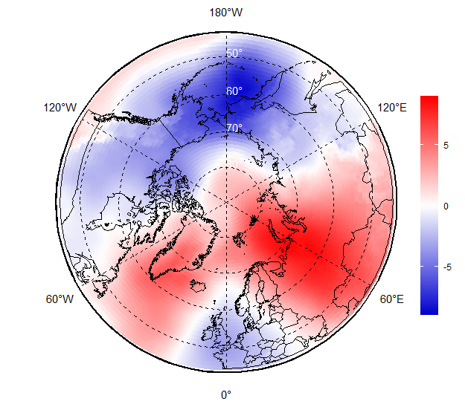
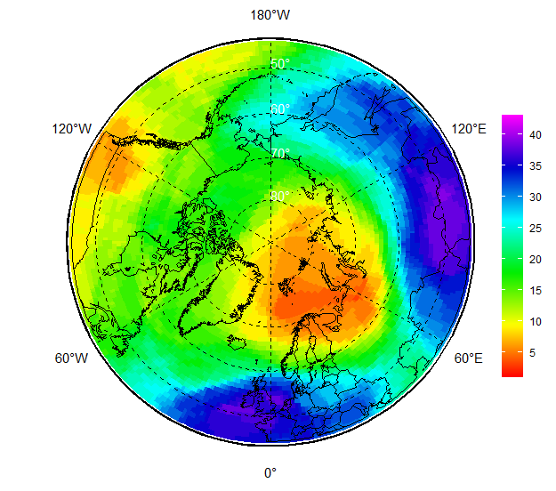
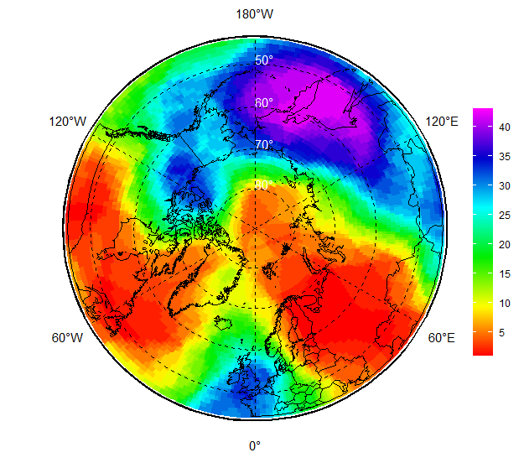
NDJ 2020/2021 atmospheric circulation
During NDJ 2020/2021 negative mean sea level atmospheric pressure (MSLP) anomalies (lower pressure, marked in blue) dominated over the E Nordic, E Siberian to C Canadian regions
Opposite situation (higher pressure, marked in red) was observed over the Central Arctic, W Nordic and W Siberian regions
That led to prevalence of zonal circulation (transfer west/east) in the troposphere over W Siberian to Alaska and meridian one over other parts of the Arctic with the center of polar vortex (dark violet) over Kamchatka region as seen on the 50hPa and 500hPa geopotential heights (H50, H500)
MSLP hPa anomaly, 1991-2020
H50 (left) and H500 (right) ranks (1979-2020)
[AARI / CCCS ERA5]

Slide 5
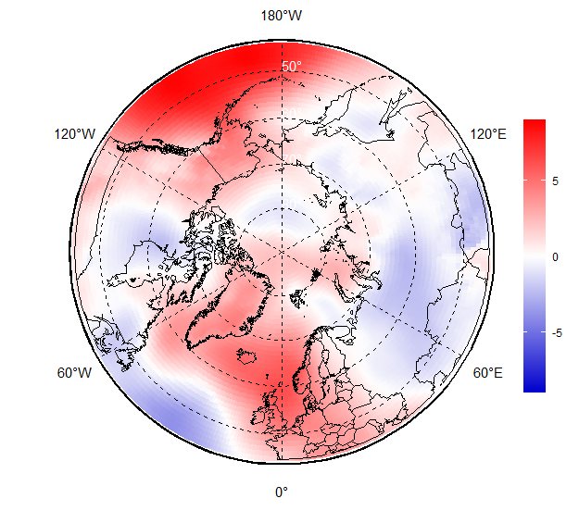
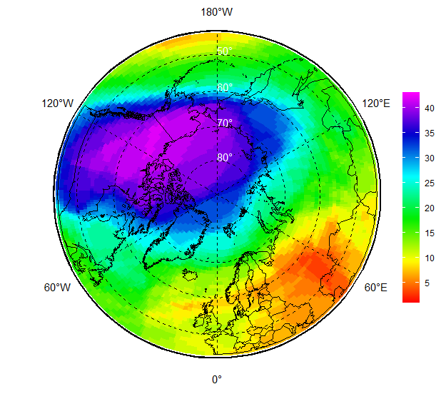
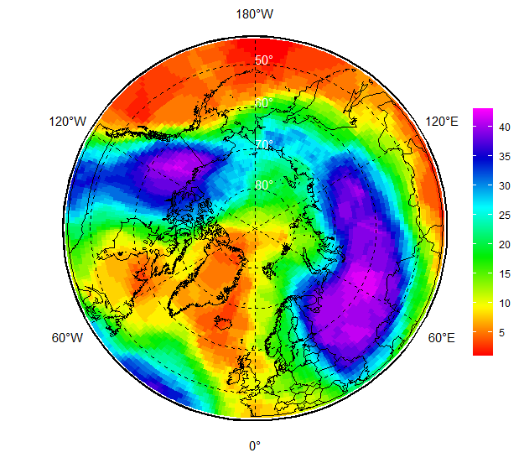
FMA 2021 atmospheric circulation
During FMA 2021 smaller negative MSLP anomalies were observed in the southern parts of Siberian regions, over Hudson Bay partly central Arctic Ocean but not in Alaska, W Canada and W&E Nordic
That led to increased anticyclonic activity in Nordic, Alaska and W part of the Arctic ocean region, more polar lows with further colder temperatures and lesser precipitation
Polar vortex (dark violet) was very intense as observed at H50 and H500 patterns and caused meridian type of circulation with several ‘cold waves’ in Nordic, W Siberian and Alaska regions
MSLP hPa anomaly, 1991-2020
H50 (left) and H500 ranks (1979-2021)
[AARI / CCCS ERA5]

Slide 6
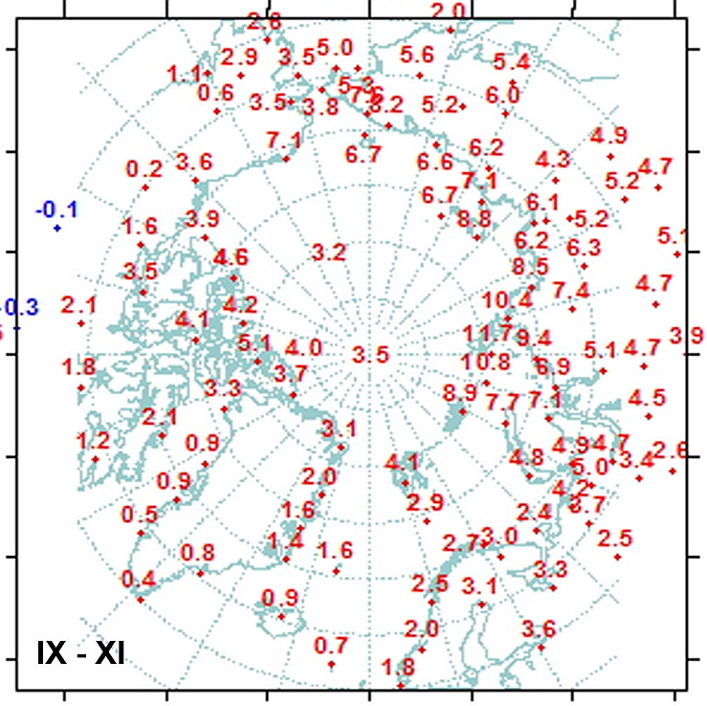
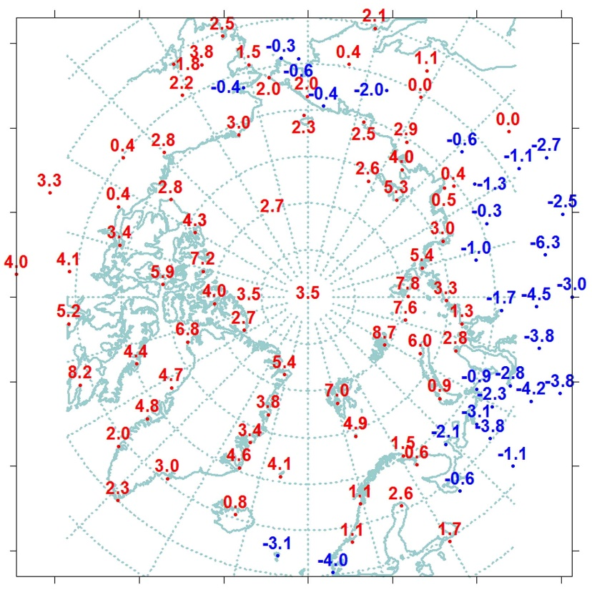
Sep 2020 – Feb 2021 SAT (T2m): anomalies
IX-XI
XII-II
The late autumn and start of winter 2020 surface air temperature across practically all Arctic regions was strongly above normal exception of S Canada.
However further during winter 2020/2021 the Arctic coastal areas eastward of E Nordic to Alaska experienced notable negative anomalies which is opposite to the previous winter 2019-2020 season
Quite warm winter conditions (3rd in row) were observed in E Canada with even extreme warmer winter conditions over N part of Canadian archipelago (1st in row)
In general positive linear trends for winter temperatures continue for all Arctic seas though for the land regions greater interannual variability is observed
[AARI]

Slide 7
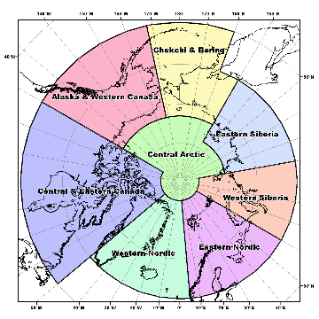

Dec 2020 – Feb 2021 SAT (T2m): anomalies, ranks and winter trends by regions
Region (old boundaries) | Anomaly | Rank | The warmest year (anomaly) | The coldest year (anomaly)
Western Nordic | 2,5 (2.5) | 9(14) | 2014 (3,9) | 1966 (-2,4)
Eastern Nordic | 0.6(5,4) | 34(3) | 1937 (6,5) | 1979 (-4,4)
Western Siberia | 0.3(7,2) | 36(3) | 2012, 2016 (7,6) | 1969 (-5,6)
Eastern Siberia | 0.2(4,6) | 25(2) | 2016 (4,6) | 1966 (-4,5)
Bering&Chukchi | 1.2(1,8) | 19(13) | 2018 (6,7) | 2002 (-2,3)
WCanada&Alaska | 2.4(-0,9) | 14(42) | 2018 (6,1) | 1965 (-5,6)
Eastern Canada | 4.2(1,2) | 3(18) | 2010 (5,0) | 1972 (-3,6)
Reference period for anomaly: 1961-1990
W Nordic
E Nordic
Bering&Chukchi
W Canada&Alaska
W Siberia
E Siberia
E Canada
Zone 60-85 °N
[AARI]

Slide 8
Dec 2020 – Feb 2021 SAT (T2m): anomalies, ranks and winter trends Arctic seas
Sea | Anomaly (previous) | Rank (previous) | The warmest year (anomaly) | The coldest year (anomaly)
N part of Greenland and Norwegian Seas | 4.7(2,1) | 5(19) | 2014 (6,1) | 1966 (-2,7)
Barents Sea | 2.8(3,3) | 22(20) | 1937 (7,6) | 1979 (-3,4)
Kara Sea | 4.0(6,5) | 19(8) | 1945 (9,8) | 1979 (-5,9)
Laptev Sea | 3.6(4,4) | 6(3) | 2012 (4,6) | 1979 (-4,4)
Eastern Siberian Sea | 2.7(2,9) | 7(7) | 2018 (6,5) | 1966 (-3,3)
Chukchi Sea | 2.1(1,6) | 17(19) | 2018 (8,8) | 1939 (-3,4)
Beaufort Sea | 3.2(0,7) | 10(29) | 2018 (6,3) | 1966 (-3,1)
N part of Canadian archipelago | 5.0(1,0) | 1(18) | 2021 (5,0) | 1949 (-3,6)
Reference period for anomaly: 1961-1990
N Greenland and Norwegian
Barents
Kara
Laptev
E Siberian
Chukchi
Beaufort
N Canadian archipelago
[AARI]

Slide 9
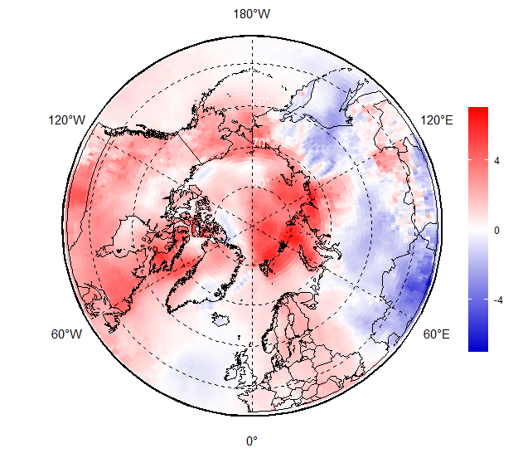
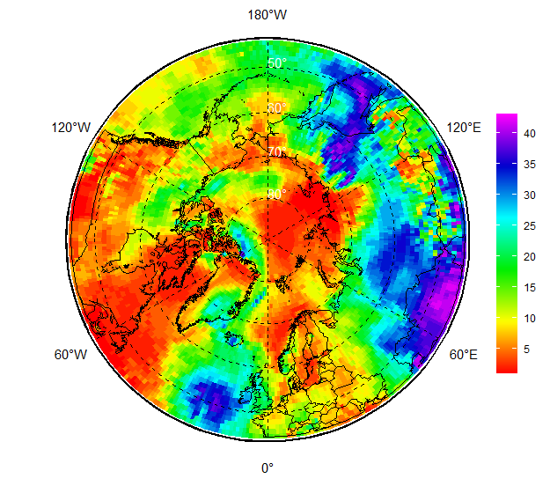
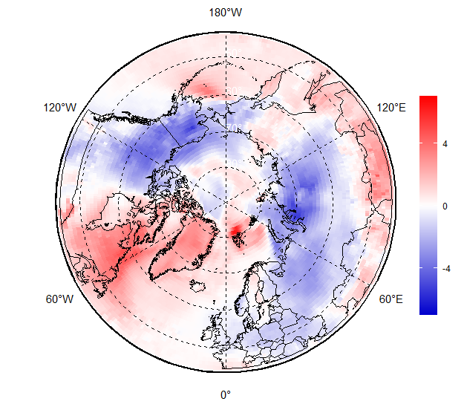
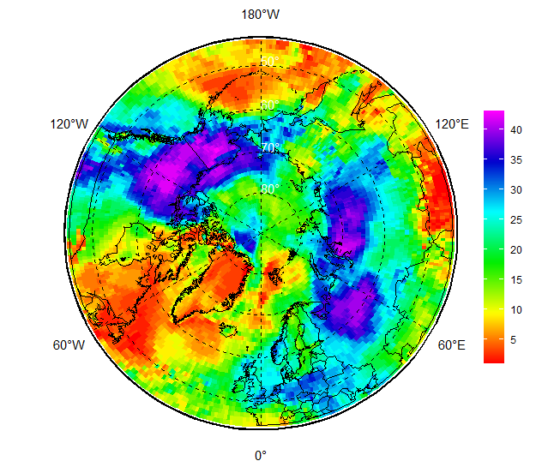
Dec 2020 – Feb 2021 SAT (T2m): anomalies, ranks: reanalysis
NDJ 2020/2021
As usual numerical reanalysis contributes and facilitates continuous in time and space description of the seasonal variability
Noticeable for the present season are very strong negative SAT anomalies on Siberian and Alaska side during FMA 2021 with opposite positive anomalies over Greenland, Svalbard for the same period.
SAT anomaly, 1991-2020
SAT rank, 1979-2020
FMA 2021
SAT anomaly, 1991-2020
Rank, 1979-2021
[AARI / CCCS ERA5]

Slide 10
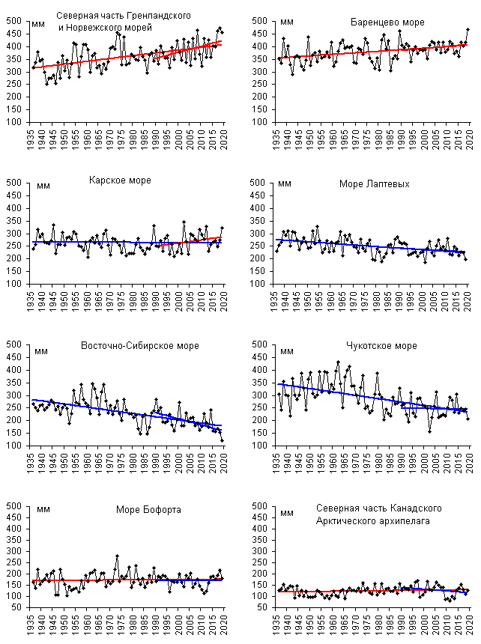
Annual precipitation trends by Arctic Seas
N Greenland and Norwegian Seas
Barents Sea
Analysis based on observations by the Arctic seas
General positive trends – wetter conditions – for the Nordic seas, Beaufort Sea
General negative trends – drier conditions - for Siberian shelf seas
No general significant trends for Canadian Arctic regions
Kara Sea
Laptev Sea
Eastern Siberian Sea
Chukchi Sea
Beaufort Sea
N Canadian Archipelago
[AARI]

Slide 11
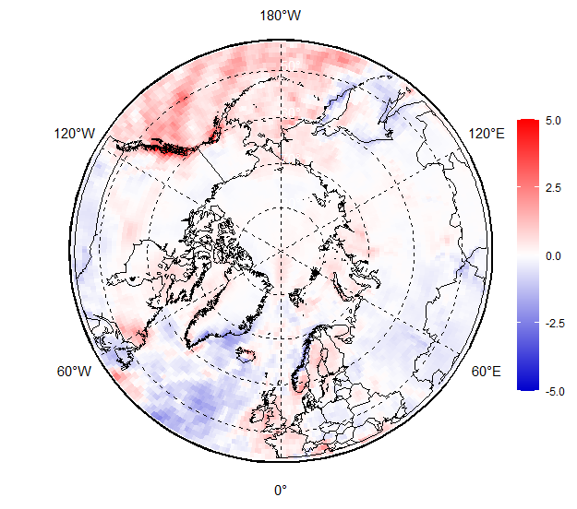
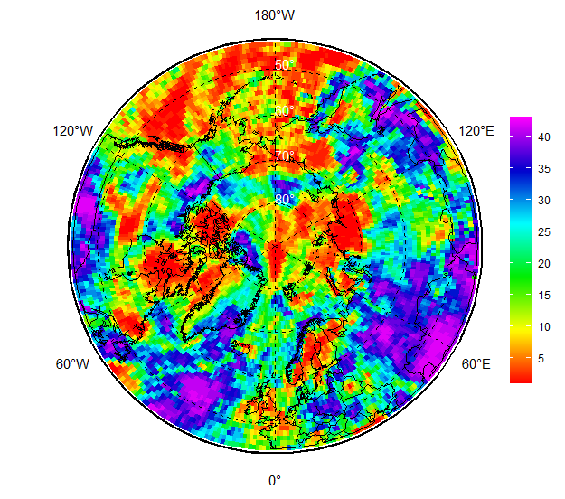
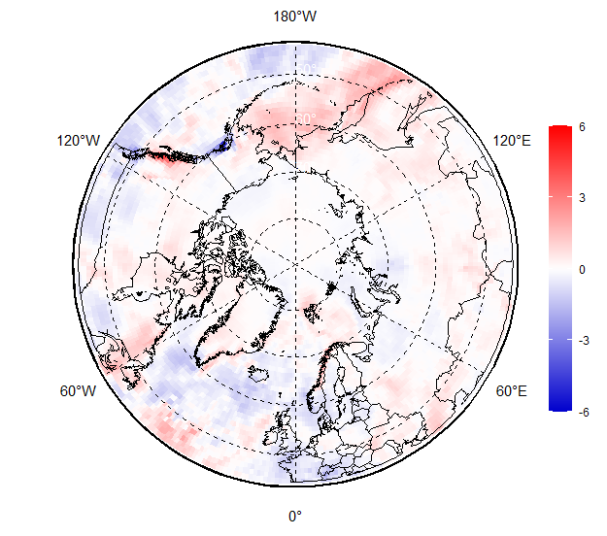
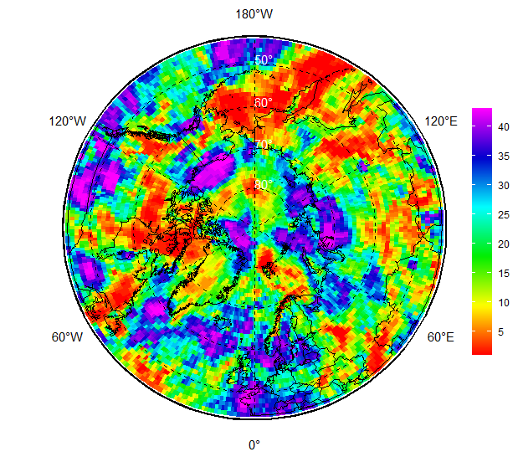
Precipitation (Prec) NDJFMA 2020/2021: anomalies and ranks
NDJ 2020/2021
For NDJ 2020/2021 and FMA 2021 Alaska, Bering&Chukchi, C Canada, Svalbard saw wetter conditions
Drier conditions were observed over parts of W and E Siberian regions
Siberian shelf seas, Sea of Okhotsk, Nordic region experienced both wetter and drier conditions
Prec Anomaly, 1991-2020
Prec Rank, 1979-2020
FMA 2021
Prec Anomaly, 1991-2020
Prec Rank, 1979-2021
[AARI / CCCS ERA5]

Slide 12
Sea ice
  Precursors in atmosphere and polar ocean
  Ice extent and ice conditions based on ice charting
  Sea ice thickness and volume based on reanalysis

Slide 13
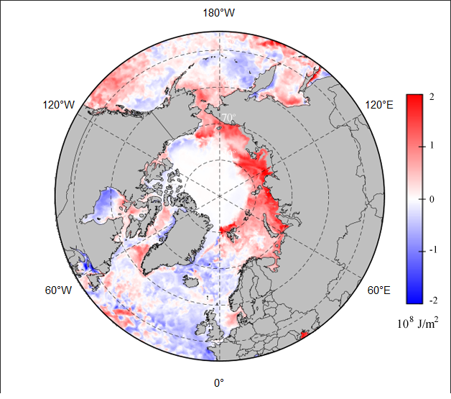
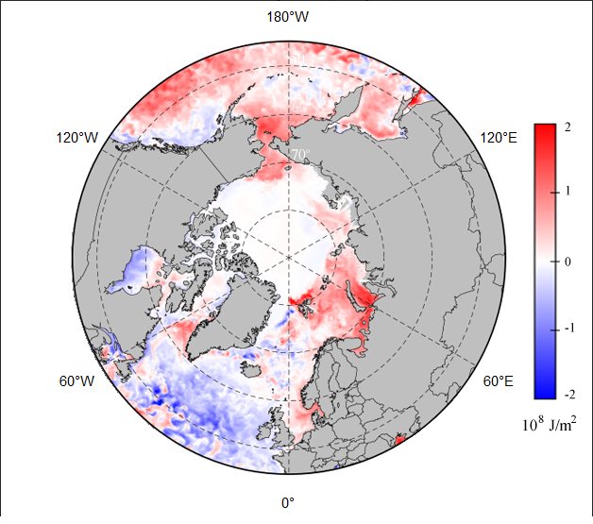
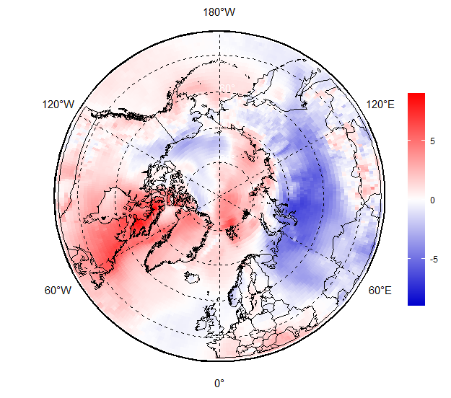
Precursors in atmosphere and polar ocean for NDJFMA 2020/2021 ice conditions
Prevailing positive ocean heat capacity (HC) anomaly (to 2000-2019) in upper 20 m during Oct – Nov 2020 for the Kara, parts of Laptev, ESS, Chukchi and Bering Seas significantly slowed freezing processes in these regions
Oppositely, zero or slightly negative HC anomalies in Oct-Nov 2020 in Beaufort Sea, parts of Canadian Arctic provided background for close to normal freeze-up
Further in winter dominance of significant negative SAT anomalies stimulated ice growth in the coastal parts of Eurasian Arctic Seas and Beaufort Sea with opposite situation in Greenland, Svalbard waters
Oct 2020 Heat Capacity
anomaly, 1993-2019
Nov 2020 Heat Capacity
anomaly, 1993-2019
DJF 2020/2021 SAT anomaly, 1991-2020
[AARI / CCCS MEMS & ERA5]

Slide 14
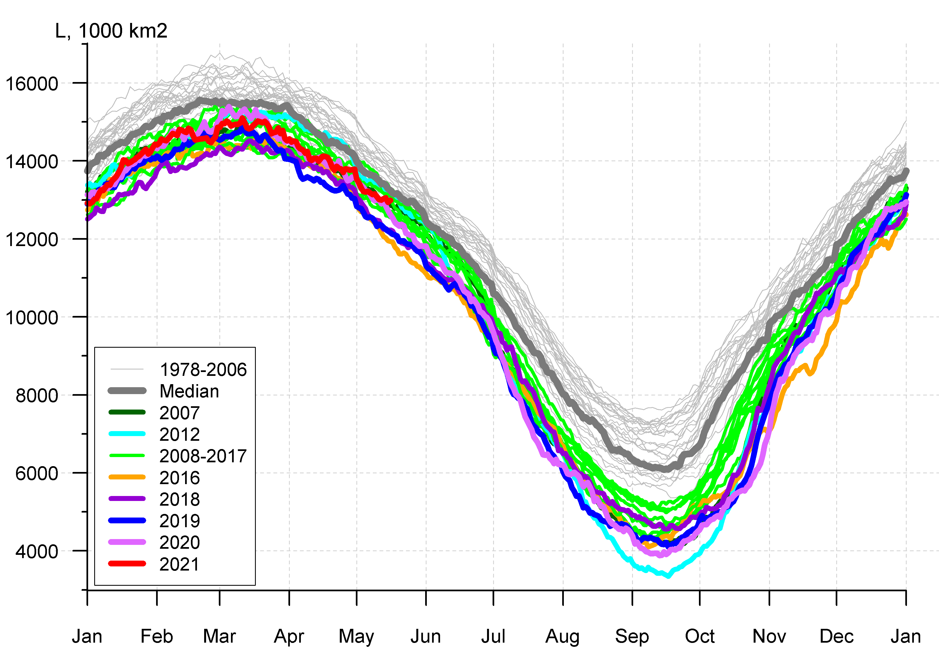
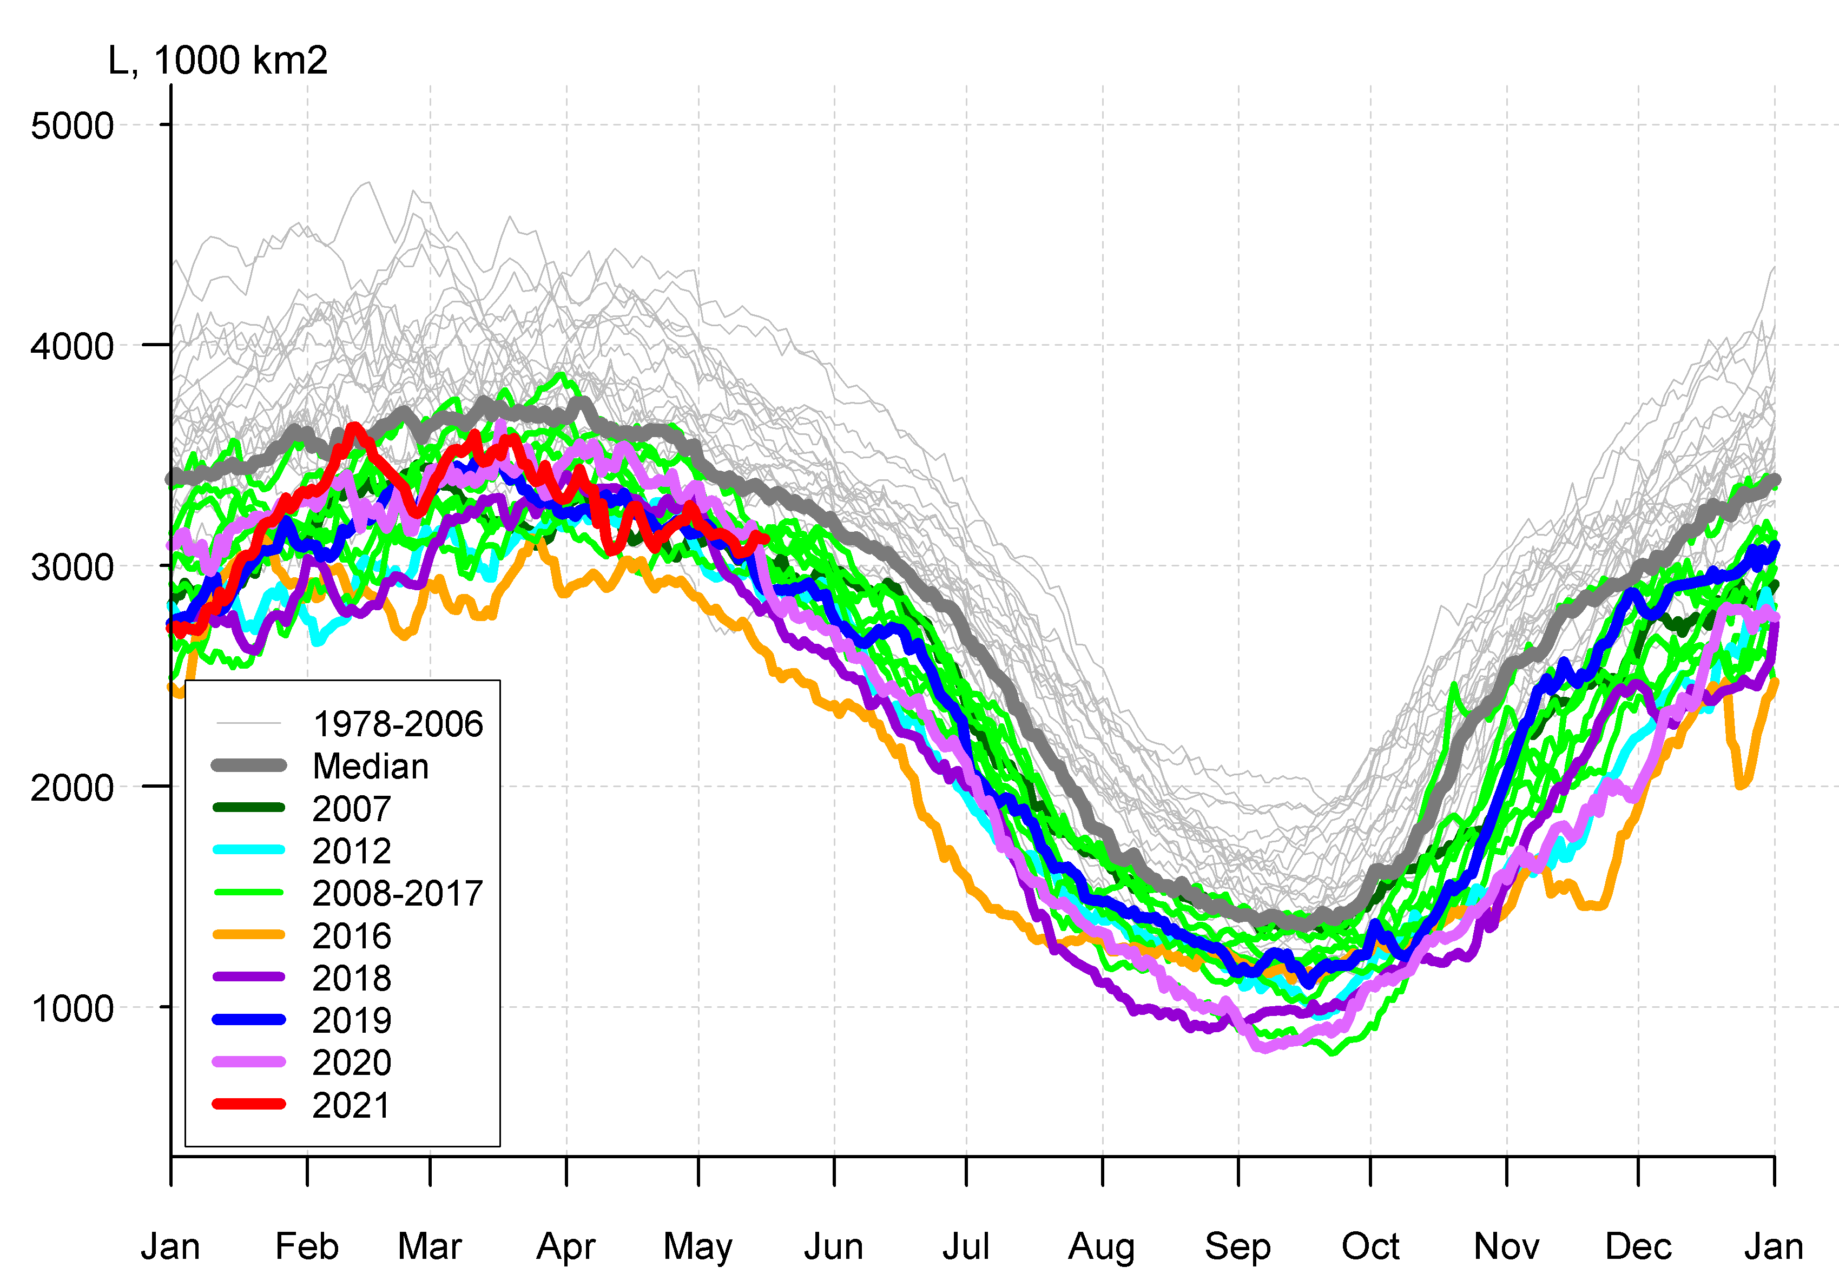
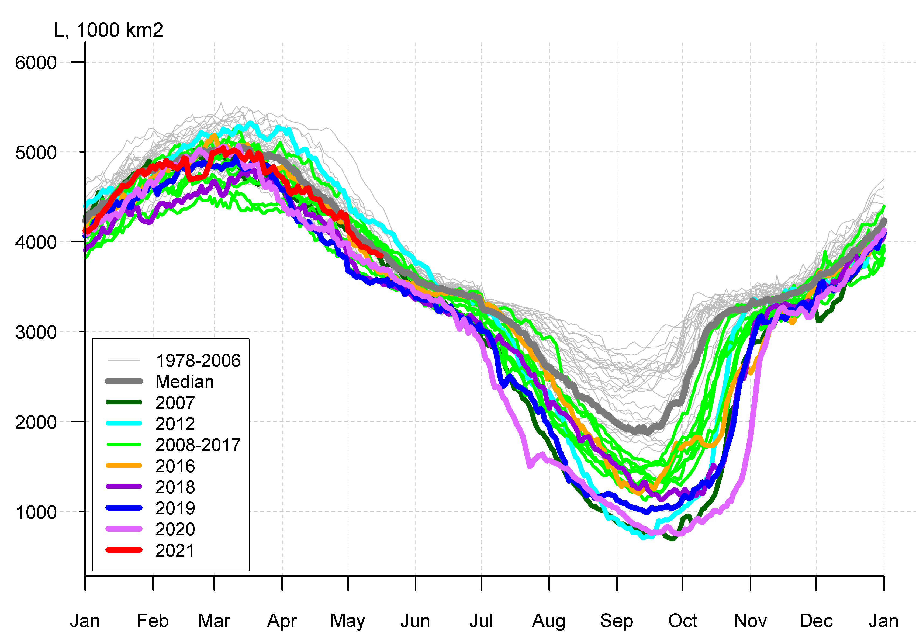
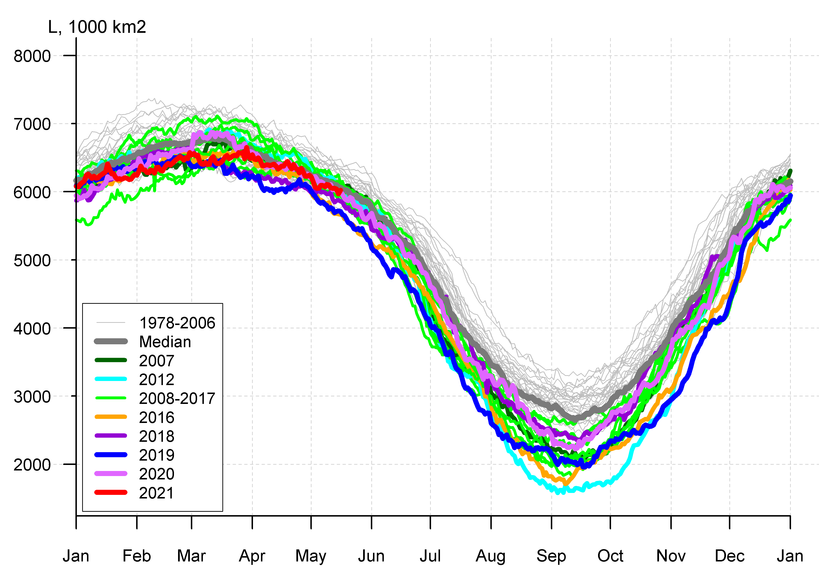

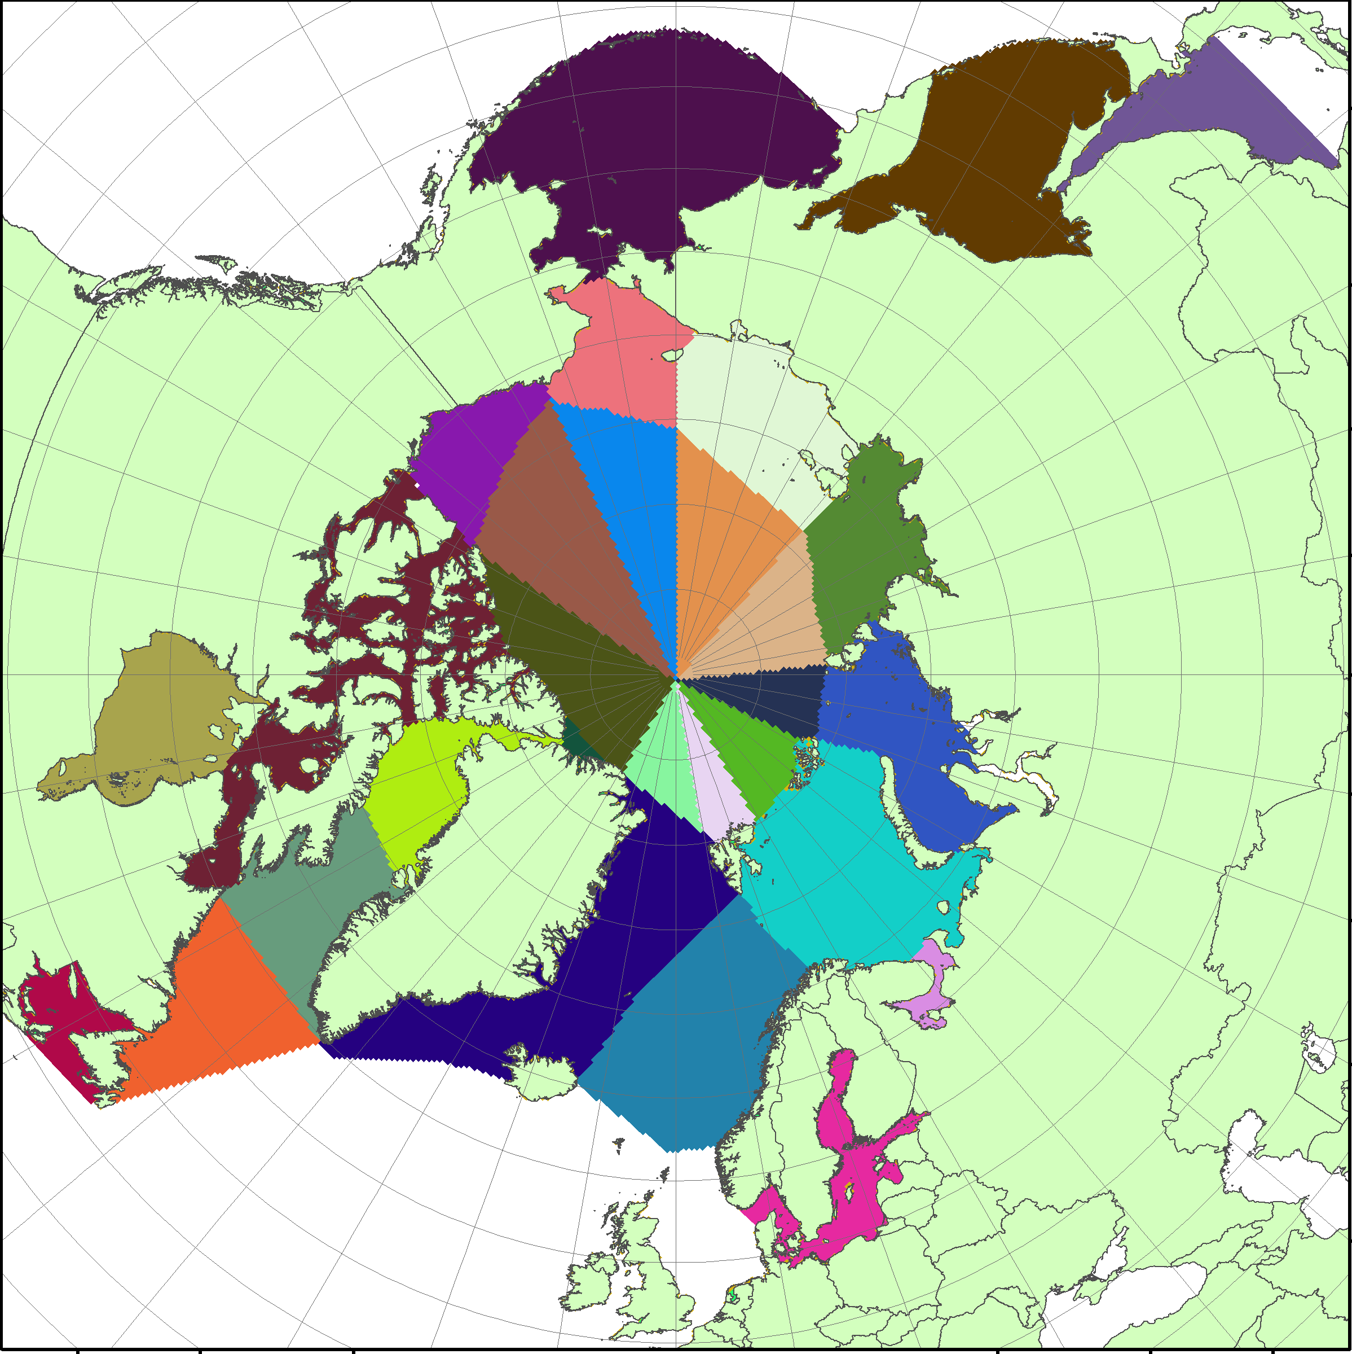
Arctic (NH) seasonal ice extent 1978…. 2021
S, 1000 km²
S, 1000 km²
S, 1000 km²
Western Arctic (WA)
Sep (Min) March (Max)
Northern Hemisphere
2012 3346
2020 3882
2016 4099
2019 4103
2007 4189
2011 4312
2015 4350
2018 4557
2008 4588
2017 4622
2010 4641
… …
… …
1982 7246
1983 7285
1980 7611
2017 14467
2018 14516
2015 14526
2016 14580
2011 14701
2006 14867
2019 14891
2007 14931
2014 14972
2021 15100
… …
2020 15390
... ...
1988 16461
1983 16547
1979 16769
Jan Feb Mar Apr May Jun Jul Aug Sep Oct Nov Dec Jan
Jan Feb Mar Apr May Jun Jul Aug Sep Oct Nov Dec Jan
S, 1000 km²
S, 1000 km²
Eastern Arctic (EA)
Canadian Arctic (CA)
CA
EA
Jan Feb Mar Apr May Jun Jul Aug Sep Oct Nov Dec Jan
Jan Feb Mar Apr May Jun Jul Aug Sep Oct Nov Dec Jan
Maximum winter ice extent, 10th in row, ~15.1 mln km² (~15,4 in 2020, 16th in row) reached 11 March 2021 (4 March in 2020). Winter 10th in row maximum in 2021 somewhat slightly if any correlates with summer 2nd in row minimum in 2020
During freezing period the lowest on record Arctic ice extent was observed in October – mid November in the Eurasian Arctic due to drastically reduced ice cover, accumulated heat content and positive SAT anomalies
WA
[AARI / NSIDC]

Slide 15
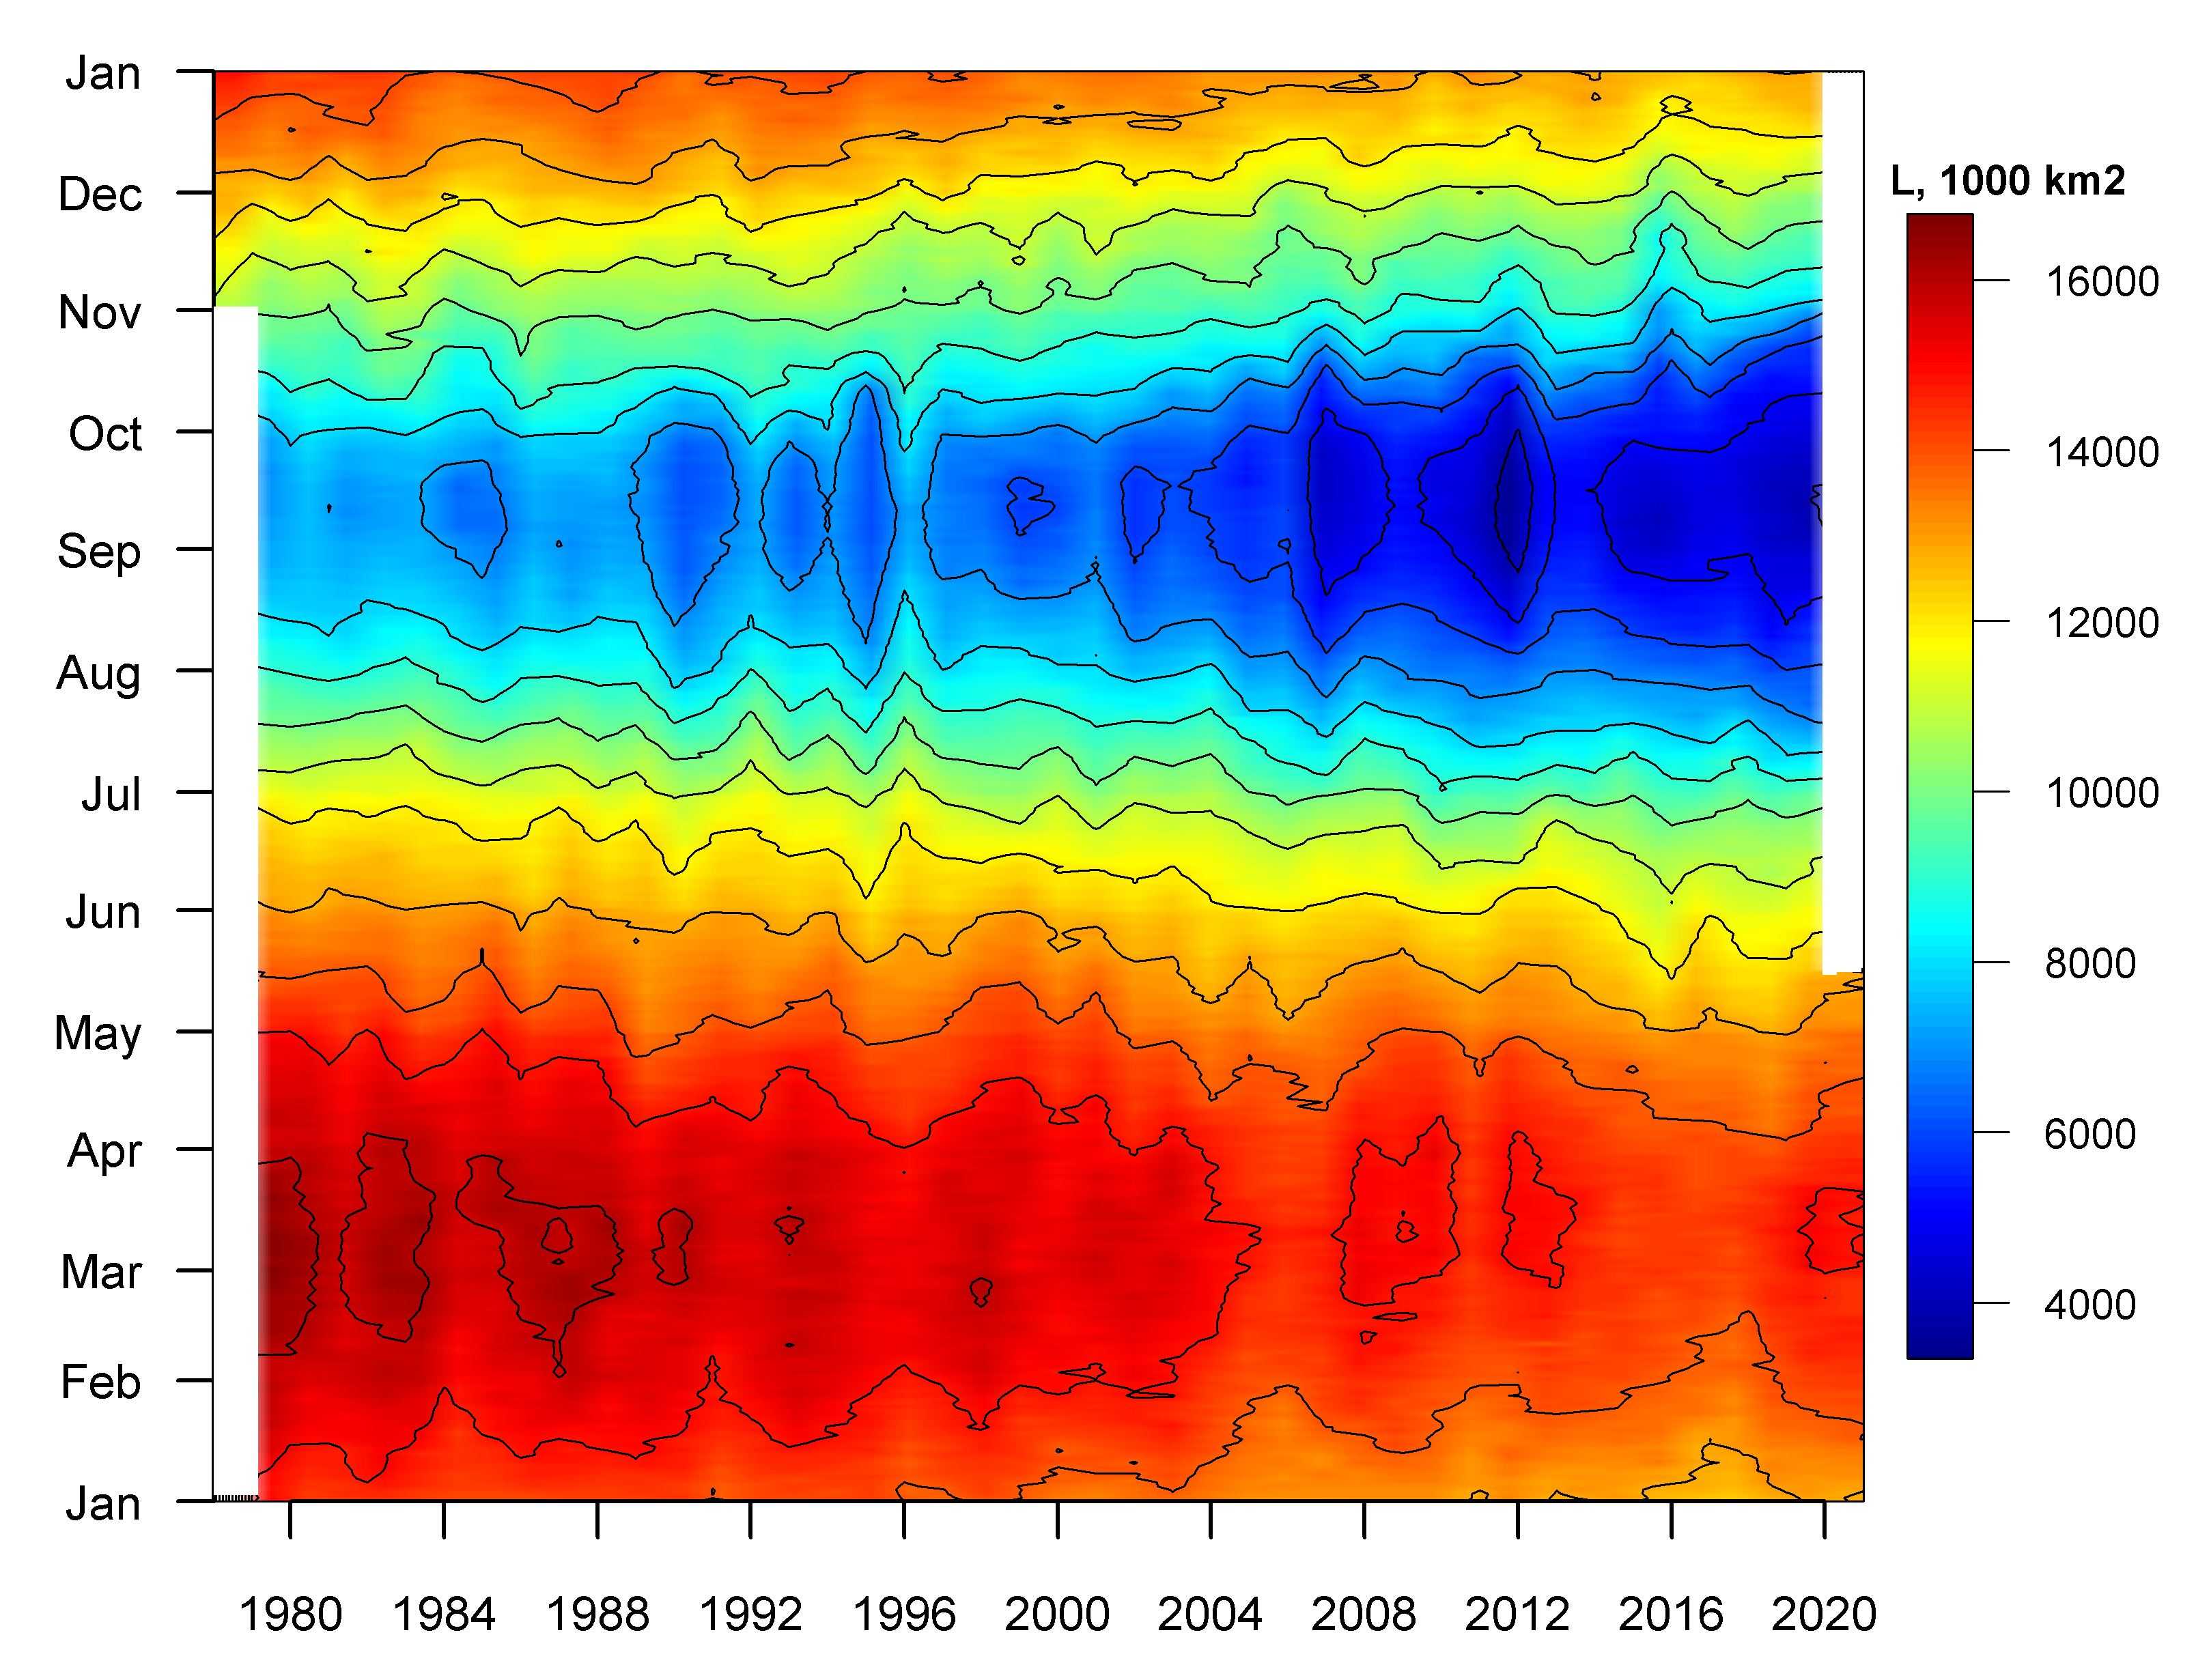
Seasonal NH ice extent variability: 1978 -2021
Seasonal patterns of daily ice extent allow to analyze interseasonal variability of ice extent
Both winter maximums and summer minimums continue to diminish
However significant interannual variability of ice extent occurs, which is a hint to a more mobile ice and variable ice conditions
[AARI / NSIDC]

Slide 16
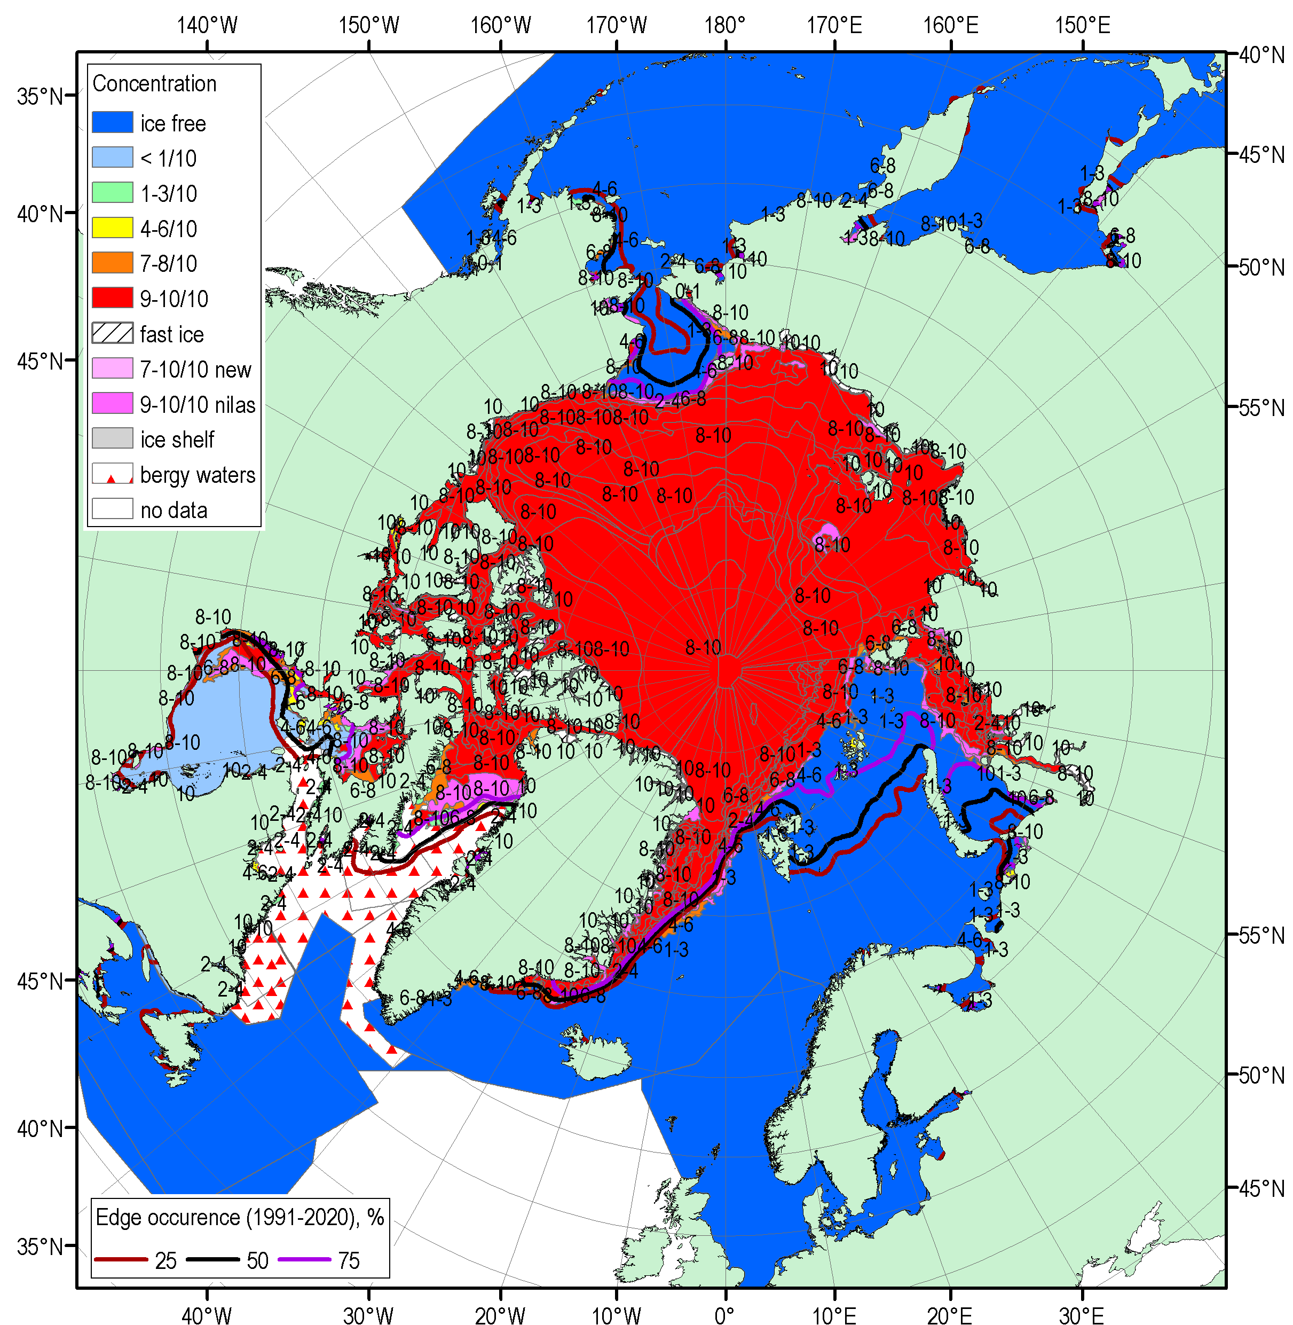
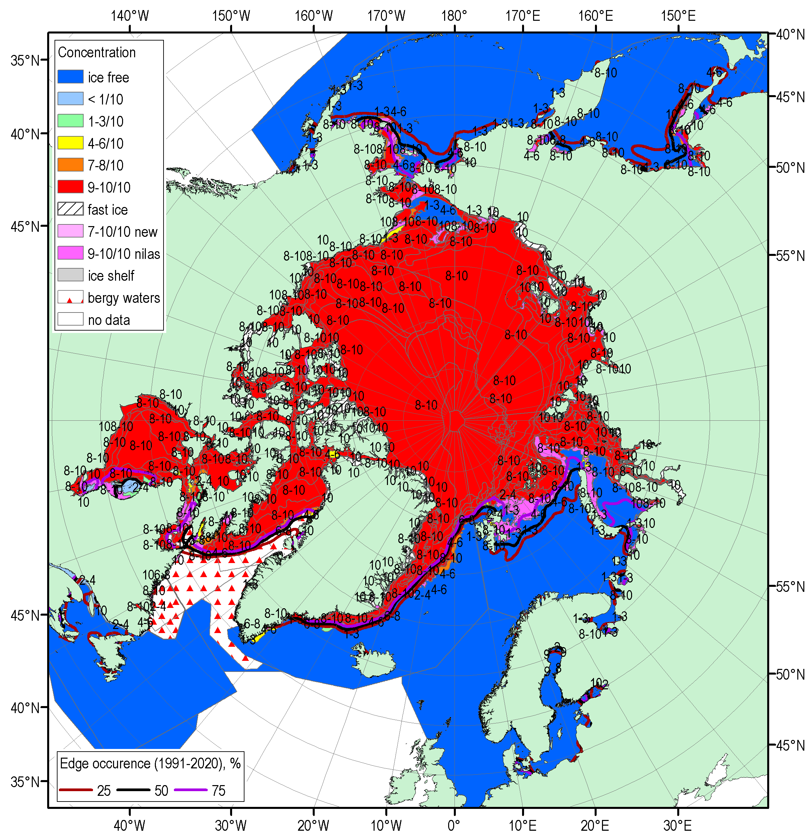
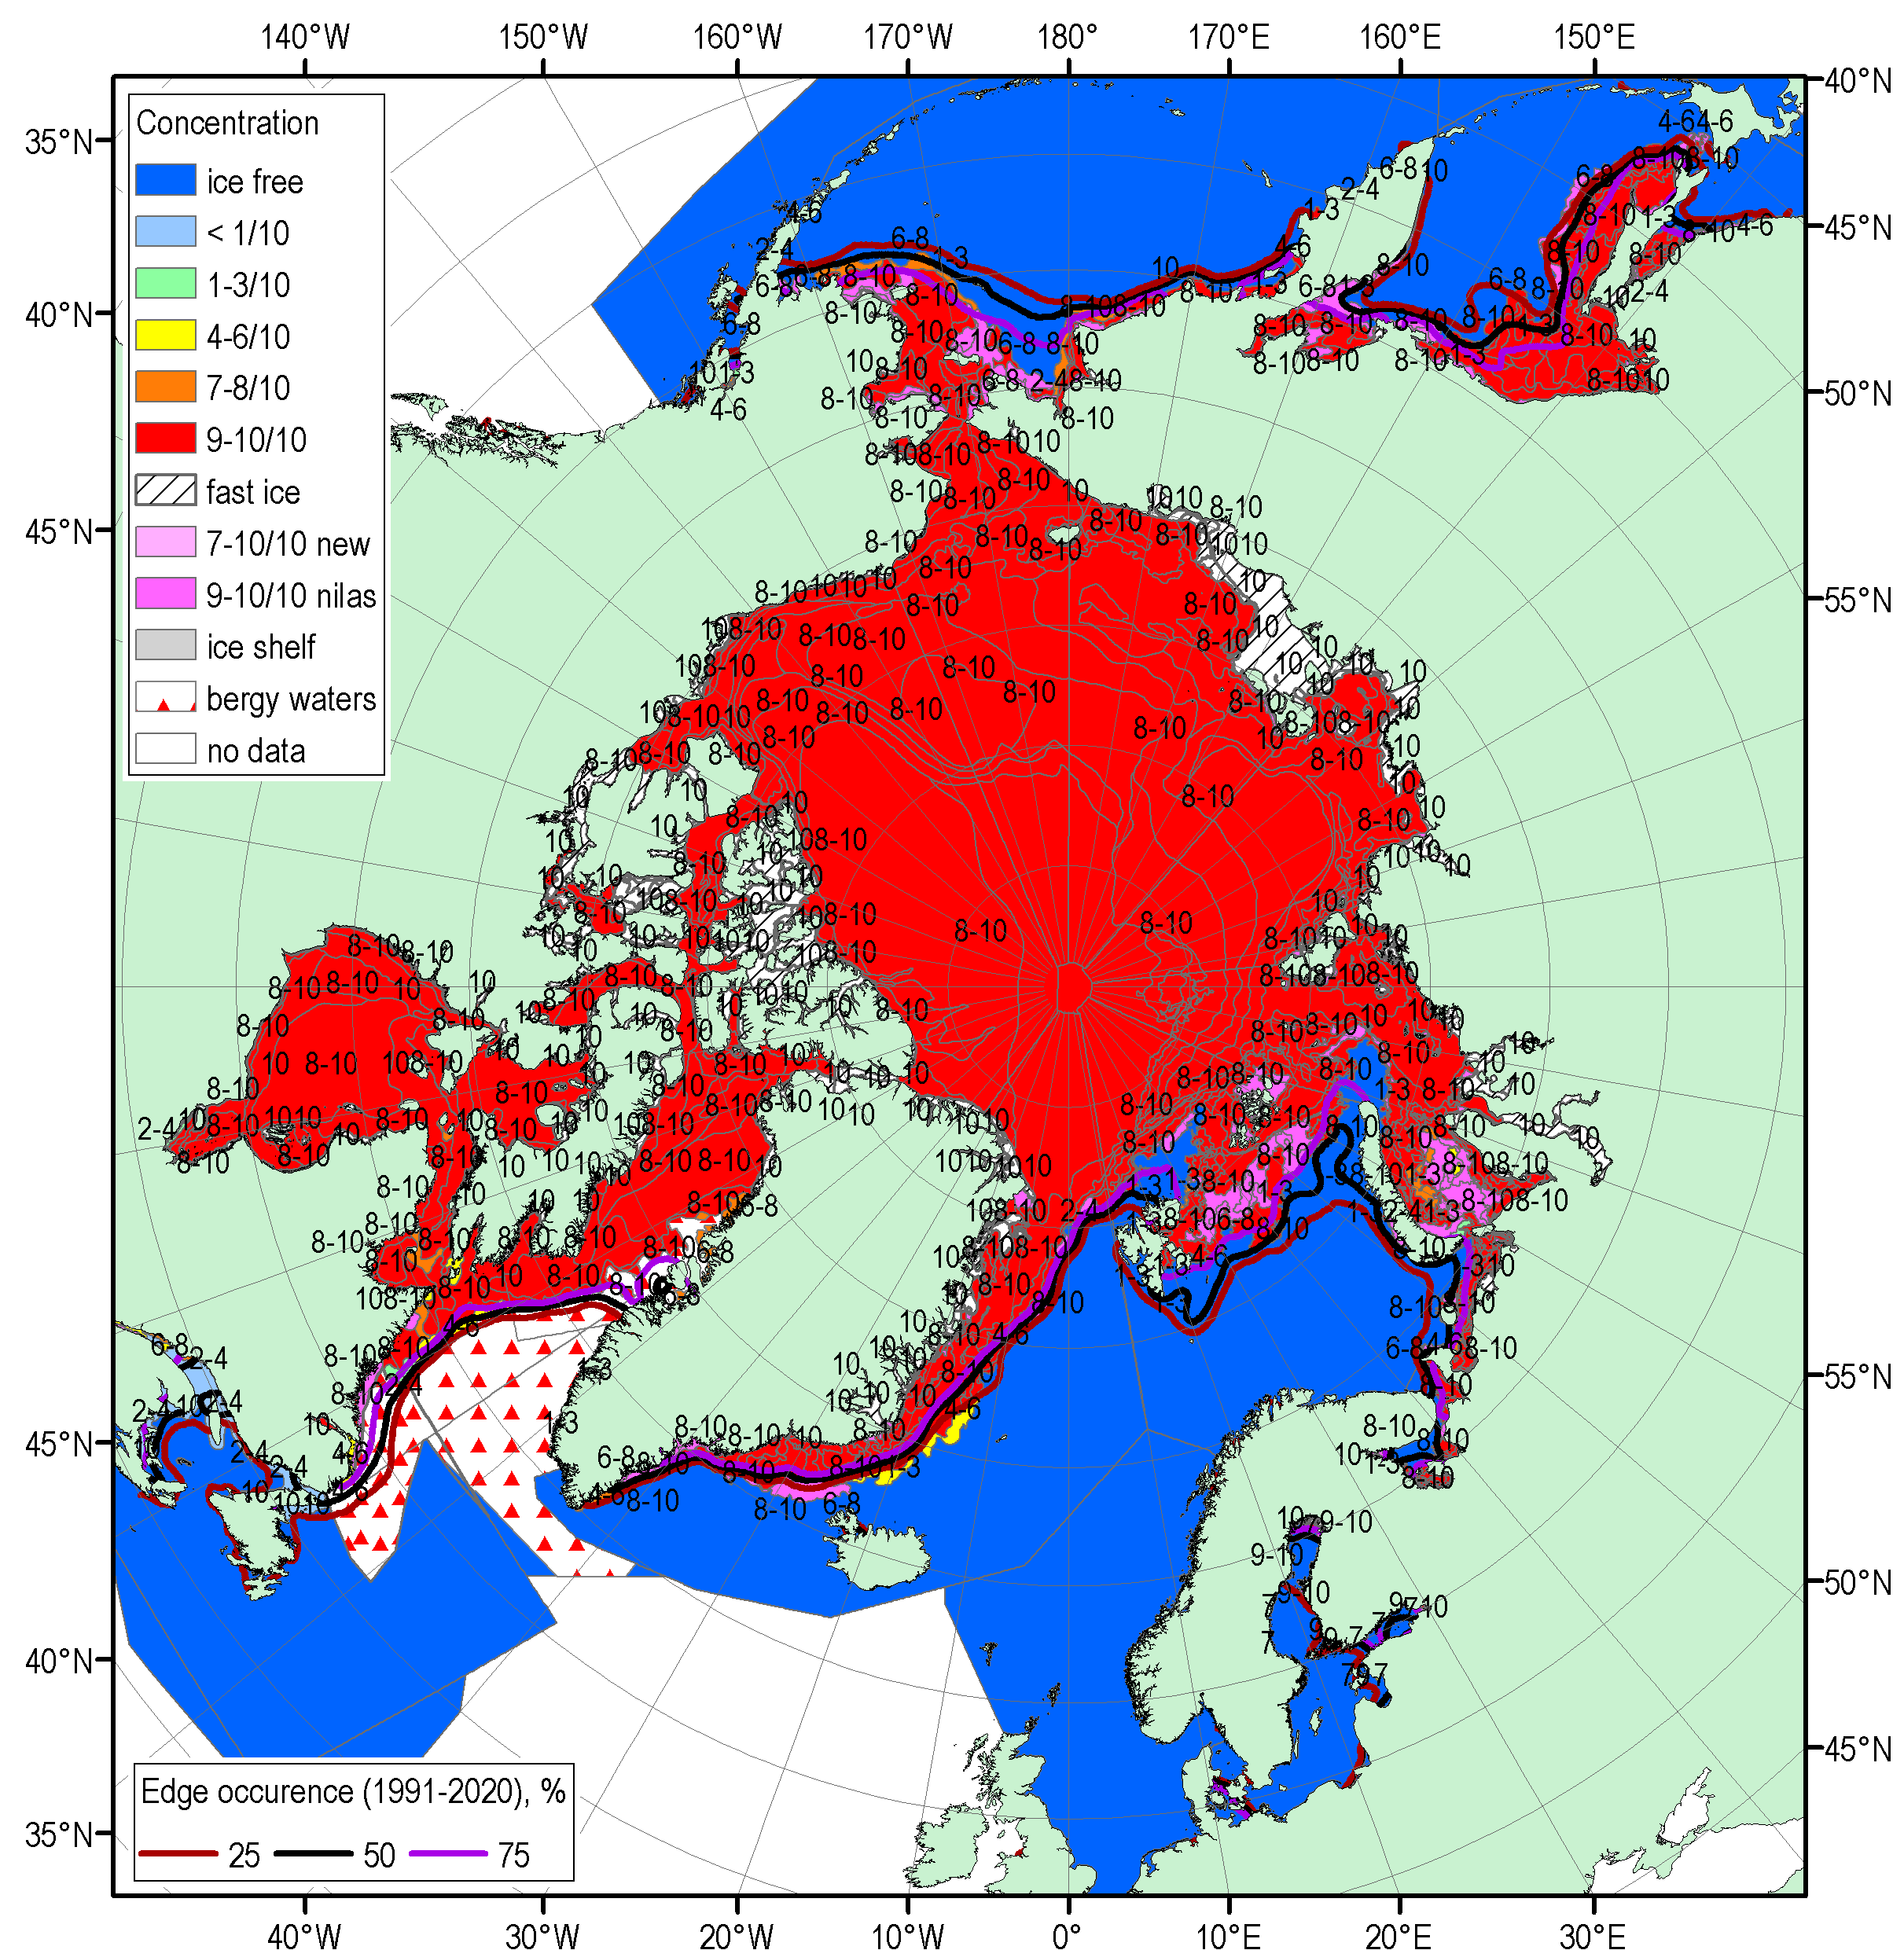
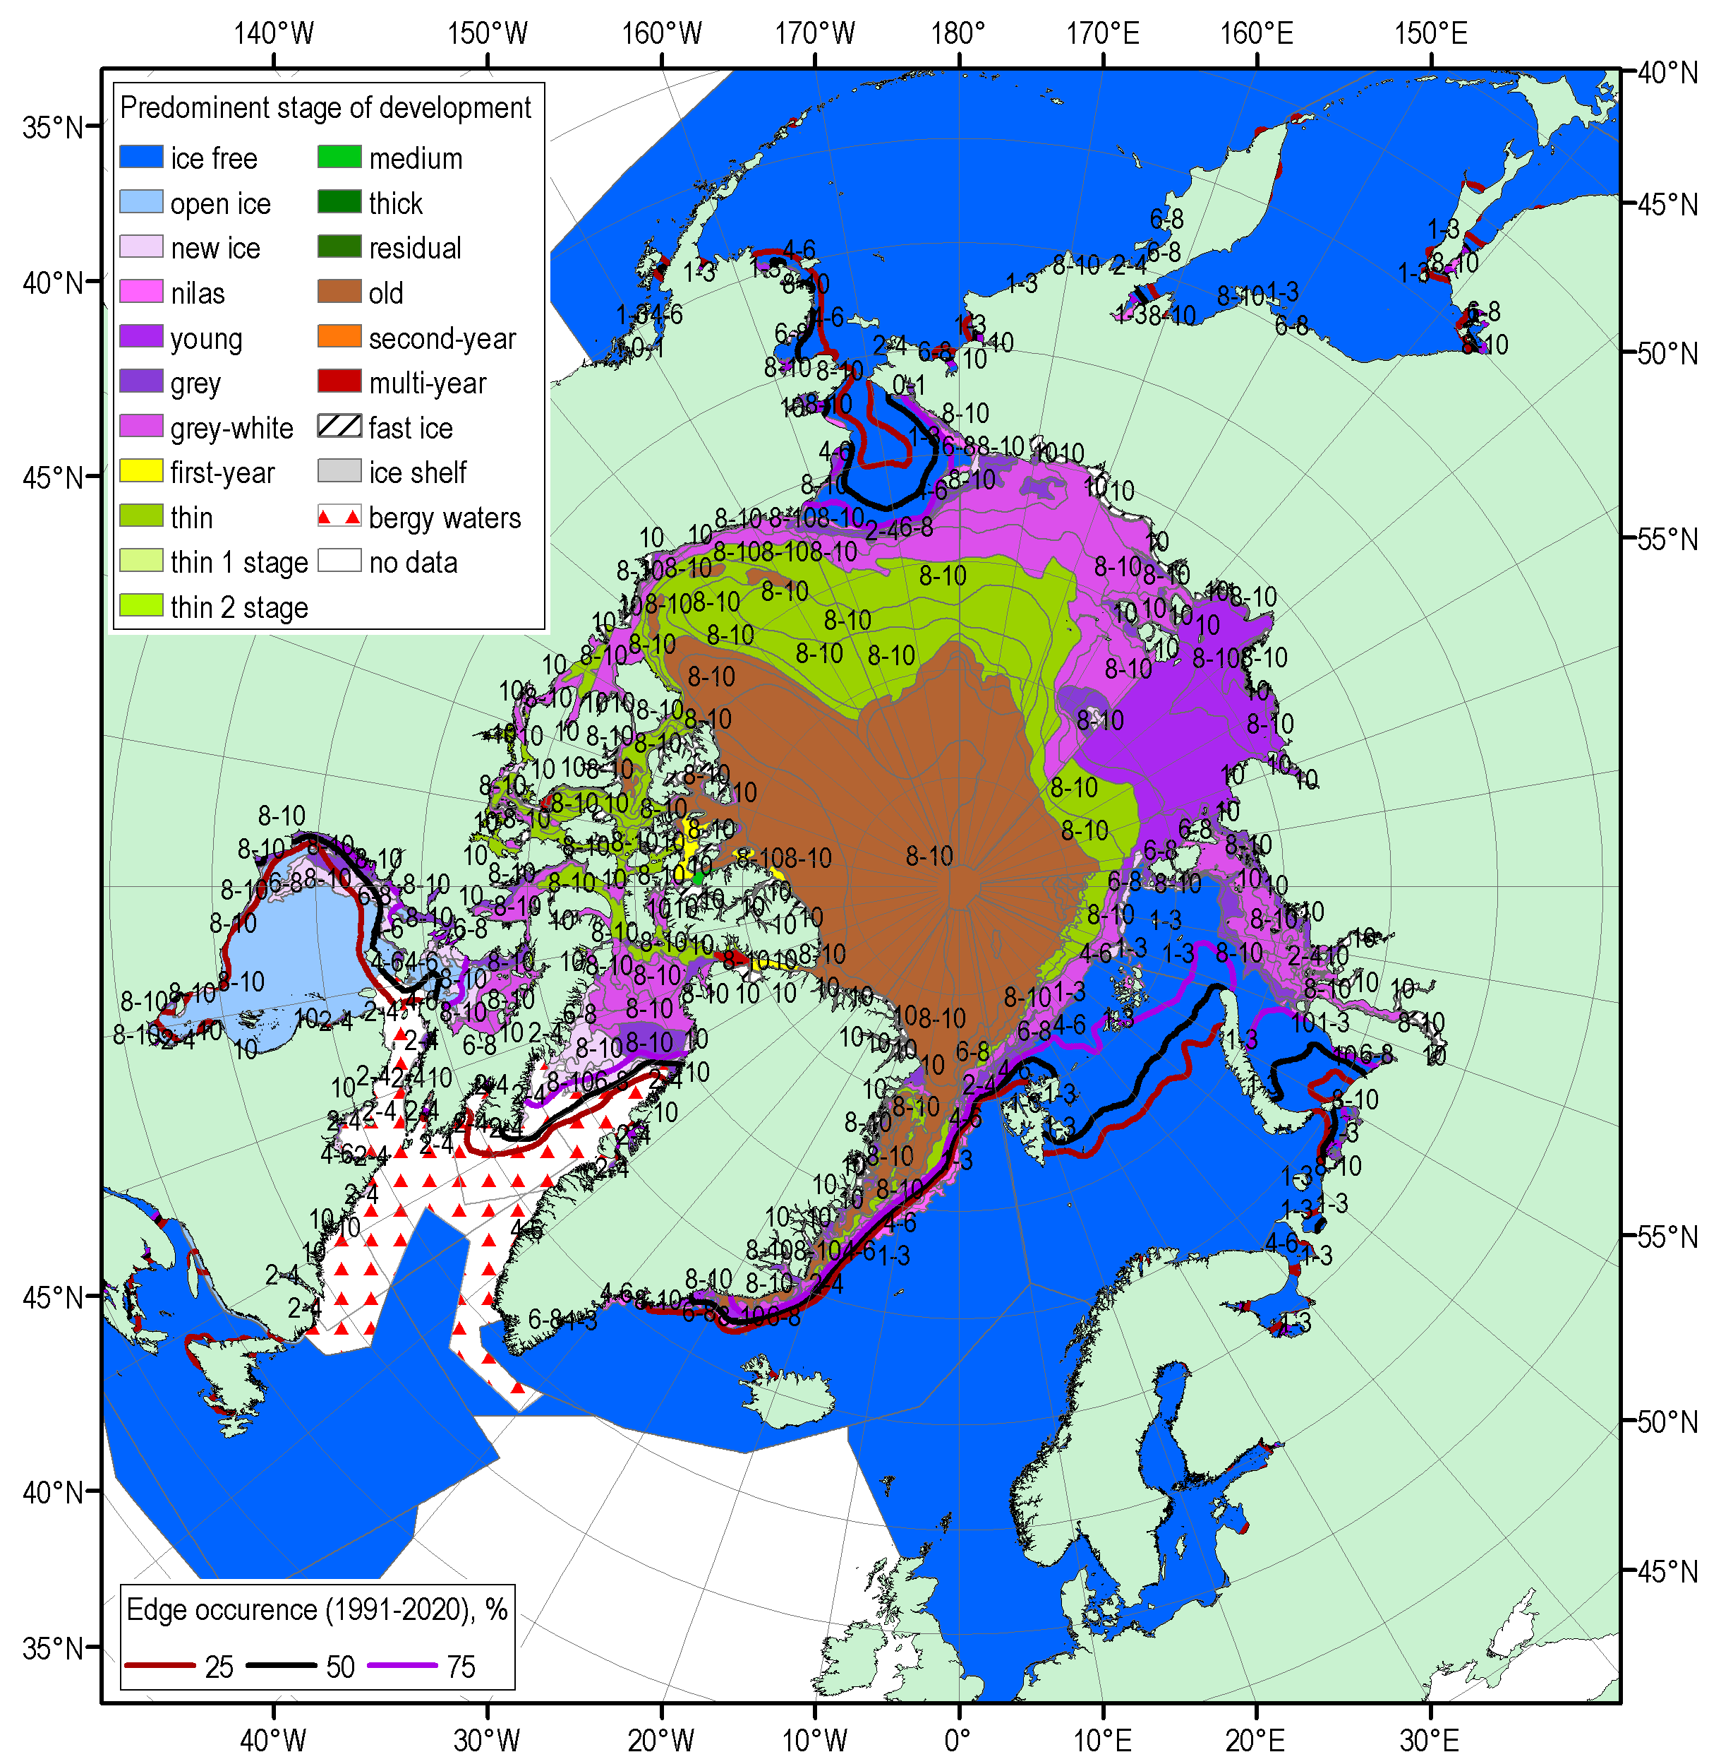
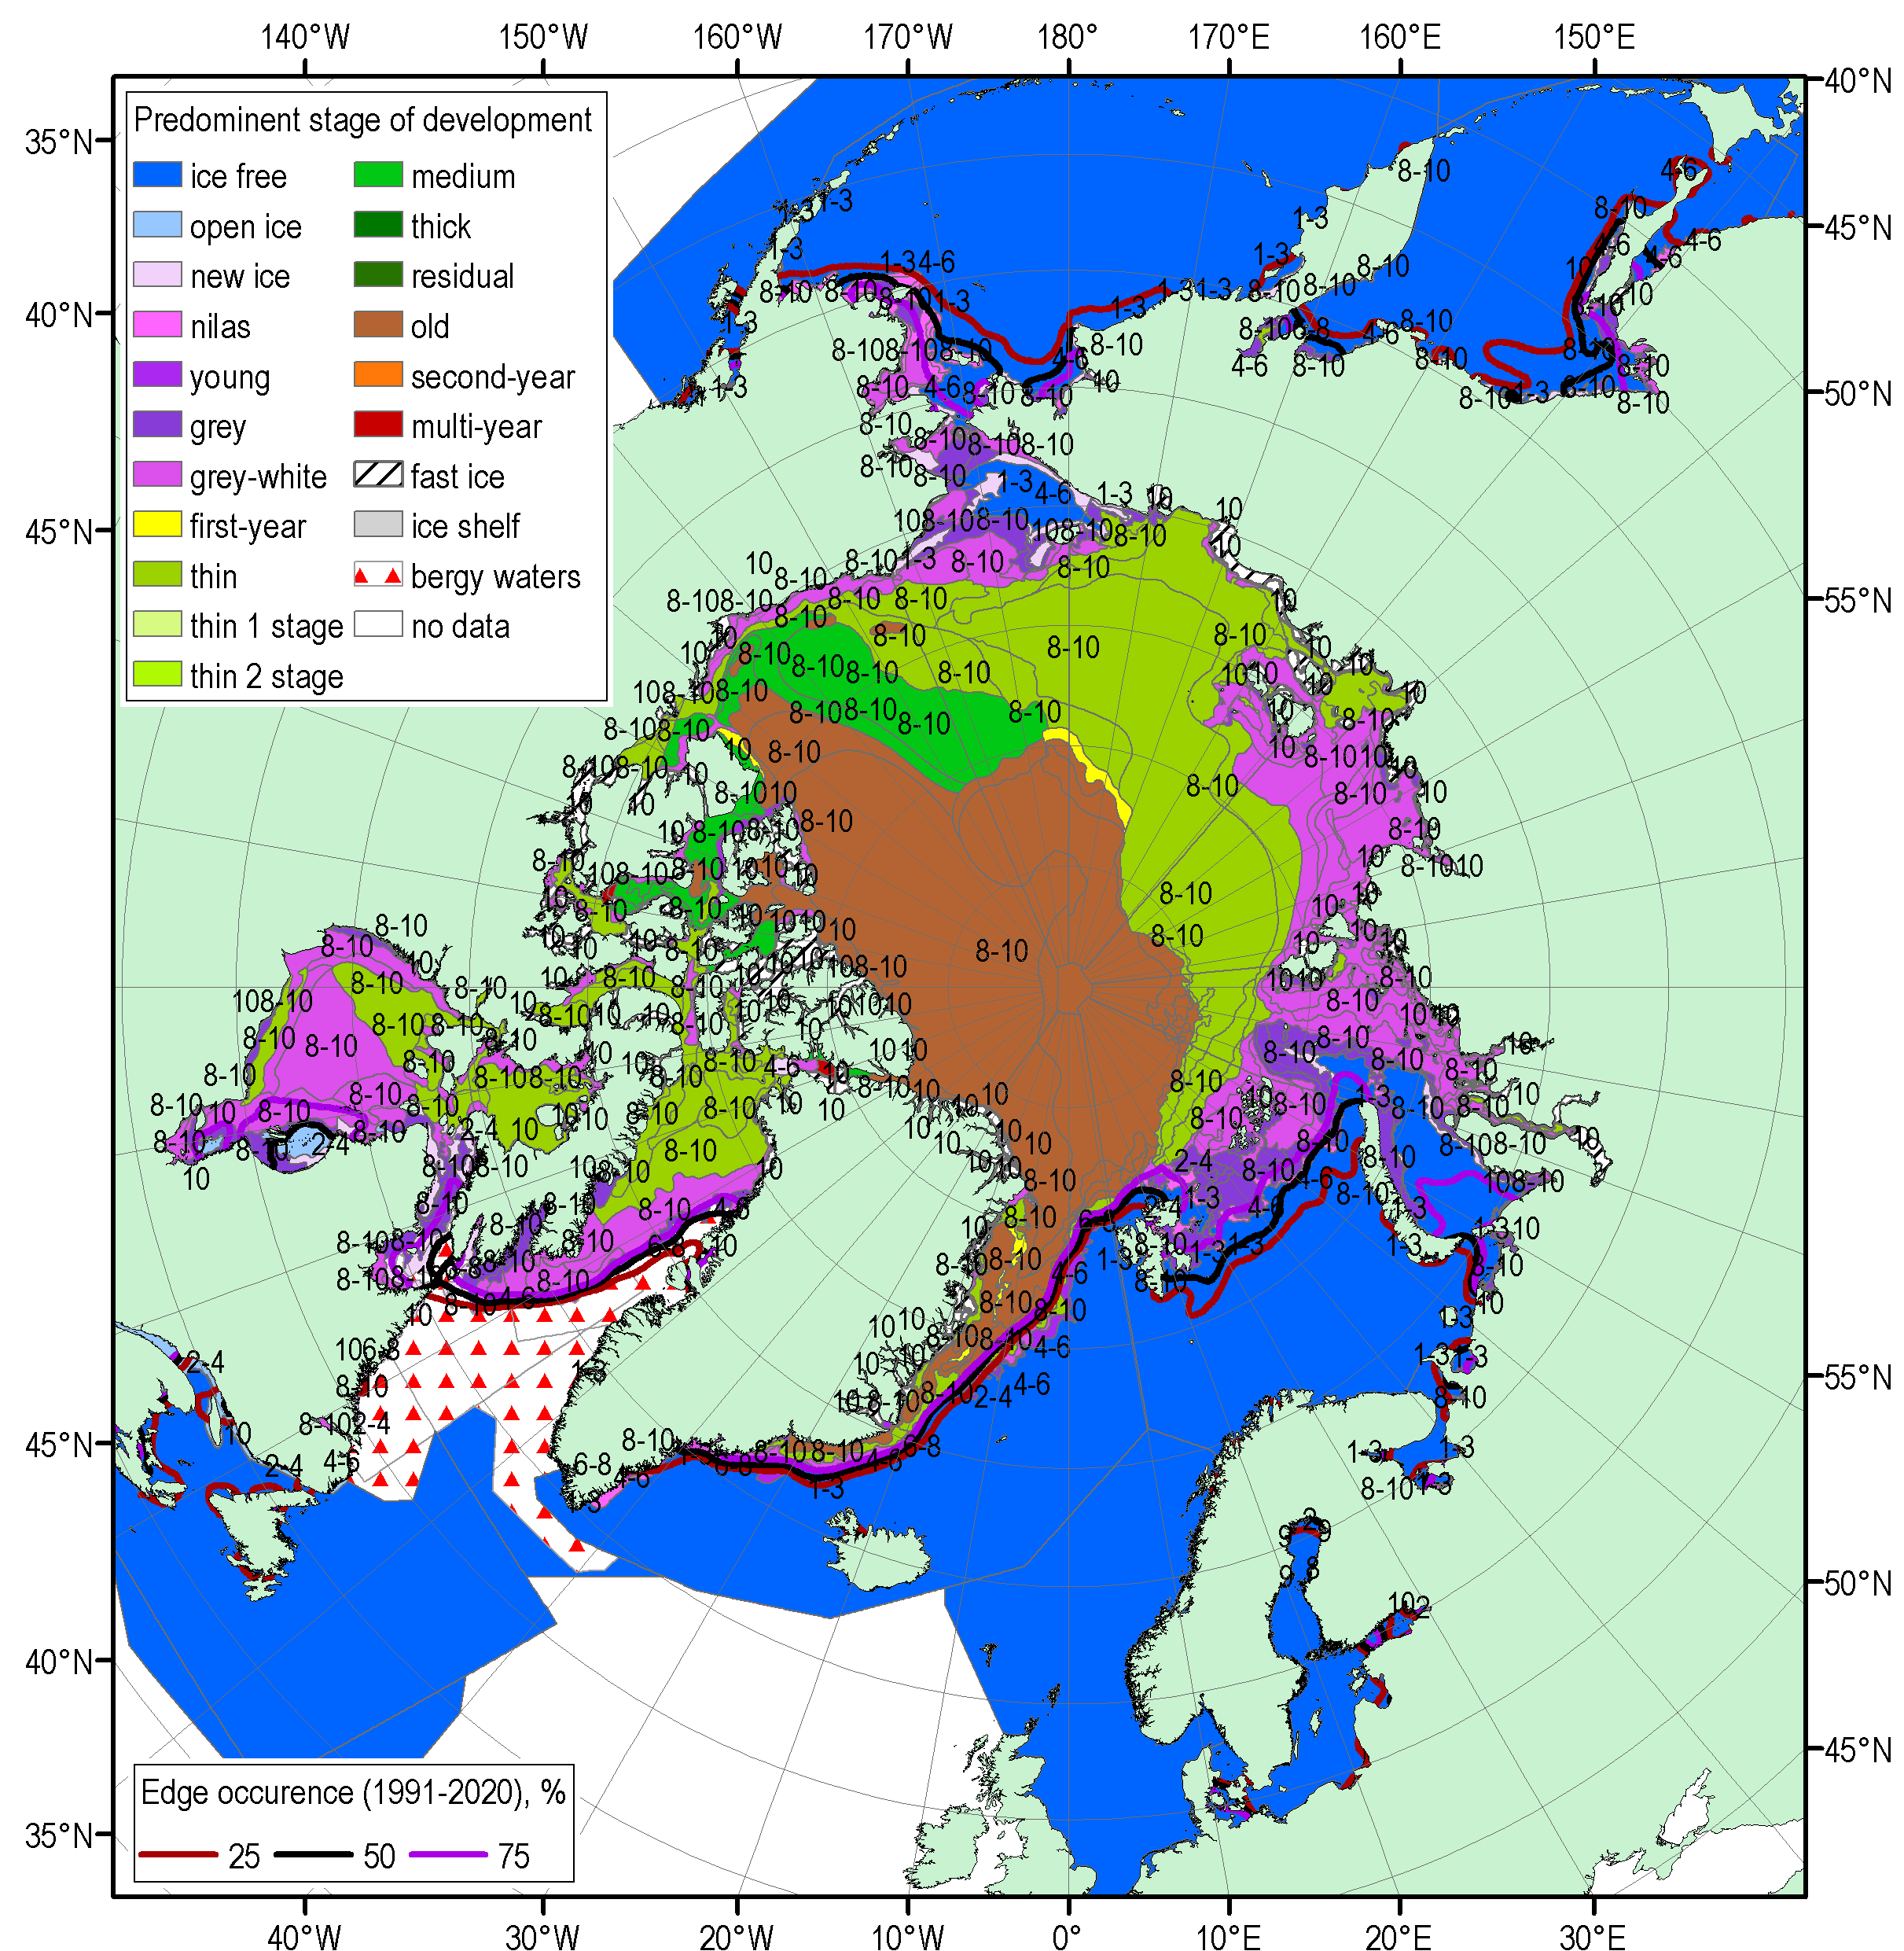
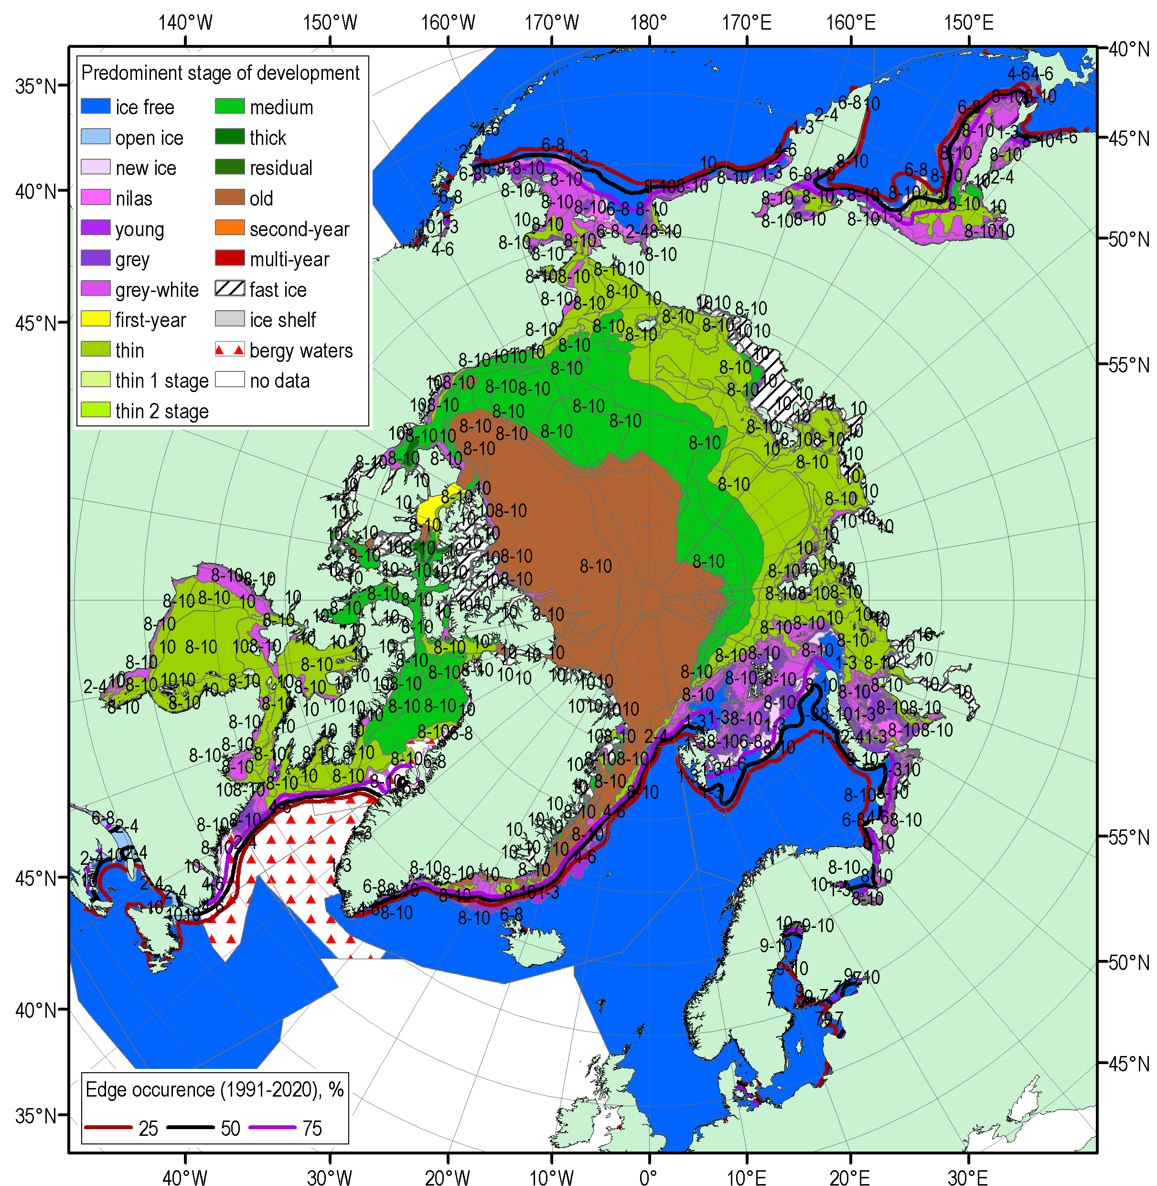
NDJ 2020/2021 Arctic sea ice – concentration and stage of development
16-19 Nov
14-17 Dec
11-14 Jan
[sea ice analysis - AARI/CIS/NIC; ice edge – AARI/NSIDC, nearest 5days, reference period: 1991-2020]

Slide 17
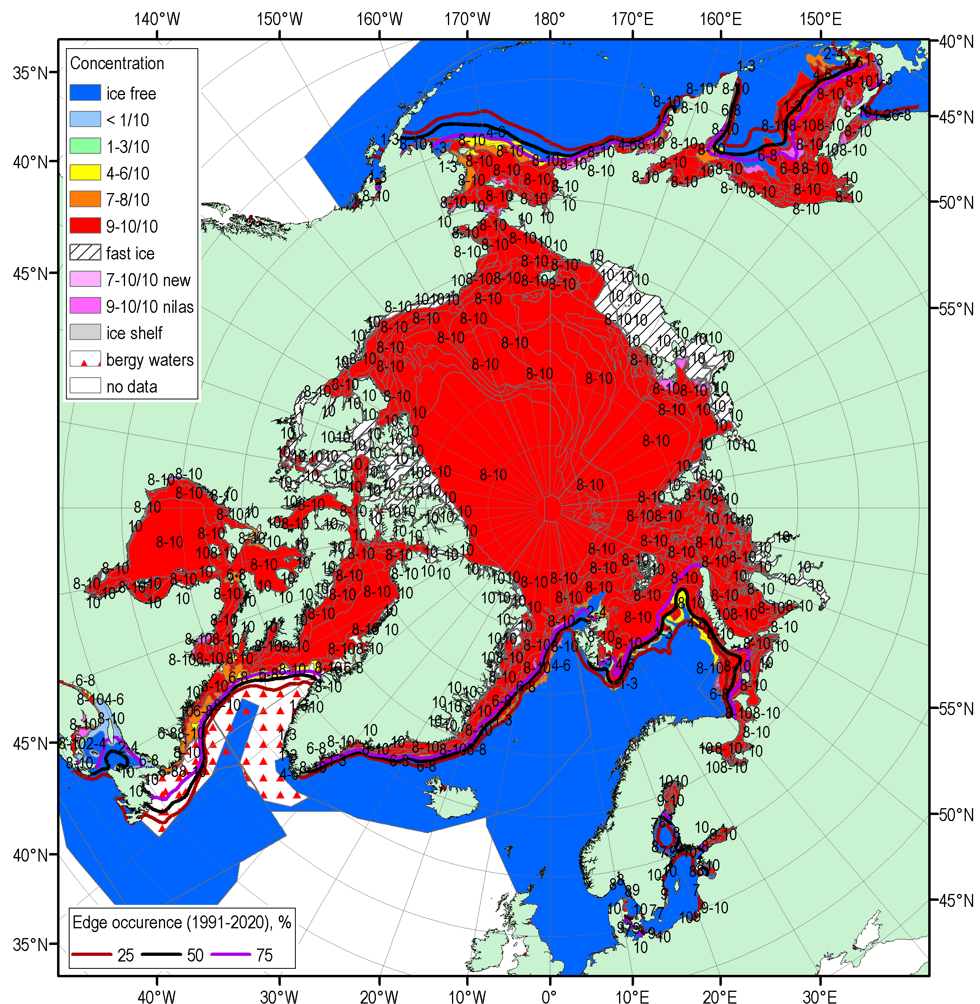
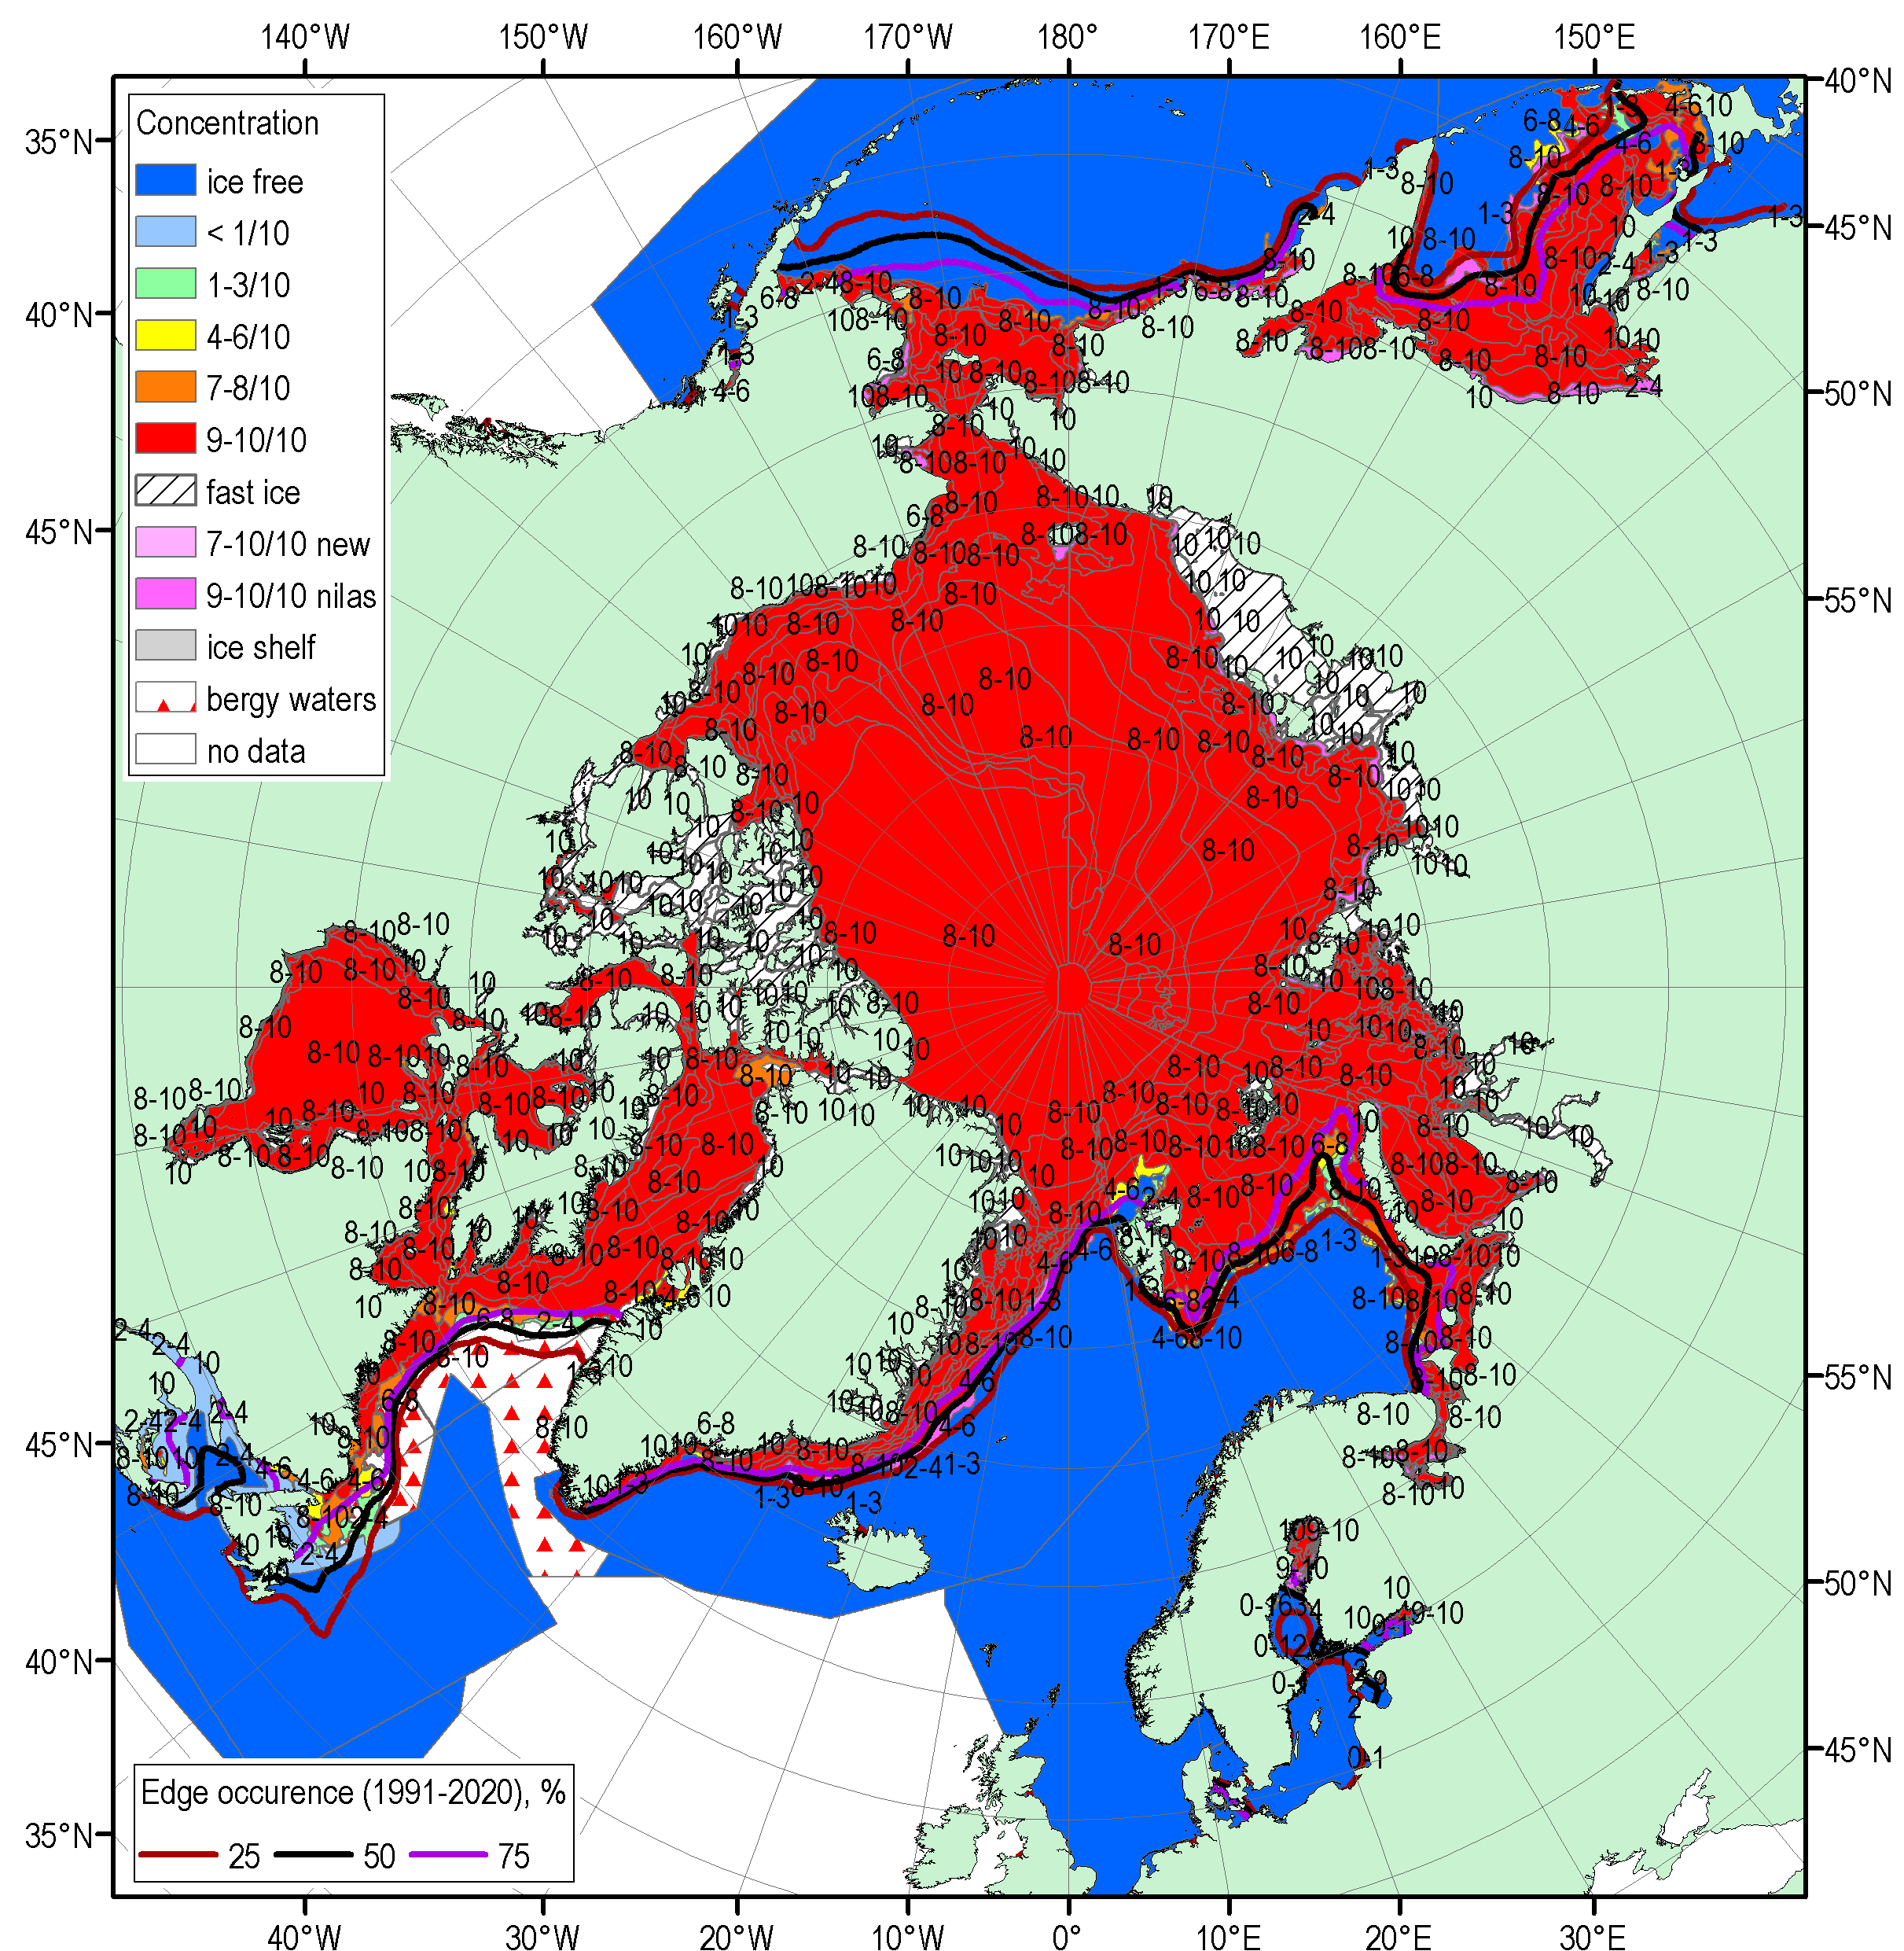
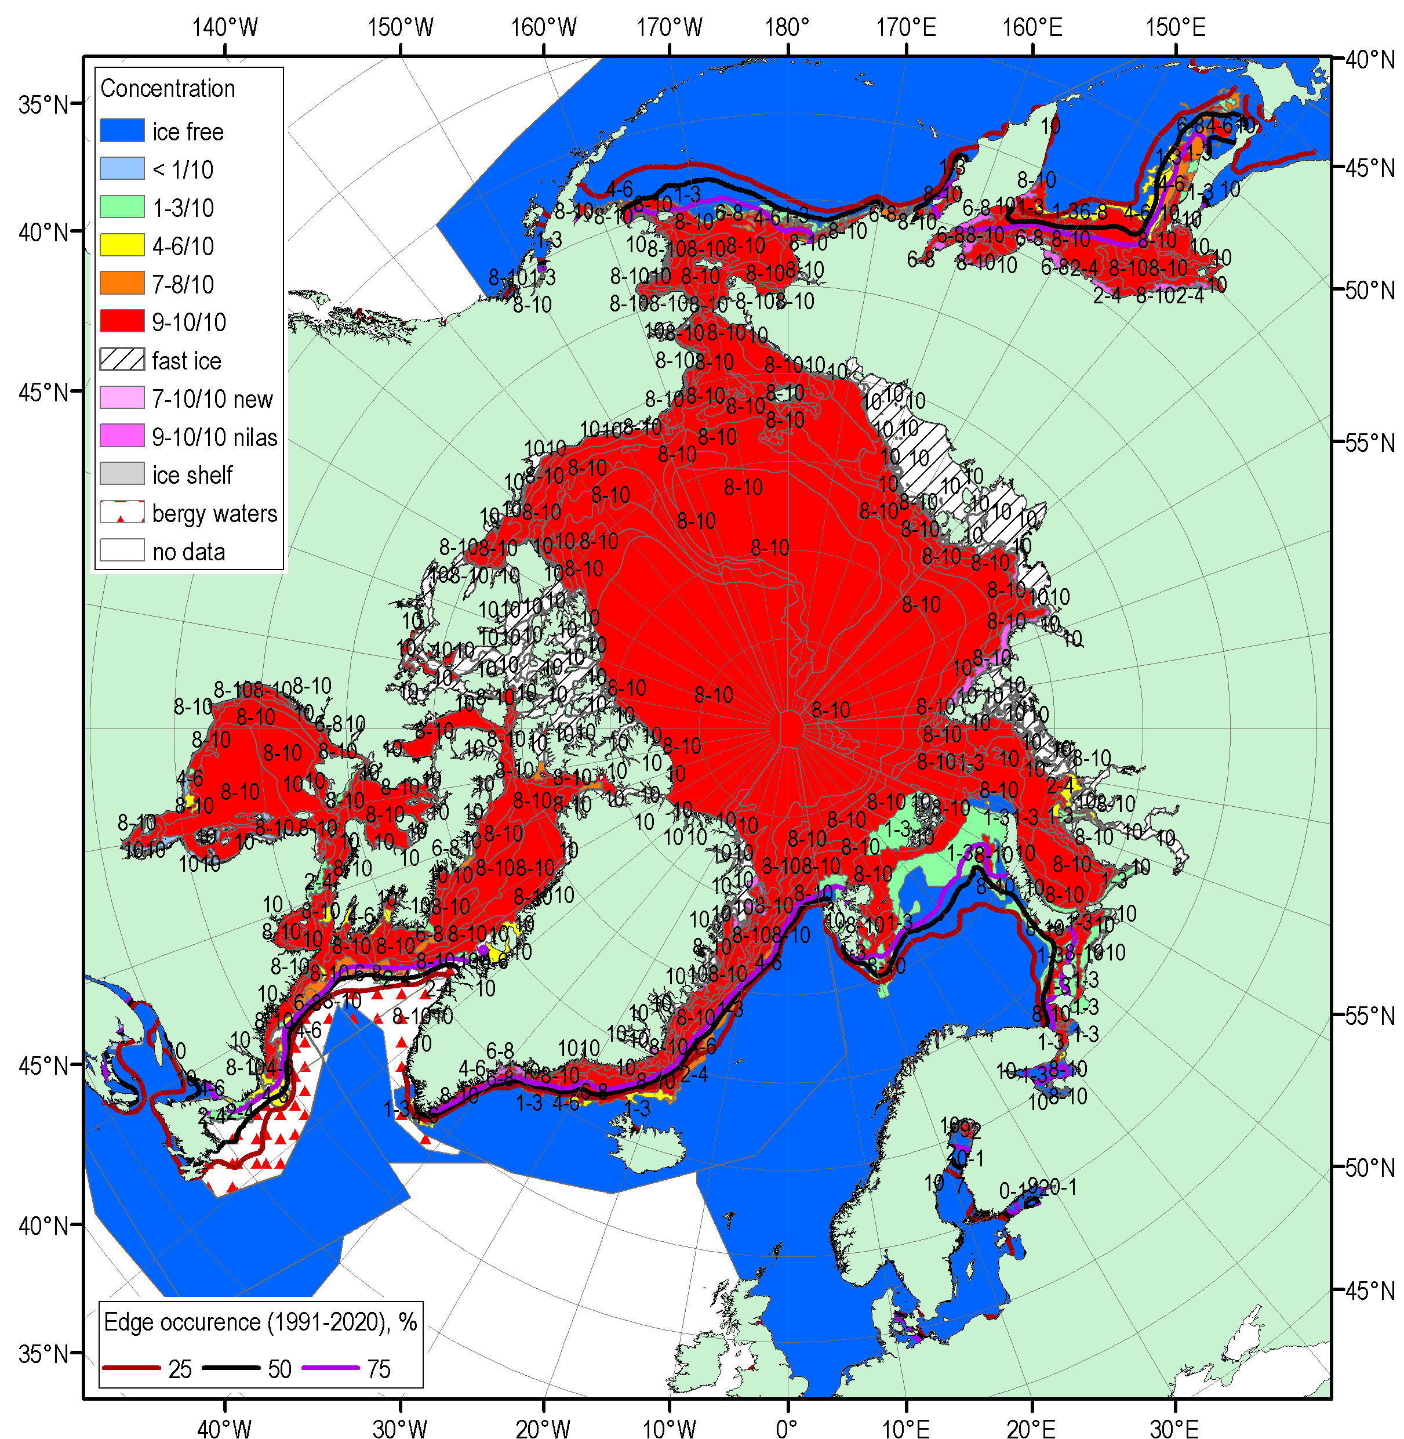
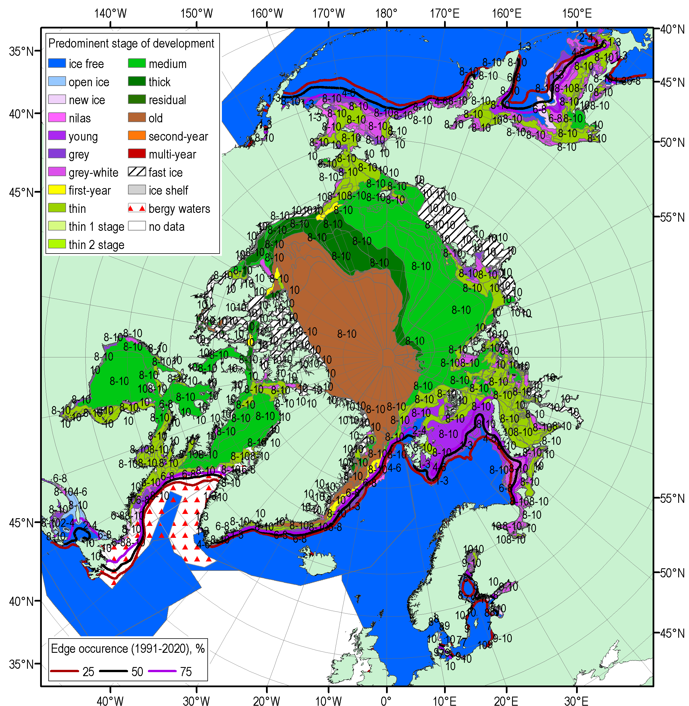
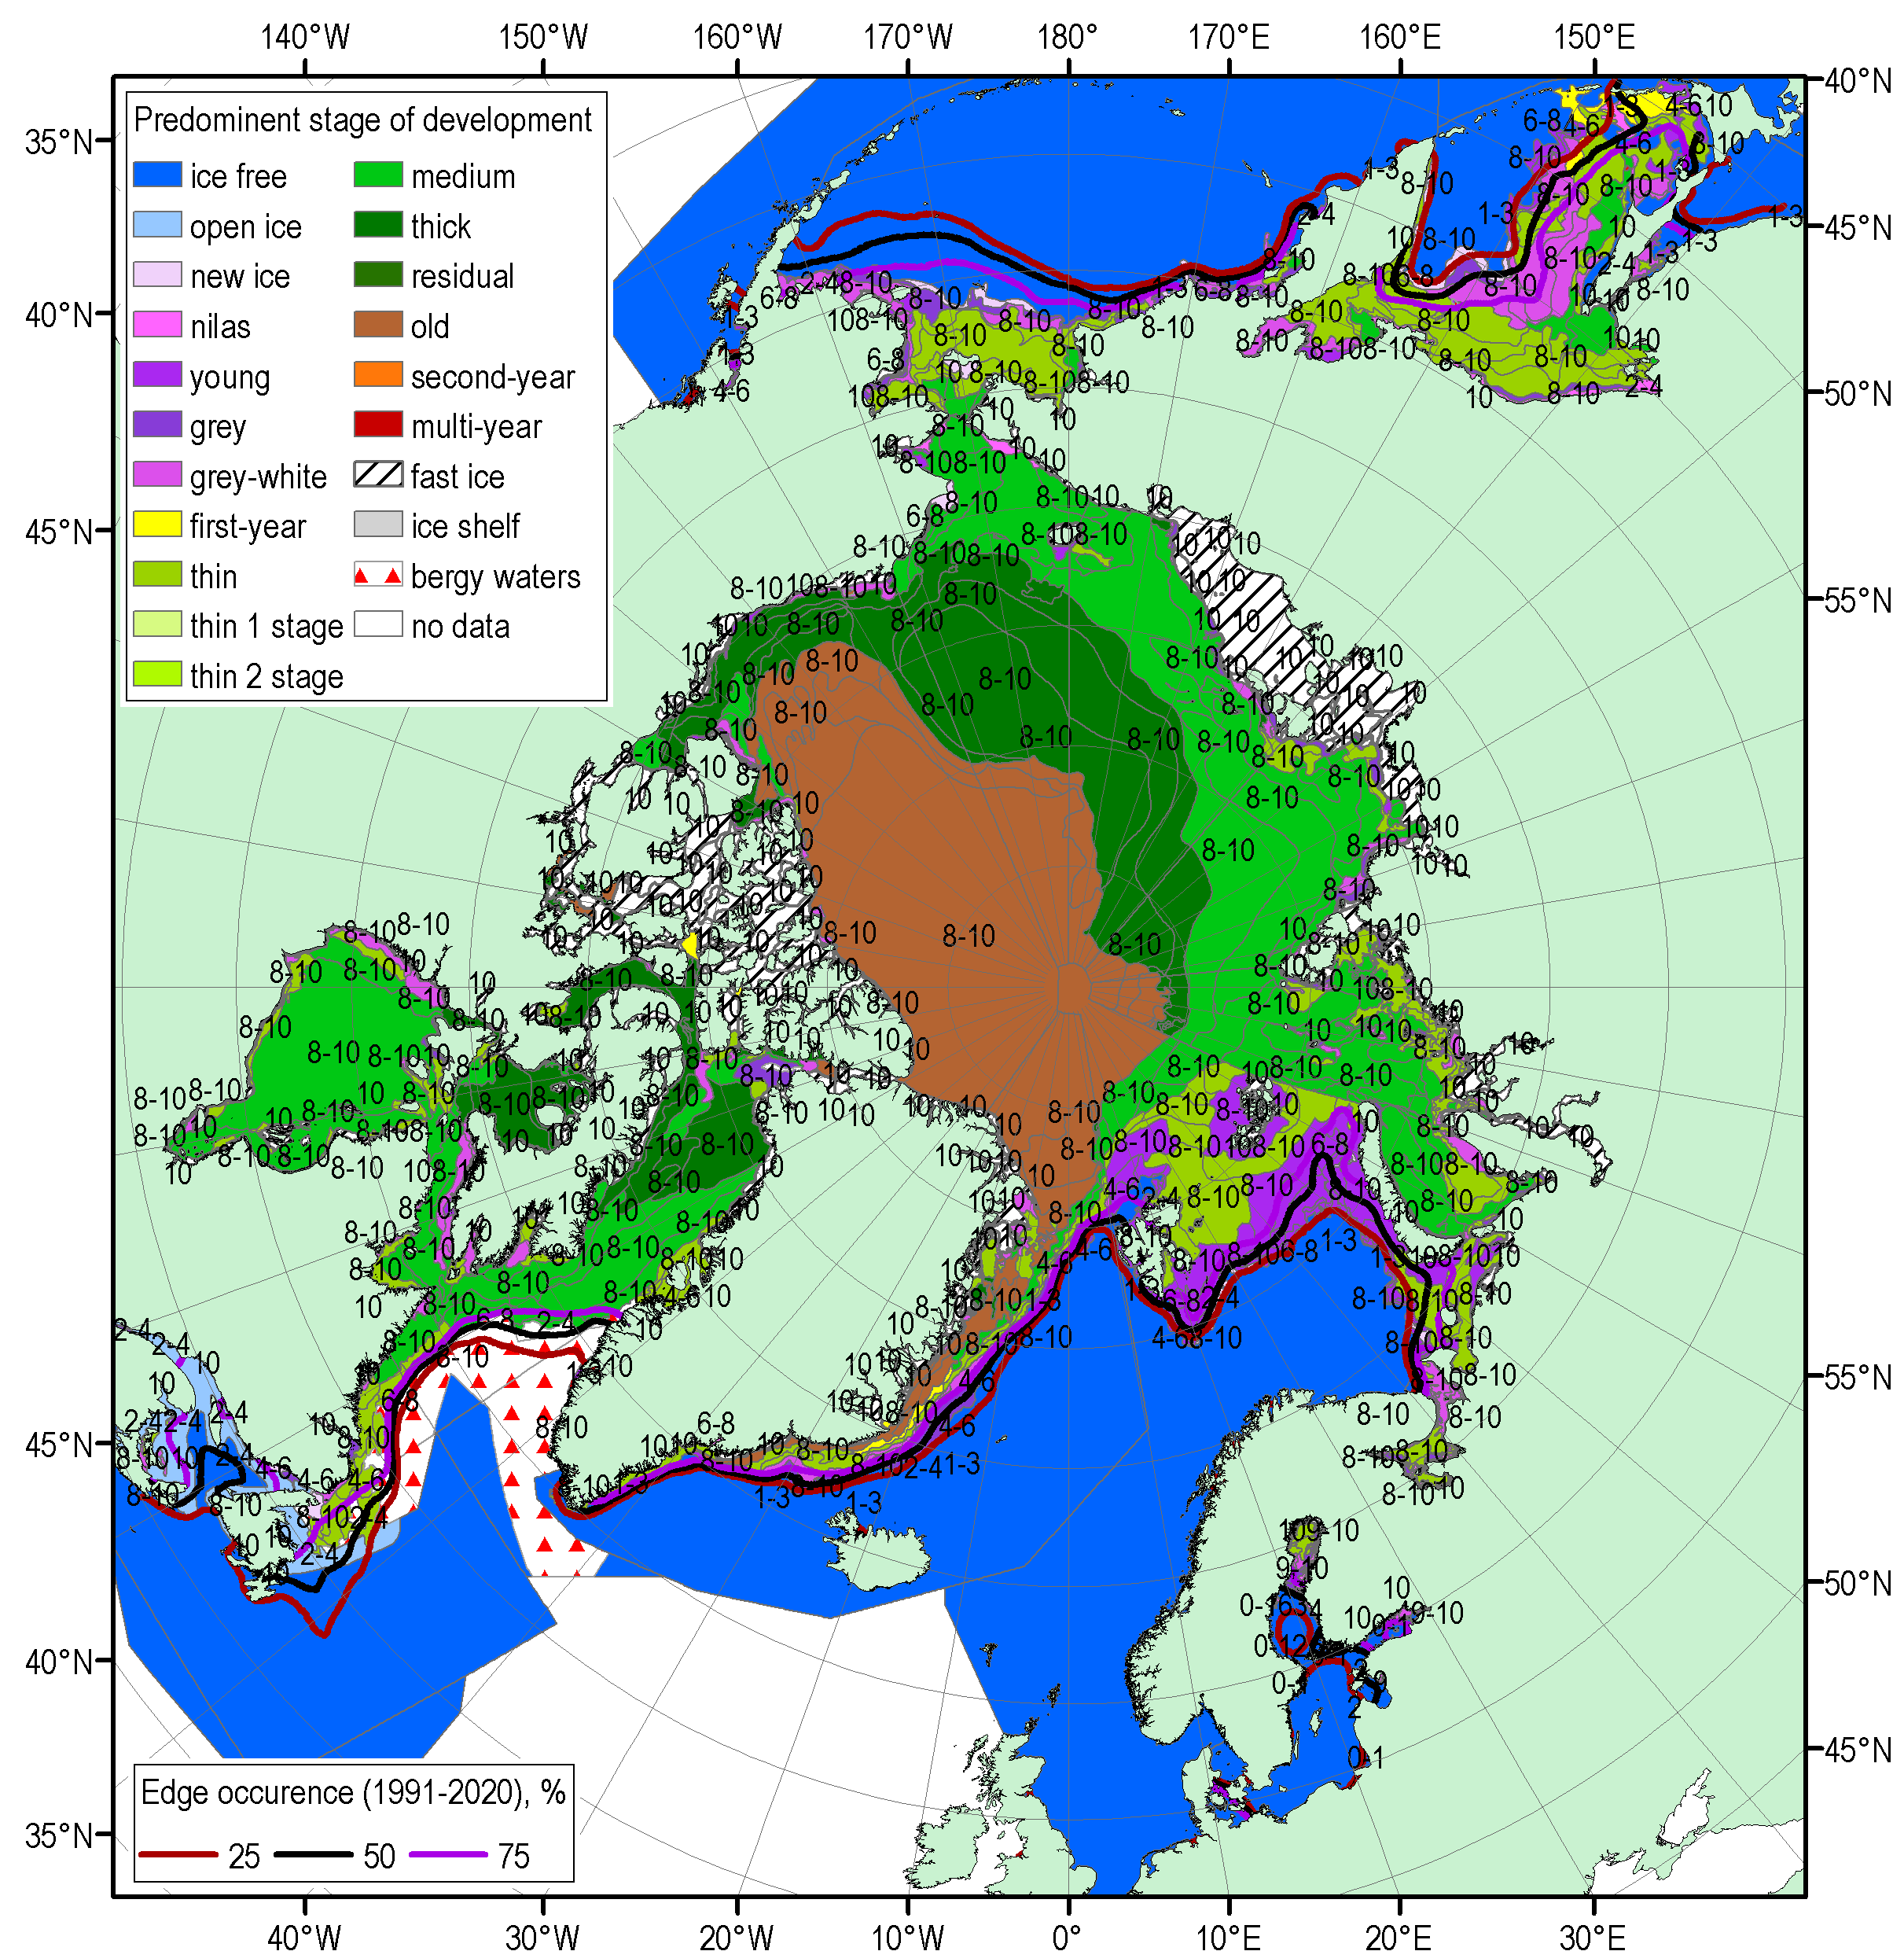
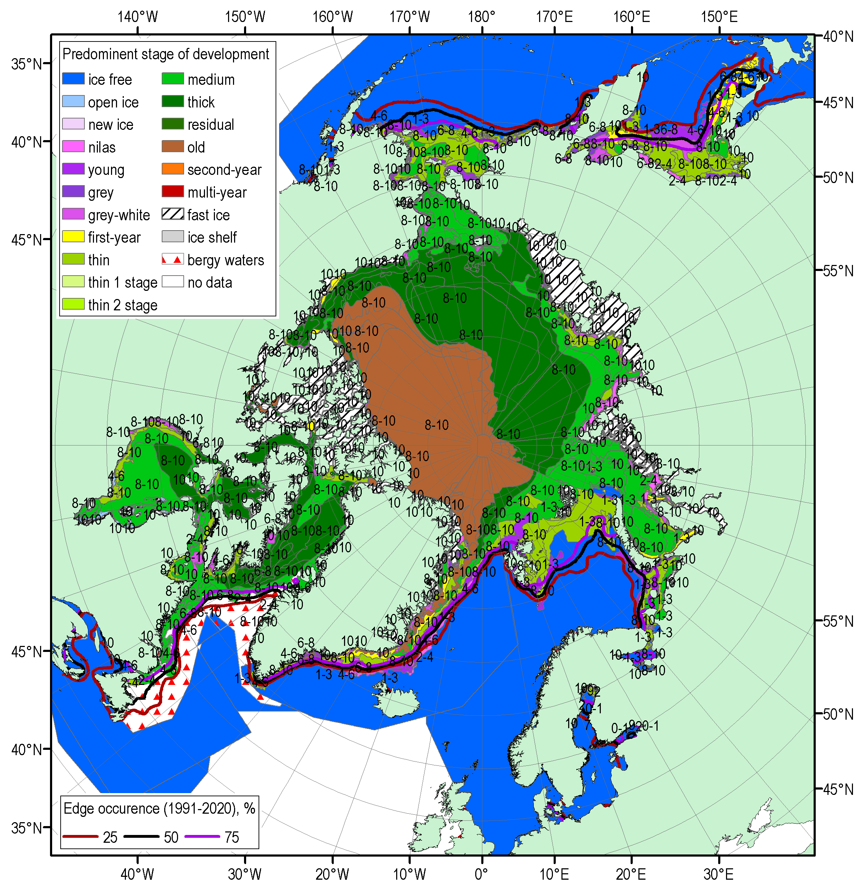
FMA 2021 Arctic sea ice – concentration and stage of development
15-19 Feb
15-18 Mar
12-16 Apr
[sea ice analysis - AARI/CIS/NIC; ice edge – AARI/NSIDC, nearest 5days, reference period: 1991-2020]

Slide 18
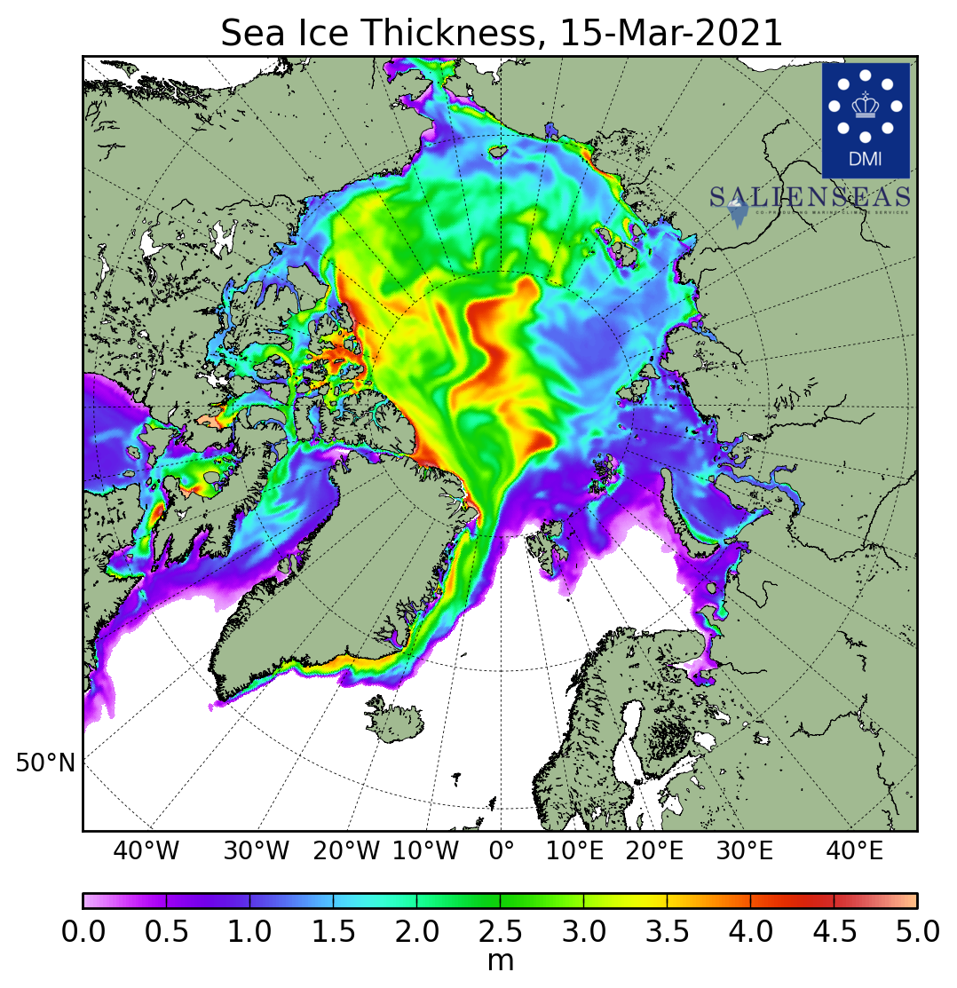
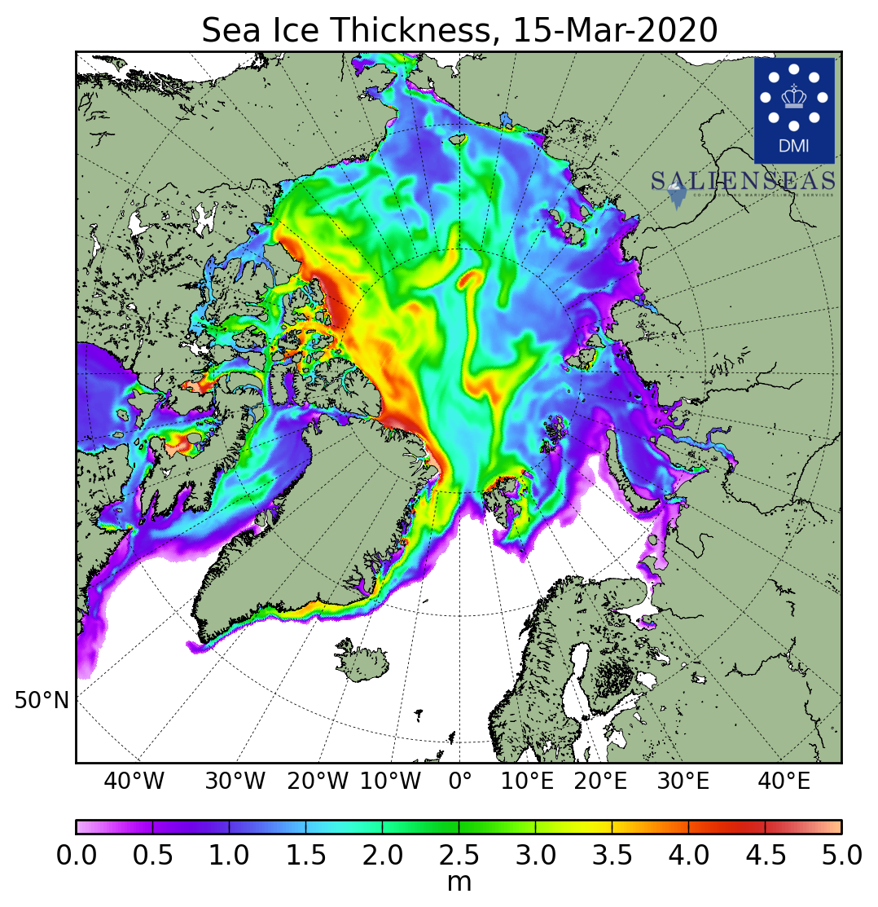
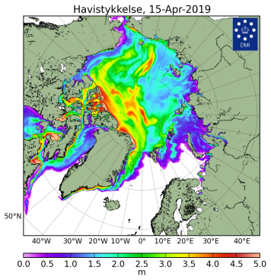
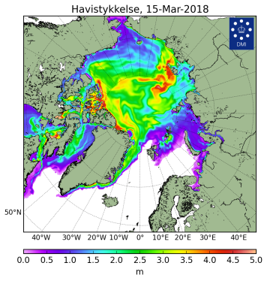
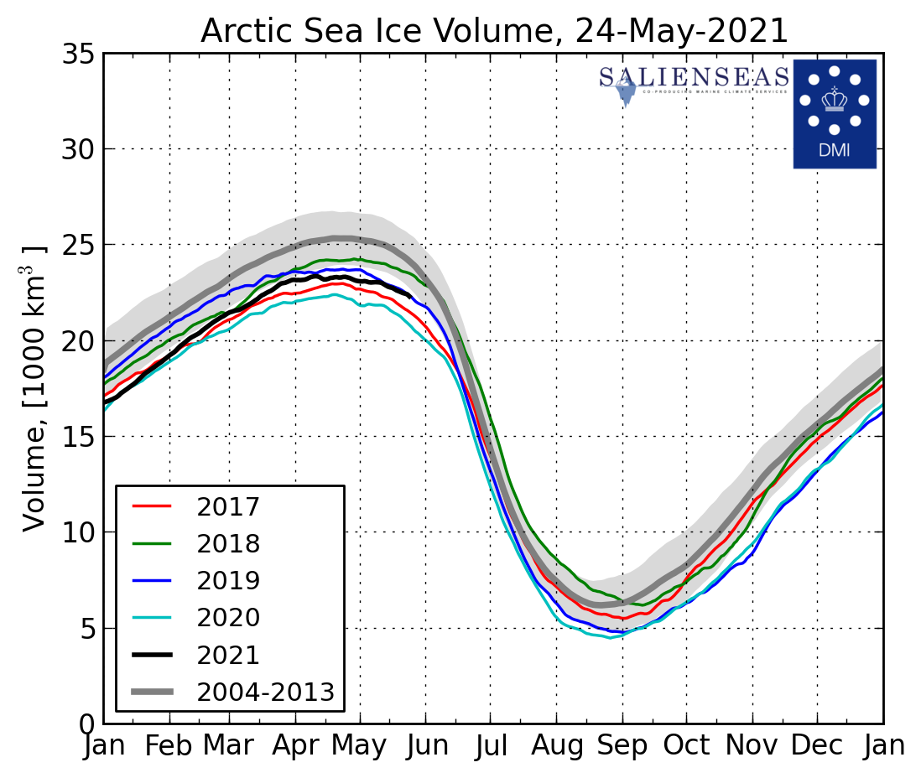
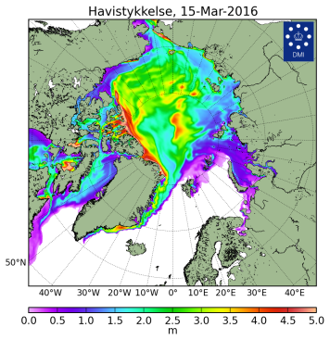
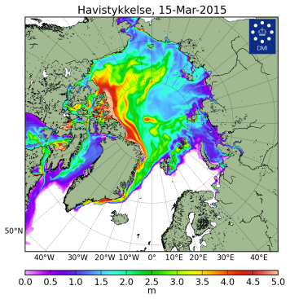
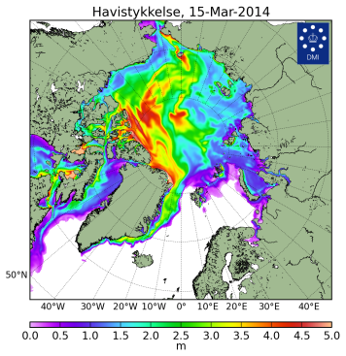
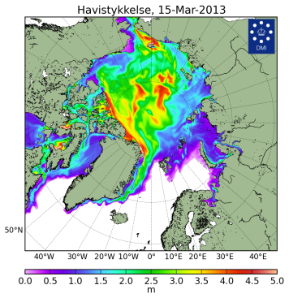
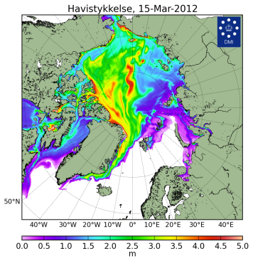
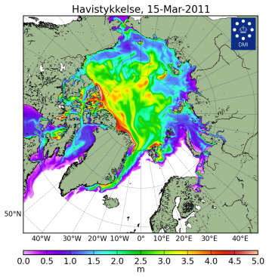






Sea ice thickness for 15 Mar 2004…2021 and ice volume
2021
2020
2019
2018
2021
2016
2015
2014
2013
Models show Arctic ice volume the lowest from Oct 2020 to end of Jan 2021 for 2004-2020 with 2nd in row in 2019
Further till mid May 2021 the ice volume is 3rd in row after 2017 and 2020
2012
2011
2010
2009
2008
2007
2006
2004
[DMI North Atlantic - Arctic Ocean model HYCOM-CICE - http://ocean.dmi.dk/models/hycom.uk.php]
[DMI]

Slide 19


Sea ice conditions during Mar 2021 maximum
Observed in March 2021 maximum sea ice extent was somewhat similar to that in March 2020
Eurasian shelf seas including the NSR were covered by medium and thick FYI (instead of thick FYI mostly) without any inclusions of old ice (which is strongly opposite for old times, e.g. 2006)
Close to normal for the last 30 year sea ice conditions were observed in the Sea of Okhotsk
Extremely mild ice conditions were observed in the Baltic Sea, though the freezing process continued well after mid March due to negative SAT anomalies in the region
15-18 Mar 2021
[sea ice analysis - AARI/CIS/NIC; ice edge – AARI/NSIDC, nearest 5days, reference period: 1991-2020]
ESA CryoSAT-2 SIT, March 2021
Blended AARI/NIC, 13-15 March 2006

Slide 20
Polar Ocean:
  Sea surface temperature
  Storms - Wave and swell height
  pH and acidification or alkalization of the Arctic ?

Slide 21






Heat content, waves and pH – NDJ 2020/2021 & FMA 2021
Prominent higher Heat Content was noticed in Kara, Bering, Labrador Seas, Svalbard waters with lower than for 1993-2020 surface heating for Greenland, parts of Barents Sea
Due to lesser ice extent Bering Sea, adjacent areas of Pacific Ocean, waters S of Svalbard were exposed to higher than in past stormy conditions with calmer conditions in most of the Nordic region
Numerical models show for the current winter/spring season both positive pH anomalies for the Arctic Basin, Laptev Sea, NE part of Kara Sea, Hudson Bay and negative pH (Kara, Greenland Sea) anomalies to the 1993-2020 period, the latter may point to acidification processes though need further verification with e.g. AMAP data
NDJ Heat Content anomaly, 1993-2020
FMA Heat Content anomaly, 1993-2020
NDJ WW&S height anomaly, 1991-2020
FMA WW&S height anomaly, 1991-2020
NDJ pH anomaly 2m, 1993-2020
FMA pH anomaly 2m, 1993-2020
[AARI / CCCS MEMS & ERA5]

Slide 22
Hydrology and land Snow:
  River discharge
  Snow water equivalent
  Snow extent

Slide 23





Impacts of precipitation on river discharge
Impacts of wetter/drier regions were reflected in the winter/spring 2020-2021 Arctic rivers discharge though there is a great difference between winter low water and spring floods (see ArcticGRO graph):
lesser drainage than normal is seen for Ob’, Enisey and Lena rivers, and further eastward during NDJ and partly FMA,
Mackenzie and Yukon rivers during the whole period, Enisey during FMA experienced greater discharge than normal which is similar to previous winter/spring 2019-2020 (bottom figures)
NDJ 2020/2021
river discharge
anomaly, 2000-2019
FMA 2021
river discharge
anomaly, 2000-2019
[AARI / CCCS GloFAS-ERA5 / ArcticGRO]

Slide 24






NDJFMA 2020-2021 land snow
[GCW / Rutgers Global SnowLab]
S, 1000 km²
During NDJFMA 2020-2021 lesser snow height as well as snow water equivalent extent dominated over W Siberia, parts of E Siberia and Canada
Positive anomalies (greater snow height) were observed in parts of Alaska, C Canada and in C Siberia
S, 1000 km²
S, 1000 km²
Mar
S, 1000 km²
NDJ 2020/2021
snow height anomaly
(1991-2020)
FMA 2021
snow height anomaly
(1991-2020)
[AARI / CCCS ERA5 / WMO GCW SnowWatch]

Slide 25







Bioclimatic weather severity
Bodman’s weather severity index (S) (dimensionless) is used for bioclimatic evaluation of weather conditions for winter half year and is calculated according to Bodman’s formula as
follows: S = (1 – 0.04 T) (1 + 0.272 v) where: v is wind speed (in m/ s) at 10 m above ground level and T is air temperature (in °C)
The scale in use to assess using S is:
> 6 extraordinary severe 5– 6 extremely severe
3– 5 severe & very severe 1– 3 slightly&less severe
< 1– mild
Milder than the last 30 years weather in Jan 2021 observed Canada&Alaska switched to more severe in Feb 2021
Similar situation observed for Feb/Mar for C&E Siberia
Nordic region experienced milder weather in Jan 2021 and more severe in Apr 2021
[AARI / CCCS ERA5]
Bodman’s index
Jan 2021
Feb 2021
Mar 2021
Apr 2021
Bodman’s index anomaly, 1991-2020
Severe
Severe
Severe
Milder
Severe
Milder
Milder
Milder
Milder
Severe

Slide 26





Current Conditions (17-24 May 2021)
Since mid April westerly, NW winds dominated in European sector with somewhat opposite patterns over Siberia and Canada
Lower SAT observed over European, Alaska and W Canadian regions
Higher SAT observed over W&E Siberia, partly Chukchi regions
N Scandinavia, Arctic coasts, E Siberia, Chukchi are still already under snow (positive anomalies) with somewhat negative anomalies in Siberia, Canada
Barents, Bering and Sea of Okhotsk are under intense melting, but not for other parts of the Arctic where fast ice zones in Siberia and Canadian Arctic are still well preserved, which is somewhat opposite to spring 20202 season
SAT, precipitation, mean wind vectors, NAO for 20-24 May 2021 (http://polarportal.dk)
AARI/CIS/NIC ice chart for 17-20 May 2021
Snow extent for 24 May 2021,
Rutgers Global snow lab

Slide 27

Thank you! Merci! Takk! Спасибо! Tak! Tack! Kiitos! þakka þér fyrir!
Naqurmiik ! Qaĝaasakuq !
Grazie! Giitu! Vielen Dank!
Dhanyavaad !
Monthly and seasonal graphs at full resolution are available at:
http://wdc.aari.ru/acf_figs/arctic/
http://wdc.aari.ru/acf_figs/season/arctic/
http://wdc.aari.ru/acf_figs/river_discharge/arctic/
http://wdc.aari.ru/datasets/d0040/arctic/png_0/

