Slide 1



May – September 2021
Arctic Seasonal Review
Vasily Smolyanitsky,
Anna Danshina (CMEMS), Anastasia Revina (ERA5),
Vladimir Ivanov (atmosphere circulation),
Vladimir Radionov (surface obs)
Arctic and Antarctic Research Institute (AARI)

Slide 2
Content of seasonal review
Review for MJJAS (May…September) 2021
  Atmosphere:
    Atmospheric circulation
    Surface air temperature – anomalies, ranks and trends by Arctic regions and seas
    Precipitation – anomalies, ranks and trends by Arctic seas
  Sea ice:
    Precursors in atmosphere and polar ocean
    Ice extent – anomalies by regions
    Ice conditions including September 2021 minimum
    Sea ice thickness and volume variability
  Polar Ocean:
    Heat content, waves and swell height (storminess) - anomalies
    pH (acidification/alkalization estimates) - anomalies
  Land hydrology:
    river discharge – anomalies
    snow extent – anomalies and ranks
  Bioclimatic weather severity
Briefs for October 2021: SAT, winds, precipitation, sea ice, snow
Majority of the described parameters are the WMO accepted Essential Climate Variables (ECV). Anomalies based on reanalysis are given for the latest 3rd WMO period 1991-2020, while those based on observations – for 1st WMO reference period 1961-1990. Ranks based on CCCS reanalysis are mostly given for 1950-2021 period, while those based on observations – for the period of observations.

Slide 3
Atmosphere
Precursors: atmospheric circulation
Surface air temperature
Precipitation

Slide 4
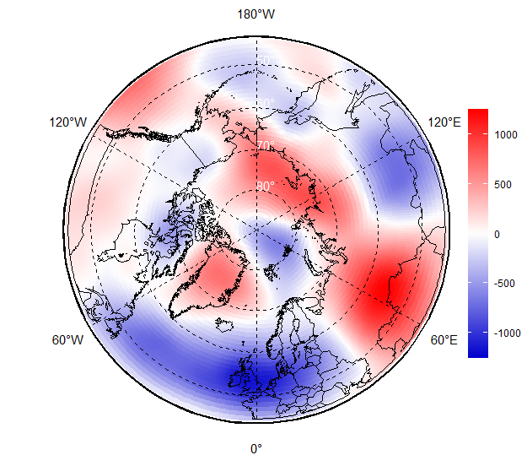
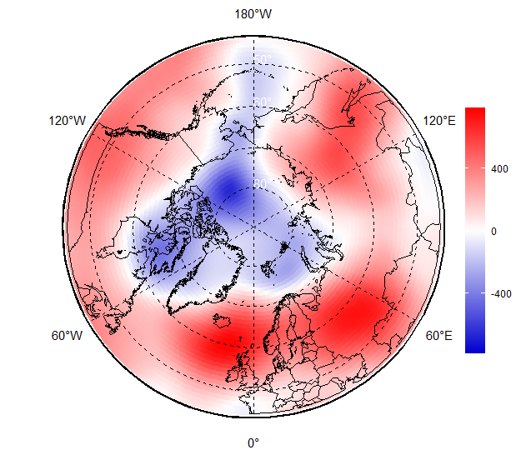
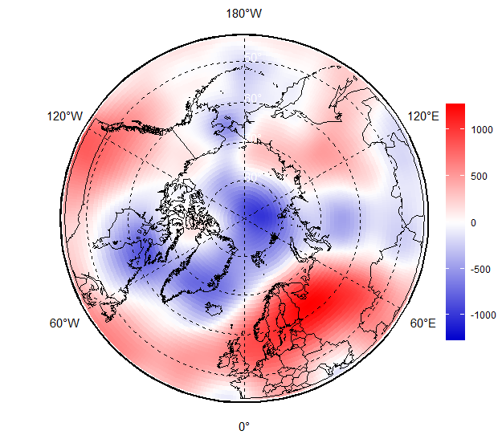
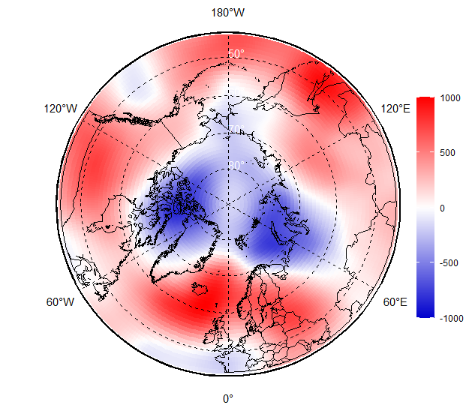
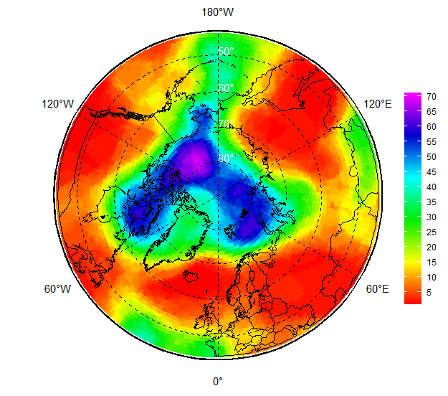
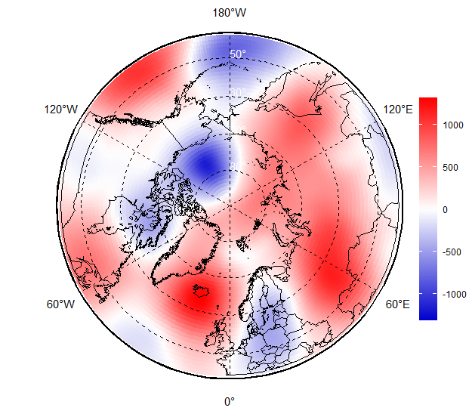
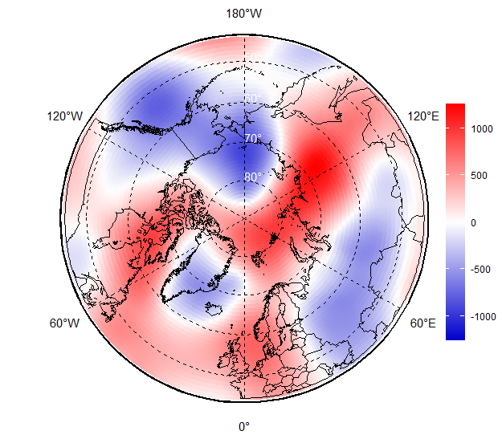
May
MJJAS 2021 upper atmosphere circulation (H500 )
In May 2021, the center of the polar vortex on the 500 hPa isobaric surface shifted from the polar region to the Kara Sea region, where the most active cyclonic activity was observed in the surface field.
In June, the main center of the polar vortex is located near the polar region, under which a stable cyclone is formed.
In July, the main vortex center shifts from the polar region to the northern coast of Taimyr, where the cyclonic circulation mode prevails in the surface air pressure field.
In August, the vortex center shifts to Canadian sector of the Arctic, where the similar cyclonic circulation mode begins to prevail in the surface field.
In September 2021, the main center of the vortex is located in the Chukchi/Alaska sector of the polar region. The high-altitude ridges, blocking the western transport of air masses in the troposphere, is located over the region of Western Europe and Ural, where a stable anticyclone is formed.
Jun
Jul
JJA 2021 H500 anomaly (1981-2010)
Aug
Sep
MJJAS 2021 H500 anomaly (1991-2020
JJA 2021 H500 rank (1950-2021)
[AARI / ERA5 reanalysis]

Slide 5
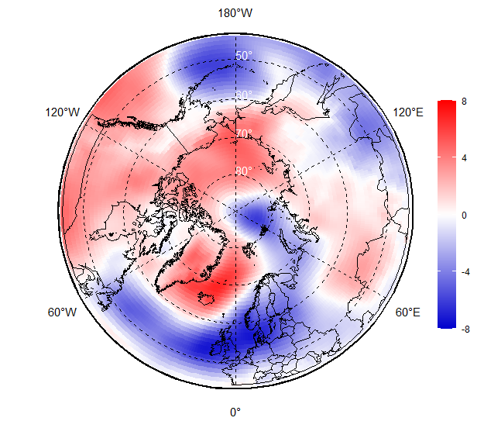
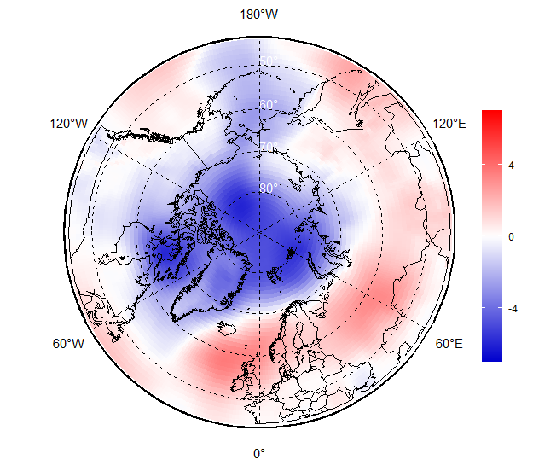
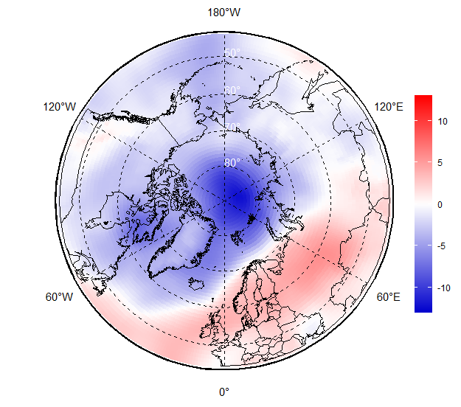
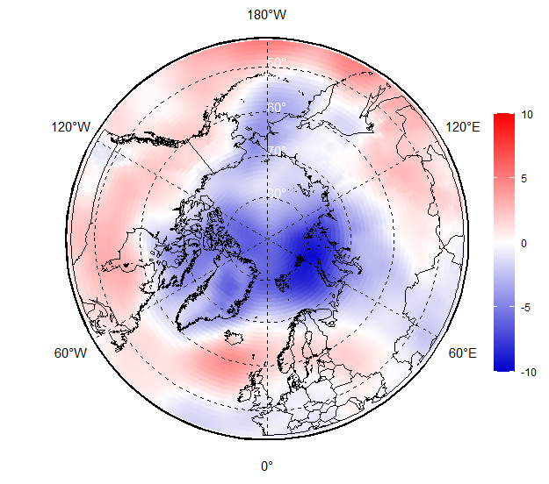
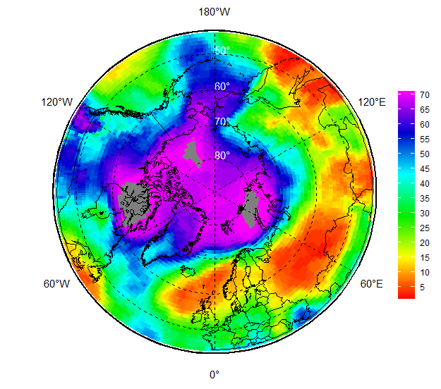
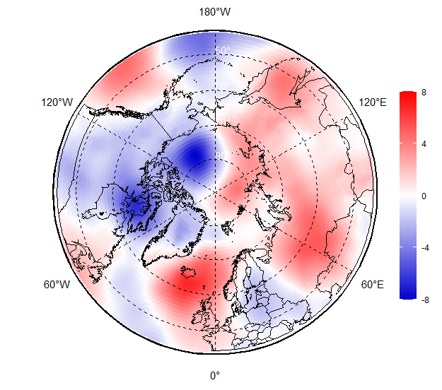
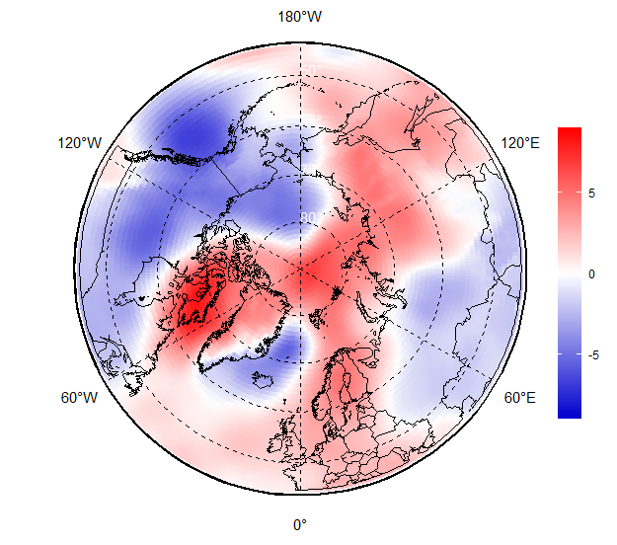
MJJAS 2021 surface atmospheric circulation
May
In the Atlantic-Eurasian sector, atmospheric processes in July and August are characterized by a high frequency of occurrence of the eastern zonal form of atmospheric circulation. In September, there is a sharp restructuring in the direction of large-scale atmospheric processes from the eastern to the meridional form of circulation.
In the Pacific-American in July and August, meridional processes are steadily predominant, but in September are replaced by the prevailing zonal type of atmospheric circulation.
In the polar region in July and August, trajectories of the North Atlantic cyclones are shifted northward in comparison with the norm. In September, under the influence of the Arctic anticyclone, low-latitude cyclone trajectories prevailed.
Jun
Jul
JJA 2021 MSLP anomaly (1991-2020)
Aug
Sep
MJJAS 2021 MSLP anomaly (1991-2020)
JJA 2021 MSLP rank (1950-2021)
[AARI / ERA5 reanalysis]

Slide 6
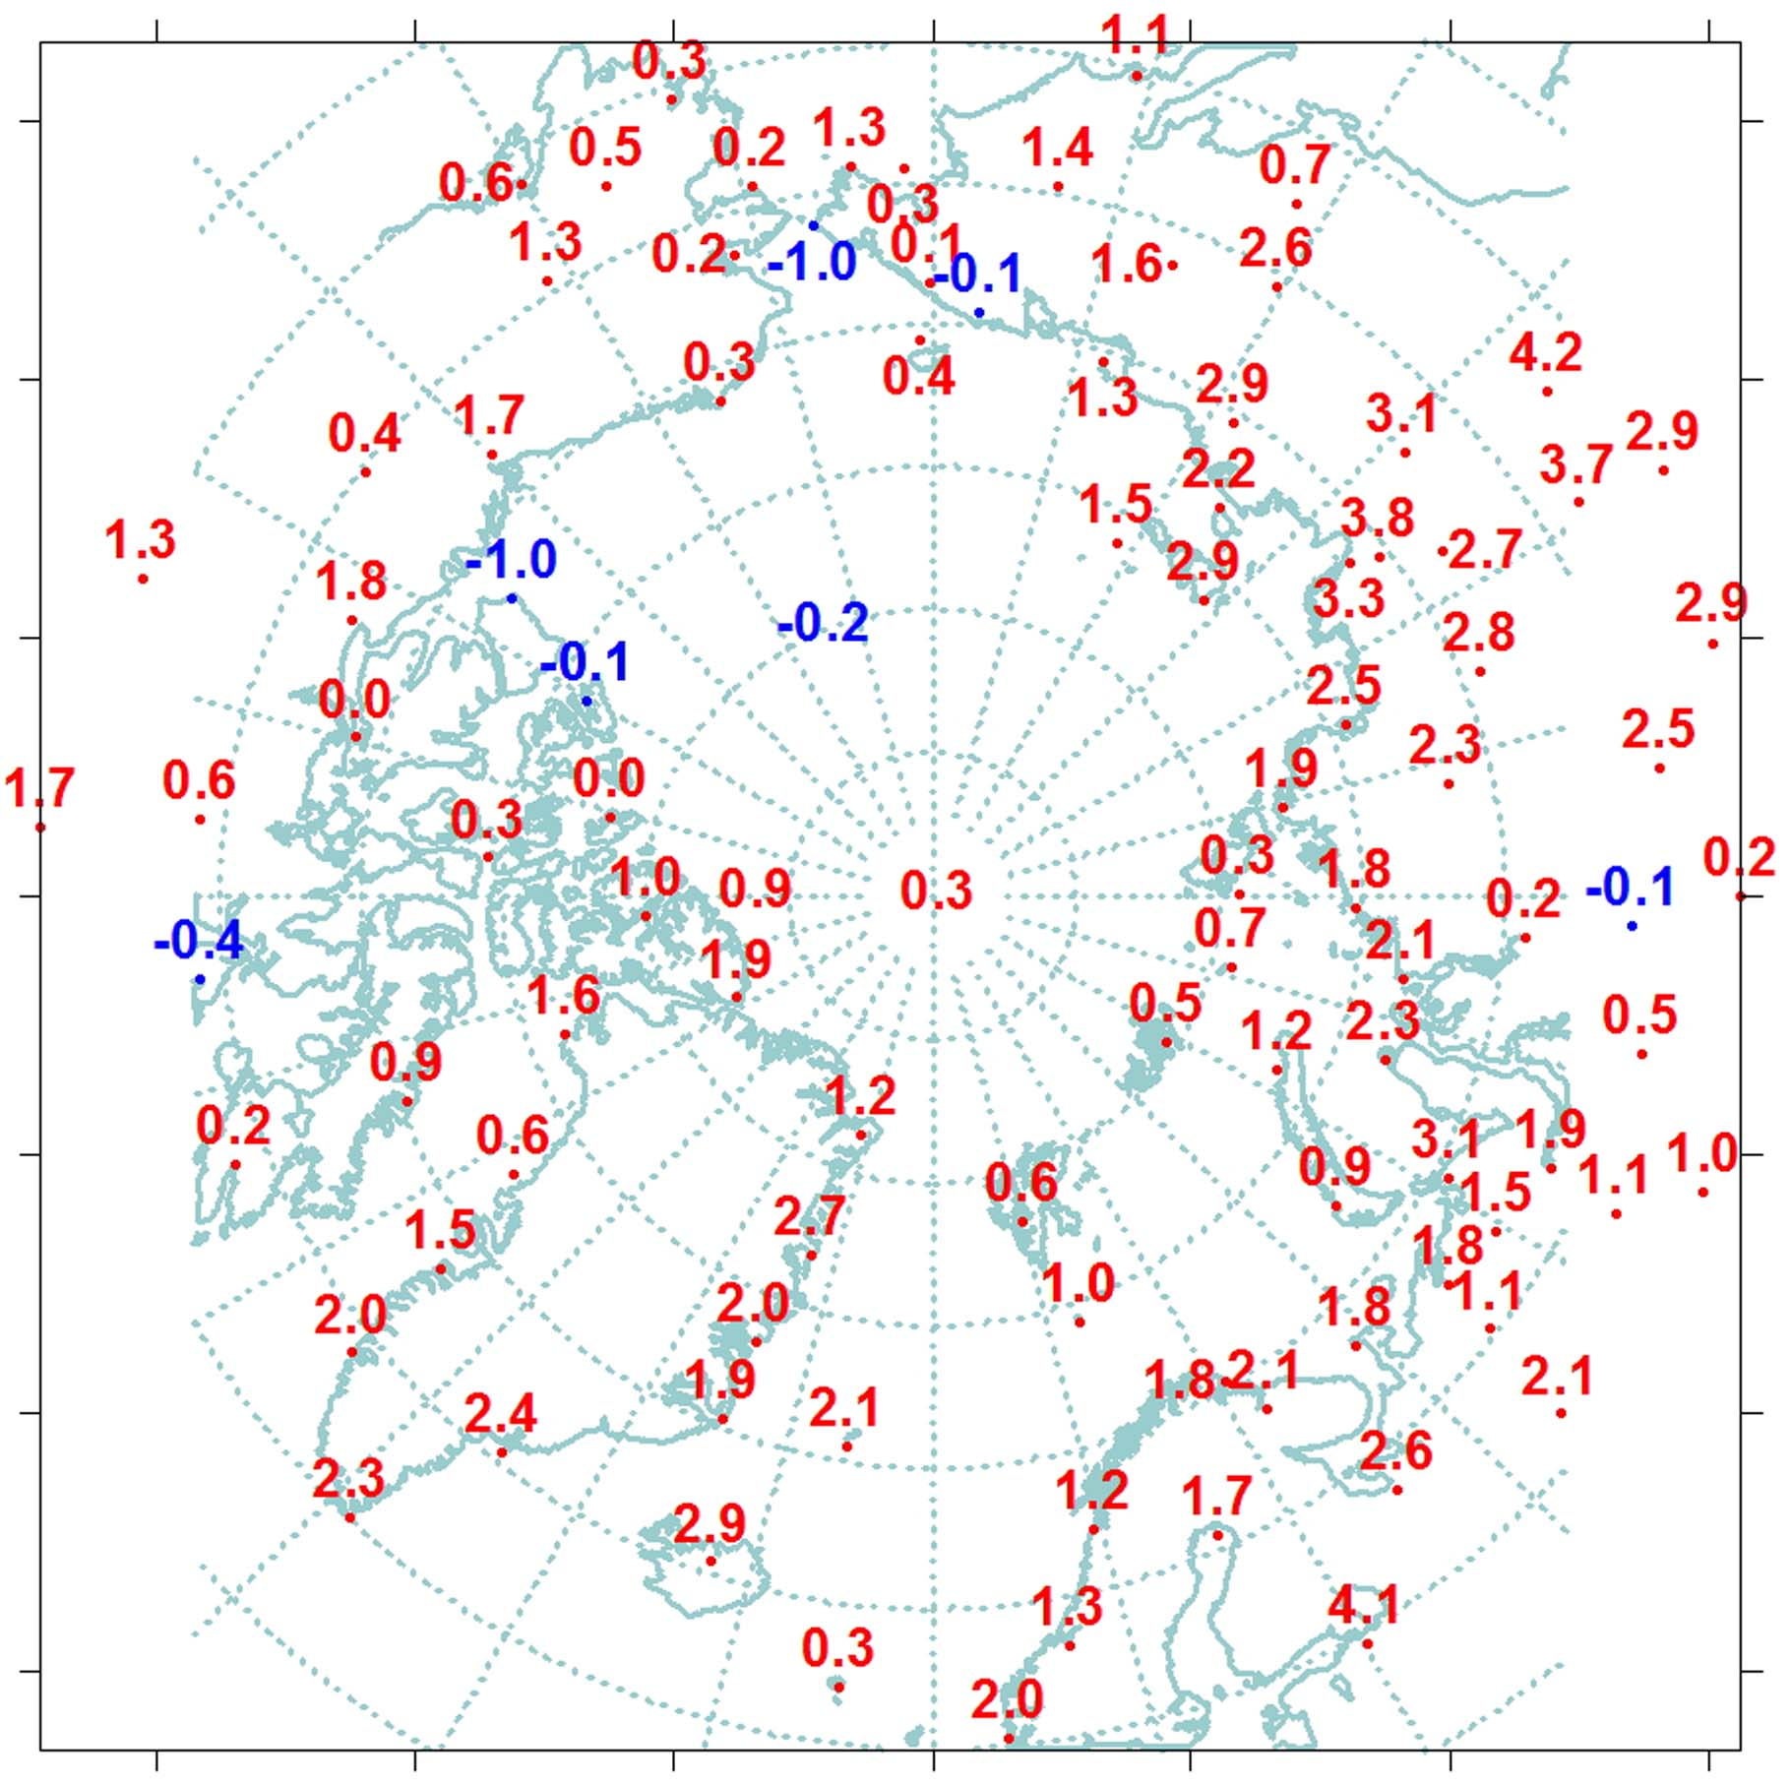
JJA 2021 Surface air temperature: anomalies (obs)
Summer 2021 was characterized by SAT anomaly (1961-1990) as +1.4°С and turned out to be the 5th warm since 1936. The SAT anomaly for the latitudinal zone of 70-85°N was equal to +1.2°C or 7th in rank, and for the latitudinal zone 60-70°N - +1.5°C or 4th in rank since 1936.
Regional analysis shows presence of significant positive SAT anomalies in the Eurasian sector. Anomaly in the Eastern Siberia region was 2.9C or the highest value since 1936.
Southern part of the Chukchi Sea and eastern part of the Beaufort Sea were characterized by small negative SAT anomalies.
In the Arctic seas, the highest positive anomalies were for the northern part of the Greenland and Norwegian Seas, as well as in the Asian sector - the Laptev and East Siberian seas.
In the Laptev Sea area, anomaly was equal to 2.6C or the second highest since 1936.
Colder
Warmer
VI-VIII
Reference period for anomaly: 1961-1990
[AARI]

Slide 7
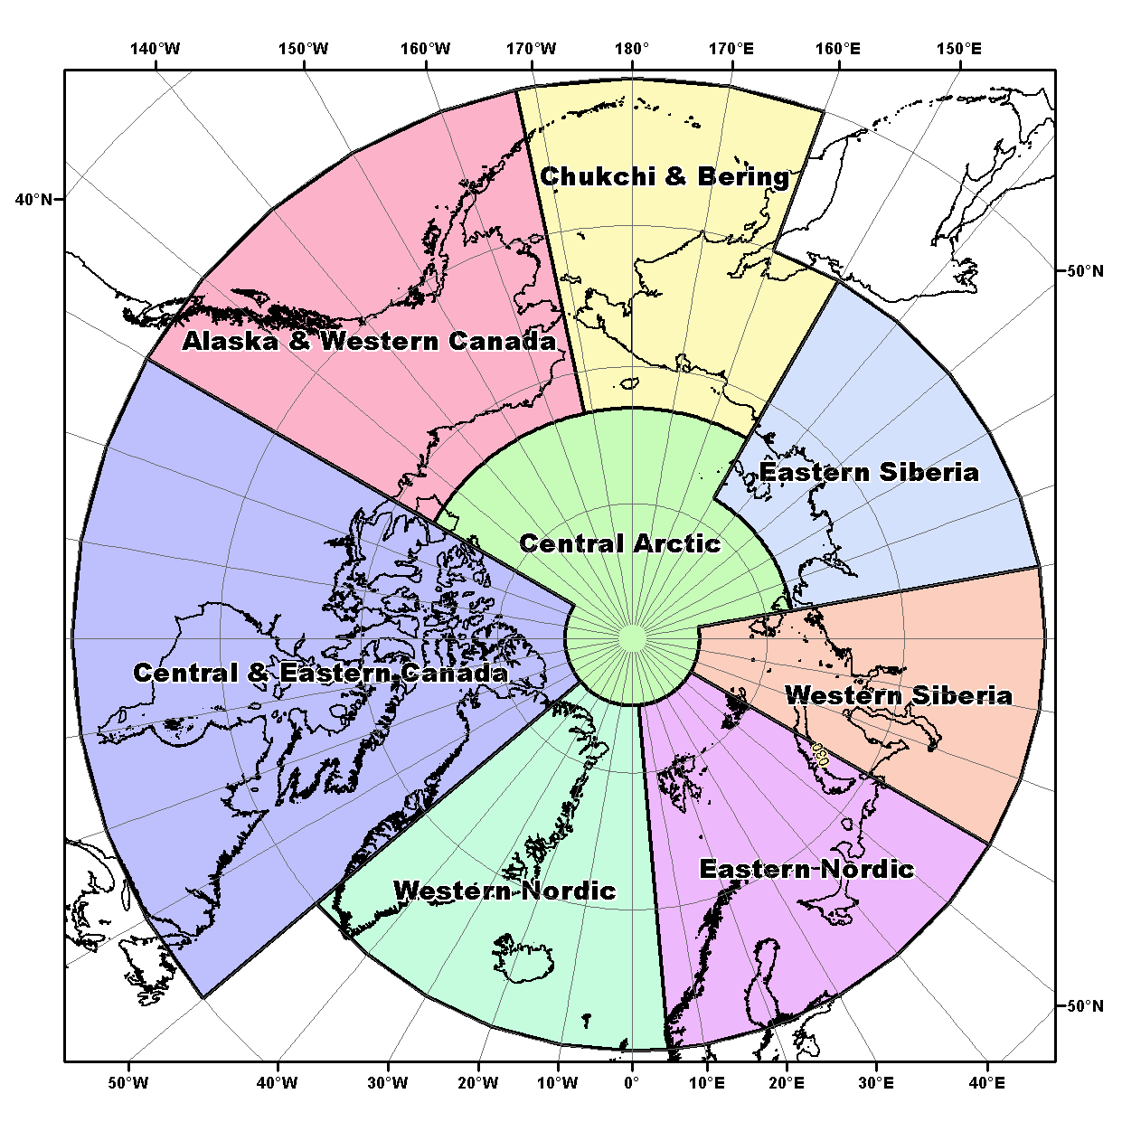

JJA 2021 Surface air temperature by regions: anomalies, ranks and trends (obs)
Region | Anomaly 2021(20) | Rank 2021(20) | Warmest year (anom) | Coldest year (anom)
Western Nordic* | 1,7 (1,3) | 2 (5) | 2003 (1,9) | 1965 (-0,7)
Eastern Nordic* | 1,8 (1,7) | 4 (5) | 2013 (2,8) | 1969 (-1,6)
Western Siberia | 1,2 (2,8) | 11 (2) | 2016 (3,6) | 1968 (-1,6)
Eastern Siberia | 2,9 (2,4) | 1 (2) | 2019, 2021 (2,9) | 1989 (-1,2)
Bering&Chukchi* | 1,1 (1,7) | 10 (6) | 2007 (2,9) | 1949 (-1,3)
WCanada&Alaska* | 0,4 (0,7) | 14 (12) | 2004 (2,9) | 1945,1955(-1,3)
Eastern Canada* | 0,9 (1,5) | 10 (6) | 2012 (2,3) | 1972 (-1,6)
70-85°N | 1,2 (1,8) | 7 (3) | 2012 (2,0) | 1963 (-0,7)
60-70°N | 1,5 (1,7) | 4 (3) | 2016 (2,0) | 1949 (-0,8)
60-85°N | 1,4 (1,7) | 5 (2) | 2016 (2,0) | 1949 (-0,8)
N Gre and Nor Seas | 1,6 (1,2) | 6 (10) | 2016 (2,4) | 1965 (-0,7)
Barents Sea | 1,2 (2,0) | 9 (3) | 2013 (2,8) | 1949 (-1,2)
Kara Sea | 1,6 (3,5) | 7 (1) | 2016 (3,1) | 1968 (-1,2)
Laptev Sea | 2,6 (2,4) | 2 (3) | 2019 (3,2) | 1962 (-1,5)
Eastern Siberian Sea | 1,4 (2,1) | 8 (3) | 2007 (3,7) | 1949 (-1,6)
Chukchi Sea | -0,2 (1,3) | 24 (9) | 2007 (3,9) | 1965 (-1,6)
Beaufort Sea | 0,2 (0,5) | 17 (14) | 2012 (2,5) | 1947 (-1,5)
N Canadian arch. | 0,9 (1,4) | 20 (8) | 2011, 2012 (2,7) | 1972 (-1,6)
* Old boundaries
Reference period for anomaly: 1961-1990
[AARI]

Slide 8
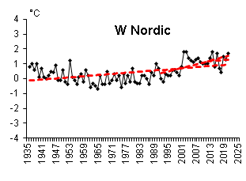
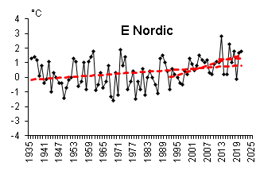
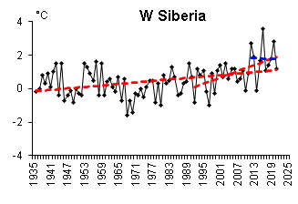
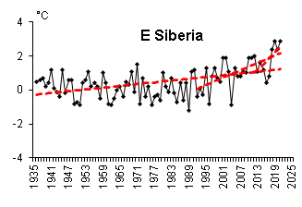
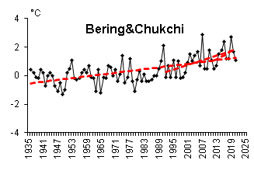
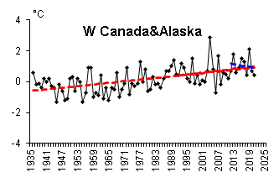
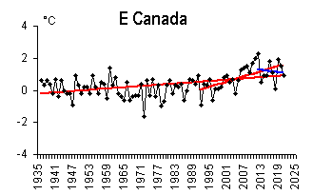
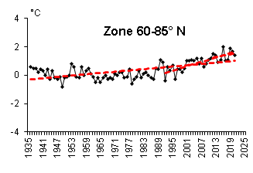
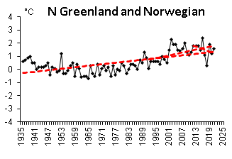
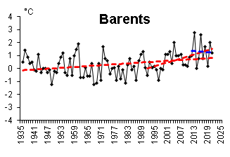
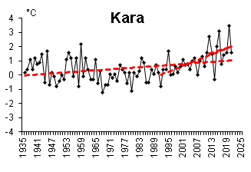
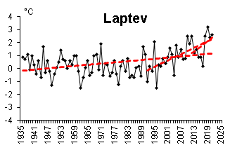
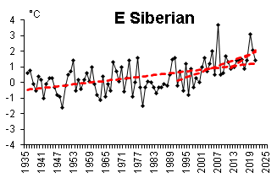
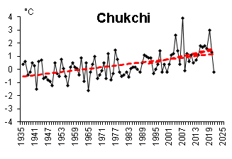
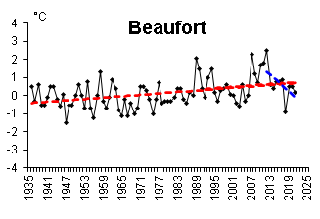
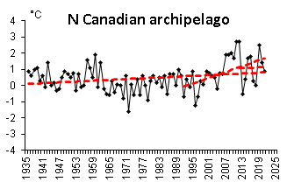
JJA 2021 Surface air temperature by regions: trends (obs)
Estimation of the linear trend shows statistically significant (5% level) positive linear trend both for the latitudinal zones N and S of 70°N, and for the whole Arctic. Summer SAT increase in these zones is equal to 1.29, 1.38 and 1.29°С over 86 years respectively.
In the last 10y period, a negative SAT trend has been observed in the W Siberia, W Canada&Alaska and E Canada regions though trend values are insignificant.
Reference period for
anomaly: 1961-1990
[AARI]
[AARI]

Slide 9
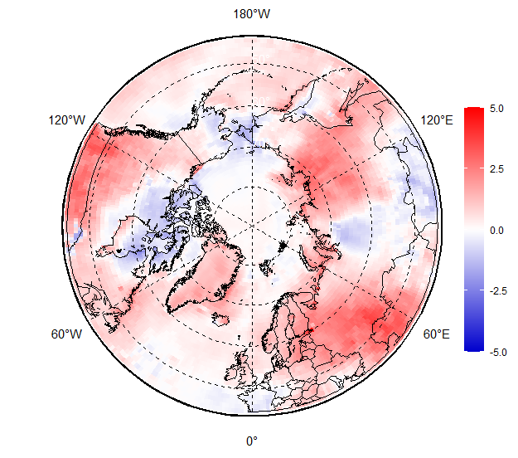
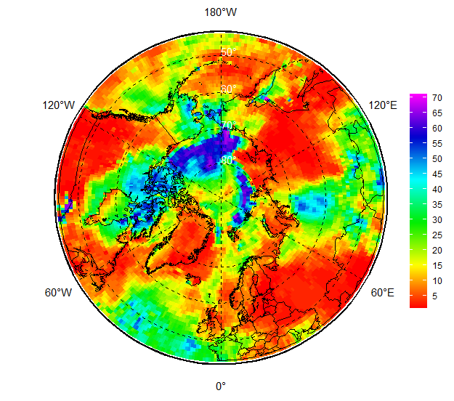
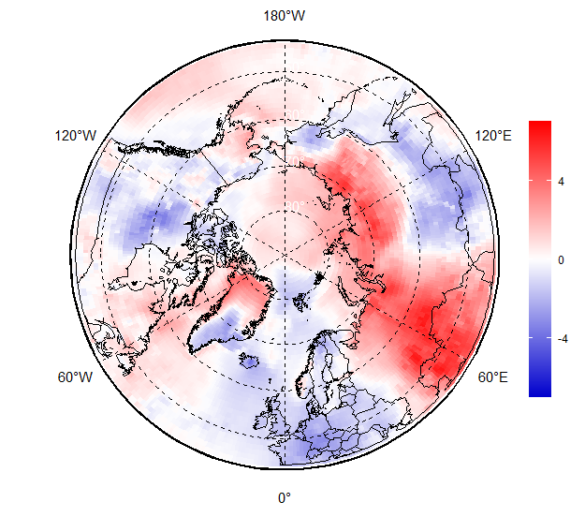
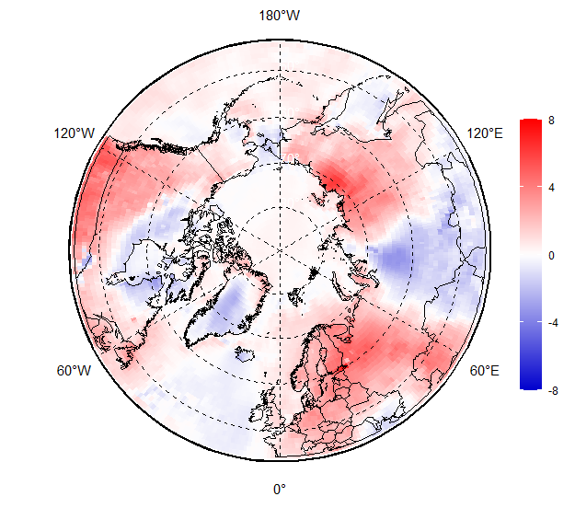
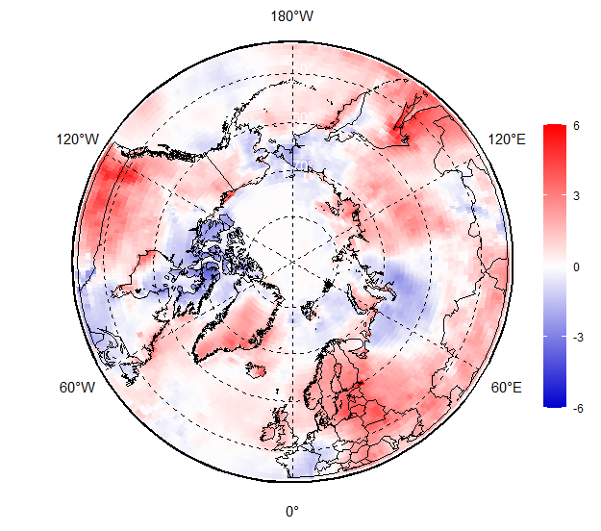
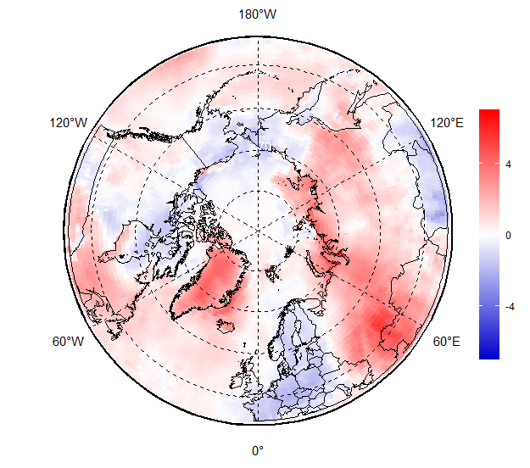
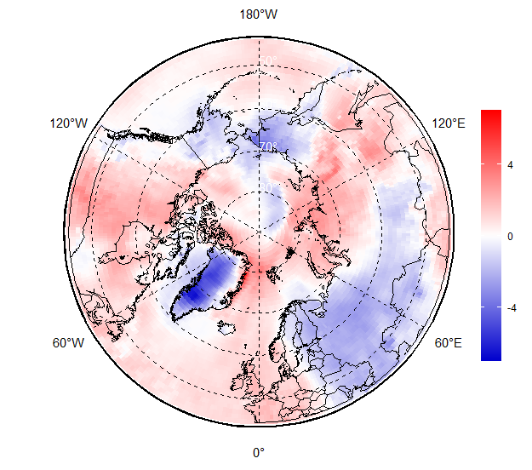
MJJAS 2021 – Surface air temperature: anomalies, ranks (reanalysis)
As usual numerical reanalysis contributes and facilitates continuous in time and space description of the seasonal variability
Noticeable for the present season are inner seasonal variability of the anomalies in the E Nordic (-++--) or Greenland (0-++-) regions as well as negative SAT anomalies in the Arctic Basin not revealed by the coastal observations
JJA SAT anomaly, 1991-2020
JJA SAT rank, 1950-2021
May
Jun
Jul
Aug
Sep
SAT anomalies, 1991-2020
[AARI / CCCS ERA5]

Slide 10
JJA 2021 surface precipitation by regions: anomalies (obs)
Region * | Relative anomaly, % 2020 (2019) | Year (maximum anomaly, %) | Year (minimum anomaly, %)
Western Nordic | 110,5 (95.9) | 1964 (120,5) | 1968 (75,2)
Eastern Nordic | 104,8 (111.2) | 1981 (128,4) | 1980 (68,5)
Western Siberia | 100,7 (98.1) | 2002 (122,6) | 1946 (72,4)
Eastern Siberia | 90,4 (86.8) | 1988 (125,2) | 1967 (78,4)
Bering & Chukchi | 93,1 (78.0) | 1954 (139,6) | 1982 (60,2)
W Canada & Alaska | 90,8 (85.0) | 1951 (164,4) | 1968 (54,1)
Eastern Canada | 89.9 (86.2) | 2005 (123,5) | 1977 (75,0)
60-70°N | 100,1 (96.6) | 1954 (115) | 1968 (88)
70-85°N | 104,5 (91.7) | 1989 (127) | 1998 (84)
60-85°N | 99,1 (93.2) | 1954 (117) | 1980 (90)
110,5 – wetter
100,7 – close to normal
89,9 - drier
* Old boundaries
Reference period: 1961-1990
In general, precipitation for the Arctic region was equal to 99.1% of norm (1961-1990) during summer 2021. South of 70°N precipitation was close to norm, 100.1%, and to the north – higher than norm, 104.5%.
The least amount of precipitation was for the Eastern Siberia and American regions - about 90% of the norm.
More abundant precipitation was observed in the Western (110.5%) and Eastern (104.8%) Nordic regions.
[AARI]

Slide 11
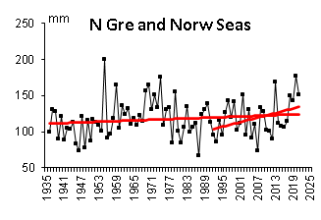
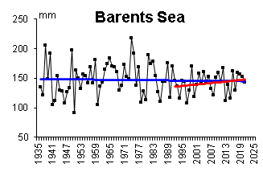
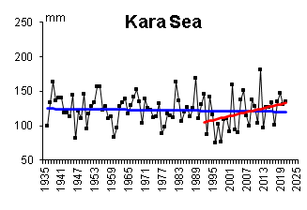
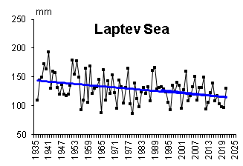
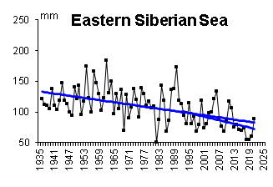
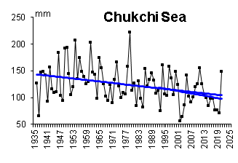
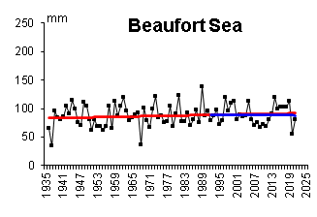
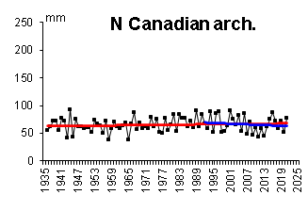
Summer Precipitation trends (obs)
Analysis of the interannual changes for the period 1936-2021 shows a tendency (statistically insignificant) towards a decrease in summer liquid precipitation in the whole region (by 2.7% of the 1961-1990 norm) and N of 70°N (5.5% of the norm).
Statistically significant (at a 5%) trend in summer precipitation is found only in the Canadian region (1.25 mm over 10 years)
In the Arctic seas, over the entire observation period, with the exception of the northern Greenland and Norwegian Seas, as well as the Beaufort Sea, a downward trend in precipitation prevails
The greatest decrease in precipitation is for the Eurasian Seas: from 3% (Barents Sea) to 43% (East Siberian Sea) of the norm
In the last 30-year period, a tendency towards an increase in the amount of liquid precipitation has appeared in some latitudinal zones, mainly due to the increase in liquid precipitation in the E Nordic and West Siberia regions. However, the values ​​of the linear trends in these areas are statistically insignificant.
[AARI]

Slide 12
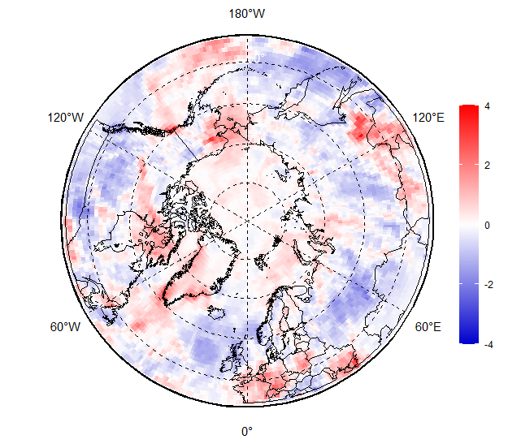
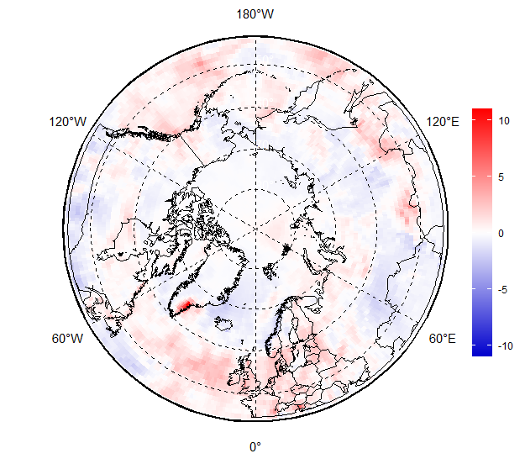
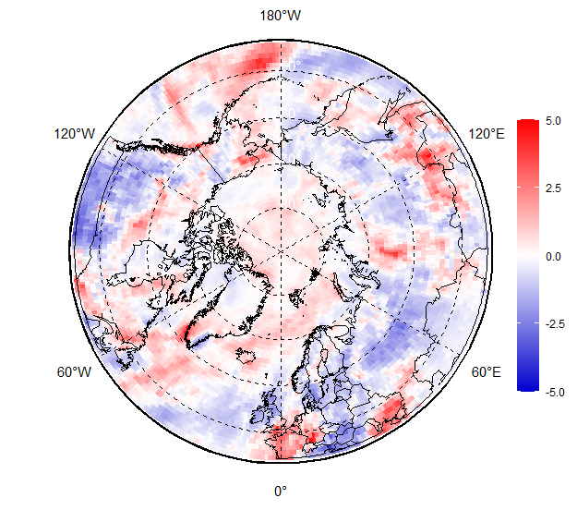



MJJAS 2021 – Surface precipitation: anomalies (reanalysis)
Additional regional features revealed by numerical reanalysis include prominent drier areas in E Nordic and Siberian regions during June and July 2021 with somewhat wetter conditions in parts of Canada and Alaska regions.
JJA prec anomaly, 1991-2020
May
Jun
Jul
Aug
Sep
SAT anomalies, 1991-2020
[AARI / CCCS ERA5]

Slide 13
Sea ice
  Precursors in atmosphere and polar ocean
  Ice extent and ice conditions based on ice charting
  Sea ice thickness and volume based on reanalysis

Slide 14




Precursors in atmosphere and polar ocean for JJAS 2021 ice conditions
Negative ocean heat capacity (HC) anomaly (to 1993-2021 and more important - to 2020) in upper 15m during June 2021 for the Kara, parts of Eastern Siberian and Chukchi Seas slowed ice melt in these regions
Further in season, dominance of significant negative surface air temperature anomalies over parts of Canadian Arctic, Chukchi Seas as well as close to zero surface air temperature anomalies over NE Kara and E ESS Seas and the Arctic Basin preserved slow melting
Resulting significant amount of residual ice in the mentioned regions by the time of September minimum is strongly opposite to 2019 and 2020.
Jun 2021 Heat Capacity 15m
anomaly, 1993-2021
Jun 2021 Heat Capacity 15m
Anomaly, 2020
JJA 2021 JJA 2020
SAT anomaly, 2000-2019
[AARI / CCCS MEMS & ERA5]

Slide 15





Arctic (NH) seasonal ice extent 1978…. 2021
S, 1000 km²
Western Arctic (WA)
S, 1000 km²
S, 1000 km²
Northern Hemisphere
Sep (Min) March (Max)
2012 3346
2020 3882
2016 4099
2019 4103
2007 4189
2011 4312
2015 4350
2018 4557
2008 4588
2017 4622
2010 4641
2021 4848
… …
1982 7246
1983 7285
1980 7611
2017 14467
2018 14516
2015 14526
2016 14580
2011 14701
2006 14867
2019 14891
2007 14931
2014 14972
2021 15100
… …
2020 15390
... ...
1988 16461
1983 16547
1979 16769
Jan Feb Mar Apr May Jun Jul Aug Sep Oct Nov Dec Jan
Jan Feb Mar Apr May Jun Jul Aug Sep Oct Nov Dec Jan
CA
EA
S, 1000 km²
S, 1000 km²
Eastern Arctic (EA)
Canadian Arctic (CA)
WA
[AARI / NSIDC]
Jan Feb Mar Apr May Jun Jul Aug Sep Oct Nov Dec Jan
Jan Feb Mar Apr May Jun Jul Aug Sep Oct Nov Dec Jan
Minimum summer ice extent, 12th in row, ~4.8 mln km² ,reached 12 Sep 2021 is by 0.9 mln km² greater than the previous year summer minimum (~3,9 in 2020, 2nd in row, reached 12 Sep 2020). This summer 12th in row minimum occured after similar winter 10th in row maximum which is opposite to 2020.
During melting period some Arctic Seas (Barents, Laptev) had the ice extent close to zero again, however, in a number of places (Kara, ESS,Chukchi) ice cover was preserved or even (Canadian Arctic) approached the 40 years median.

Slide 16

Seasonal NH ice extent variability: 1978 -2021
Seasonal patterns of daily ice extent allow to analyze interseasonal variability of ice extent
Both winter maximums and summer minimums continue to diminish
However significant interannual variability of ice extent occurs, which is a hint to a more mobile ice and variable ice conditions
[AARI / NSIDC]

Slide 17








MJJA 2021 Arctic sea ice – concentration and stage of development
17-20 May
14-17 Jun
12-15 Jul
16-19 Aug
[sea ice analysis - AARI/CIS/NIC; ice edge – AARI/NSIDC, nearest 5days, reference period: 1991-2020]

Slide 18

















Sea ice thickness for 14 Sep 2004…2021 and ice volume
[Madsen et al, 2015]
2021
2020
2019
2018
2017
2016
2015
2014
2021
Models show Arctic ice volume in 2021 much higher than in 2020 and comparable to 2017
Ice thicknesses distribution in mid Sep 2021 shows greater amount of thick FYI in Eurasian Arctic which enabled existence of several ice massifs through the whole summer, e.g. in the Kara Sea
2012
2011
2010
2009
2008
2007
2006
2004
DMI North Atlantic - Arctic Ocean model HYCOM-CICE - http://ocean.dmi.dk/models/hycom.uk.php
[DMI]

Slide 19




Sea ice conditions during Sep 2021 minimum
Observed in September 2021 11th in row summer Arctic ice cover minimum significantly differs in area shape with that for 2019 or 2020
While Eurasian Barents, Laptev shelf seas were completely ice free with the ice edge significantly northward of Svalbard and FJL, the ice conditions in NE Kara, E ESS, Beafort Seas, parts of Canadian arch. were close to 40 years normal with both the NW passage and the NSR remaining blocked in the transit straits which is opposite to last pentade
Area and thickness of both residual and second year ice in September this year for the Arctic Basin was much greater than that for 2019 or 2020
Recorded during NABOS-2021 cruise on “Akademik Treoshnikov” ice thicknesses for the same starting point of MOSAiC expedition in 2019, were significantly higher (~100…150 cm), i.e. if the PS drift started this year, it would be much longer…
13-16 Sep 2021
[sea ice analysis - AARI/CIS/NIC; ice edge – AARI/NSIDC, nearest 5days, reference period: 1991-2020]
NABOS-2021, Sept 2021

Slide 20
Polar Ocean:
  Sea surface temperature
  Storms - Wave and swell height
  pH and acidification or alkalization of the Arctic ?

Slide 21






Heat content, waves and pH – JJAS 2021
Prominent lower Heat Content (HC) was noticed in central Barents, NE Kara, Chukchi, Bering, Beaufort, Labrador Seas than norm for 1993-2020 with higher HC values for SW Kara, Laptev, parts of Greenland , Svalbard and FJL waters
Due to lesser ice extent Chukchi, Bering Seas, parts of Eurasian shelf seas and Canadian Arctic were exposed to higher than in past stormy conditions with calmer conditions in parts of the Nordic and Bering regions
Numerical models show for the current summer season both positive pH anomalies (Arctic Basin, Laptev Sea, NE part of Kara Sea, Chukchi, Hudson Bay) and negative pH (Kara, ESS, Greenland Sea) anomalies to the 1993-2021 period, which is in general similar to previous summer 2020. The negative anomalies may point to acidification processes though need further verification with e.g. through additional sensors on IABP buoys or AMAP data
JJA Heat Content 15m anomaly, 1993-2020
Sep Heat Content anomaly, 1993-2020
JJA WW&S height rank, 1950-2021
Sep WW&S height rank, 1950-2021
Sep pH anomaly 2m, 1993-2021
[AARI / CCCS MEMS & ERA5]
JJA pH anomaly 2m, 1993-2021

Slide 22
Hydrology and land Snow:
  River discharge
  Snow water equivalent
  Snow extent

Slide 23





Impacts of summer 2021 precipitation and evaporation on river discharge (reanalysis)
Impacts of wetter/drier regions due to precipitation and evaporation process were reflected in the JJAS 2021 Arctic rivers discharge:
lesser drainage than normal was seen for practically all Great Arctic rivers with more significant negative anomalies for Lena for all months, Indigirka and Kolyma in June
Greater drainage was seen for Anadyr in June and Enisey in July
Such situation this summer is similar for Eurasian Arctic to summer 2020 but is opposite for American sector as in summer 2020 Mackenzie and Yukon rivers experienced greater discharge than normal
JJA 2021 precipitation
anomaly, 1991-2020
JJA 2021 river discharge anomaly, 1991-2020
Jun
Jul
Aug
Sep
2021 river discharge anomaly (1991-2020)
AARI / ERA5 reanalysis

Slide 24





Impacts of precipitation on river discharge
Impacts of wetter/drier regions can be also traced reflected in the winter/spring 2020-2021 Arctic rivers discharge using the ArcticGRO information though there is a great difference between spring floods and summer low water:
lesser drainage than normal is seen for Ob’, Lena, Yukon rivers
Zero or slightly negative anomaly for Makkenzie river
Enisey experienced greater discharge
JJA 2021 river discharge
anomaly, 1991-2020
[AARI / CCCS GloFAS-ERA5 / ArcticGRO]

Slide 25





MJJAS 2021 land snow
S, 1000 km²
In May 2021 lesser snow height as well as snow extent dominated over Siberia, parts of E Siberia and Canada with somewhat positive anomalies in parts of E Canada and Chukchi regions
In September 2021 strong positive anomaly was observed in Alaska region with somewhat zero anomalies for other Arctic regions
Mar
May 2021
snow height anomaly
(1991-2020)
[AARI / CCCS ERA5 / WMO GCW SnowWatch]
[GCW / Rutgers Global SnowLab]

Slide 26




Bioclimatic weather severity
Bodman’s weather severity index (S) (dimensionless) is used for bioclimatic evaluation of weather conditions for winter half year and is calculated according to Bodman’s formula as
follows: S = (1 – 0.04 T) (1 + 0.272 v) where: v is wind speed (in m/ s) at 10 m above ground level and T is air temperature (in °C)
The scale in use to assess using S is:
> 6 extraordinary severe 5– 6 extremely severe
3– 5 severe & very severe 1– 3 slightly&less severe
< 1– mild
in May 2021 milder than the last 30 years weather observed in Eurasia, parts of Alaska with more severe in S Greenland, Svalbard, W Nordic regions
In September 2021 milder situation observed in Canada and C Siberia with more severe weather in Nordic, Chuckhi and parts of Greenland.
[AARI / CCCS ERA5]
May 2021
Sep 2021
Severe
Milder
Milder
Severe
Severe
Apr 2021
Bodman’s index Bodman’s index anomaly
1991-2020
Bodman’s index Bodman’s index anomaly
1991-2020

Slide 27





Current Conditions (20-26 May 2021)
Since late September westerly winds dominated in European and Siberian regions with somewhat opposite patterns over Canada
Lower SAT observed over European, Chukchi, Alaska regions
Higher SAT observed over Siberia, partly Canadian regions
N Scandinavia, Arctic coasts, E Siberia, Chukchi, Canadian Arctic are already under snow (positive anomalies) with somewhat negative anomalies in Siberia and Canada
Eurasian and Canadian Barents, Bering and Sea of Okhotsk are under intense freezeup.
Freezing process started in Bering Sea (Anadyr Gulf) on 4 Oct 2021 and in the Sea of Okhotsk (central part of the northern coast) on 19 Oct 2021 which is 2-3 weeks earlier than in 2020
SAT, precipitation, mean wind vectors, NAO for 17-21 Oct 2021 (http://polarportal.dk)
Snow extent for 21 Oct 2021,
Rutgers Global snow lab
AARI/NIC ice chart for 21-16 Oct 2021

Slide 28
Data sources:
AARI Review of Hydrometeorological Processes in the Northern Polar Region in 2021 Q1-Q3 (http://www.aari.ru/misc/publicat/gmo.php)
Copernicus Climate Change Service
  ERA5 monthly averaged data on pressure and single levels
  Marine environment monitoring service
  GloFAS operational global river discharge reanalysis
Weekly ice charts from AARI, CIS, NIC / WMO GDSIDB project (http://wdc.aari.ru)
NSIDC Near-Real-Time DMSP SSMIS Daily Polar Gridded Sea Ice Concentrations
DMI PolarPortal (http://polarportal.dk)
Arctic Great Rivers Observatory project (https://arcticgreatrivers.org/)
WMO GCW SnowWatch (FMI, ECCC, Rutgers Glob Snow Lab, http://climate.rutgers.edu/snowcover/)

Slide 29

Thank you! Merci! Takk! Спасибо! Tak! Tack! Kiitos! þakka þér fyrir!
Naqurmiik ! Qaĝaasakuq !
Grazie! Giitu! Vielen Dank!
Dhanyavaad !
Monthly and seasonal graphs at full resolution are available at:
http://wdc.aari.ru/wmo/PRCC/reanalysis/era5/png/
http://wdc.aari.ru/datasets/d0040/arctic/png/

