Slide 1



November 2021 – April 2022
Arctic Seasonal Review
Vasily Smolyanitsky (text, obs, sea ice),
Anastasia Revina (ERA5), Anna Danshina (CMEMS)
Arctic and Antarctic Research Institute (AARI)

Slide 2
Content of seasonal review
Review for NDJFMA (November 2021… April 2022)
  Atmosphere:
    Atmospheric circulation
    Surface air temperature – anomalies, ranks and trends by Arctic regions
    Precipitation – anomalies, ranks and trends by Arctic regions
  Sea ice:
    Precursors in atmosphere and polar ocean
    Ice extent – anomalies by regions
    Ice conditions including February – March 2022 winter maximum
    Sea ice thickness and volume variability
  Polar Ocean:
    Heat content, waves and swell height (storminess) - anomalies
    pH (acidification/alkalization estimates) - anomalies
  Land hydrology:
    river discharge – anomalies (introduction to particular report by Alexandr Trunin)
    snow extent – anomalies and ranks
  Bioclimatic weather severity (introduction to particular report by Anastassiya Revina and Svetlana Emelina)
Briefs for May 2022: SAT, winds, precipitation, sea ice, snow
Majority of the described parameters are the WMO accepted Essential Climate Variables (ECV). Anomalies based both on reanalysis and surface observations are given for the latest 3rd WMO period 1991-2020 with ranks given for 1950…2021/2022 period. Years corresponding to extreme SAT anomalies based on surface observations are given for 1900…2021/2022 period.

Slide 3
Atmosphere
Precursors: atmospheric circulation
Surface air temperature
Precipitation

Slide 4
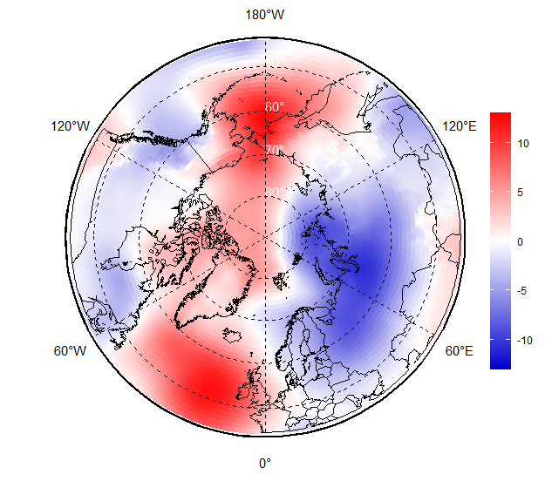
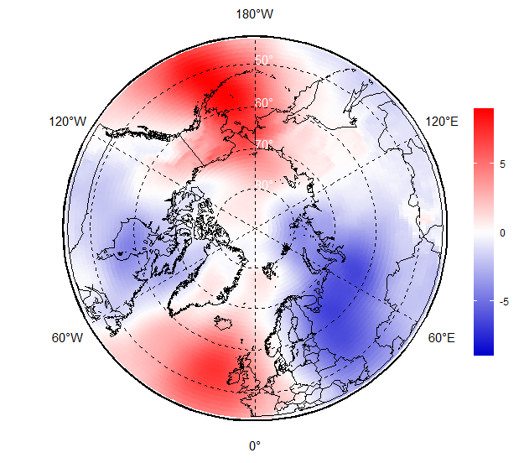
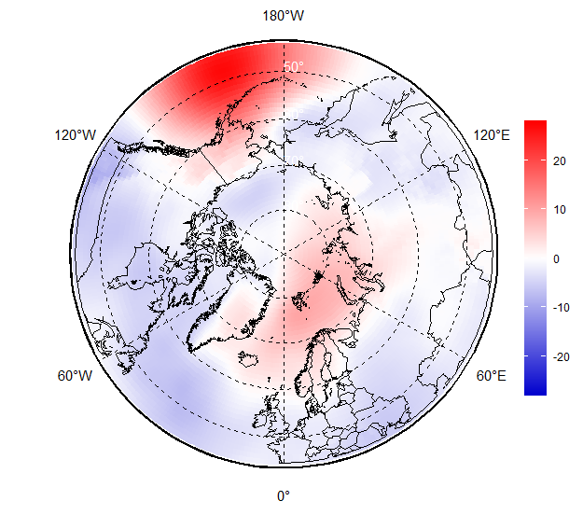
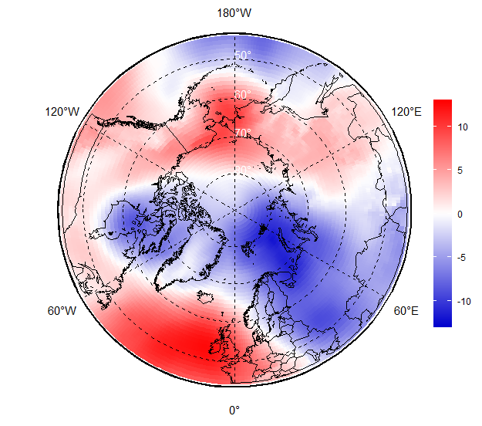
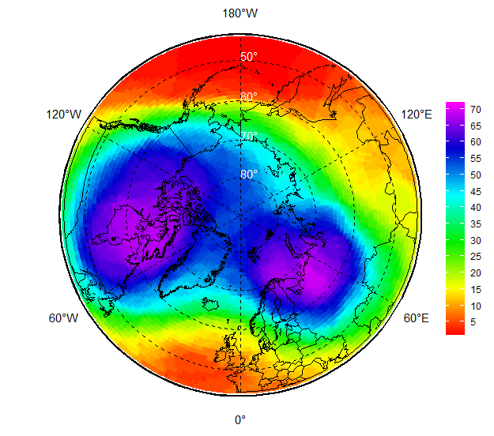
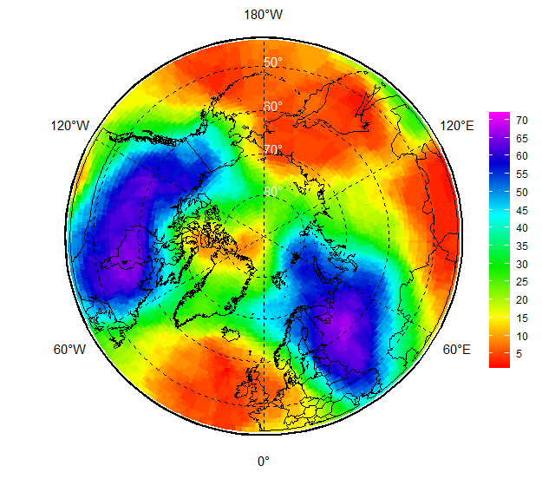
NDJ 2021/2022 atmospheric circulation
During NDJ 2021/2022 an intense bi-center polar vortex (dark violet, 50hPa and 500hPa geopotential height patterns) was observed with centers over the Hudson Bay and the Barents Seas. That led to prevalence of meridian circulation (transfer south/north) in the troposphere over W Siberian and Canadian regions and zonal one over other parts of the Arctic
For the surface atmosphere that meant predominance of negative mean sea level atmospheric pressure (MSLP) anomalies (lower pressure, marked in blue) and cyclonic activity over the E Nordic, W Siberian and Canadian regions
Opposite situation (higher pressure, marked in red) was observed over Alaska, Bering and Chukchi and W Nordic regions
Nov
Dec
Jan
NDJ MSLP hPa anomalies (1991-2020)
Mar
NDJ H50 (left) and H500 (right) ranks (1950-2021/2022)
[AARI / CCCS ERA5]

Slide 5
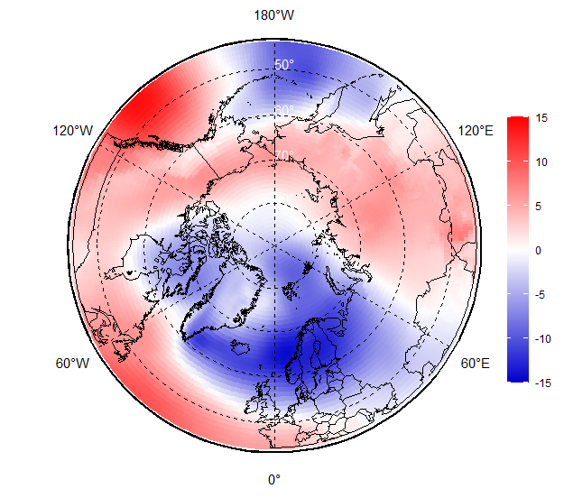
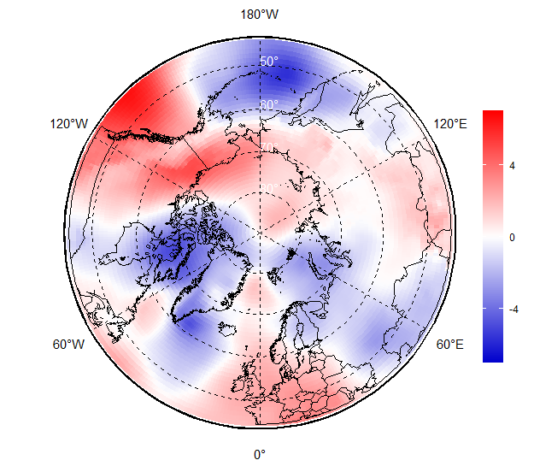
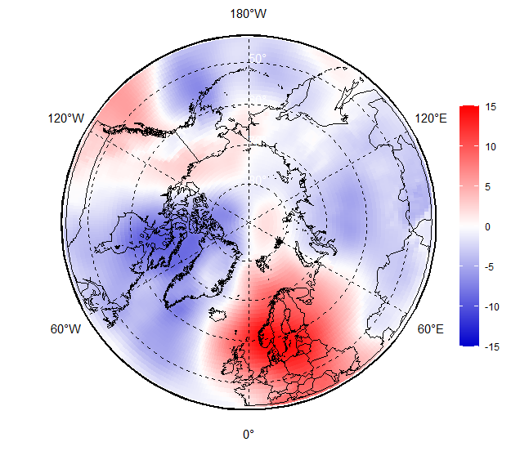
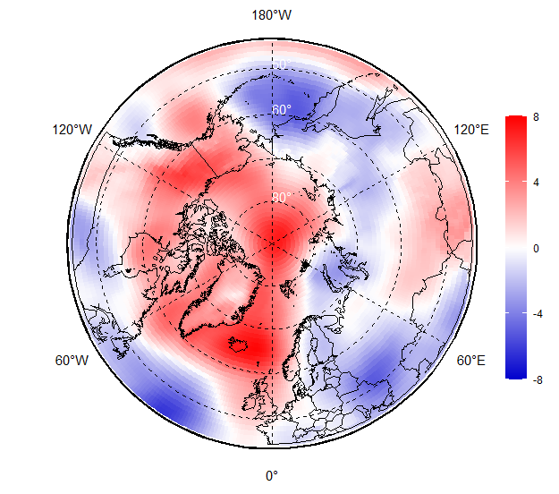
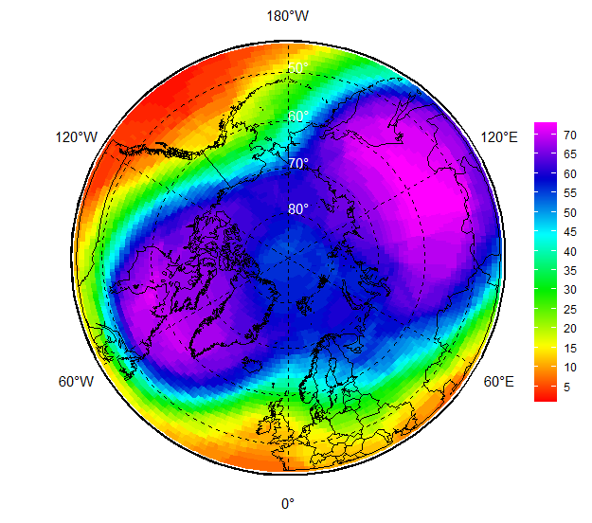
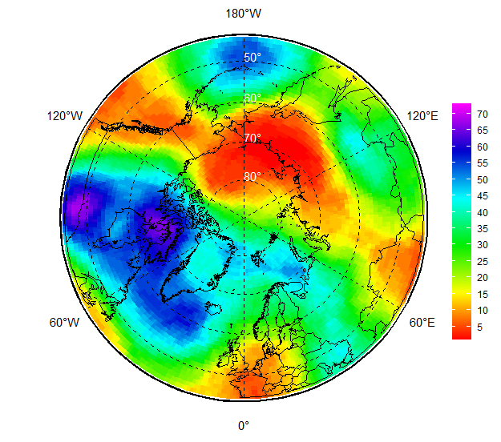
FMA 2022 atmospheric circulation
Feb
Further in season during FMA 2022 bi-center polar vortex shifted counter-clockwise with centers over the Hudson Bay and central Siberia and in general caused meridian type of circulation in Siberia and eastern Canada regions.
However, monthly patters of the surface atmosphere circulation were fully different in February, March and April with negative MSLP anomalies (cyclonic activity) over the Hudson Bay, Canadian Archipelago, Greenland and Nordic regions in February and April.
Blocking positive MSLP anomalies were observed in February from Central Siberia through Alaska to Central Canada and in April as a vast area of high pressure over Arctic Ocean, N Canada and Alaska.
Mar
Apr
FMA MSLP hPa anomalies (1991-2020)
FMA H50 (left) and H500 ranks (1950-2022)
[AARI / CCCS ERA5]

Slide 6
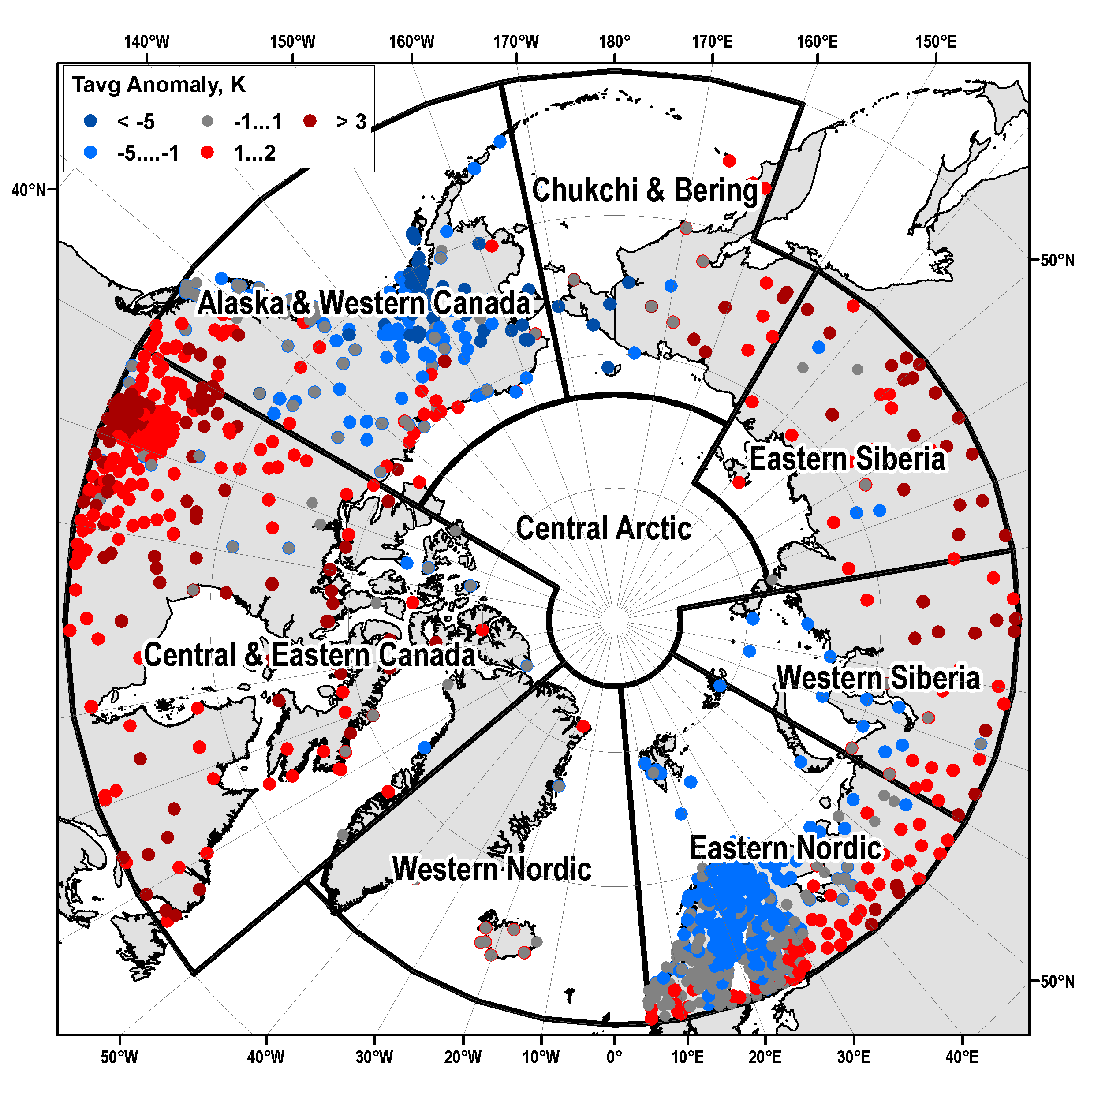
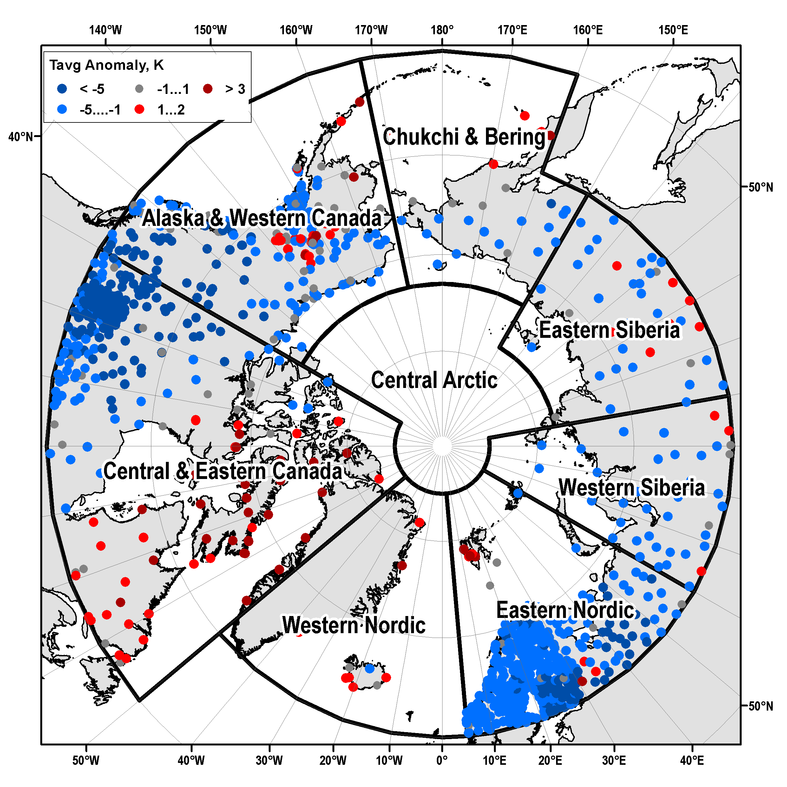
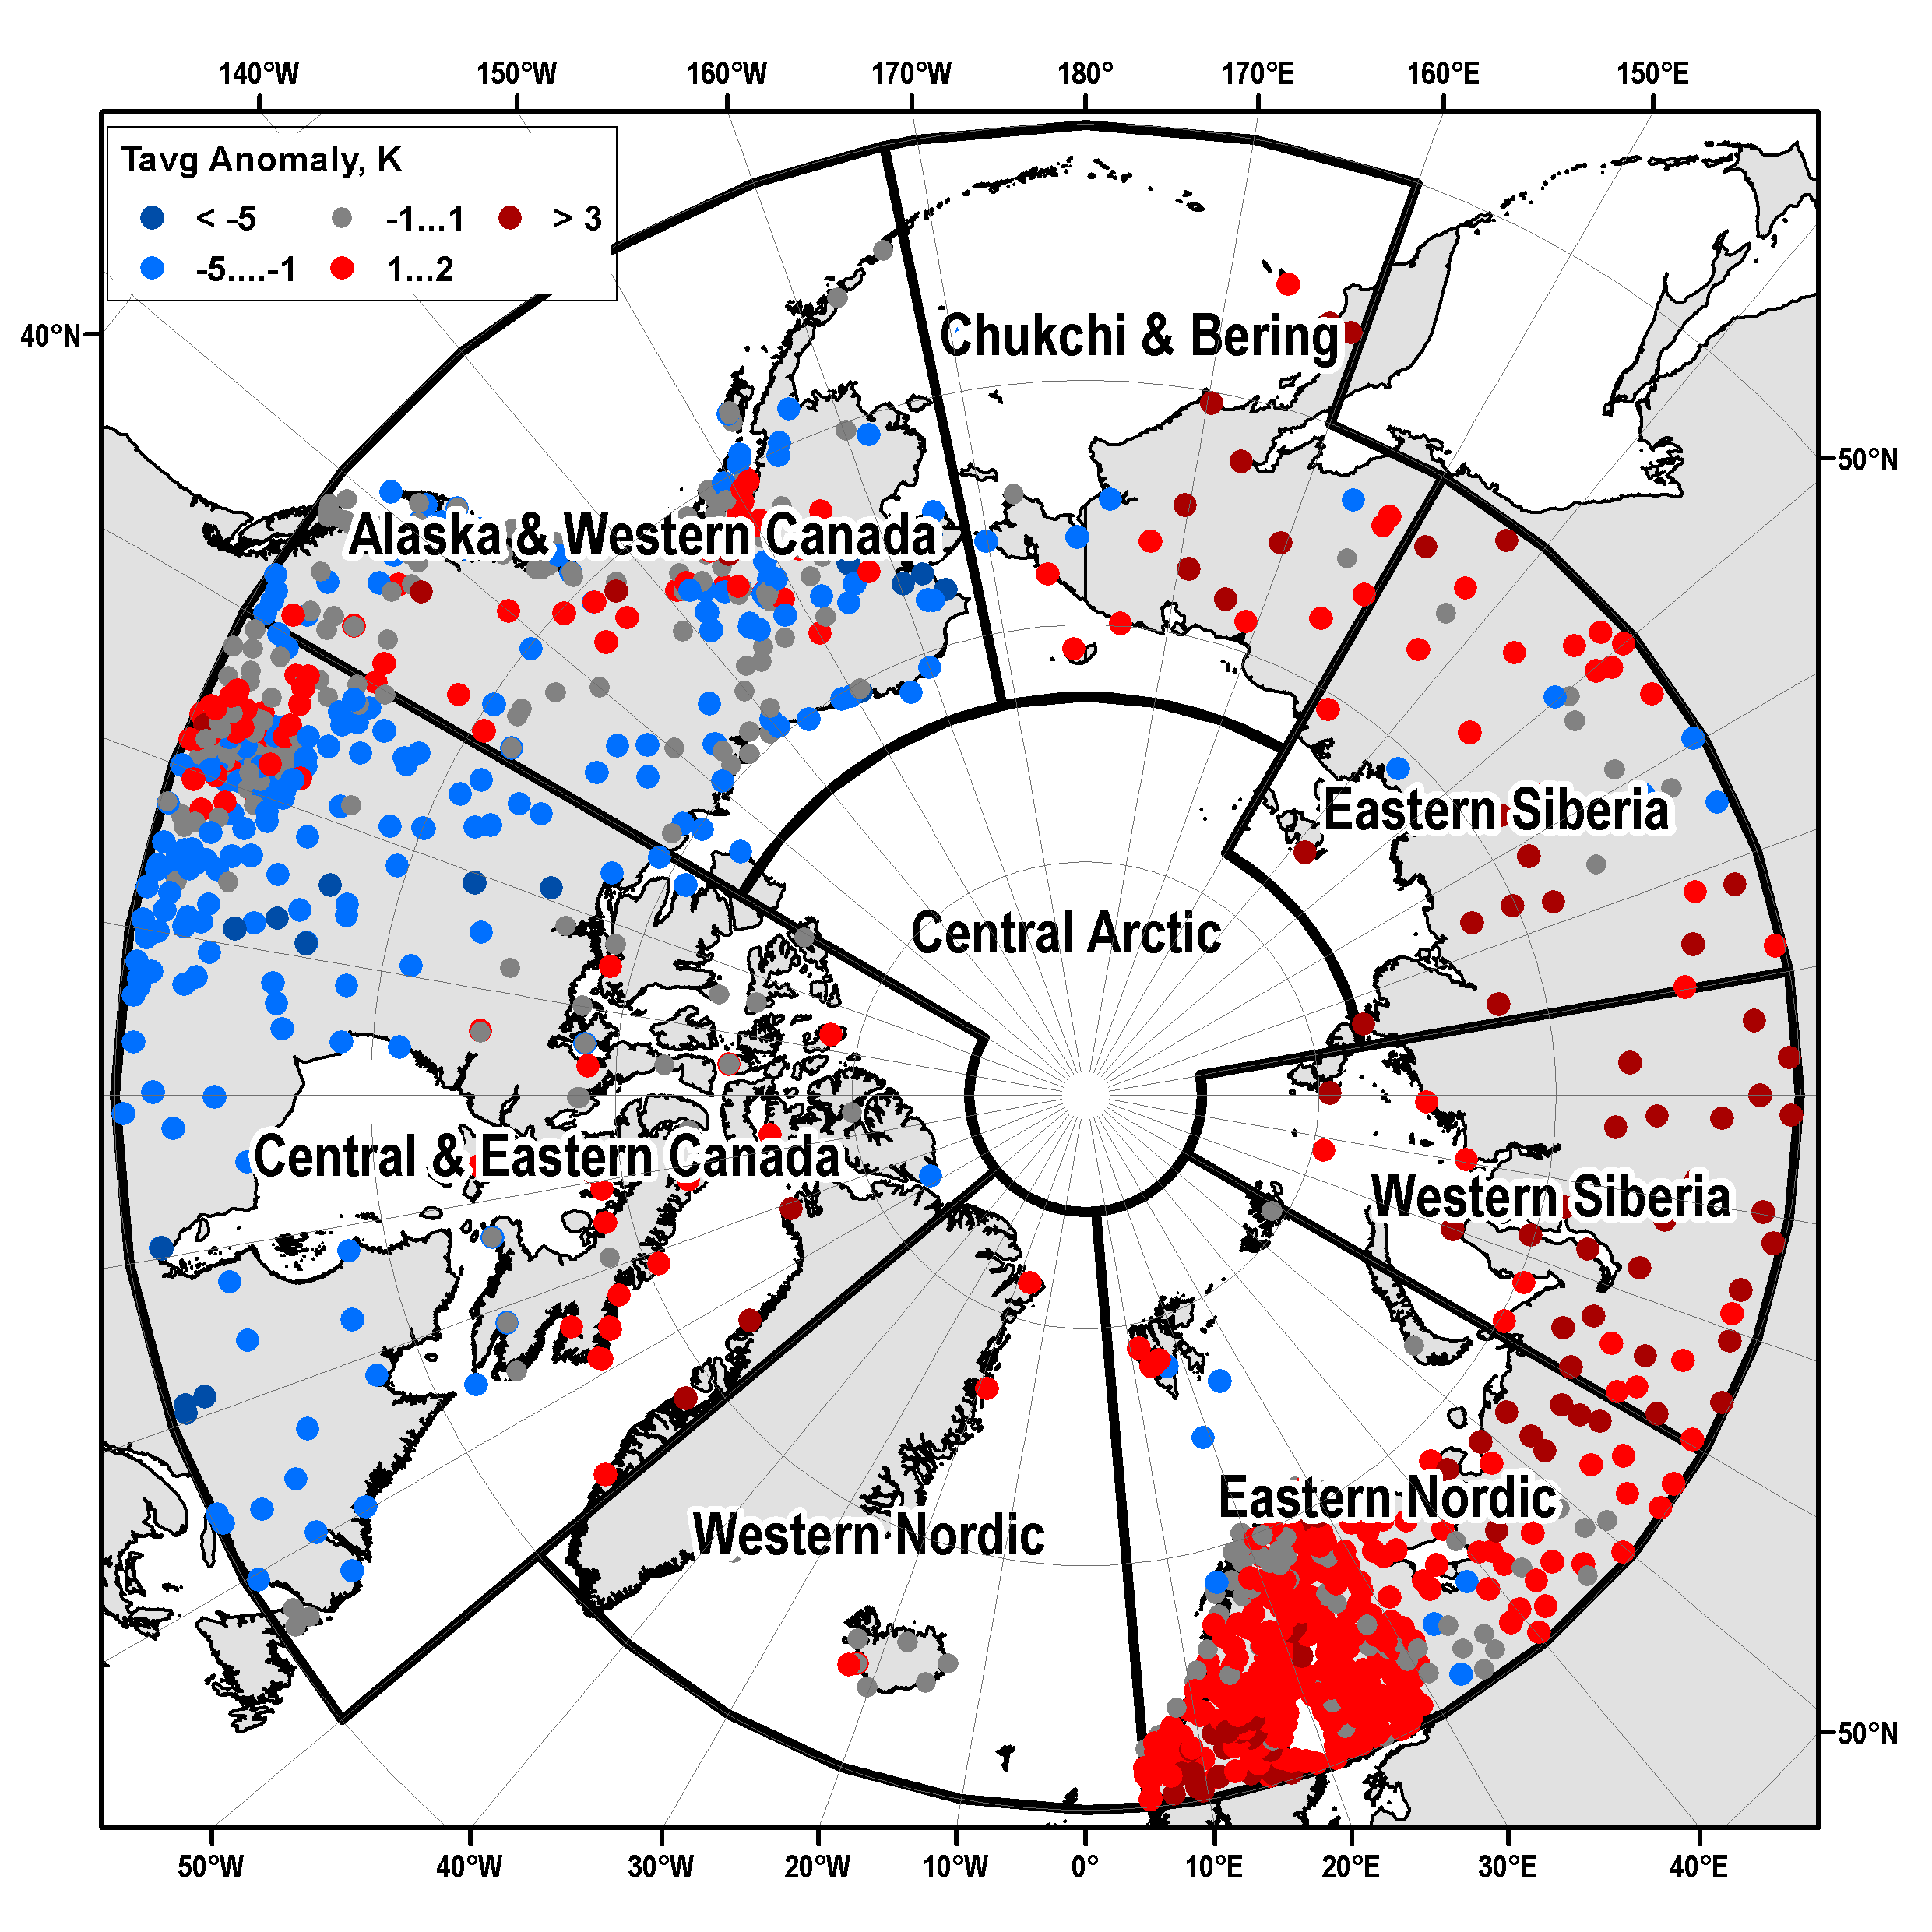
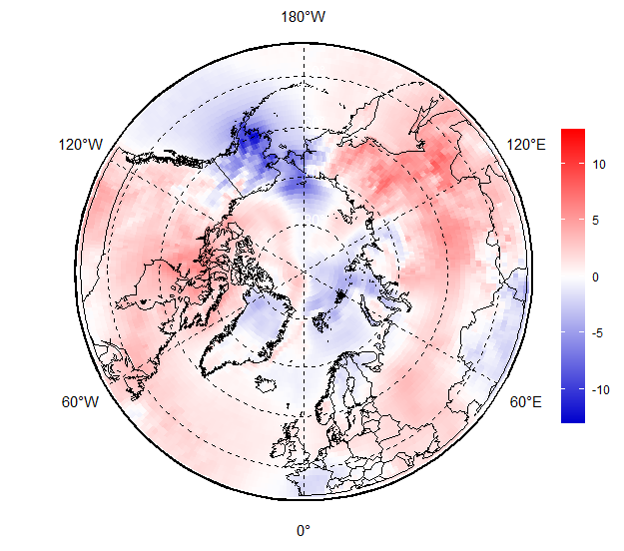
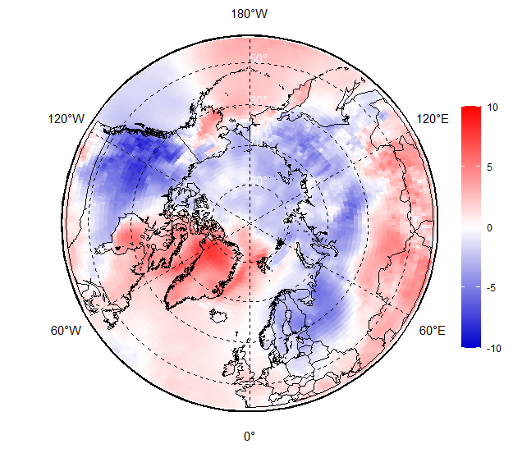
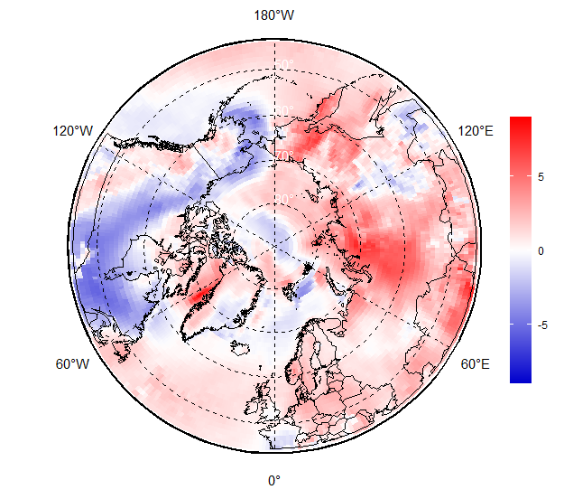
NDJ 2021-2022 Surface air temperature: anomalies (1991-2020)
Obs
Nov 2021
Dec 2021
Jan 2022
ERA5
[AARI / ERA5]

Slide 7
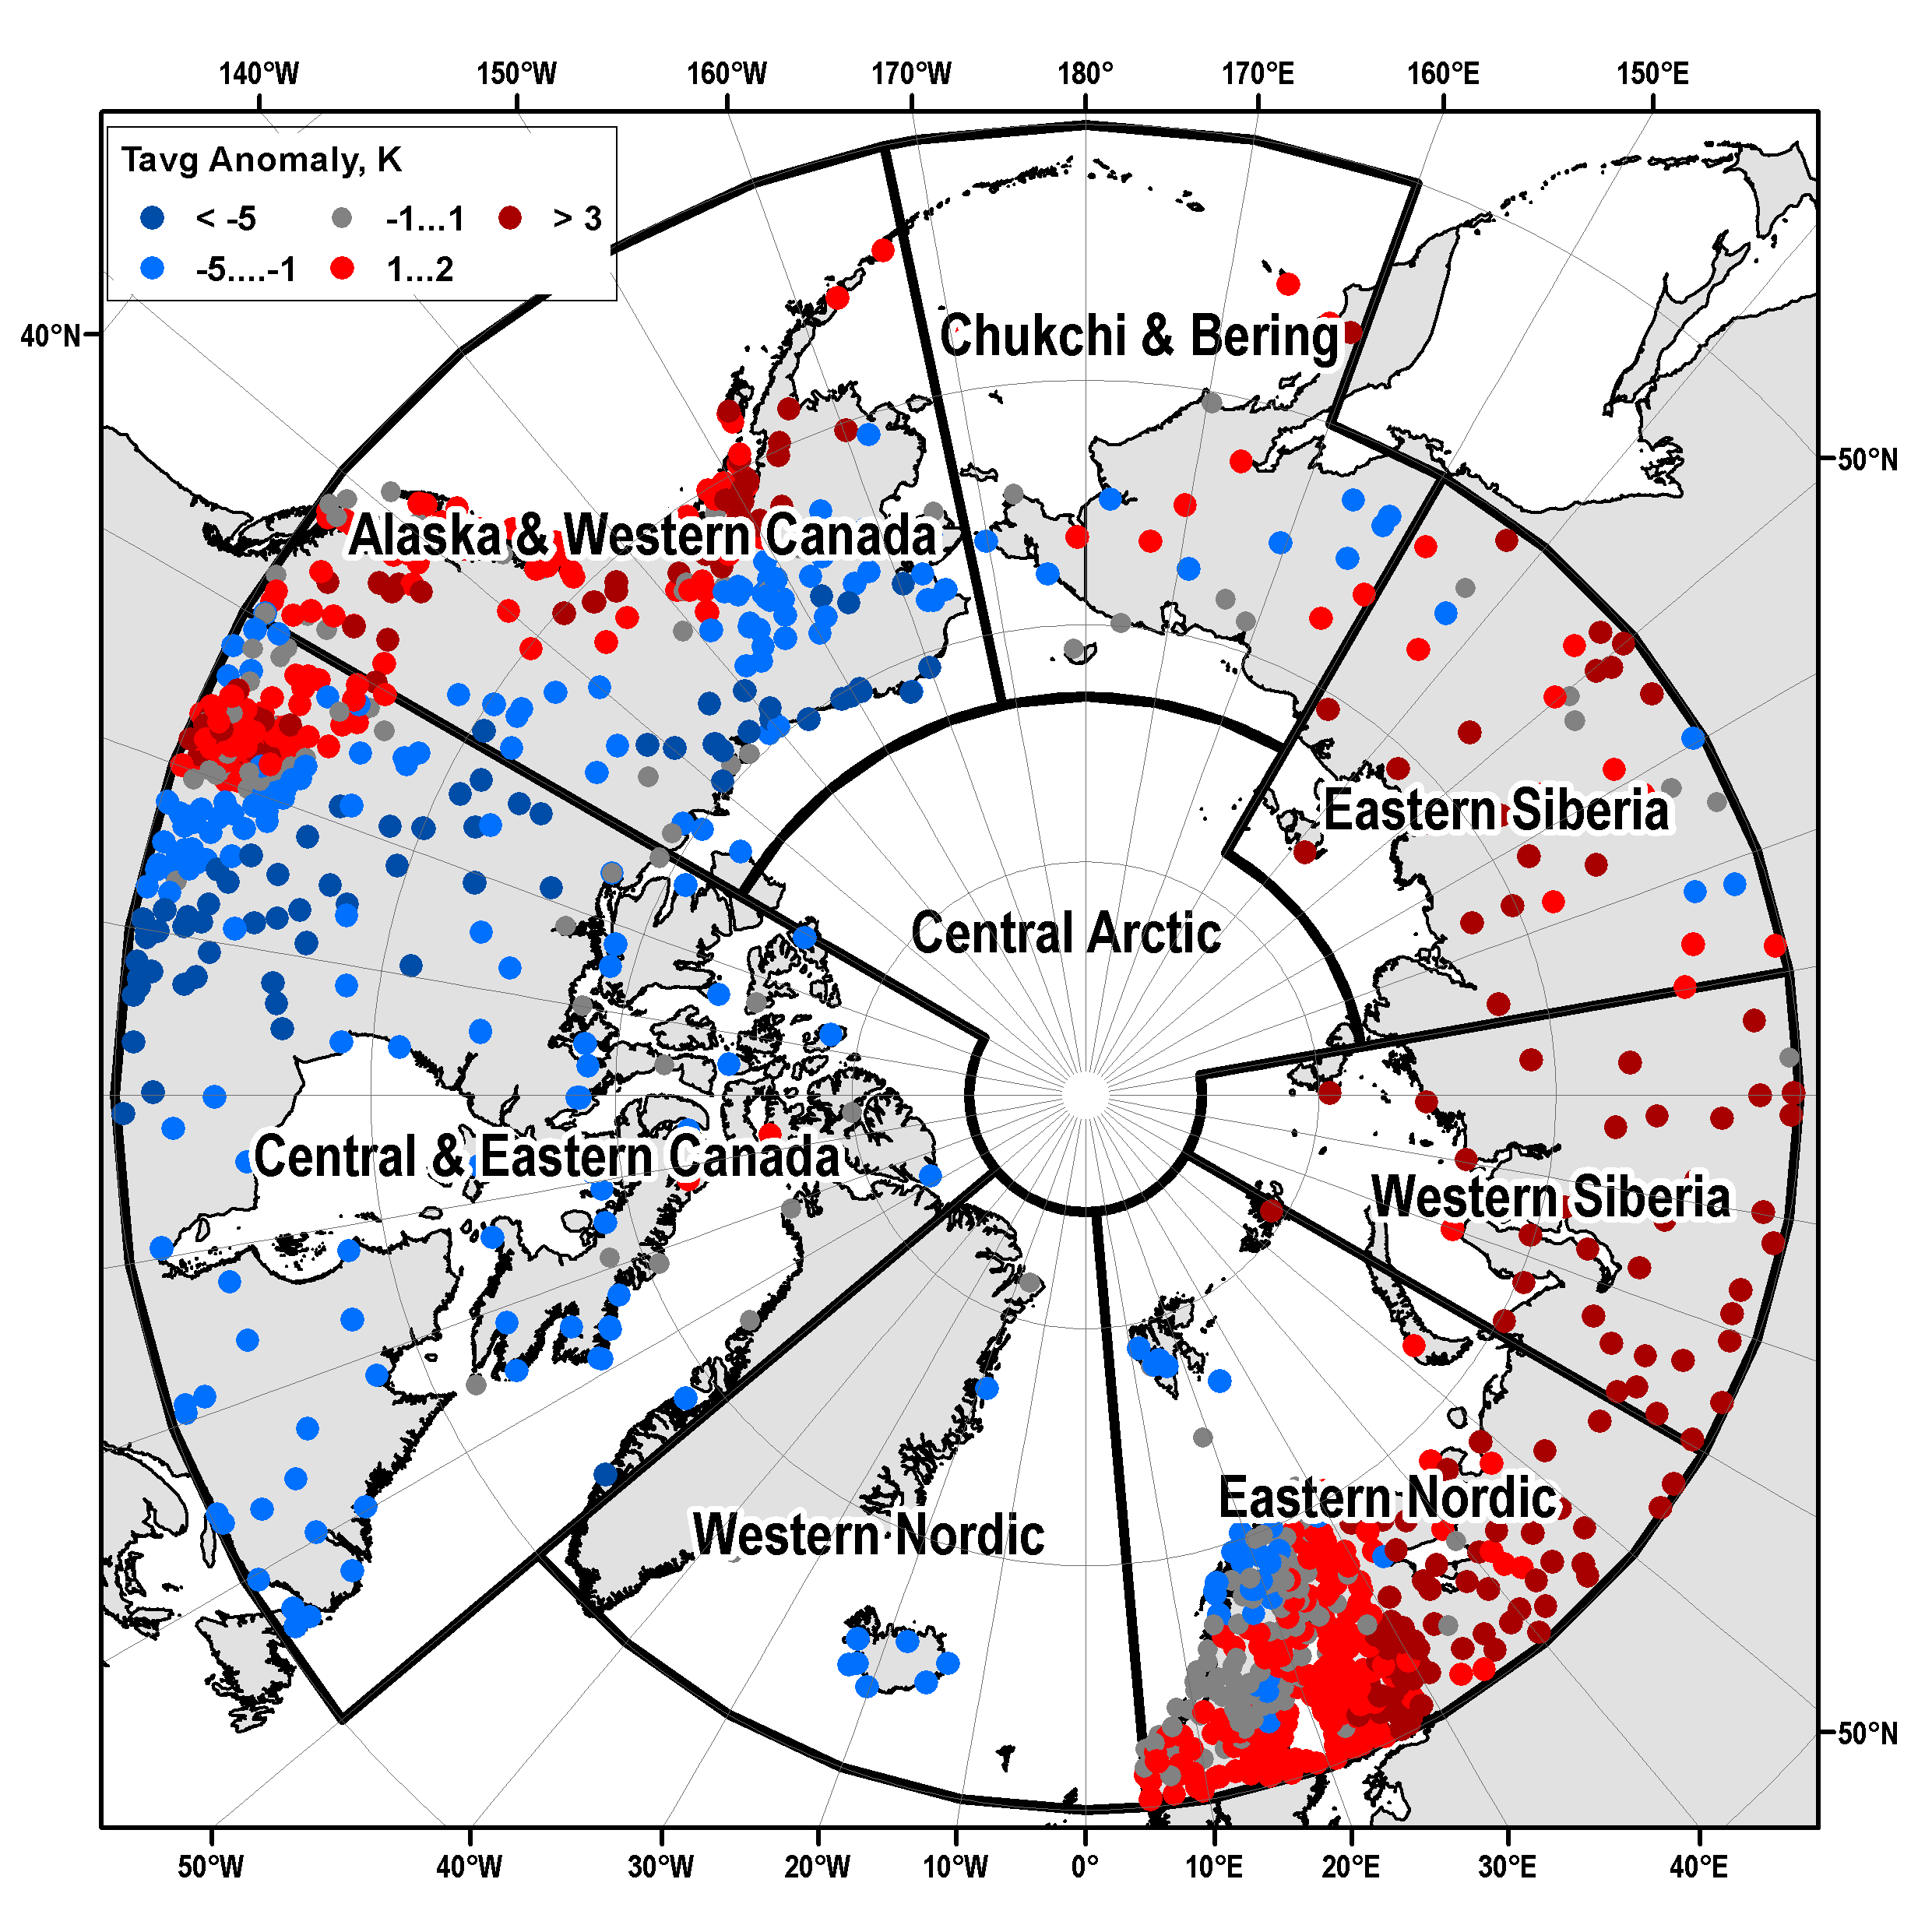
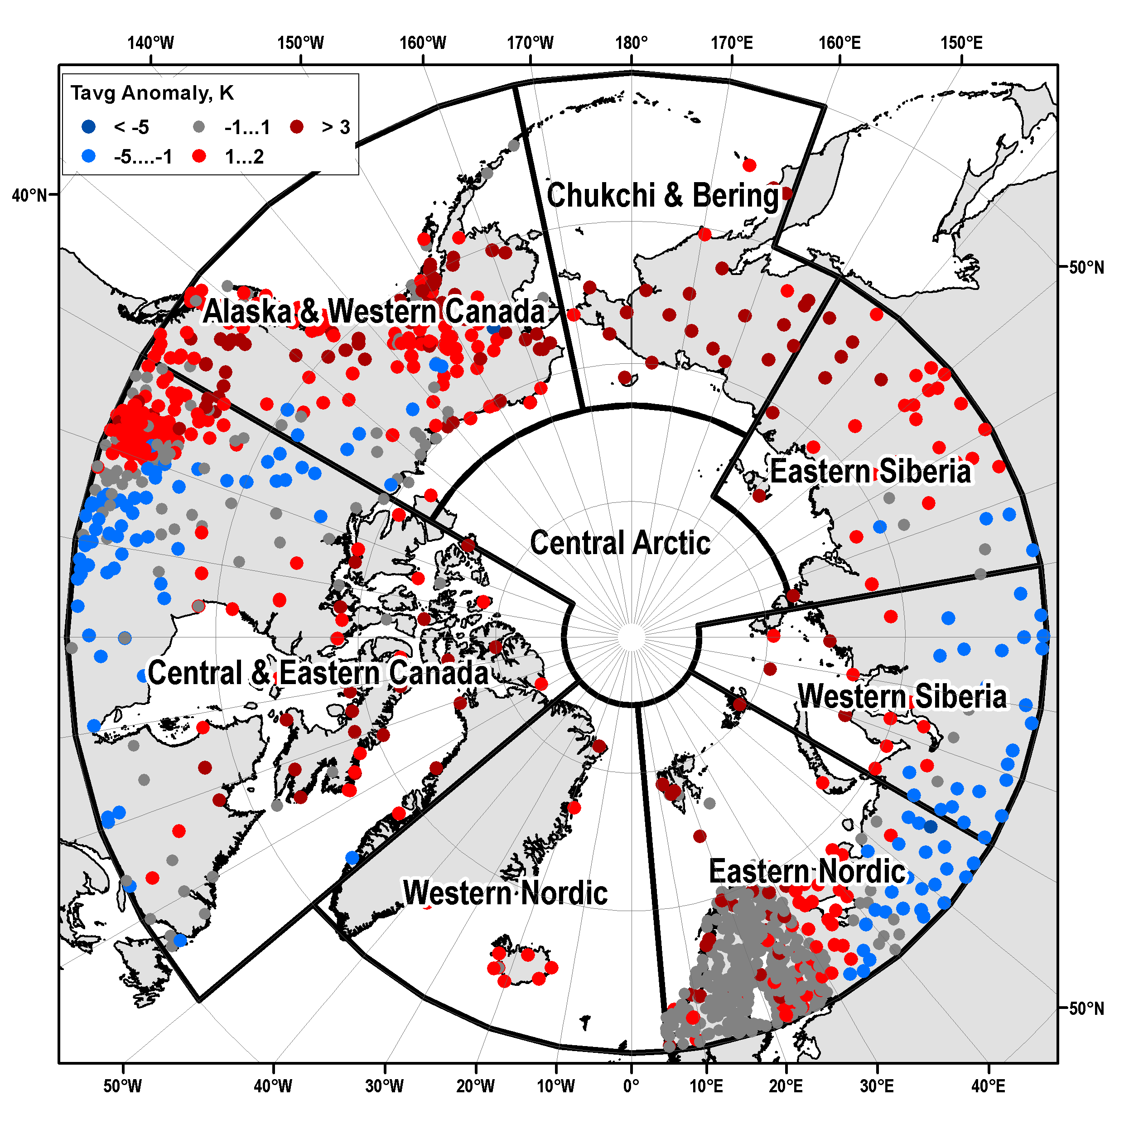
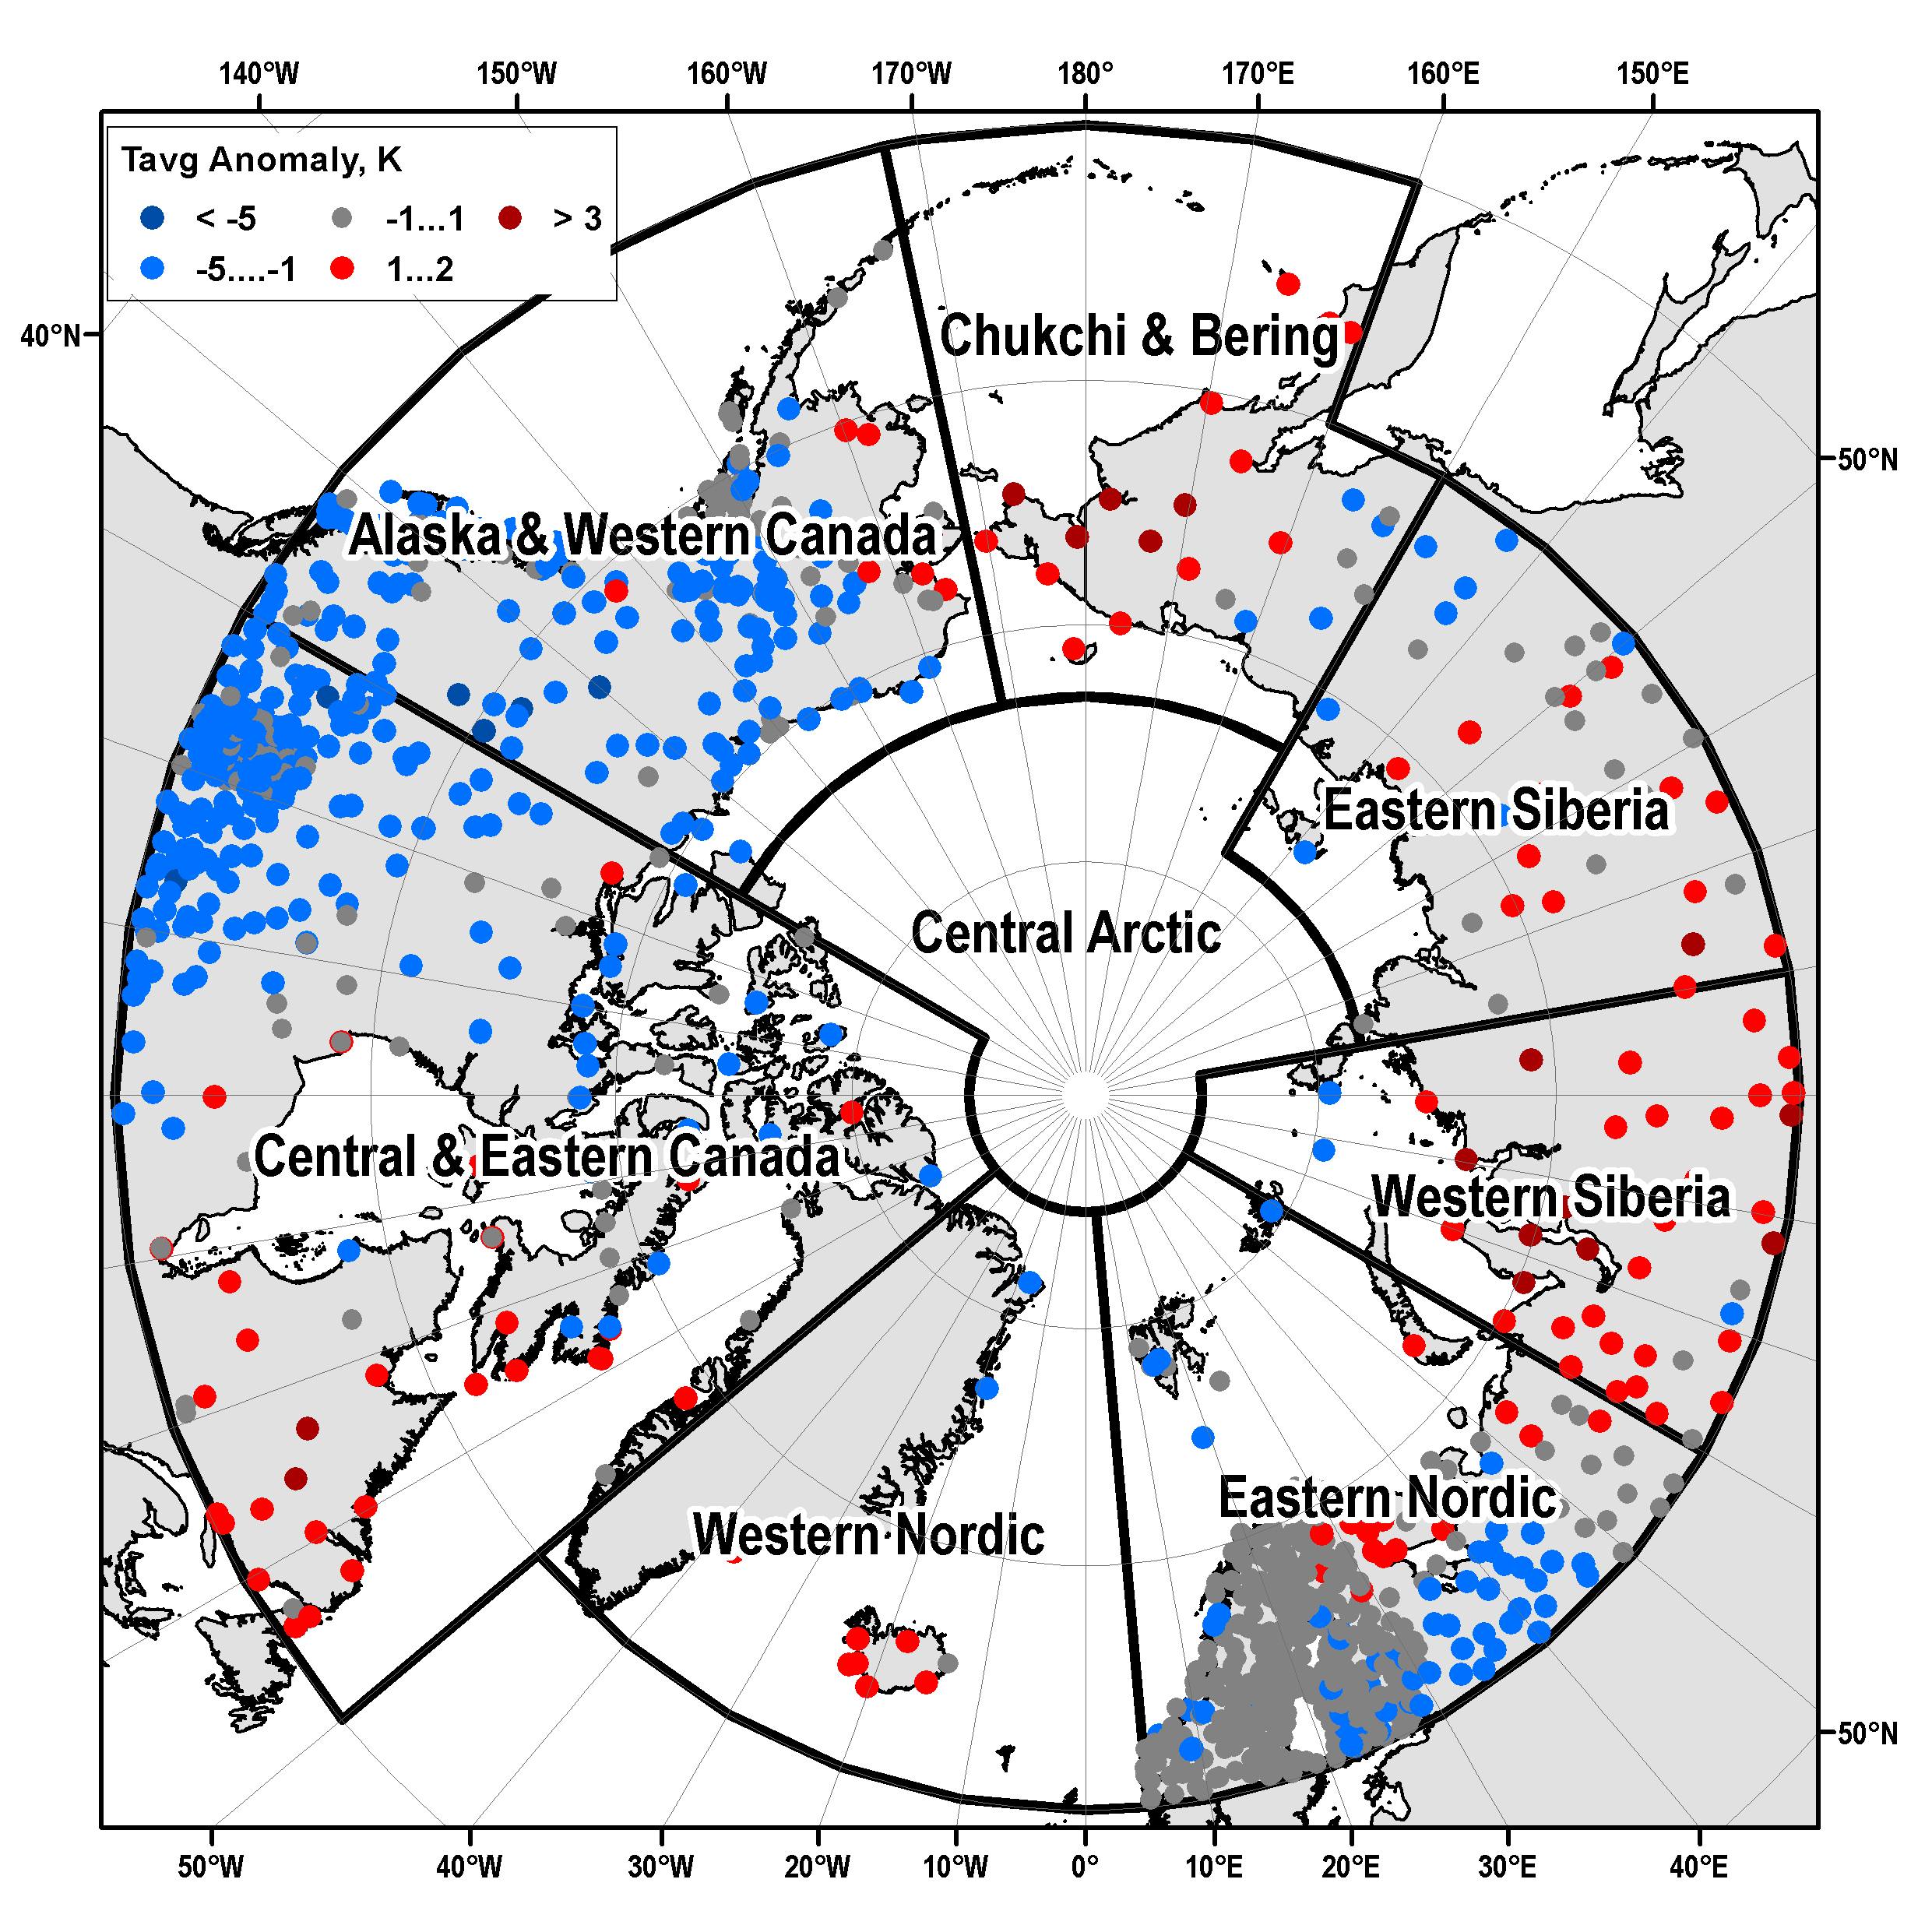
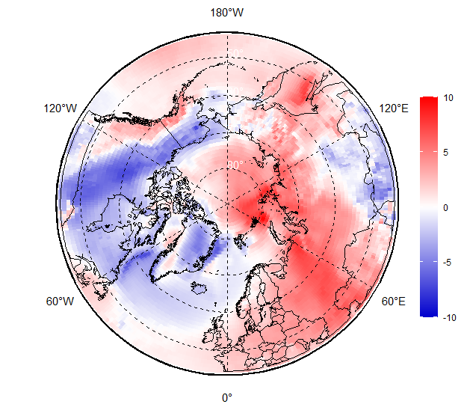
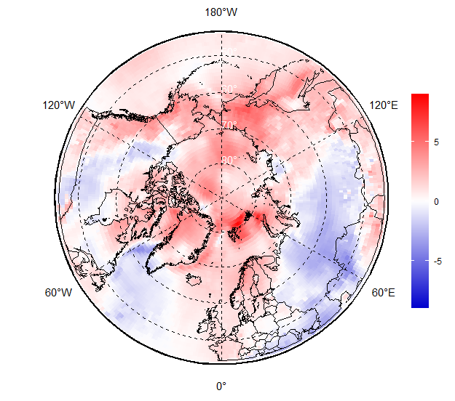
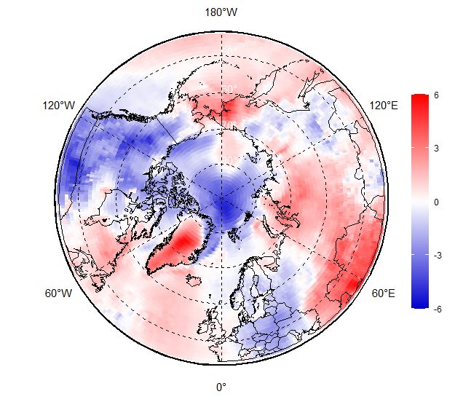
FMA 2022 Surface air temperature: anomalies (1991-2020)
Obs
Feb 2022
Mar 2022
Apr 2022
ERA5
[AARI / ERA5]

Slide 8
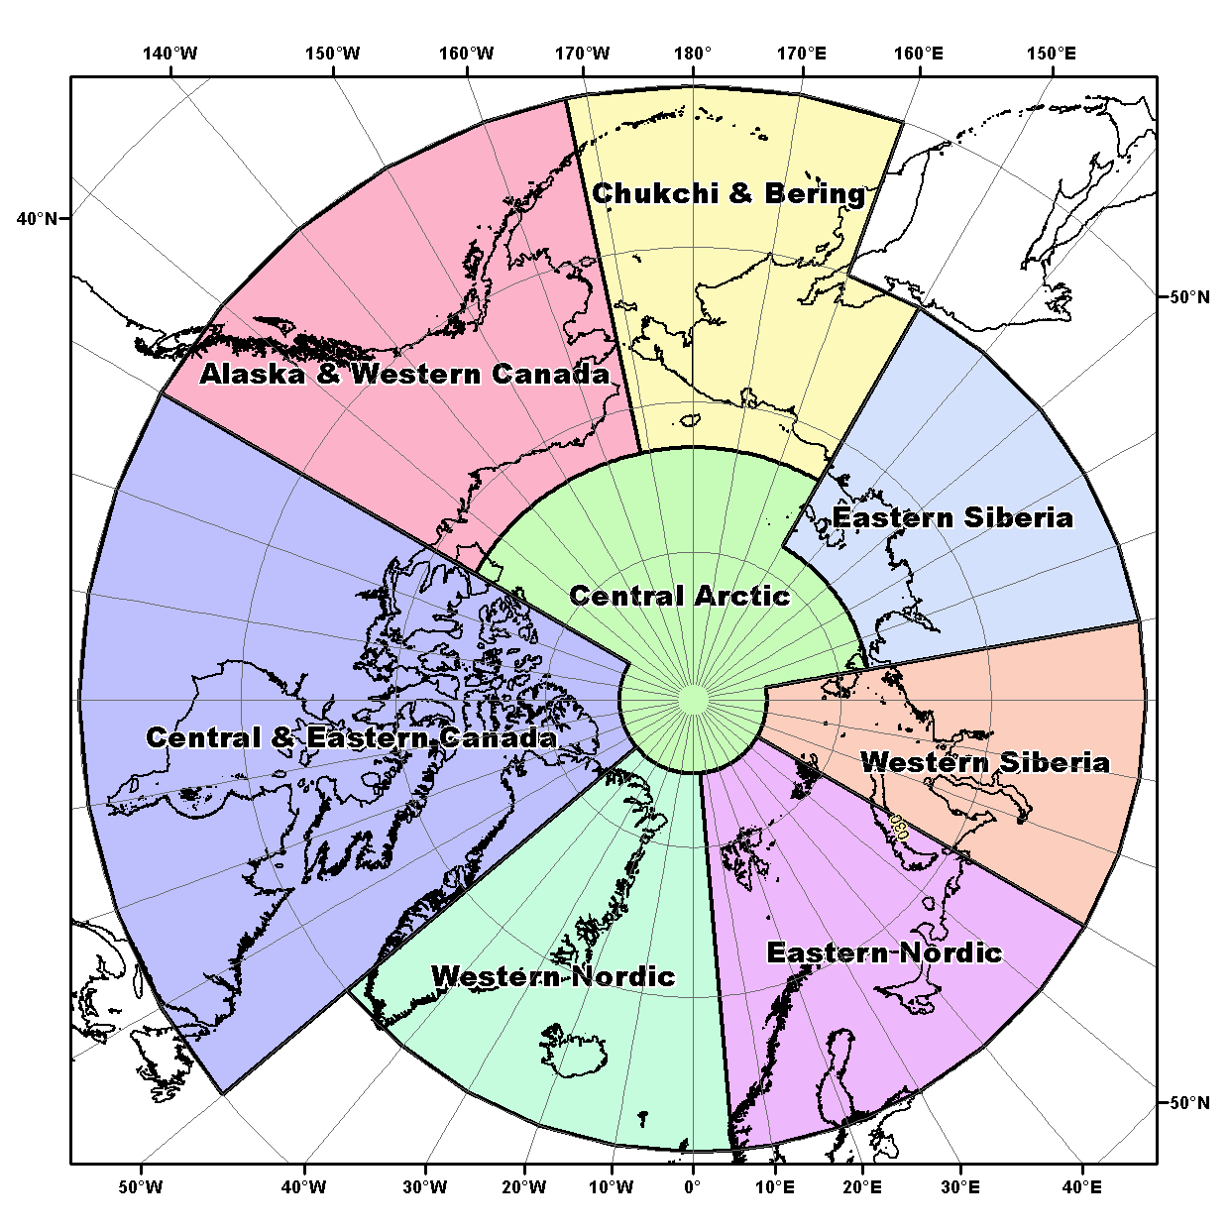
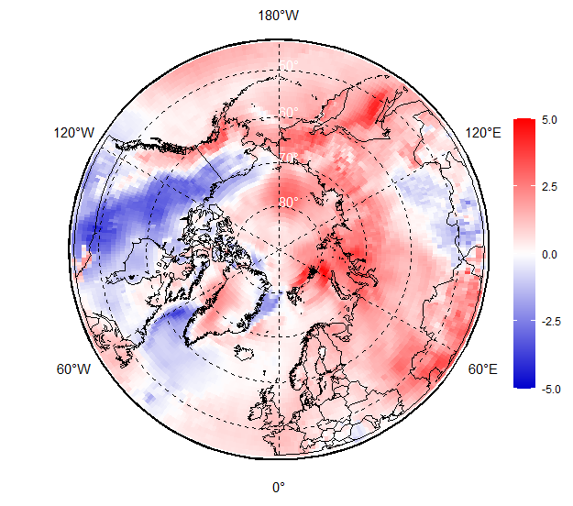
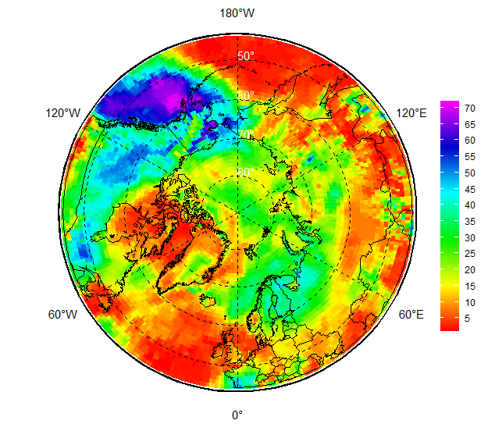
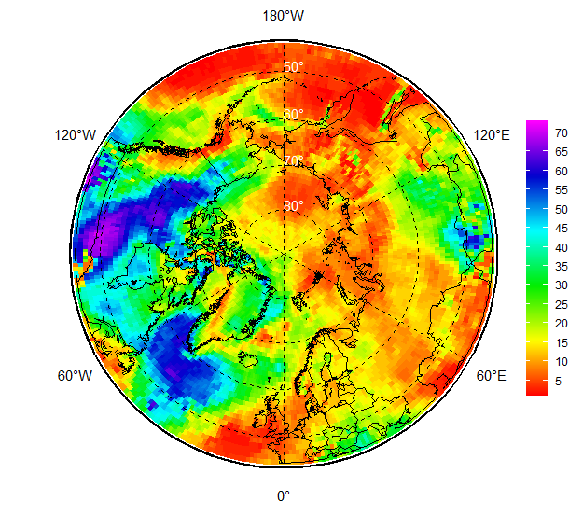
Surface air temperature
NDJ 2021-2022 anomalies and ranks (ERA5)
Nov 2021 - Apr 2022 anomalies and ranks (obs)
Anomalies: 1991-2020
Ranks: 1950-2021/2022
Region | Alaska & W Canada | Central & E Canada
2021-11 | -2.3(061|2006|1979) | 2.8(003|1985|1917)
2021-12 | -3.2(062|1933|1904) | -3.2(052|1933|1930)
2022-01 | -1.3(044|1909|1981) | 0.2(023|1950|1919)
2022-02 | -0.5(038|1904|1920) | -0.9(028|1979|1931)
2022-03 | 1.2(029|2007|1926) | 1.3(011|1964|2010)
2022-04 | -1.7(055|1972|1940) | -1.0(029|1954|1915)
Region | Western Nordic | Eastern Nordic
2021-11 | 0.2(030|1971|1941) | -0.2(033|1902|2020)
2021-12 | 1.4(013|1985|1933) | -3.0(051|1915|2006)
2022-01 | 0.6(023|1988|1950) | 1.2(015|1987|2020)
2022-02 | -1.4(056|1969|1932) | 1.6(020|1966|1990)
2022-03 | 1.6(017|1990|1929) | 0.2(028|1942|2007)
2022-04 | 0.3(027|1983|1926) | -0.9(042|1929|2011)
NDJ 2021-2022
FMA 2022
Rank
Region | Western Siberia | Eastern Siberia | Chukchi & Bering
2021-11 | 1.0(022|1968|2020) | 3.0(007|1982|2020) | -0.7(026|1969|1919)
2021-12 | -1.4(044|1968|1913) | -1.8(049|1907|2013) | -1.7(043|1993|1933)
2022-01 | 3.9(009|1969|2007) | 1.6(012|1900|2007) | 1.4(027|1910|1926)
2022-02 | 4.7(004|1966|2020) | 2.4(009|1900|1934) | -0.5(030|1902|1926)
2022-03 | -0.6(030|1960|2017) | 1.3(016|1942|2017) | 3.7(006|1901|1926)
2022-04 | 1.5(016|1984|1995) | 0.2(017|1956|1920) | 1.2(010|1976|1926)
Anom(Rank|Yearmin|Yearmax)
0.6 (012 | 1955 |1924)
[AARI / ERA5]

Slide 9
Surface air temperature
The start of winter 2021/2022 (November-December) surface air temperature experienced prominent positive – in Central and E.Canada (3rd in row), Eastern Siberia (7th in row) and negative – Alaska (62nd in row), Eastern Nordic (51st in row) anomalies (to 3rd WMO reference period 1991-2020 and 1950-2021 observation period).
During mid-winter (January-February) strong positive anomalies were observed over the Eastern Nordic (15th in row), W and E Siberia (4th – 12th in row) with negative anomalies observed over W Nordic region (56th in row).
Further by the end of winter in March – April 2022 both positive and negative anomalies were observed over Alaska (29th and 55th in row), Canadian (11th and 29th) and Nordic regions and mostly positive over Siberia (16th – 30th in row) and Chukchi (6th – 10th in row) regions.
Due to lack of surface marine observations conclusions for the Central Arctic done on reanalysis, include partly colder conditions in November 2021, predominantly warmer in February – March 2021, and colder in December 2021 and April 2022.
For the whole land Arctic prominent warmer conditions were observed in November 2021 (12th in row) with prominent colder in December 2021 (47th in row) and April 2022 (38th in row).
It should be mentioned that though extreme negative anomalies occurred with a very few exceptions in the beginning – mid 20th century, that is not the case for extreme positive anomalies which could occur (for different months and regions) as early as 1920s. Simultaneously, it should be kept in mind that though positive trends are obvious, the quantitive estimates depend on the WMO reference period chosen and density of the stations, in particular for the marine Arctic.
 | Arctic total
2021-11 | 0.6(012|1955|1924)
2021-12 | -2.6(047|1955|2006)
2022-01 | 0.6(014|1950|1926)
2022-02 | 0.6(016|1936|2016)
2022-03 | -0.1(024|1942|1926)
2022-04 | -1.5(038|1956|2010)
Anom(Rank|Yearmin|Yearmax)
0.6 (012 | 1955 |1924)

Slide 10
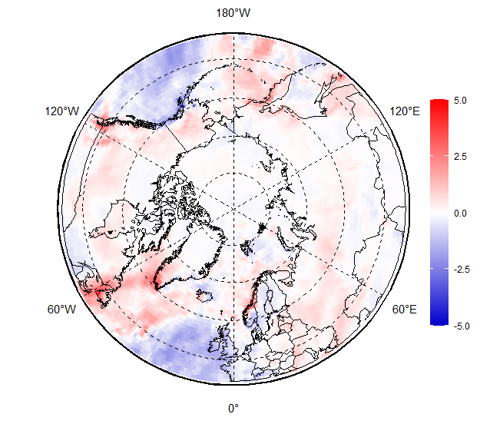
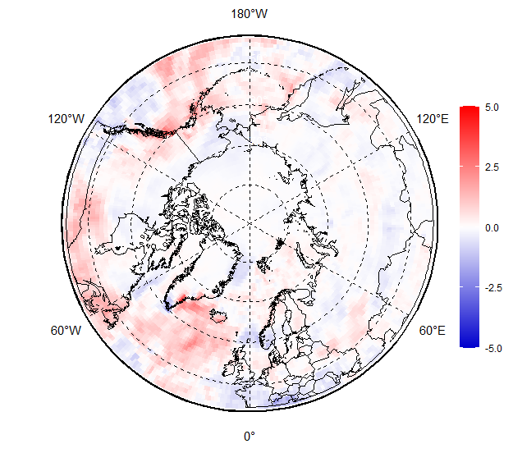
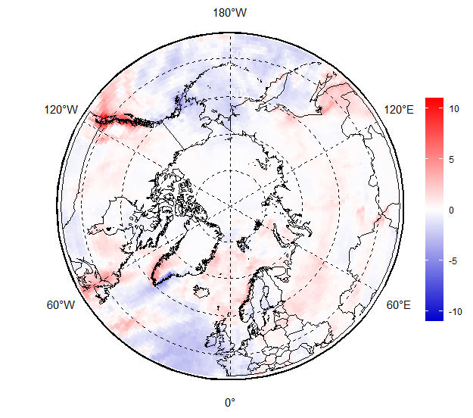
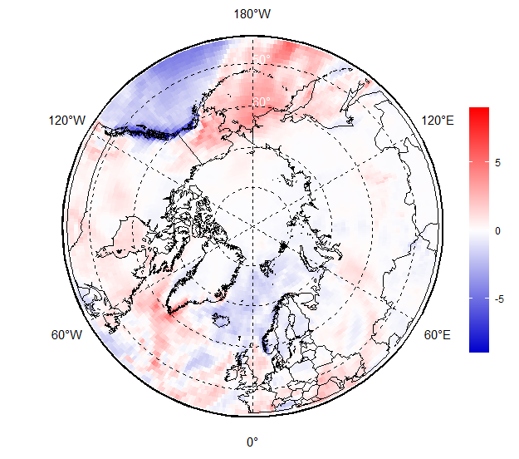
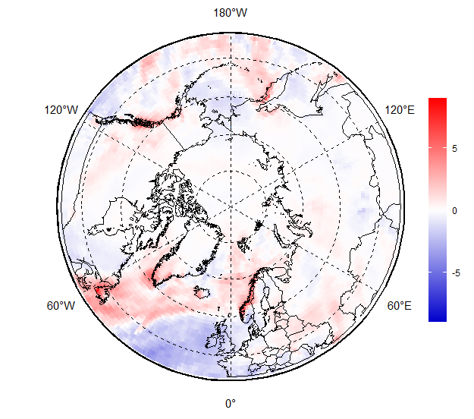
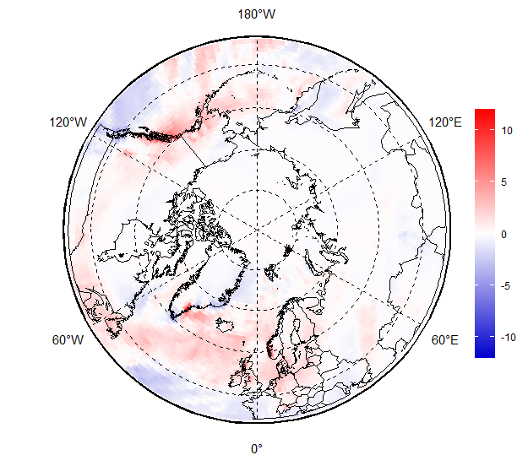
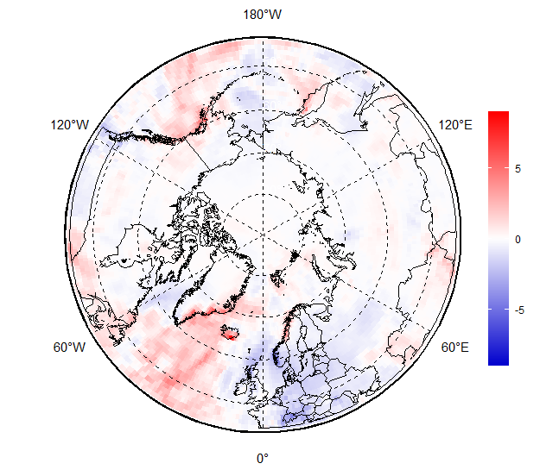
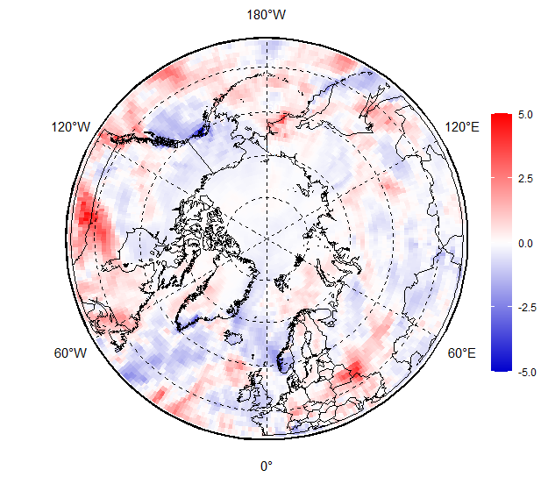
NDJFMA 2021/2022 Surface precipitation: anomalies (1991-2020)
In general, during the whole season wetter (snowy) conditions occurred in most parts of Canadian, Alaska, Bering & Chukchi and W Nordic regions
Drier conditions occurred in parts of E Nordic, Siberia and Central Arctic regions
NDJ 2021/2022
precipitation anomaly
FMA 2022
precipitation anomaly
Nov
Dec
Jan
Feb
Mar
Apr
[AARI / CCCS ERA5]

Slide 11
JJA 2021 surface precipitation by regions: anomalies (reanalysis)
Region | NDJ 2021/2022 | FMA 2022
Western Nordic | wetter | wetter
Eastern Nordic | drier | slightly drier
Western Siberia | slightly wetter | slightly drier
Eastern Siberia | normal | slightly drier
Bering & Chukchi | wetter | wetter
W Canada & Alaska | wetter | wetter
Eastern Canada | wetter | normal
Central Arctic | slightly drier | slightly drier
Reference period: 1991-2020
The least amount of precipitation was for the Eastern Nordic and Siberia regions
More abundant precipitation was observed in the Western Nordic, Bering and Chukchi and Canada and Alaska regions.
Somewhat drier or close to normal conditions are estimated for the Central Arctic
[AARI / CCCS ERA5]

Slide 12
Sea ice
  Precursors in atmosphere and polar ocean
  Ice extent and ice conditions based on ice charting
  Sea ice thickness and volume based on reanalysis

Slide 13
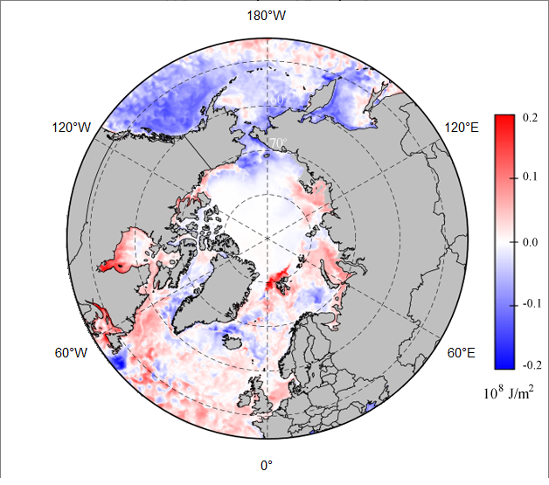
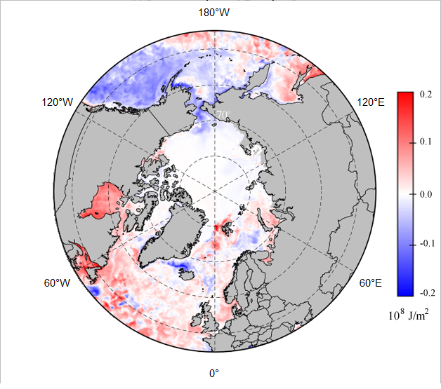
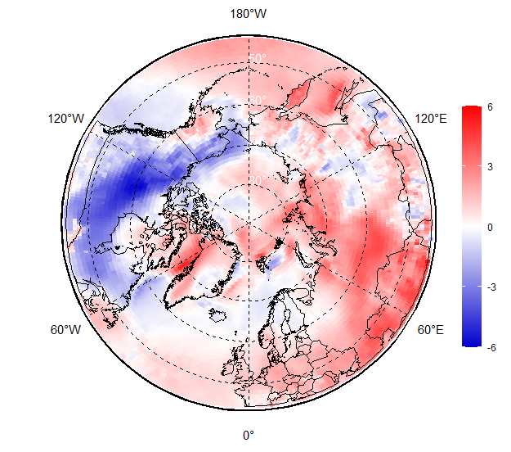
Precursors for winter 2021/2022 ice conditions
Prevailing positive ocean heat capacity (HC) anomaly during Oct – Nov 2021 for the Svalbard, Kara, Laptev, Okhotsk Seas and Hudson Bay slowed freezing processes in these regions
Oppositely, zero or negative HC anomalies in Oct-Nov 2021 in ESS, Chukchi, Bering, Baffin Seas provided background for close to normal freeze-up
Further in winter occurrence of significant positive SAT anomalies over Arctic Basin in January-February 2022 slowed the ice growth, however negative SAT anomalies in April 2022 stimulated ice growth again
Oct 2021 Heat Capacity 15m
anomaly, 1993-2020
Nov 2021 Heat Capacity 15m
anomaly, 2020
DJF 2021/2022 Apr 2022
SAT anomaly, 1991-2020
[AARI / CCCS MEMS & ERA5]

Slide 14
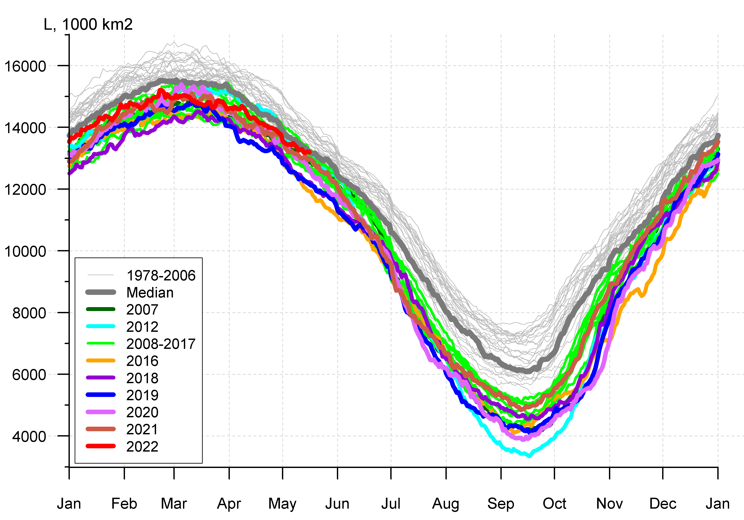
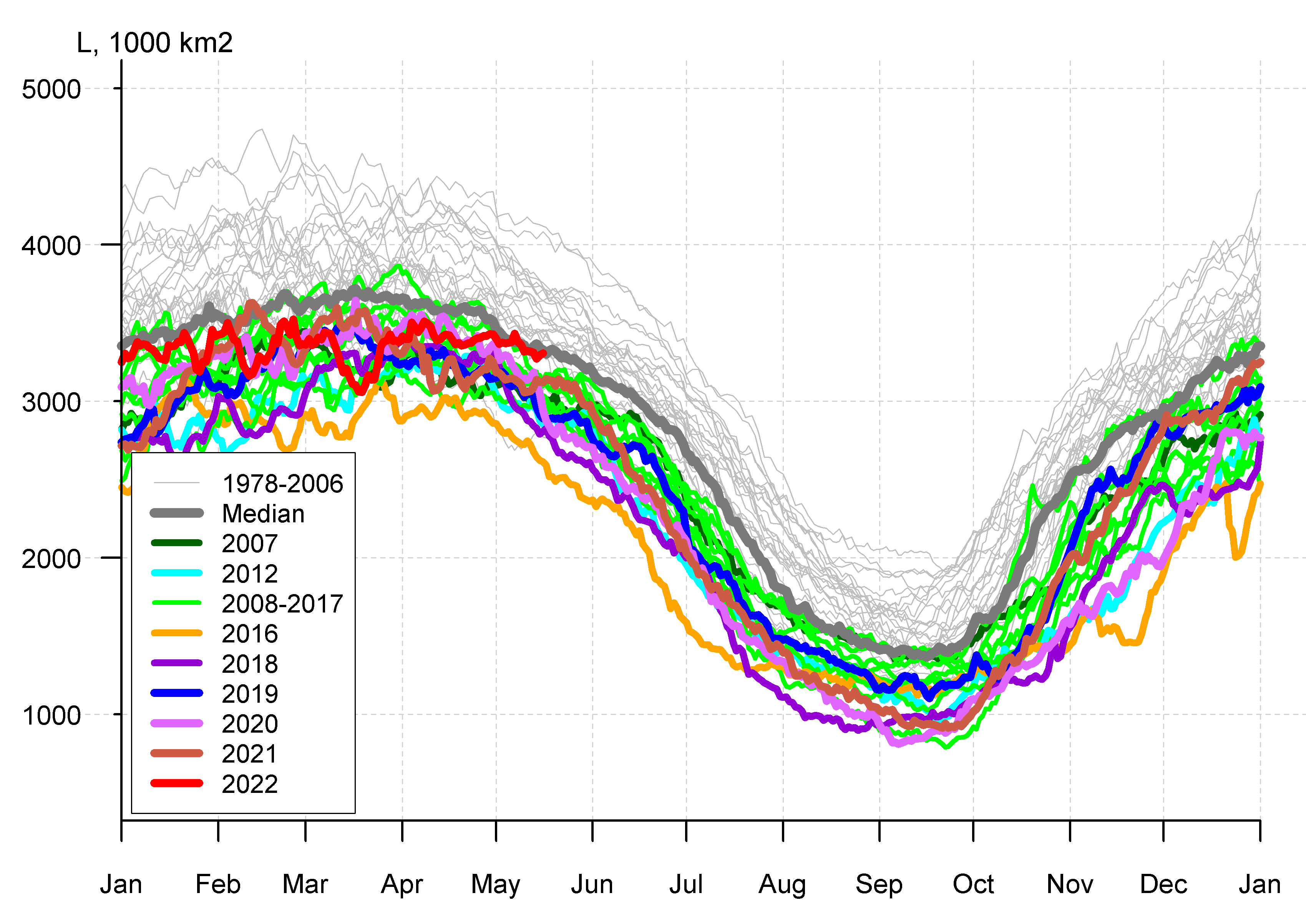

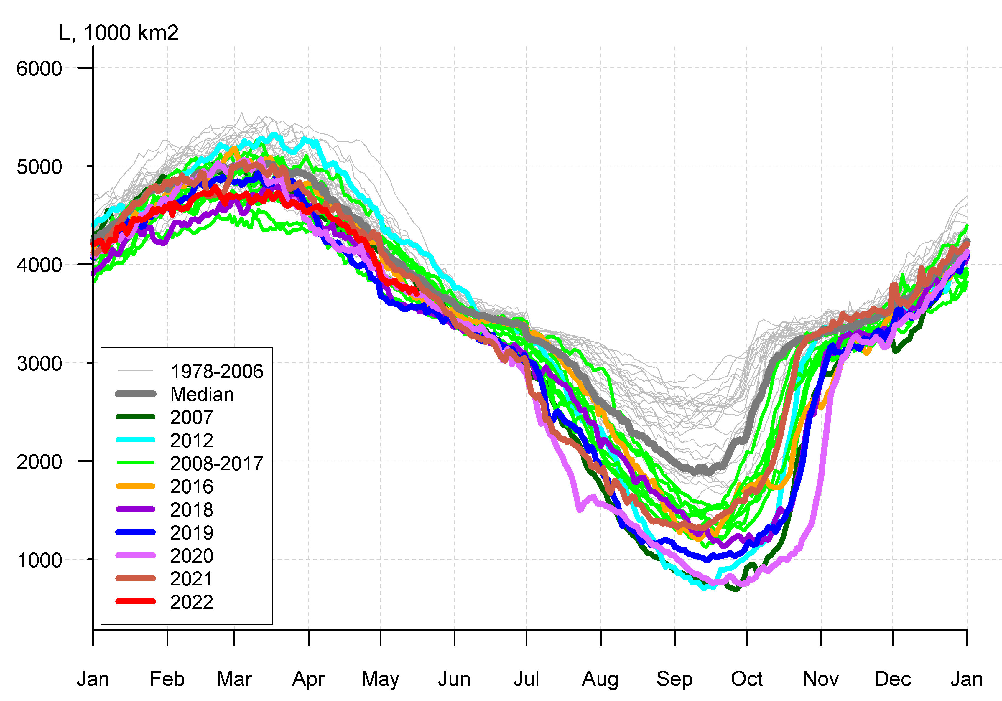
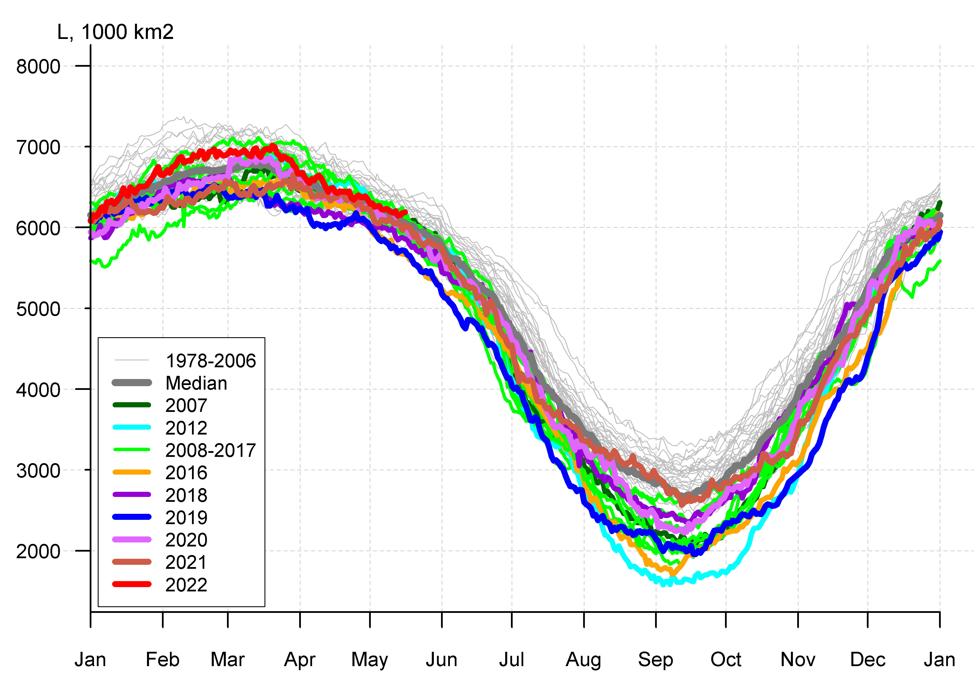
Arctic (NH) seasonal ice extent 1978…. 2022
S, 1000 km²
Western Arctic (WA)
S, 1000 km²
S, 1000 km²
Northern Hemisphere
Sep (Min) Feb/Mar (Max)
2012 3346
2020 3882
2016 4099
2019 4103
2007 4189
2011 4312
2015 4350
2018 4557
2008 4588
2017 4622
2010 4641
2021 4848
… …
1982 7246
1983 7285
1980 7611
2017 14467
2018 14516
2015 14526
2016 14580
2011 14701
2006 14867
2019 14891
2007 14931
2014 14972
2021 15100
… …
2022 15210
... ...
1988 16461
1983 16547
1979 16769
Jan Feb Mar Apr May Jun Jul Aug Sep Oct Nov Dec Jan
Jan Feb Mar Apr May Jun Jul Aug Sep Oct Nov Dec Jan
CA
EA
S, 1000 km²
S, 1000 km²
Eastern Arctic (EA)
Canadian Arctic (CA)
WA
[AARI / NSIDC]
Jan Feb Mar Apr May Jun Jul Aug Sep Oct Nov Dec Jan
Jan Feb Mar Apr May Jun Jul Aug Sep Oct Nov Dec Jan
Maximum winter ice extent, 13th in row, ~15.2 mln km² (~15,1 in 2021, 10th in row) reached 21-22 Feb 2022 (11 March in 2021). Winter 13th in row maximum in 2022 correlates with summer 12th in row minimum reached 12 Sep 2021.
Earlier by 1-2 weeks than normal date of maximum ice extent was mostly due to lower ice extent in the Sea of Okhotsk though prevalence of negative surface air temperature anomalies over the Arctic Ocean at the end of winter 2022 stimulated general ice growth till the end of April 2022 as well as led to greater than 45y median ice extent in Canadian Arctic.

Slide 15
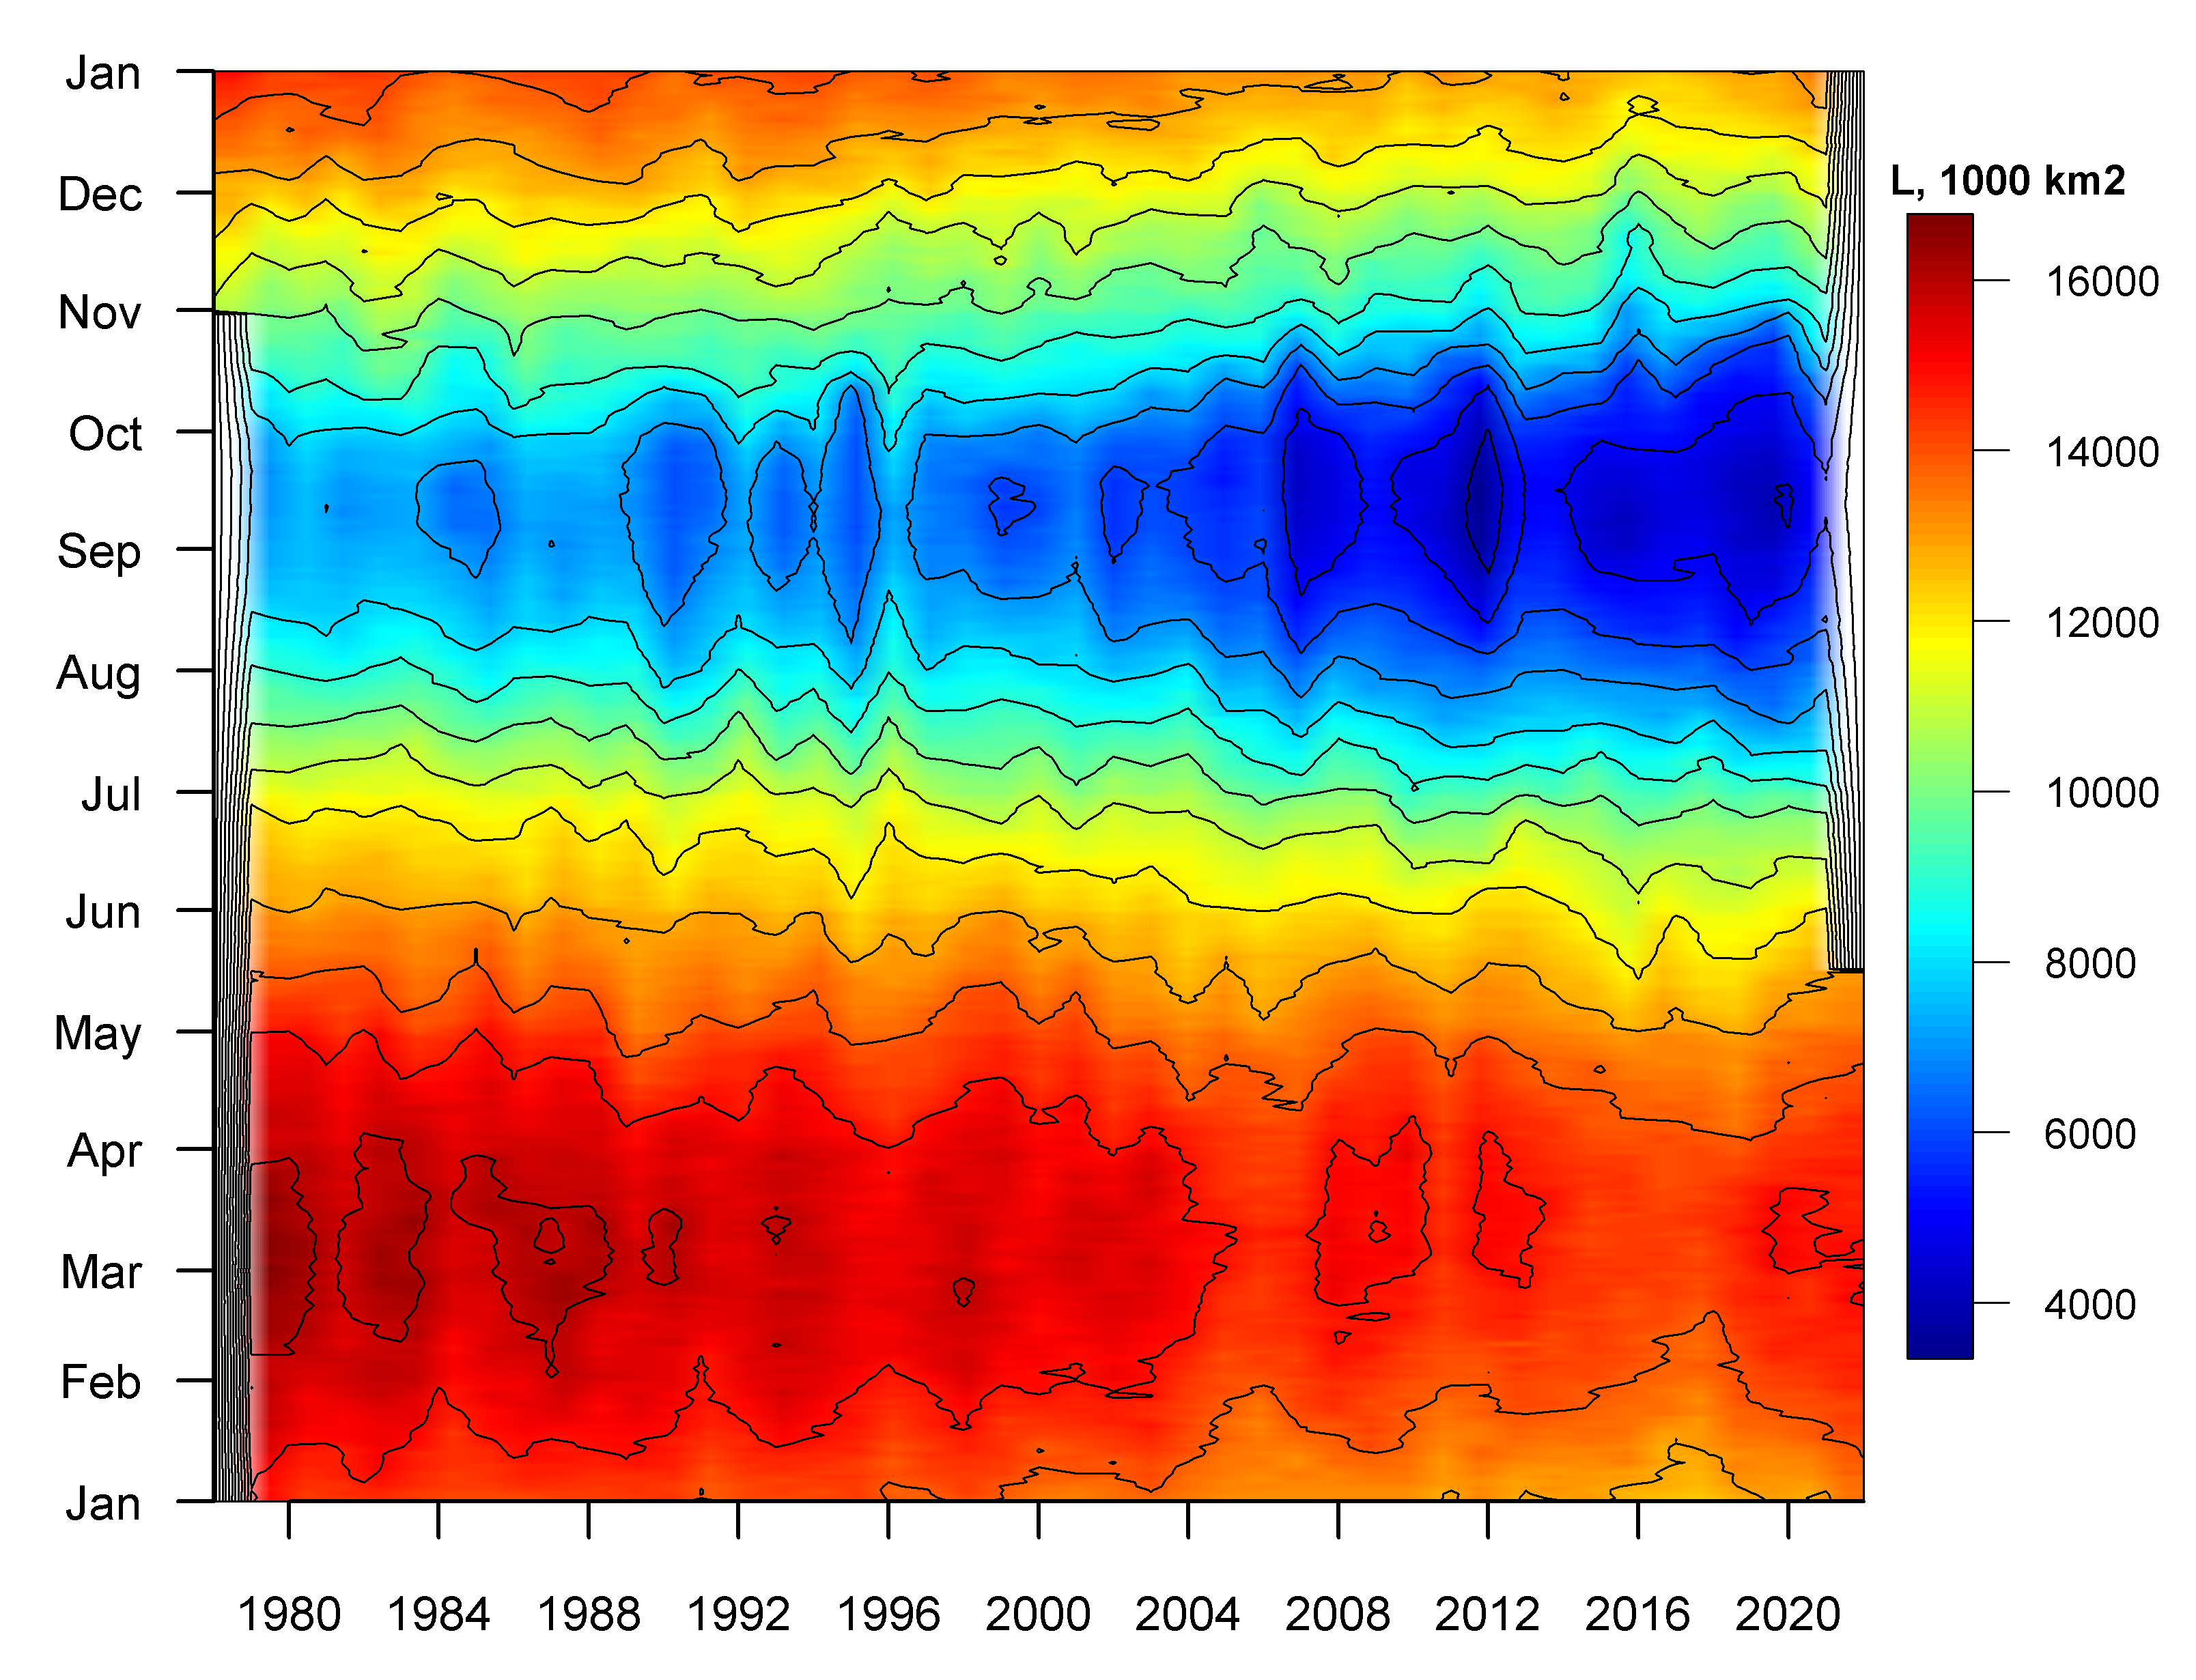
Seasonal NH ice extent variability: 1978 -2022
Seasonal patterns of daily ice extent allow to retrieve additional information on interseasonal variability of ice extent
Though both winter maximums and summer minimums continue to diminish there is certain hint to possibility for summer ice cover in 2022 be greater than in 2019-2021
[AARI / NSIDC]

Slide 16
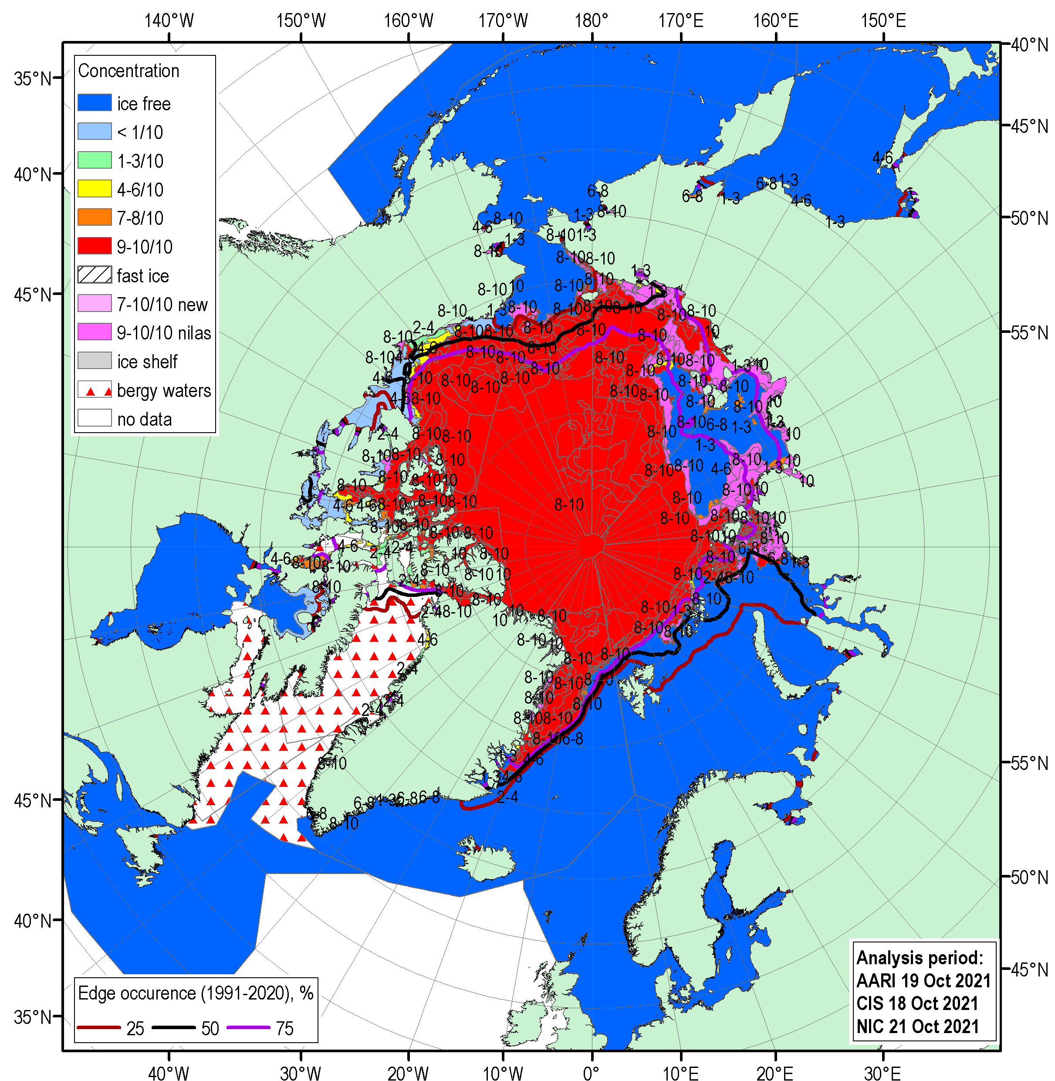
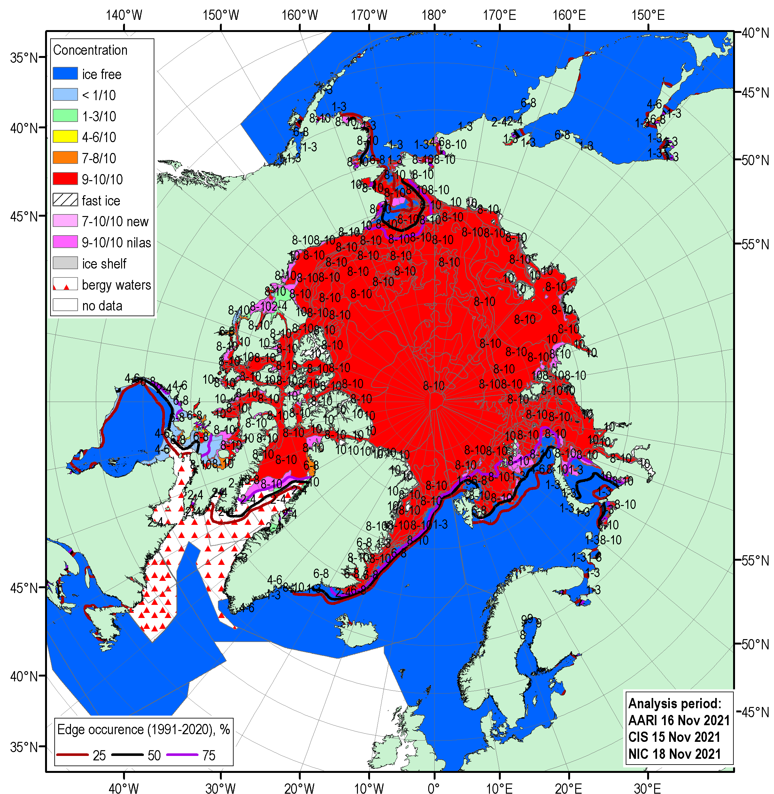
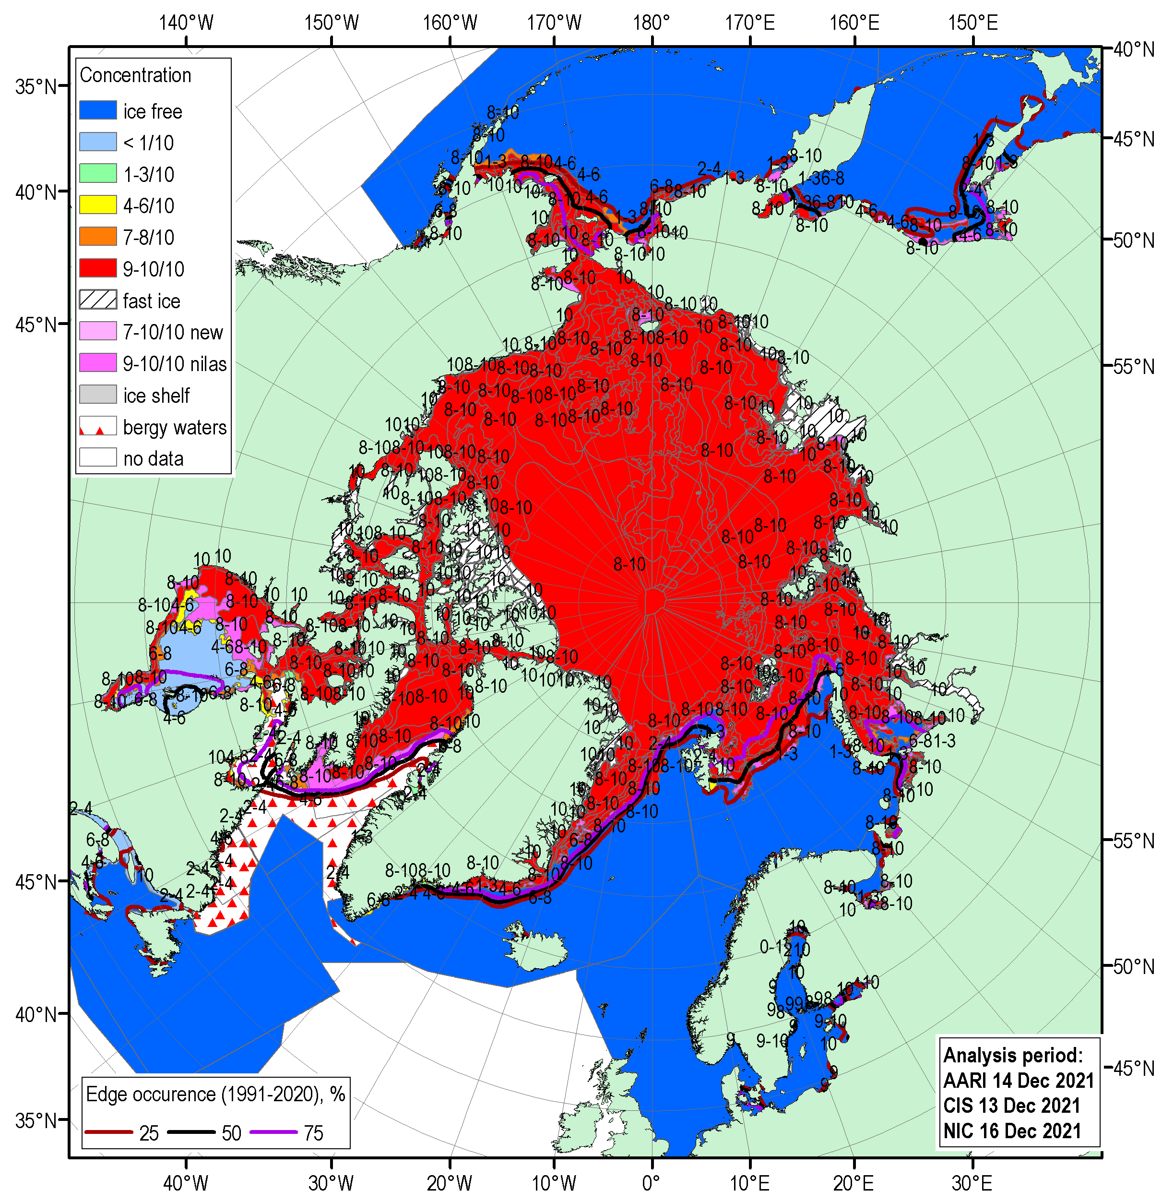
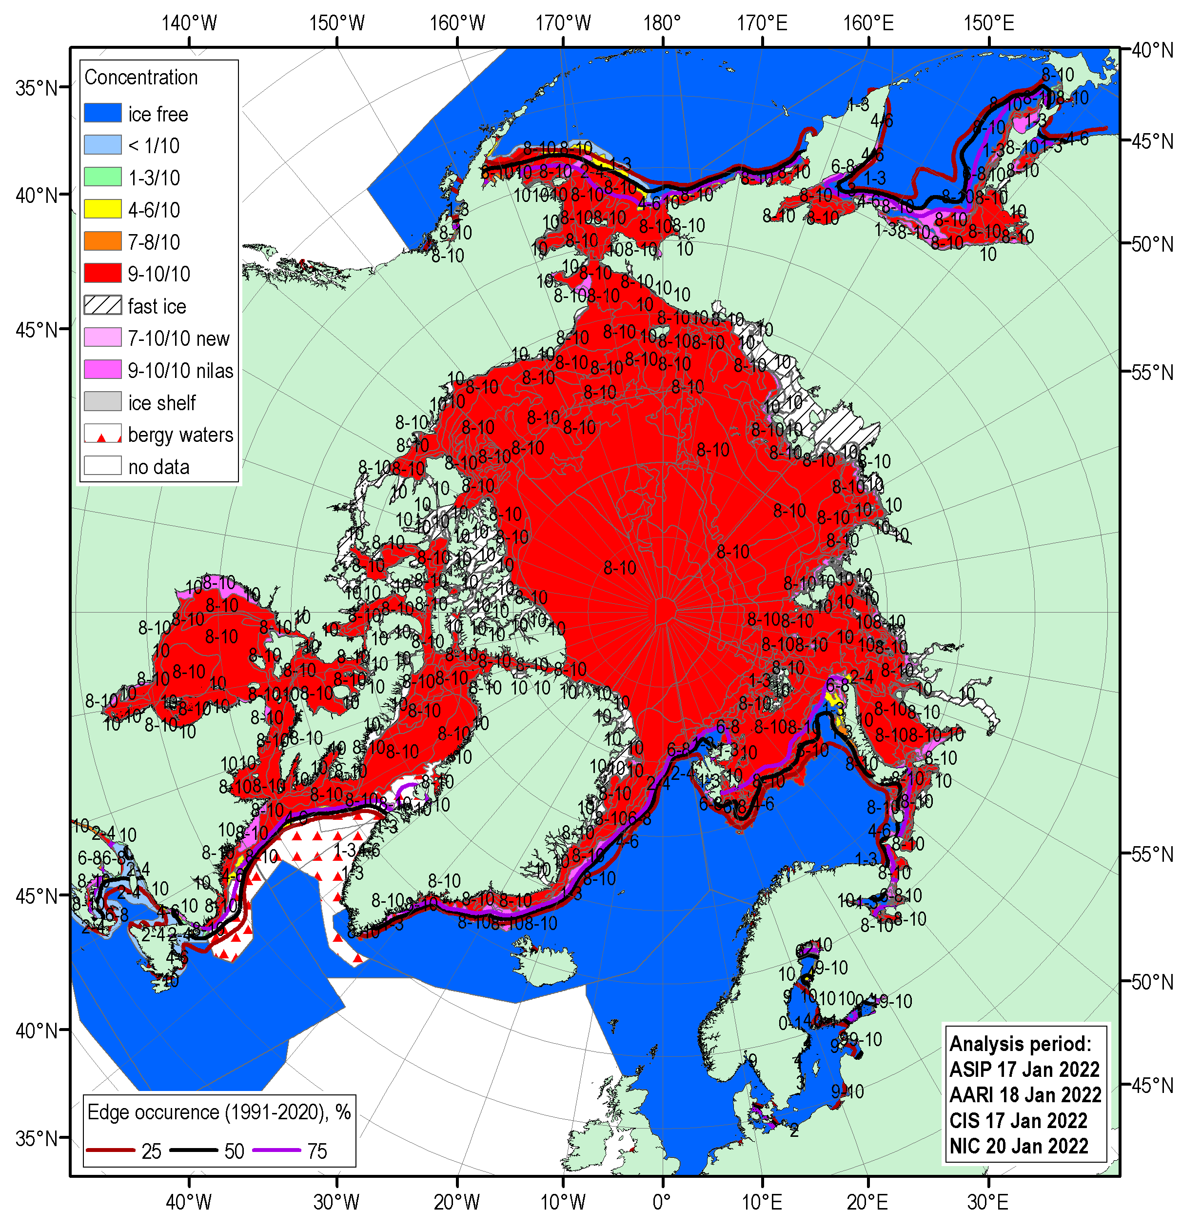
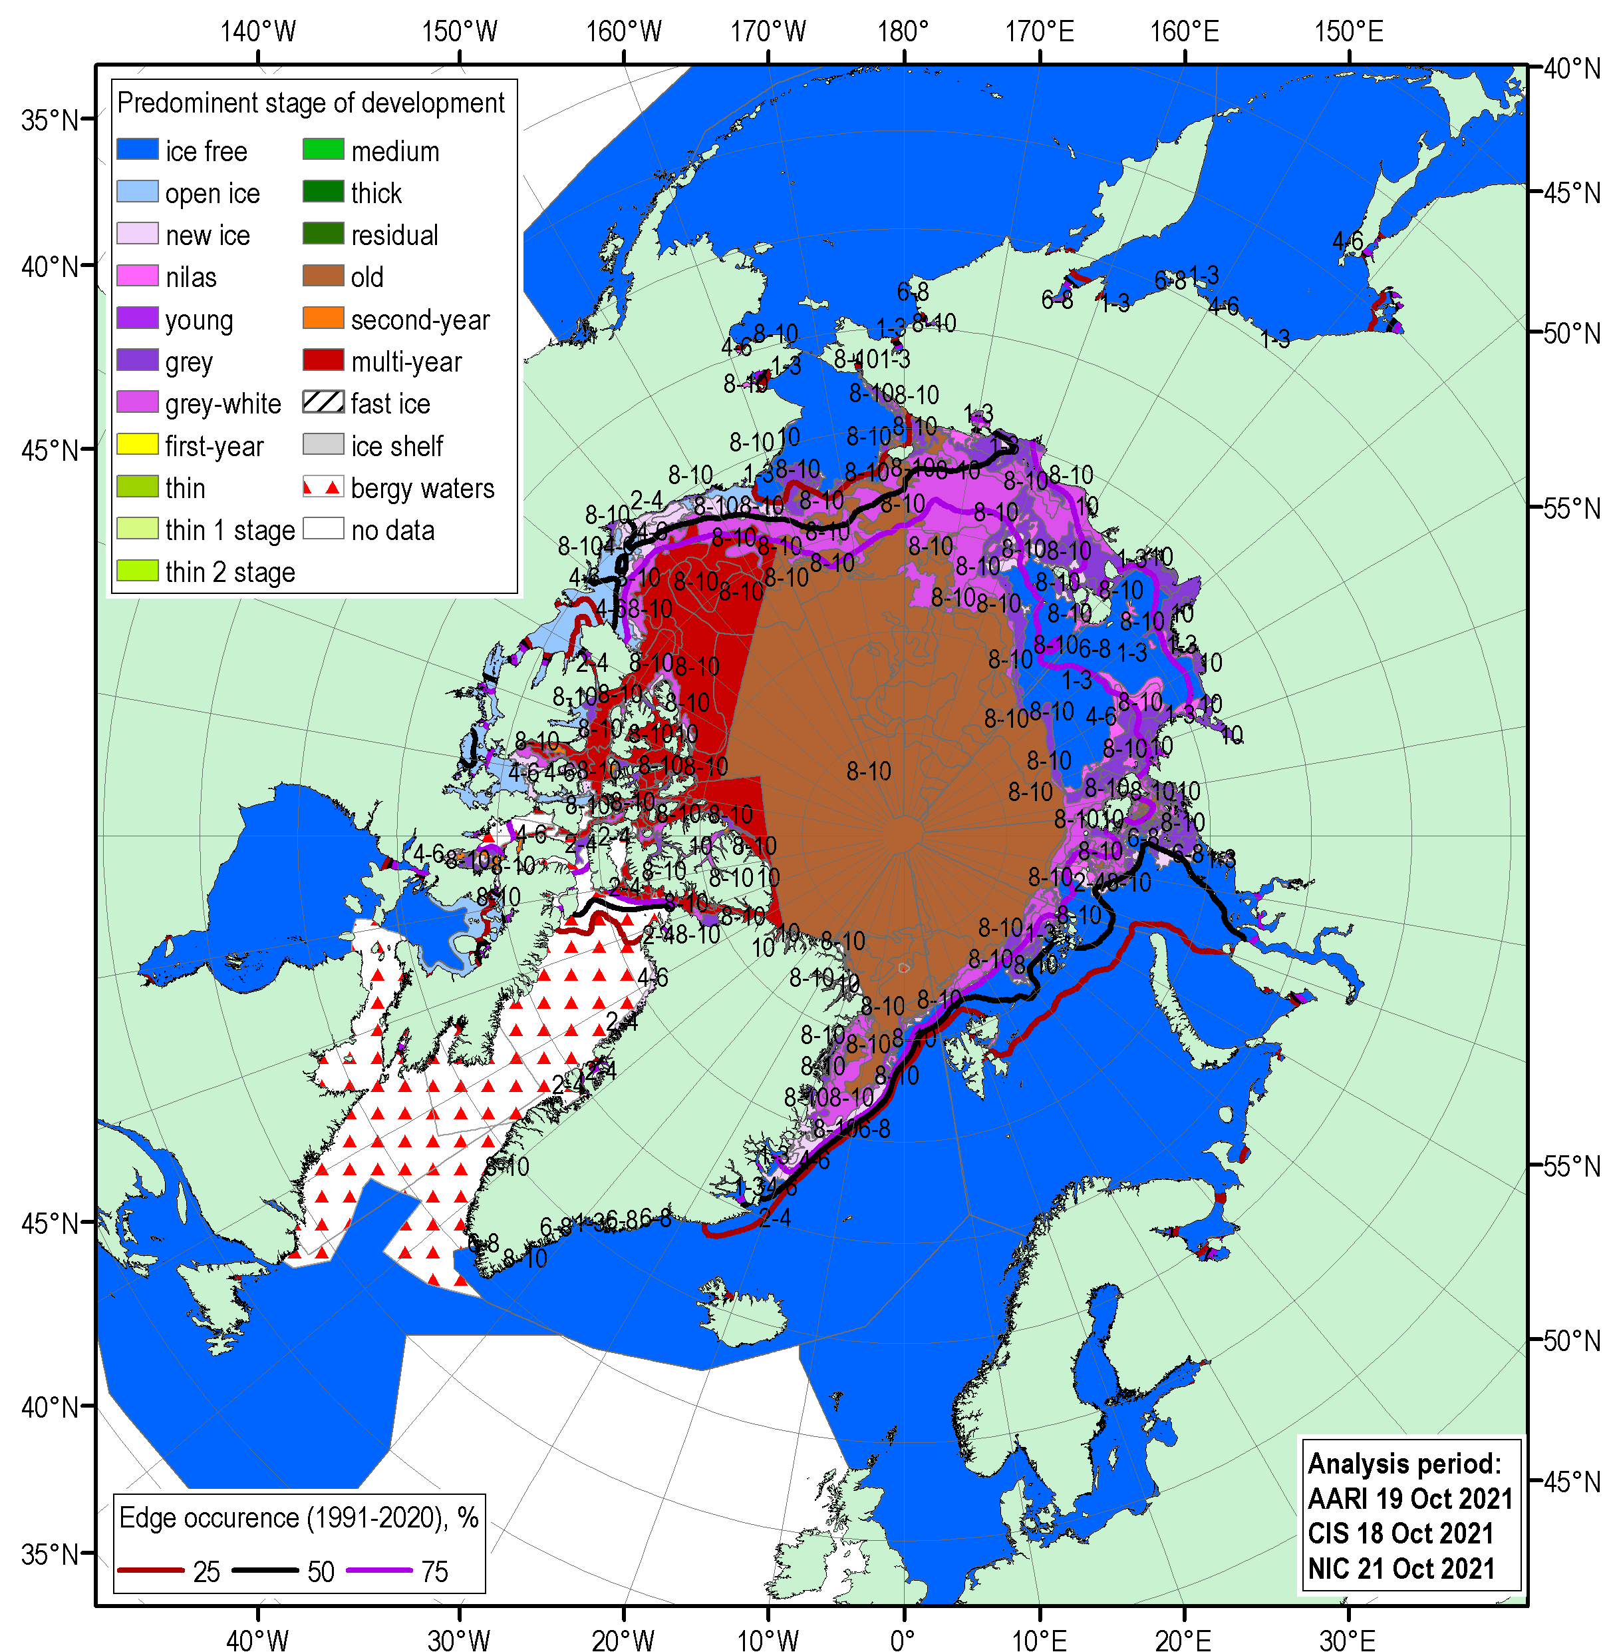
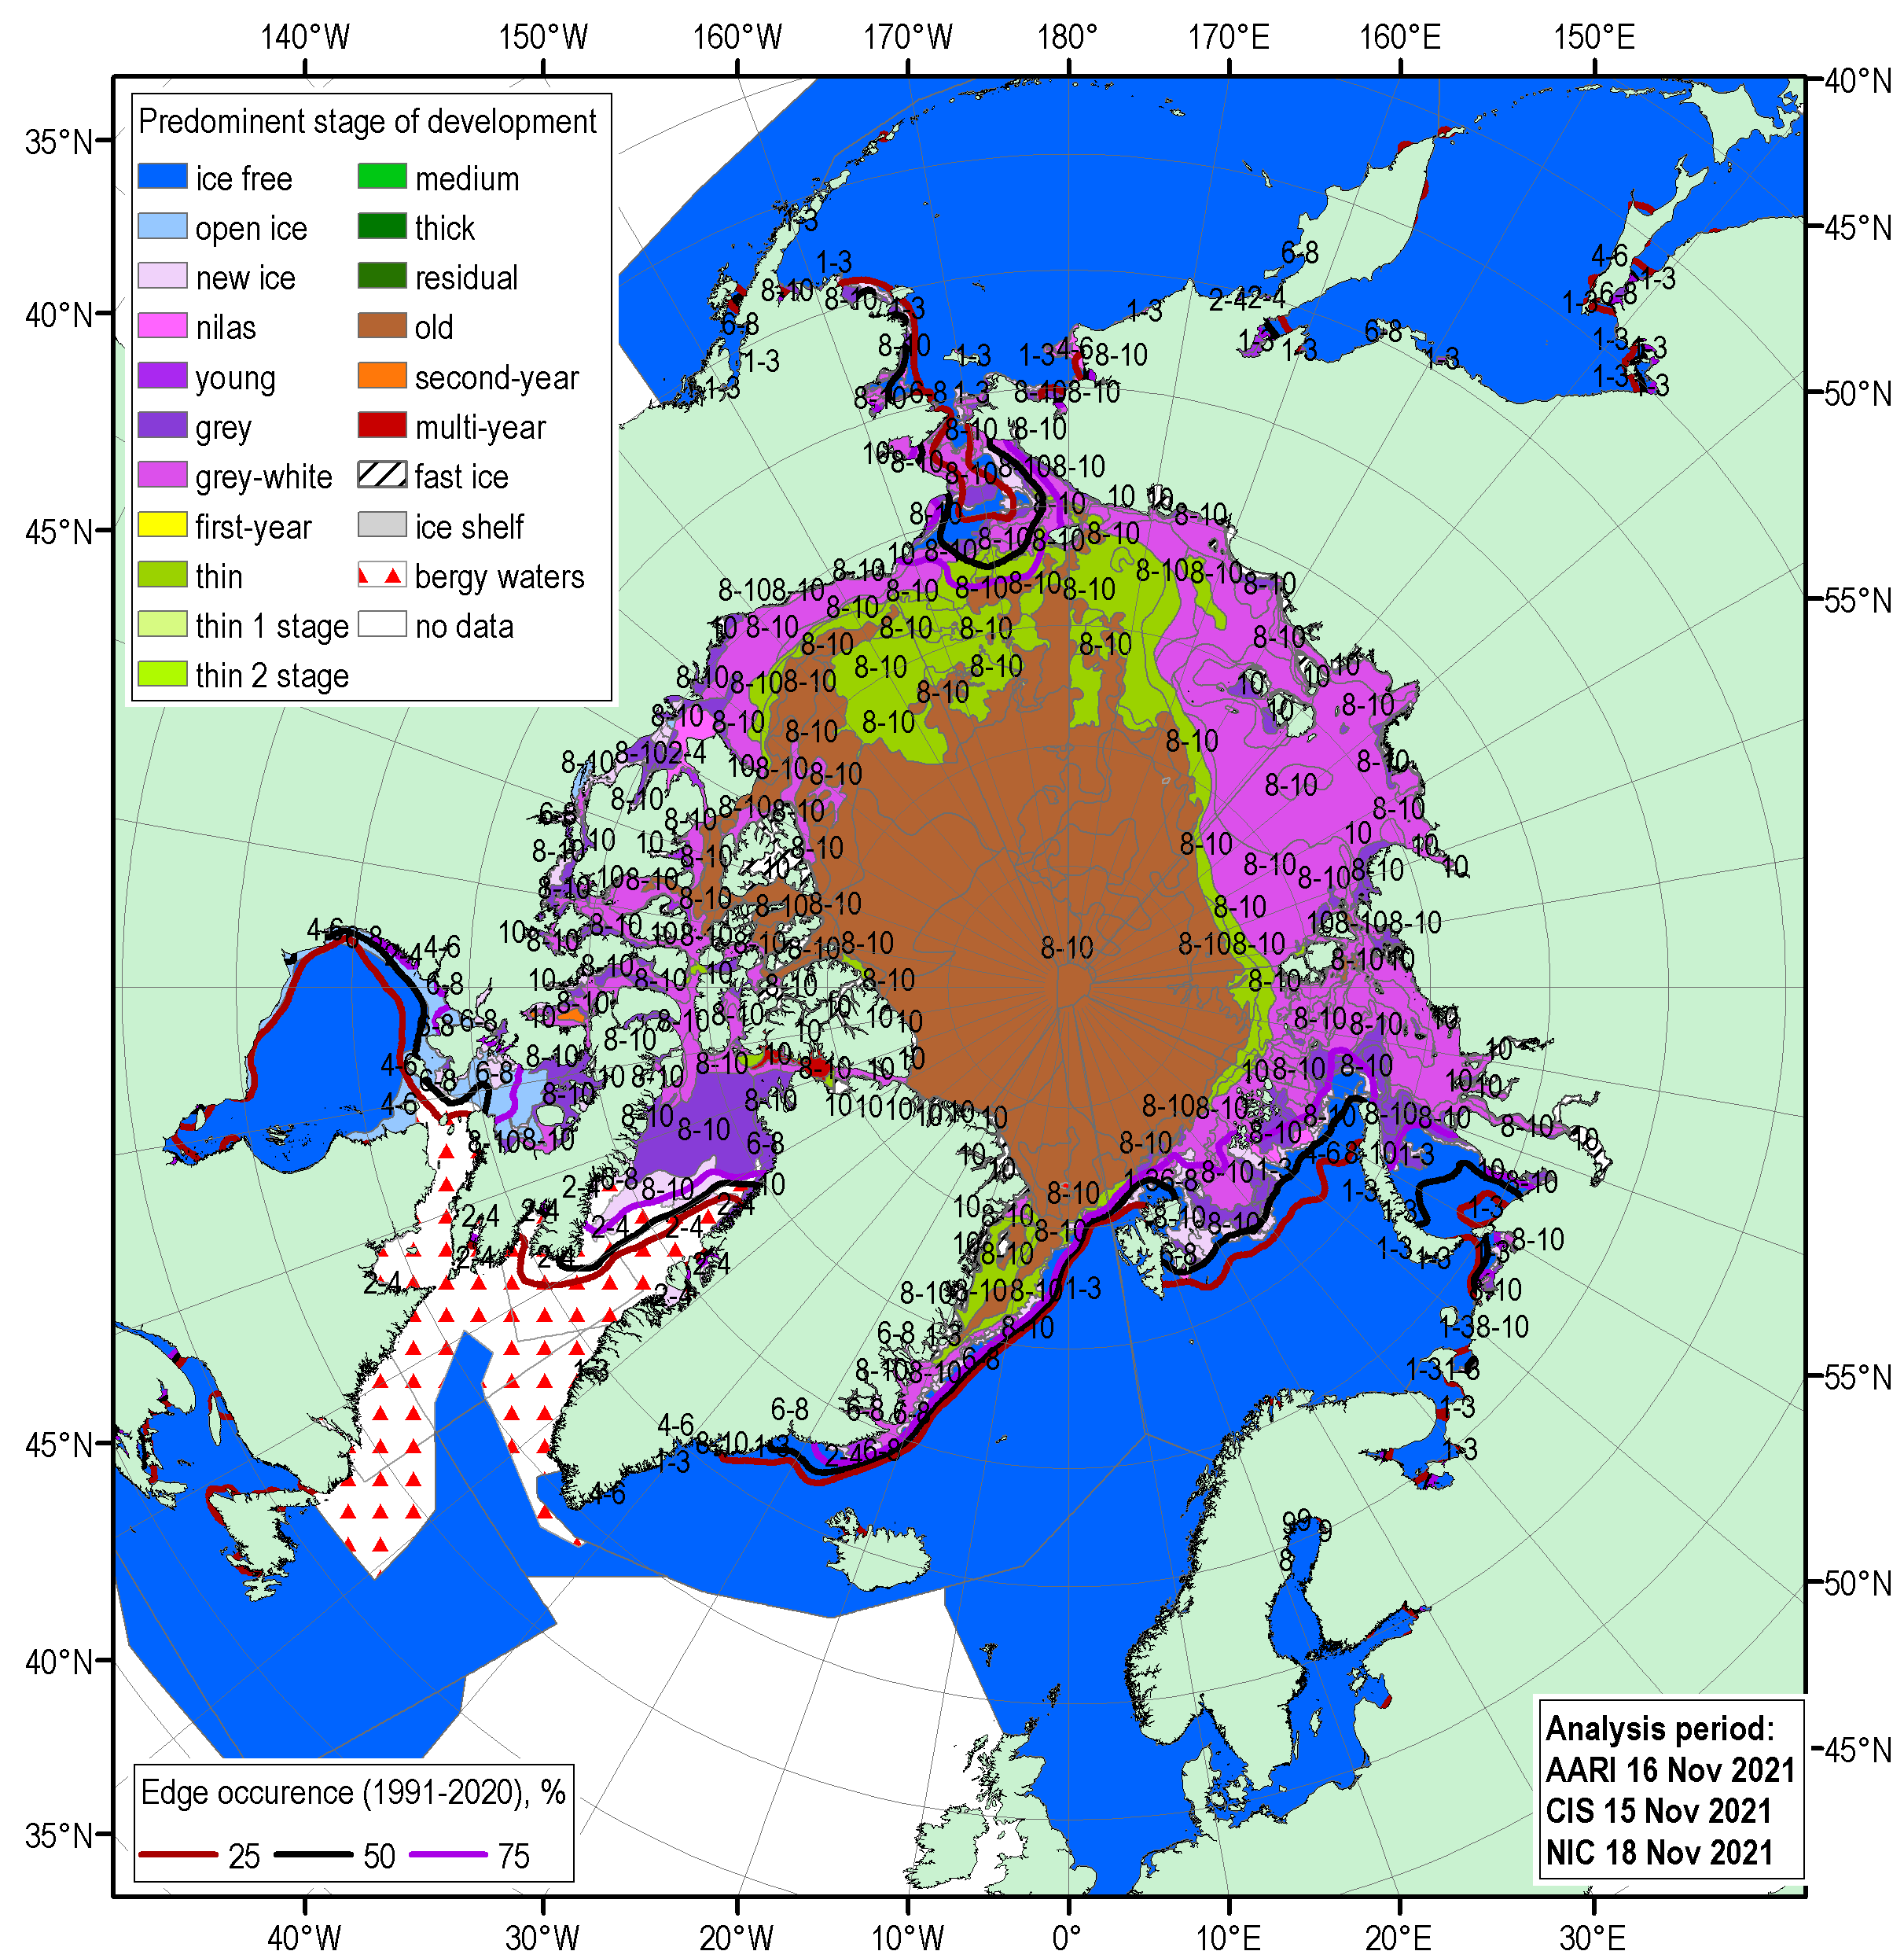


ONDJ 2021/2022 Arctic sea ice – concentration and stage of development
18-21 Oct
15-18 Nov
13-16 Dec
17-20 Jan
[sea ice analysis - AARI/CIS/NIC; ice edge – AARI/NSIDC, nearest 5days, reference period: 1991-2020]

Slide 17






FMA 2022 Arctic sea ice – concentration and stage of development
Special features of ice conditions in the Arctic during autumn – winter 2021/2022 included:
occurrence of residual and further in season the second-year ice in the NE Kara and N parts of the East Siberian Sea or within eastern lanes of the NSR,
lighter than median ice conditions in the Eastern Canadian Arctic during first part of the winter but opposite greater than median during late winter
light ice conditions in the Sea of Okhotsk during the whole winter period which is opposite to 2021
21-24 Feb (maximum)
14-18 Mar
18-21 Apr
[sea ice analysis - AARI/CIS/NIC; ice edge – AARI/NSIDC, nearest 5days, reference period: 1991-2020]

Slide 18






















Sea ice thickness for 15 Mar 2004…2022 and ice volume
2022
2021
2020
2019
2022
2018
2017
2016
2015
2014
mean 2011-2022
2022
2013
2012
2011
2010
2009
ESA CryoSAT-2 sea ice thickness
Cryosat-2 measurements show the general Arctic Basin SIT distribution in March 2022 similar to mean 2011-2022 pattern with estimate of the total Arctic ice volume, based on modelling as somewhat ~3rd lowest for 2004-2022 after 2020 and 2021
2008
2007
2006
2005
2004
[DMI North Atlantic - Arctic Ocean model HYCOM-CICE - http://ocean.dmi.dk/models/hycom.uk.php]

Slide 19
Polar Ocean:
  Sea surface temperature
  Storms - Wave and swell height
  pH and acidification or alkalization of the Arctic ?

Slide 20





Heat content, waves and pH – NDJ 2020/2021 & FMA 2021
During first part of the winter 2021/2022 higher 15 m upper ocean layer Heat Content (HC) was noticed in the Eastern Canadian Arctic, W Bering and Okhotsk seas and in Svalbard waters. Somewhat neutral or calmer sea surface conditions were observed in the Barents and Okhotsk Seas with higher stormier conditions near Iceland and in the Bering Sea.
Later in winter the HC was mostly lower or neutral to 1993-2020 average for most of the Arctic with the same exception for the sub-arctic Sea of Okhotsk and parts of Svalbard waters. Prominent higher stormier sea surface conditions were observed for the open-water Atlantic sector of the Arctic, W Bering and Okhotsk seas.
Numerical models show for the current winter season both neutral and positive pH anomalies (alkalization) for the Arctic Basin, Laptev Sea and Okhotsk Seas and negative pH for the Barents, parts of the Kara, East Siberian, Greenland Seas) anomalies to the 1993-2020 period, the latter may point to acidification processes though need further verification with ground-truth data.
NDJ Heat Content anomaly (1993-2020)
FMA Heat Content anomaly (1993-2020)
NDJ WW&S height anom (1991-2020)
FMA WW&S height anom (1991-2020)
NDJ pH anomaly 2m (1993-2020)
FMA pH anomaly 2m (1993-2020)
[AARI / CCCS MEMS & ERA5]

Slide 21
Hydrology and land Snow:
  River discharge
  Snow water equivalent
  Snow extent

Slide 22


Impacts of precipitation on river discharge
Impacts of wetter/drier colder/warmer weather conditions were to certain extent reflected in the winter/spring 2021-2022 Arctic rivers discharge though the frozen ground restricts direct effects
lesser drainage than normal is seen for Ob’, most of Enisey and Lena rivers, and further eastward through the whole season
Partly Mackenzie, Yukon and Enisey rivers experienced greater discharge than normal
Particular report on river discharge and precipitation for the Arctic Great rivers will follow.
NDJ 2021/2022 river discharge
anomaly (1991-2020)
FMA 2022 river discharge
anomaly (1991-2020)
[AARI / CCCS ERA5-GloFAS]

Slide 23


NDJFMA 2021-2022 land snow
During NDJFMA 2021-2022 lesser snow height as well as snow water equivalent dominated over parts of E Siberia, Chukchi and N Canada
Positive anomalies (greater snow height) were observed in parts of Alaska, C Canada, Nordic and W Siberia
With exception of Alaska, the snow extent over Eurasia and Canada was close to 1991-2020 normal. Alaska experienced somewhat greater snow extent
[GCW / Rutgers Global SnowLab]
2021-2022 |  | 1991-2020 Normal |  | Period of Record from 11-1966
Month | Area, 1000 km² | Mean | Departure | Rank | Maximum (Year) | Minimum (Year)
Eurasia
4 | 16,864 | 16,759 | 105 | 32/56 | 20,687 (1981) | 14,767 (2014)
3 | 24,387 | 24,091 | 296 | 33/56 | 27,950 (1981) | 20,183 (2002)
2 | 28,997 | 28,515 | 482 | 22/56 | 32,285 (1978) | 25,913 (2002)
1 | 29,687 | 29,647 | 40 | 24/56 | 32,265 (2008) | 25,823 (1981)
12 | 27,693 | 27,365 | 329 | 13/56 | 29,699 (2002) | 22,882 (1980)
11 | 22,521 | 21,181 | 1,340 | 9/56 | 24,132 (1993) | 16,796 (1979)
Canada
4 | 9,409 | 8,787 | 622 | 16/56 | 9,860 (1979) | 6,939 (2010)
3 | 10,130 | 10,074 | 56 | 27/56 | 10,368 (1982) | 9,486 (1981)
2 | 10,303 | 10,309 | -6 | 28/56 | 10,424 (2013) | 10,015 (1981)
1 | 10,348 | 10,319 | 29 | 16/56 | 10,424 (1982) | 10,060 (1981)
12 | 10,255 | 10,147 | 108 | 14/56 | 10,403 (2016) | 9,691 (1980)
11 | 8,713 | 8,948 | -235 | 32/56 | 9,978 (2018) | 7,254 (1987)
Alaska
4 | 1,487 | 1,461 | 26 | 20/56 | 1,526 (2018) | 1,360 (2016)
3 | 1,523 | 1,495 | 28 | 5/56 | 1,534 (2008) | 1,293 (1968)
2 | 1,534 | 1,513 | 21 | 1-8/56 | 1,534 (tie) | 1,417 (1968)
1 | 1,534 | 1,505 | 30 | 1-6/56 | 1,534 (tie) | 1,423 (1986)
12 | 1,534 | 1,495 | 39 | 1-3/56 | 1,534 (tie) | 1,330 (1967)
11 | 1,521 | 1,416 | 105 | 1/56 | 1,521 (2021) | 950 (1979)
S, 1000 km²
Mar
NDJ 2021/2022
snow height anomaly
(1991-2020)
FMA 2021
snow height anomaly
(1991-2020)
S, 1000 km²
[AARI / CCCS ERA5 / GCW / Rutgers Global SnowLab]

Slide 24




Bioclimatic weather severity
Bodman’s weather severity index (S) (dimensionless) is used for bioclimatic evaluation of weather conditions for winter half year and is calculated according to Bodman’s formula as
follows: S = (1 – 0.04 T) (1 + 0.272 v) where: v is wind speed (in m/ s) at 10 m above ground level and T is air temperature (in °C)
The scale in use to assess using S is:
> 6 extraordinary severe 5– 6 extremely severe
3– 5 severe & very severe 1– 3 slightly&less severe
< 1– mild
During winter 2021/2022 milder than for the last 30 years weather severity can be attributed on a basis of Bodman’s index to the most of Siberia, Central Arctic, Svalbard, parts of Canadian Archipelago areas.
Opposite situation – harsher more severe weather can be attributed to most of Canada and Alaska and to parts of Nordic region.
Particular report on bioclimatic indexes synopsis and forecast will follow.
May 2021
Harsher
Harsher
Harsher
Milder
Milder
NDJ 2021/2022 Bodman’s index
NDJ 2021/2022 Bodman’s index anomaly (1991-2020)
FMA 2022
Bodman’s index
FMA 2022 Bodman’s index anomaly (1991-2020)
[AARI / CCCS ERA5]

Slide 25





Current Conditions (16-20 May 2022)
Since second week of May westerly, NW winds dominated in European sector with somewhat opposite patterns over Siberia and Canada
Lower SAT observed over European, Alaska and W Canadian regions
Higher SAT observed over E Siberia, partly Chukchi and Canadian Archipelago regions
N Scandinavia, Arctic coasts, E Siberia, Chukchi, Alaska, N Canada are under snow (normal) with somewhat negative anomalies in Siberia
SE Barents, Bering and in particular the Sea of Okhotsk are under intense melting, but not for other parts of the Arctic where fast ice zones in Siberia and Canadian Arctic are still well preserved, which is similar to 2021 but somewhat opposite to spring 2020 season
SAT, precipitation, mean wind vectors, NAO for 22-26 Oct 2021 (http://polarportal.dk)
Snow extent and anomaly for 20 May 2022,
Rutgers Global snow lab
CIS/NIC/ASIP ice chart for 16-20 May 2022

Slide 26
Data sources:
AARI Review of Hydrometeorological Processes in the Northern Polar Region (http://www.aari.ru/misc/publicat/gmo.php)
Copernicus Climate Change Service
  ERA5 monthly averaged data on pressure and single levels
  Marine environment monitoring service
  GloFAS operational global river discharge reanalysis
Weekly ice charts from AARI, CIS, NIC, ASIP / WMO GDSIDB project (http://wdc.aari.ru)
NSIDC Near-Real-Time DMSP SSMIS Daily Polar Gridded Sea Ice Concentrations
ESA CryoSAT-2 data (AWI)
DMI PolarPortal (http://polarportal.dk)
WMO GCW SnowWatch (FMI, ECCC, Rutgers Glob Snow Lab, http://climate.rutgers.edu/snowcover/)

Slide 27

Thank you! Merci! Takk! Спасибо! Tak! Tack! Kiitos! þakka þér fyrir!
Naqurmiik ! Qaĝaasakuq !
Giitu! Vielen Dank!
Dhanyavaad !
Monthly and seasonal graphs at full resolution and for all ECVs are available at:
http://wdc.aari.ru/prcc/reanalysis/
http://wdc.aari.ru/datasets/d0040/arctic/png/

