Slide 1

  Arctic Regional Climate Centre-Network meeting
  St Petersburg, February 25-27, 2019
Integration metadata, data and services as contribution Russia to INTAROS project
Evgenii Viazilov
(RIHMI-WDC, vjaz@meteo.ru)

Slide 2
Requirements and strategy of INTAROS project
EC project: INTAROS - Integrated Arctic Observation System (2017-2021),
№ EC - H2020-BG-09-2016
Ministry of Science Russian Federation project: "Development of methods and tools of the Integrated Arctic Observing System» (2018-2020), № RFMEFI61618X0103
Strategies:
- Cooperation with key stakeholders groups in Russia.
- Collaboration in Pan-Arctic Forum on the development of iAOS
- Scientific and methodological basis proposals of Russian contribution to iAOS.
Tasks:
Interaction with Russian stakeholders, development of requirements of the iAOS using the INTAROS approaches
Development of data management plan taking into account proposals of INTAROS and specifics of existing processes for collecting and exchanging, providing and disseminating data in Arctic zone Russian Federation
Preparation of the Russian contribution to roadmap for building a future sustainable Arctic observing system

Slide 3
Participants of Russian project
National Oceanographic Data Centre of RIHMI-WDC (Russian Research institute of Hydrometeorological Information – World Data Center, Obninsk) - lead organization, development and IT support of iAOS-RF, metadata for Roshydromet observing networks in Arctic, climate and observation data sets, iAOS applications
AARI (Arctic and Antarctic Research Institute, St.- Petersburg) – support metadata for AARI observing networks, climate, observation and forecast/analysis datasets, iAOS-RF applications
NIERSC (Nansen Environmental and Remote Center, St.-Petersburg) – support metadata for remote sensing networks, snow and ice datasets, iAOS applications

Slide 4

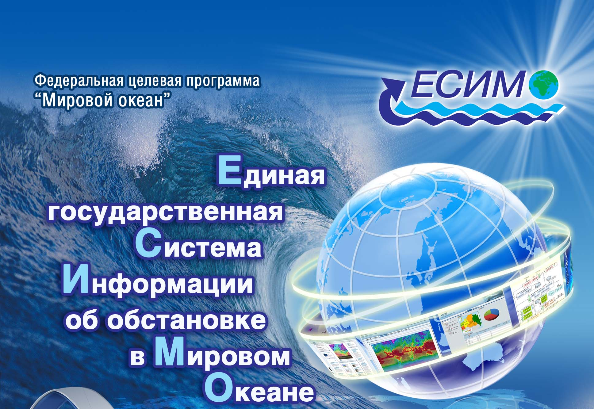
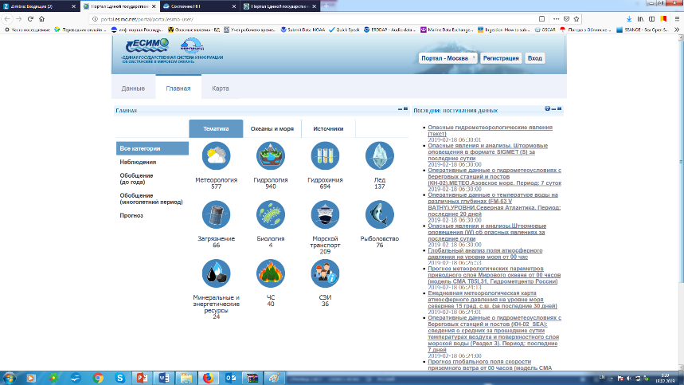
Objectives of Russian project
Metadata - Identify and promote exploitation of existing Russian observing systems and data sets for Arctic
Integration - Develop and implement Russian segment iOAS-RF for integration, analysis and access to multidisciplinary, heterogeneous and distributed data, products and services
iAOS-RF portal development will be based on technologies of Unified information system for World Ocean (ESIMO, Russian Federation, http://www.esimo.ru)
Metadata - nearly 60 000 records, more 3 000 information resources (observation, forecast, climate data); standardized codes, classifies, parameter names; open software

Slide 5
Observing networks and databases
Objectives:
Assessment of existing Russian Arctic observing and data sets, identification of essential gaps.
Preparation of data for their integration in iAOS, using experience ESIMO.
Works:
Development of software for metadata management of the observation networks and data holdings and services to provide access
Preparation of metadata databases on existing Russian observation networks (in-situ and remote sensing) and data holdings
Analysis of metadata and other information, preparation of assessments of state of Russian observation networks and databases on Arctic
Formation of the catalog of Russian Arctic data for integration into iAOS

Slide 6
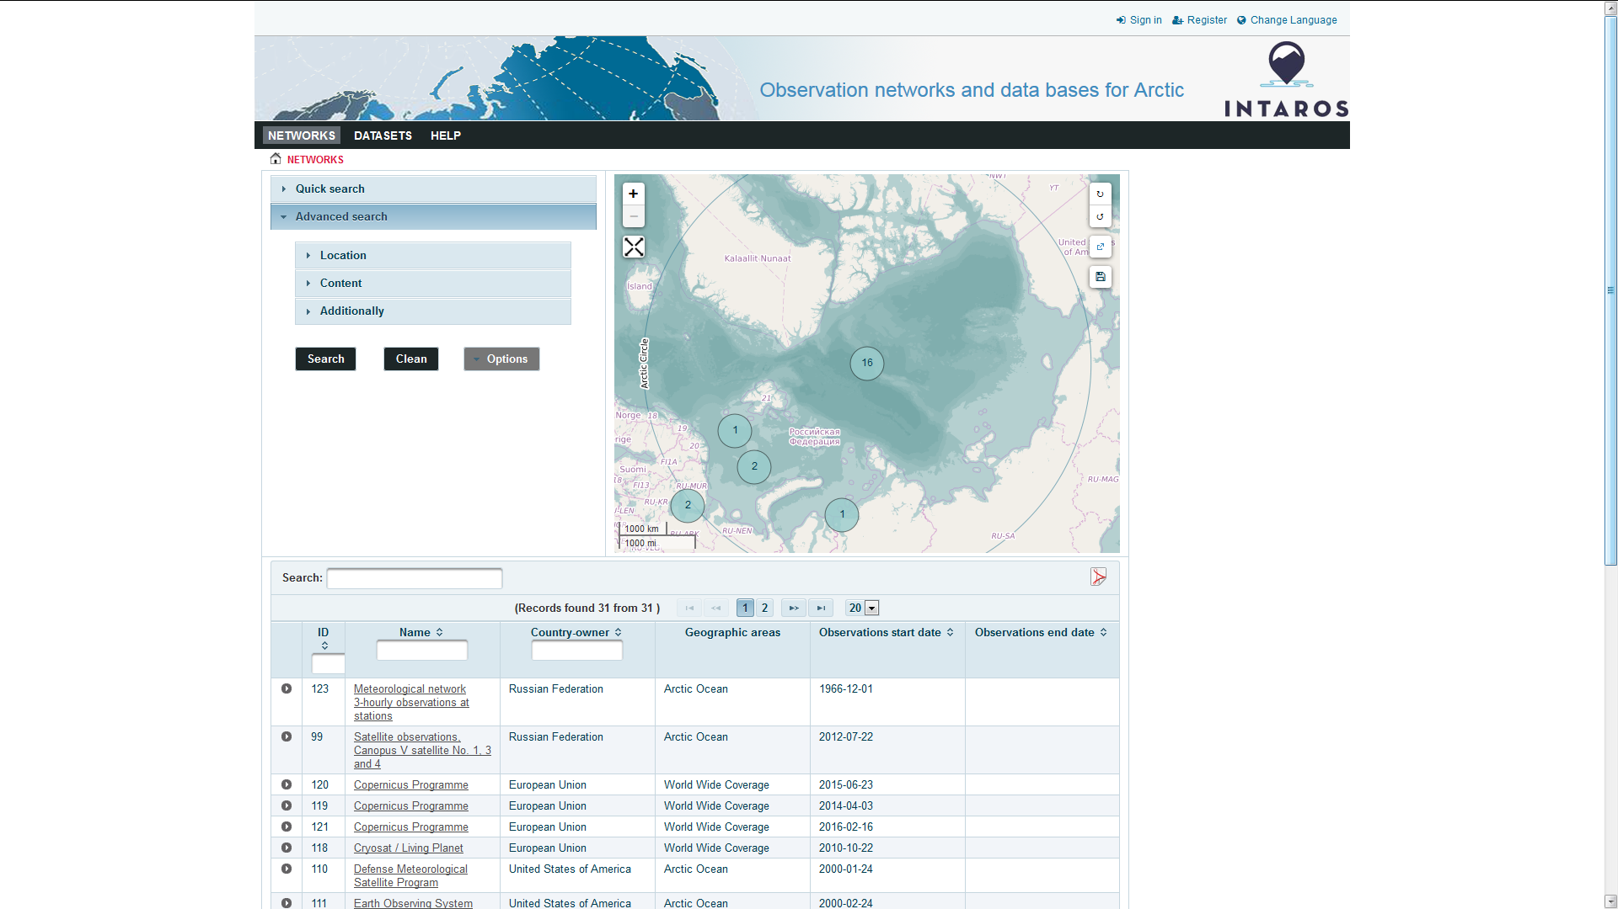
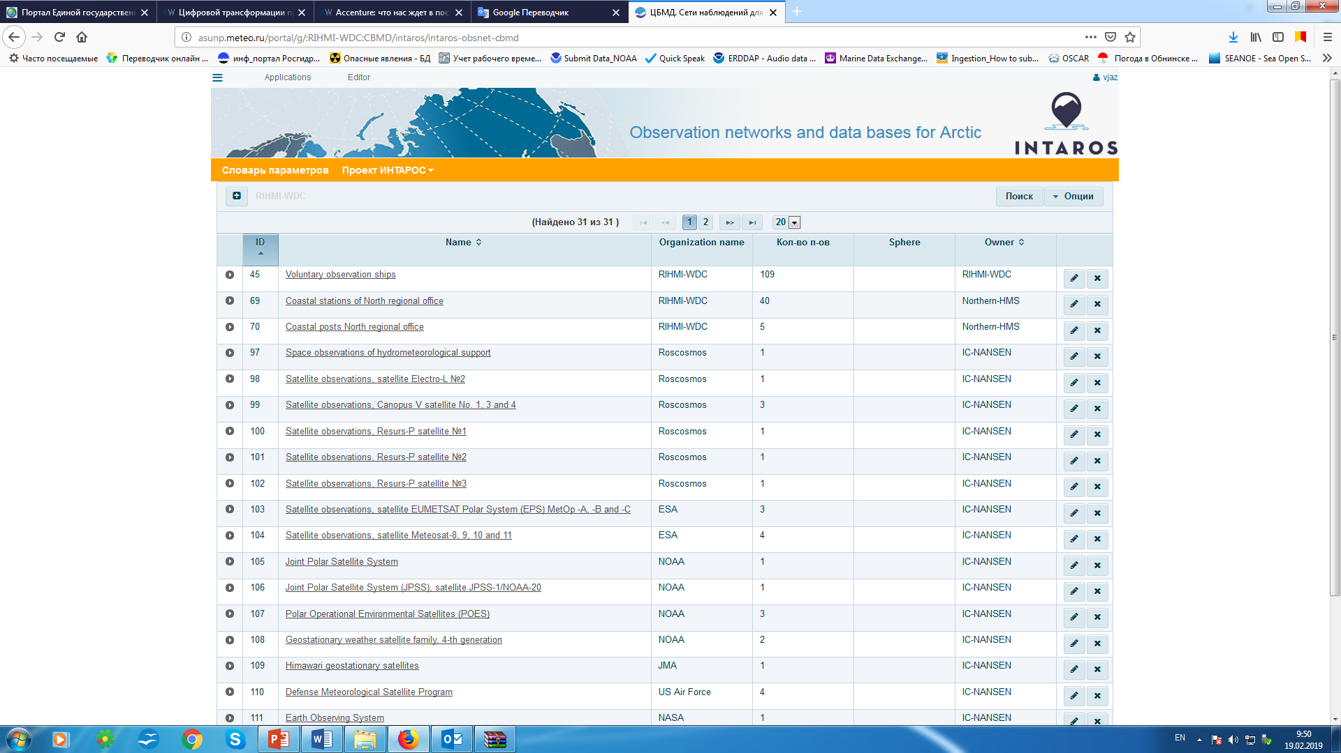
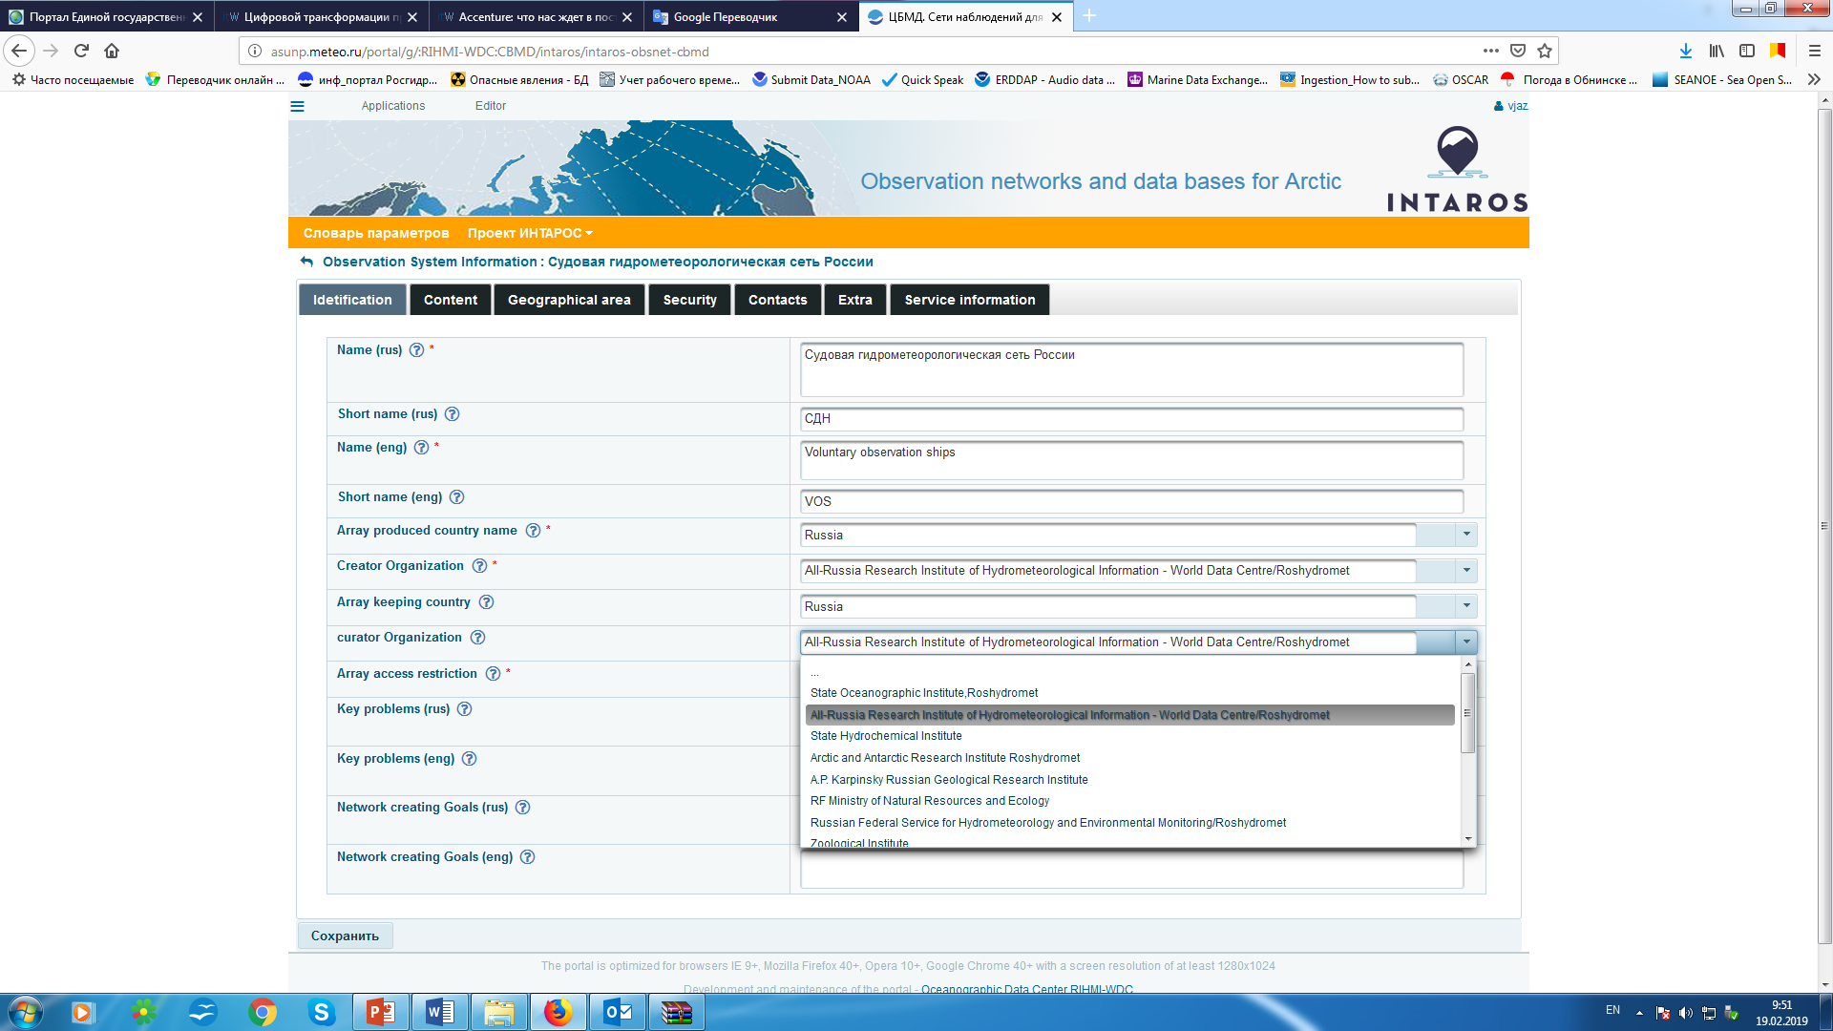
Observing networks and databases (software), http://asunp.meteo.ru/portal/intaros
6

Slide 7
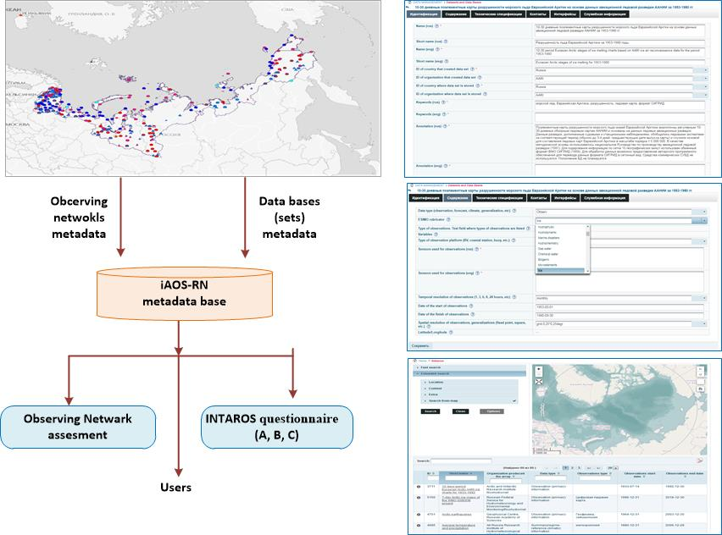
Observing networks metadata
Atmosphere (6):
meteo surface obs.(259 stations); meteo valuntary ships (35 Russian); meteo coastal obs. (22); aerological obs. (7); air pollution (42)
Ocean (4):
coastal obs. (68 stations/posts); sea level obs.(12); research vessels expeditions (4 ships), “North Pole” drifting expeditions (35 exp.)
Sea ice (3):
ice coastal obs. (75), ice obs. on river-sea stations (10), ice cover monitoring
Surface and terrestrial cryosphere (10):
hydrological obs. on river stations (175), actinometric obs. (34), heat balance obs. (17), ozone obs. (9), geophysical obs.(71), ….
Remote sensing (2) – AARI (Barentsburg), SRC “Planeta” (Moscow)
7

Slide 8
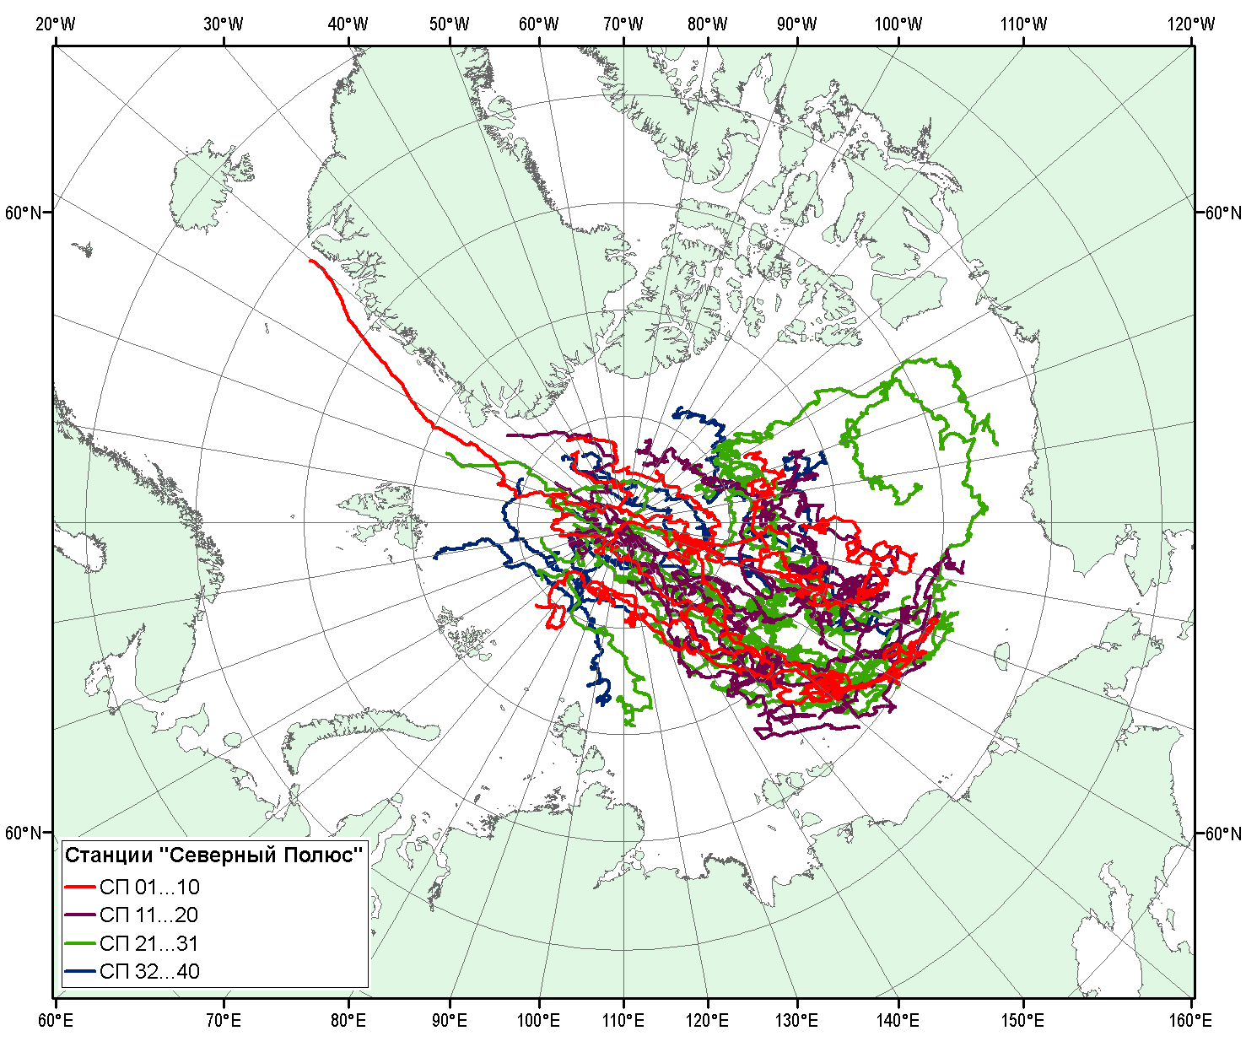
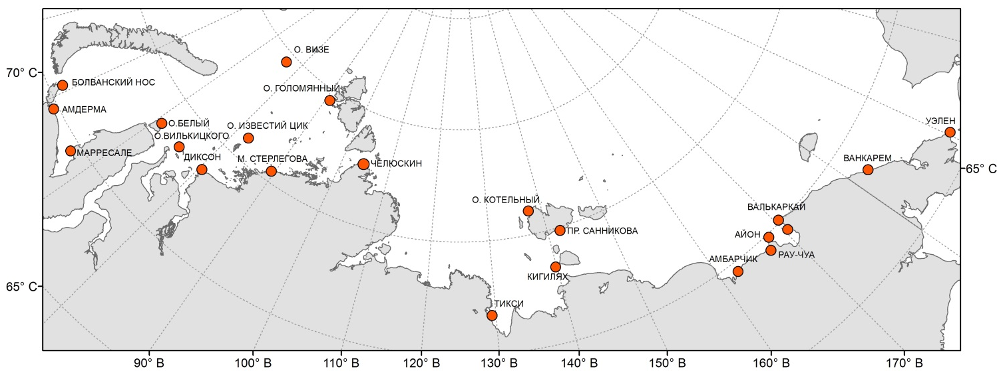
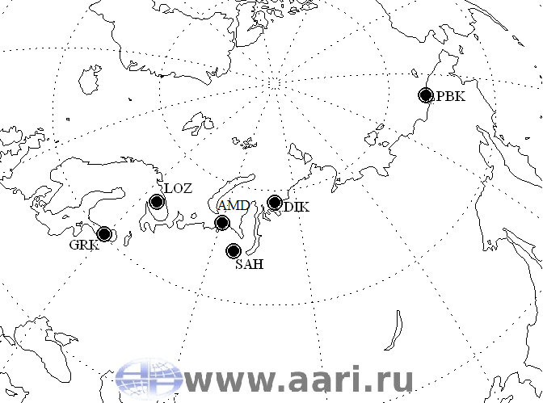
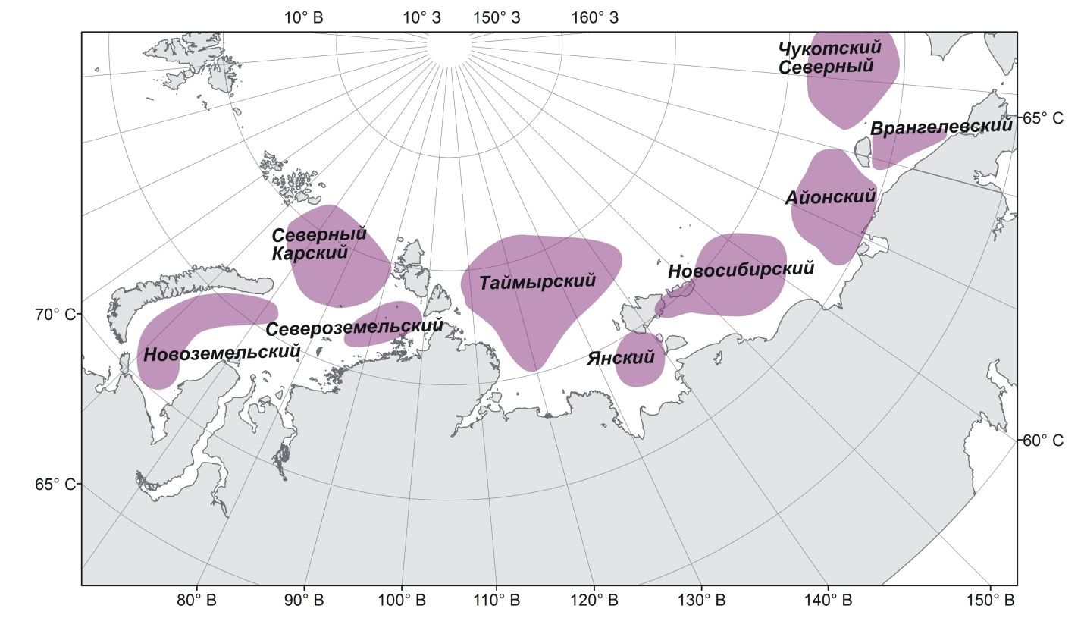
Observing networks metadata base
“Nord Pole” expeditions (1937-2013)
Polar coastal station network
Ice cover monitoring
Geophysics obs. Network
8

Slide 9
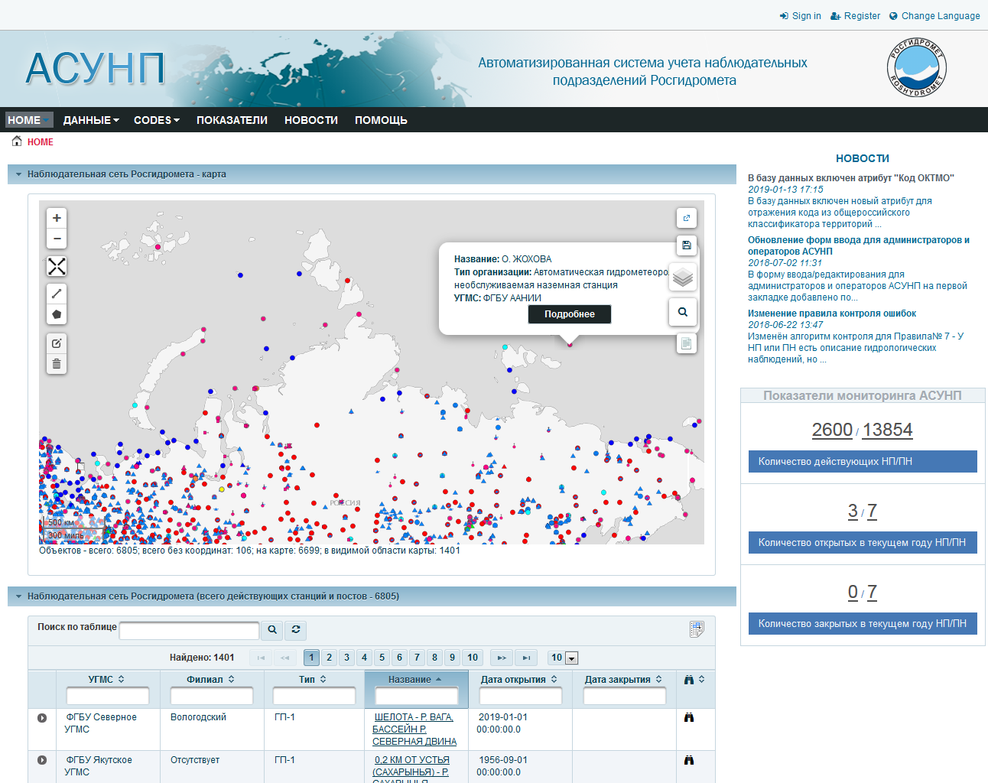
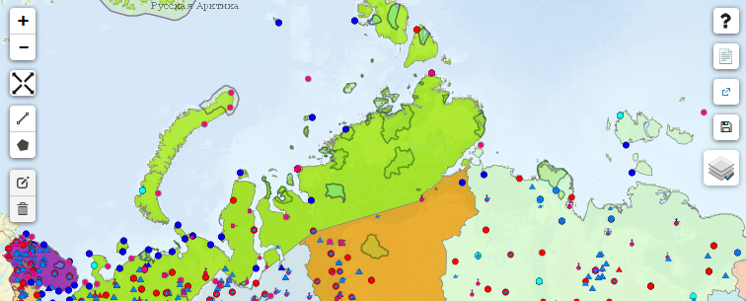
Accounting System for keeping record of Observation Units (ASOU), http://asunp.meteo.ru/portal/asunp/
Functions:
Search of information about observation networks by synoptic index, federal district, subject of RF, AZRF, river basins, network type, platforms types, etc.
Data aggregation on Roshydromet, regional offices, types of observations
Calculation of the cost of observing programs for different observations types
Access to standardized reporting
Export information in csv format
Interaction (M2M) with ESIMO, OSCAR, INTAROS by WMS, JSON (XML)

Slide 10
Databases metadata
Atmosphere (10):
meteo surface stations (obs., climate); meteo valuntary ships (obs., climate statistic); meteo on coastal stations (obs., climate), airological data (obs., climate), meteo variables - analysis and forecasts.
Ocean (9):
hydro coastal and sea level data (obs., climate); oceanographic data (obs., climate statistic); “North Pole” drifting expeditions (obs.); “North” data base (obs.); ocean variables analysis and forecasts
Sea ice (5):
ice coastal (obs., climate); ice river -sea stations (obs., climate), ice cover monitoring (analysis, forecasts)
Surface and terrestrial cryosphere (10):
snow variables (obs., climate), ground, glaciers,…
10

Slide 11
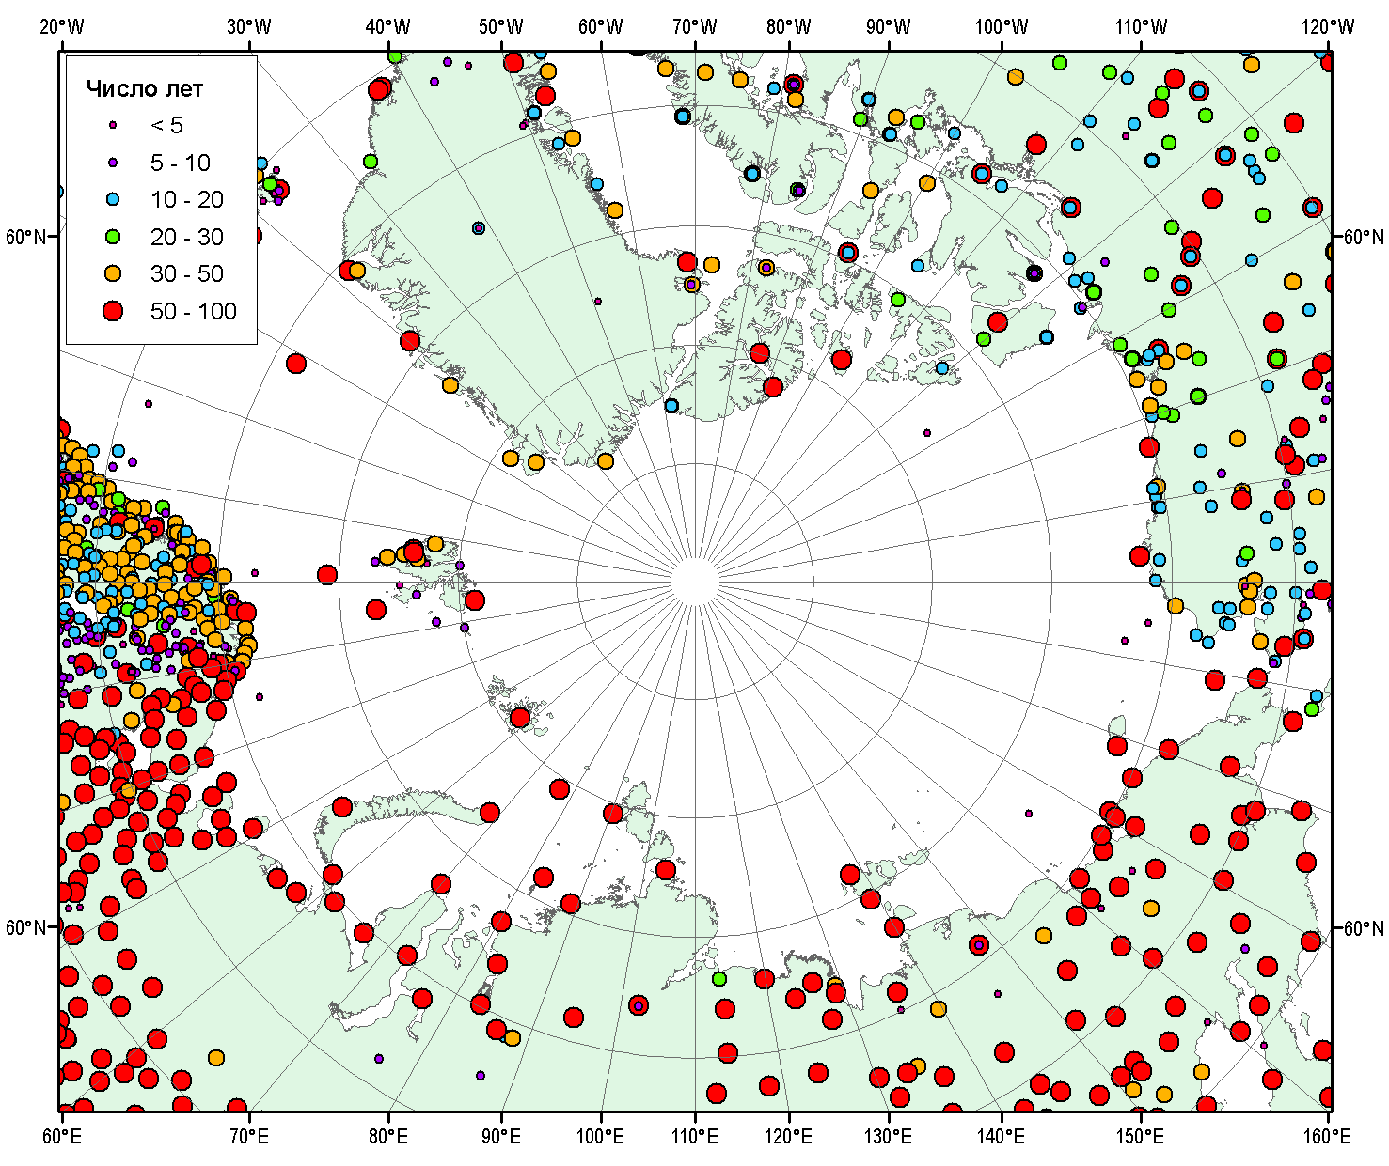
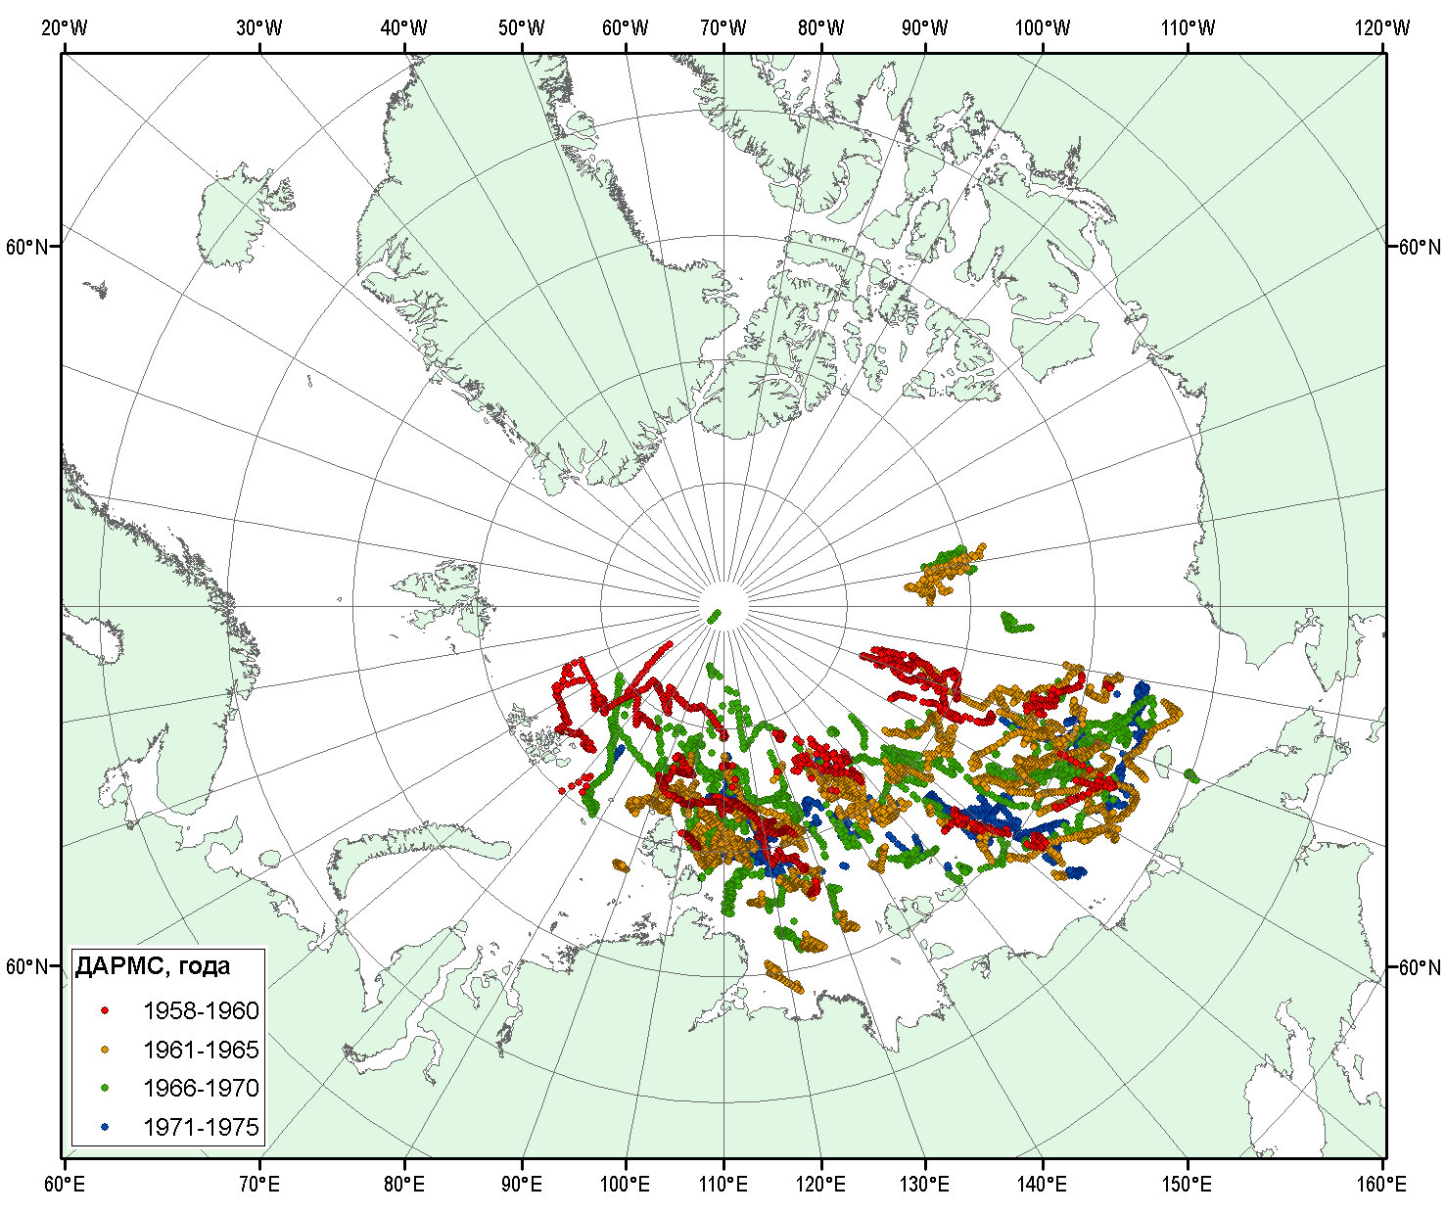
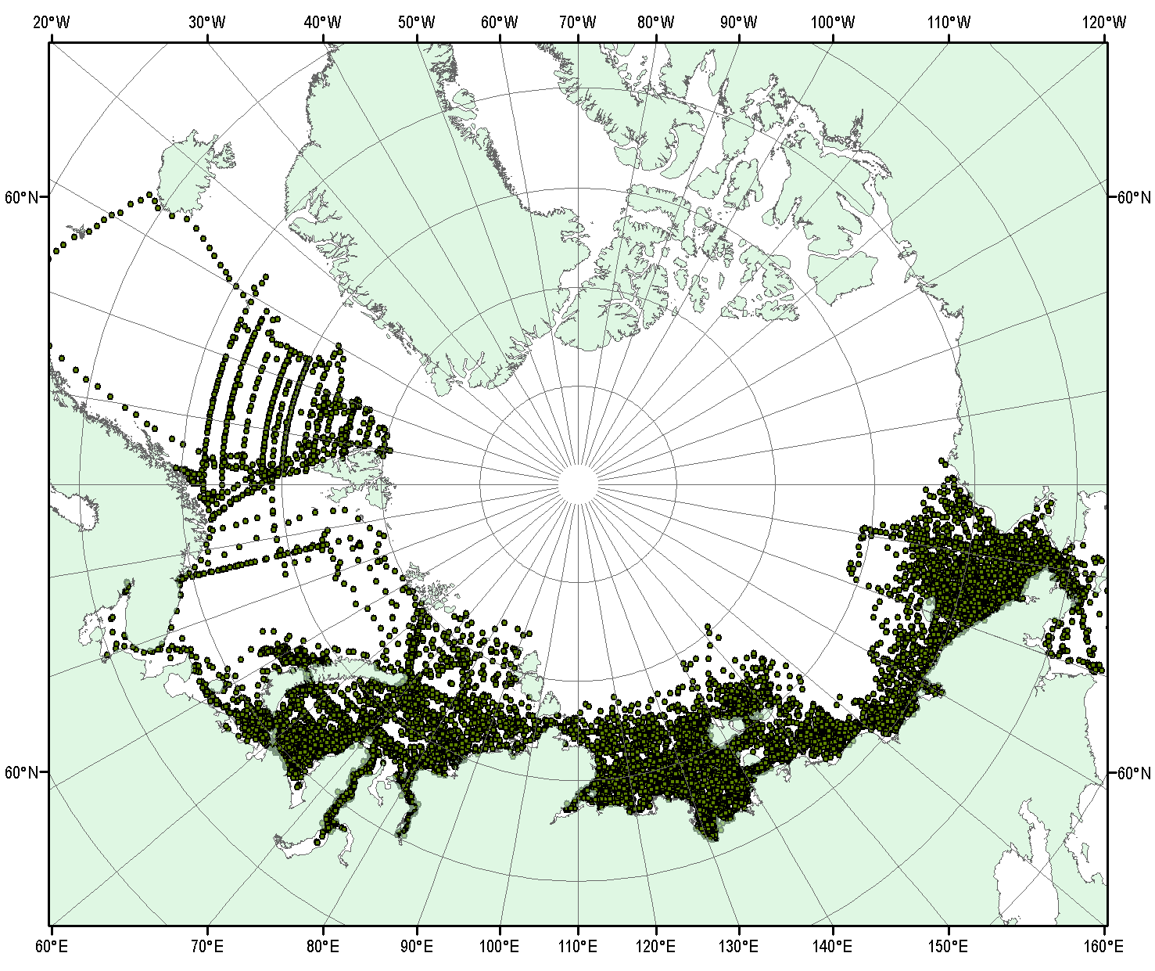
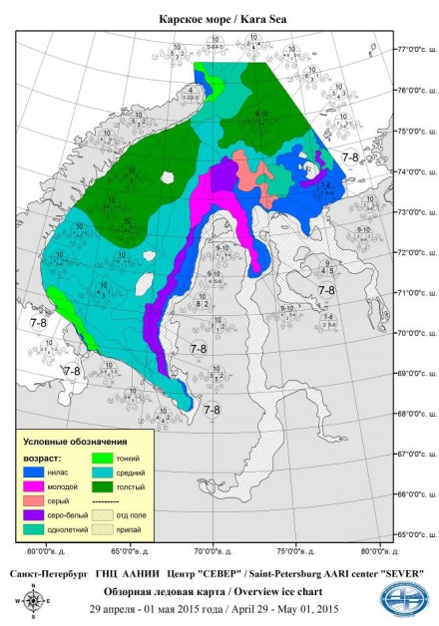
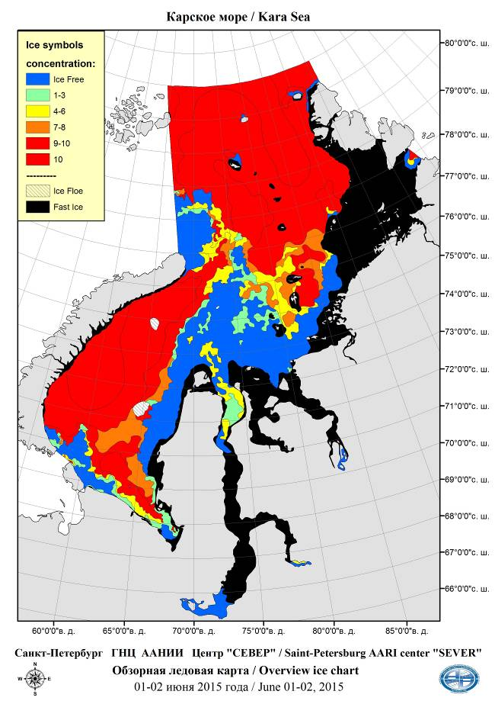
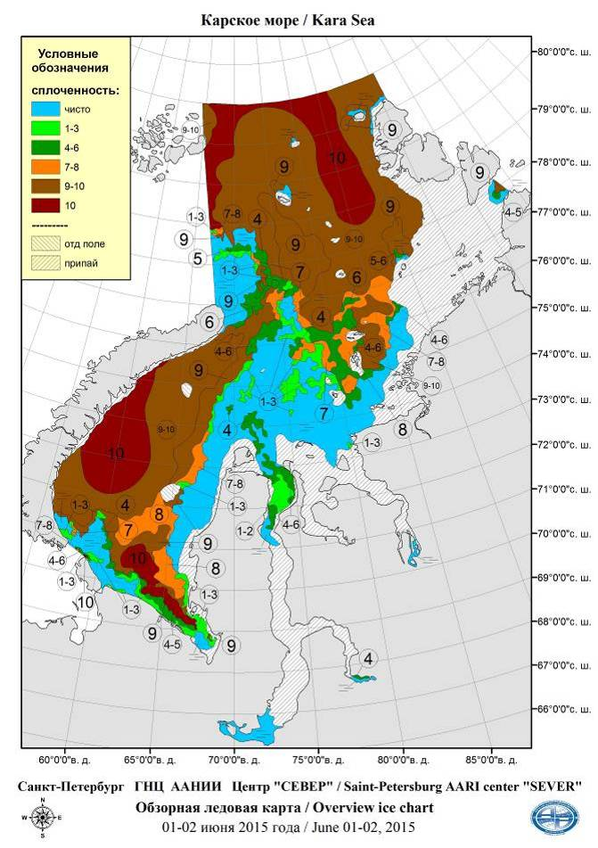
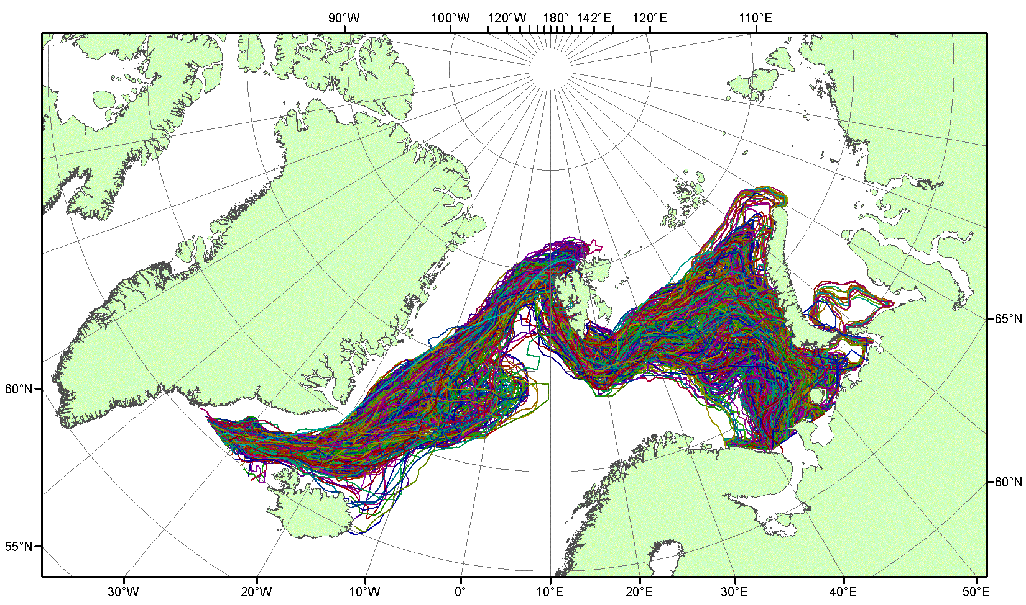
Databases metadata
WMO stations
Drifting meteo buoy
Oceanographic stations
Ice edge position, April
Overview ice maps for the Kara Sea in the summer season
11

Slide 12
Data integration and access under iAOS
Objectives:
integration of interdisciplinary and distributed databases under iAOS-RF
interaction with the European iAOS platform
access to data observation and product of iAOS-RF repository
data exchange with iAOS platform
Works:
Development of design solutions of the Russian IAOS-RF
Development of software of the Russian iAOS-RF: data integration, data management and iAOS depository support, access to data and services (portal)
Interaction of the Russian iAOS-RF with iAOS portal
Integration of databases and metadata of the Russian iAOS-RF
Evaluation, trial operation of the Russian iAOS-RF

Slide 13
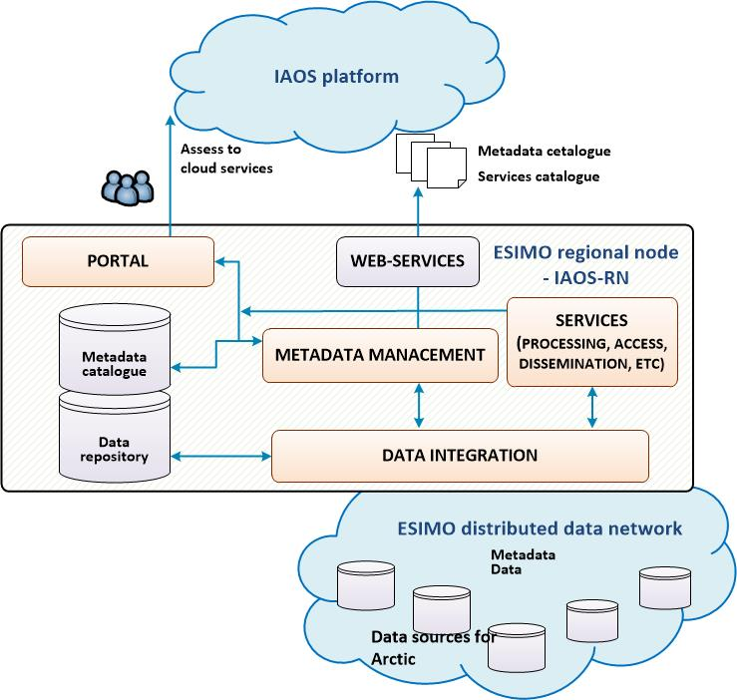
Data integration and access under iAOS
Interaction with iAOS platform
Data submission and exchange
Data integration
Metadata and data repository support
Access to data/services via portal
Data description
Data/services registration
Discovery metadata generation
Data unification and submission
Standardization
Metadata and other standards: ISO19115/19139 and OGC
Parameters Dictionary and Codes/Classifiers
NetCDF as common data format

Slide 14
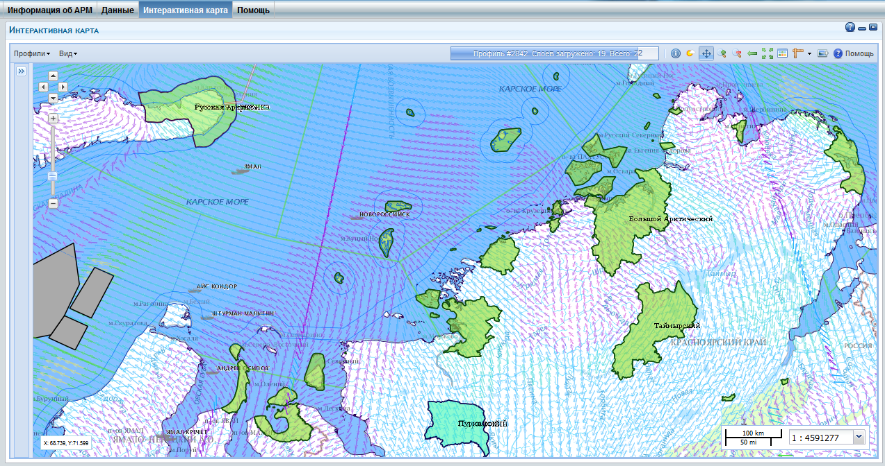
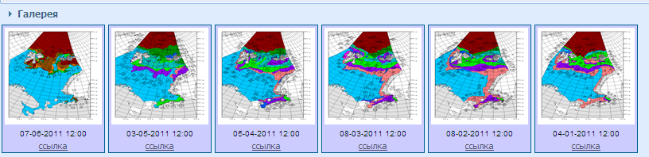
iAOS applications
Objective: System applications for support of marine and maritime industry
Works:
Development of iAOS-RF application solutions for the study and development of the Arctic by the Russian users
Development of iAOS-RF applications for information support of marine/maritime activities
Providing user access to iAOS - RF

Slide 15
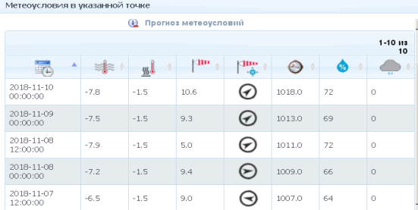
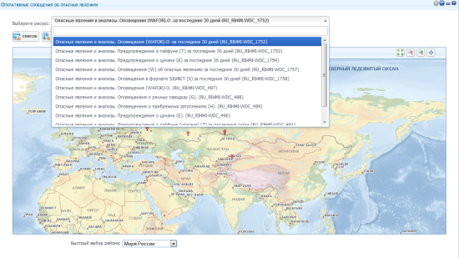
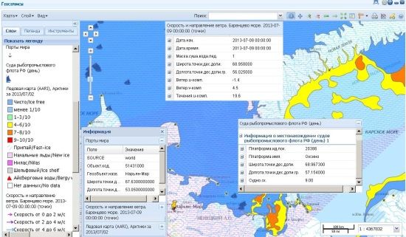
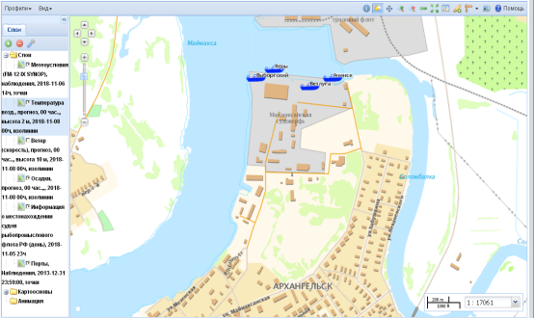
Typical services for monitoring hydrometeorological and ice situations
Monitoring of hydrometeorological situations
Real time massages: SYNOP, SEA, TESAC, BUOY, ICE, others
Access to metadata and data
Subscribing on data delivery
Monitoring Disasters
Visualization of warnings and alerts (WAREP, SIGMET, real time data) on map
Analysis of disasters, including emergency's
Monitoring of situations for ship course
Access to observation, analysis, climatic data for wind, wave, ice
Assessment of extreme parameters values in combination with the location of objects in the sea and information about emergencies
Monitoring of situations for marine ports
Access to observation, analysis, climatic data for region marine port
Assessment of extreme parameters values in combination with the location of marine port and information about emergencies
5

Slide 16
THANK YOU FOR YOUR ATTENTION !
http://asunp.meteo.ru/portal/intaros
The presentation was prepared as part of scientific research on the theme "Development of methods and tools of the Integrated Arctic Observing System": the unique identifier for
the agreement № RFMEFI61618X0103 Ministry of Science Russian Federation

