Slide 1
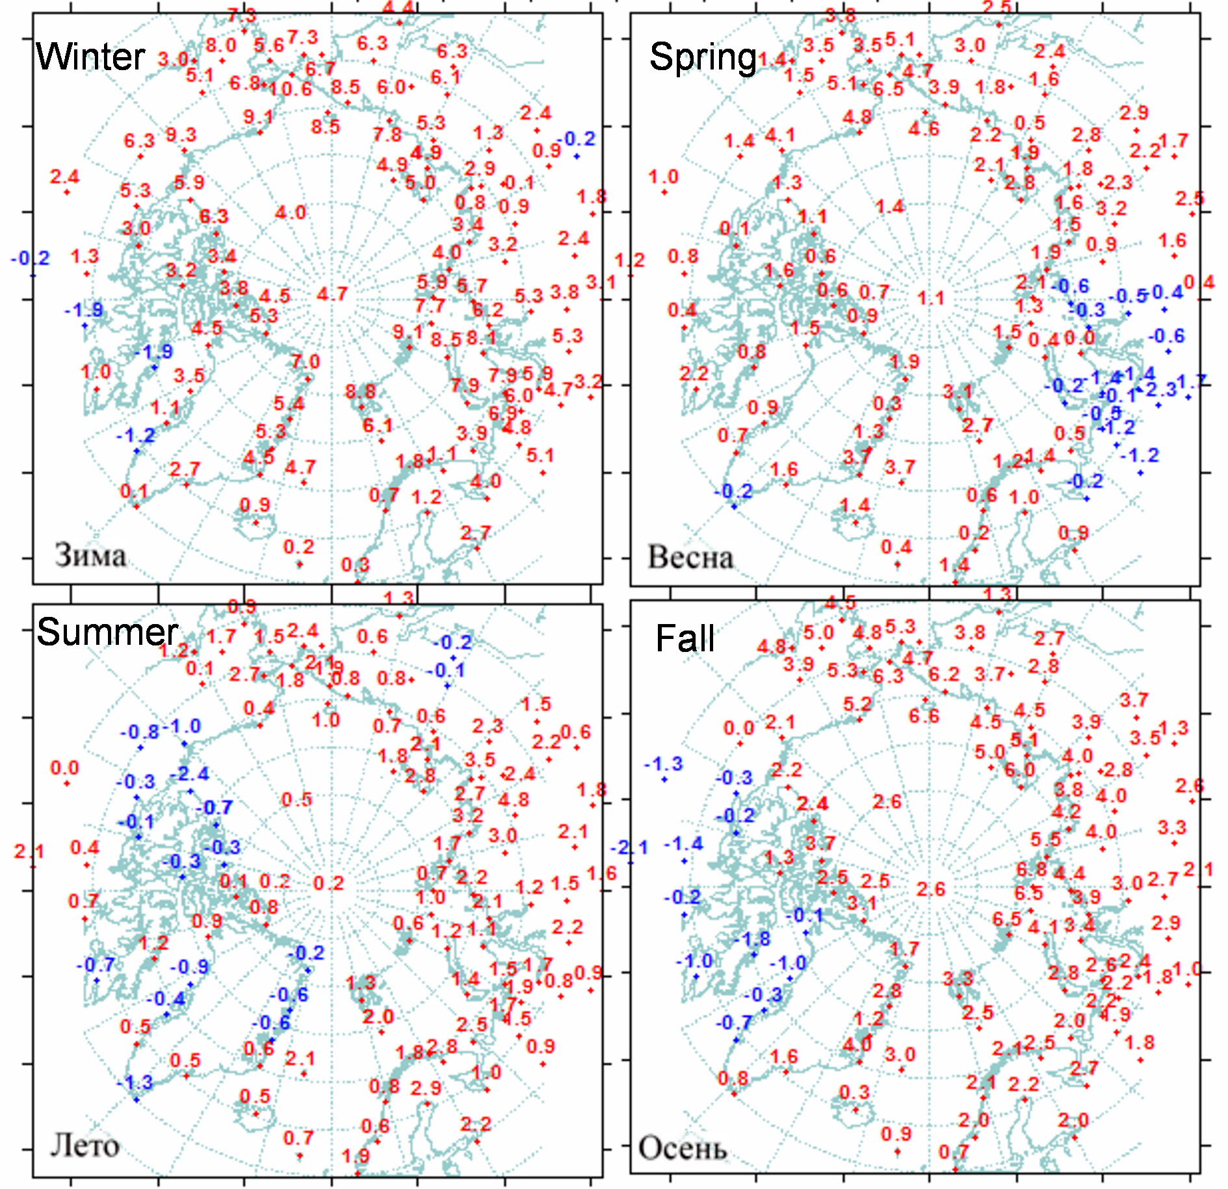
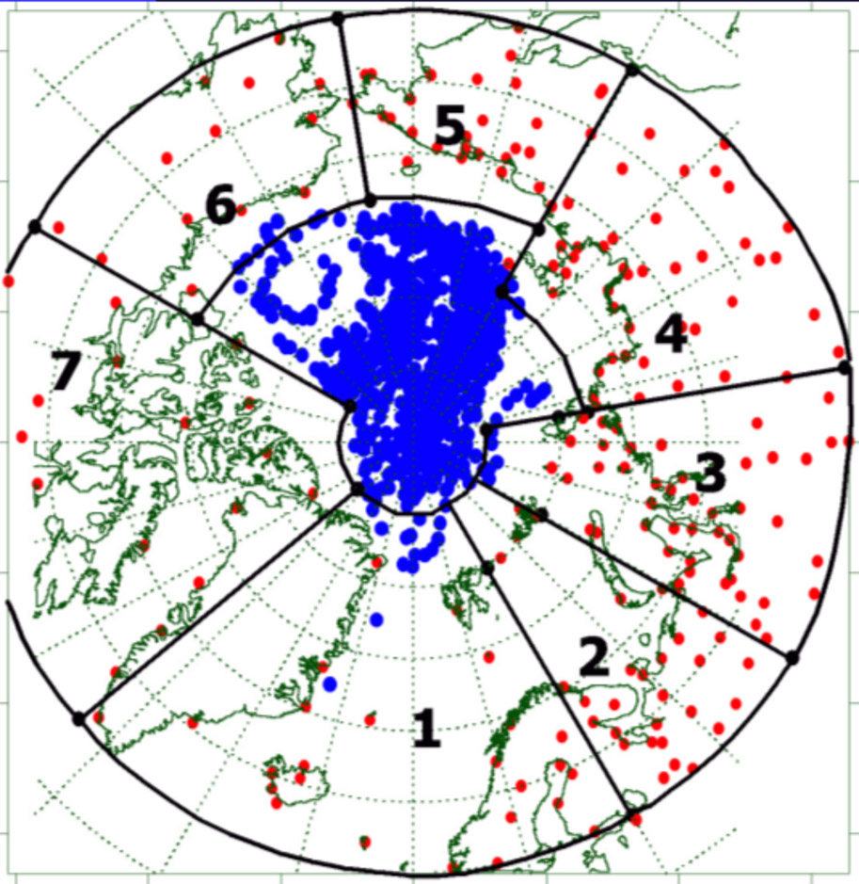
Arctic Climate Monitoring: AARI Experience
Atmospheric monitoring is based on observations at meteorological stations. We believe that monitoring is preferable to use observational data. Reanalysis data are indispensable for research and modeling, and observational data are the benchmark for assessing the quality of reanalysis, modeling and forecasts.
Average monthly data on air temperature and precipitation are used at more than 100 stations north of 60 N. lat. (Fig. 1). Blue points in the Arctic Ocean - data from the North Pole drifting stations for 1951-2012. They are used in calculating averages for 1960-1991.
Figure 1 - Position of meteorological stations (red points), drifting stations and buoys (blue points) and area boundaries
Figure 2 - Anomalies of average seasonal air temperatures in 2018

Slide 2
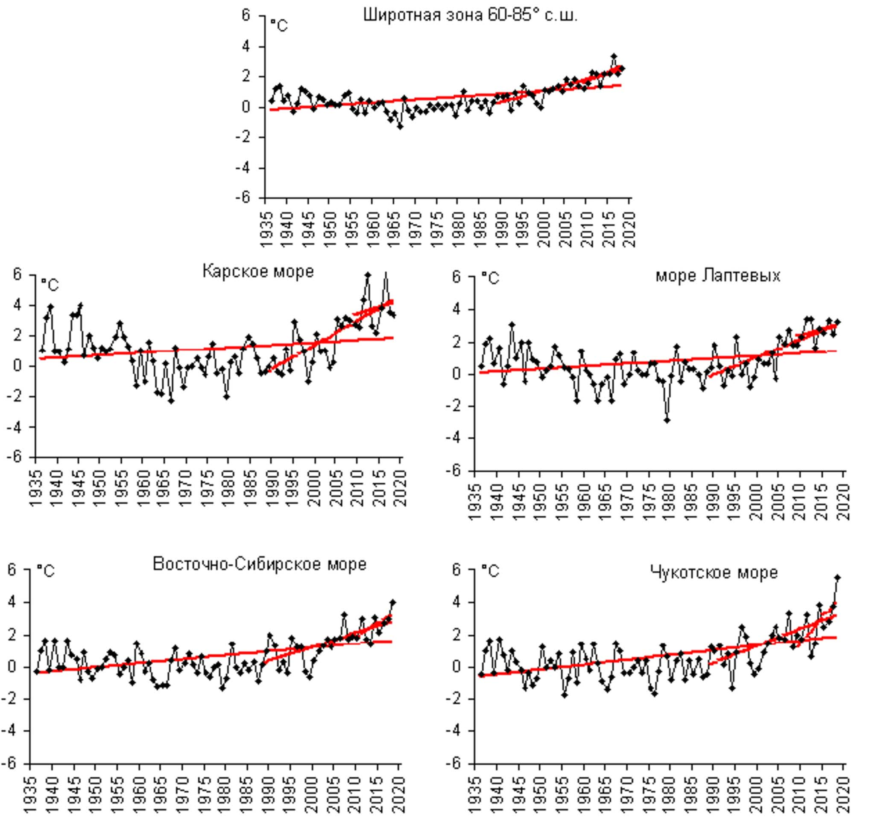
The monitoring includes estimates of the regional average temperature and precipitation for the period from the beginning of the observations for the current year (Fig. 3 and 4).
Figure 3 - Anomalies of average annual air temperature in NPR and in the Arctic seas.

Slide 3
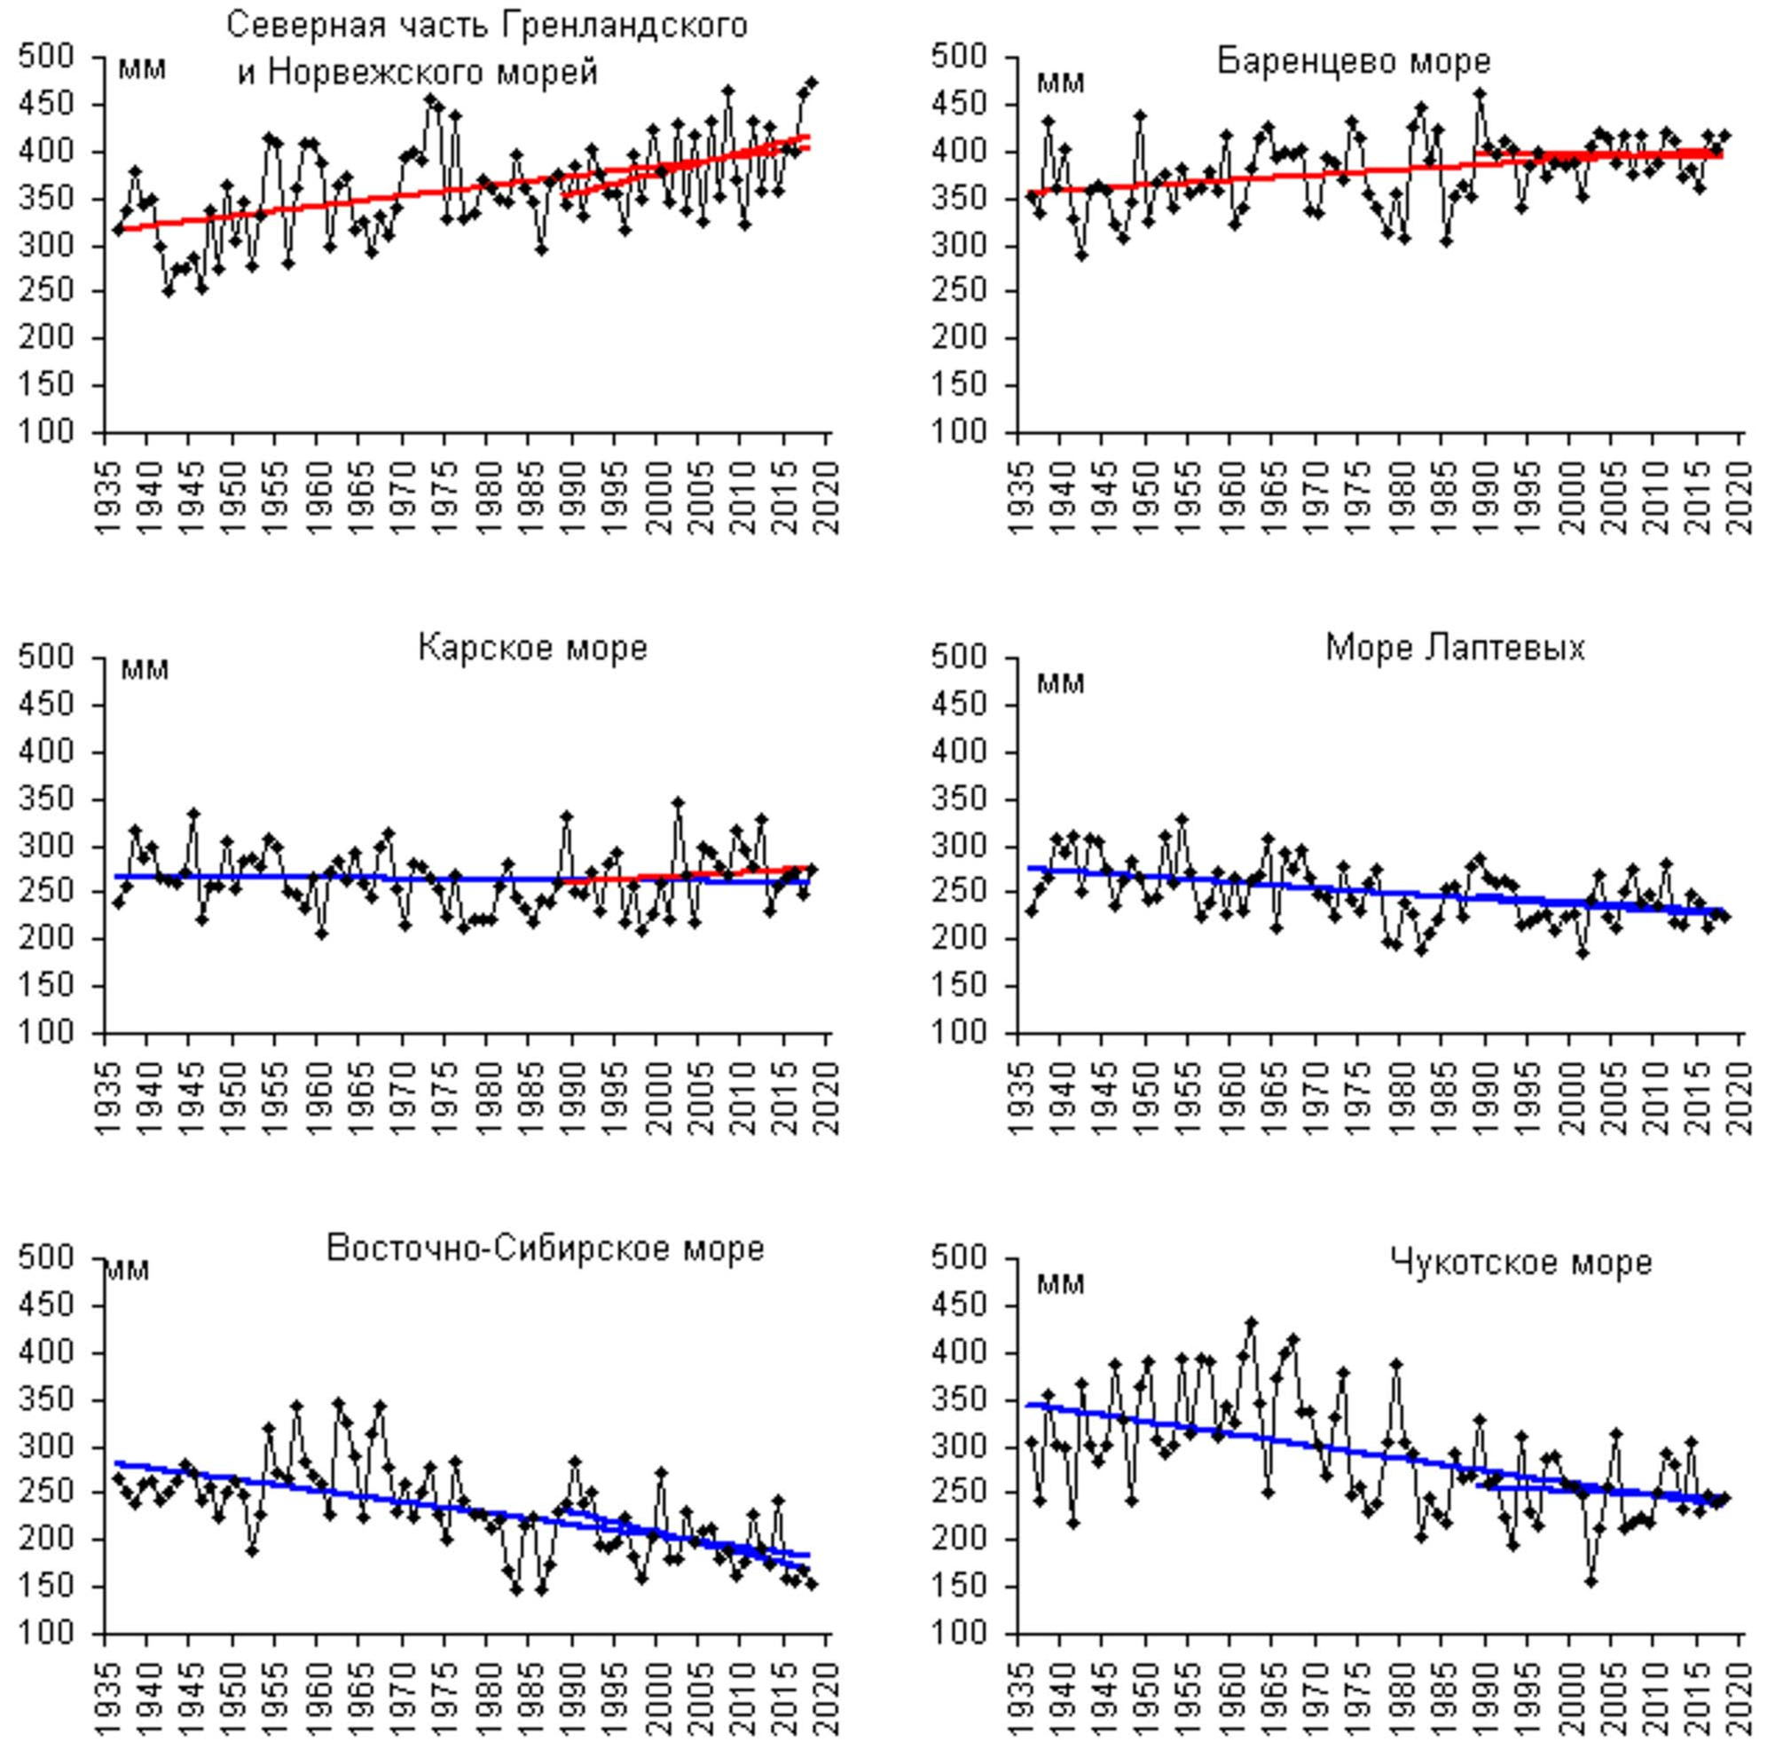
Figure 4 - Annual precipitation.

Slide 4
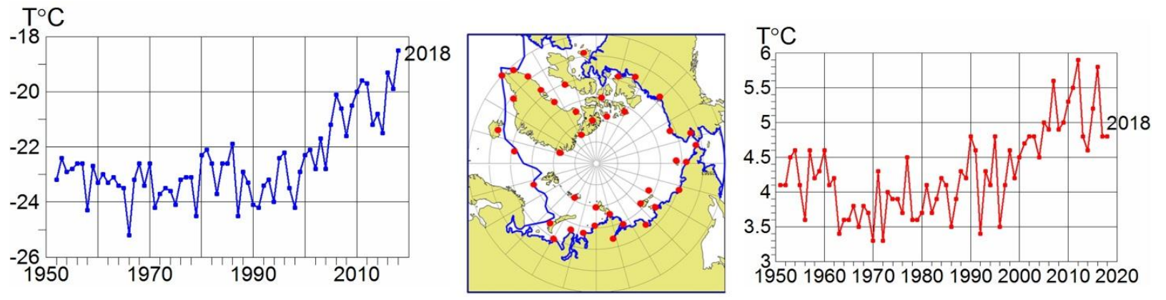
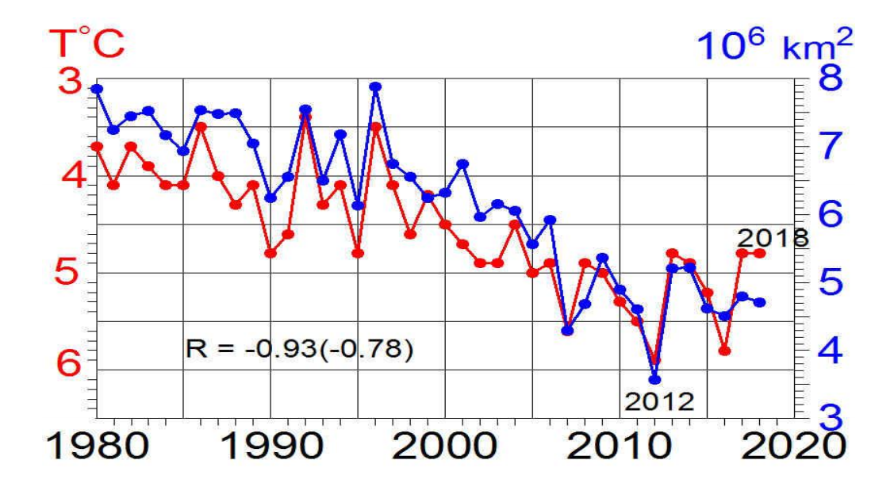
Monitoring in the marine Arctic
In addition to monitoring the entire polar region, we monitor air temperature in the marine Arctic (Fig. 5), which most reflects the effect of warming on sea ice (Fig. 6).
а б в
Figure 5. - Average for December-February (a) and for June-August (c) air temperature at 41 stations in the marine Arctic (b) in 1951–2018.
Figure 6. - Average September sea ice area in the Arctic Ocean according to the AARI data and summer air temperature in the marine Arctic

Slide 5
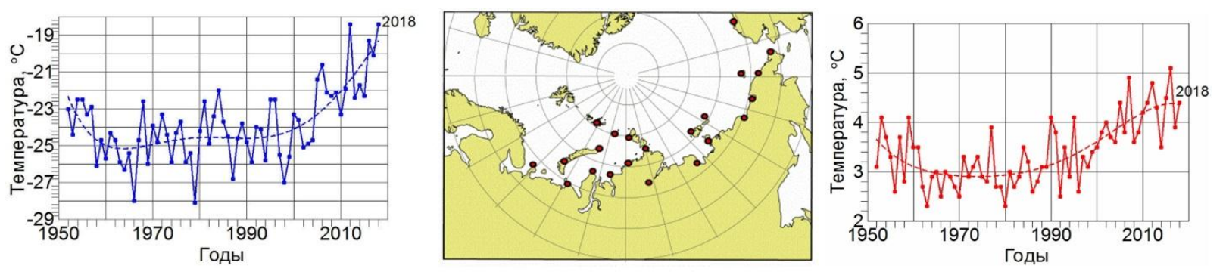
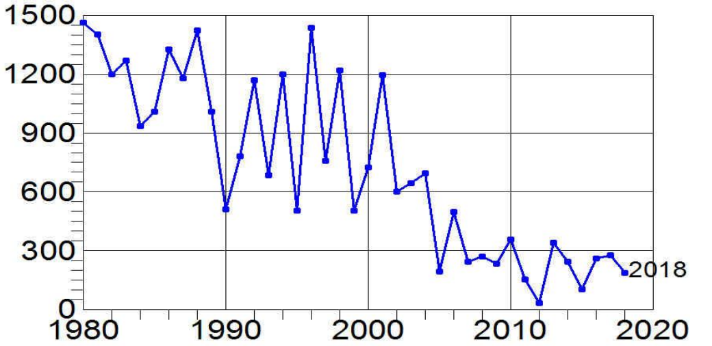
Northern Sea Route area
Due to the increasing attention to climate change in the Arctic Ocean, through which the Northern Sea Route (NSR) passes, the characteristics of the climate and ice conditions in this area of the Arctic Sea are presented below (Fig. 7).
Figure 7. - The average air temperature in winter (a) and summer (c) in the Arctic seas according to 22 meteorological stations (b).
Sea ice cover in the Arctic seas by the end of the summer has been rapidly declining since 2001, having decreased by 2005 to 300 thousand km2. In the past 14 years, its area in September has fluctuated around this level, which is 4 times less than in the 1980s. (Fig.8).
Figure 8. - Area occupied by sea ice in September in the Siberian Arctic seas according to the AARI data

Slide 6
Indicator: SAT in the marine Arctic
Winter SAT
Summer SAT
41 st
Meteost. in the marine Arctic
Summer SAT and September SIE.
Supplemented from Alekseev, G., Glok, N., Smirnov, A. On assessment of the relationship between changes of sea ice extent and climate in the Arctic // International Journal of Climatology. 2016. № 9 (36). P. 3407–3412

Slide 7
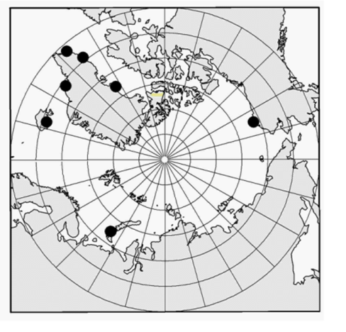
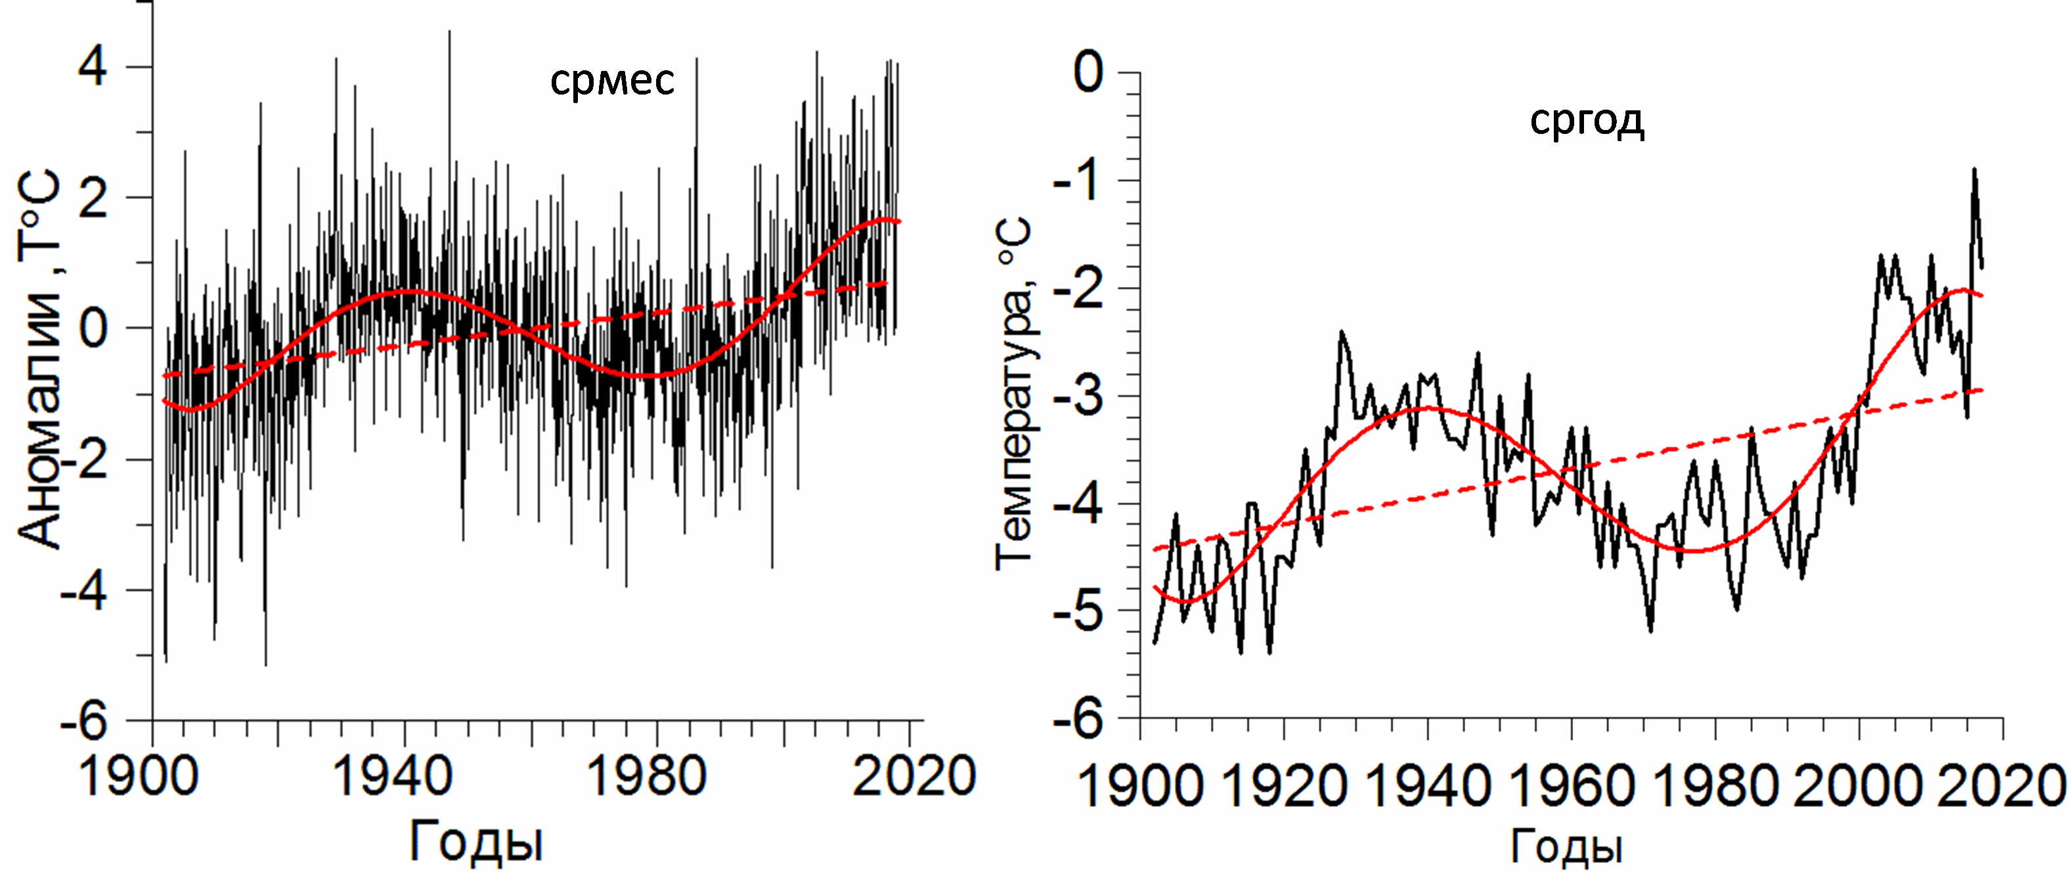
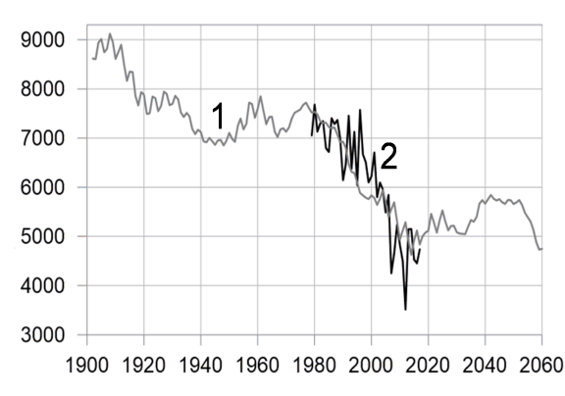
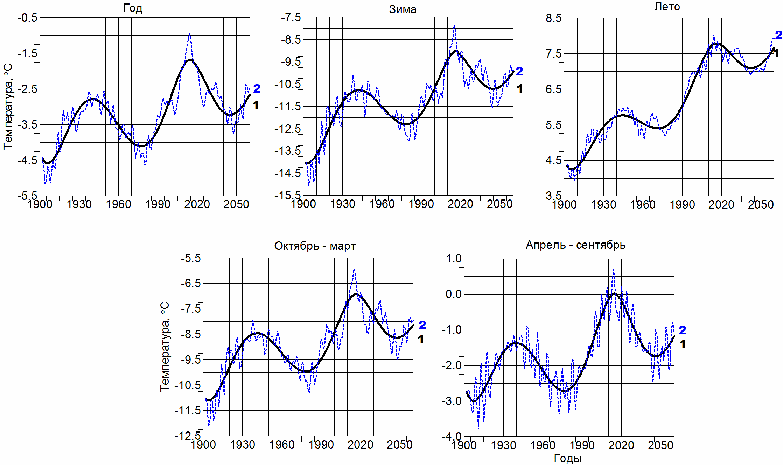
Indicator: SAT at 7 long-term Arctic stations (from 1900)
Average for the year SAT
SAT extrapolation
Sept SIE prediction
Positions of 7 stations
in the marine Arctic
Components | Contribution, %
 | Win | Spr | Sum | Fal | CHY | WHY | Year
LFO | 55 | 45 | 51 | 57 | 62 | 59 | 71
Trend | 25 | 8 | 7 | 18 | 24 | 20 | 22
T = 74 years | 30 | 37 | 44 | 39 | 38 | 39 | 49
Noise | 45 | 55 | 49 | 43 | 38 | 41 | 29
Correlation between summer SAT and monthly SIE and SIA in the marine Arctic 1979-2017
SIE
SAT
SIA
SAT

Slide 8
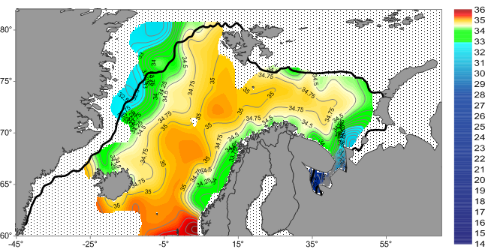
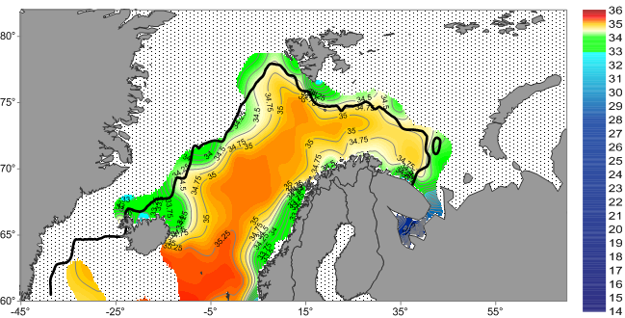
Indicator: Water temperature in the Barents Sea at Kola section
(AW temperatures in 0-200 m layer along 33°30’ E from PINRO website (http://www.pinro.ru))
Average for the year since 1901, monthly average since 1951
1987
1969
Sea surface salinity and ice edge in June 1969 and 1987 (http://www.nodc.noaa.gov/OC5/nordic-seas/, HadSST)
Correlation between the temperature in the 50–200m layer on the Kola section and SIE in the BS 1979–2014
1969
Normalized values of water temperature at the Kola section (1), SIE in the Arctic (2) and in the Barents Sea (3) in May. The correlation between (1) and (2) is -0.92 (-0.83), between (1) and (3) is -0.87 (-0.76). Sign of water temperature anomaly was changed
The normalized values of the average for a year water temperature on the Kola section (1) and air temperature in the marine Arctic (2). R is the correlation coefficient between (1) and (2)

Slide 9
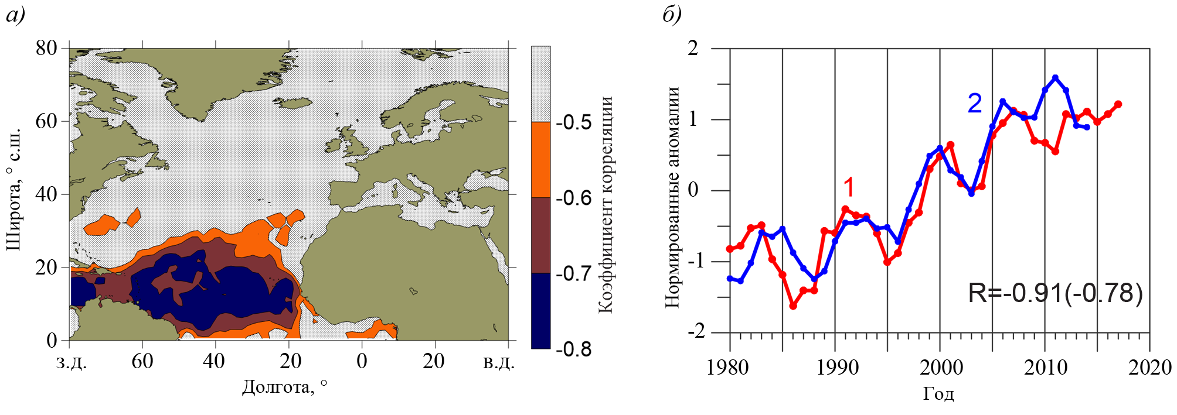
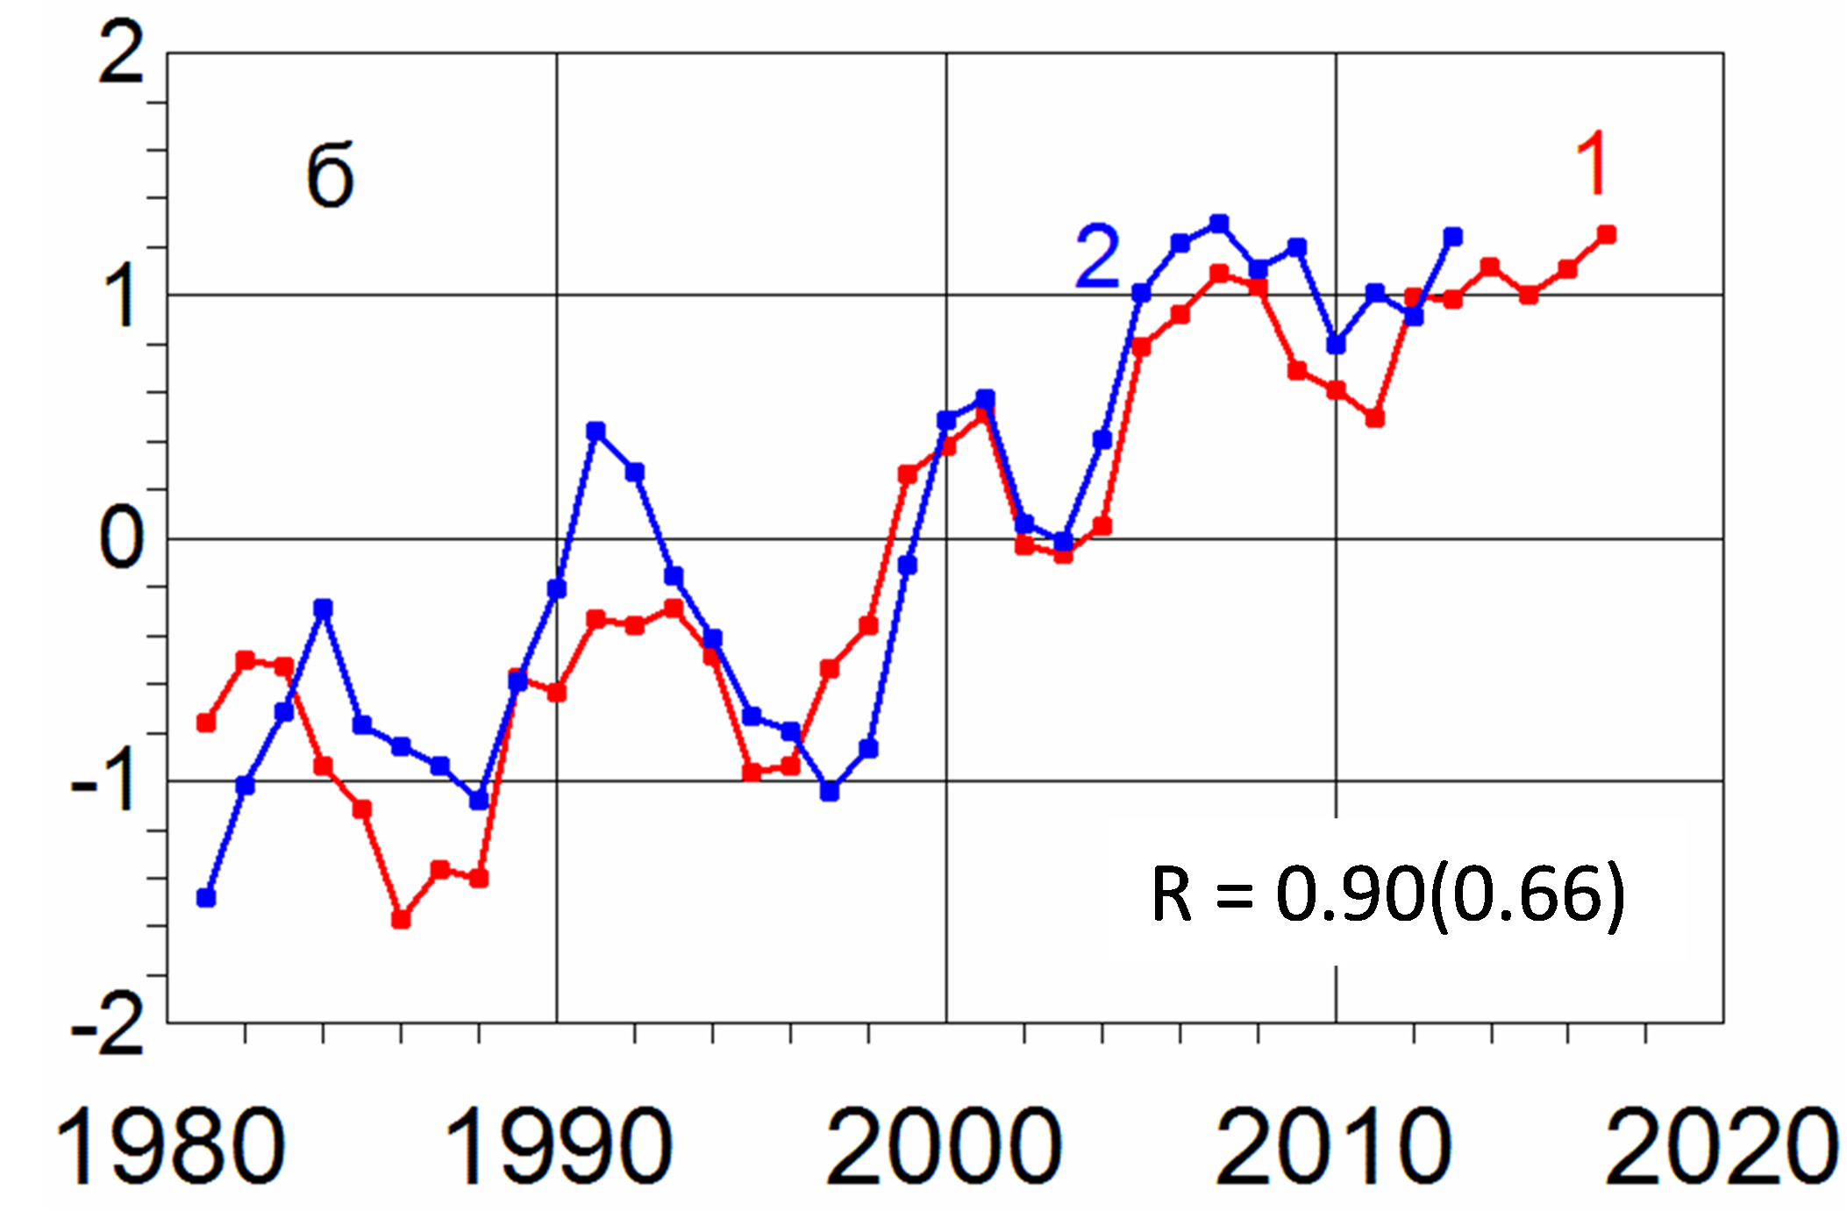
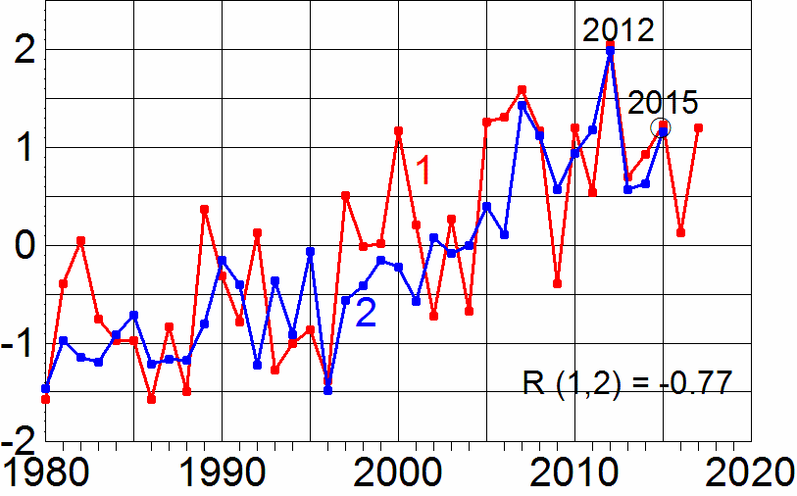
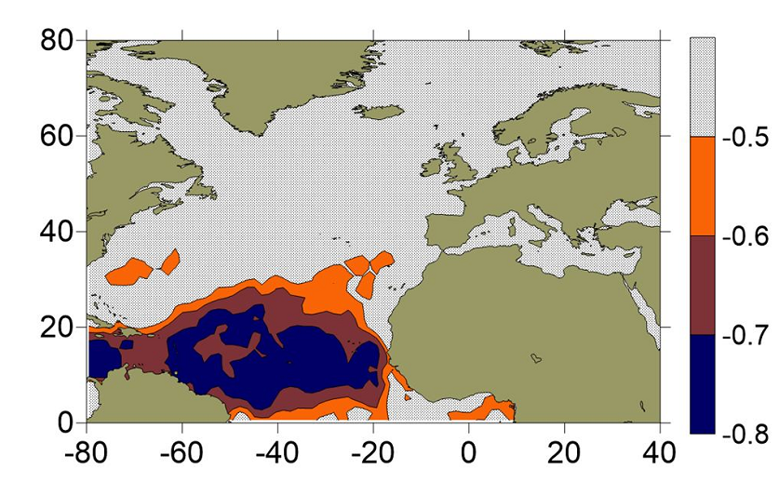
Low-latitude SST anomalies increase Arctic climate predictability
a
b
c
SSTA in Sept(1) and Sept SIE(2)
23 months later
a - SSTA in October (1) and
December SIE (2) over 26 months.
b - SSTA in October (1) and the water
temperature at Kola section in January-
February (2) over 27 months
All series were smoothed by 3 years window. In brackets is detrended correlation.
Area of strong correlation between SST and the Arctic climate parameters.

Slide 10
Statistical forecast of monthly average Arctic SIE in June - September 2019
Month | Monthly SIE, 10⁶ km² 2019
June | 11,00
July | 8,26
August | 5,35
September | 4,95

