Slide 1

LRF and training activities at NEACC
North EurAsia
Climate Centre
V.Khan, V.Tischenko, E.Kruglova, I.Kulikova, E.Ganieva

Slide 2
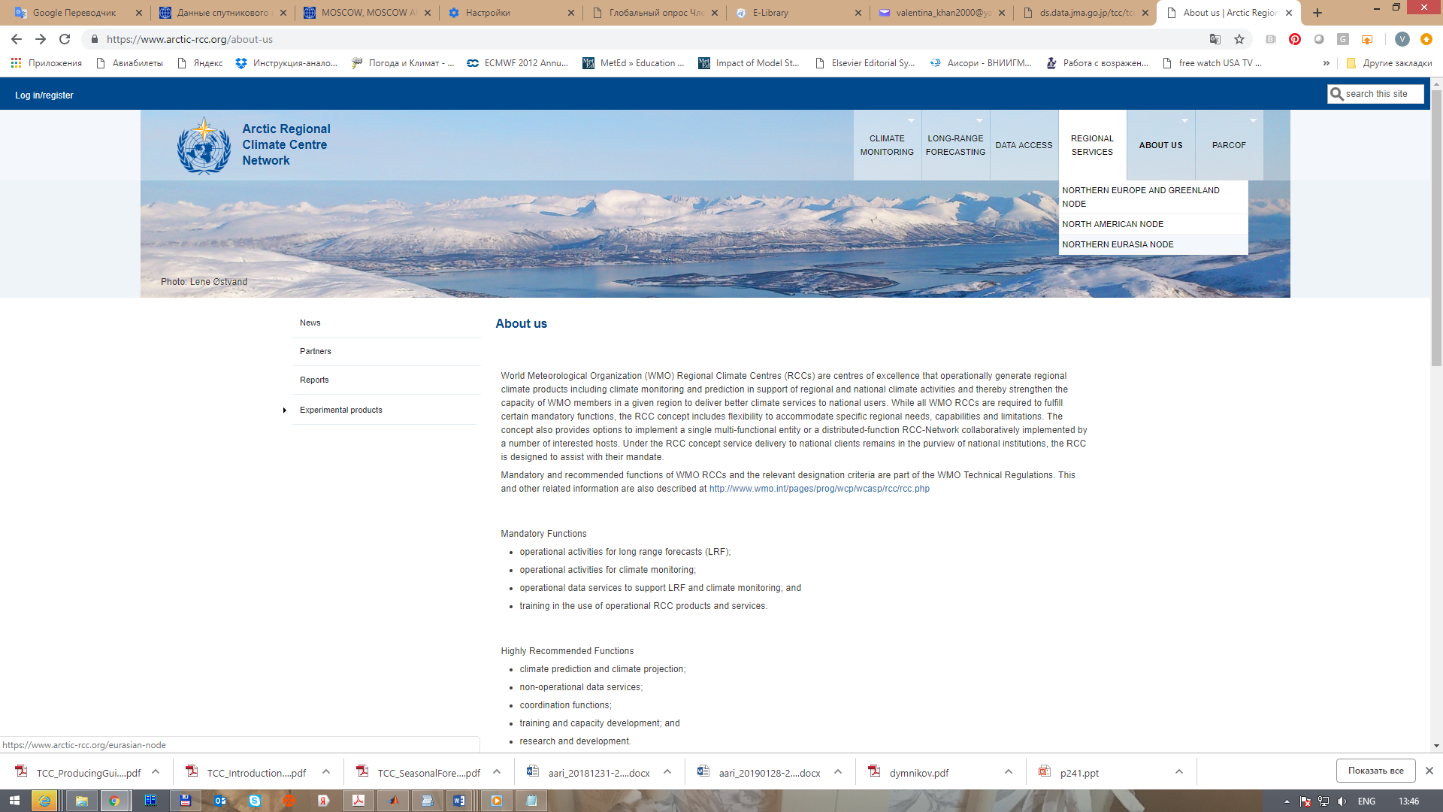
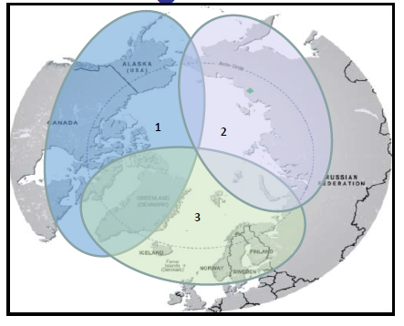
Northern Eurasia node has been composing as an multifunctional climate center for RAII Arctic region. Main contributor to LRF service provision are Hydrometcenter of Russia and Main Geophysical Observatory (main institutions of NEACC).
Web site of North Eurasia node is under development

Slide 3
Operational LRF activities at NEACC in support of North Eurasian Node of ArcRCC-N

Slide 4
LRF technology at NEACC

Slide 5
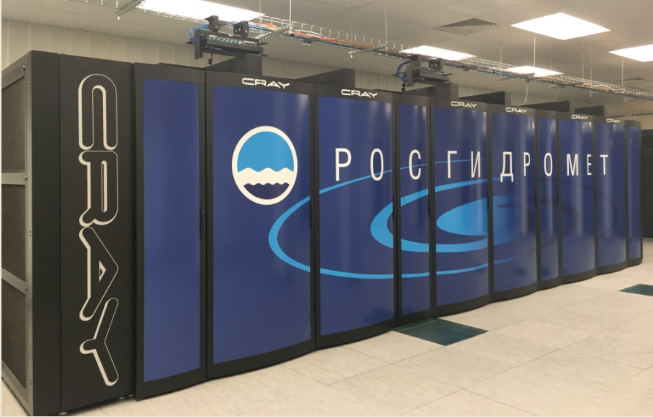
New supercomputer complex (2018) has been facilitating operational LRF work at GPC-Moscow and NEACC
- increased storage of forecast and monitoring information
- increase of resolution of dynamical model forecasts
- optimization of LRF technology
Updating of computational facilities at Roshydromet
Center | Peak Performance TFlops (10¹² Flops) | System | Cores | RAM TB/ GB per core | Manufacturer | Storage
GPC-Moscow | 1200 | Cray XC40-LC | 33696/36 | 120/3,55 | Cray (USA) | 2,8 PB Cray Sonexion 3000 + 360 TB EMC
 | 13 | Bull S6130 | 384/384 | 4/10 | Bull SAS (France)

Slide 6
The list of LRF products available at NEACC to support Northern Eurasian node
Climate forecast information
- Forecasts at subseasonal – seasonal scale on the basis of
SL-AV and MGO models (maps, surveys, numerical data)
- Circulation Indices
- Intraseasonal forecasts (at weekly time scale)
- Outlooks of seasonal forecasts
- Consensus winter and summer forecasts from NEACOF sessions
Forecasts verification
- Skill scores of operational forecasts
- Skill scores of retrospective forecasts
http://seakc.meteoinfo.ru/ Рус
http://neacc.meteoinfo.ru/ Eng

Slide 7
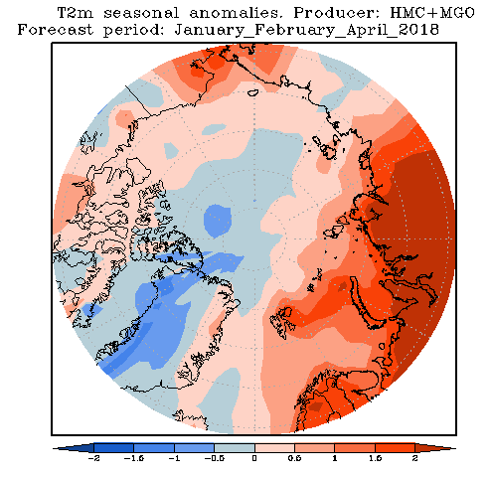
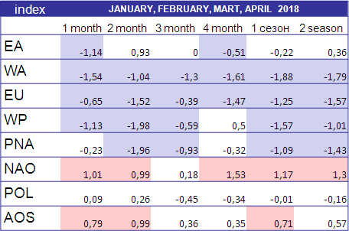
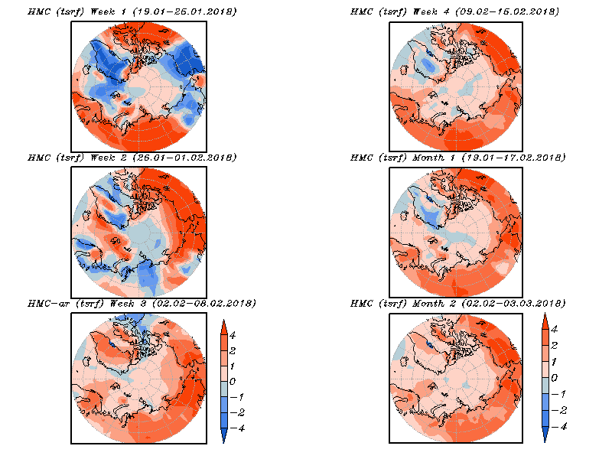
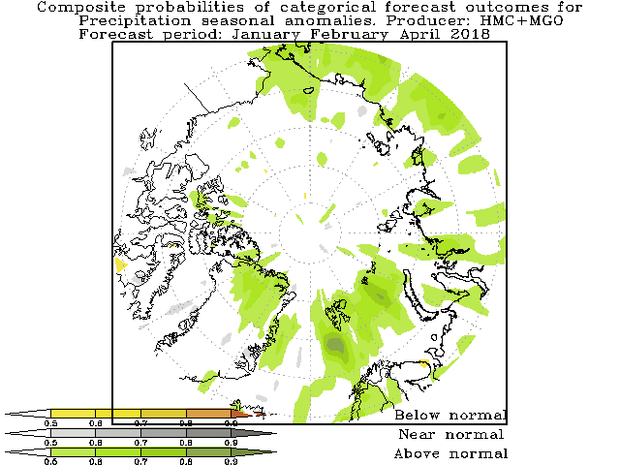
LRF products for Arctic region provided by NEACC
North EurAsia
Climate Centre
http://neacc.meteoinfo.ru/ - English version of NEACC website
http://seakc.meteoinfo.ru/ - Russian version of NEACC website
NEACC since 2015 has started to deliver climate forecast products over Arctic region in operational regime
Monthly to seasonal multimodel forecasts (SL-AV + MGO models) of basic meteorological parameters with monthly update
Forecasts of climate indices (including Arctic Oscillation Index, Polar Oscillation Index) with monthly update
Subseasonal forecasts of basic meteorological parameters over Arctic region with weekly update
Deterministic forecast of air temperature for JFMA 2018
Probabilistic forecast of precipitation for JFMA 2018
EA - East Atlantic Oscillation
WA - West Atlantic Oscillation
EU - Eurasia Pattern
WP - West Pacific Oscillation
PNA - Pacific – North American Pattern
NAO - North Atlantic Oscillation
POL - Polar Oscillation
AOS - Arctic Oscillation

Slide 8
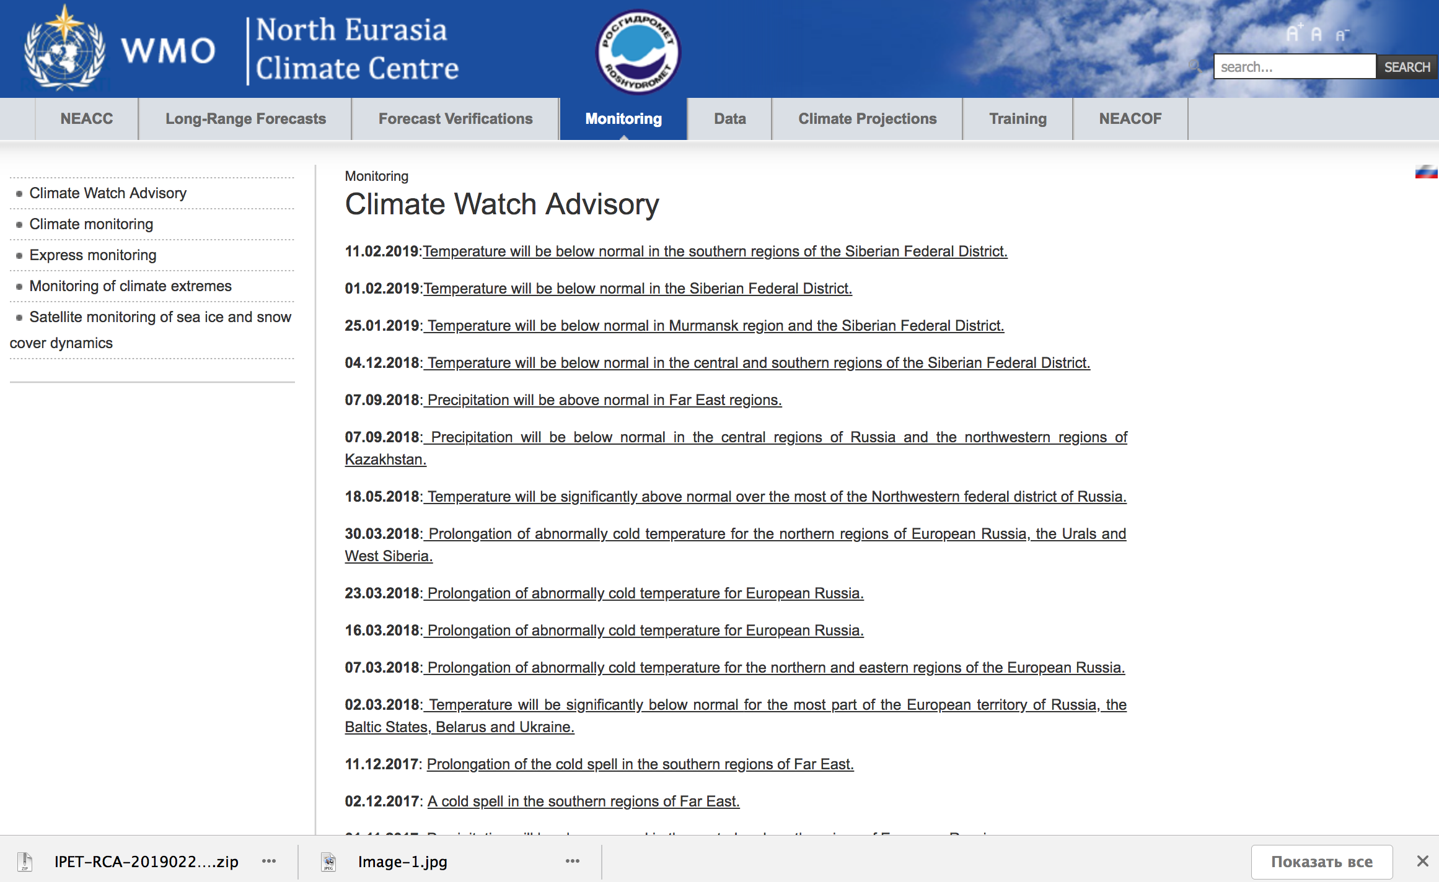
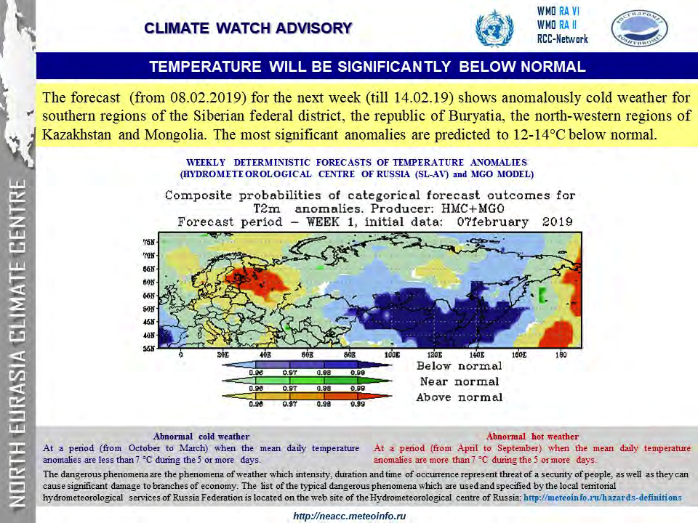

Slide 9
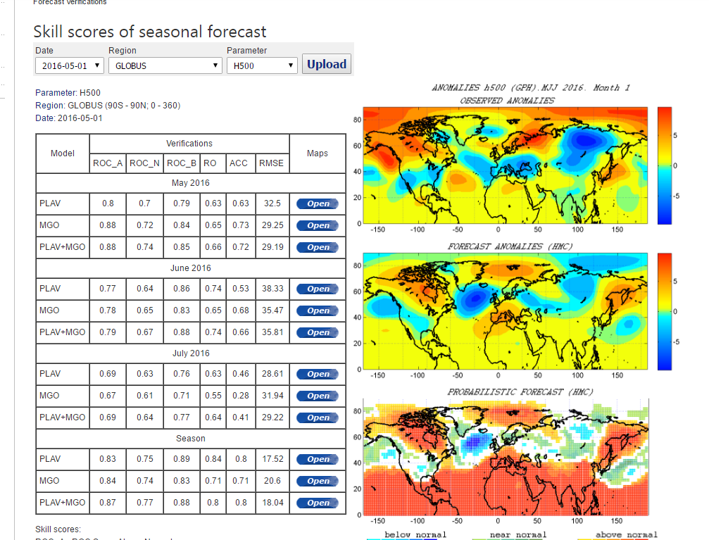
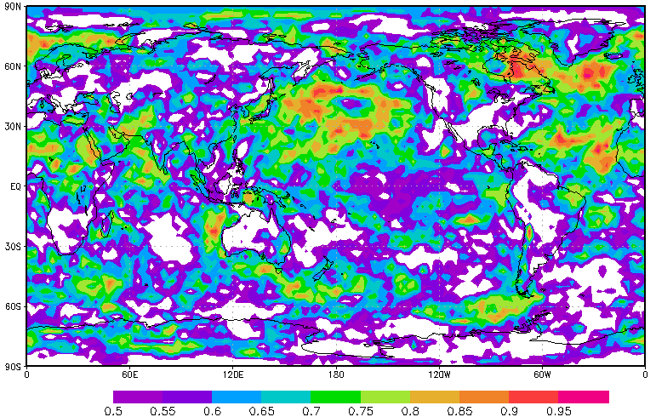
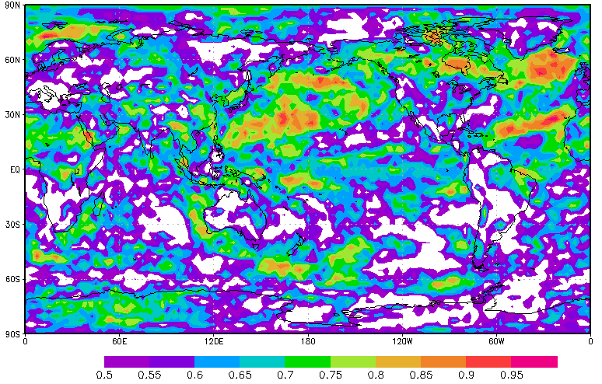
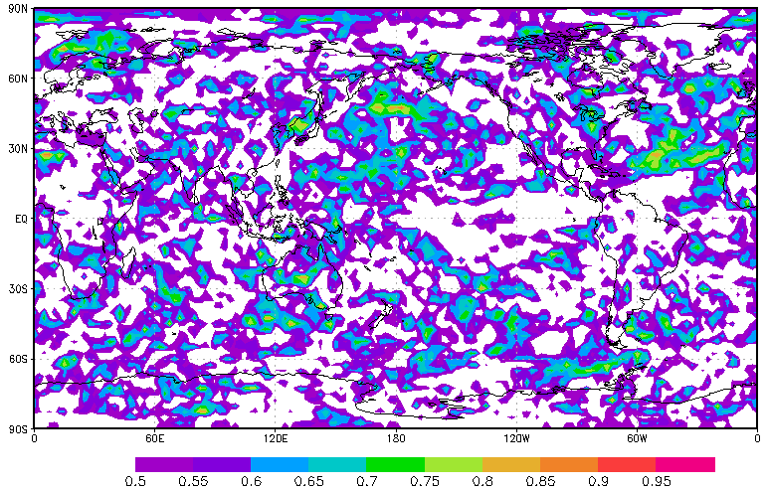
Skill scores of monthly-seasonal forecasts
Hindcasts
Operational forecasts

Slide 10
Research aimed at LRF improvement at NEACC

Slide 11
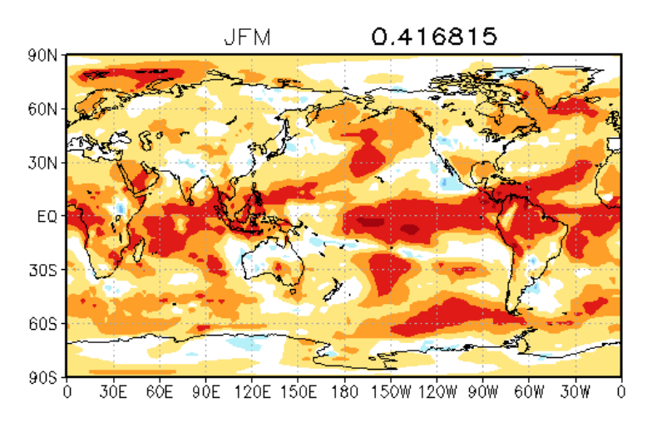
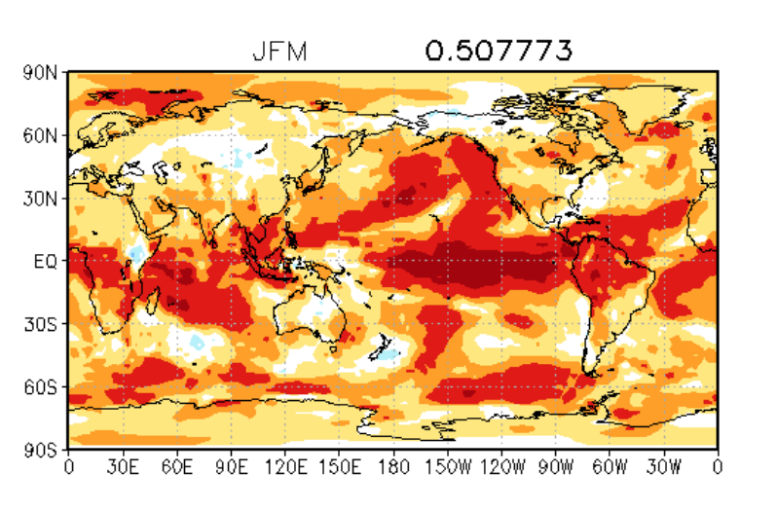
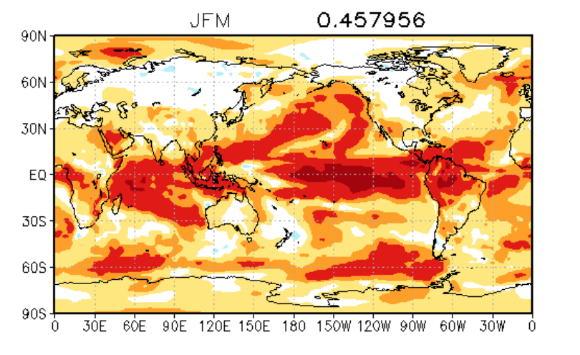

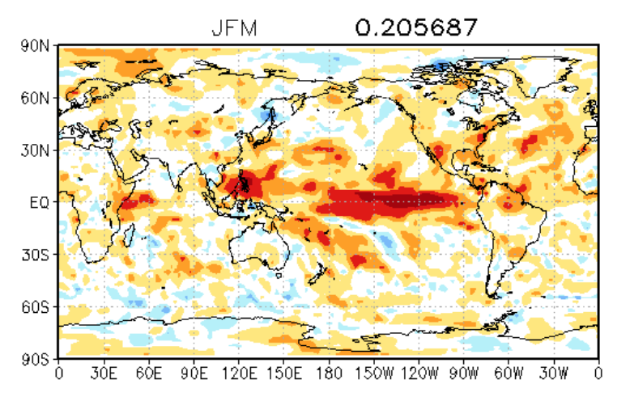
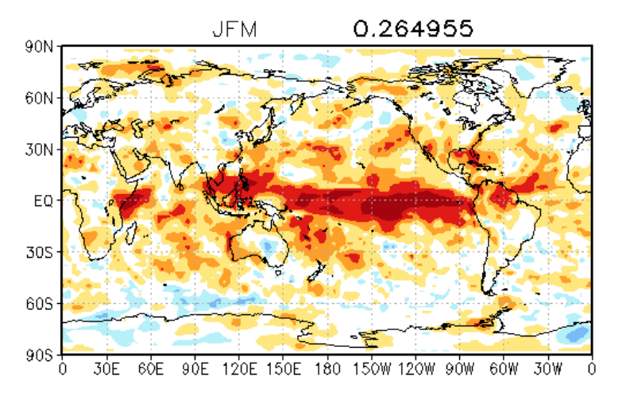
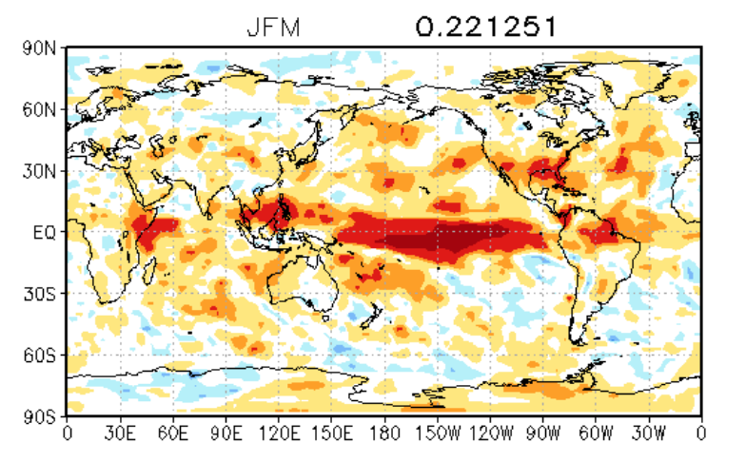
Skill scores (ACC) of some GPCs models
Washington Exeter Tokyo
t2m
Precip

Slide 12
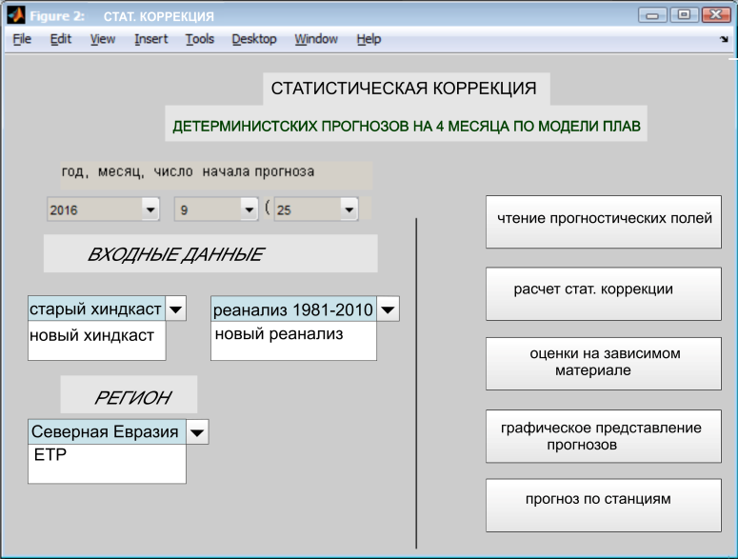
MOS scheme for deterministic seasonal forecasts used at NEACC to increase forecast quality
Hindcasts of T2m, H500, PRSML from Sl-AV
Operational forecasts of T2m, H500, PRSML from Sl-AV
NCEP/DOE data
Observational station data
Optimal statistical linear relationships between hindcast and reanalysis data
Statistical correction of operational forecasts based on linear relationships between hindcast and reanalysis data
Visualization of forecast fields
Calculation of skill scores
Interface program for statistical correction of model outputs
Арктика

Slide 13
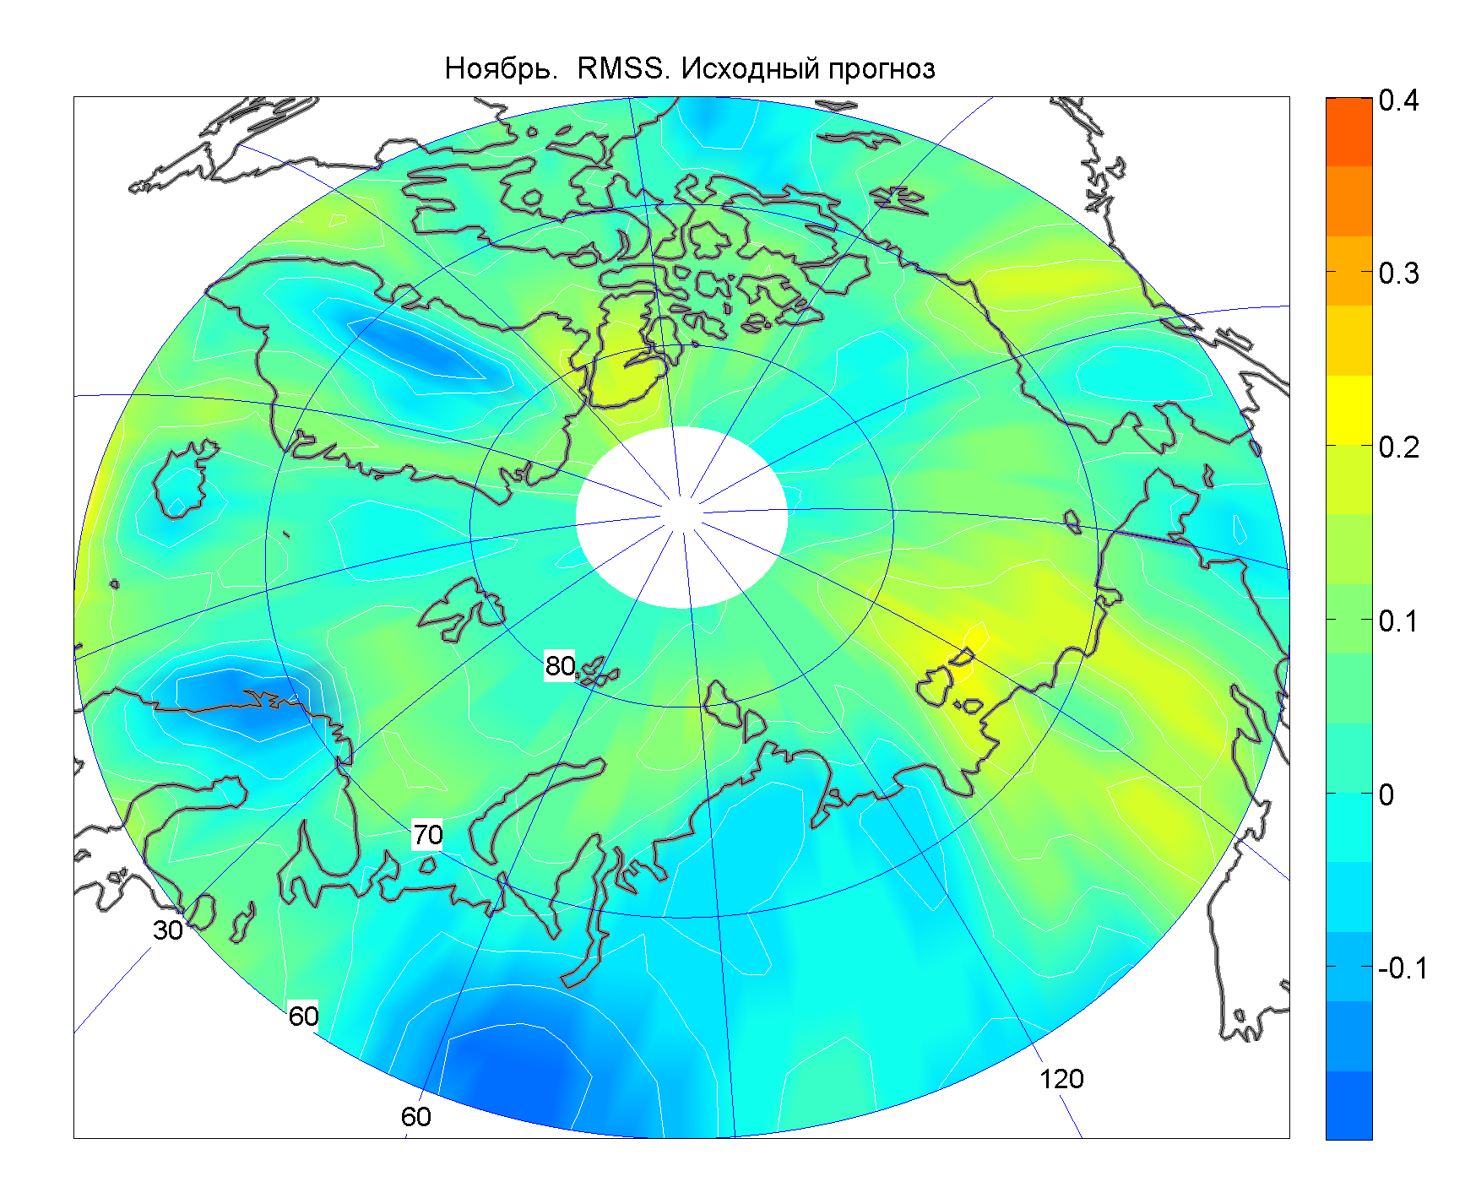
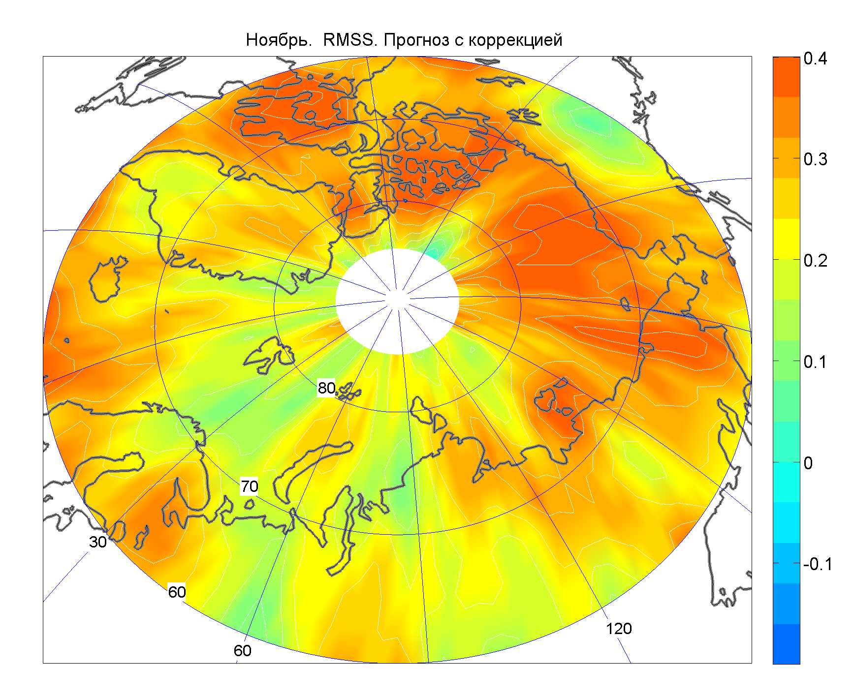
How much does MOS approach improve seasonal hindcasts from Sl-AV model in Arctic region?
RMSS of SL-AV model forecast of T2m anomaly
Hindcast data were used for period from 1982 to 2010
RMSS of corrected SL-AV model forecasts of T2m anomaly

Slide 14
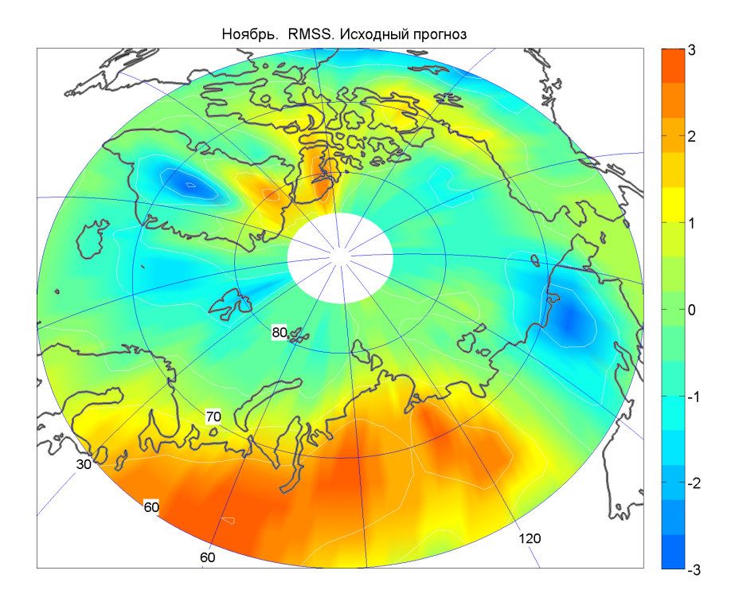
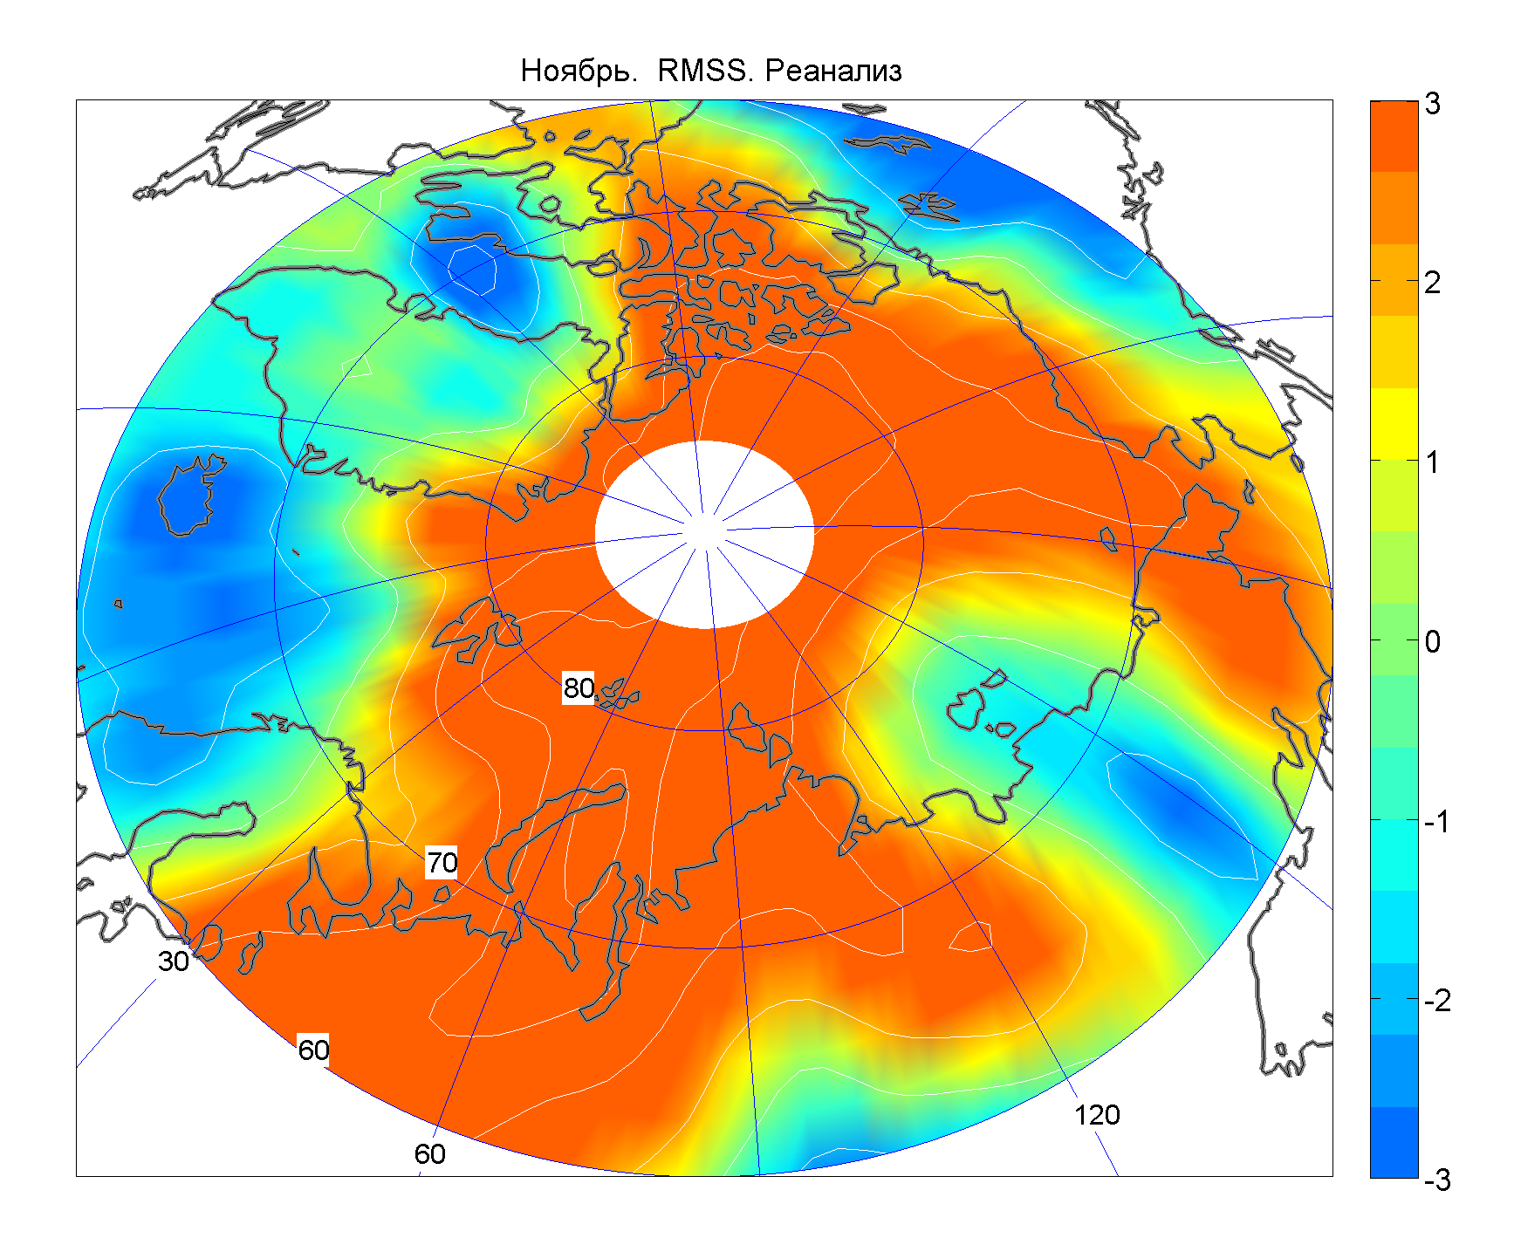
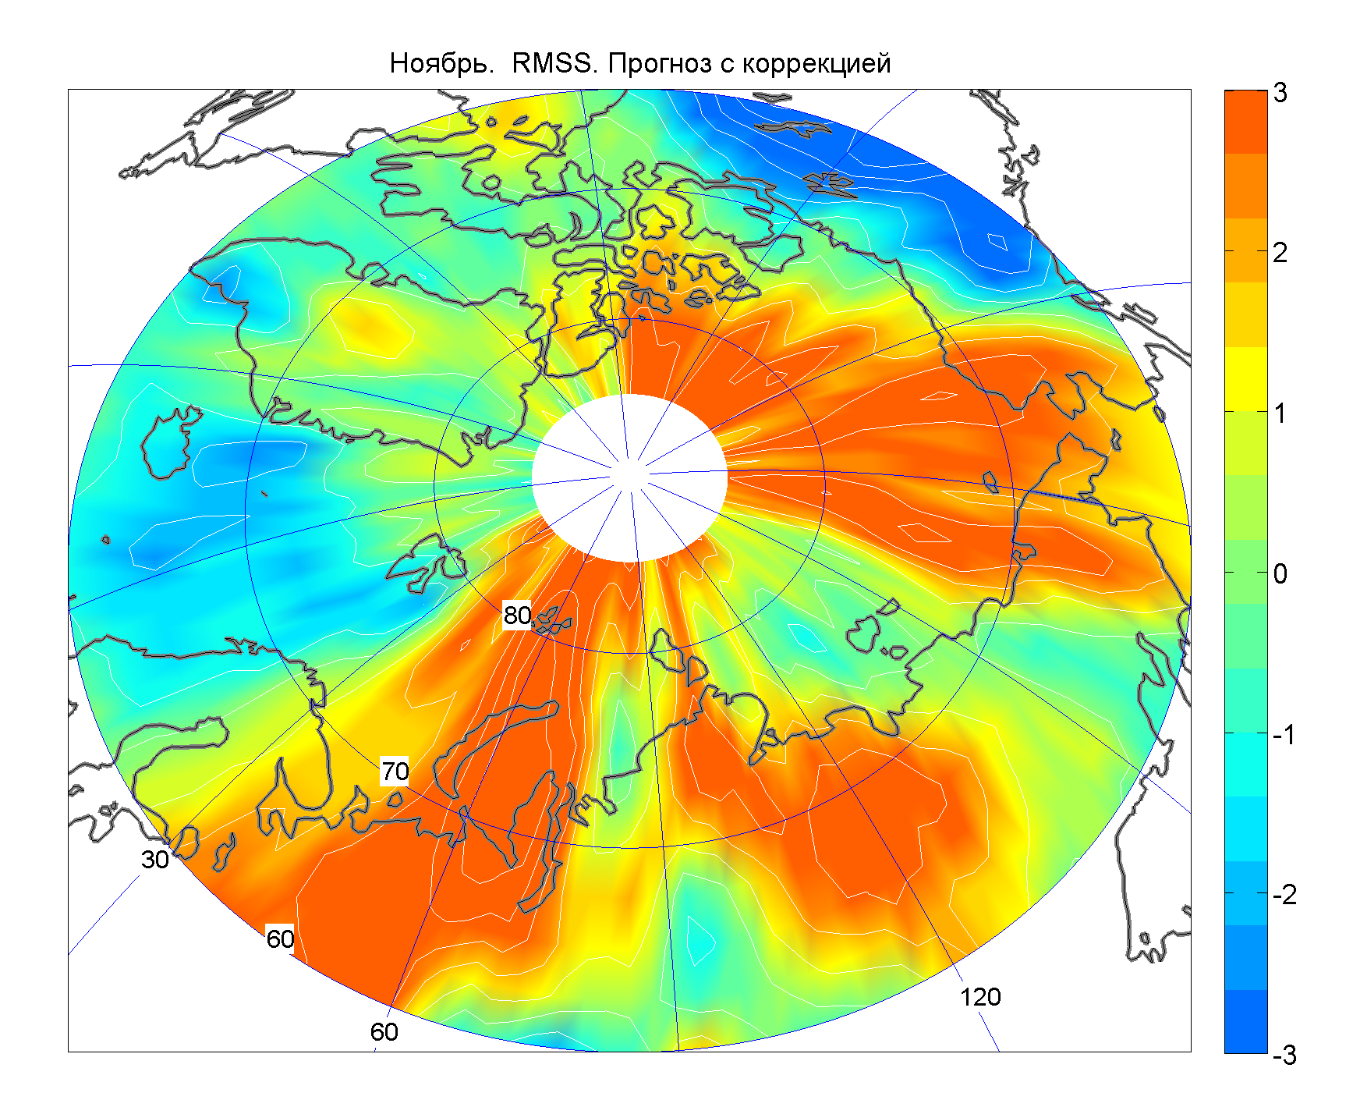
T2m anomaly forecast from Sl-AV
T2m anomaly from NCEP/NCAR data
MOS corrected T2m anomaly forecast

Slide 15
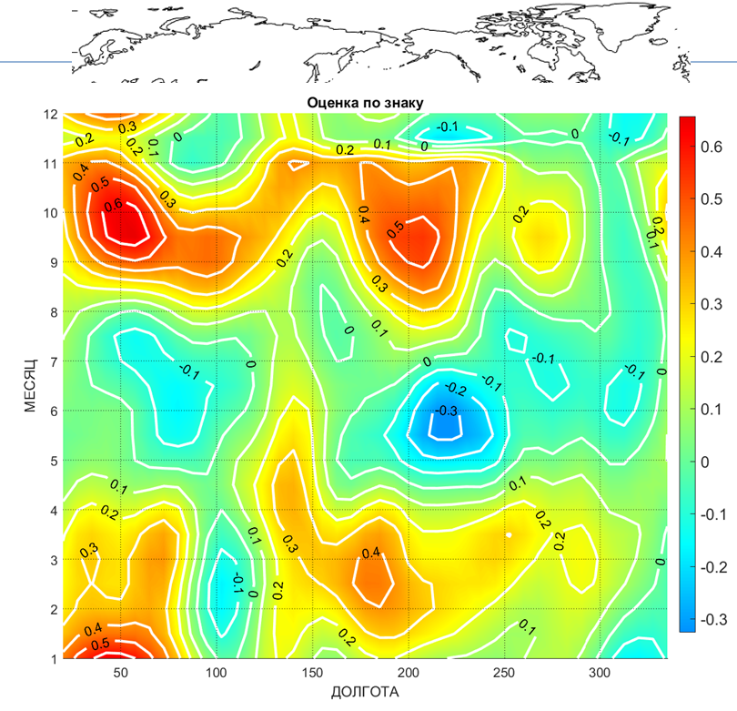
Added value of using MOS approach for operational seasonal forecasts
Operational Sl-AV forecasts were used for period from 2015 through 2018
The largest improvements are revealed for transition seasons – autumn and spring.

Slide 16
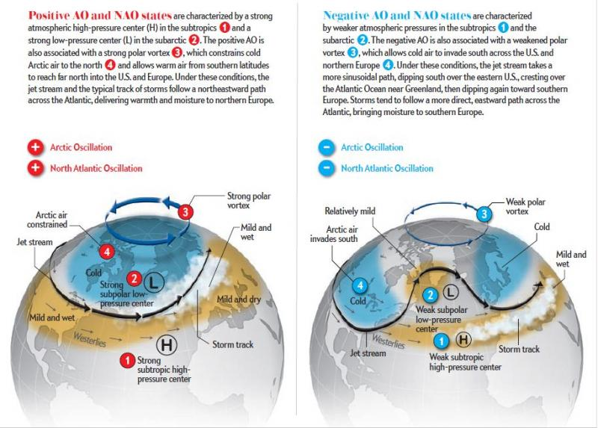
Arctic oscillation index reflects main features of large-scale circulation pattern in Arctic region and high latitudes of Northern Hemisphere.
Simulation of Arctic Oscillation variability by Sl-AV model

Slide 17
Influence of AO on air temperature regime during boreal winter in northern Eurasia from NCEP/NCAR and Sl-AV data

Slide 18
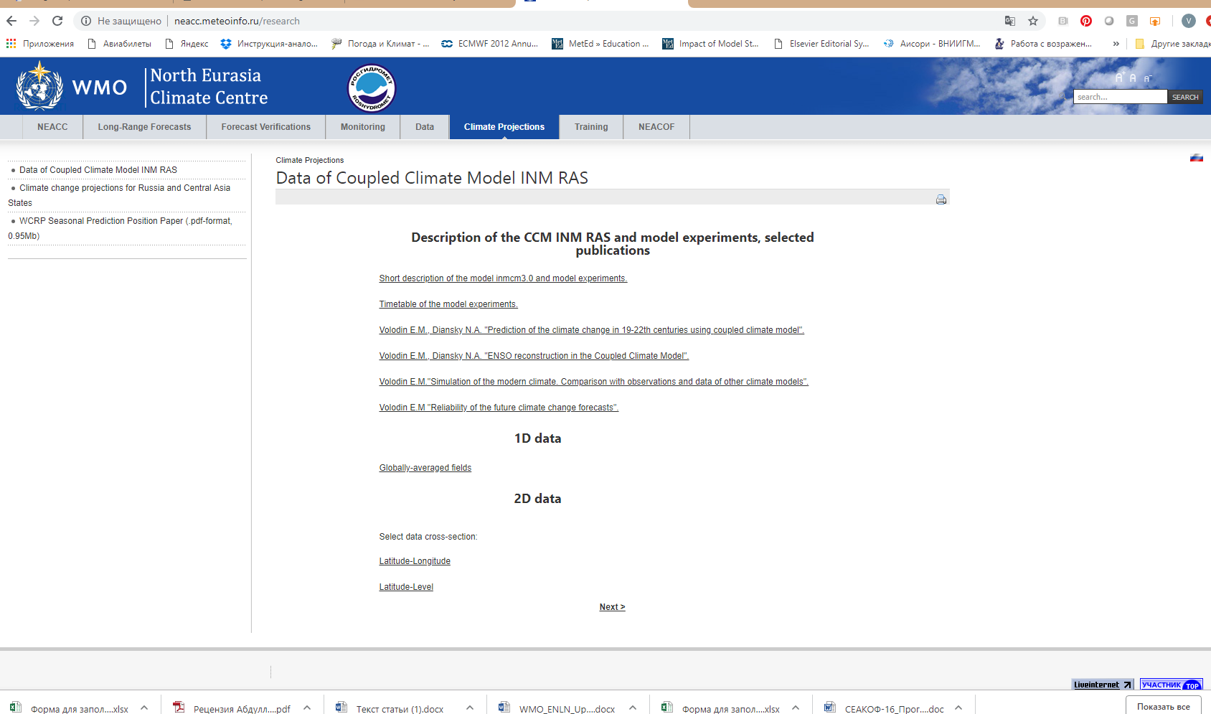
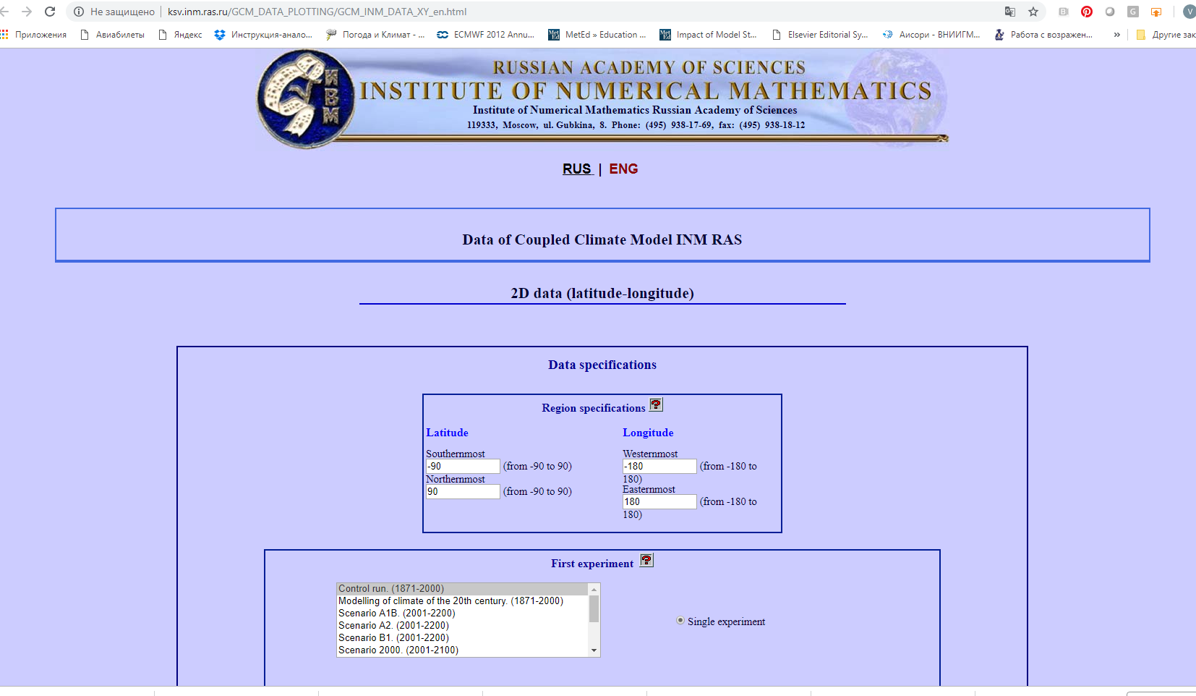
Availability of climate projections information and data through NEACC website

Slide 19
Training activities in LRF area

Slide 20
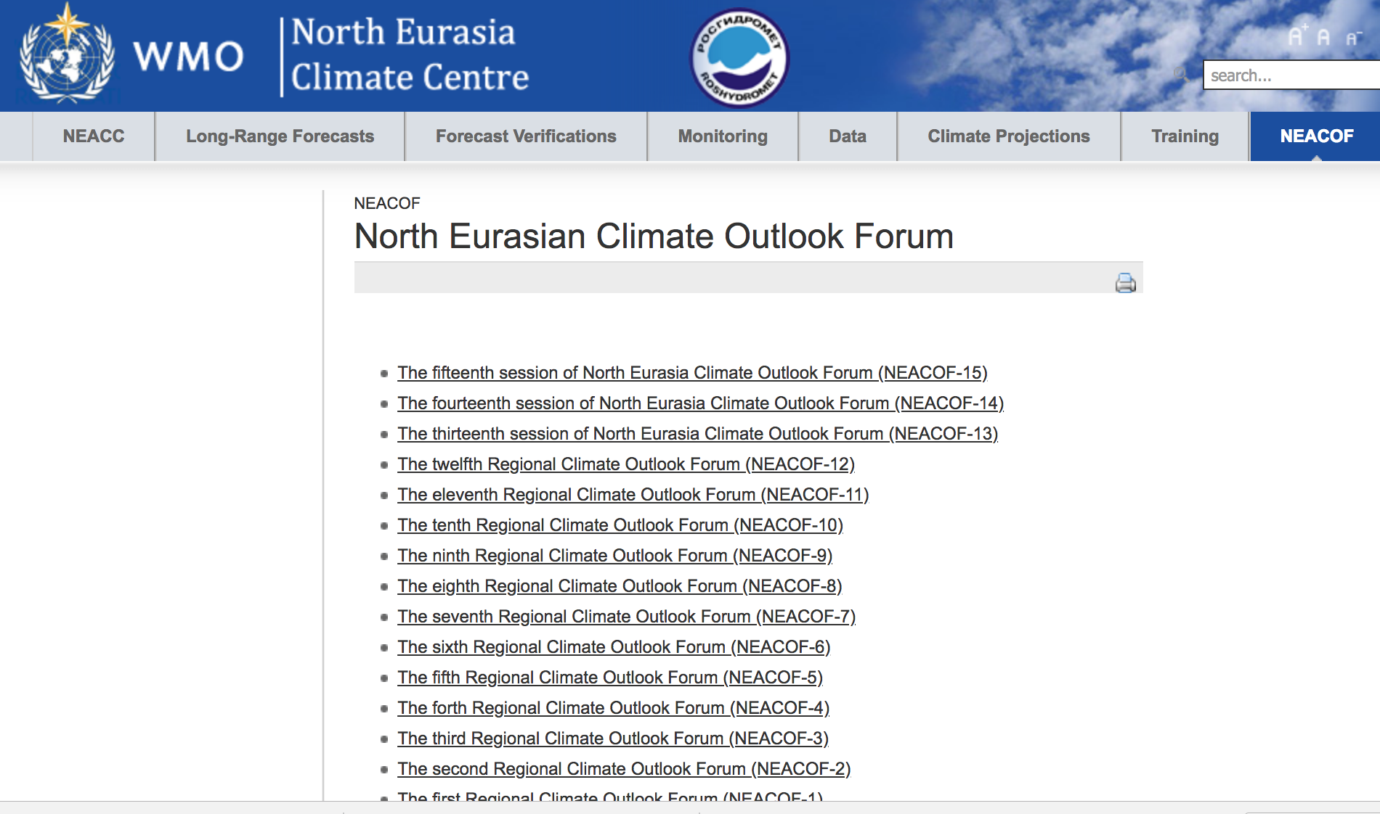

Mandatory Functions of NEACC on Training in the use of RCC products
Training courses on LRF topics (irregular);
Consultation of NHMSs for clarifications of seasonal forecasts in area of interest (upon request);
NEACOF sessions include training component (at regular time scale)

Slide 21
CST and NEACC Resources
CST )Climate Services Toolkit) is a suite of guidance, procedures and instructions, data, software tools, training resources, and examples for enabling climate services at global, regional, and national levels
The CST main target audience is National Meteorological and Hydrological Services and associated RCCs with end user beneficiaries represent by five GFCS priority sectors.
In collaboration with NEACC, CST will make regional recommendations for climate service tools
Training module of NEACOF-15 included CST overview
Feedbacks from participants of NEACOF-15 were collected
for improvement of CST functionality

Slide 22
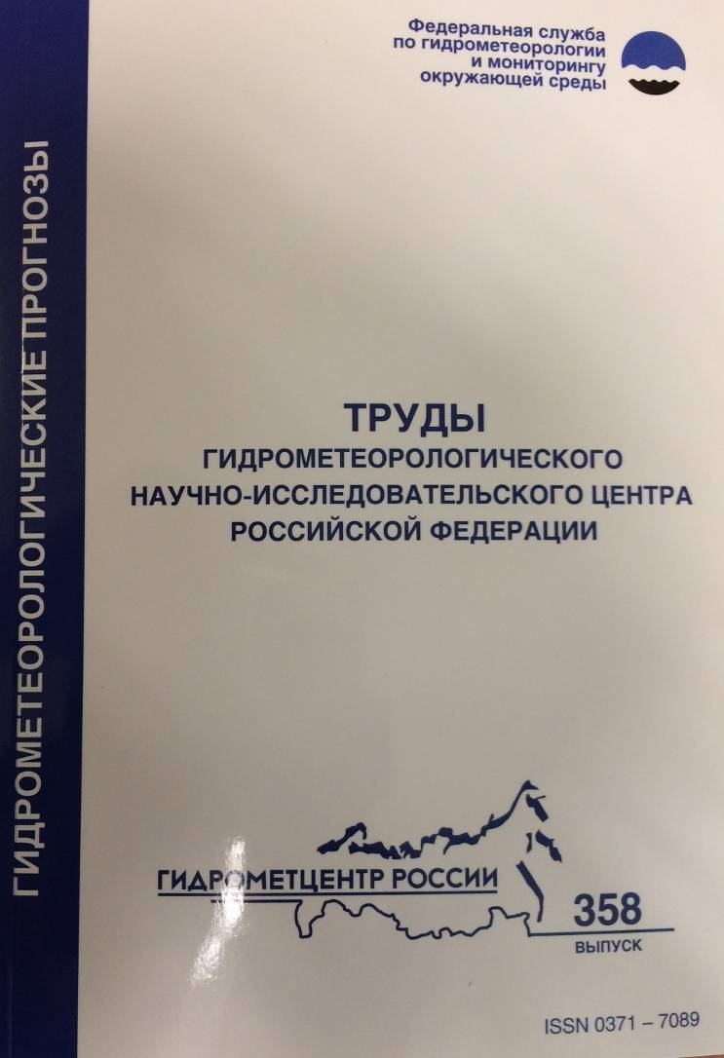
Materials of NEACOF session (research papers and technical notes) have been published in special issues of scientific-technical journal “Hydrometeorological Forecasting and Research ” (former “Trudy Gidrometcentra Rossii”)
The special volume with outcomes of NEACOF-15 held in November 2018 will be published in March 2019.
2016
2017

Slide 23

Upcoming training events
Main topic of the upcoming young scientist school is subseasonal to interannual prediction
Young specialists from NHMSs of CIS were preferentially selected for participation
(Armenia, Moldova, Kazakhstan, Kirgizstan, Tajikistan, Ukraine, Uzbekistan,)
The lectures will be given by WGSIP, ICTP, and IPET-RCA experts.
Effective collaboration of scientific and operational community
Followed the young scientist school the16 the session of NEACOF will be combined with CITIES-2019 and conducted as an parallel session during the Conference
http://indico.ictp.it/event/8739/ (school)
http://www.scert.ru/en/conferences/cites2019/ (conference and 16th session of NEACOF)
Welcome to participate in the CITIES-19 and NEACOF-16!

Slide 24
Way Forward
Keep making efforts on provision of new LRF products
Develop tool for production and verification of objective consensus forecasts
Continue LRF area research within Russian and international projects
Expand training activities in collaboration with academic and research communities
Facilitate use of CST for NHMSs within area of responsibility

Slide 25

Thank you for your attention!

