Slide 1


ArcRCC-N: briefs on Eurasian node
Vasily Smolyanitsky
Arctic and Antarctic Research Institute

Slide 2

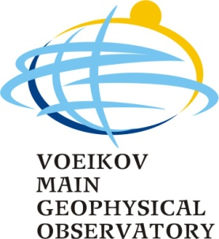

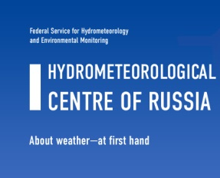
Implementation of ArcRCC-N Eurasian node
Implementation of the ArcRCC-N Eurasian node services continues to be conducted by a consortium of 4 Roshydromet institutions with following major functions:
  Arctic and Antarctic Research Institute (AARI), St.Petersburg, coordinator
    Monthly and seasonal monitoring for the basic parameters, studies of mechanisms of intra and interannual variability, mostly statistical LRF
  Hydrometcenter of Russia (RHMC), Moscow
    LRF forecasting, research for improvement of LRF quality, training, integration with NEACC and NEACOF
  Russian Institute for Hydrometeorological information – World Data Center (RIHMI-WDC), Obninsk
    Data management, integration with other data systems – INTAROS, national ESIMO, development of web-portal
  Main Geophysical observatory (MGO), St.Petersburg
    Monitoring of atmosphere chemistry, integration with longer scales, risk assessments and mitigation
Notes:
Далее будет представлена информация по специализации институтов и образцы информационной продукции.

Slide 3
ArcRCC-N in 2020 and further in 2020-2024
  Major events in 2020 include:
  2nd announcement of ARCOF during AARI 100 years jubilee conference 2-4 March 2020
  Support for ARCOF5 (May)
  Provision of extended summaries for ARCOF5,6 summaries
  Completion of web-portal, possibly integrated with other data-oriented projects (first draft by May ?)
  Input to WMO annual state of Climate in 2020 (Nov)
ArcRCC-N activities within the currently adopted Roshydromet research and development plan for 2020-2024 will be performed within several themes, including:
  support for WDCs activities (PI: RIHMI-WDC, AARI)
  support for planned AntRCC (AARI)
  development of climate services (PI: MGO, AARI)
  development of polar services (PI: AARI)
  development of numerical prediction (PI: RHMC)
Notes:
Далее будет представлена информация по специализации институтов и образцы информационной продукции.

