Slide 1

Arctic Polar Regional Climate Centre Network
Eurasian node
Vasily Smolyanitsky
Arctic and Antarctic Research Institute, St.Petersburg, Russia

Slide 2

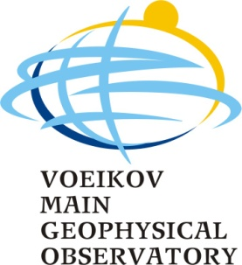

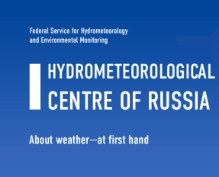
Implementation of ArcRCC-N Eurasian node
Implementation of the ArcRCC-N Eurasian node services is conducted by a consortium of 4 Roshydromet institutions, i.e. similar to existing NEARCC:
    Arctic and Antarctic Research Institute (AARI), St.Petersburg, coordinator
    Main Geophysical observatory (MGO),St.Petersburg
    Russian Institute for Hydrometeorological information – World Data Center (RIHMI-WDC), Obninsk
    Hydrometcenter of Russia (RHMC)
Notes:
Далее будет представлена информация по специализации институтов и образцы информационной продукции.

Slide 3
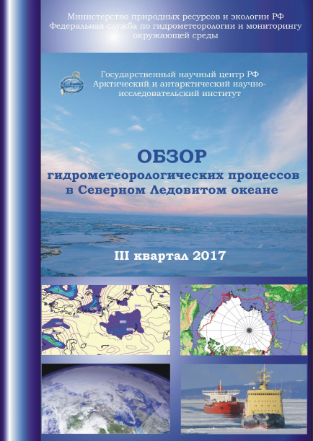
Planned content for pan-Arctic bulletin (by the end of demo-phase)
1 Meteorological conditions in the Northern Polar Region
1.1 Large-scale atmospheric processes
1.2 Meteorological parameters
2. Ice conditions and processes in the Arctic Ocean
2.1 Ice extent, concentration, SoD
2.2 Coastal fast ice
2.3 Ice drift
2.4 Fram Strait discharge
3 Oceanography
3.1 Temperature /salinity
3.2 Sea level
3.3 Wind waves
4. Land processes based on CryoNet
4.1 Glaciers
4.2 Permafrost
4.3 Rivers
Review
of hydrological and meteorological processes in the Arctic Ocean

Slide 4
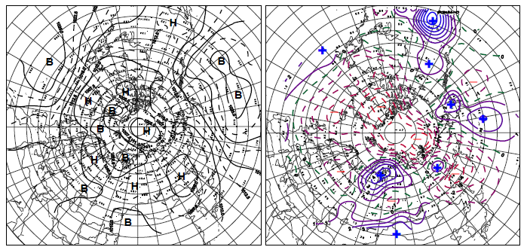
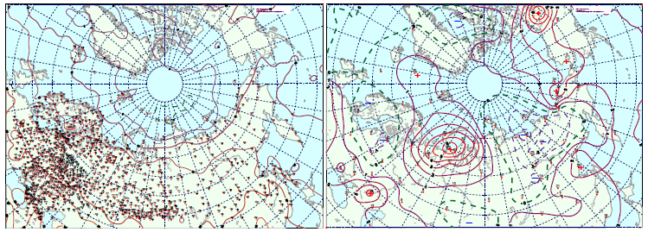
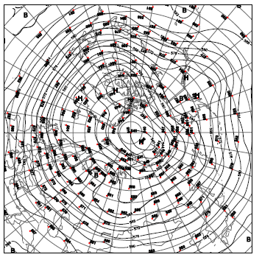
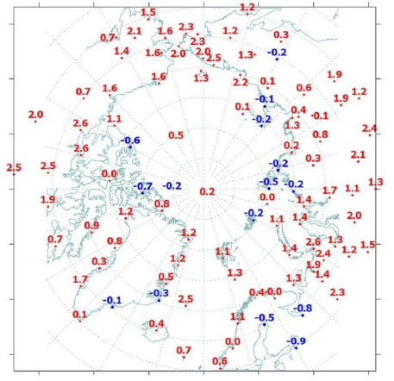
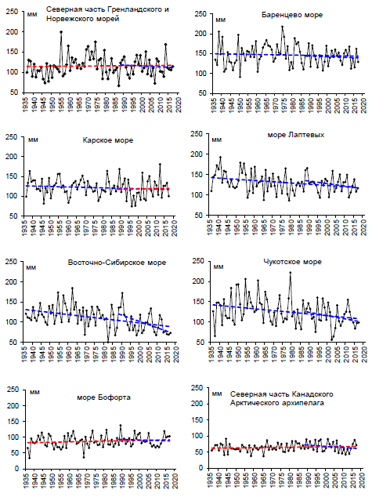
1 Meteorological conditions in the Northern Polar Region
Anomalies of SLP for….
Anomalies of surface Ta for….
Mean geopotencial at 500 gPa for….
Precipitation by regions for….
Anomalies of surface
Ta at stations for….
+ TEXT ….

Slide 5
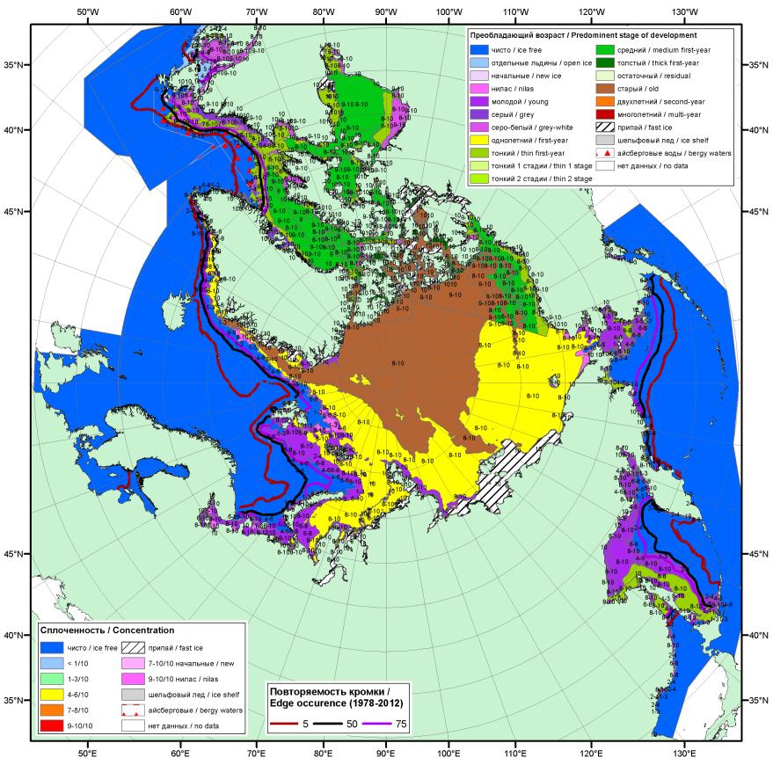
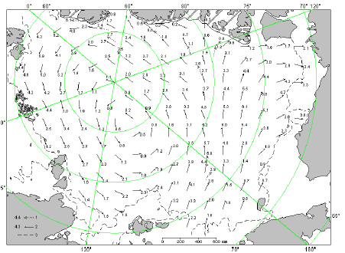
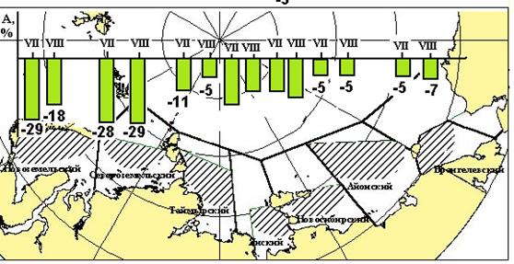
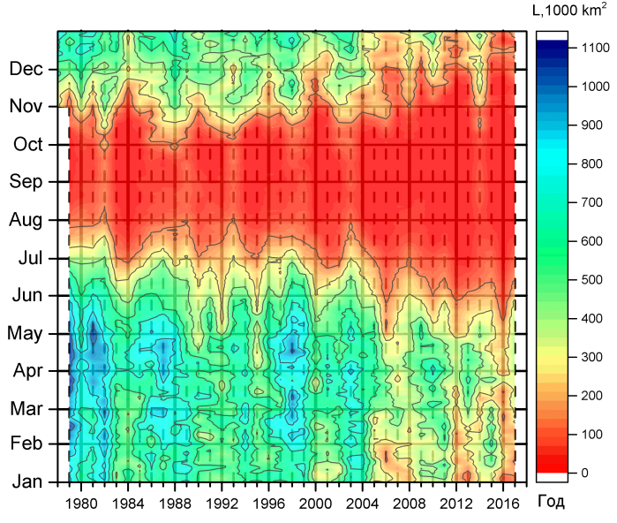
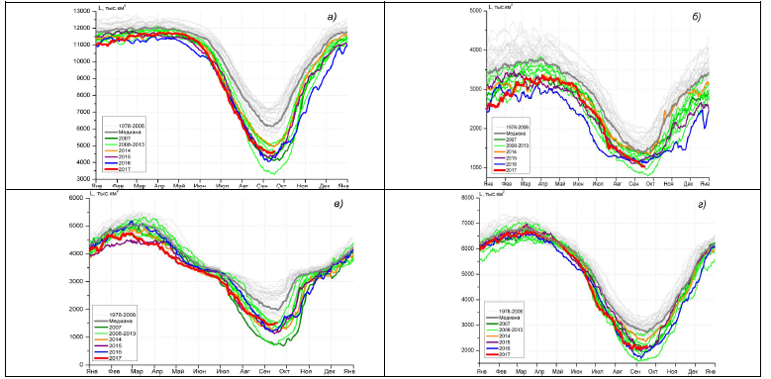
2 Ice conditions and processes in the Arctic Ocean
Ice drift
for….
Ice conditions for….
Anomalies of ….
Ice extent by sectors for….
Other parameters TBD….
+ TEXT ….

Slide 6
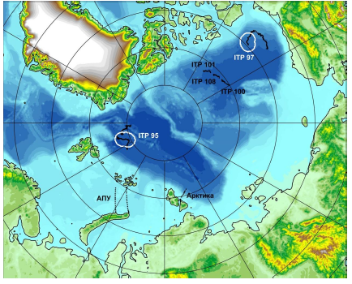
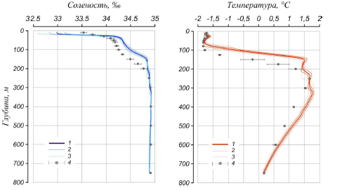
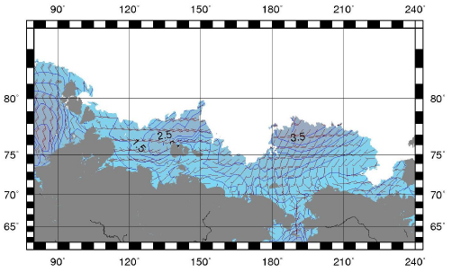
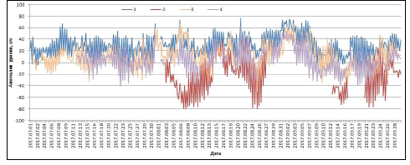
3 Oceanographic conditions in the Arctic Ocean
T,S profiles at …. for…
In-situ data used for…
waves and wind at …. for…
Sea level variations at …. for…
+ TEXT….

Slide 7
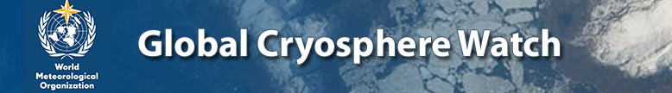
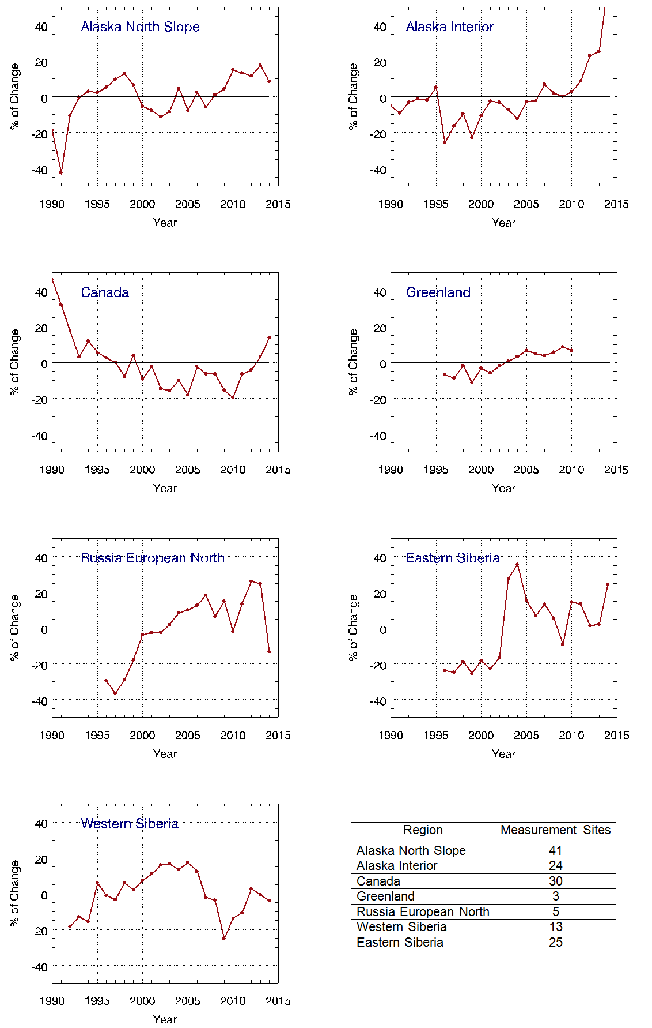
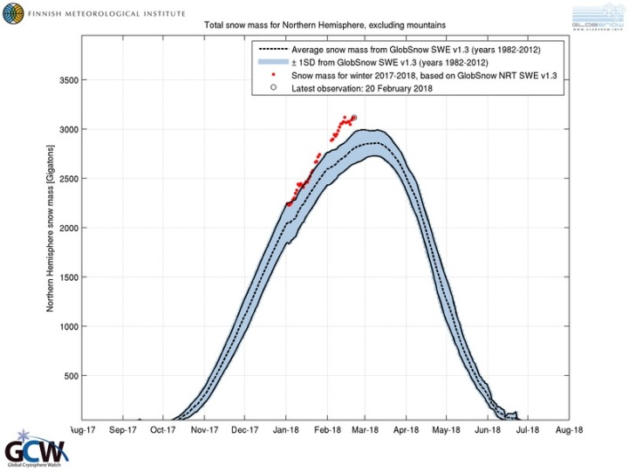
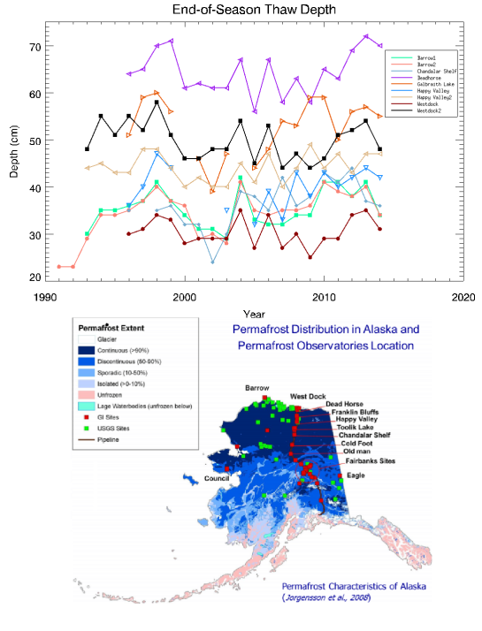
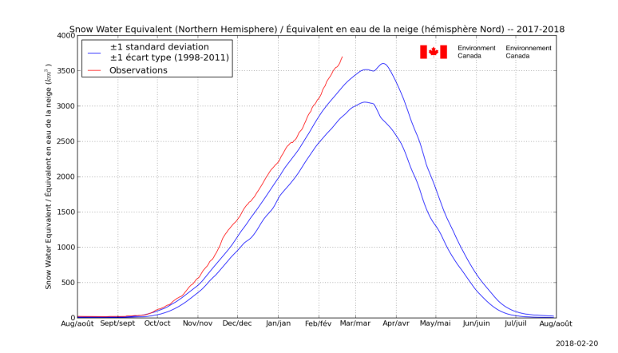
4 Permafrost
http://globalcryospherewatch.org/state_of_cryo/permafrost/
Percent Changes in active layer thickness (ALT) relative to the 1991-2014 average for 7 differeent Arctic regions. The lower right table documents the populations of measurement sites used to create corresponding time series.
+ TEXT ….

Slide 8
Content by spheres /parameters
Sphere | Parameter | Periodicity | Presentation | Year
Meteorology | SLP AT500 Tair Precipitation Freeze degrees Day Sum Snow extent Dangerous phenomena (wind?) | M, 3M, Y M, 3M, Y M, 3M, Y M, 3M, Y M, 3M, Y M, 3M, Y M, 3M, Y | chart, index chart, index chart, index chart table chart table | 2018 2019 2018 2018 2020 2020 ?
Sea Ice | Concentration/extent/edge Old ice / Stages of development Drift Fram Strait discharge Fast ice thickness/width | M, 3M, Y M, 3M, Y M, 3M, Y M, 3M, Y M, 3M, Y | chart, index chart Chart Index table | 2018 2018 2019 2020 2020 ?
Ocean | T/S profiles Waves Level | M, 3M, Y M, 3M, Y M, 3M, Y | graph chart table | 2020 ? 2020 ? 2020 ?
Land | Permafrost Fresh-water ice | 3M, Y M, 3M, Y | Table Table | 2020 ? 2020 ?
 | M – monthly, 3M – 3-monthly, Y – yearly

