Slide 1
Global RCC Review 2018: Outcomes
World Climate Applications and Services Division
Climate Prediction and Adaptation Branch
Climate and Water Department

Slide 2
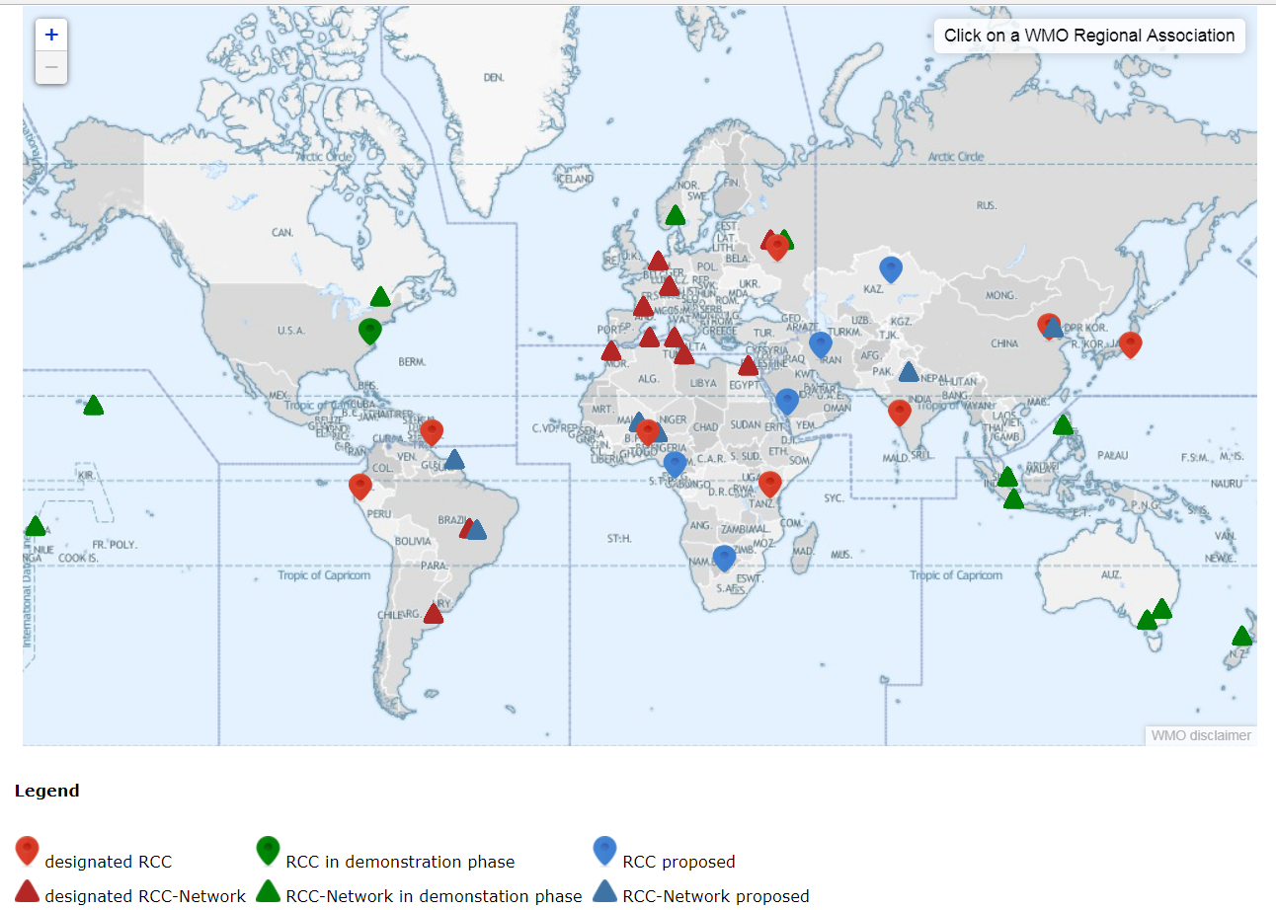
BACKGROUND
Major achievements of the operation of WMO RCCs/RCC-Networks
Formal RCC criteria and functions were established nearly a decade ago
Considerable developments and scientific advances in data, monitoring, forecasting
CCl-17 Resolution 3 - to work towards enhancing RCC operations and, inter alia, to revisit the mandatory and highly recommended functions
http://www.wmo.int/pages/prog/wcp/wcasp/rcc/rcc.php

Slide 3
Steps for designation of a WMO RCC or RCC-Network
RA considers Member requirements and agrees on an implementation plan
RA invites expressions of interest from Members/potential RCC applicants
The interested Member/org contacts P/RA re intent
P/RA considers criteria for designation, regional capabilities and needs; provides information; establishes contact with relevant experts in CCl and CBS
The candidate RCC or RCC node prepares – Demonstration Phase
When the candidate is deemed ready, P/RA informs P/CCl of steps followed and capability to meet requirements
On successful completion of demonstration phase, P/RA contacts WMO SG to request formal designation of the candidate, who will then consult with P/CCl; P/CCl is assisted by IPET-RCA in the assessment
Upon endorsement by P/CCl, WMO SG forwards request to P/CBS for action and demonstration of capability
CBS evaluates the application against designation criteria and recommends designation if criteria are met
WMO EC/Congress will consider approval of CBS recommendation; if approved, the manual will be amended, and the member/org informed.
1

Slide 4
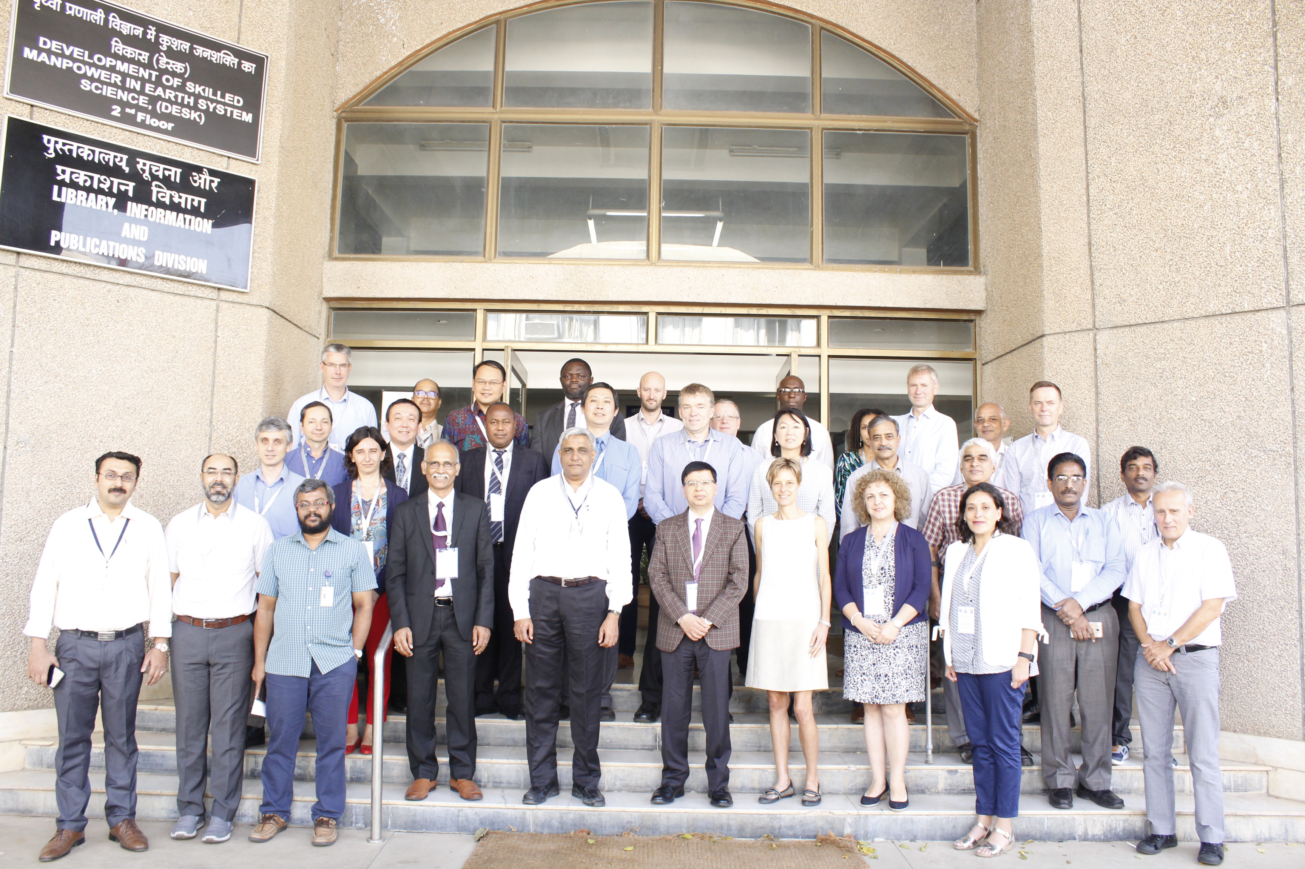
WMO RCC Review 2018 Workshop: Objectives
Share Experience
RCC status and lessons learnt
Operational arrangements and practices
Consider
Emerging climate topics of regional interest
Evolving user needs and technological advances
Review RCC functions
Propose revision/update to enhance quality and uptake
Explore ways to support CSIS Regional Approach
Linkages with GPCs
Optimize national support
WMO International Workshop on Global Review of RCC Operations
12 - 14 November 2018, Pune, India
Notes:
Some specific recommendations based on outcomes of break out group discussions presented in next slides

Slide 5
Key recommendations…
Global RCC Review 2018

Slide 6
Climate Data and Monitoring
Build NMHS capacity on methods and tools for integrated data rescue, quality control, data analysis and homogenisation
Promote regularly WMO data sharing policies in support to climate applications and services (e.g. Resolution 60 (Cg 17)) and provide guidance on good practice for data archival
Provide and promote consistent use of standard definitions of key parameters (e.g. for Climate Watch Advisories)
Provide standard normals of key climate parameters (relevant for all RCC functions)
Provide good practice guidance on use and assessment of global datasets including reanalysis
Utilise and promote the Climate Services Toolkit and assist in requirements collection for WIS 2.0 development

Slide 7
Climate Predictions and Projections
Downscale and/or customise GPC outputs in response to the needs of national and regional users, and make output model data sets available including raw data
Develop guidance on ‘mostly objective’ seasonal forecasts and ‘impact-based’ forecasts and document the selected methodology
Investigate the potential for sub-seasonal forecasts and products based on daily information
Provide guidance on reliable sources of climate change projections, assessments, use of scenarios etc.
Build own as well as NMHS capacities in climate model data access and processing
Consider becoming centres of excellence for specific functions, develop and share required expertise with other RCCs

Slide 8
Interface Mechanisms and Capacity Development
Gain endorsement from NMHS directors to ensure ‘buy-in’ and operational use of RCC products and services
Report status and progress annually to presidents of WMO RAs (with copy to appropriate subsidiary body, the Inter-Programme Expert Team on Regional Climate Activities and the RCC host institution) and invite president to share the report with all Permanent Representatives in the region
Frequently engage with NMHSs via teleconference, email, in-country visits, newsletters, thereby significantly strengthening the RCC – NMHS feedback process
Involve NMHSs in RCC strategic discussions and planning to ensure relevance
Support NMHSs in sector engagement and provide tailored products’ good practice, and consider developing regional-scale tailored products
Reformat RCOFs as Regional Climate Fora with a primary focus on building capacity through training and knowledge sharing

Slide 9
Use of Global Products and Standardisation
IPET RCA to develop guidance for RCCs
on global datasets selection and use, based on standard criteria
on optimal structure of RCC webpages, map projections, colour scale, etc.
IPET-OPSLS to develop guidance:
on good practices in the use of LRF products from GPCs, LCs and other centres including regionalisation
on methods of assessment of LRF skill
RCCs to consider strengthening or establishing connections with neighbouring RCCs and RCOFs
WMO to consider the formation of an Expert or Task Team on decadal forecast- and climate change services

Slide 10
Overarching Recommendations (1/2)
RCCs to facilitate access to digital data (not only in-situ observational data)
Consider explaining the meaning of ‘mandatory’ functions in the sense of minimum requirements for designation, thereby being the starting point for RCC functions that can be further developed according to regional needs
Mandatory functions being valid in general, they should be reviewed for some minor adjustments including in terms of consistency and in the light of the RCC Review 2018 recommendations
Provide more specific technical guidance for RCC mandatory and recommended functions
Raise awareness through publishing an article on RCC functions and role in developing climate services

Slide 11
Overarching Recommendations (2/2)
Make sure that implications of the WMO governance reform on RCC designation and operations are well understood and appropriately taken into account
Make sure that RCC Research and development needs are communicated to the appropriate bodies, e.g., WCRP/WGSIP and IPET-OPSLS
Consider regular RCC reviews and information exchange fora
IPET-RCA to explore and communicate opportunities for RCCs arising from Copernicus Climate Change Service (C3S) and Climate Services Toolkit
WMO Operational Climate Prediction workshops to include dedicated sessions for discussions on relevant RCC operational aspects

Slide 12
Thank you

