Slide 1
5th Arctic Climate Forum (ACF-5)
Arctic Regional Climate Center – network (ArcRCC-N)
27-28 May, 2020
Videoconferences
Summary version May 27th
Helge Tangen, ArcRCC-N coordinator,
Norwegian Meteorological Institute
Vasily Smolyanitsky, ArcRCC – N Northern Eurasia node coordinator (host)
Arctic and Antarctic Research Institute (AARI)

Slide 2
Key things on the forum
ACF is based on the Regional Climate Outlook Forum (RCOF) concept developed and supported by WMO in many regions around the world over the past two decades, as a key activity of WMO Regional Climate Centres (RCCs). WMO has established RCCs in many areas of the globe to fill geographical and service gaps in climate information, and to improve the collaboration and integration amongst National Meteorological and Hydrological Services (NMHS). The WMO, with active support from its Members in the Arctic region, has been making concerted efforts to implement an Arctic Regional Climate Centre Network (ArcRCC-N) to operationally provide climate scale (monthly and seasonal) circumpolar summary and outlook information for the key Arctic climate variables including temperature, precipitation and sea-ice for all of the Arctic. The ArcRCC-N includes 3 nodes (Nordic, North American, Northern Eurasia) supported by corresponding NMHS and has been in a demonstration phase since May, 2018
The key objectives of the current ACF-5 are to:
Develop the consensus statement on the current status (winter 2019/2020 – spring 2020) and future outlook (summer 2020) of the Arctic climate on a seasonal scale;
Raise awareness of end-users about new climate products and services for the Arctic, potential support to decision-making, and the current limitations;
Interact with end-users and learn about the climate information they currently use for planning, and their needs for climate information.

Slide 3
5th Arctic Climate Forum (ACF-5) videoconference - format
Schedule:
May 27th 2020, Wednesday, Day 1, 1600-1740 UTC, non-technical session, will present: key climate information from Winter/Spring 2019/20 and the Arctic Summer 2020 outlook for 8 regions in the Arctic (see ACF-5 draft as explanation); and the Consensus Statement (see ACF-5 draft as explanation) which provides an overall summary for the circumpolar Arctic;
May 28th 2020, Thursday, Day 2, 1600-1810 UTC, technical session, will provide greater detail on the Winter/Spring 2019/20 observations, and the modelled and consensus aspects of the temperature, precipitation and sea-ice information used to develop the ArcRCC products.
Following each session, the organizing committee will distribute summaries of key points
Recording – sessions will be recorded and available later at https://arctic-rcc.org/acf-spring-2020
Connection and session rules (same for 2 days):
16:00 UTC: https://bluejeans.com/431362831/9648?src=calendarLink
BlueJeans video conferencing software is available for desktops and smartphones 5-15 and is installed automatically by clicking the above link (better install 5-15 minutes in advance)
89 attendees registered – for stable and better performance, you are very kindly asked to turn off your video and mute microphone for most of the time of the sessions, unless you intend to speak – during the sessions only moderators will be unmuted by default
During the sessions use the BlueJeans “CHAT function” to ask the questions, pass comments to moderator, everyone or particular person or rise your hand for a question – all notes will be properly considered by the chair(s), moderator(s) or experts
Access to ArcRCC products and session ppts
All ArcRCC information (including the ACFs) is available at https://arctic-rcc.org/
Fast access to ACF-5 information (ppts, pdf, docs) is organized at http://wdc.aari.ru/acf5/

Slide 4
ACF-5 Non-Technical Regional Briefing Agenda Wednesday May 27, 2020, 16:00 – 17:40 UTC To determine your local time go to: https://www.timeanddate.com/worldclock/timezone/utc Intended Audience: Users interested in general climate conditions and forecasts for their region
TIME | ITEM | DETAILS
16:00 (10’) | Welcome Introduce the Arctic Climate Virtual Forum, Agenda for next two days Format, how to ask questions and make comments using the chat function. Where to find the ArcRCС products and ppts | Vasily Smolianitsky, Arctic and Antarctic Research Institute (AARI), Russia
16:10 (10’) | Background on the ArcRCC-Network (ppt, pdf) | Helge Tangen, ArcRCC Network Coordinator Norwegian Meteorological Institute (NMI)
16:20 (20’) | ArcRCC Non-technical regional climate briefing: Temperature, precipitation and sea-ice conditions North America (Alaska, Canada), Europe and Eurasia and Central Arctic - Review of winter 2019/2020, spring 2020 and Outlook for Summer 2020 (ppt, pdf) | Rick Thoman (Alaska), International Arctic Research Center (IARC), Alaska Gabrielle Gascon (Canada), Environment and Climate Change Canada (ECCC) Halldór Björnsson (Europe), Icelandic Meteorological Office (IMO) Valentina Khan (Eurasia and Central Arctic), Hydrometcenter Moscow (HMC)
16:40 (15’) | On-line discussion (with end-users): What impacts did your region face with changing climate conditions in winter 2019/20 and spring 2020? | Rick Thoman (moderator), IARC
16:55 (15’) | On-line discussion (with end-users): Based on the summer 2020 outlook, what other potential risks were not highlighted that could affect your region? | Bill Appleby (moderator), ECCC
17:10 (10’) | ArcRCC Consensus Statement for the Arctic: What it is and how it’s created (ppt, pdf) | Eivind Støylen, NMI
17:20 (20’) | Questions & Wrap-up | Vasily Smolyanitsky, AARI
17:40 | End of the day

Slide 5
ACF-5 Technical Regional Briefing Agenda Thursday May 28, 2020, 16:00 – 18:10 UTC To determine your local time go to: https://www.timeanddate.com/worldclock/timezone/utc Intended Audience: Users interested in specifics of the climate observations and models
TIME | ITEM | DETAILS
16:00 (10’) | Welcome Introduce the Arctic Climate Virtual Forum Brief review of yesterday’s agenda Format, how to ask questions and make comments Where to find the ArcRCС products and presentations | Vasily Smolianitsky, AARI
16:10 (20’) | Arctic winter 19/20 and spring 2020 Seasonal Summary: Temperature, precipitation, sea-ice , ocean, land hydrology Review of observational and reanalysis data | Vasily Smolyanitsky, AARI Gabrielle Gascon, ECCC
16:30 (5’) | Using INTAROS project results for ArcRCC Northern Eurasia node: Access to seasonal summary data (ppt, pdf) | Evgeny Vyazilov, RIHMI-WDC, Obninsk
16:35 (15’) | On-line discussion (with end-users) | Shanna Combley (moderator) U.S. National Weather Service (NWS)
16:50 (20’) | Temperature and Precipitation Introducing the multi-ensemble method Validation of the outlook for winter 19/20 and spring 2020 Review of model confidence for summer 2020 outlook | Marko Markovic, ECCC
17:10 (15’) | On-line discussion (with end-users) | Valentina Khan (moderator), HMC Moscow
17:25 (20’) | Sea-Ice Outlook for Summer 2020 Introducing the models Validation of outlook for winter 19/20 and spring 2020 Review of model confidence for summer 2020 outlook | Scott Weese, ECCC
17:45 (15’) | On-line discussion (with end-users) | Vasily Smolyanitsky (moderator), AARI Scott Weese (moderator) ECCC
18:00 (5’) | Final thoughts & Wrap-up | Vasily Smolianitsky, AARI Helge Tangen, ArcRCC Network coordinator Anahit Hovsepyan, WMO
18:10 | End of ACF-5

Slide 6
Introducing the
Arctic Regional Climate Centre Network
(ArcRCC-N)
https://www.arctic-rcc.org/
Helge Tangen
Norwegian Meteorological Institute
ArcRCC Network Coordinator
Arctic Climate Forum-5, May 27-28, 2020

Slide 7
Welcome to Arctic Climate Forum number 5 ACF-5
A forum for Arctic Regional Climate Centre Network to meet stakeholders and users
Usually: Every spring a face-to-face meeting, this spring converted to online meeting
Every fall a virtual meeting - like this one

Slide 8
What’s the difference?
Weather
Conditions of the atmosphere over a short period of time
Reported in terms of hours and days for a city, town, region
It answers these questions
What is the temperature right now?
Will I need a coat this afternoon?
Will it snow this weekend?
Climate
Average weather of a place over period of many years
Tells us what’s normal for an area.
It answers these questions
What is an average winter like in Ottawa?
Was 2015 the warmest summer on record?
Will Tromsø have above normal temperatures this summer?
Climate is what you expect, weather is what you get
(sources: NOAA, NSIDC and WMO and websites)

Slide 10
The Arctic Regional Climate Centre
NATIONAL |  | REGIONAL |  | CIRCUMPOLAR
Countries | Meteorological Organizations | Regional Climate Centres (RCCs) |  | Arctic Regional Climate Centre
United States | NOAA | North American Node | Forecasting
Canada | ECCC
Denmark | DMI | Northern European / Greenland Node | Data Services
Iceland | IMO
Norway | NMI
Sweden | SMHI
Finland | FMI
Russia | AARI | Northern Eurasia Node | Monitoring
Collaboration/Networking across Arctic regional nodes and Meteorological Organizations
Notes:
The Arctic PRCC-Network falls across three of the WMO Regional Associations, Asia, Europe and North America.
The participating nations are the 8 Arctic Council states
The structure for the Arctic PRCC-Network will be on two levels.
Each Regional Association (node) will perform all mandatory functions for the countries in its domain:
Canada will lead the North American Node (Canada and USA);
Norway will lead the Northern Europe and Greenland Node (Denmark, Finland, Iceland, Norway, and Sweden); and
the Russian Federation will lead the Eurasian Node, see Figure 1.
4th mandatory function is training that is shared across the Nodes

Slide 11
ArcRCC Products
produced each May and October
Arctic Consensus Statement:
Text and graphics that summarize the temperature, precipitation and sea-ice climate trends for the past season and forecasts for the upcoming season. A collaborate effort by the network in reviewing:
Trends in the historical monitoring data
Forecasts from the models
Using Met/Ice climate expertise, fill gaps in the data
https://arctic-rcc.org/consensus-statements
Regional Summaries
The same information that is in the consensus statement but organized by Arctic region and added information about potential impacts to regional users.

Slide 12
How is this information different than?
The Arctic Council’s Arctic Monitoring and Assessment Programme (AMAP)
i.e. the Snow Water Ice and Permafrost Assessment (SWIPA) report discusses trends and future predictions, updated once every 5-6 years
National Snow and Ice Data Centre –Arctic Report Card
Annual Summary of the Arctic climate over the past year
ArcRCC products are ongoing operational Arctic climate summary and forecast products that are updated every Winter and Summer
Notes:
Hand off to John to explain the PARCOF

Slide 13
Thank you!

Slide 14
Arctic Climate Forum May 2020 Non-Technical Review: Summary of Winter 2020 and Outlook for Summer 2020
Arctic Regional Climate Center

Slide 15
Temperature and Precipitation Terrestrial Regions
North America Node
Alaska: Includes the Yukon and the Northwest Territories
Canadian: Central and Eastern Canada and Western Greenland
European Node
Atlantic: Western Greenland, Iceland, Svalbard and Scandinavia
European
Eurasian Node
Western Siberian
Eastern Siberian
Chukchi
Central Arctic

Slide 16
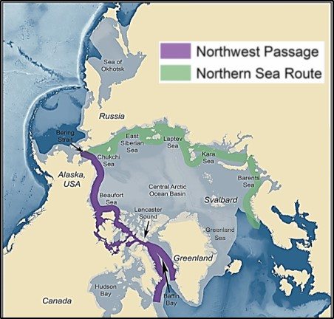
Sea-Ice Navigational Regions
Sea-Ice Regions. Map Source: Courtesy of the U.S. National Academy of Sciences.

Slide 17
How this summary was developed
Available observations +
State of the art modeling for temperature, precipitation and sea-ice +
Adjustments based on regional expertise at Arctic meteorological organizations =
Information about potential impacts for regional users.
*As a result, the regional outlooks may not always match the model output

Slide 18
North American Node

Slide 19
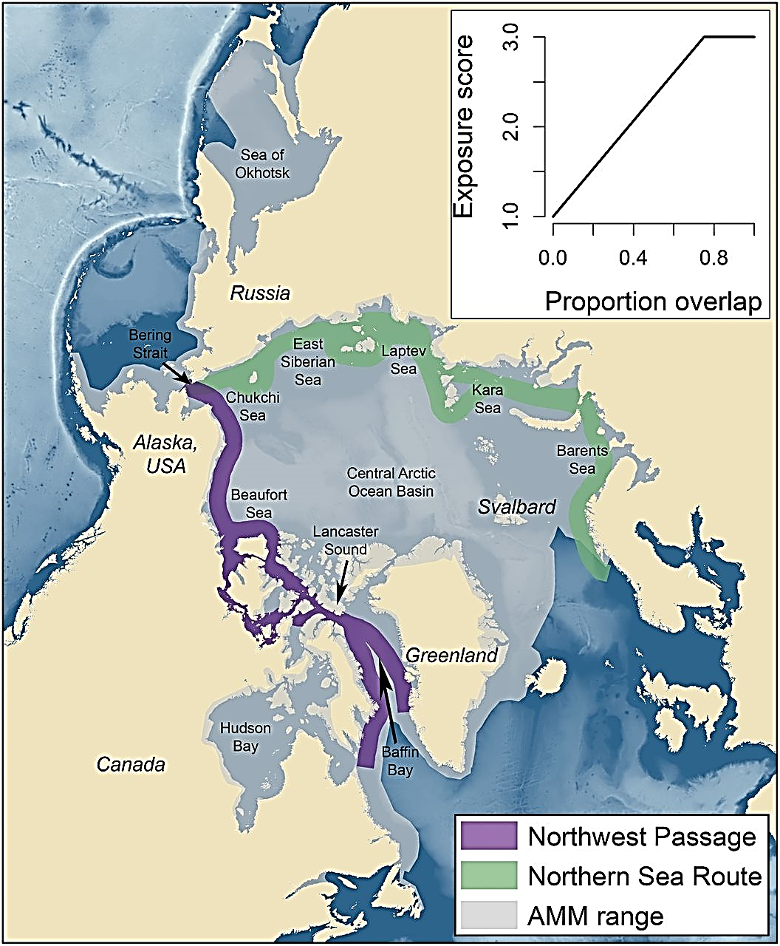
Alaska Includes the Yukon and the Northwest Territories
Seasonal Summary: Winter 2019 & Spring 2020
Observations above (+) and below (-) normal
Temperature Normal 1961-1990 | Near normal in Alaska, Yukon and the NWT | Warmest year was 2004 (+2.9˚C) | Coldest years were 1945 & 1955 (-1.3˚C)
Precipitation Normal 1961-1990 | Wetter in Alaska, Yukon and the NWT | Wettest year was 1951 (+65 %) | Driest year was 1968 (-46 %)
Sea-Ice Since 1979 | March maximum sea-ice extent: Normal for the Bering sea Chukchi and Beaufort seas were ice covered
Outlook: June, July August (JJA) 2020 |  |  |  | Multi Model Agreement
Forecast |  |  |  | High | Moderate | Low
Temp * | Bering Sea, Northern Alaska |  | Warmer | ✓
 | Western, coastal and continental Alaska, Yukon, Northwest Territories |  |  |  | ✓
 | Beaufort Sea |  | No forecast | No agreement
Precip * | Chukchi and Beaufort seas |  | No forecast | No agreement
 | Northern Northwest Territories |  | Drier |  |  | ✓
 | Bering sea |  | Wetter |  |  | ✓
 | Yukon, Alaska
Sea-Ice | Break-up | Chukchi Sea | Earlier | ✓
 |  | Western Beaufort Sea |  | ✓
 |  | Bering Sea |  |  | ✓
 | Min. Ice Extent Sept 2020 | Chukchi Sea | Below normal | ✓
 |  | Beaufort Sea
 |  |  |  |  | ✓
Greenland Sea

Slide 20
Alaska & Western Canada
Risks and Impacts
Wildfires: Above normal temperatures may increase the threat of larger than typical wildfires.
River Flooding: Above normal precipitation may increase the threat of river flooding in Alaska and the Yukon.
Coastal Erosion and Flooding: Below normal sea ice extent in the Chukchi Sea may result in longer open water fetch and will greatly enhance erosion and the increase the risk of coastal flooding from late summer storms on unprotected west facing coasts of Alaska.
Wildlife: Warmer summer temperatures increases the chances of negative impacts on fish, especially salmon that can not tolerate warm water once they enter fresh water rivers.
Hunting: Early sea ice loss may result in an a shorter seasons for sea ice-based subsistence hunting activities.
Shipping:
Early observations are already showing minimal sea-ice in the Bering Sea earlier than normal shipping activities are expected.
Early sea-ice break-up in the Beaufort Sea region may result in areas of old ice becoming become mobile earlier in the season increasing shipping hazards.

Slide 21
Canada Includes central and eastern Canada and Western Greenland
Seasonal Summary: Winter 2019 & Spring 2020
Observations above (+) and below (-) normal
Temperature Normal 1961-1990 | Near to below normal | Warmest year was 2012 (+2.3˚C) | Coldest year was 1972(-1.6˚C)
Precipitation Normal 1961-1990 | Near normal in Nunavut’s Qikiqtaaluk region Drier in Nunavut’s Kitikmeot and Kivalliq regions, Nunavik and Nunatsiavut | Wettest year was 2005 (+23.5 %) | Driest year was 1977 (-25 %)
Sea-Ice Since 1979 | March maximum sea-ice extent: Below to near normal in the Gulf of St. Lawrence and Labrador sea. All other areas ice covered
Outlook: June, July August (JJA) 2020 |  |  |  | Multi Model Agreement
Forecast |  |  |  | High | Moderate | Low
Temp | Western Greenland |  | Warmer | ✓
 | Nunatsiavut, Nunavik, Nunavut |  |  |  | ✓
 | Baffin Bay, Davis Strait, Hudson Strait, Labrador Sea
 |  |  |  |  | ✓
 | Western Hudson Bay, Eastern Hudson Bay |  | Colder to Normal |  | ✓
Precip | Nunavut Qikiqtaaluk region, northern Hudson Bay, Foxe Basin, Western Greenland |  | Wetter |  |  | ✓
 | Northeast Nunavik and Nunatsiavut (Torngat Mountains region), Labrador |  | Drier |  |  | ✓
 | Nunavut Kitikmeot and Kivalliq regions, Baffin Bay, southern Hudson Bay, Labrador Sea |  | No Forecast | No Agreement
Sea-Ice | Break-up | Baffin Bay, Davis Strait, Labrador Sea | Earlier | ✓
 |  | Western Hudson Bay | Near normal |  | ✓
 |  | Eastern Hudson Bay | Later |  | ✓
 | Min Ice Extent Sept 2020 | Canadian Arctic Archipelago | Below normal |  | ✓
Greenland Sea

Slide 22
Central and Eastern Canada, Western Greenland
Risks and Impacts
Wildfires: Above-normal temperatures and drier than normal conditions forecasted for Labrador may lead to an increased threat of wildfires
River flooding:
Wetter conditions forecasted may increase the threat of river flooding in Nunavut’s Qikiqtaaluk region.
Below-normal snowfall throughout the winter and spring should reduce the risk of flooding this year in Labrador.
Wildlife: Wetter conditions forecasted may lead to increased freezing rain in the early summer affecting wildlife foraging in Nunavut’s Qikiqtaaluk region.
Hunting: Early sea-ice loss may result in a shorter season for sea ice-based subsistence hunting activities.

Slide 23
Shipping
Northwest Passage: light ice conditions may be experienced in the southern route of the Northwest Passage in August and in the northern route by early September. However, light ice conditions may allow old ice from the Canadian Arctic Archipelago to become mobile earlier in the season increasing navigation risks.
Hudson Bay:
Faster than normal sea ice break-up is currently underway in Hudson Strait with significant areas of open water expanding in the northern portion of the strait.
Near normal break-up is expected for western Hudson Bay.
Later than normal break-up is expected for eastern Hudson Bay. Thicker ice coverage along with colder temperatures forecasted could lead to a more challenging navigation season in the eastern half of Hudson Bay.
Baffin Bay: light ice conditions may be experienced in Baffin Bay and no specific hazards are anticipated. The presence of an ice bridge in Nares Strait well into the spring normally cuts off the inflow of old ice from the Arctic Ocean into northern Baffin Bay, limiting the import of old ice into the region.
Labrador Coast: ice coverage along the Labrador coast has been normal throughout the winter and spring showing near normal ice extent but lower concentrations. Break-up in Lake Melville is expected to be normal.

Slide 24
Nordic Node

Slide 25
Atlantic
Seasonal Summary: Winter 2019 & Spring 2020
Observations above (+) and below (-) normal
Temperature Normal 1961-1990 | Warmer in Scandinavia All other regions normal | Warmest year was 2003 (+1.9˚C) | Coldest year was 1965 (-0.7˚C)
Precipitation Normal 1961-1990 | Wetter in Iceland and Norway Drier eastern Greenland and Svalbard All other regions normal | Wettest year was 1964 (+20.5%) | Driest year was 1968 (-24.9%)
Sea-Ice Since 1979 | March maximum sea-ice extent: Greenland sea Below to near normal
Outlook: June, July August (JJA) 2020 |  |  |  | Multi Model Agreement
Forecast |  |  |  | High | Moderate | Low
Temp | Southern Greenland |  | Warmer | ✓
 | Svalbard, northern and continental Greenland and Baltic sea |  |  |  | ✓
 |  |  |  |  |  | ✓
 | Iceland, Scandinavia
 | North Atlantic |  | Colder | ✓
 | Greenland and Norwegian seas |  | No Forecast | No Agreement
Precip | North Atlantic, North sea and southern Baltic sea |  | Drier |  |  | ✓
 | Norwegian and southern Baltic seas, continental Greenland, Iceland, and Scandinavia |  | No Forecast | No Agreement
Sea-Ice | Break-up | Greenland Sea | Later |  | ✓
 | Min Ice Extent Sept 2020 |  | Above Normal | ✓
Greenland Sea

Slide 26
Atlantic
Risks and Impacts
Wildfires:
Warmer temperatures and drier than normal conditions forecasted for Scandinavia indicates a potential for Wildfires, although the forecast agreement is low.
Trends in land cover in Iceland resulting from long term warming are increasing the risk of wildfires associated with droughts, with one large event so far this spring.
Flooding:
Late warming and large amounts of snow accumulation indicates a high risk of floods for inland Norway.
A combination of above normal snow accumulation and a late melt season in the highlands of northern Iceland may result in a greater risk for flooding in the coming weeks.
Permafrost: The continued trend of warmer temperatures in Svalbard leads to the thawing of the permafrost, resulting in a greater risk of landslides which may impact stability of some structures. In general this risk is also increasing in Iceland and Scandinavia due to recent warming trends

Slide 27
Atlantic
RiskS and Impacts Continued…
Wildlife / Hunting: Prolonged thick snow cover in Northern Scandinavia / Lapland may impact Reindeer not reaching the lichen that is under the snow cover.
Shipping:
Svalbard: Warmer conditions and generally near normal sea-ice around the Svalbard region may indicate normal shipping activities in this region.
Iceland: Sea-ice concentrations are unusually low in the Denmark Strait even though the marginal ice zone (MIZ) extent is near normal. The extent of the MIZ extent may pose a risk to shipping.

Slide 28
European
Seasonal Summary: Winter 2019 & Spring 2020
Observations above (+) and below (-) normal
Temperature Normal 1961-1990 | Warmer for the entire region | Warmest year was 2013 (+2.8˚C) | Coldest year was 1969 (-1.6˚C)
Precipitation Normal 1961-1990 | Wetter for the entire region | Wettest year was 1981 (+28 %) | Driest year was 1980 (-32 %)
Sea-Ice Since 1979 | March maximum sea-ice extent: Barents sea below normal
Outlook: June, July August (JJA) 2020 |  |  |  | Multi Model Agreement
Forecast |  |  |  | High | Moderate | Low
Temp | Southern Barents Sea |  | Warmer | ✓
 | Murmansk/White Sea/Continent |  |  |  |  | ✓
 | Northern Barents Sea |  | No forecast | No agreement
Precip | Entire Region |  | No forecast | No agreement
Sea-Ice | Break-up | Northern Barents sea | Later | ✓
 | Min Ice Extent Sept 2020 |  | Above Normal |  |  | ✓
Greenland Sea

Slide 29
Eurasian Node

Slide 30
Western Siberia
Seasonal Summary: Winter 2019 & Spring 2020
Observations above (+) and below (-) normal
Temperature Normal 1961-1990 | Warmer for the entire region | Warmest year was 2016 (+3.6˚C) | Coldest year was 1968 (-1.6˚C)
Precipitation Normal 1961-1990 | Wetter for the entire region | Wettest year was 2002 (+ 22.6 %) | Driest year was 1946 (- 27.6 %)
Sea-Ice Since 1979 | March maximum sea-ice extent: Kara Sea, ice covered
Outlook: June, July August (JJA) 2020 |  |  |  | Multi Model Agreement
Forecast |  |  |  | High | Moderate | Low
Temp | Western Kara Sea |  | Warmer | ✓
 | Continent |  |  |  | ✓
 | Eastern Kara Sea |  |  |  |  | ✓
Precip | Continent |  | Wetter |  |  | ✓
 | Barents sea, Murmansk coast |  | No forecast | No agreement
Sea-Ice | Break-up | Kara Sea West | Early | ✓
 |  | Kara Sea East | Near normal |  | ✓
 | Min Ice Extent Sept 2020 | Kara Sea | Below Normal | ✓
Greenland Sea

Slide 31
Western Siberia
Risks and Impacts
Wildfires: A risk of forest fires is possible in the State reserve "Verkhne-Tazovsky” region at the beginning of the summer due to above normal temperatures and below normal precipitation forecasted in the north of West Siberia.
Flooding: The threat of river flooding in Ob’ and Yenisei is uncertain.
Coastal Erosion: Forecasted high temperatures may lead to continued permafrost degradation and coastal erosion.
Wildlife/Hunting: The reduction in the sea-ice extent and permafrost degradation in tundra may create difficulties for “keystone” species, e.g. polar bears, caribou, whales etc.
Shipping: Shipping in the Northwest Passage from west to east is expected to start earlier than normal with safe and easy ice conditions for independent navigation of large-capacity tankers, gas carriers and bulk vessels. However, above normal temperatures may increase the number of icebergs due to glacier calving in the Islands Novaya Zemlya and Severnaya Zemlya, creating navigation hazards.

Slide 32
Eastern Siberia
Seasonal Summary: Winter 2019 & Spring 2020
Observations above (+) and below (-) normal
Temperature Normal 1961-1990 | Warmer for the entire region | Warmest year was 2019 (+2.9˚C) | Coldest year was 1989 (-1.2˚C)
Precipitation Normal 1961-1990 | Wetter for the entire region | Wettest year was 1988 (+25.2%) | Driest year as 1967 (-21.6%)
Sea-Ice Since 1979 | March maximum sea-ice extent: Laptev sea, ice covered
Outlook: June, July August (JJA) 2020 |  |  |  | Multi Model Agreement
Forecast |  |  |  | High | Moderate | Low
Temp | Laptev sea and continental regions |  | Warmer |  | ✓
Precip | Laptev Sea and Continent |  | Wetter |  |  | ✓
Sea-Ice | Break-up | Laptev Sea | Early |  |  | ✓
 | Min Ice Extent Sept 2020 |  | Below Normal | ✓
Greenland Sea

Slide 33
Eastern Siberia
Risks and Impacts
Wildfires: A risk of forest fires is possible for the northwest of Yakutiya region at the beginning of the summer due above normal temperatures and below normal precipitation forecasted.
Flooding: The threat of flooding of main Arctic rivers (Lena, Yana, Indigirka, Kolyma) is uncertain.
Coastal Erosion: Forecasted high temperatures may lead to continued permafrost degradation and coastal erosion.
Wildlife/Hunting: The reduction in the sea-ice extent and permafrost degradation in tundra may create difficulties for “keystone” species, e.g. polar bears, caribou, whales etc.
Shipping: Shipping across the Northern Sea Route is expected to be start earlier than normal with safe and easy ice conditions for the independent navigation of large-capacity tankers, gas carriers and bulk vessels. The navigation season on estuaries of main Arctic rivers (Lena, Yana, Indigirka, Kolyma) for cargo delivery by vessels type “river-sea” will start earlier.

Slide 34
Chukchi
Seasonal Summary: Winter 2019 & Spring 2020
Observations above (+) and below (-) normal
Temperature Normal 1961-1990 | Warmer to near normal | Warmest year was 2007 (+2.9˚C) | Coldest year was 1949 (-1.3˚C)
Precipitation Normal 1961-1990 | normal | Wettest year was 1954 (+39.6 %) | Driest year was 1982 (-39.8%)
Sea-Ice Since 1979 | March maximum sea-ice extent: Sea of Okhotsk – Below to near normal Chukchi sea, ice covered
Outlook: June, July August (JJA) 2020 |  |  |  | Multi Model Agreement
Forecast |  |  |  | High | Moderate | Low
Temp | Bering sea |  | Warmer | ✓
 | Eastern and Southern continental regions |  |  |  | ✓
 | Eastern Siberian Sea, Chukchi sea, Northern continental regions |  |  |  |  | ✓
Precip | Bering Sea and continental regions |  | Wetter |  |  | ✓
 | Eastern Siberian Sea, Chukchi sea |  | No forecast | No agreement
Sea-Ice | Break-up | Chukchi Sea | Early | ✓
 |  | East Siberian |  |  |  | ✓
 | Min Ice Extent Sept 2020 | Chukchi Sea | Below Normal | ✓
 |  | East Siberian |  |  | ✓
Greenland Sea

Slide 35
Chukchi
Risks and Impacts
Wildfires: Due to above normal precipitation forecasted wildfires are not expected
Flooding: Above normal precipitation may increase the threat of river flooding in Indigirka and the Kolyma.
Coastal Erosion: A possible increase of storm activity may negatively impact coastal erosion. Forecasted high temperatures may lead to continued permafrost degradation and coastal erosion.
Wildlife: Possible increase of storm activity at the end of summer may impact migratory birds and fish passages.
Hunting: Possible increase of storm activity may negatively impact hunting and fishing.
Shipping: Shipping across the Northern Sea Route is expected to be start earlier than normal with safe and easy ice conditions for the independent navigation of large-capacity tankers, gas carriers and bulk vessels. Cargo navigation for all vessel classes to the Chukchi sea from the Pacific Ocean will start earlier.

Slide 36
Central Arctic
Seasonal Summary: Winter 2019 & Spring 2020
Observations above (+) and below (-) normal
Temperature Normal 1961-1990 | Warmer | Warmest year was 2012 (+2.0˚C) | Coldest year was 1963 (-0.7˚C)
Precipitation Normal 1961-1990 | n/a | Wettest year was 1989 (+27%) | Driest year was 1998 (-16%)
Sea-Ice Since 1979 | March maximum sea-ice extent: Region is covered in sea-ice
Outlook: June, July August (JJA) 2020 |  |  |  | Multi Model Agreement
Forecast |  |  |  | High | Moderate | Low
Temp | Near the Alaskan, Chukchi, Eastern and Western Siberian regions |  | Warmer |  | ✓
 | North pole, European and Atlantic regions |  |  |  |  | ✓
Precip | All regions |  | No forecast | No agreement
Sea-Ice | Break-up | No Forecast
Greenland Sea

Slide 37
Discussion on regional impacts
Arctic Regional Climate Center

Slide 38
Arctic Climate Forum May 2020 Arctic Consensus Statement: Summary of Winter 2020 and Outlook for Summer 2020
Arctic Regional Climate Center

Slide 39
What is ArcRCC Consensus Statement?
A collaborative product developed amongst Arctic meteorological and ice services to synthesize observations, historical trends, forecast models and fill gaps with regional expertise.
The consensus statement provides:
a review of the major Arctic climate trends of the previous season,
verification of the previous seasons outlooks and
outlooks for the upcoming season for temperature, precipitation and sea-ice.

Slide 40
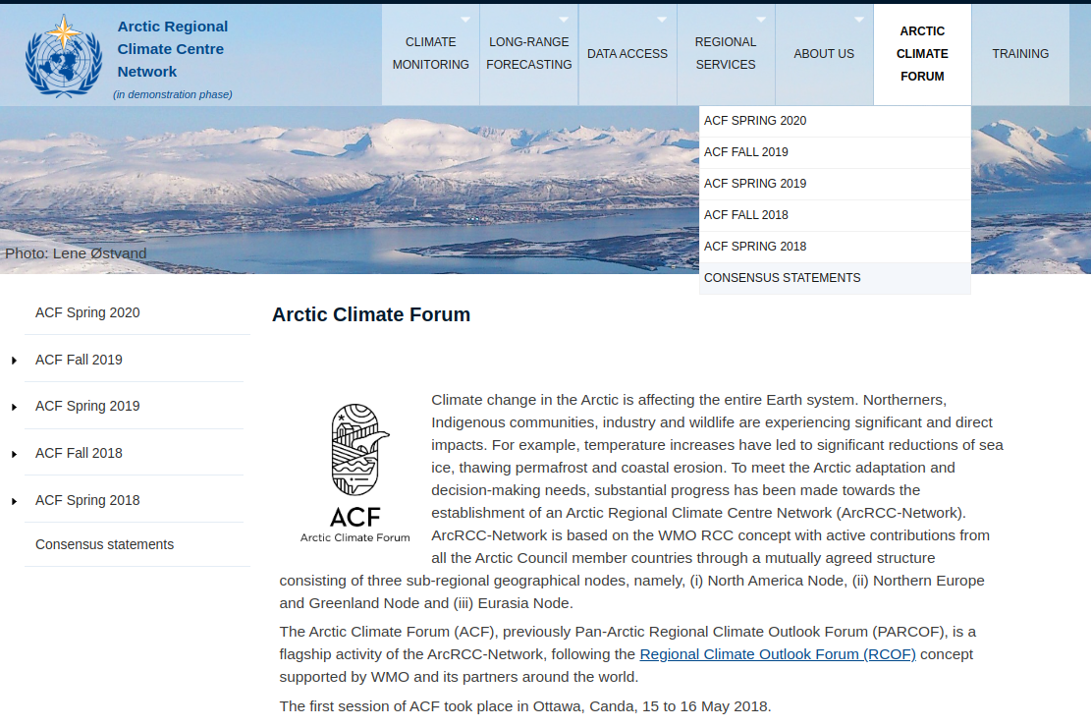
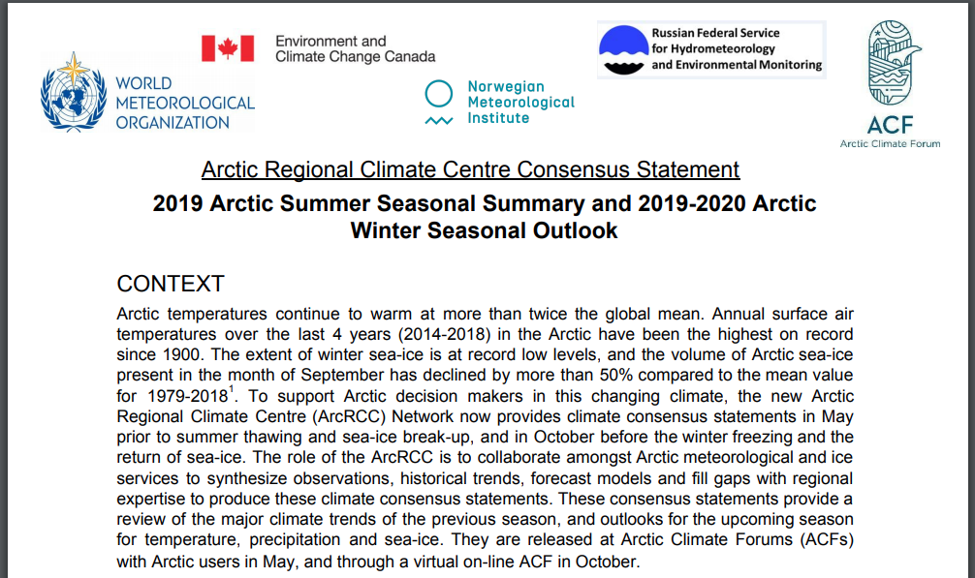
Will be published on https://arctic-rcc.org/acf

Slide 41
Circumpolar Arctic Perspective Temperature & Precipitation
Outlooks are based on eight WMO Long-Range Forecasts models.
All the model forecasts are compared and areas where all eight models
agree = high forecast confidence
disagree = low forecast confidence
Called a multi-model ensemble (MME) approach
A methodology reputed as providing the most reliable objective forecasts.

Slide 42
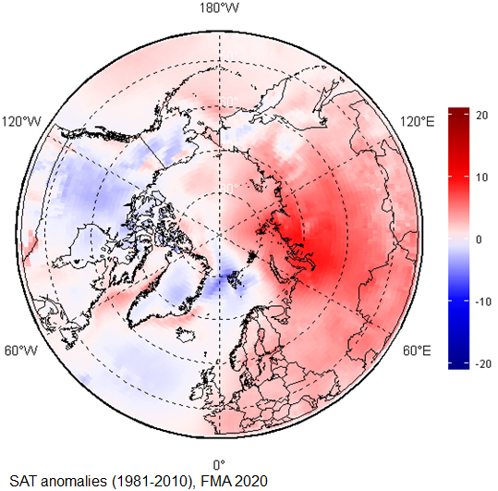
TEMPERATURE: Observations from Winter 2020
Higher than normal in the eastern hemisphere
Lower than normal in the western hemisphere
Scandinavia and the majority of the Eastern and Western Scandinavia regions experienced warmer than normal conditions (red areas)
Parts of Eastern and Western Siberia saw their fifth warmest FMA since the start of the record in 1949.
Canada, Alaska, Greenland, and the North Atlantic Ocean experienced near normal (white areas) or slightly below normal (light blue) conditions.
February, March, and April (FMA) 2020 surface air temperature anomaly based on the 1981-2010 reference period. Red indicates warner than normal temperature, and blue indicates cooler than normal temperatures. Map produced by the Hydrometcenter of Russia https://meteoinfo.ru/ Data source: ERA-5.

Slide 43
TEMPERATURE: Winter 2020
How did the forecasts perform ?
Regions | MME Temperature Forecast Agreement | MME Temperature Forecast | Observations NCAR CFSR Reanalysis | MME Temperature Forecast Accuracy
Alaska | Low | Above normal | Near normal | Low
Chukchi | High | Above normal | Above to near normal | Moderate
Eastern Siberia | High | Above normal | Above normal | High
Western Siberia | High | Above normal | Above normal | High
European | Moderate | Above normal | Above normal | High
Atlantic | Moderate | Mostly near normal | Above normal (Scandinavia only) | Moderate
Canada | Low | Above normal | Near to below normal | Low
Central Arctic | High | Above normal | Above normal | High
Notes:
The Winter 2020 temperature forecast was verified by comparing the forecast with meteorological observations and reanalysis technics to fill gaps in observations.
The observed near-normal temperatures over Alaska and the majority of Canada were not accurately forecast
Above-normal surface air temperatures over the European, Eastern Siberia, Western Siberia, and Central Arctic regions were accurately forecast for the JFMA 2020 season.
Over the Atlantic region, the forecast accuracies were variable but near-normal
Temperatures over Iceland and parts of Greenland were accurately forecast.
The observed below-normal temperatures over the Norwegian Sea and parts of Greenland were not accurately forecast.
As a general conclusion, the multi-model ensemble forecast was accurate for approximately 50-60% of the Arctic territory.

Slide 44
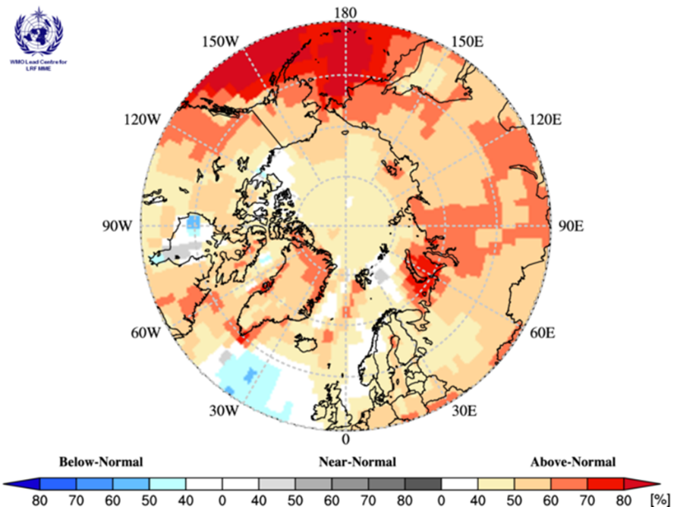
TEMPERATURE: Outlook Summer 2020
Multi model ensemble probability forecast for surface temperature for June, July, and August 2020. Three categories: below normal (blue), near normal (grey), above normal (red) and no agreement amongst the models (white). Source: www.wmolc.org.
Notes:
Surface air temperatures during summer 2020 (June, July, and August 2020) are forecast to be above normal across the majority of the Arctic regions (orange and red areas in Figure).
The confidence of the forecast is low to moderate over the majority of the continental Arctic (land areas) (yellow and orange areas in Figure), while
Forecast confidences are high for the maritime parts of the Atlantic region, the Bering Sea, and a portion of the Barents and Kara Seas (dark red areas).
The multi-model ensemble did not agree over a few maritime areas across the Arctic (white areas).
Refer back to the non-technical presentation gave you more regional details using local expertise

Slide 45
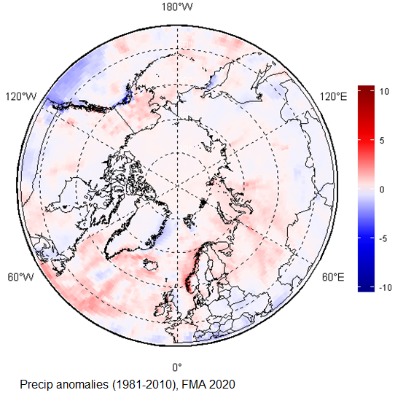
PRECIPITATION: Observations from Winter 2020
Wetter than average conditions were observed across a majority of Arctic region (red areas).
Only a few isolated areas, including the northeastern coast of Greenland, northern Canada, and a small swath over southern Alaska, experienced drier than average conditions (blue areas)
February, March, and April (FMA) 2020 precipitation based on the 1981-2010 reference period. Red indicates wetter than normal conditions, and blue indicates drier than normal conditions. Map produced by the Hydrometcenter of Russia https://meteoinfo.ru/ Data source: ERA-5.

Slide 46
PRECIPITATION: Winter 2020
How did the forecasts perform ?
Regions | MME Precipitation Forecast Agreement | MME Precipitation Forecast | Observations NCAR CFSR Reanalysis | MME Precipitation Forecast Accuracy
Alaska | Moderate | Above normal | Above normal | High
Chukchi | Moderate | Above normal | Near normal | Low
Eastern Siberia | Moderate | Above normal | Above normal | High
Western Siberia | Moderate | Above normal | Above normal | High
European | Moderate | Above normal | Above normal | High
Atlantic | Moderate | Above normal (continental regions only) | Above normal (continental regions only) | High
Canada | No agreement | No forecast | Near normal in the south and west, below in the center | N/A
Central Arctic | No agreement | No forecast | N/A | N/A
Notes:
The Winter 2020 precipitation forecast was verified by comparing the forecast with meteorological observations and reanalysis technics to fill gaps in observations.
Above-normal precipitation over the majority of the Arctic were accurately forecast for the Winter 2020 season.
The only exception was in the Chukchi area, where observed near-normal precipitation were inaccurately forecast.
There was no agreement amongst the models over the Eastern Canada and Central Arctic region (predominance of white areas over those regions).
As a general conclusion, the multi-model ensemble forecast was accurate for approximately 70% of the Arctic territory.

Slide 47
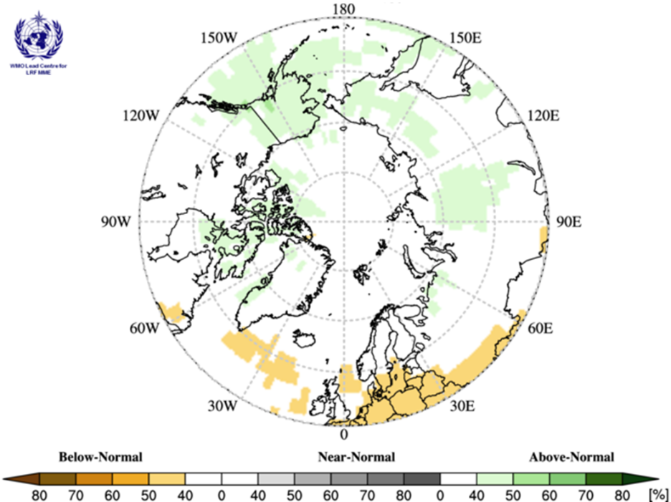
PRECIPITATION: Outlook Summer 2020
Multi model ensemble probability forecast for precipitation for JJA 2020. Green indicates wetter conditions, orange drier conditions and white, no agreement amongst the models. Source: www.wmolc.org.
Notes:
Precipitation during summer 2020 (June, July, and August) is forecast to be
above normal over Alaska, and portions and the Chukchi, Eastern Siberia, and northern Canadian region; the confidence of the forecast is low (light green areas).
below normal for a portion of Northern Atlantic; the confidence of the forecast is low (light orange areas).
The multi-model ensemble did not agree over the remainder of the Arctic region (white areas).

Slide 48
Sea-Ice: From a Circumpolar Perspective
Maximum sea-ice extent, volume and thickness is normally reached each year in the Arctic during the month of March.
The forecast for March 2020 sea ice extent was based on output from CanSIPSv2, an MME of two climate models

Slide 49
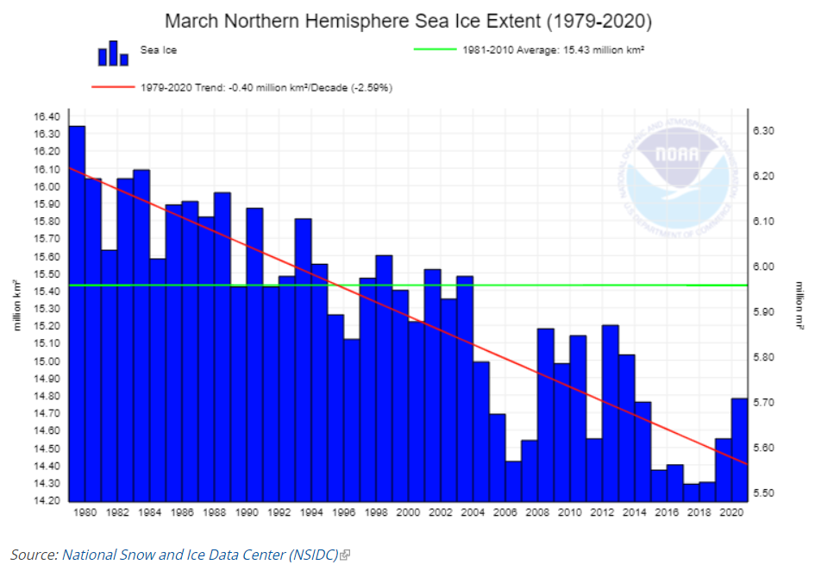
SEA-ICE Extent: Observations from Winter 2020
Notes:
2020 Sea ice extents were not at a minimum over the 40 year record, 2020 rebounded slightly but trends are still declining

Slide 50
SEA-ICE: Winter 2020
How did the forecasts perform ?
Regions | CanSIPS Sea-Ice Forecast Confidence | CanSIPS Sea-Ice Forecast | Observed Ice Extent | CanSIPS Sea-Ice Forecast Accuracy
Bering Sea | Low | Below normal | Normal | Low
Sea of Okhotsk | Low | Below to near normal | Below to near normal | High
Barents Sea | Low | Near normal | Below normal | Low
Greenland Sea | High | Near normal | Below to near normal | Moderate
Gulf of St. Lawrence | Low | Below normal | Below to near normal | High
Labrador Sea | Moderate | Below normal | Below to near normal | Moderate
Notes:
Normal ice extent in the Bering Sea, below normal was forecasted = low forecast accuracy
Below to near normal ice extent for the Sea of Okhotsk, high forecast accuracy. Normal surface pressure and air temperature patterns in the Bering and Sea of Okhotsk regions led to near normal ice coverages.
Below normal ice extent in the Barents (low accuracy) and moderate accuracy for the Barents Sea. Pronounced warm air temperature and low surface level pressure anomalies over these areas in winter 2019/20 restricted sea ice development, and ice expansion was slowed by the lack of deep, sustained cold and the presence of regular destructive wind events.
Moderate accuracy for the Labrador Sea. Above normal air temperatures in Davis Strait and over the northern Labrador Coast suppressed ice growth during the past winter, leading to significantly lower ice export from these regions southward along the Labrador Coast and into the northwestern section of the Gulf of St. Lawrence.
High Accuracy for the Gulf of St. Lawrence. Near normal temperatures and a lack of sea ice from northern regions led to a lower than normal ice extent for the Gulf.

Slide 51
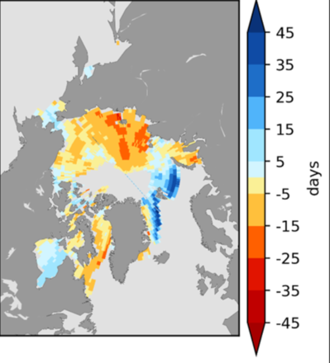
SEA-ICE: Break-up Outlook 2020
What is Normal break-up?
The first day in a 10 day period when the ice concentration goes below 50%
based on climatological period (2009-2017)
Break-Up Categories:
Late break-up
Near normal break-up
Early break-up
Regions | CanSIPS Sea-Ice Forecast Confidence | CanSIPS Sea-Ice Break-up Forecast
Baffin Bay | High | Early
Barents Sea | High | Late in northern section
Beaufort Sea | High | Early
Bering Sea* | Moderate | Near normal to late
Chukchi Sea | High | Early
East Siberian | Low | Early southern section, near normal northern section
Greenland Sea | High | Late
Hudson Bay | Moderate | Late eastern half, near normal western half
Kara Sea | Moderate | Early in the west, near normal in the east
Labrador Sea | High | Early
Laptev Sea | Low | Early
Forecast for the 2020 spring/summer break-up expressed as an anomaly (difference from normal) Source: CanSIPS (ECCC)
Notes:
These regions break-up details were covered in the non-technical regional presentation, but the consensus statement explains and shows you the model output for the entire circumpolar Canadian Arctic
“The Bering Sea ice break-up on the slide is already out of date: daily Bering Sea ice extent has been below 1981-2010 average since early March and is currently at about 75% of the 30-year median for this date. By the time of ACF-5, there is likely to be only limited ice remaining in the Bering Sea by late May

Slide 52
Minimum SEA-ICE Extent: Outlook September 2020
Regions | CanSIPS Sea-Ice Forecast Confidence | CanSIPS Sea-Ice Forecast
Barents Sea | Low | Above normal (northern section)
Beaufort Sea | Moderate | Below normal
Canadian Arctic Archipelago | Moderate | Below normal
Chukchi Sea | High | Below normal
Eastern Siberian Sea | Moderate | Below normal
Greenland Sea | High | Above normal
Kara Sea | High | Below normal
Laptev Sea | High | Below normal
September 2020 probability of sea ice at concentrations greater than 15% from CanSIPSv2 (ECCC). Forecast median ice extent from CanSIPSv2 (black) and observed mean ice edge 2011-2019 (red).
Notes:
Again, the sea-ice extent details were covered in the non-technical regional presentation, but the consensus statement explains and shows you the model output for the entire circumpolar Canadian Arctic

Slide 53
Questions & Wrap Up
Arctic Regional Climate Center

Slide 54
Thank you! Merci! Takk! Спасибо! Tak! Tack! Kiitos! þakka þér fyrir! Naqurmiik ! Qaĝaasakuq !
Grazie! Giitu! Vielen Dank!
Dhanyavaad !

