Slide 1
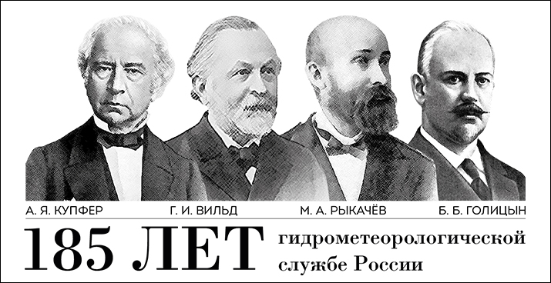

Polar initiatives of Roshydromet
Anna Bystramovich
Deputy head, Department for environmental pollution monitoring,
polar and marine activities

Slide 2
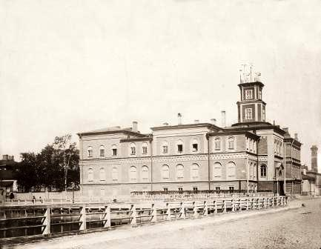
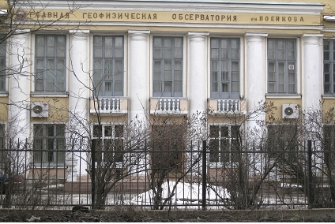

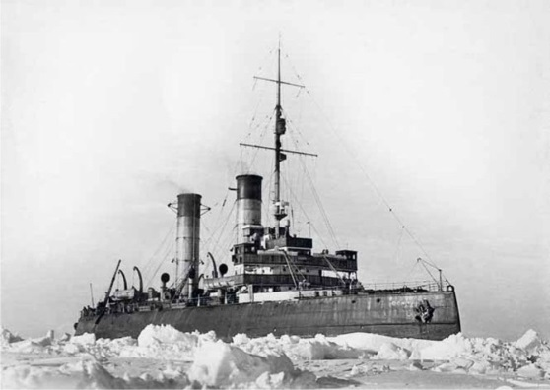

Regular geophysical observations in Russia were started in St.Petersburg 26 April 1834 with the foundation of Normal Magnetic-Meteorological Observatory of Gornij Institute
Further comprehensive development of meteorological service is linked to foundation in 1849 of the Main Physical Observatory, now the Main Geophysical Observatory
History of the Arctic Institute started in 1920 when the Northern scientific-commercial expedition was founded for coordination and provision of research and commercial activities in the Arctic

Slide 3

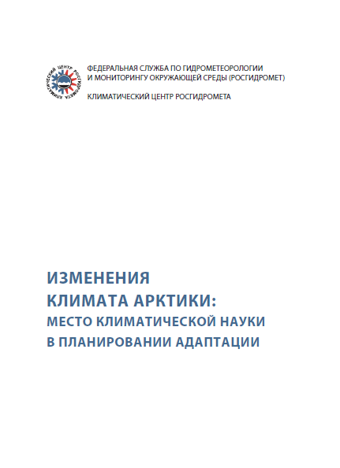
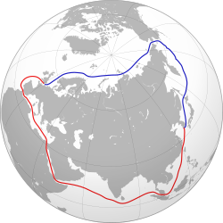
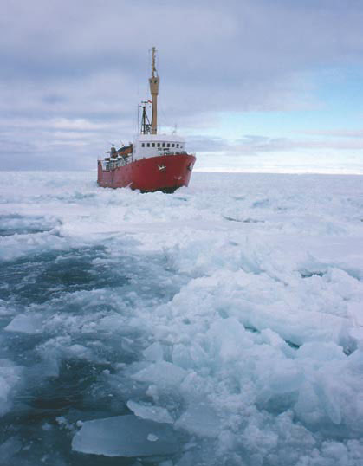
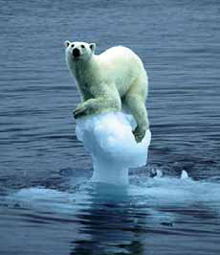
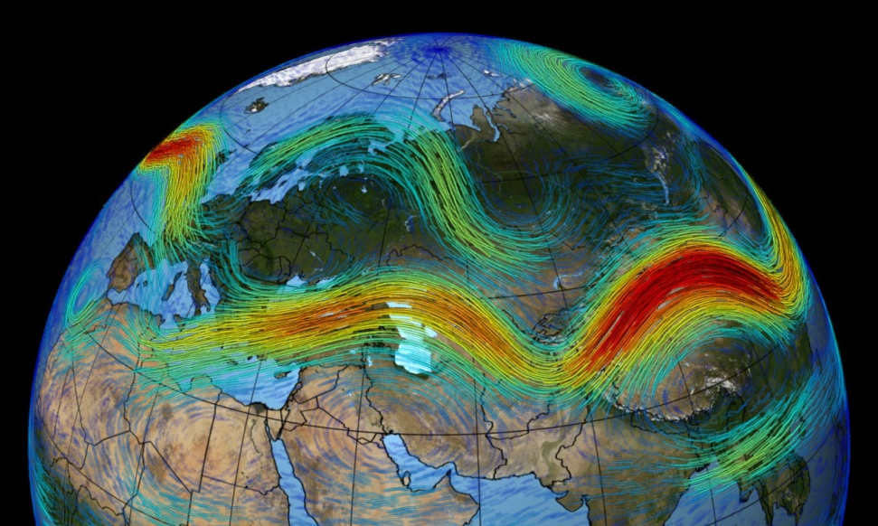
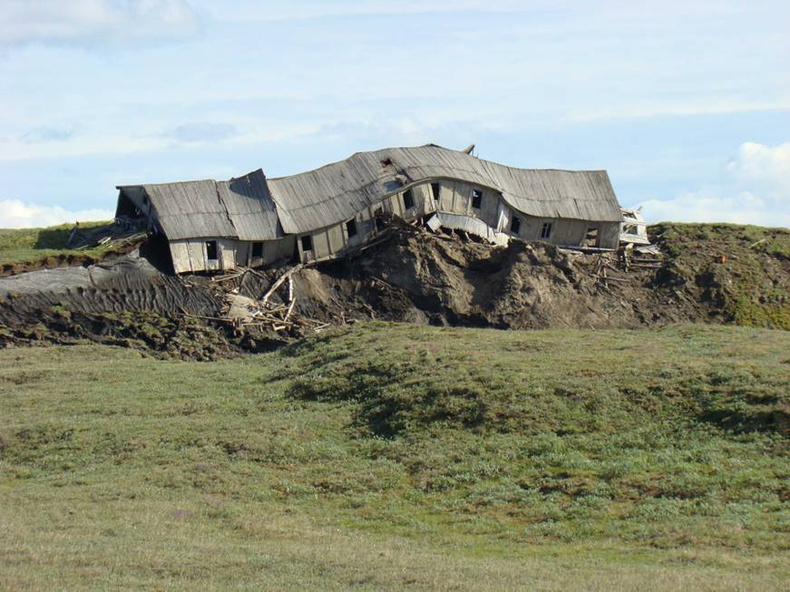
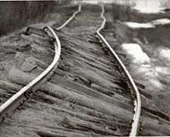
Notes:
.

Slide 4
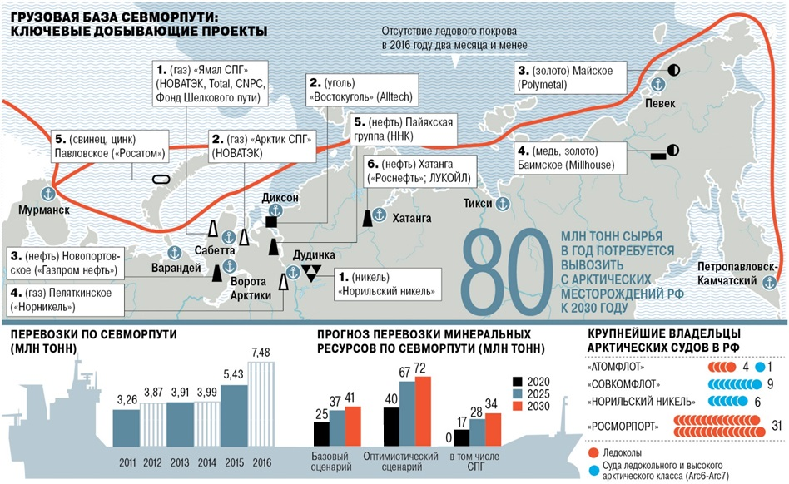
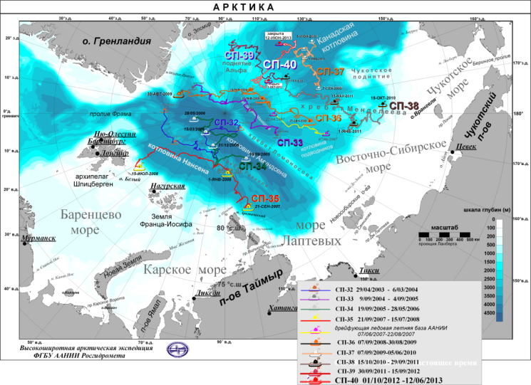
Сlimate policy of the Russian Federation in the Arctic and Roshydromet's current priorities
In general the Poshydromet climate and polar initiatives for the next decade are summarized in an “Integrated Weather and Climate Research Plan: Arktika Cross Highway”
Input of Roshydromet to the climate policy of the Russian Federation in the Arctic comprises:
the State Observation Network
R&D (including analysis tools and predictive models)
forecast (including impact assessment) of climate change
services (including information and analytical support for decision-making regarding adaptation to the current and expected climate change mitigation)
Roshydromet's current priorities in the Arctic include:
development of the observational network including its coastal and marine part
resumption of maritime expeditionary activities;
increasing computing resources;
development of hydrometeorological and climate services.

Slide 5
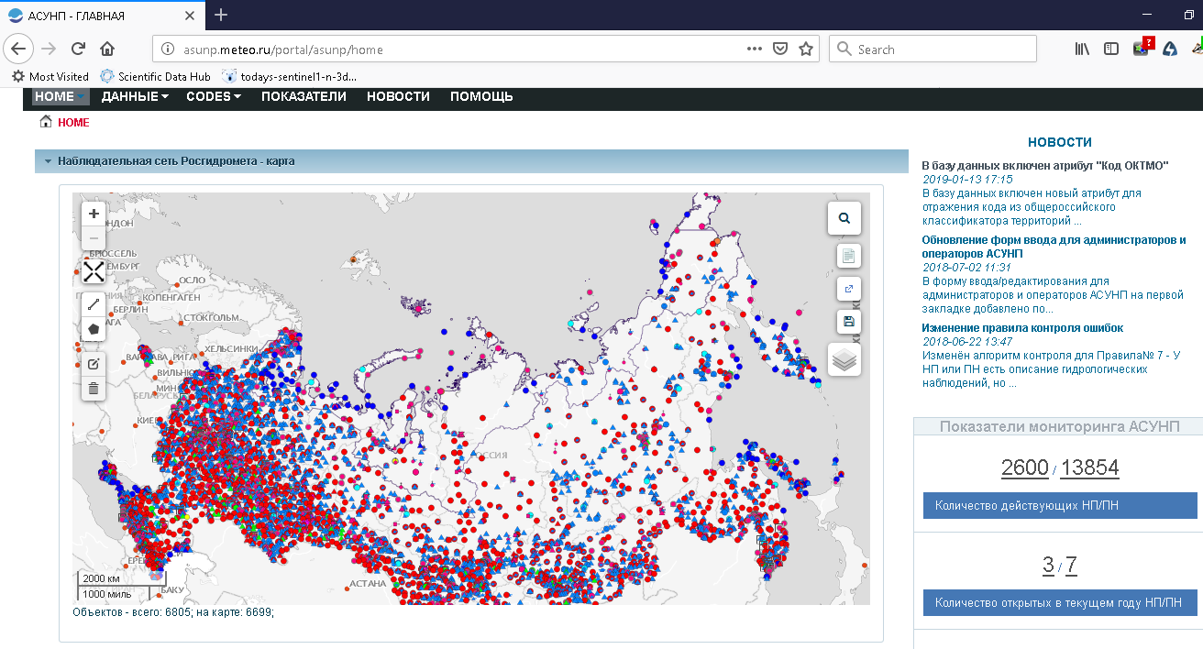
Roshydromet network

Slide 6
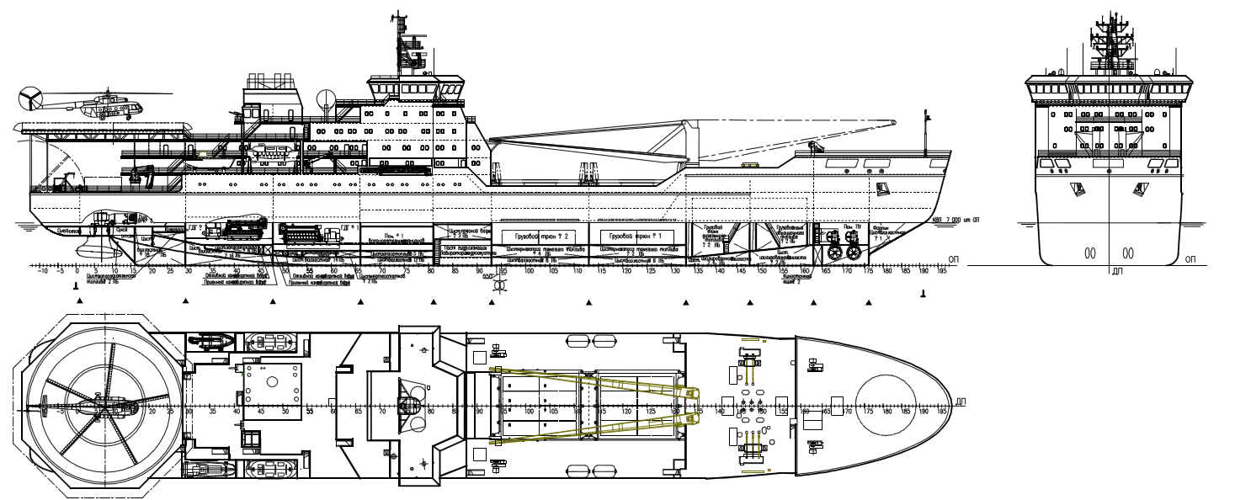
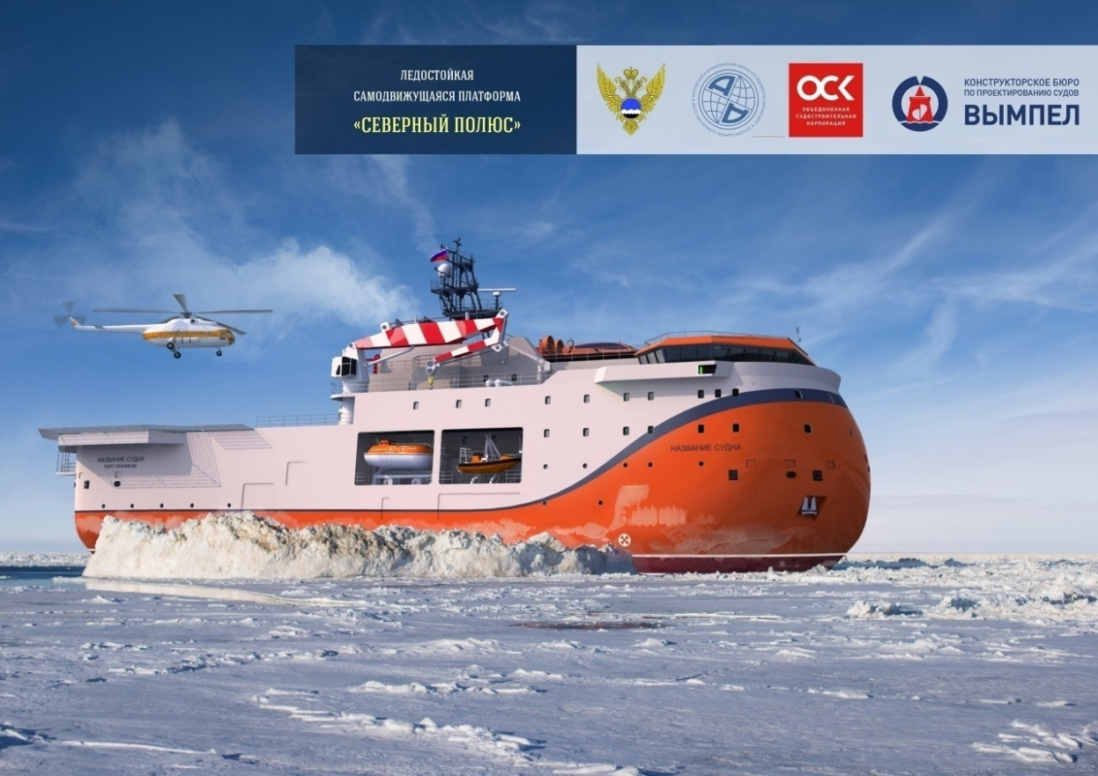
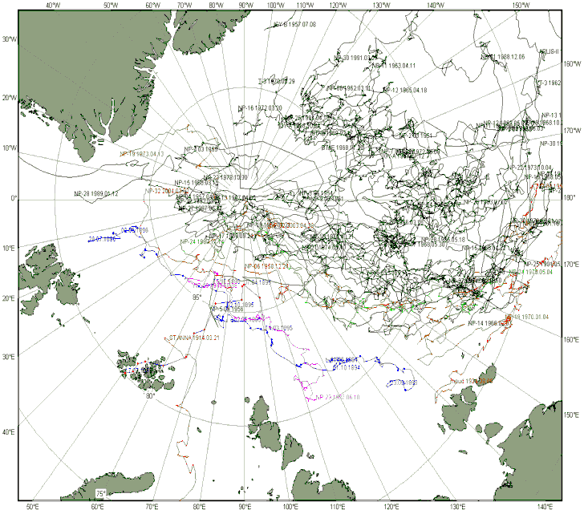
Resumption of maritime expeditionary activities
New expeditionary ice class vessel
Autonomous ice platform - future for North Pole drifting stations
1952 – 1991
2002-2013
Notes:
Отдельной составляющей развития морской научно-экспедиционной деятельности Росгидромета является возобновление деятельности дрейфующих станций «Северный Полюс» на базе самоходной ледовой научно-исследовательской платформы, строительство которой начато в 2018 году.

Slide 7
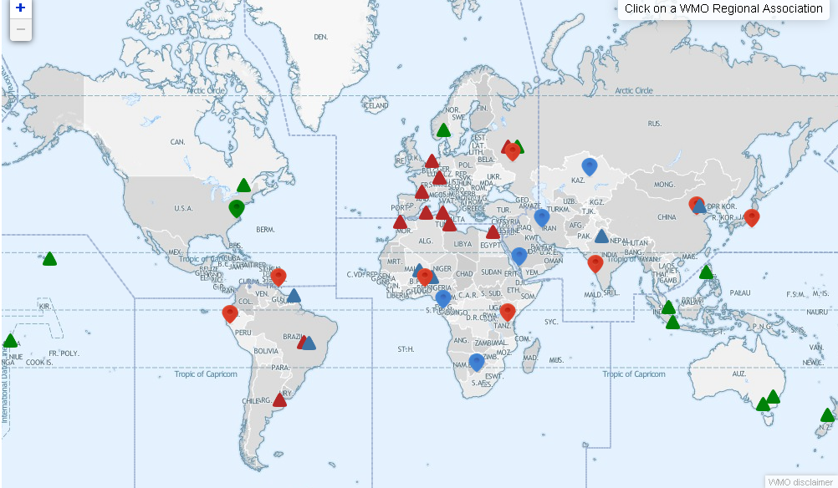

Support for the Arctic Regional Climate Center – network and planned 3rd Pole and Antarctic RCCs
ArcRCC-N
Active RCC RCC in demo phase Planned RCC
Active RCC_N RCC-N in demo phase Planned RCC-N

Slide 8
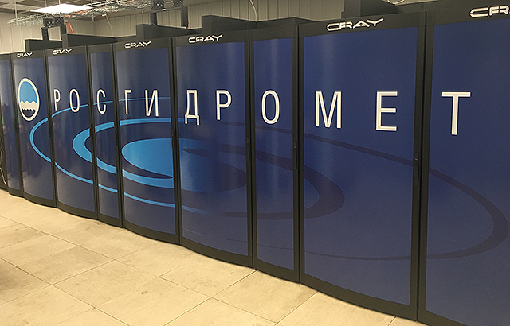
The new Roshydromet supercomputer (Hydrometcenter Moscow) for operational weather forecasting, research and assessment of climate change

