Slide 1
Development of monitoring by variables (beyond atmosphere and sea ice), intervals (beyond season), origin (in-situ/ reanalysis), formats (graphics/ text/WIS)
Vasily Smolyanitsky
Arctic and Antarctic Research Institute

Slide 2
New information sources, techniques and variables
New information sources implemented at AARI by January 2020 for monthly and seasonal monitoring
Reanalysis:
ERA5 - Monthly averaged data on single/pressure levels from 1979 to present (atmosphere, snow, ocean)
MERCATOR - Global Ocean 1/12° Physics Analysis and Forecast updated Daily (ocean)
Stations combined with analysis
Greater amount of obs from coastal stations on panarctic scale
ArcticGRO (rivers)
CALM (permafrost active layer depth)
New techniques
Scripts in R allowing automatic production of graphs both for the Arctic and Antarctic
Updates weekly (sea ice, atm), monthly (atm), seasonally (other)
Validation (jointly with HMC Moscow, YOPP ?)

Slide 3
Atmosphere
Surface air temperature
Stations: GTS
Reanalysis: NCEP, ERA5
Precipitation
Stations: GTS
Reanalysis: NCEP, ERA5
Geopotential heights (500, 200, 50 Hpa)
Reanalysis: NCEP, ERA5
Wind (daily mean, maximum in gust)
Reanalysis: ERA5

Slide 4
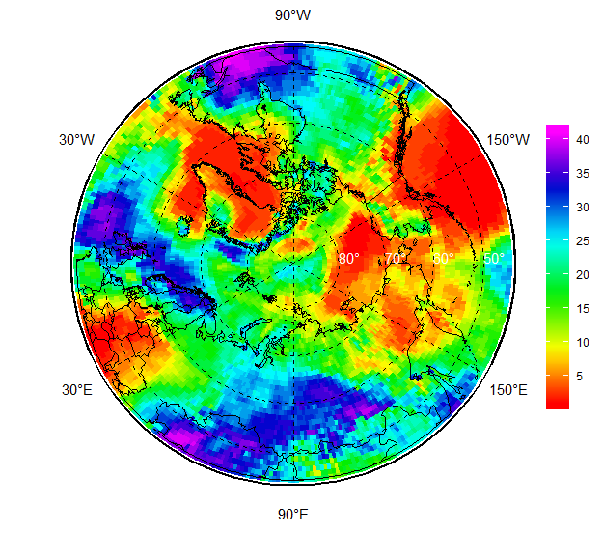
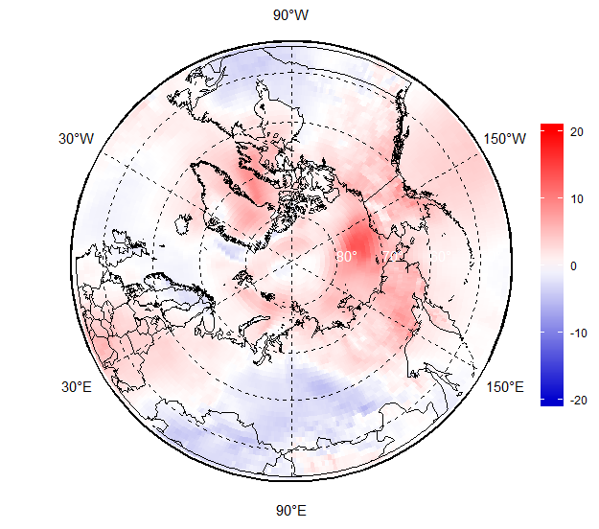
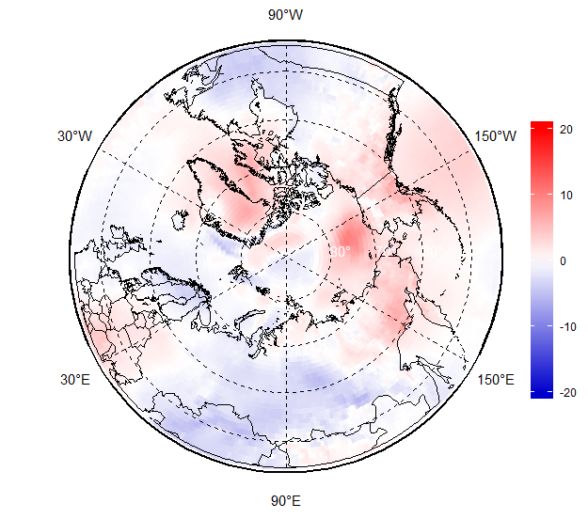
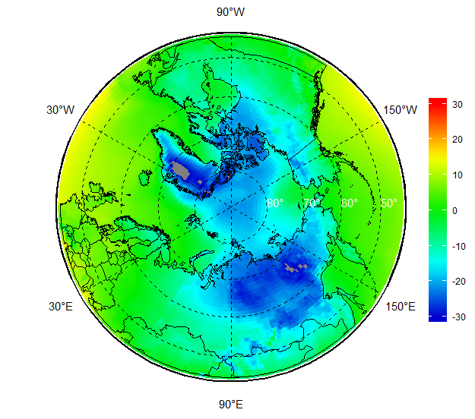
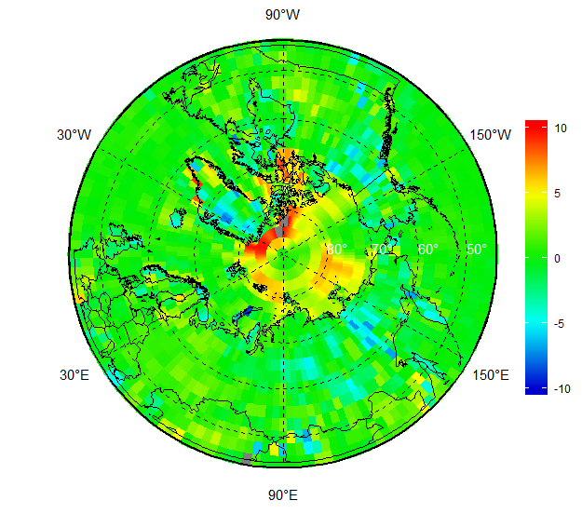
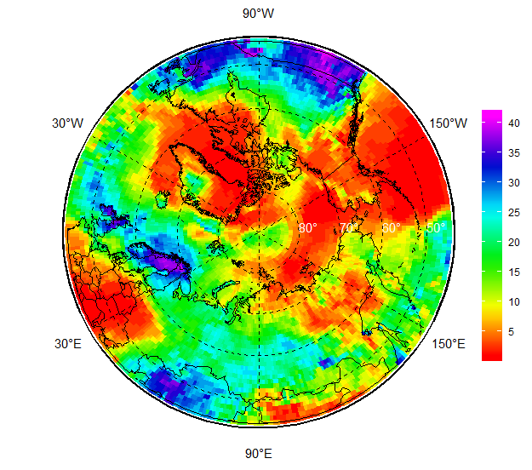
Atmosphere: SAT ERA5
Nov 2019 Anom 1981-2010 Anom 2000-2019
ERA5 – NCEP Rank Nov’2019 Rank SON 2019

Slide 5
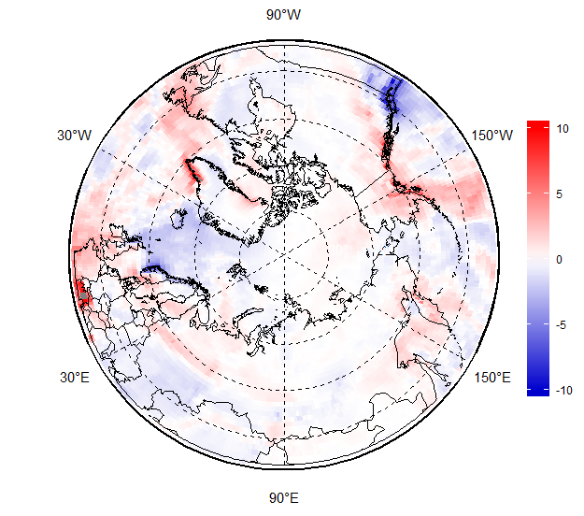
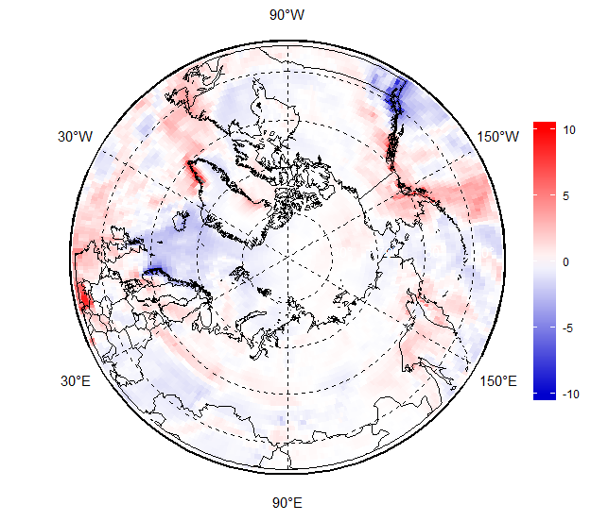
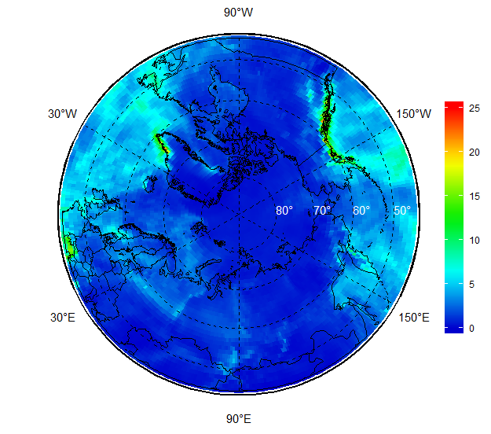
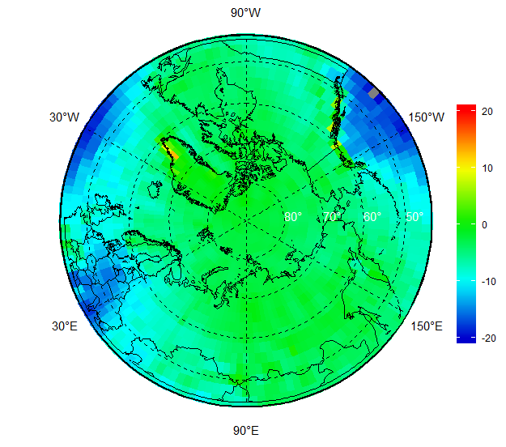
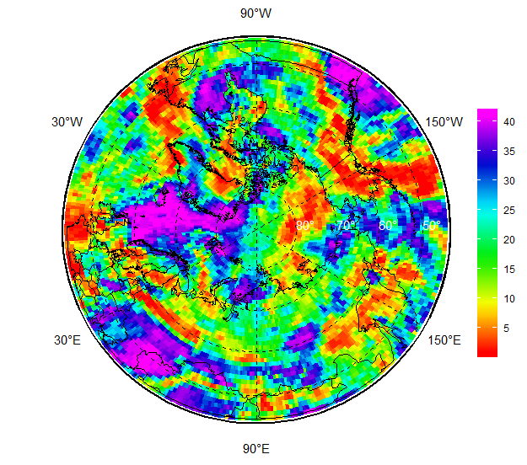
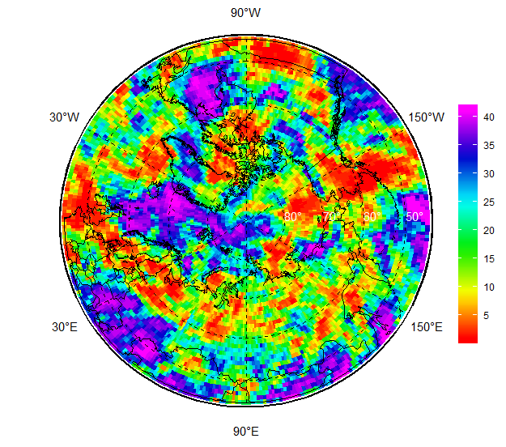
Atmosphere: Prec ERA5
Nov 2019 Anom 1981-2010 Anom 2000-2019
ERA5 – NCEP Rank Nov’2019 Rank SON 2019

Slide 6
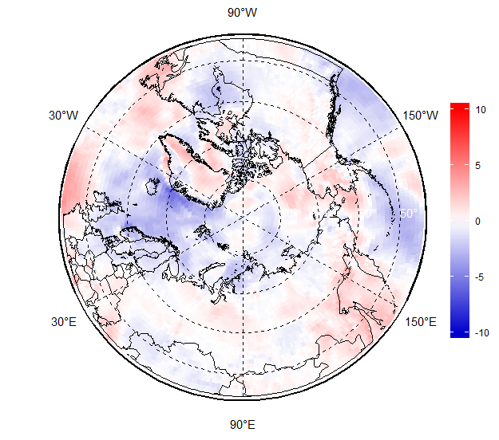
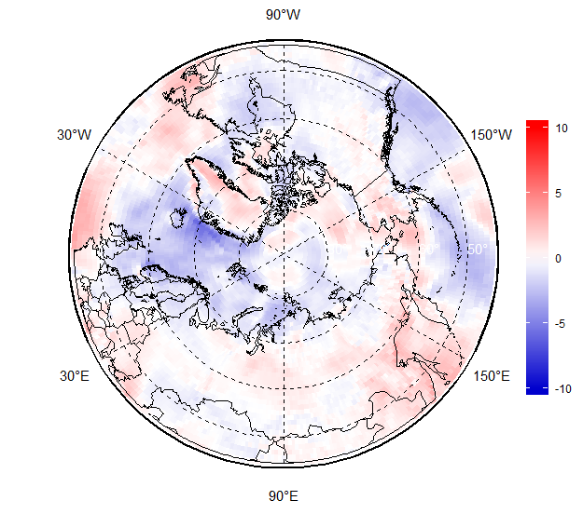
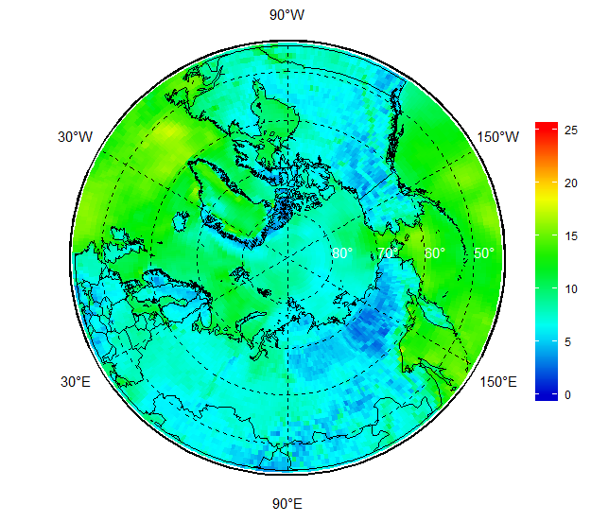
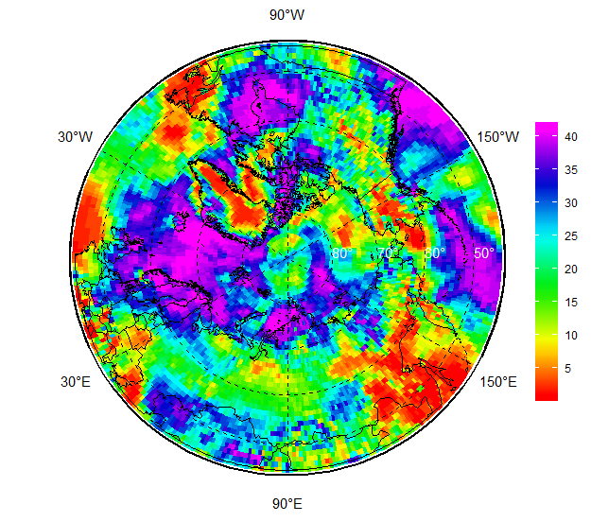
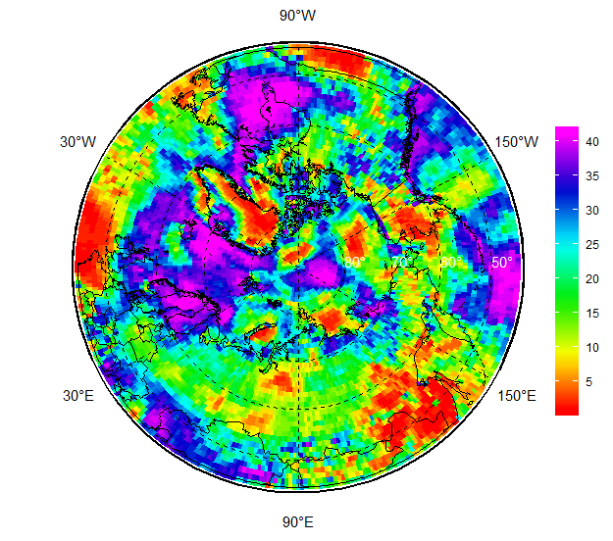
Atmosphere: Wind gust ERA5
Nov 2019 Anom 1981-2010 Anom 2000-2019
– Rank Nov’2019 Rank SON 2019

Slide 7
Sea ice
Ice extent and area
Weekly ice extent and area for the major and all regions of the Arctic and Antarctic
Ice conditions
Ice charting
Stations: sea ice phenomena for selected stations from nat’l ice services
Ice thickness
Stations: maximum ice thickness by the end of freezing period for selected stations from nat’l ice services
Reanalysis: DMI, PIOMAS

Slide 8
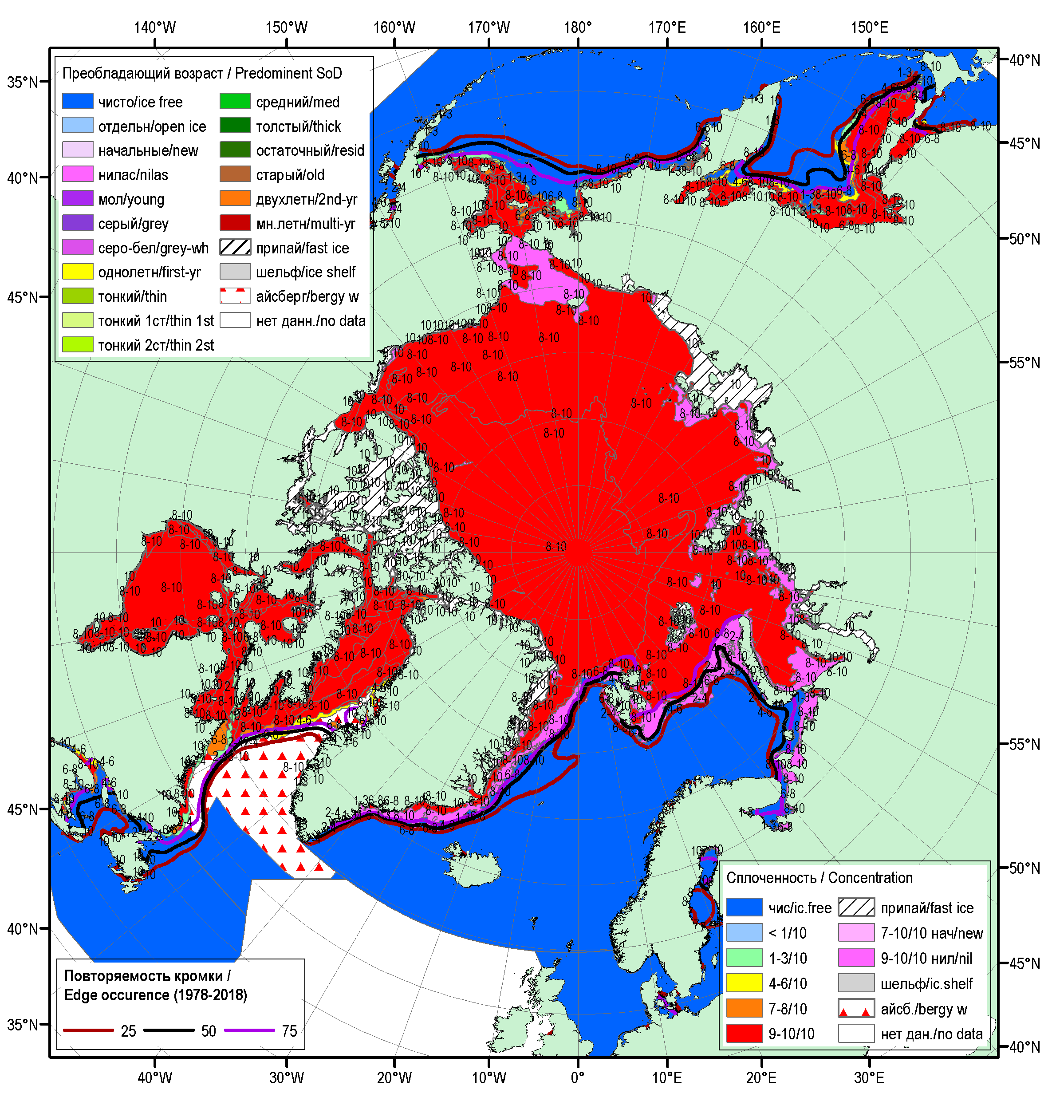
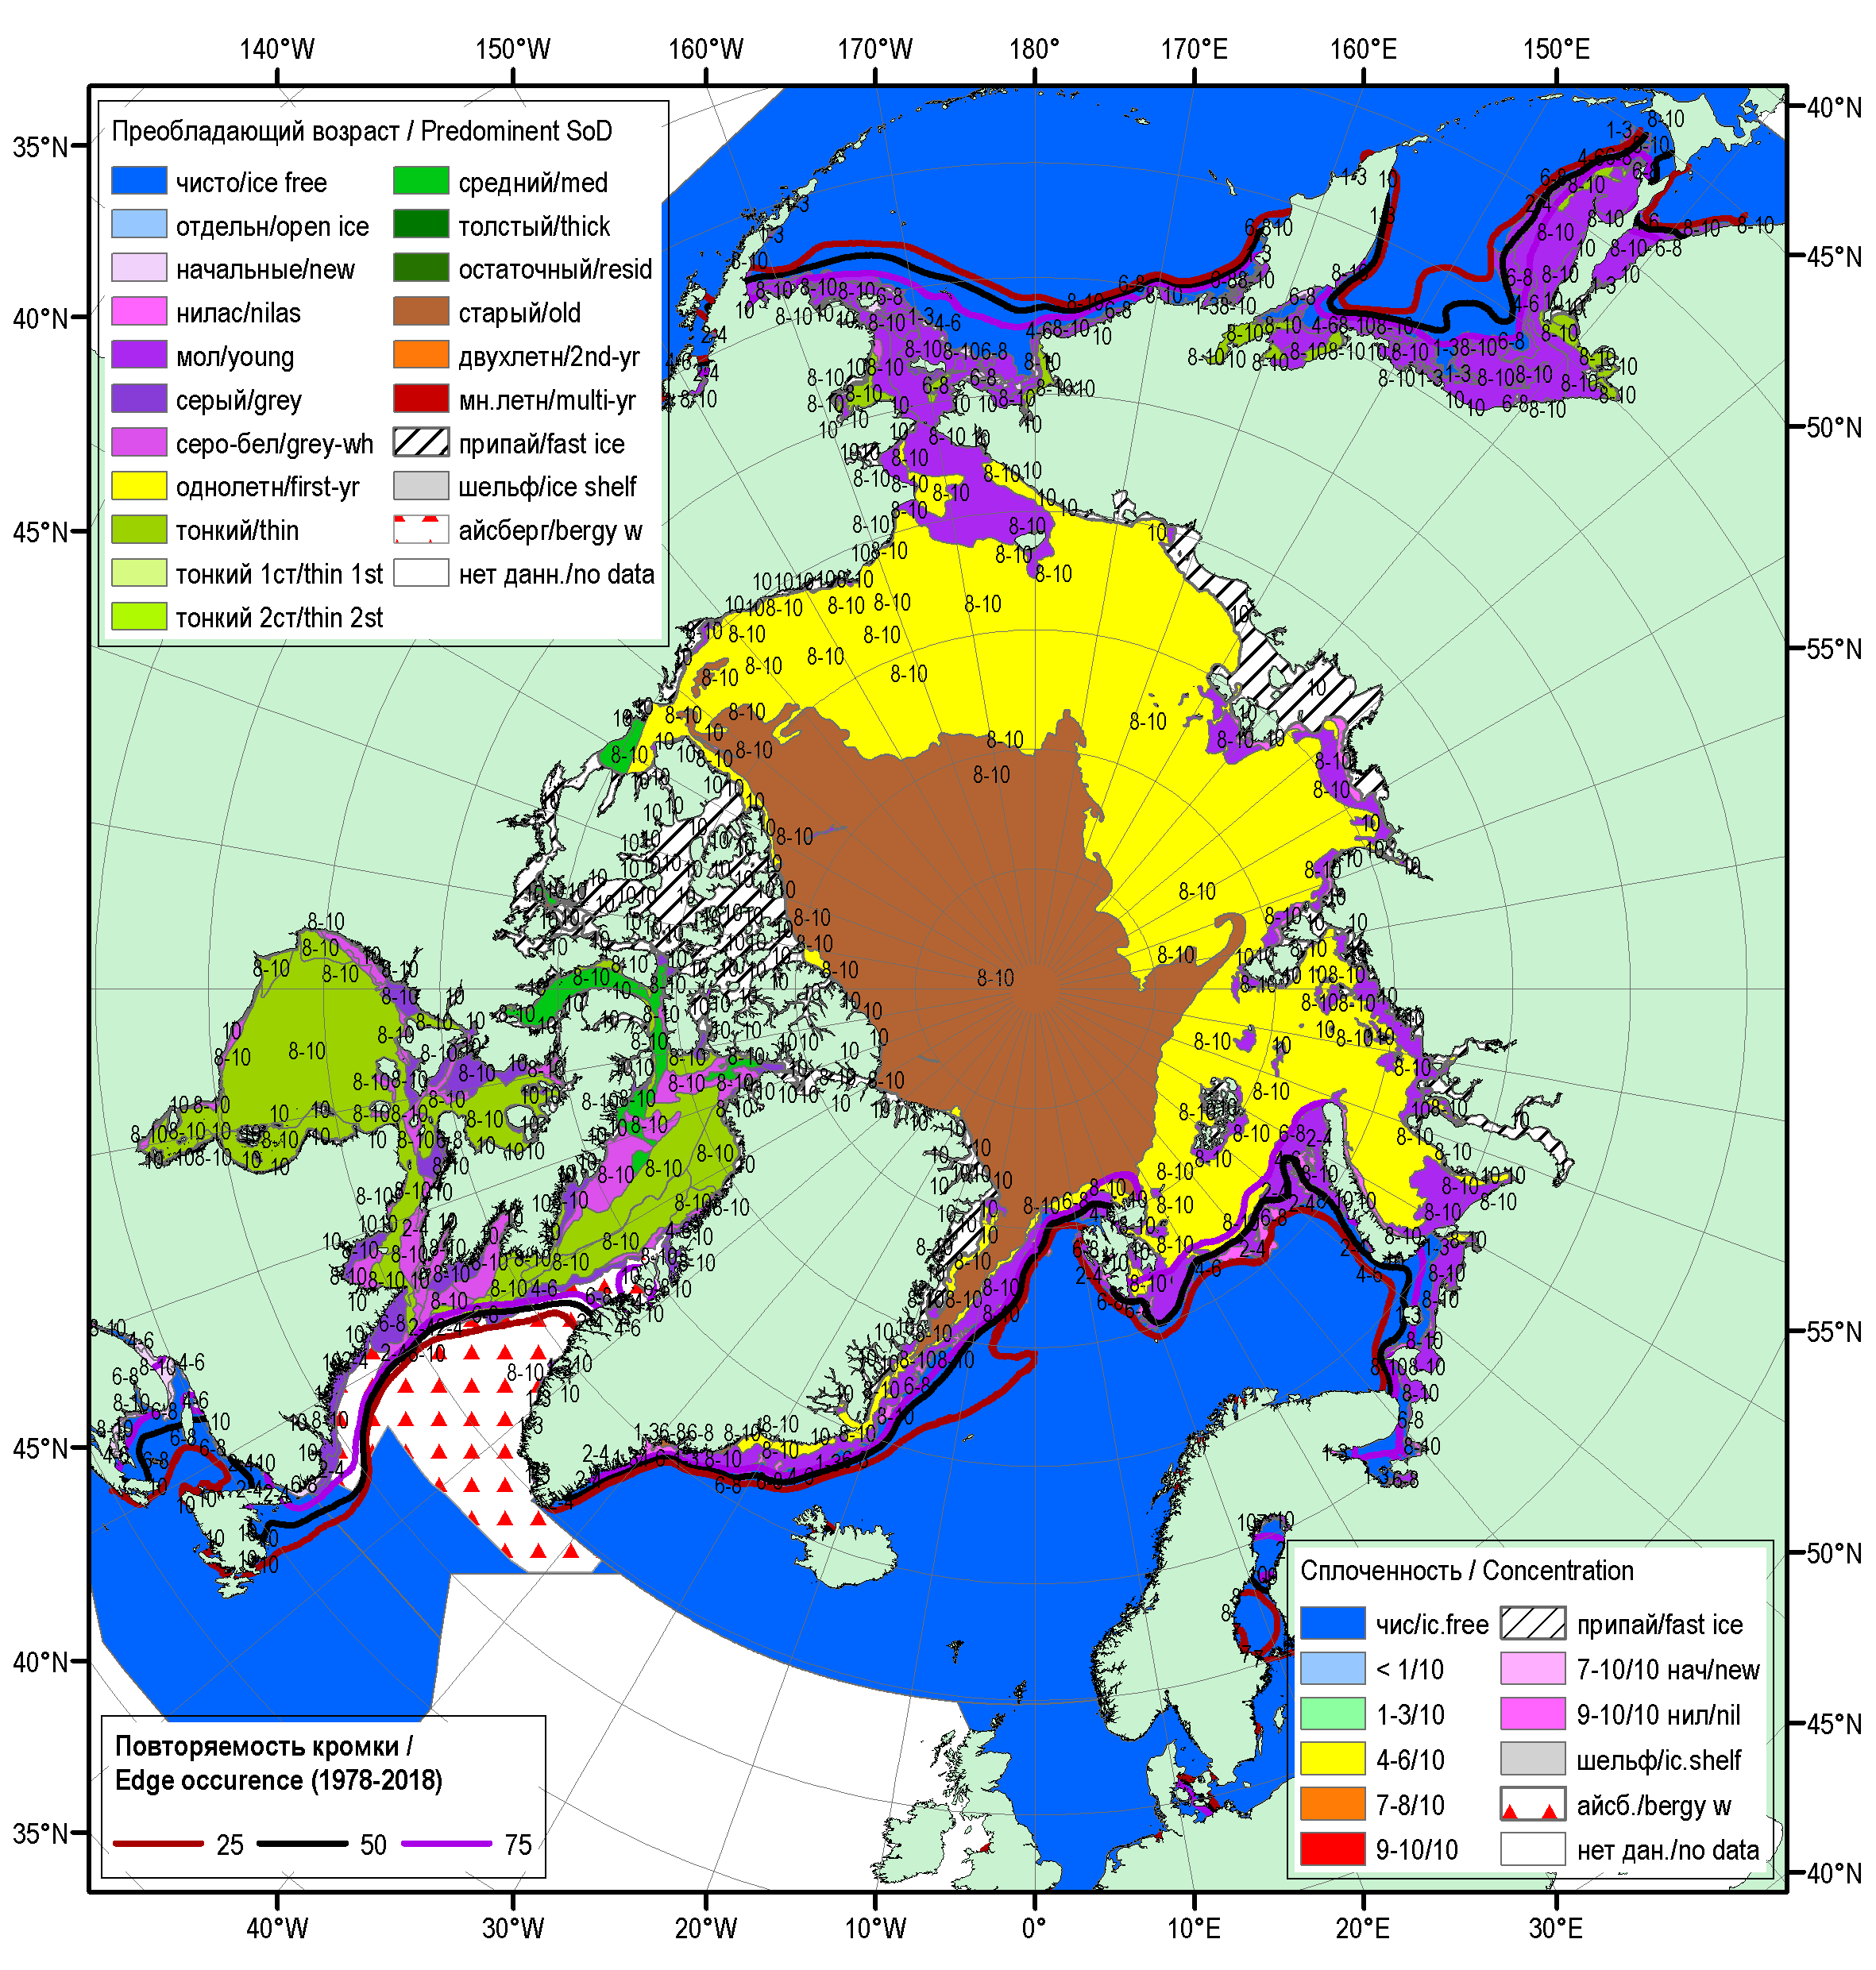
Ice conditions: 17-21 Jan 2020

Slide 9
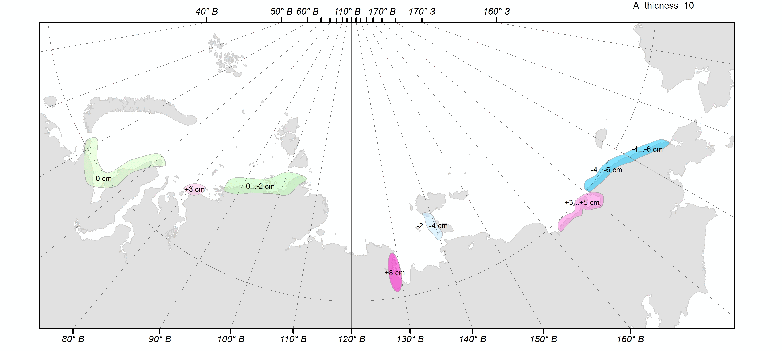
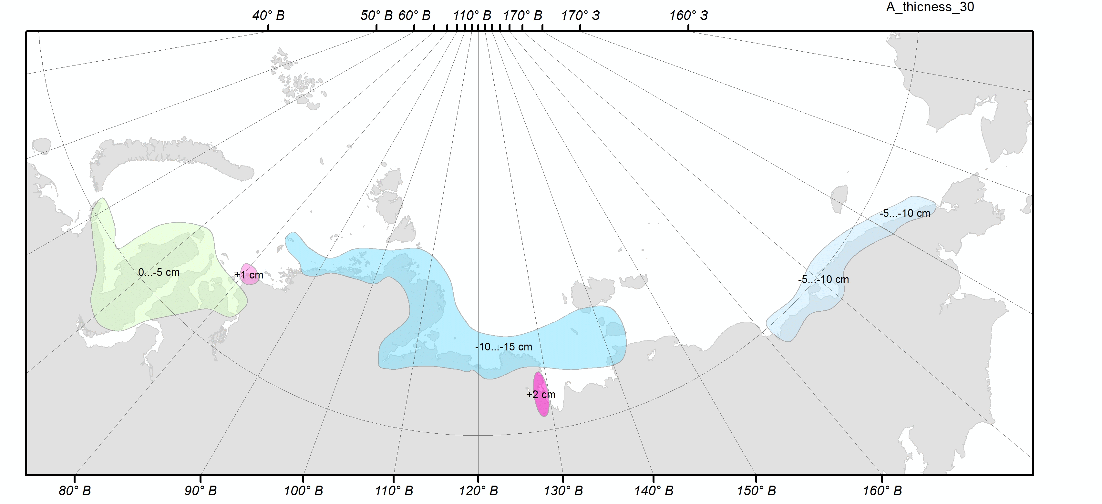
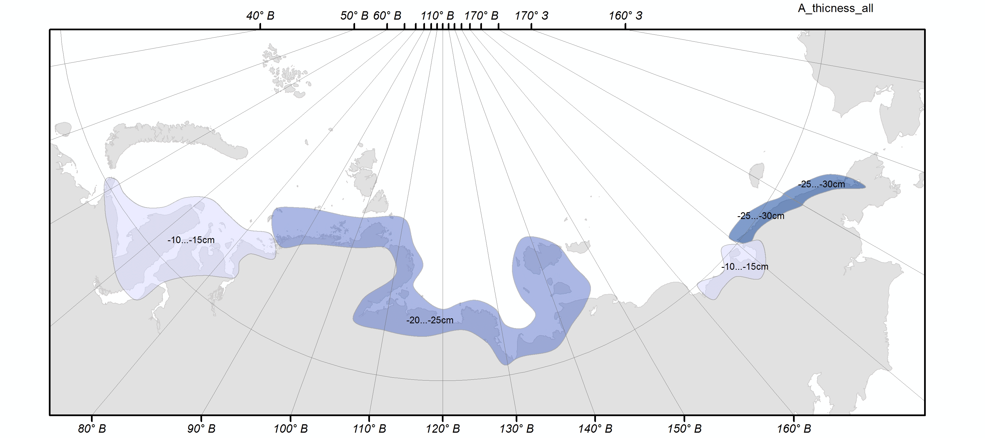
Sea ice: maximum ice thickness
EuAsia anomaly in 2019 against 2009-2019
EuAsia anomaly in 2019 against 1990-2019
EuAsia anomaly in 2019 against whole period

Slide 10
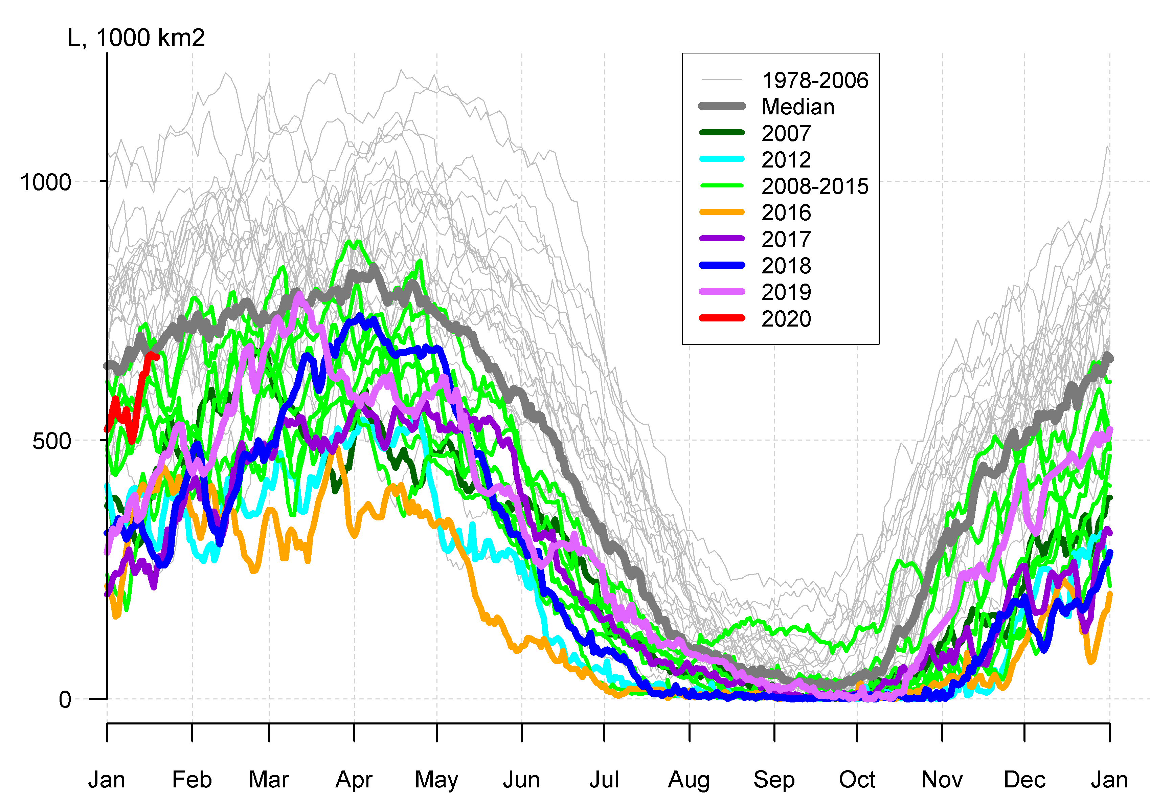
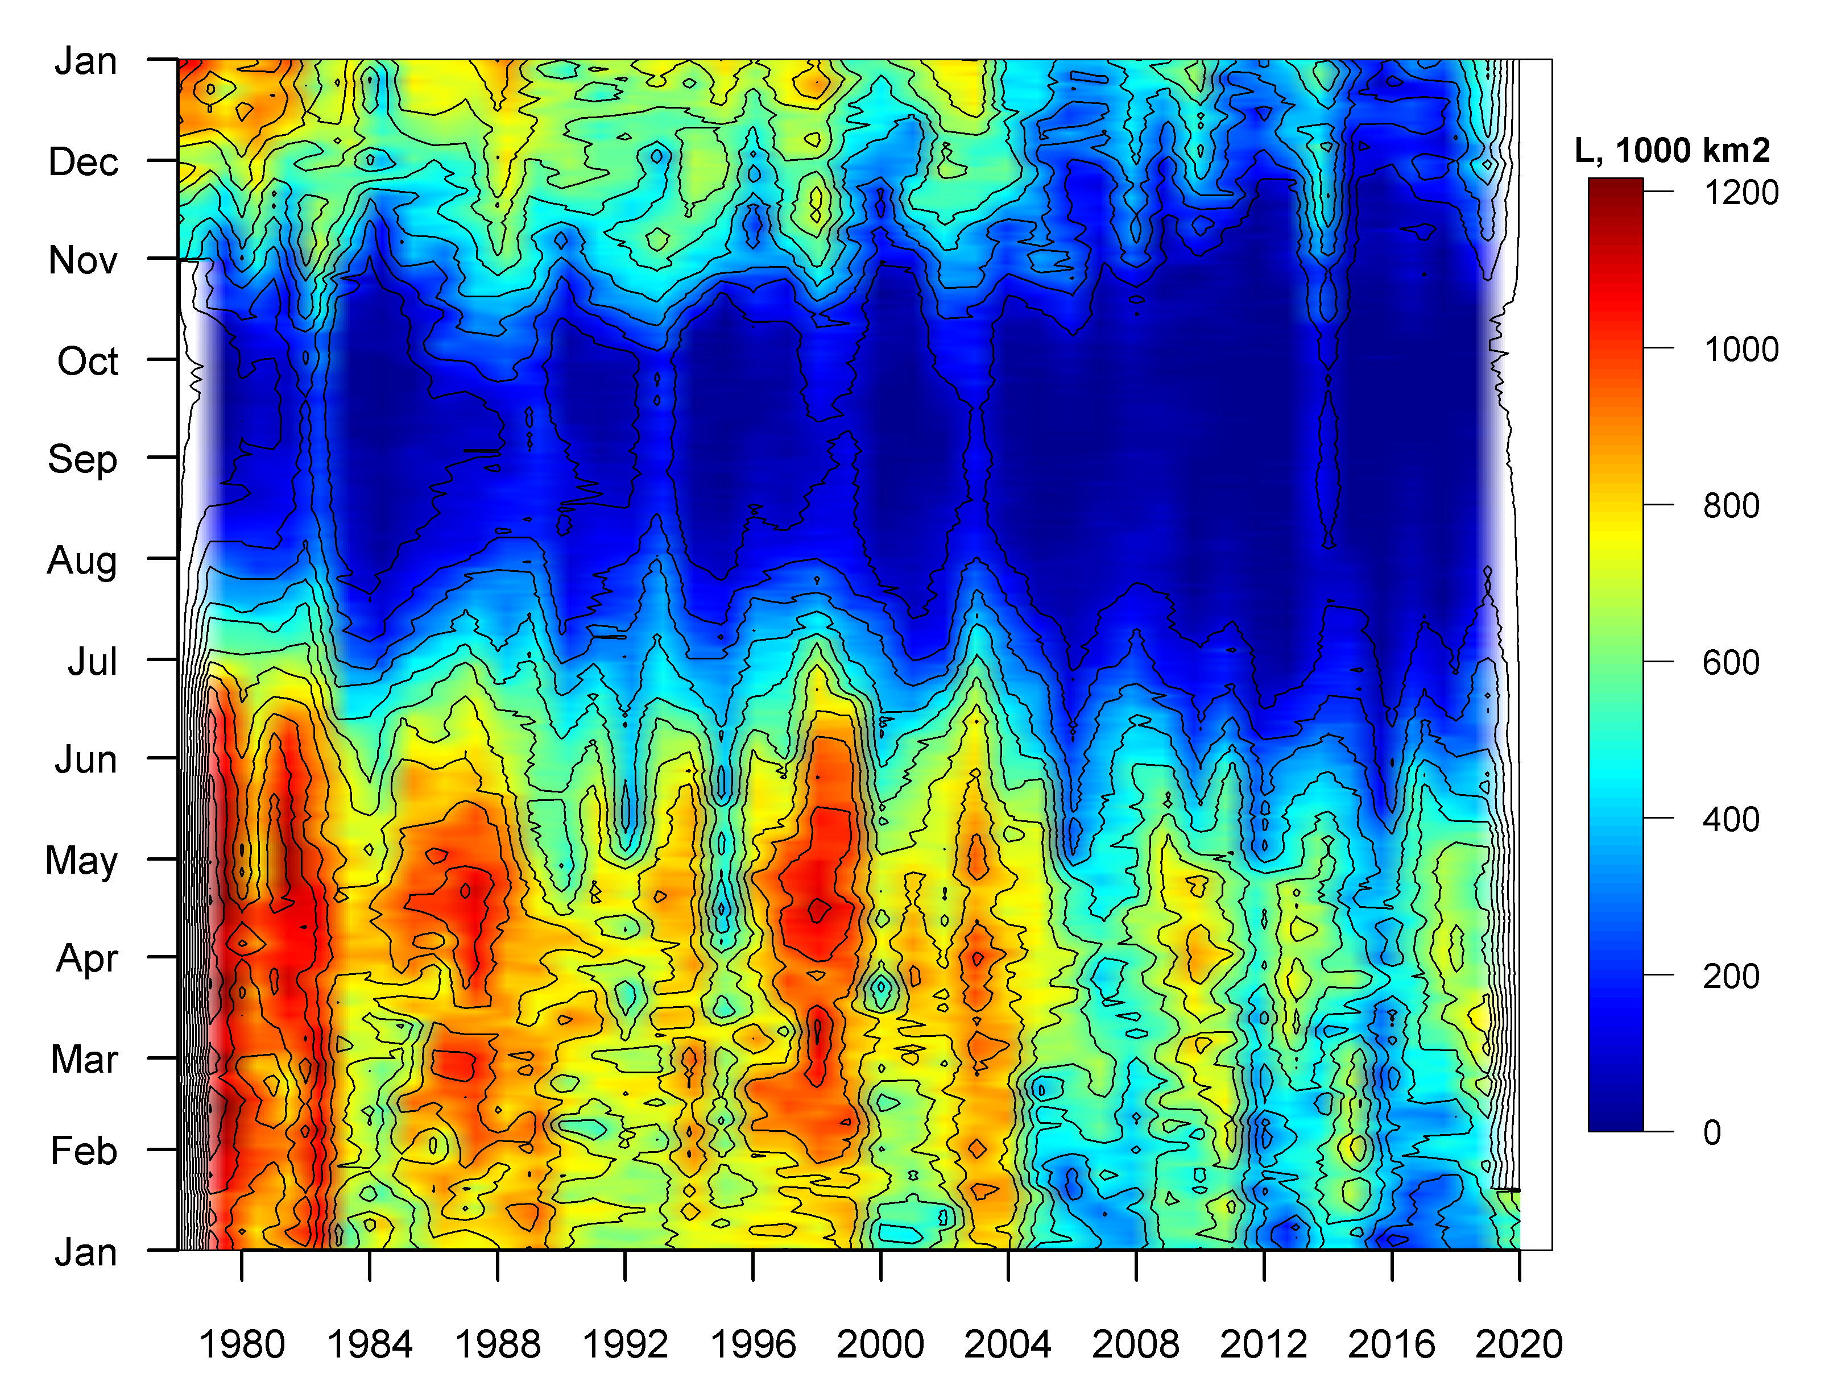
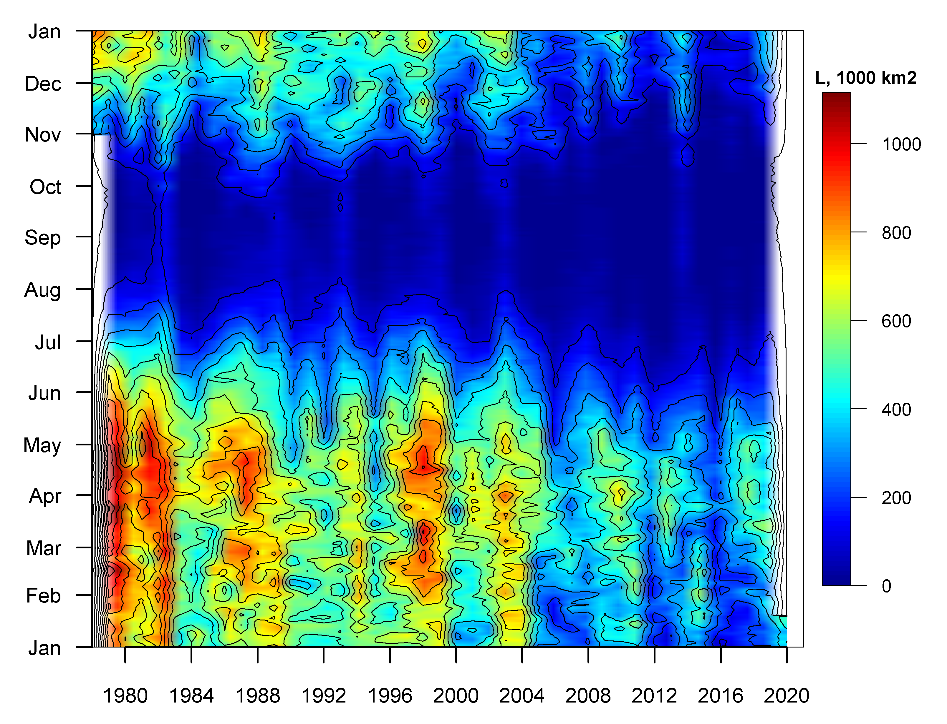
Sea ice: extent, area
Barents sea, extent
Barents sea, extent
Barents sea, area

Slide 11
Snow
Snow height
Combined stations and satellites: SnowWatch
Reanalysis: ERA5
Snow extent
Combined stations and satellites: SnowWatch
Reanalysis: ERA5
Snow water equivalent
Combined stations and satellies: SnowWatch
Reanalysis: ERA5

Slide 12
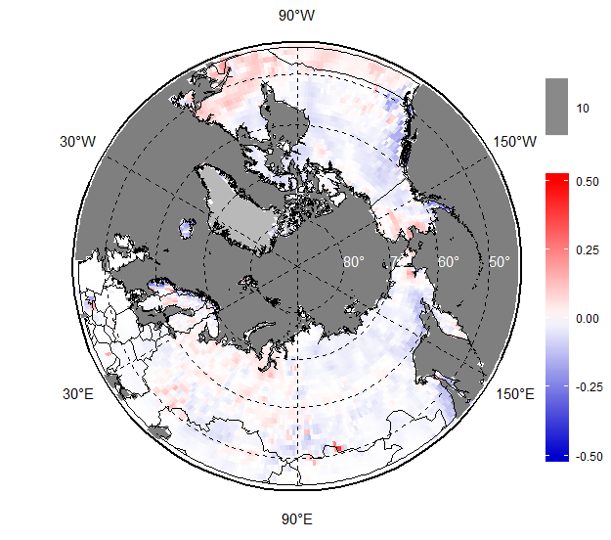
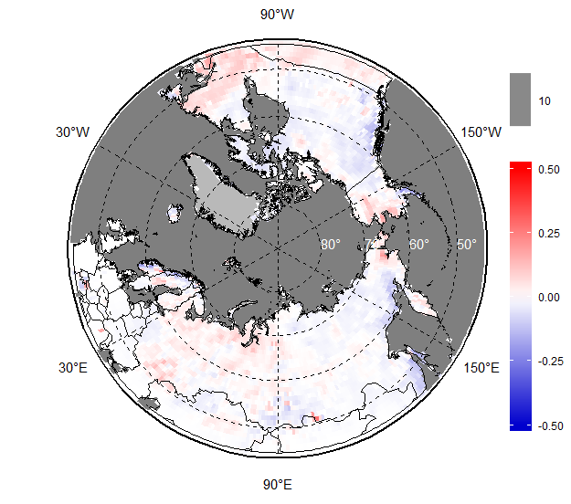
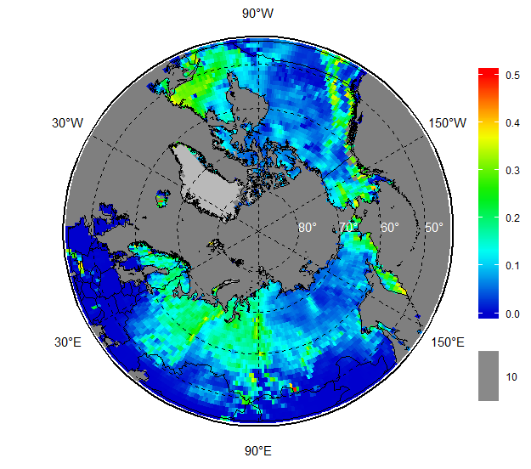
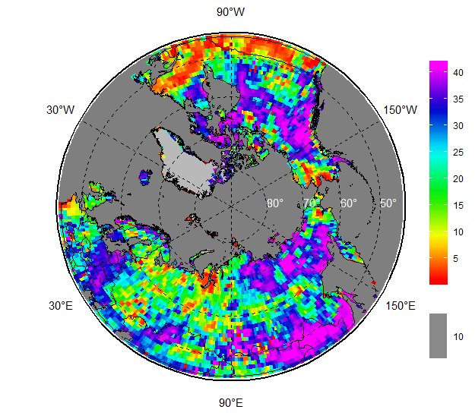
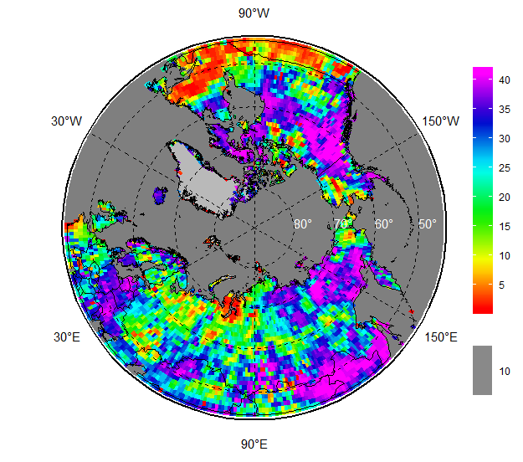
Snow: height ERA5
Mar 2019 Anom 1981-2010 Anom 2000-2019
– Rank Mar’2019 Rank MAM 2019

Slide 13
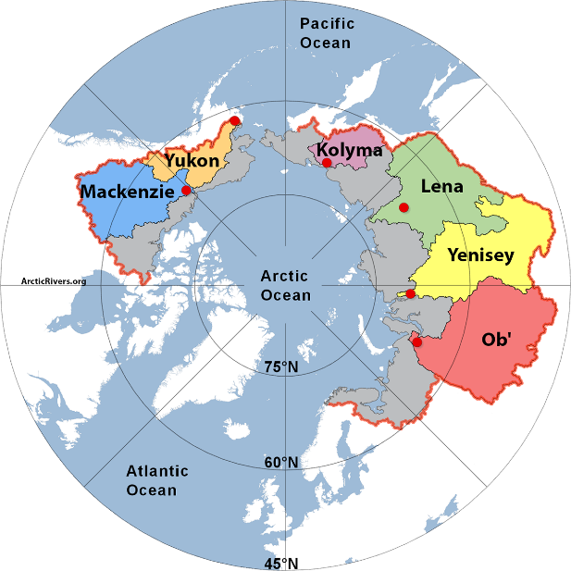
Rivers
Discharge
Stations (and analysis): ArcticGRO (Arctic Great Rivers Observatory)
Reanalysis: ERA5
Surface runoff
Reanalysis: ERA5
River basins with discharge values available from ArcticGRO

Slide 14
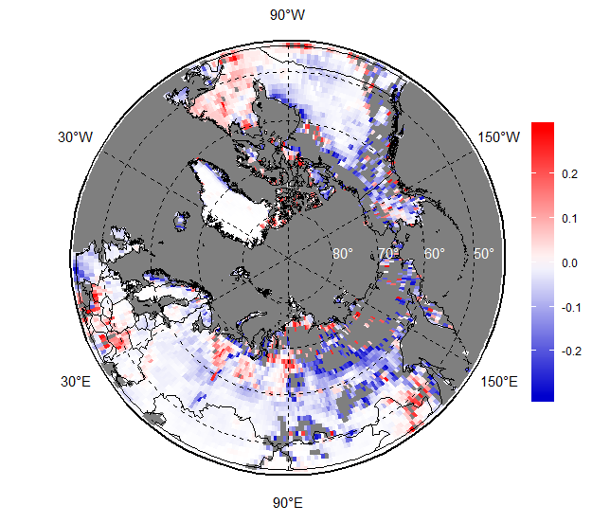
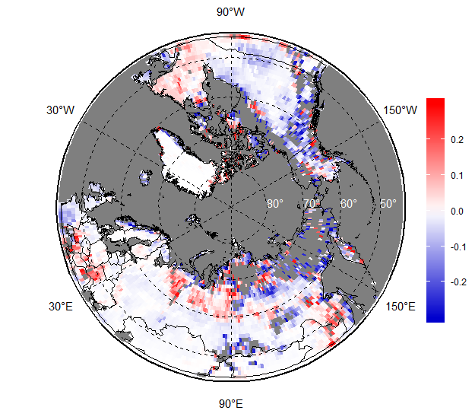
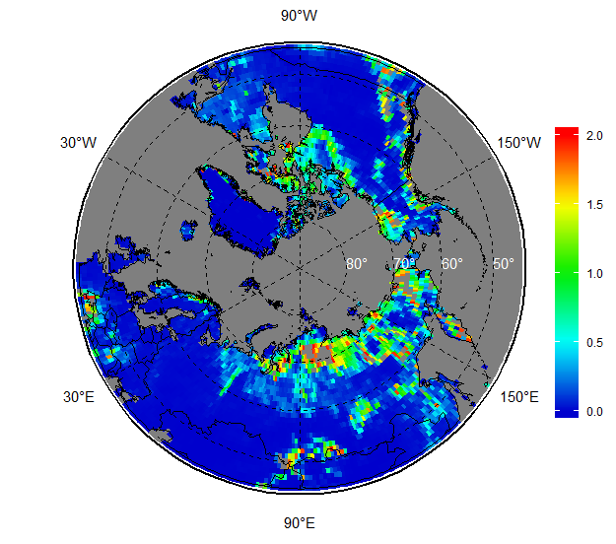
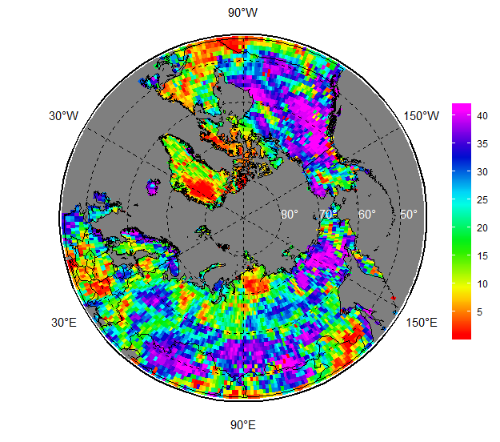
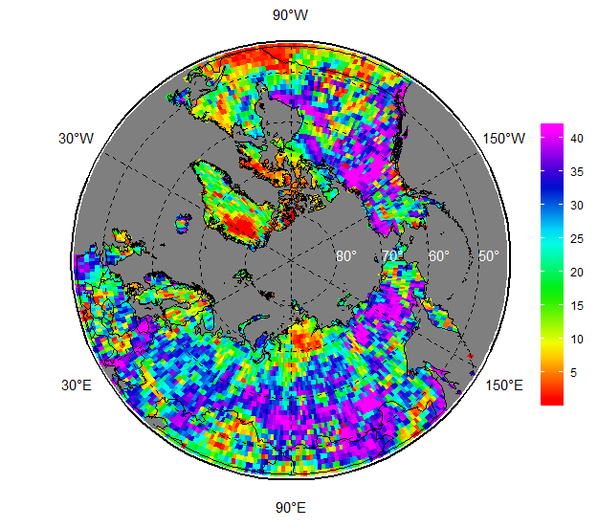
River: surface run-off ERA5
May 2019 Anom 1981-2010 Anom 2000-2019
– Rank May’2019 Rank MAM 2019

Slide 15
Ocean
Waves (wind and swell height)
Reanalysis: ERA5
Sea surface temperature
Reanalysis: ERA5
Heat capacity (20, 50, 100 meters etc)
Reanalysis: MERCATOR analysis

Slide 16
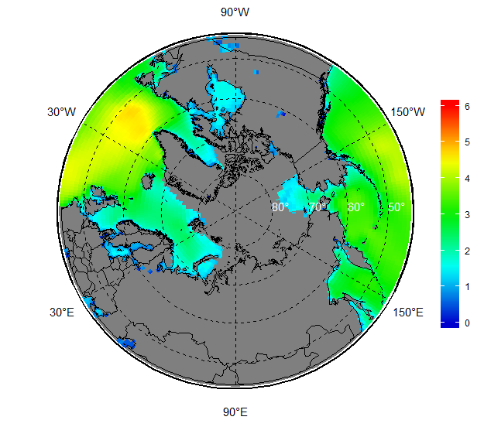
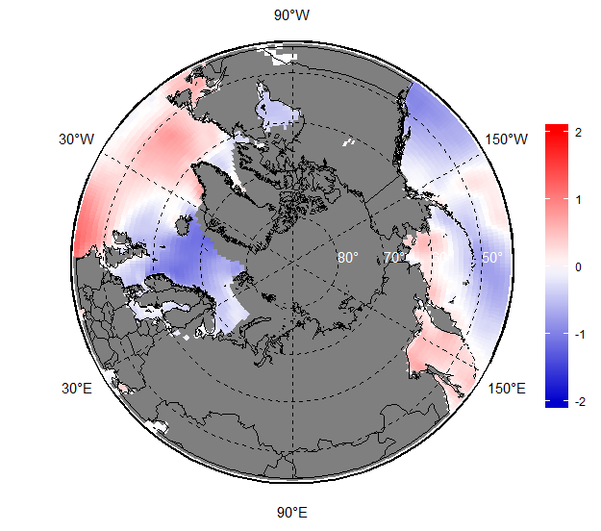
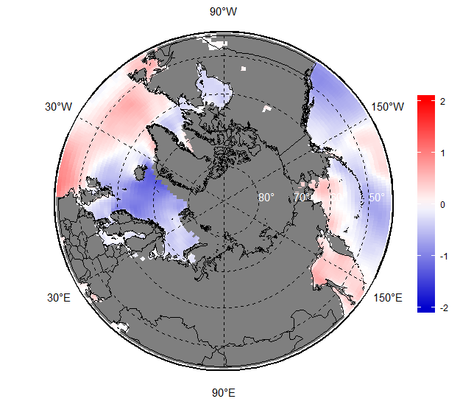
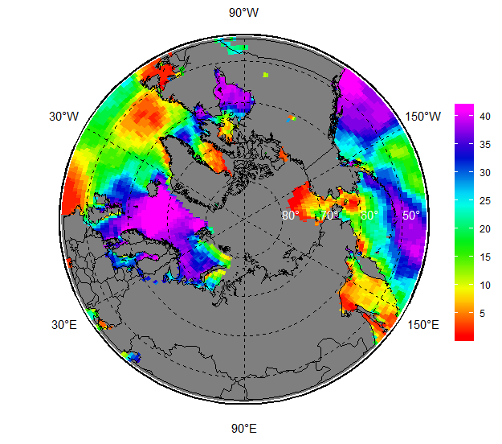
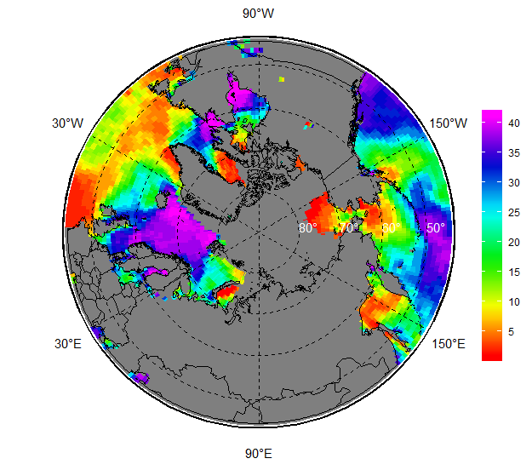
Ocean: wind+swell height ERA5
Nov 2019 Anom 1981-2010 Anom 2000-2019
– Rank Nov’2019 Rank SON 2019

Slide 17
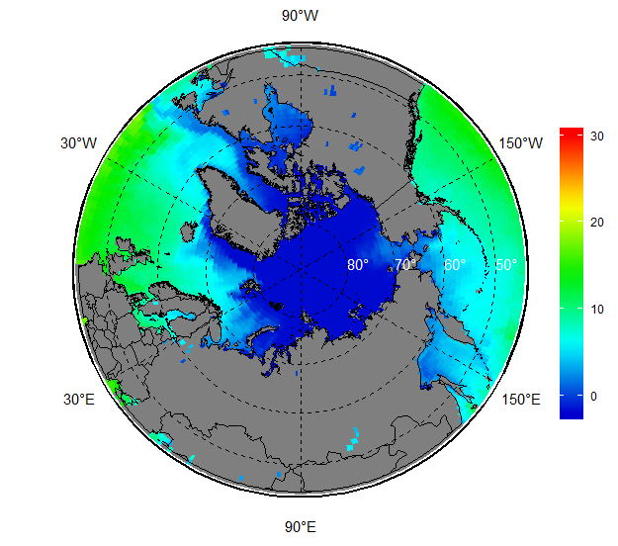
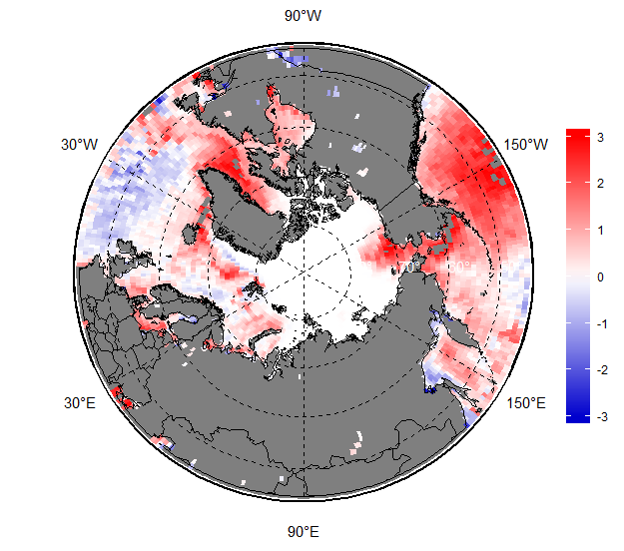
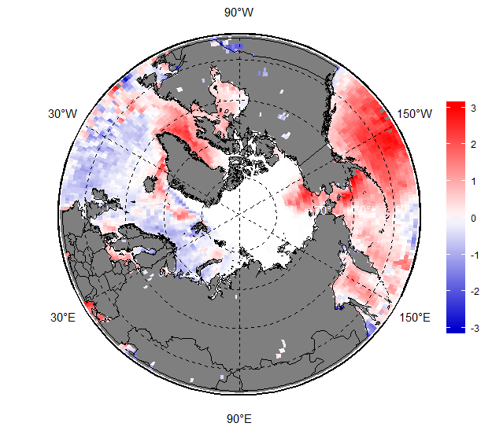
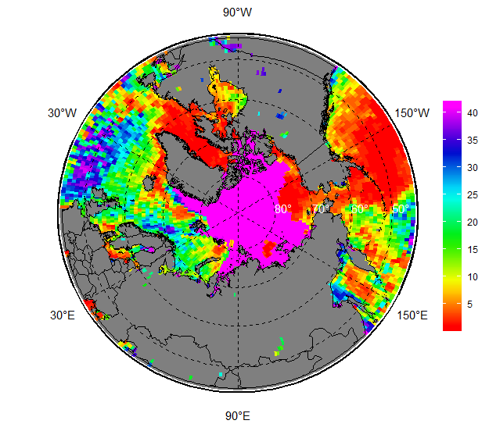
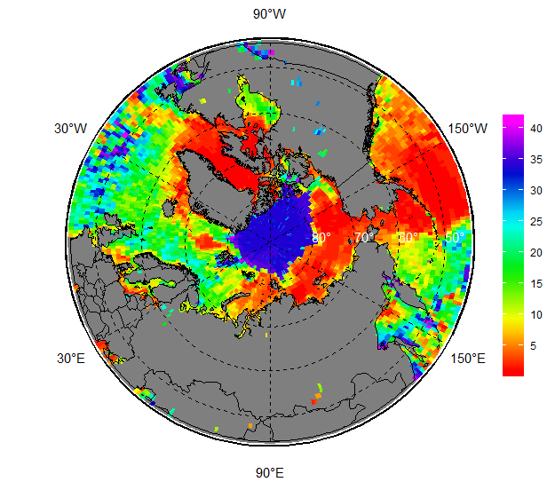
Ocean: SST ERA5
Nov 2019 Anom 1981-2010 Anom 2000-2019
– Rank Nov’2019 Rank SON 2019

Slide 18
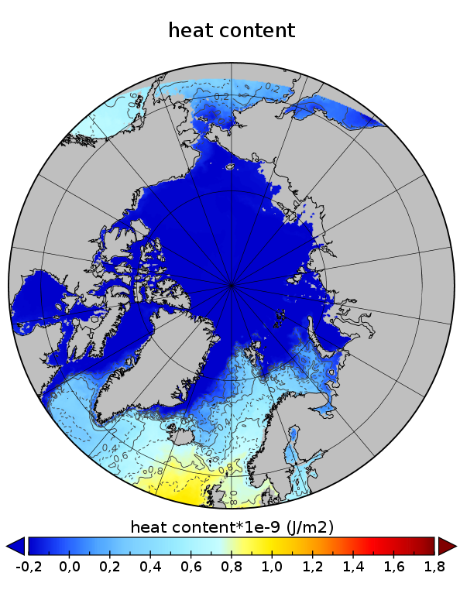
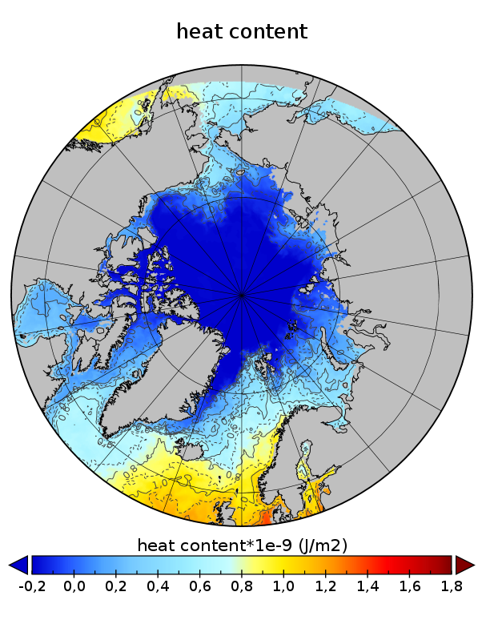
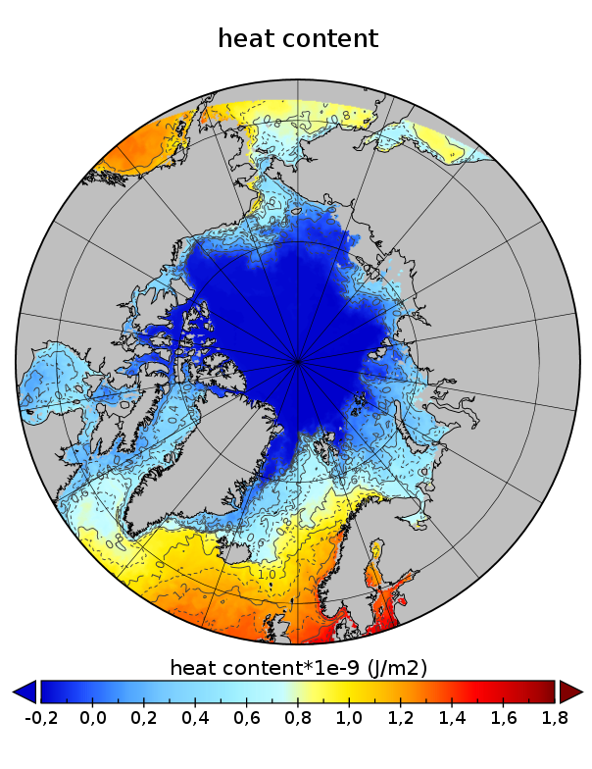
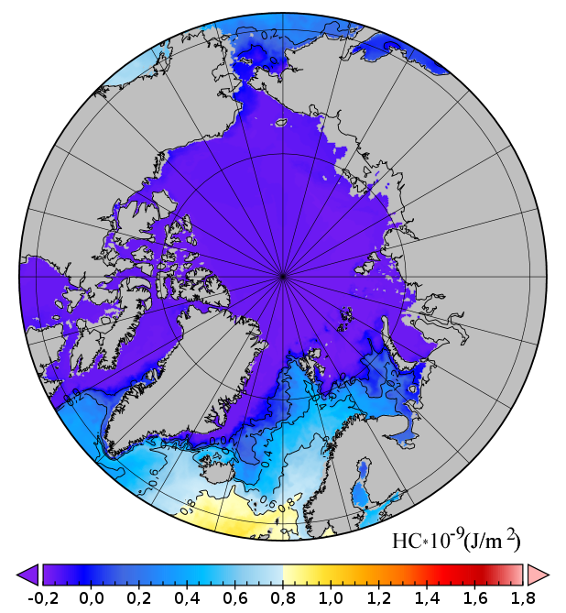
Ocean: heat content upper 20 m, MERCATOR
May 2019 Aug 2019 Oct 2019
May, diff 2019 - 2004 Oct, diff 2019 - 2004

Slide 19
Permafrost
Active layer depth (ALD)
Stations: CALM
Soil temperature by single layers
Reanalysis: ERA5
Positions of
CALM network
2019

Slide 20
Questions to be answered
Stations and in-situ data
Ensure the quality checked data is panarctic (e.g. not for Eurasia or Canada only) and timely for all kinds of observations, e.g.
surface obs become available with delay of ~1 week for the last full month from NOAA but several weeks from Roshydomet Obninsk, does additional QC is significant for ArcRCC summaries ?
Availability and timeliness of coastal obs is still a problem
CALM and ArcticGRO look to provide timely obs now but the snow obs timeliness is unclear
Reanalysis:
Cooperate with communities making validation (e.g. YOPP projects) so that we may know to what extent we may trust the variables
Choose the best from the point of accuracy, resolution, variables, timeliness, e.g. ERA5 could be the most modern for surface and pressure levels but delay is currently close to 4 weeks (for analysis) opposite to NCEP-NCAR (several days)
What are applications for the growing set of variables ?
Reference periods
At the moment different for different variables
License, umbrella, terms of use

