Slide 1
PARCOF: Temperature and Precipitation Outlooks Presentation
Marko Markovic, Bertrand Denis and Gabrielle Gascon
With support from: Adrienne Tivy and Arun Kumar

Slide 2
Plan
Introductory Part on the seasonal forecasting
- what is seasonal forecast (outlook)
- timescales, sources of predictability and skill
- why do we need ensembles an multi-model ensembles
- how skillful are seasonal forecast in general
T2m and precip seasonal real time seasonal forecasting over the Arctic:
- Temperature outlook over the Arctic
- How to use real-time outlooks combined with the historical skill
- Precipitation outlook over the Arctic.
- what can we do more with the Arctic Regional Climate Center (ArcRCC)
Example on decision making : cost/lost ratio

Slide 3
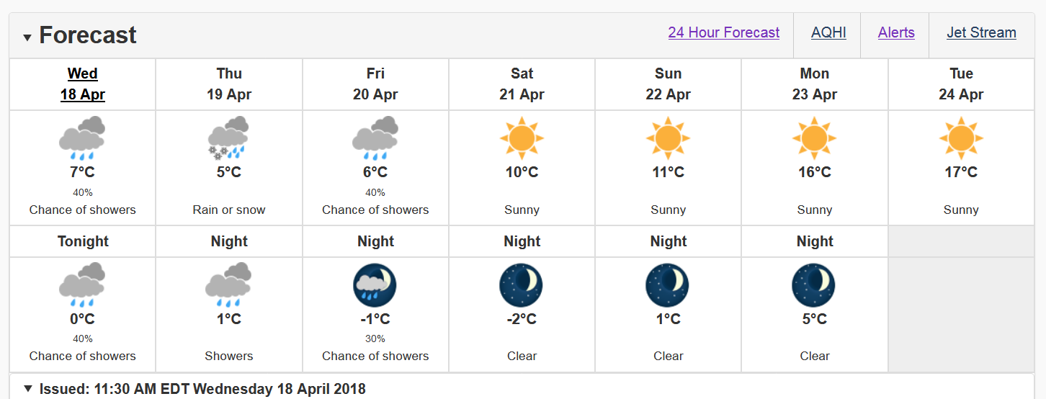
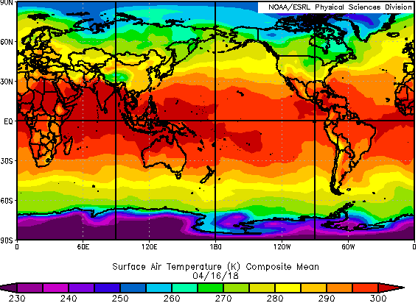
Introduction to Seasonal Forecasting
What is Seasonal Forecast?
Probably all are familiar with the weather forecasts.
Range of the weather forecast can be from 6h (now casting) to up the two weeks in advance (long range weather forecast). On the figure we have ECCC 7-day (mid range ) forecast for the city of Montreal.
How do we do it? We have a tool, a weather forecasting model, which is a set of mathematical equations. We also need the current/initial state of the atmosphere (e.g. temperature, pressure, humidity) at the time we want to perform the forecast.
- On the figure: near surface temperature state on the 16th April 2018 (takes into account storm tracks…..)
https://www.esrl.noaa.gov

Slide 4
Introduction to Seasonal Forecasting
What is Seasonal Forecast?
If we take a weather forecasting model (set of mathematical equations) and we add to it an ocean forecasting model we will obtain a climate forecasting model. First day we can forecast the weather but not after one month.
Capable to give us set of weather realisations for one year and even far beyond.
1 year
Seasonal Forecast is a climate forecast ranging up to 1 year ahead.
Season 1
Season 2
15 May 2018
June
July
August
September
October
November
December
January
February
March
April
May
June 2019
Seasonal Outlook represents a 90-day average of the seasonal forecast’s daily realisations.
We can also construct a monthly outlook which is a 30 day averaged daily realisation
In this talk we will focus on seasonal outlooks!

Slide 5
Introduction to Seasonal Forecasting
Seasonal Forecast Skill?
Skill is a measure of the forecast’s accuracy.
We use historical observations (e.g. temp, precip) to compare our forecasts to.
2 weeks
Very low skill
Not very useful in terms of daily forecasts
~95%
~90%
~65%
Thus, how the seasonal outlook (90 day average) can be useful if we lose skill in weather forecast after two weeks?
Surface air temp 4th April 2018
weather forecasting model depends on the current/initial state of the atmosphere (e.g. temperature, pressure, humidity) at the time we want to perform the forecast.
After 2 weeks weather model “forgets” the initial condition state and starts to drift away from them.

Slide 6
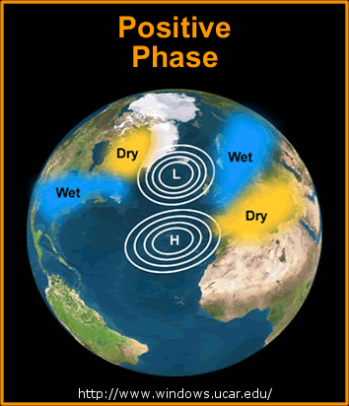
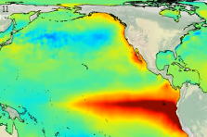
Introduction to Seasonal Forecasting
Seasonal Forecast Skill?
Climate model (seas forecast) = weather model + ocean model + boundary forcing description
Weather Forecast – up to two weeks
Seasonal forecast – 3 months, depends on the slowly evolving boundary conditions and also on the initial state of the atmosphere.
Boundary conditions influencing the seasonal forecasting skill:
- Changes in the Ocean (e.g. El Nino, Pacific Decadal Oscillation)
- Changes in the land (e.g. soil moisture, snow cover)
- Changes in the Atmosphere (e.g. circulation patters NAO, PNA )
NAO, appears very often and influences seasonal climate for ~3 weeks
El Nino, appears once in 3-5 years and influences seasonal climate for 9 months
Snow depth (22 Feb 2016 source ECCC), appears every year and influences seasonal climate during its presence, depending on the region.
https://www.metoffice.gov.uk

Slide 7
Introduction to Seasonal Forecasting
Why do we need ensembles?
- Due to the uncertainty of the initial conditions, we are also not certain about the seasonal forecast results.
forecast
uncertainty
Initial condition
uncertainty
Comparing to only one forecast, ensemble approach is always preferred because of:
Model error annulation (average, red line), (e.g. Ensemble 1 = 2, Ensemble 2 = -2) -> deterministic approach (one value).
We can use ensembles to explore chances for potential forecast results - > probabilistic approach (chance for all possible values).
Seasonal Forecast is even better if we have several climate models (multi model approach). This is because of even more ensemble members.

Slide 8
Introduction to Seasonal Forecasting
How do we communicate seasonal forecast results?
Weather forecast communicate results in terms of numbers or events.
e.g. On the 17th May 2018 it will be 18 degrees Celsius
e.g. On the 17th May 2018 light rain will start in the evening.
With seasonal forecasting this is not possible because the forecast error would be very large (remember that we have 90 days for seas forecast).
So what do we do? We calculate if the 90-day average forecast (seasonal outlook) will be: above, below or near normal. We need to define the normal or the reference period.
Defining normal climate in JJA for Ottawa.
We have to take 30 years of temp anomalies (thirty summers, thirty numbers)
Climatology: 20 deg, we select the threshold ~68% of all summers.
19.5
20.5
If the forecast for temp is higher than 20.5 we declare it above normal.
Lower 19.5 deg is below normal.
In between is near normal.
below
normal
above
normal
Temp occasion (how many times)
5
20
30
Temperature in Celsius

Slide 9
Introduction to Seasonal Forecasting
How do we communicate seasonal forecast results?
Climatology for Ottawa JJA (records for 30 summers)
Seasonal Forecast for Ottawa JJA 2018
If we have ensemble forecast with
60 members and…..
19.5
20.5
below
normal
above
normal
Below normal | Near normal | Above normal
15 | 10 | 35
25% (15/60) | 17% | 58%
Temp occasion (how many times)
5
20
30
Temperature in Celsius
We will issue the following statement:
For the summer 2018 in Ottawa, there is a ~60% chance that the temperature will be above its normal values.
Note: This is much higher than a pure chance. Since we have 3 possible occasions, pure chance is 33% (compare with a coin flip where is 50%). Chance of 60% is much higher than the one of 33%.

Slide 10
Introduction to Seasonal Forecasting
How do we communicate seasonal forecast results?
Climatology for Ottawa JJA (records for 30 summers)
Seasonal Forecast for Ottawa JJA 2018
If we have ensemble forecast with
60 members and…..
19.5
20.5
below
normal
above
normal
Below normal | Near normal | Above normal
15 | 10 | 35
25% | 17% | 58%
Temp occasion (how many times)
5
20
30
Temperature in Celsius
Another way to think about it.
In Ottawa this summer, it is possible that we have all three predefined categories for temperature, but the highest confidence (~60%) we have in the Above Normal category.
If our forecast is lower than 33% we will not have confidence since it is inferior than a pure chance. If the forecast is : 40-60% -> low confidence ; 60-80 -> moderate to high confidence; larger than 80% -> high confidence

Slide 11
Introduction to Seasonal Forecasting
How skillful are seasonal forecasts in general?
To asses real-time seasonal forecast of the multi-model ensemble, first we need to evaluate its historical performance:
If MME historical forecasts were skillful it is very likely that they will be skillful in real time too!
Historical forecasts (e.g.)
Forecasts for every summer between e.g. 1981-2010 -> 30 summers
All models all ensemble members
We calculate a score (e.g. correlation coefficient) for 30 summers for temperature and precip.
Anomaly Correlation Coefficient score : based on 17 years, MME mean of WMOLFC models
JJA T2m
JJA Precipitation
Notes:
Roc score tell us that seasonal forecast for summer is very skillful over the Tropic

Slide 12
Introduction to Seasonal Forecasting
How skillful are seasonal forecasts in general?
Anomaly Correlation Coefficient score : based on 17 years
DJF T2m
DJF Precipitation
Some facts about skill:
In winters better than in summers (more oscillations present).
Every season (e.g. MAM, AMJ,…) has a different skill.
Temperature is much better than precip (warming trend, not much precip in high latitudes).
Skill is very good in tropics, limited over extra-tropics and very restricted over the Arctic.

Slide 13
T2m and precip seasonal real time seasonal forecasting over the Arctic:
- Temperature outlook over the Arctic
- How to use real-time outlooks combined with the historical skill
- Precipitation outlook over the Arctic.
- what can we do more with the Arctic Regional Climate Center (ArcRCC)

Slide 14
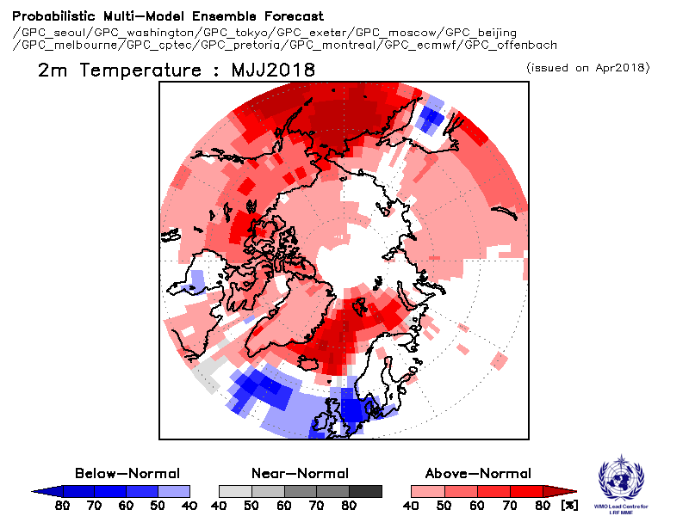
Temperature outlook over the Arctic:
May-June July 2018
North America
European Arctic
Wester Russia
Central Russia
5. Eastern Russia

Slide 15
Temperature outlook over the Arctic:
May-June July 2018
ROC score for T2m in MJJ based on 19 years of historical data (1983-2001)

Slide 16
Temperature outlook over the Arctic:
May-June July 2018
ROC score for T2m in MJJ based on 19 years of historical data (1983-2001)
Two examples of how to use historical ROC score with the actual real time forecasts:
Forecast over the Taymyr peninsula (Russia)
Forecast over the continental Nunavut (Canada)
Real time forecasts:
Taymyr: ~40% chance for above normal
Nunavut: ~60% chance for above normal
Historical skill according to the ROC score:
Taymyr: 60-70% (moderate skill)
Nunavut: <50% (no skill)
What would we expect for the MJJ:
1. Taymyr : We expect above normal temp, but we don’t have high confidence (40%), we can make decisions based on seas forecast due to the presence of the historical skill.
2. Nunavut: We don’t make decisions, no historical skill. However the forecast of above normal temp is still possible.

Slide 17
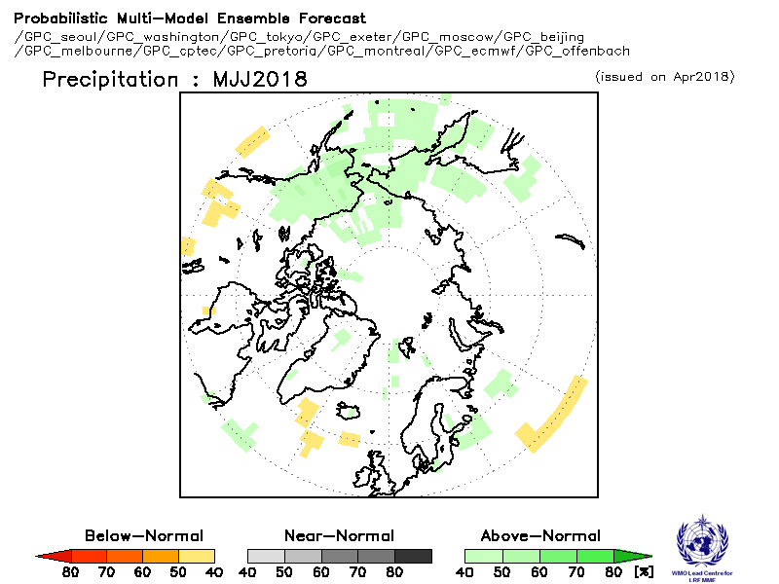
Precipitation outlook over the Arctic:
May-June July 2018
North America
European Arctic
Wester Russia
Central Russia
5. Eastern Russia

Slide 18
Precipitation outlook over the Arctic:
May-June July 2018
ROC score for Precipitation in MJJ based on 19 years of historical data (1983-2001)

Slide 19
So, what can we conclude for the MJJ 2018
seasonal forecast over the Arctic?
Considering multi-model ensemble forecast and a limited model skill over the Arctic:
T2m: There is probability of 50% or more that the temperature will be above normal in the Northwestern and northern Alaska and north western Canada. Over the European Arctic there is low probability ~40% for below normal temperature in the southwestern Norway. We expect low probability of ~40% for above average temperature in the eastern Europe and central and northern Russia.
Precipitation: there is a low probability of 40 or more for above average precipitation over Alaska an easternmost parts of Russia. Otherwise, there is an equal chances for above, below or near normal temperatures over the Arctic belt.

Slide 20
What can we do more with the
Arctic Regional Climate Center (ArcRCC)
ArcRCC
Regional Climate Center founded by the World Meteorological Organisation to:
Promote climate monitoring over the Arctic
Promote seasonal and sub-seasonal forecasting over the Arctic
Promote climate research over the Arctic
Promote climate services over the Arctic
Promote operational data to for better long range forecasts
Met Service of Norway is working towards a platform (a web page) to enables all this goals to the users.

Slide 21
Breakout-group questions
What are seasonal forecast, seasonal forecast outlook and how we communicate it?
Are seasonal outlooks useful to you?
Which forecasting timescales (e.g. a week, a few weeks, a month, a season) are you interested in?
What regions or which season (e.g. spring, summer,..) are the most important to you?
How much skill you need in order to make a decision (real-time versus historical forecast)?
Do you think we should present this in a different way (to complex)?
Would you like to have a training session about using the seasonal forecast products in decision making?

Slide 22
More questions, if time permits
………………………………….

Slide 23
Example on decision making: cost/lost ratio

Slide 24
Take home messages
Seasonal forecast has limited skill over the arctic region (contrary to the tropics)
…..
…
…..
….

