Slide 1
Outline:
Introductory slides on state of seasonal sea ice forecasting
inclusions of sea ice models to coupled forecast systems is a relatively new development
challenge of ice thickness initialization
how NAIS has been forecasting in the absence of models (other ice services?) and SIPN
2. WMO operational model forecasts (September or the whole summer?)
CanSIPS (ECCC/Canada)
CFSv2
others?
3. SIPN Consensus statement
4. Subjective input from the PARCOF team?
ex. presence of MYI in the CAA a potential indicator of trafficability in the NWP
5. Summary statements?

Slide 2
Introductory slides on the state of seasonal forecasting
Notes:
* Coupled sea ice models in seasonal forecast systems is a relatively new development – being studied extensively on the research side but only a few forecast centers have it implemented operationally …. More coming on
Question – should we only use WMO forecast models?

Slide 3
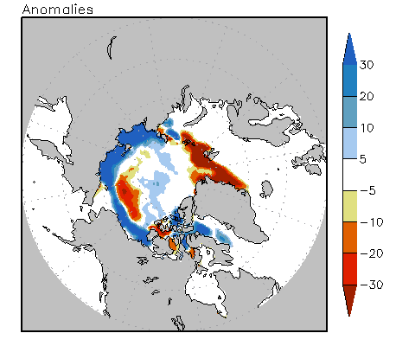
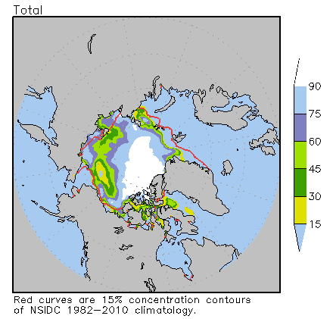
September 2018 ice concentration: CFSv2
* couldn’t find skill maps – pull from literature?

Slide 4
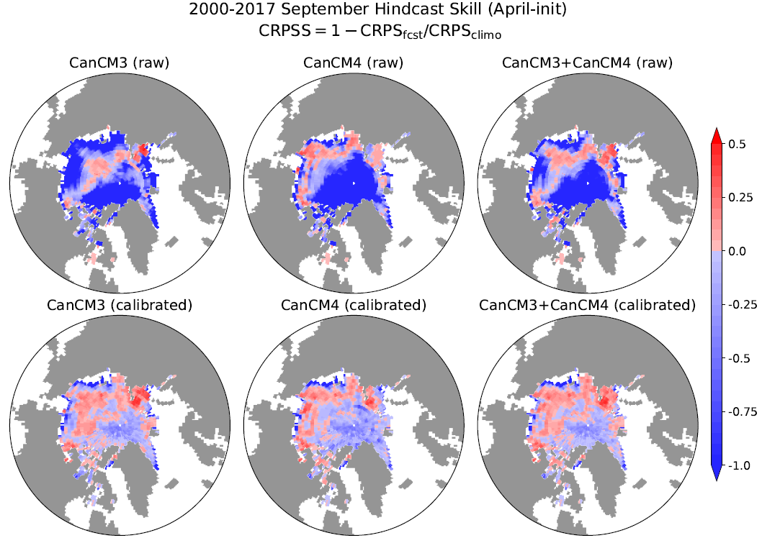
September 2018 ice concentration: CanSIPS skill
Notes:
Skill increases with calibration …. higher skill when both models are combined ..... slides that follow are calibrated
Note lack of skill in central arctic ocean, greenland sea
Note funny representation of the CAA because of coarse resolution – can’t use for NWP
Continuous rank probaiblity skill score

Slide 5
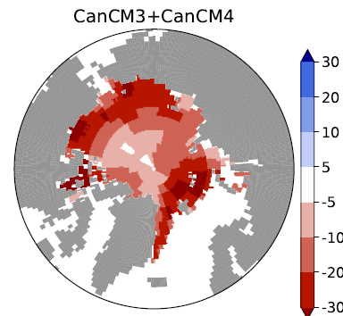
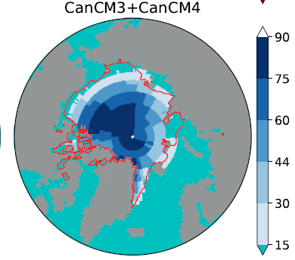
September 2018 ice concentration: CanSIPS
Anomalies
Total
Notes:
Can be compared with CFSv2
Ensemble mean
Red line is NSIDC mean ice extent

Slide 6
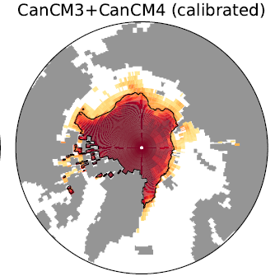
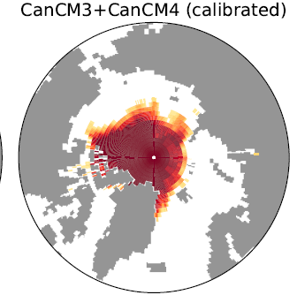
September 2018 ice concentration: CanSIPS * probabilistic forecast*
Probability ice conc. > 15%
Probability ice conc. > 50%
Notes:
* Can be compared with CFSv2

Slide 7
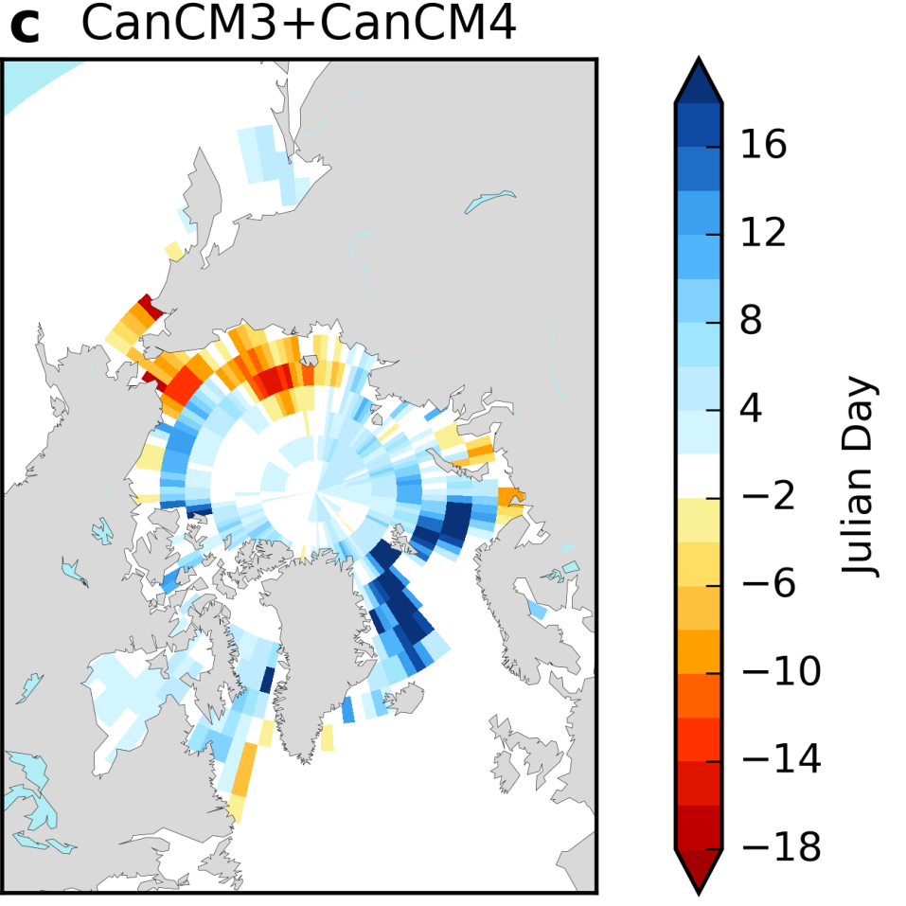
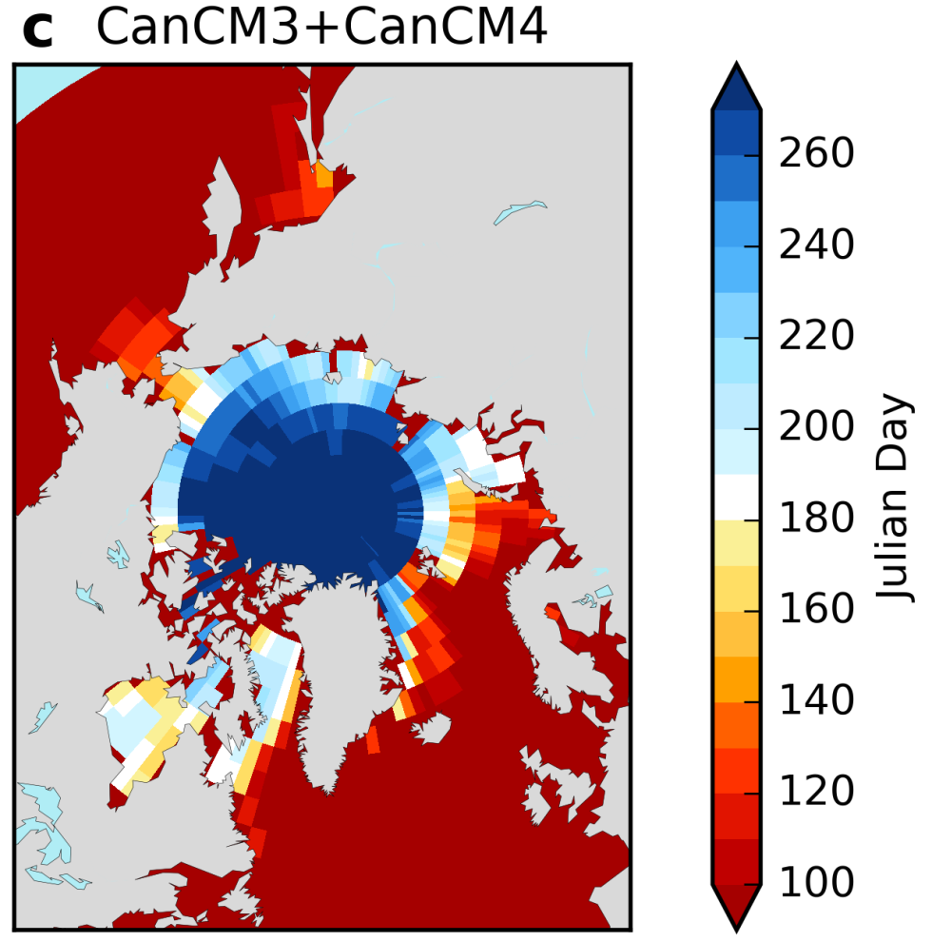
Summer 2018 break-up dates: CanSIPS * need to add context for interpretation*
anomaly
julian day
Notes:
* Can be compared with CFSv2

Slide 8
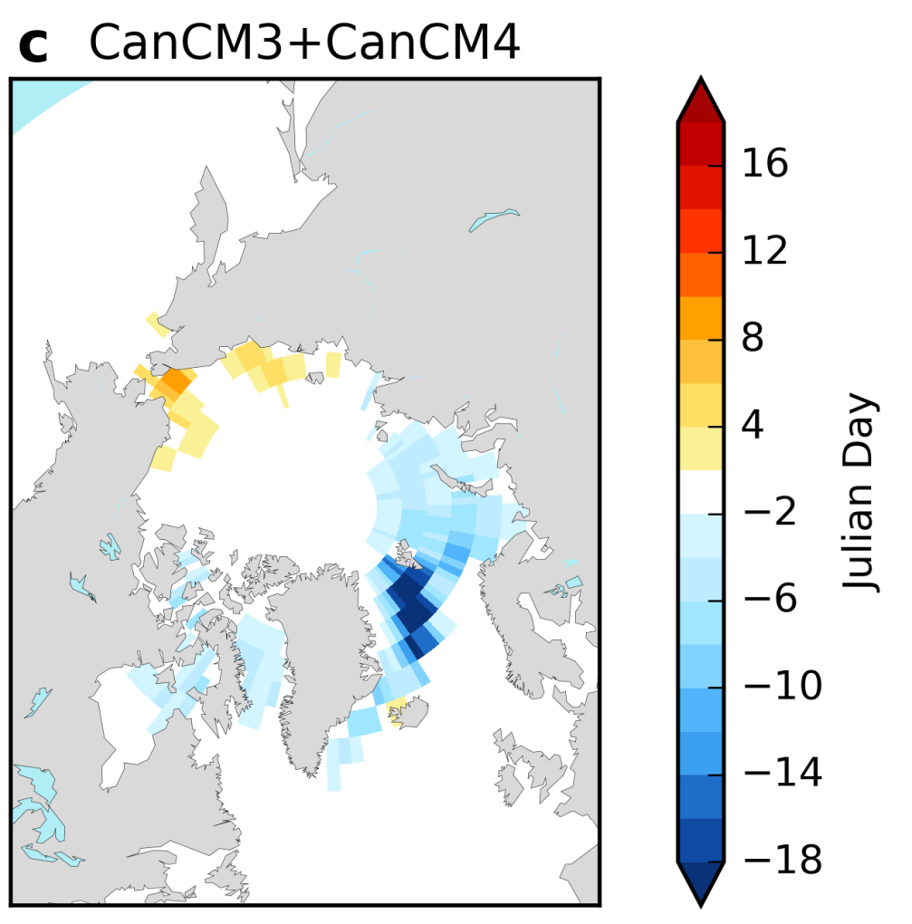
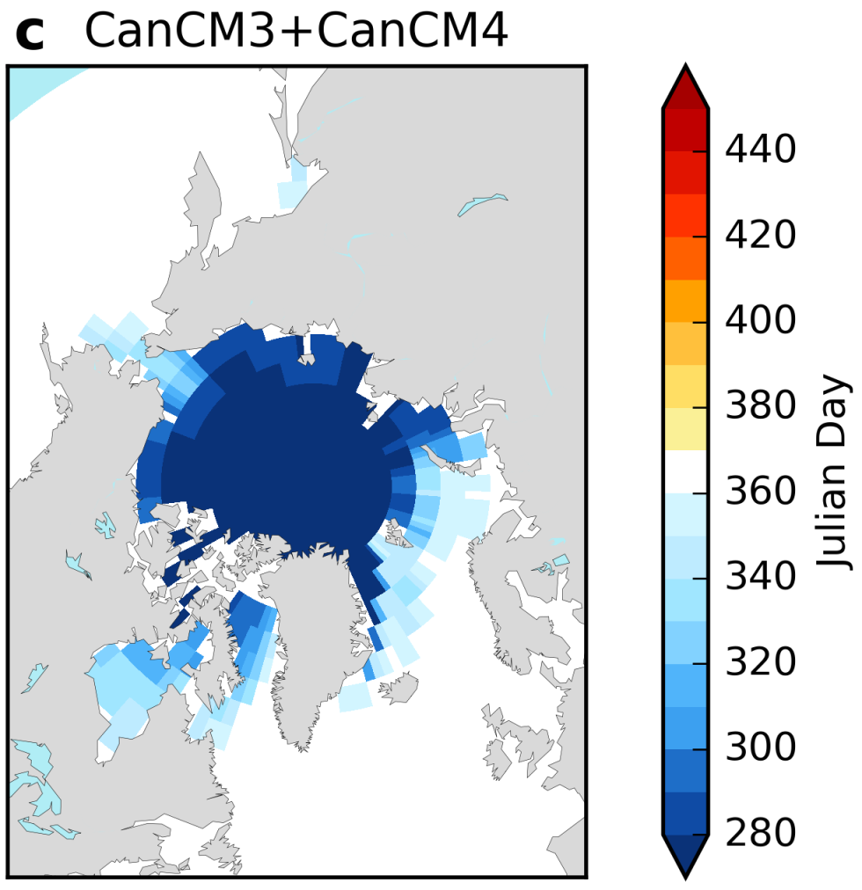
Fall 2018 freeze-up dates: CanSIPS
anomaly
julian day
Notes:
* Can be compared with CFSv2

Slide 9
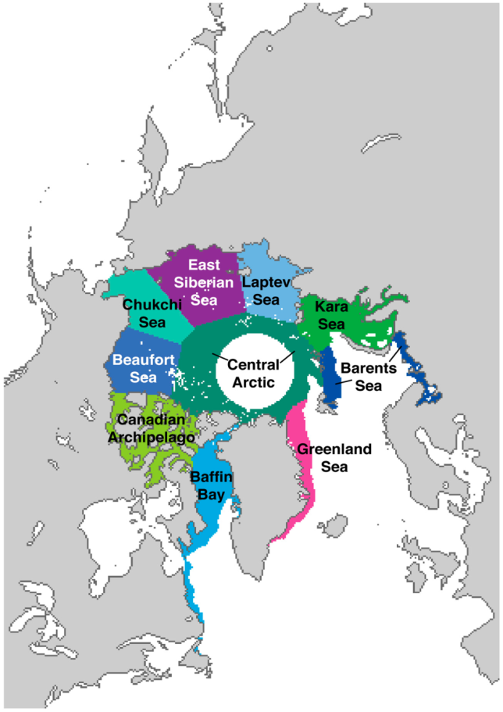
SIPN Consensus Statement
For any or all of the following predictands, rank expected September 2018 sea ice minimum conditions relative to those observed for the preceding 9 years 2009-2017 (Fig. 1), as follows:
Higher than average (upper tercile of 2009-2017)
Near average (middle tercile of 2009-2017)
Lower than average (lower tercile of 2009-2017)
Unprecedented low (lower than all previous years in the satellite era)
Predictands
1) Pan-Arctic sea ice extent (or area)
2) Sea ice area* in the following Arctic sectors (see Fig. 2):
(a) Beaufort/Chukchi Seas
(b) Baffin Bay/Canadian Archipelago
(c) Barents/Kara Seas
(d) Laptev/East Siberian Seas
3) Accessibility** of the following shipping routes (see Fig. 3):
(a) Northern Sea Route
(b) Northwest Passage
Notes:
* Can be compared with CFSv2

Slide 10
Other forecasts? CIS? AARI?
Notes:
* Can be compared with CFSv2

Slide 11
Summary Statements
* do we need a sea ice outlook / consensus statement for 2018 summer season?
If yes,
just based on WMO models or taking into consideration SIPN/others
It could be done regionally like the SIPN forecast with qualitative wording around uncertainty?
likely, highly likely, etc…
* Do we do this at the meeting or before? For timing, SIPN ends the Wednesday before the PARCOF
Notes:
* Can be compared with CFSv2

Slide 12
Break-out Q’s for sea ice
General discussion on needs for sea ice outlooks:
what are your needs for decision making?
where do you get information now?
what’s the potential impact of good sea ice information; what skill do you need?
what lead times are critical and do you need information as the season unfolds?
Feedback on PARCOF sea ice presentation:
What information/products presented are useful and how would you use it?
Does it need to be presented in a different way?
What would you like to see?
What are critical gaps? Scale, skill, etc..
Notes:
* Can be compared with CFSv2

