Slide 1
State of the Arctic Climate
To add on final version
Add affiliation on final version
1st Pan-Arctic Climate Outlook Forum (PARCOF-1)
May 15, 2018

Slide 2
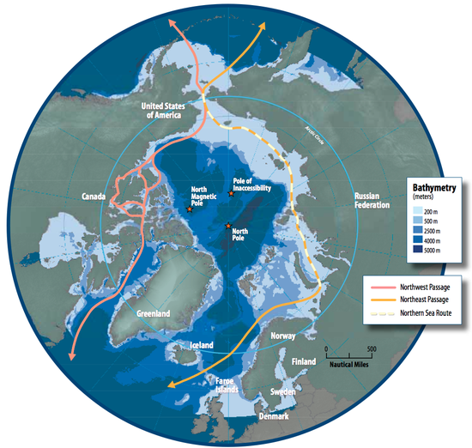
The Arctic matters
Shipping
Transportation
Tourism
Hunting
Economic development
Resilient communities
Climate adaptation
Notes:
Need to write speaker notes for this slide.
Figure shoes Arctic shipping routes
The presentation is organized the following way:
This slide will provide an overview of the main spheres of interest for the Arctic region and briefly introduce why knowledge of the Arctic climate is important.
This will be followed by a short introduction of the different climates within the Arctic: dry/wet, cold/warm, coastal/continental, and different vegetation/ground cover (tundra, permafrost, glacier, ice sheet, ocean, sea ice, boreal forest). The following slide will also mention that monitoring and forecasting arctic climate is more challenging than other parts of the world due to the lower density of observations compared to mid-latitude and high population areas.
The bulk of the presentation focuses on three main parameters: temperature, precipitation, and sea ice. Each have two slides: i) general trend/pattern, and ii) a notable event from last season as example of climate variability
The last sea ice slide will also be used as a transition to the last topic: social aspects and impacts of climate change on indigenous communities (1 or 2 slides)
The last slide will provide concluding remarks linking to what will be covered during the workshop.

Slide 3
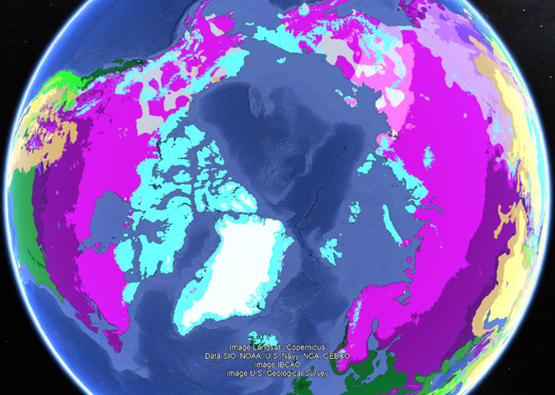
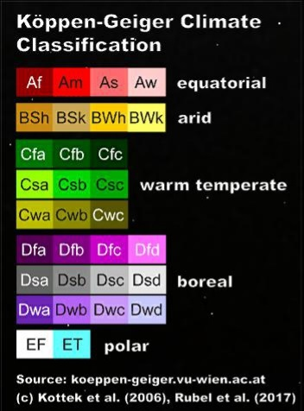
Climate classification of the Arctic
Notes:
Weather vs Climate
Weather: day-to-day state of the atmosphere, and its short-term variation in minutes to weeks.
Climate: weather of a place averaged over a period of time.
Plus, see next slide for what could me mentioned for this slide.
Why is there so much variability in climate and weather in Arctic? The Arctic covers a large area, and is characterized by several different climates. This presentation will provide an overview of the general characteristics of the Arctic climate, especially temperature, precipitation, and sea ice, as well as their changes currently observed, and a few highlights from the previous winter.

Slide 4
Features of regional climate
The Arctic is composed of different climatic zones.
Large amount of climate variability:
Average January temperatures: -34 °C to 0 °C
Average July temperatures: -10 °C to +10 °C
Maritime (cool, moist) vs continental climate (dry, cold)
Above/below the Arctic circle; affect the amount of sunlight
Different vegetation/land type: sea ice, glacier, snow, tundra
Low density of observation
Notes:
Speaker notes for previous slide

Slide 5
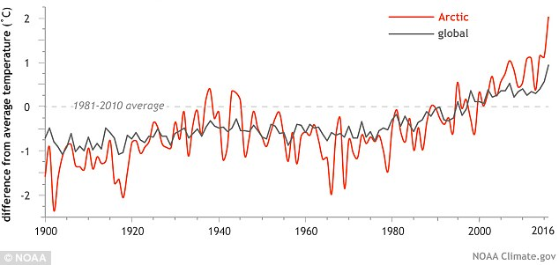
Arctic surface air temperature trends
The Arctic is currently warming at more than twice the rate of global mean temperatures.
Larger positive temperature trends north of 60 °N compared to other latitudes.
Notes:
Figure caption from State of the Arctic Report card 2017: “Arctic (land stations north of 60° N) and global mean annual land surface air temperature (SAT) anomalies (in °C) for the period 1900-2016 relative to the 1981-2010 mean value. Note that there were few stations in the Arctic, particularly in northern Canada, before 1940. “
In 2017, average for the Arctic was +1.6 °C , while extensive regions over the central Arctic showed anomalies exceeding +5 °C.
The +1.6 °C mean surface air temperature anomaly from October 2016 to September 2017 is the second highest value since 1900; the highest value was for October 2015-September 2016.

Slide 6
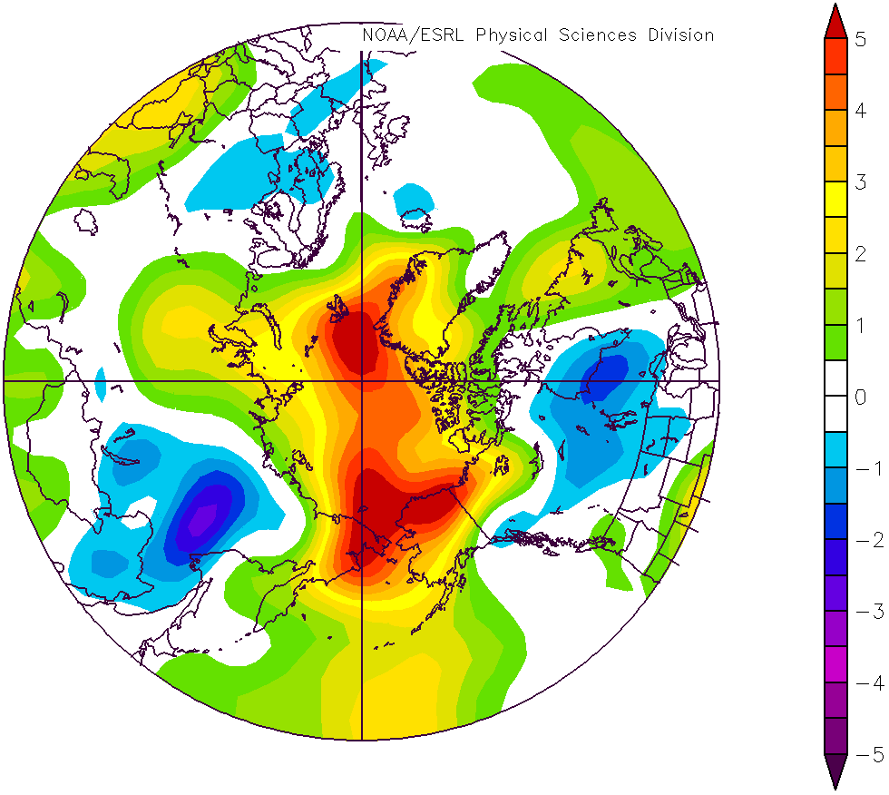
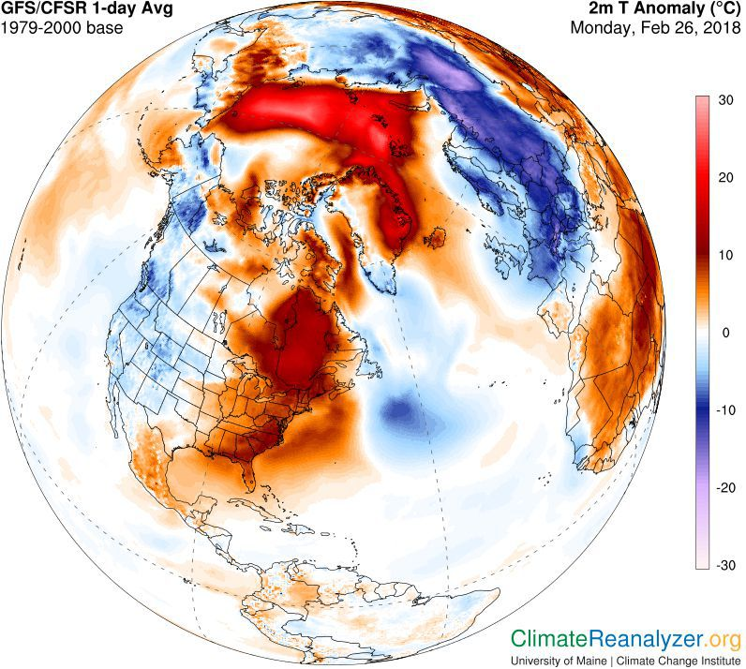
Winter 2017-2018:
Warmer than normal conditions
October 2017 – March 2018
925 mb air temperature anomaly (°C) compared to 1981-2010 climatology
Highlights:
Above freezing temperatures at the North Pole in February 2018, while Europe experienced below normal conditions.
NCEP/NCAR Reanalysis
Notes:
The overall surface air temperature in the Arctic during the 2017-2018 winter was again above average (positive anomaly).
Regional anomalies:
1) Temperatures at the North Pole event climbed above freezing levels in February 2018. The anomaly was large and persistent, and was reflected on the October 2017-March 2018 temperature anomaly graph.
2) Eurasia, on the other hand, experiences near-to-cooler-than average conditions, as seen in both images. Cooler temperatures were associated to a negative Arctic Oscillation (AO). Negative AO is characterized by a weakening of the circumpolar wind pattern, a pattern that favors cold air outbreaks over much of the United States as well as parts of Europe and Asia.
3) Moderately warm conditions over the North American portion of the Arctic
Suggested additional speaker notes for this slide if willing to go into more details (or if there is a question on teleconnections between the Arctic and mid-latitudes): mention how changes in Arctic climate can lead to changes in mid-latitude weather through weakening of the Polar Vortex (warm at the poles, and colder at mid-latitudes)

Slide 7
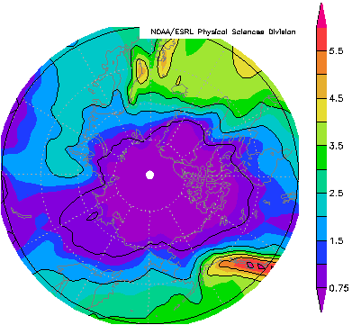
Precipitation in the Arctic 1981-2010 annual precipitation (mm/day) climatology
Annual precipitation ranges between 0.28 mm/day to 6.32 mm/day
Precipitation in the Arctic is typically:
High over oceans
High in mountainous area
Low inland
Low over sea ice
Russia
Canada
Alaska
GCPC combined precipitation dataset
Low density of observation in the Arctic is especially challenging for monitoring of precipitation.
Notes:
High precipitation in mountainous areas (Rocky Mountains, southern Greenland, Scotland, Norway) is due to orography

Slide 8
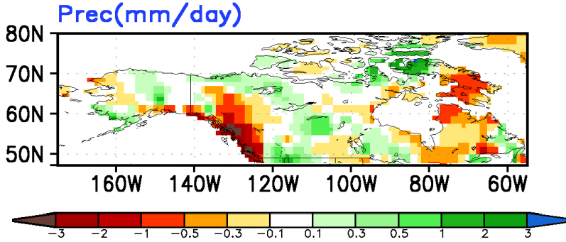
Winter 2017-2018:
Dry and wet conditions
December 2017 – February 2018
Precipitation anomaly (mm/day) compared to 1999-2010 climatology
Notable event:
A total of 25 cm of snow in 24 hours in Whitehorse, Canada contributed for February 2018 to be wettest on record at that location since 1943.
Dry
Wet
Notes:
High spatial variability in precipitation anomaly in the Arctic.
Whitehorse is the green pixel surrounded by red.

Slide 9
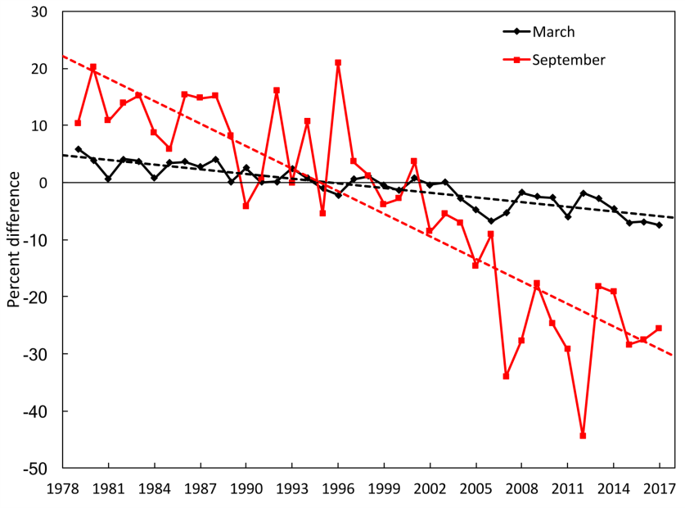
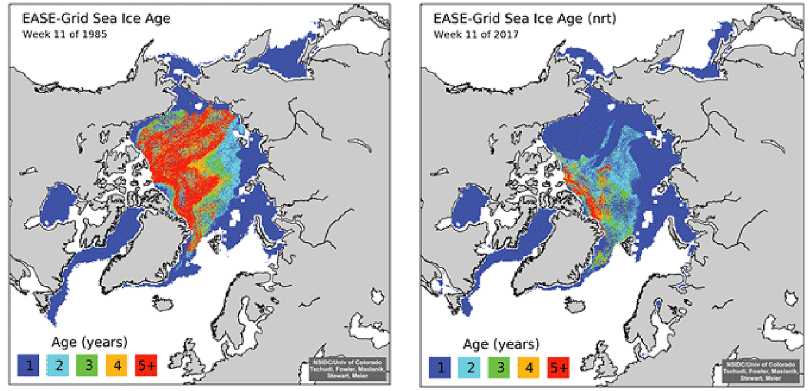
Arctic sea ice extent
Decreasing minimum (Sept.) and maximum (March) sea ice extent relative to the mean values for the period 1981-2010.
Source: Perovich et al. (2017) [in Arctic Report Card 2017], https://www.arctic.noaa.gov/Report-Card
The age of sea ice has been decreasing between 1985 (left) and 2017 (right). Younger ice is thinner than older ice, and more vulnerable to melt in the summer.
Notes:
Sea ice extent: decrease is larger for minimum sea ice extent (Sept) than maximum sea ice extent (March)
Top figure: Time series of ice extent anomalies in March (the month of maximum ice extent) and September (the month of minimum ice extent). The anomaly value for each year is the difference (in %) in ice extent relative to the mean values for the period 1981-2010. The black and red dashed lines are least squares linear regression lines. The slopes of these lines indicate ice losses of -2.7% and -13.2% per decade in March and September, respectively. Both trends are significant at the 99% confidence level.

Slide 10
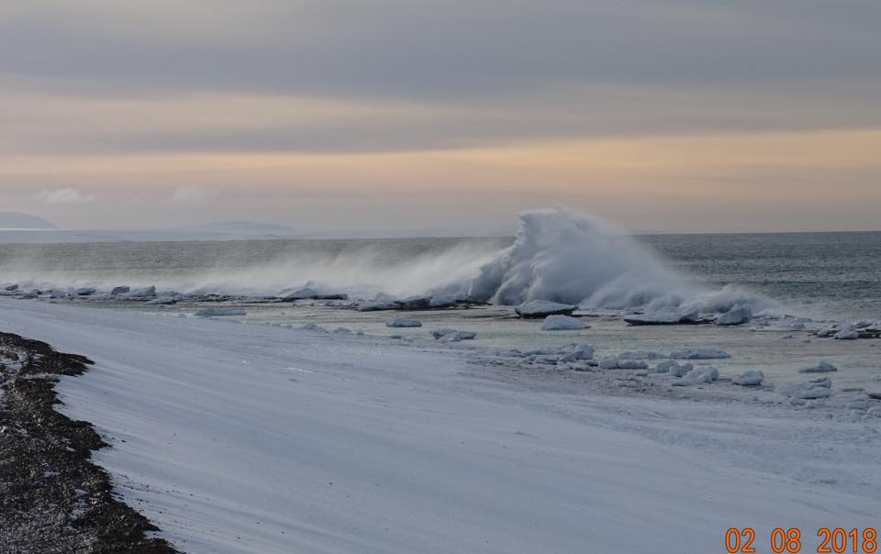
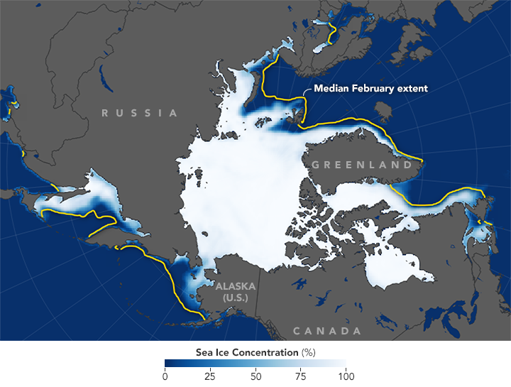
Winter 2017-2018: 2018 winter maximum was second smallest on record
Highlights:
Smallest sea ice extent in January and February since 1979.
Persistently low sea ice extent in the Bering Strait.
Vast stretches of open water near Gambell, Alaska
Photo by Clarence Irrigoo Jr., February 8, 2018.
Image by Joshua Stevens, NASA Earth Observatory. Data from the National Snow and Ice Data Centre.
Notes:
Low sea ice extent in the Bering Strait was associated to a combination of i) much warmer than usual surface sea water in summer-fall 2017, and ii) more frequent storms in the region, breaking up ice, inhibiting the development of thick ice.
The map average concentration of Arctic sea ice in February 2018 compared to the median February extent between 1981-2010 (gold line). Land is gray, ocean is navy blue, and sea ice appears in shades of white (higher sea ice concentration) and blue (lower concentration).
Here, could be an opportunity to segue to the impacts of climate change on indigenous communities with examples of how low sea ice in the Bering Strait affected the communities.
No sea ice to protect from storm surge caused lost of power and damage to du ice rubbles covering beaches at Little Diomede
Local experts and Sea Ice for Walrus Outlook reported a lack of walrus in the Gambell area
Website source for average concentration of Arctic sea ice in February 2018: https://earthobservatory.nasa.gov/IOTD/view.php?id=91817

Slide 11
Part 1 – impact on indigenous communities
social aspects and impacts of climate change on indigenous communities

Slide 12
Part 2 – if needed
social aspects and impacts of climate change on indigenous communities

Slide 13
Concluding remarks
Large variability of climate regimes in the Arctic
Observational records of temperature, precipitation (amounts and type), and sea ice are common indicators of changes in the Arctic.
Interconnectivity between the different components of the Arctic climate system
With increased interest in the Arctic, it is important develop regionally-focused climate monitoring and prediction tools.
Notes:
Stations part of the Arctic Atmospheric Observatory Program
Examples of link between the different components of the climate system:
Low sea ice (in the Bering Strait and the Arctic in general) has also been linked to increased temperatures near the North Pole in recent years (including this February 2018 warmth event); loss of sea ice “is making it easier” for weather systems to transport heat poleward.
Darkening of ocean and land: melting of glaciers and sea ice increases the amount of sunlight absorbed by the surface, further increasing the warming
Warming of the Arctic is not uniform: some regions are actually experiencing a cooling.
“With increased interest in the Arctic, it is important develop regionally-focused climate monitoring and prediction tools.”
Interests: commercial, industrial, recreational, etc.
Through this workshop, we will learn about monitoring and predicting Arctic climate. We will also learn from users what factors and important in decision-making for Arctic activities.

