Slide 1

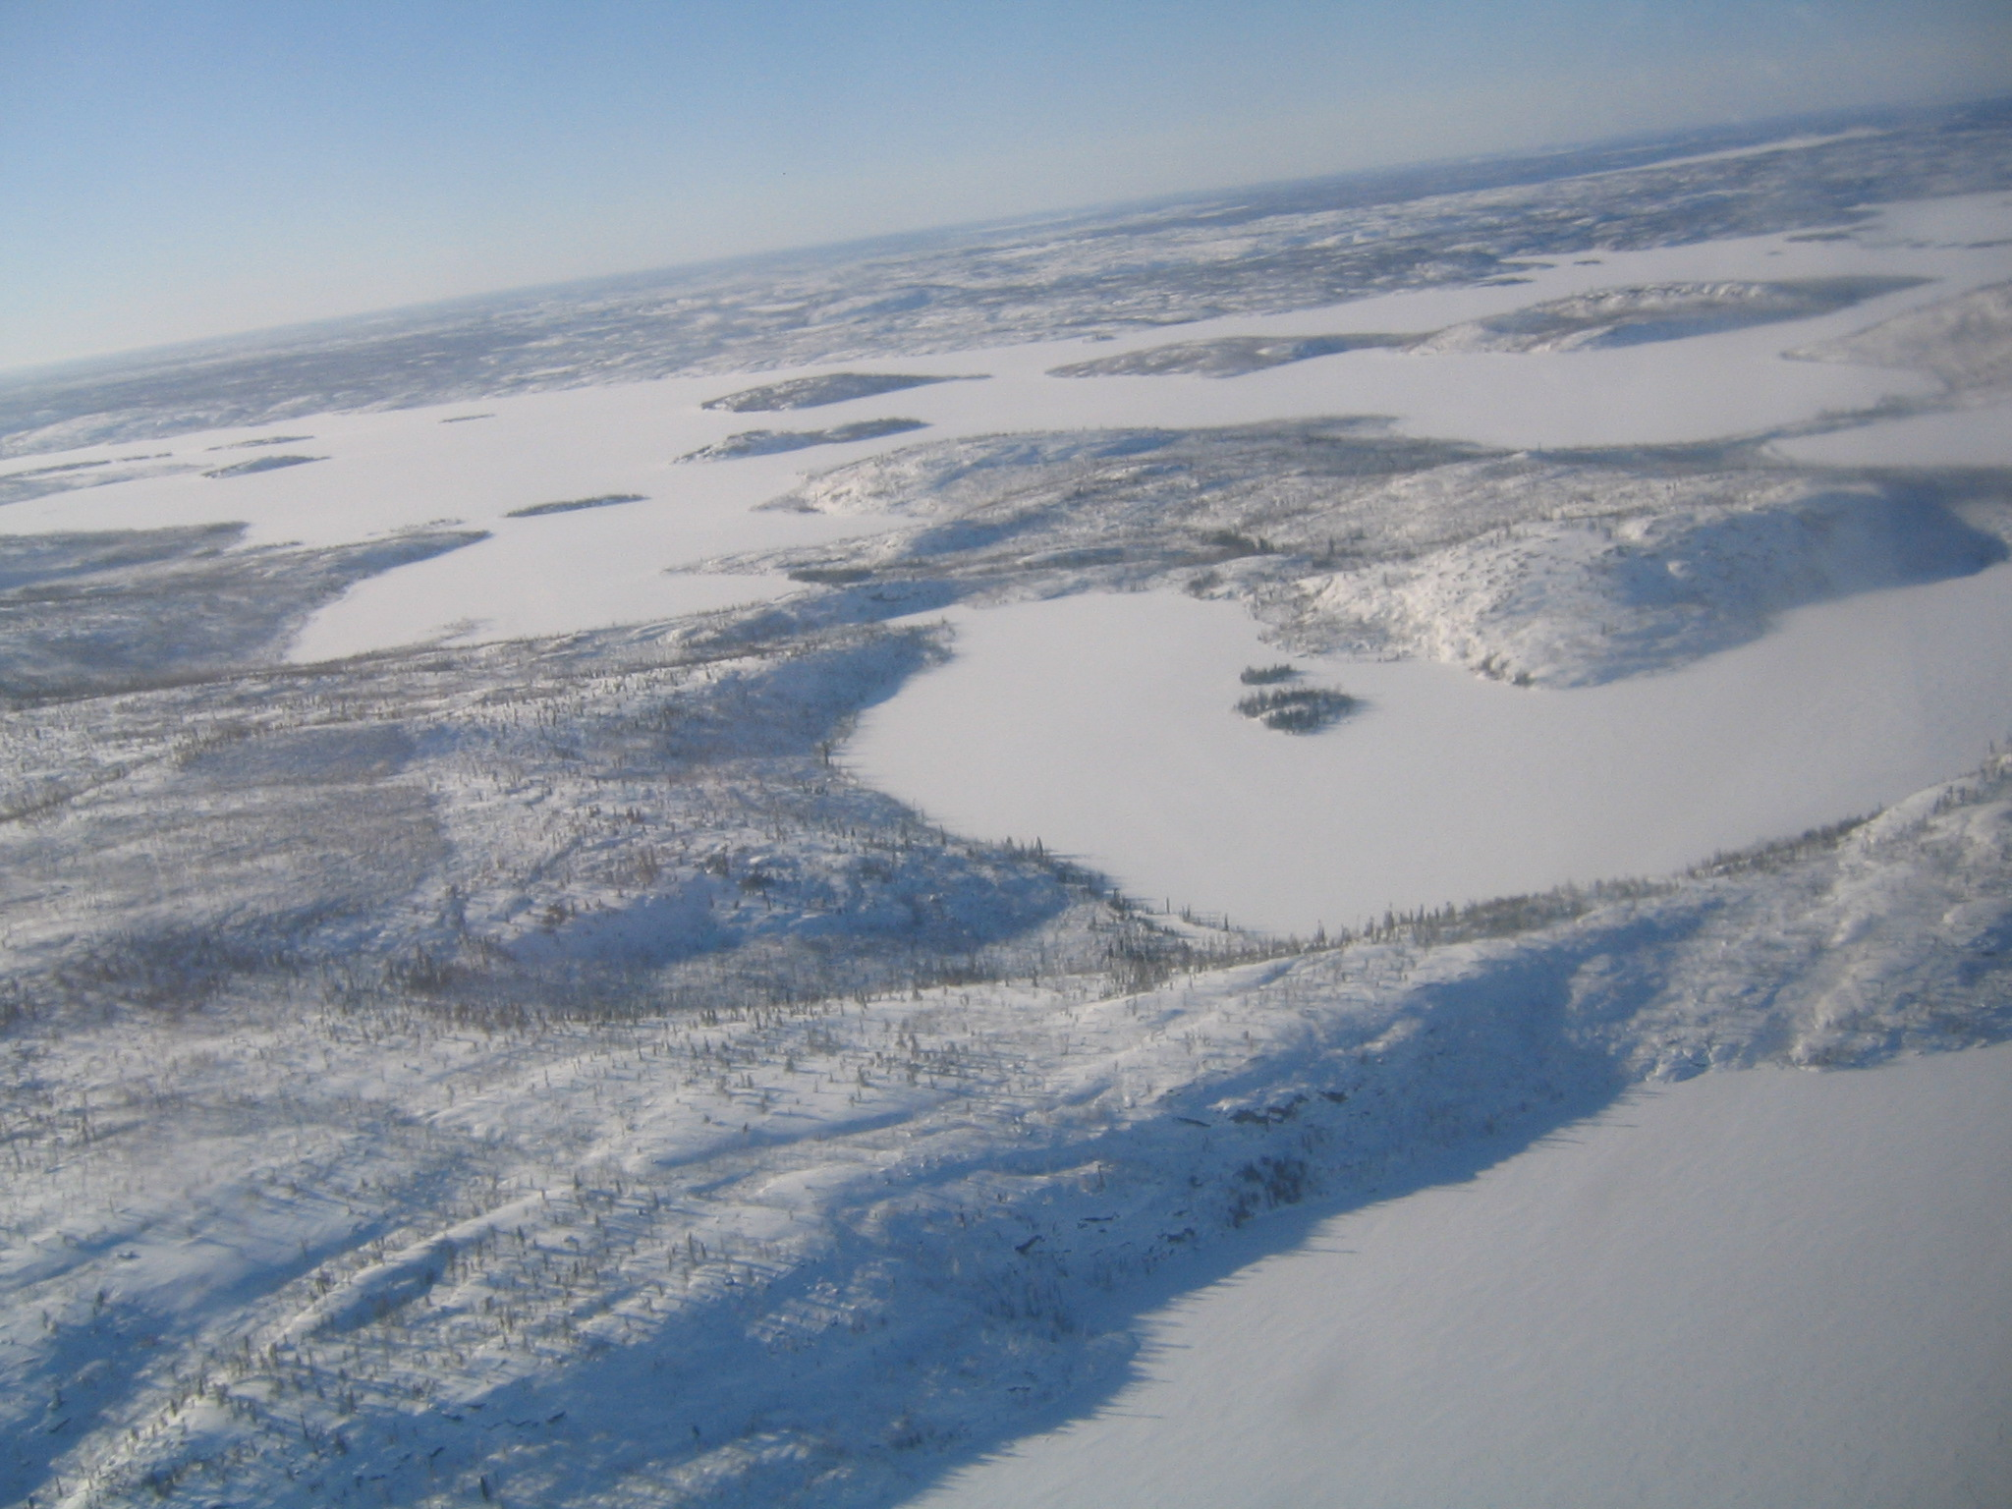
World Meteorological Organization
Working together in weather, climate and water
WMO
Global Cryosphere Watch (GCW)
Mission, Objectives, Expected Outcomes, Implementation
GCW First Implementation Meeting
November 21-25, 2011
Geneva, Switzerland
Barry Goodison
World Meteorological Organization, Geneva, Switzerland
http://www.wmo.int/pages/prog/www/polar/index_en.html
www.wmo.int

Slide 2
World Meteorological Organization (WMO)
WMO is UN Specialized Agency
  Coordinates collective Member contributions in weather, water and climate
  189 States & Territories signatory to its Convention
  Established in 1950, earlier roots from 1873 (IMO)
  International cooperation has been its hallmark
  Sponsored all International Polar Years
Services anchor its work and are based more and more on our understanding of the earth’s environmental system
Notes:
2

Slide 3
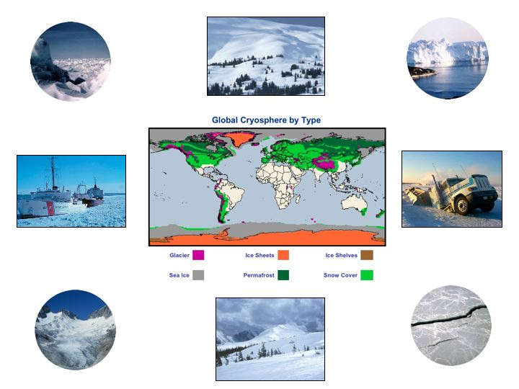
The cryosphere collectively describes elements of the earth system containing water in its frozen state and includes:
sea ice, lake and river ice, snow cover, solid precipitation, glaciers, ice caps, ice sheets, ice shelves, permafrost and seasonally frozen ground.
The cryosphere exists at all latitudes and in about one hundred countries.
is undergoing dramatic changes
is one of the most under-sampled elements within the climate system
is important (water, climate, transport, etc.)

Slide 4
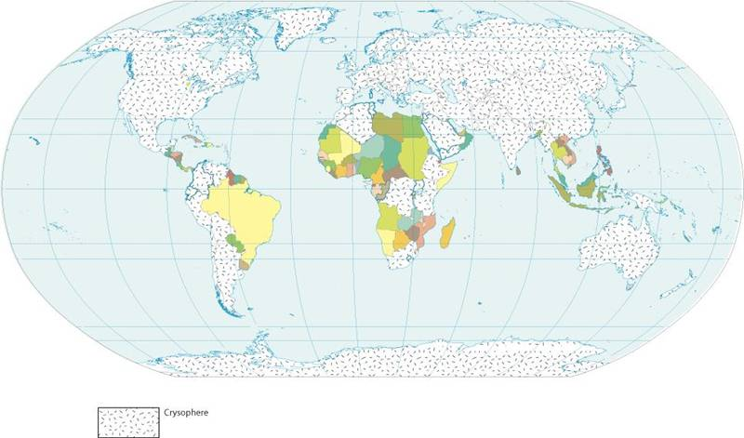
Countries where cryosphere occurs
sea ice, lake and river ice, snow cover, solid precipitation, glaciers, ice caps, ice sheets, ice shelves, permafrost and seasonally frozen ground.
~ 100 countries identified with cryospheric components
Cryosphere truly is global

Slide 5
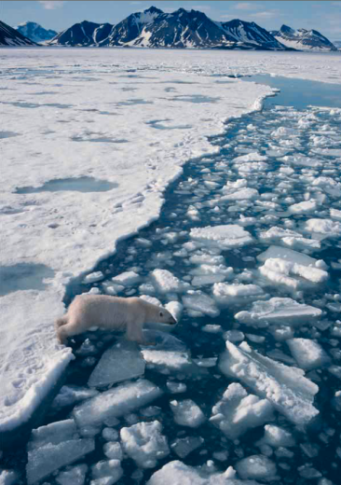
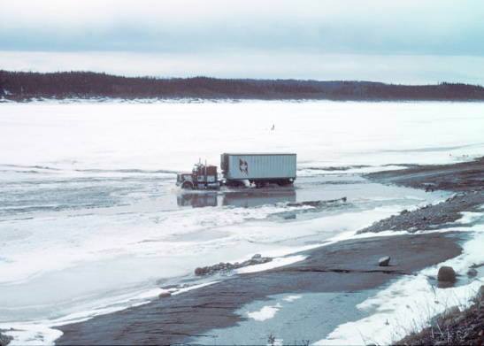
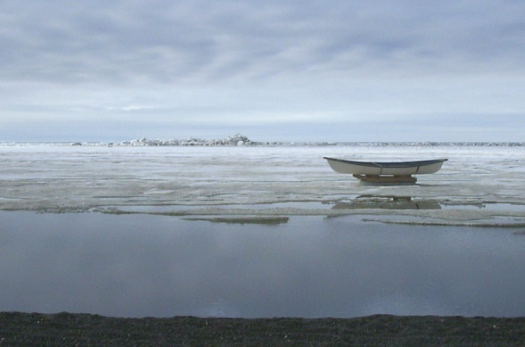
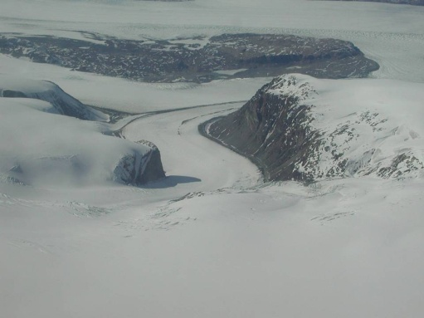
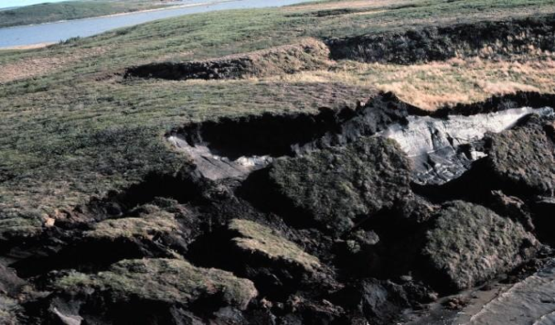
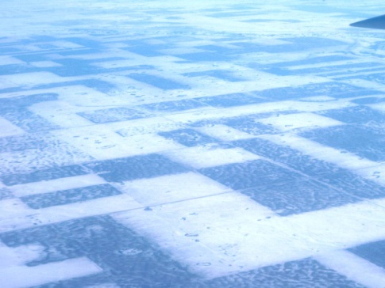
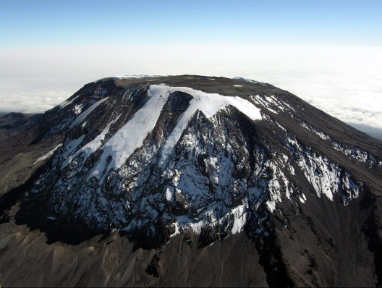
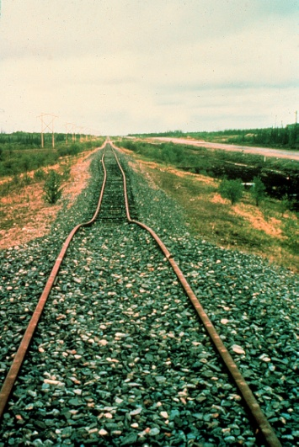
Media and Policy Perspectives
Socio-economic Impacts
No turning back on arctic warming
Inuit say spring in the Arctic is becoming more dangerous
Warning
for the North; Polar bears could face extinction as global climate change warms the Arctic
Thawing permafrost, GHG emission and coastal erosion
Melting Ice sheets, glaciers and global sea level rise
Tourism at risk
Disappearing Glaciers Menace Water Supplies
Farmers worried about absence of snow
Damage to buildings and infrastructure
Floods feared as glaciers melt

Slide 6
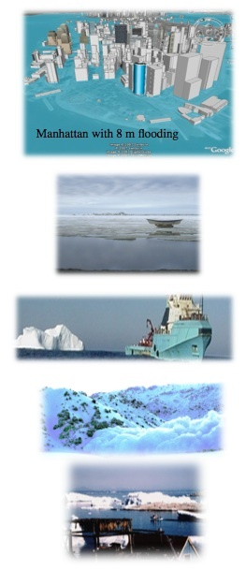
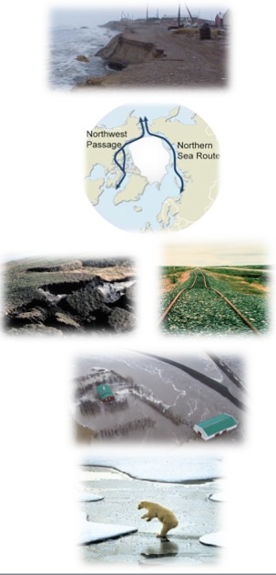
A Changing Cryosphere is Important - Globally
Changes in the cryosphere can have significant impacts on water supply, transportation, infrastructure, hunting, fisheries, recreation, and ecology.
Sea level rise threatens vital infrastructure.
Changes in sea-ice affect access to the polar oceans and resources, tourism, and security. Declining summer sea-ice affects ocean circulation and weather patterns.
Natural hazards such as icebergs, avalanches and glacier outburst floods create risks.
Permafrost thawing impacts infrastructure and is potentially a major source of methane, a greenhouse gas.
Changes in the cryosphere impact water supply, food production, freshwater ecosystems, hydropower production, and the risk of floods and droughts.
Retreating sea ice results in a loss of habitat for mammals such as polar bears and seals.
Notes:
Manhattan figure from http://freegeographytools.com/2007/high-resolution-sea-level-rise-effects-in-google-earth

Slide 7
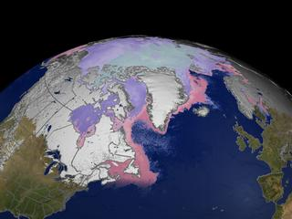
Global Cryosphere Watch-
A WMO Initiative
“The 15th WMO Congress (May 2007) welcomed the proposal of Canada that WMO will create a Global Cryosphere Watch which would be an important component of the IPY legacy. Congress requested the WMO Inter-commission Task Group on IPY to establish an ad-hoc expert group to explore the possibility of creation of such global system and prepare recommendations for its development.”
Considerations
IPY 2007-2008 identified Shrinking Snow and Ice: Rapid Changes in Polar Regions as the first of four key issues requiring urgent attention
IPCC WG 1 and 2 reports highlighted for first time importance of the cryosphere, observed changes of some elements of global cryosphere and potential impacts on societies and countries;
ACIA, ICARPII, (and now SWIPA and SCAR’s Antarctic Climate Change and the Environment reports) identified the cryosphere as a critical element in monitoring and understanding changes in the our polar systems;
the development of the conceptual framework for the Cryosphere Observing System (CryOS)
cryosphere is an integrative element within climate system and indicator of climate change

Slide 8
To monitor the cryosphere we need to measure a broad spectrum of snow and ice properties
WMO
Snow
- snow water equivalent (SWE), depth, extent, density, snowfall, albedo
- in-situ climate & synoptic (manual, auto), weather radar, remote sensing
Solid Precipitation
- in-situ climate & synoptic (manual, auto), remote sensing (challenging)
Lake and River Ice
- freezeup/breakup, thickness, snow on ice
- in-situ (shore based), remote sensing
Sea Ice
- extent, concentration, type (age), thickness, motion, icebergs, snow on ice
- landfast (manual), ship-based & aerial reconnaissance, satellite & airborne reconnaissance
Glaciers, Ice Caps, Ice sheets
- mass balance (accumulation/ablation), thickness, area, length (geometry), firn temperature, snowline/equilibrium line, snow on ice
- ground-based (in-situ), remote sensing
Frozen Ground/Permafrost
- soil temperature/thermal state, active layer thickness, borehole temperature, extent, snow cover
- in-situ (manual, auto), remote sensing (new)
Green: mature capability; Blue: moderate/developing capability; Red: little or no capability
But, the responsibility for these measurements is scattered: snow in terrestrial programs, sea ice in oceans, and then there is WMO, GCOS, GTOS, GOOS, CEOS, IPA, WCRP, research institutes etc. etc.
...... Needed over the entire range of time and space scales for weather, climate, water and environmental matters
These are the basis for GCOS Essential Climate Variables (ECV’s)
Notes:
These are the basis for GCOS Essential Climate Variables (ECV’s)

Slide 9

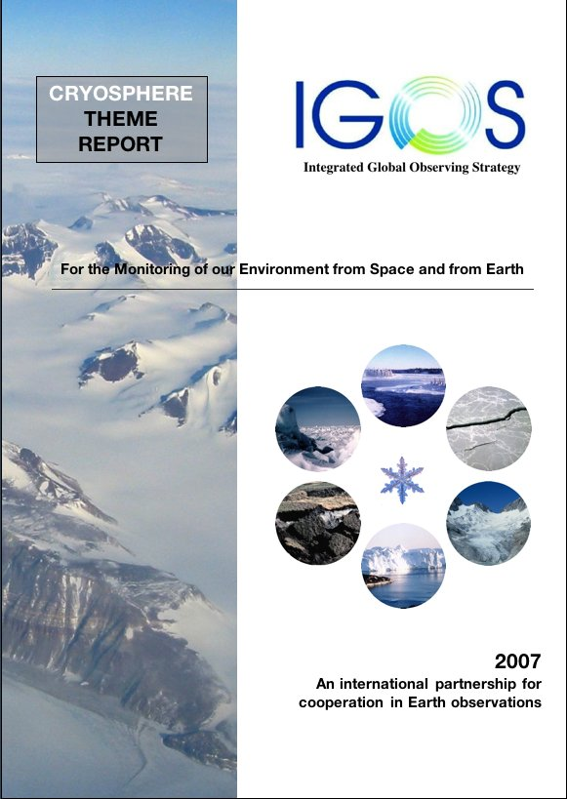


The IGOS Cryosphere Theme was developed primarily to:
* create a framework for improved coordination of cryospheric observations
assess current capabilities and requirements for cryospheric observations
Over 100 recommendations provide the basis for subsequent actions. But who will take action?
Global Cryosphere Watch
WMO
2008

Slide 10
GLOBAL CRYOSPHERE WATCH (GCW)
observation, monitoring, assessment, product
development, research through to prediction
WMO
Mission: GCW will provide authoritative, understandable, and useable data, information, and analyses on the past, current and future state of the cryosphere to meet the needs of WMO Members and partners in delivering services to users, the media, public, decision and policy makers. GCW will:
implement the IGOS Cryosphere Theme (CryOS);
support reliable, comprehensive observations through an integrated observing approach in collaboration with relevant national and international programmes and agencies;
provide the scientific community with the means to predict the future state of the cryosphere;
facilitate the assessment of changes in the cryosphere and their impact; support decision making and environmental policy development;
provide authoritative information on the current state and projected fate of the cryosphere for use by the scientific community, media, public, decision and policy makers – meet user needs

Slide 11
GCW Linkages/Partnerships
WMO
GCW will contribute to WIGOS and WIS and to GCOS and will strengthen the WMO contribution to the GFCS
The strong community desire to establish a network of stations (reference or supersites), CryoNET will require partnering
GCW will provide leadership in the effort to establish best practices, guidelines and standards for cryospheric measurements by Members, Partners and scientific community and for cryosphere terminology.
GCW will work with, and build on, existing programs such as GCOS (including GTOS (GTN-G, GTN-P, GTN-H), and work with partners such as WMO Technical Commissions, Regional Associations and its co-sponsored programs (WCRP), space agencies, World Data Centers, scientific associations, other national and international bodies and institutes, etc.
GCW will contribute to GEOSS through WIGOS and the implementation of CryOS
GCW will need a one-stop portal for authoritative up-to-date cryosphere data and products/information (prototype at met.no). GCW is not seen to be a data archive, but would link to associated data centres.

Slide 12
Partnerships
Considering all of the above, it is essential to understand that:
GCW is not assuming the mandate of any of the Partners/Collaborators
instead
GCW enables Partners/Collaborators to exercise their mandate effectively

Slide 13
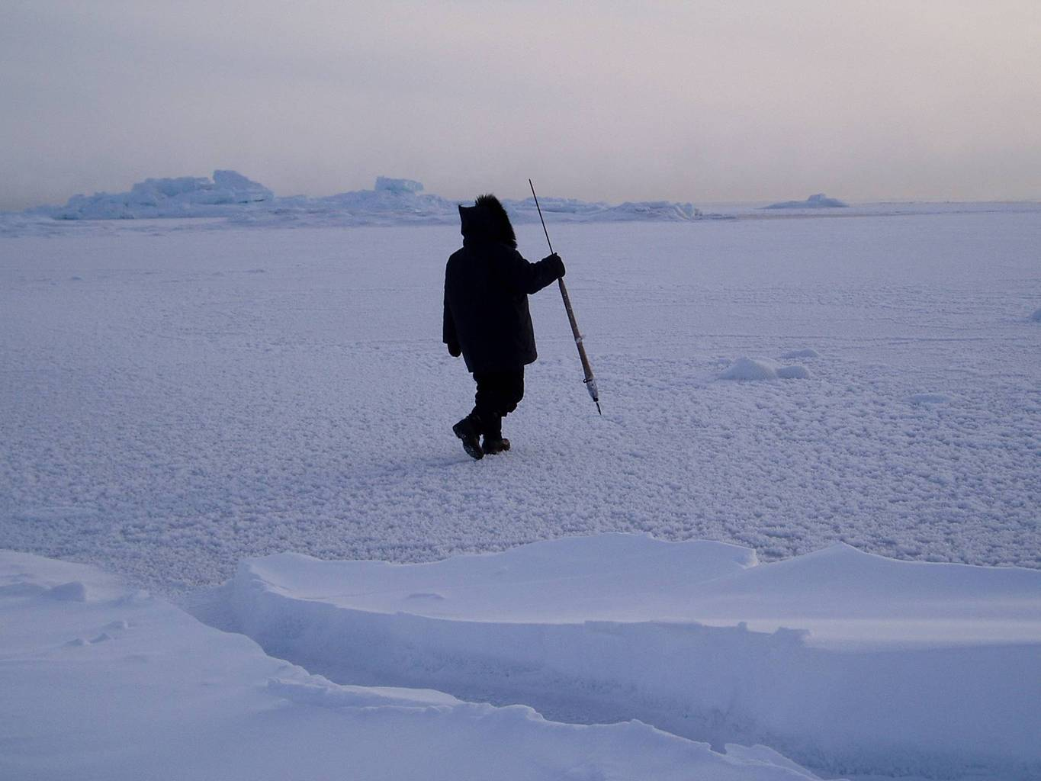
The Global Cryosphere Watch (GCW)
First GCW Implementation Meeting, Nov 21-25 2011
The 16th WMO Congress (2011) agreed that WMO needs to have a focus on global cryosphere issues to be able to provide authoritative information to meet Members’ responsibilities on regional and global weather, climate, water and related environmental matters, and decided to embark on the development of the Global Cryosphere Watch (GCW), as an IPY Legacy, with a view of an operational GCW.
EC-PORS will guide GCW Development
Key Tasks
Implement recommendations of CryOS;
Initiate pilot and demonstration projects;
Establish cryosphere reference sites;
Develop an inventory of satellite products for GCW;
Develop a web portal and interoperability for cryosphere users and providers;
Capacity building;
Communication and outreach;
Monitor scientific progress.
Notes:
GCW is a WMO initiative promoted by WMO Congress and Executive Council. The new WMO Executive Council Panel on Polar Observations, Research and Services is to provide guidance on the development of GCW. As Murphy’s Law would have it, the EC-PORS is meeting this week in Ottawa and Barry Goodison who has been overseeing its development is at that meeting and cannot be here.

Slide 14
Direct contact with WMO Members:
GCW Focal Points/Contacts
Region I: Ethiopia, Kenya, Morocco, Niger, United Republic of Tanzania, Zambia (South Africa is a member of EC-PORS)
Region II: China, Islamic Republic of Iran, India (TBC), Japan, Kazakhstan, Maldives, Thailand, Tajikistan, Uzbekistan
Region III: Argentina, Colombia, Peru (Chile is a member of EC-PORS)
Region IV: Canada, United States of America
Region V: Australia, Malaysia, New Zealand
Regions VI: Austria, Belgium, Finland, France, Iceland, Netherlands (the), Norway, Russian Federation, Sweden, Switzerland, United Kingdom of Great Britain and Northern Ireland (Germany is a member of EC-PORS)

Slide 15
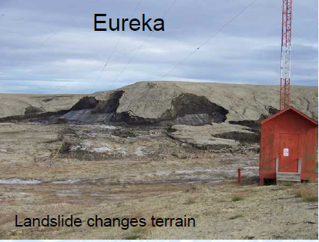
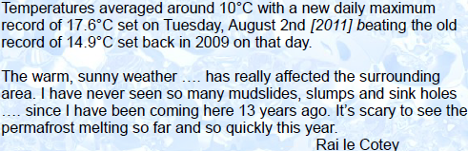
The Global Cryosphere Watch (GCW)
The 16th WMO Congress (2011) agreed that WMO needs to have a focus on global cryosphere issues to be able to provide authoritative information to meet Members’ responsibilities on regional and global weather, climate, water and related environmental matters, and decided to embark on the development of the Global Cryosphere Watch (GCW), as an IPY Legacy, with a view of an operational GCW.
EC-PORS will guide GCW Development
Notes:
GCW is a WMO initiative promoted by WMO Congress and Executive Council. The new WMO Executive Council Panel on Polar Observations, Research and Services is to provide guidance on the development of GCW. As Murphy’s Law would have it, the EC-PORS is meeting this week in Ottawa and Barry Goodison who has been overseeing its development is at that meeting and cannot be here.

Slide 16
GCOS – A Key GCW Partner
"The International Permafrost Association (IPA) expects that GCW will help to revolutionize our understanding of frozen ground, helping the IPA to fill the missing link between ground observations and global observing systems. Through the Global Terrestrial Network for Permafrost (GTN-P), the IPA will ensure that data, information and expertise are provided in a timely manner to GCW." (President, IPA)
“The World Glacier Monitoring Service (WGMS) is certainly willing to support GCW with data, information and expertise from within the Global Terrestrial Network for Glaciers (GTN-G).” (Director, WGMS)
"The National Snow and Ice Data Center (NSIDC) fully supports the GCW, and endeavors to collaborate and interface NSIDC services in support of its critical mission" (Director, NSIDC)
GCOS Steering Committee agreed that GCW co-ordinate the cryosphere components in GCOS/GOOS/GTOS and to achieve a more integrated picture of the cryosphere
GTOS agreed GCW should work directly with the GTN’s in developing GCW

Slide 17
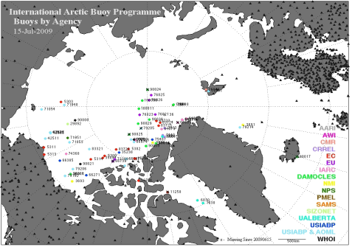
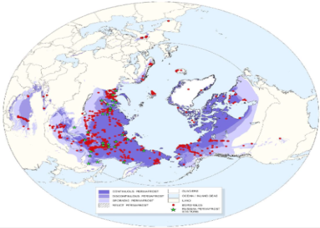
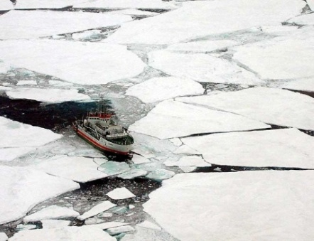


Polar Network of Networks: GOS forms a core
Challenge of sustaining and funding networks in remote harsh, cold environments and new networks established during IPY and meeting challenges associated with automation
IABP
ASBN
RBSN
IPA
Sea Ice
ABN
AWS
Joint Programmes
GAW
WCRP
Arctic HYCOS
GCOS (GOOS, GTN-P, -G,-H)
AMDAR
Notes:
This is solely to point out that there are many different networks, including those of external bodies (eg IPA), that WMO has the opportunity to engage and help in delivering its polar mandate. WMO’s (integrated) Global Observing System (GOS) (in-situ and space based) forms an essential core for polar observing.

Slide 18
Links to GCOS identified in the GCW Implementation Strategy
Co-ordination of cryospheric activities with GCOS, including the climate-related components of GOOS and GTOS;
Providing the mechanism to integrate the atmospheric, terrestrial (including hydrology) and marine cryosphere Essential Climate Variables (ECVs) within GCOS;
Proposing measures to develop and coordinate cryospheric components of the WIGOS, GCOS/GOOS/GTOS and other systems, so that cryospheric products will meet most user requirements within approximately 10-15 years, using the CryOS framework as a basis for developing and implementing GCW;
Facilitating the establishment of high-latitude supersites with co-located measurements of key variables, especially permafrost and snow cover, thus enhancing GCOS/GTOS Networks for Permafrost (GTN-P), Glaciers (-G) and Hydrology (-H) and including the measurements of solid precipitation, as encouraged by GCOS.

Slide 19
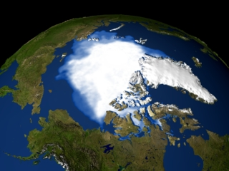
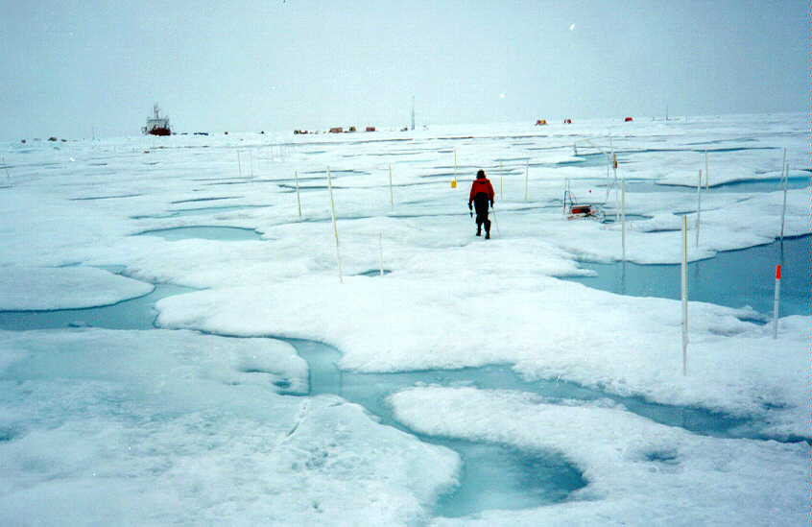
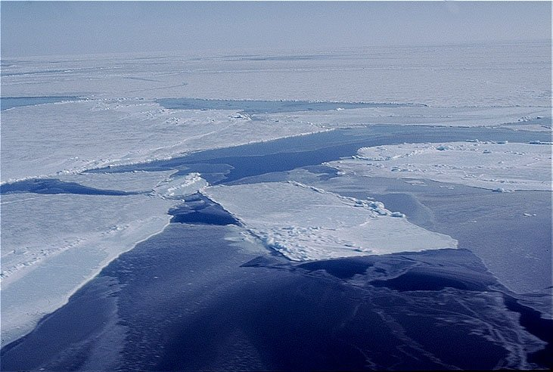
Issue: Perspective and Scale
WMO
Arctic-wide and Global
10s of km
Remote Sensing
Modeling
100s of meters
Field Measurements
Point
= Calibration/Validation Scales
From Waleed Abdalati ICARPII
Notes:
One of the major challenges for GCW is to match time and space scale for different users. For sea ice is it ranges the monthly mean ice cover over the Arctic Basin to landfast ice that directly affects communities and their people. In-situ data and high resolution satellite data are essential to produce information for validating arctic wide or global products or initializing models. And we need to understand the associated processes, the atmosphere-ice-ocean interactions, to explain current variability and change and predict for conditions.

Slide 20
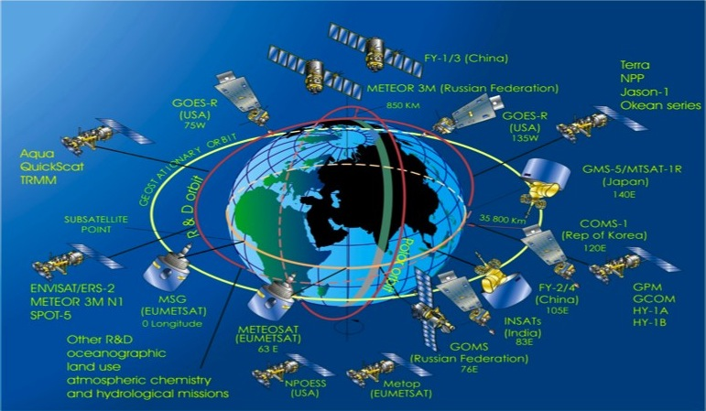
Observing the Cryosphere
The cryosphere observing system includes satellites…
Notes:
PPS emerged from this meeting and is gaining widespread traction – WCRP, CAS, IPD….. Could it help SAON provide a scientific focus for Arctic Council activities as well as a collaborative IPD?
20

Slide 21
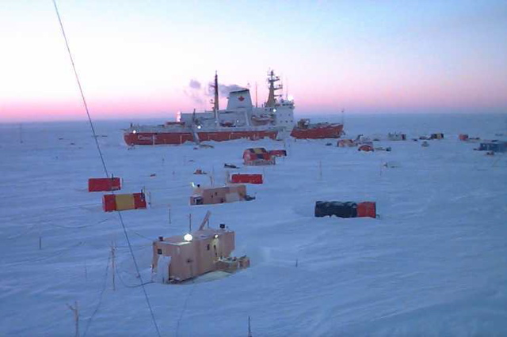
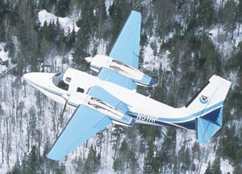
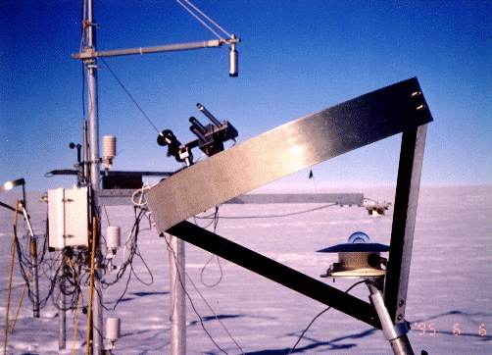
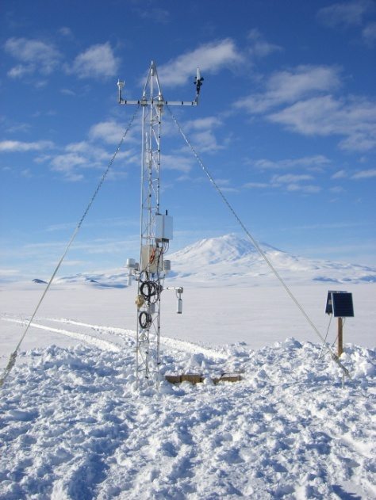
..... in situ, marine, and aircraft measurements …
Notes:
21
But of course to understand the entire sea ice syatem we need other obs, including airborne, and in-situ.

Slide 22
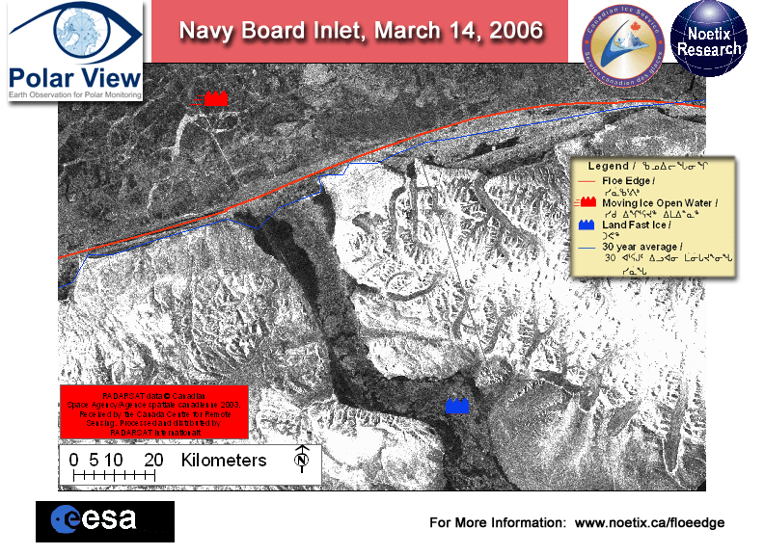
..... and traditional knowledge.
A conceptual model of Inuit ice terminology is being developed for incorporation into the floe ice edge monitoring product.
Notes:
Hirose (Noetix Research inc.) and Laidler (U of T) proposing to incorporate the conceptual model of ice terminology being developed by Laidler into the floe ice edge monitoring product

Slide 23
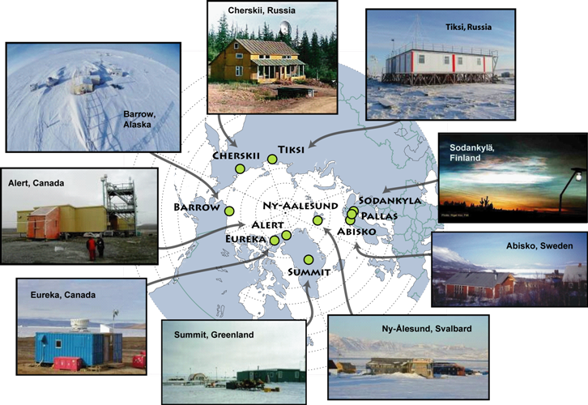
Challenges: Identifying Reference Sites
WMO
Arctic Atmosphere Observing Network A Basis for CryoNET?
Notes:
These atmospheric observatories could be the core for broader environmental monitoring. Many of these are part of the GAW network for measuring atmospheric composition.

Slide 24
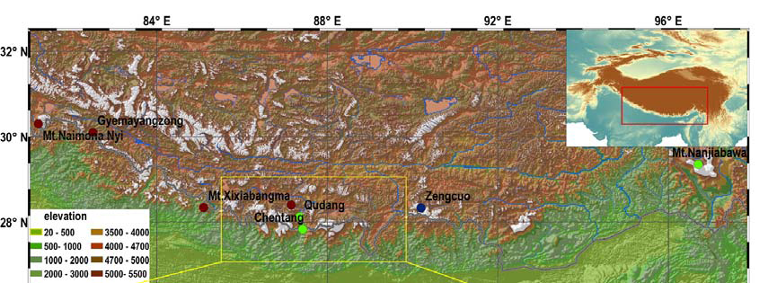
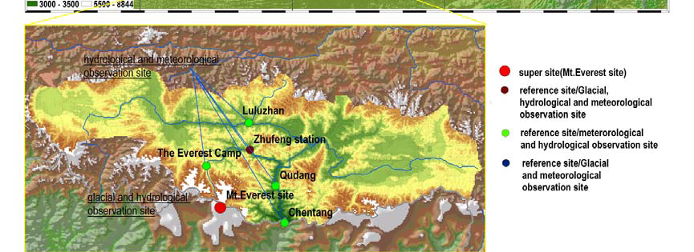
Distribution of Himalayas Cryospheric Observation Network
(HIMALCON)
Courtesy, Xiao Cunde, CMA/CAS

Slide 25
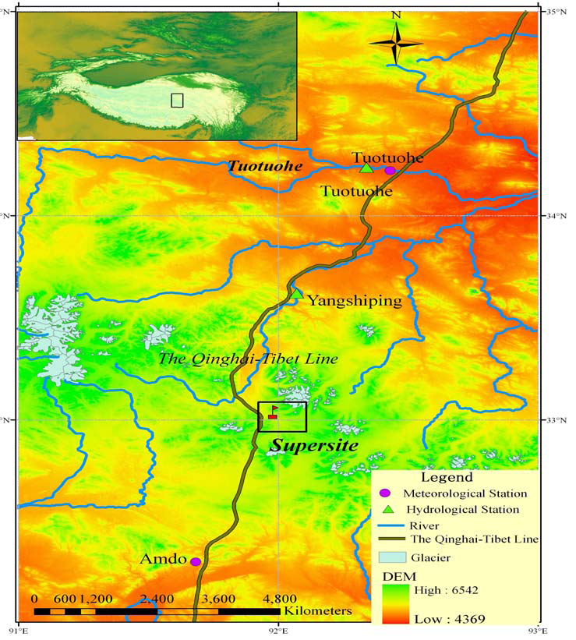
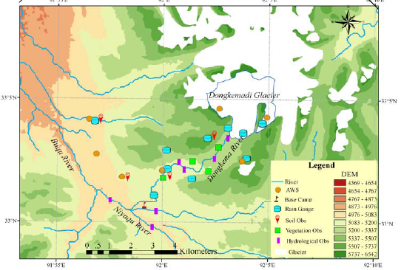
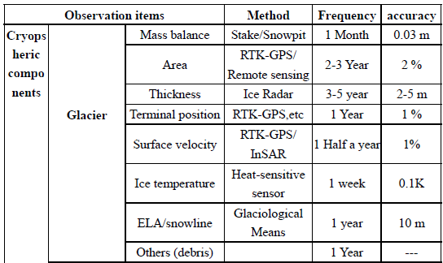
Distribution of Tanggula Cryospheric Observing Network (TCON)
Courtesy, Xiao Cunde, CMA/CAS

Slide 26
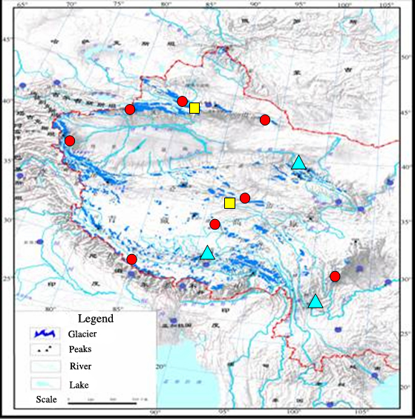
Issue for in-situ cryospheric observation stations: varying ownership and operational status
WMO
National
Cryospheric observation stations in China
National supported observation stations：2
Academy-based observation stations：3
Institute-based observation stations：9
Academic
Institute
Even nationally, cryospheric observations are the responsibility of different institutes or agencies.
This is the case in most countries and makes data sharing even more challenging
Notes:
World Glacier Monitoring Service (WGMS)
Global Land Ice Measurement from Space (GLIMS) – This is a glacier database at NSIDC
26

Slide 27
Standards, Guidelines,
Metadata
Churchill RCT1 (top) Dec 2000:
Huge rocks create deep drifts, dry patches
RCT2 (bottom) Mar 2003:Open tundra with small obstacles creates 20-30 cm drifts
Flagging of trees points away from Hudson’s Bay
Need for community agreed guidelines, best practices, standards and metadata – applies to all cryospheric components
All part of dialogue between users (e.g. modellers) and network operations
All are needed for reference and super sites
Notes:
It is not just the sensor, but the actual siting and at remote areas one does not know what the snow will do – snow is redistributed and moves around or may be “frozen” in one spot for the season. Located near Churchill on Hudson Bay

Slide 28
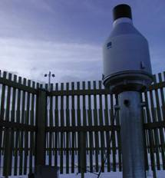
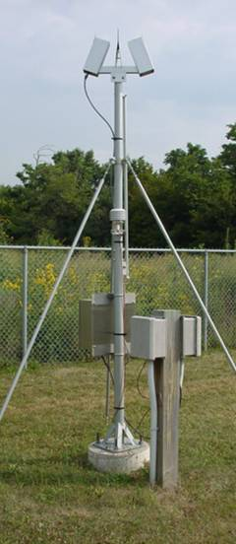
Quantification of Cold Region Precipitation – Demonstration Project
development of data sets, adjusted for known systematic errors, suitable for meteorological, hydrological and climate modelling
through GCW and with others (CIMO, WIGOS, GCOS), update observing procedures and standards for cryospheric variables
Development and assessment of new technologies for precipitation measurement in cold climate regions is essential – IPWG, CIMO
WMO/CIMO/GCW focus on Precip in Cold Regions – strong link with GPCC
GPM - Ground Validation in high latitudes
What do modellers need to validate precipitation in cold climates?
What can we do for determining precipitation in data sparse regions, such as polar and alpine?
What do we do in Antarctica?
Impact of automation
Notes:
There will likely be an intercomparison of solid precipitation measurement using automatic gauges by WMO CIMO – this is a serious outstanding issue which is criticla for GCW to address to be successful – there must be reliable estimates of global precip, in all forms. This is a critical issue for GPCC to do its best estimate of precip and associated errors. There is no reliable satellite based measurement of snowfall at high latitudes over land/snow surfaces.

Slide 29
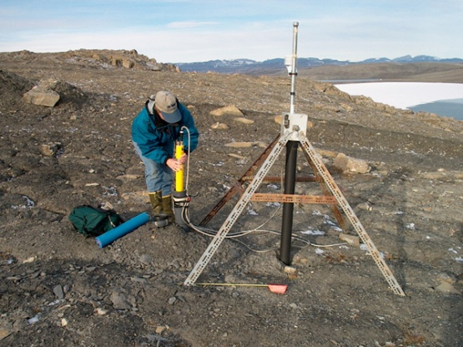
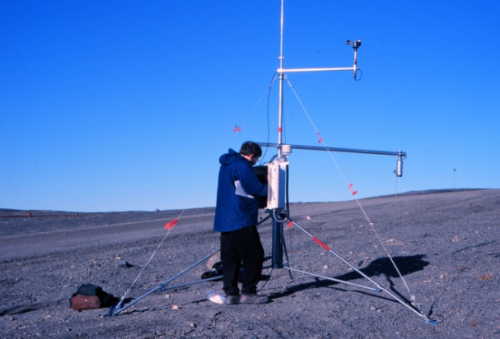
Trends in Permafrost Temperature across the Canadian Arctic
Western Arctic
0.1°C per decade
0.3°C per decade
Mackenzie Valley
High Arctic
Eastern Arctic
Alert 15 m depth
Iqaluit Monthly ground temperatures at 5 m depth
Trend 5 m Ground Temperature 1993-2000 +0.4°C per year
Trend 1994-2004 +0.07°C/yr

Slide 30
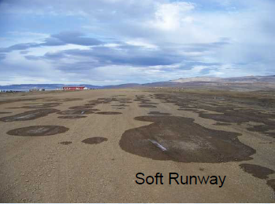
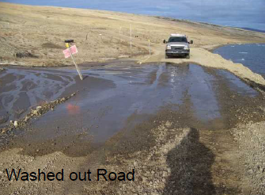
Warming Impact at Eureka, 2011
Need for Real-time Data to address daily operations??
Need to operationalize permafrost temperature measurements?

Slide 31
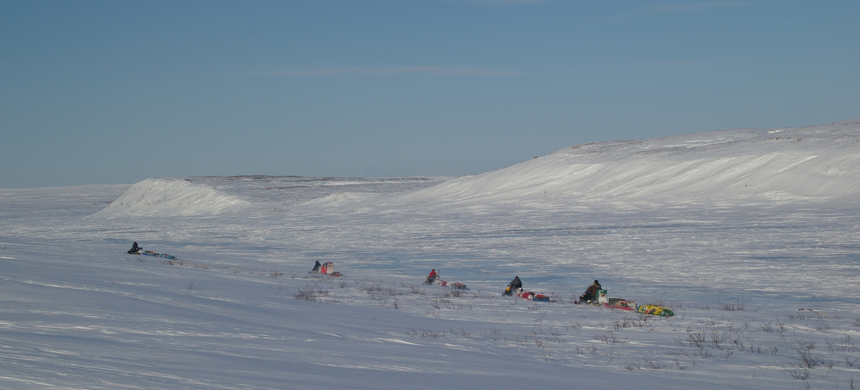
SnowSTAR 2007 traverse across the Canadian tundra: challenges of deriving an areal SWE estimate
Points for GCW to Consider in meeting user needs:
  time and space scale of global product(s) – snow extent, depth, SWE, albedo? wetness? on sea ice/ice masses?
  global vs regional; alpine vs continental
  production of standardized products, consistent over time
  data fusion and merging of time series
  incorporation of in-situ data
  produce products that can be matched to models of varying scales
  evaluation of product(s)

Slide 32
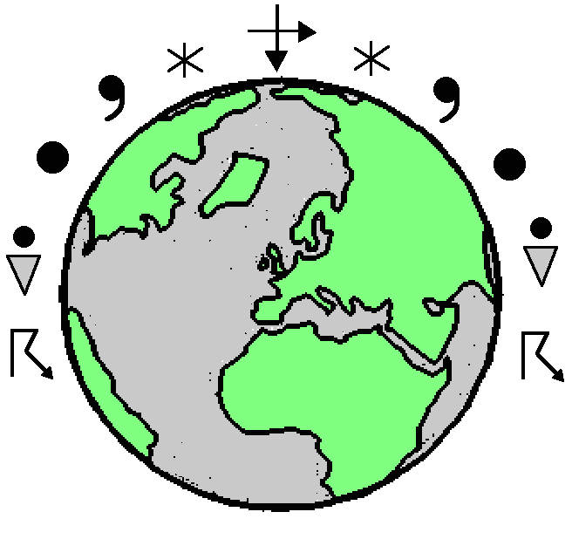
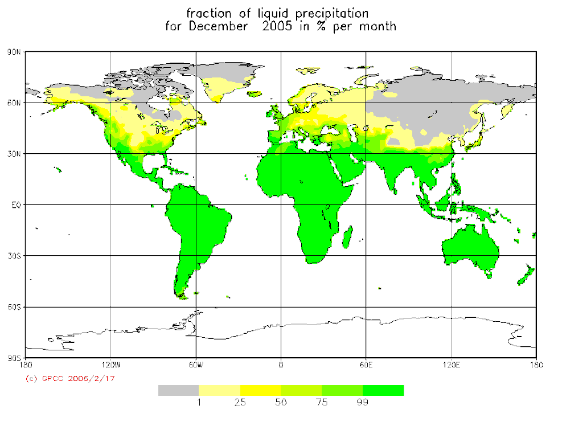
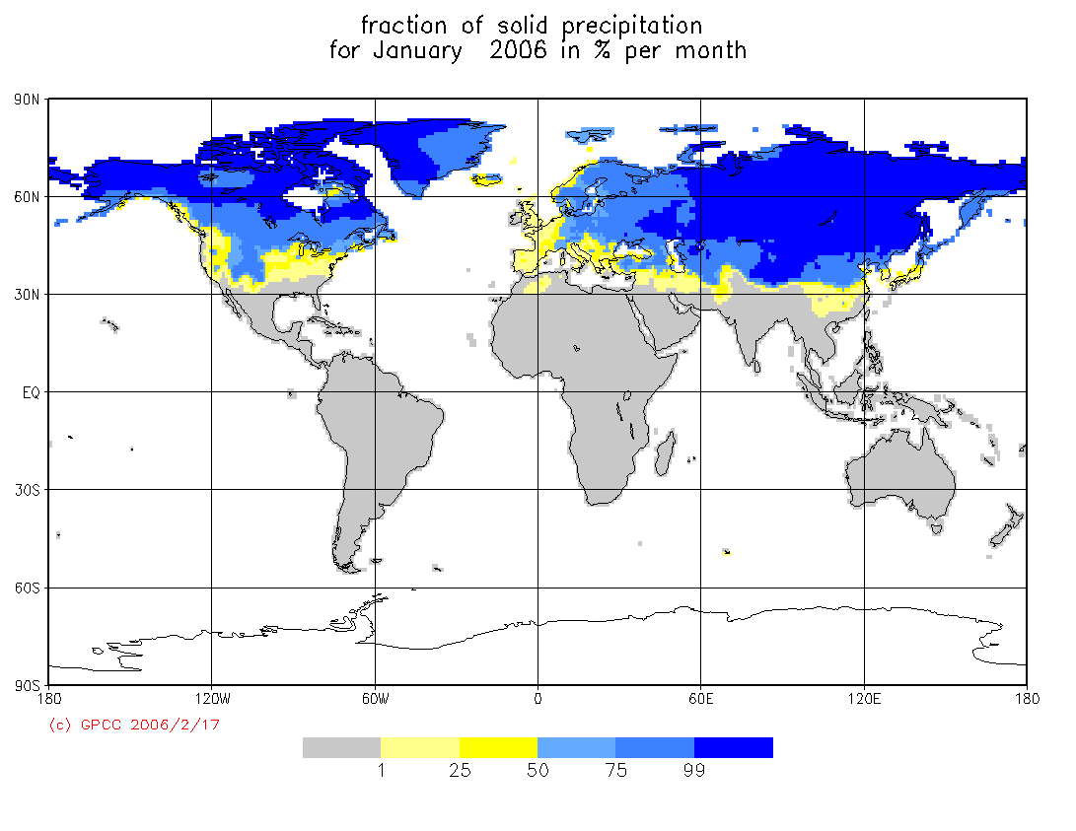
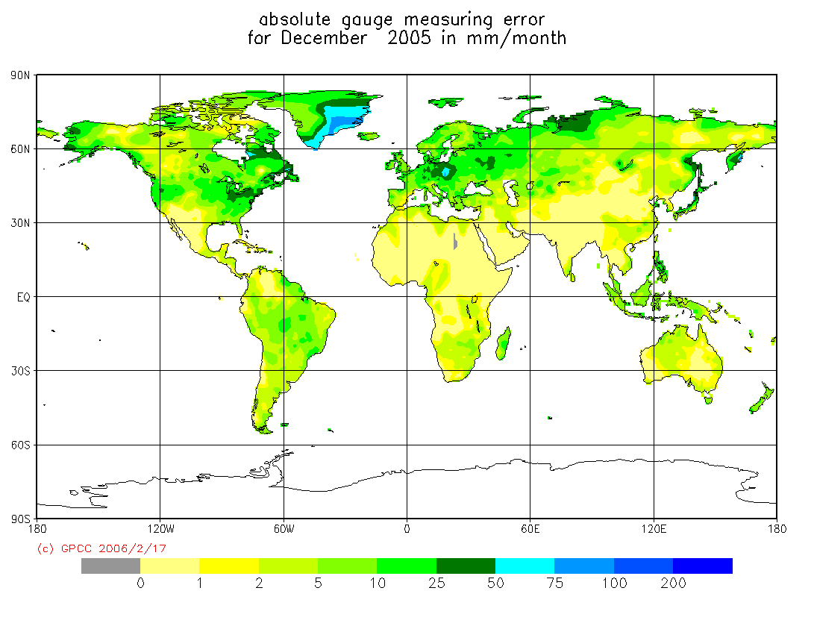
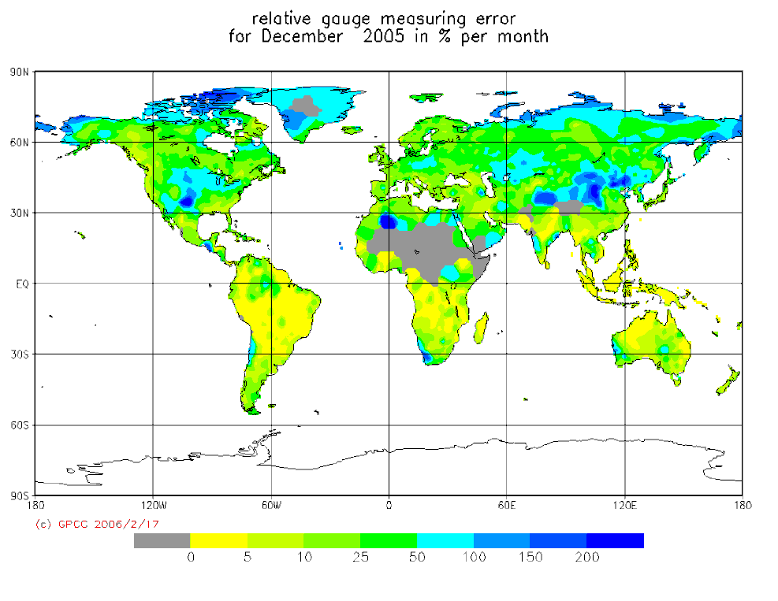
New GPCC products based on synoptic data
fraction of liquid precipitation (%)
fraction of solid precipitation (%)
absolute measuring error (mm/mon)
relative measuring error (%)

Slide 33
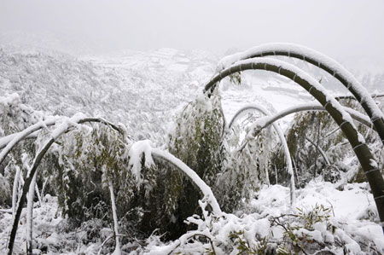






Snowfall Extremes 2007-2008 and some impacts:“Hot-spots”- reporting by NMHSs?
By Jan. 31, disastrous winter weather had levied a toll of US$2.5 billion in China's forestry sector.
Athens Feb 17 2008
Buenos Aires July 10, 2007 first in 89 years
Ottawa – snowiest capital in the world by mid-March 410cm had fallen
Car dealership roof collapses – not really designed for snow loads
China
clearing snow
Ottawa, Canada snow clearing

Slide 34

GCW portal functionality
It should support both
  Data producers
  Data consumers
Data discovery has first priority
Higher order functionality should be enabled wherever possible
  Visualisation
  Transformation
Notes:
Given the open data space of GCW, enabling higher order functionality like distributed visualisation and transformation would require some harmonisation of protocols. this has to be enabled on a dataset basis through proper description of interfaces to the datasets and implementation of layers accessing the data.
The first priority is anyway enabling data discovery across the data centres contributing to GCW.

Slide 35

Distributed data management
Notes:
The GCW portal is collecting information from a set of distributed data management systems. It collects metadata, not data and prepares this for discovery, enabling users to perform a dedicated search for cryosphere related data without entering a multiple of systems.
The idea is that GCW should present information contained within WIS centres, World Data System centres (e.g. NSIDC) and other types of data centres. GCW will be based upon the interoperability framework defined through WMO Information System, but in order to integrate information from various sources not belonging to WIS, a certain level of pragmatism is required for the interoperability standards.

Slide 36


Notes:
A sample from the demonstration portal illustrating some functionality. In the current situation, all datasets can be discovered, local datasets may also be visualised, subscribed etc.
Concerning subscription, the portal also offers RSS feeds for local datasets. Further investigation of using this technology for geolocated datasets are being done.
Transformations of local datasets are currently supported, although not in the GCW demonstration portal. We are in other projects working on visualisation (works e.g. in CryoClim) and transformation (under development in NORMAP) of remote datasets.

Slide 37
The GCW web portal will make GCW data and information available to WMO Members, their partners, and users while providing the ability to exchange data and information among a distributed network of providers of data and products. The portal, as a part of WIS, will allow for rapid exchange of data, metadata, information, and analyses.

Slide 38
Major Accomplishments:
Summer of 1998 Project
documented the response of the Arctic cryosphere to an anomalously warm summer, and compared this to other warm summers in the period of record
demonstrated the complexity of the interactions between climate and the cryosphere and between the various components of the cryosphere e.g. the importance of critical synoptic events in clearing ice plugs, and in controlling glacier melt
developed a number of important climate and cyrosphere data series in the high Arctic for assessing climate variability and change, and for GCM validation (e.g. open water percent in QEI, regional sea ice concentration, lake ice freeze-up break-up, glacier mass balance).
provided new understanding of ice plug formation and break-up process

Slide 39
Expected Outcomes
Near-term Tasks for GCW
WMO
GCW is a mechanism for implementing the IGOS Cryosphere Theme (“CryOS”). Determine which CryOS recommendations can be implemented in GCW and how and by whom
Compile existing guidelines and standards for cryospheric measurements. Strive for increased data exchange.
Identify candidate GCW reference sites. Evaluate the appropriateness of the location, the types of measurement, existing measurements standards, and availability of data. WMO would use named GCW focal points in countries asking for input on which, if any, of their sites (or collection of sites in an area) could be candidate reference sites.
Develop an inventory of candidate satellite products for GCW. The products must be mature and generally accepted by the scientific community. Identify needed intercomparison of products to ensure GCW is an authoritative information.

Slide 40
Proposed Near-term Tasks for GCW …2
WMO
Pilot and demonstration projects would test the Global Cryosphere Watch (GCW) concept of operations. Determine which pilot projects and regional/national demonstration projects are feasible (e.g. Sea ice, snow, permafrost,....., regional contributions, research to operations demos,.........) (SVALI: Stability and Variations of Arctic Land Ice? Lidar mapping of glacier surfaces over Iceland?)
Implement GCW partnerships i.e. National and international operational and research agencies, institutes and scientific bodies involved in the generation and use of cryospheric data and information, from in-situ, space based and modelled sources
Evaluate the feasibility of a web portal. IPY data centres/portals, such as the Norwegian Meteorological Institute (met.no), Canadian Cryosphere Information Network (CCIN), British Antarctic Survey (BAS), US National Snow and Ice Data Centre (NSIDC) could be suitable contributors in development of a virtual portal.

Slide 41
Initial Expected Outcomes for
GCW Near-Term Tasks
WMO
Begin implementation of IGOS Cryosphere Theme recommendations.
Determine pilot projects and regional/national demonstration projects
Establish cryosphere reference sites, co-ordinate development of guidelines, best practices and standards and cryosphere terminology
Develop an inventory of satellite products for GCW.
Establish GCW partnerships i.e. National and international operational and research agencies, institutes and scientific bodies involved in the generation and use of cryospheric data and information, from in-situ, space based and modelled sources (NSIDC, IPA, WGMS)
Implement an operational GCW web portal.
Identify needs for capacity building, communication and outreach, and identify potential funding sources.
PLUS IDEAS FROM THE FIRST GCW IMPLEMENTATION WORKSHIP
GCW can only be successful through collaboration,partnership,action

Slide 42

Conceptual Framework for GCW Operation

Slide 43

GCW Tasks and Timelines
WMO

Slide 44

GCW can only be successful through collaboration and partnership
WMO Initiative:
Global Cryosphere Watch
Спасибо
Gracias
Thank you
Merci
شكرا
谢 谢

Slide 45

AWS Installation in Antarctic inland during IPY by CMA (Courtesy CMA)

