Slide 1
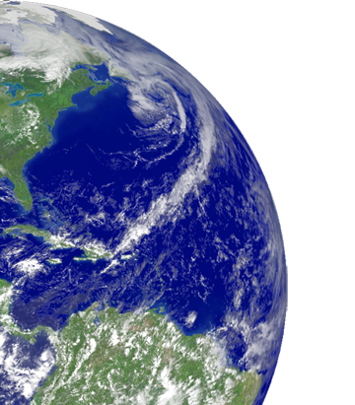
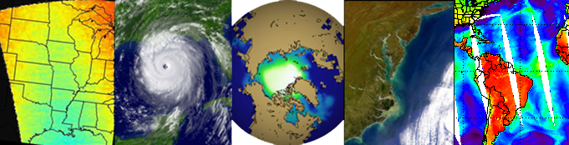

GCW Implementation Plan
Jeff Key
National Oceanic and Atmospheric Administration (NOAA)

Slide 2
Motivation
At this meeting you will help determine specific directions, tasks, services, products, contributions, and management structure for GCW.
All of these ideas need to be put on paper, in an Implementation Plan.
We would like to have a complete draft of the IP by mid-January 2012, for presentation to EC-PORS at their meeting in early February.

Slide 3
WORLD METEOROLOGICAL ORGANIZATION
WMO GLOBAL CRYOSPHERE WATCH
(GCW)
GCW IMPLEMENTATION PLAN
(GCWIP)
Version 0.1
(19 November 2011)

Slide 4
General Layout of the IP
Executive Summary
Introduction
Implementation
Deliverables and Milestones
Management
Partnerships
Resources

Slide 5
This is how the topics of this meeting map to the Plan.
We will gather ideas for the Plan throughout the week. We also hope to have at least some entries in the “Who” column.

