Slide 1
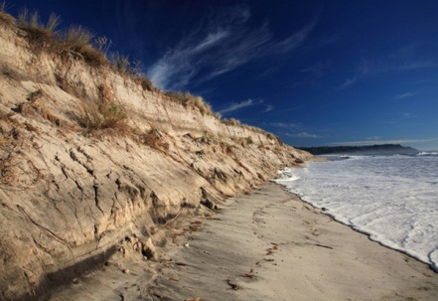
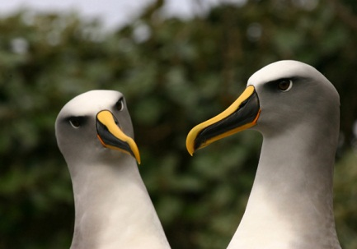
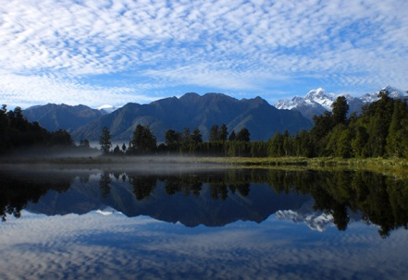
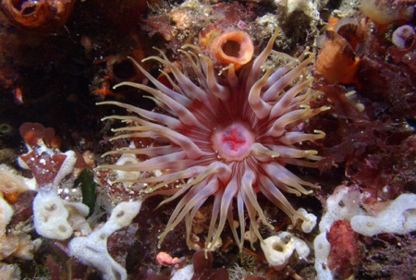
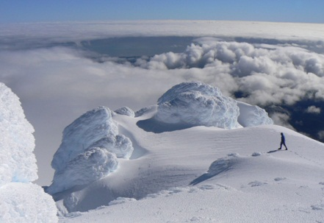
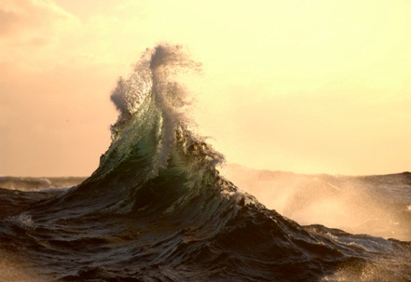
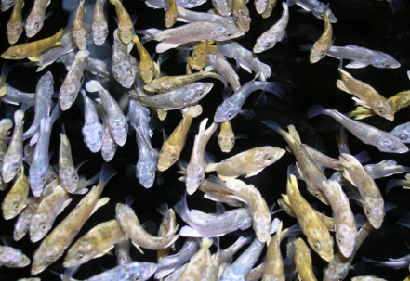
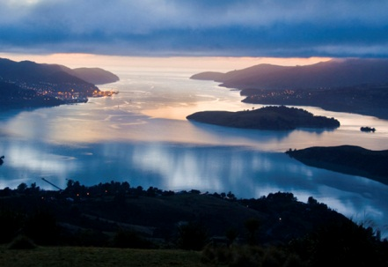
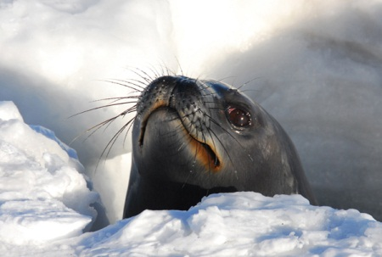
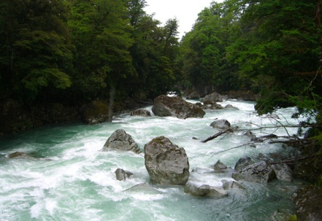
1rst Global Watch Croysphere Meeting
Perspective on Cryosphere issues and GCW Contribution
New Zealand

Slide 2
Cryosphere User in New Zealand
2 Crowne Research Institute (IRL and NIWA)
3 Universities (Otago, Canterbuy, Wellington)
Antarctica New Zealand
Users : Standard New Zealand, Tourism Industry

Slide 3
Current Interest
Antarctica New Zealand
  3 Main programs
  Over 20 sous programmes
  Part of WMO (eg AC21 subprogram)
Sea Ice
  Estimation of Sea Ice Thickness
  Interaction between oceans and Artarctic Shelves

Slide 4
Current Interest
Glaciers
  Impact of Climate Change on glacier mass balance
  End of summer line monitoring
Monitoring
  High altitude climate and snow monitoring at 11 stations (web portal: Cliflo)
  Modelling snow processes
  Seasonal snow cover through remote sensing and monitoring
  Translation of glaciers and snow melt to inflows
Collaboration through Snow and Ice Research Group (SIRG)

Slide 5
User Need
High resolution data and information
  Remote sensing information
  Lost cost information
Ice Information
  Glacier Mass balance update
  Sea Ice Information
Snow information
  Snow depth, snow density
  Snow water equivalent
  Associated climate information (rainfall, solid/liquid, temperature, relative humidity, solar radiation, wind, global circulation indice,,….)

Slide 6
Way forward
Data sharing (data bank) and international collaboration
Remote sensing information
Regional knowledge of cryosphere for Southern Hemisphere

