Slide 1
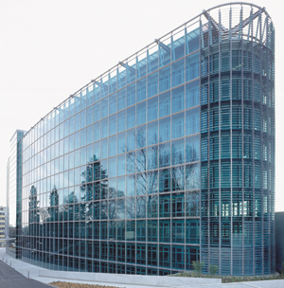
Breakout Group #1
We’re #1!

Slide 2
Ideas for formation of teams
Don’t create parameter teams (e.g., sea ice, snow, etc.), but teams to address specific needs
Each team should have some representation and/or contact point for each parameter
Use existing infrastructure (e.g., IICWG, CliC, IPA, etc.) to provide basis/resource for teams
Recruit potential participants:
  CryoList, etc.
  APECS for incorporating early-career scientists
  Recruit at science conferences. GCW booth at AGU, EGU, etc.?

Slide 3
Teams
Terminology
Bridging
Observing System Development
Outreach
Assessment
Products and Services (Bazaar)
Some teams could be consolidated as sub-teams within other teams

Slide 4
Terminology Team
Develop/evaluate terminologies, glossaries, vocabularies, ontologies, CryoPedia(?)
Define ‘supersite’ vs. ‘reference site’ vs. other observation sites

Slide 5
Bridging Team
Make scientific and operational communities aware of each other
Facilitate interaction and collaboration between the two communities

Slide 6
Observing System Development Team
Help establish reference/super sites
Evaluation site requirements and consider non-supersite locations (labs vs. automated sites, single parameter sites)
Periodically update/review of observing system requirements and capabilities

Slide 7
Outreach Team
Available on request to speak to media, policymakers, etc.
Provide guidance for ‘outreach’ products to provide to public and policymakers (on request?)
Provide authoritative voice on cryosphere issues (e.g., Times Atlas imbroglio)
Scientists will be source of information
Communication/public affairs personal to assist (coordination, copy editing material)
  Facilitate training of students and early career scientist and incorporation of them into the cryosphere community
Potential activities:
  Press releases? – but can’t step on toes of existing organizations
  Quarterly/semi-annual newsletter compiling interesting/important info about entire cryosphere
  Blog? Social media (facebook/twitter)?

Slide 8
Assessment Team (under another team)
Provide cryosphere contribution to WMO State of the Climate report
Decadal and multi-decadal surveys of state of the cryosphere (either produce, facilitate production, or collate assessments produced by others)

Slide 9
Products and Services Team
(Bazaar Team)
Clearinghouse for potential products/services
Select/recruit various products (portal products and related services)
Evaluation of candidate products (from various organizations)
Facilitate harmonization of products (e.g., sea ice estimates)
Outreach team could be a sub-team within this team?

Slide 10



Happy American Thanksgiving!
Go Lions!

