Slide 1
High Asian Cryosphere Observation
(HAC/GCW)
First GCW Implementation Meeting
Xiao Cunde
(1. State Key Laboratory of Cryopsheric Science, CAS; 2. Chinese Academy of Meteorological Sciences, CMA)
21-24 November 2011, Geneva, Switzerland

Slide 2
Outline
High Asian Cryosphere and importance
Existing network and re-design for GCW
Gaps

Slide 3
The “Third Pole” (Himalaya and Tibetan Plateau)
Main issues for regional sustainable development are cryospheric, and should be addressed by the Global Cryosphere Watch (GCW)
Location of High Asian cryosphere

Slide 4
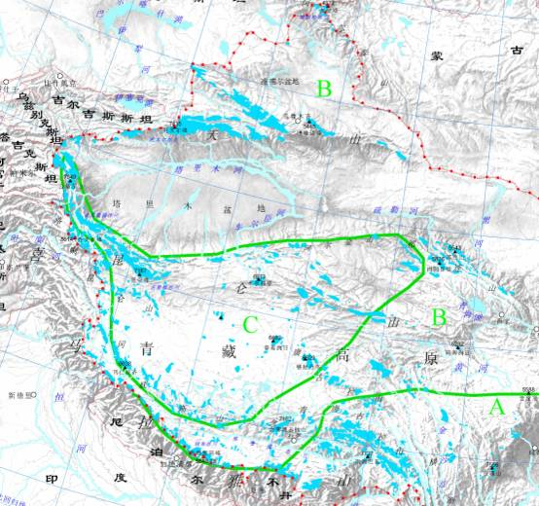
Glacier
Frozen ground
Snow cover
SFG
PF
Stable SC
Major cryosphere components in China
Glacier
Frozen ground
Snow cover
Total：46377
Area：59425km²
Volume: 5.6×10¹²m³
Area：Permafrost
220×10⁴km²
Ice volume：9.5×10¹²m³
Area：Stable area
420 ×10⁴km²
SWE：750×10⁸m³

Slide 5
Atmosphere
Weather/Climate
Biosphere
Hydrosphere
Ecology/Oasis
Cryosphere
Sea level/Water
Adaptation
Disasters
Eposphere
Lithosphere
Framework of Cryosphere Science

Slide 6
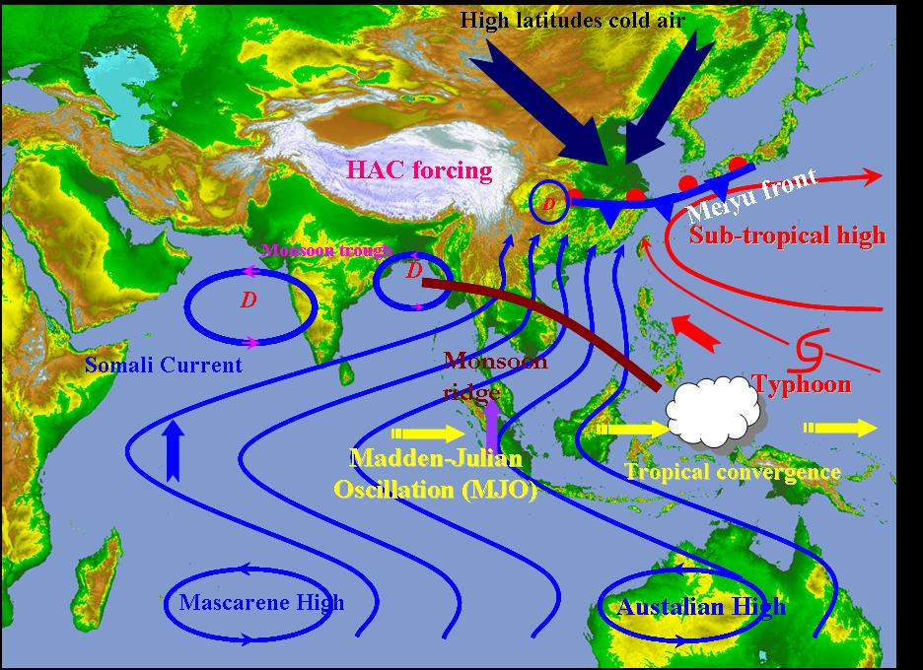
High Asian Cryosphere (HAC) versus Weather/Climate

Slide 7
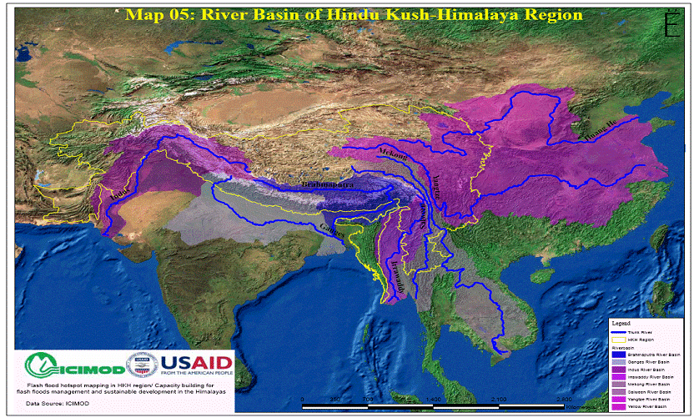
HAC versus water, showing basins like Indus, Ganges, Brahmaputra, Yangtze, Yellow and Mekong rivers (ICIMOD, 2005), and Tarim River

Slide 8
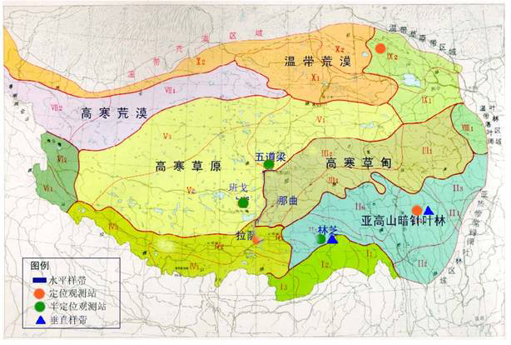
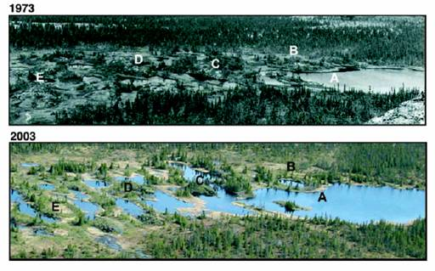
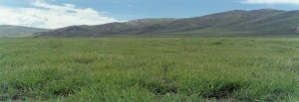
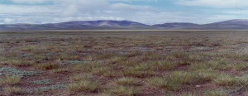
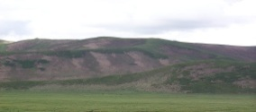

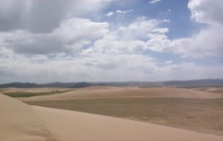
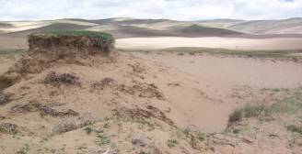
1973
Siberia
2003
Bioclimatic zones
Alpine meadow
Alpine grassland
Relation of HA ecology and FG change, different to Arctic

Slide 9
Outline
Upland Asian Cryosphere and importance
Existing network and re-design for GCW
Gaps

Slide 10
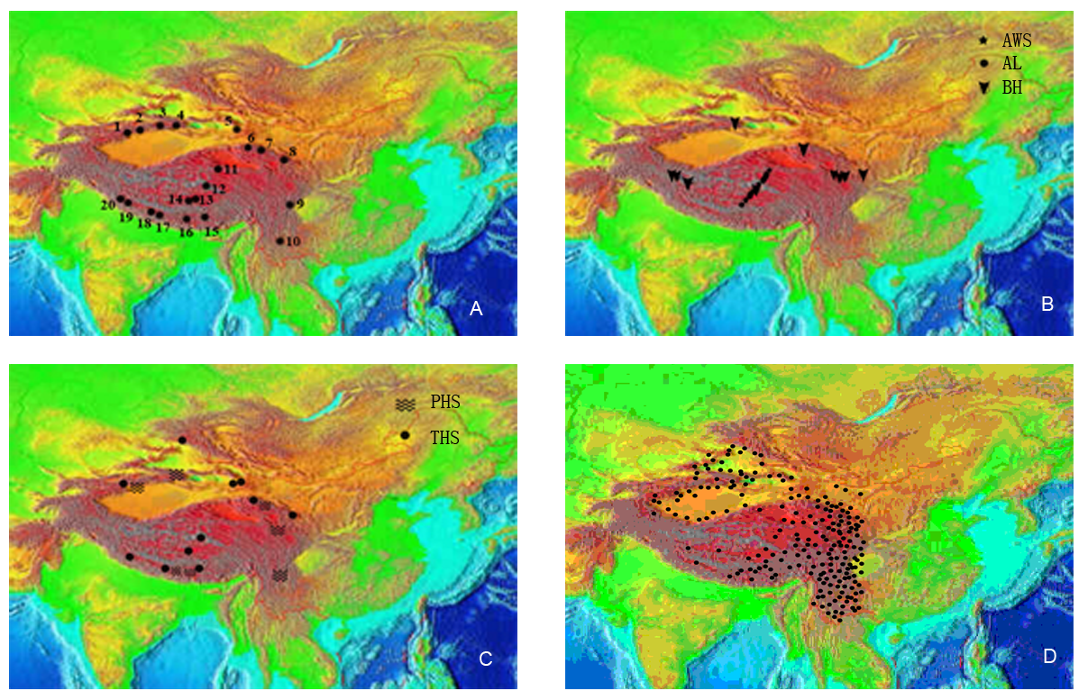
Glacier
Frozen ground
Hydrology
Snow cover
Existing observation sites over HAC

Slide 11
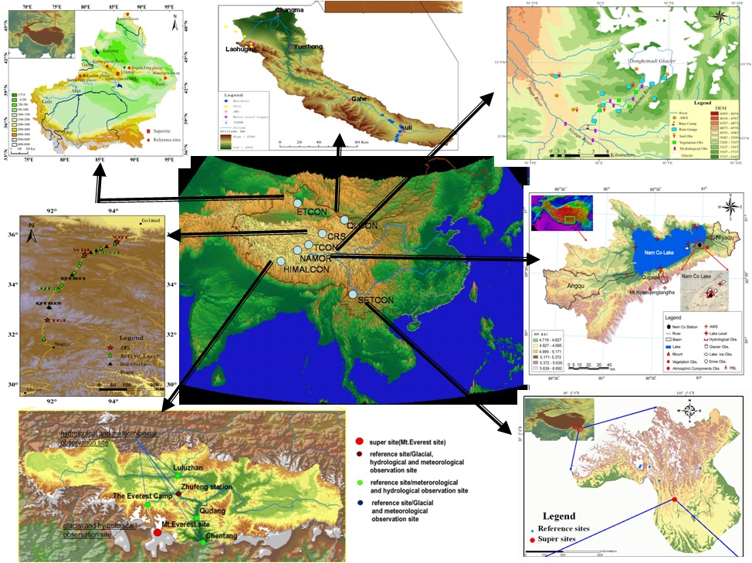
Re-designed HAC network, 7 supersites

Slide 12
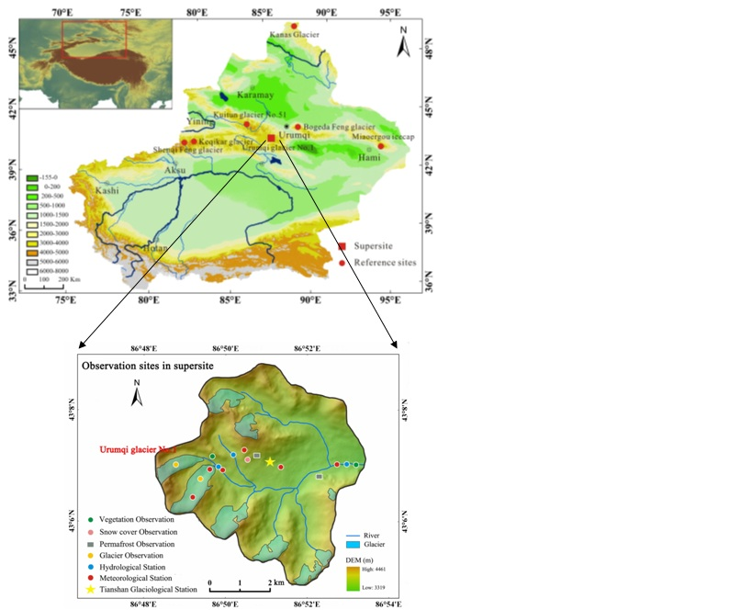
1. HAC-ETCON (East Tianshan)

Slide 13
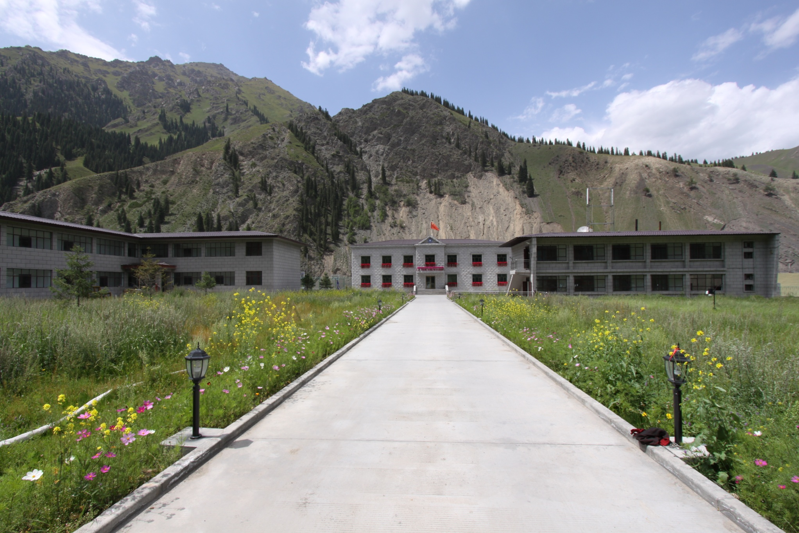

Slide 14
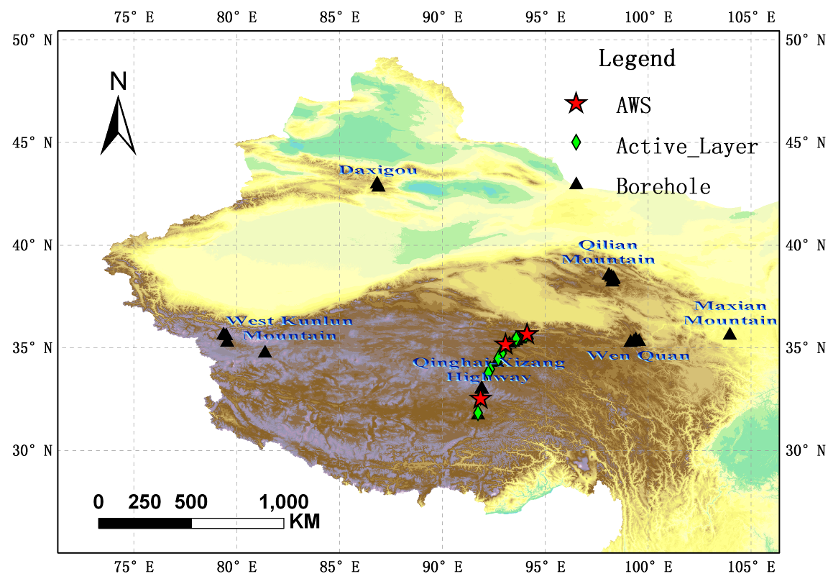
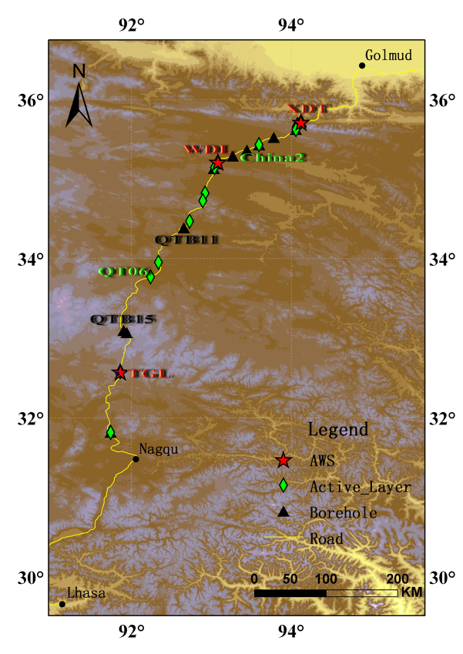
2. HAC-CRS (Germud)

Slide 15
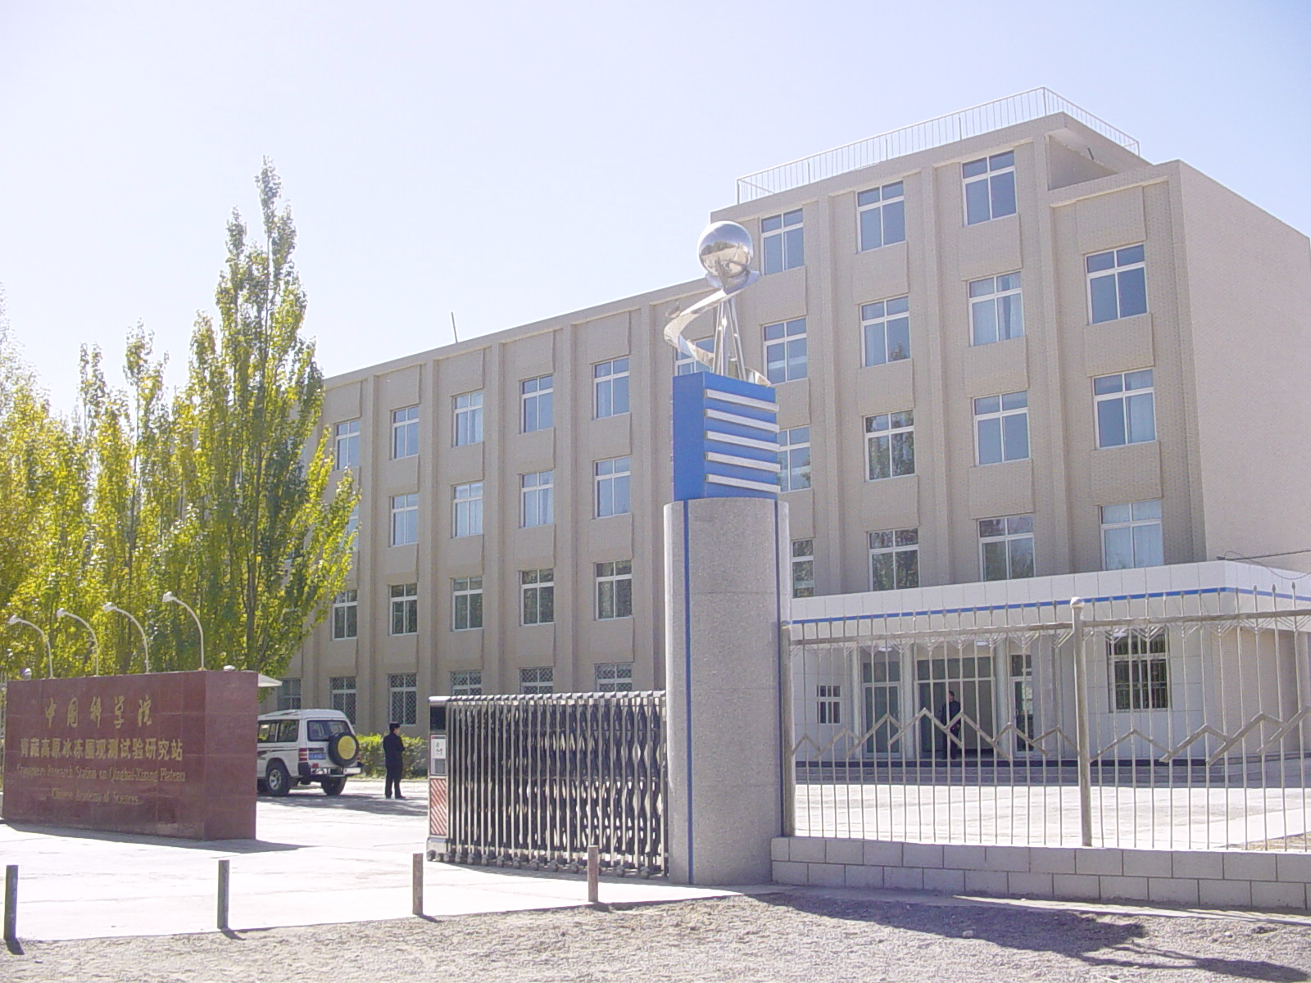

Slide 16
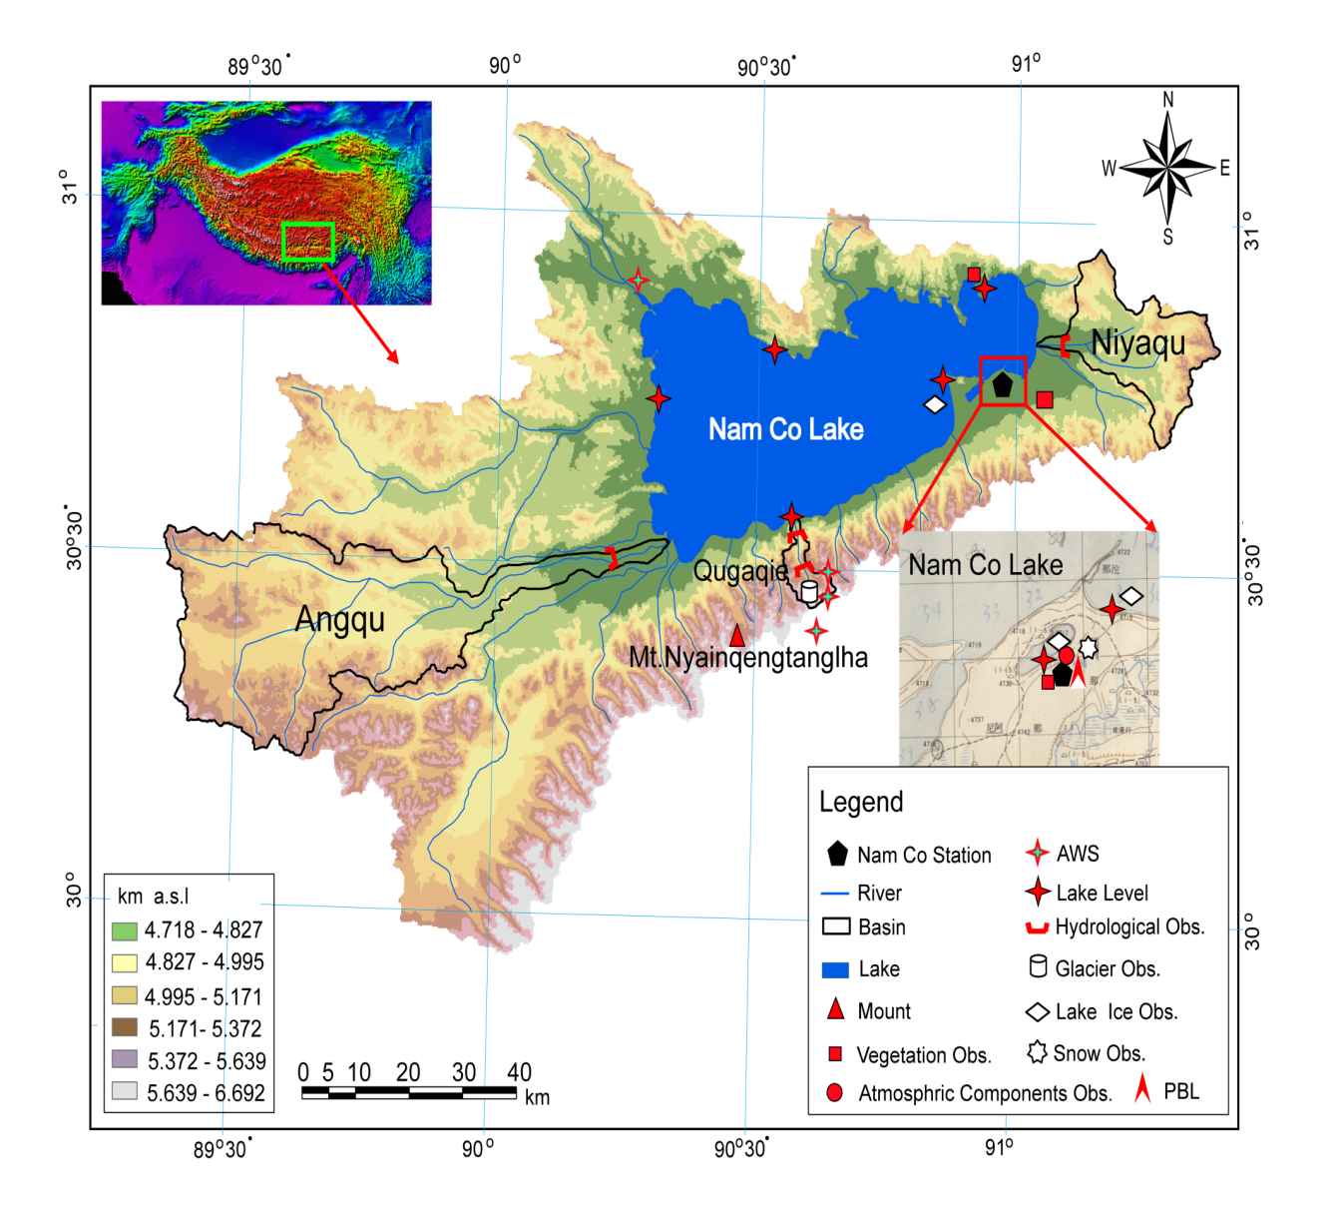
3. HAC-NAMOR (Nam Co)

Slide 17
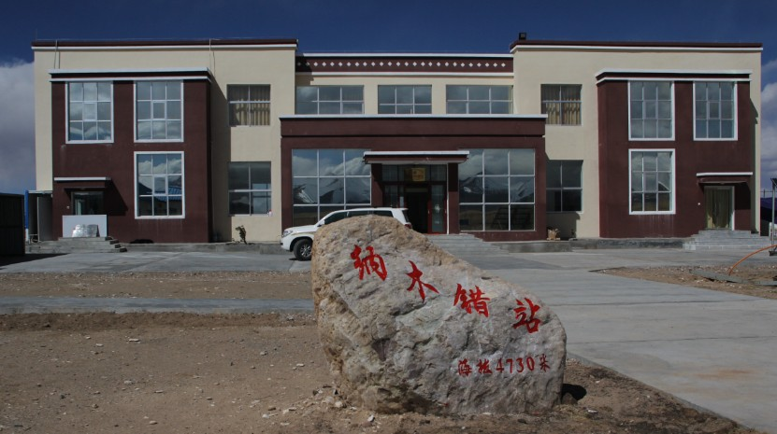

Slide 18
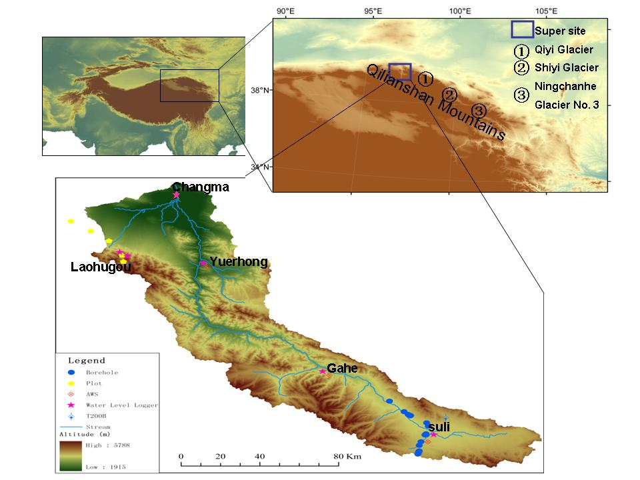
4. HAC-QLCON (Qilian Mt)

Slide 19
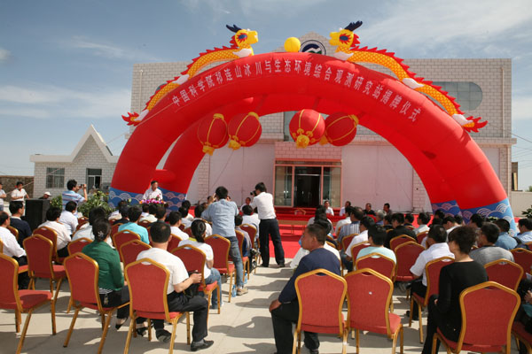

Slide 20
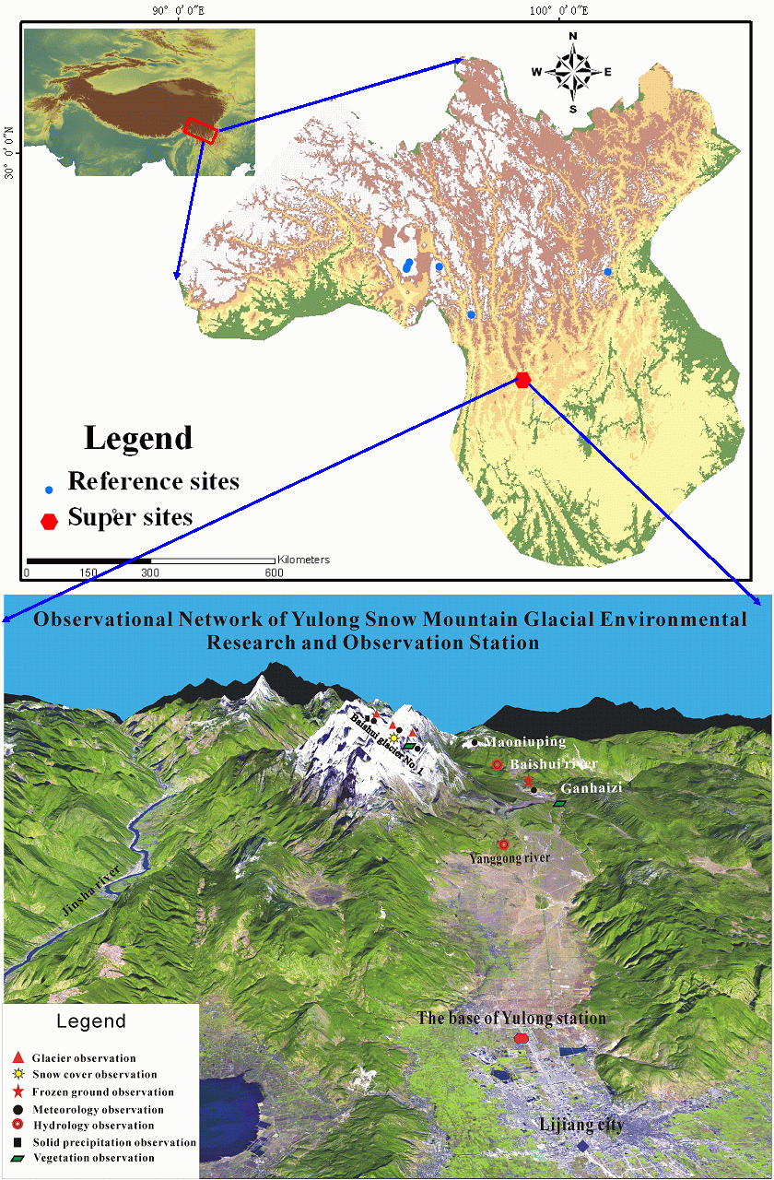
5 HAC- SETCON (Southeast Tibet)

Slide 21
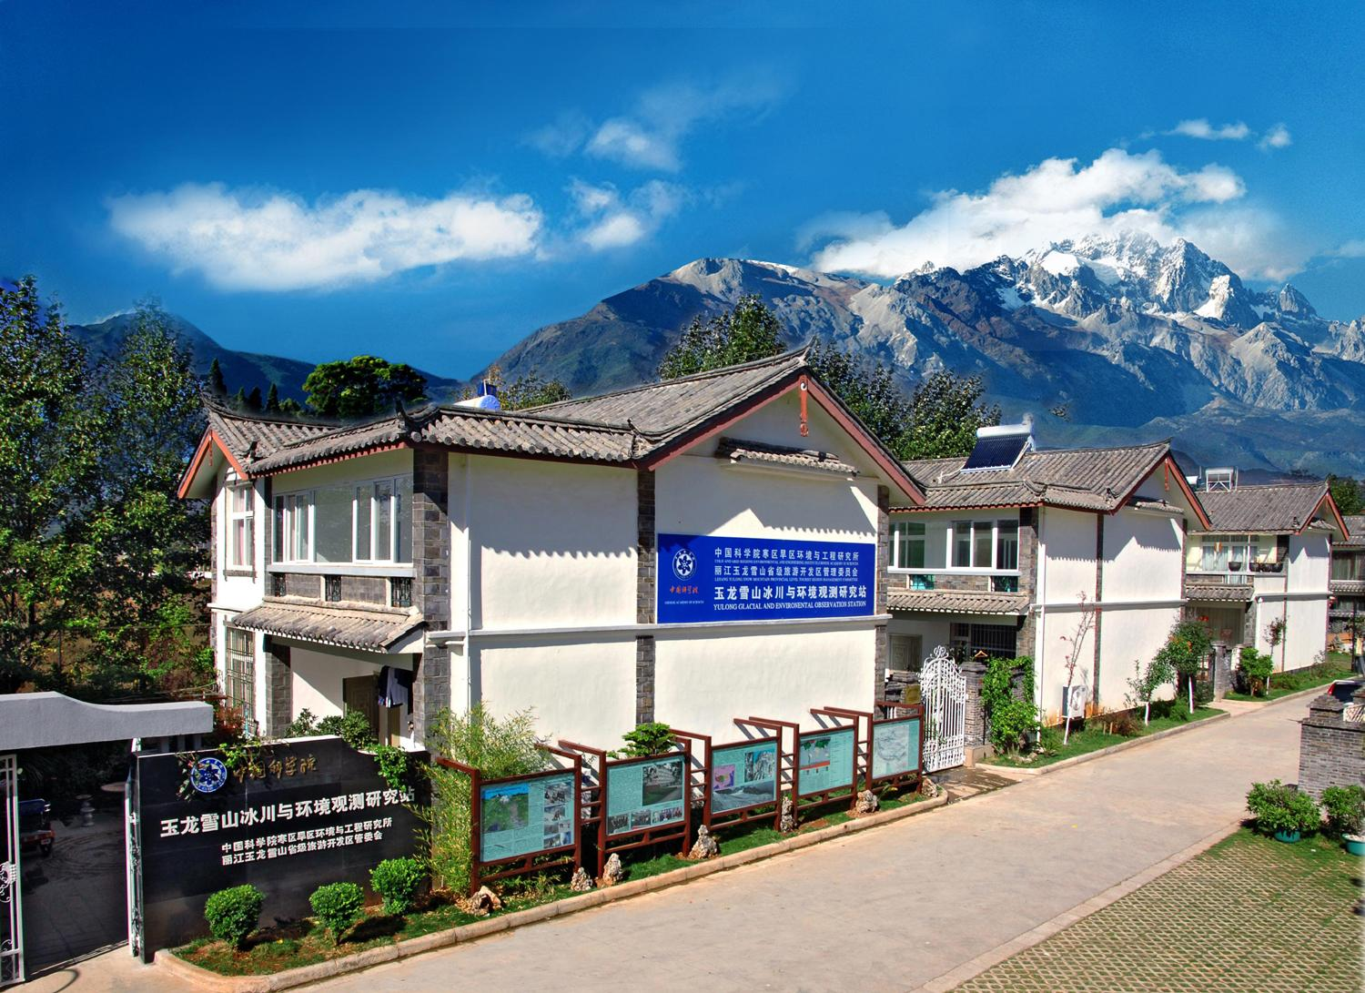

Slide 22
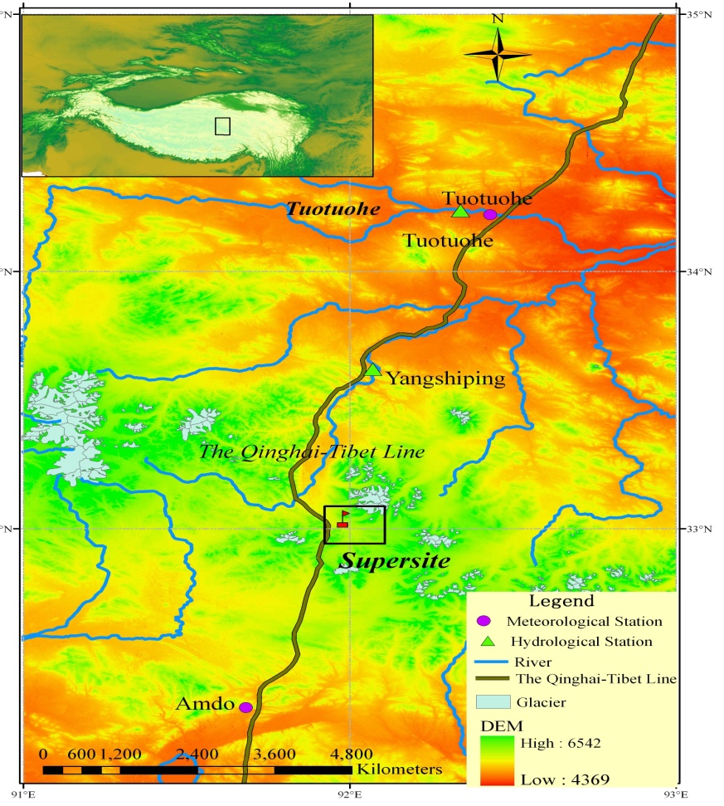
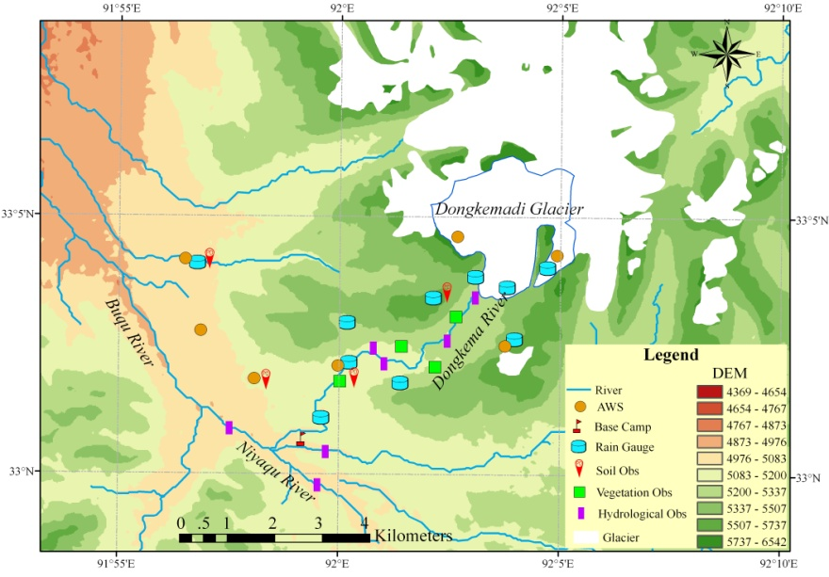
6. HAC-TCON (Tanggula Mt)

Slide 23
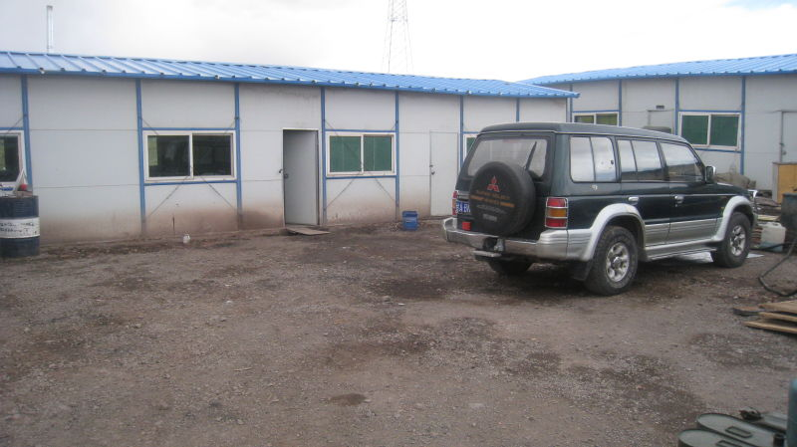

Slide 24
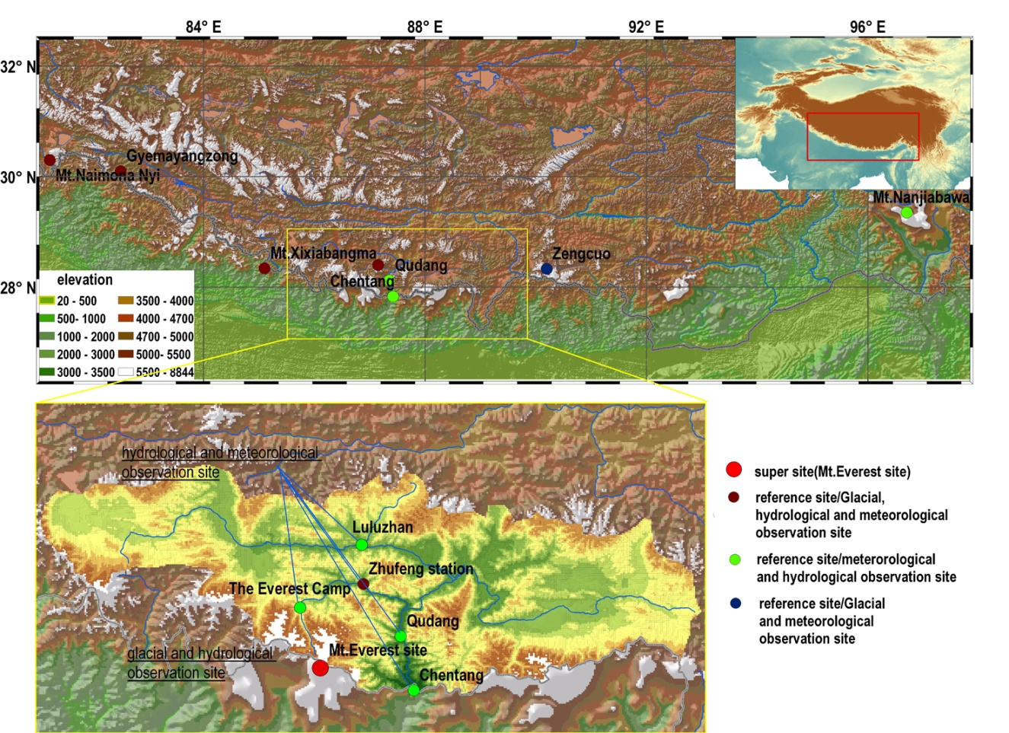
7 HAC-HIMALCON (Himalayas)

Slide 25
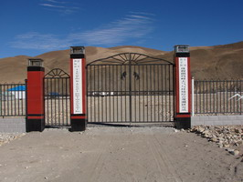

Slide 26
Observed ECVs and methods __glacier
Components | ECVs | Methods（manual/auto） | accuracy | Standard method recommended
Glacier | Mass balance | stake/snow pit（manual） water balance（manual/auto） Geodetic survey (altimetry, in-situ survey, stereography, DEM) (manual/Aut)） | 5 mm ~ 20 mm 10 mm ~ 100 mm - | Stake/snow pit
 | Surface ice velocity | In-situ survey (theodolite, all-station, RTK-GPS（manual） InSAR（auto） Sub-pixel methods（auto） | 1 mm ~ 1 m - variable | In-situ survey
 | Area | in-situ geodetic（manual） stereography（manual） remote sensing（auto） | 1 mm ~ 1 m Instrument depends variable | in-situ geodetic
 | Thickness | ice-penetrating radar（manual） DEM (SAR、in-situ geodetic、stereography, remote sensing）（manual/auto） | ~ 5m - | Ice-penetrating radar
 | Ice temperature | 20m quartz temperature sensor（manual/auto） | 0.1℃ | 20m quartz temperature sensor(auto)
 | Meltwater runoff | Hydrological section survey（manual/auto） | Instrument depends | Hydrological section survey (manual/aotu)
 | Surface energy balance | AWS（auto） | Instrument depends | AWS

Slide 27
Observed ECVs and methods __frozen ground
Components | ECVs | methods（manual/auto） | accuracy | Standard method recommended
Frozen ground | Active layer temperature | auto | 0.05 | Thermistor (auto)；the uppermost sensor should at least 20 cm above the up-limit of permafrost
 | Soil moisture（unfrozen water） | auto | 3% | Vitel moisture sensor，TDR (auto)
 | Active layer thickness | auto | <5cm | Interpolation method，thermistor (auto)
 | Permafrost temperature | auto | 0.05 | Borehole thermistor (auto), the uppermost sensor should at least 15 m bellow the stable annual temperature layer
 | Surface energy balance | AWS (auto) | Instrument depends | AWS

Slide 28
Observed ECVs and methods __Snow cover
Components | ECVs | methods（manual/auto） | accuracy | Standard method recommended
Snow cover | Depth | Snow meter (auto), ruler | 0.005m | Ruler (manual)
 | Water content | Snow property meter(manual) |  | Snow property meter (manual)
 | density | Weight/volume (manual) | 0.01 | W/V (manual)
 | area | Vision + remote sensing | 0.001~0.01km² | Vision + remote sensing (manual + auto)
 | impurities | Sampling and analyses |  | Coulter Counter, BC instrument (auto)

Slide 29
Observed ECVs and methods __freshwater ice
Components | ECVs | Methods(manual/auto) | accuracy | Standard method recommended
Lake/River ice | Initial ice | Vision + Remote sensing | 1-3 d | Vision + Remote sensing
 | Frozen-up date | Vision + Remote sensing | 1-3d | Vision + Remote sensing
 | Melting date | Vision + Remote sensing | 1-3d | Vision + Remote sensing
 | Break-up date | Vision + Remote sensing | 1-3d | Vision + Remote sensing
 | Frozen duration | Vision + Remote sensing | 1-3d | Vision + Remote sensing
 | area (%) | Vision + Remote sensing |  | Vision + Remote sensing
 | thickness | ruler | 1cm | ruler
 | density | manual |  | manual

Slide 30
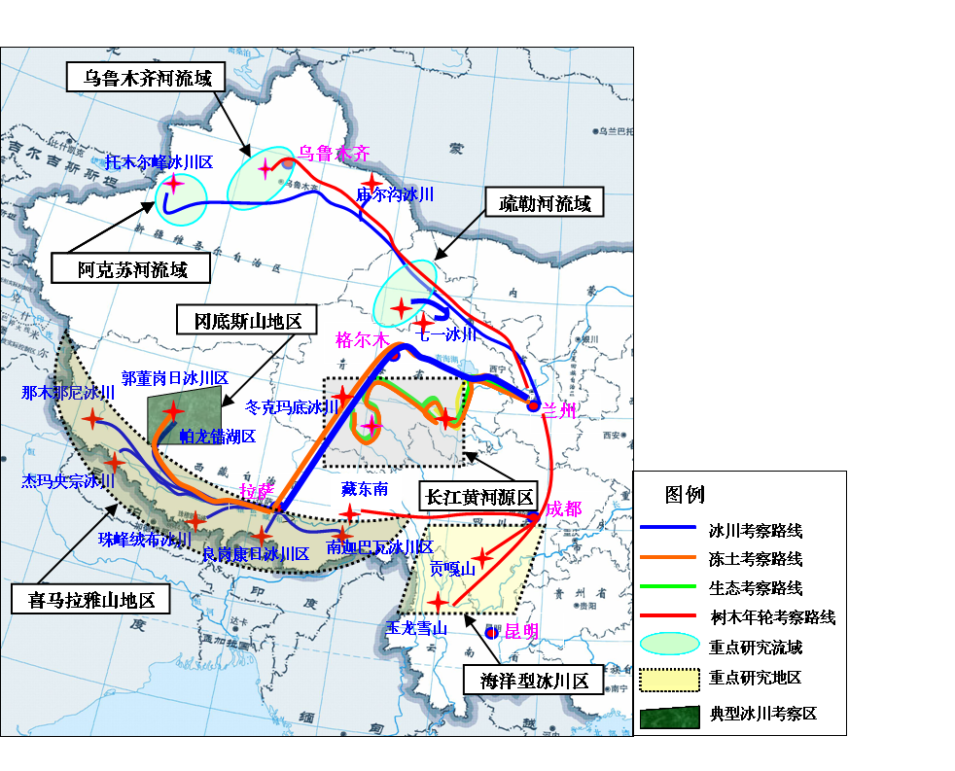
Research-based observations going on every year.

Slide 31
Outline
Upland Asian Cryosphere and importance
Existing network and re-design for GCW
Gaps

Slide 32
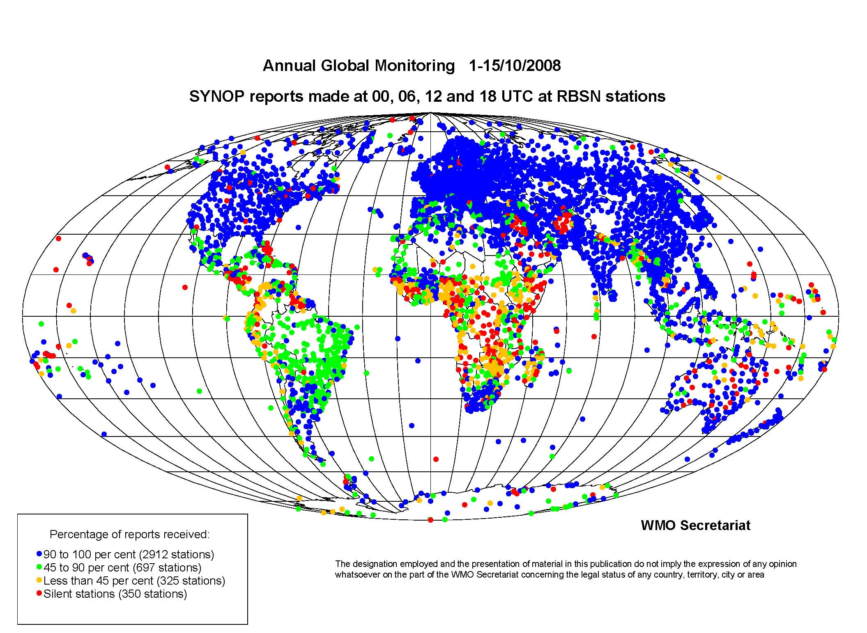
Observation: GAPS

Slide 33
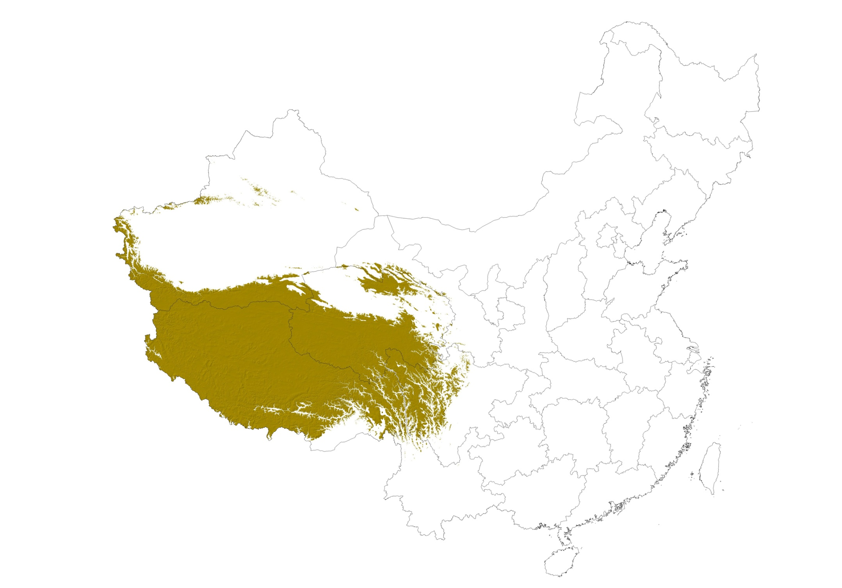
Area above 4000 m a.s.l.

Slide 34
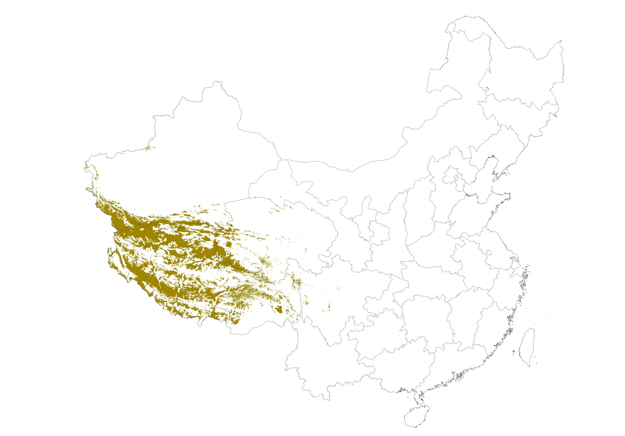
Area above 5000 m a.s.l.

Slide 35
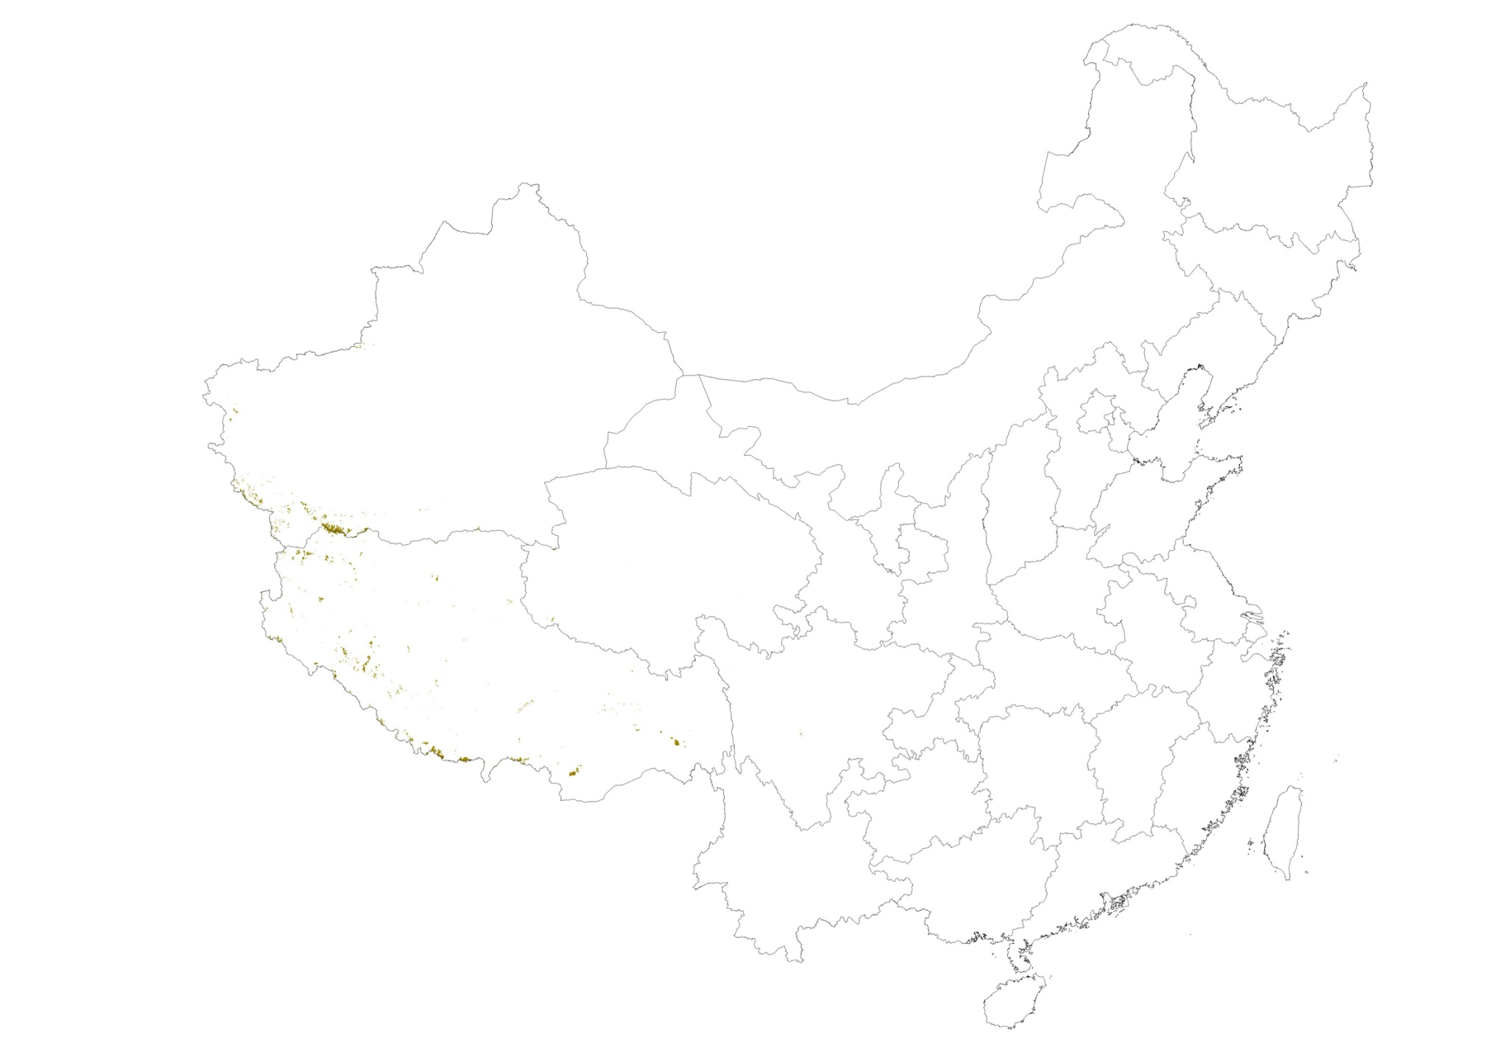
Area above 6000 m a.s.l.

Slide 36
Gaps ___ glacier
Applications | Essential Cryospheric Variables (ECV)*
Dynamic models, Meltwater runoff, Basin-scale degree-day model (DDF), Energy-balance model | Mass balance (MB), ELA, terminal position, ice temperature，ice flow, geometric shape (length, width, area, thickness, volume), surface energy balance
* Green: operated ECVs

Slide 37
Gaps ___ snow cover
Applications | Essential Cryospheric Variables (ECV)*
CMIP3-5 CLM, Snow-melt floods forecast degree-day model energy-balance model | Area (S), depth (h), SWE, snow cover duration (SCD), albedo，density，water content, accumulation，sublimation，snow temperature，rainfall ratio，surface energy exchange
* Green: operated ECVs

Slide 38
Gaps ___ frozen ground
Applications | Essential Cryospheric Variables（ECV）*
Permafrost models， CLM， FG-Atmospheric coupled models FG-vegetation coupled models | Soil temperature，ice content，AL，zero curtain，soil types，humus，vegetation types，talik，surface energy balance，low limit，geomorpholgy
* Green: operated ECVs

Slide 39
Gaps ___ Sea ice
Applications | Essential Cryospheric Variables（ECV）*
Sea ice models Fishing Gas station harbour | concentration，thickness，area，open water，snow cover on ice，roughness（ridging）, frozen date，break-up date，salinity，ice temperature，transparency，flow vector，surface energy balance
* Green: operated ECVs

Slide 40
Gaps ___ freshwater ice
Applications | Essential Cryospheric Variables（ECV）*
River ice | Length of frozen river，thickness，frozen date，break-up date，snow cover on ice，concentration，types，roughness，ice volume，width，flow velocity
Lake ice | Frozen date，break-up date，thickness, snow cover on ice，concentration，temperature，salinity，surface energy balance
* Green: operated ECVs

Slide 41

水

Slide 42
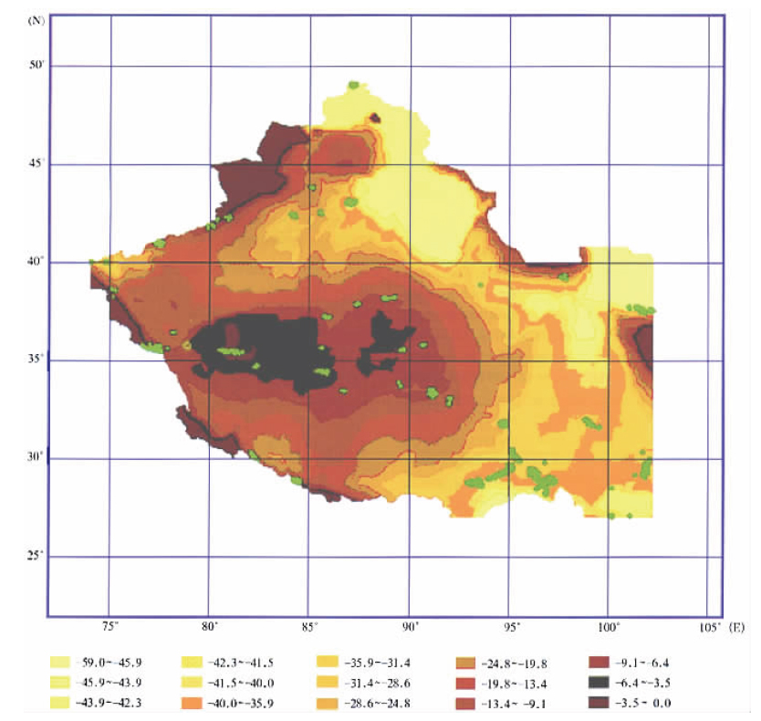
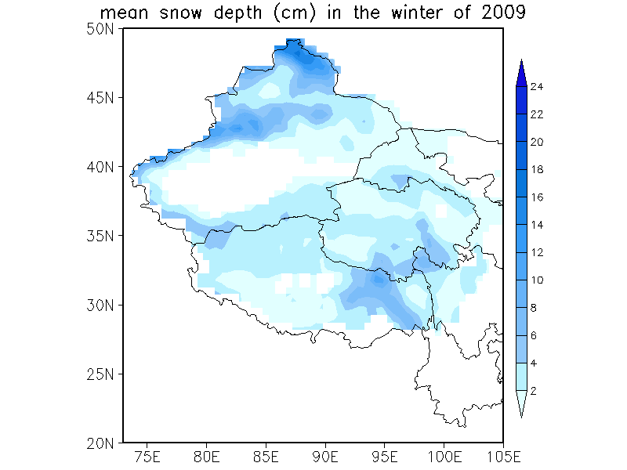
Glacier changes since Little Ice Age
（Large in marginal，small interior）
Snow cover distribution
（thick in marginal，rare interior）
Key regions of rapid meltwater shortage : “S” shaped

Slide 43
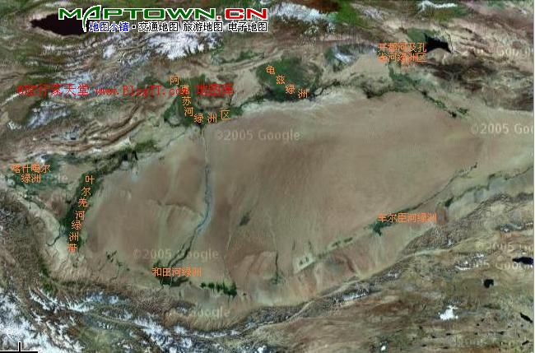
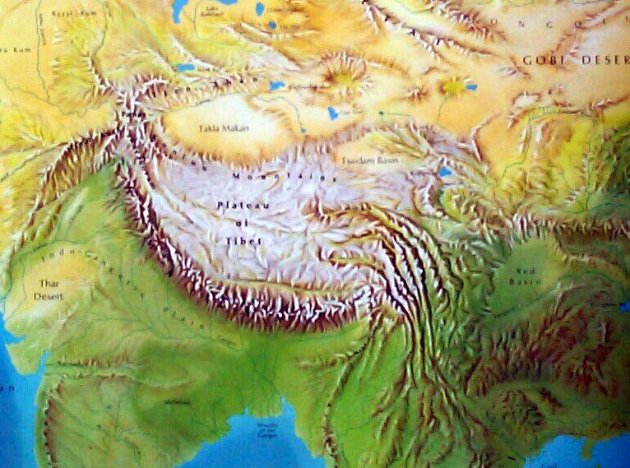
Kaidu and Kongque River Oasis
Aksu Oasis
Guizi Oasis
Hexi Corridor
Kashiger Oasis
Yerqiang Oasis
Cheercheng Oasis
Qilian Mts
Hetian Oasis
1
2
4
3
High-altitude climate monitoring in future

Slide 44
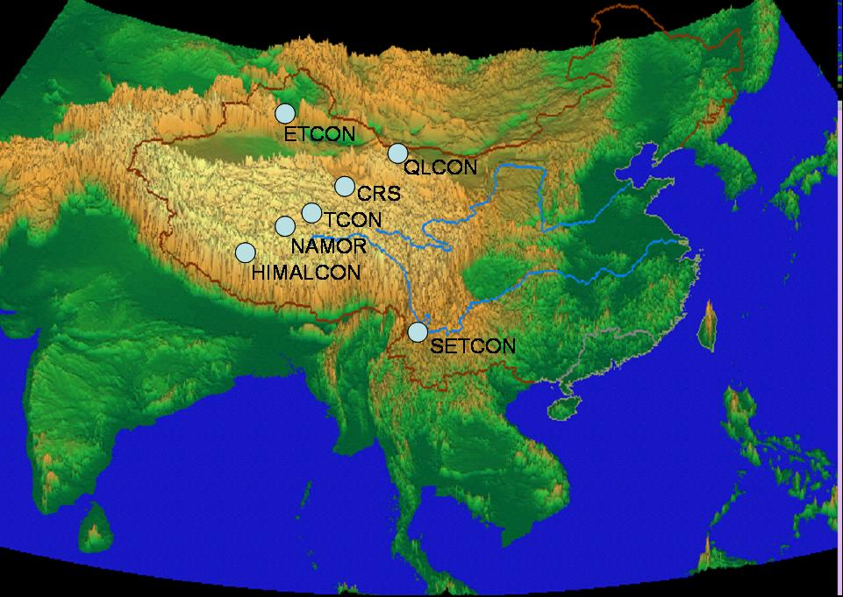
supersites
reference sites
Data assimilation in GCW, such as snow cover and frozen ground?
Point obs.
Pixel
grids
basin
region
global
Coordinated observation
Data assimilation
Scale-transformation
Numerical modeling

Slide 45
Snow cover single-point assimilation
CEOP site in Siberia
Land process model：CoLM
Microwave radiation transfering model：MEMLS
data：AMSR-E。
Che T, Li X, Armstrong R L, and Zhang T J, 2009. An experiment of assimilating passive microwave remote sensing data into a land surface model to improve the estimation of snow depth. Remote Sensing of Environment, in second revision

Slide 46
Multiple-site based data assimilation

Slide 47
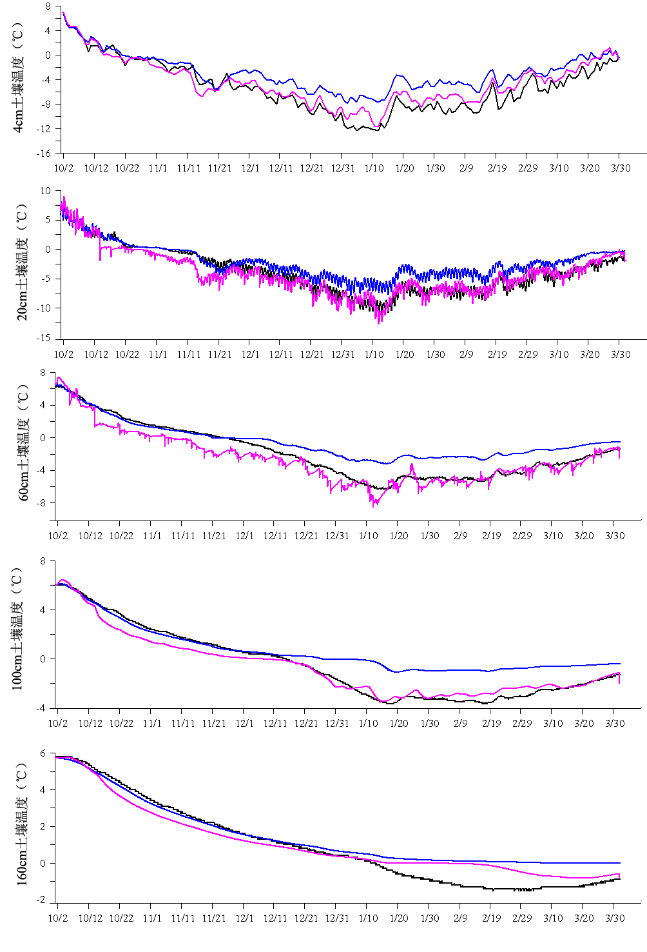
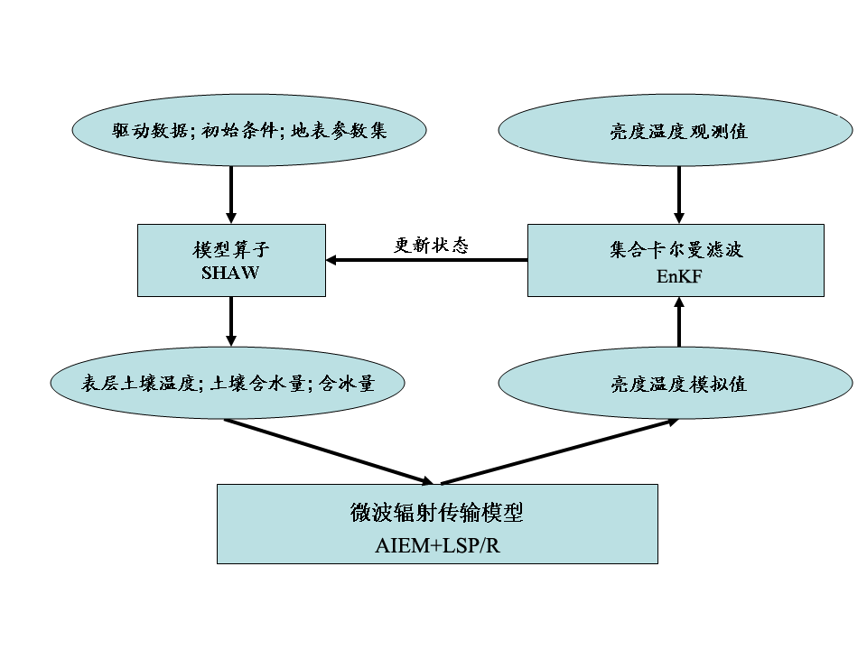
Frozen ground: SSM/I bright temperature assimilation (winter)
4cm
20cm
60cm
100cm
160cm
晋锐, 李新. 同化站点观测和SSM/I亮温改善冻土活动层状态变量的模拟精度. 中国科学, 2009, 39(9): 1220-1231.

Slide 48
Summary and questions
Existing fairly good regional CryNet on High Asia
Still large gaps compared to IGOS-Cryosphere, harsh condition of HA not enable observing all ECVs
GCW may need define ECVs in every specific region, i.e., regional standards. Which ECVs should be international standards, and which should be regional?
Define reference sites and supersites?

Slide 49
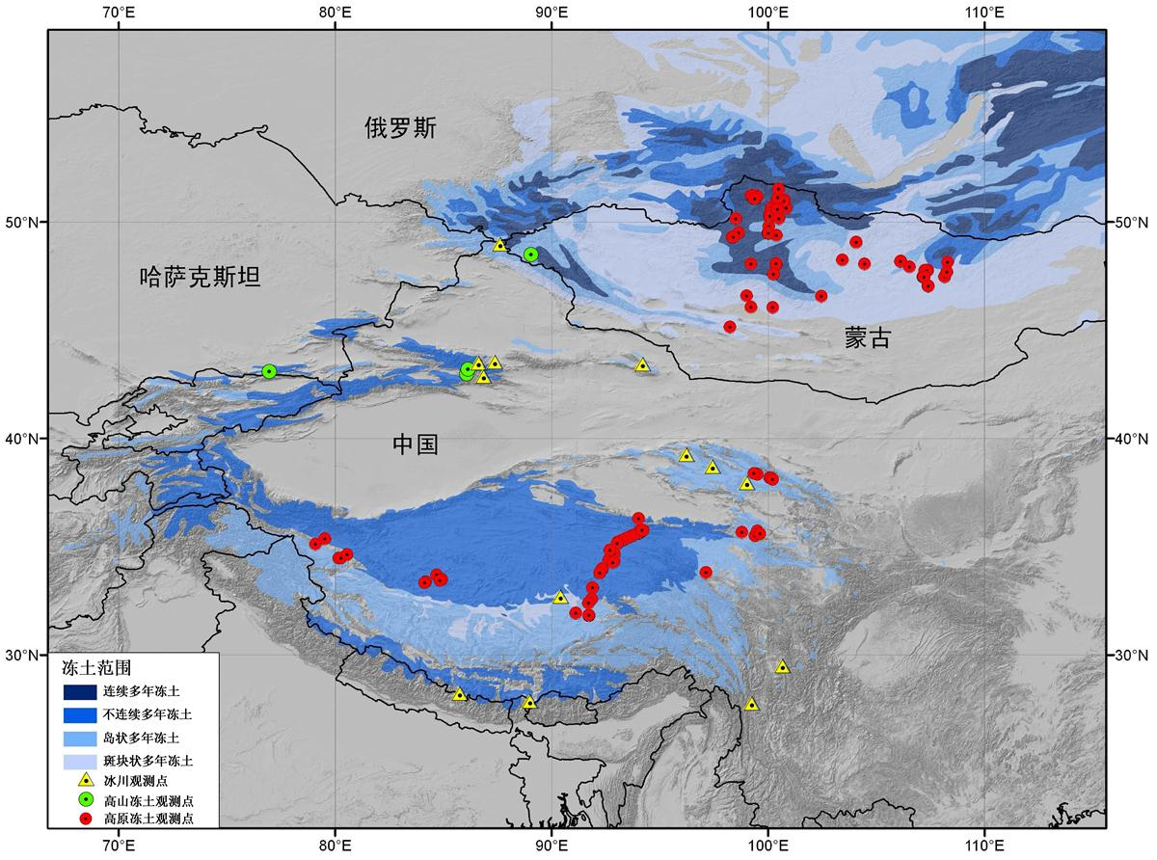
Regional coordination to shape a fully High Asia

Slide 50
Questions?
Acknowledgements: Li Zhongqin, Zhao Lin, Kang Shichang, He Yuanqin, Qin Xiang, He
Xiaobo, Li Xin contribute to this presentation.

