Slide 1
Modelling and Data Assimilation Needs
for improving the representation
of Cold Processes at ECMWF
presented by
Gianpaolo Balsamo
with contributions from
Patricia de Rosnay, Richard Forbes, Anton Beljaars, Lars Isaksen,
Peter Bauer, Jean-Noel Thepaut, and other colleagues

Slide 2
Outline
Introduction
- Observing cold processes
Recent examples of Modelling advances in cold regions
- Clouds & precipitation micro-physics
- Snow modelling and the water cycle
Recent examples of Data Assimilation advances in cold regions
- Snow analysis
Summary

Slide 3
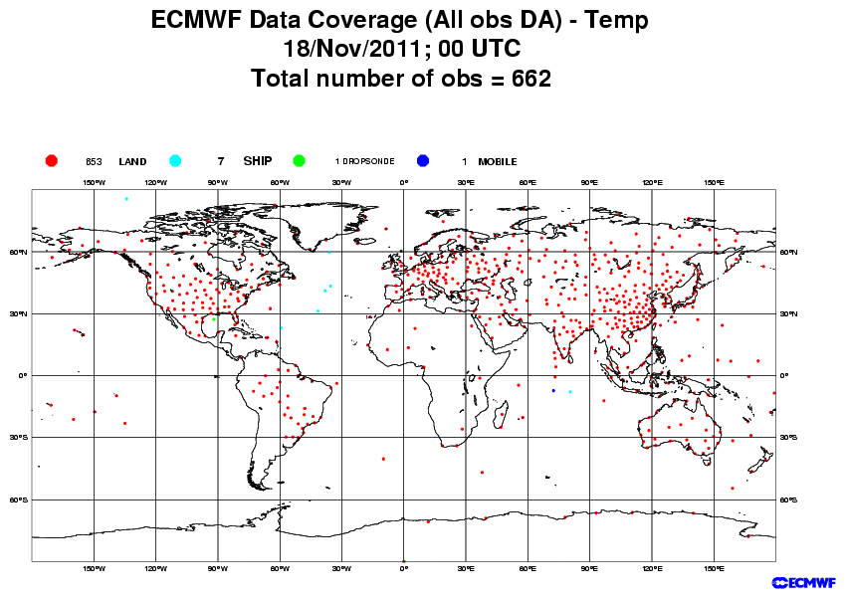
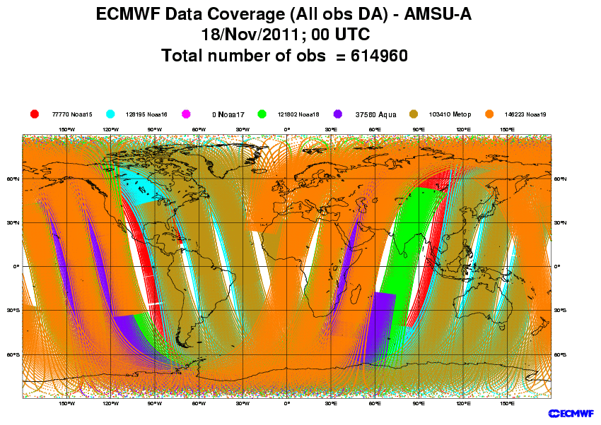
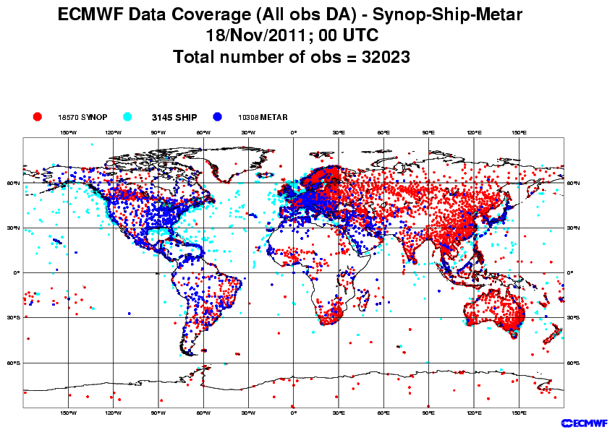
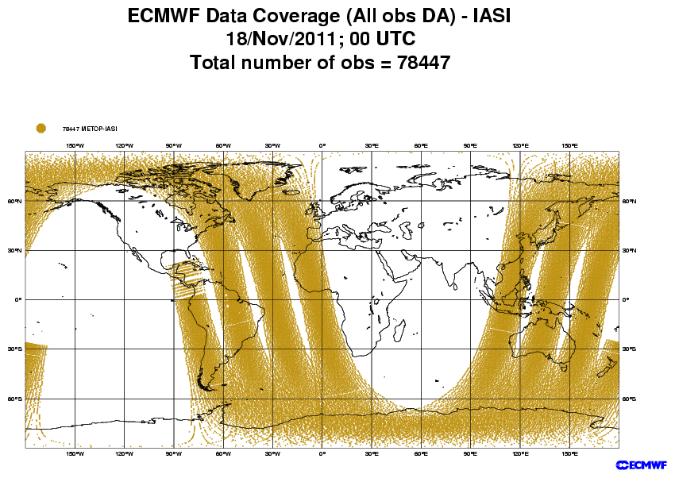
Observations in cold regions
http://www.ecmwf.int/products/forecasts/d/charts/monitoring/coverage/
ECMWF does collect, monitor, pre-process, quality-check, select and assimilate in the atmospheric and land surface analyses up to millions of observations daily. The polar regions, well covered by polar-orbiting satellites lacks from ground-based sites.

Slide 4
Outline
Introduction
- Observing cold processes
Recent examples of Modelling advances in cold regions
- Clouds & precipitation micro-physics
- Snow modelling and the water cycle
Recent examples of Data Assimilation advances in cold regions
- Snow analysis
Summary

Slide 5
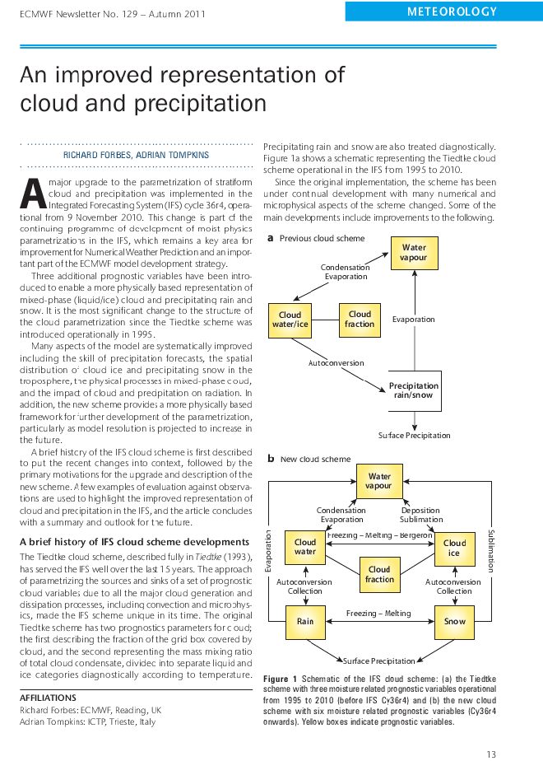
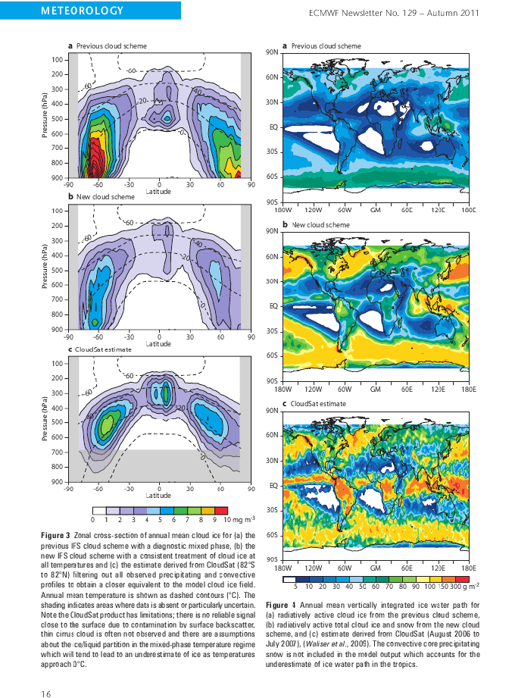
Clouds&Precipitation status in 36R4 (as in S4)
An ECMWF Newsletter article in Autumn 2011 issue (N129) documents Operational developments in clouds and precipitation (A major upgrade)
Revised clouds and precipitation components of the IFS model and related improvements are summarized in an ECMWF news item
(Forbes and Tompkins, 2011). This model version is adopted by the new seasonal forecasting system (System-4)

Slide 6
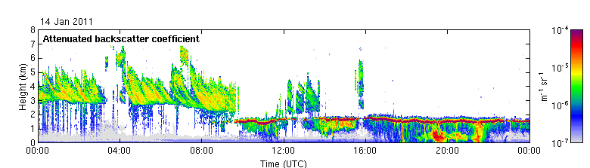
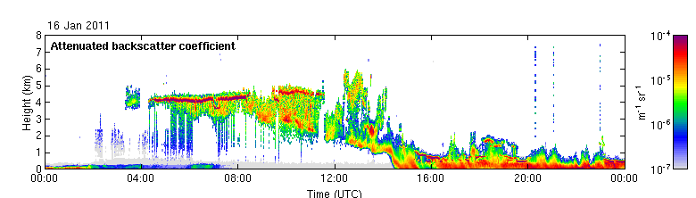
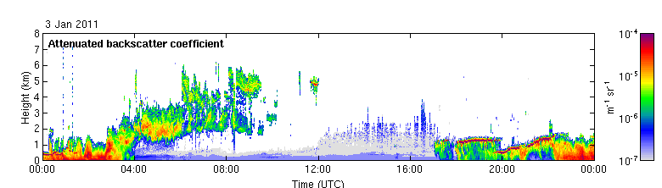
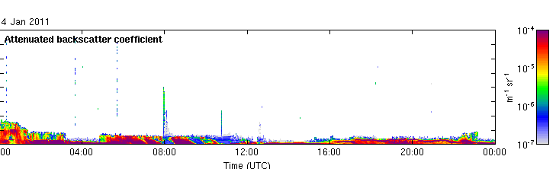
Observations of mixed-phase cloud
Sodankyla – northern Finland (67N, 38E)
Courtesy of Richard Forbes
14 Jan 2011
Ice cloud and SLW layer at 2km, ice falling out
16 Jan 2011
SLW layer at 4km, ice falling out
4 Jan 2011 case study
Low-level liquid/ice cloud (fog) observed

Slide 7
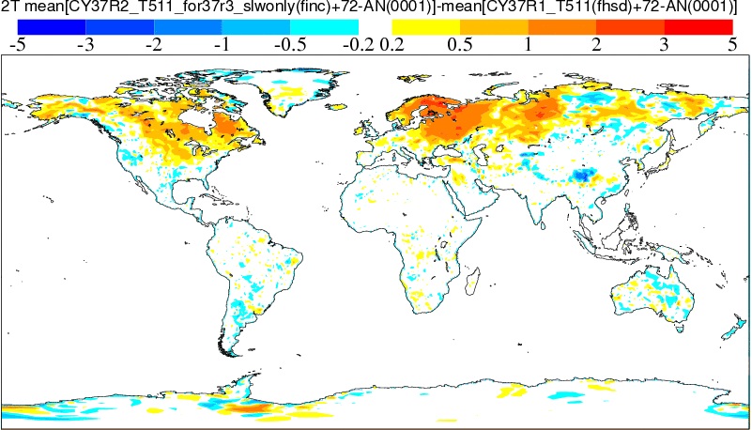
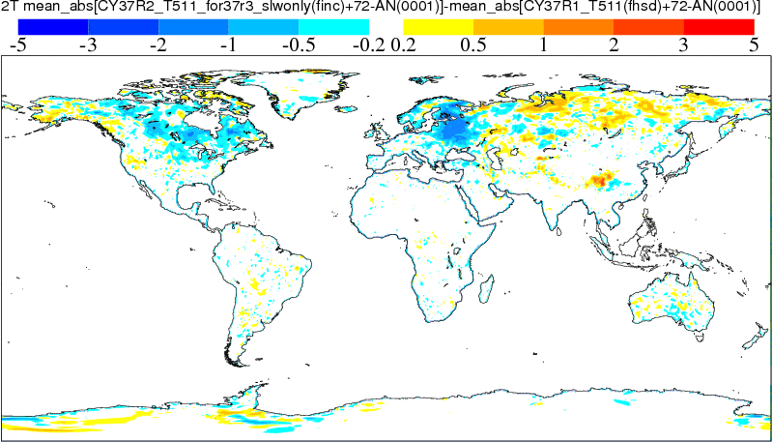
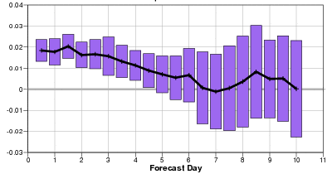
Super-cooled liquid water
Radiative impact on low-level temperature over land
°C
Courtesy of Richard Forbes
Mean T2m change (72hr forecast for Jan 2011) for Cy37r3 slw cloud changes
Changes to representation of super-cooled liquid water in Cy37r3 positive impact.
General increase in occurrence of super-cooled liquid water, particularly in weakly forced situations.
Improved temperature bias and reduced errors in winter -time low cloud over land.
Impacts clearly seen in NH and European T1000 scores.
As above, but change in mean absolute error (generally reduced)
NH T1000 hPa r.m.s.e for Jan/Feb 2011
Control – Expt (+ve is good)
Notes:
ECMWF Training Course
02 May 2000
Moist Processes

Slide 8
Outline
Introduction
- Observing cold processes
Recent examples of Modelling advances in cold regions
- Clouds & precipitation micro-physics
- Snow modelling and the water cycle
Recent examples of Data Assimilation advances in cold regions
- Snow analysis
Summary

Slide 9
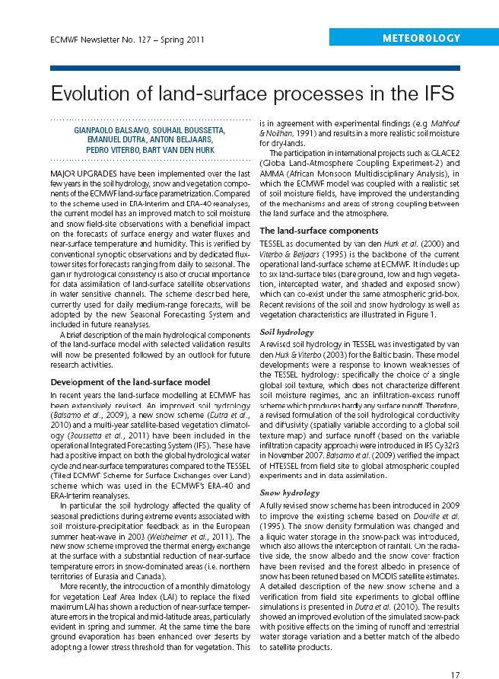
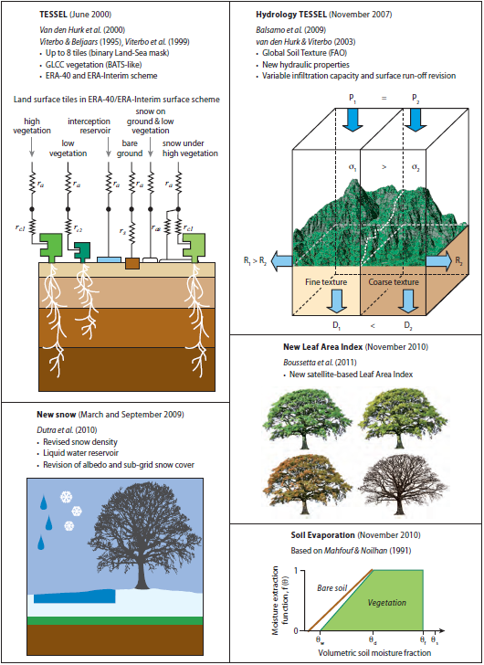
Land surface model status in 36R4 (as in S4)
An ECMWF Newsletter article in Spring 2011 issue (N127) documents Operational developments since the ERA-Interim land surface scheme
Revised soil, snow, and vegetation components of the IFS model are summarized (based on 3-supporting publications) in a
ECMWF news item. This model version is adopted by the new seasonal forecasting system (System-4)

Slide 10
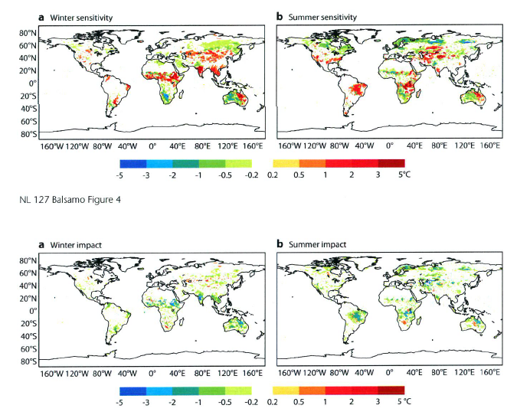
Forecasts sensitivity and impact to land
Sensitivity of a set of T2m Day-2 forecasts in winter 2008 (DJF) and Summer 2008 (JJA)
Cooling 2m temperature Warming 2m temperature
Forecast Impact (Mean Absolute Error reduction of the T2m Day-2 forecast error)
Improving temperature Degrade 2m temperature
The revised land surface scheme in CY36R4 is compared to the land surface model version (CY31R2 LSM used in ERA-Interim) for its sensitivity and impact on the short-term weather forecasts of 2m temperature showing an improvement also in Day-2 range

Slide 11
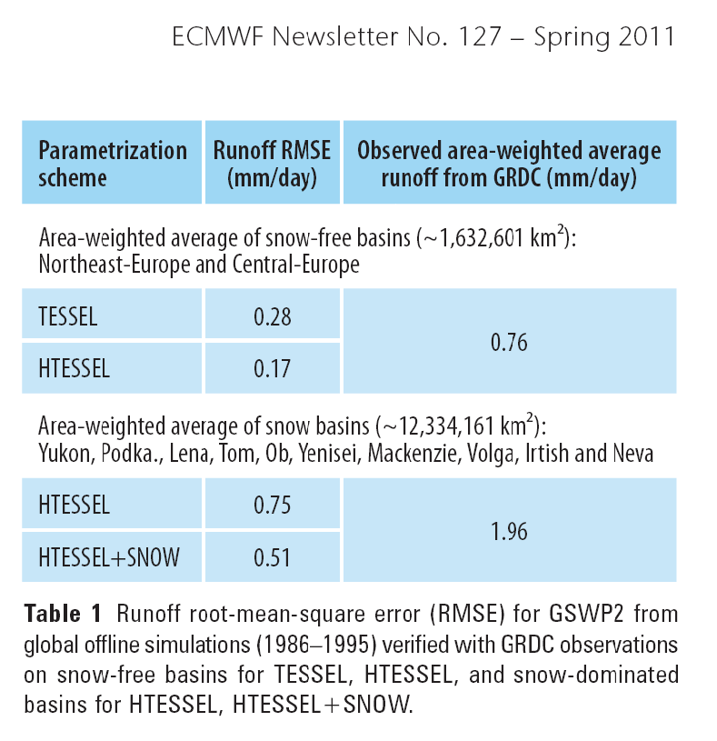
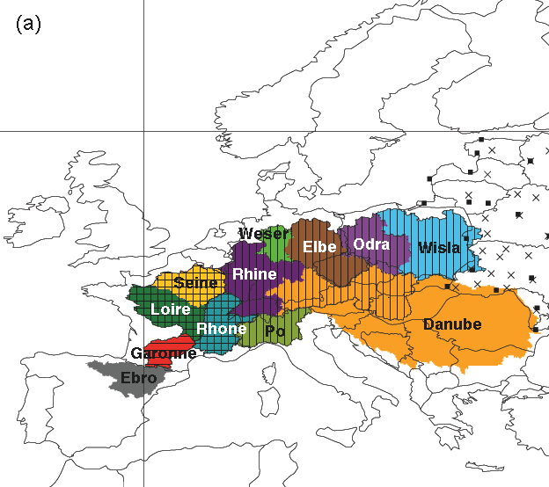
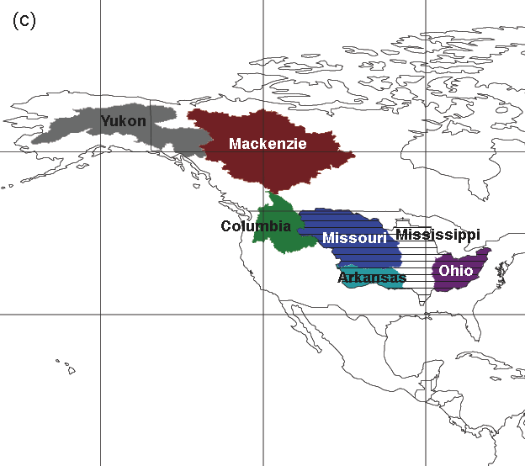
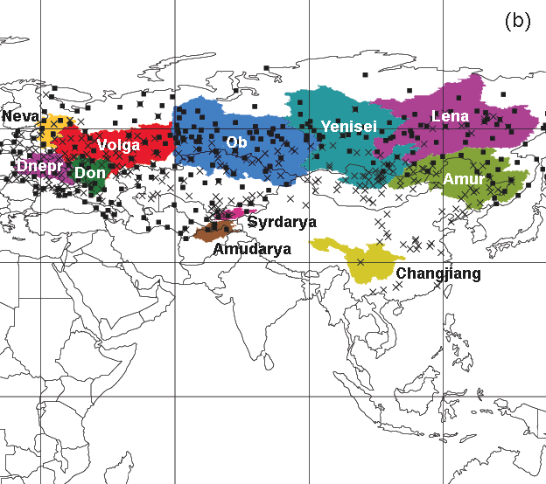
Assessing impact on hydrological cycle
Monthly runoff verification over large river basins in collaboration with M. Hirschi (ETH-Zurich)
In collaboration with
ETH-Zurich, see also:
Hirschi et al. 2006,
J. Hydromet.,
7(1), 39-60
Using an equal forcing (this time based on ERA40GPCP corrected forcing) TESSEL and the new land surface model version currently operational can be evaluated against river discharges of main Northern Hemisphere river at monthly timescales (no routing). New activities with river-routing schemes can assess hydrological impact on daily timescale (Pappenberger et al. 2010)

Slide 12
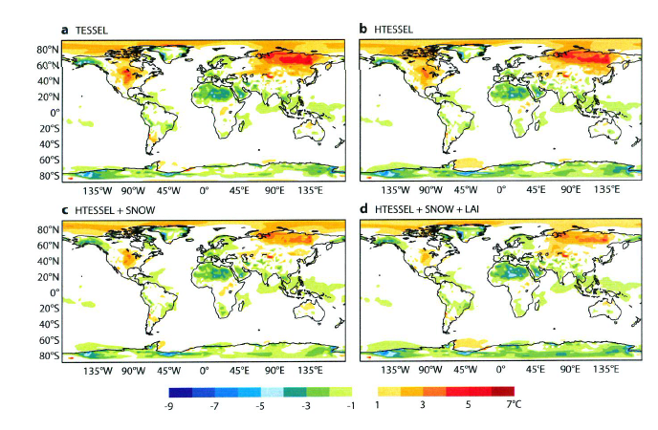
Land-related climate improvements
Hindcast (13-months integrations with specified daily SSTs). Here shown the evolution of the annual mean T2m errors compared to analysis
simulations colder than ERA-I Analysis Warmer than ERA-I Analysis
The revised land surface scheme in CY36R4 (d) is compared to the land surface model version (a, CY31R2 LSM used in ERA-Interim) for its impact on long-range forecasts of 2m temperature showing an improvement on annual mean 2m temperature

Slide 13
Outline
Introduction
- Observing cold processes
Recent examples of Modelling advances in cold regions
- Clouds & precipitation micro-physics
- Snow modelling and the water cycle
Recent examples of Data Assimilation advances in cold regions
- Snow analysis
Summary

Slide 14
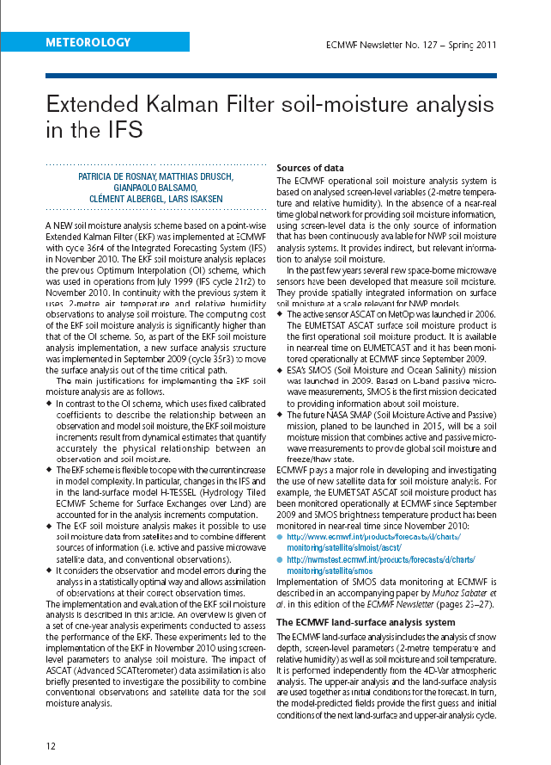
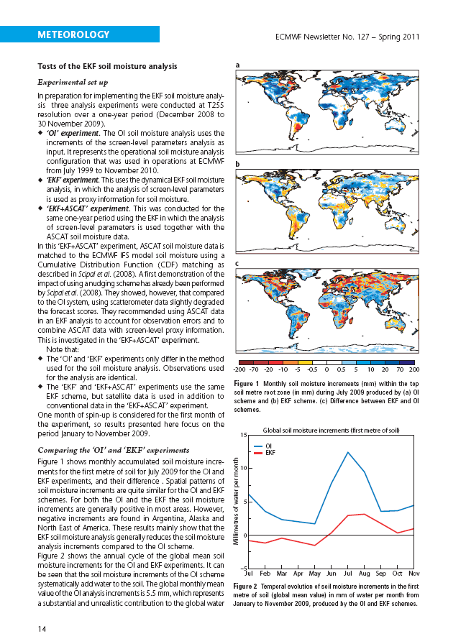
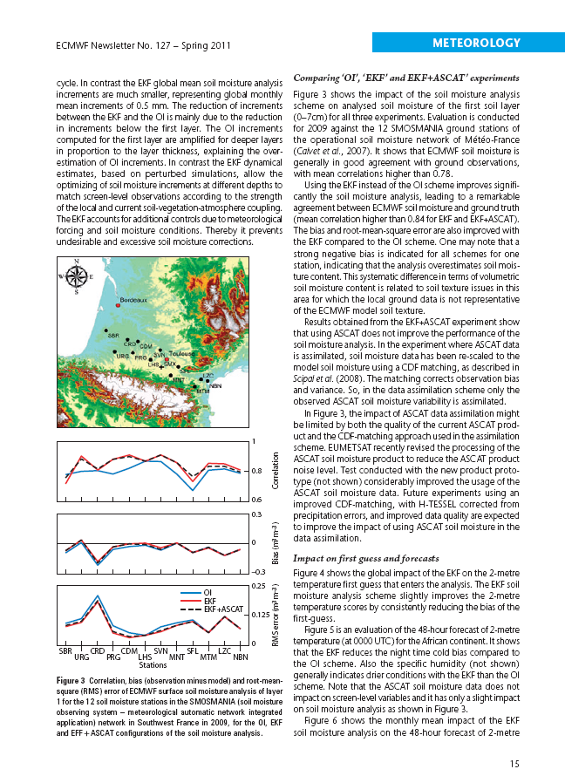
Soil Moisture Analysis Status
An ECMWF Newsletter article in the Spring 2011 issue (N127) documents Operational developments on the Soil Moisture Analysis at ECMWF
The Extended Kalman Filter Soil Moisture Analysis greatly improves the hydrological consistency across assimilation cycles reducing soil moisture increments and is improving the Day-2 weather forecasts for 2m temperature in summer.

Slide 15
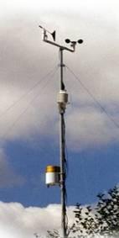
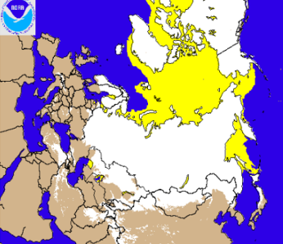
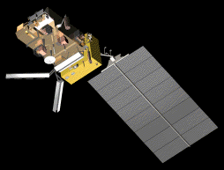

Land surface data assimilation evolution
1999 2004 2010/2011
OI screen level analysis
Douville et al. (2000)‏
Mahfouf et al. (2000)‏
Soil moisture 1D OI analysis based on Temperature and relative humidity analysis
SYNOP Data
Revised snow analysis
Drusch et al. (2004)‏
Cressman snow depth analysis using SYNOP data improved by using NOAA / NSEDIS Snow cover extend data (24km)
NOAA/NESDIS IMS
Optimum Interpolation (OI) snow analysis
Pre-processing NESDIS data
High resolution NESDIS data (4km)
de Rosnay et al., in prep., 2011
SEKF Soil Moisture analysis
Simplified Extended Kalman Filter
Drusch et al. GRL (2009)
de Rosnay et al. ECMWfFNews Letter (2011)‏
Use of satellite data
METOP-ASCAT SMOS
de Rosnay et al., 2011 Sabater et al., 2011
Validation activities
Albergel et al. 2011
Notes:
15

Slide 16
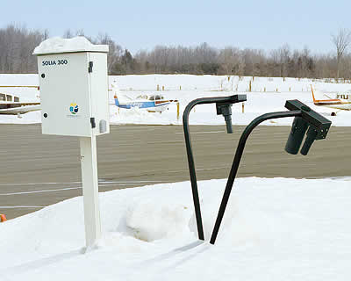
A New Snow Analysis
Snow Quantities:
- Snow depth SD (m)
- Snow water equivalent SWE (m) – ie mass per m²
- Snow Density ρ_{s}, between 100 and 400 kg/m3
Background variable used in the snow analysis:
- Snow depth S^{b}
computed from forecast SWE and density
(Dutra et al., J Hydromet. 2009)
Observation types:
- Conventional data: SYNOP snow depth (S^{O})
- Satellite: Snow cover extent (NOAA/NESDIS)‏
[m]

Slide 17
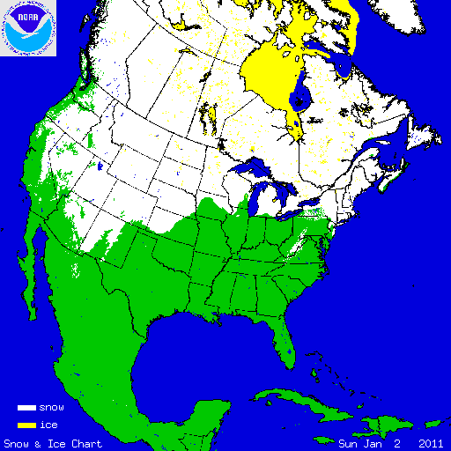
NOAA/NESDIS Snow extent data
Interactive Multisensor Snow and Ice Mapping System
Time sequenced imagery from geostationary satellites
AVHRR,
SSM/I
Station data
Northern Hemisphere product
Daily
Polar stereographic projection
Resolution
24 km product (1024 × 1024)
4 km product (6044 x 6044)
Information content: Snow/Snow free
Format:
24km product in Grib
4 km product in Ascii
More information at: http://nsidc.org/data/g02156.html

Slide 18
Snow analysis recent improvements
- 1987-2010: Cressman Interpolation (1959) ; use of SYNOP
- 2004: Introduction of the use of NOAA/NESDIS data (resol. 24km)
- 2010: New snow analysis:
  OI: Optimum Interpolation Snow analysis, using weighting functions of Brasnett, J. Appl. Meteo. (1999). OI snow depth analysis (used at ECMWF, CMC, JMA) makes a better use of the model background than Cressman (used at DWD and still used at ECMWF in ERA-Interim).
  NESDIS: NOAA/NESDIS 4km ASCII snow cover product (substituting the 24 km GRIB product). The new NESDIS product is of better quality with better coverage in coastal areas.
  QC: Introduction of blacklist file and rejection statistics. Also allows easier identification of stations related to MS queries.
Notes:
18
18

Slide 19
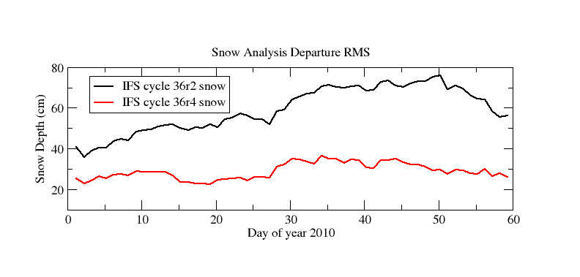
Comparison against SYNOP snow data
Old analysis (Cressman and NESDIS 24km)
New analysis (OI and NESDIS 4km)
RMSD between analysis and observations
de Rosnay, Balsamo and Isaksen, IGARSS 2011
→ Much reduced analysis errors with the new snow analysis
than with the old one
Notes:
19

Slide 20
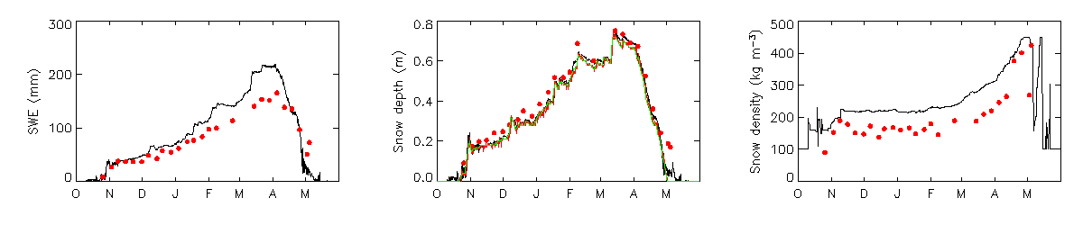
Independent snow validation
Sodankyla, Finland (67.368N, 26.633E)
Winter 2010-2011
ECMWF deterministic analysis
SYNOP snow depths
FMI-ARC snow pit
and ultrasonic depth gauge
Figures produced by
R. Essery, Univ Edinburgh)

Slide 21
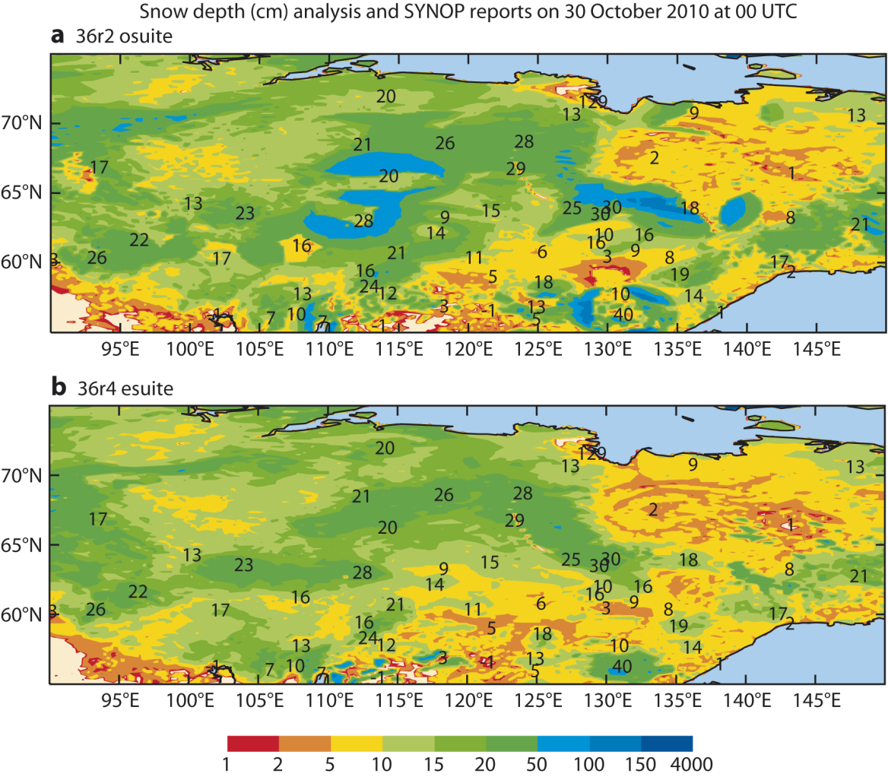
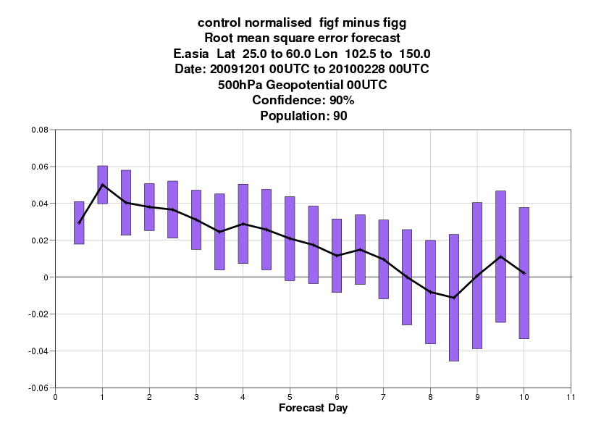
New snow Analysis
in Operations
Cressman +24km NESDIS
Old: Cressman
NESDIS 24km
New: OI
NESDIS 4km
OI Brasnett 1999 +4km NESDIS
FC impact (East Asia):
- OI has longer tails than Cressman and considers more observations.
- Model/observation information optimally weighted by an error statistics.

Slide 22
Summary
Observations in cold remote regions
  Quality-observations do trigger scientific advances with operational use!
  GCW initiative is key to sustain and foster new observing facilities
Clouds and Precipitation model status
  Documented improvements in the Autumn ECMWF Newsletter (N129)
Land surface model status
  Documented forecast and hydrological impact in the Spring ECMWF Newsletter (N127)
Land surface ongoing model developments
  Natural Land Carbon Dioxide emissions, Lakes modelling
Land surface Analysis status
  Documented forecast and hydrological impact in the Spring ECMWF Newsletter (N127)
  A New Snow Analysis (operational since Nov. 2010) with improved methodology and use both SYNOP data, IMS snow cover (4km) and large positive impact on atmospheric forecasts (particularly in East-Asia).

Slide 23
Thanks for your attention
  ECMWF newsletters accessible at:
  http://www.ecmwf.int/publications/newsletters/
  There are 2 posters on land modelling and snow analysis

