Slide 1
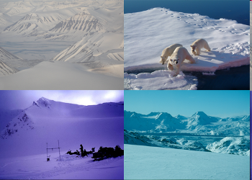
The CryoClim system for cryospheric climate monitoring
Rune Solberg⁽¹⁾, Øystein Rudjord⁽¹⁾, Arnt-Børre Salberg⁽¹⁾, Mari Anne Killie⁽²⁾, Lars-Anders Breivik⁽²⁾, Øystein Godøy⁽²⁾, Steinar Eastwood⁽²⁾, Liss Marie Andreassen⁽³⁾, Solveig H. Winsvold⁽³⁾, Max König⁽⁴⁾
⁽¹⁾ Norwegian Computing Center (NR), P.O. Box 114 Blindern, NO-0314 Oslo, Norway, Email: rune.solberg@nr.no
⁽²⁾Norwegian Meteorological Institute, P.O. Box 43 Blindern, NO-0313 Oslo, Email: mari.a.killie@met.no
⁽³⁾Norwegian Water Resources and Energy Directorate, P.O. Box 5091 Majorstua, NO-0301 Oslo, Email: lma@nve.no
⁽⁴⁾Norwegian Polar Institute, NO-9296 Tromsø, Email: max.koenig@npolar.no

Slide 2
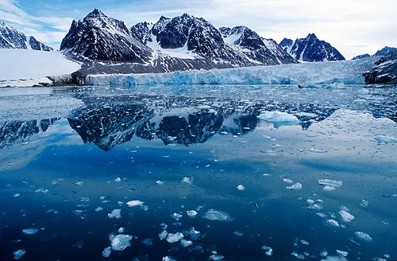
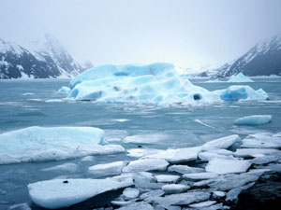
The CryoClim project
Goal: Develop an operational and permanent service for cryospheric climate monitoring
National contribution: To GEOSS and GCW following GCOS monitoring principles and GMES, GEOSS and WMO recommendations and standards
Monitoring of:
  Sea ice (global)
  Seasonal snow (global)
  Glaciers (Norway)
Time series: Longest possible time series based on earth observation data
Access: Free of charge web service and web portal for searching, browsing and ordering
Development: By NR, met.no, NVE and NPI based on funding from NSC and run by ESA’s PRODEX programme
Operation: Run by mandated, operational organisations (METNO, NVE, NPI) as a network of automated nodes

Slide 3
Cryospheric Baseline (CB) products
ECV | ID | Full name | Region | Frequency | Sensor | Grid size | Time span | Provision
Sea Ice
O.1 | SIC | Sea Ice Concentration | Global | Daily | SMMR, SSM/I | 12.5 km | 1979-present | METNO/OSISAF
O.1 | SIE | Sea Ice Edge | Global | Daily | SMMR, SSM/I | 12.5 km | 1979-present | METNO/OSISAF
Snow
T.3 | SCE | Snow Cover Extent (PMR) | Global | Daily | SMMR, SSM/I | 12.5 km | 1979-present | METNO
T.3 | SCE | Snow Cover Extent (optical) | Global | Daily | AVHRR GAC | 5 km | 1981-present | METNO
T.3 | SCE | Snow Cover Extent (multi-sensor) | Global | Daily | SMMR, SSM/I, AVHRR GAC | 5 km | 1979-present | METNO
Glaciers Mainland Norway
T.2.1 | GAO | Glacier Area Outline | Norway | 1-30 years | Landsat TM/ETM+, aerial photos | 30 m | 1930s/1982-present | NVE
 | GLO | Glacier-dammed Lake Outline | Norway | 1-30 years | Landsat TM/ETM+, aerial photos | 30 m | 1930s/1982-present | NVE
T.2.1 | GPP | Glacier Periodic Photo | Norway | Annual | In situ photos | N/A | 1980-present | NVE
Glaciers Svalbard
T.2.1 | GAO | Glacier Area Outline | Svalbard | 1-10 years | SPOT, aerial photos | 20 m | 1936/1984-present | NPI
T.2.1 | GST | Glacier Surface Type | Svalbard | Annual | ERS, ASAR, Radarsat | 30 m | 1992-present | NPI
T.2.2 | GBA | Glacier Balance Area | Svalbard | Annual | ERS, ASAR, Radarsat | 30 m | 1992-present | NPI

Slide 4
Status CB
ECV | ID | Full name | Status | Region | Frequency | Sensor | Grid size | Time span | Provision
Sea Ice
O.1 | SIC | Sea Ice Concentration | OK | Global | Daily | SMMR, SSM/I | 12.5 km | 1979-present |  | METNO/ OSISAF
O.1 | SIE | Sea Ice Edge | OK | Global | Daily | SMMR, SSM/I | 12.5 km | 1979-present |  | METNO/ OSISAF
Snow
T.3 | SCE | Snow Cover Extent (PMR) | OK | Global | Daily | SSM/I | 12.5 km | 1987-present |  | METNO
T.3 | SCE | Snow Cover Extent (optical) | Phase 4 | Global | Daily | AVHRR GAC | 5 km | 1981-present |  | METNO
T.3 | SCE | Snow Cover Extent (multi-sensor) | Phase 4 | Global | Daily | SMMR, SSM/I, AVHRR GAC | 5 km | 1979-present |  | METNO
Glaciers Mainland Norway
T.2.1 | GAO | Glacier Area Outline | OK | Norway | 1-30 years | Landsat TM/ETM+, aerial photos | 30 m | 1930s/1982-present |  | NVE
 | GLO | Glacier-dammed Lake Outline | OK | Norway | 1-30 years | Landsat TM/ETM+, aerial photos | 30 m | 1930s/1982-present |  | NVE
T.2.1 | GPP | Glacier Periodic Photo | Phase 4 | Norway | Annual | IIn situ photos | N/A | 1980-present |  | NVE
Glaciers Svalbard
T.2.1 | GAO | Glacier Area Outline | OK | Svalbard | 1-10 years | SPOT, aerial photos | 20 m | 1936/1984-present |  | NPI
T.2.1 | GST | Glacier Surface Type | OK | Svalbard | Annual | ERS, ASAR, Radarsat | 30 m | 1992-present |  | NPI
T.2.2 | GBA | Glacier Balance Area | Phase 4 | Svalbard | Annual | ERS, ASAR, Radarsat | 30 m | 1992-present |  | NPI

Slide 5
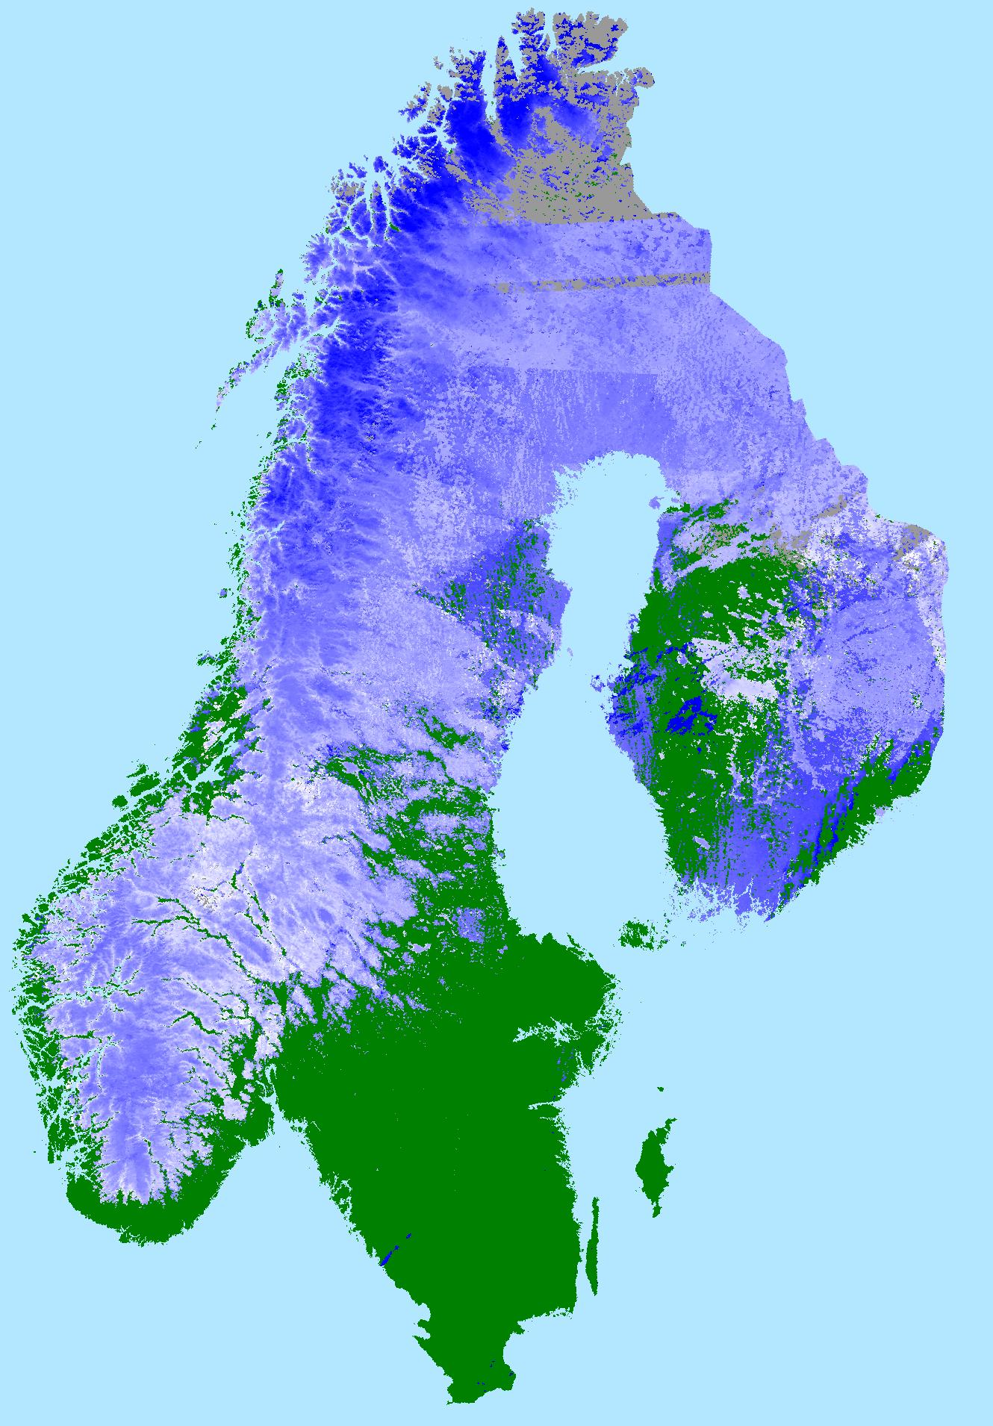
General product model
A baseline product is typically a map of an aggregated geophysical variable
Aggregation periods are typically
  Day
  Week
  Month
  Season
  Year
Typical information layers of the product:
  Average
  Minimum
  Maximum
  Standard deviation
  Number of observations
  Uncertainty
File format: netCDF CF

Slide 6
Climate-change Indicator (CI) products
ECV | Name | Region | Presentation | Time span | Provision
Sea Ice
O.1 | Maximum sea ice extent | Global | Graph | 1979-present | METNO/OSISAF
O.1 | Minimum sea ice extent | Global | Graph | 1979-present | METNO/OSISAF
Snow
T.3 | Length of snow season | Global | Map/graph | 1979-present | METNO
T.3 | First day of sustained snow cover | Global | Map/graph | 1979-present | METNO
T.3 | Last day of sustained snow cover | Global | Map/graph | 1979-present | METNO
Glaciers Mainland Norway
T.2.1 | Glacier area change | Norway | Graph | 1930/1982-present | NVE
T.2.1 | Glacier length change | Norway | Graph | 1930/1982-present | NVE
T.2.2 | Glacier mass balance change | Norway | Graph | 1930/1982-present | NVE
Glaciers Svalbard
T.2.1 | Glacier area change | Svalbard | Graph | 1984-present | NPI
T.2.1 | Glacier length change | Svalbard | Graph | 1984-present | NPI
T.2.2 | Glacier mass balance change | Svalbard | Graph | 1992-present | NPI

Slide 7
Status CI
ECV | Name | Status | Region | Presentation | Time span | Provision
Sea Ice
O.1 | Maximum sea ice extent | OK | Global | Graph | 1979-present | METNO/OSISAF
O.1 | Minimum sea ice extent | OK | Global | Graph | 1979-present | METNO/OSISAF
Snow
T.3 | Length of snow season | Phase 4 | Global | Map/graph | 1979-present | METNO
T.3 | First day of sustained snow cover | Phase 4 | Global | Map/graph | 1979-present | METNO
T.3 | Last day of sustained snow cover | Phase 4 | Global | Map/graph | 1979-present | METNO
Glaciers Mainland Norway
T.2.1 | Glacier area change | OK | Norway | Graph | 1930/1982-present | NVE
T.2.1 | Glacier length change | OK | Norway | Graph | 1930/1982-present | NVE
T.2.2 | Glacier mass balance change | OK | Norway | Graph | 1930/1982-present | NVE
Glaciers Svalbard
T.2.1 | Glacier area change | Phase 4 | Svalbard | Graph | 1984-present | NPI
T.2.1 | Glacier length change | Phase 4 | Svalbard | Graph | 1984-present | NPI
T.2.2 | Glacier mass balance change | Phase 4 | Svalbard | Graph | 1992-present | NPI

Slide 8
Sub-service sea ice
Aggregated, gridded Sea Ice Concentration (SIC) based on daily EUMETSAT OSI SAF reprocessed data
Climate-change indicators: Sea ice area and sea ice extent
Algorithm:
  Probabilistic approach based on a Bayesian model
  Combination of two algorithms:
    Bristol algorithm
    Bootstrap frequency-mode algorithm
  Dynamic algorithm calibration
    Better consistency between satellites
    Better representation of seasonal variations
Products for the northern and southern hemisphere
Long time series:
  1979–1986 based on SMMR
  1987–now based on SSM/I
Evaluation and validation against NSIDC products and weekly sea ice charts

Slide 9
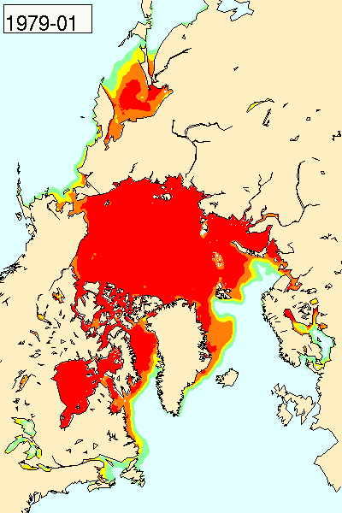

Sea ice products
Sea Ice Concentration
Sea Ice Edge
Sea ice climate change indicators
Monthly sea ice concentration 1979-2007

Slide 10
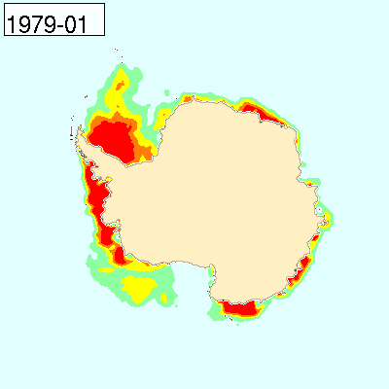
Sea ice products
Sea Ice Concentration
Sea Ice Edge
Sea ice climate change indicators
Monthly sea ice concentration 1979-2007

Slide 11
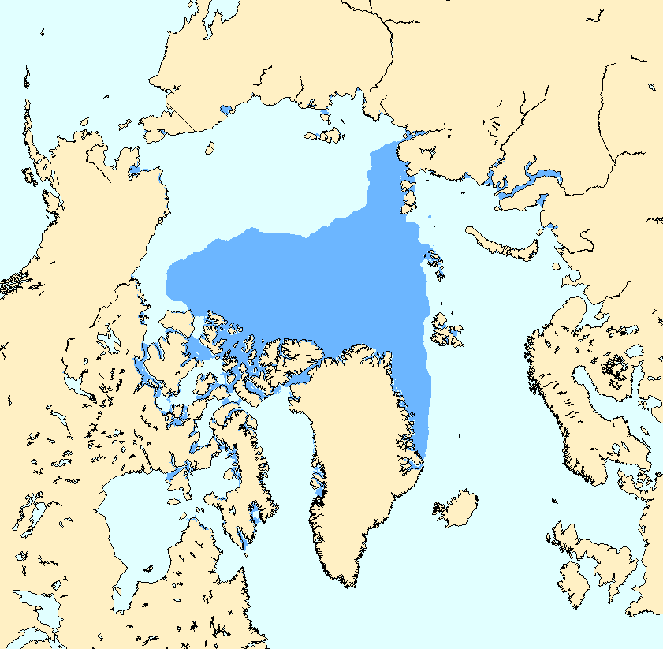
Sea ice products
Sea Ice Concentration
Sea Ice Edge
Sea ice climate change indicators
SIE Sep. 2007

Slide 12
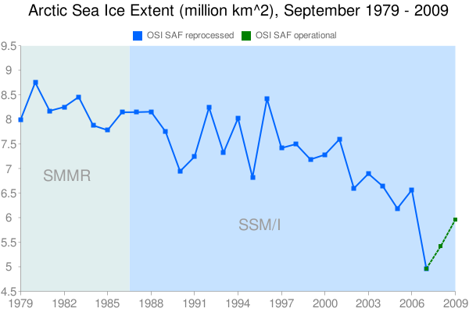
Sea ice products
Sea Ice Concen-tration
Sea Ice Edge
Sea ice climate change indicators

Slide 13
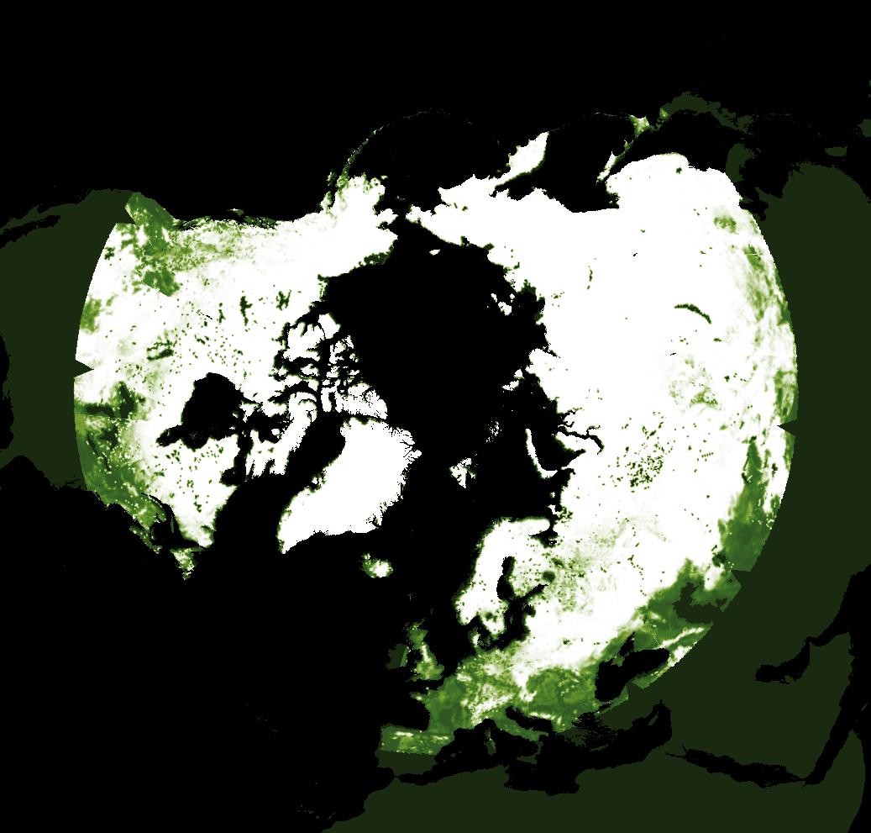
Sub-service Snow
Snow Cover Extent (SCE)
Three prototype algorithms/products:
  SCE from PMR (12.5 km)
    Based on SSM/I
    Bayesian model combining different channel features
  SCE from optical (5 km)
    Based on AVHRR GAC
    Sub-pixel temporal model based on local reflectance reference values
  SCE multi-sensor (5 km)
    Bayesian combination of the two approaches above
Time series: 1979/1981 – now
Snow Cover Extent from 15 January 2010 based on SSM/I

Slide 14
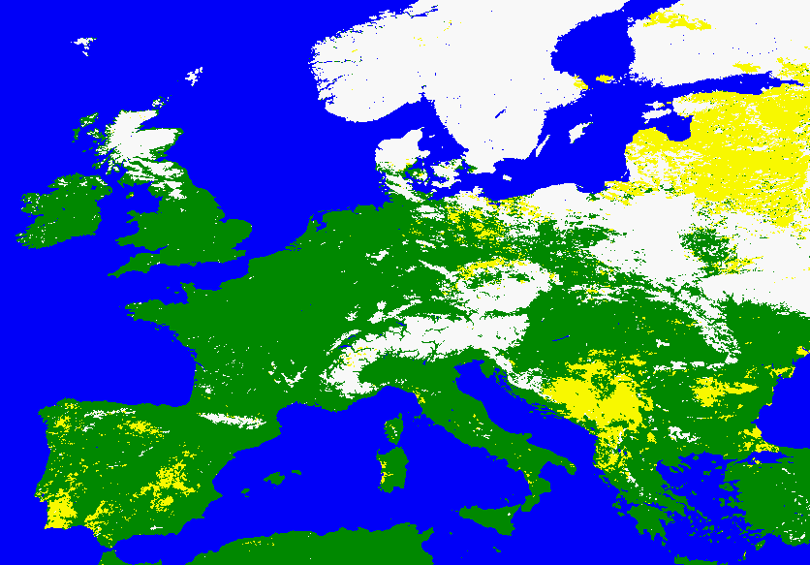
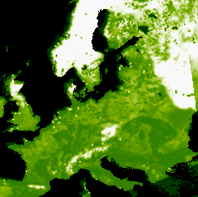
PMR compared with MODIS snow cover product
MODIS 1 March 2010
SSM/I 1 March 2010
Probability of snow

Slide 15
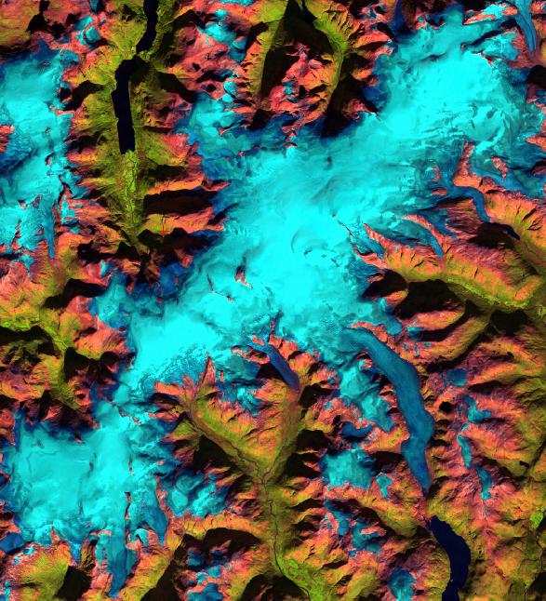
Sub-service glaciers mainland Norway
Products:
  Glacier Area Outline (GAO)
  Glacier-dammed Lake Outlines (GLO)
  Glacier Periodic Photo series (GPP)
  Climate-change indicator products
Retrieval based on a semi-automated method using Landsat TM/ETM+ data
Produced according to GLIMS standard and delivered to WGMS
Jostedalsbreen
Notes:
Jostedalsbreen

Slide 16
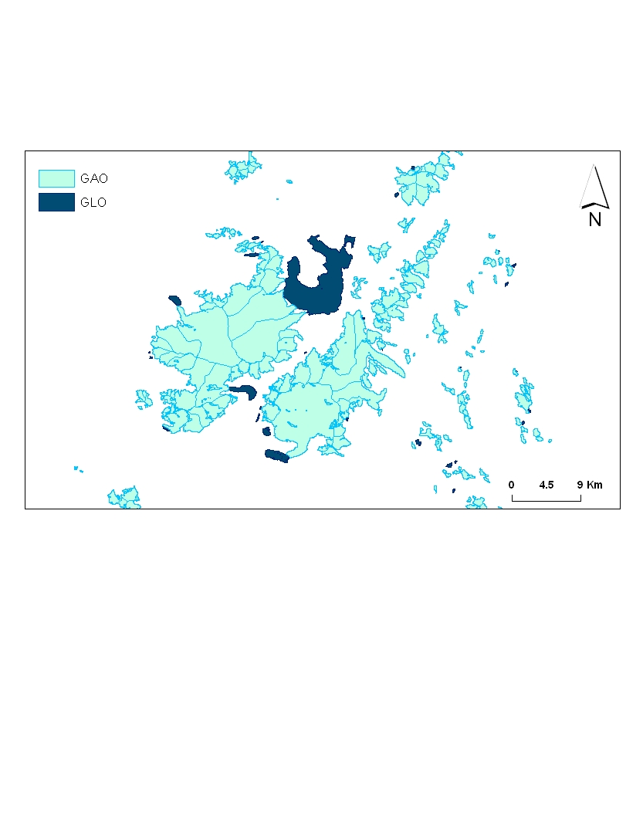
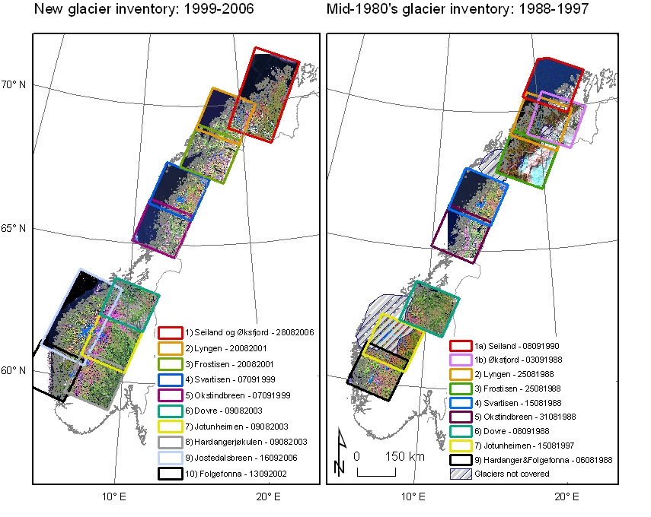
GAO and GLO glacier products
First time ever mapping of GAO for all of Norway
GAO: 3719 glacier units mapped (hydrological units)
GLO: 477 glacier lakes mapped
Most glaciers mapped two times within the periods 1988–1997 and 1999–2006
Svartisen
1988-1997
1999-2006
Notes:
Svartisen

Slide 17
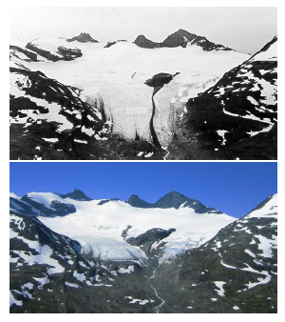
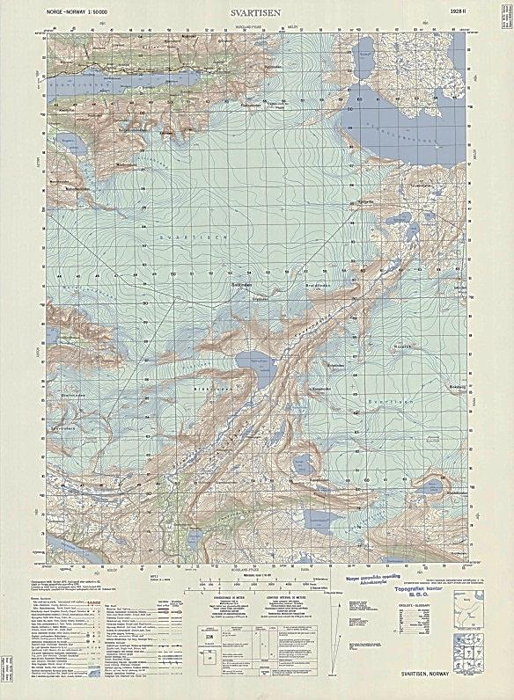
Other products
Glacier Periodic Photo (GPP) series
  Used for additional information to the public
  No validation, but delivered as is
Pre-satellite era GAO
  Provides long-term information
  Based on digitized maps and aerial photos
  Covering the period 1950-1980
1949
2008
Glacier periodic photo series
Topographic map 1:50,000 of Svartisen (photographed 1968)
Notes:
Storbreen (Jotunheimen)

Slide 18
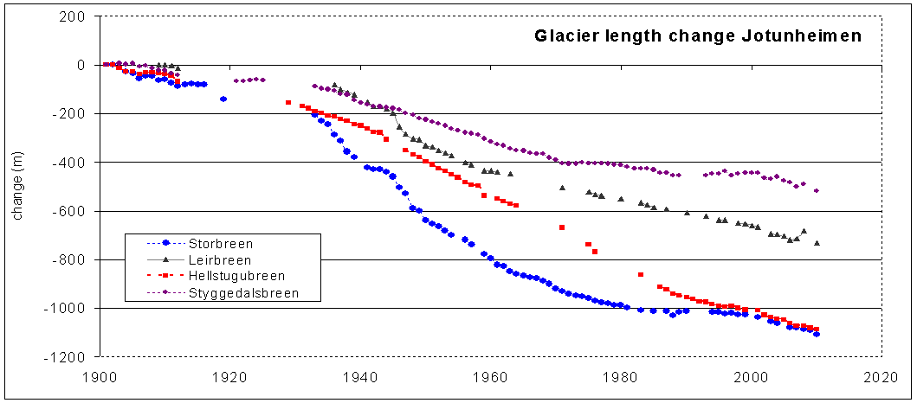
Climate-change indicators

Slide 19
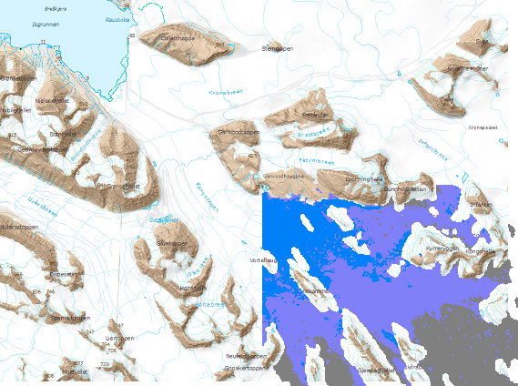
Sub-service glaciers Svalbard
Products defined:
  Glacier Area Outline (GAO)
  Glacier Surface Type (GST)
  Glacier Balance Area (GBA)
  Glacier change indicators
Glacier surface type product from newly developed algorithm
Glacier balance area product from algorithm developed in EuroClim
Updated annually
30 meter resolution, based on SAR data from ERS-1, ERS-2, Envisat ASAR and Radarsat
Glacier surface type of the upper part of Kongsvegen (blue – ice, violet – superimposed ice, grey – firn, transparent – no classification area)

Slide 20
Example GAO

Slide 21
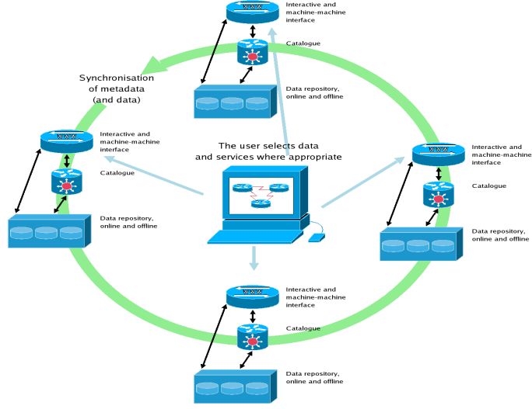
CryoClim web service and portal
Main functionality
Search for data
  Catalogue services
  Human and machine interfaces
  Interfaces to other (cryosphere) catalogues
Visualise data
  WMS
  Combine with external data sets
Download data
  Push (subscription)
  Pull
Framework
INSPIRE
GEOSS
WMO Information System
Distributed system
Service oriented architecture (SOA)

Slide 22
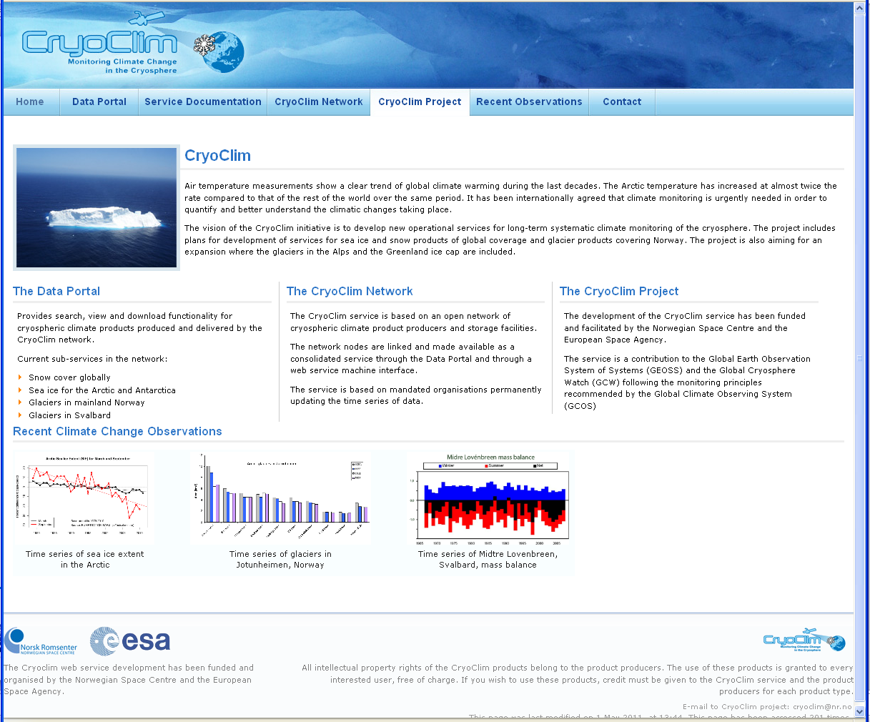

Slide 23
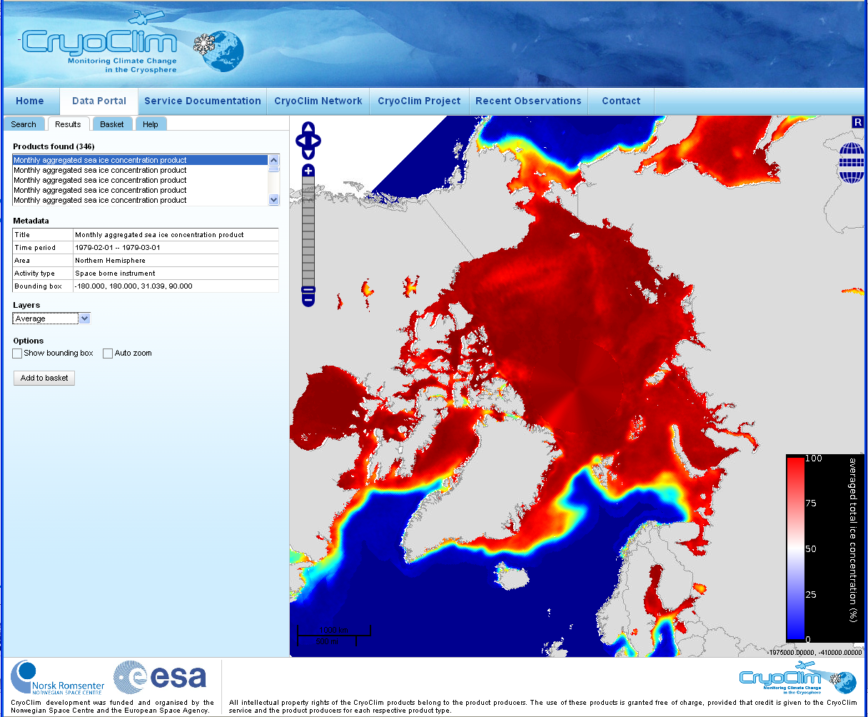
The web portal
www.cryoclim.net

Slide 24
Key user organisations
World Meteorological Organization (WMO) / Global Climate Observing System (GCOS) / World Climate Research Programme (WCRP)
European Environment Agency (EEA), European Topic Centre / Air And Climate Change (ETC/ACC)
Max Planck Institute for Meteorology
UK Met Office Hadley Centre
University of Hamburg / Center for Integrated Climate System Analysis and Prediction – CliSAP

Slide 25
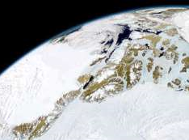
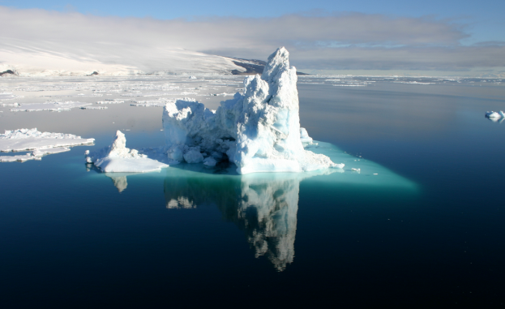
Conclusions
Development of a permanent service for cryospheric climate monitoring
Project status: 3 out of 4 phases carried out
Products:
  Sea ice: 1979-present
    Sea ice concentration
    Sea ice edge
  Snow cover: 1979-present
    Snow cover extent
  Glaciers mainland Norway: 1930s/1984–present
    Glacier area outline
    Glacier dammed lake outline
    Glacier periodic photo series
  Glaciers Svalbard: 1992–present
    Glacier surface type
    Glacier balance area
  All sub-services:
    Climate change indicators
Freely available through web service and web portal: www.cryoclim.net
Fully operational service from early 2013, first products available now

