Slide 1
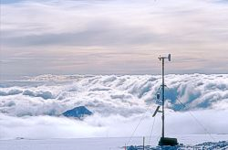
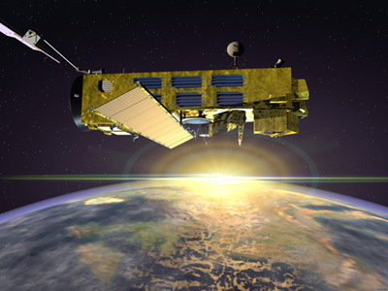
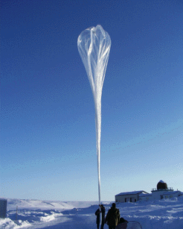
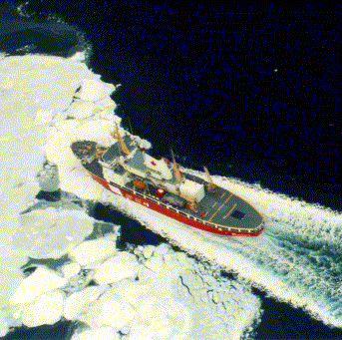
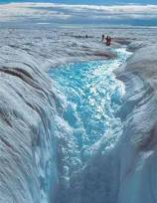
Global Cryosphere Watch
Summary Day 3
Partnerships as enablers
Jim Abraham
Co-chair, Observations Task Team WMO EC Polar Observations, Research and Services,
Meteorological Service of Canada
Notes:
1

Slide 2
Partnerships as enablers:
Access to data
  Data management systems (Libre)
  Quality control approaches (GPCC)
  Archives: long term records, global datasets
  Portals
  Standards and policies (Creative Commons)
  Unique data (INTAS SSCONE USSR-RU)
Intercomparisons

Slide 3
Partnerships as enablers:
Products and services
  Reports, analyses, assessments
  Inventories (including metadata standard)
  Trends, extents, indicators....
  Terminology (GTN-G)
  Support to users (NSIDC)
  New products (Snow extent for albedo in NWP, snow on ice)

Slide 4
Partnerships as enablers:
Collaborative research, projects etc.
Ideas and Lessons Learned
  Bazaar (NSIDC)
  CRYSYS
Intercomparisons
  ECV satellite climate records (WOAP)
  Algorithms (SE,SWE)
  Instruments (SPICE)
  Products (CryoClim, NSIDC) to develop uncertainties)

Slide 5
Partnerships as enablers:
Prediction
  WCRP/CliC
Training and development
  PhD, Workshops, summer schools (SVALI)
New technologies
  Cameras (WGMS)
Infrastructure for joint collaboration
  Svalbard

Slide 6
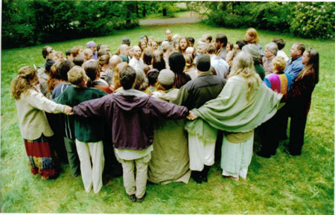
Partnerships as enablers: stay warm and enjoy the love

