Slide 1

CryoNet
Establishment of reference sites
Austrian - Alpine perspective
W. Schöner
Zentralanstalt für Meteorologie und Geodynamik
Climate Research Department
Vienna, Austria

Slide 2
How to define a super-site?
either looking for sites already measuring relevant variables of the atmosphere and the cryopshere e.g. glacier mass balance, energy balance at the surface, borehole temperatures, snow height, ….
or defining monitoring/research questions (user needs) to be solved e.g. reaction of glaciers on climate? How relevant are glaciers for the water cycle? ….

Slide 3
ENVIronmental Research and Monitoring SONNBLICK

Slide 4
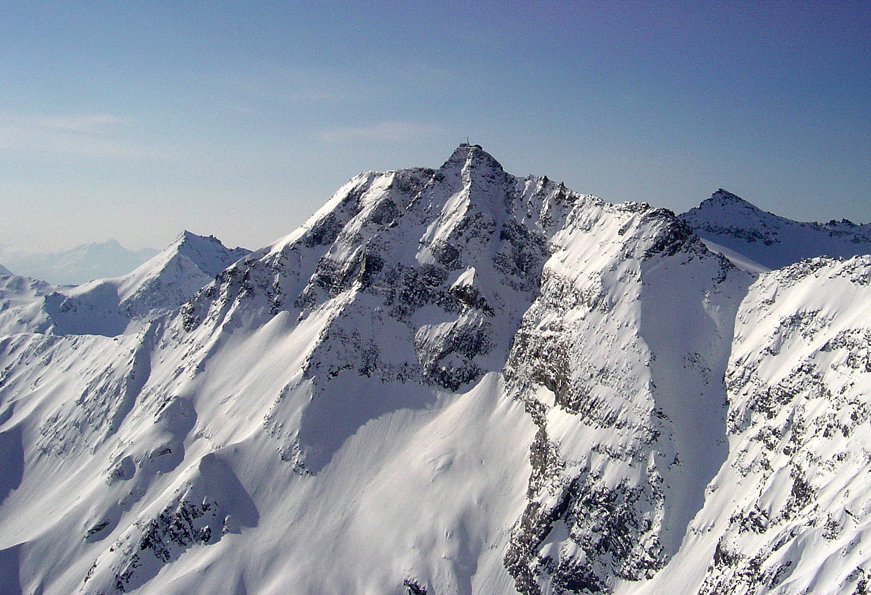


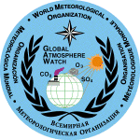



SONNBLICK
Glaciers: mass balances (winter accumulation, ablation), surface energy balance, glacial discharge, frontal retreat, thickness, glacier flow, snowcover, …
Permafrost: Borehole temperatures, borehole seismic, borehole inclinometers, GST network, surface energy balance, snowcover, ….
Snowcover: snow depth network, snow temperature, snow density, snow chemistry, stable isitopes,
Atmosphere: GAW, GAW-DACH, radiation (BRSN standard), precipitation netork, amount of solid precipitation, ….

Slide 5
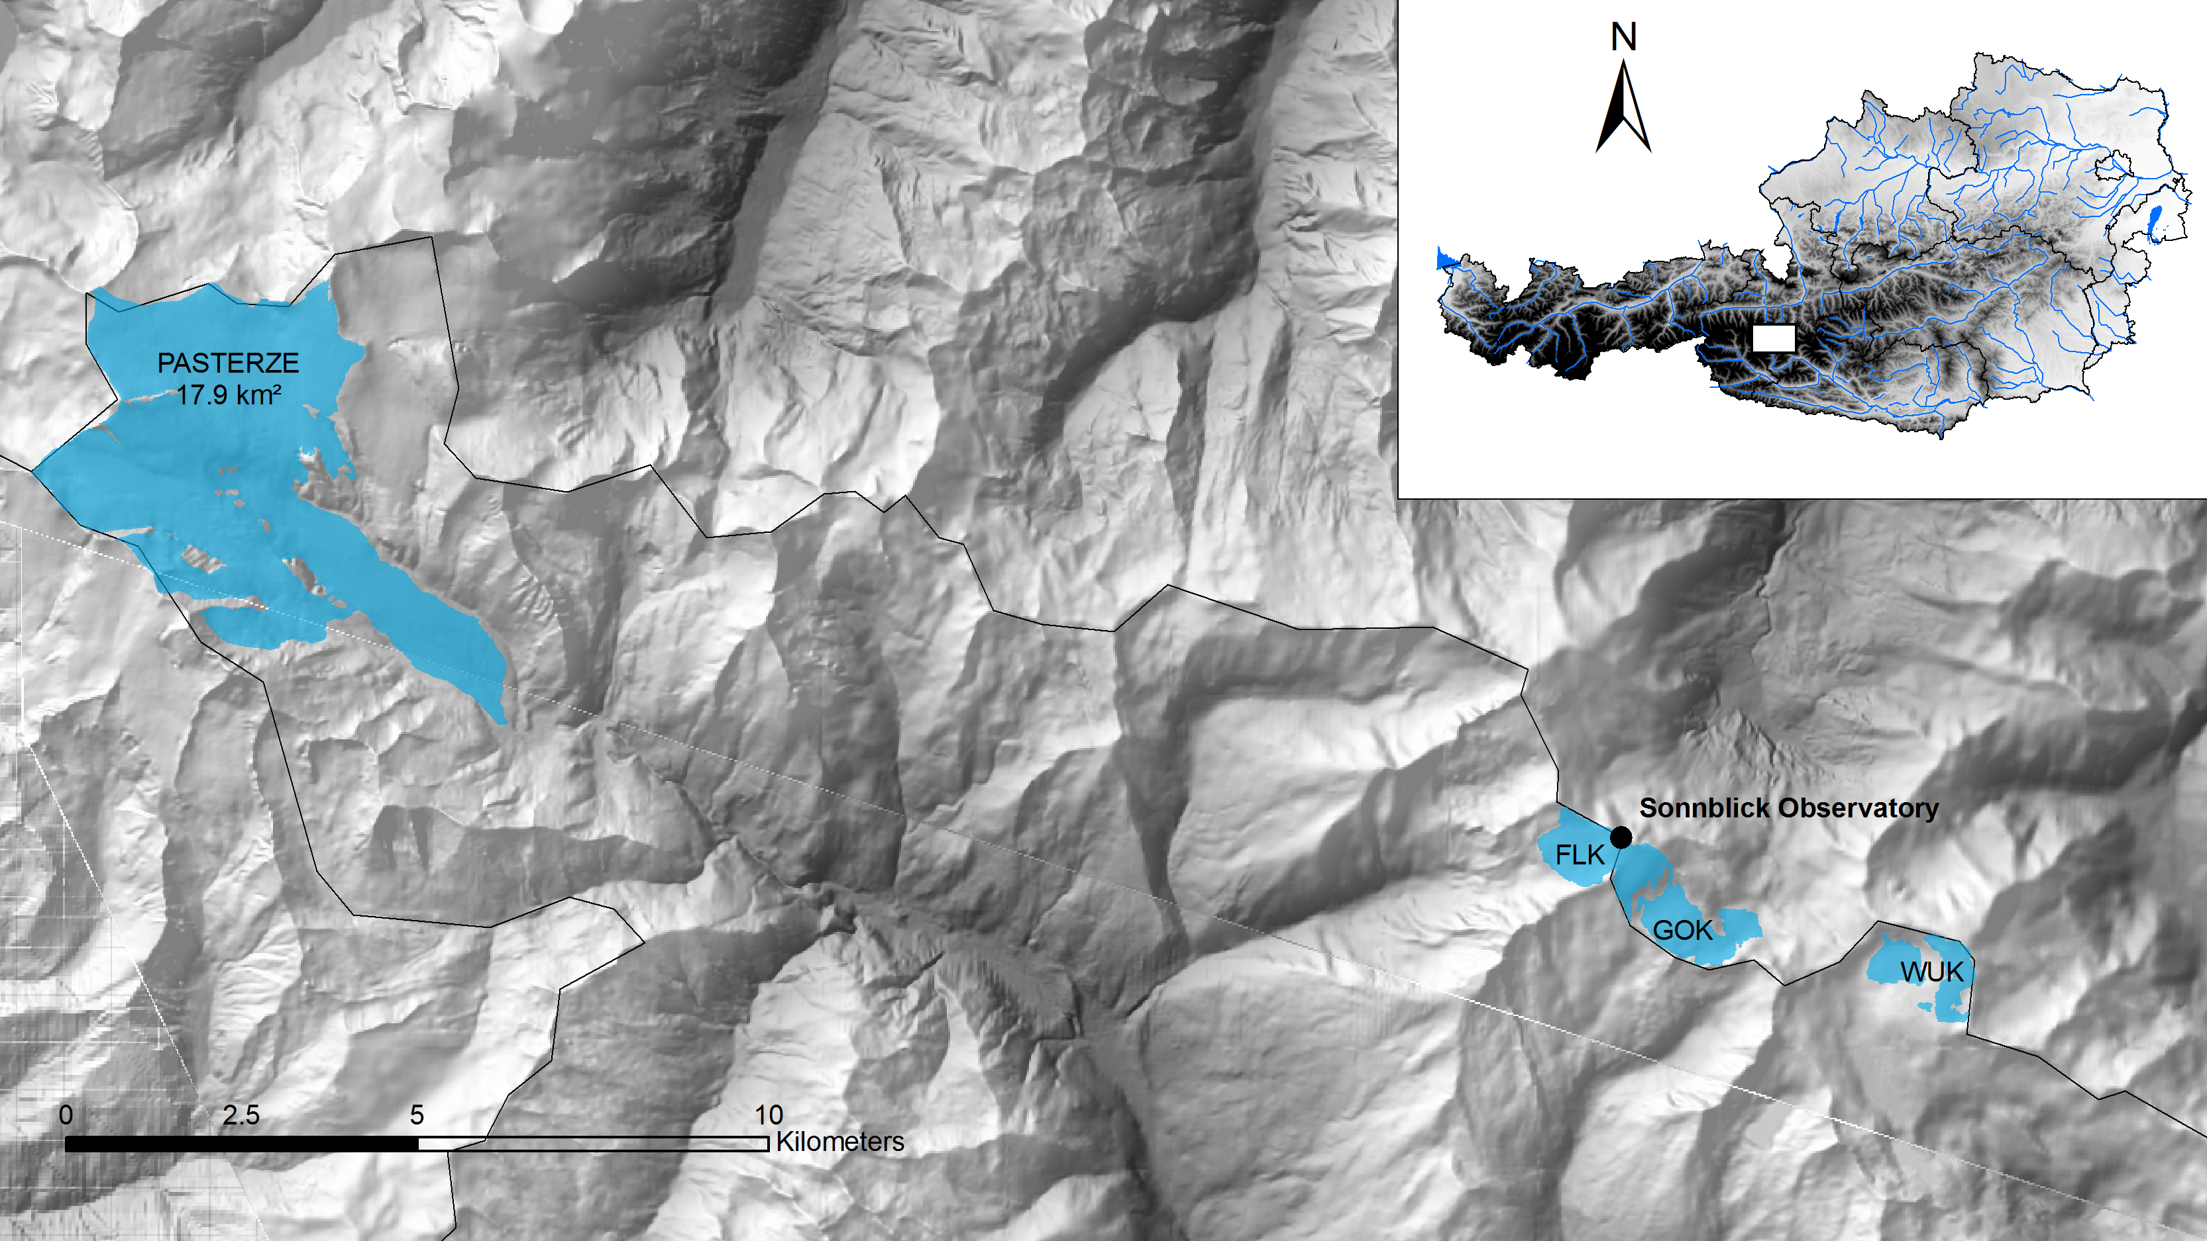
SONNBLICK network:

Slide 6
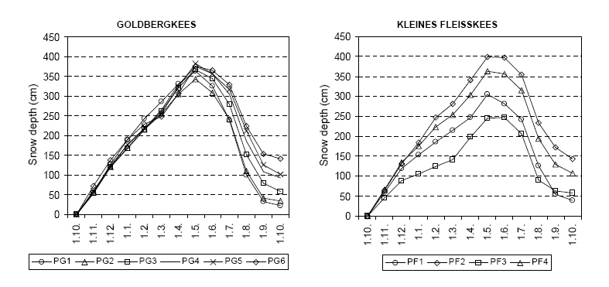
Alpine main divide – strong climate gradients esp. precipitation

Slide 7
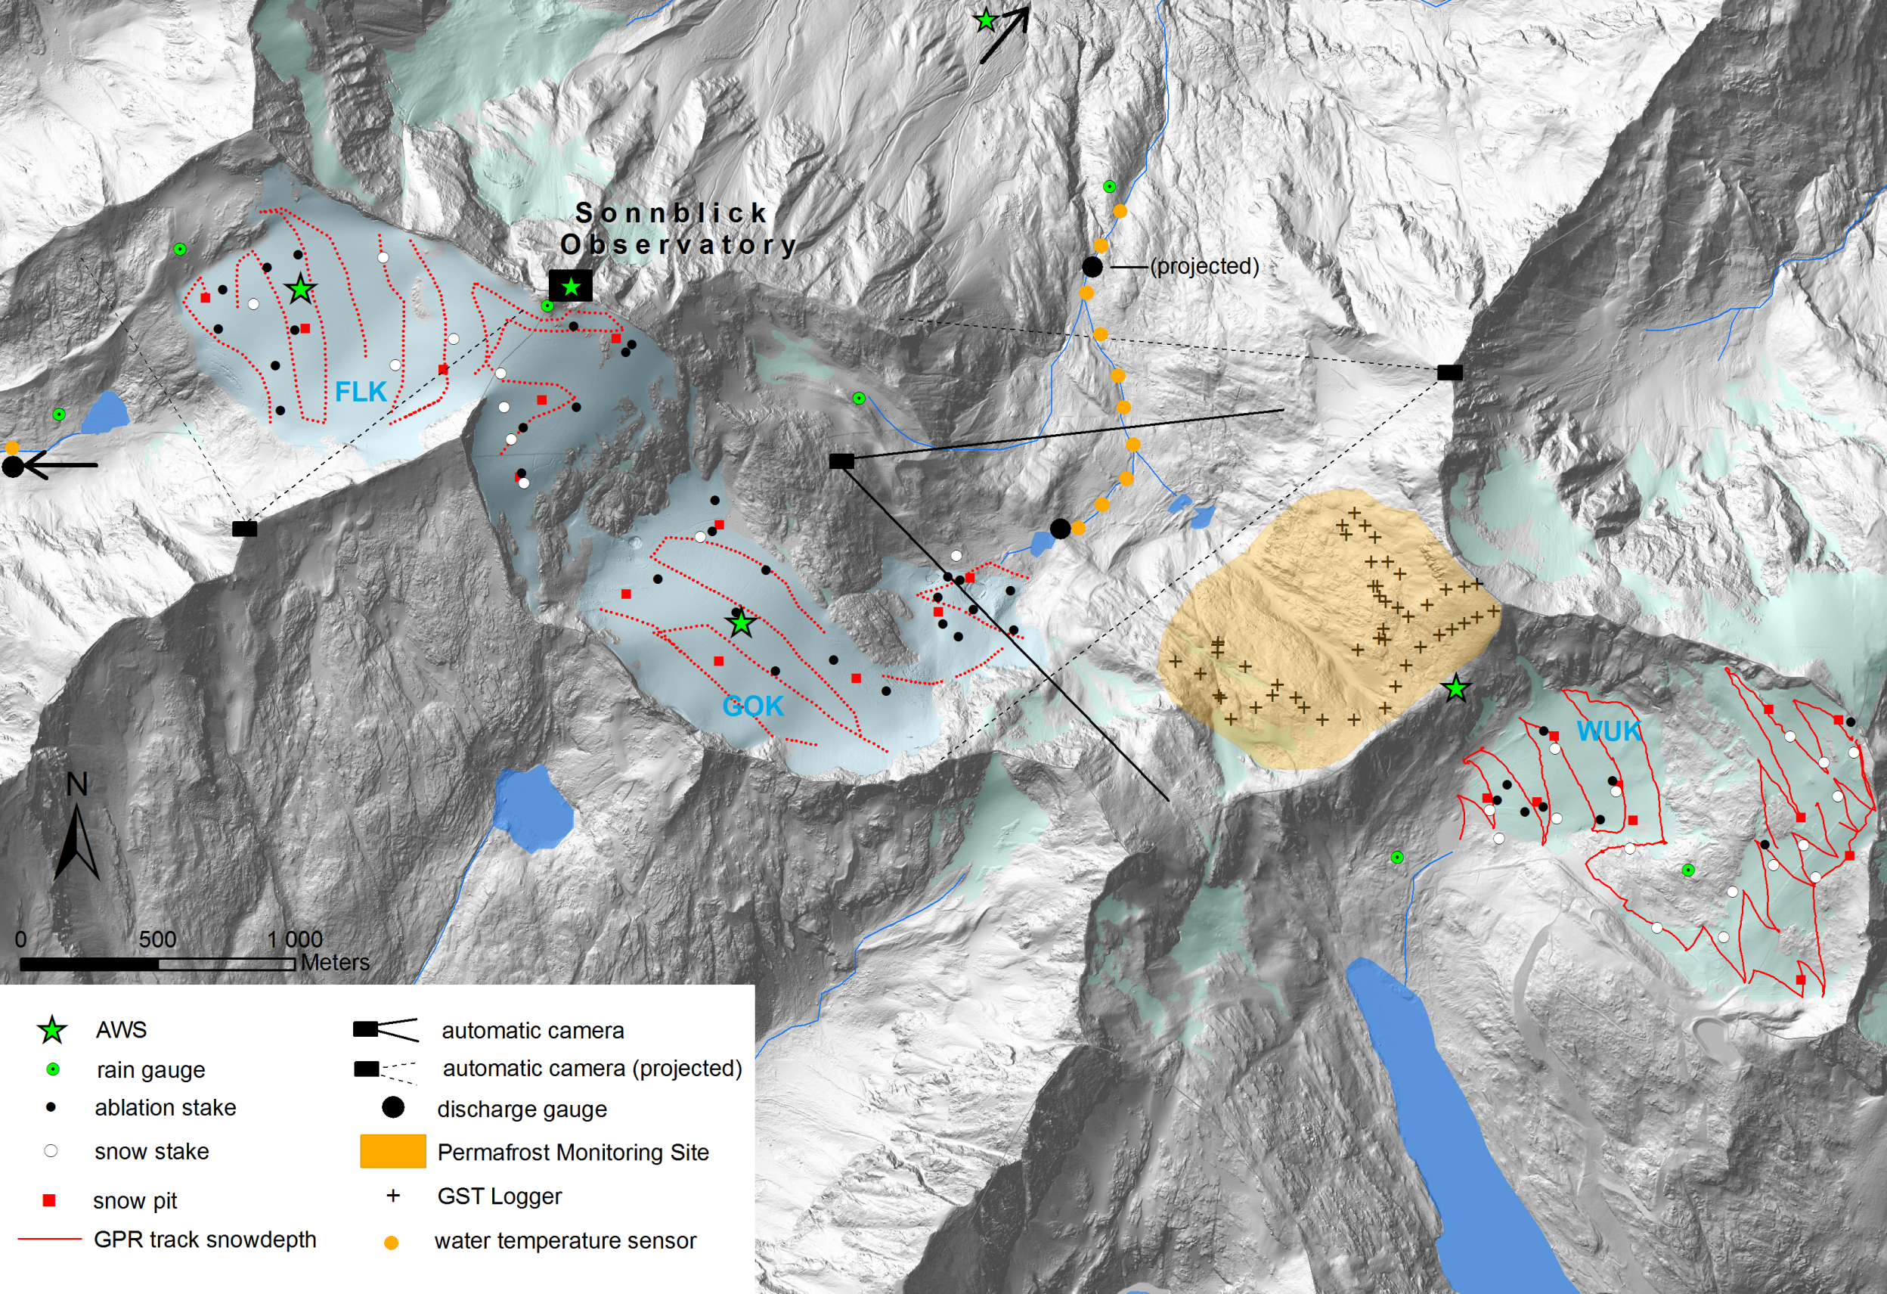
SONNBLICK network:

Slide 8
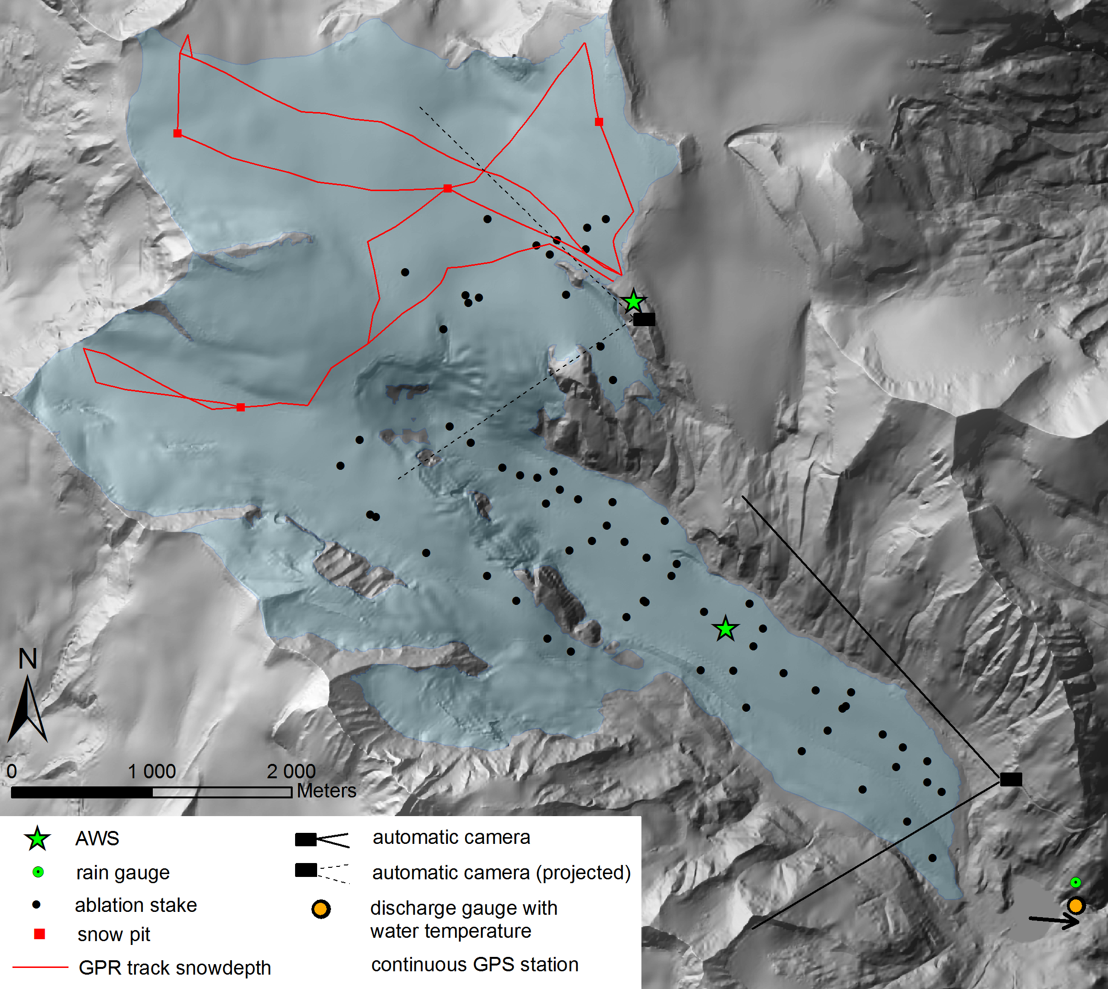
SONNBLICK network / Pasterze glacier:

Slide 9
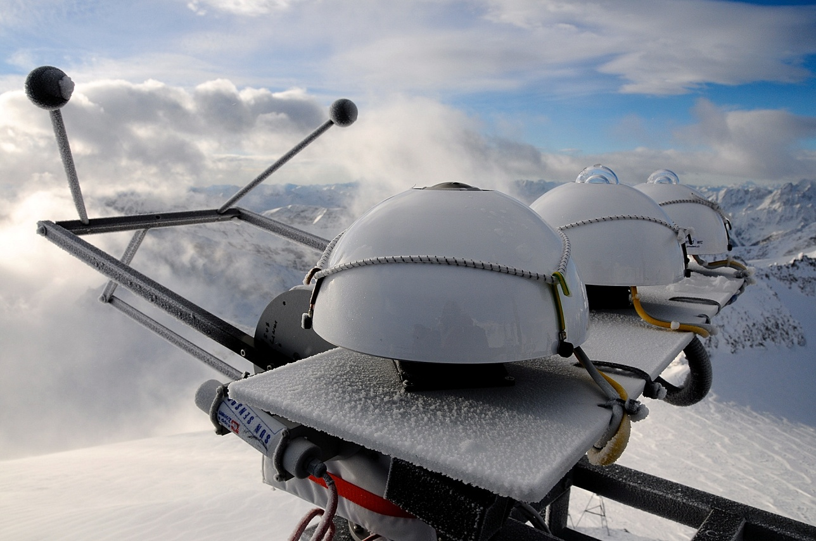
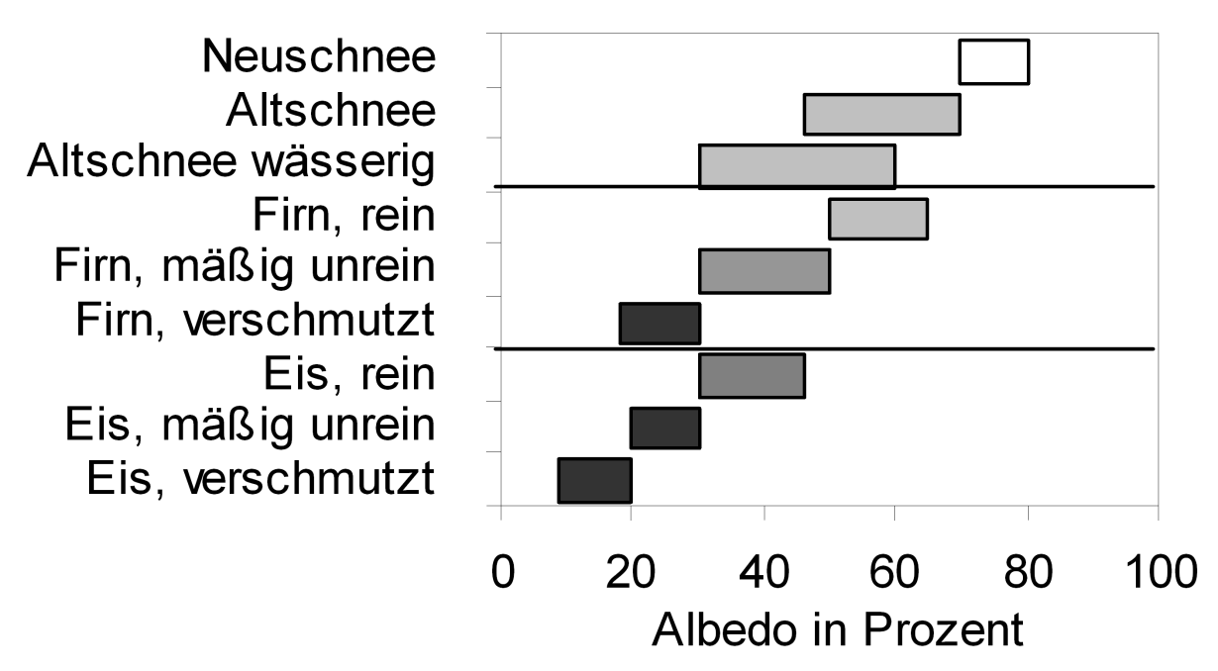
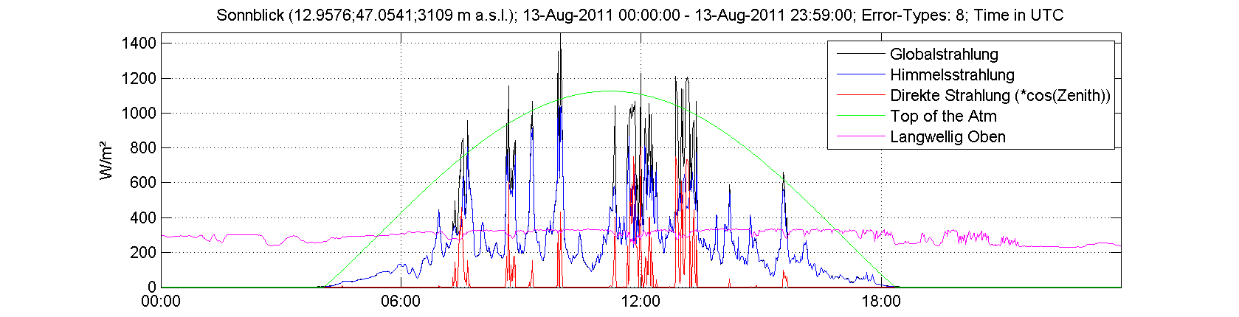
Key element: radiation balance (at BRSN standard), ALBEDO (incl. deposition)

Slide 10
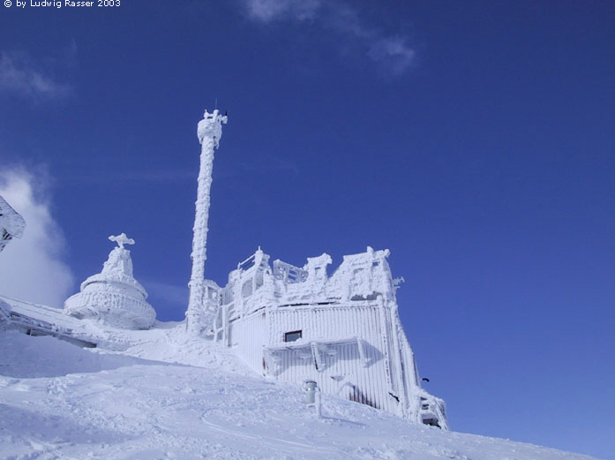
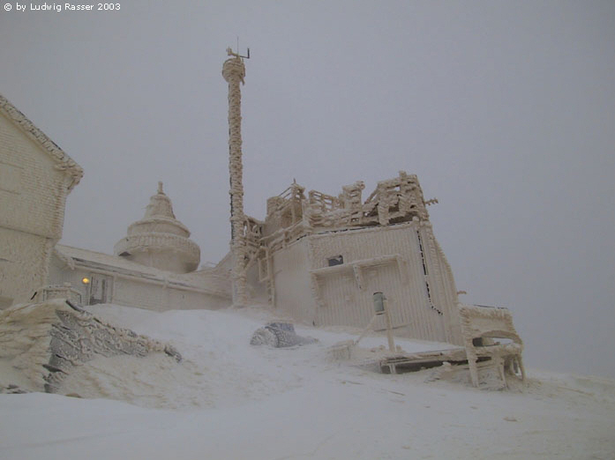

Slide 11
Link to hydrology and at stream flow ecology :
+ modelling strategy

Slide 12
Precipitation / type of precipitation,
highly relevant for cryosphere
SONNBLICK solid precipitation
1891 - 2010

Slide 13
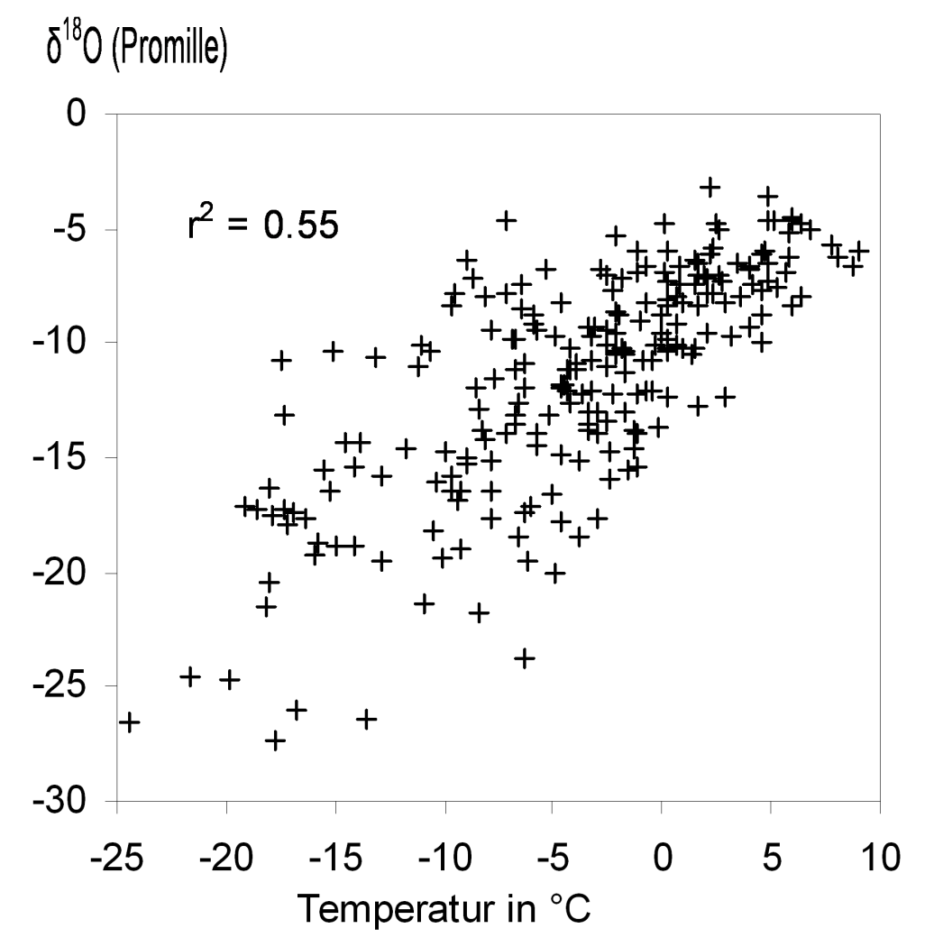
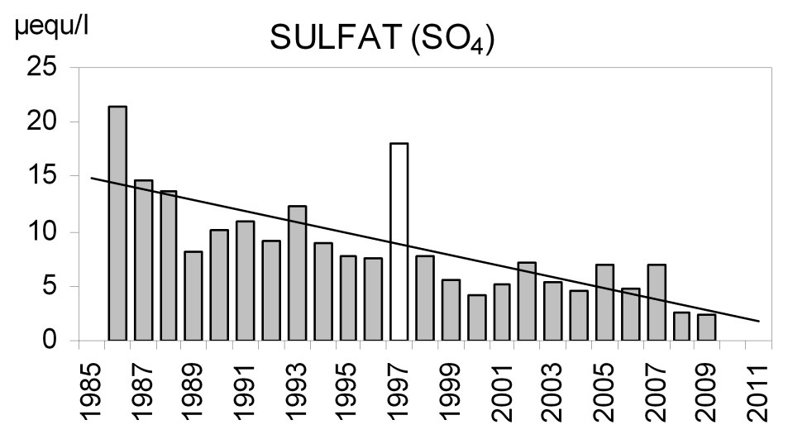
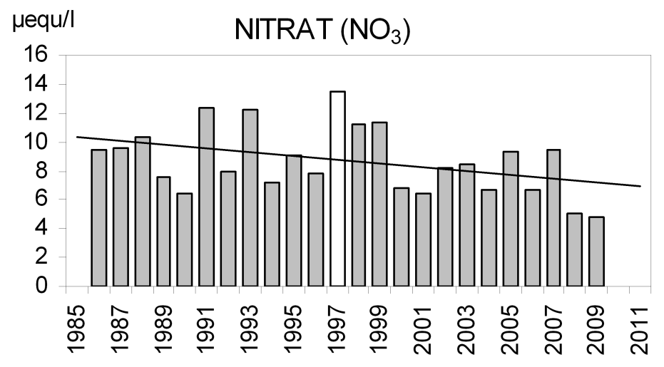
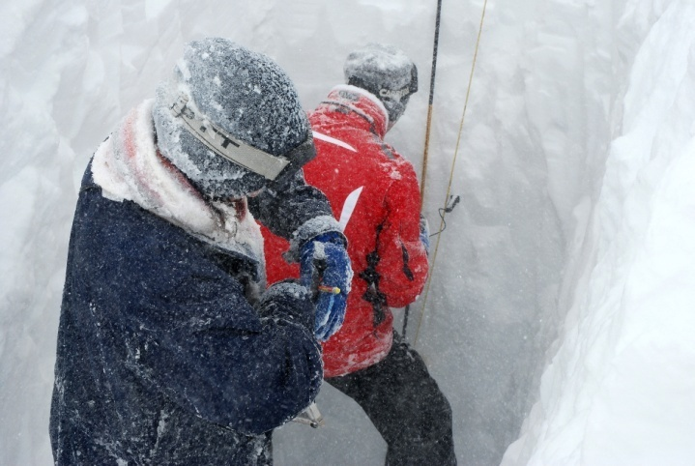
Snow chemistry, stable isotopes in snow

Slide 14
Alpine air temperature and role of SO4 aerosols in the 1960s-1980s for temperature
Air temperature (°C)
Sulfate concentration rel to 1800

Slide 15
Linkage to satellite data example of Sonnblick:
Cryopsheric products:
EU-Cryoland, AT-ASAG
Atmospheric products:
GPS precipitable water
Ground truth, calibration, increasing spatial coverage

Slide 16
Discussion
Define monitoring questions?
„Virtual super sites“?
Linkages to hydrology and ecology, ….
Feedbacks e.g. albedo (BC, dust falls, …)
Data from cryospheric monitoring for other users (e.g. atmospheric deposition, stable isotopes for paleoclimate reconstructions, ----)
Need for modelling (assistance)

Slide 17
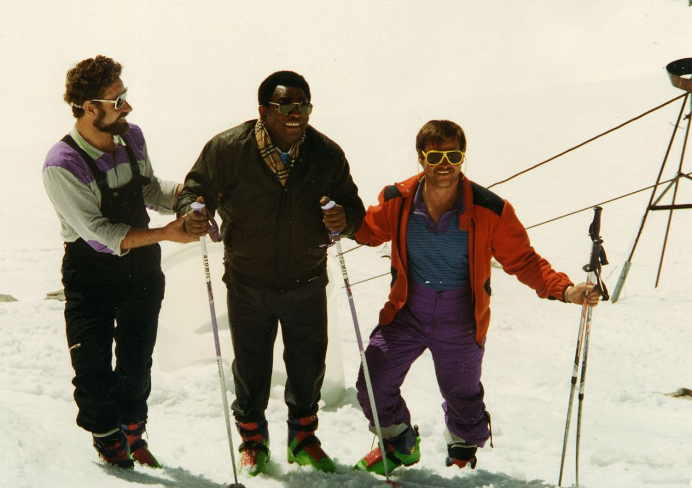
Former WMO Secretary General Obasi at Sonnblick in 1991

