Slide 1




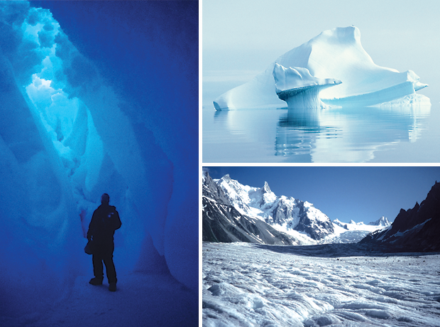
National Snow and Ice Data Center
A brief overview and data management projects
Cooperative Institute for Research
in Environmental Sciences
University of
Colorado
Walt Meier, Mark Parsons, and Mark Serreze

Slide 2
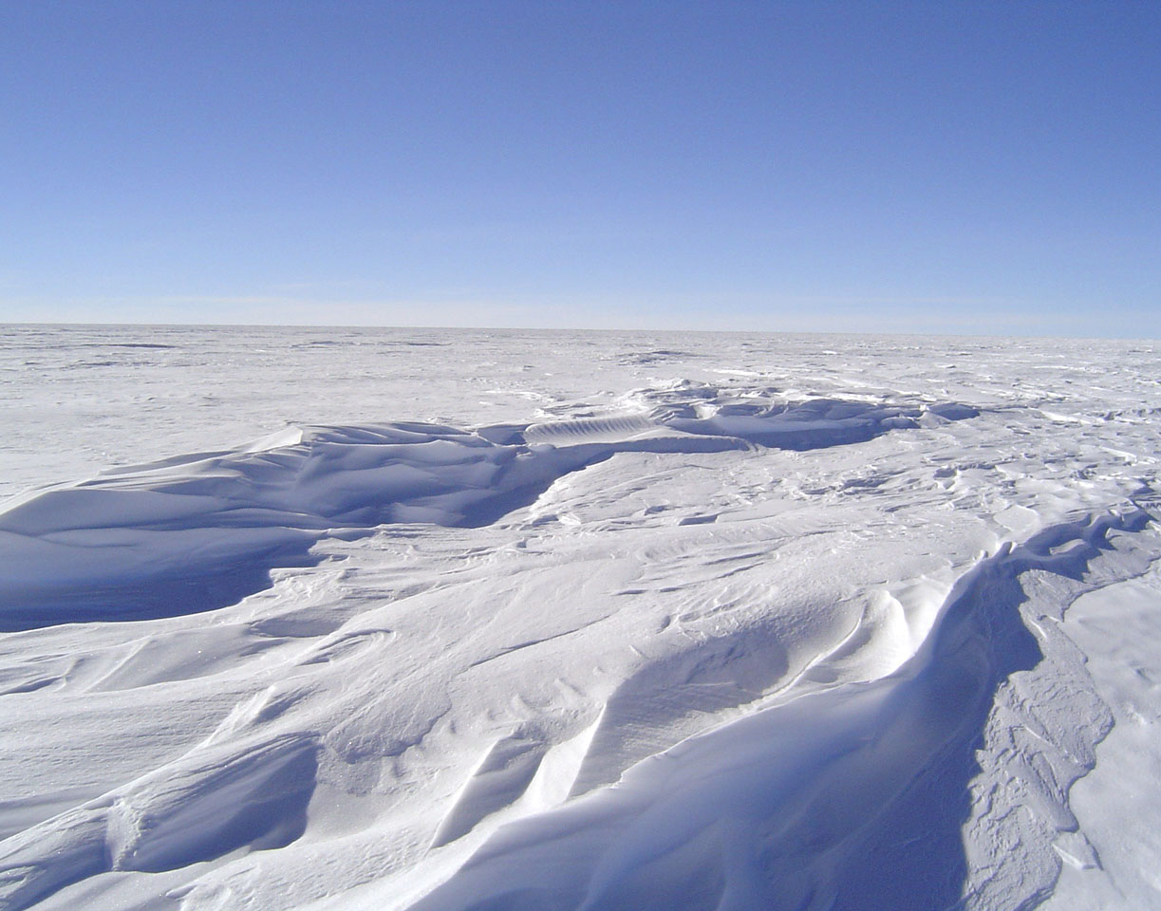
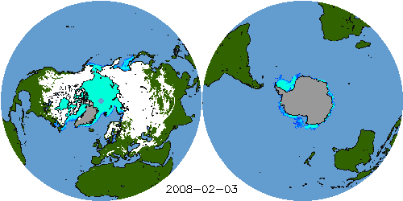
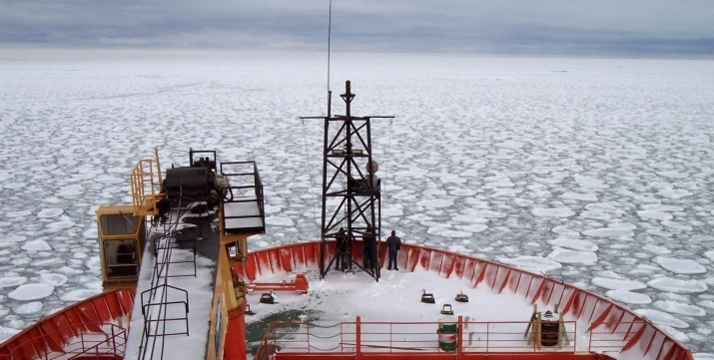
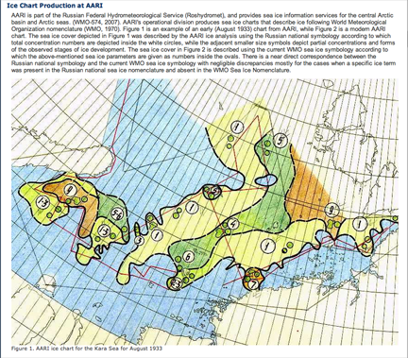
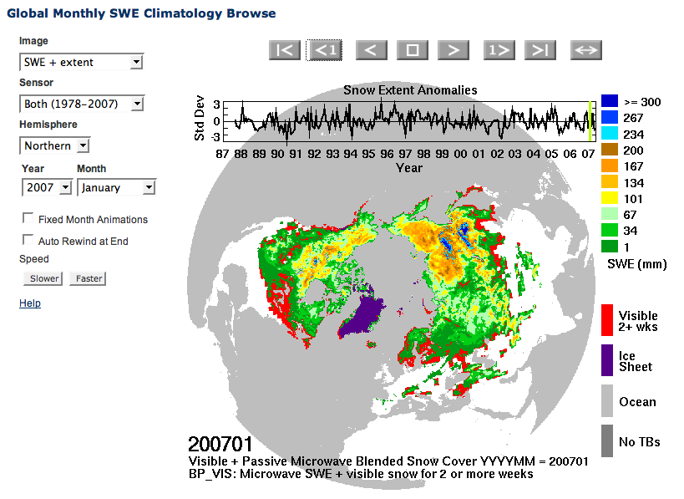
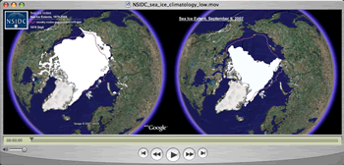
The National Snow and Ice Data Center…
Manages and
distributes
scientific data
Performs scientific
research
Supports data
users
Creates tools for
data access
Educates the public
about the cryosphere
Notes:
Images:
Top left: Near Real-Time SSM/I EASE-Grid Daily Global Ice Concentration and Snow Extent, 3 February 2008
Top right: Pancake ice seen off the bow of the research vessel Aurora Australis, in the Southern Ocean near Antarctica. Photo courtesy Ted Scambos.
Bottom right: Data from the Sea Ice Index, shown on Google Earth and distributed from our Web site in the form of a Quick Time movie. The left image is an animated time series of sea ice extent from 1979 to 2006; the static image on the right compares the extent in 2007.
Bottom left: Global Monthly SWE Climatology Browse, from http://nsidc.org/data/nsidc-0271.html
Center: A section of the online data set documentation from Sea Ice Charts of the Russian Arctic in Gridded Format, 1933-2006 (http://nsidc.org/data/g02176.html).

Slide 3
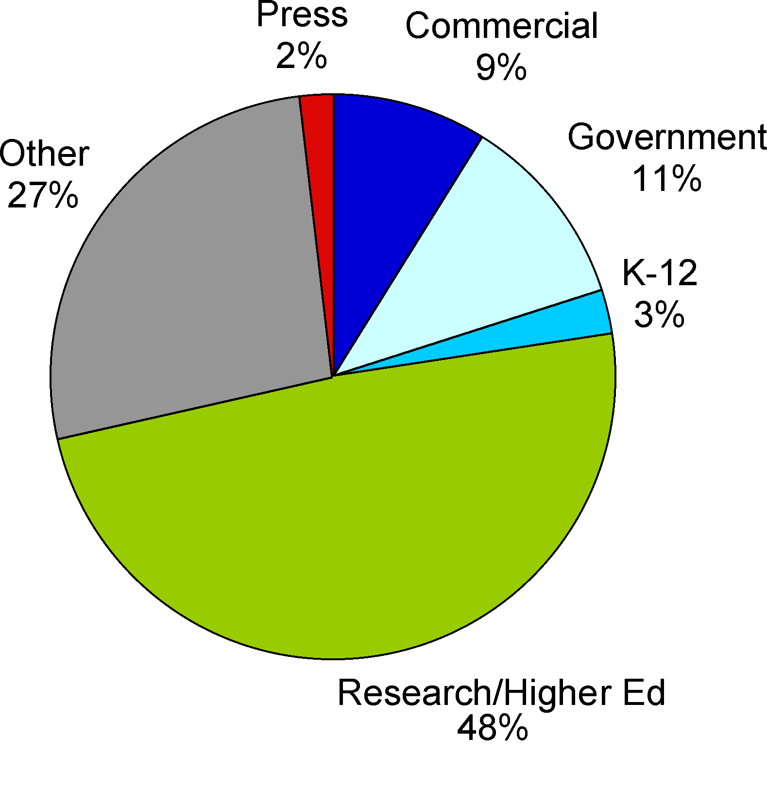
Products
More than 600 data and information products, most freely available online
  Satellite
  In situ (station data
  and the like)
  Model output
  Most digital, some analog
Users

Slide 4
Funding agencies
Objectives
Research
20%
Data management
80%

Slide 5
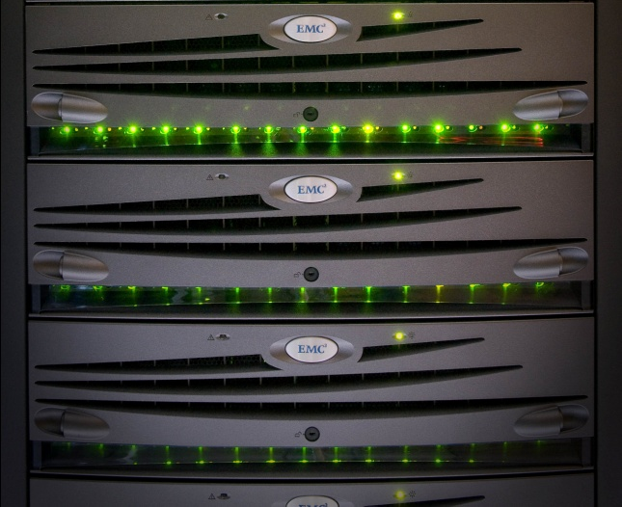
NSIDC Distributed Active Archive Center
Data from NASA’s past and current Earth Observing System (EOS) satellites and other satellite and field measurement programs.
Passive microwave
VIS/IR Moderate Resolution
Satellite & Airborne Altimetry
AMSR-E (Aqua)
AMSR (ADEOS II)
SMMR (Nimbus 7)
SSM/I, SSMIS (DMSP series)
MODIS (Terra/Aqua)
snow and ice products
AVHRR polar data
(NOAA series)
ICESat I / GLAS altimetry
and atmospheric lidar data
Digital Elevation Models (DEMs)
IceBridge
Yearly Ingest | Total Archive | Yearly Distribution
25.7 TB | 98.8 TB | 150.0 TB
11.6 million files | 27.2 million files | 17.5 million files
* Metrics for 2010 calendar year

Slide 6
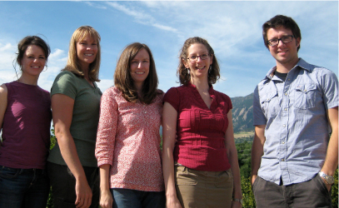
NSIDC User Services Office
Expert and timely assistance in selecting and obtaining data
David Korn, Amanda Leon, Molly McAllister, Donna Scott, Betsy Sheffield
Expertise in remote sensing, data manipulation and programming, outreach, and customer service
Support for data set documentation, data specific tools, and problem solving
Highest customer service satisfaction rating in the federal government
(per external NASA reviews)

Slide 7
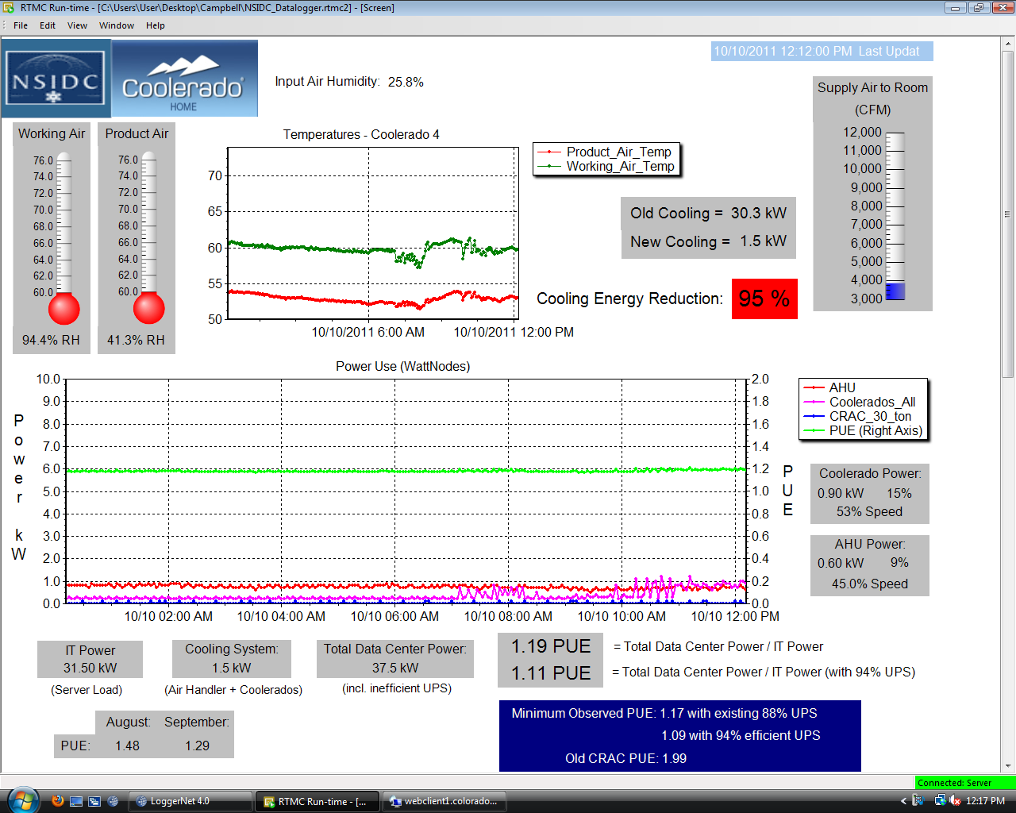
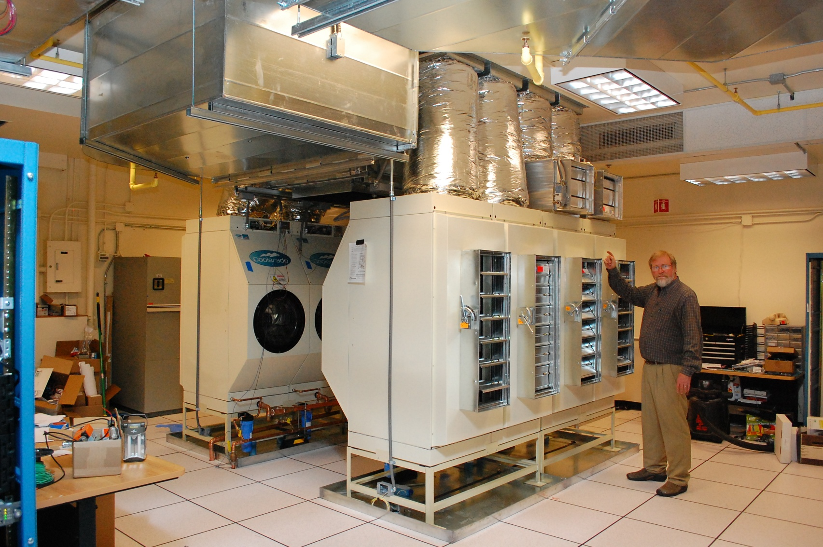
Green data center project
Largely funded by a $500,000 NSF Grant
Phase I complete: A 70% to 97% reduction in cooling energy while still meeting all hardware temperature and humidity specifications
Phase II underway: Rooftop 50 KW solar array, expanded UPS
Recipient of 2011 CO-LABS Governor’s Award for High Impact Research

Slide 8
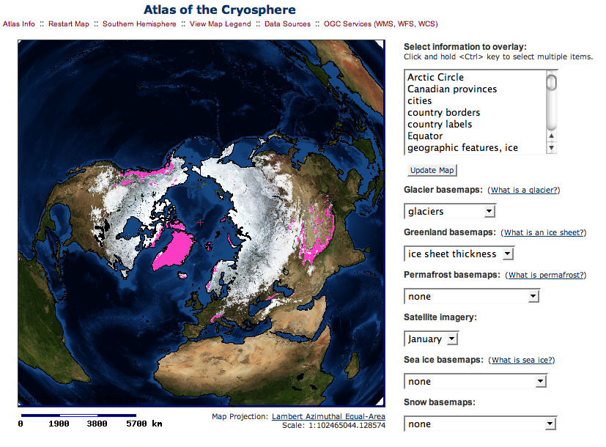
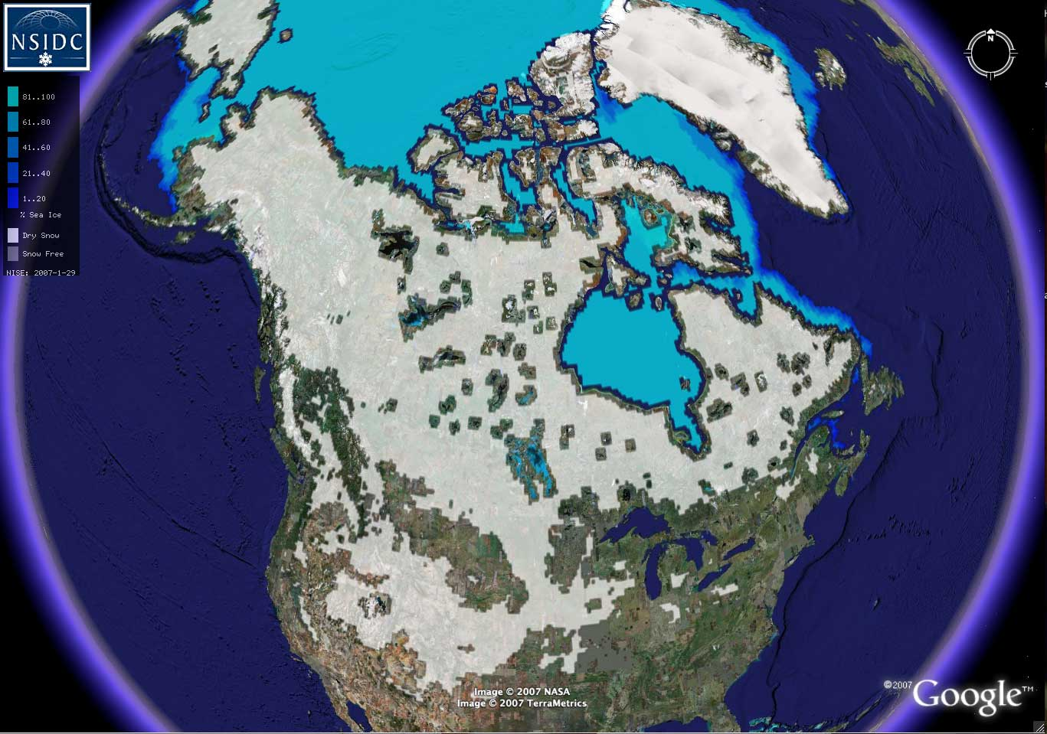
Evolving as a data center
Data search and services: EDB and Polaris
Data and service casting: Libre
Interoperability: ACADIS
The above fall broadly under Informatics: “Delivering the right information, to the right person in the right place and time, in the right way”
Plotting our future:
Software architect
Linking with CU library system (Data Conservancy)
WMS map server
Google Earth
Notes:
Top, cryospheric data layers in the Atlas of the Cryosphere (http://nsidc.org/data/atlas/)
Bottom, Near Real-Time SSM/I EASE-Grid Daily Global Ice Concentration and Snow Extent data, shown on Google Earth (http://nsidc.org/data/virtual_globes/)

Slide 9
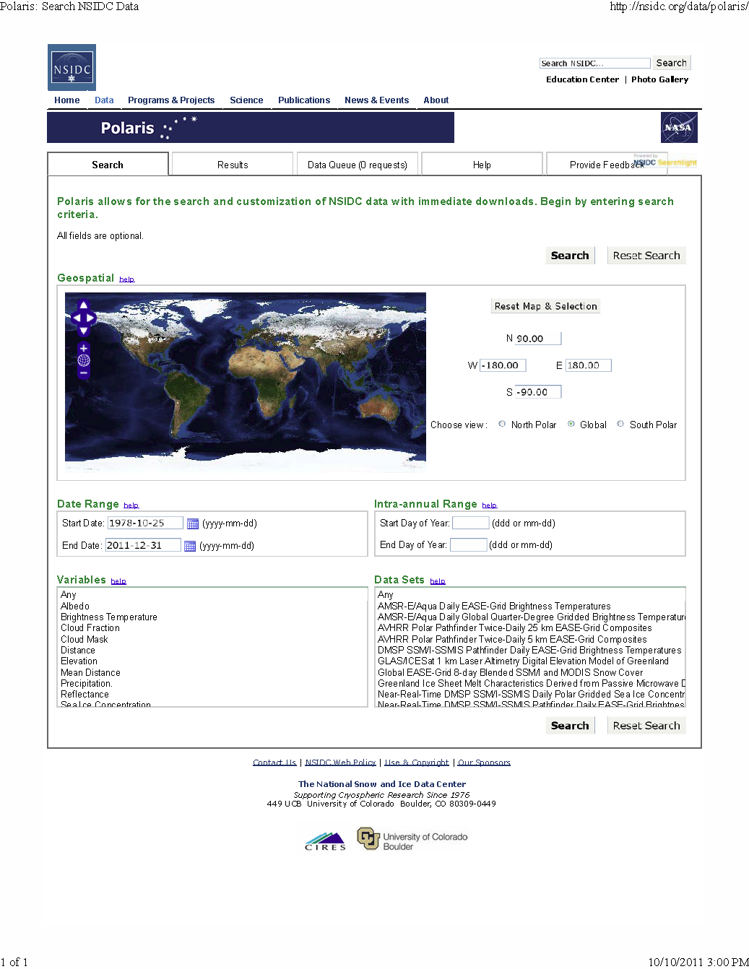
Enterprise Database (EDB) and Polaris
EDB is the current major data management infrastructure project at NSIDC.
EDB will serve as the authoritative, consistent, and extensible representation of NSIDC data holdings.
Polaris leverages EDB’s file level metadata to provide subsetting, re-projection and other services.
EDB replaces a collection of historical databases and utilizes PostGIS and the ISO 19115 metadata standards.
EDB is the infrastructure
Polaris is the interface

Slide 10
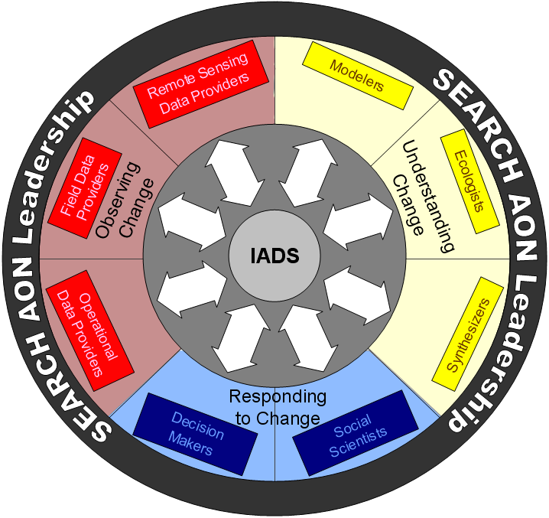
ACADIS: Advanced Cooperative Arctic Data and Information Service
ACADIS, a joint NSIDC/UCAR effort, is managing all Arctic data for NSF
Key year 1 goals:
Continued data Ingest through CADIS as ACADIS system develops
Form Data Advisory Committee
Make all NSF Arctic data visible through NSIDC
Prototype integrated/value added products
ACADIS

Slide 11
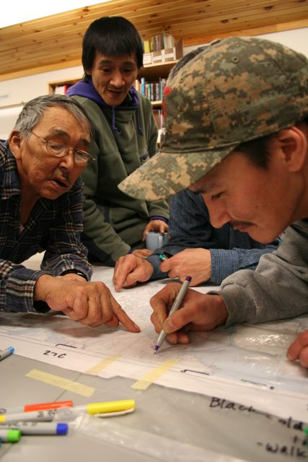
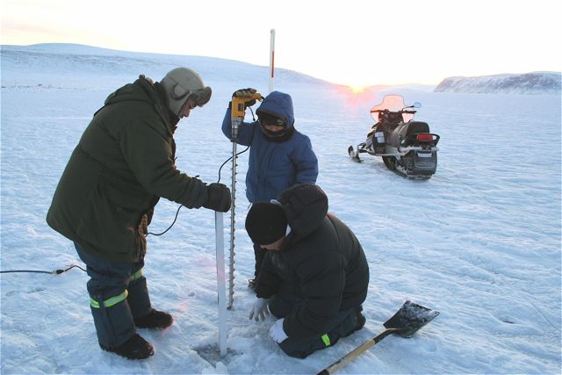
NSF: Exchange for Local Observations and
Knowledge in the Arctic (ELOKA)
Why
Local and community based knowledge of the Arctic is informing science, policy, and development.
Communities look for their work to have influence beyond a particular research project and to be passed down to youth and shared broadly but ethically.
There is an increasing need to manage the information so that local knowledge-holders can decide how to manage their “data” and how to share it with others effectively
What
ELOKA provides data management services and user support to facilitate the collection, use, exchange, and preservation, of local observations and knowledge.
Currently have interviews, maps, and community measurements of sea ice, narwhal behavior, environmental change, and ecology
ELOKA will become an arm of ACADIS

Slide 12

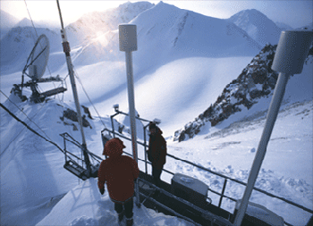
NSIDC will sustain the basic principles of data management
Preservation without access is pointless; access without preservation is impossible
Keep it simple and flexible: it’s about data, not systems!
Think about long-term archiving when planning for data collection
Document uncertainty
Involve scientists and users in data management, and data managers in science
Photo © Bjørn Anders Nyomen
Notes:
Top photo: © Bjørn Anders Nyomen
Bottom photo: Courtesy IPYDIS

Slide 13

Is a portal a one stop shop?
These ideas from the inspired mind of Mark Parsons

Slide 14
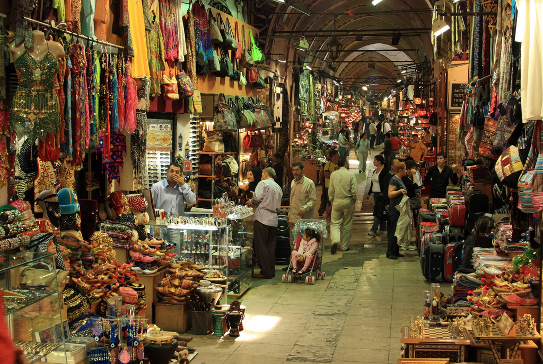
Or Grand Bazaar!
photo by Frank Kovalchek (CC-BY)
These ideas from the inspired mind of Mark Parsons
Notes:
Rather than a one-stop shop, a better metaphor could be a marketplace or bazaar—a virtual space where all data can be found, but specialist portals provide the expertise, information, and referrals necessary to identify and understand data within a specific disciplinary context. Returning to the ecosystem metaphor, each of these specialists can be seen as filling different niches by providing and exchanging specialized services. At a practical level this implies that disciplines and research or decision focus areas need to develop portals to meet their needs. It also means that data centers need to expose their data and metadata through multiple protocols that allow these different systems to automatically identify and acquire the information to be presented in ways that are meaningful to their designated user communities. IPY has had initial success creating a union catalog where multiple data centers expose their metadata through the Open Archives Initiative Protocol for Metadata Harvesting. The GCMD serves as an overall authority catalog in this initial system and harvests all available metadata, but, more importantly, individual archives can choose to harvest and expose only select data in ways relevant to their users. Evolving examples of these specialized portals range from a global cryospheric portal to a portal offering a local and traditional knowledge perspective of biodiversity change.

Slide 15

Some Bazaar Technologies
Open metadata harvesting (OAI-PMH, CSW, etc.)
Data Casting through RSS and Atom feeds to advertise data and any updates
Service Casting to advertise related data services
“Badging” data as open in a machine readable way
Specialized aggregation of data casts and service casts
OpenSearch
These ideas from the inspired mind of Mark Parsons
Notes:
OpenSearch is a set of simple formats used for sharing search results in a federated system. OpenSearch was developed by a subsidiary of Amazon and has been very successful in the commercial world (it underlies the Amazon Marketplace), but is only now beginning to be used in science. An advantage of OpenSearch is that it provides a way for data stewards to present information that would be otherwise inaccessible to search engines and web crawlers. More importantly, it allows those most familiar with the content in question to enable search in a way that is most appropriate.

Slide 16
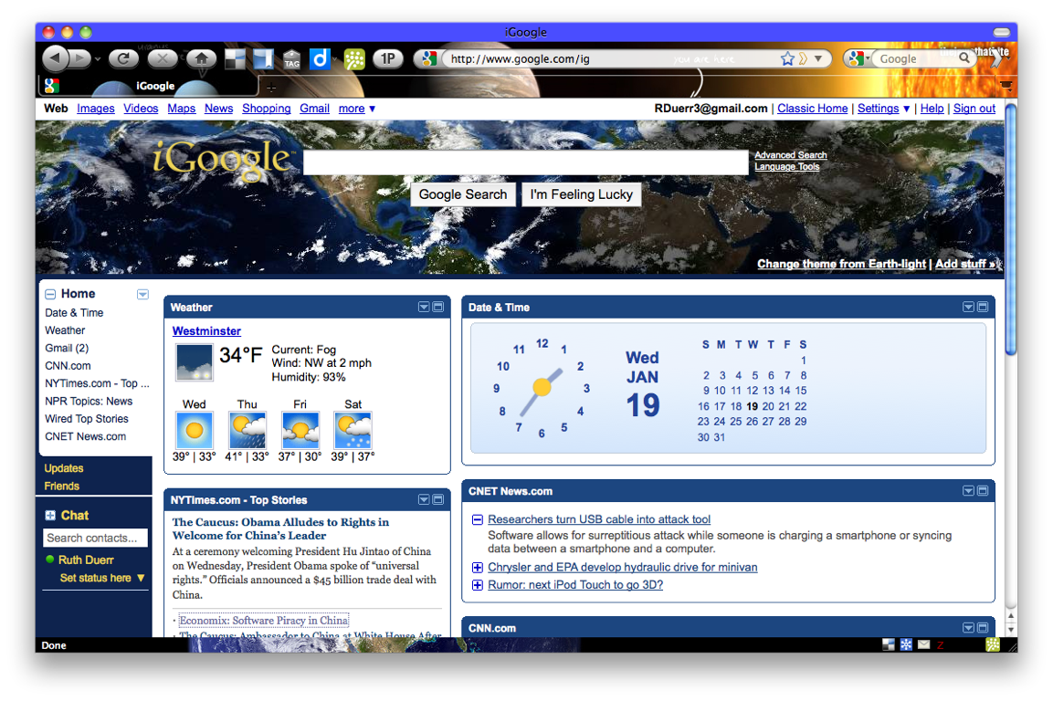


What if....
Finding data matching your interests was as easy as subscribing to the news?
myData News.org
Greenland 1 km DEM has been published
A Digital Elevation Model (DEM) of Greenland acquired by A. Researcher is available in binary format at a 1 KM grid spacing in a polar stereographic projection ... more
Greenland Ice Sheet Melt Characteristics Data updated
Greenland Ice Sheet Melt Characteristics now available via OpenSearch API
Presented at the Data Stewardship: Data Discovery Session
27th Conference on Interactive Information Processing Systems (IIPS)
91st American Meteorological Society Annual Meeting
Preparing Data for Ingest, presented 10/27/09 by R. Duerr LID590DCL Foundations of Data Curation
Notes:
An example of Data Casting

Slide 17
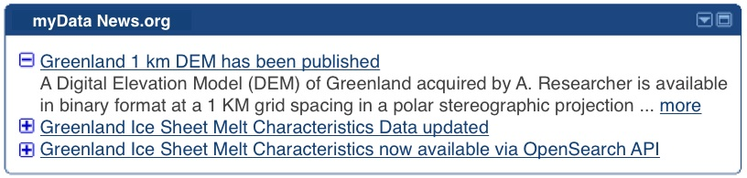
What if....
Finding data matching your interests was as easy as subscribing to the news?
myData News.org
Greenland 1 km DEM has been published
A Digital Elevation Model (DEM) of Greenland acquired by A. Researcher is available in binary format at a 1 KM grid spacing in a polar stereographic projection ... more
Greenland Ice Sheet Melt Characteristics Data updated
Greenland Ice Sheet Melt Characteristics now available via OpenSearch API
Presented at the Data Stewardship: Data Discovery Session
27th Conference on Interactive Information Processing Systems (IIPS)
91st American Meteorological Society Annual Meeting
Preparing Data for Ingest, presented 10/27/09 by R. Duerr LID590DCL Foundations of Data Curation

Slide 18
Libre - Aggregation Support
Search API
Use search API's to find casts for specific subject areas
Cast Crawler
Seed crawler
with new sites
Monitor known casts for updates
Find new casts on known sites
Seed list
Schedule
Feed the aggregator with new casts
Heritrix
Aggregation Server
Support storage & retrieval of active cast entries
Feed the aggregator with new or updated casts
Retrieve a feed matching OpenSearch Criteria
http://nsidc.org/libre/
Presented at the Data Stewardship: Data Discovery Session
27th Conference on Interactive Information Processing Systems (IIPS)
91st American Meteorological Society Annual Meeting
Preparing Data for Ingest, presented 10/27/09 by R. Duerr LID590DCL Foundations of Data Curation
API = Application Programming Interface
Notes:
This is the overall Libre approach based on data casting and service casting that could be adopted by GCW.
We are using the existing search API's to locate casts on the web
Heritrix is the web crawler behind the Internet Archive. open source - we are tailoring it to find casts
early in the IPY at data management meetings held to enable effective discovery, we found that metadata was considered a fearsome topic that would drain the time of the scientists and was thus to be avoided. Simple tools such as web-based templates with drop-down lists and on-line tutorials, along with substantial personal assistance helped ease the process. As automation increases, the job can be made easier but willingness and ease for the data collector to express and share knowledge about data particularities will always be essential. One positive outcome of this experience garnered through IPY and elsewhere has been support for development of curricula in science data management. This may be provided through block courses, on-line tutorials, or as a more formal component of graduate degree programs. Several promising initiatives are underway and being viewed with interest.
About Libre
Libre embodies the spirit of the Polar Information Commons (PIC). We are growing a collaborative polar community by fostering open data sharing. Data sharing is vital to the interconnectedness that characterizes today's research questions. To that end, we offer tools and services that make data sharing and access easy. We've figured out the data sharing technology and tools, so you don't have to.
Norms for Knowledge and Data Sharing
Libre supports PIC's norms for knowledge and data sharing:
Acknowledge the authorship or source of all materials that they use from the PIC, including use of an appropriate citation when data are used in a formal scientific publication.
Give the appropriate recognition to the PIC as a digital community resource in their publications and value-added products and services.
Notify the relevant PIC contributors (or the PIC community more generally) about their use of specific digital materials from the PIC, and about any suspected significant errors, limitations, or other problems that they may have discovered in the course of their use of those materials.
Acknowledge that they are primarily responsible for determining whether the PIC materials they use are of sufficient quality and appropriateness for their objectives.
Contribute back to the PIC any value-added data, information, or other digital content derived entirely or largely from PIC materials, with appropriate citation of and documentation about PIC and non-PIC inputs.

Slide 19
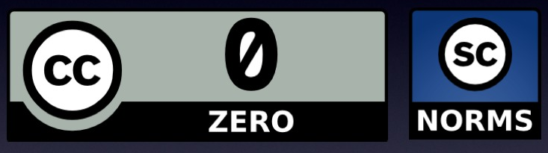

CC Zero waiver + norms
waive rights ➝ public domain
+
attribution /citation through community norms, not a contract
http://polarcommons.org/ethics-and-norms-of-data-sharing.php
CC = Creative Commons
Notes:
The core principle of the PIC is that data should not be seen as the property of an individual, but should instead be seen as a public good. And like any public good it should be used and shared responsibly and ethically.
But this ethical behavior cannot be mandated but instead should be based on a set of community norms. Initial norms of behaviour are listed on the PIC web site. They include concepts like attribution of data providers, adequate description of data quality and uncertainty, and sharing derivative works. And if you think about it, this is the way science works. There is no legal obligation to follow the scientific method and basic practices like data citing original sources. It’s just the expected behaviour of the community.
An evolving legal and social science research agenda is needed to best balance between society’s need for open data and the need to protect people, heritage, endangered species, and cultures from misuse. Information science has begun to explore some of these issues in medicine [39], human rights [40], and locational privacy [41], but broader research more focused on data rather than publications is needed.

Slide 20
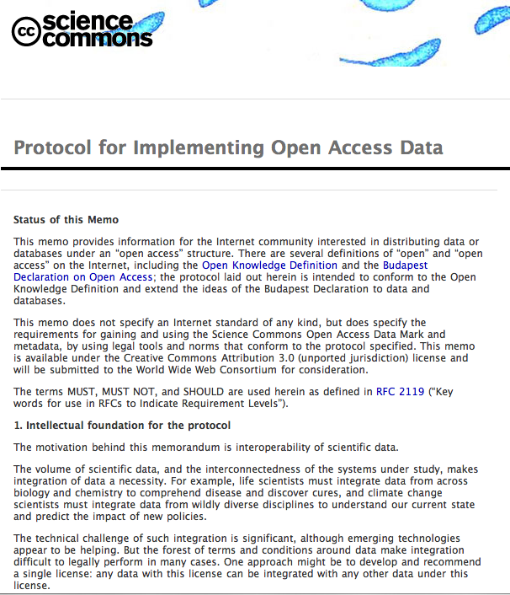
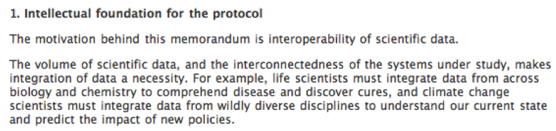
Notes:
this is the protocol. it lays out our arguments for convergence on the public domain.

Slide 21
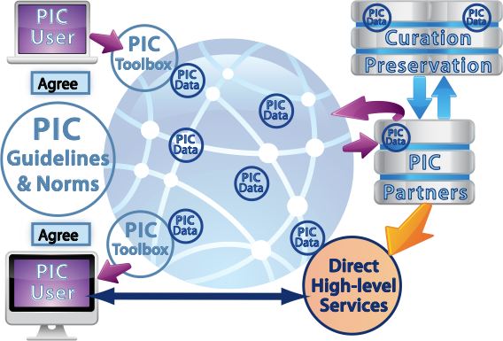

A Conceptual Architecture for the PIC
Notes:
Øystein could probably explain this slide if he had to.

