Slide 1



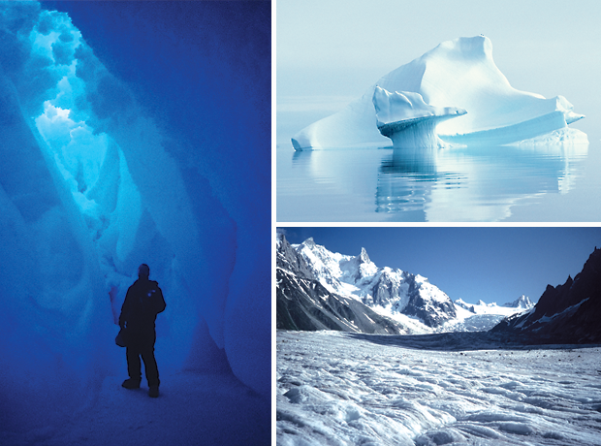
Satellite Sea Ice Products
Cooperative Institute for Research
in Environmental Sciences
University of
Colorado
Walt Meier, Mark Parsons, Mark Serreze
National Snow and Ice Data Center
Geneva, Switzerland 21-24 November 2011
GCW Workshop

Slide 2
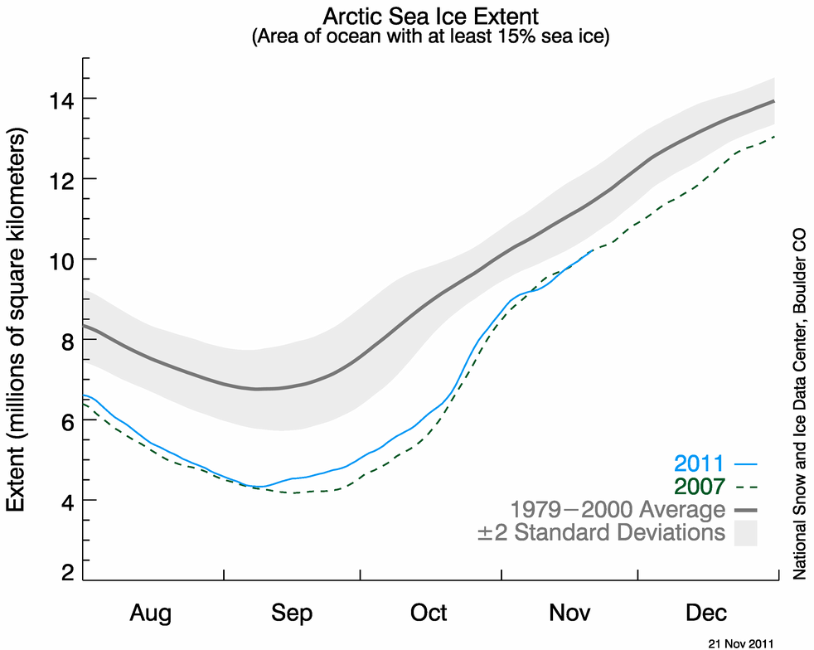
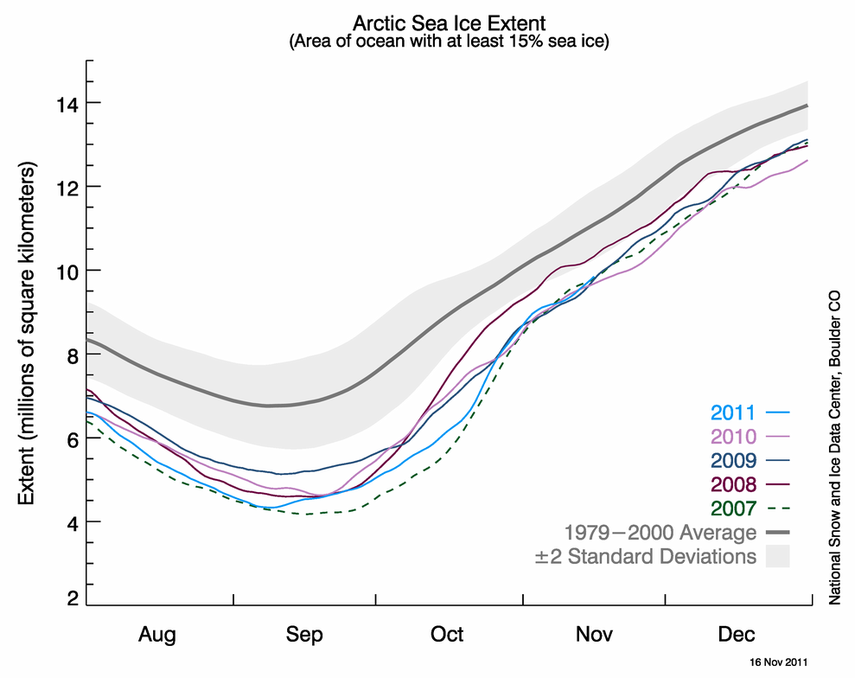
Current NSIDC sea ice extent

Slide 3
Passive microwave sea ice products
NSIDC
  NASA Team, Bootstrap
  NOAA/NSIDC CDR (combined NT, BT; NetCDF_CF; data quality)
  Sea Ice Index (images, extent/area stats)
  News and Analysis website (NRT science analysis)
  MASIE (Multi-sensor Analyzed Sea Ice Index)
JAXA
  AMSR-E, AMSR2 (2012)
  Sea Ice Monitor (extent timeseries)
NASA Goddard (most distributed through NSIDC)
Cryosphere Today (Univ. Illinois)
  ice area timeseries, browse images
ArcticROOS (Nansen Environmental and Remote Sensing Center)
PolarView (Danish Meteorol. Institute)
EUMETSAT Ocean and Sea Ice Satellite Application Facility
  NetCDF_CF, error estimates

Slide 4
Operational sea ice products
International Ice Chart Working Group members
  Canadian Ice Service
  U.S. National Ice Center
  Danish Meteorological Institute (PolarView)
  Norwegian Meteorological Institute
  Federal Maritime and Hydrographic Agency of Germany
  Arctic and Antarctic Research Institute
  Swedish Meteorological and Hydrological Institute
  British Antarctic Survey
Finnish Meteorological Institute
NSIDC/NIC MASIE (Multi-sensor Analyzed Sea Ice Extent)
EUMETSAT Ocean and Sea Ice Satellite Application Facility

Slide 5
Sea ice concentration/extent websites
Source | Web site | Type of product
NSIDC NASA Team, Bootstrap | http://nsidc.org/data/seaice/pm.html | Gridded concentration data files
NOAA/NSIDC CDR | http://nsidc.org/data/g02202.html | Gridded concentration data files
NSIDC Sea Ice Index | http:/nsidc.org/data/seaice_index/ | Value-added data (browse, timeseries)
NSIDC News and Analysis | http://nsidc.org/arcticseaicenews/ | Value-added data and analysis
NSIDC MASIE | http://nsidc.org/data/masie/ | Operational, multi-sensor data, browse, timeseries
University of Bremen | http://www.iup.uni-bremen.de/seaice/amsr/ | Browse, data, timeseries
JAXA Sea Ice Monitor | http://www.ijis.iarc.uaf.edu/cgi-bin/seaice-monitor.cgi?lang=e | Browse, timeseries
NASA Goddard | http://neptune.gsfc.nasa.gov/csb/index.php?section=234 | Browse, timeseries
Cryosphere Today | http://arctic.atmos.uiuc.edu/cryosphere/ | Browse, timeseries (ice area)
ArcticROOS | http://www.arctic-roos.org/ | Timeseries
EUMETSAT OSI-SAF | http://www.osi-saf.org/ | Gridded data files, browse
Danish Meteorol. Institute (EUMETSAT OSI-SAF) | http://ocean.dmi.dk/arctic/icecover.uk.php | Timeseries
PolarView | http://www.polarview.org/services/simf.htm | Browse
Canadian Ice Service | http://ice-glaces.ec.gc.ca/ | Operational ice charts, climatologies
U.S. National Ice Center | http://www.natice.noaa.gov/ | Operational ice charts
Google Arctic Sea Ice graphs | https://sites.google.com/site/arcticseaicegraphs/ | Browse, timeseries (aggregate)
Watt’s Up With That blog | http://wattsupwiththat.com/reference-pages/sea-ice-page/ | Browse, timeseries (aggregate)

Slide 6
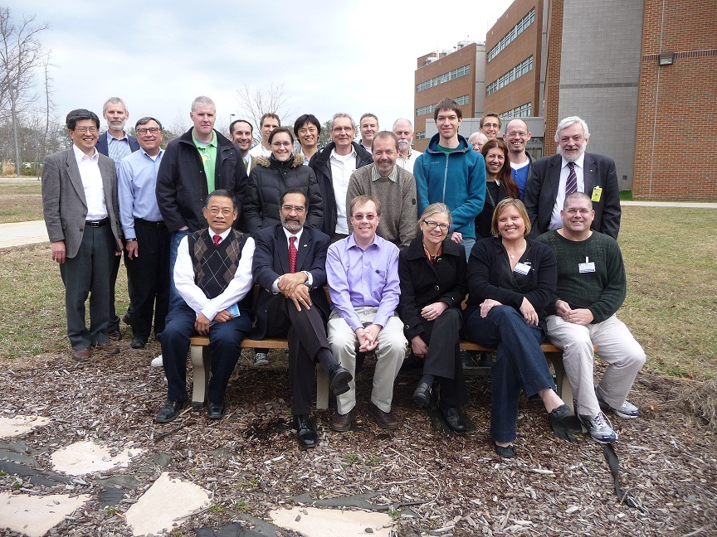
Satellite-derived Sea Ice Products Community Workshop
26 total attendees from 8 countries
  Ten attendees’ travel partially or fully funded by WCRP CliC
Algorithm developers
Product distributors
Operational community
Users (models, remote sensing)
Input solicited from invitees who could not attend
Focused mostly on discussion of major issues
  Uncertainties
  Documentation
  Conventions and methods
  Data formats
  Future plans for collaboration
15-16 March 2011
NASA Goddard
Workshop sponsored by WCRP CliC

Slide 7
Satellite-derived Sea Ice Products Community Workshop
Key Recommendations
Uncertainty estimates at grid-cell level need to be further developed
Validation of uncertainty estimates
Work towards consistent ancillary information
  land masks (Antarctic ice shelves)
  regional masks
  climatology period
Potential consideration of feasibility for ensemble estimate
Collaborate on community endeavors
  Sea Ice Outlook
  Future assessments
  Describing daily/monthly minimum extent
  Review journal article of algorithm products
Data formats – NetCDF and/or other self-describing fields

Slide 8
Primary sea ice concentration algorithms
Archived at NSIDC
  SMMR-SSM/I
    NASA Team (NTA)
    Bootstrap (SBA)
  AMSR-E
    NASA Team 2 (NT2)
    AMSR Bootstrap (ABA)
Other algorithms
  ASI (AMSR) – Univ. of Bremen
  Bristol (BRI) – EUMETSAT OSI-SAF
  Norsex (NOR) – Norwegian Polar Institute
  Cal/Val (CAL), aka AES-York

Slide 9
Sea ice algorithm comparison
NTA – NSIDC SSM/I standard product
NT2 – AMSR-E standard product
ABA – derived from AMSR-E standard product
ASI – produced at Univ. Bremen from AMSR-E
Run in-house
from SSM/I:
  SBA – SSM/I Bootstrap
  BRI – Bristol algorithm
  NOR – Norsex algorithm
  CAL – Cal/Val algorithm
Common (expanded) land mask and weather filters
All gridded to 25 km polar stereographic grid

Slide 10
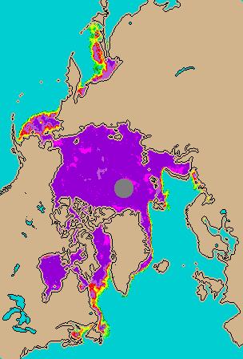
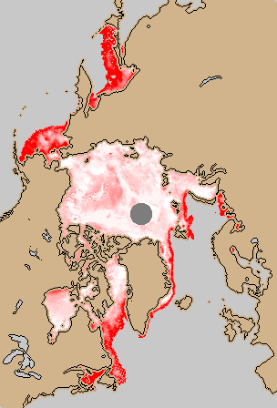
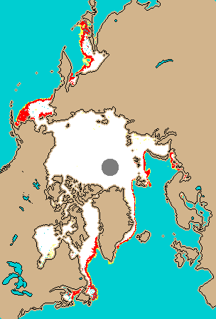

March – September 2008 Sea Ice
Avg. Concentration
Conc. Range
Melt/Extent Indicator
%
%
0
20
40
60
80
90
100
0
25
4
8
likely
melt
Max – Min concentration
# algorithms >15%
Combined from all 8 algorithms

Slide 11
Total sea ice area, 2007 and 2008
Avg. of 8 algorithms
& ±1 st. dev. range
2007
2008

Slide 12
Total sea ice extent, 2007 and 2008
Avg. of 8 algorithms
& ±1 st. dev. range
2007
2008

Slide 13
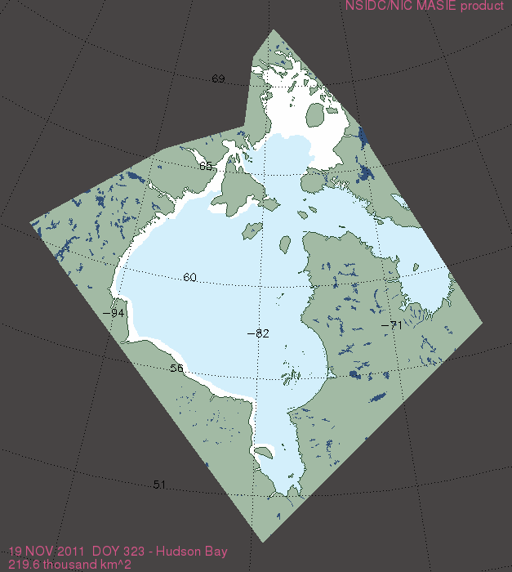
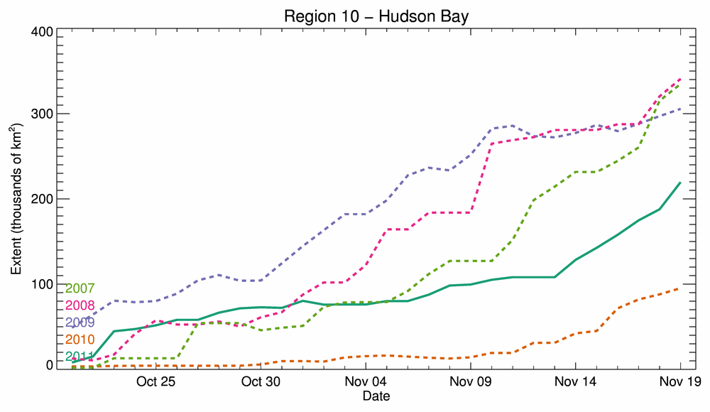
MASIE – a new operational product
http://nsidc.org/masie/
Produced operationally at U.S. National Ice Center (NOAA IMS)
Multiple data sources (PM and non-PM) interpreted by human analysts
Operational, so best that can be done on a give day – i.e., not consistent over long term
4 km resolution, ice extent only (ice/no-ice for each grid cell)
Available as GeoTIFF, shapefile, KML, PNG browse; and comma-delimited text files of total extent
Entire Arctic and individual regions
Since 2006, but only last month publically available

Slide 14
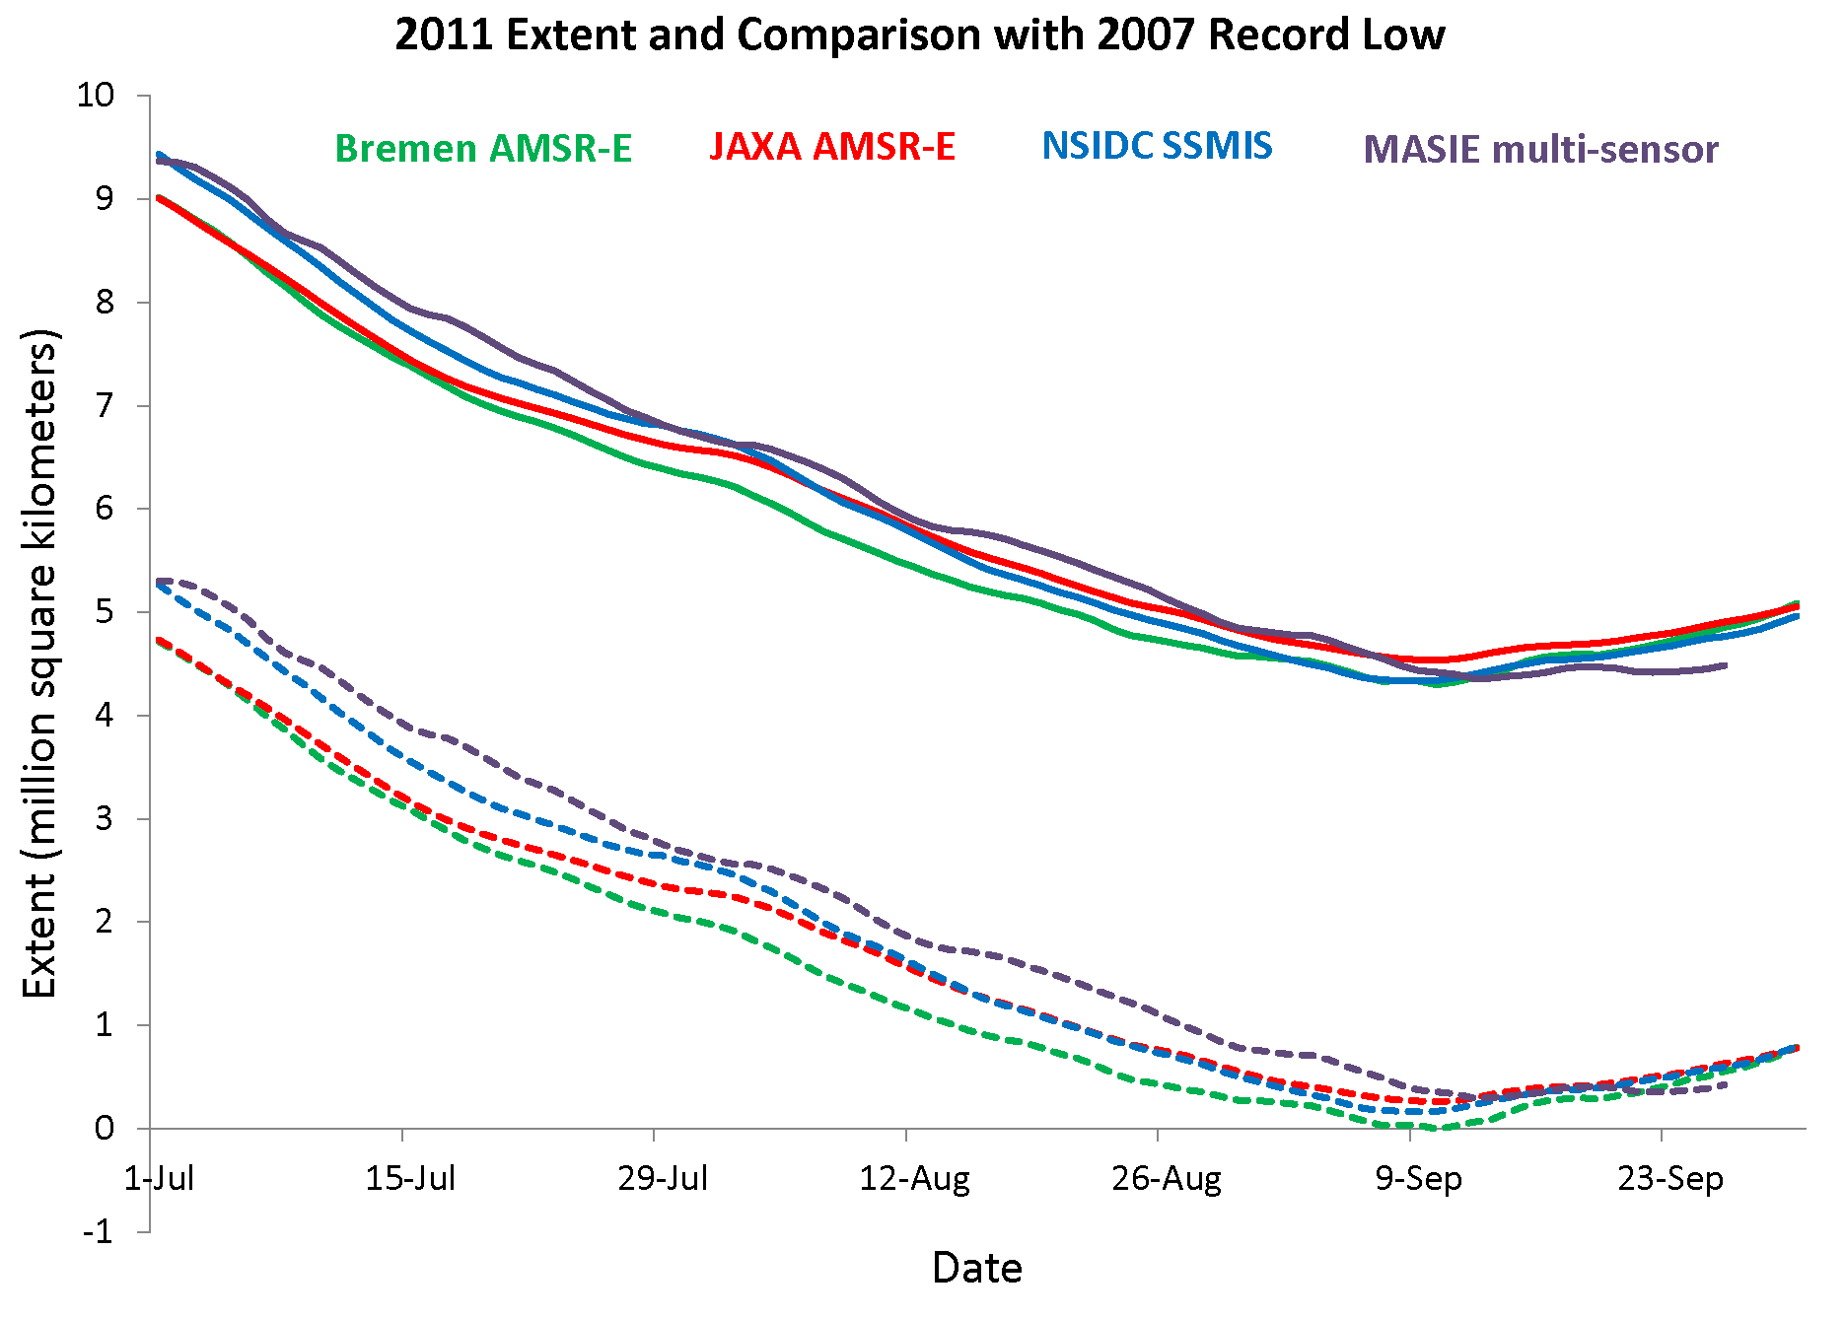
Sea ice extent, summer 2011
Total Extent
Extent relative to 2007 record
Only Bremen showed 2011 dipping below 2007

Slide 15
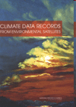
What is a Climate Data Record?*
“A time series of measurements of sufficient length, consistency, and continuity to determine climate variability and change” – U.S. NRC Report on Climate Data Records from Environmental Satellites, 2004
  At least 30+ years
  Thorough inter-sensor calibration
  Detailed data quality information
  Metadata for data preservation
* In NASA-speak: “Earth Science Data Record” (ESDR)
In ESA-speak: “Essential Climate Variable” (ECV)

Slide 16
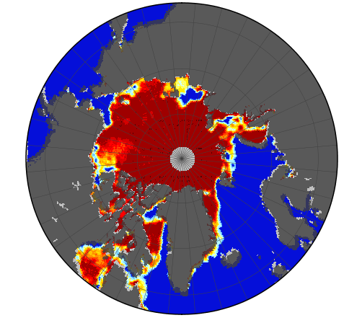
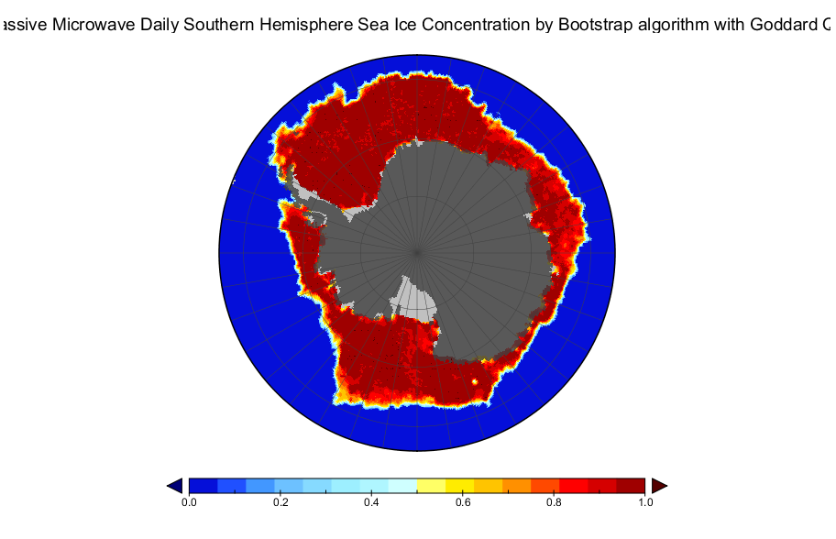
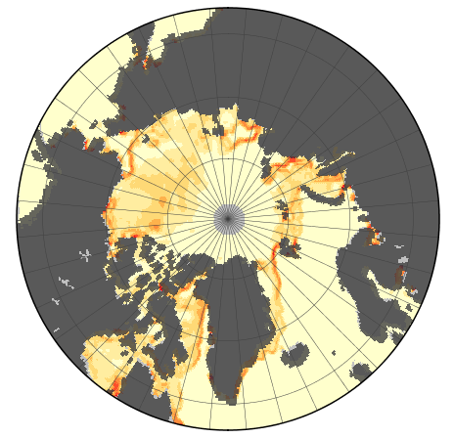
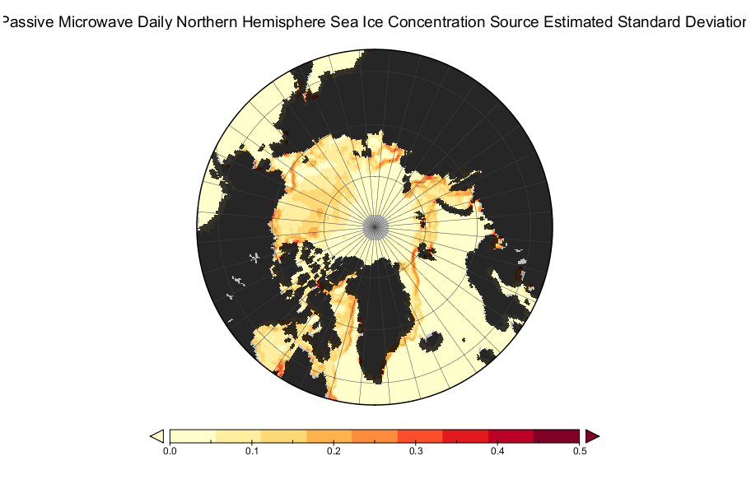
NOAA/NSIDC sea ice CDR
15 June 2007
NOAA Climate Data Record program
Combined NTA, SBA
  SBA ice edge
  Highest concentration from NTA and SBA
  Standard deviation field
  Data quality flags (melt, land spillover)
NetCDF4 with CF metadata
Plan to transition Information Service products (Sea Ice Index and News and Analysis) to use CDR
Concentration
0%
25
50
75
100
St. Dev. Field
25
50
0%

Slide 17
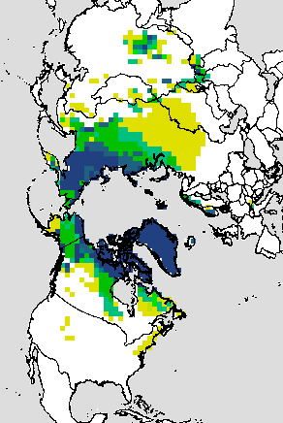
CDRs and ESDRs at NSIDC
NOAA CDRs for sea ice concentration, ice age, ice motion
NASA ESDRs for sea ice melt, snow cover, ice sheet albedo and melt
  Ground freeze/thaw, ice sheet velocity ESDRs also coming to NSIDC
  http://nsidc.org/data/measures/
Rutgers University Global Snow Lab, http://climate.rutgers.edu/snowcover/

Slide 18
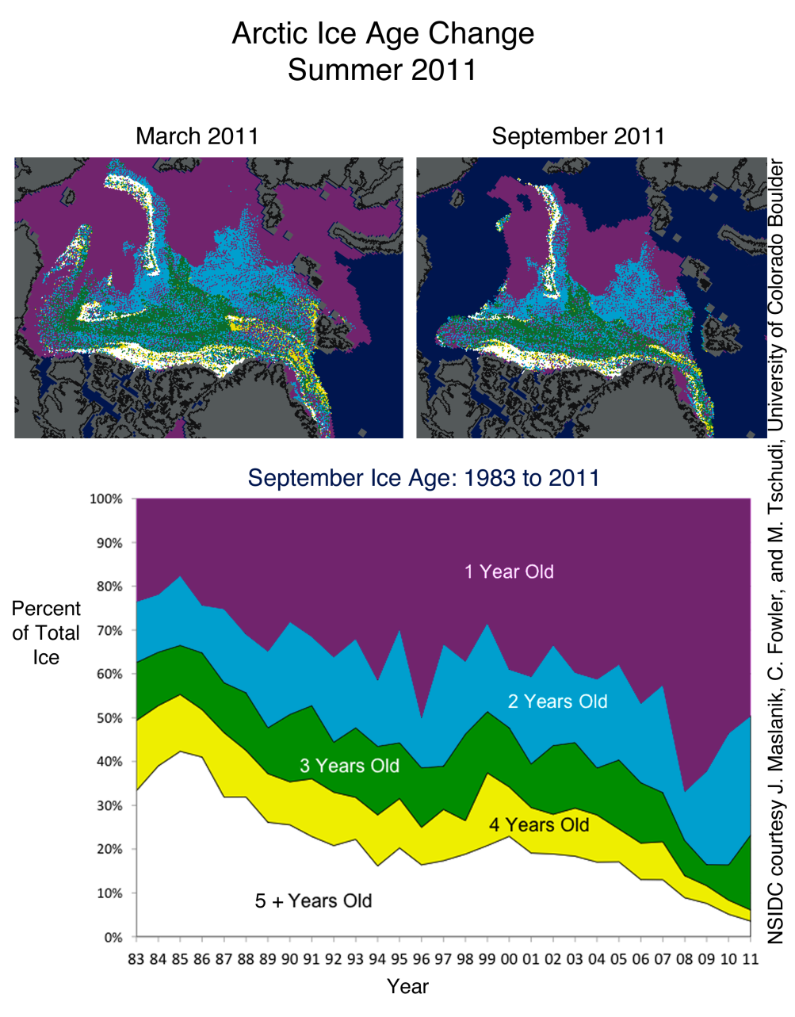
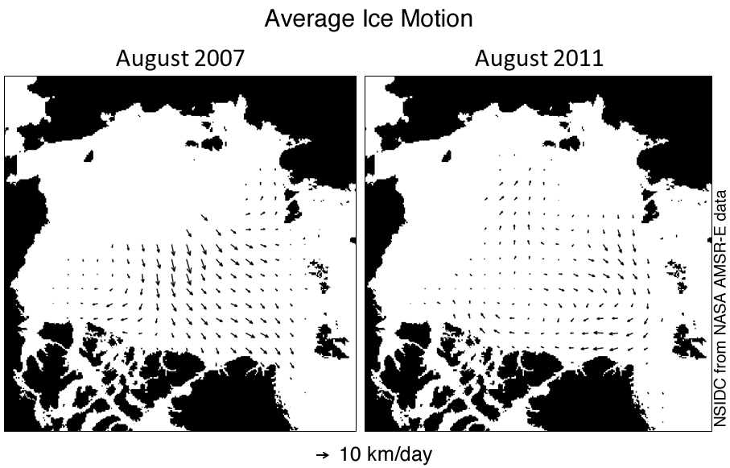
Other sea ice CDR products being developed
Ice motion
Ice age
Ice thickness
  Vis/IR (Key et al.)
  CryoSat?

Slide 19
Should all sea ice products be considered equal?
Requirements for climate products
  Use validated, peer-reviewed methods
  Demonstrate long-term consistency
    Operational products can provide targeted information for real-time users as well as validation for climate products
  Bear a reasonable resemblance to reality and a confidence level in that resemblance to reality (i.e., data quality/error information)
  Processing transparent and reproducible
  Archived in a self-describing format, but distributed in a variety of usable formats (e.g., GIS, KML, GeoTIFF, browse, etc.)
Currently*: OSI-SAF, NOAA/NSIDC, MASIE
* In Walt’s humble opinion

Slide 20
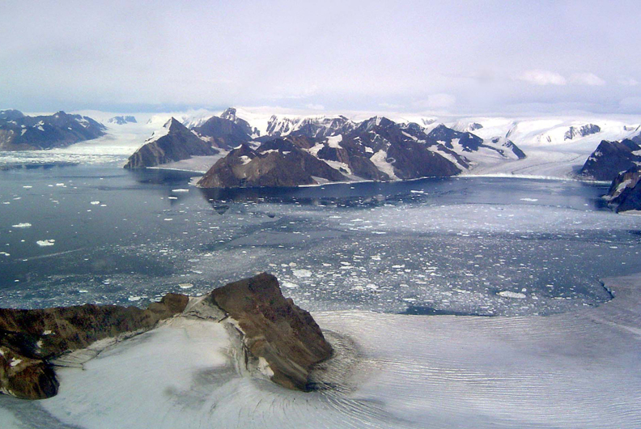
Thank you!
Notes:
Jorum Glacier, Antarctica. Photo courtesy Ted Scambos

