Slide 1
World-wide NMS sea ice services
ETSI-IV outcomes
(based on ETSI-IV report and report for JCOMM-II by C-CORE, CIS & ETSI by Vasily Smolyanitsky (ETSI/AARI), John Falkingham (CIS), Thomas Puestow (C-CORE) et al)‏

Slide 2
National Ice Services - Mandate
Ensure the safety of marine activities in the ice-infested waters and protect the environment
Provide knowledge of the ice environment sufficient to support environmental sciences and the development of informed policies

Slide 3

National Ice Services
Northern hemisphere
  Arctic Ocean: Russia, USA
  Canadian Arctic: Canada
  Eurasian Arctic, Bering and White Seas: Russia
  North Atlantic and Barents Sea: Norway
  North Pacific, Bering, Beaufort and Chukcha Seas: USA
  Greenland Sea, Davis Strait, Baffin Bay: Denmark, Canada
  Iceland Sea: Iceland
  Baltic Sea (BSIS: Denmark, Estonia, Finland, Germany, Latvia, Lithuania, Netherlands, Norway, Poland, Russia, Sweden)
  Far East Seas: China, Japan, Russia, USA
  Caspian Sea: Russia
  Great Lakes: NAIS (NAIS: Canada/USA)‏
Southern hemisphere
  Hemispheric analysis: USA
  Regional analysis: Ross Sea, USA
  Regional analysis: Atlantic and Indian sectors, Russia
  Sectoral analysis: Argentina, Australia
Source: WMO Publication
No.574 “Sea Ice Information Services in the World”, edition 2010

Slide 4
National Ice Services - Products
Polar orbiting satellites are primary information source
    Synthetic aperture radar
    Passive microwave radiometer, scatterometer
    Optical and infrared sensors
    Radar altimeters
In-situ measurements for gap-filling and validation
    Drifting buoys / Manned drifting stations / ice camps
    Coastal stations (e.g. sea level)‏
    Aircraft observations

Slide 5
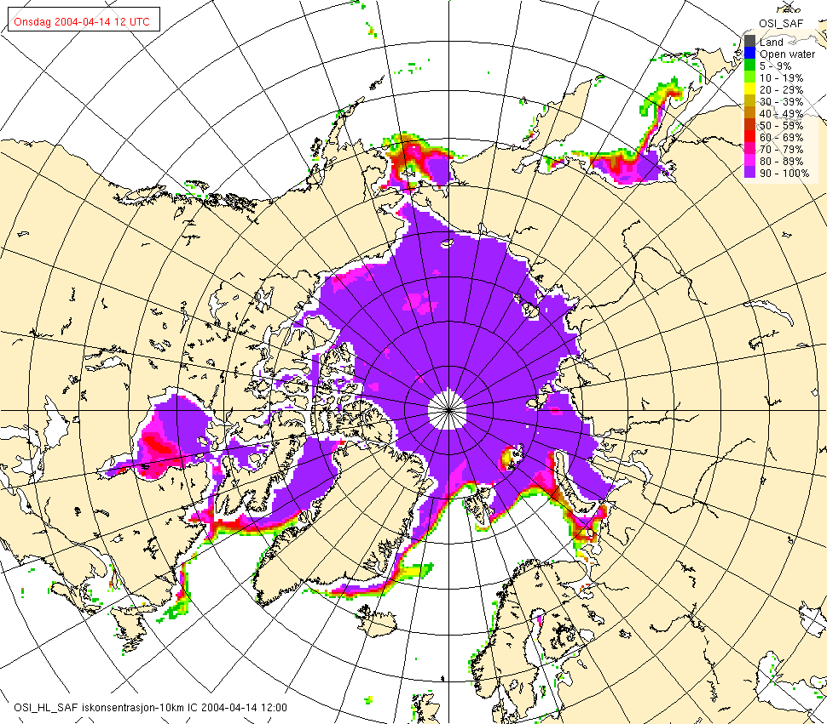
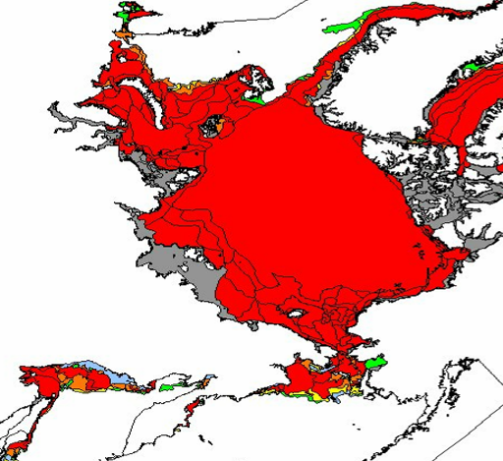
National Ice Services - Products
Low resolution hemispheric products
Ice distribution and age produced by several centers
Based on passive microwave satellite imagery (Spatial resolution ~25 km)‏
Produced weekly or bi-weekly, occasionally daily
Uses: climate change, navigation support for long-range planning
Spatial resolution not sufficient to for ship routing through ice

Slide 6
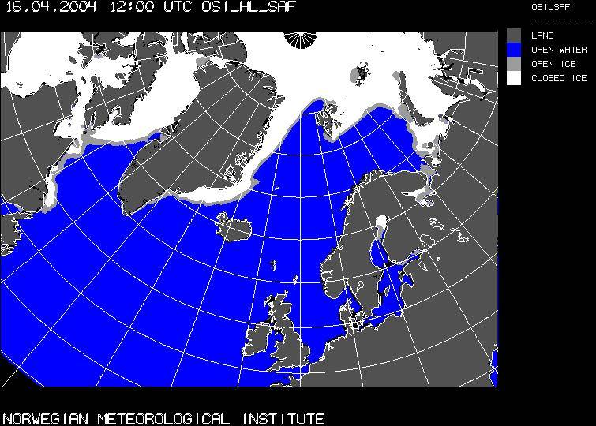
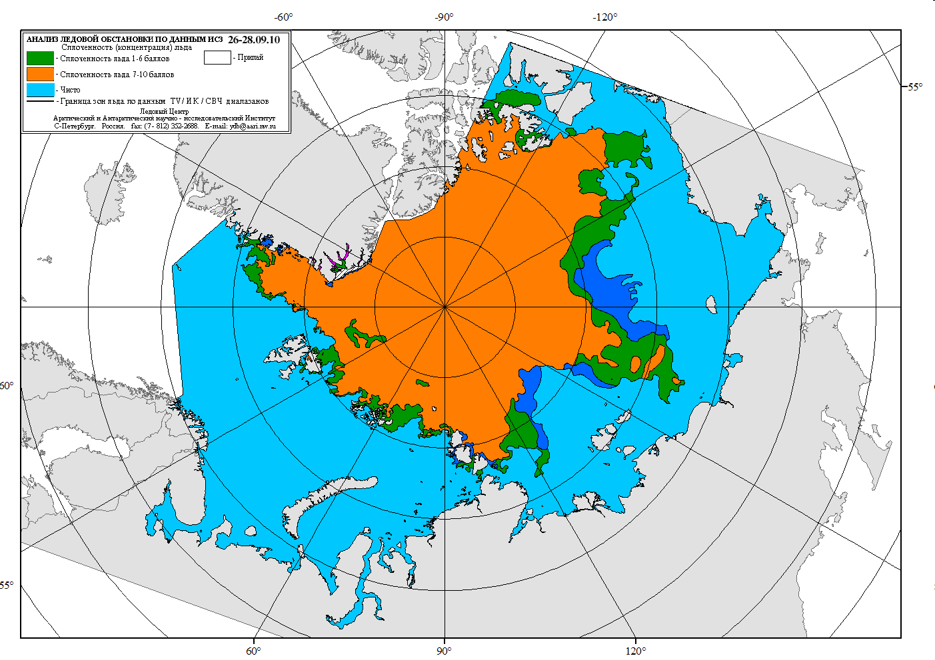
National Ice Services - Products
Semi-hemispheric products
Similar in attributes to hemispheric products
Additional satellite data may be used
More manual analysis may be applied

Slide 7
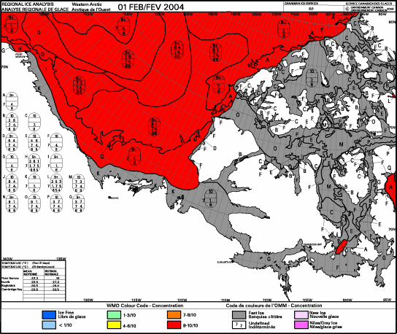
National Ice Services - Products
Regional ice charts
Typically produced weekly or bi-weekly
Use of standard nomenclature, coding system and colour scheme across all national ice services
Not all national services have yet implemented standard colour scheme

Slide 8
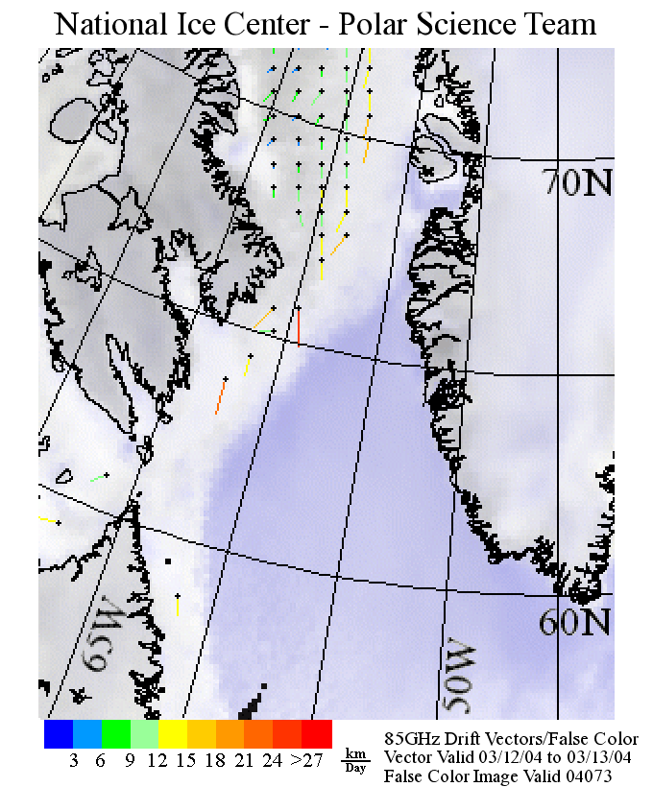
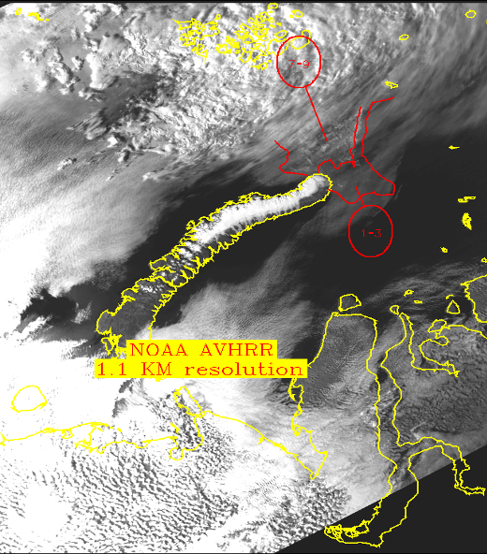
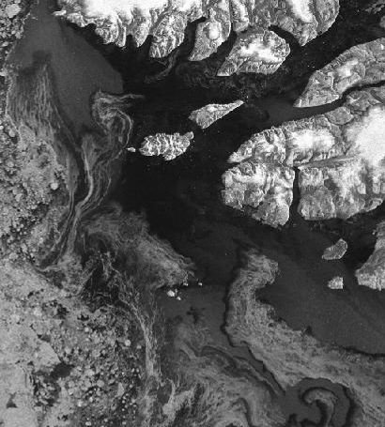
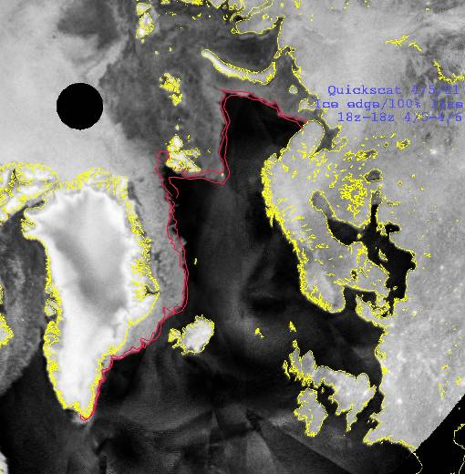
National Ice Services - Products
High-resolution charts
Daily production, largely based on satellite imagery
  Passive microwave (e.g. SSM/I): global observations, ice concentration, motion, thickness; resolution 10-25 km)‏
  Optical (e.g. AVHRR, MODIS) resolution ~ 250m - 1km
  SAR (RADARSAT, ENVISAT): resolution 25 – 100 m

Slide 9
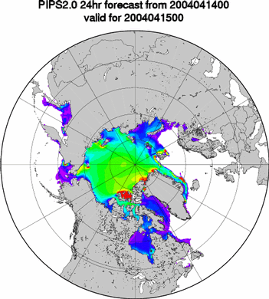
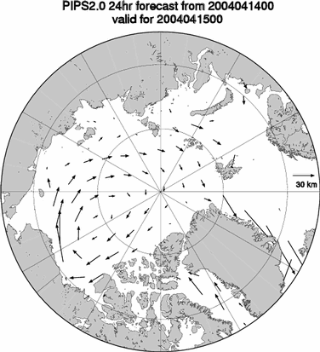
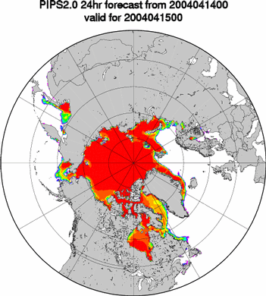
National Ice Services - Products
Ice forecast services
Some services provide Ice movement, concentration and thickness forecasts based on numerical modelling
Ice Thickness
Ice Displacement
Ice Concentration

Slide 10
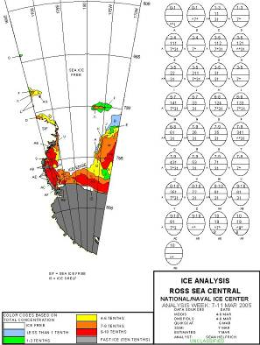
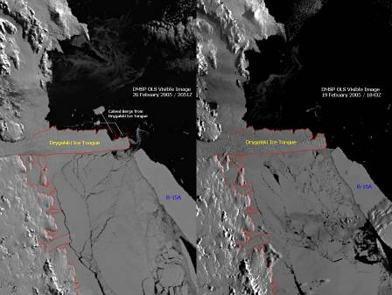
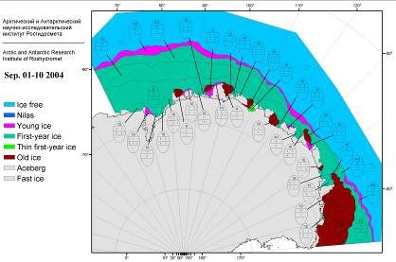
National Ice Services - Products
Antarctic sea ice products
Low resolution products
Hemispheric analysis: USA
Regional analysis: Russia
Sectoral analysis: Argentina, Australia

Slide 11
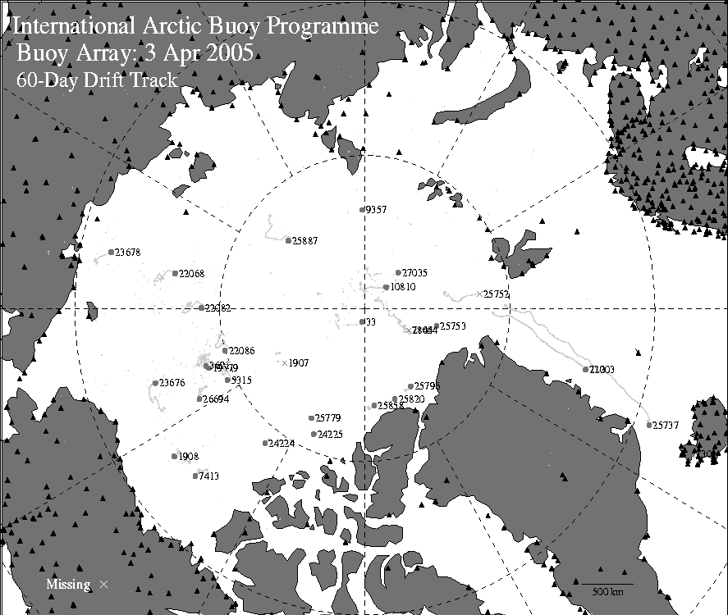
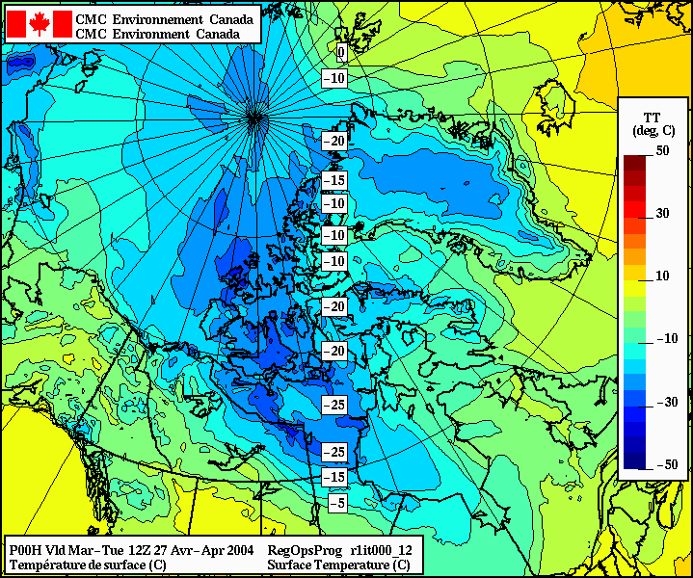
National Ice Services - Products
Supporting products
Atmospheric Pressure
Winds
Meteorological information
Ocean currents
In-situ observations
Ocean Currents

Slide 12
Sea ice services integration
Regional
  North American Ice Service (CIS-NIC)‏
  Baltic Ice Service (11 Baltic countries)‏
  European Ice Service (DMI-FMI-met.no-SMHI)‏
Global
  Polarview (GMES)
  MyOcean (GMES)
  Ice logistics portal (ETSI/IICWG/IPY)
    http://www.bsis-ice.de/IcePortal/
    http://www.ipy-ice-portal.org/
* GMES - Global Monitoring for Environment and Security (GMES) is a joint initiative of the European Commission (EC) and the European Space Agency (ESA)

Slide 13
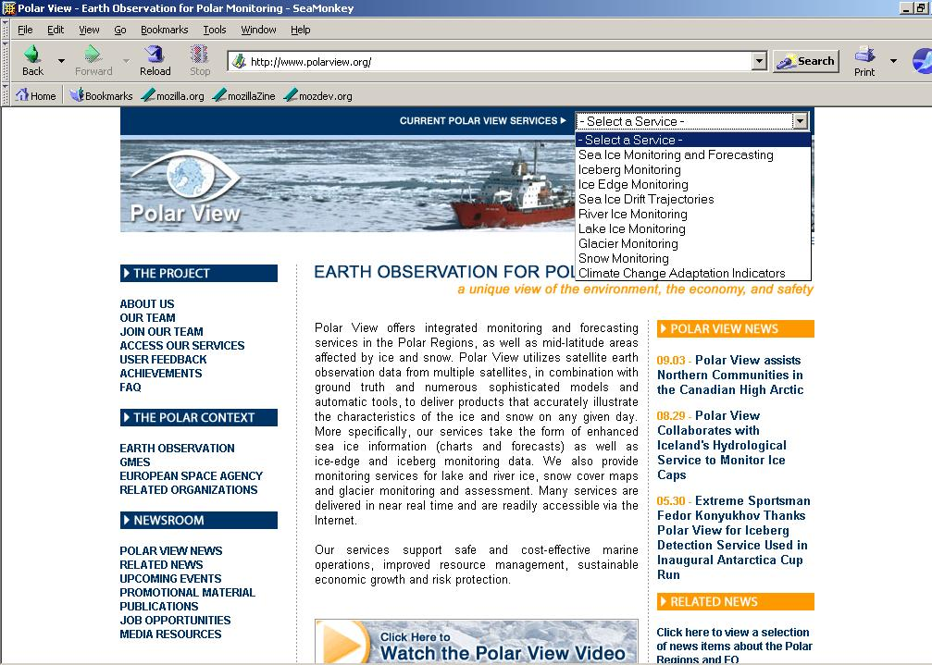

Slide 14
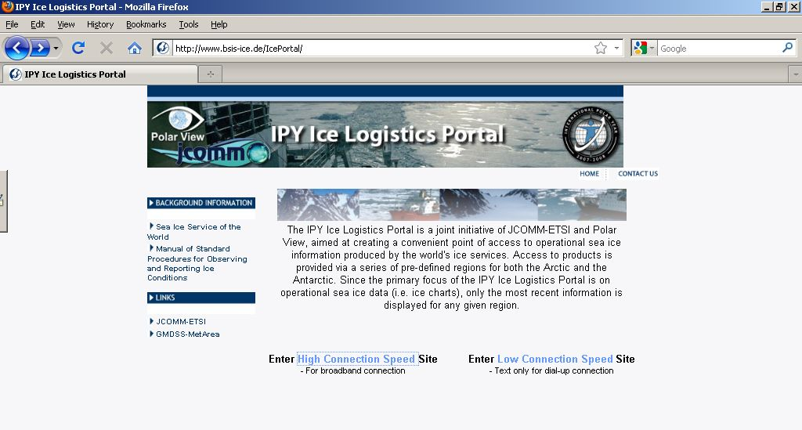

Slide 15
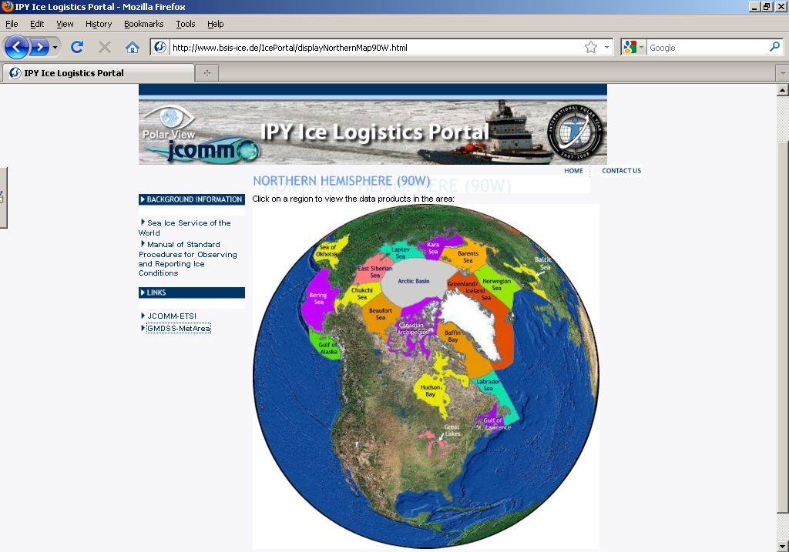
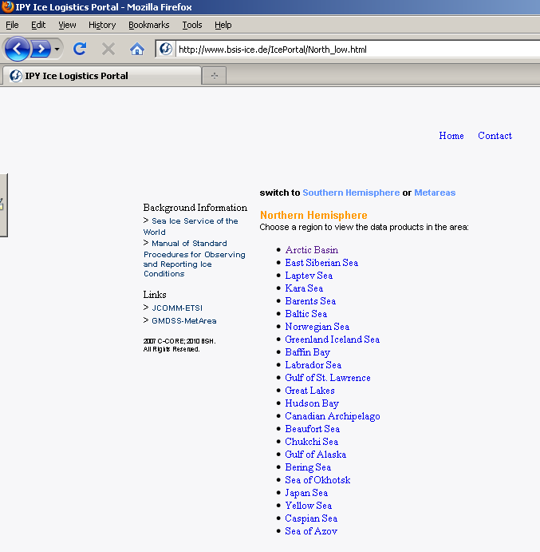

Slide 16
Complete information on ice services is maintained (by JCOMM ETSI) in the WMO publication No. 574 “Sea Ice Services in the World”, updated annually.

Slide 17
Ice services coordination
Formal
  JCOMM Expert Team on Sea Ice
Forum
  International Ice Charting Working Group
  Baltic Sea Ice Meeting

Slide 18
ETSI composition (2009-...)‏
8 core-members, including the chair, representing Northern and Southern ice services, presently: Argentina, Canada, China, Finland, Germany, Norway, Russian Federation (chair), United Kingdom
Representatives of regional and international sea ice bodies in particular the Baltic Sea Ice Meeting, European Ice Service, International Ice Charting Working Group and North American Ice Service
Additional experts as appropriate, representing the range of activities related to sea ice.
Notes:
I was asked to review the state of ocean data, products and services in the Arctic.
I hope to do that in this fashion.
The view through the porthole will give you a hint …

Slide 19
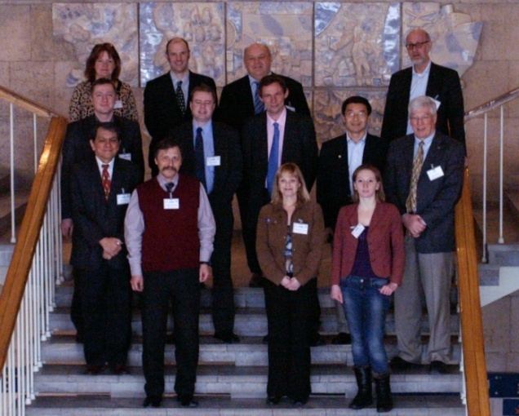
ETSI-IV & GDSIDB-XII – 1-5 March 2010
The ETSI-IV & GDSIDB-XII sessions took place in St.Petersburg, Russian Federation, in March 2010.
The final report is JCOMM Meeting Repot #74
Notes:
I was asked to review the state of ocean data, products and services in the Arctic.
I hope to do that in this fashion.
The view through the porthole will give you a hint …

Slide 20
JCOMM ETSI-IV outcomes in relative to GMDSS (definitions updates to documents, actions, projects)…

Slide 21
Sea ice information in GMDSS
It was agreed by the Expert Team that the “ice edge” is the primary warning information and is the only information that the ice services will consider mandatory to provide in the context of GMDSS. Beyond this level of information, each individual ice service can decide what to provide depending on its own unique circumstances.
The level of detail, i.e. the spatial resolution that must be provided on the ice edge, was discussed by the Team. It was noted that there is a restriction on GMDSS bandwidth and so the ET agreed to limit the delineation of the ice edge to a maximm of 10 points per sub-area.

Slide 22
Sea ice information in addition to GMDSS
Details of what may be available to users as part of additional (recommended) services to GMDSS if transmission is not restricted to HF fax should be included in WMO No.9 Volume D and comprise:
  routine ice charts with daily – weekly periodicity, providing regional recommendations (graphic HFax product);
  routine and customized ice charts with various complexity, scale and periodicity (hours - 7 days), providing tactical and regional recommendations (binary SIGRID-3/JPEG/S-57/etc product);
  high-resolution annotated satellite imagery, commonly providing tactical recommendations to the masters (1 hour – 1 day) (binary product);
  prognostic (hours - 7 days) ice charts for ice parameters critical for safety and success of navigation (binary product);
  supplementary synoptic and prognostic (hours - 7 days) meteorological charts or grids (binary or textual products);
  medium to long-term ice and meteorological phenomena forecasts with a lead-time of more than 7 days (commonly based on empirical models) (mostly textual products).

Slide 23
Arctic and sub-arctic METAREAS
Formal issues to be resolved during the transition period include implementation of several outcomes throughout the METAREAs XVII-XXI and relevant parts of METAREAs I and IV, including:
  Development of a consistent definition of ice edge throughout the issuing ice services (e.g. Canadian practice for the METNAV bulletins is 10% ice concentration as the ice edge with a disclaimer that there may be trace ice and bergs outside the ice edge, however, this is inconsistent with current Russian practice).
  Reconciliation of the ice edge as there must be continuity of the ice edge from one METAREA to the adjacent METAREA in addition to consistency of information in the agreed 300 nm overlap area; to that effect it is proposed to develop procedures for that information exchange between the METAREAs with one hour in advance before it is transmitted to users to allow for this coordination.

Slide 24
Arctic and sub-arctic METAREAS
Disclaimer as concern was expressed that the more detailed local ice information may be missed or ignored in favour of the METNAV bulletin; to that effect it is proposed that all the METNAV area bulletins take a common approach to providing a Disclaimer such as "For detailed local ice information go to….".
Cross-area coordination and consistency must be established among the coordinators as soon as possible.
  To this effect it proposed that Canada, Denmark, Norway and Russia collaborate in preparation and exchange of sample bulletins for a single day as a means of verifying the formats and coordination of information at the boundaries.
  The broadcast times for MSI in the Arctic METAREAs must be clarified and staggered so each Issuing Service can properly follow the previous.
  It recommended that the 3 Issuing Services meet together for joint training / back-up plan discussion at the UK Met office. UK Met Office has offered to provide some expertise based on their experience with METAREA I.

Slide 25
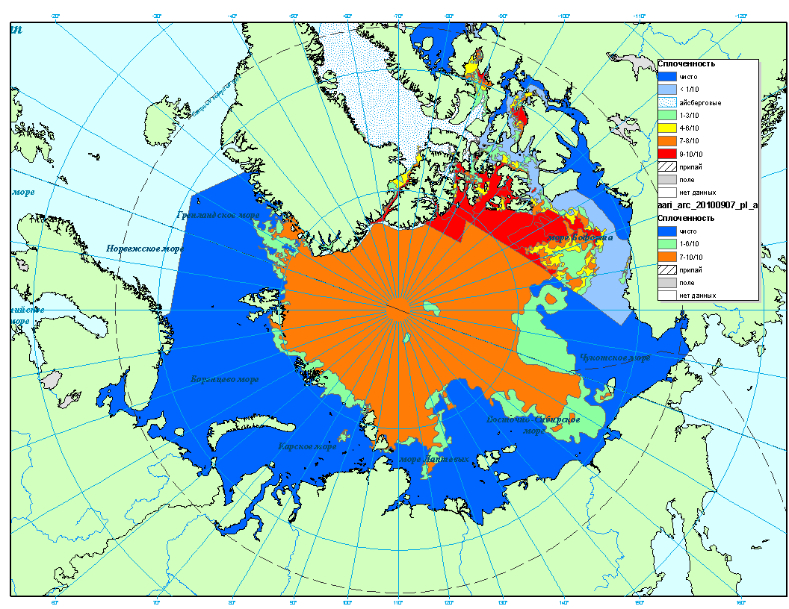
AARI (7.09.2010) and CIS (6.09.2010) ice charts for the Arctic Ocean

Slide 26
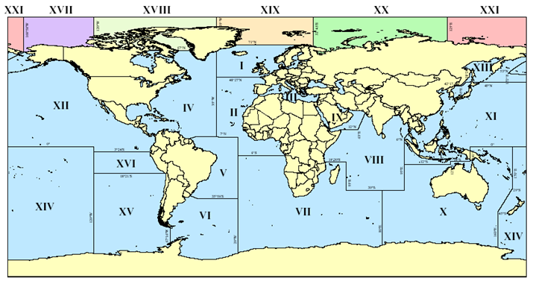
METAREAS with sea ice

Slide 27
(#32) Sea Ice Analysis Training
JCOMM SOFSPA projects for 2010-12
Expected Outcomes:
  COMET training modules, Workshop and Manuals
Key Activities:
  1st two COMET sea ice modules developed
  3rd Ice Analysts Workshop
  English version of Manual for Ice Experts – Ice Observers reviewed
Timeline/milestones:
  Sept 2010: COMET Module 1
  Dec 2011: COMET Module 2
  IAW Workshop June 2011
ETs, Other Organizations and participants:
  ETSI

Slide 28
(#22) Catalogue on Met-Ocean Object Class for ENC
JCOMM SOFSPA projects for 2010-12
Expected Outcomes:
  Met-Ocean object class for wind, wave height, surface current based on templates from the Ice Objects Catalogue
Key Activities:
  Coordinate with IHO to validate requirement
  Finalize the draft object catalogue
Timeline/milestones:
  Oct 2010: Meeting between WMO/IHO/WMO
  Jan 2012: Finalize the met-ocean object class
ETs, Other Organizations and participants:
  ETMSS, ETWS, ETSI, IHO, IMO

Slide 29
(#33) Ice Information in ENCs
JCOMM SOFSPA projects for 2010-12
Expected Outcomes:
  Standard for Exchange File; Ice Objects Catalogue 5.0, Presentation Schemes, Data Structure, File Naming Conventions, Demonstration Suite for JCOMM-IV
Key Activities:
  Harmonize the standards documents that have been developed in parallel by CIS and AARI/Transas
  Develop data and software package as a demonstration package for JCOMM-IV
Timeline/milestones:
  June 2011: harmonize standards
  June 2012: demonstration package
ETs, Other Organizations and participants:
  ETSI, experts from Transas

Slide 30
(#24) Update Sea Ice Standards
JCOMM SOFSPA projects for 2010-12
Expected Outcomes:
  WMO Sea Ice Nomenclature - Vol 1 – Terminology and Vol 2 Illustrated Glossary – Supplement 6 – Baltic Sea Ice Terms
  SIGRID-3, Prototype for New Formats for Sea Ice Data Assimilation
Key Activities:
  Update and Publish WMO Sea Ice Nomenclature
Timeline/milestones:
  Sept 2010: Publish SIGRID-3 update
  Mar 2011: Publish Sea Ice Nomenclature
  June 2012: New Format Prototype
ETs, Other Organizations and participants:
  ETSI, ETOOFS, SCG

Slide 31
(#25) Global Sea Ice Digital Data Bank (GDSIDB)
JCOMM SOFSPA projects for 2010-12
Expected Outcomes:
  GSIDB updated with historical Sea Ice charts and logs
  Updated normals for sea ice based on GDSIDB
Key Activities:
  Historical data submitted and quality controlled
  Advertisement of new data
Timeline/milestones:
  Updated once a year
  June 2012: Normals updated
ETs, Other Organizations and participants:
  ETSI, NSIDC

Slide 32
(#20) Supporting Issuing Services and AMOCs for GMDSS in the Arctic Ocean
JCOMM SOFSPA projects for 2010-12
Expected Outcomes:
  Experimental suite of Met-Ocean products for the Arctic (text)
  Experimental suite of Met-Ocean products for the Arctic (graphic)
Key Activities:
  Development of integrated sea ice-marine weather text products
  Development of integrated sea ice-marine weather graphic products
Timeline/milestones:
  January 2011: Text suite available
ETs, Other Organizations and participants:
  ETSI, ETMSS, ETOOFS

Slide 33
(#28) Coordinate the implementation of GMDSS in the Arctic Ocean
JCOMM SOFSPA projects for 2010-12
Expected Outcomes:
  GMDSS services implemented in the Arctic METAREAs in 2011
Key Activities:
  Revise WMO Manuals and Guides for Marine Meteorological Services in relevant parts
  Procedures for coordinated delivery of services in the Arctic METAREAs
Timeline/milestones:
  June 2010: Revise Manuals and Guides
  Oct 2011: Procedures established
  Jan 1, 2011: GMDSS services implemented in the Arctic Ocean
ETs, Other Organizations and participants:
  ETSI, ETMSS

