Slide 1

International Hydrographic Organization
The IHO Data Registry (S-100)
- how it can support e-Navigation and a Universal Maritime Data Model

Slide 2
S-57
Hydrographic data transfer standard
Uses:
Electronic Navigational Charts (ENCs)
Additional Military Layers (AML)
Marine Information Overlays (MIO)
Inland ENC
Port ENC
….. others

Slide 3
S-57 Limitations
No longer a contemporary GIS standard (30+ years old)
Inflexible maintenance regime (“freezing” of editions)
Difficult to accommodate emerging requirements
ASL’s, emergency wreck marking buoy, PSSA’s, …
Cannot easily support contemporary requirements
gridded bathymetry, imagery, time-varying information, mixed data sets, etc

Slide 4
Why S-100
broad, contemporary geospatial framework standard
Not specific to ECDIS or charting
Enables use of hydro data in other products and services
Based on ISO 19100 series of geographic standards
interoperable with other ISO data profiles
Standards are never “frozen”
“Plug and play” updating
Notes:
Product Specifications based on S-100 will be assigned a S-10x number.

Slide 5
What is S-100 ?
a framework standard – an implementation guide
describes components for
a registry for managing
- feature concept dictionaries, and
feature portrayal
product specifications

Slide 6
registry
a database that contains the essential elements required to establish and define product specifications
feature
the codification that describes a real-world entity
- geospatial data
product specification
the detailed specification for a standardised data input/output
content, arrangement, portrayal, carrier, etc …..
= the “plans” , the “recipe”, the “data template”
examples: ENC prod spec

Slide 7

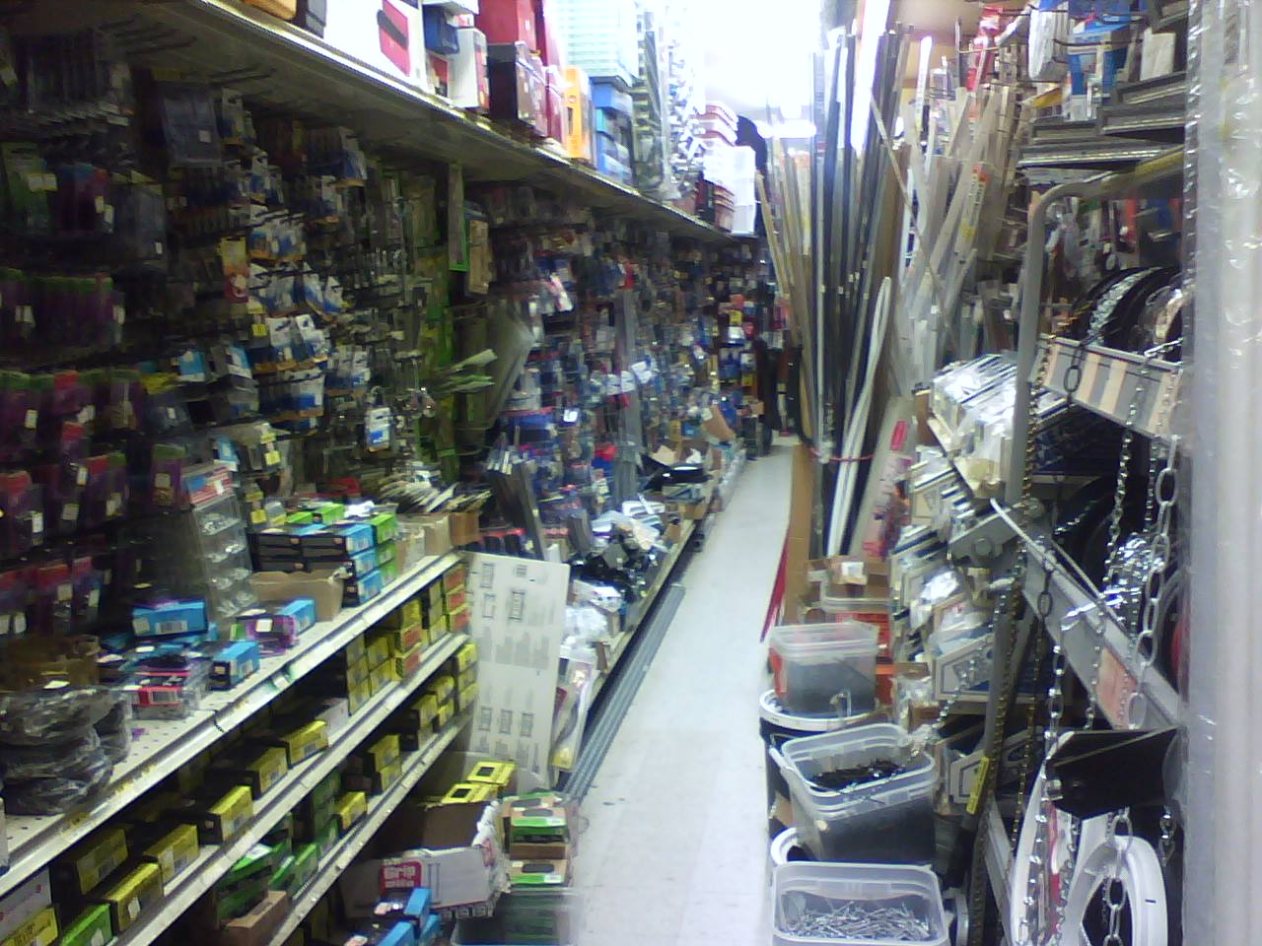

Organizational Guidelines and Principles
… to create a store
… to build things

Slide 8
S-100 and the Registry

Slide 9
ISO 19100 data framework
S-100 : based on ISO 19100 series
S-100 Geospatial Information (GI) Registry
19107
- spatial schema
19117
- portrayal
19139
- metadata - XML schema implementation
Supplementary FCD Register
Main FCD Register
Supplementary Portrayal Register
S-100 data framework
19109 - rules for application schema
Main Portrayal Register
Supplementary Metadata Register
19126
- feature concept dictionaries and registers
19135
- procedures for registration of geog information items
Main Metadata Register
Supplementary Product Specifications Register
Main Product Specifications Register
Supplementary Data Producer Code Register
19110
- methodology for feature cataloguing
19129
- imagery, gridded and coverage data framework
Main Data Producer Code Register
19111
- spatial referencing by coordinates
19131 - data product specifications
19113
- quality principles
19114
- quality evaluation procedures
19115
- metadata implementation specification

Slide 10
S-100 Geospatial Information (GI) Registry
Supplementary FCD Register
Supplementary Portrayal Register
Main Feature Concept Dictionary Register
Main Portrayal Register
Supplementary Metadata Register
Main Metadata Register
Supplementary Product Specifications Register
Supplementary Data Producer Code Register
Main Product Specifications Register
Main Data Producer Code Register

Slide 11
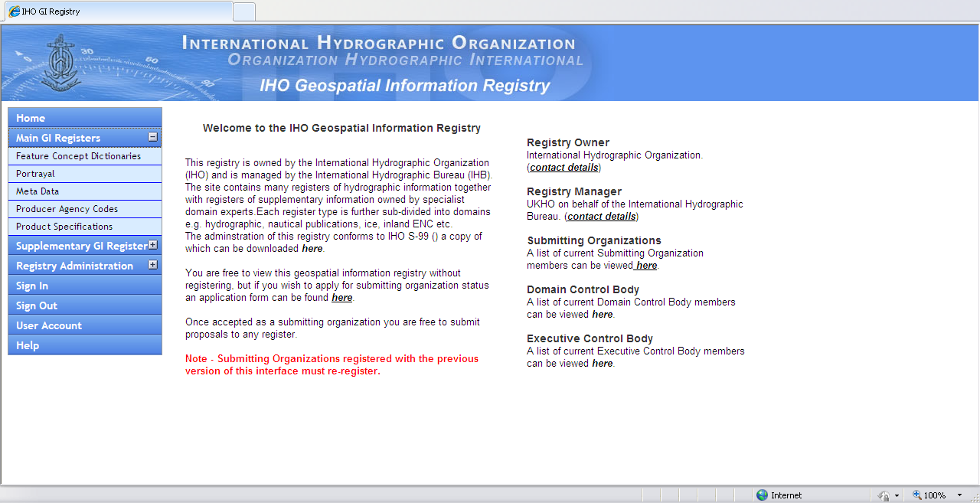
S-100 Registry
http://195.217.61.120/iho_registry/

Slide 12
register entries organised under “domains”
(so far: hydrography, sea ice, nautical publications, inland ENCs, …..)
registry open to extension and use by other “Submitting Organizations” and for new domains
Submitting Organizations propose then regulate their domain data - via the unified register control body
all features tagged with domain “owner”

Slide 13
Supplementary Register
Domain
nn
Domain
2
Main Register
Domain
1
Domain
xx
Domain
B
Domain
A

Slide 14
No end-date
register entries stay in register, even after supersession
“valid”
latest version (use for new prod specs)
“superseded”
previous version/s (referenced by existing prod specs)
“retired”
no longer recommended for use
∴ any feature, or any product spec, can be changed as and when required

Slide 15
Using the S-100 Registry
Is what you want already in the S-100 registry?
Then use it !
Not in the registry ?
Then, find or become a submitting organization and :
propose a revision
propose something new
propose to establish a new domain
Operating Rules in S-99 (active Jan 2011)

Slide 16
S-100 Registry
other ISO 191nn Registries
Feature
(FCD) elements
Feature
(FCD) elements
Portrayal elements
Portrayal elements
Prod Spec adopted “owned” and amended by relevant authority
New Product Specification (standard)
Metadata elements
Metadata elements

Slide 17
Product specifications will be the key regulated standards for IHO and IMO - not S-100

Slide 18
Timetable
1 January 2010 | S-100 in force
late 2010 | S-100 – Registry available for expansion
1 January 2011 | S-99 - Registry Operating Rules in force
Late 2012 | S-101 - ENC Product Specification released
2014 ??? | First S-101 ENCs released
2025 + | S-57 declared inactive

Slide 19
Summary
S-100 Registry is available for more than hydrography and charting
relevant bodies act as submitting organizations
according to their own “rules”
dynamic nature of registers means no need for a closed or restricted list of submitting organizations
Submitting Organizations stay in control !
S-100 does not define the e-Nav data architecture or data infrastructure
–

Slide 20
S-100 will support a variety of data sources, products and services
UNCLOS boundaries
Inland ENC
?
Sea ice
?
MIO
?
High density bathymetry
Web services
?
Gridded data
3D & temporal
?
Nautical Publications (S-102)
AML
Future ENC (S-101)
S-100

Slide 21


