Slide 1
NFL-SAR case Leeway of Capsized 21ft Center Consol Powerboat
Art Allen
Oceanographer CG-534

Slide 2
Initial Capsizing position to 1st Location position. LKP of Initial position 62-75 miles due West of Clearwater, 150 ft (25fm) of water 5:30pm L (01 19:30z FEB 2009)
Found: 02 1643z MAR 09
27 33.7N 083 28.4W

Slide 3
Drift Objects: SLDMB (0%) and Swamped Skiff (1.7% leeway) 3 Scenarios: 1) Area at time of sinking to 1st location, 2) LKP from 1st location to 2nd location 3) LKP from 2nd location to 3rd. NAM winds and HYCOM currents

Slide 4
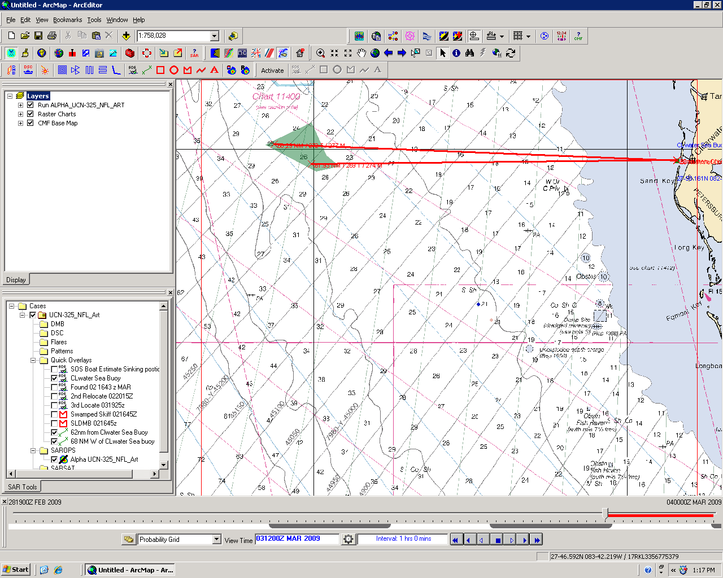
Notes:
LOB 62 to 68 nm West of Sea Clearwater Sea Buoy that end in 25 fathoms (150 ft) of water.

Slide 5
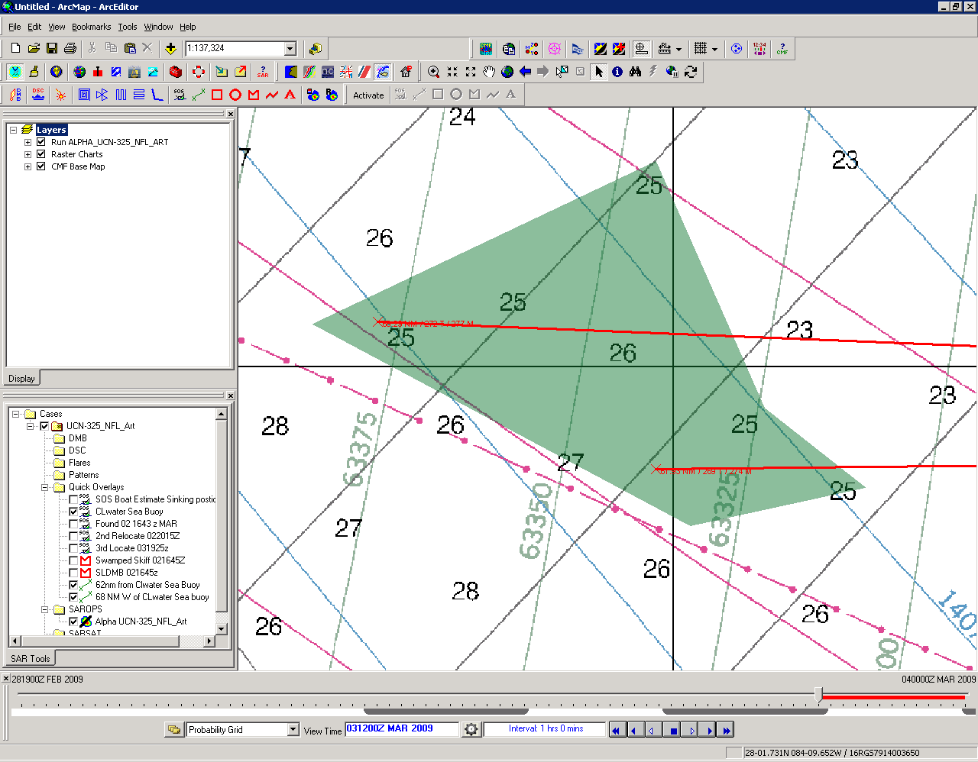
Notes:
LOB 62 to 68 nm West of Sea Clearwater Sea Buoy that end in 25 fathoms (150 ft) of water.
Close up of Capsized area scenario

Slide 6
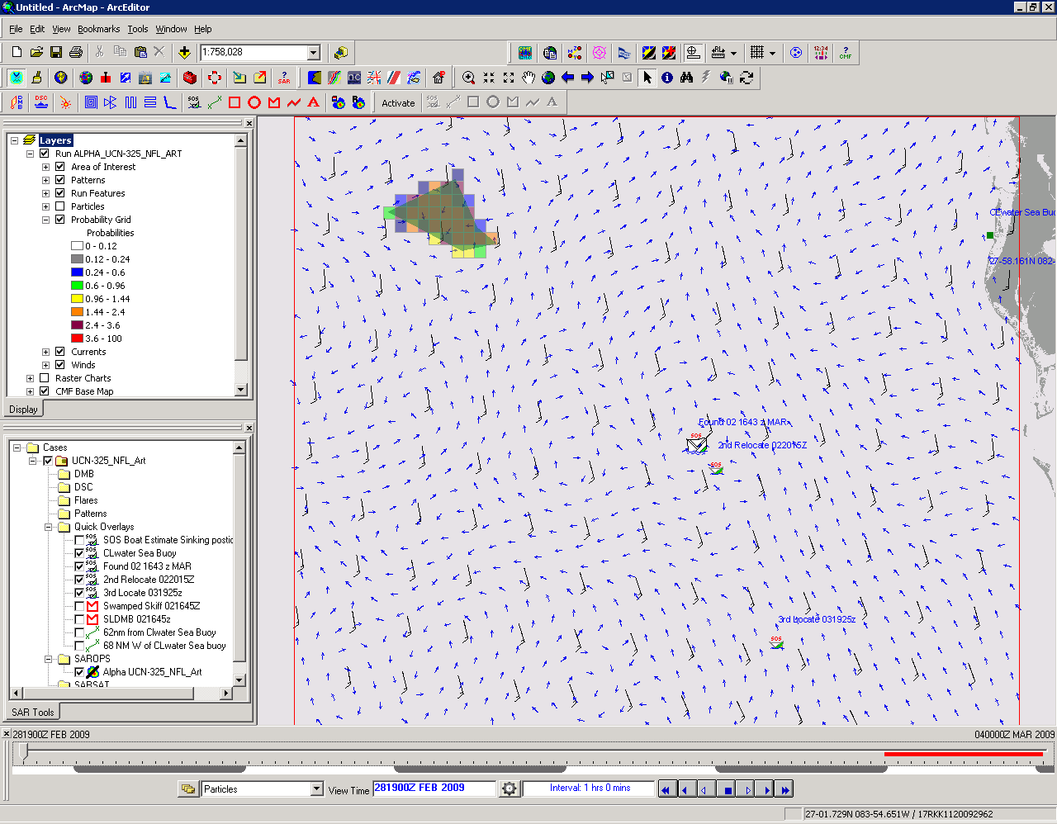
Notes:
NAM winds 14kts from south, weak HYCOM currents
Prob Grid both SLDMB and swamped Skiff

Slide 7
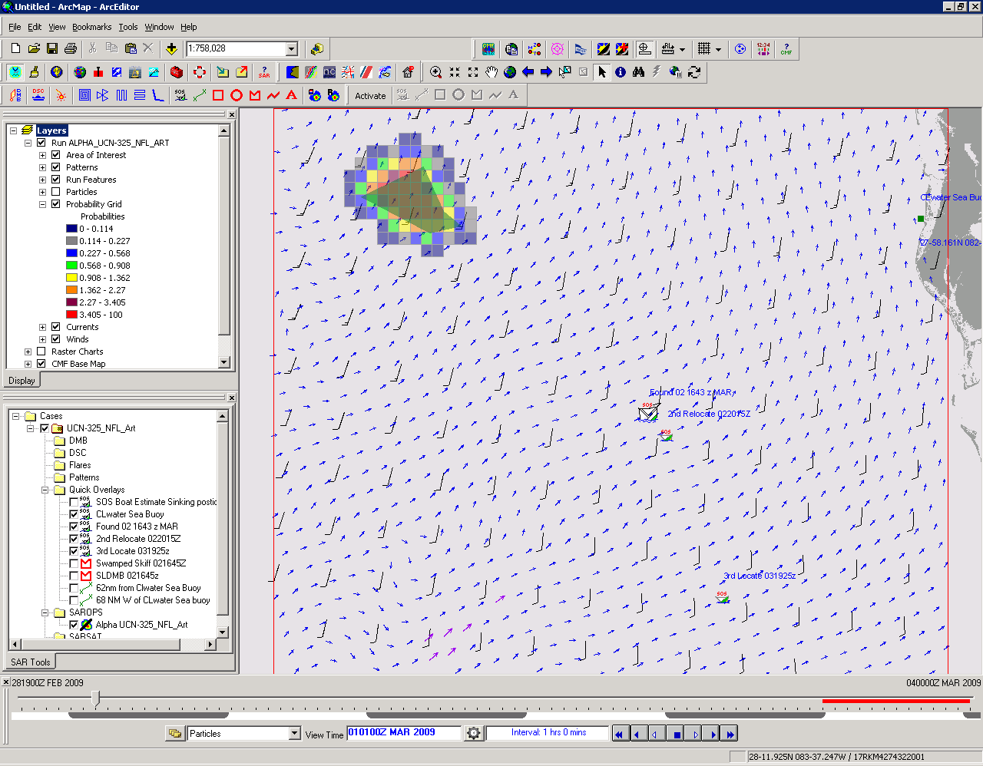
Notes:
NAM Winds 11 knots from S, 0.3kts HYCOM currents to NE

Slide 8
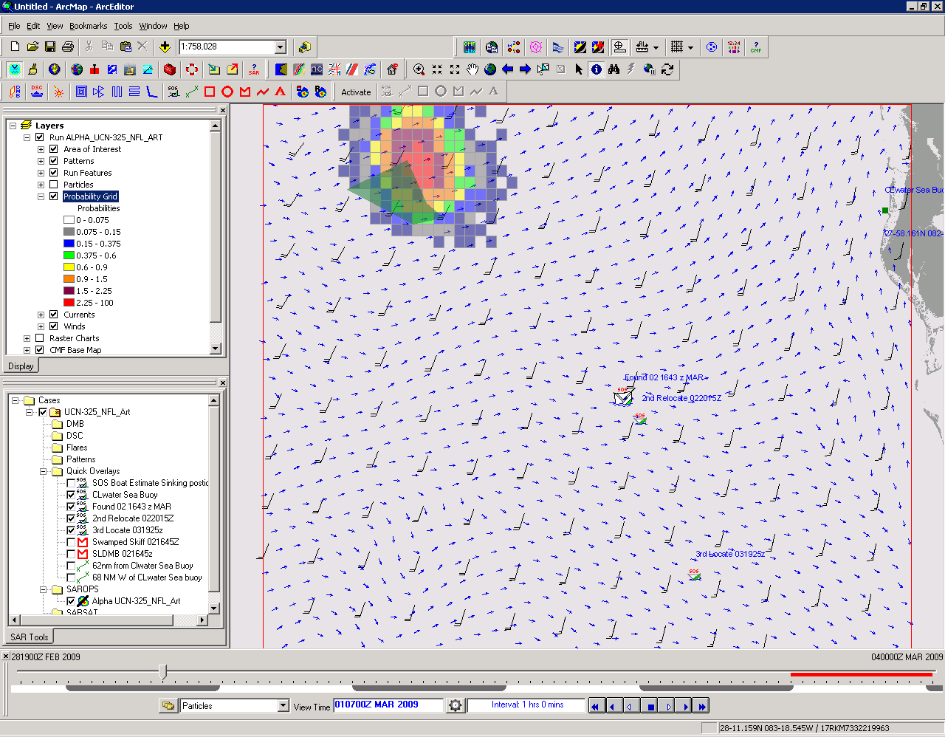
Notes:
NAM winds 16.4 knts, HYCOM current 0.5 kts

Slide 9
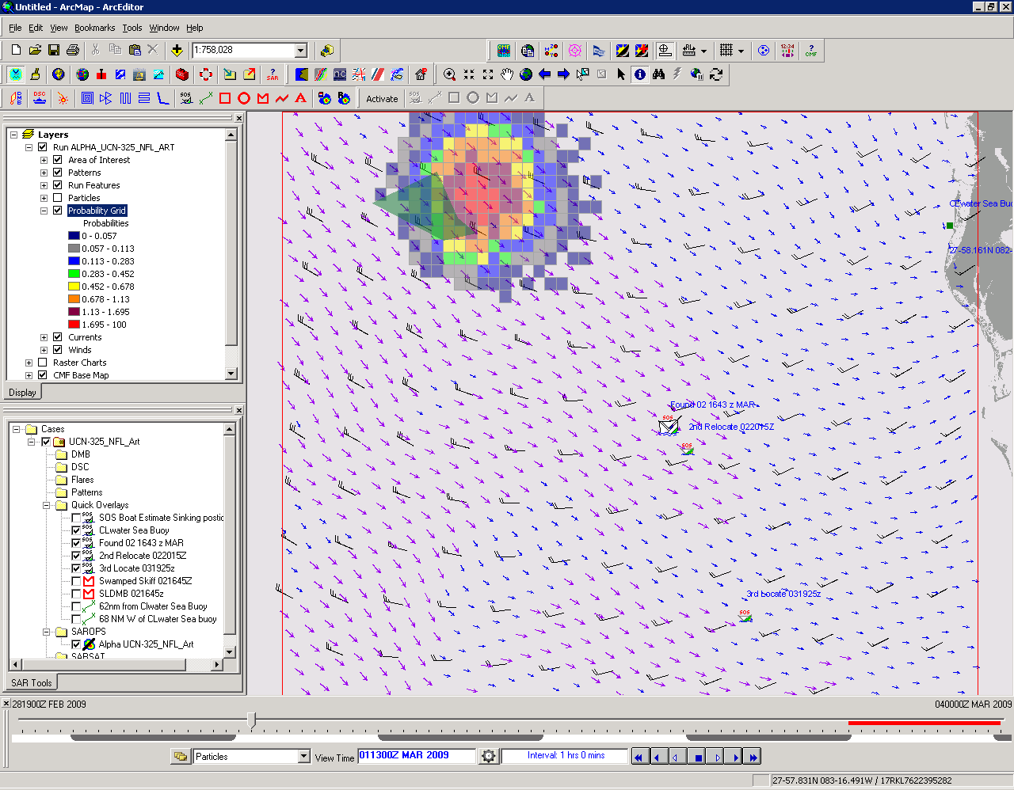
Notes:
NAM winds 26.6 knots, 1.2 knots HYCOM currents

Slide 10
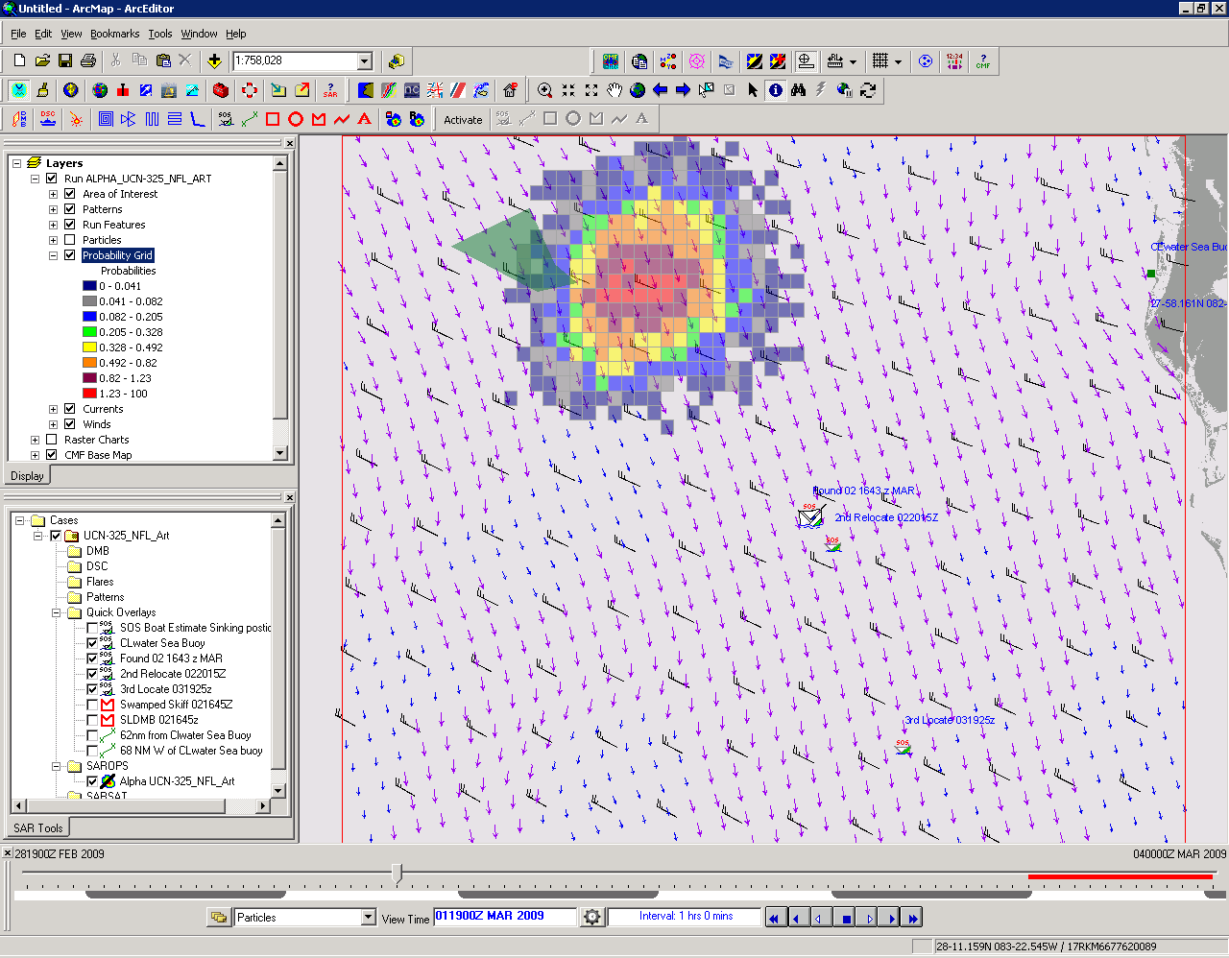
Notes:
22.5 kts NAM 1.1 kts HYCOM

Slide 11
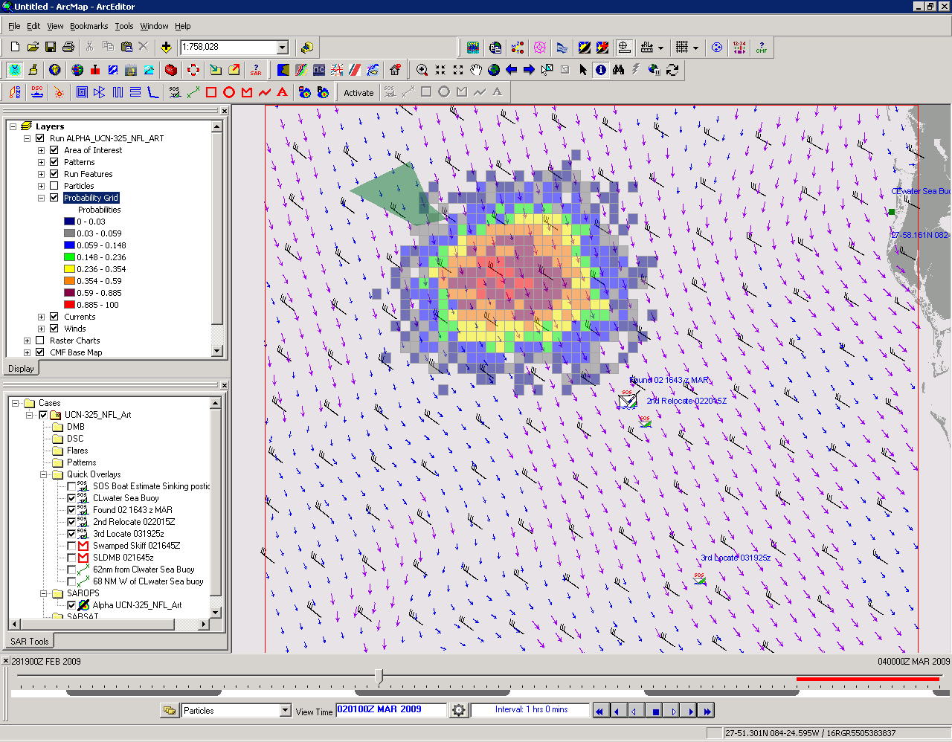
Notes:
26.0 NAM , 1.0 Kts HYCOM

Slide 12
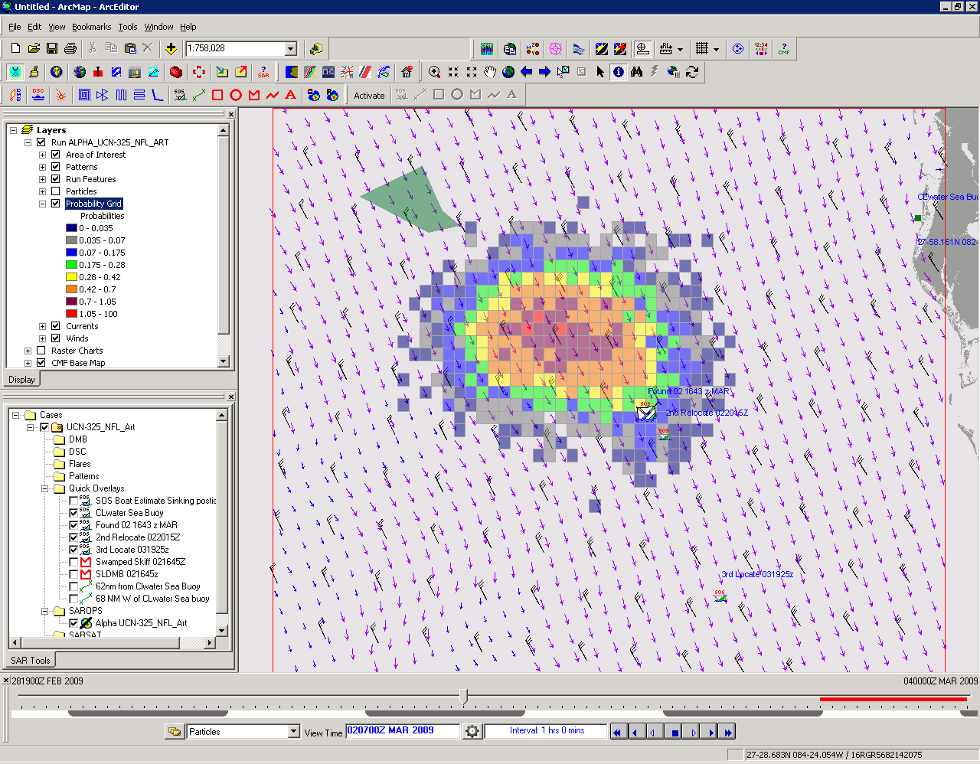
Notes:
25.1 Knots, 1.2 HYCOM

Slide 13
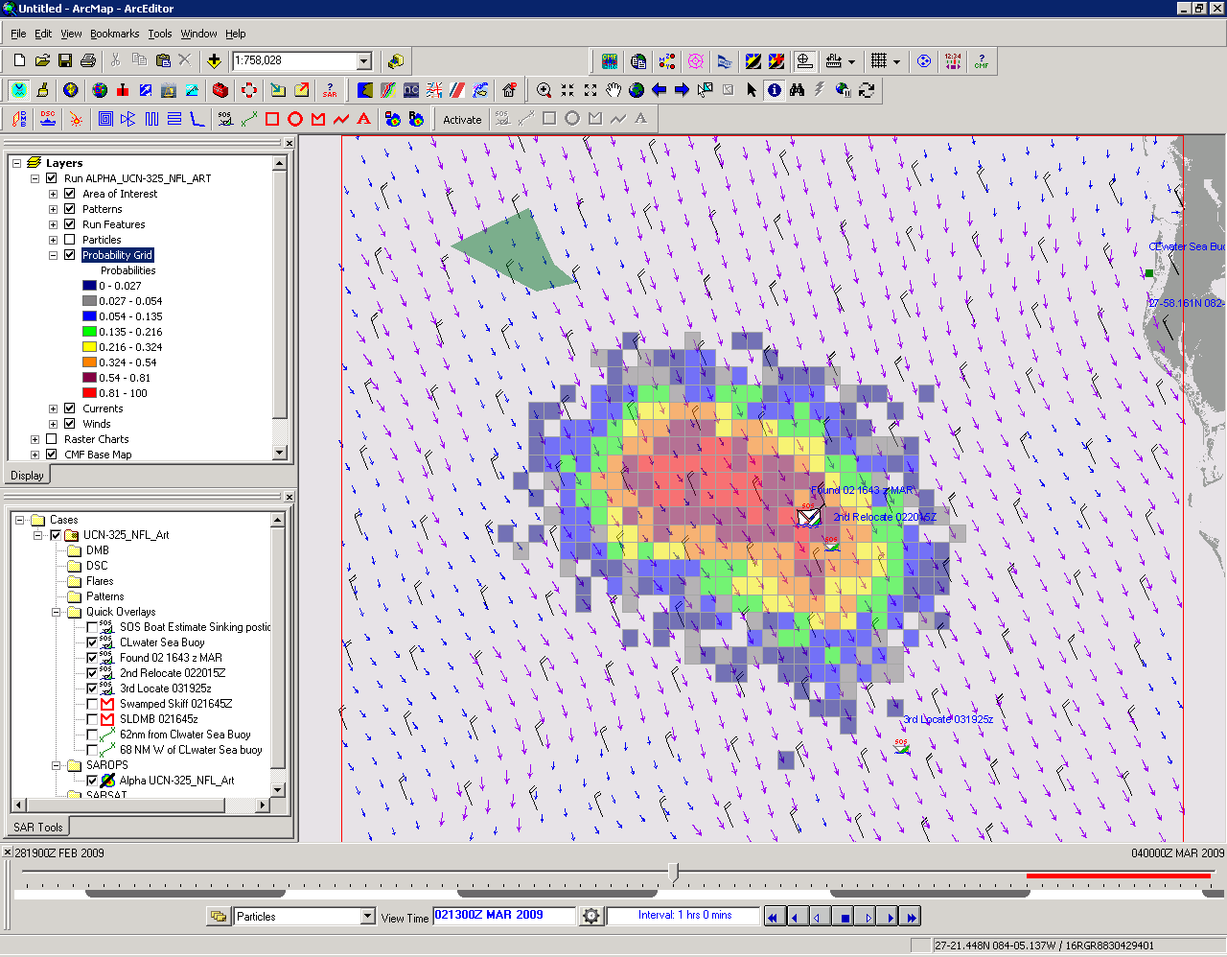
Notes:
17.5 kts, 1.3 kts HYCOM

Slide 14
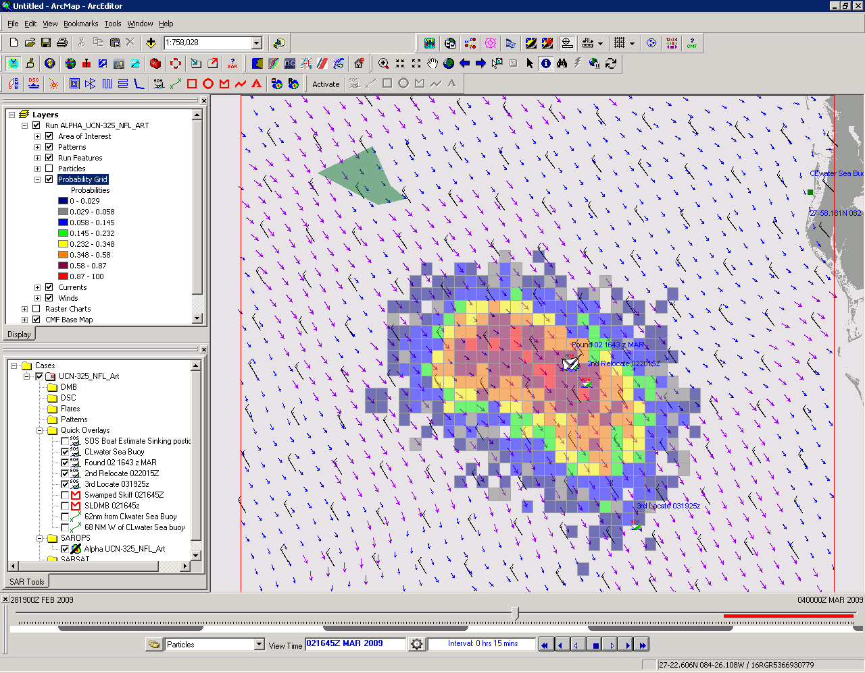
Notes:
FOUND at 02 1645z 14.0 kts, 1.2 kts

Slide 15
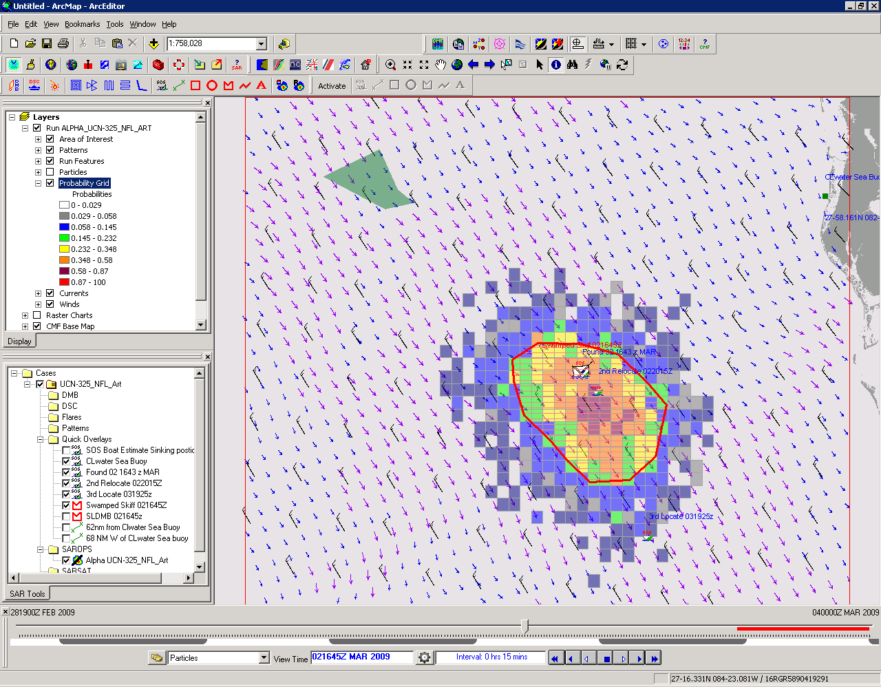
Notes:
Swamped Skiff Prob Grid only, 1.3 knots

Slide 16
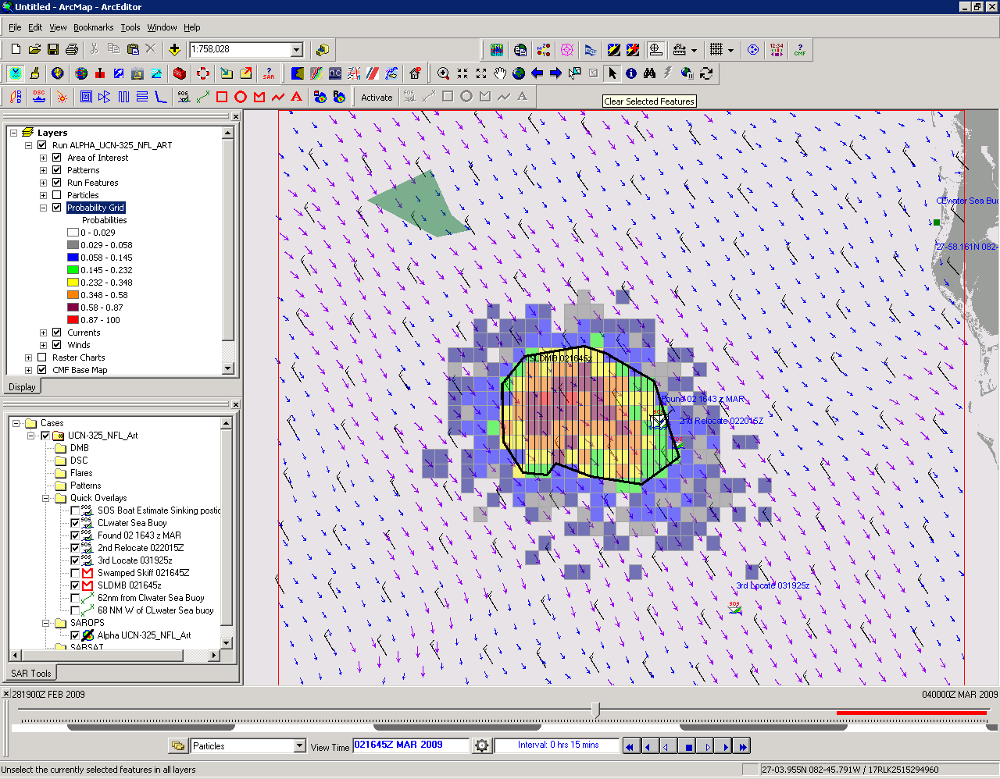

Slide 17
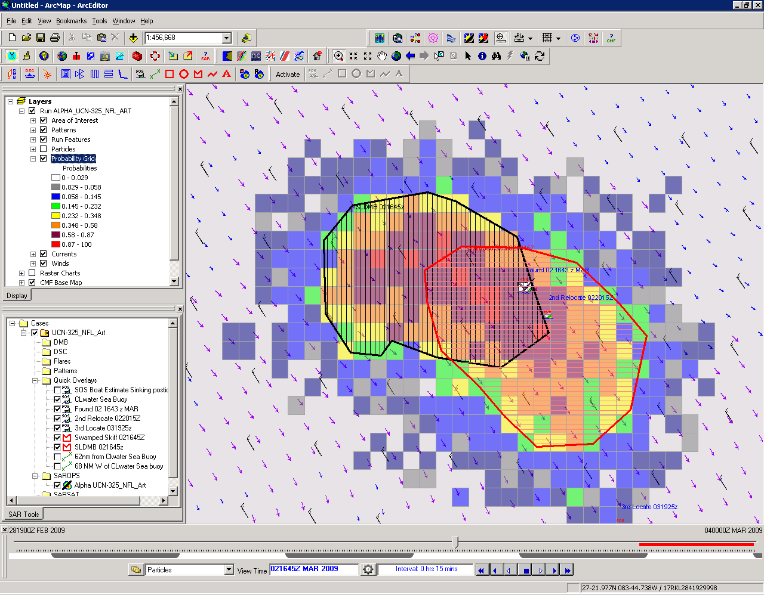
FOUND
Capsized 21’ CC
SLDMB
0% Leeway
Swamped Skiff
1.7% Leeway
Notes:
Capsized 21ft Center Consol Powerboat has a leeway between 0.0 and 1.7% of wind, let’s try to narrow that down.

Slide 18
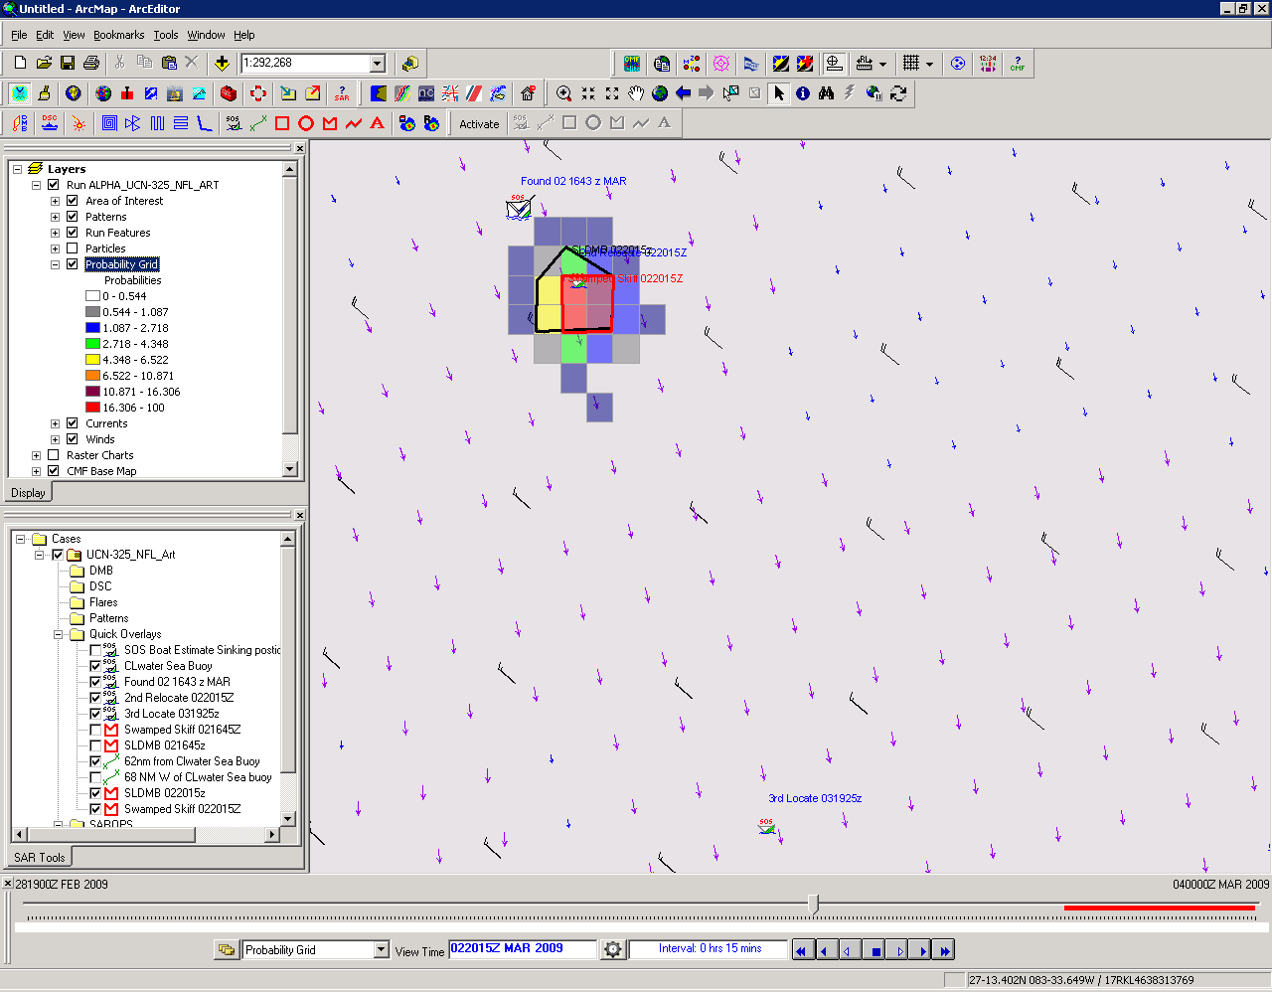
Notes:
Probability Grid both SLDMB and Swamped Skiff, outline Black for SLDMB and red for Swamped skiff. Too short to separate

Slide 19
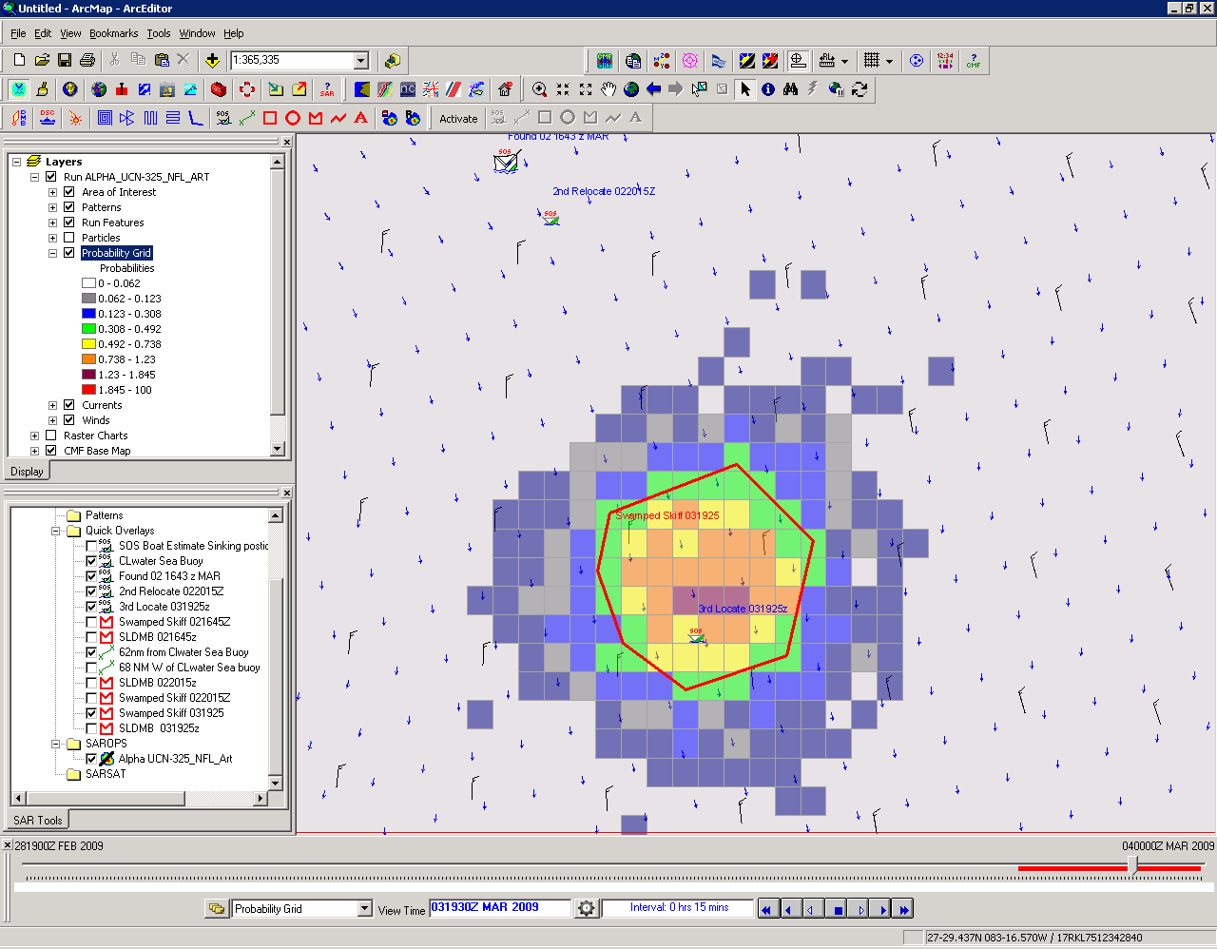
Notes:
Swamped Skiff Prob grid from 2nd relocate to final relocation.

Slide 20
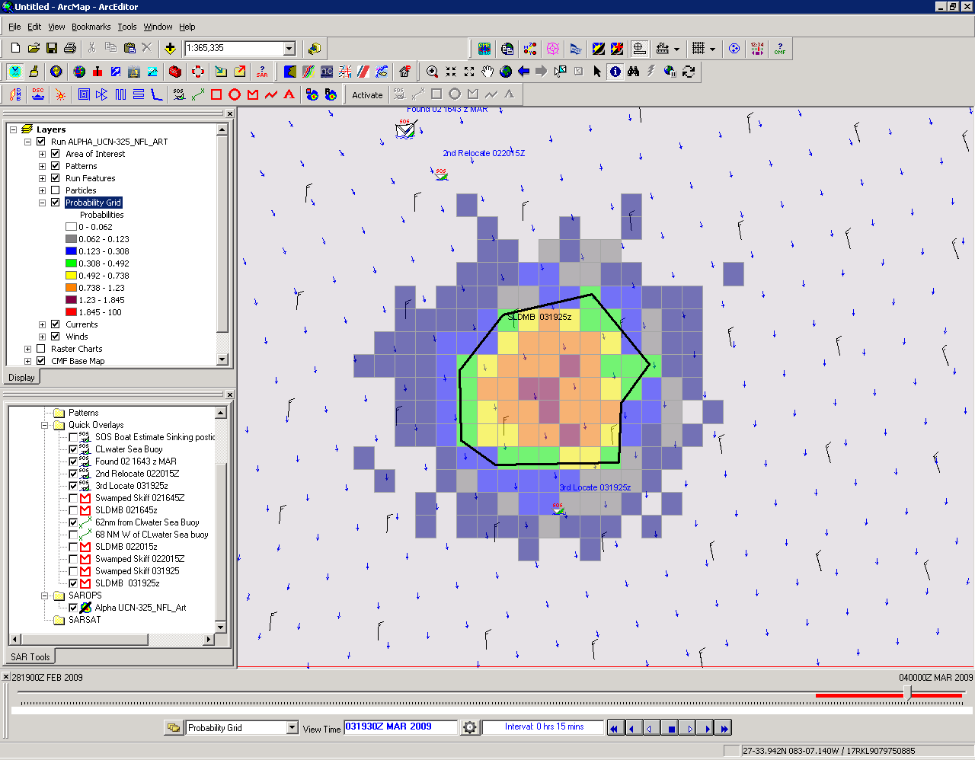
Notes:
SLDMB prob grid at final relocation from 2nd location

Slide 21
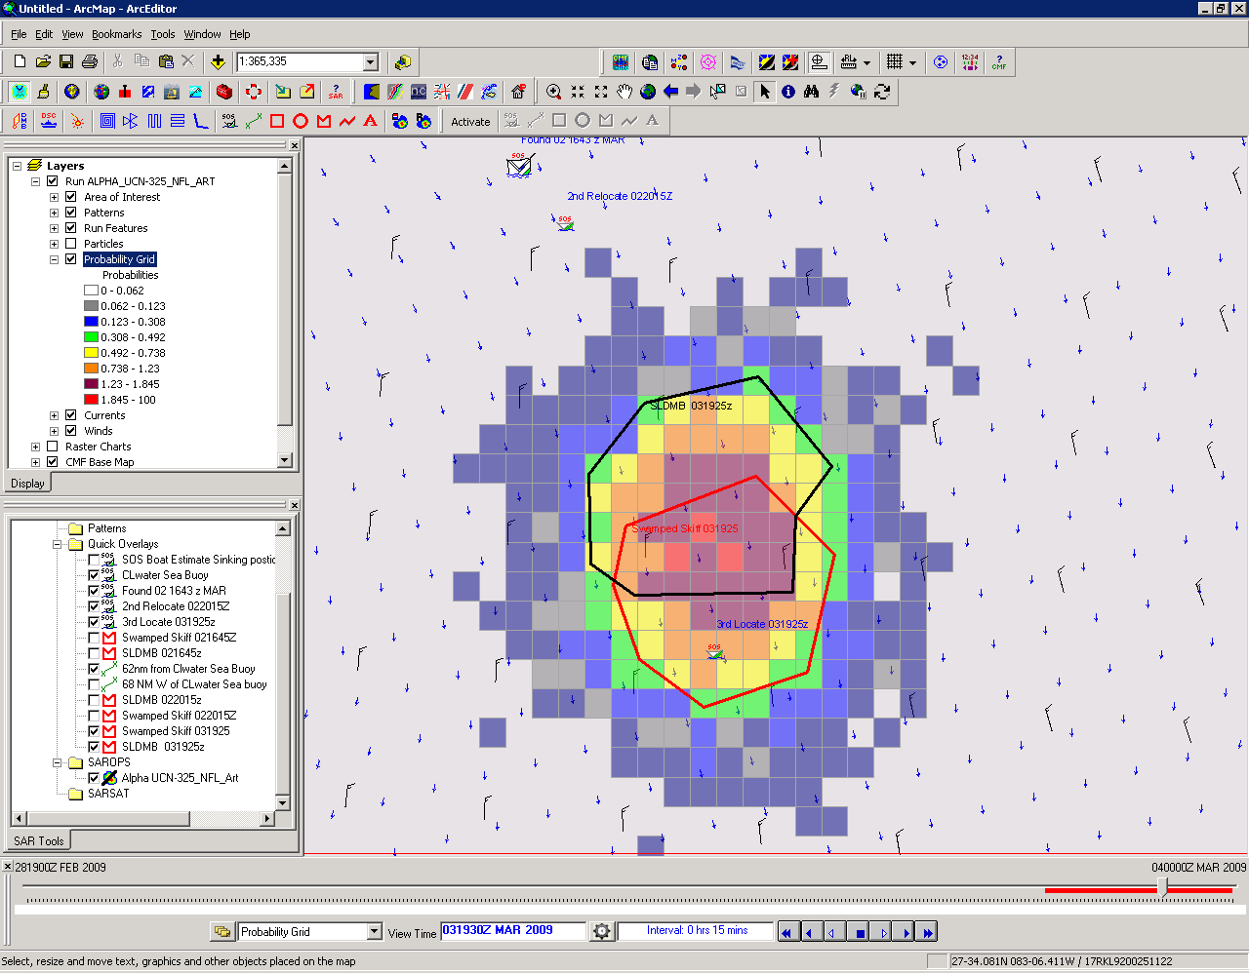
1st & 2nd relocation
Capsized 21’ CC
SLDMB
0% Leeway
Swamped Skiff
1.7% Leeway
Notes:
Both SLDMB and swamped skiff Probability grid,
Uncertainty initial capsizing position means we can’t narrow first estimate. Second run was too short.

Slide 22
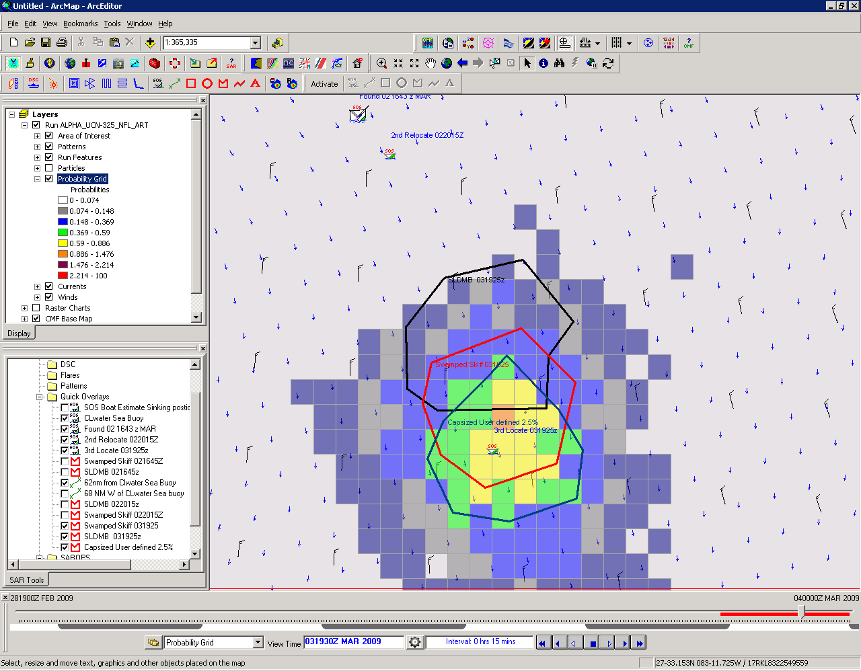
1st & 2nd relocation
Capsized 21’ CC
SLDMB
0% Leeway
Swamped Skiff
1.7% Leeway
User Defined
2.5% Leeway
Notes:
So 2.5 % does okay in this trail run, lets go back to initial run and test.

Slide 23
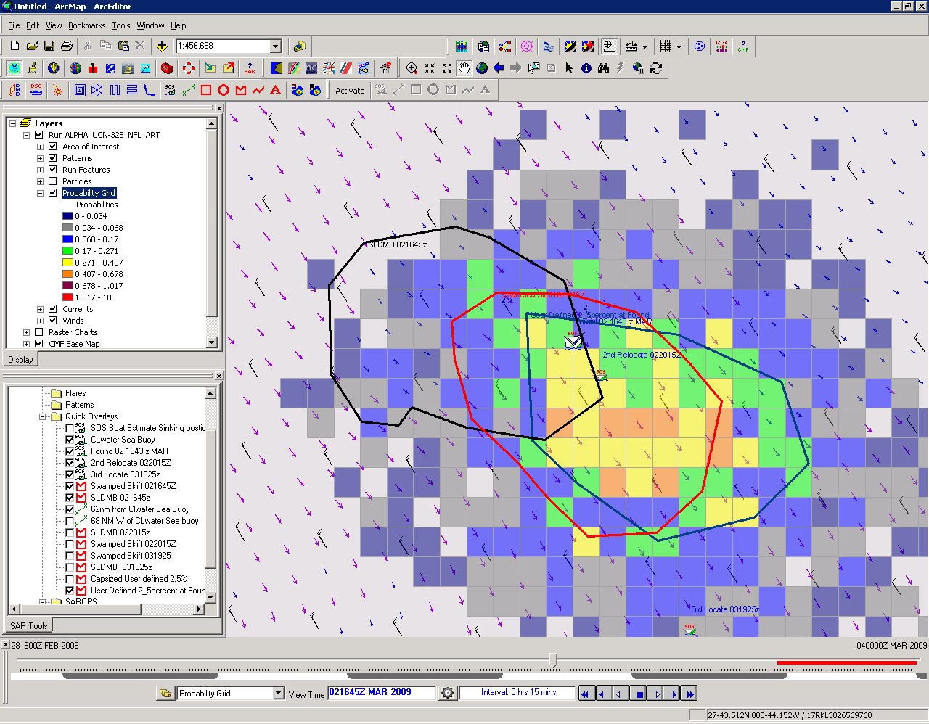
1st & 2nd relocation
Capsized 21’ CC
SLDMB
0% Leeway
Swamped Skiff
1.7% Leeway
User Defined
2.5% Leeway
Notes:
Well, capsized CC was found inside all three, so we are stuck with leeway between 0 and 2.5 % or at this point the swamped skiff at 1.7% does pretty good.

