Slide 1

Expert Team on Sea Ice
Vasily Smolyanitsky
ETSI chair
Arctic and Antarctic Research Institute (AARI)
St.Petersburg, Russia

Slide 2
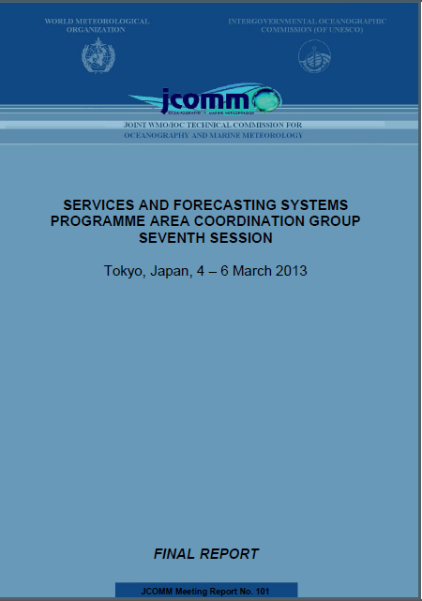
ETSI meetings and events (Oct 2012 – Oct 2013)
  GCW Implementation Meeting 2st session. 20 – 22 Nov 2012, Vienne, Austria
Report to GCW on ETSI, nat ice services , ice charting role in GCW and archival, publication and exchange standards
  (2) JCOMM ETMSS-4 session, 27 February – 2 March 2013,
  JMA, Tokyo, Japan
Report to TSMAD-24 on IceObjCat, ETSI role and progress in Ice in ECDIS
WP for ice in S-1xx
  (3) JCOMM SCG-7 session, 4-6 March, 2013, JMA, Tokyo, Japan
Report to SCG on ETSI activities, discussion and adoption of ETSI WP for 2013-2017
  (4) JCOMM/IICWG IAW-4, June
  (5) JCOMM ETSI-5, May or November

Slide 3
ETSI ToR and membership (JCOMM-4 resolution 12.4/4)
Up to eight Members, including the chairperson, representative of a range of activities related to sea ice and the ice-covered regions within JCOMM, and to maintain an appropriate geographical representation. It is expected that, in general, the ETSI will be self-funding. ETSI representatives will also act as full members of ETMSS and ETMC.
Representatives of regional and international sea ice bodies in particular the Baltic Sea Ice Meeting, European Ice Service, International Ice Charting Working Group and North American Ice Service will also be invited to participate at their own expense.
Additional experts may be invited as appropriate, representative of the range of activities related to sea ice, on a self-funded basis, and in general with no resource implications to JCOMM.
Beatriz LORENZO (Argentina)
Darlene LANGLOIS (Canada)
Keld QVISTGAARD (Denmark)
Jurgen HOLFORT (Germany, vice-chair)
Keiji HAMADA (Japan)
Nicholas HUGHES (Norway)
Vasily Smolyanitsky (Russia, chair)
Caryn PANOWICZ (USA)
Gonzalo CONCHA (Chile)
Sihai LI (China)
Antti KANGAS (Finland)

Slide 4
ETSI WP projects for 2013-2017
Project #26 Support and enhance the polar components of GMDSS
Project #27: Support and enhance ENC/Electronic Chart Display Information System (ECDIS) for ice navigation
Project #28: Maintain and update sea ice technical documentation
Project #29 Support for Sea ice climatology and ice in information systems
Project #13: Training and capacity development for sea ice
Project #31: Enhance the integrated ice services and forecasting

Slide 5
Sea ice / <ETSI && IICWG> activities concept schema
GMDSS polar components
GFCS
CryoNet
WIS
SaftyNet NAVTEX text
RFx transmission
Ice charting
Ice obs
Docs
Integrated
Ice Services
Charting, Obs
SAR/Vis/IR imagery
Ice forecasts
MetOcean
Docs
Training
ENC/ECDIS

Slide 6
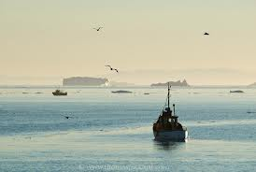
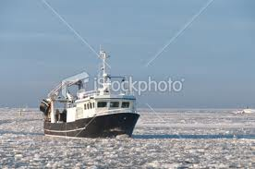
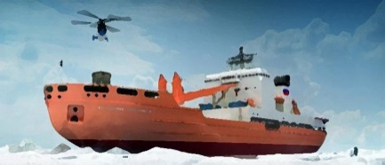
#26 Support and enhance the polar components of GMDSS (1)
Project leaders:
  Vasily Smolyanitsky
Description:
  Polar components of the GMDSS as well as provision of services for areas with occurrence of floating ice differ in many aspects from mid-latitude or ice free areas of the World Ocean.
  Navigation near but outside of the ice and ice navigation needs proper support both for safety and efficiency in terms of regular provision of integrated sea ice information, preferably in graphic form. If restricted to current Inmarsat transmissions, the Issuing Services still have limitations in coverage and ability to provide binary information in high latitudes.
  Starting with June 2011 the new 5 Arctic METAREAs are put into a Full Operational Capacity with new procedures to support sea ice information in SafetyNET and NAVTEX bulletins and a special ice GMDSS server gmdss.aari.ru to support exchange of information between the Preparation Services.
  The objective of the project will be for ETSI to continue with IICWG, ETMSS, IMO and IHO to support and enhance the polar components of GMDSS and ice navigation services, Southern Ocean and information on complex sea states, and under the agreed scheme for IMO e-Navigation including the Polar Code.
or?
or?

Slide 7
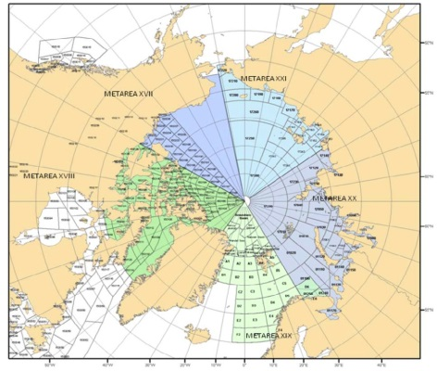
#26 Support and enhance the Polar components of GMDSS (2)
Key outcomes:
  sustained and enhanced bi-polar components of GMDSS
  input to IMO on ice and weather safety related input for Polar Code
Key activities:
  support for operational exchange of information for polar GMDSS
  training and harmonization of practices across the Preparation Services, exchange and transition of experience to Southern hemisphere METAREAs, regular “Ice Analysts Workshops”, possibly jointly with GMDSS meteorologists
  supervision, enhancement and testing of SafetyNET and NAVTEX standards
  support to developing international code of safety for ships operating in polar waters (Polar Code) by providing input on weather and ice safety related to Polar Code to IMO.
Timeline / Milestones:
  4th “Ice Analysts Workshop” (Jun/Jul 2013 ?) including session on Southern hemisphere
  Reports to IICWG-14 (Oct’2013, Iceland), ETSI-V (Nov’2013, Canada) and IICWG (Chile, 2014)
ETs, Other Organizations and participants:
  ETSI, ETMSS, IICWG, …..
Implementation of JCOMM-4 decisions
    8.3.4 & 8.3.10 (Safety-related Marine Meteorological Services)

Slide 8
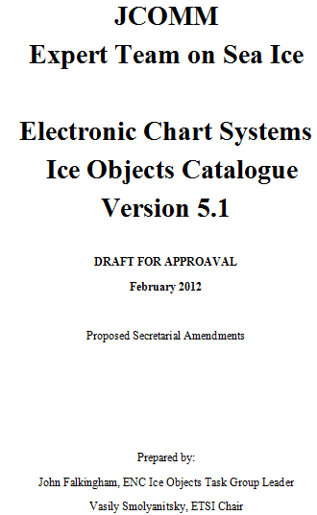
#27 Support and enhance ENC/ECDIS for ice navigation (1)
Project leaders:
  Juergen Holfort, Vasily Smolyanitsky, ETSI TG ENCIO
Description:
  Sea ice information is mandatory for presentation on ENC though the scope of sea ice parameters and presentation mechanisms differ across the implementations of sea ice presentation in various Electronic Chart Display Information System (ECDIS).
  In 2006 the ETSI entered into partnership with the IHO Transfer Standard Maintenance and Applications Development Working Group (TSMAD) and in 2007 adopted the first version 4.0 of the “Ice Objects Catalogue”, based on the harmonized existing national practices and intended to extend the IHO S-57 standard for sea ice.
  In 2007-2011 the Catalogue was tested and implemented in Canadian and Russian manufactured ECDIS along with corresponding presentation library. Results of the activity were regularly reported to TSMAD and presented during JCOMM-IV.
  Arising requirements from the end-users dictate further amendments to the Catalogue along with its implementation as a new IHO adopted S-100 standard
  Objective of the project will be to support and enhance ENC/ECDIS capabilities for ice information following extending requirements from the end-users for complex ice navigation services and taking into account the IMO and IHO work in developing the concept of e-Navigation in cooperation with the IICWG and national ice services.

Slide 9
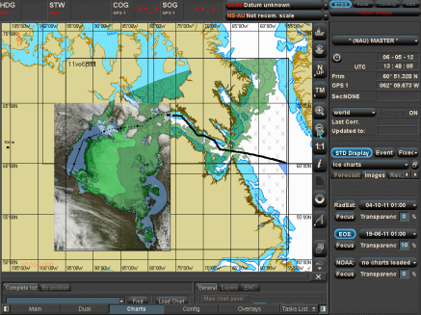
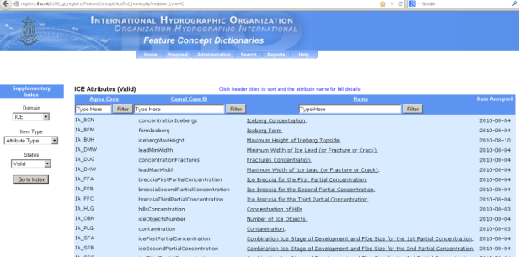
#27 Support and enhance ENC/ECDIS for ice navigation (2)
Key outcomes:
  IHO S-1xx standard for sea ice object catalogue
  Capability at National Ice Services for S-1xx data files
Key activities:
  Formal management of Ice Objects Catalogue
  Develop standard at IHO as S-10x
  Interact with ENCS manufacturers and OGC to develop software to accept ice data
  Support Nat’l ice services to develop capability/begin production of S-57/S-1xx data files
  Support implementation of MetOcean Catalogue
Timeline / Milestones:
  Preparation of a draft S-107 (or other number 10x) and presentation to IICWG (Oct’2012)
  Preparation of a portrayal registry for the most commonly used parameters of the ice objects catalog
  Formalization of ideas and proposals reached at the IICWG (ETSI-V, current TSMAD session)
ETs, Other Organizations and participants:
  ETSI, BSH, IICWG, TSMAD
Implementation of JCOMM-4 decisions
  8.3.4 & 8.3.10 (Safety-related Marine Meteorological Services)

Slide 10
#28 Maintain and update sea ice technical documentation (1)
Project leaders:
  Vasily Smolyanitsky, Darlene Langlois, IICWG
Project description:
  The WMO sea ice technical documentation is regulating the descriptive (nomenclature and glossaries), coding, exchange and presentation procedures for sea ice cover as well as existing sea ice best practices for observations and services on regional and world-wide scale.
  In a broader sense, it would be favorable for operational and research community if the same or under the same umbrella documentation is developed for all kinds of floating ice – sea, lake and river ice.
  Following requirements from the end-users and in the framework of implementation of CryoNet as well as in connection with anticipated requested from the International Polar Initiative (IPI), ETSI will maintain, update and extend as appropriate WMO sea ice standards in interaction and cooperation with the International Ice Charting Working Group (IICWG).
Expected outcomes:
  Updates to WMO ice charting following ECDIS standards
  Updates to WMO ice standards in parts of river and lake ice
  Documentation on ice observations and best practices
  Regular update for user and input information requirements

Slide 11
#28 Maintain and update sea ice technical documentation (2)
Key activities:
  “Sea Ice Nomenclature” (WMO-No.259); vol. I-III
  “SIGRID-3: a vector archive format for sea ice charts” (WMO/TD-No. 1214) and “Ice Chart colour code standard” (WMO/TD-No. 1215);
  “Sea-Ice Information Services in the World” (WMO-No.574) as extension for Polar Regions of WMO-No. 9, Volume D;
  “Ice Objects Catalogue” as a joint WMO/IHO standard for ice in the Electronic Chart Display Information System (ECDIS);
  “Understanding and Identifying Old Ice in Summer” and “Manual for Ice Experts – Ice Observers” as the new WMO sea ice publications.
Timeline / Milestones:
  Finalize and adopt additions to WMO-No.259 arising from the “Ice Objects Catalogue” version 5.1” (ETSI-V)
  Develop annual update to WMO-No.574 (mid 2013)
  Finalize additions to WMO/TD-No. 1214 & 1215 on point and linear objects (ETSI-V)
  Provide harmonization across the sea ice standards arising from adopted additions
ETs, Other Organizations and participants:
  ETSI, IICWG, CryoNet team
Implementation of JCOMM-4 decisions
  8.3.4 (Safety-related Marine Meteorological Services)
  8.5 (Future priorities for the services and forecasting system programme)

Slide 12
#29 Support for sea ice climatology and ice in information systems (1)
Project leaders:
Vasily Smolyanitsky, Caren Panowicz, IICWG
Project description:
Based on a variety of sources, including the ice air reconnaissance introduced for the Arctic as early as in 1920s, ice charting provides a unique opportunity to significantly extend our knowledge on variability of ice conditions in space prior to commencement of global space borne ice cover monitoring. Moreover, the ice charts are still capable to deliver information on such sea ice parameters which are absent or poorly assessed with the help of automatically processed satellite data.
The ice charting material is based on a single WMO sea ice standard – “WMO Sea-Ice Nomenclature” (WMO, 1970-2010).
In 1989 the WMO CMM initiated the “Global Digital Sea Ice Data Bank” (GDSIDB) project to support development of the sea ice climatology based on the ice charting with 2 archival centers – AARI, Russia and NSIDC, USA.
Since 1990s most of the ice services including BSIS, Canada, Japan, Russia, USA, are contributing to the project. Most of the ice charting data prior to 2000s is stored in a 0.25°x0.25° raster SIGRID, SIGRID-2 (WMO, 1989 and 1994), Ease-grid formats, while after 2000 the data is stored in a vector SIGRID-3 format (WMO, 2004).
The project will concentrate a) on availability of the historical sea ice material in formats and services exchangeable with user community, b) reprocessing of the data and update of ‘blended’ climatology and c) visibility of material within JCOMM and corresponding WMO projects likely CryoNet, WIS.

Slide 13
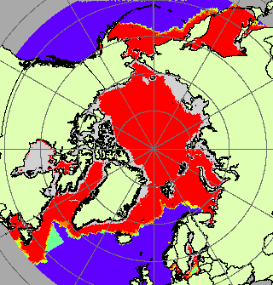
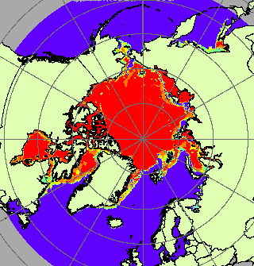
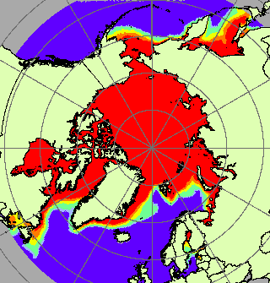
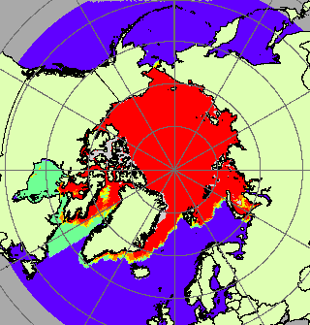
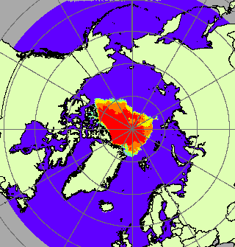
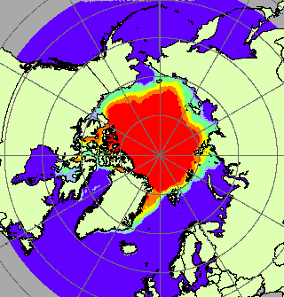
#29 Support for Sea ice climatology and ice in information systems (2)
Expected Outcomes:
  Updated semicentennial and longer ice ‘blended’ climatology for reanalysis and forecasting
  Updates to WMO sea ice technical publications (SIGRID-3 format)
Key Activities:
  Regular (weekly - annual) input to GDSIDB ice charting archive in standard WMO formats from contributing ice services / centers
  Reprocessing of data, update of climatology on annual basis and comparison with passive microwave
  Visibility and availability of initial and climatological material in exchangeable formats (WMS, WIS/CryoNet, NetCDF, etc) and supporting and documentation
Timeline/milestones:
  Report to IICWG-14 meeting (Reykjavik, Oct’13)
  5th JCOMM ETSI session (Ottawa, Nov’13)
ETs, Other Organizations and participants:
  ETSI, ETMC, IICWG, CryoNet team
Implementation of JCOMM-4 decisions
  5.4.3 (Polar Met-Ocean and sea ice information services)
  8.3.4 (Safety-related Marine Meteorological Services)
March: Max, Min and Med (blended)
September: Max, Min and Med (blended)

Slide 14
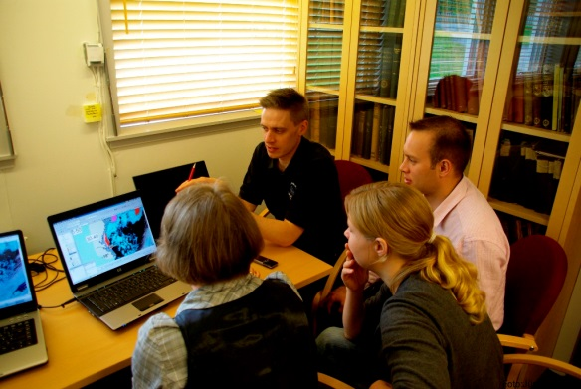
#13 Capacity Development /CB for Ocean Forecasting and Sea Ice (1)
Key activities:
Ice Analysts workshops
Extending COMET modules for sea ice
Extending WMO No.259 Volume II and MANICE
IAW-4 agreed by IICWG-13 themes
Use of variety of satellites for sea ice and iceberg analysis
How to use Beam modes, polarizations, channels / MODIS, NOAA AVHRR / new satellites
METAREA southern hemisphere
Use of free software/ Data products from other ice services/ Standards for bulletin
Melt/breakup and Freeze up
Attendees:
Experienced analysts from northern hemisphere (and new)
Southern hemisphere analysts or trainees
Location: AARI
Duration: 3 days (Tuesday to Thursday)
Timing: June/July 2013 or 2014 ?
Lead: Vasily Committee: Caryn, Darlene, Jürgen, EIS
Other topics for future discussion:
/ Common climate charts for the arctic / Develop standards for production of climate charts/Development of manual similar to MANICE for these charts / Update and harmonization of WMO standards / Data information systems for ice charts / Comparison of oil spill in ice products

Slide 15
#31 Enhance the integrated ice services and forecasting (1)
Project Leaders: Vasily Smolyanitsky, Nick Hughes
Project Description:
Provision of services for efficiency and safety of navigation and other operations in the ice-covered waters require integrated approach in terms the ice and sea state parameters and products to be regularly, timely and in the binary formats delivered to end-users (navigators, off-shore platforms, search and rescue, emergency support)……..
The objective of the project will be for ETSI in tight collaboration with the International Ice Charting Working Group (IICWG) to coordinate enhancement of integrated ice services by tracking and summarizing best practices and requirements to products and information, facilitating exchange of experience and resources in ice analysis, operational forecasting and numerical modeling of ice and related to ice parameters and harmonization of the services.
This project should provide advice and input to corresponding projects led by JCOMM ETOOFS and TT on MPERSS.
Key activities:
tracking and summarizing requirements to input data (current and perspective spaceborne information and ground observations) and products;
updates (every ~1-2 years) of national best practices in “Sea-Ice Information Services in the World” (WMO-No.574), preferably compatible with the WMO-No. 9, Volume D;
exchange and transition of experience in ice analysis, forecasting and harmonization of practices across the Services, training for developing Ice Services, including support for regular “Ice Analysts Workshops” and “Ice Assimilation Workshops”.
Input to ETOOFS guide ?

Slide 16
#31 Enhance the integrated ice services and forecasting (2)
Key outcomes:
enhanced ice services following user-requirements
enhanced ice diagnostic and forecast products beyond the ice charting
input to MPERSS implementation in Polar Regions
Timeline / Milestones:
4th “Ice Analysts Workshop” (Jun/Jul 2013 or later)
2013 and further updates to WMO-No.574 (mid 2013, 2015)
Update to WMO RRR;
Reports to IICWG-14 (Oct’2013, Iceland), ETSI-V (Nov’2013, Canada) and IICWG (Chile, 2014)
ETs, Other Organizations and participants:
ETSI, IICWG, nat met services for oil spills (?)
Implementation of JCOMM-4 decisions (noted by paragraph number of JCOMM-4 report
  8.3.4 (Safety-related Marine Meteorological Services)
  8.3.10 (Safety-related Marine Meteorological Services)

Slide 17
Events for 2013-2014:
Modifying the ETSI and GDSIDB paradigm and ToRs ?
e.g. closer relations and fit with GCW and Cryonet ?

Slide 18
Events for 2013-2014:
GCW First Asia Cryonet implementation meeting (Beijing, China, 03-05 December 2013)
CryoNet Team Meeting & GCW Advisory Meeting: (20-24 January, Iceland)
ETSI-5 (25 - 28 March, Ottawa, Canada)
IAW-4 workshop (June 2014, Helsinki, Finland)
TSMAD ?
IICWG-15 (2014, Punta-Arenas, Chile)

