Slide 1

Report by Japan Meteorological Agency (JMA)
Keiji HAMADA
Office of Marine Prediction,
Global Environment
and Marine Department
Japan Meteorological Agency (JMA)
Harerun
(Mascot of JMA)
Notes:
Thank you! chairperson. Good morning, ladies and gentlemen. I am Keiji Hamada from Japan Meteorological Agency. I would like to talk about National Report by JMA.

Slide 2
Contents
Introduction
Data sources
Analysis and output products
Sea Ice prediction model
Notes:
These are contents of my presentation.

Slide 3
Introduction

Slide 4
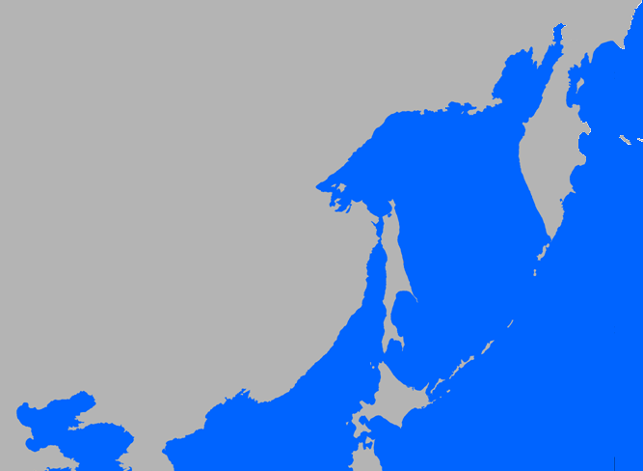
JMA’s analysis area
Sea of Okhotsk
Hokkaido
Yellow Sea
Pacific Ocean
Japan Sea
Notes:
JMA has been operationally monitoring sea ice conditions and providing sea ice information in the Sea of Okhotsk since 15th December 1970.
This is JMA’s analysis area.
Everyday from November to July, we analyze sea ice conditions in these sea area.

Slide 5




PURPOSE
To support fishing, shipping and coastal and harbor activities
For tourism
As an index of global warming
Hokkaido is the only place where sea ice can be seen in Japan. Many tourists visit Hokkaido to see sea ice in winter.
It is considered the variation of sea ice extent is an important index of global warming.
Notes:
These are purposes of sea ice analysis.
To support fishing, shipping and coastal and harbor activities.
For tourism. Hokkaido is the only place where sea ice can be seen in Japan. Many tourists visit Hokkaido to see sea ice in winter.
As an index of global warming, it is considered the variation of sea ice extent is an important index of global warming.

Slide 6
Data sources

Slide 7


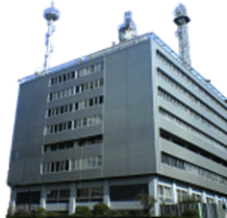


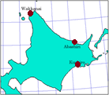
Data sources for the analysis in JMA
Aircrafts
Ministry of Defense
Japan Coast Guard
Satellites
Himawari, NOAA etc.
Vessels and Ships
Japan Coast Guard
JMA HQ
Tokyo
weather stations
Wakkanai
Abashiri
Kushiro
in Hokkaido, north of Japan
Ice edge data
U.S. NIC
Notes:
Next slide shows data sources for the analysis in JMA.
We use satellite data, aircraft observation data, vessel and ship observation data, NIC ice edge data and visible observation data from weather stations in Hokkaido.

Slide 8
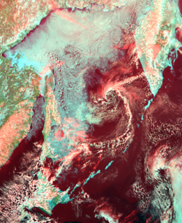
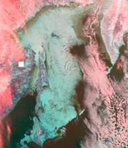
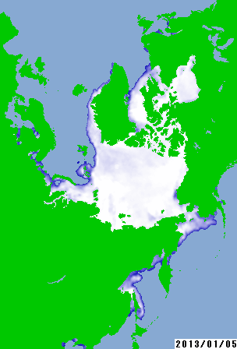
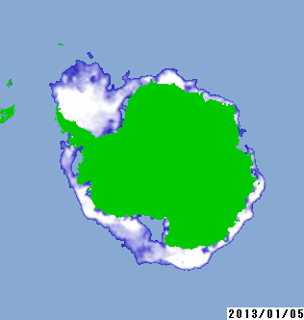
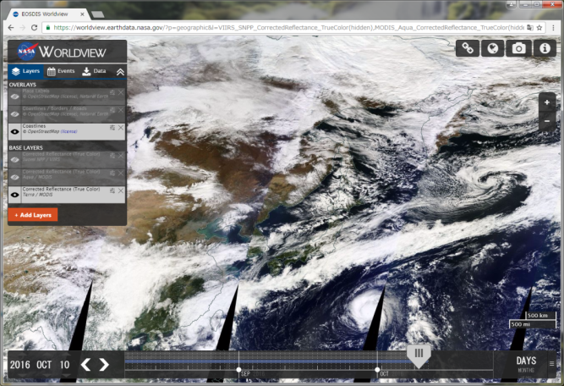
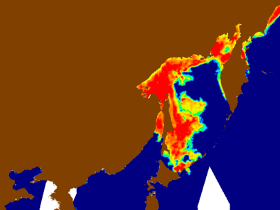
Satellite images using sea ice analysis in JMA
Mainly used
For global analysis
Himawari/AHI
NOAA, Metop/AVHRR
DMSP/SSM/I
additional optical information
Terra, Aqua/MODIS and Suomi NPP/VIIRS
GCOM-W1/AMSR2
NASA WORLDVIEW website
Notes:
Next slide shows satellite images using sea ice analysis in JMA.
We mainly use Himawari/AHI, NOAA AVHRR, Metop AVHRR.
MODIS and AMSR2 are used as additional optical information.
SSM/I is used for global analysis.

Slide 9
Analysis and
output products
Notes:
Next, I would like to talk about operations, data, services and product.

Slide 10
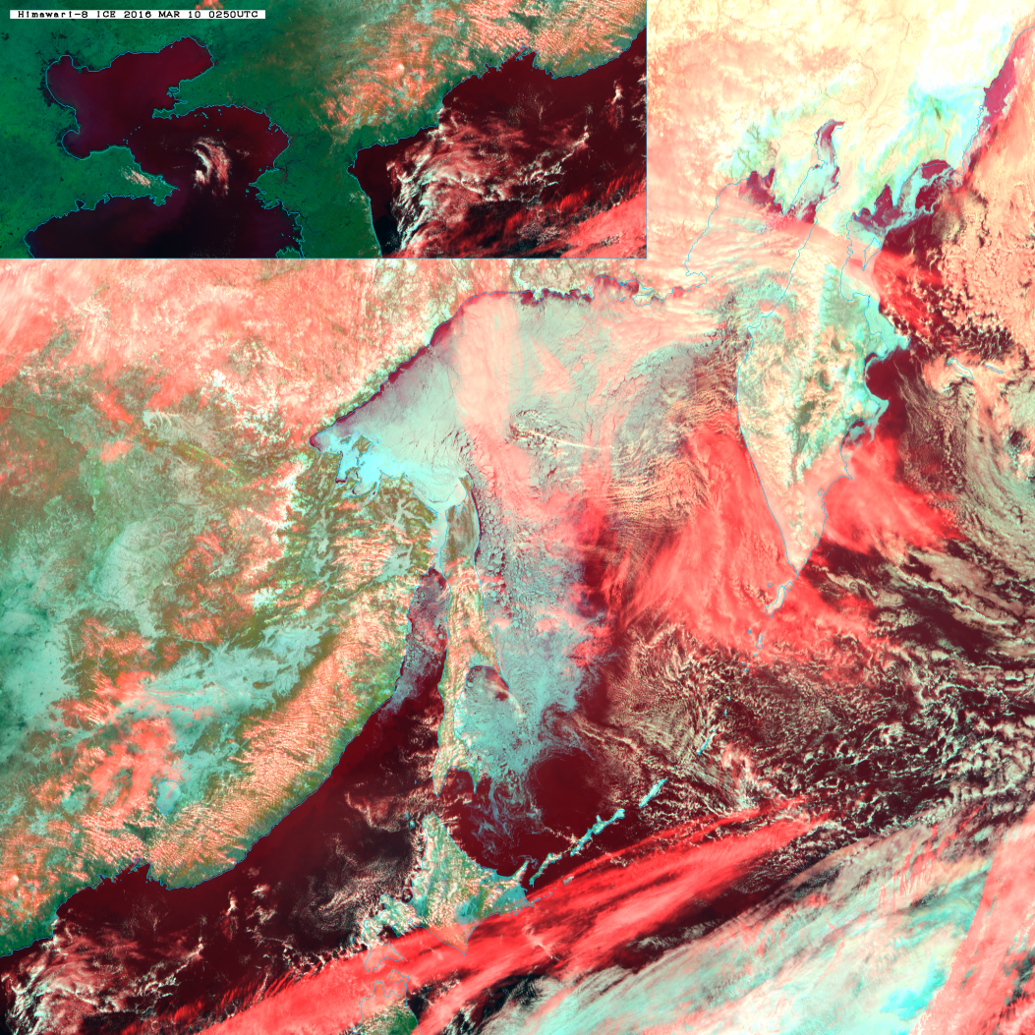
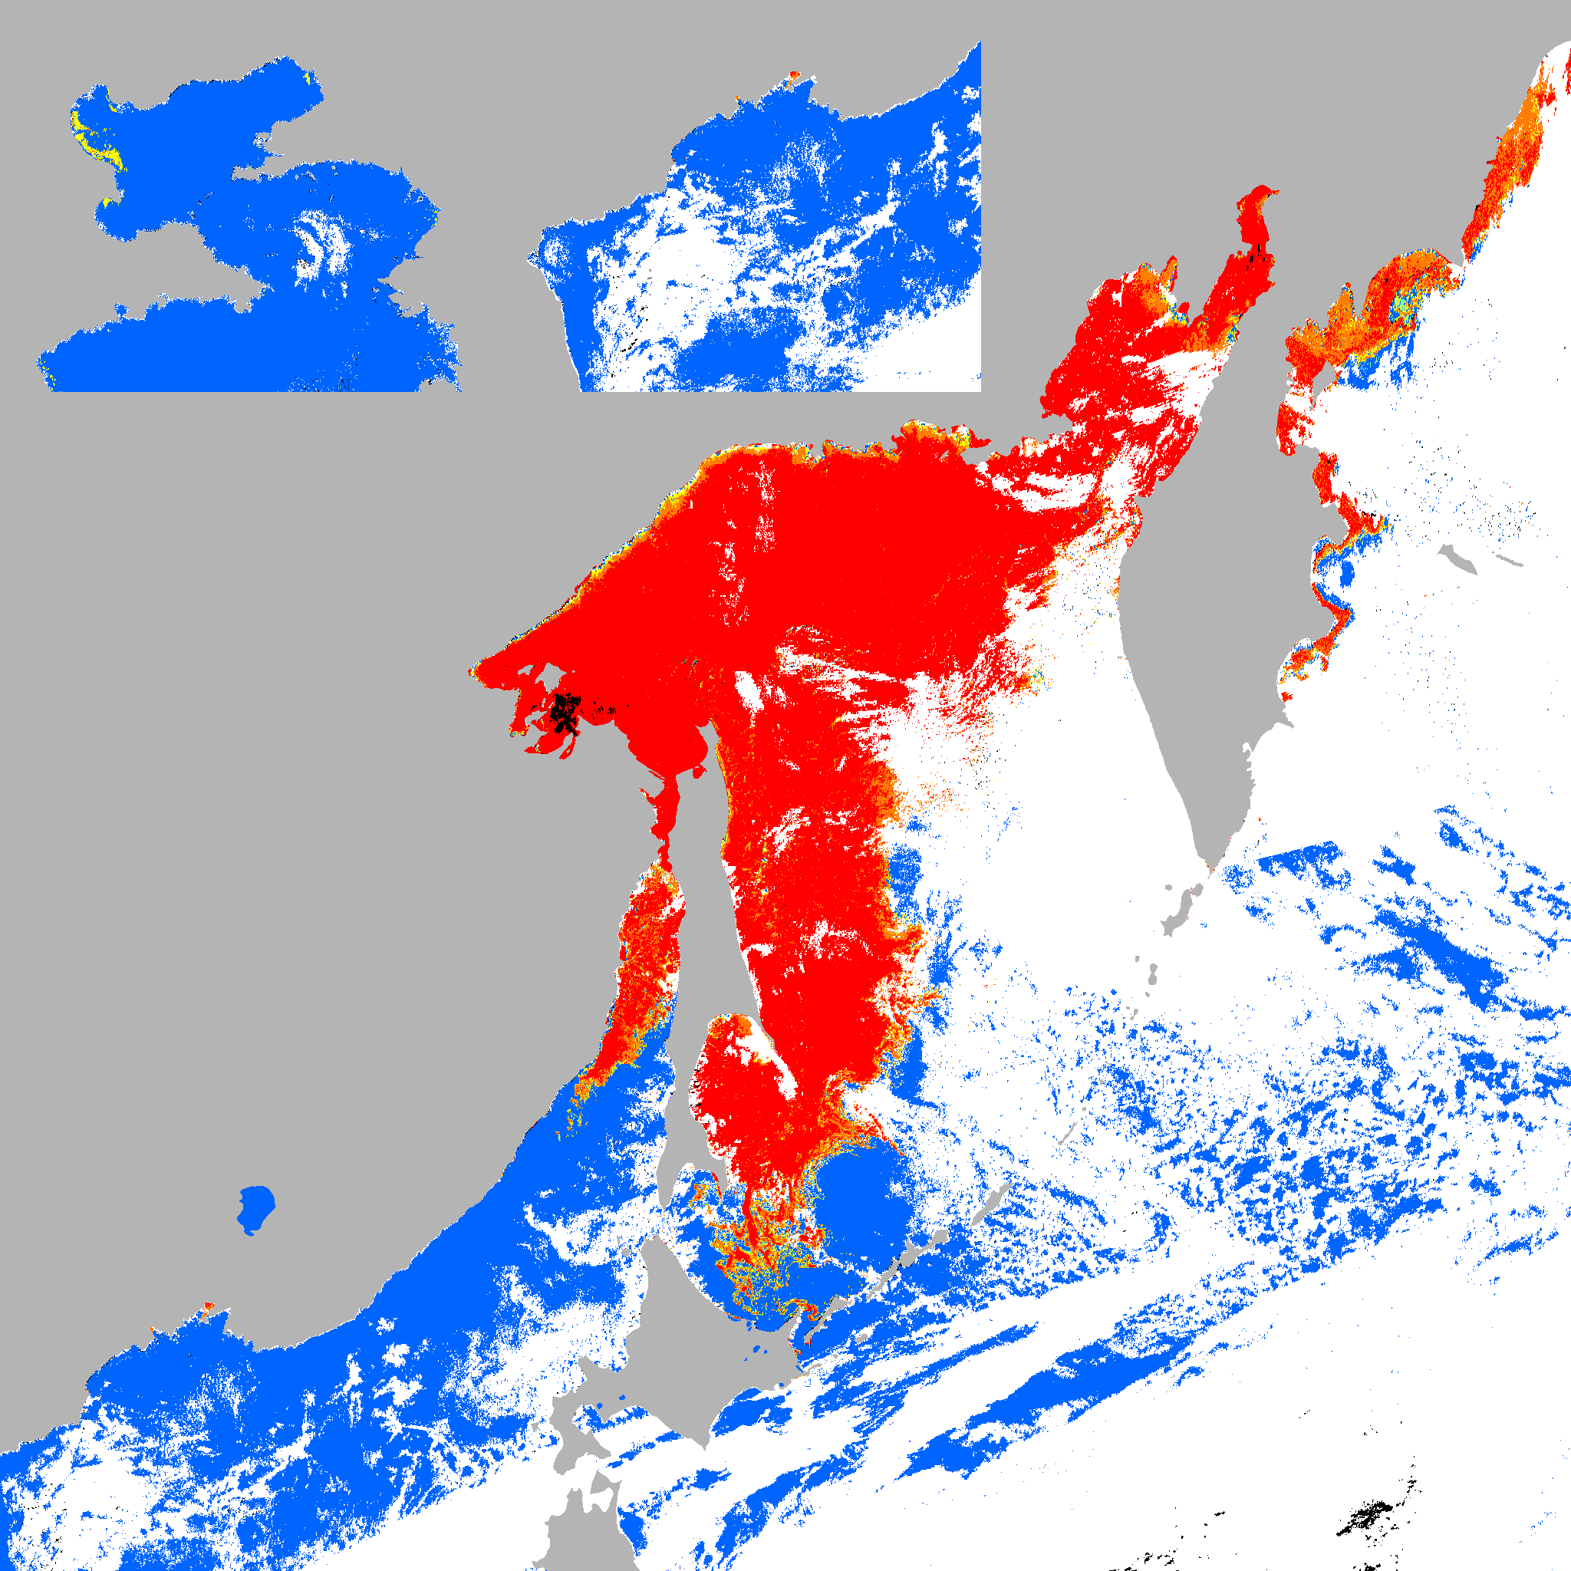
Automated determination of sea ice concentration
for the Sea of Okhotsk from Himawari-8
Composite image
Red:band13(IR, 10.4μm), Green:band4(NIR, 0.86 μm), Blue:band3(VIS, 0.64μm)
snapshot image of automated determination of sea ice concentration
0300UTC 10 March 2016

Slide 11
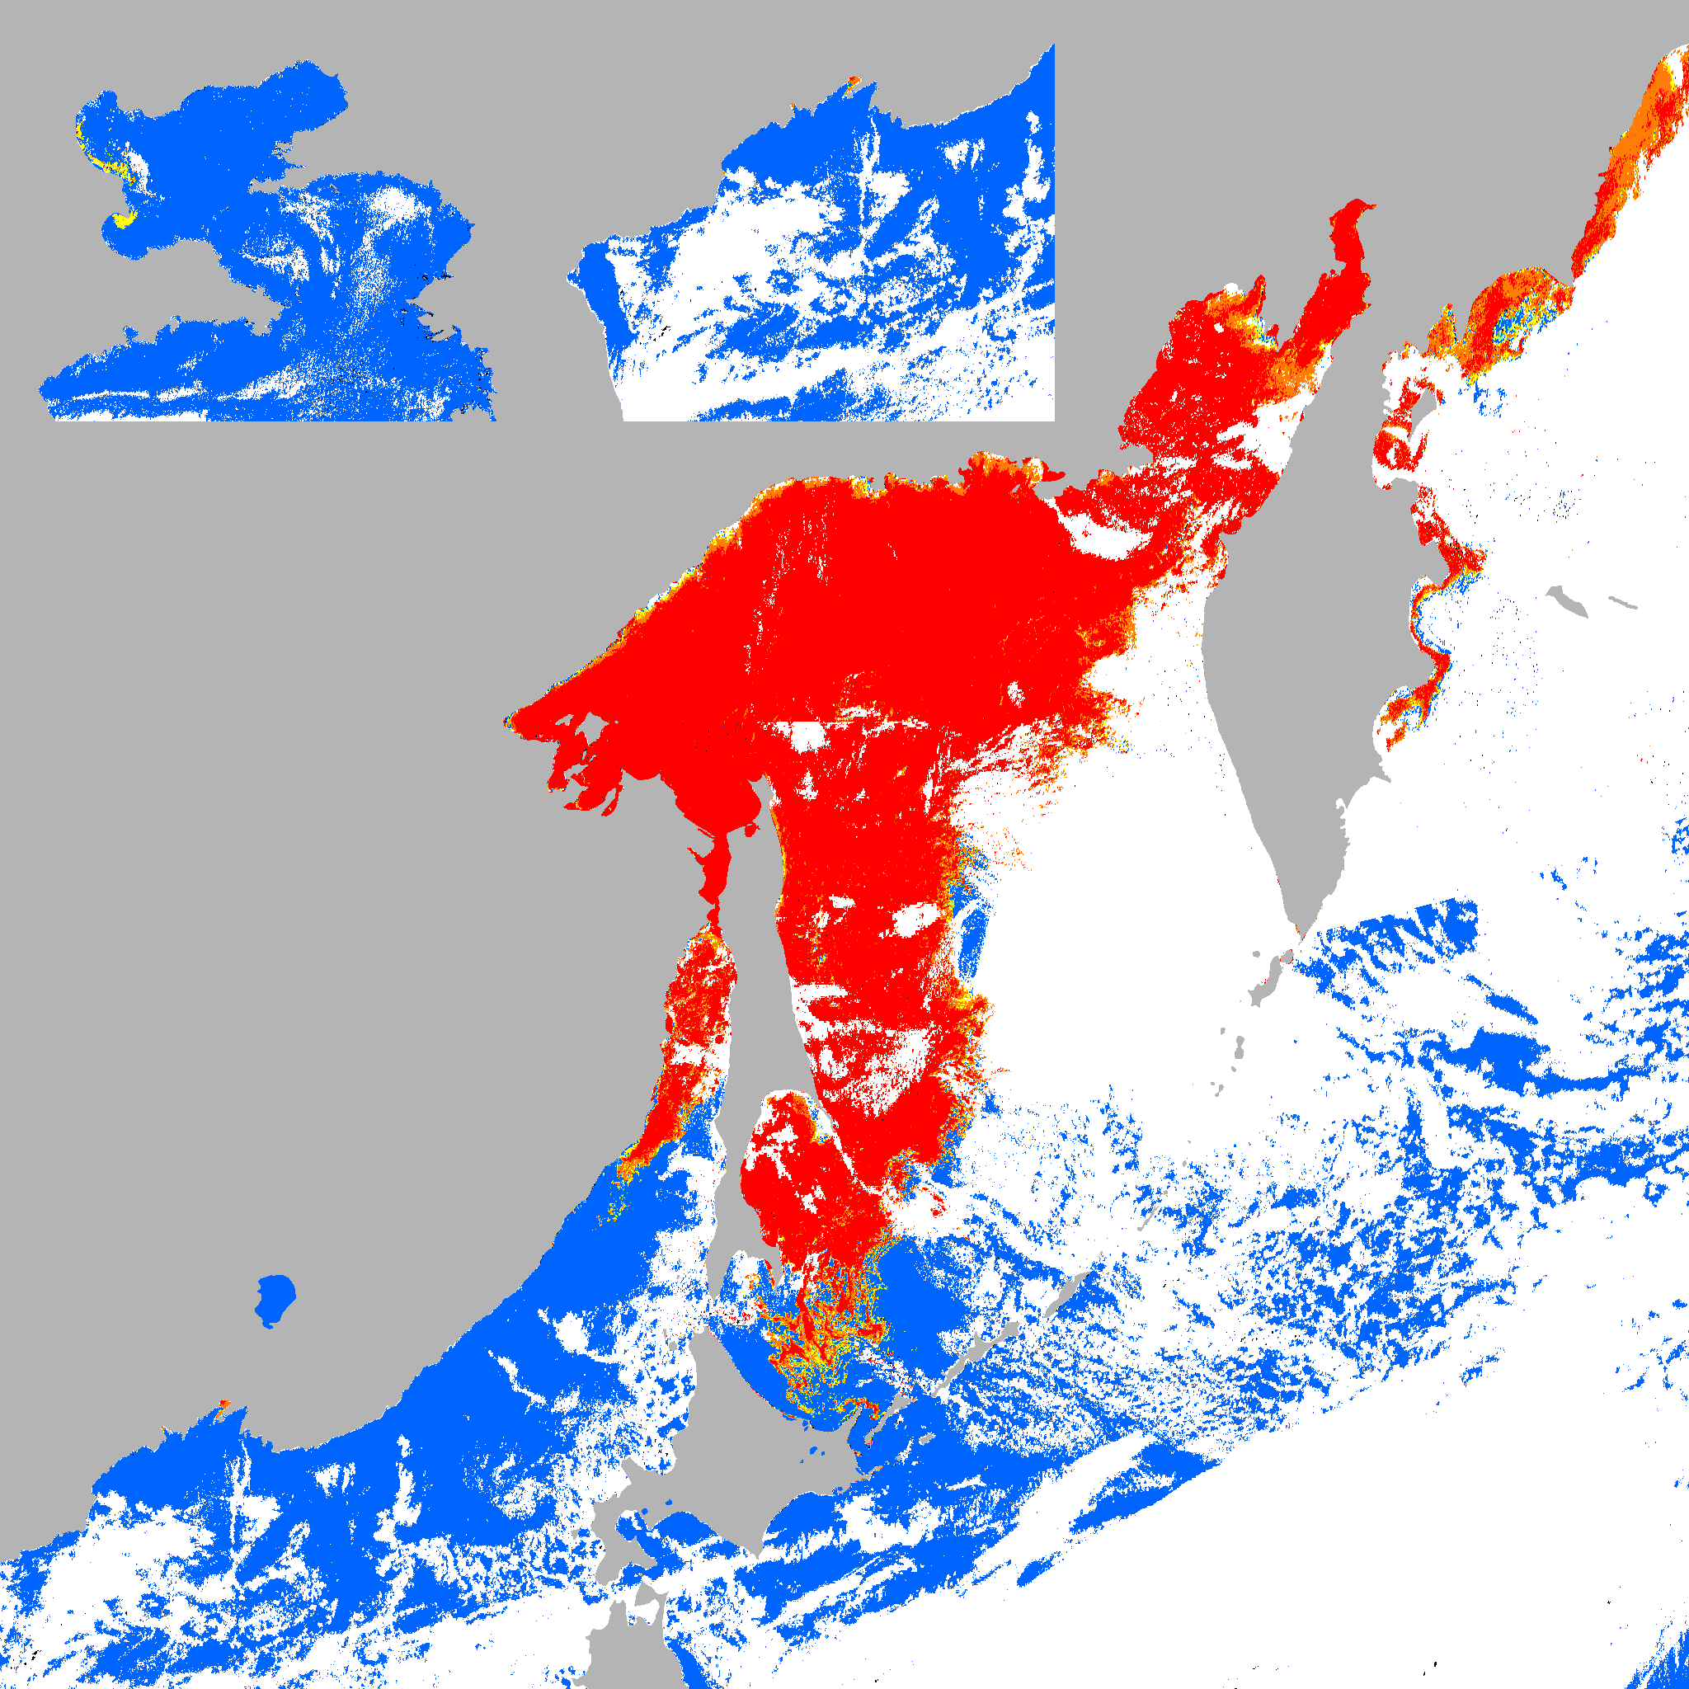

Image animation of automated determination of from Himawari-8 every 10 minutes
Snapshot image
Superposition image
10 March 2016

Slide 12
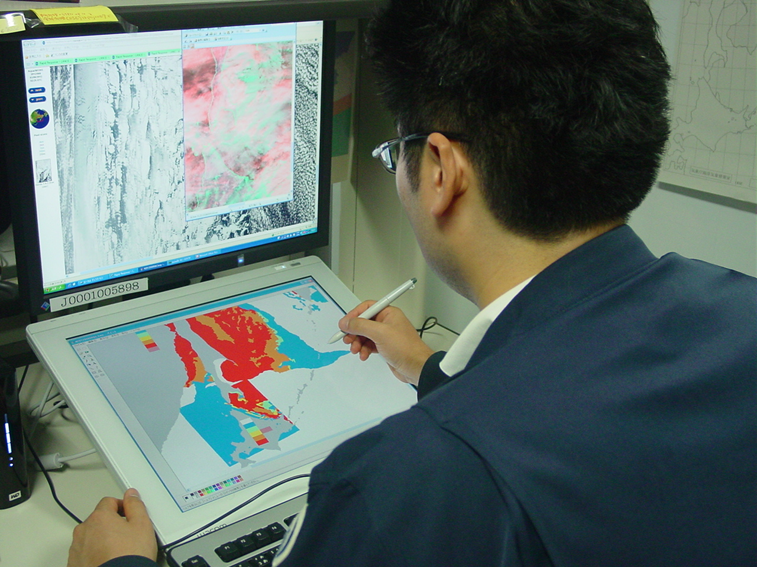
Analysis of sea ice for the Sea of Okhotsk
We analyze sea ice by using GIMP and the pen tablet in JMA HQ.
Notes:
This photograph shows analysis of sea ice for the Sea of Okhotsk. We analyze sea ice by using free software GIMP and the pen tablet in JMA HQ in Tokyo.

Slide 13
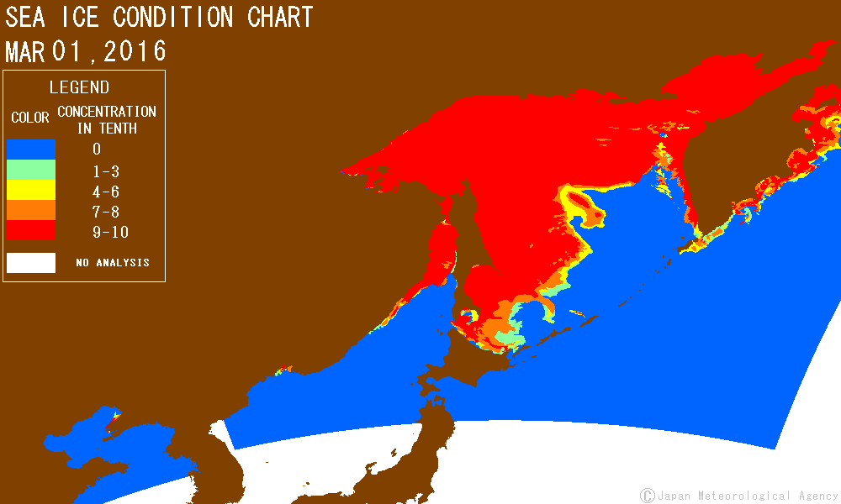

Daily sea ice analysis chart
( North East Asian Regional Global Ocean Observation System )
http://ds.data.jma.go.jp/gmd/goos/data/rrtdb/jma-pro/man_ice_okh_D.html
Notes:
Daily sea ice analysis charts are available on the NEAR-GOOS website.
These charts include no-analysis areas due to clouds.

Slide 14
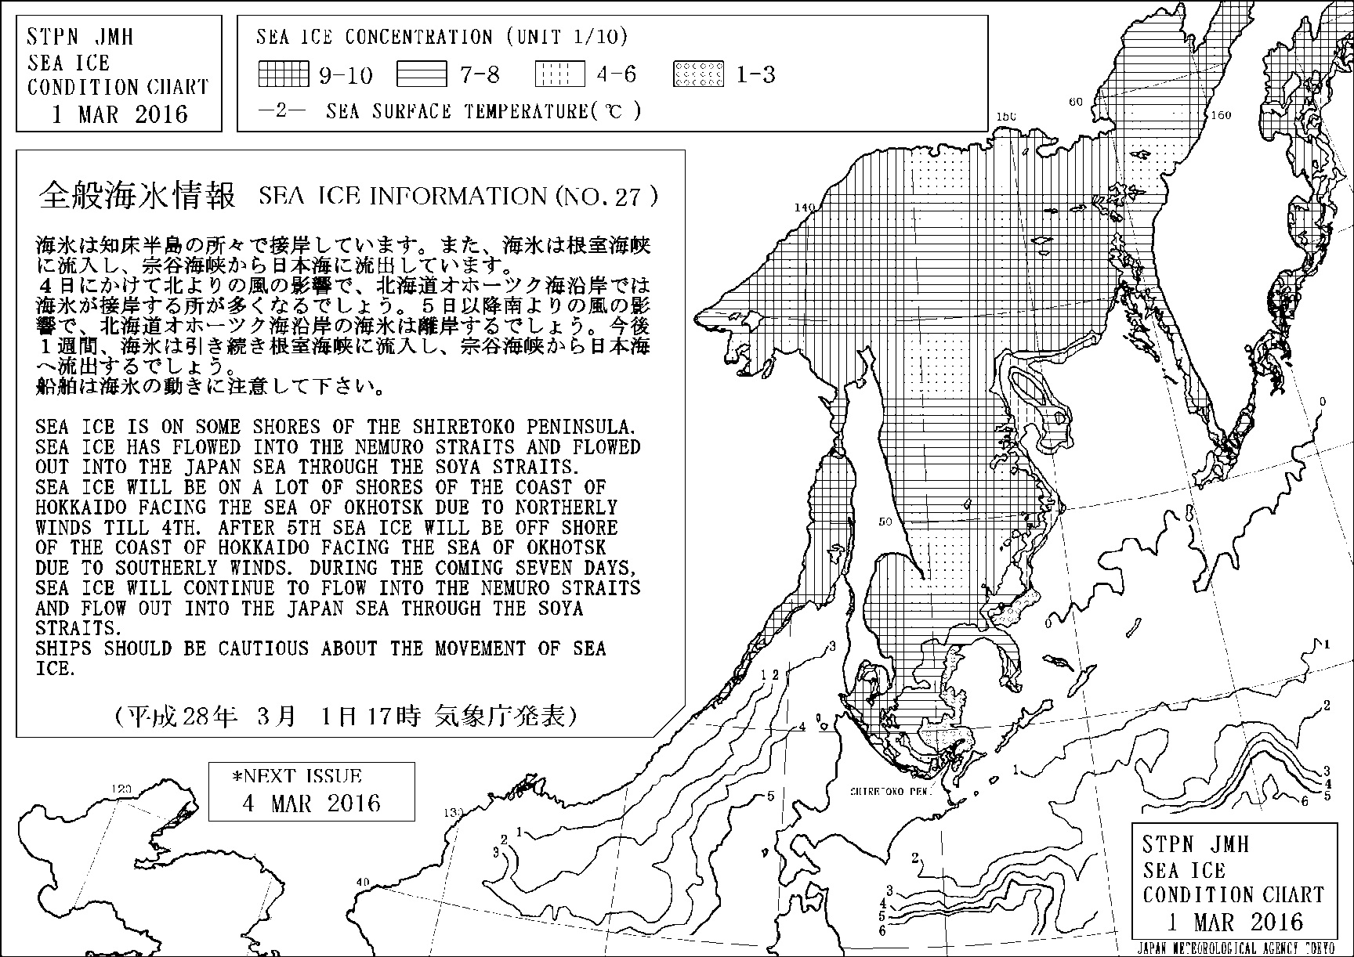
Sea ice information
Broadcasted on radio facsimile and posted on the JMH website
http://www.jma.go.jp/jmh/sml_00_stpn.html
Notes:
Sea ice information is broadcasted on radio facsimile and posted on the JMH website every Tuesday and Friday from December to May.
The charts show sea ice edges and four classes of sea ice concentration with description of sea ice conditions and one week forecast information in Japanese and English.

Slide 15
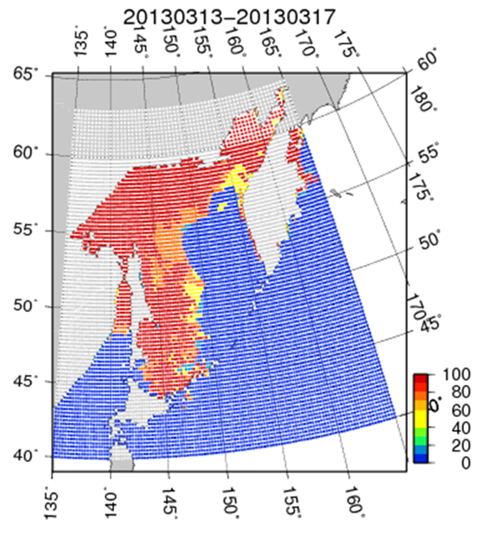
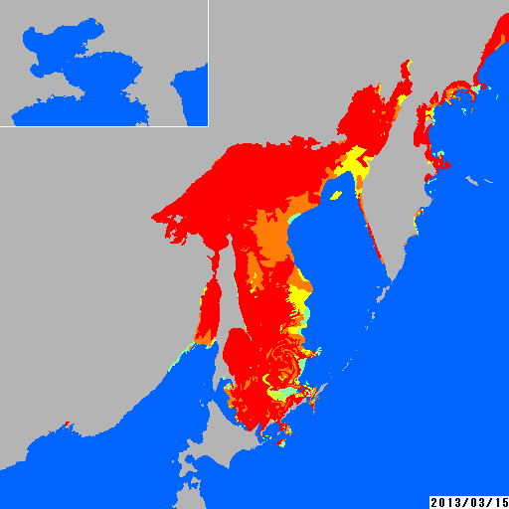
Dataset of sea ice extent
Sigrid-2 data
40N-63N, 135E–165E
Sea ice extent
every five days
from November to July
from 1971 to date
Submit
Once a year
GDSIDB
Notes:
We make dataset of sea ice extent every five days from November to July from 1971 to date.
This data is converted to Sigrid-2 format.
We submit Sigrid-2 data to GDSIDB once a year.

Slide 16
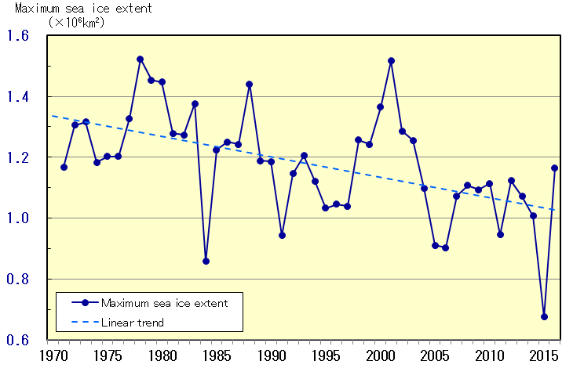
Long term trend of sea ice extent (Okhotsk)
http://www.data.kishou.go.jp/kaiyou/english/seaice_okhotsk/series_okhotsk_e.html
Notes:
We issue long term trend of sea ice extent for the Sea of Okhotsk once a year.

Slide 17
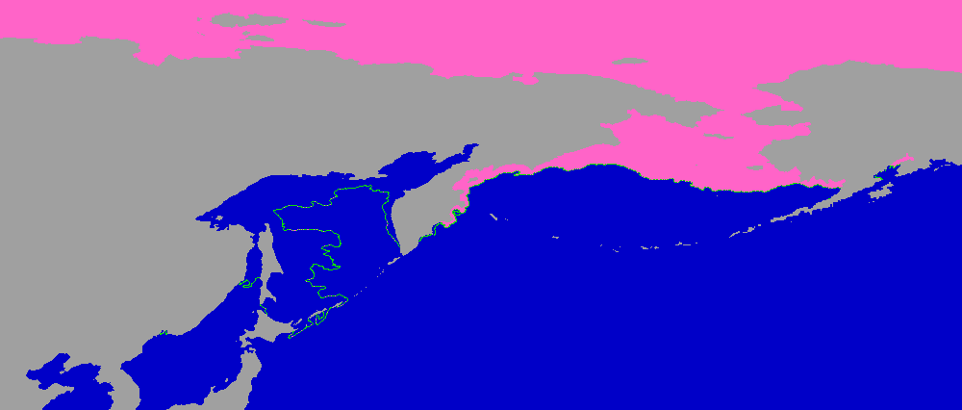
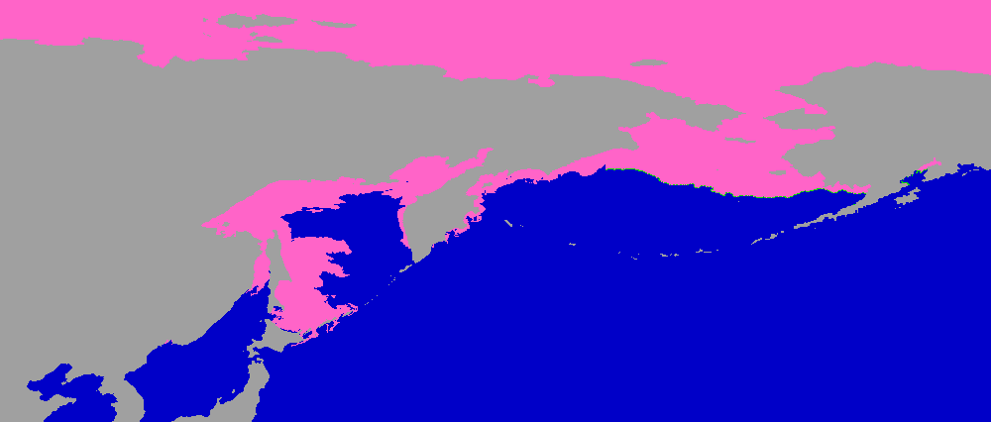
Global sea ice Analysis (U.S. NIC ice edge data)
Merged sea ice chart
Used for JMA’s weather chart
Boundary conditions for JMA’s Meso Scale Model
Notes:
I explain two global sea ice analysis.
Firstly, NIC ice edge data is used.
The upper image is the data made from NIC ice edge data by using Microsoft Paint.
In JMA’s analysis area, JMA’s sea ice chart is merged.
This global sea ice data is used for JMA’s weather chart and as boundary conditions for JMA’s Meso Scale Model.

Slide 18
Global sea ice Analysis (DMSP SSM/I data)
NASA Team Algorithm
Grid Interval
0.25 degree
- Boundary conditions for JMA’s Global Spectral Model
1.0 degree
- Use for the Japanese 55-year Reanalysis
- Boundary conditions for JMA’s Climate Prediction Model
Notes:
Next, I explain Global sea ice analysis by using DMSP SSM/I data briefly.
Sea ice is derived by NASA Team Algorithm.
Grid interval is 0.25 degree and 1.0 degree.
0.25 degree grid interval data is used for boundary conditions for JMA’s global spectral Model.
1.0 degree grid interval data is used for the Japanese 55-year reanalysis and as boundary conditions for JMA’s Climate Prediction Model.

Slide 19
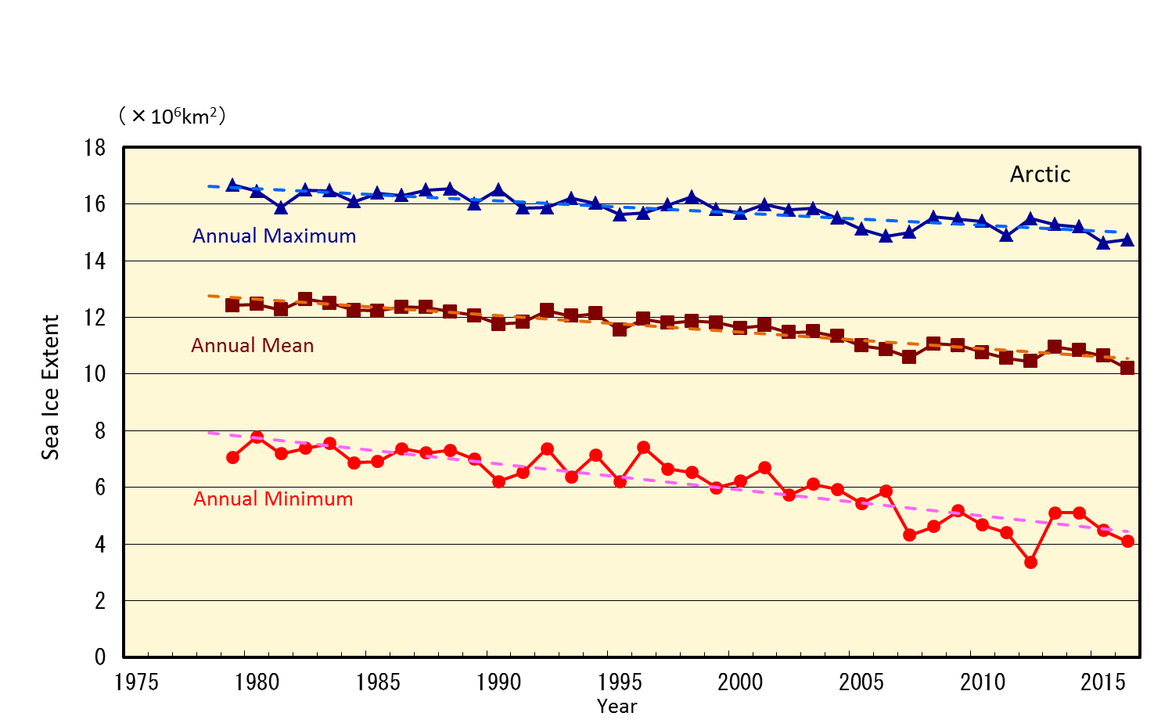
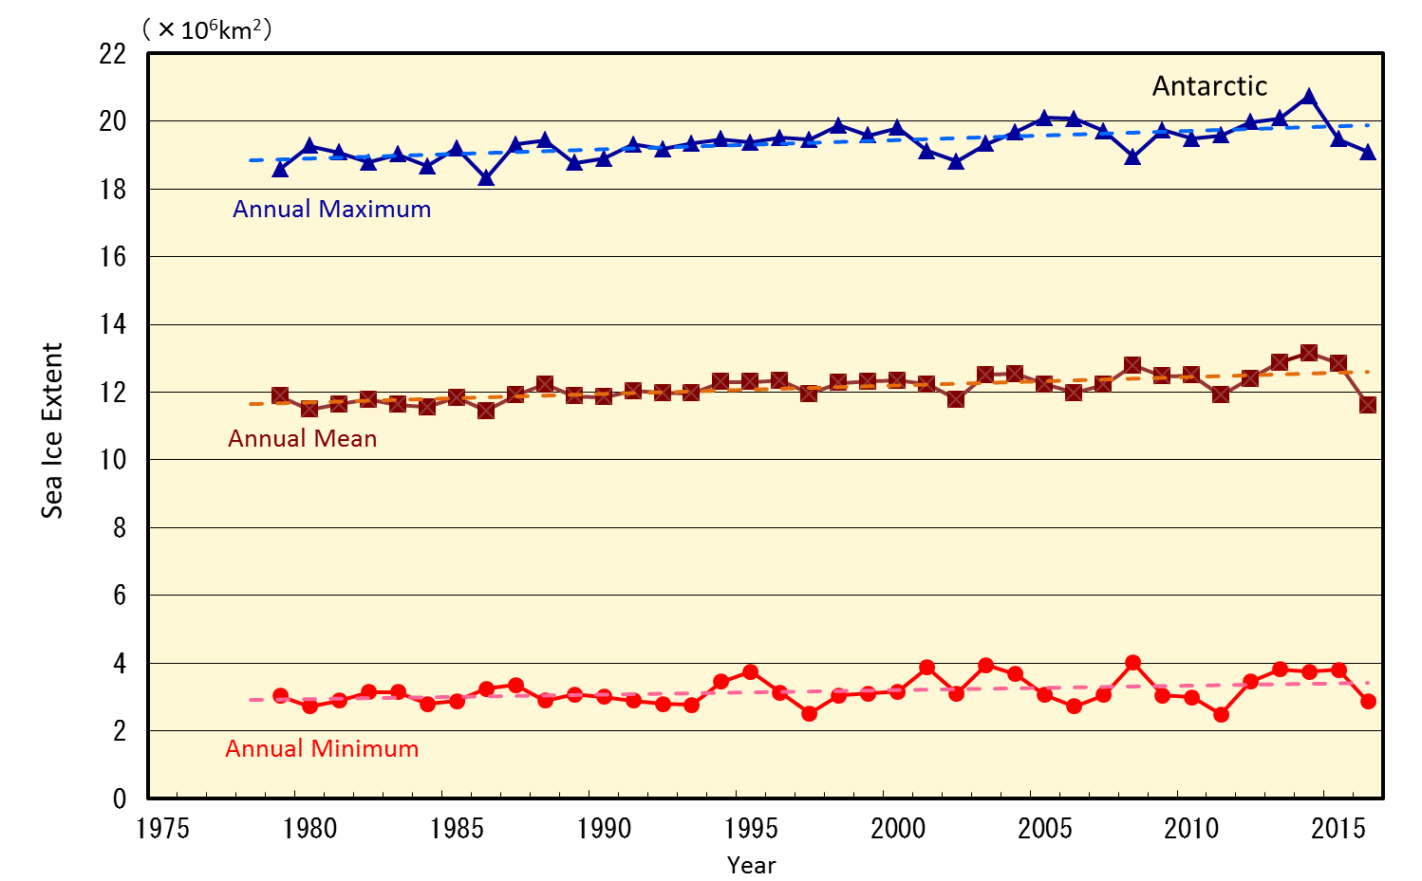
Long term trend of sea ice extent
(Arctic and Antarctic)
sea ice extent for Arctic
sea ice extent for Antarctic
http://www.data.kishou.go.jp/kaiyou/english/seaice_global/series_global_e.html
Notes:
We issue long term trend of sea ice extent for the Arctic and Antarctic once a year.

Slide 20
Sea Ice prediction model

Slide 21
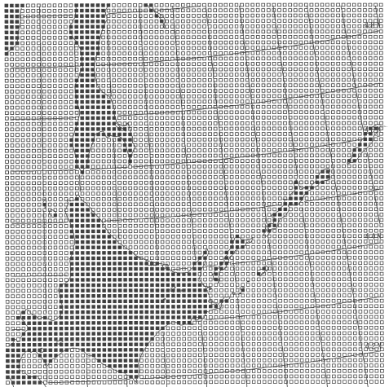
Sea Ice Prediction Model
Forecast area
The Southern Part of the Sea of Okhotsk and the Neighboring
waters
Grid Size
12.5km
Forecast Time
7days
Dynamical processes
Viscous-Plastic Method
Thermodynamical processes
Heat Exchange between Sea Ice, Atmosphere and Sea Water
Forecast Area
Forecast Area
Notes:
A numerical model has been operated since 1991.
Forecast area is shown on this figure, the southern part of the Sea of Okhotsk and the neighboring waters.
Grid size 12.5km. Forecast time 7days.
dynamical processes Viscous-plastic model.
Thermodynamical process heat exchange between sea ice, atmosphere and sea water.

Slide 22
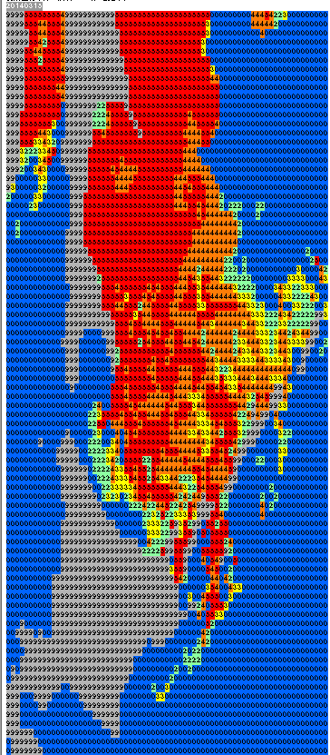

Sea Ice Prediction Model
Initial Conditions
Sea Ice Concentration
(The windows bitmap file of sea ice analysis chart is converted to grid data )
Sea Ice Thickness
(derived from the previous forecast)
Boundary Conditions
Sea Surface Temperature (JMA SST analysis)
Sea Surface Current (statistical data)
Meteorological Data (JMA NWP Data)
Forecast Data
Sea Ice Concentration
Sea Ice Thickness
Sea Ice Motion
Initial condition
Sea ice concentration
Notes:
Initial conditions Sea Ice Concentration The windows bitmap file of sea ice analysis chart is converted to grid data.
Sea Ice Thickness is derived from the previous forecast.
Boundary conditions are Sea Surface Temperature, Sea Surface Current and Meteorological Data.
Forecast data are Sea Ice Concentration, Sea Ice Thickness and Sea Ice Motion.

Slide 23
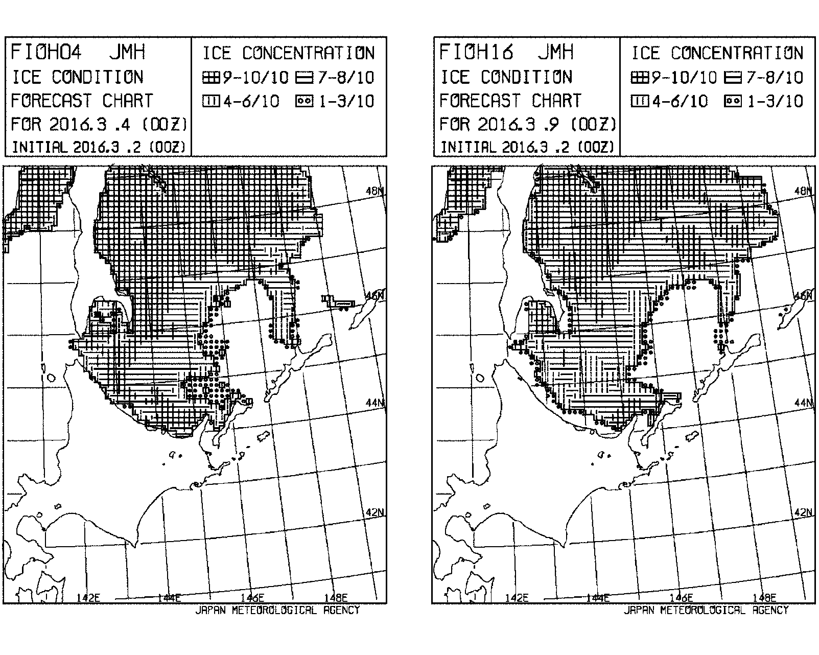
Numerical Sea Ice Prognosis Chart
Broadcasted on radio facsimile and posted on the JMH web site
http://www.jma.go.jp/jmh/sml_00_fioh0416.html
Notes:
Numerical sea ice prognosis charts show the distribution and concentration of sea ice of two days ahead and seven days ahead.
This chart is also broadcasted on radio facsimile and posted on the JMH website every Wednesday and Saturday.
I will explain JMA’s numerical sea ice prediction model later.

Slide 24
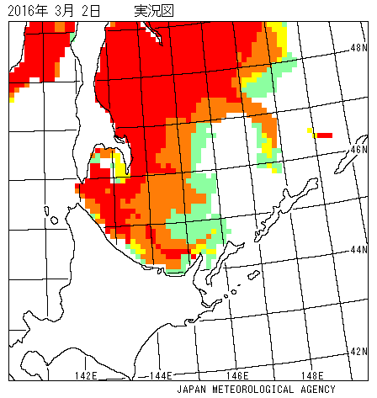
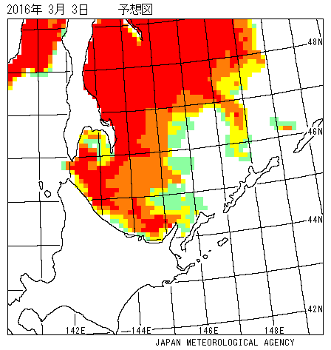
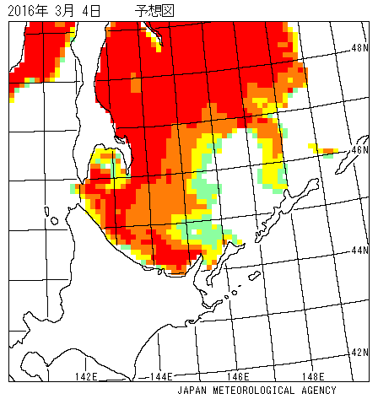
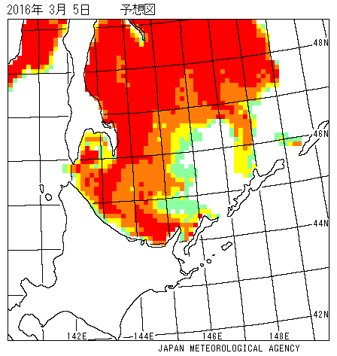
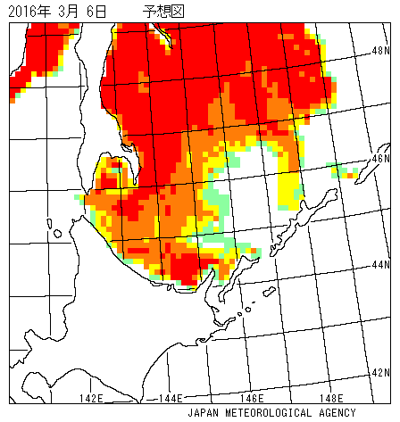
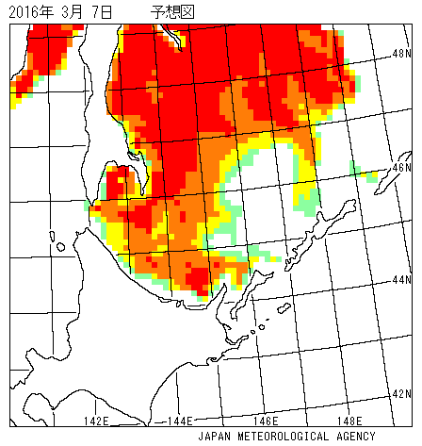
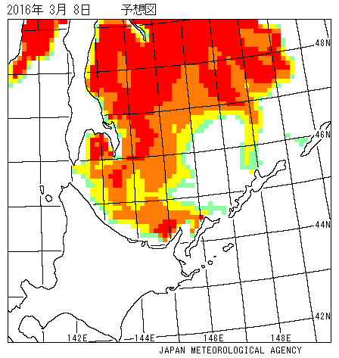
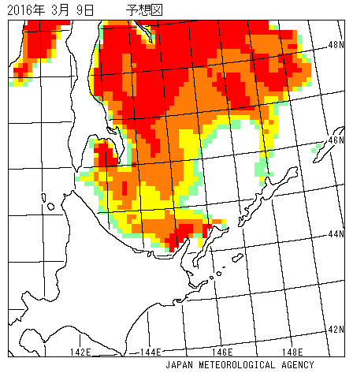

Numerical Sea Ice Prognosis Chart
Initial
FT=1day
FT=2day
FT=3day
FT=4day
FT=5day
FT=6day
FT=7day
http://www.data.jma.go.jp/gmd/kaiyou/db/seaice/forecast/nsif.html (in Japanese)
Notes:
The color charts show initial conditions and forecast for the next 7 days.
They are updated on the JMA website every Wednesday and Saturday in Winter.

Slide 25
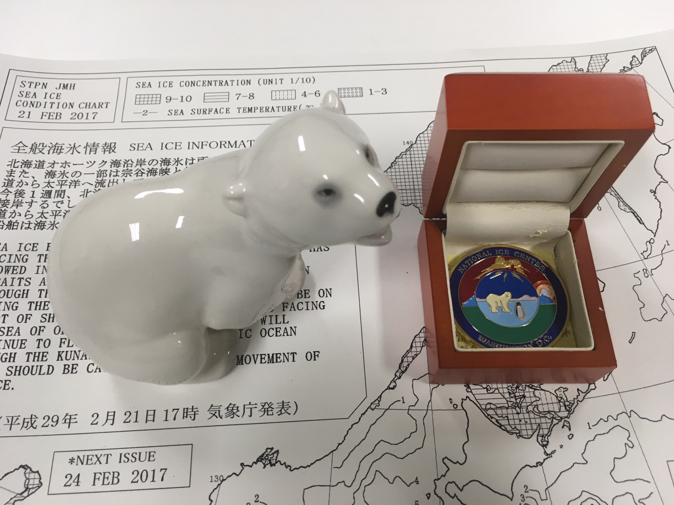
Thank you

