Slide 1
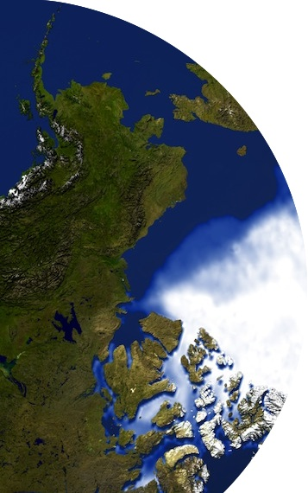
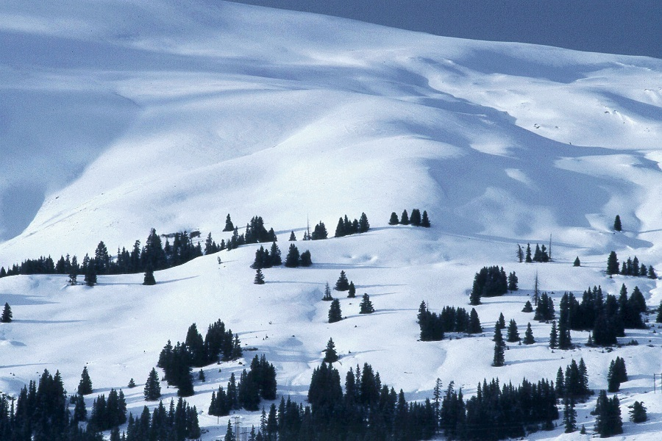
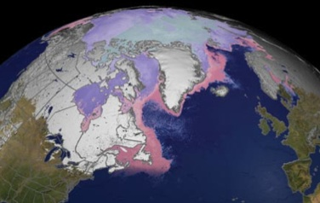
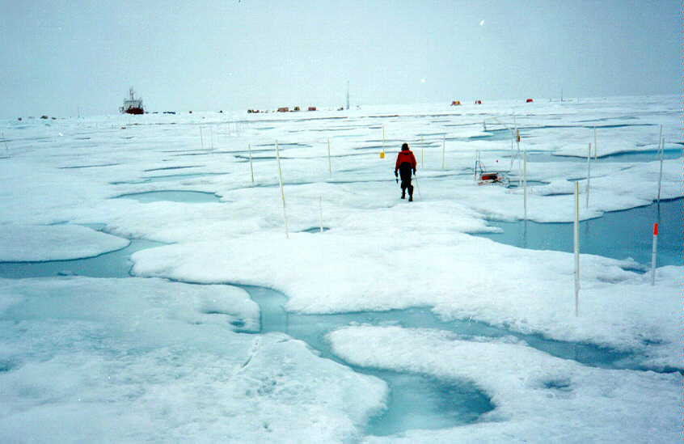
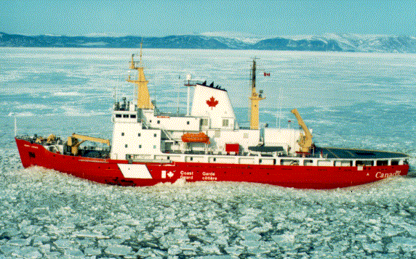

The Global Cryosphere Watch
globalcryospherewatch.org
Jeff Key
NOAA/NESDIS
Madison, Wisconsin USA
CliC Science Steering Group Meeting, Boulder, 9-12 February 2015

Slide 2
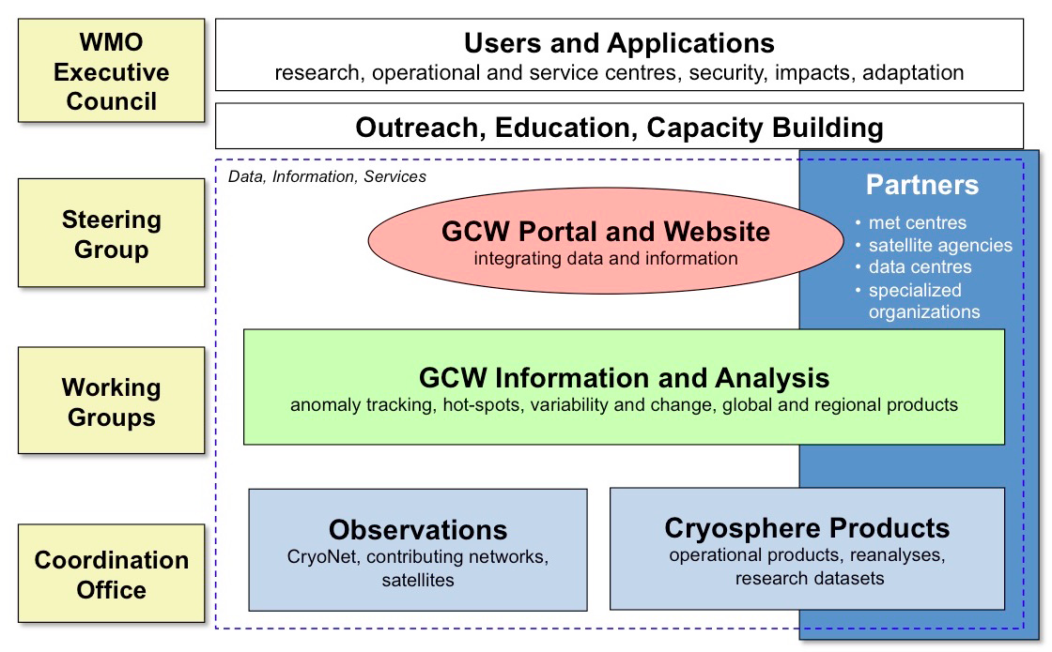
GCW Organization and Framework
Mission: GCW will provide authoritative, clear, and useable data, information, and analyses on the past, current and future state of the cryosphere. WMO’s ability to support ongoing development and delivery of weather, climate, and water services contributes to ensuring the sustainable development and well being of nations. GCW will provide, directly or indirectly, data, information, products and analyses that will help Members and partners provide needed services to the wider user community.

Slide 3
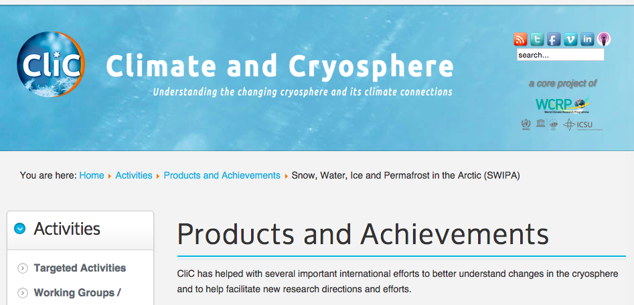
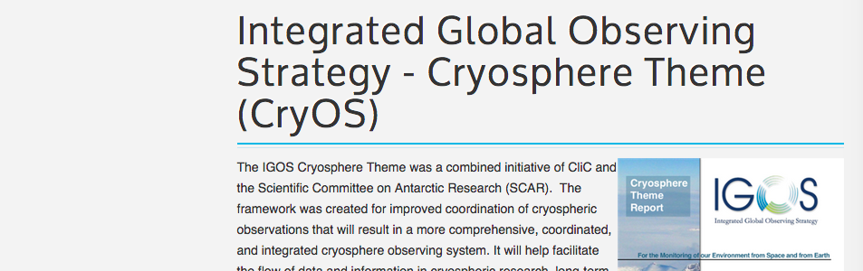
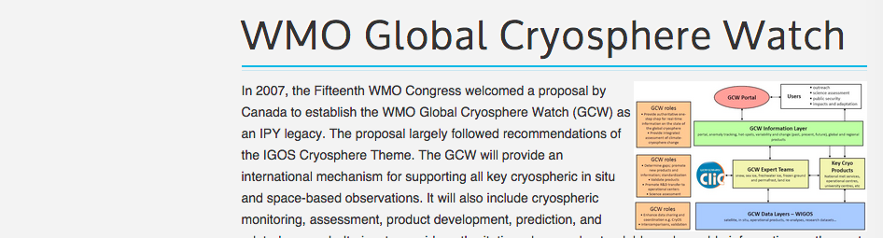
CliC was involved in GCW early on
…
…

Slide 4


A few fundamental differences between
CliC and GCW
≠
CliC has a research focus. GCW, being part of WMO, has an operational focus but fosters research-to-operations.
CliC emphasizes modeling (currently). GCW emphasizes observations.
CliC has a climate focus. GCW spans multiple time scales (e.g., CryoNet sites must be long-term).
CliC is a co-sponsored programme (WMO, IOC, ICSU) with JSC oversight. GCW is a WMO project overseen by the WMO Executive Council.
They also have much in common, not the least of which is the cryosphere, the people who study it, and the idea of fostering interaction.

Slide 5
What is GCW doing?
(What’s happening that wouldn’t otherwise happen?)
GCW is
developing a network of surface observations called "CryoNet", which builds on existing networks;
developing measurement guidelines and best practices;
refining observational requirements for the WMO Rolling Review of Requirements;
engaging in and supporting intercomparisons of products, e.g., the GCW Snow Watch project;
creating unique products, e.g., the SWE Tracker, in collaboration with partners;
engaging in historical data rescue (e.g., snow depth);
building a cryosphere glossary;
providing up-to-date information on the state of the cryosphere;
providing access to metadata and data through a portal.

Slide 6


GCW-CliC Collaboration
Surface network development; research to operations
Observational “best practices”
Data and metadata; interoperability
Ice product intercomparison project
CliC modeling activities would benefit GCW, and GCW data would benefit the modeling efforts; collaboration in planning contributions and participation in YOPP
User needs - Surveys of user needs; observational requirements
Ideas for new products
Outreach - website and other materials.
Teams – CliC members can participate on GCW teams.
Links to APECS?

Slide 7
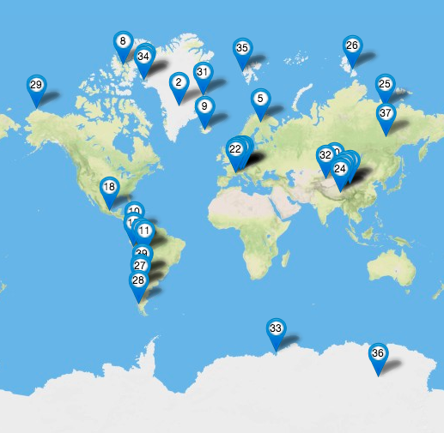
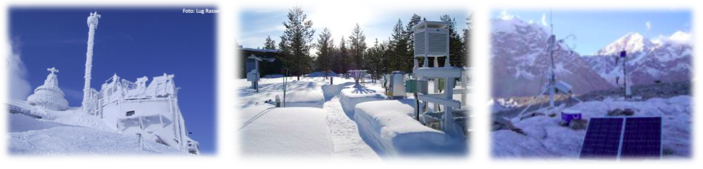
CryoNet and the GCW surface network
GCW may be able to help “operationalize” observations in some CliC research projects.
Some SEARCH and AON sites are already part of CryoNet.
CliC’s modeling activities would benefit GCW, and GCW’s data would benefit the modeling efforts.
Notes:
7

Slide 8
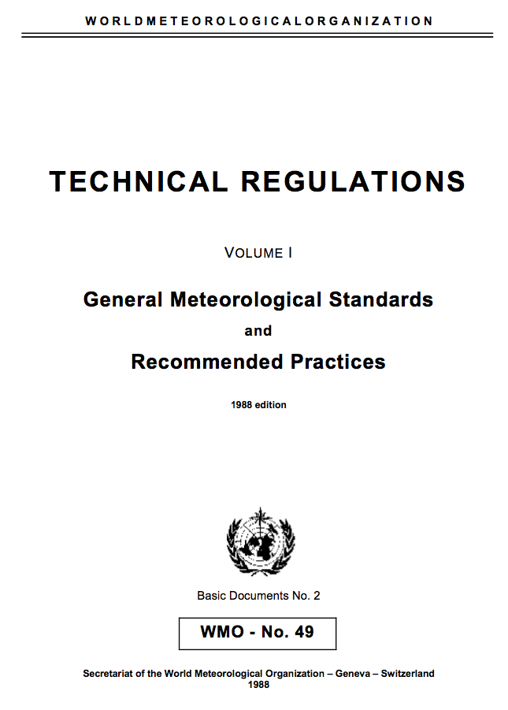
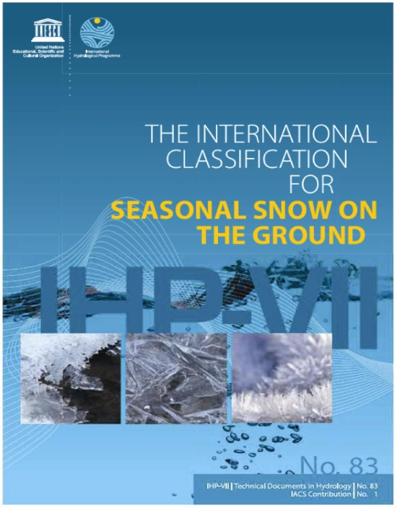
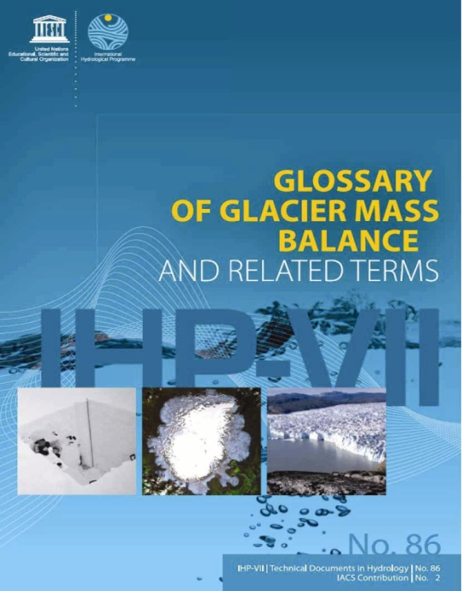

Measurement standards and practices
SEARCH and AON are discussing measurement methods. Collaboration with GCW is essential.
GCW is part of the WMO Integrated Observing System (WIGOS) and contributes to technical regulations of WMO through WIGOS
“IUGG urges snow and ice scientists, practitioners, and scientists from related disciplines to adopt these new schemes as standards.”

Slide 9
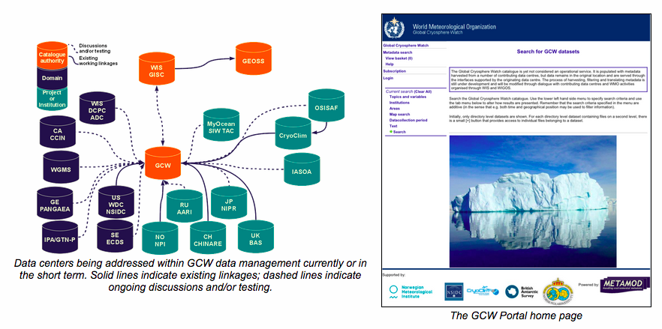
GCW Data Portal
CliC members concerned about data formats, metadata, and data center interoperability, e.g., GRISO, WDAC) are encouraged to work GCW.
The GCW Data Portal is part of WIS, a data Collection and Production Centre (formal designation of WMO), and is interoperable with data centres.

Slide 10
Product Intercomparisons
APP-x
CryoSat-2
A robust, international, ice thickness intercomparison project along the lines of GCW’s Snow Watch or the GEWEX CREW series of workshops would be beneficial to both groups.
SMOS
PIOMAS

Slide 11
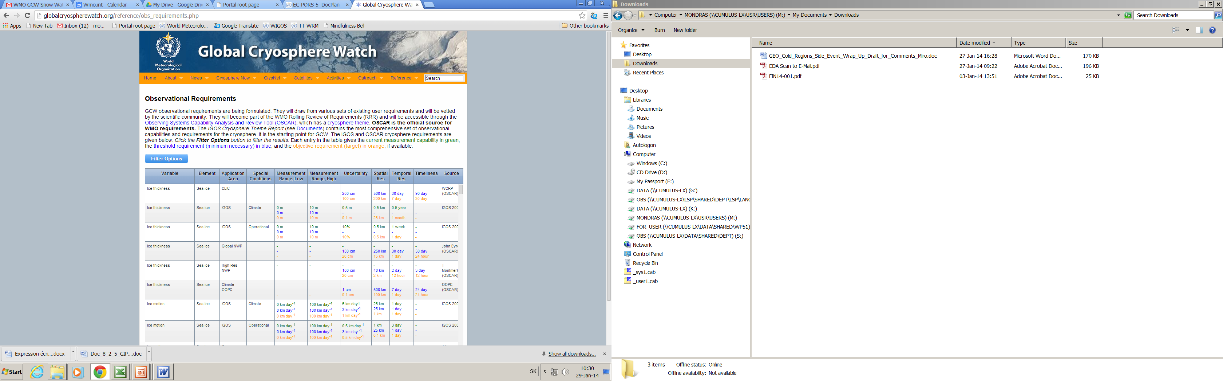
User Needs and Requirements
While CliC is currently focused on modeling, any activities that involve defining or revising observational requirements would fit with GCW’s efforts.
User needs – Surveys of user needs beyond observational requirements could be developed jointly.

Slide 12
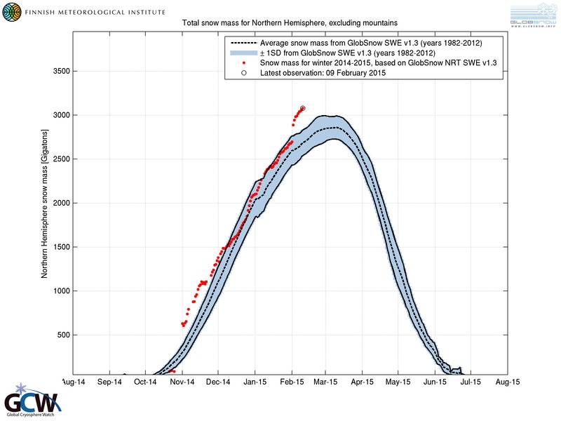
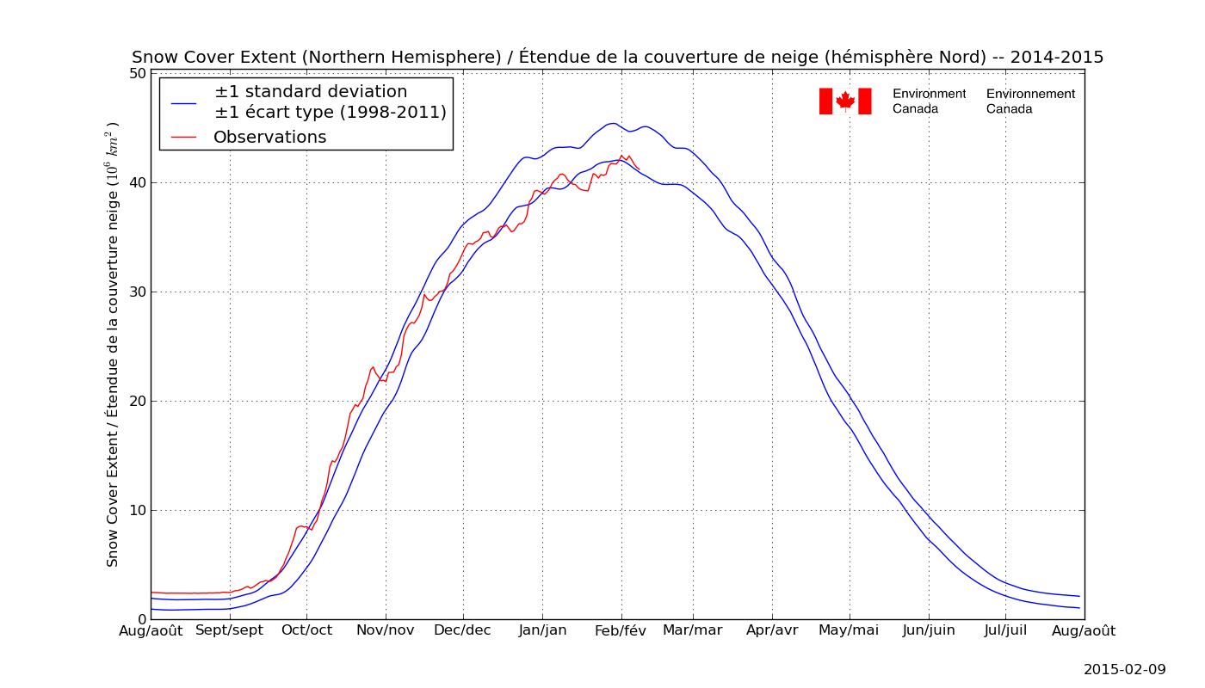
Products
Ideas for new products, like “Trackers”, are welcome.

Slide 13
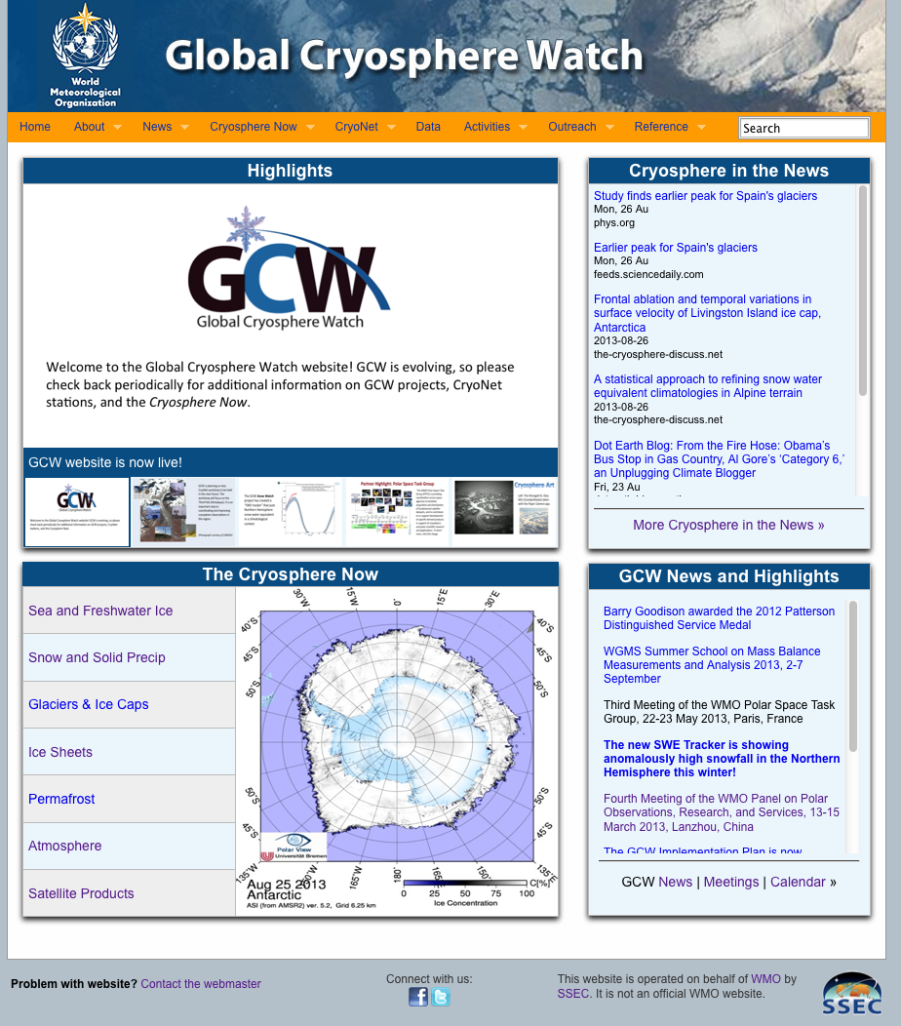
Website and
Outreach
CliC has already shared some website technology with GCW (news, calendar). Other possibilities: CliC’s Resource database; iceplan.org (sea ice group’s project planning tool)
globalcryospherewatch.org

Slide 14
CliC members are encouraged to participate on GCW teams. Young scientists are especially encouraged to participate! (JB is on the GSG)
Working Groups and Teams
Observations Working Group
  CryoNet Team
  Best Practices Team
  Solid Precipitation Team
Integrated Products Working Group
  Snow Watch Team
Information and Services Working Group
  Portal Team
  Terminology Team
  Website and Outreach Team (products, assessments)

Slide 15
